Slide 1
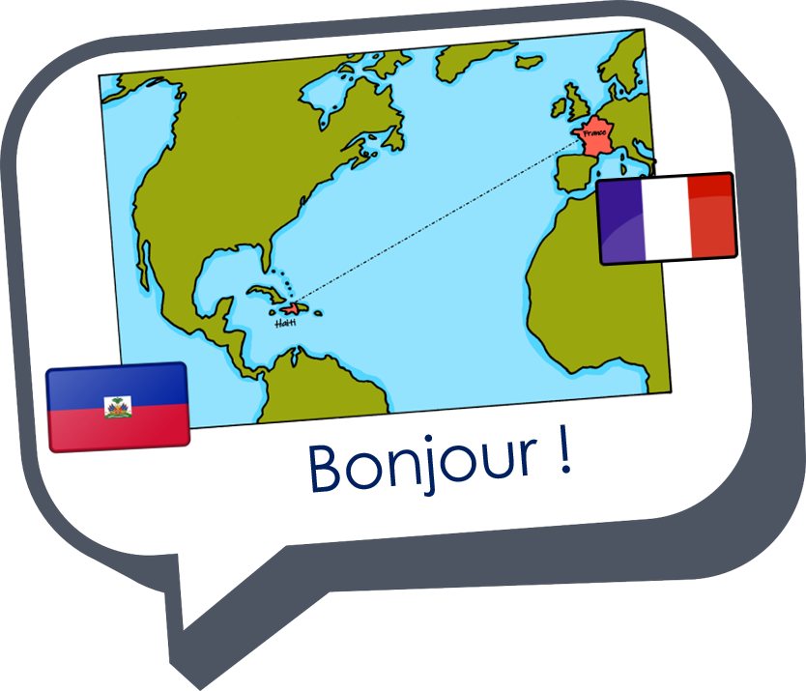
Interactions
Échange en ligne
vert
Follow ups 1-5
Notes:
Artwork by Steve Clarke. Pronoun pictures from NCELP (www.ncelp.org). All additional pictures selected from Pixabay and are available under a Creative Commons license, no attribution required.
Phonics: liaison
Vocabulary: ont [8] ils [13] elles [38] bâtiment [1952] café [1886] cinéma [1623] école [477] église [1782] hôtel [1774] magasin [1738] musée [2216] parc [1240] pont [1889] poste [489] rue [598] université [1192] beau belle [393] bon bonne [94] mauvais [274] nouveau nouvelle [52] vieux vieille [671]
Revisit 1: avoir [8] j’ai [8] quoi [297] un [3] une [3] café [1886] cinéma [1623] hôtel [1774] poste [489] école [477] très [66] utile [1003] différent [350] idéal [1429] important [215] indépendant [954] moderne [1239] propre [237] sale [2906]
Revisit 2: sommes [5] nous [31] allemand [844] espagnol [1666] amusant [4695] calme [1731] différent [350] difficile [296] facile [822] important [215] indépendant [954] jeune [152]
malade [1066] méchant [3184] prudent [1529] seul [102]
Londsale, D., & Le Bras, Y. (2009). A Frequency Dictionary of French: Core vocabulary for learners London: Routledge.
The frequency rankings for words that occur in this PowerPoint which have been previously introduced in these resources are given in the SOW and in the resources that first introduced and formally re-visited those words.
For any other words that occur incidentally in this PowerPoint, frequency rankings will be provided in the notes field wherever possible.

Slide 2
Adjectives before the noun
Remember that some adjectives go before the noun:
Several of these adjectives are irregular. Let’s practise them.
These are adjectives that refer to beauty, age, good/bad or size:
B
un beau parc a beautiful park
une belle église a beautiful church
A
un vieux musée an old museum
une jeune fille a young girl
G
une bonne école a good school
une mauvaise université a bad university
S
un grand magasin a big shop
une petite poste a small post office
Notes:
Timing: 2 minutes
Aim: to recap some adjectives that go before the noun.
Procedure: 1. Click to present the information.
2. Elicit the English meanings.

Slide 3
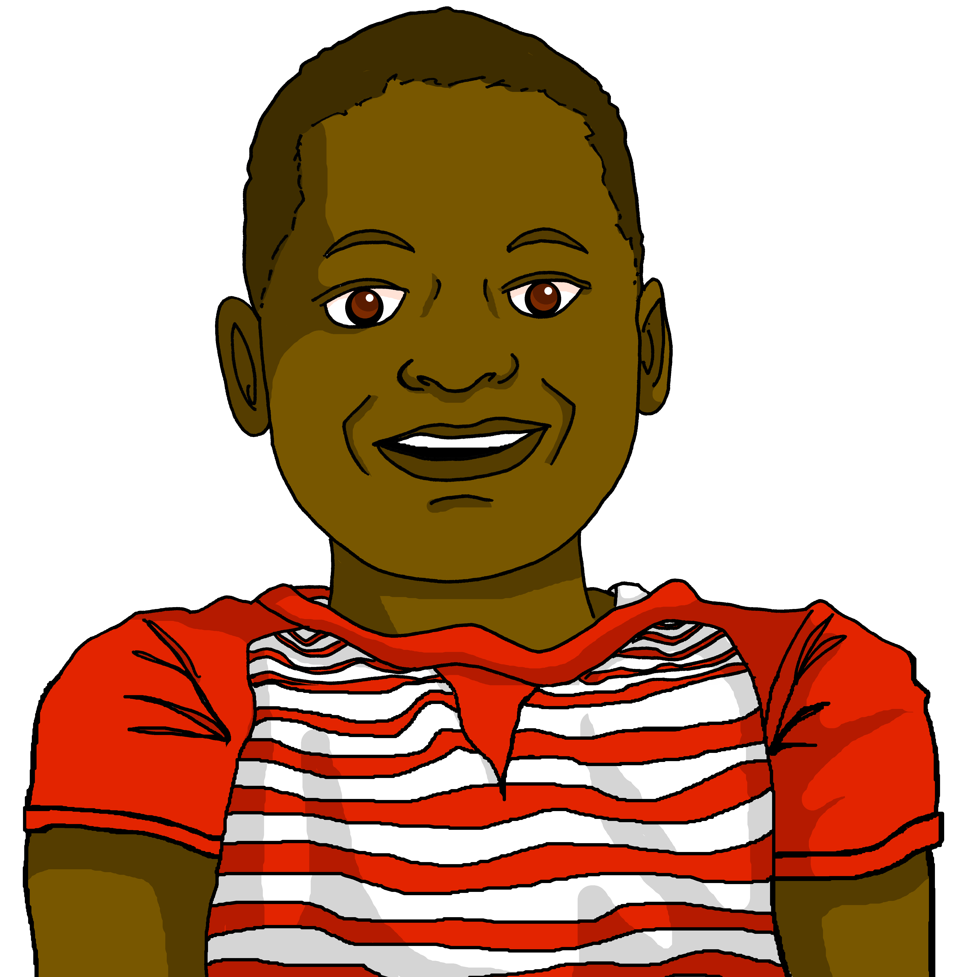
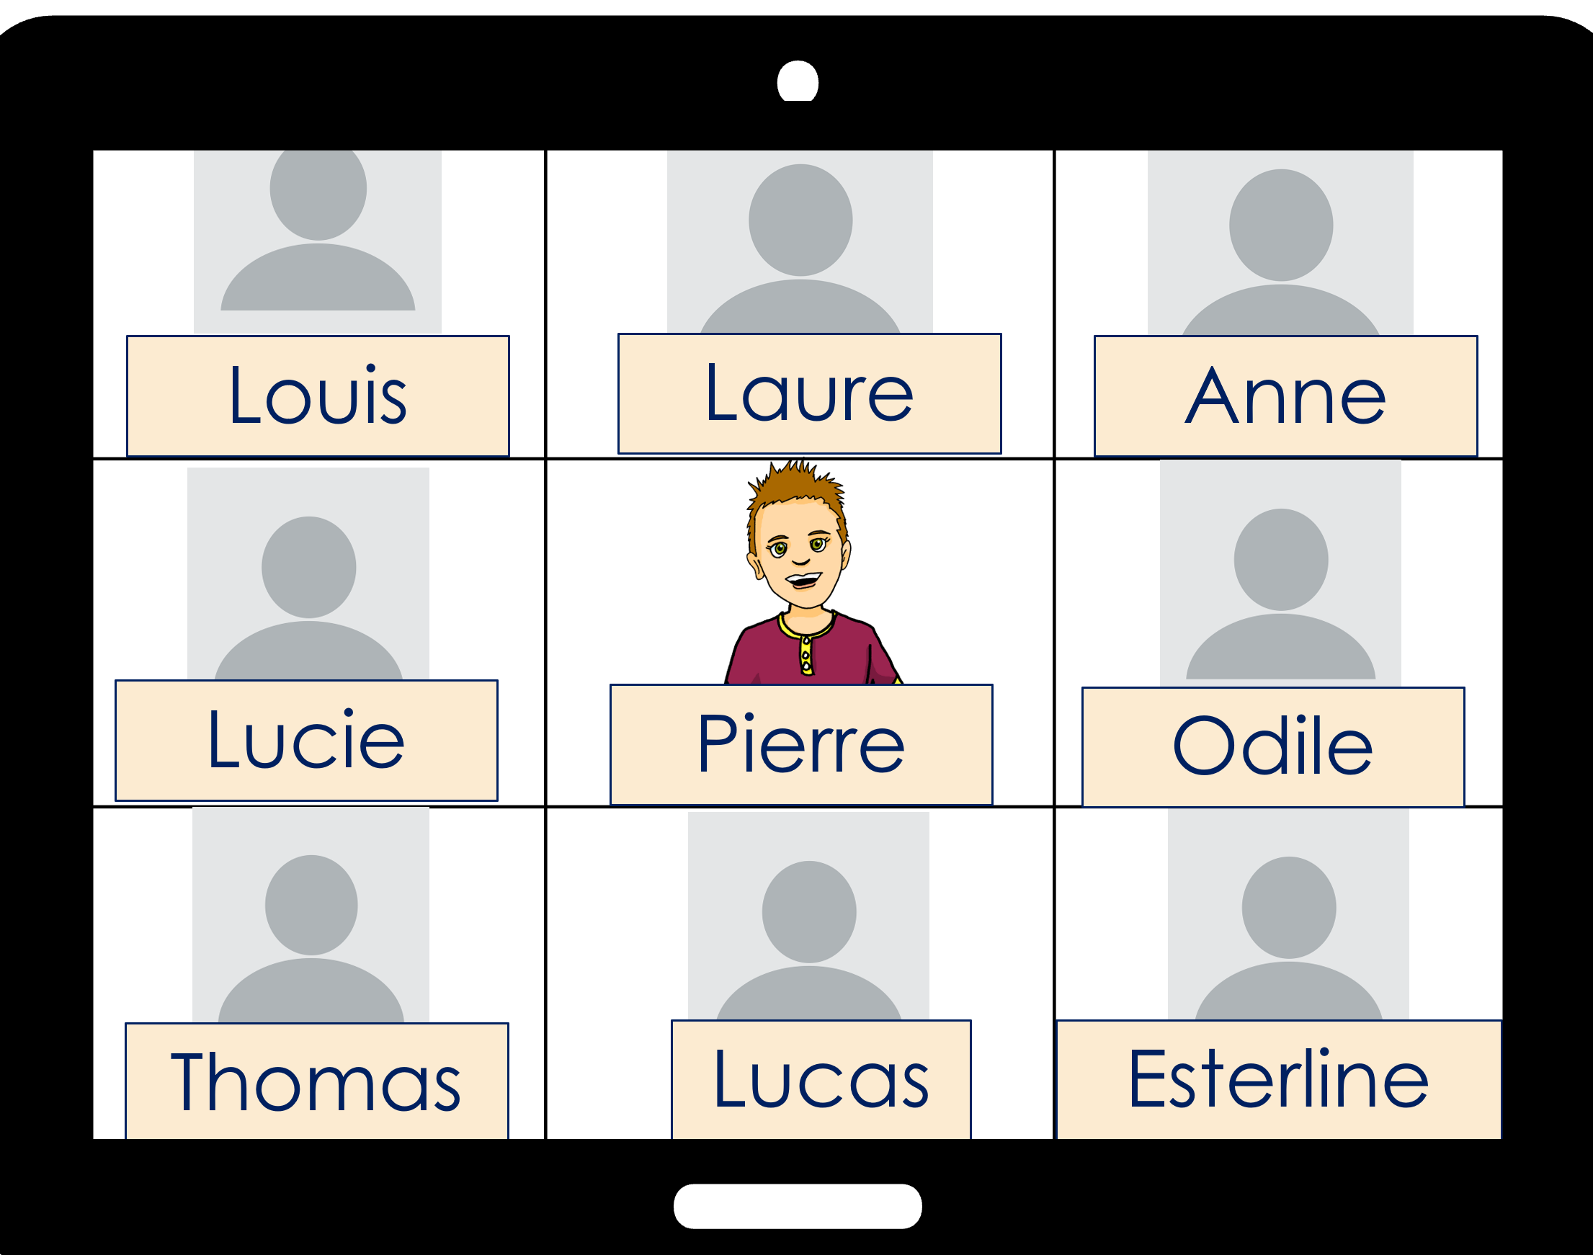
Follow up 1:
Jean-Michel parle à la classe de Pierre.
Il dit quoi ? Lis les phrases avec ton/ta partenaire.
prononcer
Il y a un bâtiment important .
[important]
Remember!
You pronounce the ‘t’ here because it is followed by a vowel.
Il y a un vieux marché .
[vieux]
Il y a un café allemand .
[allemand]
C’est un petit café .
[petit]
Il y a une excellente rue .
[excellente]
Il y a un parc sale .
[sale]
Il y a une école espagnole .
[espagnole]
C’est une bonne école .
[bonne]
Notes:
Timing: 2 minutes
Aim: to practise written recognition of correct adjective placement; to practise liaison with ‘t’.
Procedure:
Clarify the context; J-M is talking to Pierre’s class.
Explain that pupils need to say the sentence putting the adjective in the correct place.
Give pupils 30 seconds to talk to their partner about the first sentence, deciding where the adjective should go.
Elicit their responses. Click to reveal the correct word order and click on the speech bubble to hear the sentence.
5. Repeat steps 3-4 with the remaining sentences. Note: teachers will decide whether to give feedback after each sentence or after pupils have had time to work out and practise all the sentences.

Slide 4
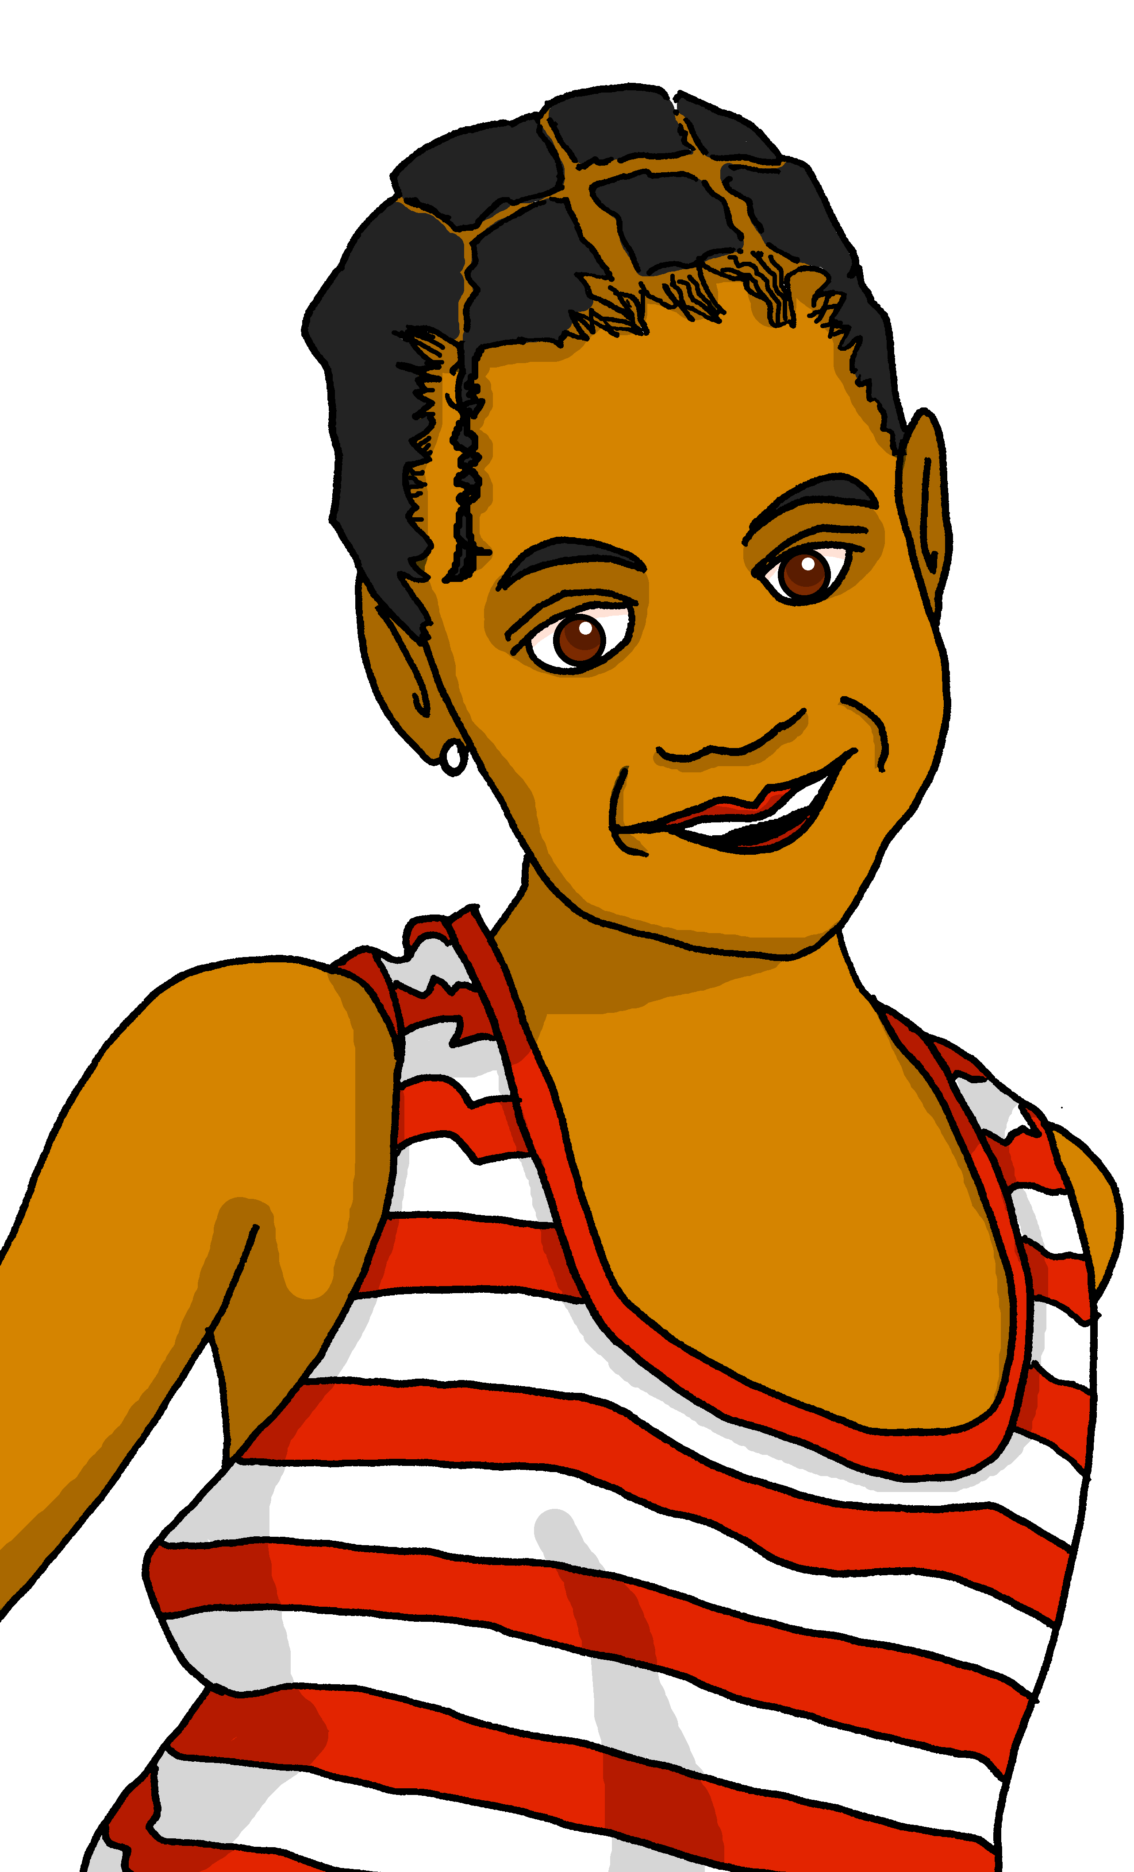
Follow up 2:
Adèle et Pierre sont un peu tristes pour Haïti.
Lis les phrases. Qui a quoi ? Écris deux listes en anglais.
lire
Nous avons beaucoup de choses !
Ils ont une jolie plage* mais…
we have | they have
lots of things | a pretty beach
a good school | an old school
a big park | a good market
 | a beautiful chuch in ruins
 | a very small green space
Ils ont une vieille école.
Nous avons une bonne école.
Ils ont un bon marché mais...
Ils ont une belle église en ruine !
Nous avons un grand parc.
Ils ont un très petit espace* vert.
☹
la plage – beach | l’espace – space
Notes:
Timing: 5 minutes
Aim: to practise written recognition of 2nd and 3rd person plural forms of avoir and several nouns and prenominal adjectives.
Procedure:
Read the title and instructions and ensure the task scenario is understood. Adèle and Pierre are thinking about the effects of the 2010 earthquake on Haiti where their cousins live.
Complete the first one as an example with the class.
Pupils decide from the form of avoir if Adèle and Pierre are saying ‘we’ or ‘they’ have.
They then write the noun+adjective in English in the correct column (of a table that they draw in their books).
Click to correct.
Pupils complete items 2 – 9. Click to provide feedback on each item.
If desired, click on each sentence to hear it pronounced.

Slide 5
Follow up 3:
Parle en français.
parler
Personne A
1) Ils ont un petit…
……………………………….
Personne B
école | parc

They have a small park.
Ils ont un petit…
Ils ont un petit parc.
B
A
Notes:
Timing: 5 minutes
Aim: to practise aural recognition of irregular prenominal adjectives and their connection with correct nouns; to practise aural comprehension of previously taught nouns; to practise clear pronunciation when reading aloud.
Procedure: 1. Use this slide to model the task.
2. Pupil A reads his/her sentence beginning aloud.
3. Pupil B selects the correct noun to finish the sentence, based on the adjective form that s/he hears.
4. Pupil A writes down the full sentence meaning in English.
5. Then they will swap roles and repeat the task. 6. See next slides for answers, and handouts at the end of the presentation.

Slide 6
parler
Round 1
Personne A
1) Ils ont un vieux…
……………………………….
2) Nous avons une vieille…
……………………………….
3) Nous avons un bon …
……………………………….
4) Ils ont un nouveau …
……………………………….
5) Ils ont une grande…
………………………………..
Personne B
parler
bâtiment | poste
université | cinéma
école | parc
rue | café
magasin | église
They have an old building.
We have an old university.
We have a good park
They have a new café.
They have a big church.
Notes:
ANSWERS ROUND 1 - – Do not display during the task. Use the pupil handouts provided at the end of
this presentation.
6

Slide 7
parler
Round 2
Personne B
1) Nous avons une belle…
……………………………….
2) Ils ont un beau…
……………………………….
3) Ils ont une nouvelle…
……………………………….
4) Ils ont une mauvaise…
……………………………….
5) Nous avons un vieux…
………………………………..
Personne A
centre commercial | rue
pont | église
cinéma | poste
école | hôtel
université | musée
parler
We have a beautiful street.
They have beautiful bridge.
They have a new post office.
They have a bad school.
We have an old museum.
Notes:
ANSWERS ROUND 2
7

Slide 8
Follow up 4:

Écris cinq phrases.
1. Nous avons un petit café.
1. N_____ a_________ u__ p_______ e________.
écrire
We have a small café.
2. Ils ont une rue importante.
2. I_____ o_________ u__ q_______ i________.
They (m, mixed) have an important street.
3. Elles ont une bonne université.
3. E_____ o_________ u__ b_______ i________.
They (f) have a good university.
4. Nous avons une école différente.
4. N_____ a_________ u__ e_______ d________.
We have a different school.
5. Elles ont une nouvelle poste.
5. E_____ o_________ u__ n_______ p________.
They (f) have a new post office.
Notes:
Timing: 10 minutes (or 5 minutes for 3 sentences)
Aim: to practise written production of this week’s new language.
Procedure:
Click for written versions of the sentences.
Click on the answer sentences to hear them.

Slide 9
vocabulaire
Follow up 5 - Écris en français : Can you get at least 15 points?
mots
l’ | Spanish (m) | easy (m/f) | alone (m)
 | useful (m/f) | German (f) | we are
 | (the) post office | (the) hotel | (the) cinema
 | good (m) | good (f) | (the) café
 | bad (m) | new (m) | new (f)
 | beautiful (f) | they have _{(m, m/f pl)} | old (f)
 | they (f) have | old (m) | beautiful (m)
espagnol
facile
seul
x3
utile
allemande
nous sommes
la poste
l’hôtel
le cinéma
x2
bon
bonne
le café
mauvais
nouveau
nouvelle
belle
ils ont
vieille
x1
elles ont
vieux
beau
Notes:
Timing: 5-10 minutes
Aim: to practise written production of vocabulary from this week and two revisited weeks.
Procedure: 1. Give pupils a blank grid. They fill in the French meanings of any of the words they know, trying to reach 15 points in total. 2. Remind pupils that adjectives can refer to male or female persons and they should note this in their translations. E.g. pleased (f), short (m).
Note: The most recently learnt and practised words are pink, words from revisit 1 are green and those from revisit 2 are blue, thus more points are awarded for them, to recognise that memories fade and more effort (heavy lifting!) is needed to retrieve them.
9

Slide 10
parler
Round 1
Round 2
Personne A
1) Ils ont un beau…
……………………………….
2) Nous avons une vieille…
……………………………….
3) Nous avons un bon …
……………………………….
4) Ils ont un nouveau …
……………………………….
5) Ils ont une grande…
………………………………..
Personne A
centre commercial | rue
pont | église
cinéma | poste
école | hôtel
université | musée
parler





Notes:
Handout A
10

Slide 11
parler
Round 1
Round 2
Personne B
Personne B
1) Nous avons une belle…
……………………………….
2) Ils ont un beau…
……………………………….
3) Ils ont une nouvelle…
……………………………….
4) Ils ont une mauvaise…
……………………………….
5) Nous avons un vieux…
………………………………..
parler
bâtiment | poste
université | cinéma
école | parc
rue | café
magasin | église





Notes:
Handout B
11

Slide 12
vocabulaire
Follow up 5 - Écris en français : Can you get at least 15 points?
mots
l’ | Spanish (m) | easy (m/f) | alone (m)
 | useful (m/f) | German (f) | we are
 | (the) post office | (the) hotel | (the) cinema
 | good (m) | good (f) | (the) café
 | bad (m) | new (m) | new (f)
 | beautiful (f) | they have _{(m, m/f pl)} | old (f)
 | they (f) have | old (m) | beautiful (m)
x3
x2
x1
Notes:
HANDOUT
12

