Slide 1
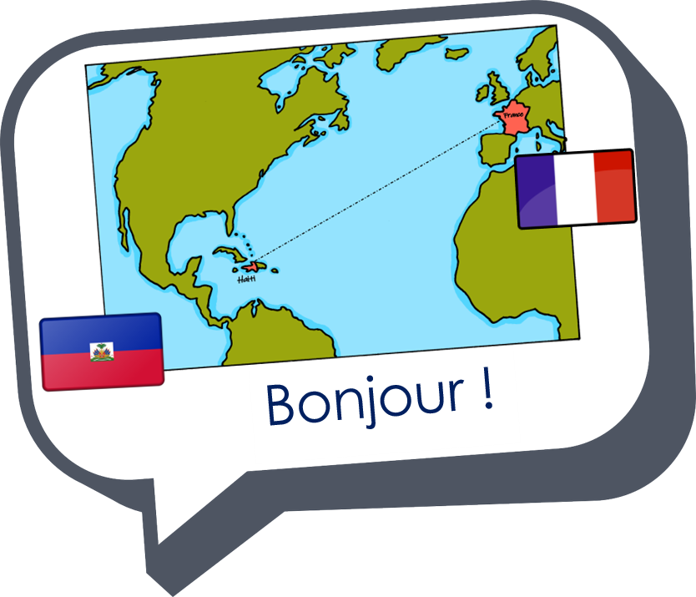


Interactions
Échange en ligne
vert
Follow ups 1-5
Notes:
Artwork by Steve Clarke. Pronoun pictures from NCELP (www.ncelp.org). All additional pictures selected from Pixabay and are available under a Creative Commons license, no attribution required.
Phonics: liaison
Vocabulary: avons [8] avez [8] nous [31] vous [50] bâtiment [1952] derrière [805] devant [198] entre [55] où [48] dans [11] sur [16] sous [122] ici [167]
Revisit 1: activité [452] chaise [3419] chanson [2142] garçon [1599] fille [629] jeu [291] langue [712] règle² [488] spectacle [1687]
Revisit 2: être [5] suis, est, es [5] je [22] tu [112] il [13] elle [38] qui ? [14] ami(e) [467] école [477] monsieur [79] madame [294] professeur(e) [110] absent [2016] actif [1219] anglais [784] content [1841] créatif [>5000] grand [59] français [251] indépendant [954] intelligent [2509] négatif [1520] petit [138] positif [949] présent [216] sportif [2670] triste [1843] bien [47] mal [277] Salut ! [2205] Ça va ? [54/53] Oui [284] Non [75] Bonjour ! [1972] Au revoir [n/a]
Londsale, D., & Le Bras, Y. (2009). A Frequency Dictionary of French: Core vocabulary for learners London: Routledge.
The frequency rankings for words that occur in this PowerPoint which have been previously introduced in these resources are given in the SOW and in the resources that first introduced and formally re-visited those words.
For any other words that occur incidentally in this PowerPoint, frequency rankings will be provided in the notes field wherever possible.

Slide 2


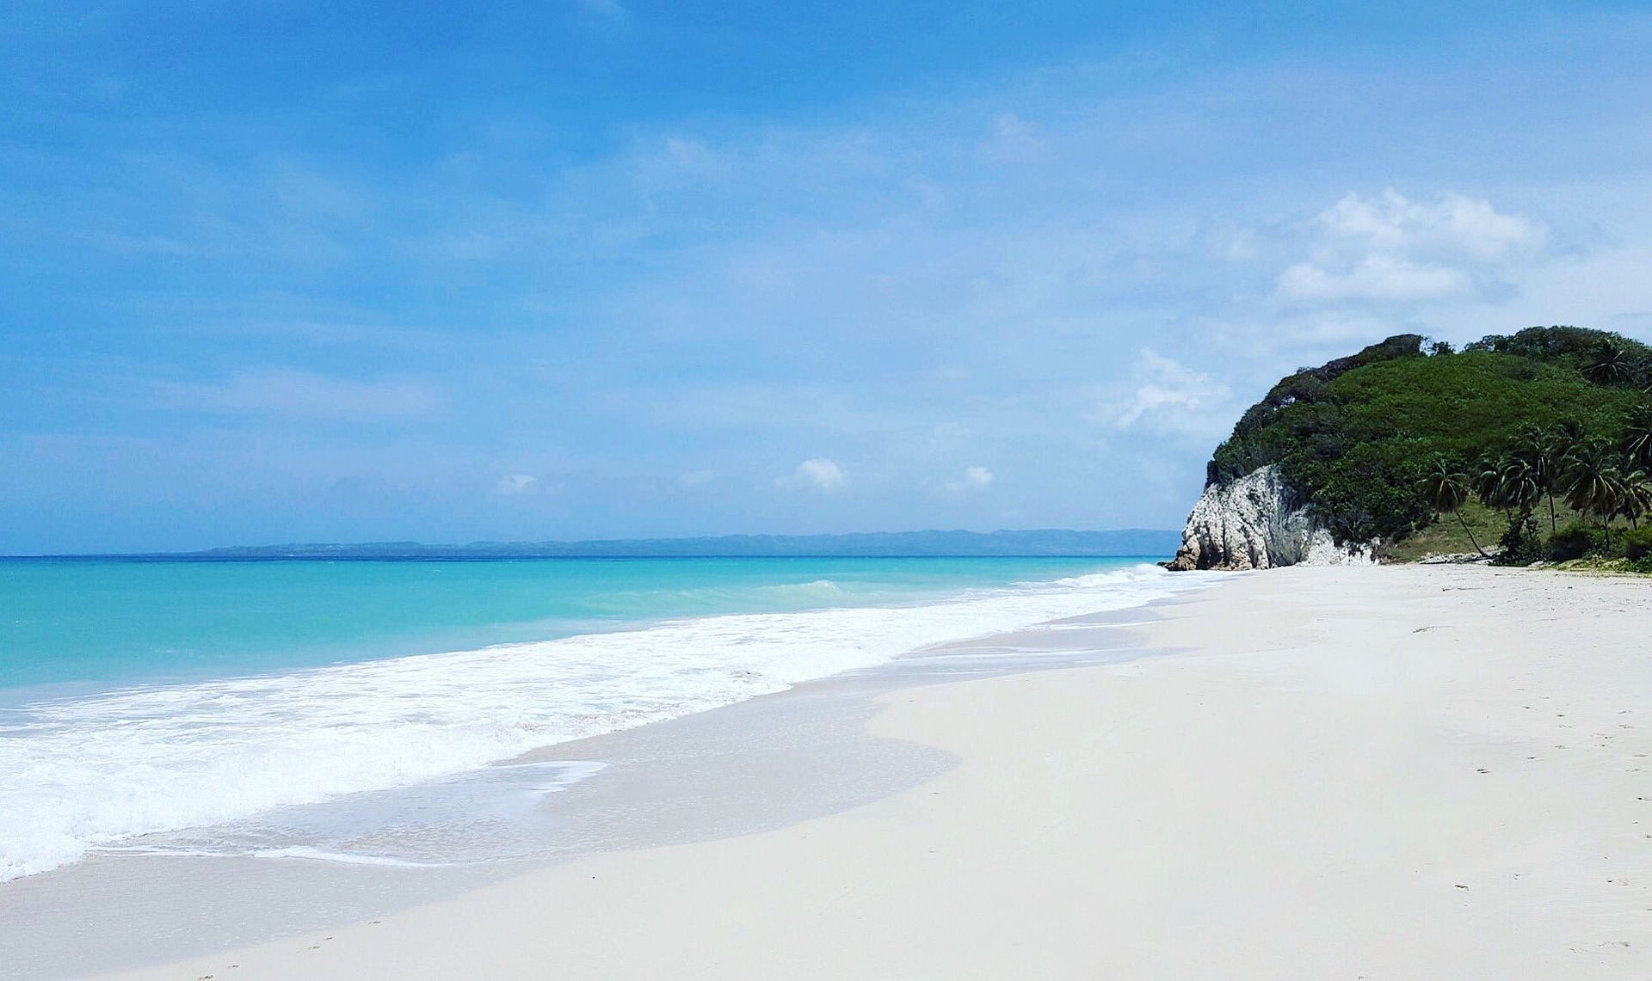


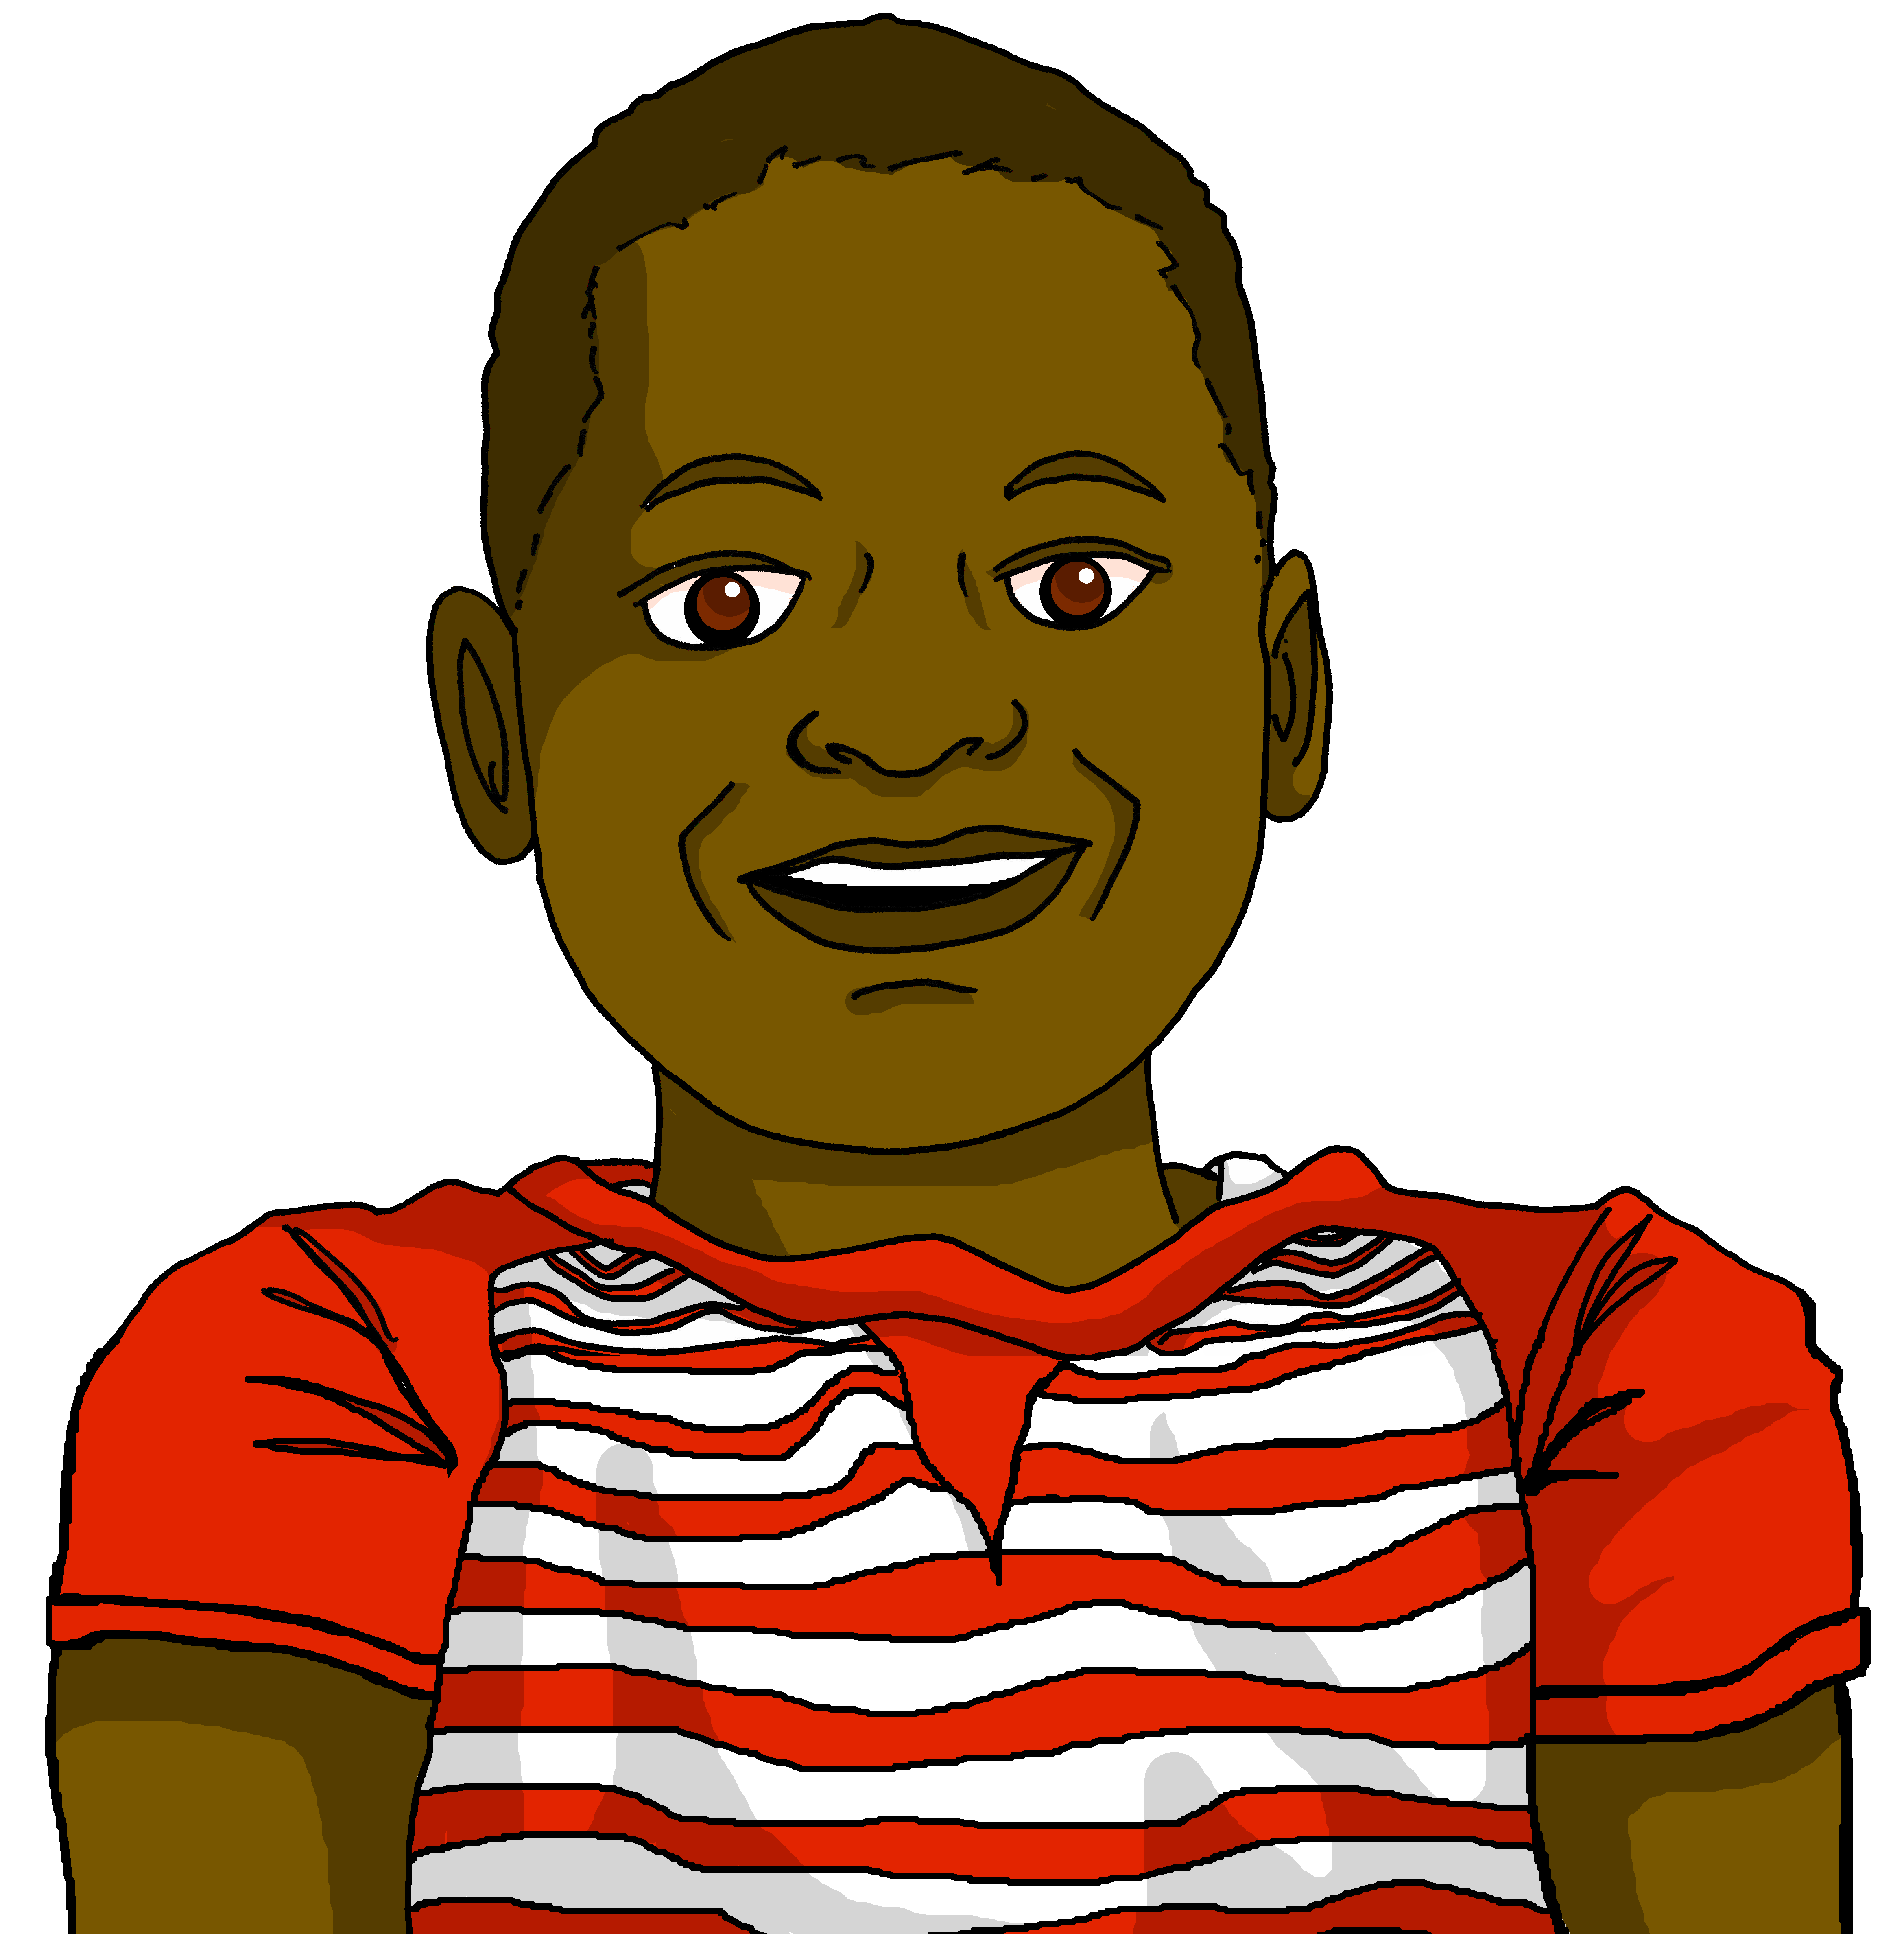

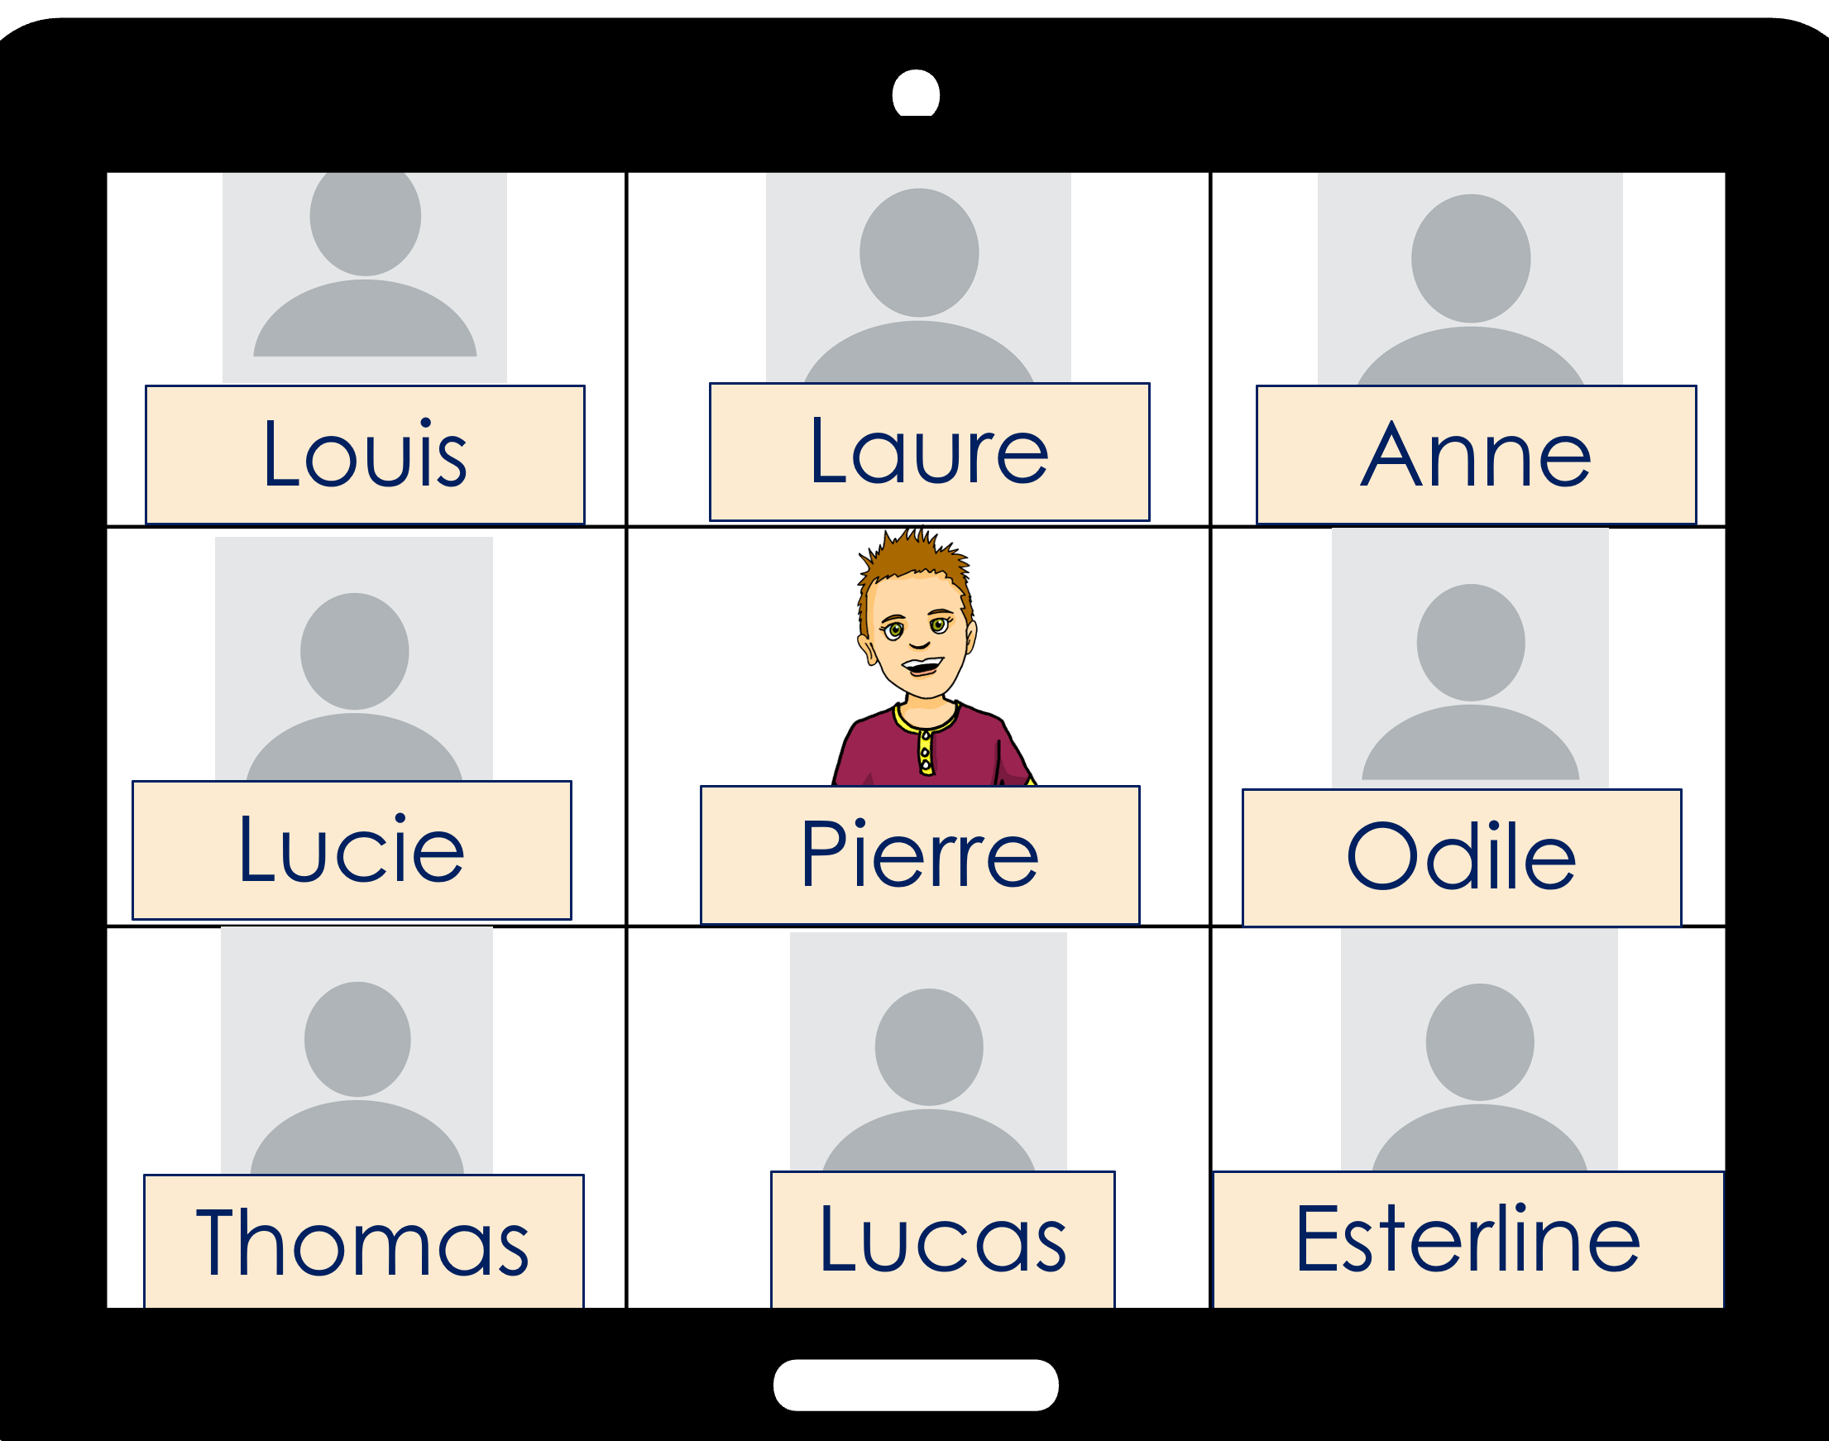
Follow up 1:
Jean-Michel parle à la classe de Pierre.
Lis les messages.
prononcer
Salut, tout le monde ! vous êtes là ?
Salut, tout le monde ! vous êtes là ?
Vous avez des bâtiments modernes…
Vous avez des bâtiments modernes…
…nous avons un marché et des églises.
…nous avons un marché et des églises.
Vous avez des activités sportives.
Vous avez des activités sportives.
Vous avez des espaces verts…
Vous avez des espaces verts…
…mais nous avons des plages !
… mais nous avons des plages !
l’espace – space | la plage – beach
Notes:
Timing: 2 minutes
Aim: to practise liaison; to revisit previously taught vocabulary in new sentences.
Procedure:
1. Clarify the context; Pierre’s class is talking to Jean-Michel’s class in Haïti.
2. Then click to reveal the first sentence. Pupils read it aloud, chorally.
3. Click again to reveal the sentence, with audio, and with the liaison highlighted.
4. Ask pupils to interpret (translate orally into English).
4. Repeat steps 2-4 with items 2-6.

Slide 3


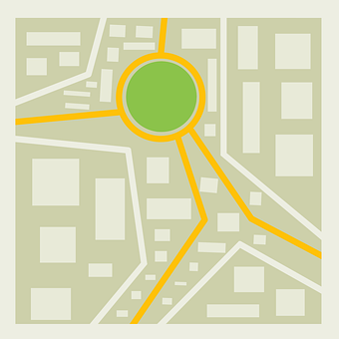





derrière, devant, entre
[behind, in front of, between]
To say something is between, use entre:
To say something is in front ot, use devant:
To say something is behind, use derrière:
derrière
Nous avons un parc derrière l’église.
[behind]
entre
[between]
Nous avons un cinéma entre le musée et la poste.
devant
[in front of]
Nous avons un musée devant l’école.
Notes:
Timing: 2 minutes
Aim: to recap the three new adverbs of location.
Procedure:
Click to present the information.
Elicit English translations for the French examples provided.

Slide 4




Follow up 2:
[1/5]
Lis. C’est quoi ? C’est où ?
Vrai ou faux ?
lire
Nous avons un cinéma devant l’université.
Notes:
[1/5]
Timing: 5 minutes (5 slides)
Aim: to practise written recognition and comprehension of the new adverbs (derrière, devant, entre).
Procedure:
1. Ensure that pupils understand the task. They need to read what Jean-Michel says about his home town to decide whether the sentence is true or false.
2. Teachers elicit the response.
3. Click to reveal answers.

Slide 5



Follow up 2:
[2/5]
Lis. C’est quoi ? C’est où ?
Vrai ou faux ?
lire
Nous avons un parc entre l’école et un bâtiment.
Notes:
[2/5]

Slide 6


Follow up 2:
[3/5]
Lis. C’est quoi ? C’est où ?
Vrai ou faux ?
lire
Nous avons une église devant le marché.
Notes:
[3/5]

Slide 7


Follow up 2:
[4/5]
Lis. C’est quoi ? C’est où ?
Vrai ou faux ?
lire
Nous avons une poste derrière le cinéma.
H
Notes:
[4/5]

Slide 8

Follow up 2:
[5/5]
Lis. C’est quoi ? C’est où ?
Vrai ou faux ?
lire
Nous avons un hôtel derrière la poste.
H
Notes:
[5/6]

Slide 9


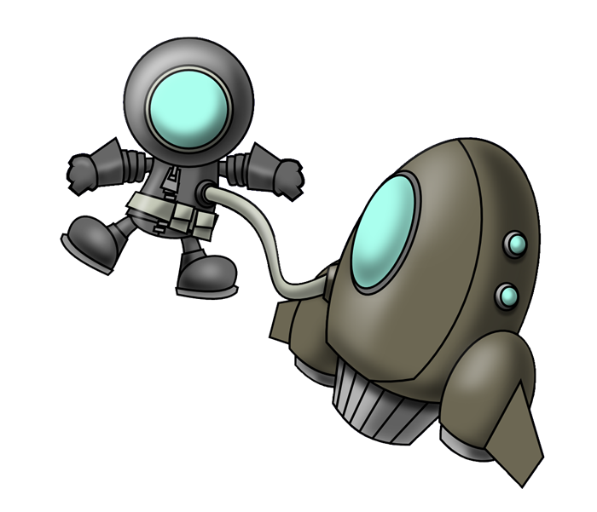

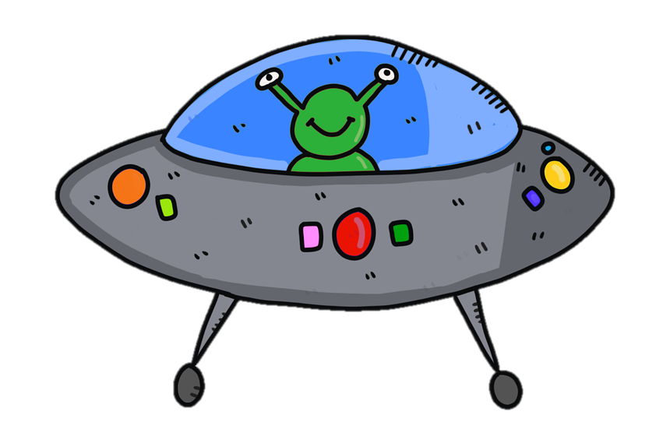

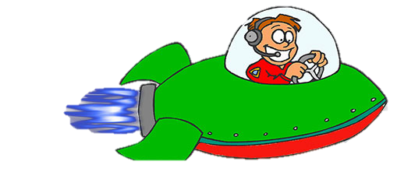







qui ?
vous avez
Follow up 3: Écris en anglais.
Attention ! They disappear fast! Then try to say the French for all the words on your list.
le bâtiment
sous
nous avons
dans
derrière
sur
devant
entre
le marché
où ?
Notes:
With thanks to Amanda Izquierdo for the task design.
Timing: 5 minutes
Aim: to practise written recall of meanings of 12 items of vocabulary from this week’s new and revisited list.
Procedure:
Click to animate. A word will pass across the screen.
Pupils write down the English meaning.
Repeat for items 2-12.
In pairs, pupils try to say the French for all the items on their list.
Note: they may not manage to do them all but should not worry at this stage. Follow up 5 offers another opportunity to revisit much of the same vocabulary.
Answers:
nous avons
entre
vous avez
le bâtiment
sur
devant
le marché
dans
sous
où ?
derrière
qui ?

Slide 10



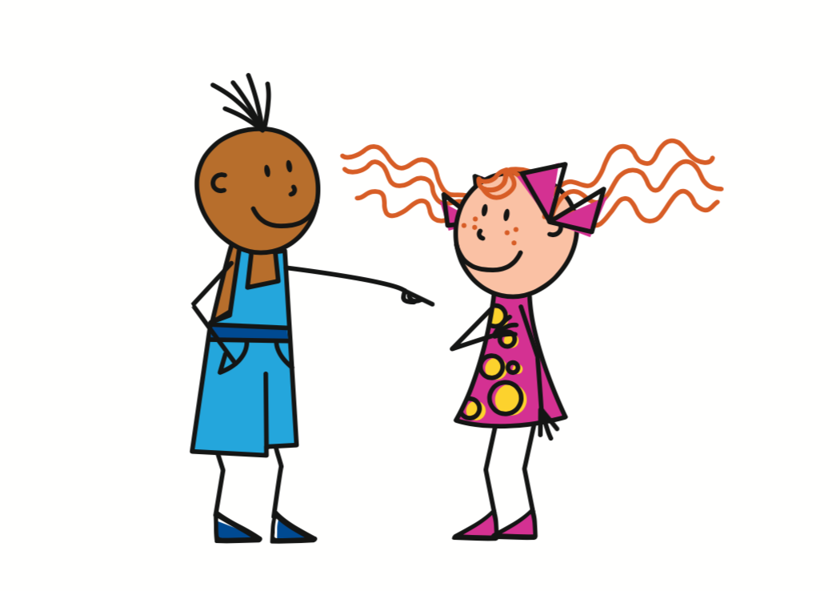

Asking questions
In English, we add ‘do’, in French we just make our voice go up.
Remember! To change a statement into a yes/no question, raise your voice at the end:
J’ai un cinéma.
J’ai un cinéma ?
I have a cinema.
Do I have a cinema?
Tu as un parc.
Tu as un parc ?
You have a park.
Do you have a park?
Vous avez des magasins ?
Vous avez des magasins.
You (all) have (some) shops.
Do you (all) have (some) shops?
Notes:
Timing: 2 minutes
Aim: to revisit how to form intonation questions.
Procedure:
Click to present the information.
Elicit the English at each stage from pupils after presenting the French examples.

Slide 11


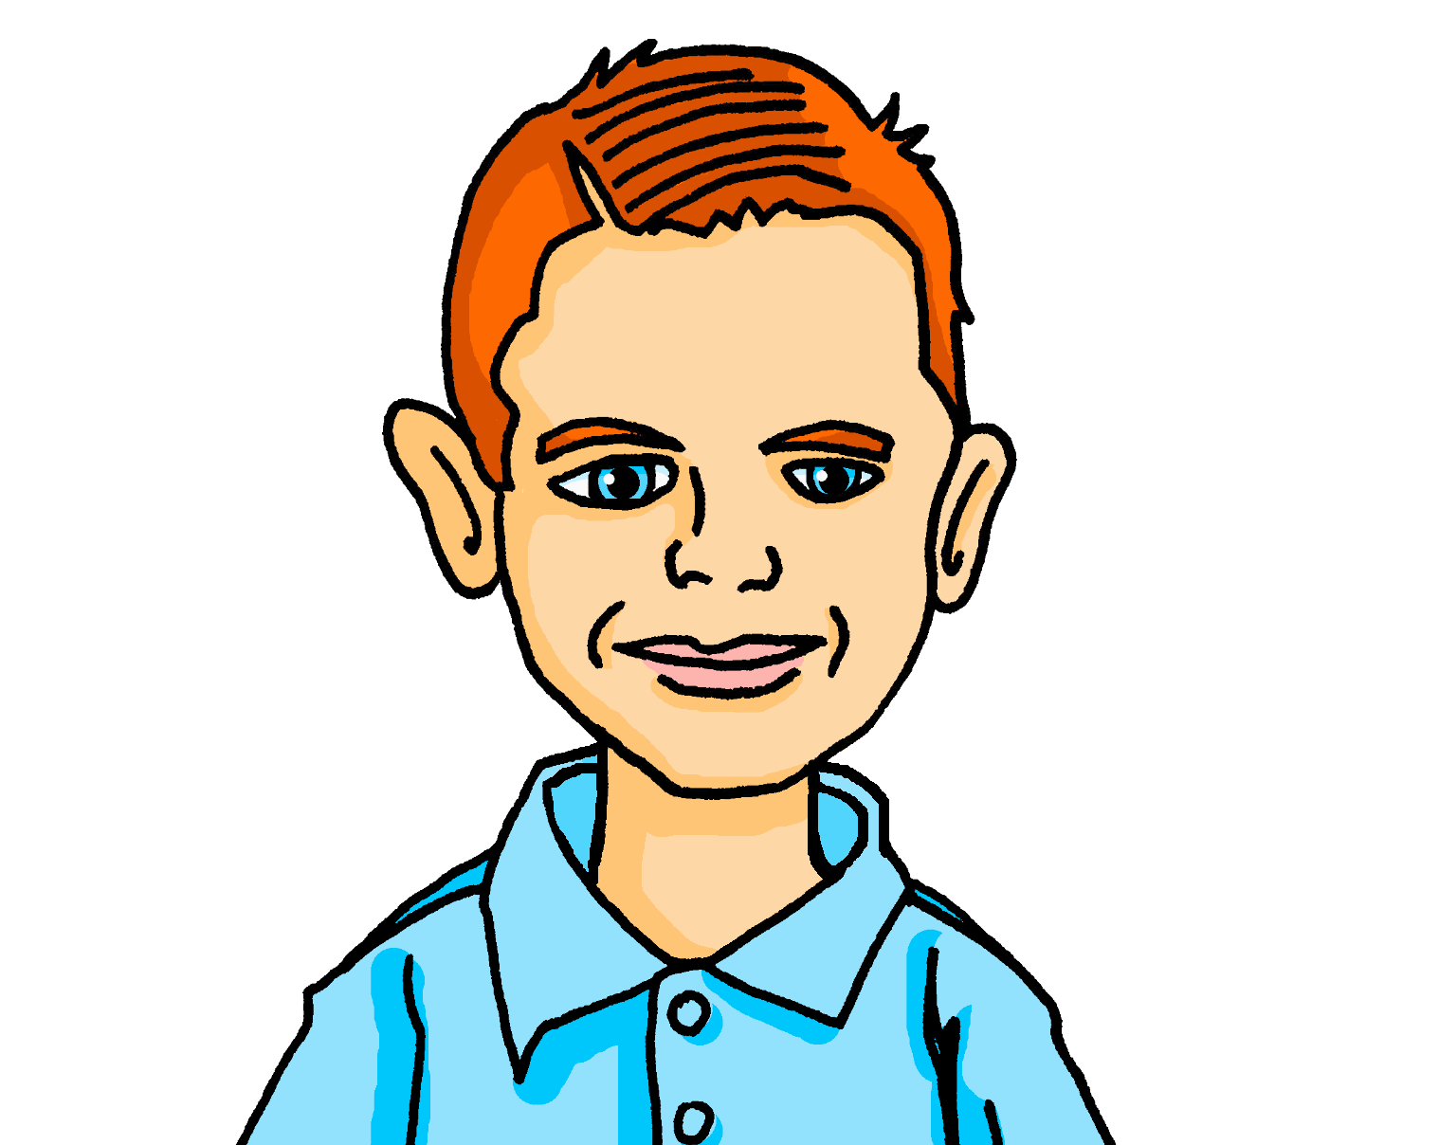


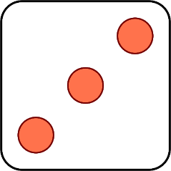
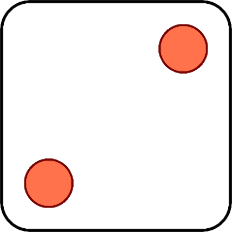


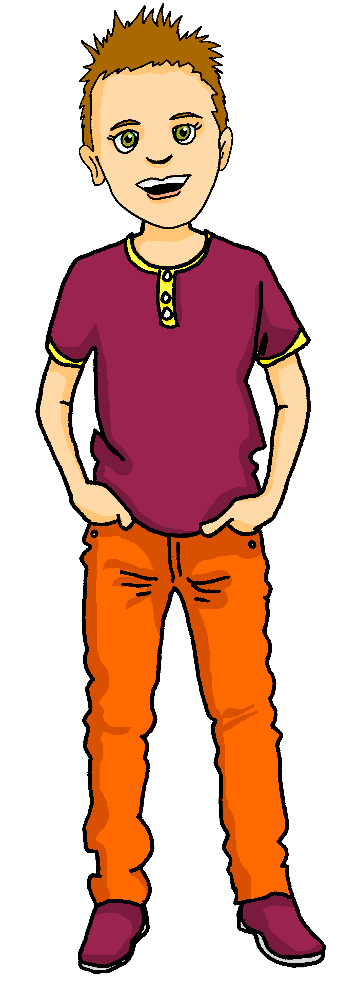
Follow up 4:
Parle en français.
Pierre is helping Max to practise his French. What does Max have to say?
parler
Salut, Pierre ! Ça va ?
Nous avons un marché.
Il a des parcs verts ?
Tu as un cinéma moderne ?
Vous avez des activités créatives ?
J’ai une idée intéressante.
Tu as des bâtiments modernes.
1 | I have
2 | You have
3 | Do you have…?
4 | Does he have…?
5 | We have
6 | Do you (all) have ?
1 | some green parks
2 | some modern buildings
3 | an interesting idea
4 | a market
5 | a modern cinema
6 | some creative activities
Notes:
Timing: 5 minutes
Aim: to practise oral production of statements and questions with parts of avoir, nouns and adjectives.
Procedure:
1. Click to ‘roll’ the dice.
2. Pupils create a short sentence in French from the English prompt. They say the answer chorally.
3. Click to reveal the correct sentence.
4. Repeat until all combinations have been tried.

Slide 12




vocabulaire
Follow up 5 - Écris en français : Can you get at least 15 points?
mots
 | creative (m) | in | under
 | who ? | positive (m) | negative (m)
 | (the) activity | (the) ruler, rule | (the) show
 | between | where ? | on (top of)
 | (the) market | behind | in front of
 | We have | You (all) have | (the) building
x3
créatif
dans
sous
qui ?
positif
négatif
x2
l’activité
la règle
le spectacle
entre
où ?
sur
le marché
derrière
devant
x1
Nous avons
Vous avez
le bâtiment
Notes:
Timing: 5-10 minutes
Aim: to practise written production of vocabulary from this week and two revisited weeks.
Procedure:
1. Give pupils a blank grid. They fill in the French meanings of any of the words they know, trying to reach 15 points in total.
2. Remind pupils that adjectives can refer to male or female persons and they should note this in their translations. E.g. pleased (f), short (m).
Note:
The most recently learnt and practised words are pink, words from revisit 1 are green and those from revisit 2 are blue, thus more points are awarded for them, to recognise that memories fade and more effort (heavy lifting!) is needed to retrieve them.
12

Slide 13
vocabulaire
Follow up 5 - Écris en français : Can you get at least 15 points?
mots
 | creative (m) | in | under
 | who ? | positive (m) | negative (m)
 | (the) activity | (the) ruler, rule | (the) show
 | between | where ? | on (top of)
 | (the) market | behind | in front of
 | We have | You (all) have | (the) building
x3
x2
x1
Notes:
HANDOUT
13

