Slide 1

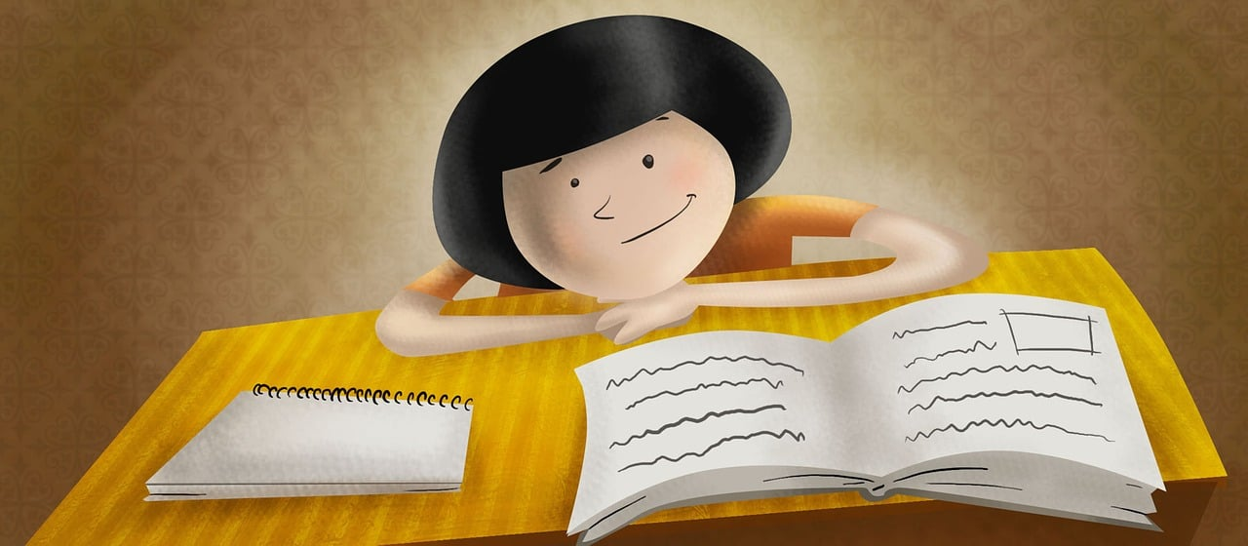
Expressing likes and saying what I and others do
Je révise !
bleu
Follow ups 1-5
Notes:
Artwork by Steve Clarke. Pronoun pictures from NCELP (www.ncelp.org). All additional pictures selected from Pixabay and are available under a Creative Commons license, no attribution required.
Phonics: Revisit SSC from this term and from previous learning:
[-tion] [qu] [-s-] [h] [-ien] [j/g] [ç/c] [SFC] [u] [ou] [(a)in] open [eu] [ch] [(e)au]
Vocabulary: Revisit vocabulary (new words in bold) from this term and from previous learning:
Revisit 1: cyclisme [>5000] exercice [1290] gymnastique [>5000] natation [>5000] ski [4751] sport [2011]
Revisit 2: tu vas je vais [53] tu es je suis [5] à (meaning ‘at/in/to’)[4] marché [280] piscine [>5000]
Londsale, D., & Le Bras, Y. (2009). A Frequency Dictionary of French: Core vocabulary for learners London: Routledge.
The frequency rankings for words that occur in this PowerPoint which have been previously introduced in these resources are given in the SOW and in the resources that first
introduced and formally re-visited those words.
For any other words that occur incidentally in this PowerPoint, frequency rankings will be provided in the notes field wherever possible.

Slide 2



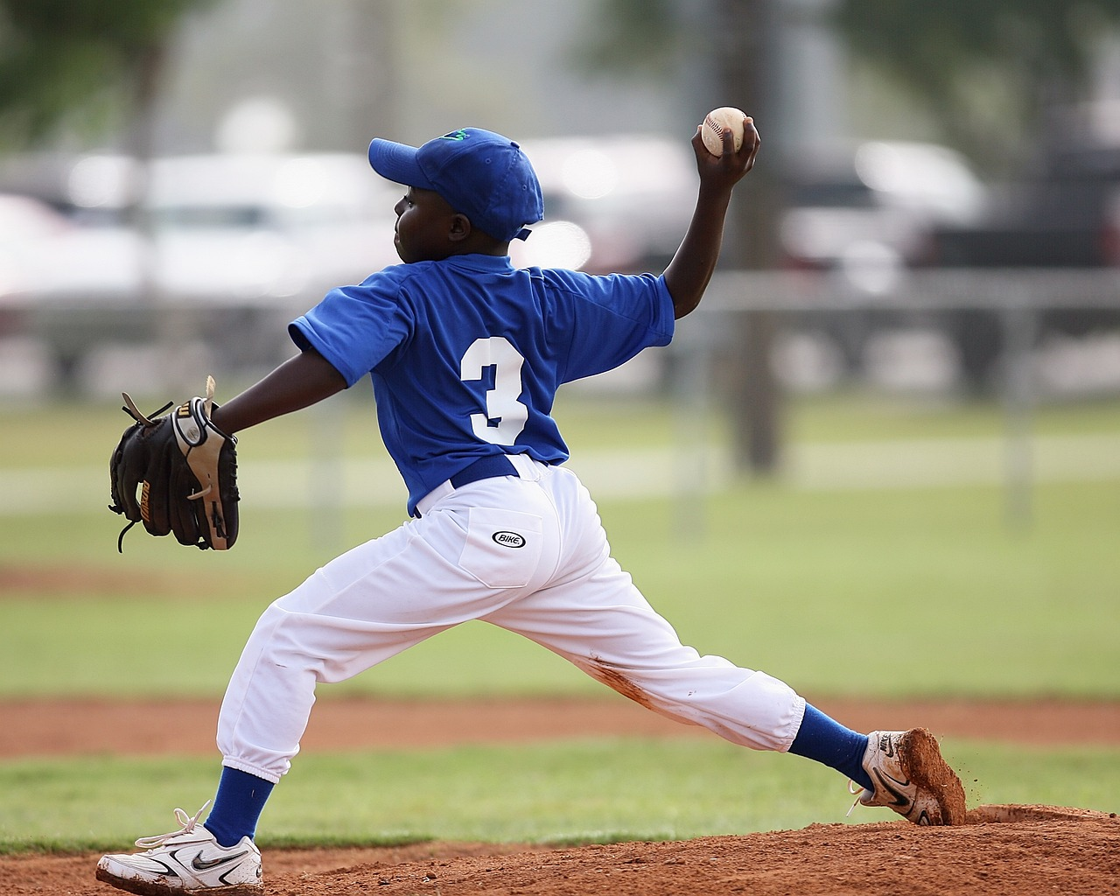
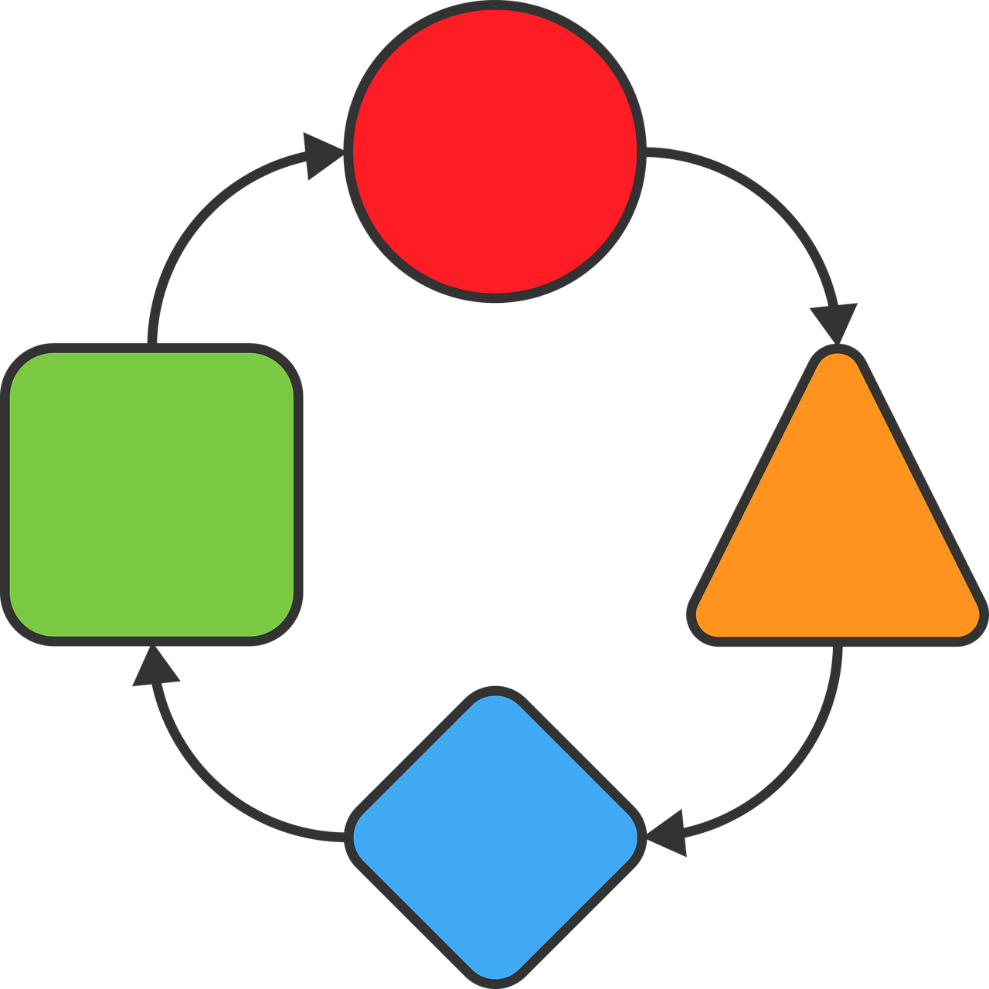








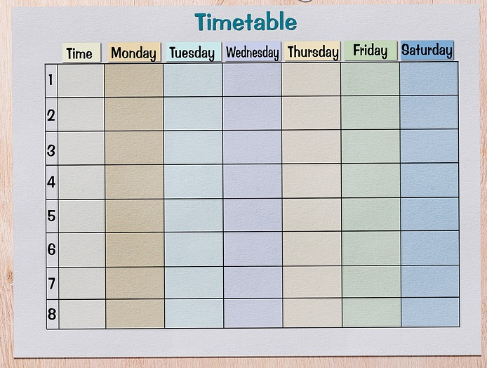
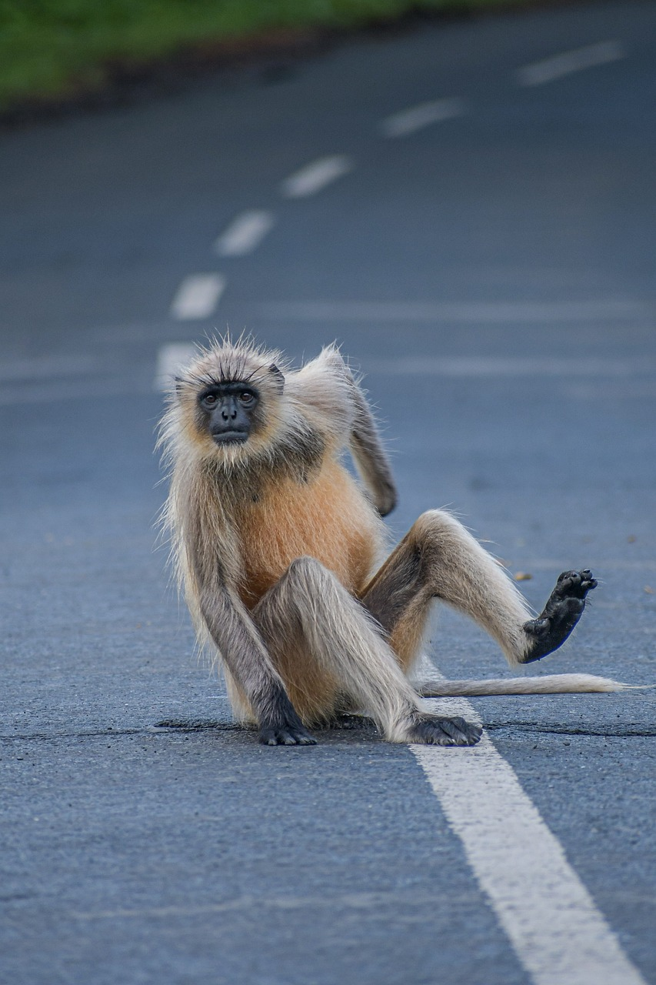
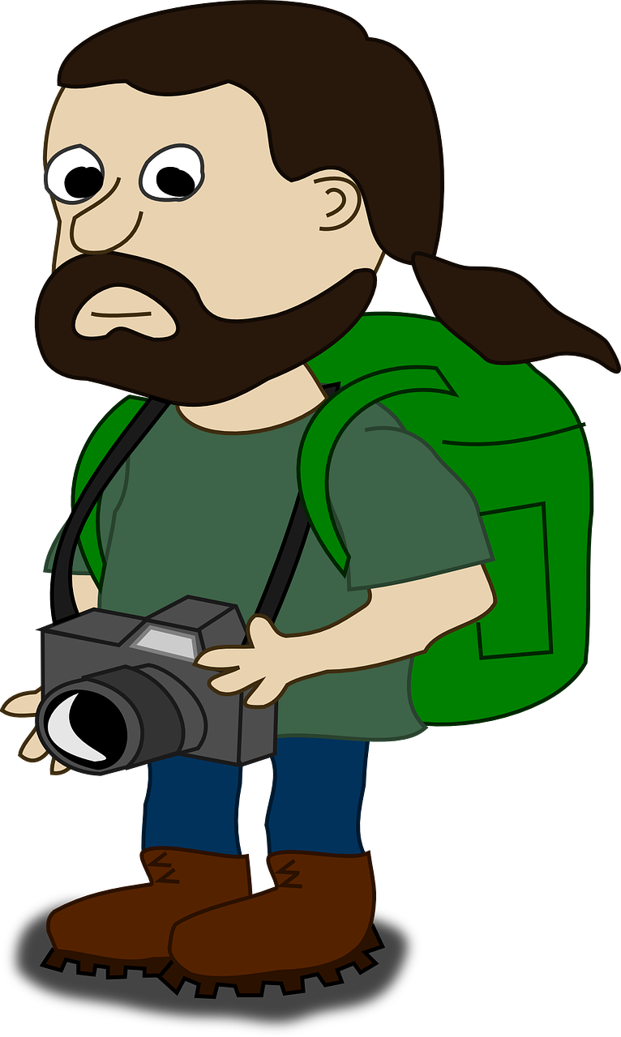
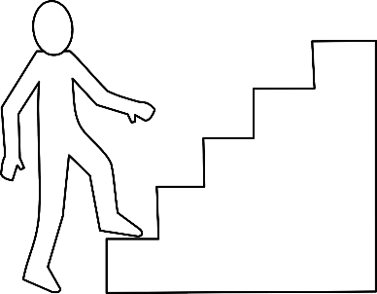

Follow up 1
Prononce les mots.
prononcer
correction
projet
[project]
public
correction |  | lancer | projet | public |  | toit
équivalent |  | juger |  | coup |  | épaule
exploser | horaire | comédien |  | voyageur | point | marche
lancer
[to throw]
toit
[roof]
60
équivalent
juger
[to judge]
coup
[knock, blow]
épaule
[shoulder]
$$\frac{1}{10}$$
S
exploser
[explode]
horaire
[timetable]
comédien
[comedian]
voyageur
[traveller]
point
[full stop]
marche
[step]
0
START
Notes:
Timing: 5 minutes
Aim: to practise applying knowledge of several SSC to unknown words.
Procedure:
1. Start the timer. Pupil A tries to read aloud all of the words pronouncing them correctly, within the 60 seconds allowed.
2. Pupil B listens. If Pupil A mispronounces by mistake, Pupil B can direct him/her to start again from the beginning.
3. They swap roles and repeat the task.
4. Teacher then uses animations to elicit pronunciations chorally.
Word frequency of unknown words and cognates:
comédien [4253] correction [3005] coup [299] épaule [2495] équivalent [2476] exploser [2678] horaire [3192] juger [395] lancer [514] marche [906] point [n/a] projet [228] public [285] toit [2894] voyageur [2629]

Slide 3


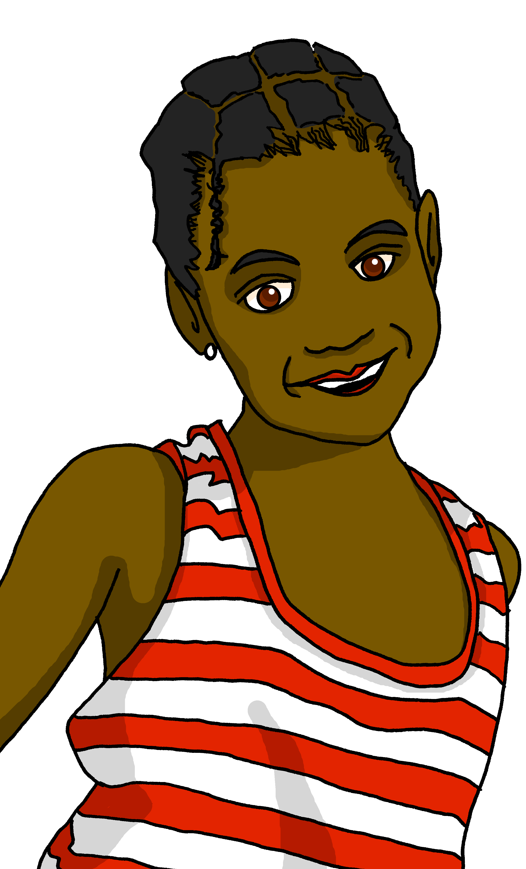
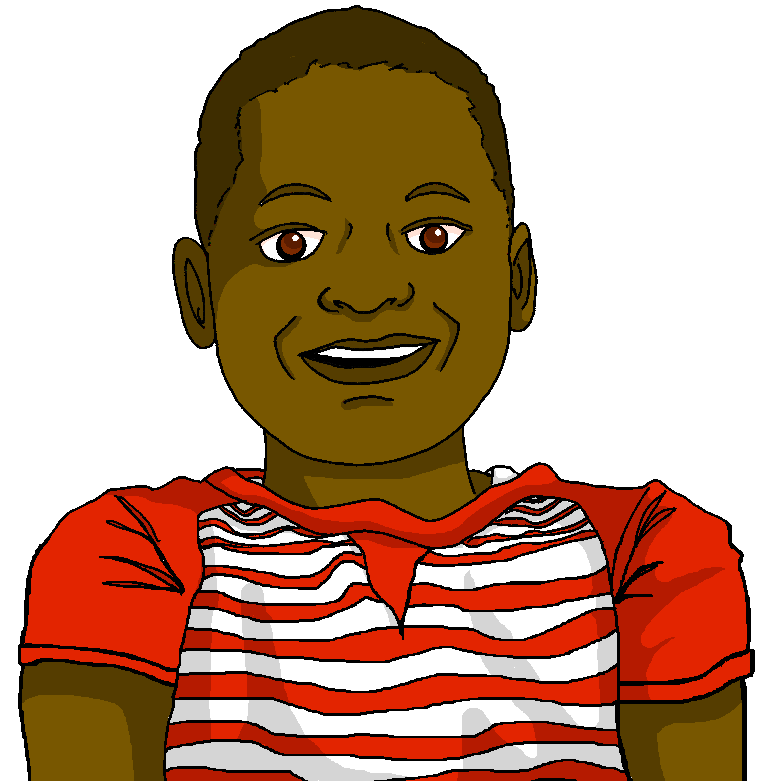
Follow up 2
Clémentine parle à Jean-Michel.
Écoute et écris le bon mot.
écouter
 |  | en anglais
 | parents | amie | I do cooking with my parents.
 | père | mère | I correct homework with my dad.
 | cousine | cousin | I talk with my (female) cousin.
 | famille | amis | I sing with my friends.
 | frère | ami | You buy a present for your friend.
 | amis | parent | You spend the weekend with your friends.
 | père | sœur | You explain the reason to your sister!
 | parents | famille | Today you’re eating with your family.
1
1
2
2
3
3
4
4
5
5
6
6
7
7
8
8
Notes:
Timing: 5 minutes
Aim: to practise aural recognition of mon|ma|mes, ton|ta|tes and their connection with use and meaning.
Procedure:
Click the numbered buttons to listen.
Pupils select the person/people based on the possessive adjective that they hear.
Click to correct after each one, to give pupils instant feedback.
Click to bring up 2nd set of audio buttons.
Play the full audio for each item.
Pupils write or say the English meaning.
Click to correct.
Transcript:
1. Je fais la cuisine avec mes [parents].
2. Je corrige les devoirs avec mon [père].
3. Je parle avec ma [cousine]
4. Je chante avec mes [amis].
5. Tu achètes un cadeau pour ton [ami]
6. Tu passes le weekend avec tes [amis]
7. Tu expliques la raison à ta [soeur]
8. Aujourd’hui, tu manges avec ta [famille].

Slide 4

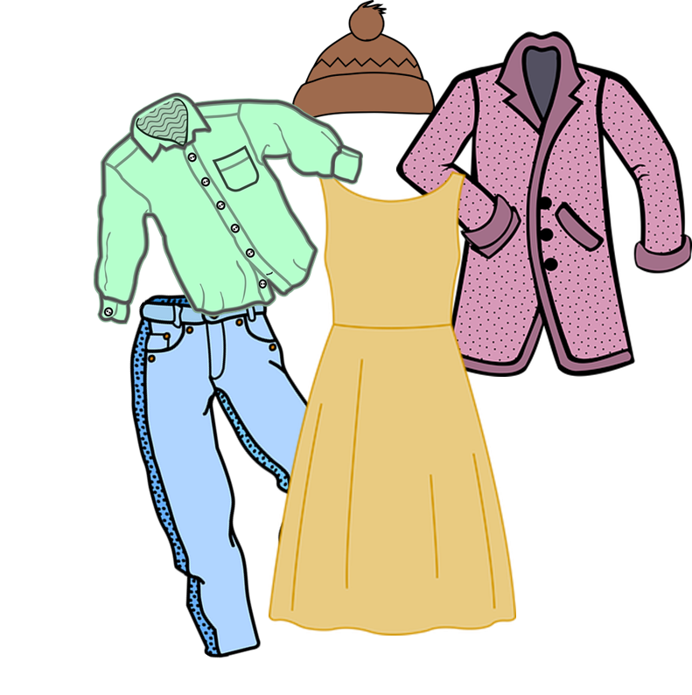



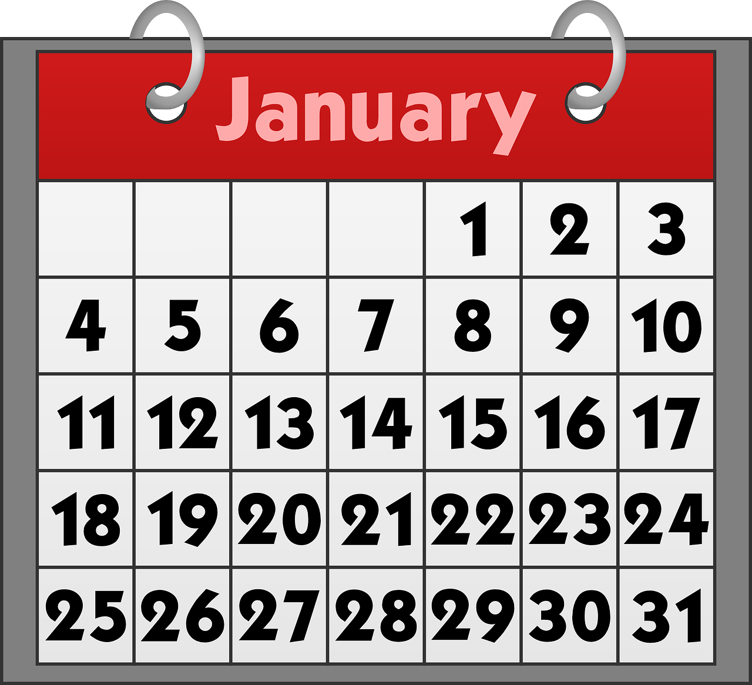

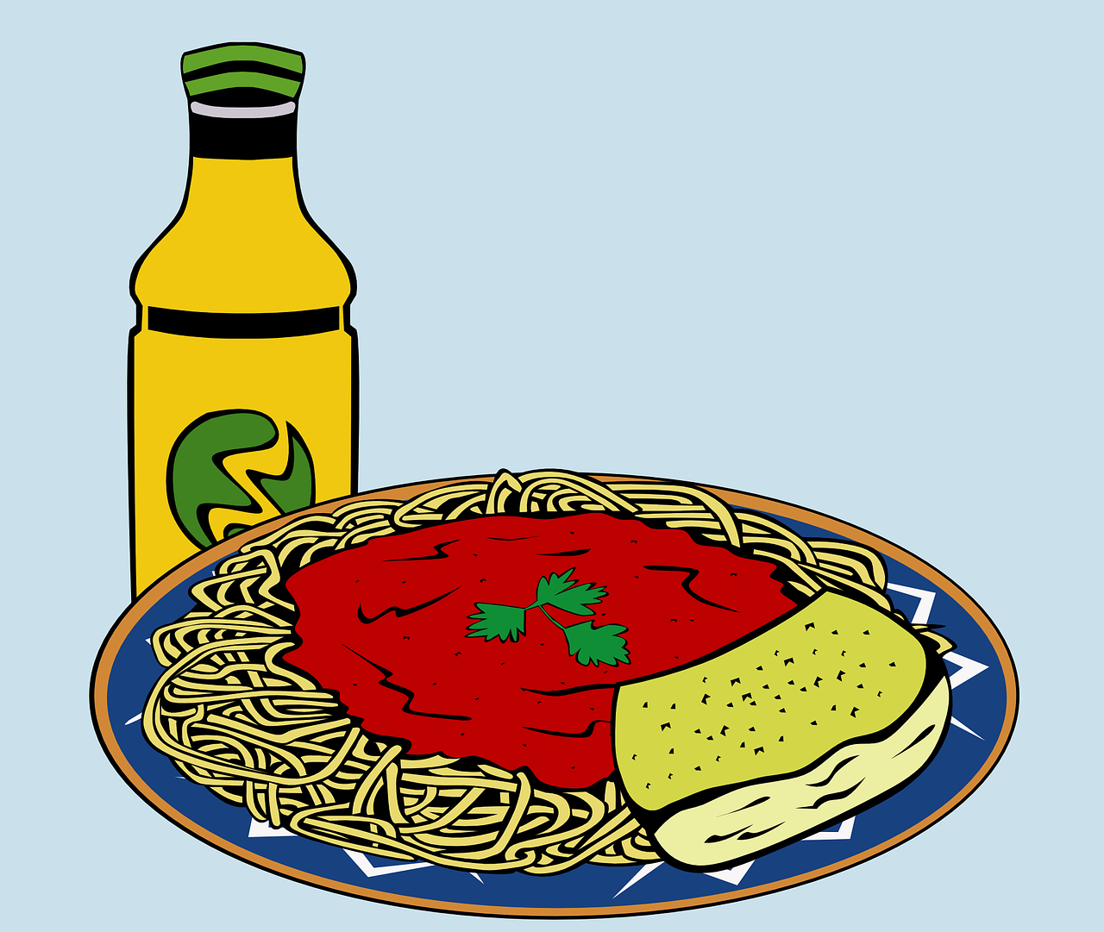




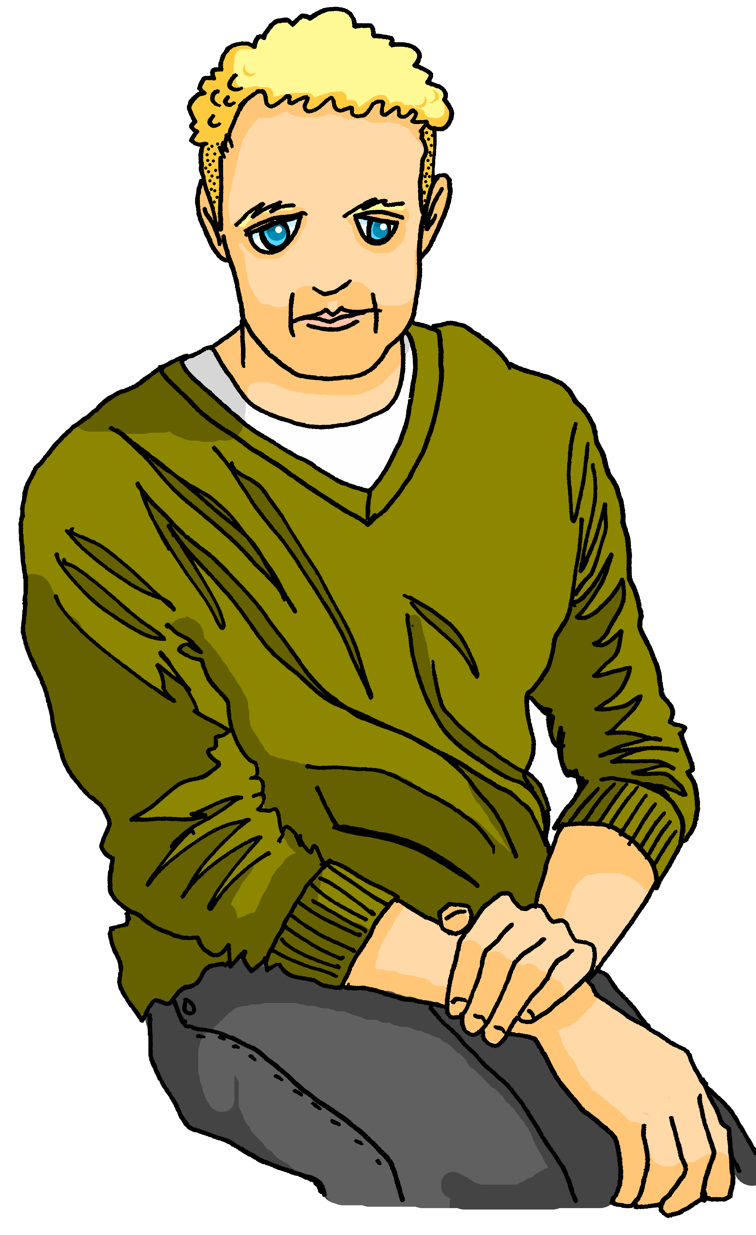
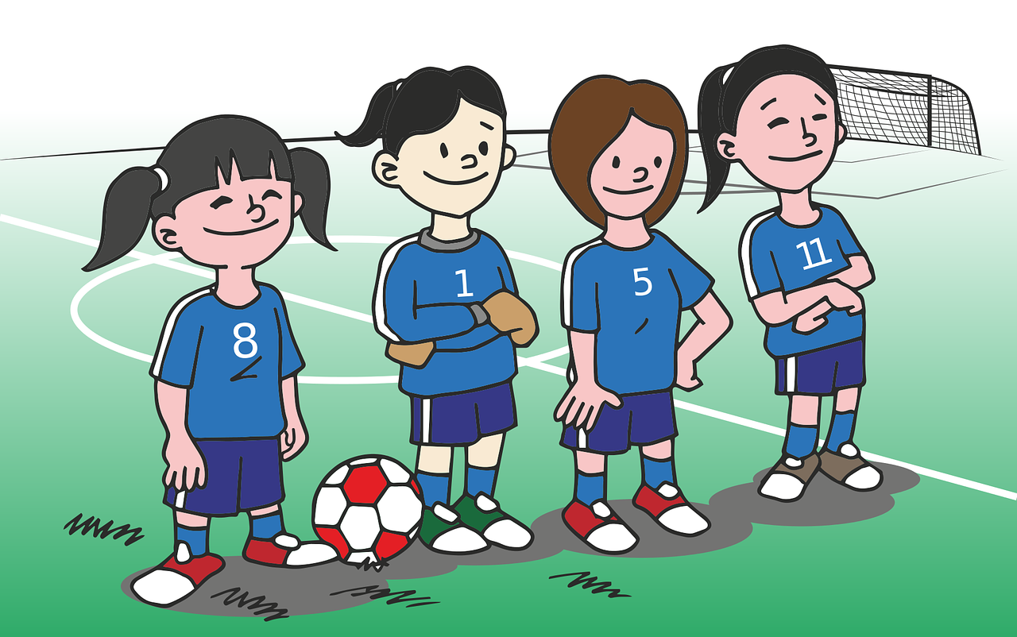
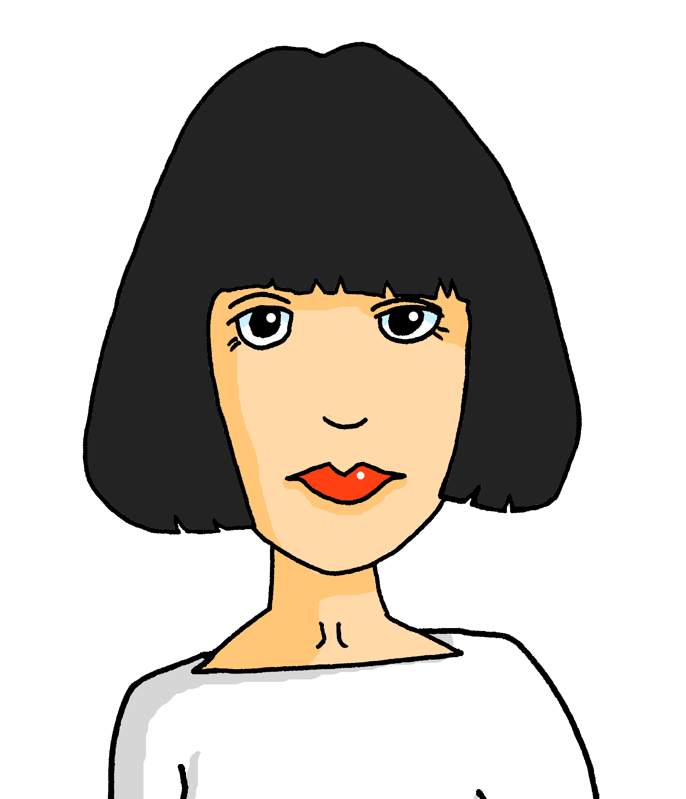


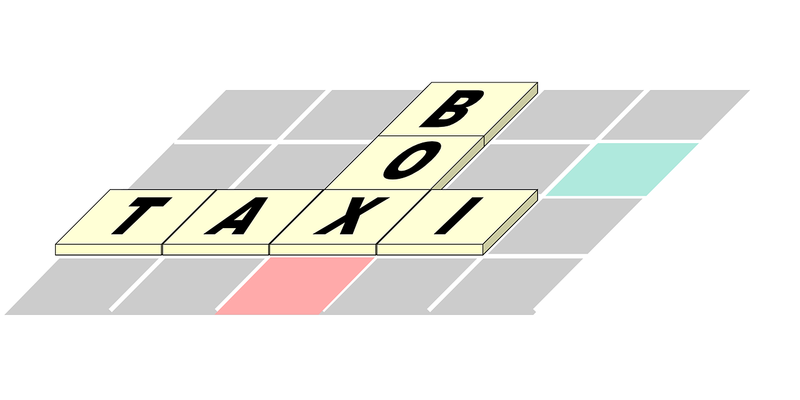


Follow up 3
Parle en français.
parler
___ équipe
__ yeux
___ effort
___ fleur
___ activité
mon
___ parents
___ vêtements
ma
___ rue
___ cheveux
___ semaine
___ santé
___ solution
___ problème
___ ordinateur
___ repas
mes
Notes:
Timing: 5 minutes
Aim: to practise spoken production of a range of vocabulary and practise applying possessive adjective agreement to things, where the gender is purely grammatical.
Procedure:
With this first slide, pupils read the words and say them aloud with the appropriate possessive adjective.
On the next slide pupils also recall the nouns and their gender/number in French, and call out answers with the appropriate possessive adjective (eg. ‘ma semaine’).
Note: Teachers may wish to omit one or other of the two slides, depending on the needs of the class.
Items in order:
ma semaine
mes cheveux
mon problème
ma solution
mes vêtements
mon ordinateur
mon équipe
ma rue
ma santé
mon effort
mon activité
mes parents
ma fleur
mon repas
mes yeux

Slide 5


Follow up 3
Parle en français.
parler
mon
ma
mes
Notes:
Timing: 5 minutes
Aim: to practise spoken production of a range of vocabulary and practise applying possessive adjective agreement to things, where the gender is purely grammatical.
Procedure:
With this first slide, pupils read the words and say them aloud with the appropriate possessive adjective.
On the next slide pupils also recall the nouns and their gender/number in French, and call out answers with the appropriate possessive adjective (eg. ‘ma semaine’).
Note: Teachers may wish to omit one or other of the two slides, depending on the needs of the class.
Items in order:
ma semaine
mes cheveux
mon problème
ma solution
mes vêtements
mon ordinateur
mon équipe
ma rue
ma santé
mon effort
mon activité
mes parents
ma fleur
mon repas
mes yeux

Slide 6



vocabulaire
Follow up 4 - Écris en anglais : Can you get at least 15 points?
mots
 | la piscine | le marché | je vais
 | tu es | tu vas | à
 | l’exercice | la gymnastique | le cyclisme
 | le sport | la natation | le ski
(the) swimming pool
(the) market
I go, am going
x3
you are
you go, are going
to, at, in
(the) exercise
(the) gymnastics
(the) cycling
x2
(the) sport
(the) swimming
(the) skiing
Notes:
Timing: 5-10 minutes
Aim: to practise written production of vocabulary from this week and two revisited weeks.
Procedure:
1. Give pupils a blank grid. They fill in the English meanings of any of the words they know, trying to reach 15 points in total.
2. Remind pupils that adjectives can refer to male or female persons and they should note this in their translations. E.g. pleased (f), short (m).
Note:
The most recently learnt and practised words are pink, words from revisit 1 are green and those from revisit 2 are blue, thus more points are awarded for them, to recognise that memories fade and more effort (heavy lifting!) is needed to retrieve them.
6

Slide 7
vocabulaire
Follow up 4- Écris en français : Can you get at least 15 points?
mots
 | to, at, in | (the) market | (the) swimming pool
 | I go, am going | you go, are going | you are
 | (the) swimming | (the) skiing | (the) sport
 | (the) cycling | (the) exercise | (the) gymnastics
à
le marché
la piscine
x3
je vais
tu vas
tu es
la natation
le ski
le sport
x2
le cyclisme
l’exercice
la gymnastique
Notes:
Timing: 5-10 minutes
Aim: to practise written comprehension of vocabulary from this week and previous weeks.
Procedure:
Give pupils a blank grid. They fill in the French meanings of any of the words they know, trying to reach 15 points in total.
Note:
The most recently learnt and practised words are pink, words from the previous week are green and those from earlier are blue, thus more points are awarded for them, to recognise that memories fade and more effort (heavy lifting!) is needed to retrieve them.
7

Slide 8

Follow up 5a
Écoute. C’est quelle catégorie ?
 | gris | jaune | vert
 | le | les | la
 | la médecin | le professeur | Madame Dupont
 | le cousin | la sœur | le père
 | l’ordinateur | la fenêtre | la chaise
 | la cuisine | le ménage | les devoirs
 | seize | vingt-deux | treize
 | chanter | étudier | répéter
 | du pain | de la glace | des tomates
 | l’histoire | le français | l’anglais
1
couleur
écouter
2
mots pour ‘the’
personne
numéro/
nombre
3
personne
4
famille
maison
famille
5
salle de classe
maison
mots pour ‘the’
6
activité
7
numéro/nombre
activité
couleur
8
manger
9
manger
salle de classe
étudier
10
étudier
Notes:
Timing: 5 minutes
Aim: to practise aural recognition of previously taught vocabulary and associate it with semantic categories.
Procedure:
Click the numbered buttons to listen.
Pupils select the category based on their understanding of the connection between the words they hear.
Click to correct after the first 1-2 items, to give pupils instant feedback.
Then continue with items 3-10 and elicit responses at the end, click to confirm the answers.
Transcript:
1. Gris | jaune | vert
2. Le | les | la
3. La médecin | le professeur | Madame Dupont
4. Le cousin | la sœur | le père
5. L’ordinateur | la fenêtre | la chaise
6. La cuisine | le ménage | les devoirs
7. Seize | vingt-deux | treize
8. Chanter | étudier | répéter
9. Du pain | de la glace | des tomates
10. L’histoire | le français | l’anglais

Slide 9
vocabulaire
Follow up 4a - Écris en anglais : Can you get at least 15 points?
mots
 | la piscine | le marché | je vais
 | tu es | tu vas | à
 | l’exercice | la gymnastique | le cyclisme
 | le sport | la natation | le ski
x3
x2
Notes:
HANDOUT
9

Slide 10
vocabulaire
Follow up 4b - Écris en français : Can you get at least 15 points?
mots
 | to, at, in | (the) market | (the) swimming pool
 | I go, am going | you go, are going | you are
 | (the) swimming | (the) skiing | (the) sport
 | (the) cycling | (the) exercise | (the) gymnastics
x3
x2
Notes:
HANDOUT
10

