Slide 1
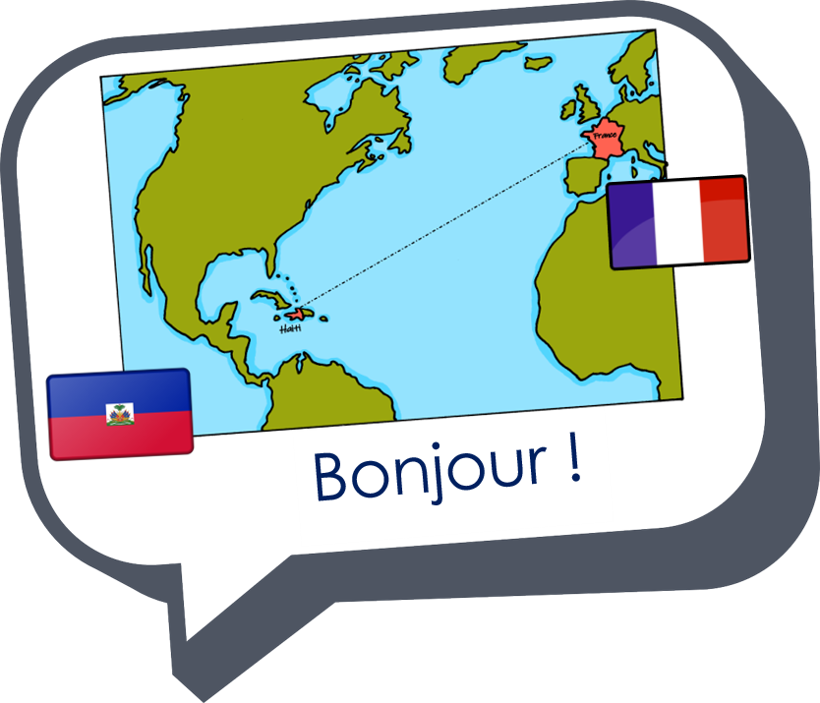
Expressing likes and saying what I and others do
bleu
Partitive du, de la,
de l’ des
SSC [h] muet
Notes:
Artwork by Steve Clarke. Pronoun pictures from NCELP (www.ncelp.org). All additional pictures selected from Pixabay and are available under a Creative Commons license, no
attribution required.
Frequency of new words:
Phonics: petit [138]
Vocabulary: Salut ! [2205] présent [216] absent [2016] je [22] il [13] elle [38] être [5] suis, est
Londsale, D., & Le Bras, Y. (2009). A Frequency Dictionary of French: Core vocabulary for learners London: Routledge.
The frequency rankings for words that occur in this PowerPoint which have been previously introduced in these resources are given in the SOW and in the resources that first
introduced and formally re-visited those words.
For any other words that occur incidentally in this PowerPoint, frequency rankings will be provided in the notes field wherever possible.
1

Slide 2




[h]
prononcer
heure
Notes:
Timing: 1 minute
Aim: To consolidate SSC [h]
Procedure:
1. Present the letter(s) [h] and click for the ‘silence’ icon, bringing your finger to your lips to show that the [h] muet is not pronounced.
2. Bring up the word ”heure” on its own, say it, pupils repeat it, so that they have the opportunity to focus all of their attention on the connection between the written word and its SSC.
3. Roll back the animations and work through 1-3 again, but this time, dropping your voice completely to listen carefully to the pupils pronouncing ”heure” and, if using, doing the gesture.
Gesture suggestion:
https://www.signbsl.com/sign/hour (first video, top left of webpage)
The sign is left hand pointing up and palm facing inwards, index finger of the right hand traces a round clock face on the palm.
Word frequency (1 is the most frequent word in French):
heure [99]
Source: Londsale, D., & Le Bras, Y. (2009). A Frequency Dictionary of French: Core vocabulary for learners London: Routledge.
2

Slide 3
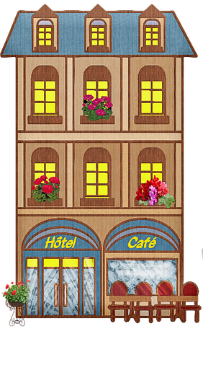

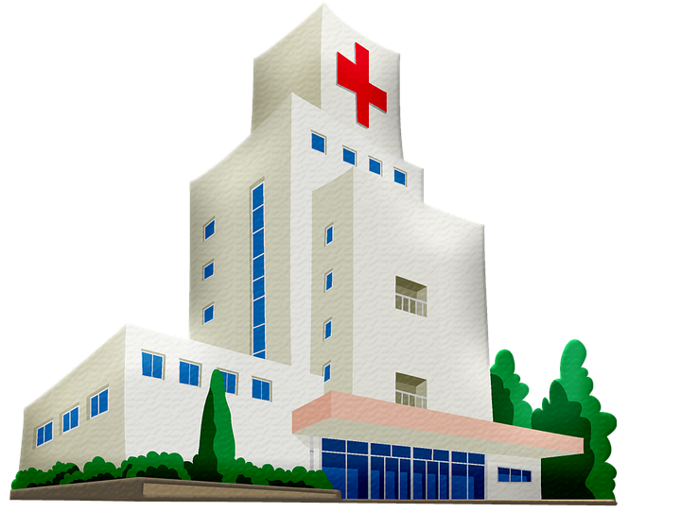

[h]
prononcer
histoire
hôtel
heure
winter
hôpital
hiver
Notes:
Timing: 2 minutes
Aim: To introduce SSC [j/soft g]
Procedure:
1. Introduce and elicit the gesture of ‘silence’ for [h] muet and pronunciation and then the source word again ‘heure’ (with gesture, if using).
2. Then present and elicit the pronunciation of the four cluster words.
The cluster words have been chosen for their high-frequency, from a range of word classes, with the SSC (where possible) positioned within a variety of syllables within the words (e.g. initial, 2nd, final etc.). Additionally, we have tried to use words that build cumulatively on previously taught SSCs (see the Phonics Teaching Sequence document) and do not include new SSCs. Where new SSCs are used, they are often consonants which have a similar symbol-sound correspondence in English.
Word frequency:
heure [99] histoire [263] hôpital [1308] hôtel [1774] hiver [1586]
Source: Londsale, D., & Le Bras, Y. (2009). A Frequency Dictionary of French: Core vocabulary for learners London: Routledge.
3

Slide 4

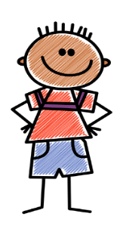
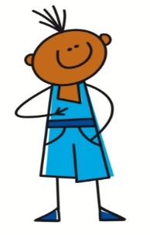
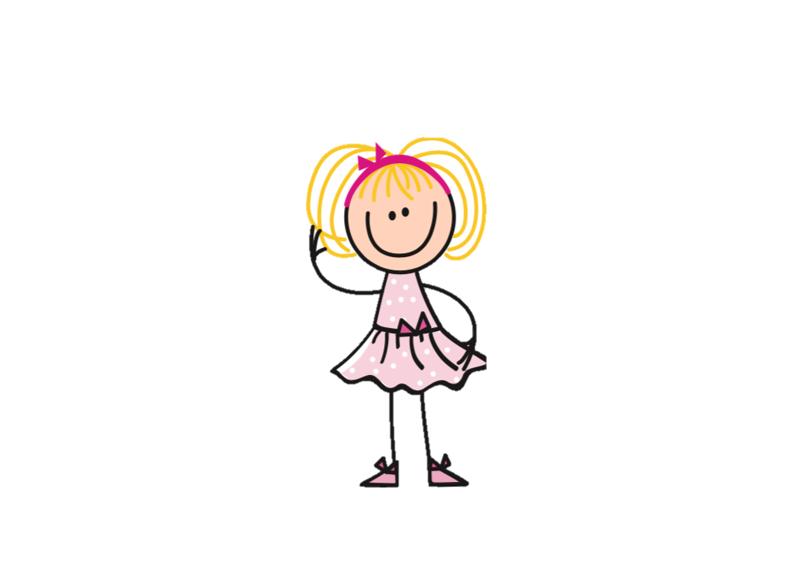



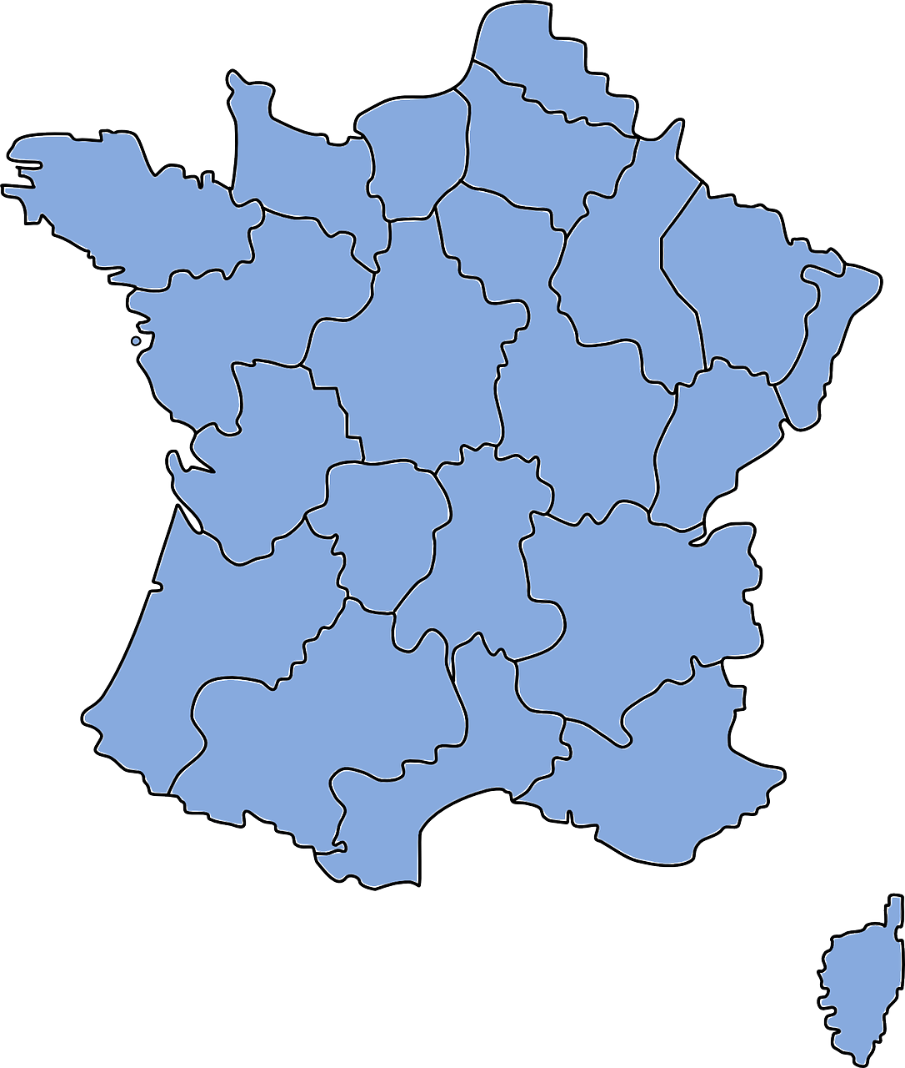




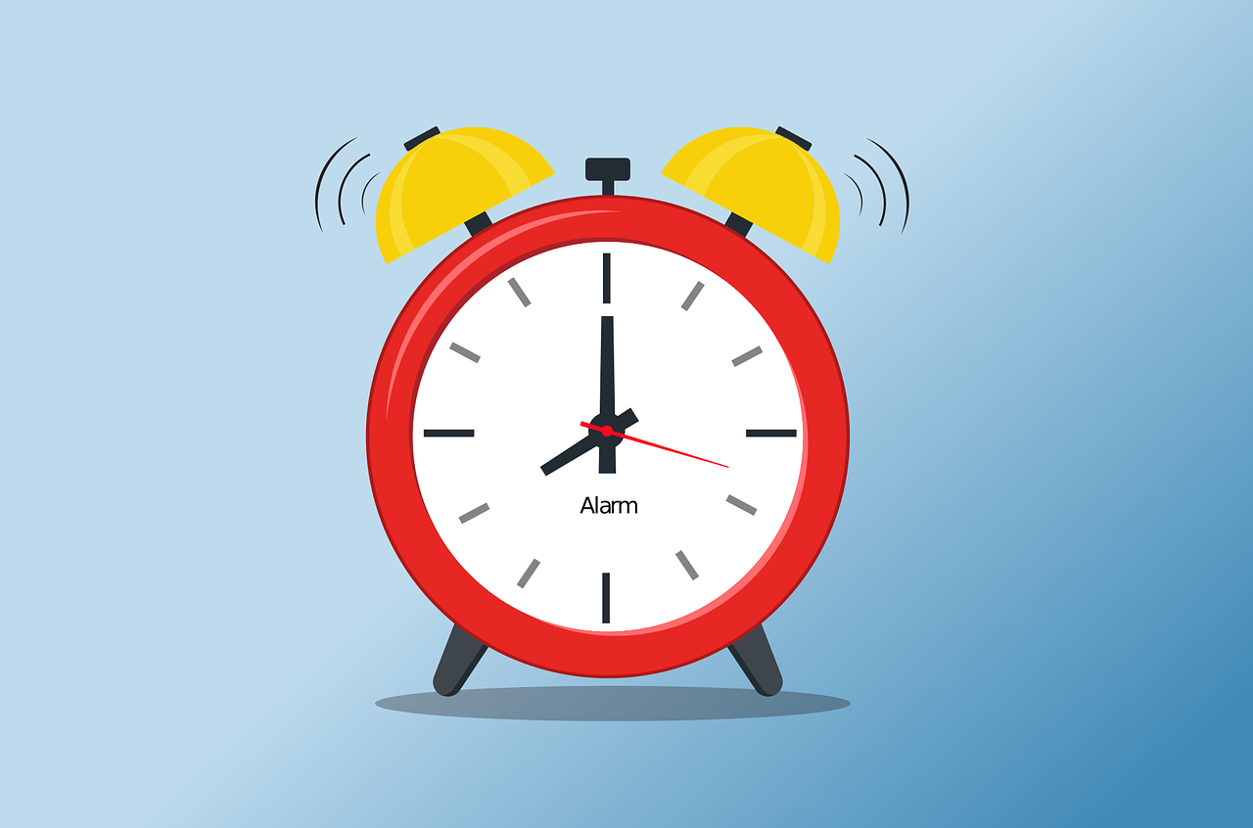


prononcer
Prononce les phrases. Qui fait quoi ?
Henri
Hakim
Honore
Hervé
Hilde
Hélène
Hélène
1
Henri
2
Honore
3
…mange dans huit hôtels horribles.
…va à l’hôpital en hiver.
…habite à Honfleur.
Hervé
4
Hilde
5
Hakim
6
…aime l’histoire d’Haïti.
…est heureuse à huit heures.
… voyage à Haïti en helicoptère.
Notes:
Timing: 5 minutes
Aim: to consolidate knowledge of SSC [h]; to practise comprehension of some previously taught vocabulary.
Procedure:
Pupils read the phrases aloud in pairs and match them to each person.
Click on buttons to play the audio.
Pupils listen and check their answers.
Click to reveal answers.
Transcript:
1. Hélène mange dans huit hôtels horribles.
2. Henri va à l’hôpital en hiver.
3. Honore habite à Honfleur.
4. Hervé aime l’histoire d’Haïti.
5. Hilde est heureuse à huit heures.
6. Hakim voyage à Haïti en helicoptère.
4

Slide 5


The partitive article
du, de la, de l’, des
We already know the words for ‘the’ and ‘a’ in French. These are called articles:
noun (m)
noun (f)
noun (m/f before a vowel)
definite (the)
le poisson
la glace
l’ eau
the fish
the ice cream
the water
It is common to say ‘une eau minérale’, for example.
indefinite (a/an)
un poisson
une glace
une eau
a fish
an ice cream
a water
We use it in French for an ‘unspecified amount or ‘part’.
This article doesn’t exist in English.
To say ‘some’ we use the partitive article:
partitive (some)
du poisson
de la glace
de l’ eau
some fish
some ice cream
some water
Notes:
Timing: 2 minutes
Aim: to introduce the partitive article and revisit definite and indefinite articles.
Procedure:
Click through the animations to present the information.
Elicit English translations for the French examples provided.

Slide 6
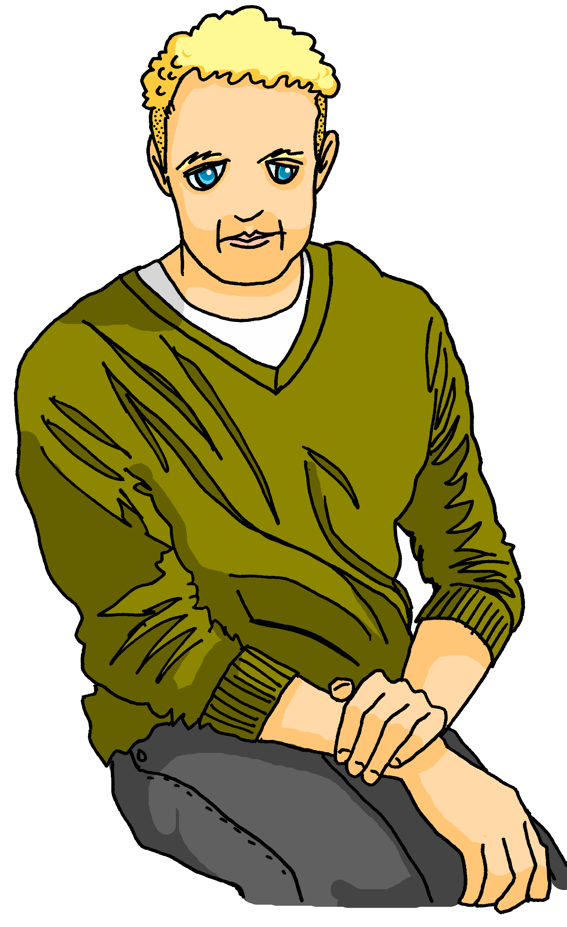

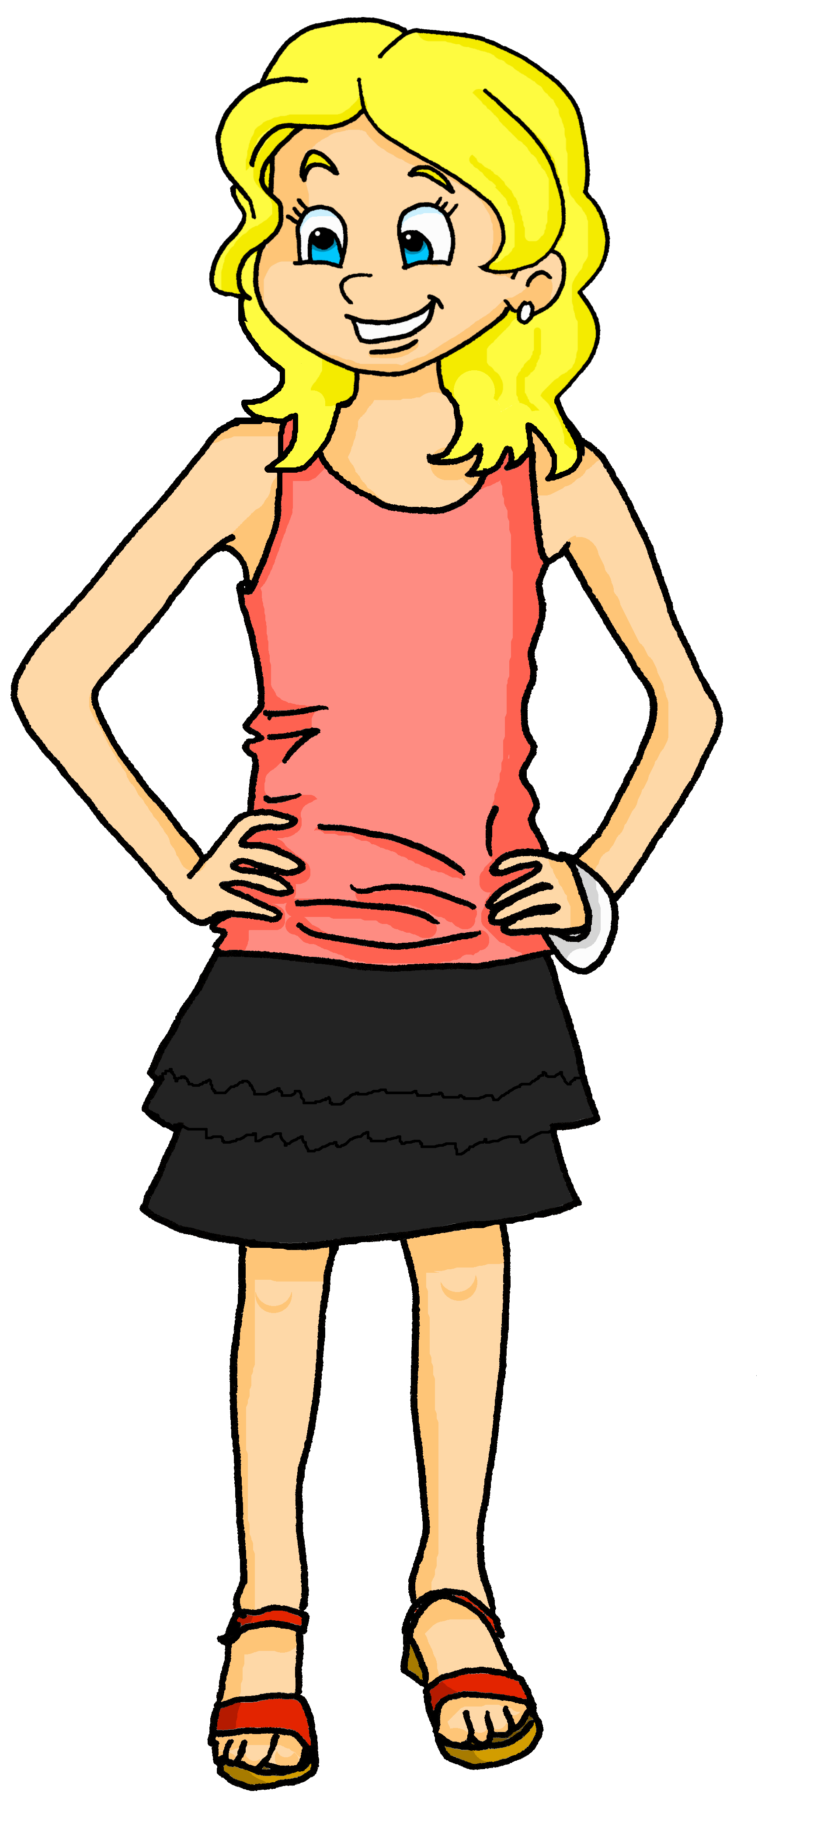



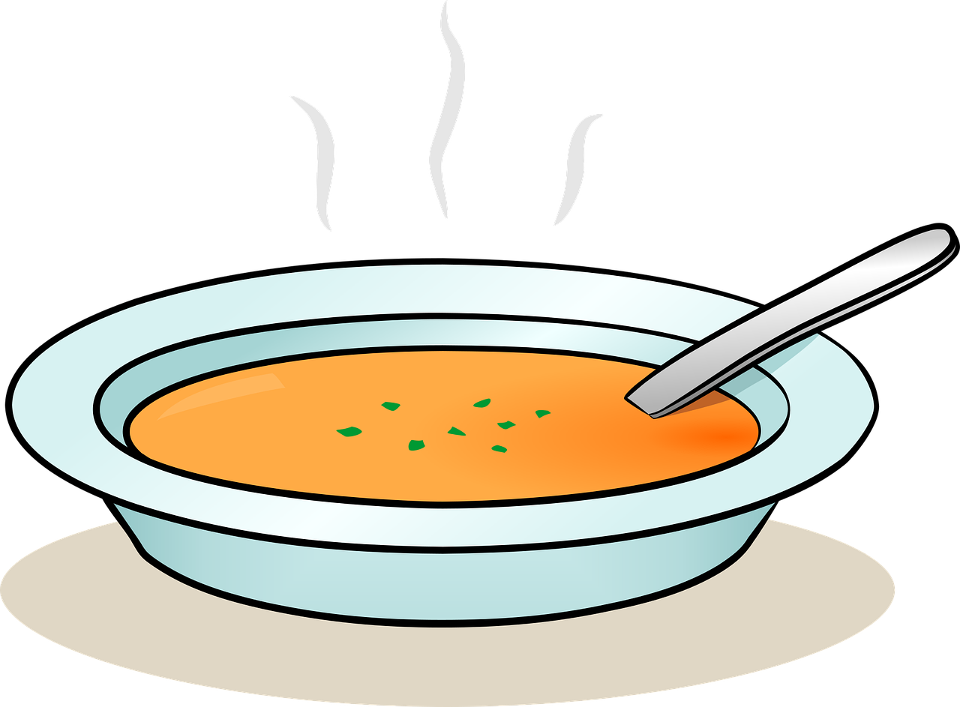

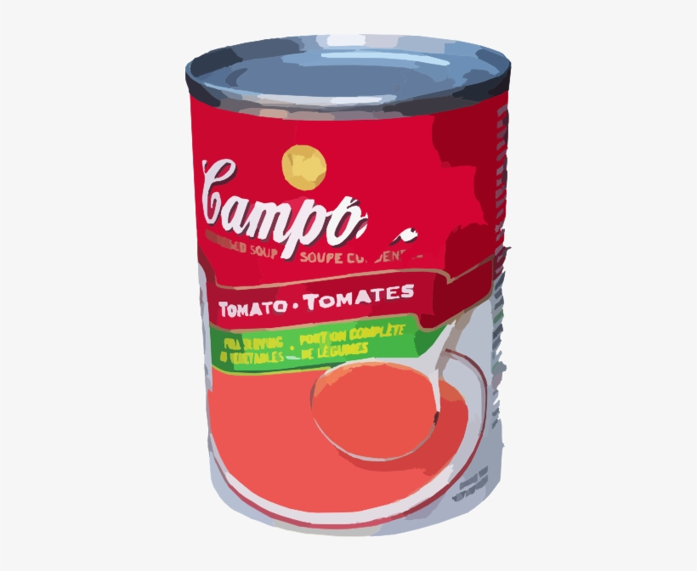



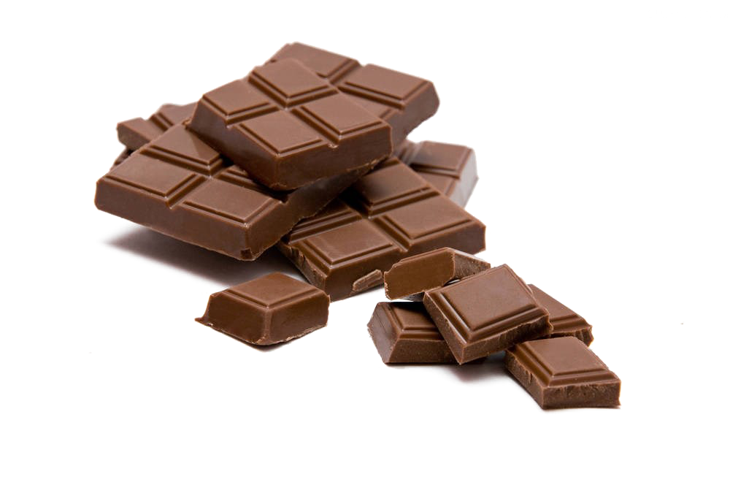




lire
Au marché
 | A | B
Adèle et Hervé préparent un pique-nique.
Lis et choisis la bonne image.
1
un pain
2
de la soupe
3
un fruit
4
du chocolat
du poisson
5
une glace
6
Notes:
Timing: 7 minutes
Aim: to practise written recognition of the partitive article to indicate a ‘part’ or portion.
Procedure:
Remind pupils that un/une means ‘a/an’ and indicates a whole something, whilst the partitive article du/del/de l’/des indicates a ‘part’ of a whole, so ‘some’ of something.
Ask pupils to write 1-6 and for each item on the shopping list, they decide which picture fits and write A or B. Is it a whole or a part?
Elicit answers from pupils and click to confirm them.
6

Slide 7

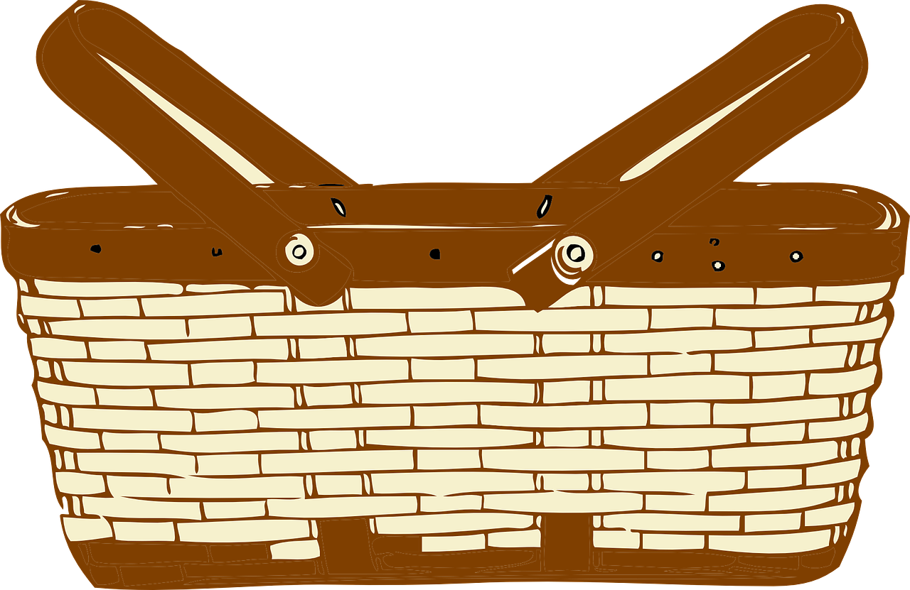





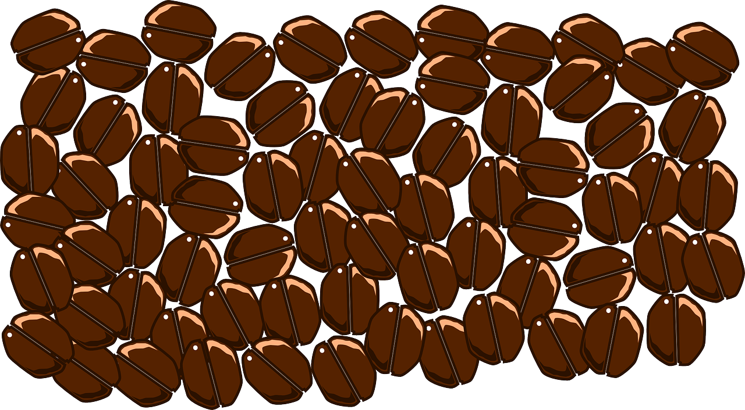
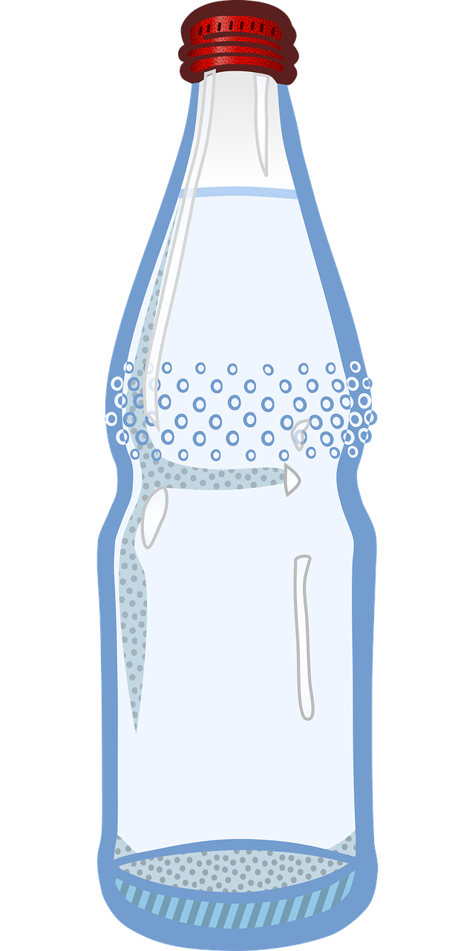




écouter
Au marché
Remember! un/une indicates a whole, du/de la/de l’ indicates a part or ‘some’.
Écoute et choisis la bonne image.
 | A | B
 | A | B
1
4
2
5
6
3
Notes:
Timing: 5 minutes
Aim: to practise aural recognition of the partitive article to indicate a ‘part’ or portion.
Procedure:
1. Click the numbers to play the audio.
2. Students write 1-6 and use the presence or absence of the indefinite/partitive article to choose a or b.
3. Click to reveal the answers.
Transcript:
un poisson
de la glace
de l’eau
un gâteau
du café
un fromage
7

Slide 8

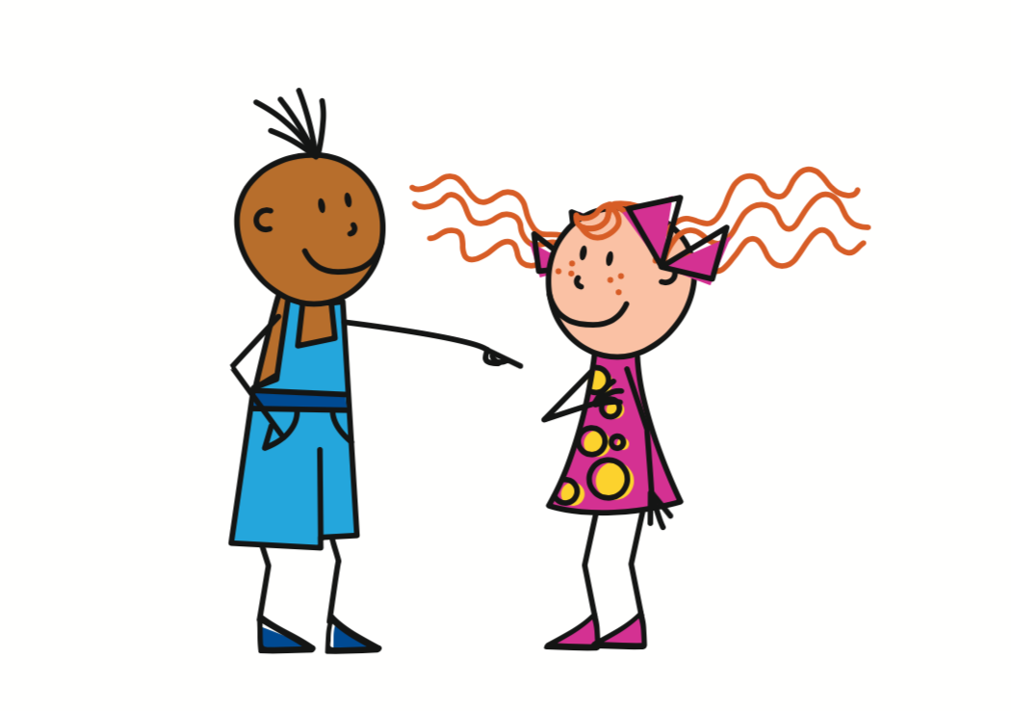

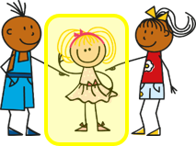
Two new verbs
Note the accents ! You have learnt another verb like this: répéter.
Acheter means ‘to buy’:
Boire means ‘to drink’:
The ‘je’ and the ‘tu’ forms are the same. Faire is also like this.
j’achète
I buy
je bois
I drink
tu achètes
you buy
tu bois
you drink
il achète
he buys
il boit
he drinks
elle achète
she buys
elle boit
she drinks
Notes:
Timing: 2 minutes
Procedure:
Present the singular persons of two new verbs.
Explain that ‘acheter’ works like all regular –ER verbs, but adds additional accents, like répéter, which they were already taught.
Explain that ‘boire’ is a different kind of verb, the je and tu forms are the same, which is like another verb they know, faire.
Elicit English translation for the French examples provided. These two verbs are on the list for learning this week.
8

Slide 9

lire
Lis les messages. C’est Adèle (je) ou Hervé (il) ?
Ou c’est impossible de savoir ?
 |  | Adèle (I) | Hervé (he) | ???
 | Il fait les courses.
 | j’/il achète de la glace.
 | Je bois de l’eau.
 | Je/il prépare un gâteau.
 | Il boit du café.
 | Je/Il mange du pain.
1
2
3
4
5
6
Notes:
Timing: 7 minutes
Aim: to practise written recognition of singular parts of the new verbs (and previously taught verbs) and connect them with their meaning.
Procedure:
Remind pupils that they need to pay attention to the verb endings to decide if it is Adèle, Hervé or if it is impossible to tell.
Click to listen and check the responses (note that for the –ER verbs both versions of the answers are recorded because you cannot tell from the verb ending) OR elicit the responses orally from pupils and click to confirm the answers.
Elicit English meanings of each phrase.
Transcript:
Il fait les courses.
j’achète de la glace. Il achète de la glace.
Je bois de l’eau.
Je prépare un gateau. Il prépare un gateau.
Il boit du café.
Je mange du pain. Il mange du pain.
9

Slide 10
Au revoir !
bleu
Notes:
10

