Slide 1

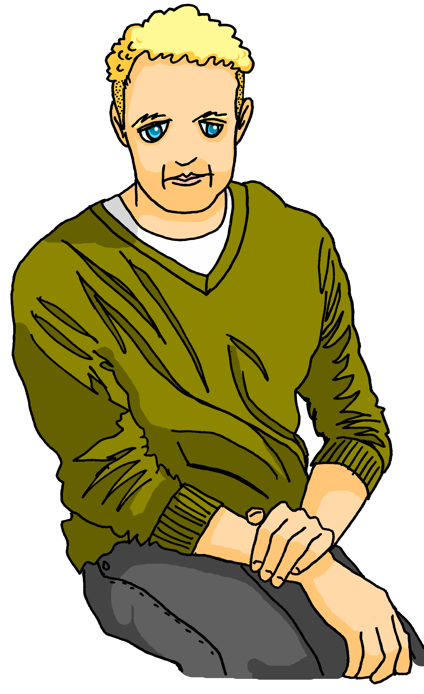
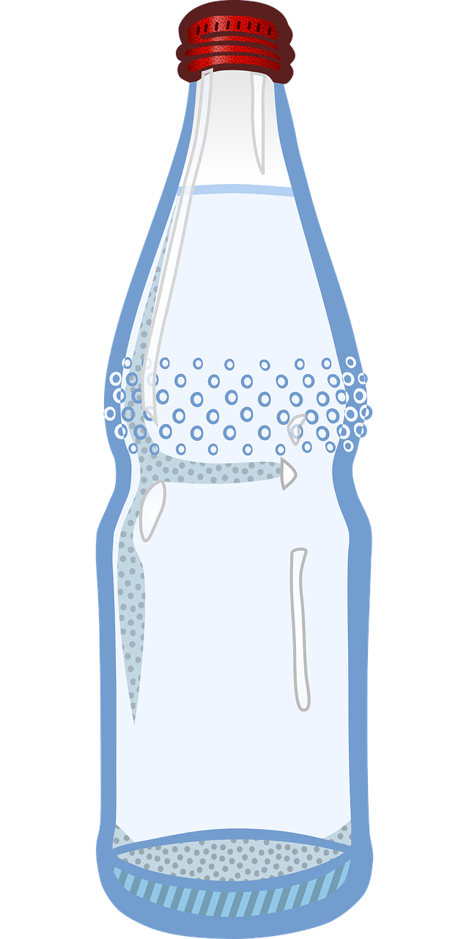
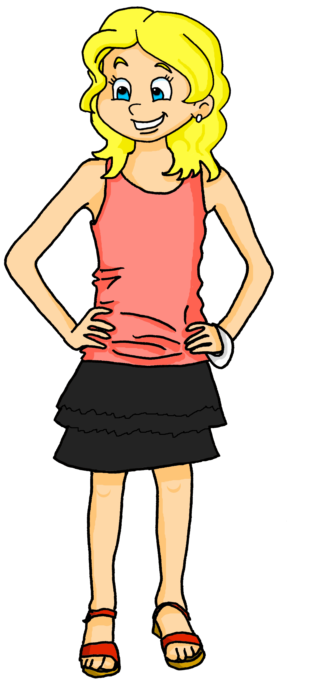







Saying what I and others do
bleu
Follow ups 1-5
Notes:
Artwork by Steve Clarke. Pronoun pictures from NCELP (www.ncelp.org). All additional pictures selected from Pixabay and are available under a Creative Commons license, no attribution required.
Phonics: Revisit SSC j (soft g) jour [78] j’ai [8 - avoir] génial [3872] sujet [353] partager [527]
Vocabulary (new words in bold): donner à manger [n/a] laver [3503] ranger [2774] cuisine² [2618] repas [2948] - revisit: aimer [242] détester [2898]
Revisit 1: football [2602] tennis [3687] corde [3784] fois [49]
Revisit 2: il y a un [3] deux [41], trois [115], quatre [253], cinq [288], six [450], sept [905], huit [877], neuf [787], dix [372], onze [2447], douze [1664] des [2] combien [800] treize [3285], quatorze [3359], quinze [1472], seize [3285], dix-sept [3812], dix-huit [3592], dix-neuf [4851], vingt [1273], vingt et un [1273/6/3], vingt-deux, vingt-trois, vingt-quatre, vingt-cinq, vingt-six, vingt-sept, vingt-huit, vingt-neuf, trente [1646]
Londsale, D., & Le Bras, Y. (2009). A Frequency Dictionary of French: Core vocabulary for learners London: Routledge.
The frequency rankings for words that occur in this PowerPoint which have been previously introduced in these resources are given in the SOW and in the resources that first
introduced and formally re-visited those words.
For any other words that occur incidentally in this PowerPoint, frequency rankings will be provided in the notes field wherever possible.

Slide 2



[h]
prononcer
heure
Notes:
Timing: 1 minute
Aim: To consolidate SSC [h]
Procedure:
1. Present the letter(s) [h] and click for the ‘silence’ icon, bringing your finger to your lips to show that the [h] muet is not pronounced.
2. Bring up the word ”heure” on its own, say it, pupils repeat it, so that they have the opportunity to focus all of their attention on the connection between the written word and its SSC.
3. Roll back the animations and work through 1-3 again, but this time, dropping your voice completely to listen carefully to the pupils pronouncing ”heure” and, if using, doing the gesture.
Gesture suggestion:
https://www.signbsl.com/sign/hour (first video, top left of webpage)
The sign is left hand pointing up and palm facing inwards, index finger of the right hand traces a round clock face on the palm.
Word frequency (1 is the most frequent word in French):
heure [99]
Source: Londsale, D., & Le Bras, Y. (2009). A Frequency Dictionary of French: Core vocabulary for learners London: Routledge.
2

Slide 3
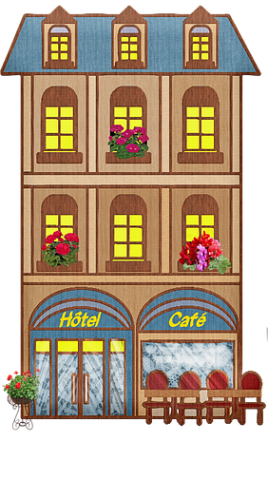



[h]
prononcer
histoire
hôtel
heure
winter
hôpital
hiver
Notes:
Timing: 2 minutes
Aim: To introduce SSC [j/soft g]
Procedure:
1. Introduce and elicit the gesture of ‘silence’ for [h] muet and pronunciation and then the source word again ‘heure’ (with gesture, if using).
2. Then present and elicit the pronunciation of the four cluster words.
The cluster words have been chosen for their high-frequency, from a range of word classes, with the SSC (where possible) positioned within a variety of syllables within the words (e.g. initial, 2nd, final etc.). Additionally, we have tried to use words that build cumulatively on previously taught SSCs (see the Phonics Teaching Sequence document) and do not include new SSCs. Where new SSCs are used, they are often consonants which have a similar symbol-sound correspondence in English.
Word frequency:
heure [99] histoire [263] hôpital [1308] hôtel [1774] hiver [1586]
Source: Londsale, D., & Le Bras, Y. (2009). A Frequency Dictionary of French: Core vocabulary for learners London: Routledge.
3

Slide 4










prononcer
Follow up 1:
Prononce les mots.
30
horrible
ha ha !
héros
horizon
hôtel
S
humain
hiver
historique
hélicoptère
honorable
hésiter
habitat
0
DÉBUT
Notes:
Timing: 5 minutes
Aim: To practise pronunciation of words with [h] muet, particularly cognates which are pronounced with an audible ‘h’ in English.
Procedure:
Pupil A chooses 4 of the 12 words.
Pupil B must pronounce all 12 words correctly in the 30 second time limit in order to identity his/her partner’s 4 words.
If B pronounces a word with audible ‘h’, A can give a 3 x second penalty.
Swap roles and repeat the activity.
4

Slide 5


Follow up 2
Écoute et écris les bonnes lettres.
écouter
A I | E drink | I a/an | K coffee
B you | F eat | J some | L cake
C he | G buy |  | M fruit
D she | H prepare |  | N water
 |  |  | O fish
 |  |  | P ice cream
 |  |  | Q chocolate
 |  |  | R bread
1
D
E
J
K
5
C
F
I
P
2
A
H
I
O
6
A
G
J
R
3
C
G
I
L
7
B
E
J
N
4
B
F
J
Q
8
D
F
I
M
Notes:
Timing: 5 minutes
Aim: to practise aural comprehension of this week’s new language.
Procedure:
Click the numbered buttons to listen.
Pupils select 4 letters for each sentence.
Click to correct after each one, to give pupils instant feedback.
If time allows, elicit the French sentences from pupils chorally and click again for the audio, to listen and check.
Transcript:
1. Elle boit du café.
2. Je prépare un poisson.
3. Il achète un gateau.
4. Tu manges du chocolat.
5. Il mange une glace.
6. J’achète du pain.
7. Tu bois de l’eau.
8. Elle mange un fruit.

Slide 6





vocabulaire
Follow up 3a - Écris en anglais : Can you get at least 15 points?
mots
 | tes | le parent | mes
 | l’équipe | l’ouest | il va
 | l’est | elle va | le nord
 | le sud | aller | je vais
 | le café | boire | l’eau
 | le poisson | acheter | la glace
your (mfpl)
(the) parent
my (mfpl)
x3
(the) team
(the) west
he goes, is going
(the) east
she goes, is going
(the) north
x2
(the) south
to go, going
I go, am going
(the) coffee
to drink, drinking
(the) water
x1
(the) fish
to buy, buying
(the) ice cream
Notes:
Timing: 5-10 minutes
Aim: to practise written production of vocabulary from this week and two revisited weeks.
Procedure:
1. Give pupils a blank grid. They fill in the English meanings of any of the words they know, trying to reach 15 points in total.
2. Remind pupils that adjectives can refer to male or female persons and they should note this in their translations. E.g. pleased (f), short (m).
Note:
The most recently learnt and practised words are pink, words from revisit 1 are green and those from revisit 2 are blue, thus more points are awarded for them, to recognise that memories fade and more effort (heavy lifting!) is needed to retrieve them.
6

Slide 7
vocabulaire
Follow up 3b- Écris en français : Can you get at least 15 points?
mots
 | (the) parent | my (mfpl) | your (mfpl)
 | (the) west | he goes, is going | (the) team
 | (the) north | (the) south | (the) east
 | to go, going | I go, am going | She goes, is going
 | (the) water | (the) ice cream | (the) fish
 | to buy, buying | to drink, drinking | (the) coffee
le parent
mes
tes
x3
l’ouest
il va
l’équipe
le nord
le sud
l’est
x2
je vais
elle va
aller
l’eau
la glace
le poisson
x1
acheter
boire
le café
Notes:
Timing: 5-10 minutes
Aim: to practise written comprehension of vocabulary from this week and previous weeks.
Procedure:
Give pupils a blank grid. They fill in the French meanings of any of the words they know, trying to reach 15 points in total.
Note:
The most recently learnt and practised words are pink, words from the previous week are green and those from earlier are blue, thus more points are awarded for them, to recognise that memories fade and more effort (heavy lifting!) is needed to retrieve them.
7

Slide 8



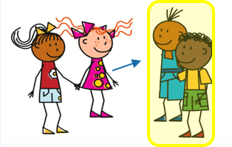
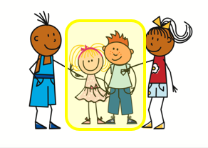

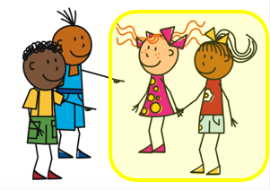
-ER verbs (singular and plural)
Note the accents ! You have learnt other verbs like this: répéter, préférer.
Remember the endings for –ER verbs:
Il achète du poisson.
He buys some fish.
Ils mangent du poisson.
They eat some fish.
Remember the liaison after ils/elles before a verb beginning with a vowel or h muet.
Elle achète un poisson.
She buys a fish.
Elles achètent un poisson.
They buy a fish.
Notes:
BEFORE FOLLOW UP 3
Timing: 2 minutes
Procedure:
Present the singular and plural forms of the –ER verbs.
Elicit English translations of the French examples.
Click to remind pupils about liaison after ils/elles.
8

Slide 9

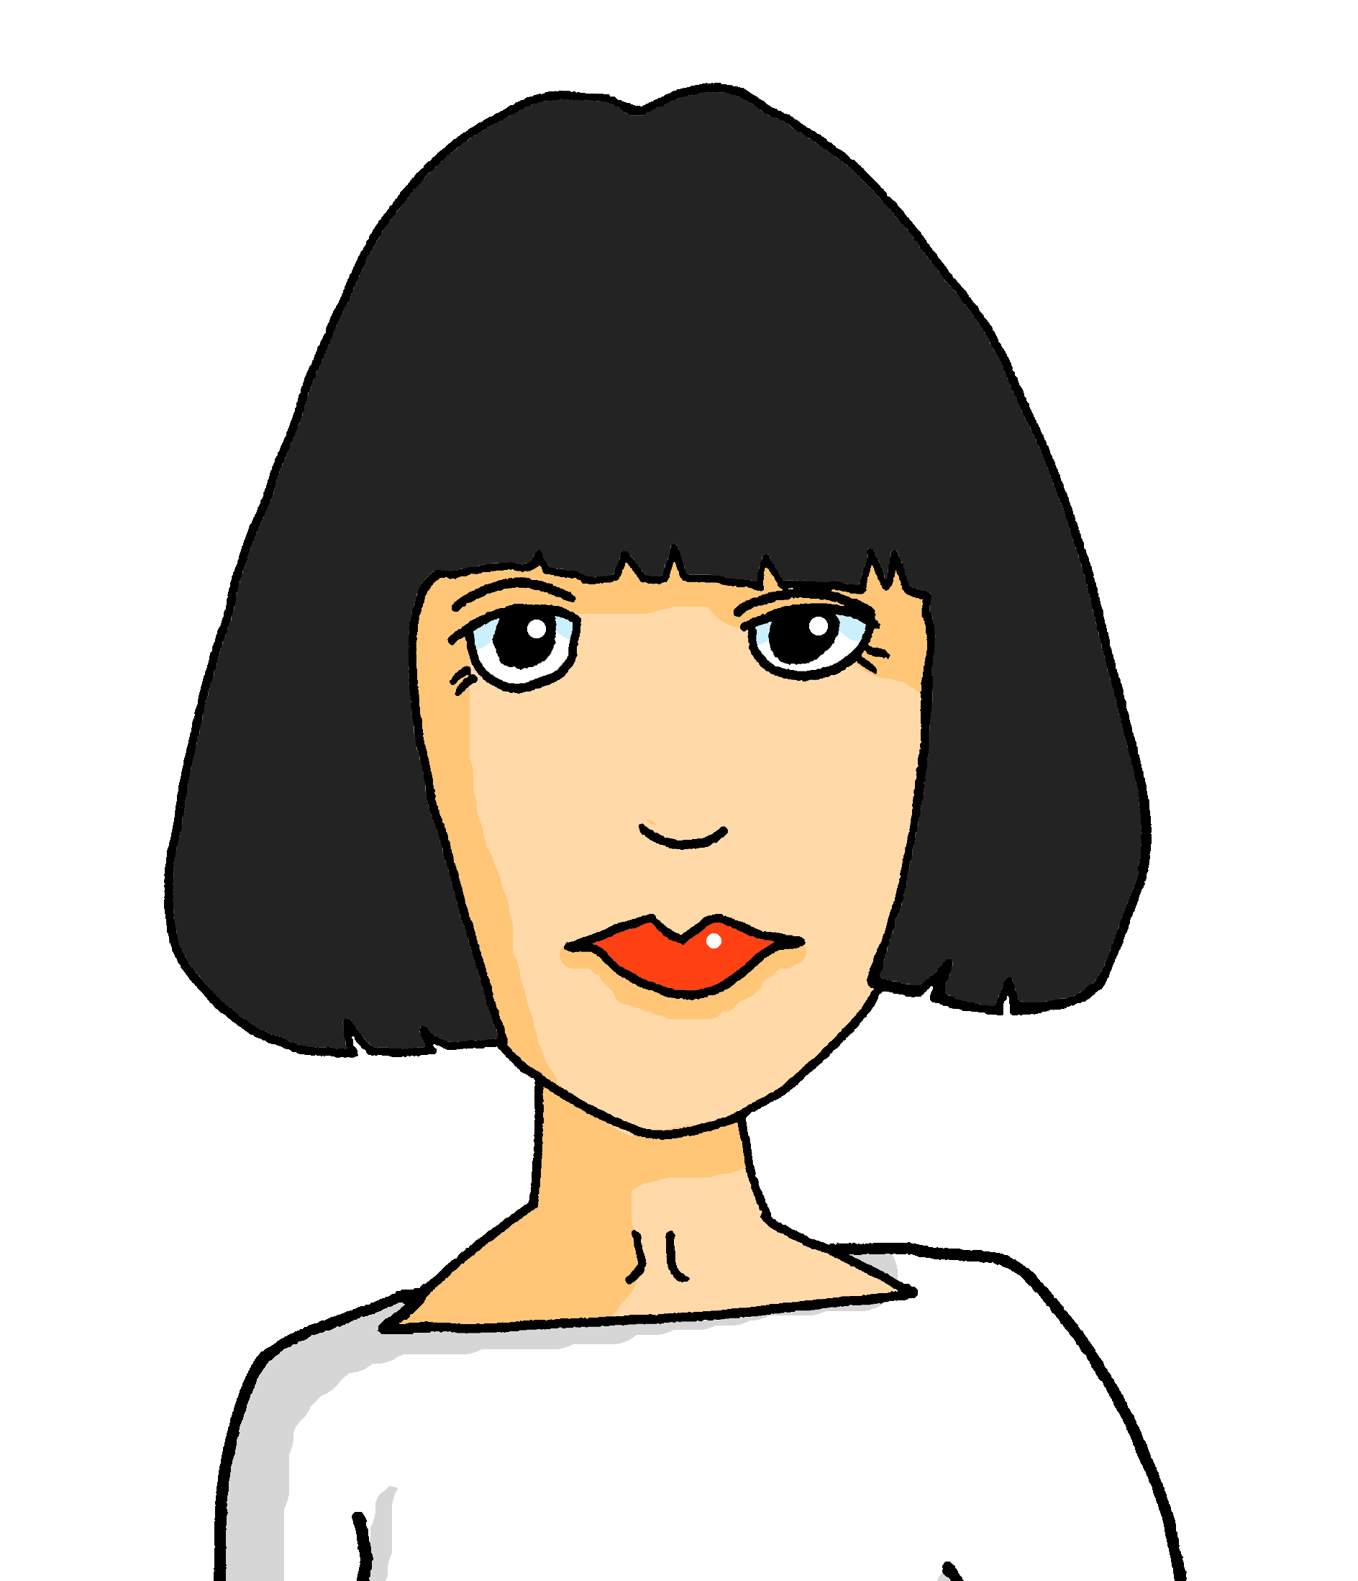


Follow up 4
Lis les messages. C’est Pierre (il) ou ses parents (ils) ?
lire
 | we / they | en anglais
Ils organisent un pique-nique.
Il achète du pain.
Ils achètent des tomates.
Il prépare des activités.
Il aime manger de la glace.
Ils mangent de la salade.
Ils préparent des sandwichs.
Il mange du gâteau.
1
They
organise a picnic.
2
He
buys some bread.
3
They
buy some tomatoes.
4
He
prepares some activities.
5
He
likes eating ice cream.
6
They
eat (some) salad.
7
They
prepare some sandwiches.
8
He
eats some cake.
Notes:
Timing: 5 minutes
Aim: to practise written comprehension of singular and plural –ER verbs and previously taught vocabulary.
Procedure:
Teacher to read the context and ensure this is clear. Pupils need to pay attention to the verb endings to decide if this is something Pierre does (he) or his parents do (they).
Pupils write 1-8.
Pupils to read the messages.
They decide for each one whether the subject is he or they and write this down.
They then write the English for the remainder of the sentence.
6. Elicit answers from pupils and click to confirm.

Slide 10



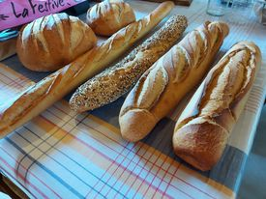
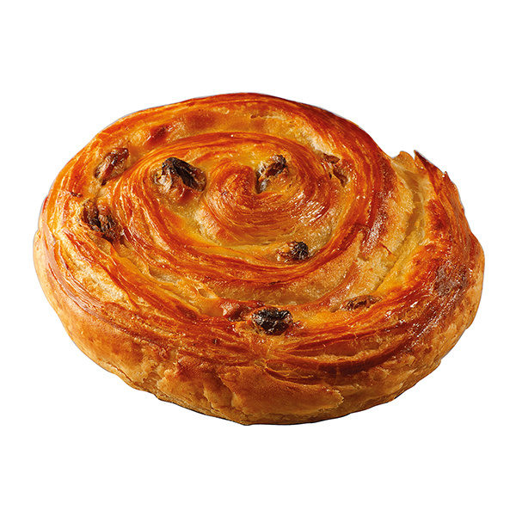
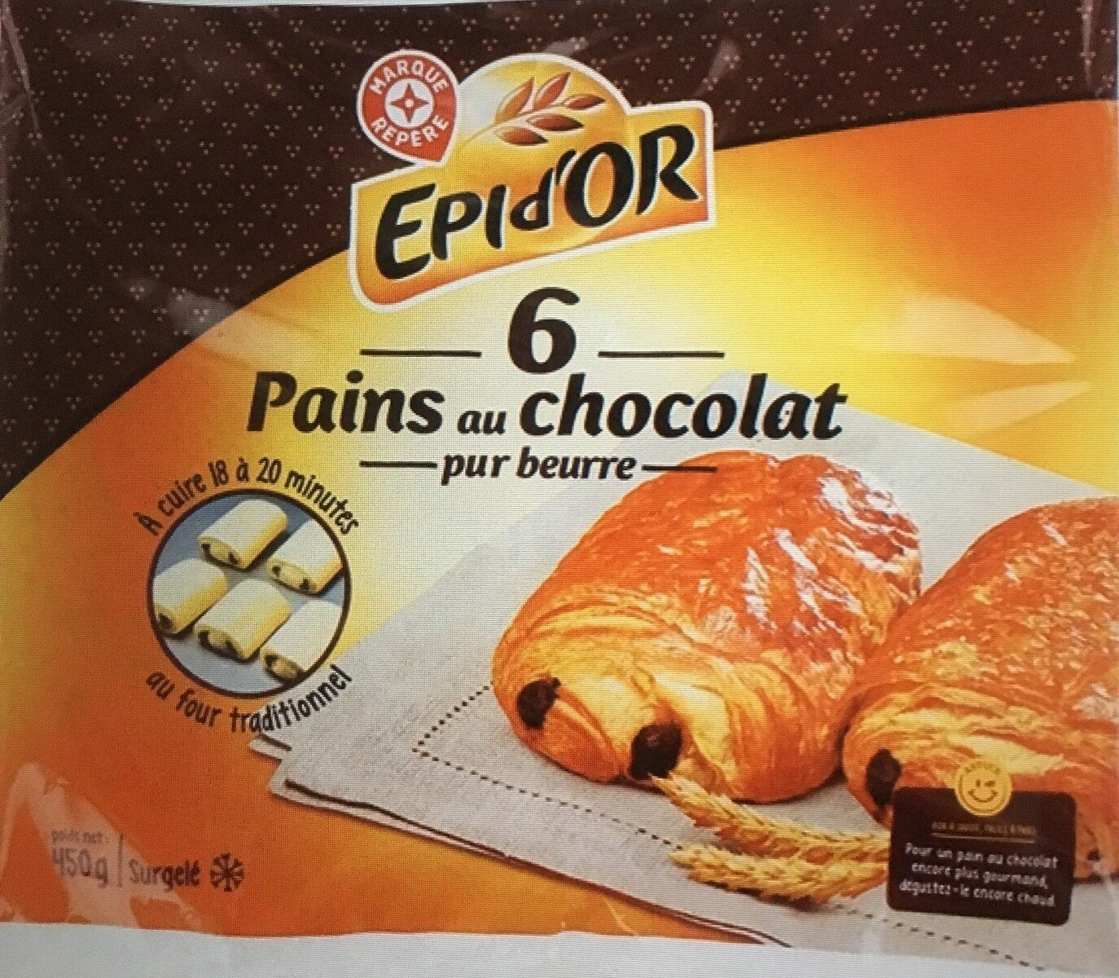
À la boulangerie*
une grosse boule
une petite boule
un pain de deux
une baguette
un pain moulé
une baguette aux céréales
We usually say ‘un pain’ when it’s a specific kind. E.g. un pain de deux. Otherwise use ‘du pain’ (some bread).
un pain aux raisins
un pain au chocolat
la boulangerie – bakery
Notes:
Timing: 1 minute
Aim: to introduce pupils to different sorts of French bread and to give more detail about using ‘un’ (indefinite) or ‘du’ (partitive) articles with bread.
Procedure:
Tell pupils that bread is very good in France! Ask them if they have ever eaten any of these types of bread (they might know ‘baguette’, ‘pain au chocolat’, ‘pain aux raisins’.
Pupils have a go at pronouncing each type of bread.
Click on each phrase to hear the name of the bread pronounced.
Click to bring up the callout about when people usually use ‘un’ and ‘du’ with pain.
Image attribution:
Pain au chocolat/pain aux raisins: world.openfoodfacts.org

Slide 11
Follow up 5
Parle en français. [1/8]
parler
Est-ce que/qu’ | je/j’ tu il elle | bois boit fais fait mange manges achète achètes | un une du de la de l’ des | poisson café pain glace tomate(s) eau gâteau(x) sandwich(s)
He buys/is buying some water.
Notes:
Timing: 5 minutes
Aim: to practise sentence-building using language from this week.
Procedure:
1. Click to bring up the English prompt.
2. Pupils say the sentence.
3. Click to highlight the French sentence.
4. In the audio version, click the audio button to listen and check, too.
5. Continue with items 2-7 and then the final slide is for further pair work.
Transcript:
Il achète de l’eau.
Tu bois du café ?
Elle fait un gâteau.
Tu achètes un pain (de 2) ?
Tu manges du poisson ?
Il mange du gâteau.
J’achète des sandwichs.

Slide 12
Follow up 5
Parle en français. [2/8]
parler
Est-ce que/qu’ | je/j’ tu il elle | bois boit fais fait mange manges achète achètes | un une du de la de l’ des | poisson café pain glace tomate(s) eau gâteau(x) sandwich(s)
Do you drink/Are you drinking (some) coffee?
Notes:
[2/8]
Transcript:
Est-ce que tu bois du café ? | Tu bois du café ?

Slide 13
Follow up 5
Parle en français. [3/8]
parler
Est-ce que/qu’ | je/j’ tu il elle | bois boit fais fait mange manges achète achètes | un une du de la de l’ des | poisson café pain glace tomate(s) eau gâteau(x) sandwich(s)
She makes/is making a cake.
Notes:
[3/8]
Transcript:
Elle fait un gâteau.

Slide 14
Follow up 5
Parle en français. [4/8]
parler
Est-ce que/qu’ | je/j’ tu il elle | bois boit fais fait mange manges achète achètes | un une du de la de l’ des | poisson café pain glace tomate(s) eau gâteau(x) sandwich(s)
Do you buy/Are you buying a (loaf of) bread?
Notes:
[4/8]
Transcript:
Est-ce que tu achètes un pain (de 2) ? | Tu achètes un pain (de 2) ?

Slide 15
Follow up 5
Parle en français. [5/8]
parler
Est-ce que/qu’ | je/j’ tu il elle | bois boit fais fait mange manges achète achètes | un une du de la de l’ des | poisson café pain glace tomate(s) eau gâteau(x) sandwich(s)
Do you eat/Are you eating (some) fish?
Notes:
[5/8]
Transcript:
Est-ce que tu manges du poisson ? | Tu manges du poisson ?

Slide 16
Follow up 5
Parle en français. [6/8]
parler
Est-ce que/qu’ | je/j’ tu il elle | bois boit fais fait mange manges achète achètes | un une du de la de l’ des | poisson café pain glace tomate(s) eau gâteau(x) sandwich(s)
He eats/is eating (some) cake.
Notes:
[6/8]
Transcript:
Il mange du gâteau.

Slide 17
Follow up 5
Parle en français. [7/8]
parler
Est-ce que/qu’ | je/j’ tu il elle | bois boit fais fait mange manges achète achètes | un une du de la de l’ des | poisson café pain glace tomate(s) eau gâteau(x) sandwich(s)
I buy/am buying some sandwiches.
Notes:
[7/8]
Transcript:
J’achète des sandwichs.

Slide 18

Follow up 5
Parle en français. [8/8]
Écris cinq phrases en anglais. Utilise les mots ici.
Ton/ta partenaire dit tes phrases en français.
parler
30
Est-ce que/qu’ | je/j’ tu il elle | bois boit fais fait mange manges achète achètes | un une du de la de l’ des | poisson café pain glace tomate(s) eau gâteau(x) sandwich(s)
S
0
DÉBUT
Notes:
[8/8]
Procedure:
Both pupils write 5 sentences (in English) made up of words from the table.
They swap sentences.
Partner A tries to say all B’s sentences in French within 30 seconds.
Then Partner B tries to say all A’s sentences in French within 30 seconds.

Slide 19
vocabulaire
Follow up 3a - Écris en anglais : Can you get at least 15 points?
mots
 | tes | le parent | mes
 | l’équipe | l’ouest | il va
 | l’est | elle va | le nord
 | le sud | aller | je vais
 | le café | boire | l’eau
 | le poisson | acheter | la glace
x3
x2
x1
Notes:
HANDOUT
19

Slide 20
vocabulaire
Follow up 3b - Écris en français : Can you get at least 15 points?
mots
 | (the) parent | my (mfpl) | your (mfpl)
 | (the) west | he goes, is going | (the) team
 | (the) north | (the) south | (the) east
 | to go, going | I go, am going | She goes, is going
 | (the) water | (the) ice cream | (the) fish
 | to buy, buying | to drink, drinking | (the) coffee
x3
x2
x1
Notes:
HANDOUT
20

