Slide 1
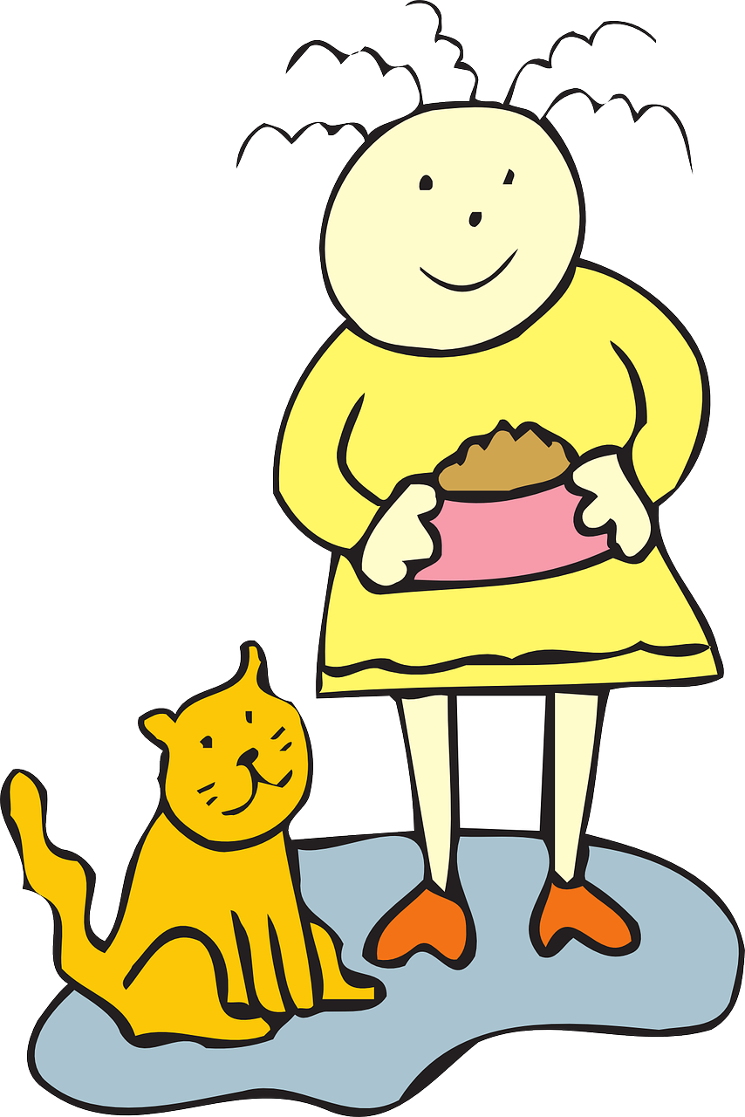
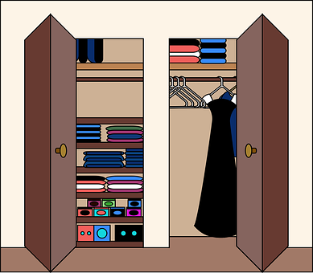
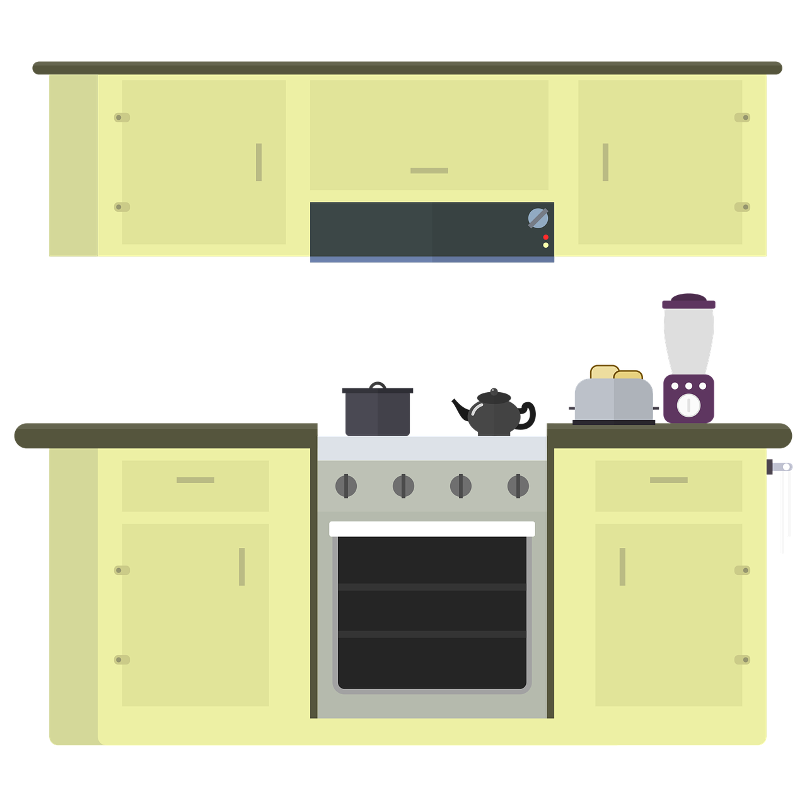
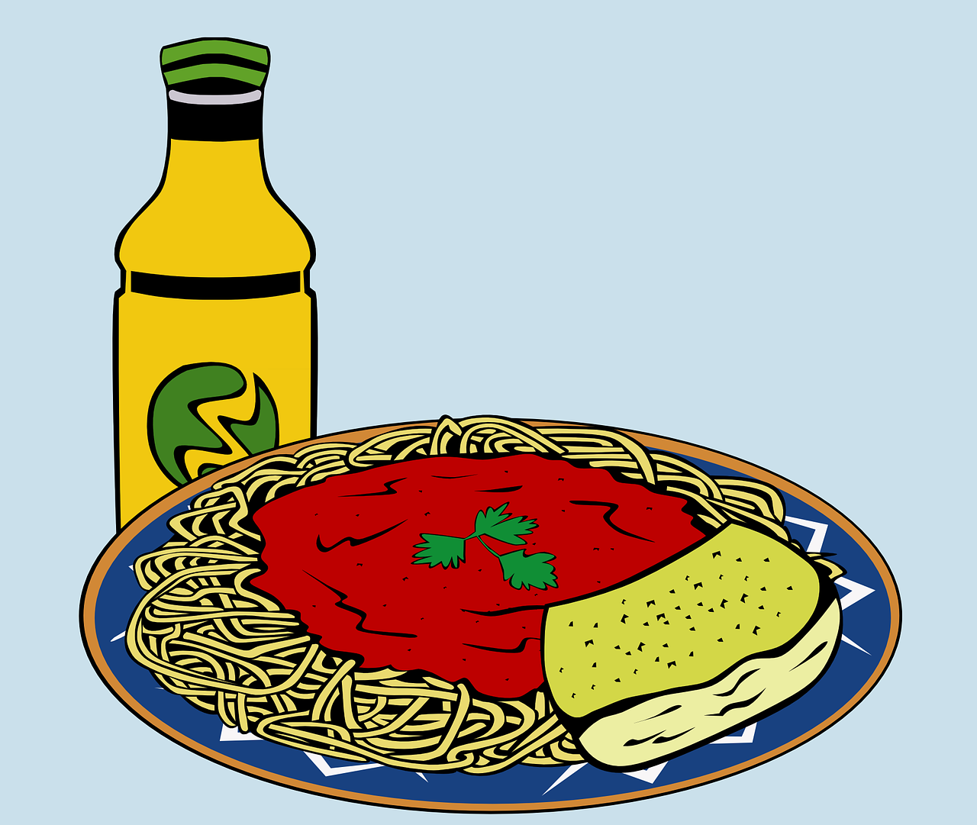
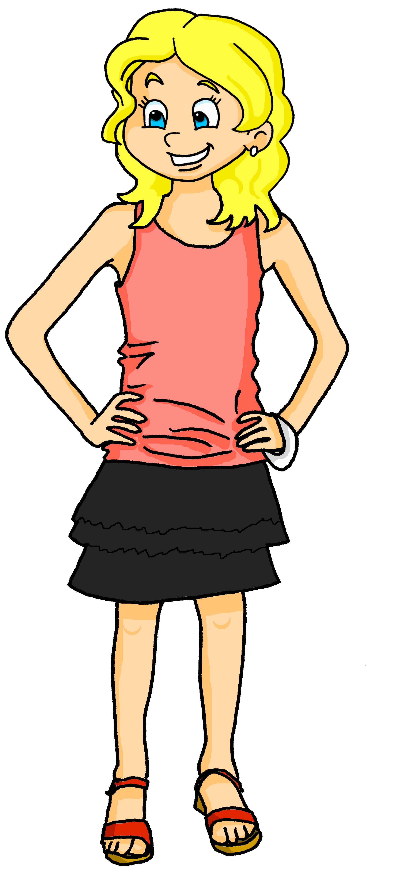
Saying what I and others do
bleu
2-verb structures
SSC [j/soft g] hard [g]
Notes:
Artwork by Steve Clarke. Pronoun pictures from NCELP (www.ncelp.org). All additional pictures selected from Pixabay and are available under a Creative Commons license, no attribution required.
Phonics: Revisit SSC j (soft g) jour [78] j’ai [8 - avoir] génial [3872] sujet [353] partager [527]
Vocabulary (new words in bold): donner à manger [n/a] laver [3503] ranger [2774] cuisine² [2618] repas [2948] - revisit: aimer [242] détester [2898]
Revisit 1: football [2602] tennis [3687] corde [3784] fois [49]
Revisit 2: il y a un [3] deux [41], trois [115], quatre [253], cinq [288], six [450], sept [905], huit [877], neuf [787], dix [372], onze [2447], douze [1664] des [2] combien [800] treize [3285], quatorze [3359], quinze [1472], seize [3285], dix-sept [3812], dix-huit [3592], dix-neuf [4851], vingt [1273], vingt et un [1273/6/3], vingt-deux, vingt-trois, vingt-quatre, vingt-cinq, vingt-six, vingt-sept, vingt-huit, vingt-neuf, trente [1646]
Londsale, D., & Le Bras, Y. (2009). A Frequency Dictionary of French: Core vocabulary for learners London: Routledge.
The frequency rankings for words that occur in this PowerPoint which have been previously introduced in these resources are given in the SOW
and in the resources that first introduced and formally re-visited those words.
For any other words that occur incidentally in this PowerPoint, frequency rankings will be provided in the notes field wherever possible.
1

Slide 2
[j/soft g]
prononcer
jour
Notes:
Timing: 1 minute
Aim: To introduce SSC [j/soft g]
Procedure: 1. Present the letter(s) and say the [j/soft g] sound first, on its own. Students repeat it with you. 2. Bring up the word ”jour” on its own, say it, students repeat it, so that they have the opportunity to focus all of their attention on the connection between the written word and its sound.
3. Roll back the animations and work through 1-3 again, but this time, dropping your voice completely to listen carefully to the students saying the [j/soft g] sound, pronouncing ”jour” and, if using, doing the gesture.
Gesture suggestion:
https://www.signbsl.com/sign/day The sign is both palms facing inwards, towards each other, finger tips slightly overlapping – then pulled apart – the motion mimes the break of day with the sun rising.
Word frequency (1 is the most frequent word in French):
jour [78].
Source: Londsale, D., & Le Bras, Y. (2009). A Frequency Dictionary of French: Core vocabulary for learners London: Routledge.
2

Slide 3
[j/soft g]
prononcer
I have
j’ai
génial
jour
déjà
gymnastique
Notes:
Timing: 2 minutes
Aim: To introduce SSC [j/soft g]
Procedure:
1. Introduce and elicit the pronunciation of the individual SSC [j/soft g] and then the source word again ‘jour’ (with gesture, if using). 2. Then present and elicit the pronunciation of the four cluster words.
The cluster words have been chosen for their high-frequency, from a range of word classes, with the SSC (where possible) positioned within a variety of syllables within the words (e.g. initial, 2nd, final etc.). Additionally, we have tried to use words that build cumulatively on previously taught SSCs (see the Phonics Teaching Sequence document) and do not include new SSCs. Where new SSCs are used, they are often consonants which have a similar symbol-sound correspondence in English.
Word frequency: jour [78] j’ai [8 - avoir] génial [3872] gymnastique [>5000] déjà [58]
Source: Londsale, D., & Le Bras, Y. (2009). A Frequency Dictionary of French: Core vocabulary for learners London: Routledge.
3

Slide 4
prononcer
Prononce les noms.
. Écoute les noms des animaux. C’est [ien] ou [(a)in]?
Attention ! C’est [j]/soft [g] ou hard [g] ?
Julien
Morgane
Angéline
Gérard
Margot
George
Gaelle
Jacques
Notes:
Timing: 5 minutes
Aim: to consolidate SSC [j/soft g] and hard [g].
Procedure:
Pupils play the role of teacher.
Click for one of the pupils on the slide to raise their hand.
Pupils call the name (as they would call on a pupil in class, as the teacher).
Click on the name to listen and check.
Continue until all 8 pupils have raised their hands and had their names called.
4

Slide 5
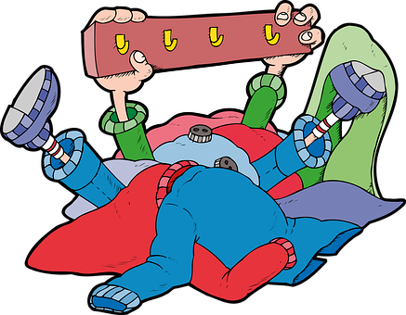
vocabulaire
Vocabulaire
mots
to tidy up, put away
to wash, washing
to feed, feeding
ranger
laver
donner à manger
You have learnt that ‘cuisine’ also means ‘cooking’.
Word for word, this means ‘ to give to eat’.
the kitchen
(the) meal
la cuisine
le repas
Notes:
Timing: 7 minutes (two slides)
Aim: to present and practise written comprehension and read aloud of five new words for this week.
Procedure:
Click to bring up the French word and say the word together with the pupils.
Click to bring up the English picture and meaning.
Continue until all five words have been presented.
Click to re-animate each word and elicit pronunciation from pupils.
In the audio version, teachers can click on the pictures to hear the words again, if required.
5

Slide 6
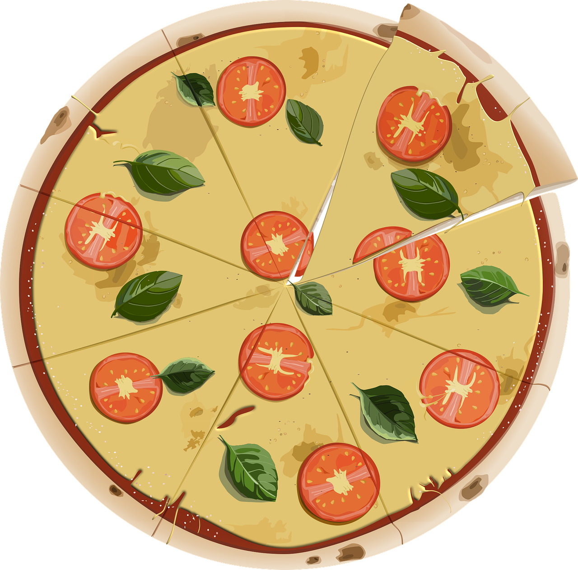
vocabulaire
Parle en français. Le verbe, c’est quoi ?
Parle en français. Le verbe, c’est quoi ?
mots
to do, make
to share, sharing
to prepare, preparing
to like, liking
to work, working
to wash, washing
to tidy up, put away
to feed, feeding
to play, playing
to share, sharing
to play, playing
to feed, feeding
to wash, washing
to tidy up, put away
to do, make
to prepare, preparing
to like, liking
to work, working
faire
ranger
aimer
donner à manger
laver
travailler
partager
préparer
jouer
Notes:
Timing: 7 minutes (slide 2)
Aim: to present and practise written comprehension and read aloud of previously taught verbs and three new verbs for this week.
Procedure: 1. Click for an English item. Elicit pronunciation of the French from pupils.
2. Click to cover the French word with a picture.
3. Continue with the remaining items.
4. Optional at this stage: elicit the French from pupils, (English prompts reappear on each mouse click) this time without written French support.
5. In the audio version click on the image to hear the audio for each verb.
6

Slide 7
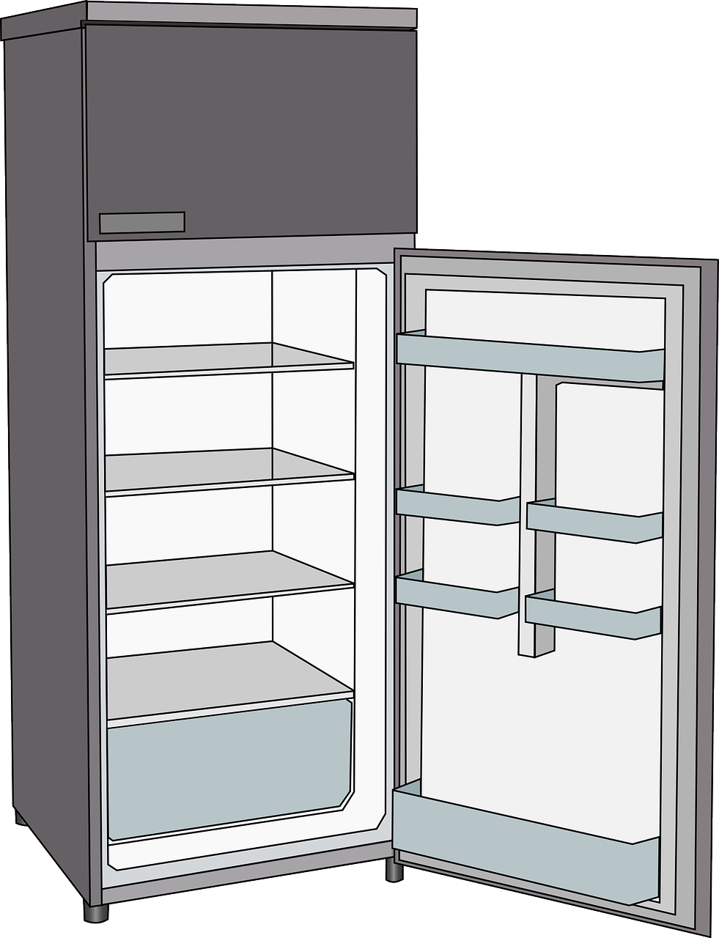
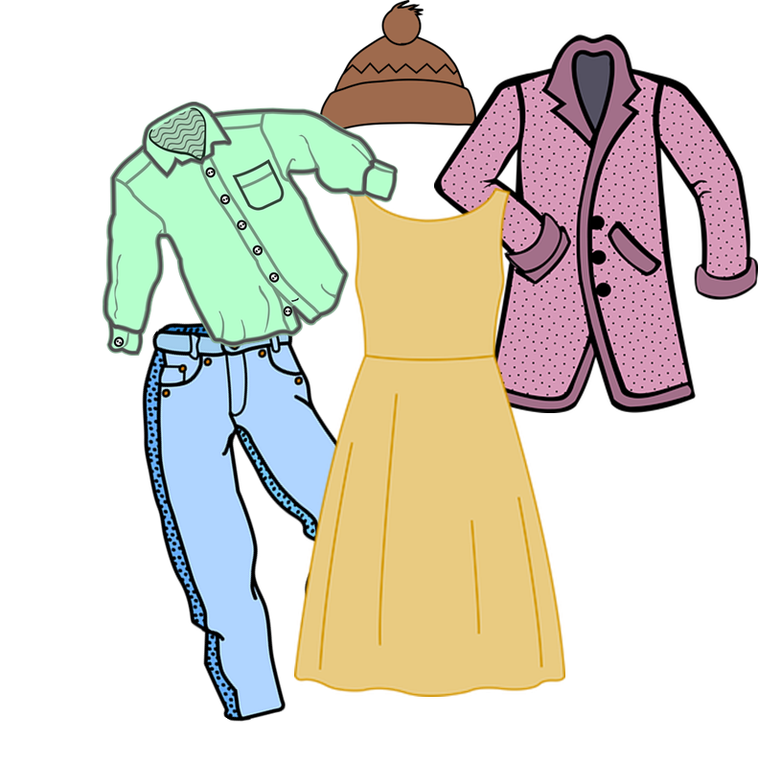
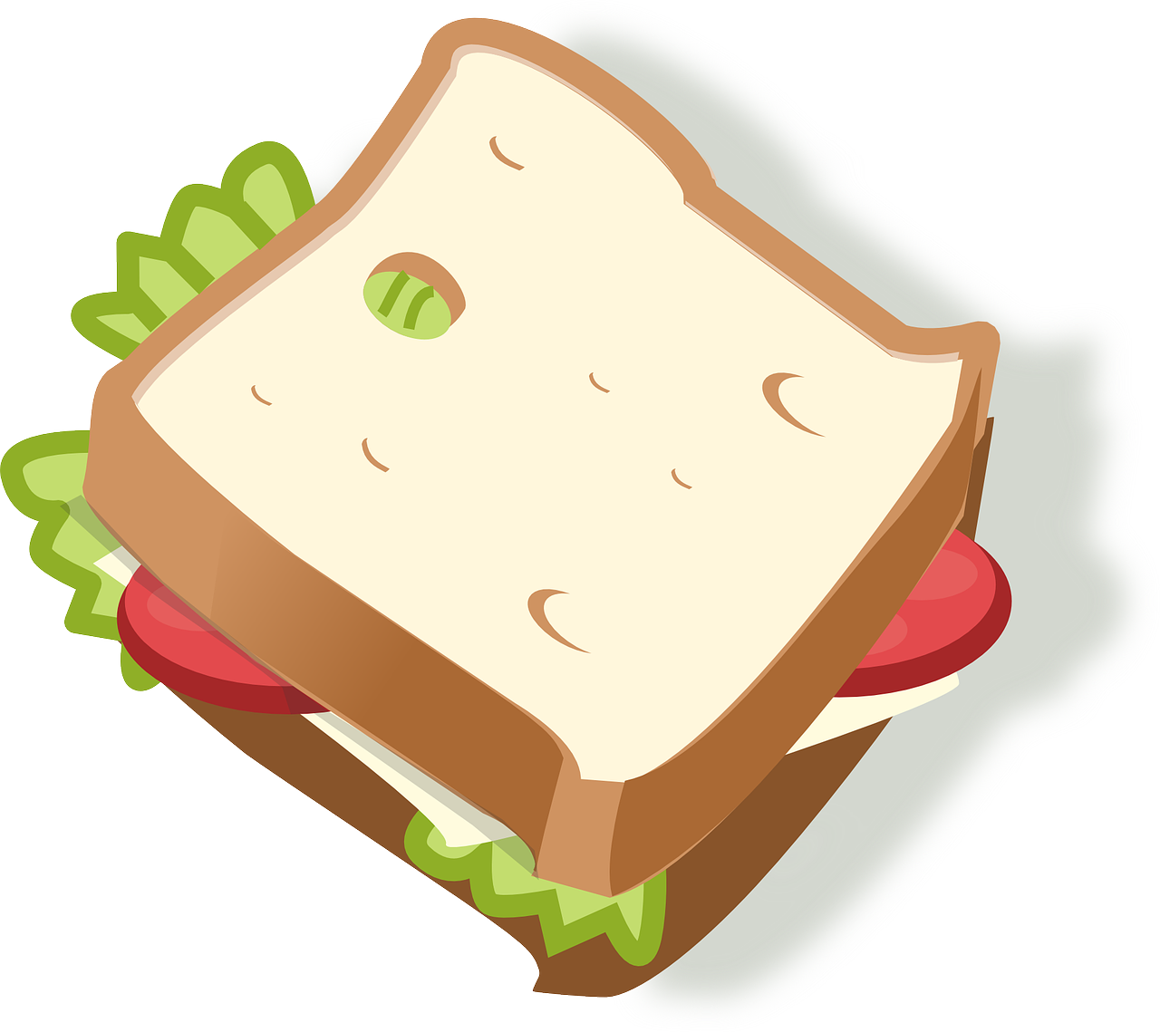
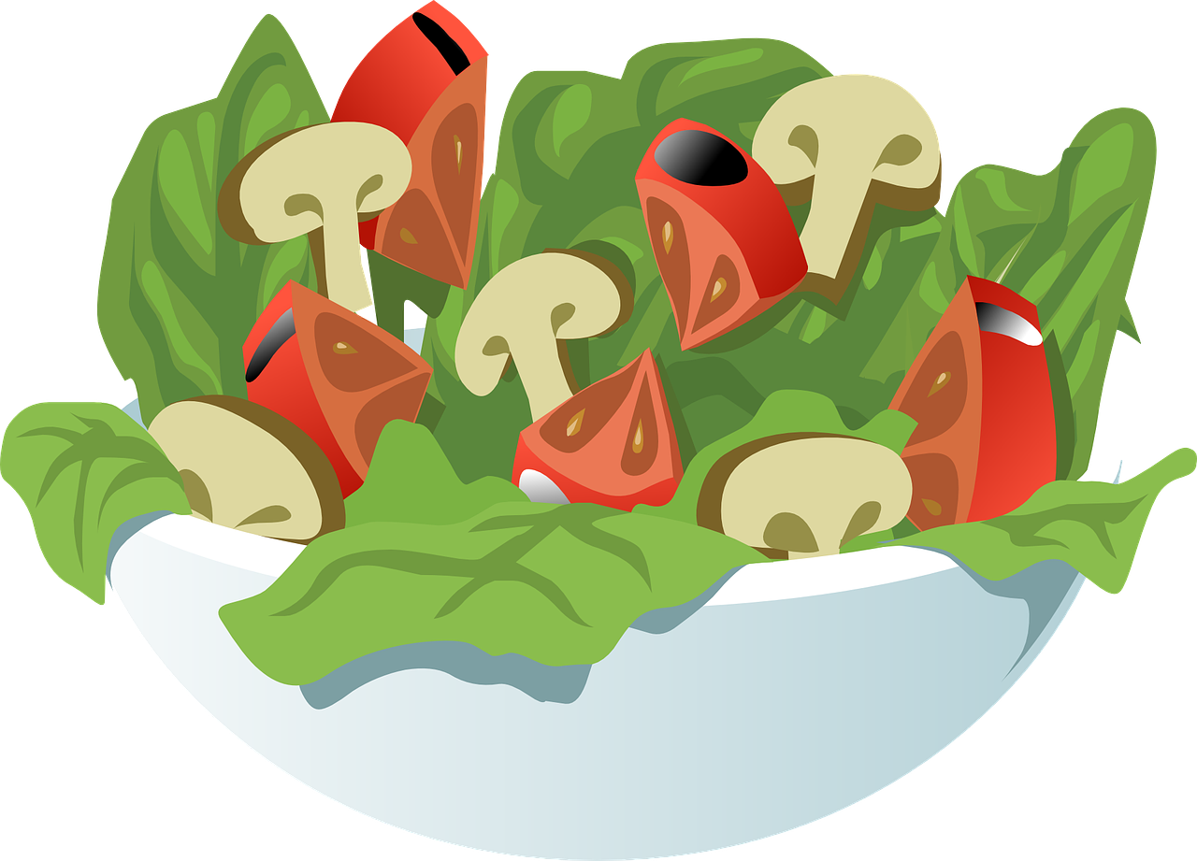
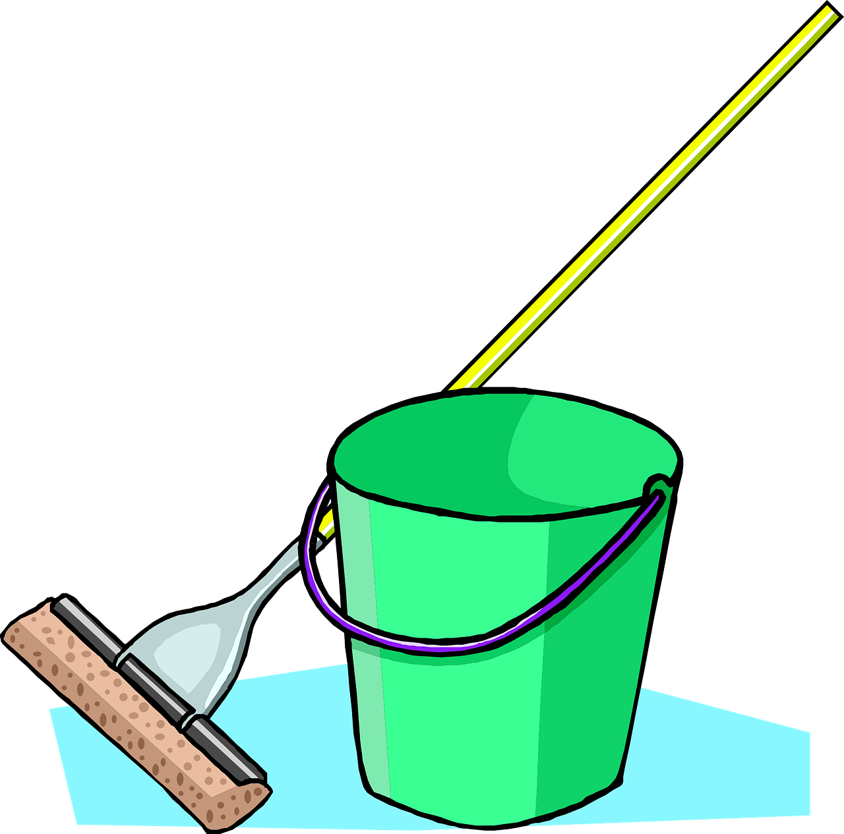
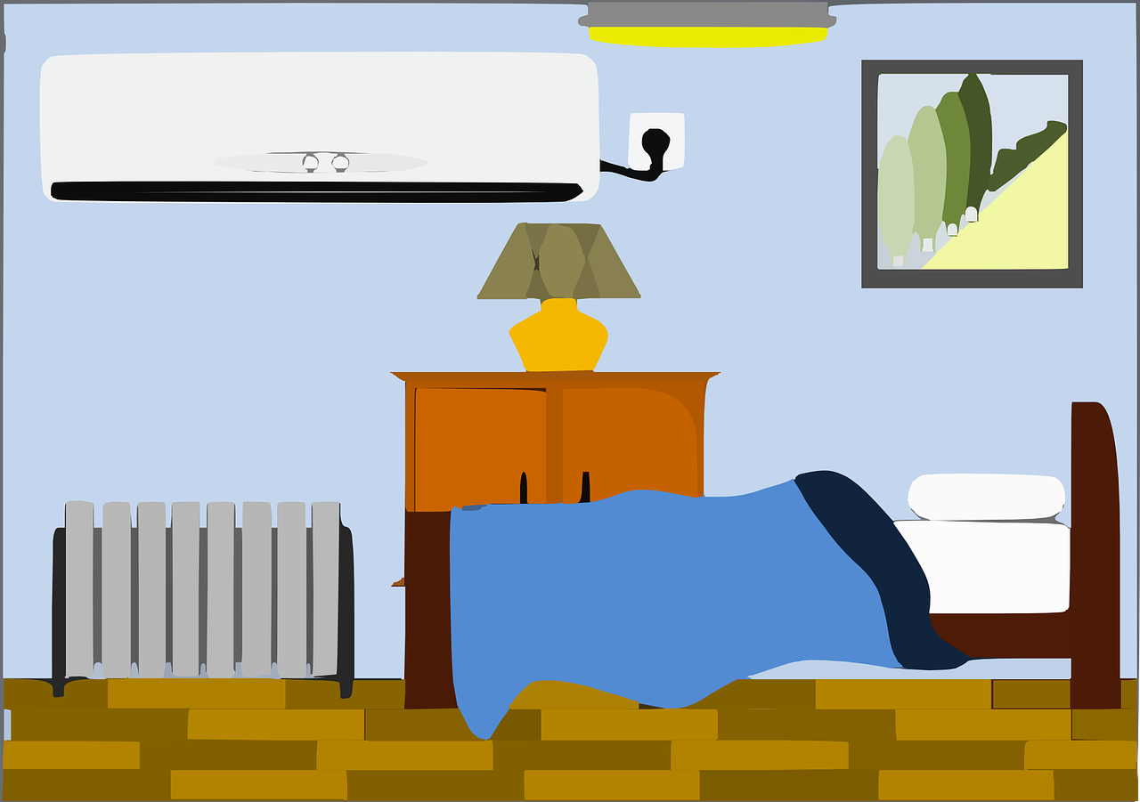
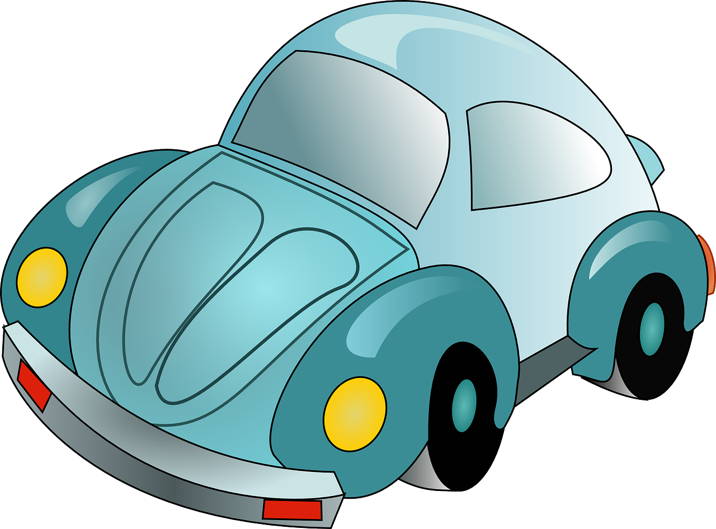
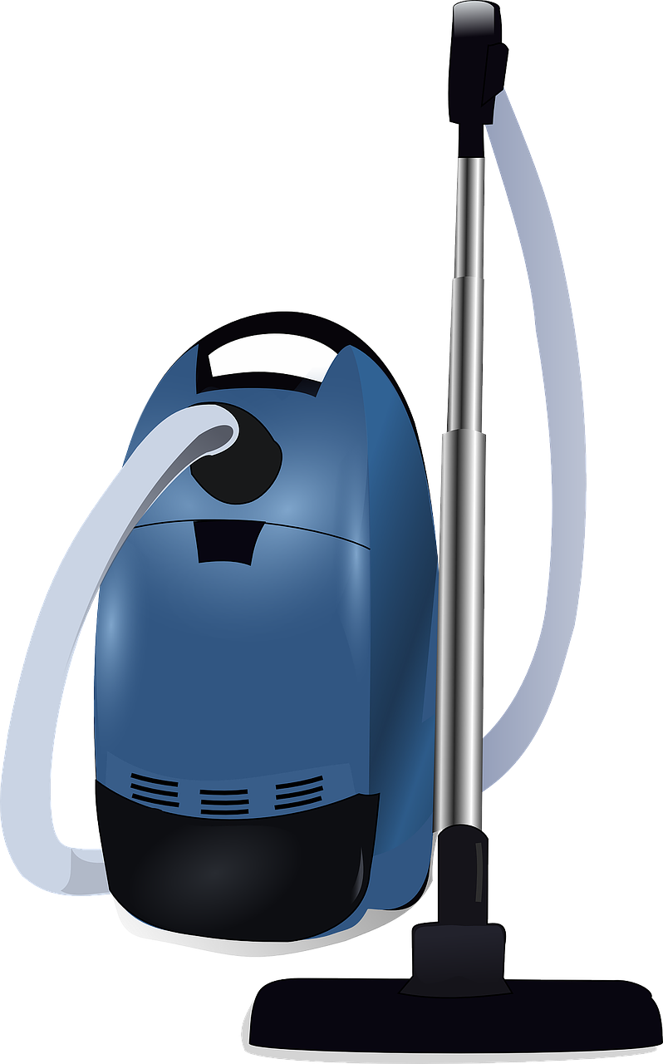
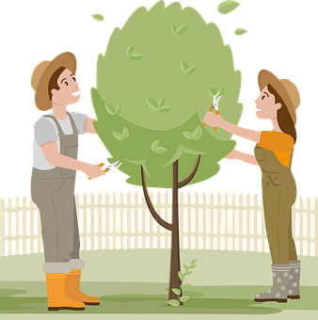
lire
Comment aider à la maison ?
8-9
1 | faire le ménage dans la chambre
2 | faire le ménage dans la cuisine
3 | faire le lit
4 | faire une salade
5 | faire un gâteau
6 | faire les courses
7 | ranger les vêtements
8 | ranger les courses
9 | préparer un sandwich
10 | préparer un repas simple
11 | passer le mop
12 | passer l’aspirateur*
13 | laver la voiture
14 | donner à manger aux animaux
15 | travailler dans le jardin
1
C’est quelle tâche pour quel âge ?
2
10-11
3
4-5
4-5 ans | 6-7 ans | 8-9 ans
10-11 ans | 12 ans +
4
6-7
5
8-9
6
12+
7
6-7
8
8-9
9
4-5
10
10-11
11
6-7
12
10-11
13
12+
14
4-5
* l’aspirateur - vacuum
15
12+
Notes:
Timing: 7 minutes
Aim: to practise written comprehension of new and previously taught vocabulary
Procedure:
Read the title and explain the context of the task. These are suggested ages for different household chores from a French website.
Do [1] with them to model the task.
Pupils complete 2-15, writing down only 1-15 and the ages in digits.
Teacher elicits answers in French phrases from pupils for 2-15 (i.e. numéro deux, c’est quelle tâche ? c’est quel âge ?) and clicks to reveal the age.
For the audio version click on the numbers to hear the phrases.
Note: for some classes it will be useful to remove some activities. Cut to two activities per age. Retain those with this week’s vocabulary.
Source for information: https://www.comment-economiser.fr/comment-enfant-peuvent-aider-maison.html
7

Slide 8
Knowing who does what [1/2]
This is the form of a verb you see in a dictionary.
[–er verbs: more than one person]
jouer
to play
Remember we change the verb ending to refer to different people:
To mean ‘we’ with a verb, remove –er and add –ons:
Nous jouons au tennis.
We play tennis.
You could say this to your headteacher if you saw them skipping!
To mean ‘you(plural)’ or you(formal) with a verb:
Vous jouez à la corde.
You(all) play skipping.
You(formal) play skipping.
To mean ‘they’ with a verb:
Elles jouent au foot.
They (f) play football.
Ils aiment aussi le foot.
They (m) like football, too.
Notes:
[1/2]
Timing: 3 minutes (two slides)
Aim: to recap the plural forms of –er verbs. Pupils have been taught these previously.
Procedure:
Click through the animations to present the new information.
Elicit English translations for the French examples provided.

Slide 9
Knowing who does what [2/2]
[faire: more than one person]
faire
to do, make
Faire is an irregular verb. You already know the singular forms:
These are the plural forms:
je fais
I do, make
Nous faisons la cuisine.
We do the cooking.
tu fais
you do, make
Vous faites les courses.
You (all) do the shopping.
il/elle fait
he/she does, makes
Ils/Elles font le ménage.
They do the housework.
Notes:
Timing: 3 minutes (two slides)
Aim: to introduce the plural forms of the irregular verb faire. This is new knowledge.
Procedure:
Click through the animations to present the new information.
Elicit French translations for the singular forms of faire.
Elicit English translations for the French examples of the plural forms of faire.

Slide 10
écouter
Comment est-ce qu’ils aident à la maison ?
C’est Jean-Michel et Clémentine (nous) ? Ou c’est Adèle et Pierre (vous) ?
 | we | you (all)
Écoute et écris en anglais.
1
1
wash the car.
… __________________________________________
2
2
put away clothes.
… __________________________________________
3
3
prepare meals.
… __________________________________________
4
4
do the housework/cleaning in the kitchen.
… __________________________________________
5
5
work in the garden.
… __________________________________________
6
6
also help in the garden.
… __________________________________________
7
7
(sometimes) do the shopping.
… __________________________________________
Notes:
Timing: 7 minutes
Aim: to practise aural recognition of two plural forms (we and you (all)) of –ER verbs and faire.
Procedure:
Read the title and click to bring up the instructions.
Clarify the task. Pupils listen out first for the verb form and decide if it refers to ‘we (nous)’ or ‘you all (vous)’. They write 1-7 and note ‘we’ or ‘you all’
Click to bring up the answers.
Click to bring up the 2nd table, 2nd set of audio buttons and instruction.
Pupils listen again and write the chore in English.
6. Click to elicit and confirm the answers.
Transcript 1:
[Vous] lavez la voiture. [Nous] rangeons les vêtements. [Nous] préparons des repas. [Vous] faites le ménage dans la cuisine. [Nous] travaillons dans le jardin. [Vous] aidez aussi dans le jardin. Parfois, [nous] faisons les courses.
Transcript 2:
Vous lavez la voiture. Nous rangeons les vêtements. Nous préparons des repas. Vous faites le ménage dans la cuisine. Nous travaillons dans le jardin. Vous aidez aussi dans le jardin. Parfois, nous faisons les courses.
10

Slide 11
Two-verb structures
Remember! When a sentence has two verbs, the 2nd verb is in infinitive form.
Remember how to say ‘like doing’:
This is the 1st verb.
This is the 2nd verb.
J’aime aider à la maison.
I like helping at home.
Tu aimes donner à manger aux animaux.
You like feeding the animals.
Il/Elle aime faire une salade.
S/he likes making a salad.
Nous aimons ranger les choses.
We like putting away the things.
Vous aimez faire les gâteaux.
You (all) like making cakes.
Ils/Elles aiment laver les vélos.
They like washing the bikes.
Notes:
Timing: 3 minutes
Aim: to recap two-verb structures with aimer and détester.
Procedure:
Click through the animations to present the information.
Elicit English translations for the French examples provided.

Slide 12
lire
Clémentine has spilled glitter over her Christmas English homework.
Lis les messages d’Adèle et de Pierre.
Ils font quoi ? Ils aiment faire quoi ?
C’est une activité ou c’est une activité et une opinion?
Nous aidons souvent à la maison.
Nous faisons le lit tous les jours.
1
5
Nous aimons donner à manger à Médor et Chouchou.
Nous rangeons les vêtements une fois par semaine.
2
6
Nous détestons ranger les courses mais nous faisons parfois la cuisine.
Nous aimons travailler dans le jardin.
3
7
Nous aimons faire des pizzas – c’est génial !
Nous ne faisons pas les courses mais nous lavons la voiture une fois par mois.
4
8
Notes:
Timing: 7 minutes
Aim: to practise written comprehension of 1st person plural verbs and two-verb structures (1st person plural) with aimer.
Procedure:
Read the title and explain the context of the task. Adèle and Pierre are talking about what they do at home. Sometimes they just say what they do/don’t do. Sometimes they say what they like/hate doing.
Do [1] with them to model the task and draw their attention to the word that follows the gap. Is it a verb? If so, then this must be a sentence with two verbs, one of them (aimer/détester) giving an opinion. If it is not a verb, then the sentence is just giving the activity in a single-verb sentence.
Click through the animations to bring up answers.
Finally, if desired, click on the numbered buttons to hear full audio for each sentence and elicit the English meanings.
12

Slide 13
Au revoir !
bleu
Notes:
13

