Slide 1
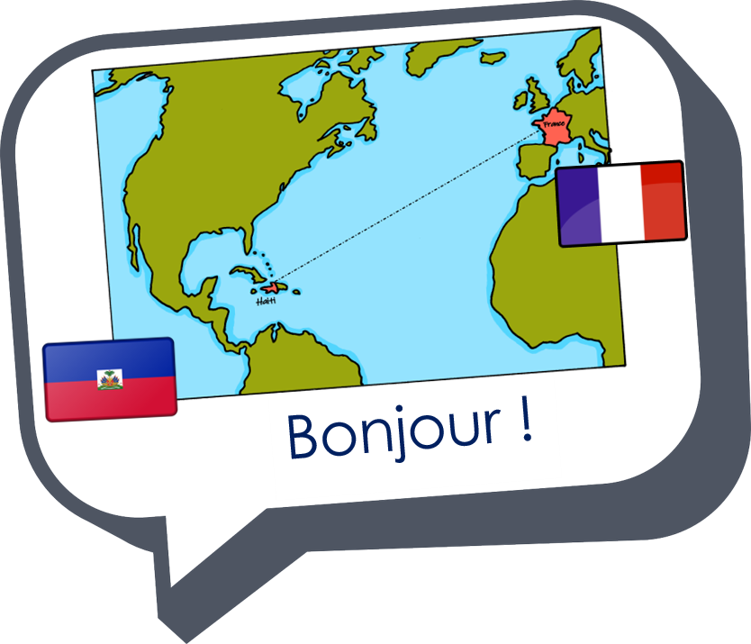
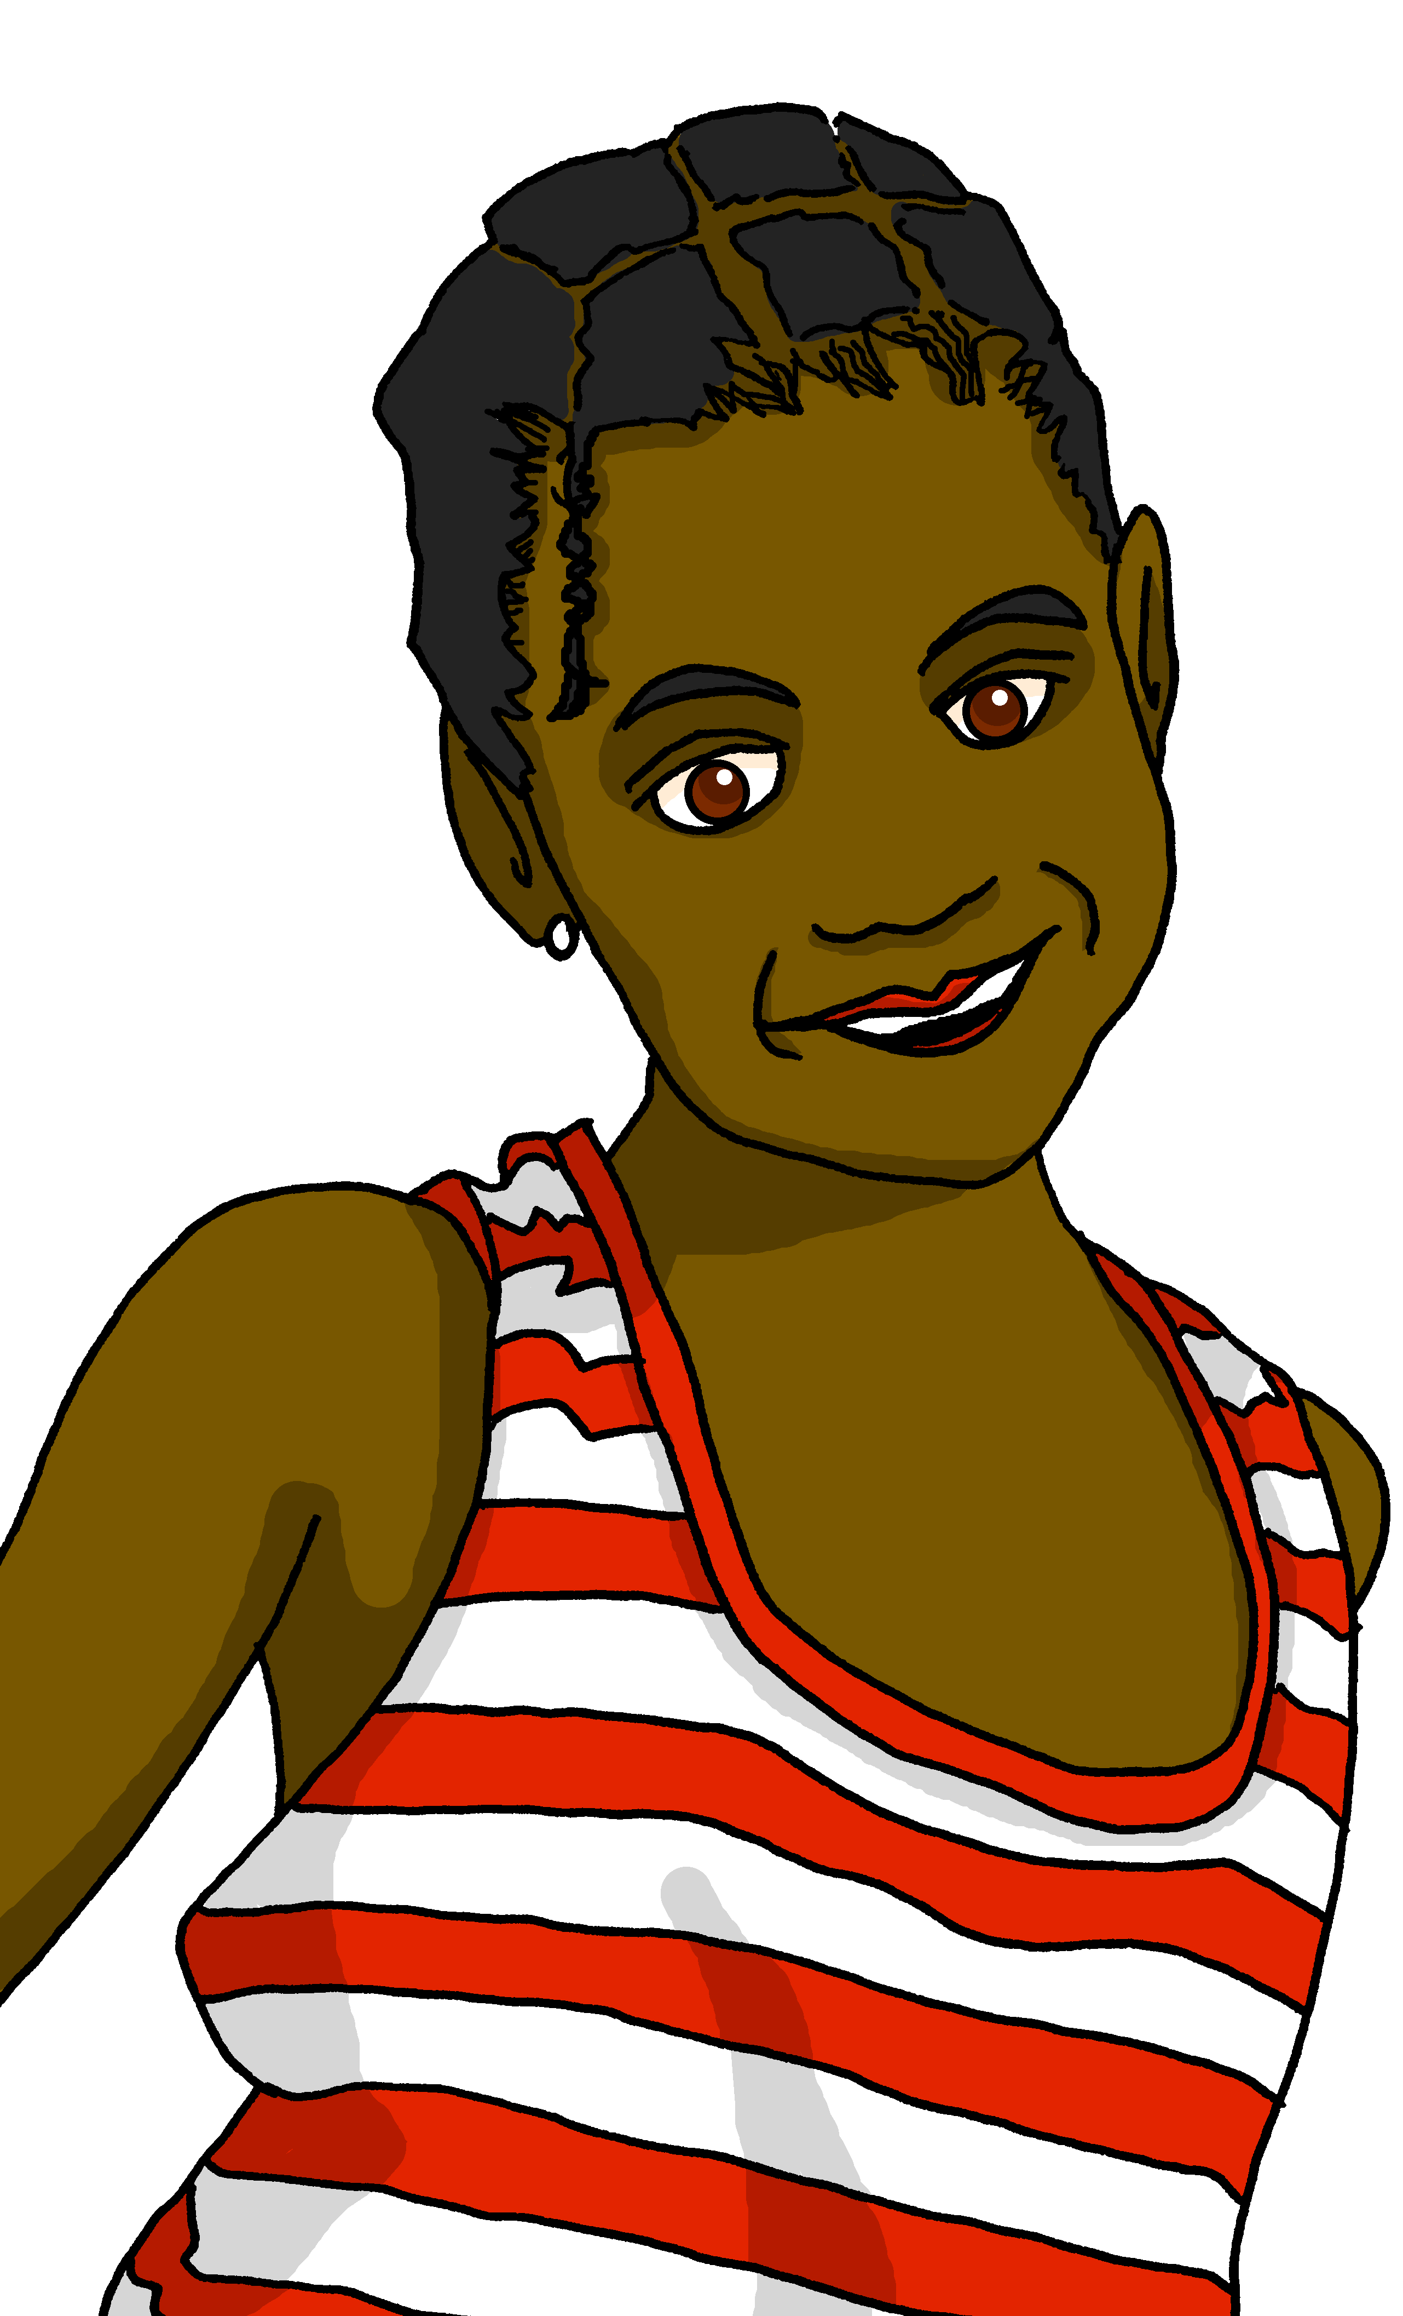
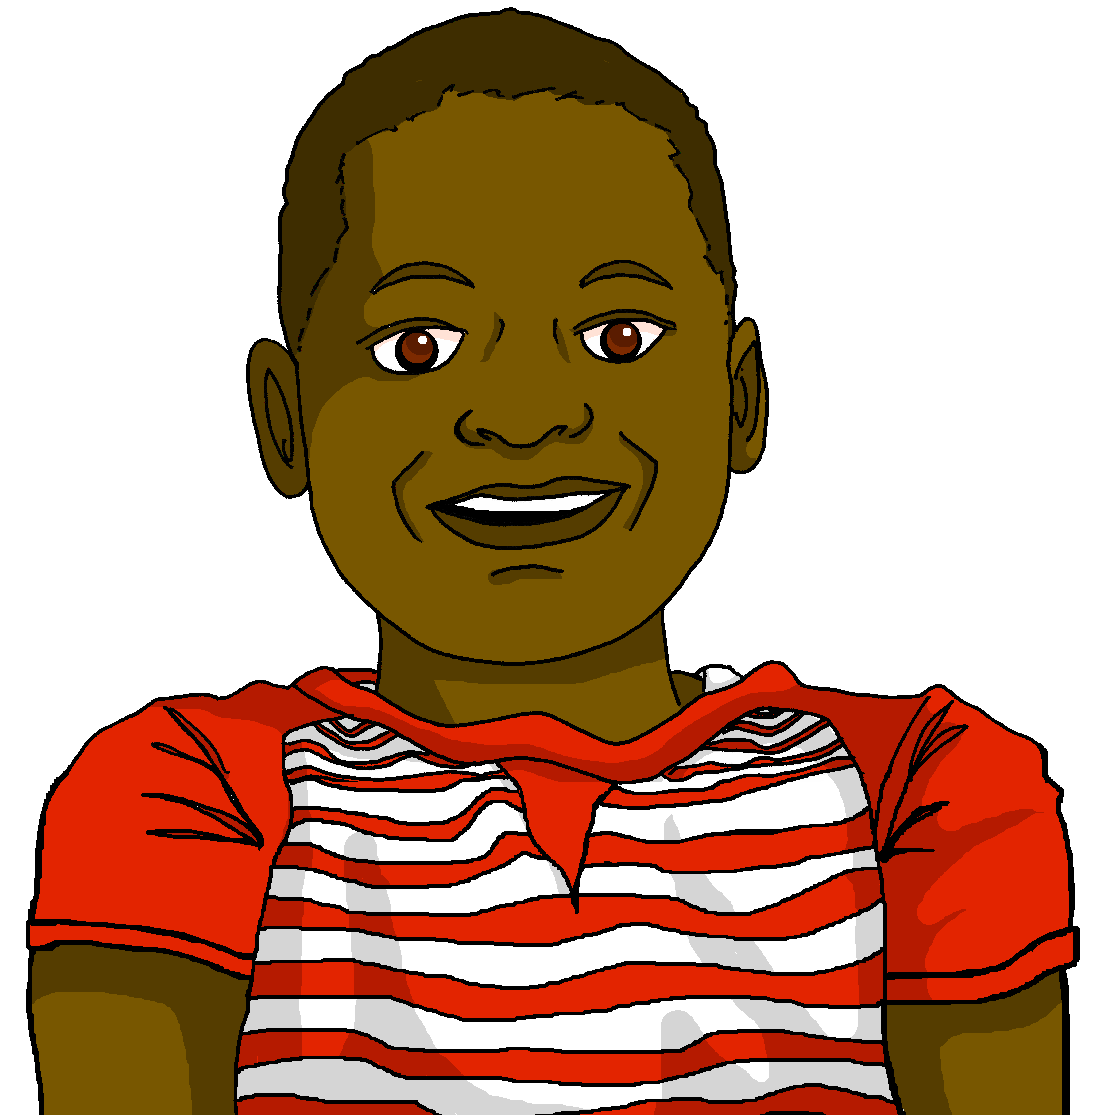
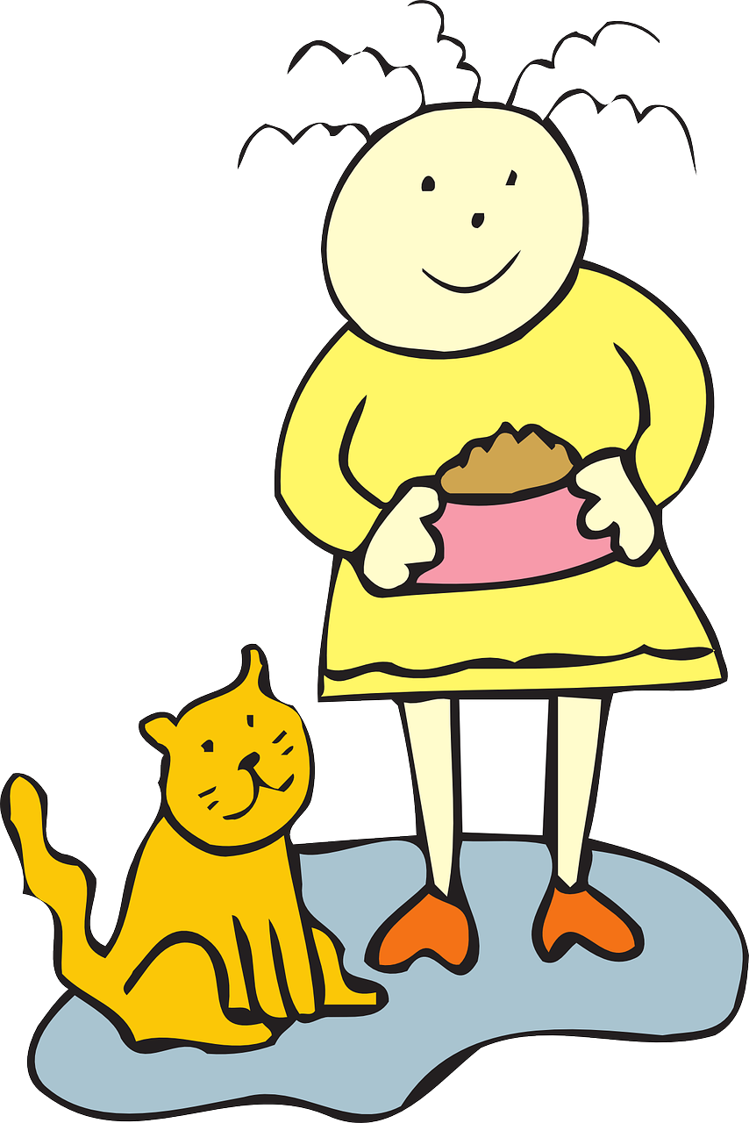
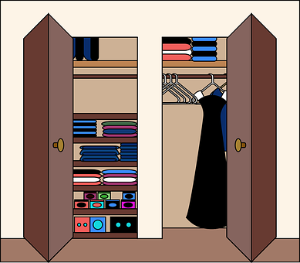

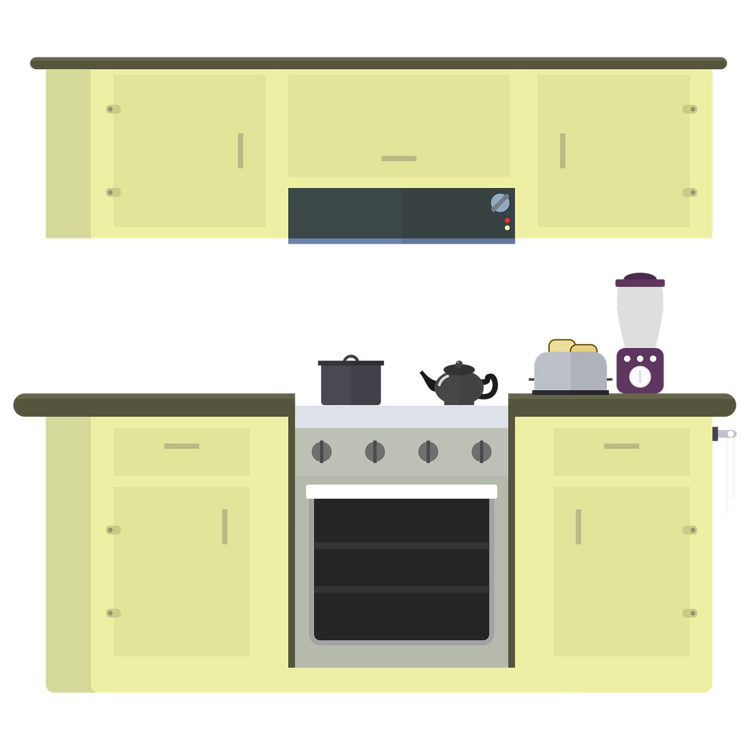
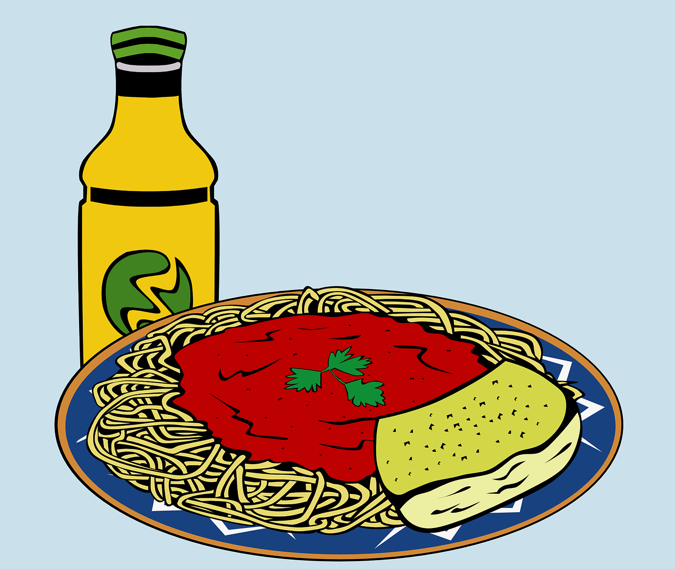
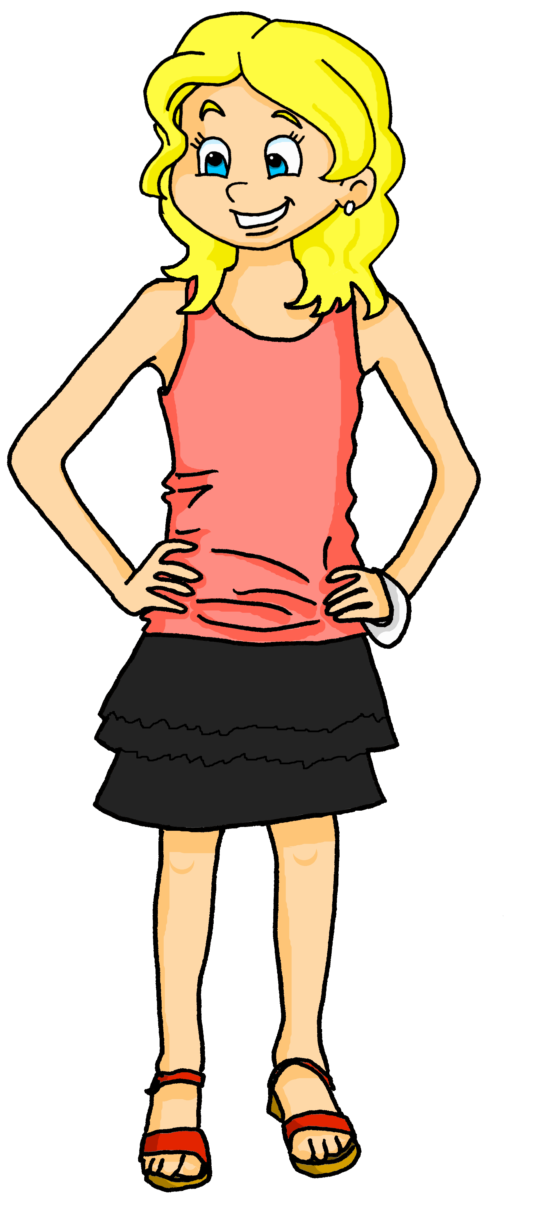
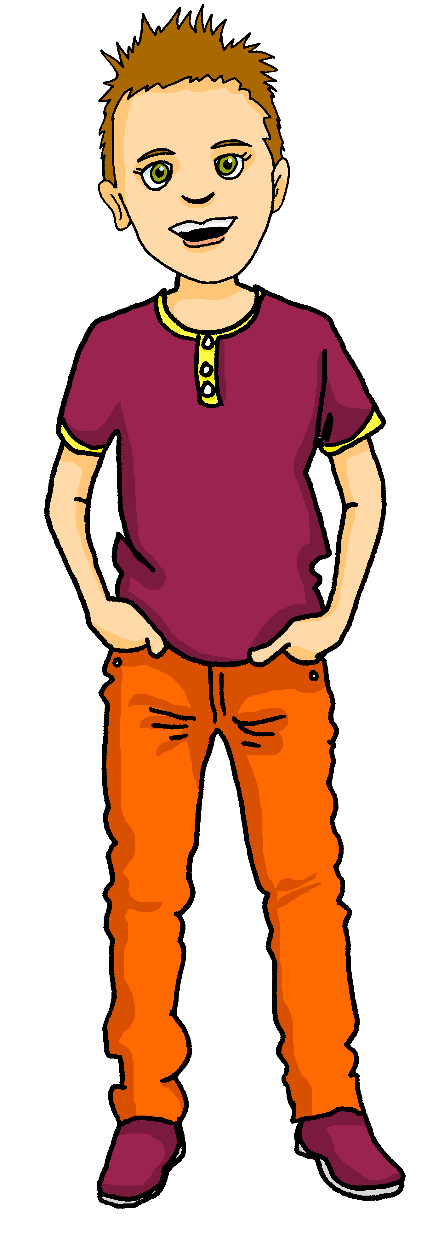
Saying what I and others do
bleu
Follow ups 1-5
Notes:
Artwork by Steve Clarke. Pronoun pictures from NCELP (www.ncelp.org). All additional pictures selected from Pixabay and are available under a Creative Commons license, no attribution required.
Phonics: Revisit SSC j (soft g) jour [78] j’ai [8 - avoir] génial [3872] sujet [353] partager [527]
Vocabulary (new words in bold): donner à manger [n/a] laver [3503] ranger [2774] cuisine² [2618] repas [2948] - revisit: aimer [242] détester [2898]
Revisit 1: football [2602] tennis [3687] corde [3784] fois [49]
Revisit 2: il y a un [3] deux [41], trois [115], quatre [253], cinq [288], six [450], sept [905], huit [877], neuf [787], dix [372], onze [2447], douze [1664] des [2] combien [800] treize [3285], quatorze [3359], quinze [1472], seize [3285], dix-sept [3812], dix-huit [3592], dix-neuf [4851], vingt [1273], vingt et un [1273/6/3], vingt-deux, vingt-trois, vingt-quatre, vingt-cinq, vingt-six, vingt-sept, vingt-huit, vingt-neuf, trente [1646]
Londsale, D., & Le Bras, Y. (2009). A Frequency Dictionary of French: Core vocabulary for learners London: Routledge.
The frequency rankings for words that occur in this PowerPoint which have been previously introduced in these resources are given in the SOW and in the resources that first
introduced and formally re-visited those words.
For any other words that occur incidentally in this PowerPoint, frequency rankings will be provided in the notes field wherever possible.

Slide 2


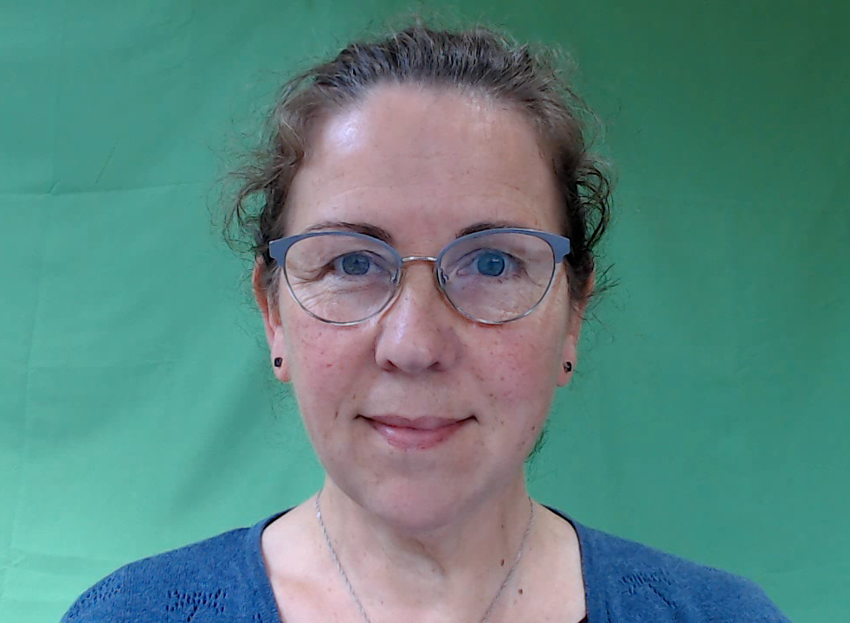


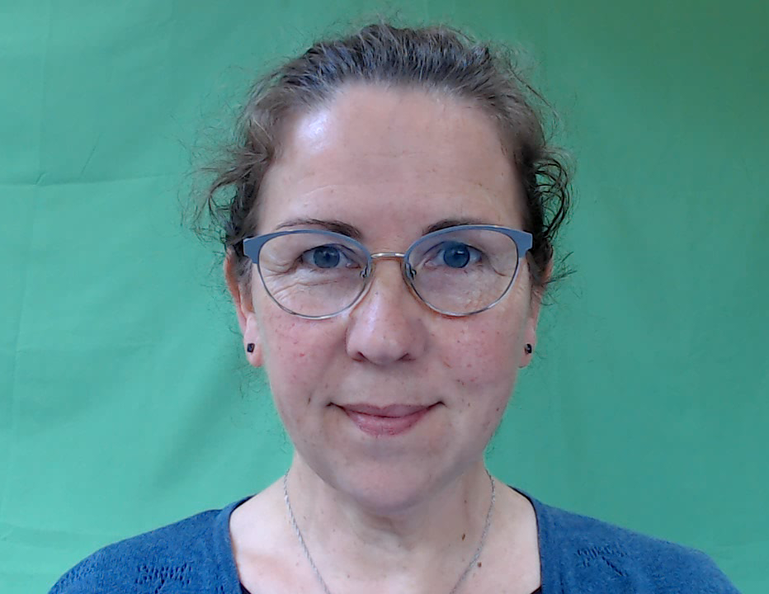
[j/soft g]
prononcer
jour
Notes:
Timing: 1 minute
Aim: To introduce SSC [j/soft g]
Procedure:
1. Present the letter(s) and say the [j/soft g] sound first, on its own. Students repeat it with you.
2. Bring up the word ”jour” on its own, say it, students repeat it, so that they have the opportunity to focus all of their attention on the connection between the written word and its sound.
3. Roll back the animations and work through 1-3 again, but this time, dropping your voice completely to listen carefully to the students saying the [j/soft g] sound, pronouncing ”jour” and, if using, doing the gesture.
Gesture suggestion:
https://www.signbsl.com/sign/day
The sign is both palms facing inwards, towards each other, finger tips slightly overlapping – then pulled apart – the motion mimes the break of day with the sun rising.
Word frequency (1 is the most frequent word in French):
jour [78].
Source: Londsale, D., & Le Bras, Y. (2009). A Frequency Dictionary of French: Core vocabulary for learners London: Routledge.
2

Slide 3




[j/soft g]
prononcer
I have
j’ai
génial
jour
déjà
gymnastique
Notes:
Timing: 2 minutes
Aim: To introduce SSC [j/soft g]
Procedure:
1. Introduce and elicit the pronunciation of the individual SSC [j/soft g] and then the source word again ‘jour’ (with gesture, if using).
2. Then present and elicit the pronunciation of the four cluster words.
The cluster words have been chosen for their high-frequency, from a range of word classes, with the SSC (where possible) positioned within a variety of syllables within the words (e.g. initial, 2nd, final etc.). Additionally, we have tried to use words that build cumulatively on previously taught SSCs (see the Phonics Teaching Sequence document) and do not include new SSCs. Where new SSCs are used, they are often consonants which have a similar symbol-sound correspondence in English.
Word frequency:
jour [78] j’ai [8 - avoir] génial [3872] gymnastique [>5000] déjà [58]
Source: Londsale, D., & Le Bras, Y. (2009). A Frequency Dictionary of French: Core vocabulary for learners London: Routledge.
3

Slide 4

prononcer
Follow up 1:
You may hear soft [g/j], hard [g] or [gn], which sounds like the ‘gn’ in lasagne.
Écoute. L’intrus, c’est quoi ?
 | rouge | gris | orange
 | partager | voyager | organiser
 | la gymnastique | le golf | le rugby
 | la montagne | la plage | la campagne
 | grand | génial | grave
 | le village | le magasin | l’église
1
2
3
4
5
6
Notes:
Timing: 5 minutes
Aim: To practise aural distinction of French words with the SSC [j/soft g] and hard [g] in sets of three words. Some words are known, others are cognates, some will be taught later in the SOW.
Procedure:
Do the first one to model the task.
Click to listen.
Pupils try to note down (in French) the odd one out.
Click to reveal the answer, drawing pupils’ attention to the soft ‘g’ in rouge and orange and the hard ‘g’ in gris, which makes it the odd one out.
Continue with items 2-7.
Elicit answers from pupils and click to confirm the answers.
Transcript:
rouge | gris | orange
partager | voyager | organiser
la gymnastique | le golf | le rugby
la montagne | la plage | la campagne
grand | génial | grave
le village | le magasin | l’église
4

Slide 5





Follow up 2:
Adèle écrit un email à Sanaya.
Lis les phrases. C’est nous (we) ou ils (they) ?
lire
 | we / they
Ils détestent faire le lit.
Nous détestons faire une salade.
Ils détestent ranger les courses
Nous aimons faire les gâteaux.
Ils aiment préparer des repas.
Ils détestent faire le ménage dans la cuisine.
Nous détestons ranger les vêtements.
Nous aimons laver la voiture.
1
they
😠
2
we
😠
3
they
😠
4
we
❤
5
they
❤
6
they
😠
7
we
😠
8
we
❤
Notes:
Timing: 10 minutes (two slides)
Aim: to practise written comprehension of 2-verb structures with ‘nous’ and ‘ils’ forms of aider / détester.
Procedure:
Teacher to read the context and ensure this is clear. Adèle writes to Sanaya about her and Pierre and her two cousins Clémentine and Jean-Michel.
Pupils to read the messages.
They decide for each one whether the subject is we or they and if the opinion is like or hate.
Elicit answers from pupils and click to bring up answers.
5. Move to the next slide to practise comprehension of the rest of the sentence.

Slide 6

Follow up 2b
Écoute les phrases et écris en anglais.
écouter
They hate making the bed.
We hate making a salad.
They hate putting the shopping away.
We like making cakes.
They like preparing meals.
They hate doing the cleaning in the kitchen.
We hate putting clothes away.
We like washing the car.
1
2
3
4
5
6
7
.
8
Notes:
Aim: to practise aural comprehension of 2-verb structures with ‘nous’ and ‘ils’ forms of aider / détester.
Procedure:
These are the same sentences pupils have just read.
This time they listen, without reference to the text, and write the full sentence meanings.
Elicit answers from pupils and click to bring up answers.

Slide 7





vocabulaire
Follow up 3a - Écris en anglais : Can you get at least 15 points?
mots
 | combien | seize | quinze
 | dix-neuf | vingt-quatre | douze
 | treize | trente | vingt-sept
 | la corde | le tennis | une fois
 | un/une | des | il y a
 | le repas | ranger | laver
 | le football | donner à manger | la cuisine
how many
16
15
19
24
12
x3
13
30
27
(the) rope
(the) tennis
(a/one) time
x2
a/an (m), a/an (f)
some
there is/are
(the) meal
to tidy up, put away
to wash, washing
x1
(the) football
to feed, feeding
(the) kitchen
Notes:
Timing: 5-10 minutes
Aim: to practise written production of vocabulary from this week and two revisited weeks.
Procedure:
1. Give pupils a blank grid. They fill in the English meanings of any of the words they know, trying to reach 15 points in total.
2. Remind pupils that adjectives can refer to male or female persons and they should note this in their translations. E.g. pleased (f), short (m).
Note:
The most recently learnt and practised words are pink, words from revisit 1 are green and those from revisit 2 are blue, thus more points are awarded for them, to recognise that memories fade and more effort (heavy lifting!) is needed to retrieve them.
7

Slide 8
vocabulaire
Follow up 3b- Écris en français : Can you get at least 15 points?
mots
 | 12 | 16 | how many
 | 15 | 19 | 24
 | 30 | 27 | 13
 | there is/are | a/an (m), a/an (f) | some
 | (the) tennis | (the) rope | (a/one) time
 | (the) kitchen | (the) meal | (the) football
 | to tidy up, put away | to wash, washing | to feed, feeding
douze
seize
combien
quinze
dix-neuf
vingt-quatre
x3
trente
vingt-sept
treize
il y a
un/une
des
x2
le tennis
la corde
une fois
la cuisine
le repas
le football
x1
ranger
laver
donner à manger
Notes:
Timing: 5-10 minutes
Aim: to practise written comprehension of vocabulary from this week and previous weeks.
Procedure:
Give pupils a blank grid. They fill in the French meanings of any of the words they know, trying to reach 15 points in total.
Note:
The most recently learnt and practised words are pink, words from the previous week are green and those from earlier are blue, thus more points are awarded for them, to recognise that memories fade and more effort (heavy lifting!) is needed to retrieve them.
8

Slide 9
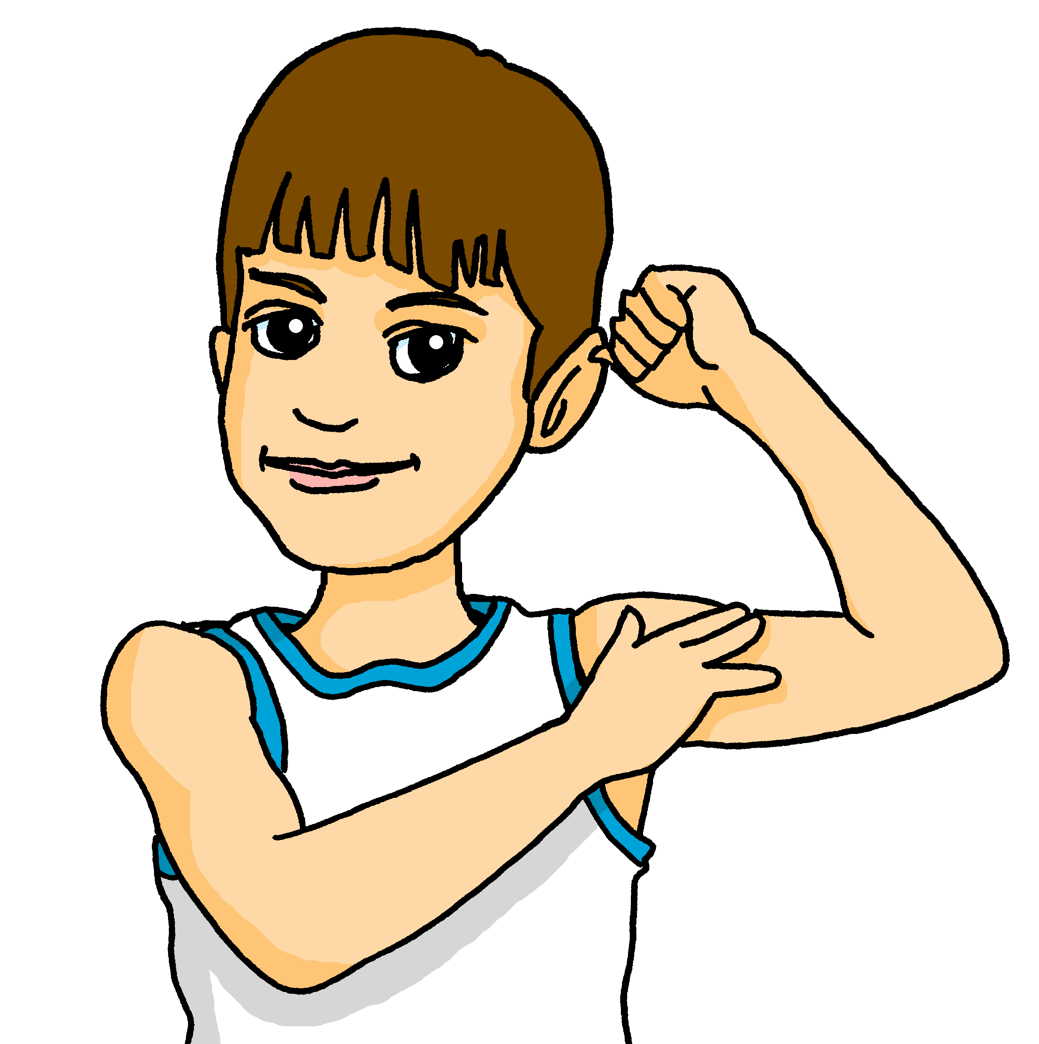
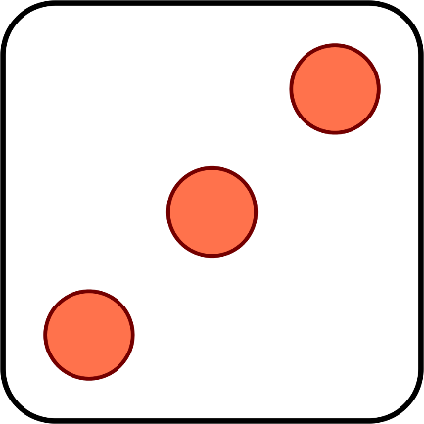




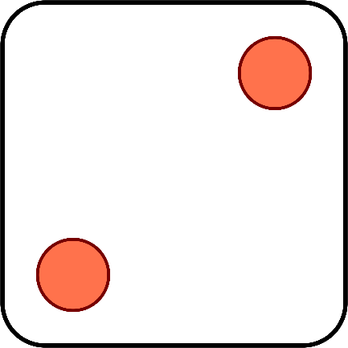
Follow up 4
Pierre et Yves inventent un jeu amusant.
Parle en français. Ils ont combien de points au total ?
parler
vingt-trois
quatorze
vingt-et-un
quinze
dix-neuf
treize
seize
dix-huit
Notes:
Timing: 4 minutes
Aim: to practise oral recall of numbers.
Procedure:
1. Click to ‘roll’ the dice for Pierre and Yves.
2. Students say the total shown on the two dice in French.
3. Click again to move on to the next number.
Word frequency of unknown words and cognates used (1 is the most frequent word in French):
point [97]
Source: Londsale, D., & Le Bras, Y. (2009). A Frequency Dictionary of French: Core vocabulary for learners London: Routledge

Slide 10








Follow up 5
Pose des questions en français pour trouver le partenaire correspondant ou la partenaire correspondante.
Exemple :
parler
Oui, nous aimons faire de la natation.
Non, nous détestons jouer au foot.
Vous aimez faire de la natation ?
Oui !
Vous êtes C ?
Vous aimez jouer au foot ?
A
B
C
Notes:
Timing: 5 minutes (three slides)
Aim: to practise asking and answering questions using plural vous and nous with 2-verb structures.
Procedure:
1. Model the task using the example. Click to demonstrate each step.
2. Then move to the next slide for the first round – there is no need for printing with this activity.
Note that pupils work in pair asking and answering with another pair.

Slide 11
Follow up 5: [1/2]
A
B
C
D
parler
E
F
G
H
I
J
K
L
Notes:
DISPLAY THIS SLIDE
Timing: 8-10 minutes
Aim: to practise asking and answering questions.
Procedure:
1. Pair B chooses one letter – that is the ‘person’ they are.
2. Pair A asks yes/no questions to work out who B are
The four questions are:
Vous aimez jouer au foot ?
Vous aimez faire de la natation ?
Vous aimez jouer au tennis ?
Vous aimez faire de l’exercice ?
3. Pair B answers with full phrases (as per the example on the previous slide).
4. Pair A keeps going until they have worked out which letter Pair B are
5. Swap roles and play again.
Note: this round of the game can be played several times, with pupils taking it in turns.
There is a further round of the game with different language to practise on the next slide.

Slide 12


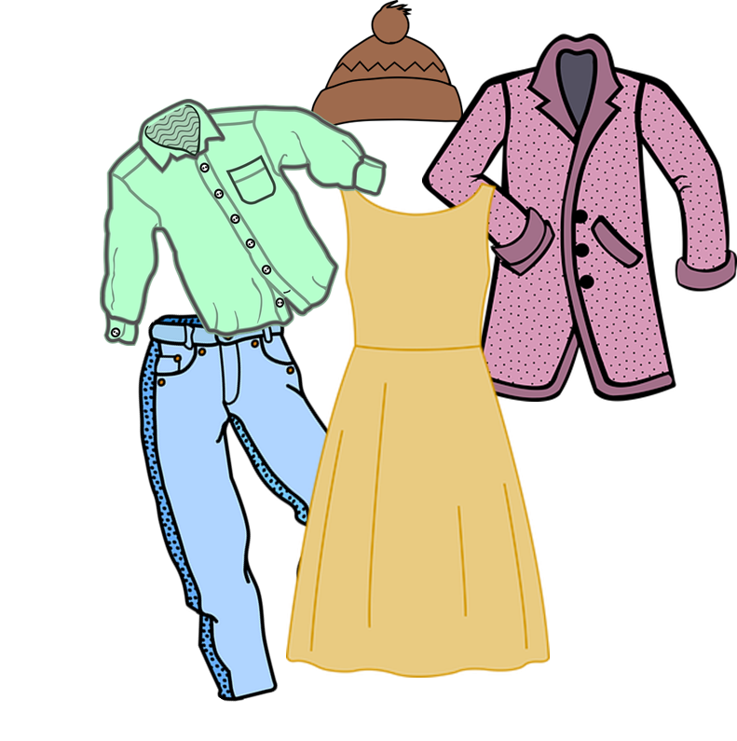

Follow up 5: [2/2]
A
B
C
D
parler
E
F
G
H
I
J
K
L
Notes:
DISPLAY THIS SLIDE
Timing: 8-10 minutes
Aim: to practise asking and answering questions.
Procedure:
1. Pair B chooses one letter – that is the ‘person’ they are.
2. Pair A asks yes/no questions to work out who B are.
The four questions are:
Vous aimez préparer un repas ?
Vous aimez laver la voiture ?
Vous aimez ranger les vêtements ?
Vous aimez faire le ménage dans la cuisine ?
3. Pair B gives full sentence answers using the ‘nous’ form.
4. Pair A keeps going until they have worked out which letter Pair B is.
5. Swap roles and play again.
Note: this round of the game can be played several times, with pupils taking it in turns.

Slide 13
vocabulaire
Follow up 3a - Écris en anglais : Can you get at least 15 points?
mots
 | combien | seize | quinze
 | dix-neuf | vingt-quatre | douze
 | treize | trente | vingt-sept
 | la corde | le tennis | une fois
 | un/une | des | il y a
 | le repas | ranger | laver
 | le football | donner à manger | la cuisine
x3
x2
x1
Notes:
HANDOUT
13

Slide 14
vocabulaire
Follow up 3b - Écris en français : Can you get at least 15 points?
mots
 | 12 | 16 | how many
 | 15 | 19 | 24
 | 30 | 27 | 13
 | there is/are | a/an (m), a/an (f) | some
 | (the) tennis | (the) rope | (a/one) time
 | (the) kitchen | (the) meal | (the) football
 | to tidy up, put away | to wash, washing | to feed, feeding
x3
x2
x1
Notes:
HANDOUT
14

