Slide 1
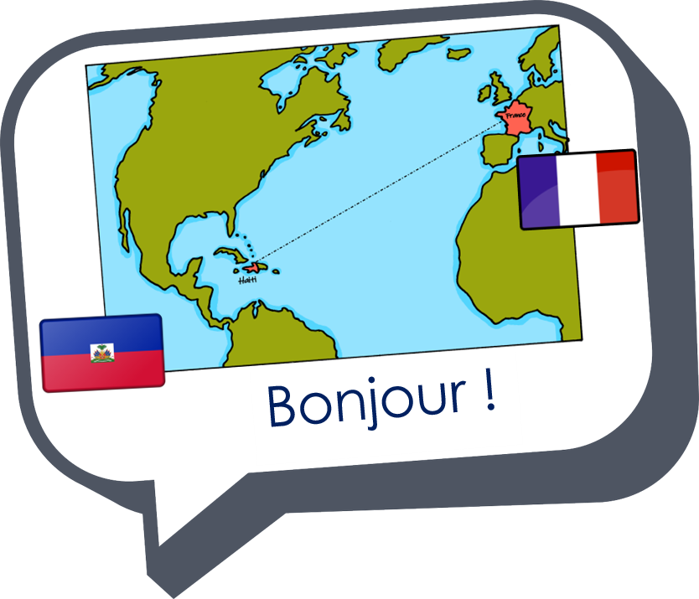






Saying what I and others do
bleu
faire with sports
SSC [-qu-]
Notes:
Artwork by Steve Clarke. Pronoun pictures from NCELP (www.ncelp.org). All additional pictures selected from Pixabay and are available under a Creative Commons license, no attribution required.
Phonics: Revisit SSC [-qu-] question[144] quatre[283] musique [1139] expliquer [252] unique [402]
Vocabulary (new words in bold): cyclisme [>5000] exercice [1290] gymnastique [>5000] natation [>5000] ski [4751] sport [2011]
Revisit 1: Il fait [25] automne [1503] été [623] printemps [1288] hiver [1586] beau [393] mauvais [274] chaud [1852] froid [1307] quand [119]
Revisit 2: cacher [914] maintenant [192] normalement [2018]
Londsale, D., & Le Bras, Y. (2009). A Frequency Dictionary of French: Core vocabulary for learners London: Routledge.
The frequency rankings for words that occur in this PowerPoint which have been previously introduced in these resources are given in the SOW
and in the resources that first introduced and formally re-visited those words.
For any other words that occur incidentally in this PowerPoint, frequency rankings will be provided in the notes field wherever possible.
1

Slide 2


[qu]
prononcer
question
Notes:
Timing: 1 minute
Aim: To introduce SSC [qu]
Procedure:
1. Present the letter(s) and say the [qu] sound first, on its own. Students repeat it with you.
2. Bring up the word ”question” on its own, say it, students repeat it, so that they have the opportunity to focus all of their attention on the connection between the written word and its sound.
3. Say the word and do the gesture, if using.
4. Roll back the animations and work through 1-3 again, but this time, dropping your voice completely to listen carefully to the students saying the [qu] sound, pronouncing ”question” and, if using, doing the gesture.
Gesture: https://www.signbsl.com/sign/question
The 2nd video from the left – trace the shape of a question mark in the air
Word frequency (1 is the most frequent word in French):
question [144]
Source: Londsale, D., & Le Bras, Y. (2009). A Frequency Dictionary of French: Core vocabulary for learners London: Routledge.
2

Slide 3


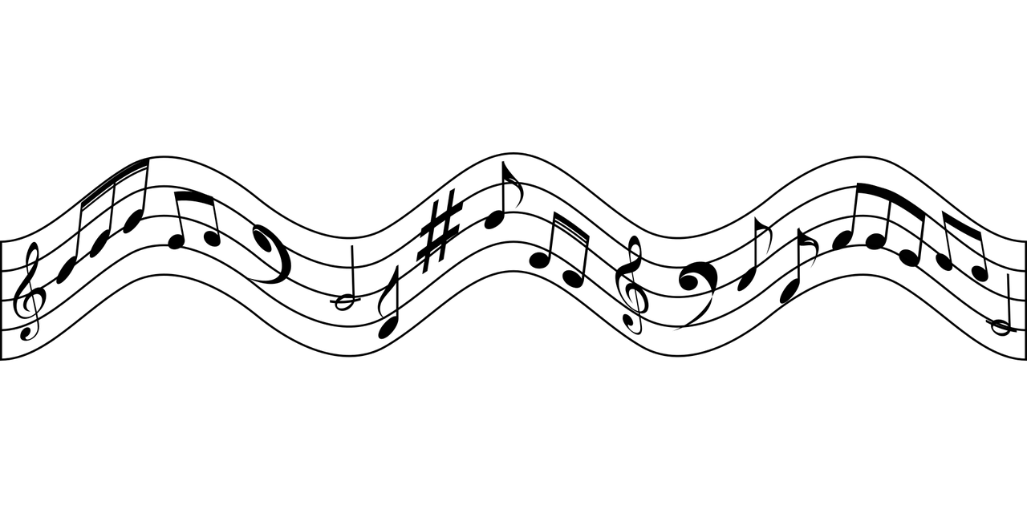
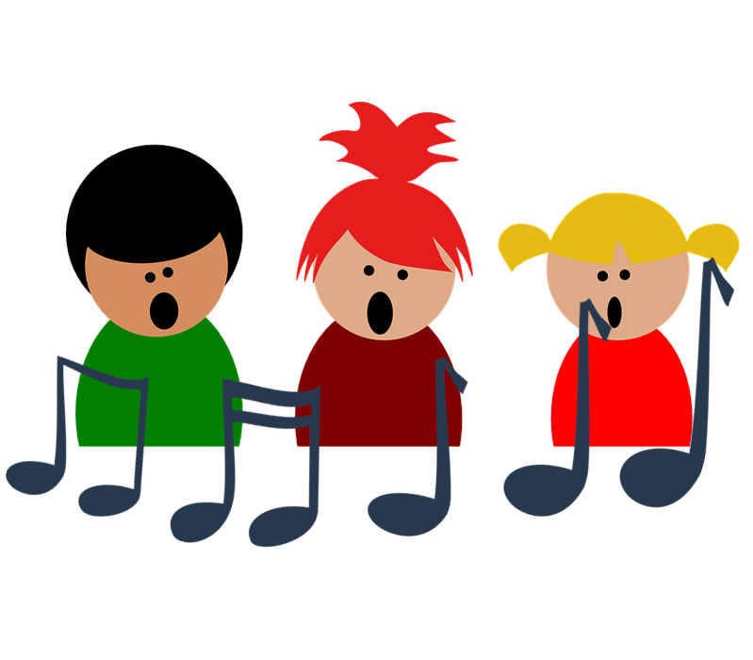
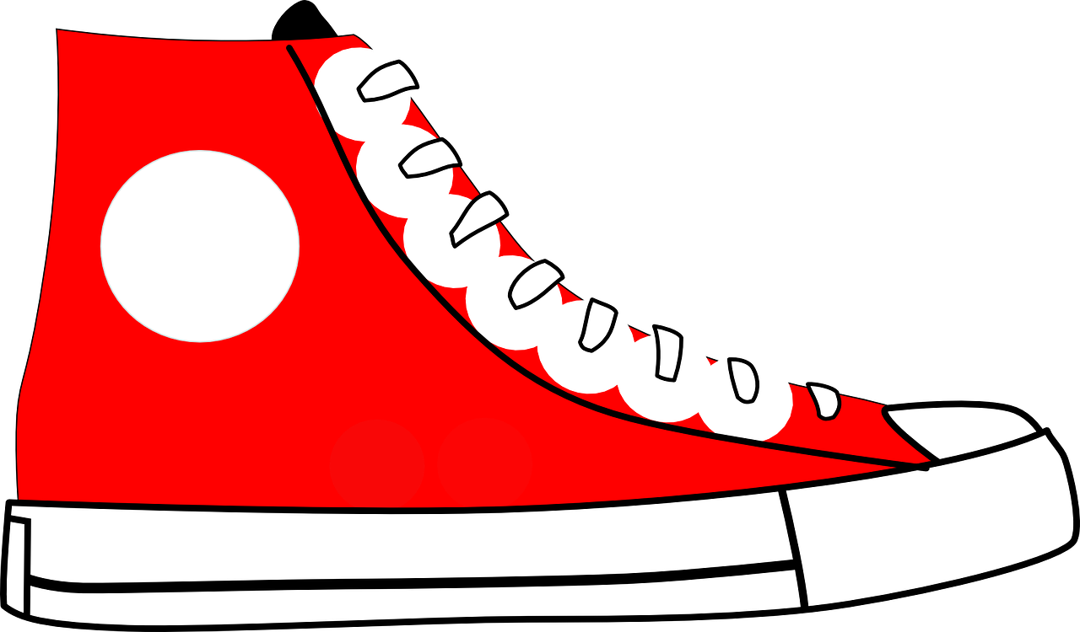
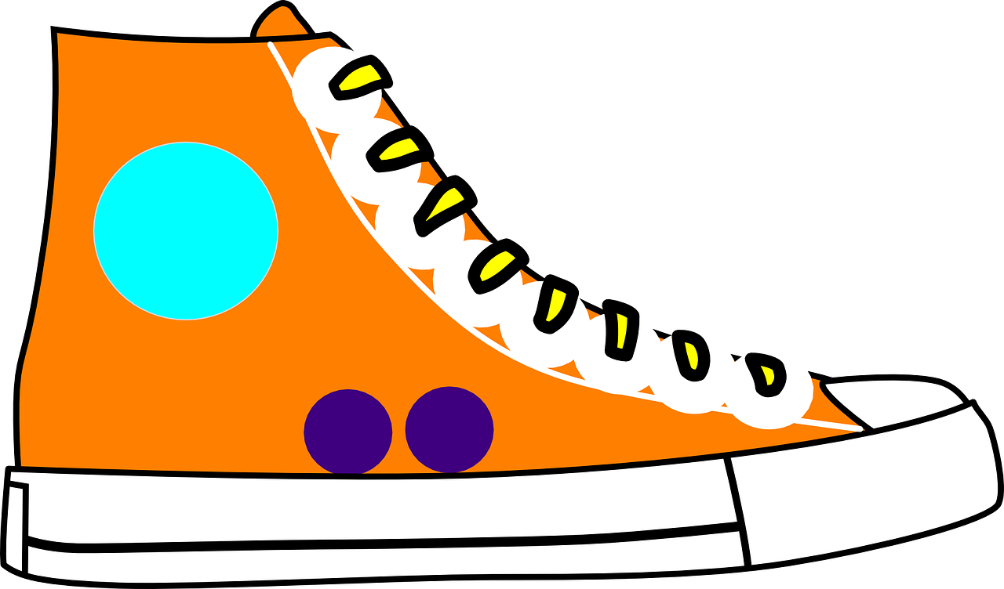
[qu]
prononcer
to explain
quatre
expliquer
question
musique
unique
Notes:
Timing: 2 minutes
Aim: To introduce SSC [qu]
Procedure:
1. Introduce and elicit the pronunciation of the individual SSC [qu] and then the source word again ‘question’ (with gesture, if using).
2. Then present and elicit the pronunciation of the four cluster words.
The cluster words have been chosen for their high-frequency, from a range of word classes, with the SSC (where possible) positioned within a variety of syllables within the words (e.g. initial, 2nd, final etc.). Additionally, we have tried to use words that build cumulatively on previously taught SSCs (see the Phonics Teaching Sequence document) and do not include new SSCs. Where new SSCs are used, they are often consonants which have a similar symbol-sound correspondence in English.
Word frequency:
quatre [283] musique [1139] expliquer [252] unique [402] question [144]
Source: Londsale, D., & Le Bras, Y. (2009). A Frequency Dictionary of French: Core vocabulary for learners London: Routledge.
3

Slide 4


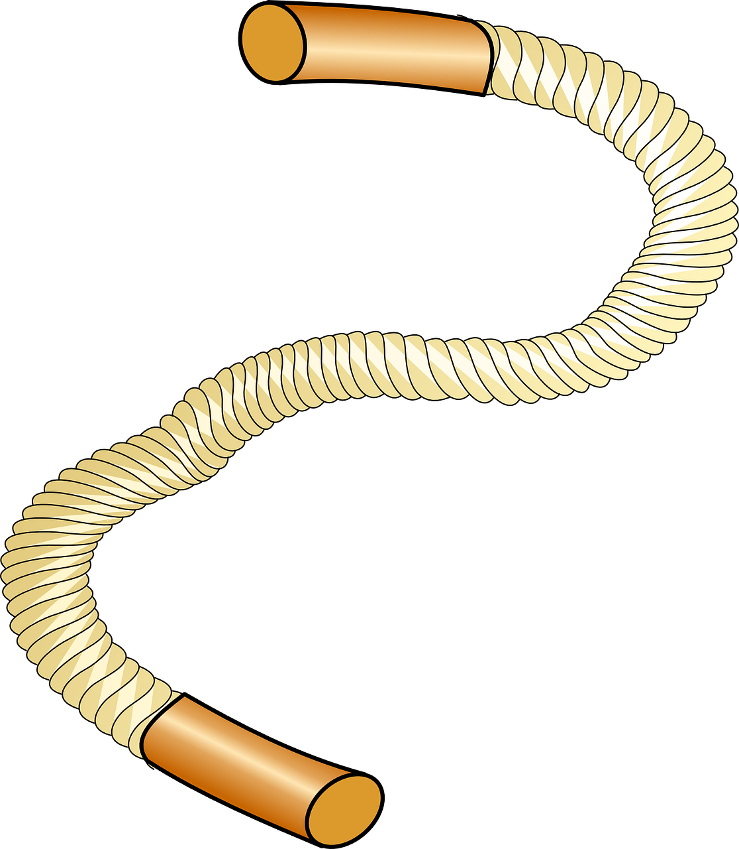
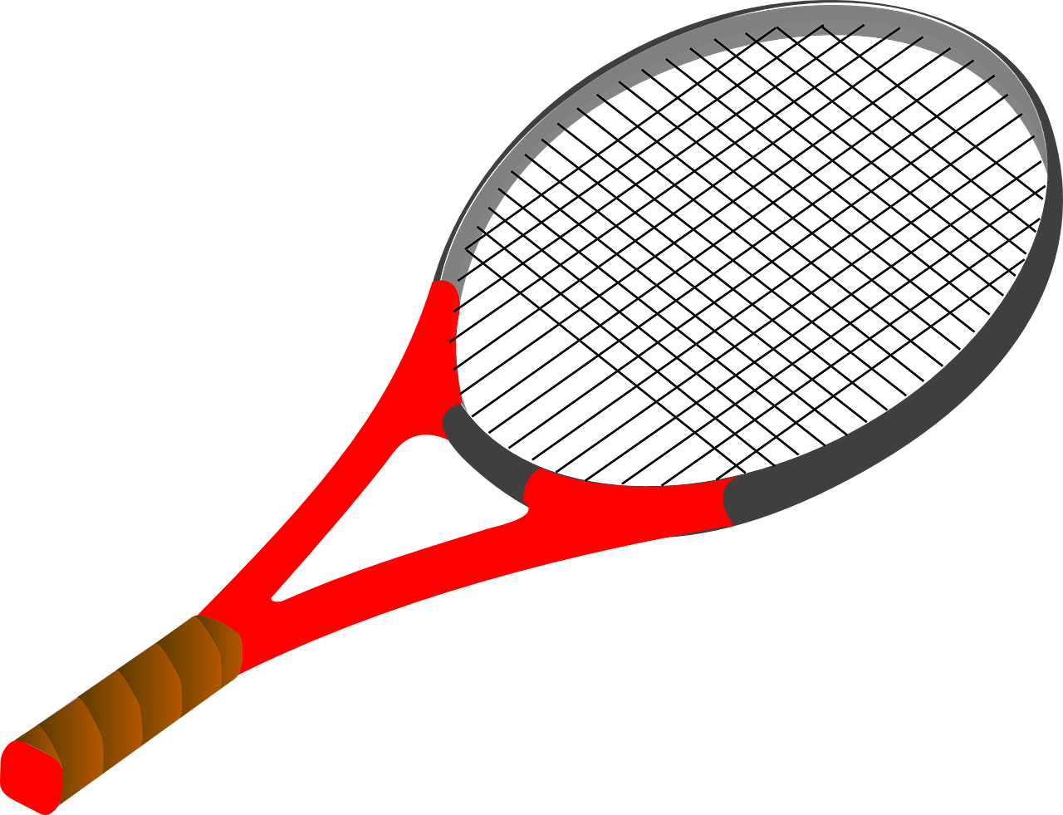



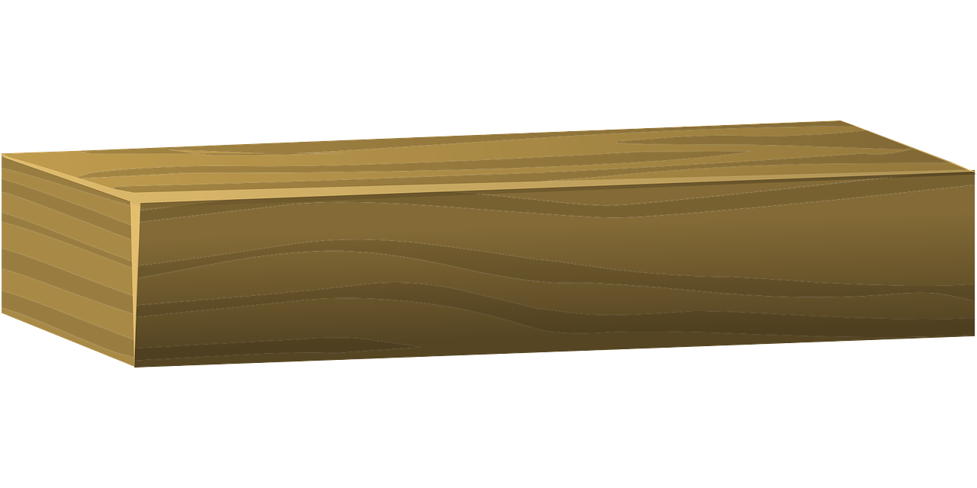
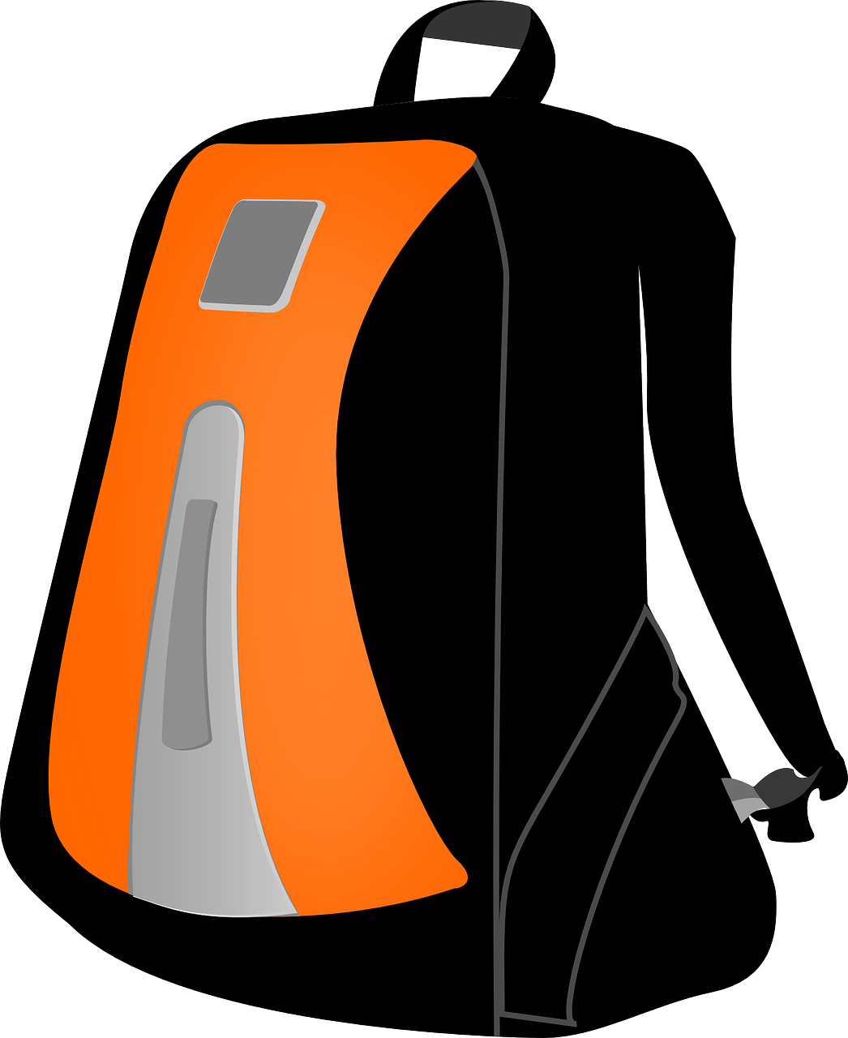


prononcer
Le sport
Écoute. C’est [qu] ou [c] ou [ch] ?
Puis, prononce les mots.
1
2
3
4
5
q u i l l e
p l a n c h e
c o r d e
c a s q u e t t e
r a q u e t t e
__
__
__
__
__
6
7
8
9
10
s a c d e
s p o r t
m a s q u e
d e
s n o r k e l i n g
c h a u s s u r e
b r i q u e
d e y o g a
__
b a l l o n d e
g y m n a s t i q u e
__
__
__
__
Notes:
Timing: 5 minutes
Aim: to practise aural distinction between words with [qu], [c] and [ch] sounds.
Procedure:
Read the instruction.
Do the first one with pupils. Remind them that [qu] sounds like [c] but that [c] can only come before a, o, u.
Elicit responses chorally and click to reveal the answers.
Transcript:
raquette
quille
planche
corde
casquette
chaussure
brique de yoga
sac de sport
ballon de gymnastique
masque de snorkeling
Frequency of unknown words and cognates:
raquette [>5000] quille [>5000] planche [3610] corde [3784] casquette [>5000] chaussure [3638] brique [>5000] yoga [>5000] sac [2343] sport [2011] ballon [3692] gymnastique [>5000] masque [3856] snorkeling [>5000]
Source: Lonsdale, D., & Le Bras, Y. (2009). A Frequency Dictionary of French: Core vocabulary for learners London: Routledge.

Slide 5





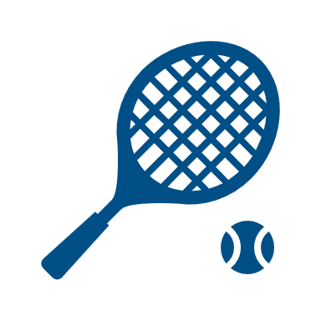



vocabulaire
Vocabulaire
mots
Écoute et prononce bien.
le sport
la natation
le ski
l’exercice
la gym(nastique)
le cyclisme
Notes:
Timing: 7 minutes (two slides)
Aim: to present and practise written comprehension and read aloud of previously taught vocabulary and the six new words for this week.
Procedure:
1. Click to bring up the French word and say the word together with the pupils. (In the audio version, the audio is activated as the word appears and again as the picture appears).
2. Click to bring up the picture.
3. Click to animate the French word again (no audio this time) and elicit repetition of the word.
4. Repeat with all six items and then proceed to the next slide.
5

Slide 6
vocabulaire
mots
Comment dit-on ça en anglais ?
le sport
la natation
le ski
l’exercice
la gym(nastique)
le cyclisme
Notes:
[2/2]
Aim: to practise written comprehension and read aloud of previously taught vocabulary and the six new words for this week.
Procedure:
1. Click to bring up an English picture/word prompt.
2. Pupils find the corresponding French word and read it aloud, chorally.
3. Repeat with all 8 items.
4. Click on the French word to hear it pronounced, if desired.
6

Slide 7


faire de with sports
⚠ de + le → du
de + la → de la
de + l’ → de l’
To say ‘do’ with sports, use faire de:
⚠ This use of ‘de’ + article is called the partitive.
Je fais du sport.
I do (some) sport.
Tu fais de la natation.
You do (some) swimming.
Elle fait de l‘exercice.
She does (some) exercise.
Remember to use faire un/une with other nouns:
Je fais un cadeau
I make/am making a present.
Il fait une activité.
He does/ is doing an activity.
Notes:
Timing: 2 minutes
Aim: to introduce the partitive article ‘de’ with sports and contrast it with faire + un/une + noun.s
Procedure:
Click through the animations.
Elicit English from pupils following the ?.
Note: in weeks 8 and 9 pupils will also learn to use the partitive with other nouns (food and drink).

Slide 8

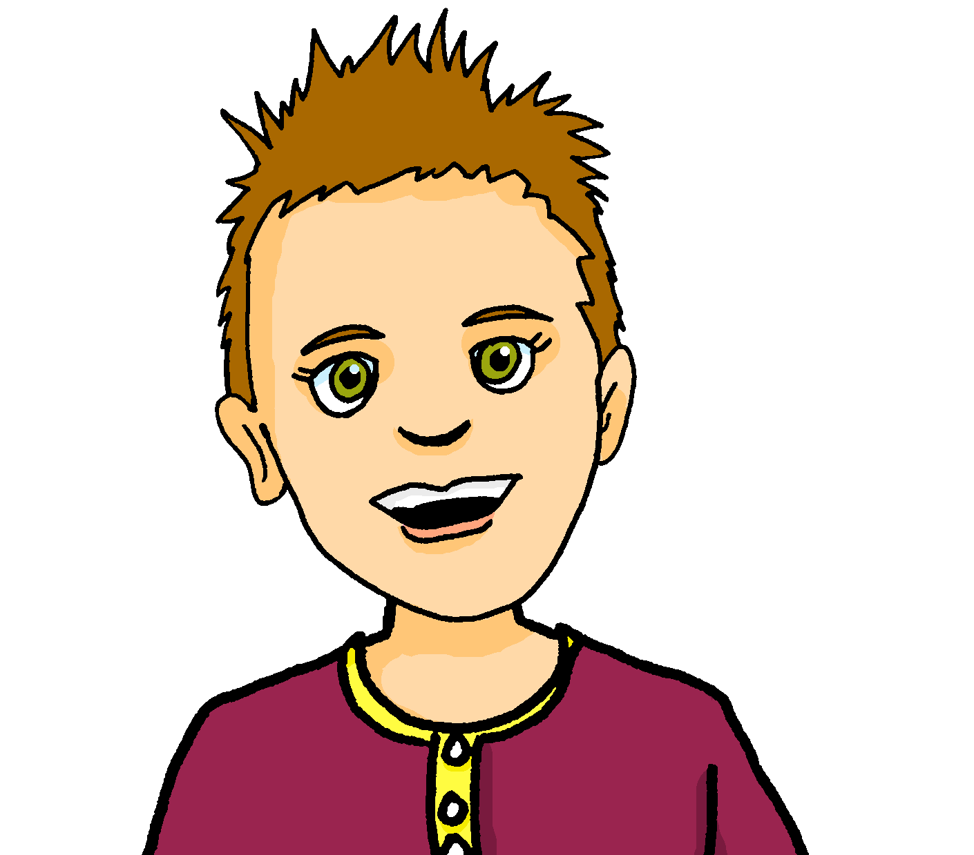

écouter
Écoute. L’activité, c’est quoi ?
⚠ Attention ! Je fais means I do/make
and I’m doing/making.
Or we could say ‘go|am going skiing.’
 | A | B | en anglais
1 | ski | liste
2 | activité | natation
3 | cyclisme | gâteau
4 | gymnastique | ski
5 | exercice | cyclisme
6 | voyage | sport
Or ‘I go|am going swimming.’
1
1
I do | am doing skiing.
2
2
I do | am doing swimming.
Or ‘I go|am going cycling.’
3
3
I do | am doing cycling.
4
4
I do | am doing gymnastics.
5
5
I do | am doing exercise.
6
6
I do | am doing sport.
Notes:
Timing: 6 minutes
Aim: to practise connection of the partitive article with the correct activity and aural recognition of vocabulary.
Procedure:
Pupils listen to each phrase.
Attending to the article following ‘je fais’ pupils decide between Pierre’s activities.
On the 2nd time of listening, pupils write the English meaning of the sentences.
Click to reveal answers.
Transcript:
Je fais du [ski].
Je fais de la [natation].
Je fais du [cyclisme].
Je fais de la [gymnastique].
Je fais de l’ [exercice].
Je fais du [sport].
8

Slide 9





lire
Lis les phrases et identifie l’image correspondante.
Écris le verbe correct. C’est ‘jouer’ ou ‘faire’ ?
écrire
1 | Il joue à la pétanque.
2 | Tu joues au tennis.
3 | Elle fait de la natation.
4 | Je fais du cyclisme.
5 | Je joue à la corde.
6 | Tu joues au foot.
7 | Elle fait de l’exercice.
8 | Il fait du ski.
1
____
A
A | B | C
D |  | E
F | G | H
2
____
H
3
____
G
4
____
F
5
____
D
6
____
E
7
____
C
8
____
B
Notes:
Timing: 6 minutes
Aim: to practise written recognition of the singular forms of ‘faire’ and connect these with meaning.
Procedure:
1. Read the rubric and ensure that pupils understand the task.
2. Pupils read the sentences and note down the letter of the picture. (1=A etc.)
3. Answers revealed on clicks.
4. Pupils then write the correct form of the missing verb (jouer or faire).
5. Click to reveal the correct answers.
6. Optional – click the numbered buttons to hear the full sentences.
Pétanque image attribution: Arvedui89, CC BY-SA 4.0 via Wikimedia Commons

Slide 10


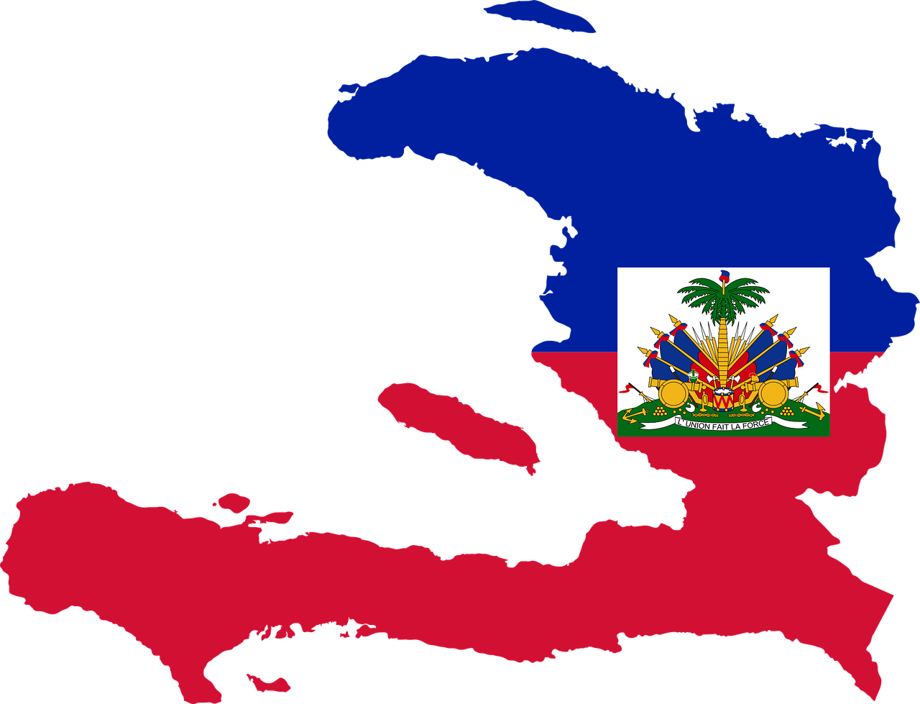

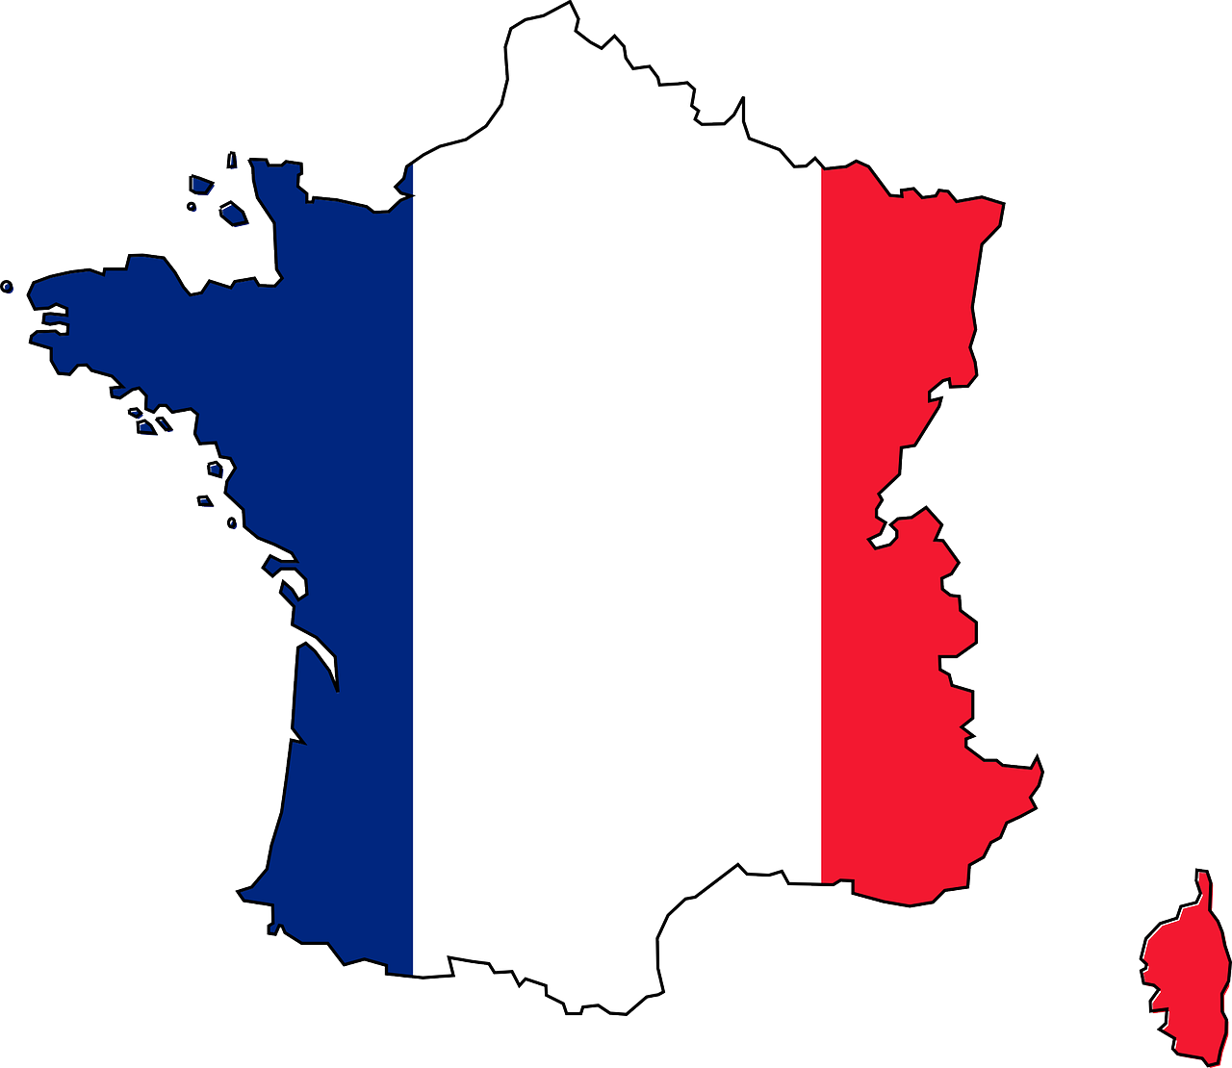














parler
Les sports au Canada, à Haïti et en France.
Le sport numéro 1 au Canada, c’est quoi ?
le football
le basket
l’atlétisme
le hockey sur glace
la crosse
le football
le baseball
le criquet
le tennis
le rugby
le basket
le curling
le golf
le football
le tennis
l’équitation
le basket
le judo-jujitsu
le handball
le rugby
le golf
le canoë kayak
la voile
Notes:
Timing: 6 minutes (two slides)
Aim: to introduce pupils to the most popular sports in our three countries – Canada, Haïti and France; to show them that French and English share many words for sports; to practise the pronunciation of different sports.
Procedure:
Click to hear or read the title question: Le sport numéro 1 au Canada, c’est quoi ?
Elicit answer from pupils. Note that at this point we haven’t revealed which country is which, but after pupils identify ‘le hockey sur glace’, click to bring up the three country symbols.
Ask further questions, for example: le sport préféré en France, c’est quoi ? Et à Haïti ? Le sport numéro [5] au Canada, c’est quoi ?
Pupils respond, pronouncing the correct sports. Click on the picture to hear the audio, as required.
Frequency of unknown words and cognates:
équitation [>5000] basket [>5000] judo-jujitsu [>5000] handball [>5000] rugby [>5000] golf [4936] canoë kayak [>5000] voile [3155] hockey [>5000] sur [16] glace [2580] crosse [>5000] criquet [>5000] curling [>5000] atlètisme [>5000]
Image attribution:
Information:
https://french-iceberg.com/sports-in-france/
https://neoprimesport.com/3810/top-10-most-popular-sports-of-canada-in-the-year-2021-22/
https://www.topendsports.com/world/countries/haiti.htm
10

Slide 11
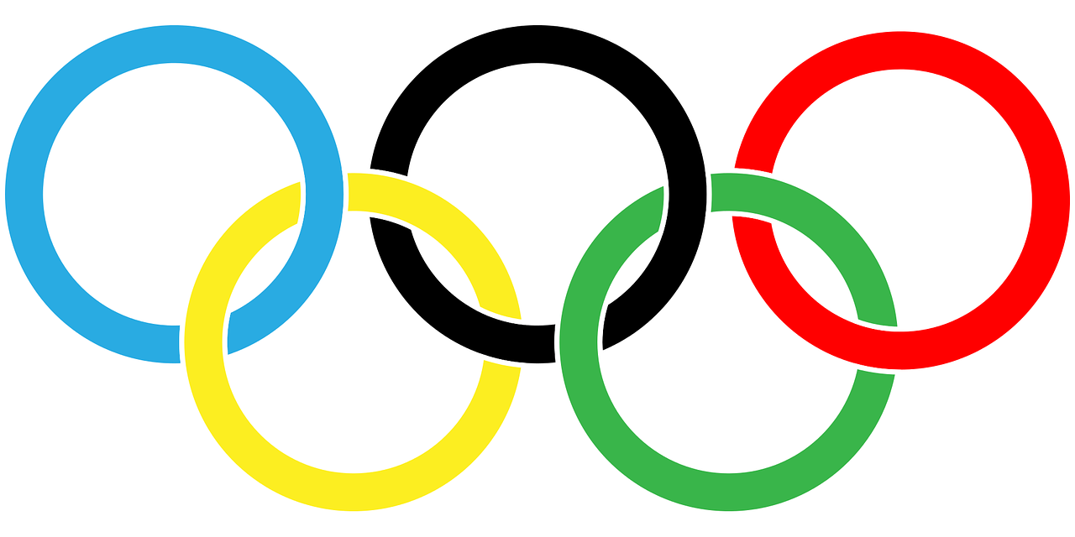



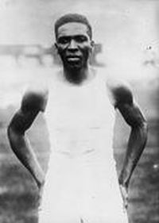


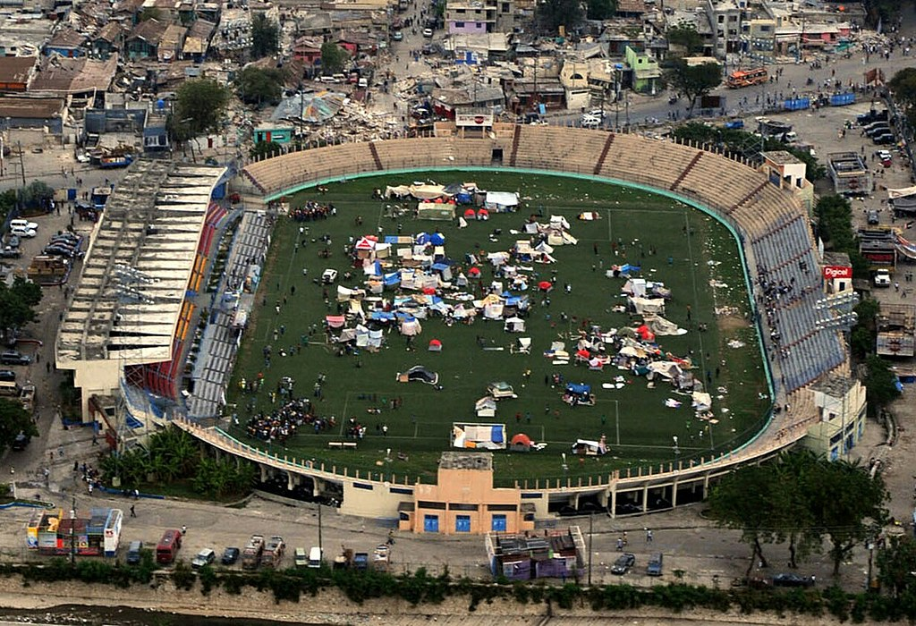
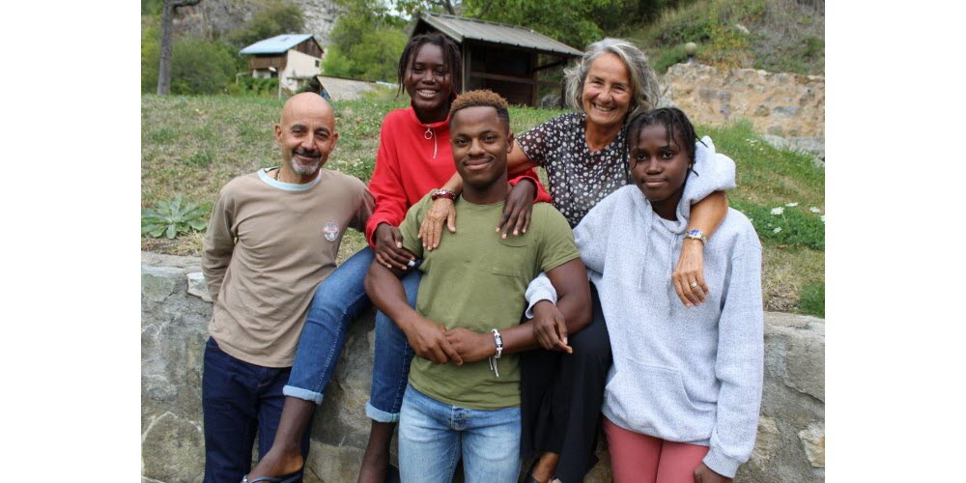
parler
Haïti aux Jeux olympiques
During the opening ceremony of the 1936 Berlin Olympic Games, Haiti and Liechtenstein discovered that their flags were identical! So, Liechtenstein added a yellow crown and Haïti’s flag has their coat of arms.
Le stade Silvio Cator, Port-au-Prince
En 1928 Silvio Cator gagne la médaille d’argent pour le saut en longeur.
En 2022, Richardson Viano
(19 ans) représente Haïti aux Jeux olympiques de Pékin (Beijing). Il participe à la compétition de ski.
Photo Le DL /Karine PAYEN
Notes:
Aim: to find out more about sporting success in Haiti, remembering that in previous lessons we have highlighted that most young people in Haiti do not have access to the sporting facilities that many other countries (e.g., France and Canada and the UK) have.
Procedure:
Allow pupils to read the story about the identical flags in English. Click to reveal the two countries’ flags.
Click to bring up the text and pictures of the two Haitian athletes.
Read the text aloud, so pupils can follow. (Click on the text to hear the audio, if preferred).
Elicit pupils’ understanding.
Tell pupils that Silvio Cator’s medal was the 2nd and last medal that Haiti won in the Olympics so he is a special athlete for the country and has Haiti’s only stadium named after him. It is in the capital city, Port-au-Prince. In 2010 Haiti experienced a terrible earthquake and in the photo you can see people taking refuge in the stadium.
Tell them that 2022 in Beijing was the first time Haiti has ever sent any athletes to a winter Olympics (remember that their country is a Caribbean island of 11 million people, where, although about 2/3 country is mountainous, it hardly ever snows, so there are no opportunities to practise winter sports like skiing!)
Frequency of unknown words and cognates:
gagner [258] médaille [3361] argent [472] saut [3841] longeur [>5000] olympique [3199] compétition [2651]
Image attribution:
Silvio Cator: Unknown author, Public domain, via Wikimedia Commons
Le stade Silvio Cator: U.S. Navy photo by Mass Communication Specialist 2nd Class Joel Carlson, Public domain, via Wikimedia Commons
Long jump: Diegobiavati, CC BY-SA 4.0 via Wikimedia Commons
Information:
https://www.ledauphine.com/culture-loisirs/2020/09/29/le-reve-de-richardson-viano-representer-haiti-aux-jo?fbclid=IwAR1CzwfHTyMc4fiBwv8u-IqUiEJiPUhF4suPrqpwijyaAjXGAY8BNhYxbbo
11

Slide 12
Au revoir !
bleu
Notes:
12

