Slide 1
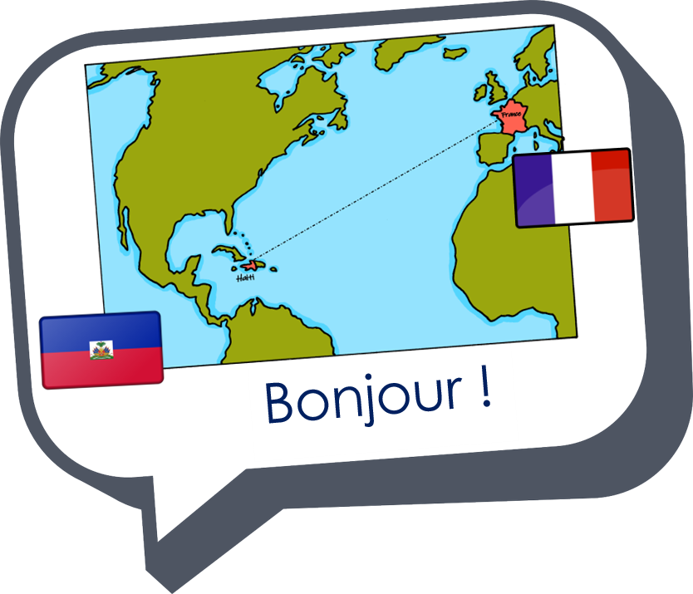


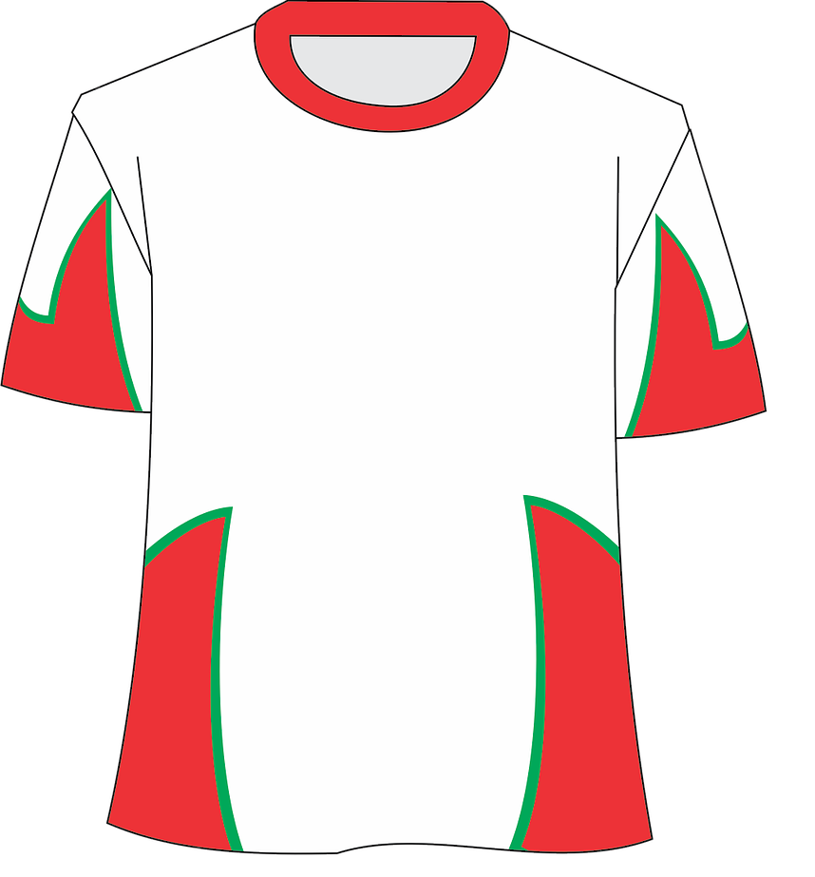




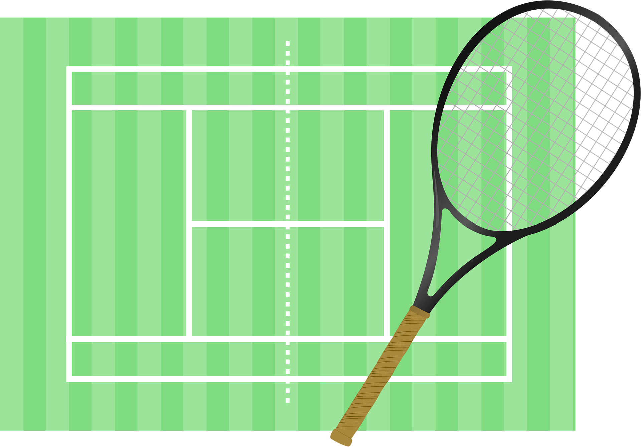
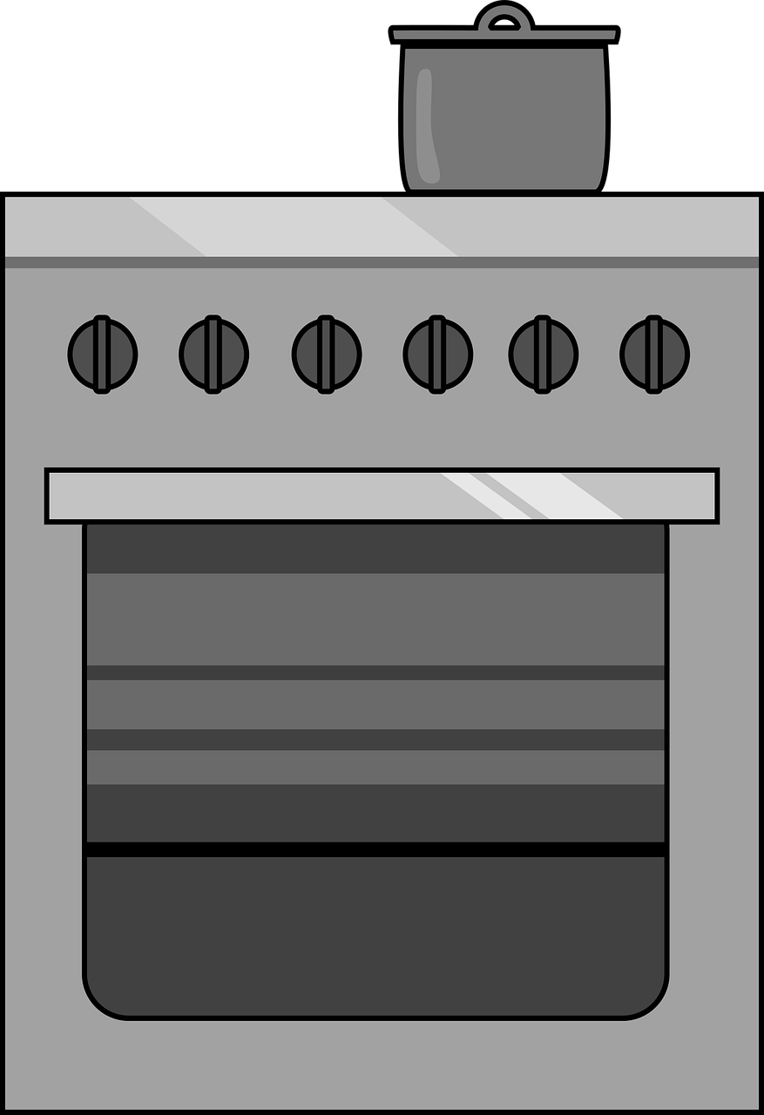
Saying what I and others do
bleu
mon, ma, mes
jouer with sports, faire with activities
SSC [-s-]
Notes:
Artwork by Steve Clarke. Pronoun pictures from NCELP (www.ncelp.org). All additional pictures selected from Pixabay and are available under a Creative Commons license, no attribution required.
Phonics: Revisit SSC [-s-] maison [325] chose [125] magasin [1736] église [1782] cuisine [2618]
Vocabulary (new words in bold): équipe [814] parent [546] mes [60] tes [330]
Revisit 1: tu fais [25] effort [388] voyage [904] carte [955] gâteau [4845] liste [924]
Revisit 2: étudier [960] partager [527] parfois [410]
Londsale, D., & Le Bras, Y. (2009). A Frequency Dictionary of French: Core vocabulary for learners London: Routledge.
The frequency rankings for words that occur in this PowerPoint which have been previously introduced in these resources are given in the SOW
and in the resources that first introduced and formally re-visited those words.
For any other words that occur incidentally in this PowerPoint, frequency rankings will be provided in the notes field wherever possible.
1

Slide 2

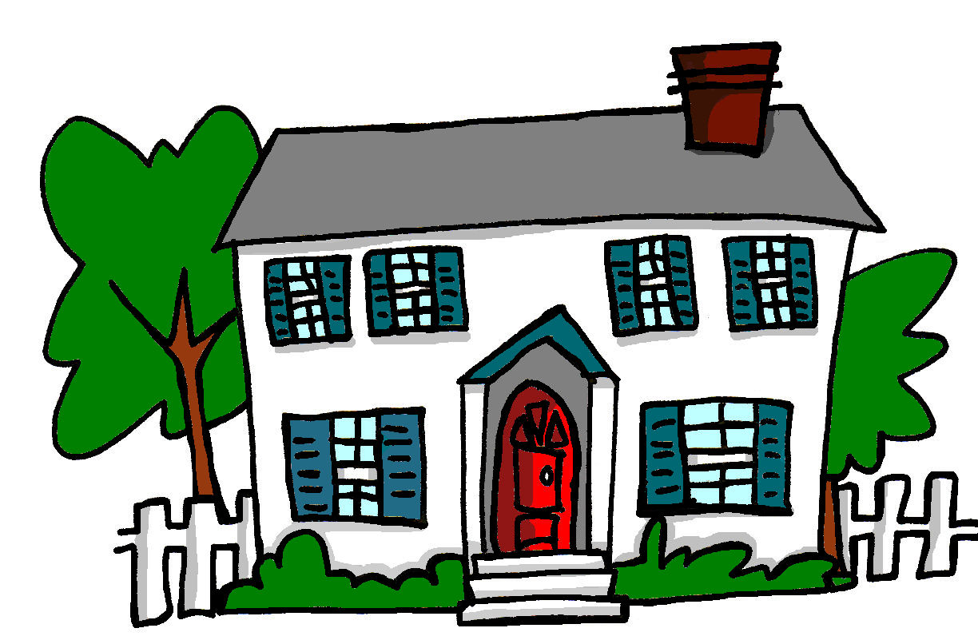
[-s-]
prononcer
maison
Notes:
Timing: 1 minute
Aim: To introduce SSC [-s-]
Procedure:
1. Present the letter(s) and say the [-s-] sound first, on its own. Students repeat it with you.
2. Bring up the word ”maison” on its own, say it, students repeat it, so that they have the opportunity to focus all of their attention on the connection between the written word and its sound.
3. A possible gesture for this would be to trace the outline of a house in the air with two fingers (see BSL video, link below).
4. Roll back the animations and work through 1-3 again, but this time, dropping your voice completely to listen carefully to the students saying the [-s- between vowels] sound, pronouncing ”maison” and, if using, doing the gesture.
Gesture: https://www.signbsl.com/sign/house
British Sign language for house traces the outline of a house in the air with two fingers, starting together at the top and drawing outwards and downwards.
Word frequency (1 is the most frequent word in French):
maison [325]
Source: Londsale, D., & Le Bras, Y. (2009). A Frequency Dictionary of French: Core vocabulary for learners London: Routledge.
2

Slide 3

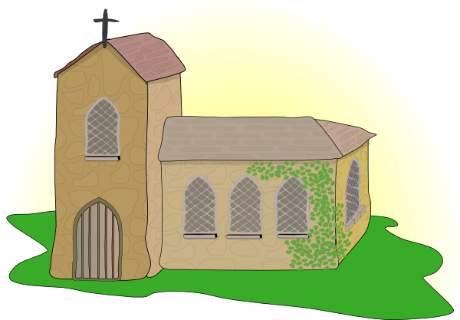

[-s-]
prononcer
magasin
église
maison
[thing]
chose
cuisine
Notes:
Timing: 2 minutes
Aim: To introduce SSC [-s-]
Procedure:
Introduce and elicit the pronunciation of the individual SSC [-s-] and then the source word again ‘maison’ (with gesture, if using).
Then present and elicit the pronunciation of the five cluster words.
The cluster words have been chosen for their high-frequency, from a range of word classes, with the SSC (where possible) positioned within a variety of syllables within the words (e.g. initial, 2nd, final etc.). Additionally, we have tried to use words that build cumulatively on previously taught SSCs (see the Phonics Teaching Sequence document) and do not include new SSCs. Where new SSCs are used, they are often consonants which have a similar symbol-sound correspondence in English.
Word frequency:
maison [325] chose [125] magasin [1736] église [1782] cuisine [2618]
Source: Londsale, D., & Le Bras, Y. (2009). A Frequency Dictionary of French: Core vocabulary for learners London: Routledge.
3

Slide 4

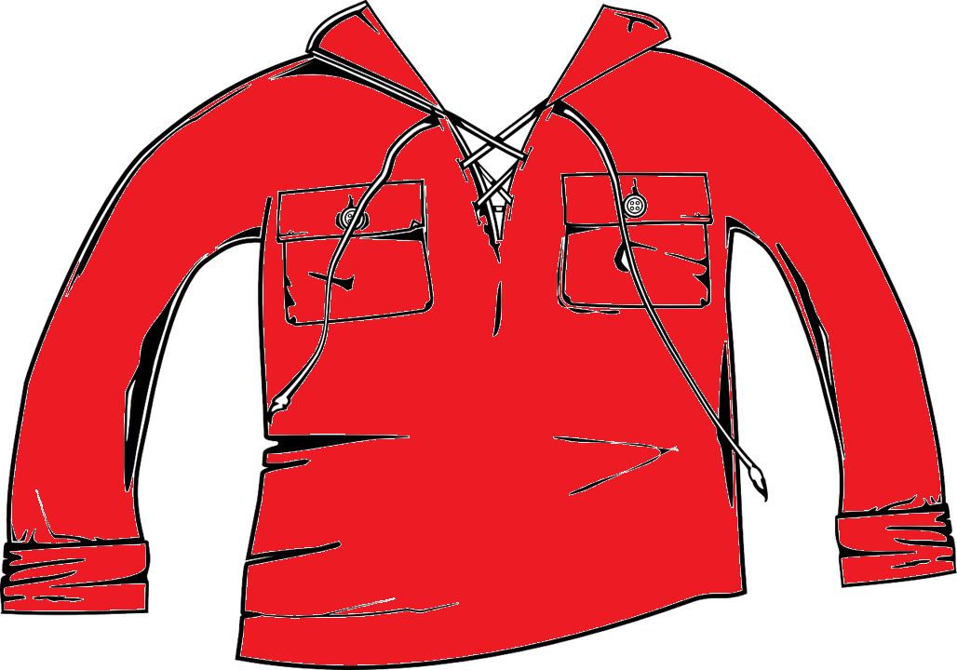

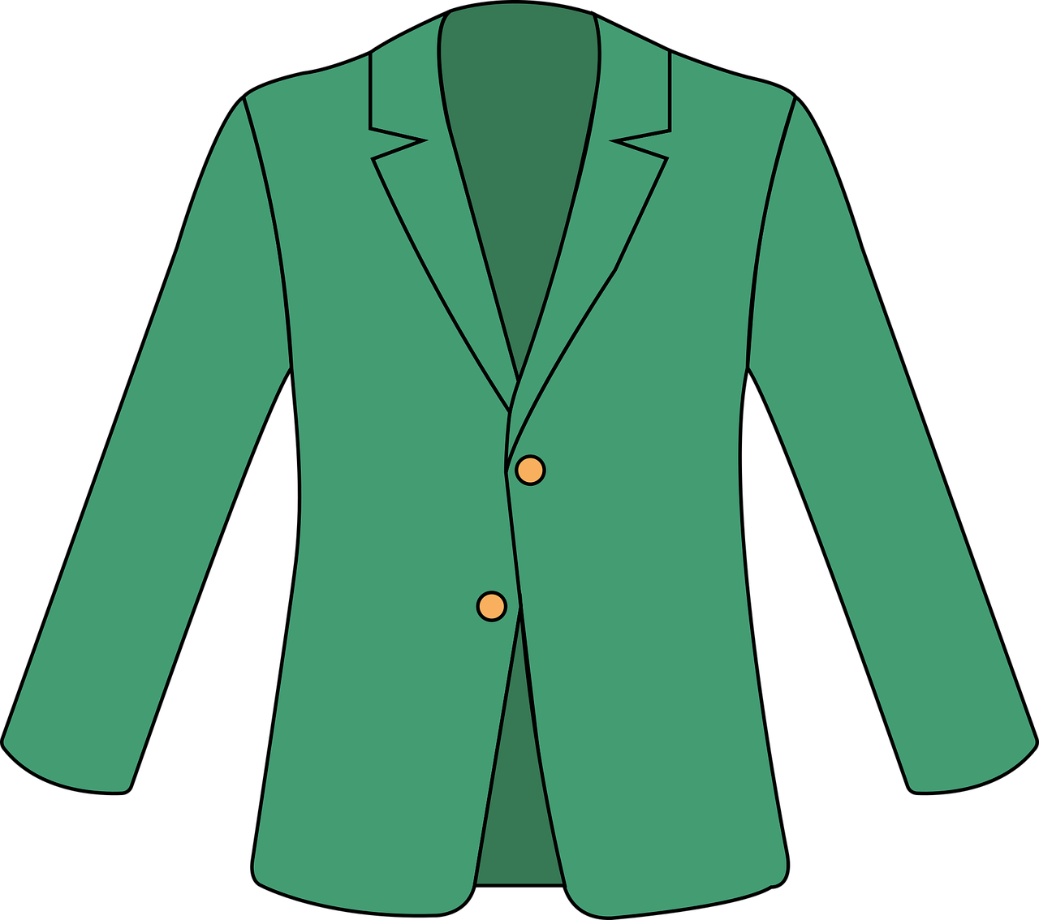
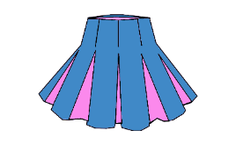
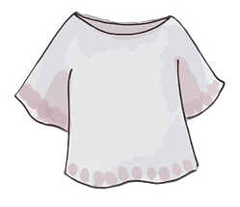


prononcer
Faire les magasins*
* faire les magasins – to go shopping (not food)
Écoute. C’est [s-/ss] ou [-s-] ?
Puis, prononce les mots.
[s-/ss] [-s-]
[s-/ss] [-s-]
une liste
une veste
une blouse
des chaussures
une vareuse
une jupe plissée
des choses
des chaussettes
1
5
2
6
7
3
4
8
Notes:
Timing: 5 minutes
Aim: to practise aural distinction between words with [s-/ss] and [-s-] sounds.
Procedure:
Read the instruction.
Do the first one with pupils. Remind them that [-s-] sounds like ‘z’.
Elicit responses chorally and click to reveal the answers.
Transcript:
une liste
une veste
une blouse
des chaussures
une vareuse
une jupe plissé
des choses
des chaussettes
Frequency of unknown words and cognates:
chaussette [>5000] jupe [>5000] plissé [>5000] chaussure [3638] blouse [>5000] vareuse [>5000] veste [>5000]
Source: Lonsdale, D., & Le Bras, Y. (2009). A Frequency Dictionary of French: Core vocabulary for learners London: Routledge.

Slide 5


mon, ma, mes | ton, ta, tes
Remember we use mon to mean my for masculine nouns and ma for feminine:
To mean ‘my’ with plural nouns, use mes.
my brothers
my brother
my sisters
mon frère
mes sœurs
my sister
mes frères
ma sœur
Use tes to mean ‘your’ with plural nouns:
Remember we also use mon (my) or ton (your) for nouns beginning with a vowel or silent ‘h’:
your female friends
your male friend
your female friend
ton ami
your male friends
tes amis
ton amie
tes amies
⚠ Remember liaison here, too.
⚠ Remember liaison, here.
ton équipe
your team
mes parents
my hotel
mon hôtel
my parents
mes cousines
my history, story
mon histoire
my female cousins
Notes:
Timing: 2 minutes
Aim: to recap mon/ma, ton/ta and introduce mes, tes.
Procedure:
Click through the animations.
Elicit English from pupils following the ?.
Note: the liaison is also highlighted, and will be practised in the slides that follow.

Slide 6


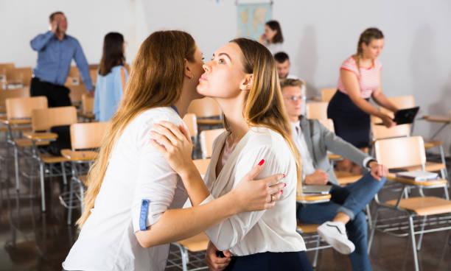


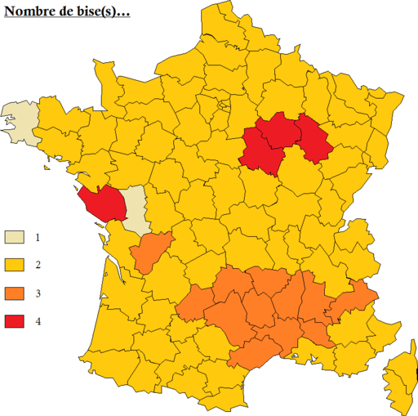
écouter
Faire la bise
*dire – to say
En France, faire la bise est pour dire* bonjour et au revoir.
*plusieurs – several
Il est naturel de faire la bise plusieurs* fois par jour avec la famille et les amis.
la bise
lire
En général, on fait deux bises, mais ça dépend de la région.
3. Doing two kisses is:
rare | usual | impossible
1. The text is mostly about:
kissing | family | France
On fait la bise aussi dans beaucoup de pays, par exemple, en Espagne, en Italie, au Portugal.
4. Faire la bise is done in:
France only | French-speaking places only |
many places
2. Faire la bise is for saying:
hello | goodbye | both hello and good bye
Notes:
Timing: 6 minutes
Aim: to introduce pupils to the custom of greeting people with a kiss on the cheek (faire la bise); to practise the comprehension of previously taught language in a longer text and to begin to develop pupils’ lexical inferencing ability, guiding them to use the words they know and some cognates to infer plausible meanings of words they don’t know.
Procedure:
Read the text aloud, so pupils can follow. (Click on the text to hear the audio, if preferred).
Click for the first question.
Elicit answers from pupils and click to check the answer. Refer pupils back to the text.
Repeat steps 2-3 for the remaining 3 questions.
Frequency of unknown words and cognates:
bise [>5000] dépendre [791] dire [37] général [147] naturel [760] plusieurs [213]
Image attribution: Morgan Maurice, CC BY-SA 4.0 via Wikimedia Commons
6

Slide 7
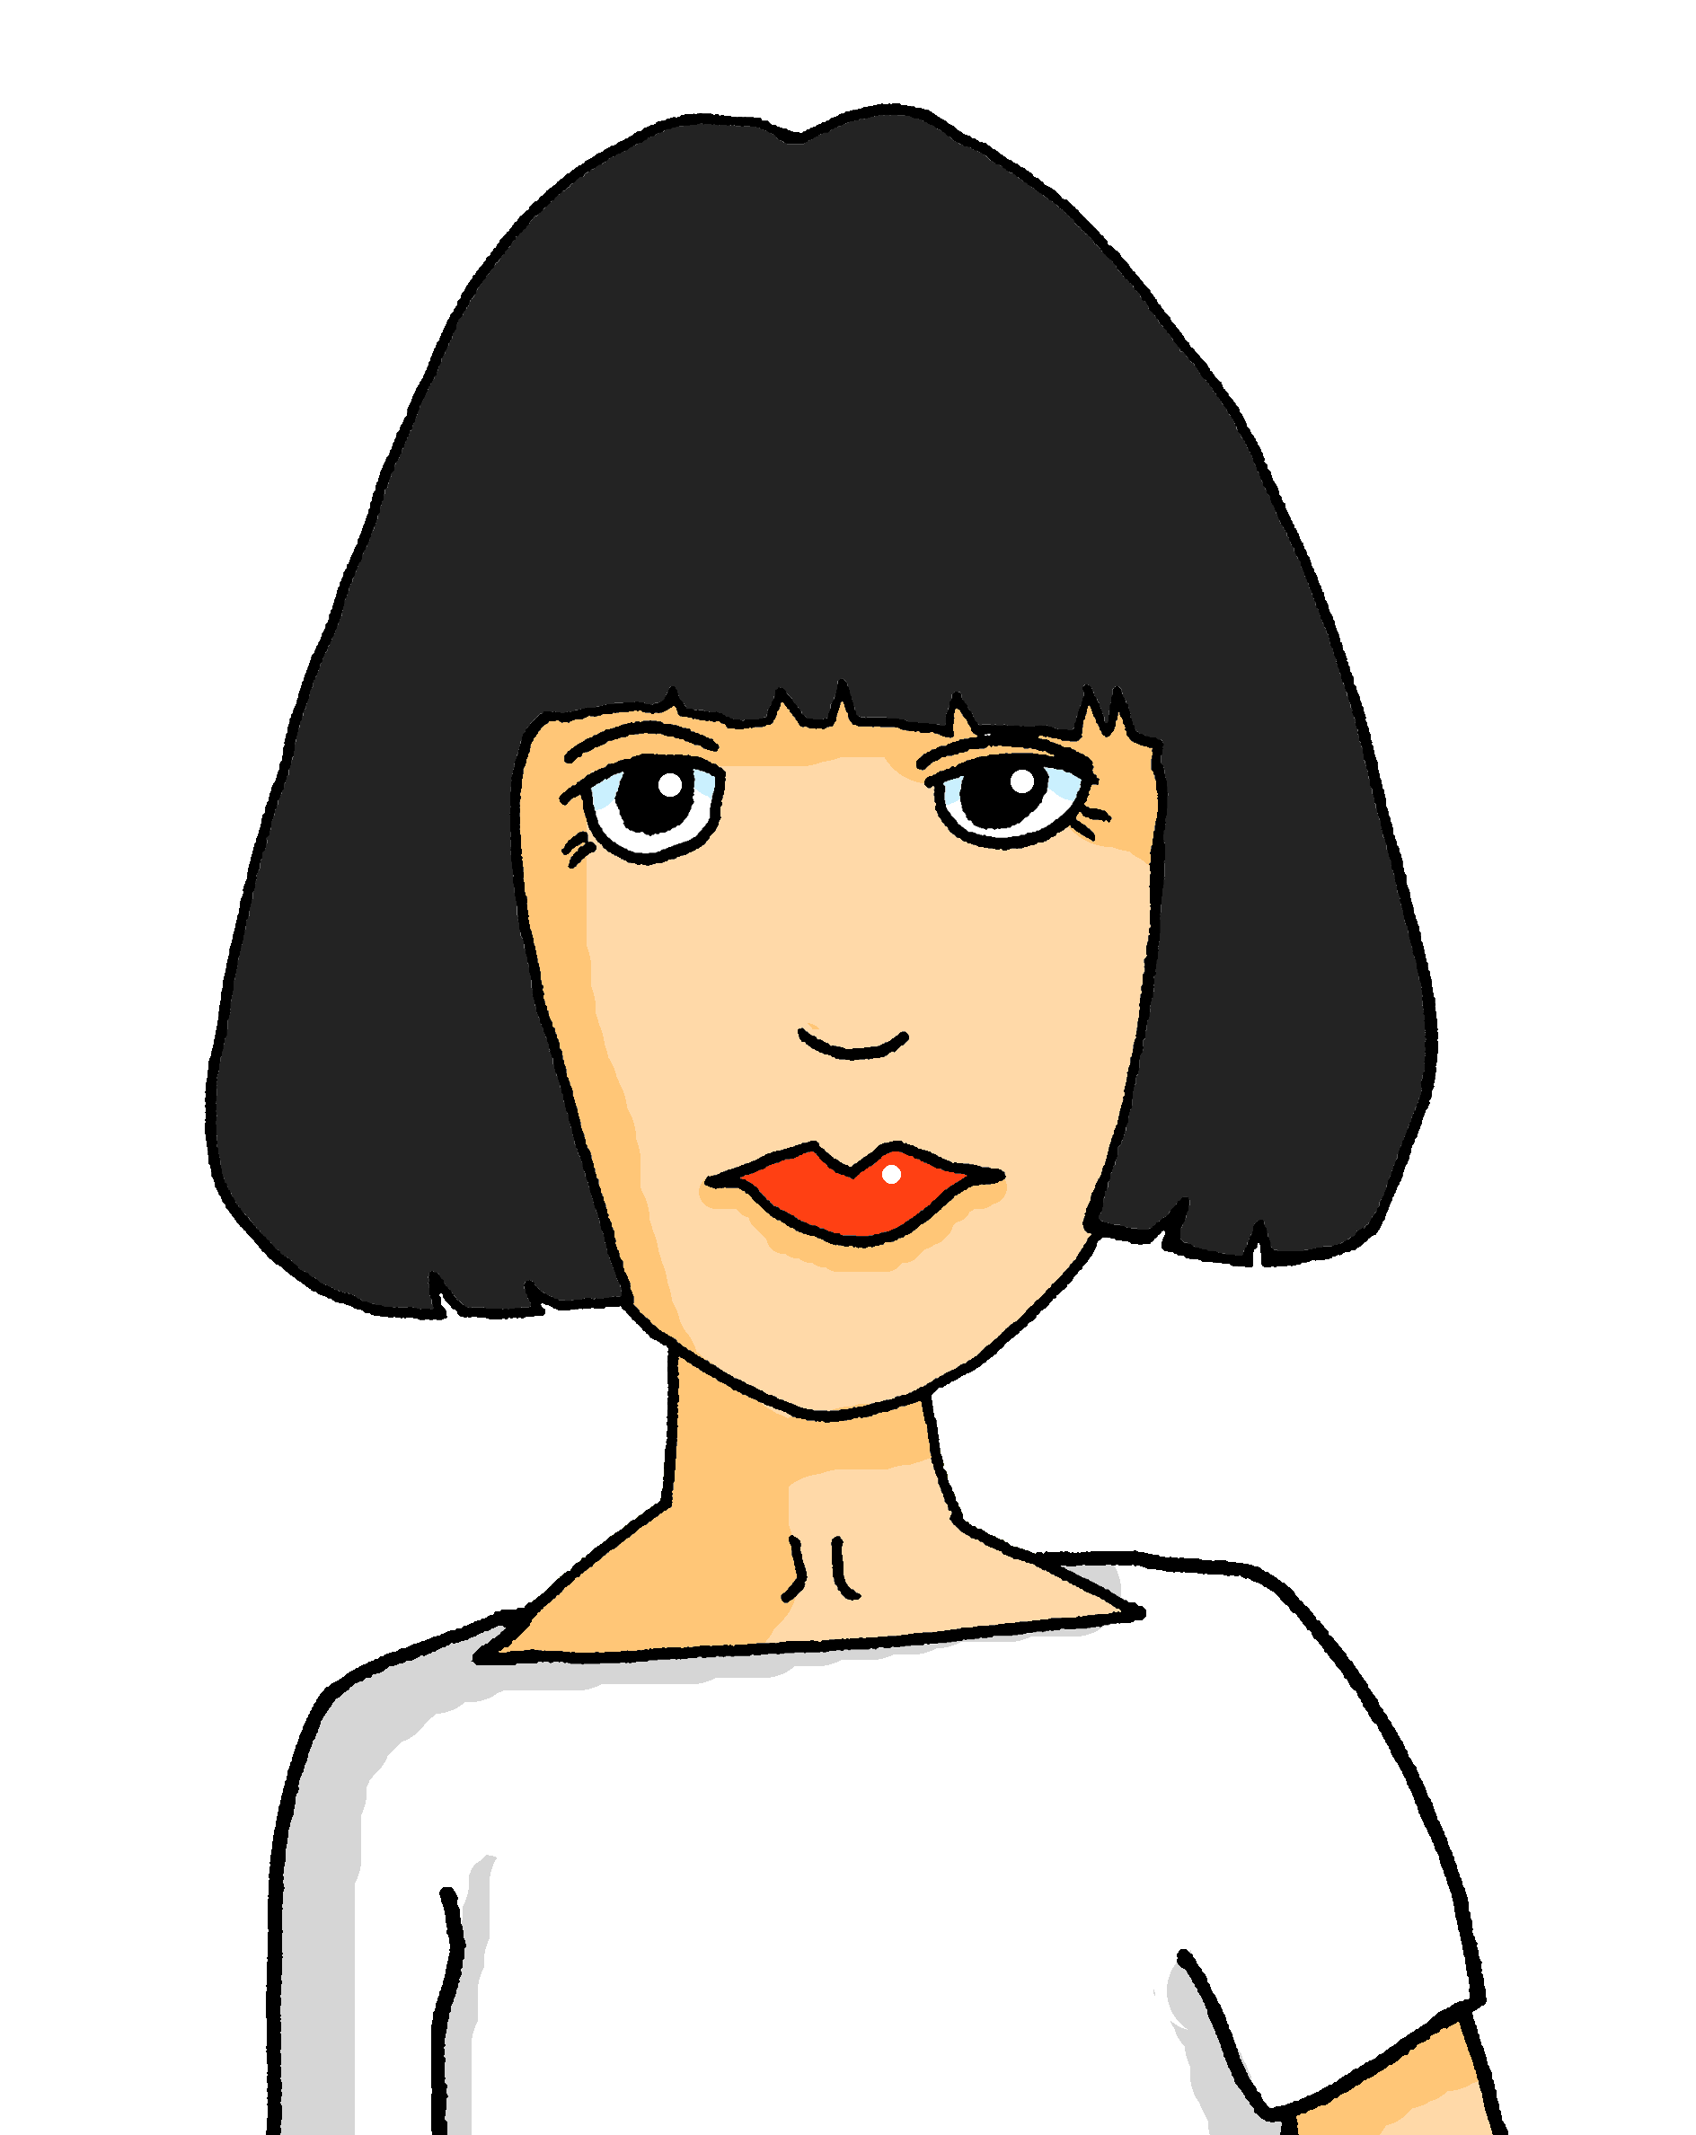
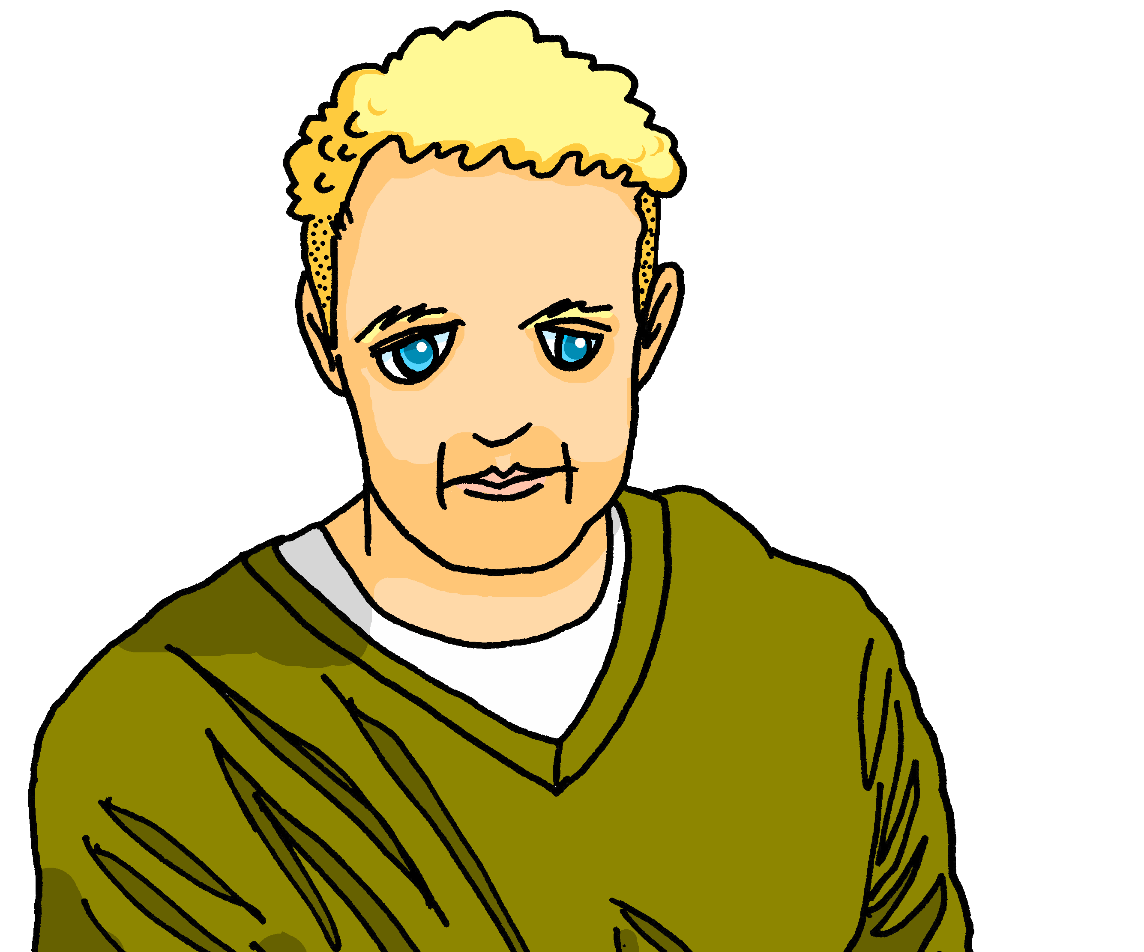
Prononce et vérifie.* Qui parle à qui ?
*vérifier – to check
prononcer
Ils sont mes parents.
They are my parents.
1
Notes:
[1/10]
Timing: 8 minutes (10 slides)
Aim: to practise pronunciation with mon/ton, mes/tes (+ liaison) and to practise comprehension of previously taught language.
Procedure:
Click to bring up the sentence.
Pupils read the sentence aloud, chorally.
Click to listen and check.
Repeat pronunciation, as needed.
Elicit the English meaning of the sentence.
Click to reveal the translation.
Repeat steps 1-6 for the remaining 9 slides.
Note: An additional step is for pupils to work out who is talking to whom? (Adèle is talking to Jean-Michel) – this first sentence makes it clear it is Adèle or Pierre, but we need more sentences to work out which of them it is.)
Transcript:
Ils sont mes parents.

Slide 8

Prononce et vérifie.* Qui parle à qui ?
*vérifier – to check
prononcer
C’est ta tortue.
This is your tortoise.
2
Notes:
[2/10]
Transcript:
C’est ta tortue.

Slide 9


Prononce et vérifie.* Qui parle à qui ?
*vérifier – to check
prononcer
C’est ton animal.
C’est ton animal.
This is your pet.
3
Notes:
[3/10]
Transcript:
C’est ton animal.

Slide 10
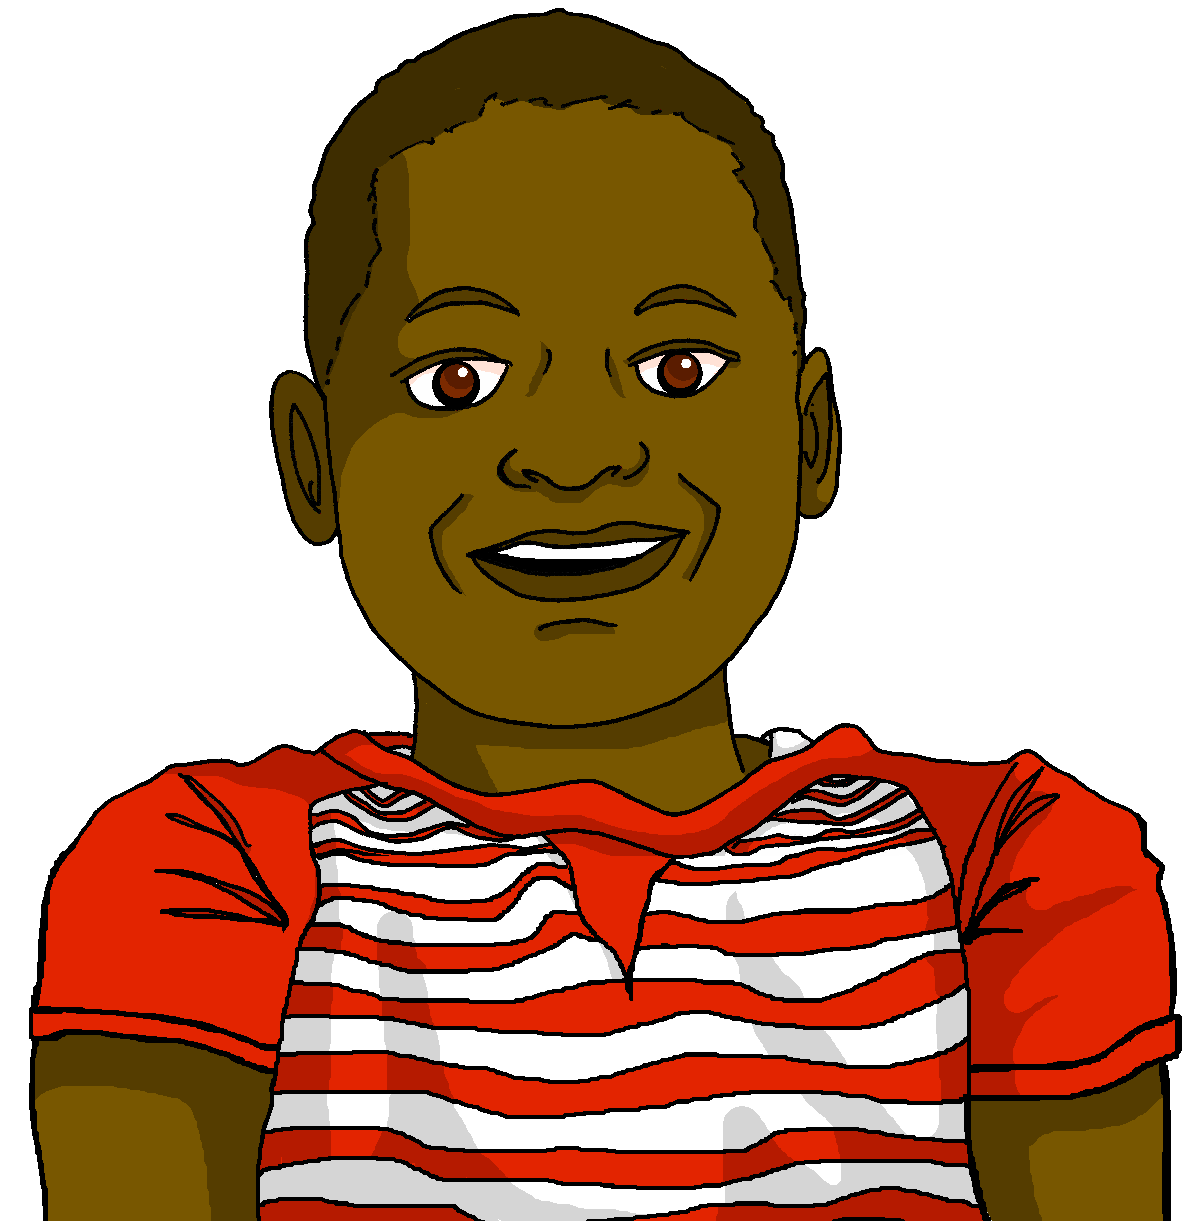
Prononce et vérifie.* Qui parle à qui ?
*vérifier – to check
prononcer
Tu es mon cousin.
You are my (male) cousin.
4
Notes:
[4/10]
Transcript:
Tu es mon cousin.

Slide 11
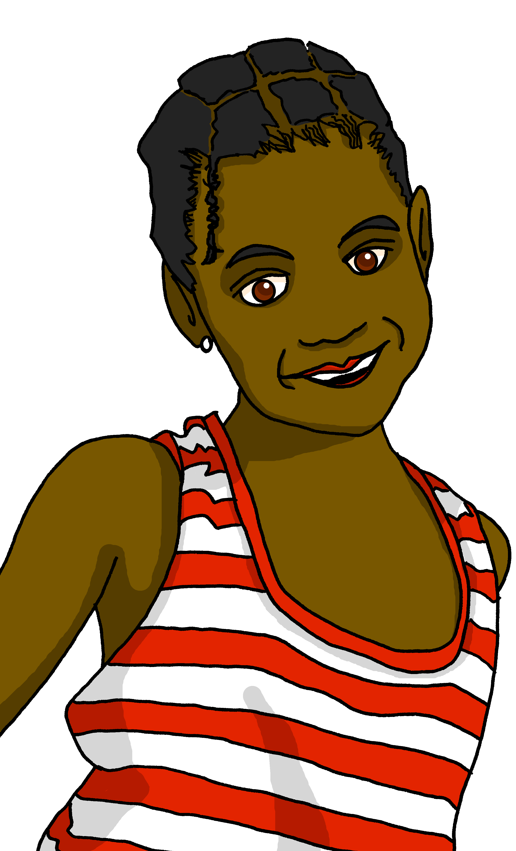
Prononce et vérifie.* Qui parle à qui ?
*vérifier – to check
prononcer
Elle est ta sœur.
She is your sister.
5
Notes:
[5/10]
Transcript:
Elle est ta sœur.

Slide 12
Prononce et vérifie.* Qui parle à qui ?
*vérifier – to check
prononcer
C’est ton équipe de foot.
C’est ton équipe de foot.
This is your football team.
6
Notes:
[6/10]
Transcript:
C’est ton équipe de foot.

Slide 13
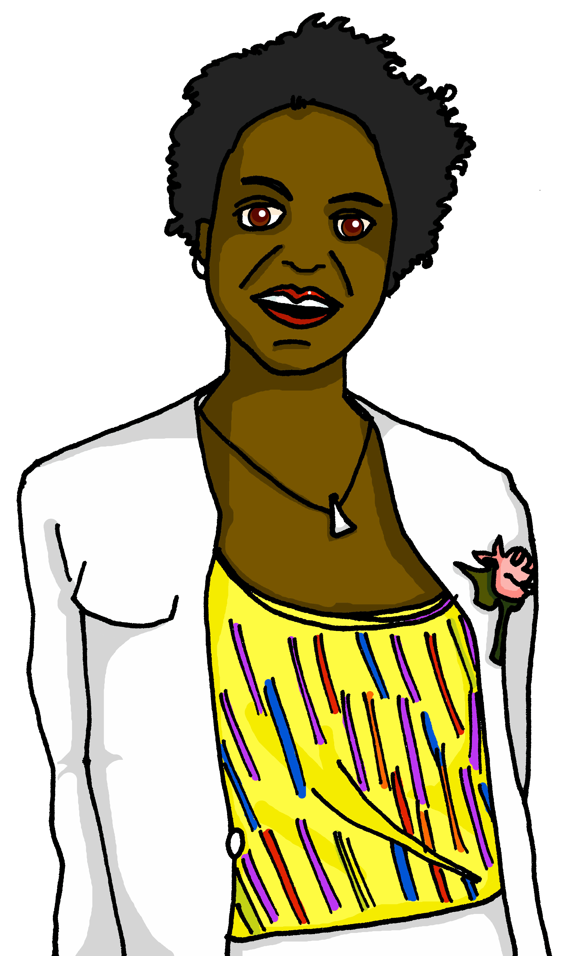
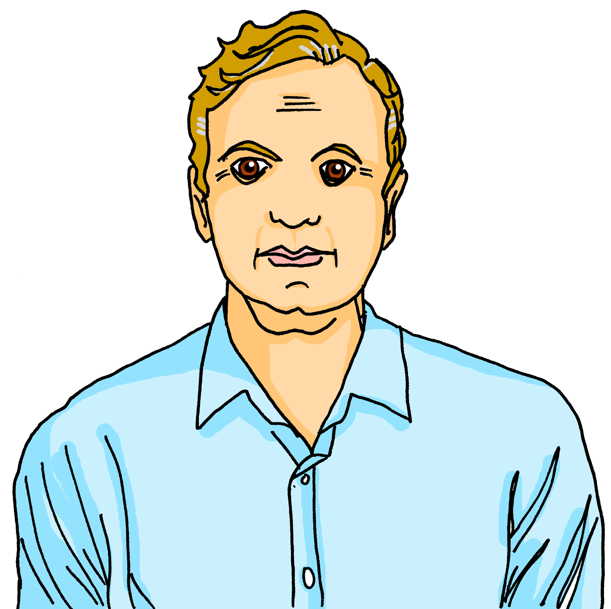
Prononce et vérifie.* Qui parle à qui ?
*vérifier – to check
prononcer
Ils sont tes parents.
They are your parents.
7
Notes:
[7/10]
Transcript:
Ils sont tes parents.

Slide 14
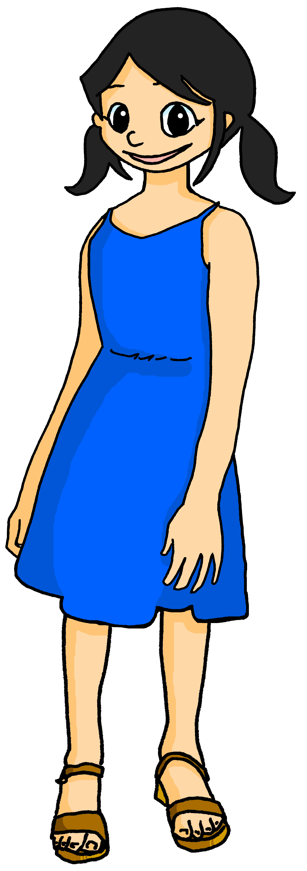
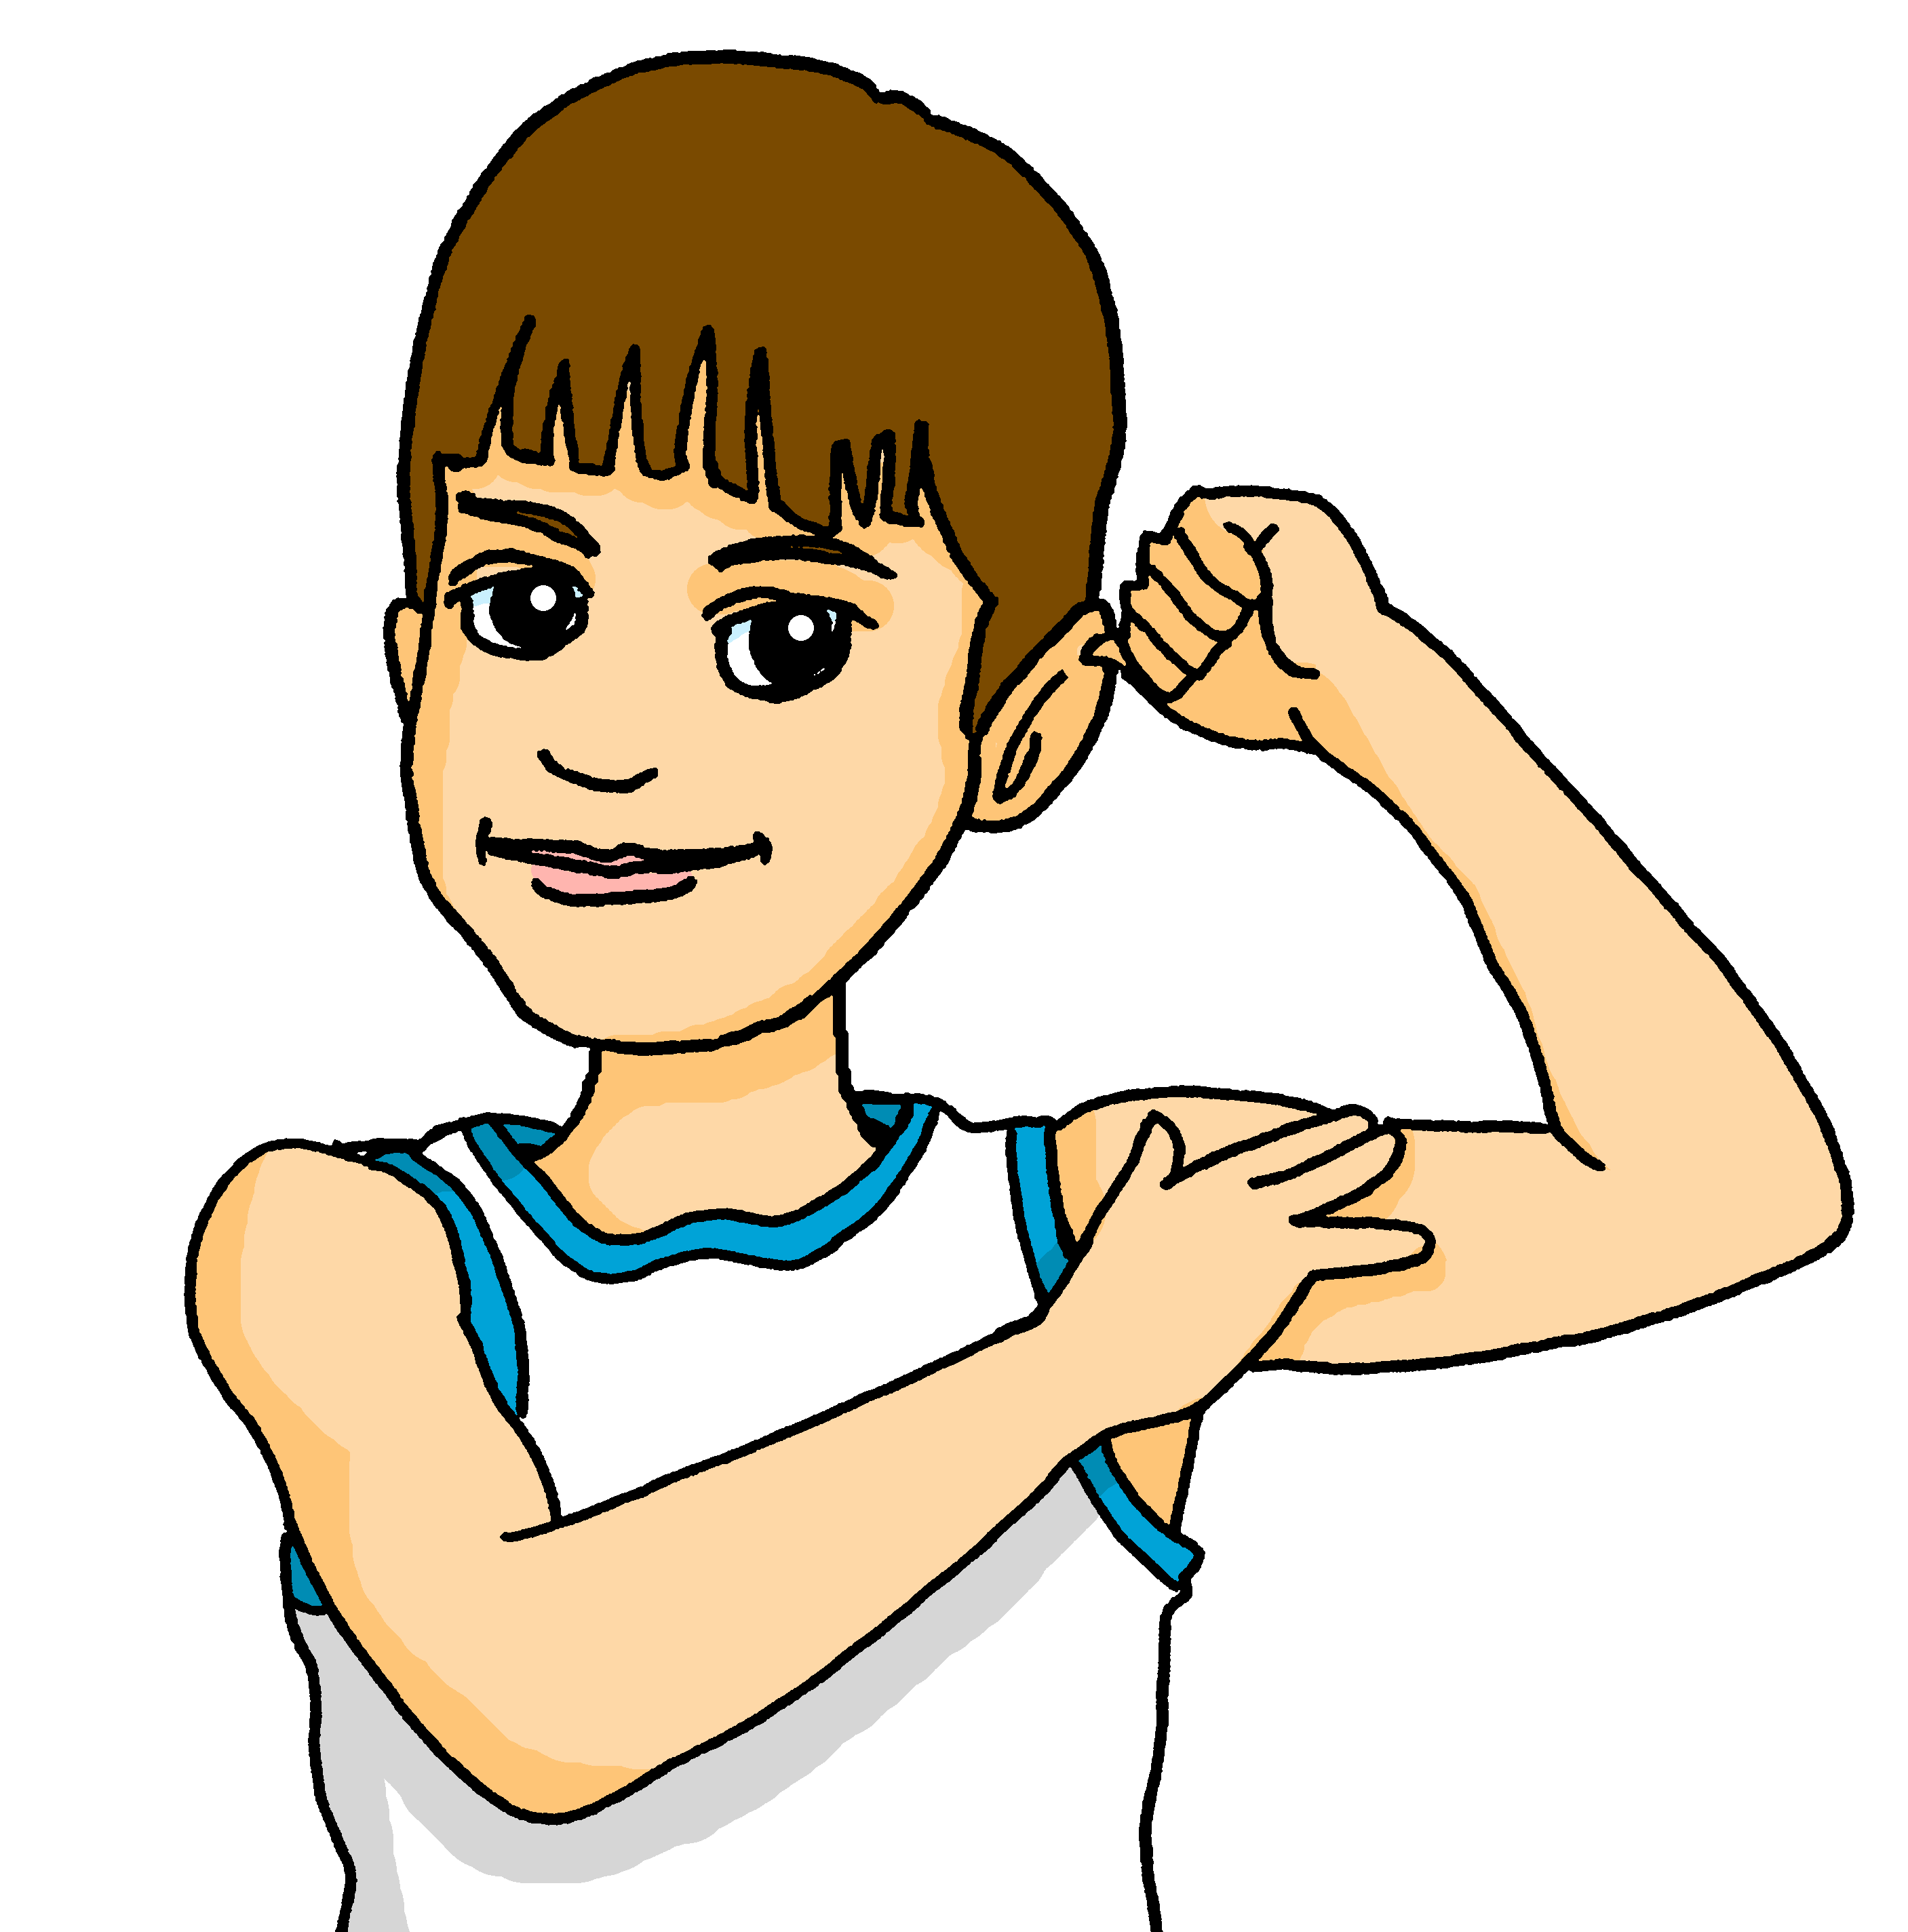
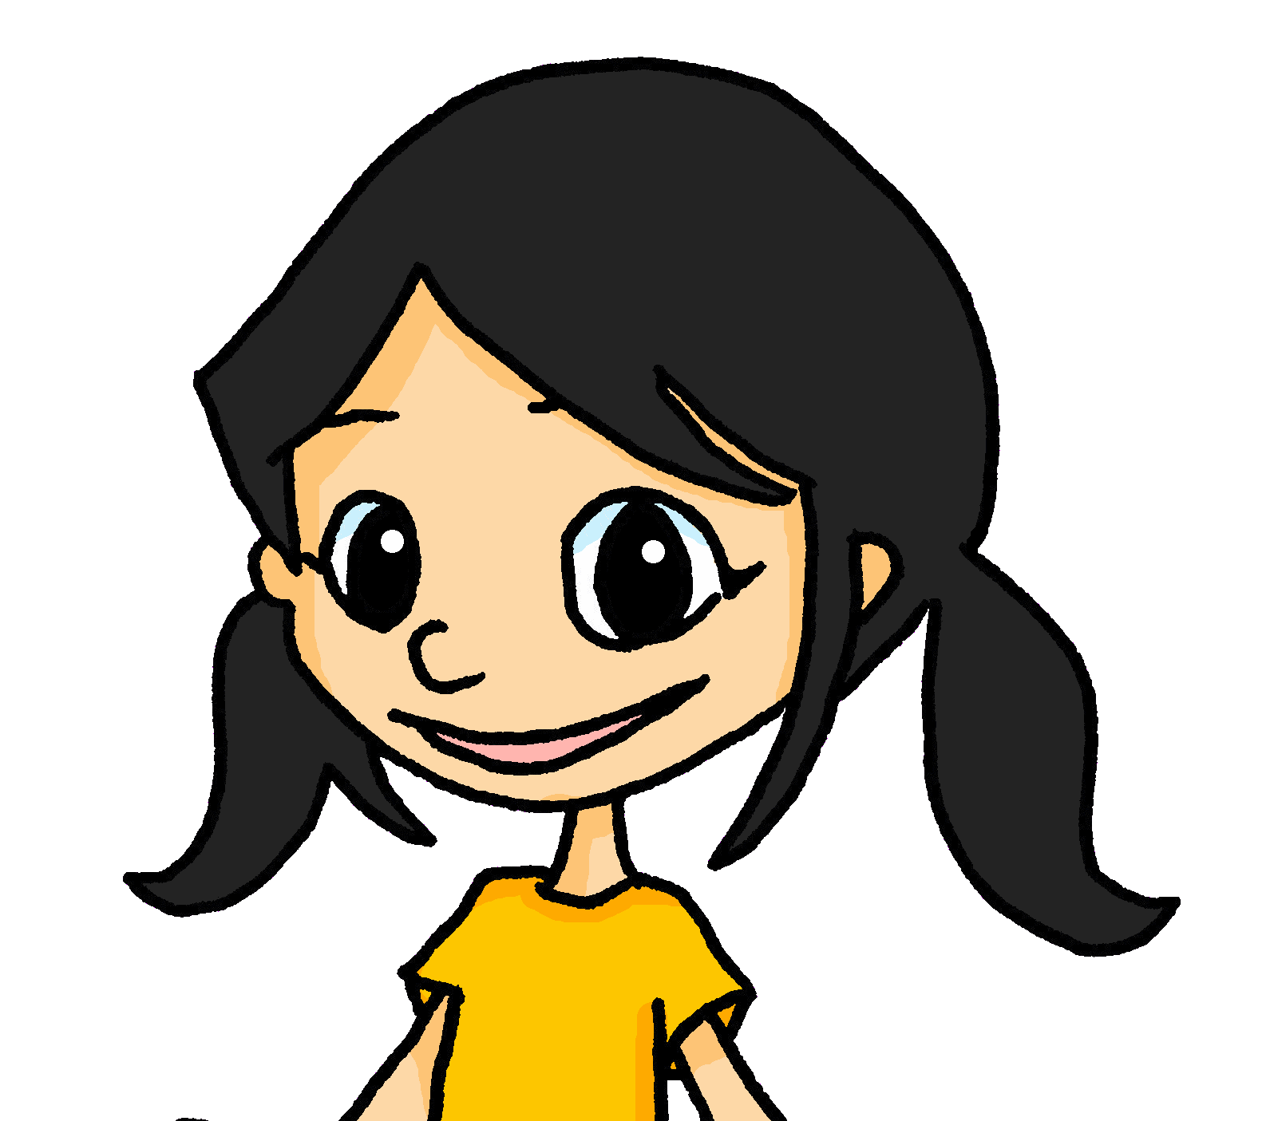
Prononce et vérifie.* Qui parle à qui ?
*vérifier – to check
prononcer
Ils sont mes amis.
Ils sont mes amis.
They are my friends.
8
Notes:
[8/10]
Transcript:
Ils sont mes amis.

Slide 15
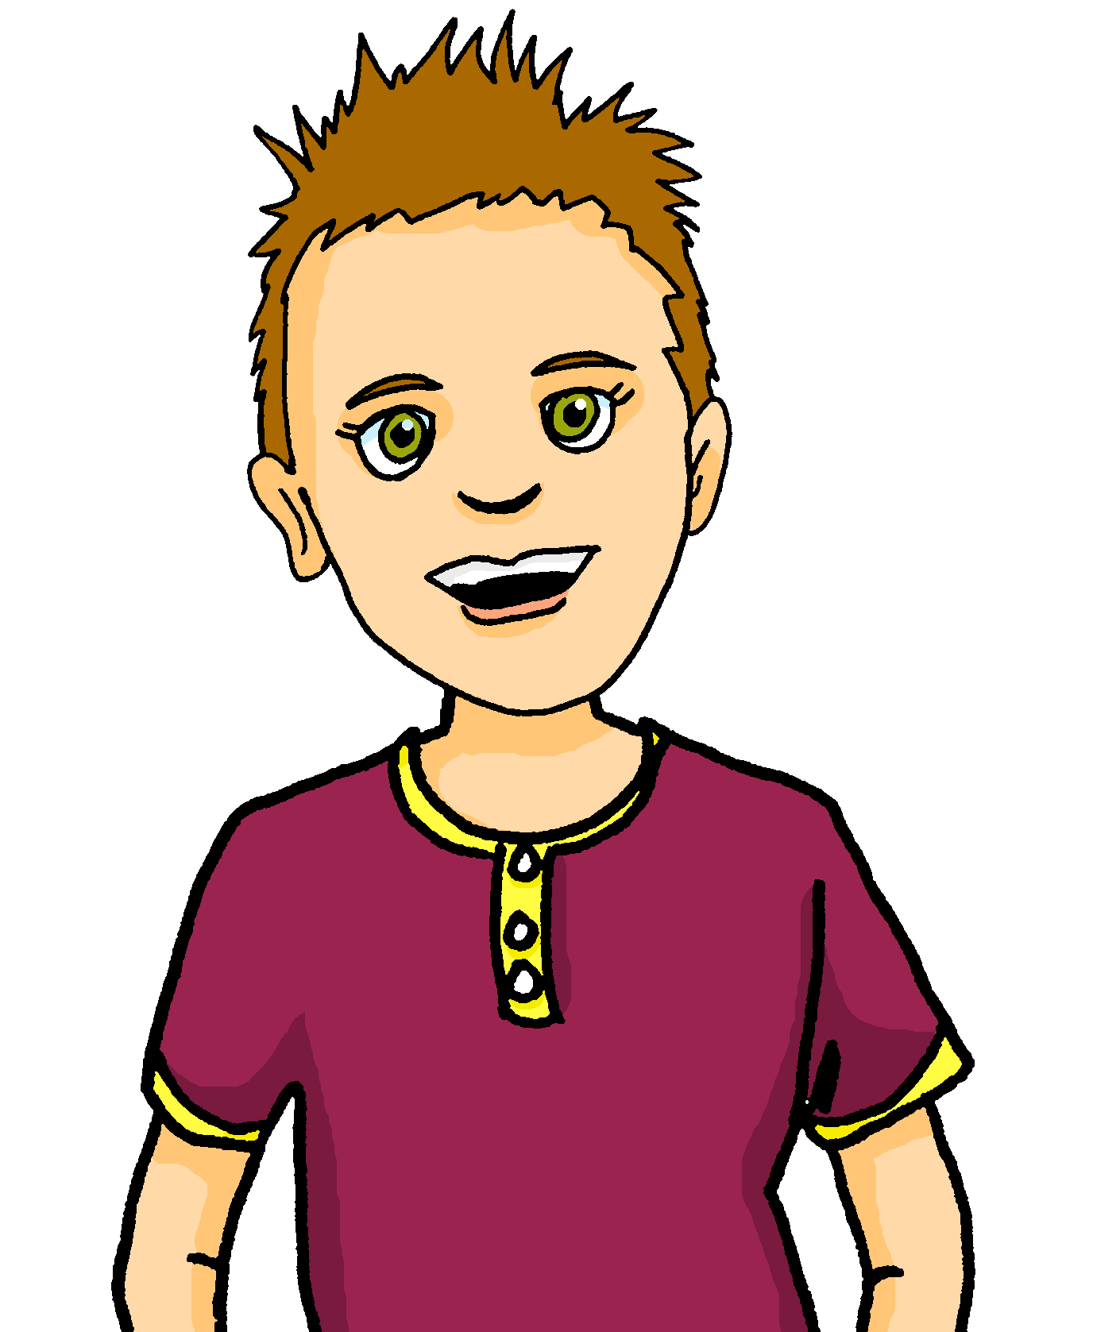
Prononce et vérifie.* Qui parle à qui ?
*vérifier – to check
prononcer
Il est mon frère.
He is my brother.
9
Notes:
[9/10]
Transcript:
Il est mon frère.

Slide 16
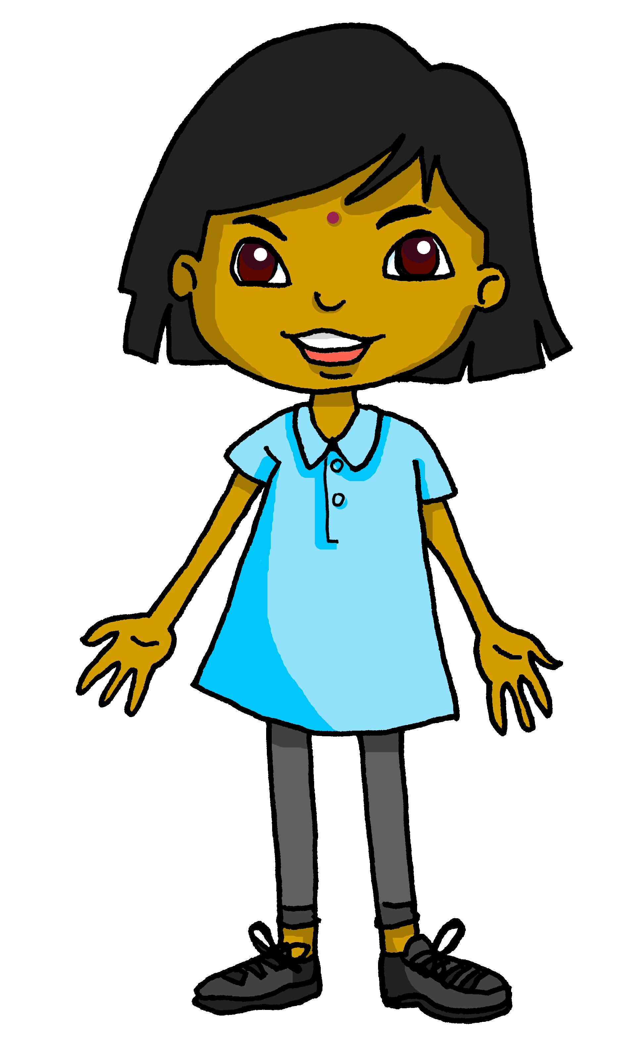
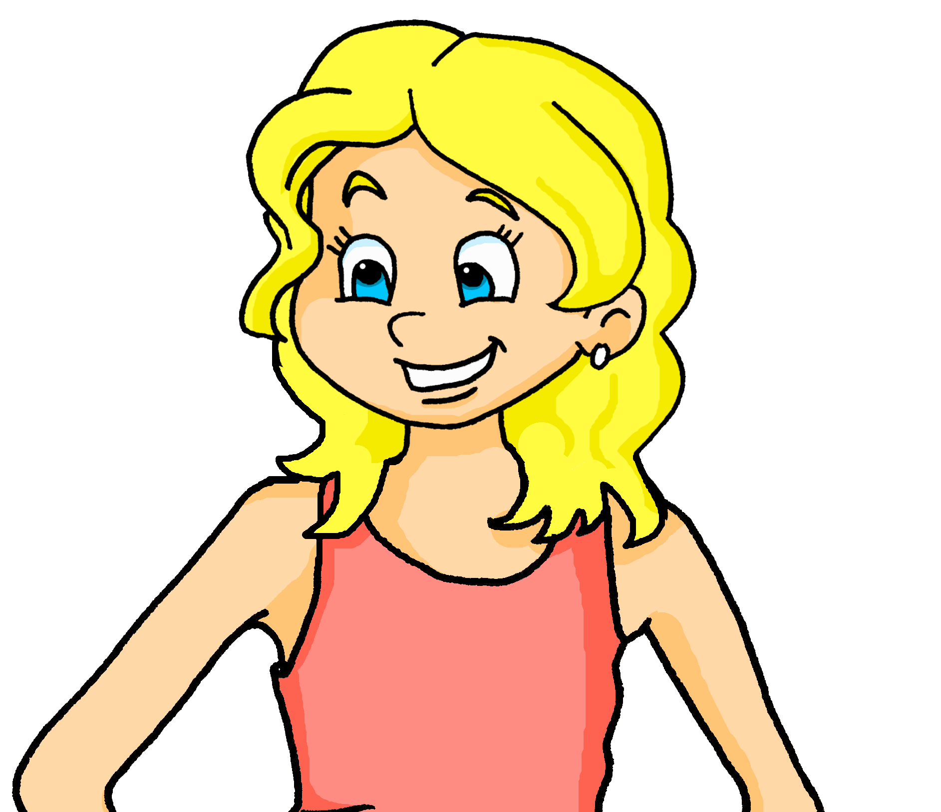
Prononce et vérifie.* Qui parle à qui ?
*vérifier – to check
prononcer
Elle est mon amie anglaise.
Elle est mon amie anglaise.
She is my English (female) friend.
Qui parle à qui ?
Adèle parle à Jean-Michel.
10
Notes:
[10/10]
Transcript:
Elle est mon amie anglaise.

Slide 17
écouter
Écoute. Clémentine parle à Adèle. Écris le mot correct.
⚠ Attention ! The final word is missing. Listen to what goes before to work out who Clémentine is talking about.
Clémentine
Adèle
1 | amie | amis
2 | parents | père
3 | mère | frère
4 | soeur | amie
1 | parents | mère
2 | parents | équipe
3 | mère | amie
4 | père | mère
1
1
5
5
2
2
6
6
3
3
7
7
4
4
8
8
Notes:
Timing: 5 minutes
Aim: To practise aural comprehension of mon/ma/mes and ton/ta/tes, including before vowels and plural nouns.
Procedure:
Students write 1-8 and write the noun that matches each possessive adjective.
Click the number to play the audio.
Answers and the full audio (including the noun) are provided with the 2nd set of audio buttons.
Transcript:
Je joue au foot avec mes [amis].
Je fais la cuisine avec mon [père].
Je fais une liste pour ma [mère].
Je joue à la corde avec mon [amie, frère].
Tu fais un effort à la maison pour tes [parents].
Tu joues au foot avec ton [équipe].
Tu fais un gâteau pour ton [amie].
Tu ne joues pas à la pétanque avec ta [mère].
17

Slide 18

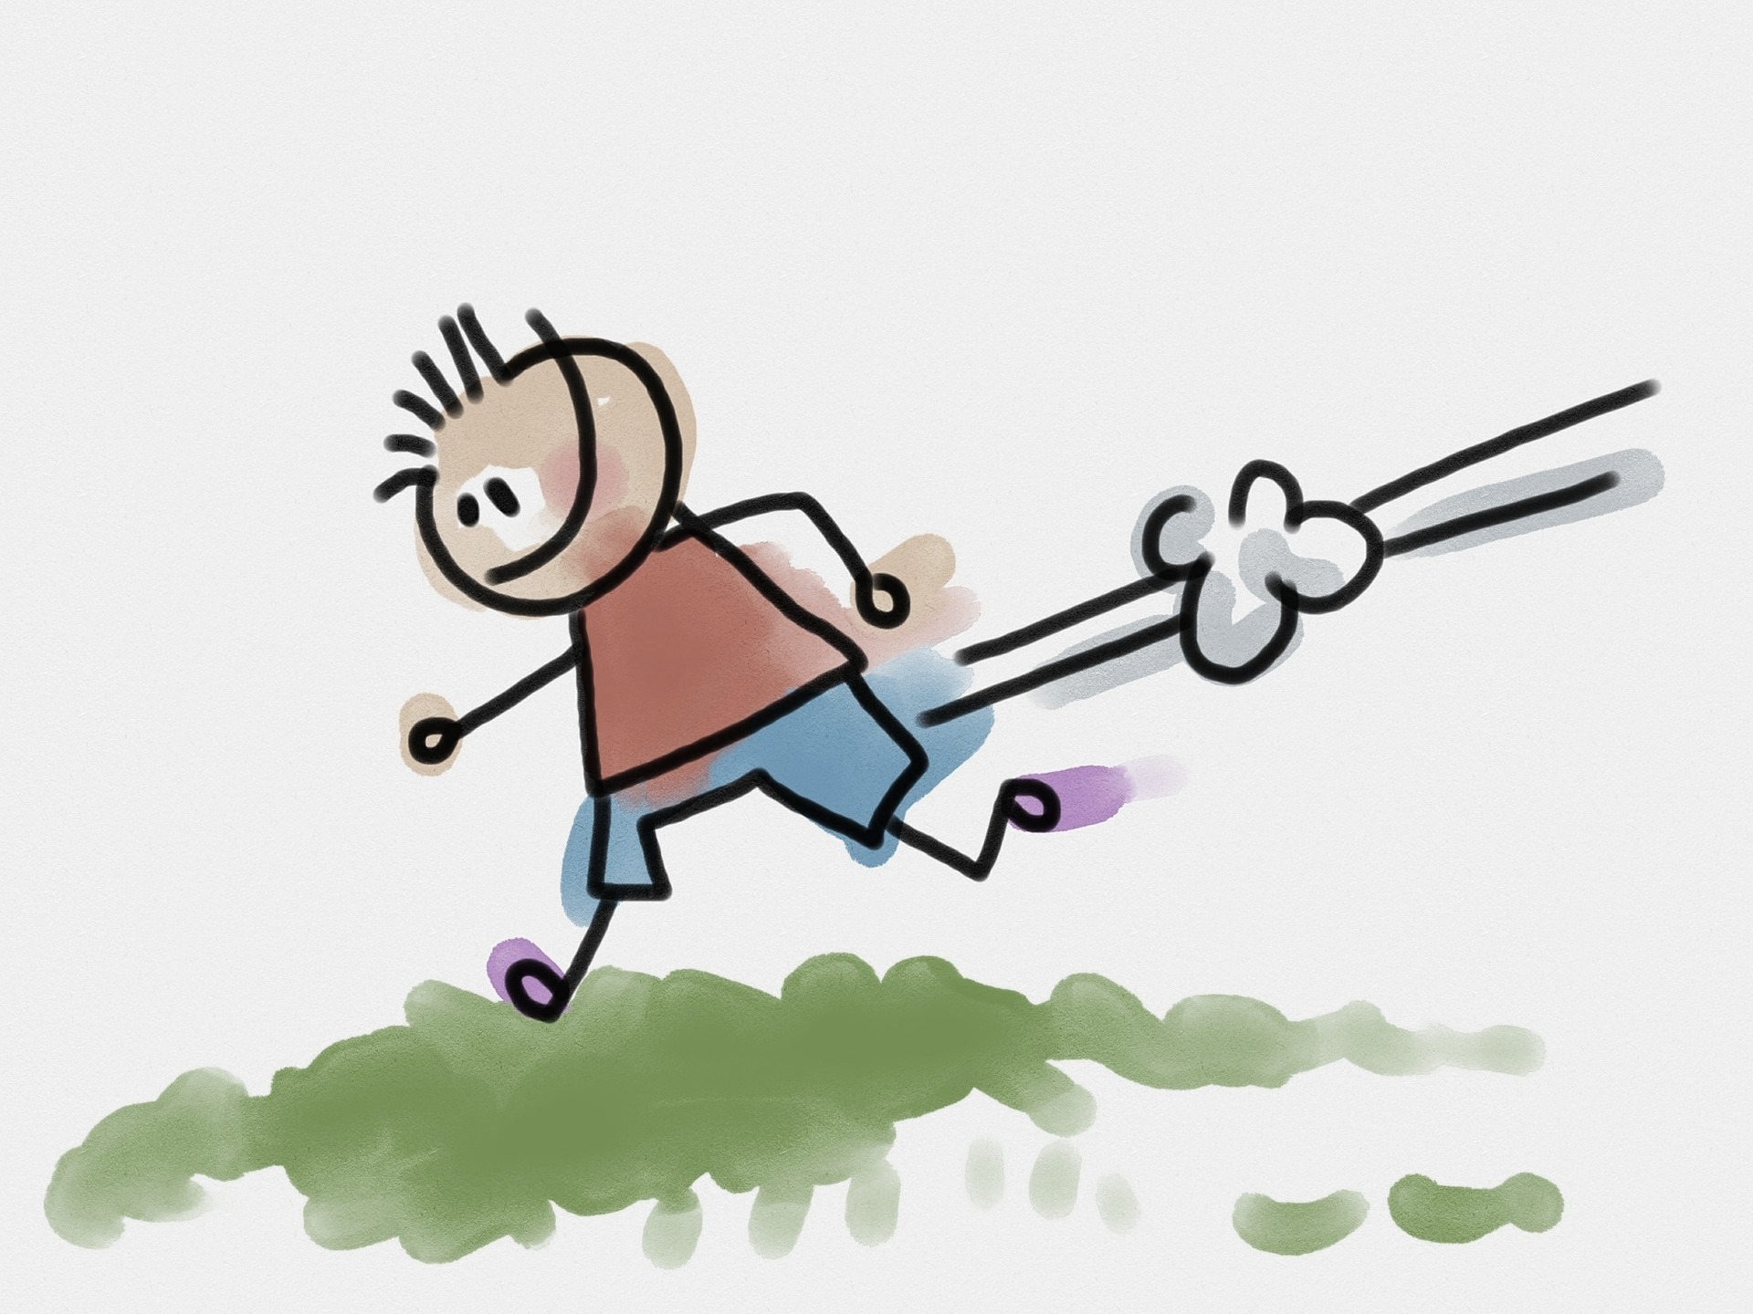
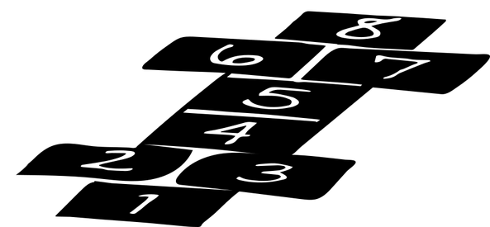
prononcer
Follow up 1: Les sports à Haïti
Lis le texte.
*peu de – few
Peu de* Haïtiens ont accès au tennis, au golf ou aux terrains de foot.
Alors, les enfants jouent souvent au foot dans la rue avec deux équipes de cinq joueurs. C’est très populaire entre les garçons et les filles.
Ils aiment aussi jouer à la marelle et au jeu de chat.
la marelle
le jeu de chat
Notes:
Timing: 5 minutes
Aim: to introduce some cultural information about Haitian children’s sporting opportunities and favourite pastimes.
Procedure:
Click on each text to hear it.
Elicit translations of each sentence.
Ask pupils what they think about this.
Info source: https://www.petitfute.com/p43-haiti/guide-touristique/c13007-jeux-loisirs-et-sports.html#:~:text=Le%20football%20ou%20le%20soccer,des%20%C3%A9quipes%20f%C3%A9minines%20que%20masculines.
18

Slide 19
Au revoir !
bleu
Notes:
19

