Slide 1
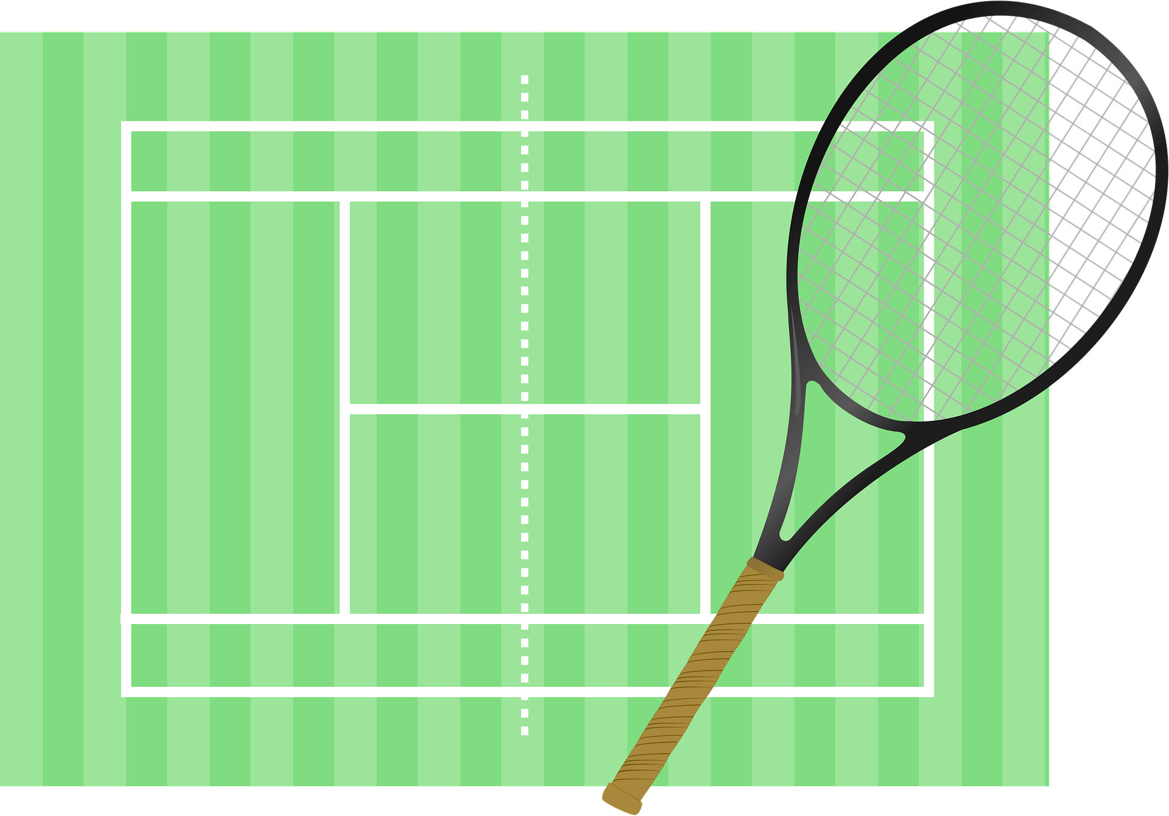
Saying what I and others do
bleu
Follow ups 1-5
Notes:
Artwork by Steve Clarke. Pronoun pictures from NCELP (www.ncelp.org). All additional pictures selected from Pixabay and are available under a Creative Commons license, no
attribution required.
Phonics: Revisit SSC [-s-] maison [325] chose [125] magasin [1736] église [1782] cuisine [2618]
Vocabulary (new words in bold): équipe [814] parent [546] mes [60] tes [330]
Revisit 1: tu fais [25] effort [388] voyage [904] carte [955] gâteau [4845] liste [924]
Revisit 2: étudier [960] partager [527] parfois [410]
Londsale, D., & Le Bras, Y. (2009). A Frequency Dictionary of French: Core vocabulary for learners London: Routledge.
The frequency rankings for words that occur in this PowerPoint which have been previously introduced in these resources are given in the SOW and in the resources that first
introduced and formally re-visited those words.
For any other words that occur incidentally in this PowerPoint, frequency rankings will be provided in the notes field wherever possible.

Slide 2
[-s-]
prononcer
maison
Notes:
Timing: 1 minute
Aim: To introduce SSC [-s-]
Procedure: 1. Present the letter(s) and say the [-s-] sound first, on its own. Students repeat it with you. 2. Bring up the word ”maison” on its own, say it, students repeat it, so that they have the opportunity to focus all of their attention on the connection between the written word and its sound.
3. A possible gesture for this would be to trace the outline of a house in the air with two fingers (see BSL video, link below). 4. Roll back the animations and work through 1-3 again, but this time, dropping your voice completely to listen carefully to the students saying the [-s- between vowels] sound, pronouncing ”maison” and, if using, doing the gesture.
Gesture: https://www.signbsl.com/sign/house
British Sign language for house traces the outline of a house in the air with two fingers, starting together at the top and drawing outwards and downwards.
Word frequency (1 is the most frequent word in French):
maison [325]
Source: Londsale, D., & Le Bras, Y. (2009). A Frequency Dictionary of French: Core vocabulary for learners London: Routledge.
2

Slide 3
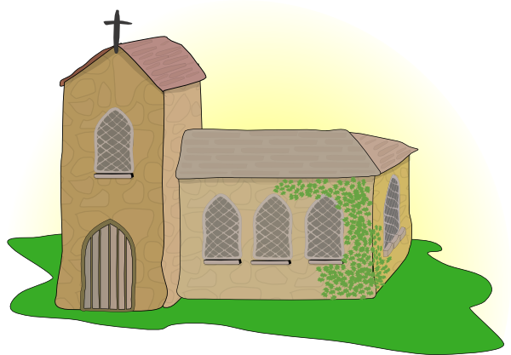
[-s-]
prononcer
magasin
église
maison
[thing]
chose
cuisine
Notes:
Timing: 2 minutes
Aim: To introduce SSC [-s-]
Procedure:
Introduce and elicit the pronunciation of the individual SSC [-s-] and then the source word again ‘maison’ (with gesture, if using). Then present and elicit the pronunciation of the five cluster words. The cluster words have been chosen for their high-frequency, from a range of word classes, with the SSC (where possible) positioned within a variety of syllables within the words (e.g. initial, 2nd, final etc.). Additionally, we have tried to use words that build cumulatively on previously taught SSCs (see the Phonics Teaching Sequence document) and do not include new SSCs. Where new SSCs are used, they are often consonants which have a similar symbol-sound correspondence in English.
Word frequency: maison [325] chose [125] magasin [1736] église [1782] cuisine [2618] Source: Londsale, D., & Le Bras, Y. (2009). A Frequency Dictionary of French: Core vocabulary for learners London: Routledge.
3

Slide 4
prononcer
Follow up 1: Hard or soft [-s-]?
We know that hard s in French sounds like ‘z’.
The French s is hard when it is between two vowels, including in a liaison.
Exemple:
mes amis
The French s is soft when:
Exemples:
la soupe
it is at the beginning of a word or syllable
it is before or after a consonant
there is a double [s]
insister
poisson
Notes:
Timing: 2 minutes
Aim: to recap spelling rules governing SSC [-s-]
Procedure: 1. Click to present the information.
2. Check understanding.
4

Slide 5
prononcer
Follow up 1
Prononce les mots. C’est différent de l’anglais ?
excuse
session
assister
phrase
princesse
musique
résister
progression
case
télévision
base
solution
Notes:
Timing: 5 minutes
Aim: to practise oral production of [-s-] in cognates. Pupils need to apply the rules and then work out which words have a different [-s-] sound from English.
Procedure:
Ensure that pupils know these are all French words that are similar to English words, but may not sound the same.
Pupils pronounce all the words and work out with a partner which words have a different [-s-] sound in English.
Elicit pupils’ suggestions, then click to highlight the 5 words that have a different [-s-] sound. Note that in English ‘excuse (verb’ has the same sound as in French but excuse (noun) does not.
4. Click on each word to hear the audio, if desired.
5

Slide 6
Follow up 2
Écoute bien. Qui parle ?
la famille Kergosien
1
2
3
écouter
4
5
6
7
A n n i c k
J a c q u e s
M y l è n e
H e r v é
C l a u d i n e
C l é m e n t i n e
J e a n – M i c h e l
A d è l e
P i e r r e
L u l u
É l o i
C h o u c h o u
M é d o r
Notes:
Timing: 5 minutes
Aim: to practise aural comprehension of full sentences with familiar language.
Procedure:
Teacher clarifies pupils need to work out who is speaking by listening to 7 sentences.
Pupils can be encouraged to make notes in English to help them.
Alternatively, the teacher can provide more support by eliciting the English sentence meanings one by one.
When pupils have suggested their answer, click to reveal.
Answer: Clémentine
Transcript:
Pierre, tu es mon cousin.
Médor est ton chien. Annick et Jacques sont mes parents.
Adèle est ta sœur. Lulu est ma tortue. Hervé et Claudine sont tes parents. Jean-Michel est mon frère.

Slide 7
quel | quelle
To ask ‘which’ with a masculine noun, use ‘quel’:
Tu joues quel sport ?
Which sport do you play?
Je joue au foot avec mon équipe.
I play football with my team.
With a feminine noun, use ‘quelle’ to mean ‘which’:
Tu fais quelle activité ?
Which activity do you do?
Je fais les courses avec mes parents.
I go shopping with my parents.
Notes:
DO THIS BEFORE FOLLOW UP 3
Timing: 2 minutes
Aim: to recap quel/quelle
Procedure:
Click through the animations.
Elicit English from pupils following the ?.

Slide 8
Follow up 3
Écoute. La question, c’est quoi ?
Tu joues quel… ? | Tu fais quelle… ? | en anglais
 |  | I play skipping with my friend (f).
 |  | I play tennis with my sister.
 |  | I go on a trip with my parents.
 |  | I make a card for your birthday.
 |  | I play basketball with my friends.
 |  | I make an effort at school for my teachers.
 |  | I make a cake for my cousin (f).
 |  | I play football with my team.
écouter
1
2
3
4
5
6
7
8
Notes:
Timing: 5 minutes
Aim: to practise connecting questions with appropriate questions; to practise comprehension of previously taught language and structures.
Procedure:
Pupils listen to a set of answers and have to work out which question (Tu joues..) or (Tu fais…) was asked.
Then they listen again and try to write the meaning in English.
Click to correct part 1, then part 2.
Transcript:
1. Je joue à la corde avec mon amie. 2. Je joue au tennis avec ma sœur. 3. Je fais un voyage avec mes parents. 4. Je fais une carte pour ton anniversaire. 5. Je joue au basket avec mes amis. 6. Je fais un effort à l’école pour mes professeurs. 7. Je fais un gâteau pour ma cousine. 8. Je joue au foot avec mon équipe.

Slide 9
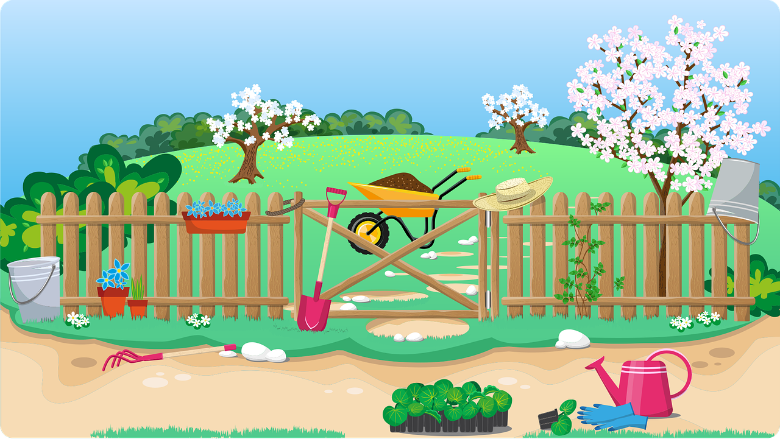
Follow up 4
Écris les phrase en français.
écrire
Tu fais un voyage avec ta famille.
⚠ Attention ! English has one word for my and one for your. French has three. Look at the noun that follows to work out if you need mon, ma, mes | ton, ta, tes.
1
go on (do)
with
your
2
Elle joue au foot avec mes amis !
plays
with
my
3
Il fait un gâteau avec ma mère.
makes
with
my
Tu joues à la corde avec tes amis.
4
play
with
your
5
Je joue avec mon chien dans le jardin.
play
with
my
in
the
6
Tu fais quelquechose avec ton animal ?
Do
do
something*
with
your
?
something – quelque chose
Notes:
Timing: 5-10 minutes
Aim: to practise written production of language and structures from this week.
Procedure:
Do the first item together with pupils.
Pupils complete 2-6.
Elicit answers orally, and click to confirm.

Slide 10
vocabulaire
Follow up 5a - Écris en anglais : Can you get at least 15 points?
mots
 | étudier | partager | parfois
 | le gâteau | le voyage | tu fais
 | le parent | l’effort | la carte
 | mes | l’équipe | tes
x3
to study, stuyding
to share, sharing
sometimes
(the) cake
(the) trip, journey
you do, are doing
x2
(the) parent
(the) effort
(the) card
x1
my (mfpl)
(the) team
your (mfpl)
Notes:
Timing: 5-10 minutes
Aim: to practise written production of vocabulary from this week and two revisited weeks.
Procedure: 1. Give pupils a blank grid. They fill in the English meanings of any of the words they know, trying to reach 15 points in total. 2. Remind pupils that adjectives can refer to male or female persons and they should note this in their translations. E.g. pleased (f), short (m).
Note: The most recently learnt and practised words are pink, words from revisit 1 are green and those from revisit 2 are blue, thus more points are awarded for them, to recognise that memories fade and more effort (heavy lifting!) is needed to retrieve them.
10

Slide 11
vocabulaire
Follow up 5b - Écris en français : Can you get at least 15 points?
mots
 | to study, studying | to share, sharing | sometimes
 | (the) card | (the) trip, journey | (the) cake
 | (the) team | you do, make | (the) effort
 | my (mfpl) | your (mfpl) | (the) parent
x3
étudier
partager
parfois
la carte
le voyage
le gâteau
x2
l’équipe
tu fais
l’effort
x1
mes
tes
le parent
Notes:
Timing: 5-10 minutes
Aim: to practise written comprehension of vocabulary from this week and previous weeks.
Procedure: Give pupils a blank grid. They fill in the French meanings of any of the words they know, trying to reach 15 points in total.
Note: The most recently learnt and practised words are pink, words from the previous week are green and those from earlier are blue, thus more points are awarded for them, to recognise that memories fade and more effort (heavy lifting!) is needed to retrieve them.
11

Slide 12
vocabulaire
Follow up 5a - Écris en anglais : Can you get at least 15 points?
mots
 | étudier | partager | parfois
 | le gâteau | le voyage | tu fais
 | le parent | l’effort | la carte
 | mes | l’équipe | tes
x3
x2
x1
Notes:
HANDOUT
12

Slide 13
vocabulaire
Follow up 5b - Écris en français : Can you get at least 15 points?
mots
 | to study, studying | to share, sharing | sometimes
 | (the) card | (the) trip, journey | (the) cake
 | (the) team | you do, make | (the) effort
 | my (mfpl) | your (mfpl) | (the) parent
x3
x2
x1
Notes:
HANDOUT
13

