Slide 1
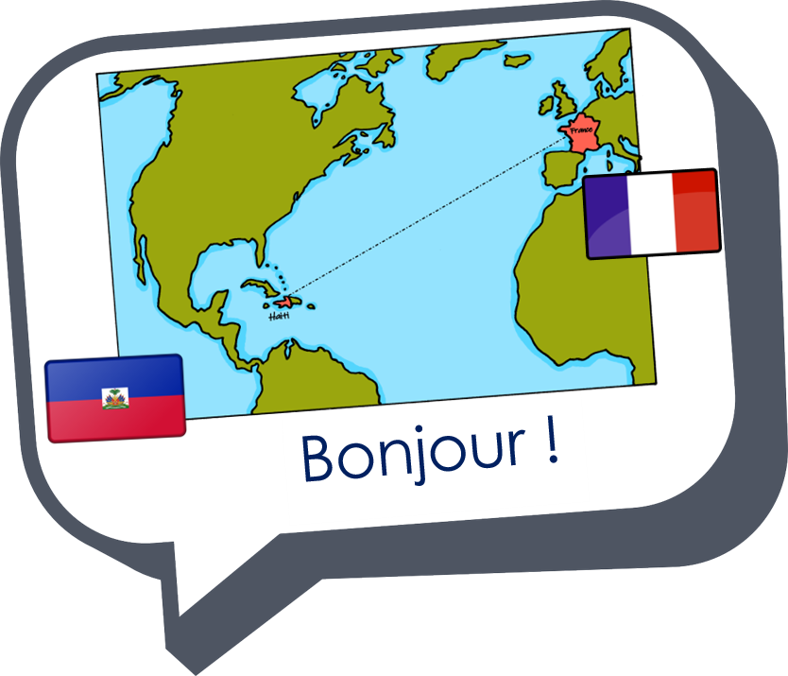
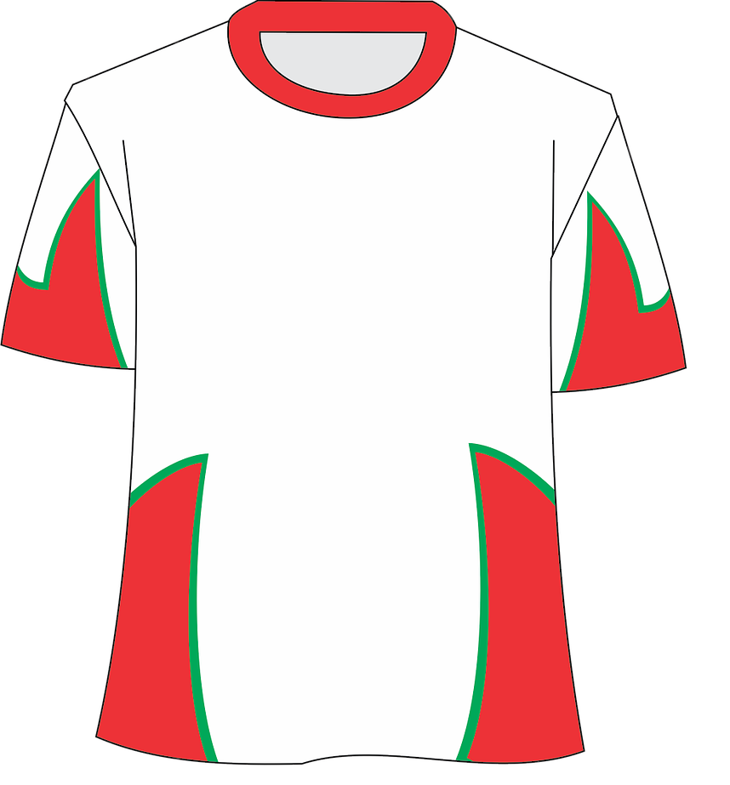

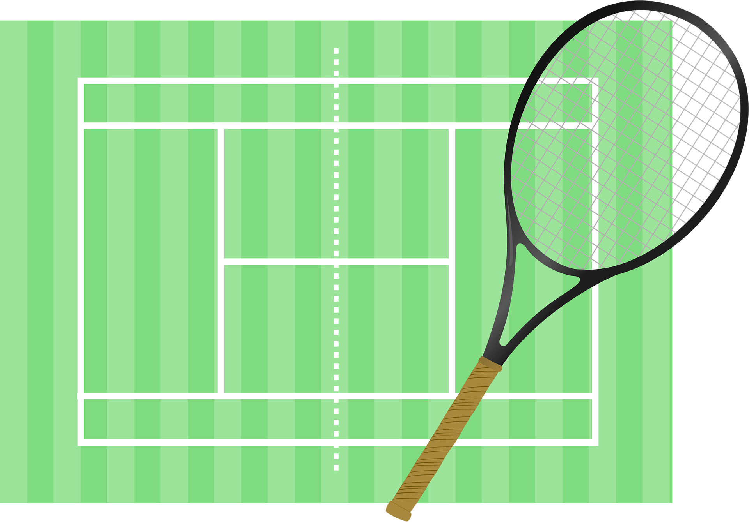
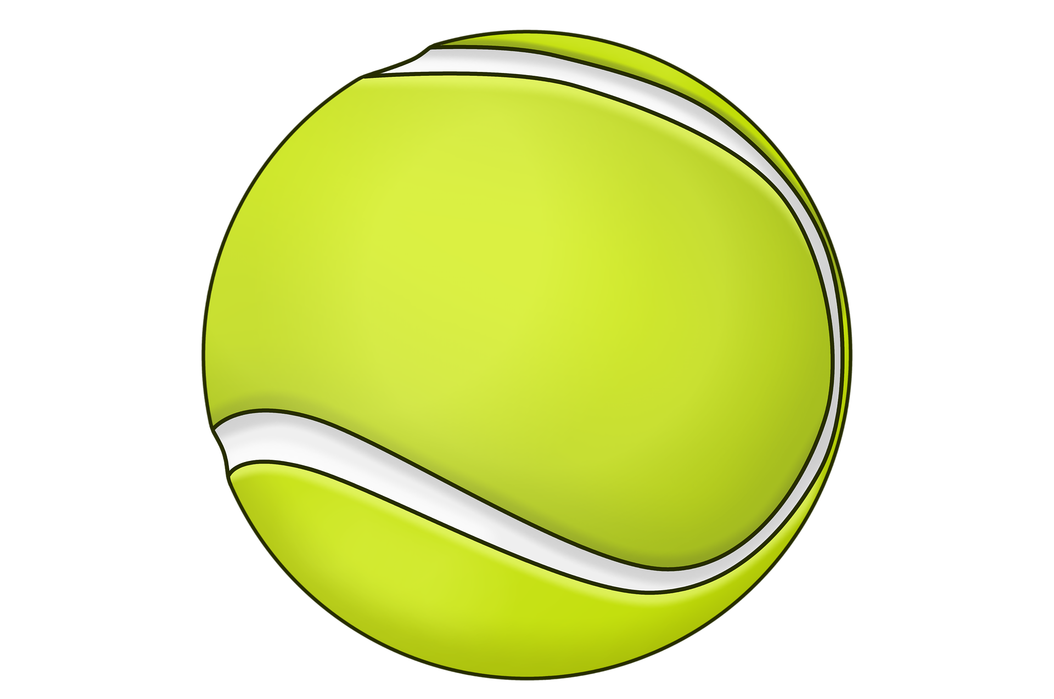
Saying what I and others do
bleu
jouer with sports
SSC [ien]
Notes:
Artwork by Steve Clarke. Pronoun pictures from NCELP (www.ncelp.org). All additional pictures selected from Pixabay and are available under a Creative Commons license, no
attribution required.
Phonics: Revisit SSC [-ien] ancien [392] bien [47] bientôt [1208] chien [1744] combien? [800]
Vocabulary (new words in bold): corde [3784] football [2602] fois [49] tennis [3687] quand [119]
Revisit 1: faire [25] je fais, il/elle fait activité [452] cuisine [2618] courses [1289] ménage [2326]
Revisit 2: corriger [1639] expliquer [252] fermer [757] demander [80] écouter [49] regarder [425] poser [218] aide [457] classe [778] devoirs [39] idée [239] question [144] phrase [2074] porte [696] professeur/professeure [110] réponse [456] solution [608]
Londsale, D., & Le Bras, Y. (2009). A Frequency Dictionary of French: Core vocabulary for learners London: Routledge.
The frequency rankings for words that occur in this PowerPoint which have been previously introduced in these resources are given in the SOW
and in the resources that first introduced and formally re-visited those words.
For any other words that occur incidentally in this PowerPoint, frequency rankings will be provided in the notes field wherever possible.
1

Slide 2


[ien]
prononcer
good, well
bien
Notes:
Timing: 1 minute
Aim: to recap SSC [ien]
Procedure:
1. Present the letter(s) and say the [ien] sound first, on its own. Students repeat it with you.
2. Bring up the word ”bien” on its own, say it, students repeat it, so that they have the opportunity to focus all of their attention on the connection between the written word and its sound.
3. A possible gesture for this would be to give a thumbs up sign.
4. Roll back the animations and work through 1-3 again, but this time, dropping your voice completely to listen carefully to the students saying the [ien] sound, pronouncing ”bien” and, if using, doing the gesture.
Word frequency (1 is the most frequent word in French):
bien [47]
Source: Londsale, D., & Le Bras, Y. (2009). A Frequency Dictionary of French: Core vocabulary for learners London: Routledge.
2

Slide 3
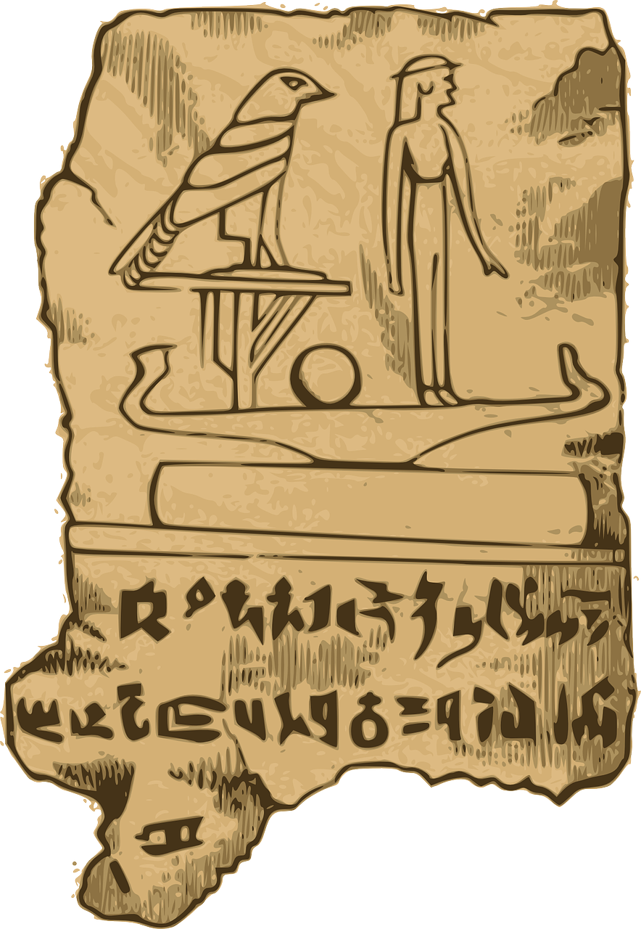
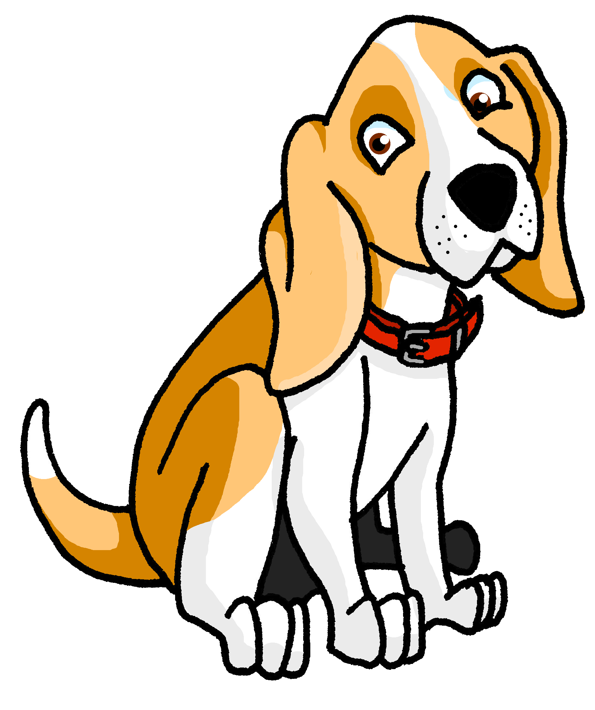


[ien]
prononcer
chien
ancien
bien
€ ?
bientôt
combien
Notes:
Timing: 2 minutes
Aim: to revisit SSC [ien]
Procedure:
1. Introduce and elicit the pronunciation of the individual SSC [ien] and then the source word again ‘bien’ (with gesture, if using).
2. Then present and elicit the pronunciation of the five cluster words.
The cluster words have been chosen for their high-frequency, from a range of word classes, with the SSC (where possible) positioned within a variety of syllables within the words (e.g. initial, 2nd, final etc.). Additionally, we have tried to use words that build cumulatively
Word frequency (1 is the most frequent word in French):
ancien [392] bien [47] bientôt [1208] chien [1744] combien? [800]
Source: Londsale, D., & Le Bras, Y. (2009). A Frequency Dictionary of French: Core vocabulary for learners London: Routledge.
3

Slide 4

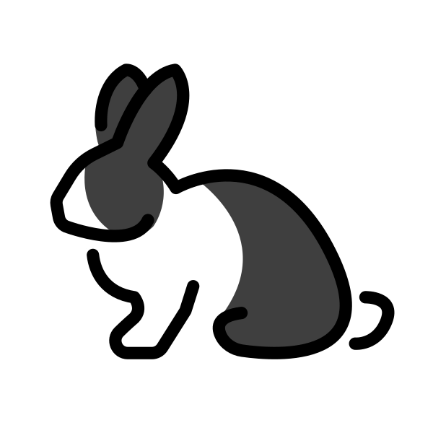



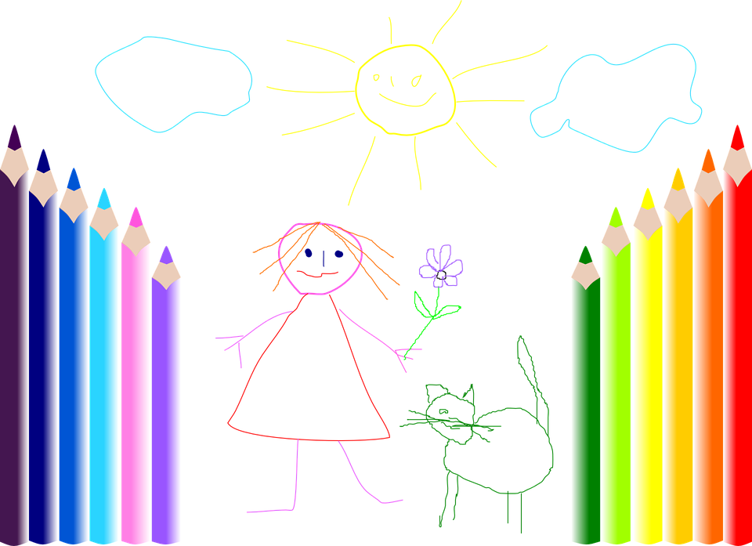




prononcer
Écoute. C’est [ien] ou [(a)in] ?
Puis, prononce les mots.
[ien] [(a)in]
[ien] [(a)in]
l a p i n
p a i n
i t a l i e n
p a r i s i e n
d a l m a t i e n
d e s s i n
c h e m i n
c a n a d i e n
1
______
5
______
2
______
6
______
______
7
______
3
way, path
4
______
8
______
Notes:
Timing: 5 minutes
Aim: to practise aural distinction between words with [ien] and [(a)in].
Procedure:
Read the instruction.
Do the first one with pupils. Remind them that [ien] and [ain] sound very similar but the ‘i’ sound in [ien] is what will help them distinguish.
Elicit responses chorally and click to reveal the answers.
Transcript:
lapin
pain
italien
parisien
dalmatien
dessin
chemin
canadien
Frequency of unknown words and cognates:
canadien [611] chemin [859] dalmatien [>5009] dessin [2624] italien [1477] lapin [>5009] pain [2802] parisien [2529]
Londsale, D., & Le Bras, Y. (2009). A Frequency Dictionary of French: Core vocabulary for learners London: Routledge.

Slide 5


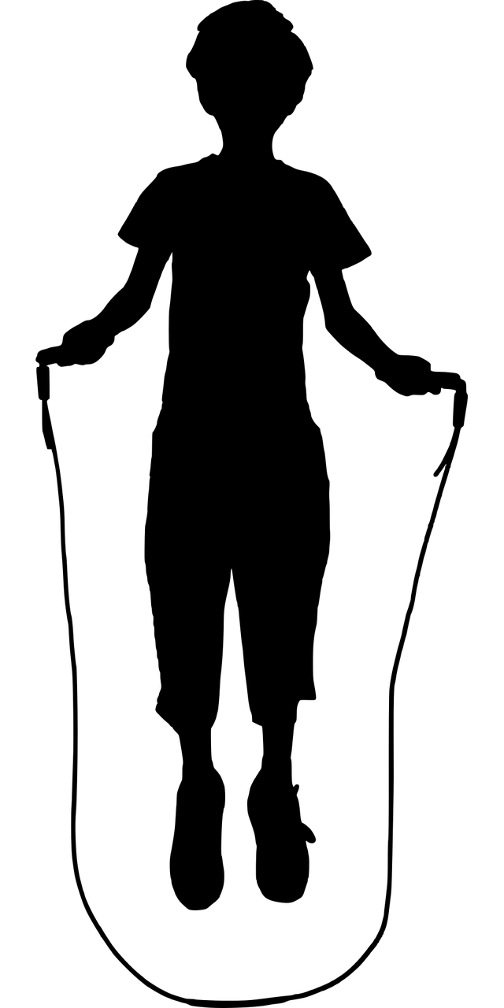
aimer (to like) jouer (to play)
⚠ We leave out ‘the’ in English.
Use aimer + le/la/les to say what you like:
J’aime le football.
I like football.
Il aime le tennis.
He likes tennis.
⚠ Remember:
à + le → au
Use jouer + à + le/la/les to say what you play:
Je joue au football.
I play football.
Il joue au tennis.
He plays tennis.
Elle joue à la corde.
She plays skipping.
Tu joues à la pétanque ?
Do you play pétanque?
Notes:
Timing: 2 minutes
Aim: to recap aimer meaning and its use with definite articles and introduce jouer à to say you play a sport.
Procedure:
Click through the animations to present the information.
Elicit English translations for the French examples provided.

Slide 6



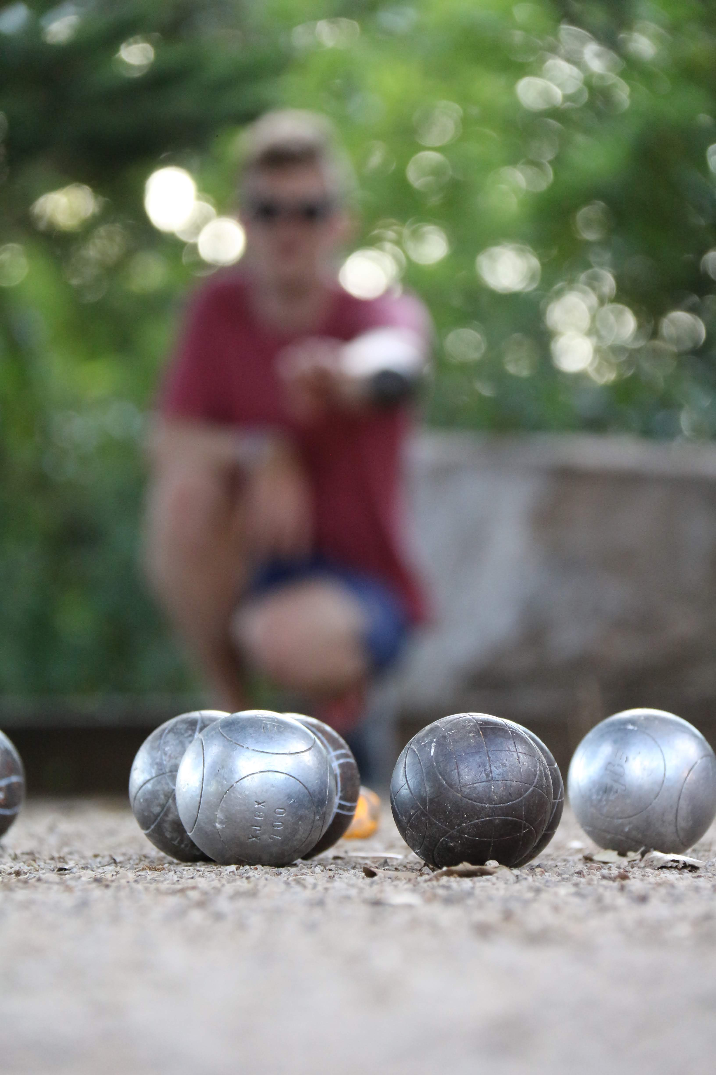

écouter
La pétanque
*surtout - mainly
eleventh
La pétanque est un jeu de boules. C’est le onzième sport en France et c’est populaire dans beaucoup de pays, par exemple, en Espagne, en Thaïlande et en Chine.
popular
China
players
C’est un sport *surtout masculin (85% des joueurs sont des hommes), mais on organise aussi des compétitions mixtes.
men
lire
4. This sport is played by:
males only| males & females together|
males & females separately
1. The text is mostly about:
countries | a sport | a competition
2. In France this sport is:
not popular | the most popular | very popular
3. Pétanaue is played:
in Asia and Europe| only in Europe| only in France
une boule
Notes:
Timing: 6 minutes
Aim: to introduce pupils to the French sport of pétanque; to practise the comprehension of previously taught language in a longer text and to begin to develop pupils’ lexical inferencing ability, guiding them to use the words they know and some cognates to infer plausible meanings of words they don’t know.
Procedure:
Read the text aloud, so pupils can follow. (Click on the text to hear the audio, if preferred).
Click for the first question.
Elicit answers from pupils and click to check the answer. Refer pupils back to the text.
Repeat steps 2-3 for the remaining 5 questions.
Click to highlight words in the text and ask pupils to suggest what they mean. Click to reveal the answers.
Note that teachers should support pupils here, steering them to look at the words they know and what they have understood so far about the text and their English vocabulary.
Frequency of unknown words and cognates:
pétanque [] boule [] onzième [] populaire [] Espagne [] Thaïlande [] Chine [] surtout [] masculin [] joueur [] homme [] on []compétitionn [] mixte []
Image attribution: Brunobuisson, CC BY-SA 4.0 via Wikimedia Commons
Information: https://fr.wikipedia.org/wiki/P%C3%A9tanque, https://www.thelocal.fr/20200721/ten-things-you-didnt-know-about-ptanque/
6

Slide 7
écouter
Écoute. Is Adèle talking about liking or playing?
⚠ Attention ! The verb is missing. Listen to what follows to work out if the meaning is liking or playing.
 | like(s) | play(s) | en anglais
1
2
3
4
5
6
7
8
1
Pierre likes football.
1
2
Mum likes pétanque.
2
3
Dad also plays football.
3
4
I play volleyball.
4
5
Léa likes hockey.
5
6
She also plays tennis with me.
6
7
Pierre plays basketball at school.
7
8
Yves likes handball.
8
Notes:
Timing: 6 minutes
Aim: to practise aural recognition of the ‘le/la’ and ‘au’ and understand their connection to the use and meaning of the two verbs aimer and jouer.
Procedure:
Pupils listen to each phrase.
Attending to the word following the beep (which obscures the verb) pupils decide if the meaning is liking or playing.
On the 2nd time of listening, pupils write the English meaning of the sentences.
Click to reveal answers.
Teachers may want to challenge pupils to produce (chorally, not individually) the French for the English sentence answers they can see. If so, they can click on the 2nd set of audio buttons to listen and check with the full sentences.
Note: if pupils need more support with this task, gapped versions of the English answers could be provided.
Transcript:
Pierre [aime] le football.
Maman [aime] la pétanque.
Papa [joue] au football, aussi.
Je [joue] au volley.
Léa [aime] le hockey.
Elle [joue] au tennis avec moi, aussi.
Pierre [joue] au basket à l’école.
Yves [aime] le handball.
7

Slide 8

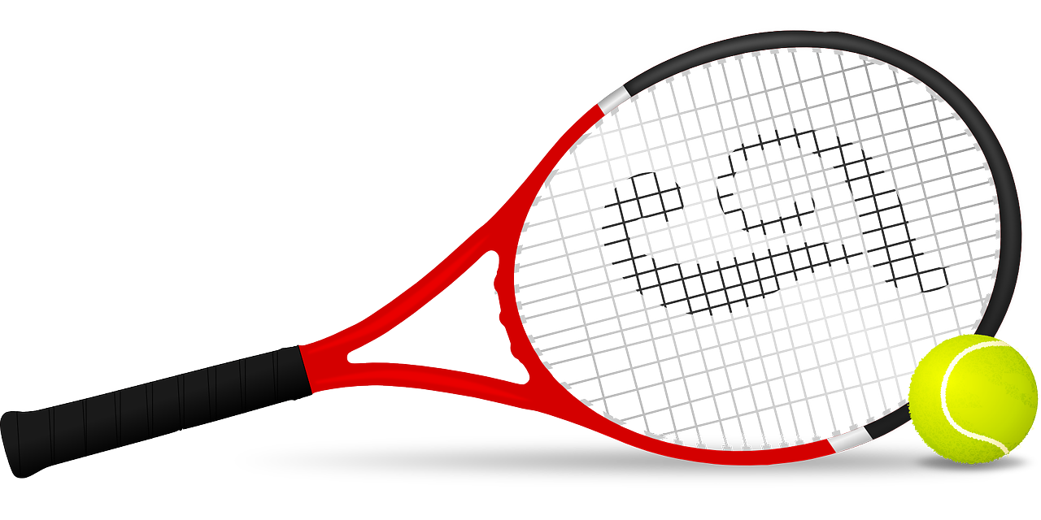


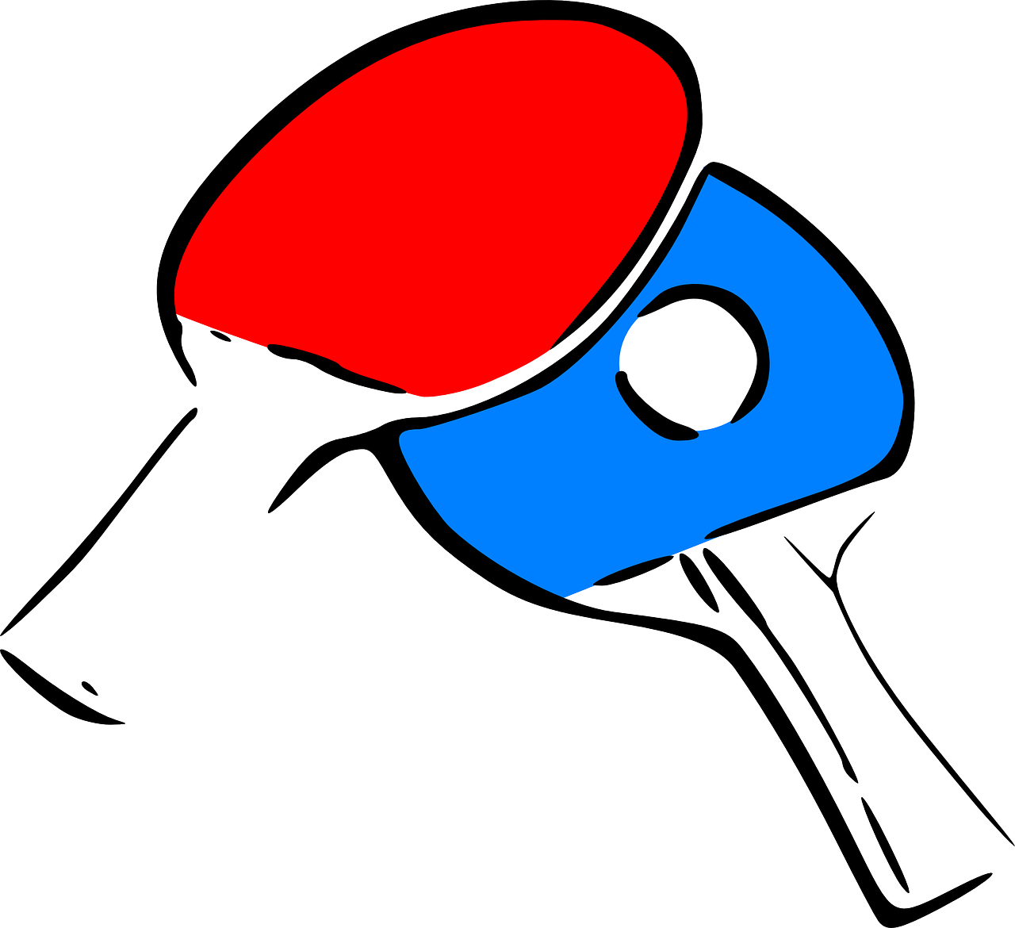
Quand il fait du soleil…
You can join two clauses together to make longer sentences:
⚠ Put a comma here to represent the pause when you say it.
Quand il fait beau, je joue au tennis.
When it is fine/good weather, I play tennis.
You can use the two clauses the other way around, too:
⚠ A comma is optional here.
Je joue au ping-pong quand il fait froid.
I play table tennis when it is cold.
Notes:
Timing: 2 minutes
Aim: to recap il fait meaning ‘he does, is doing’ and introduce it to mean ‘it is’ for weather.
Procedure:
Click through the animations to present the information.
Elicit English translations for the French examples provided.

Slide 9
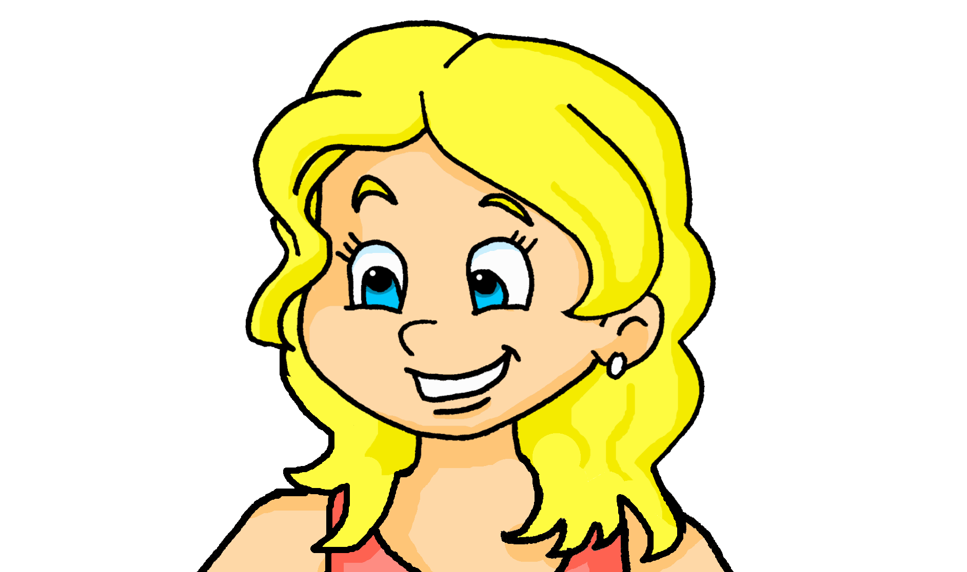
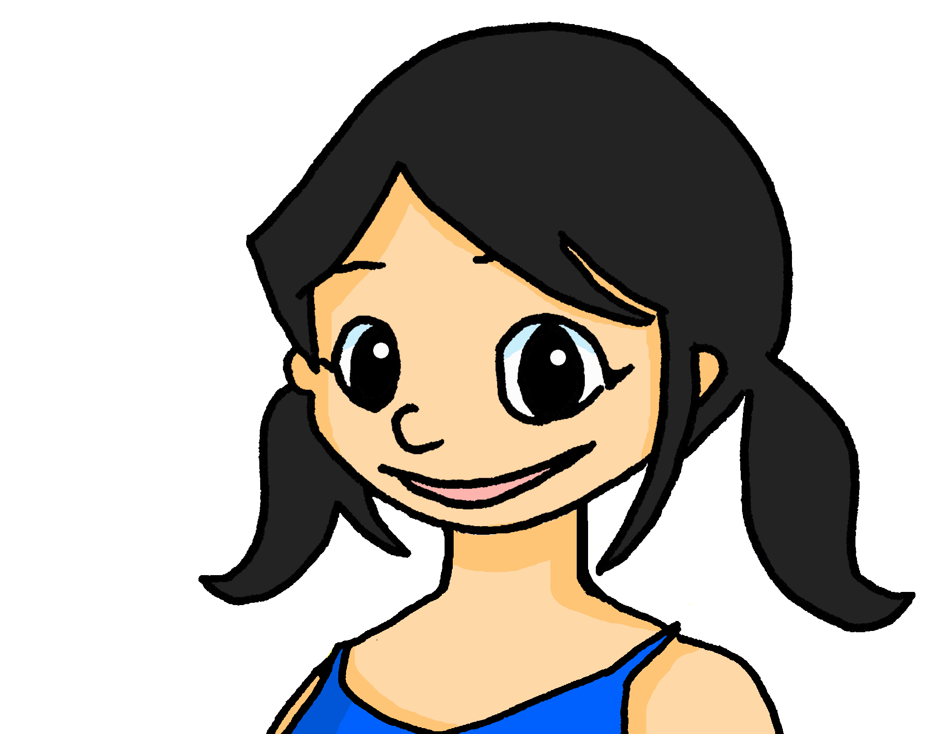
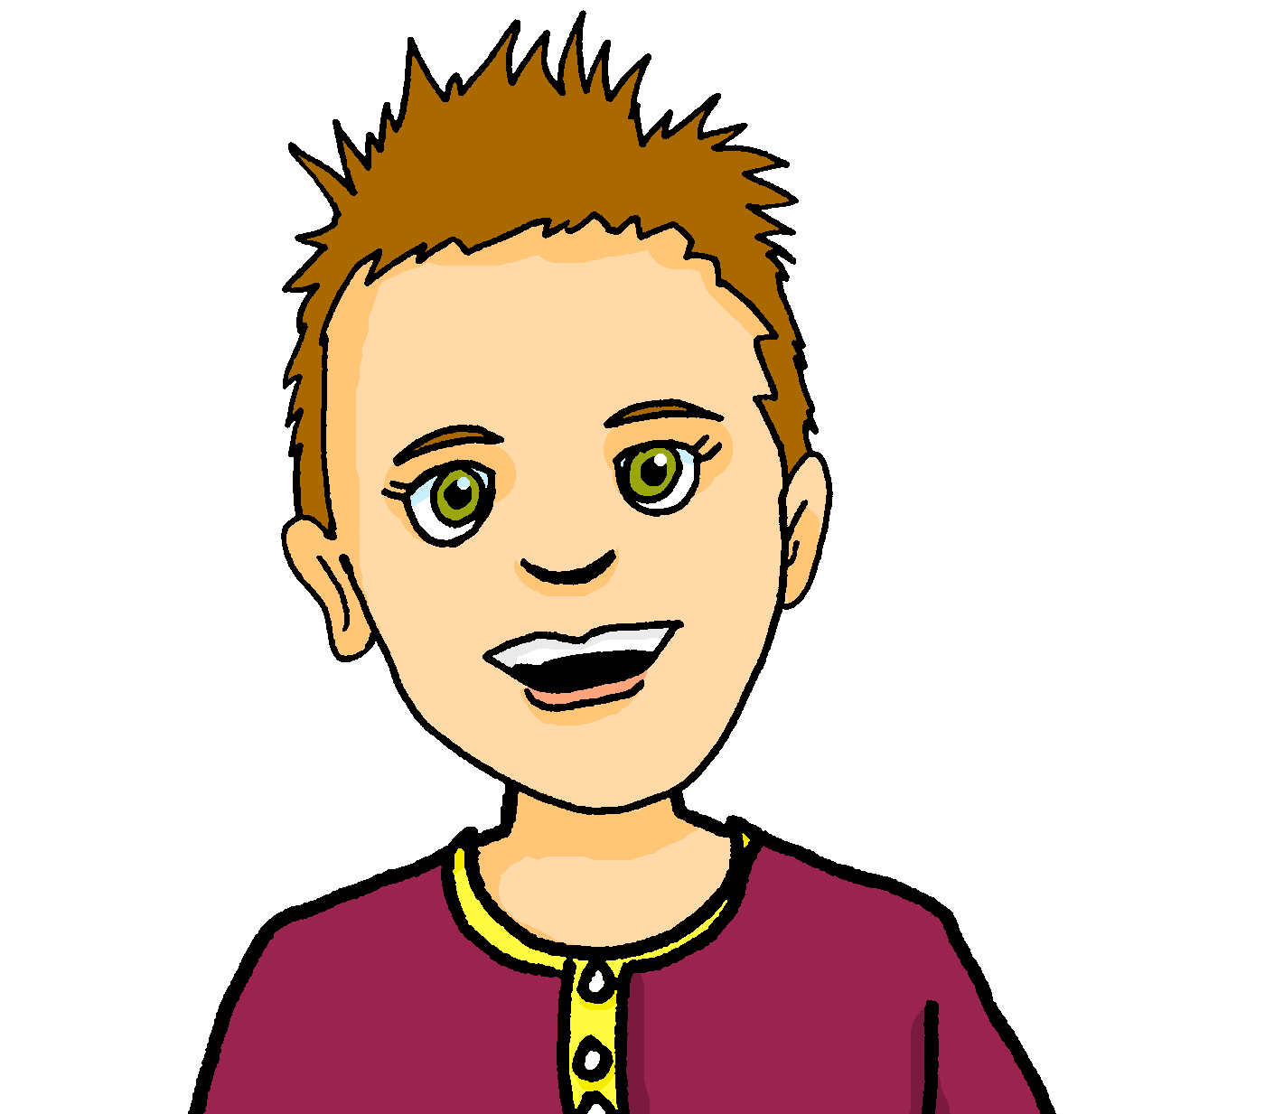
lire
fais la cuisine.
Lis les phrases et écris les infos en anglais.
Adèle (I)
1
Je joue au tennis quand il fait beau.
play tennis, when good weather
play football in a mixed team
2
Il aime aussi le tennis en été.
3
Elle aime le badminton mais elle préfère le hockey.
Léa (she)
likes badminton, prefers hockey
4
Il joue au football à l’école une fois *par semaine.
*par - per
doesn’t play football, hates it
5
Je joue au football dans une équipe mixte.
likes beach volleyball
*equipe - team
6
Elle ne joue pas au foot – elle déteste ça.
Pierre (he)
7
also likes tennis in summer
Elle aime le volleyball de plage.
plays football at school once a week
8
Il n’aime pas le volley quand il fait chaud.
doesn’t like volleyball when it’s hot
Notes:
Timing: 5 minutes
Aim: to check more complete understanding of the new vocabulary in longer sentences.
Procedure:
1. Pupils read the sentences and record the information (can be in note form) under the three people headings: Adèle (I), Pierre (he), Léa (she).
2. Answers are revealed on a mouse click.
3. If desired, click the numbered buttons to hear each French sentence.

Slide 10
Au revoir !
bleu
Notes:
10

