Slide 1
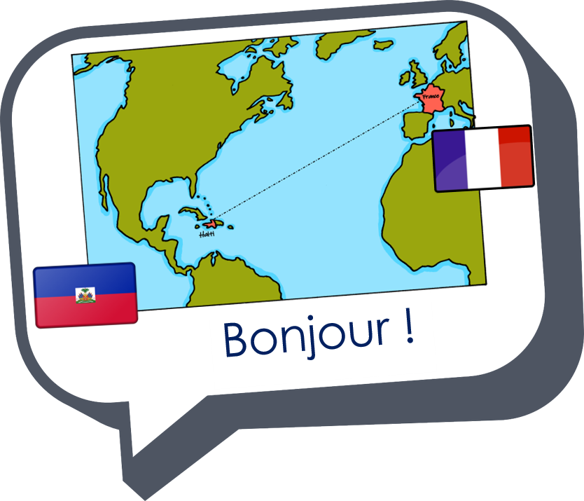





Saying what I and others do
bleu
Follow ups 1-5
Notes:
Artwork by Steve Clarke. Pronoun pictures from NCELP (www.ncelp.org). All additional pictures selected from Pixabay and are available under a Creative Commons license, no
attribution required.
Phonics: Revisit SSC [tion] attention [482] international [282] population [509] question [144] solution [608]
Vocabulary (new words in bold): Il fait² [25] automne [1503] été [623] printemps [1288] hiver [1586] beau [393] mauvais [274] chaud [1852] froid [1307] quand [119]
Revisit 1: tu vas je vais [53] tu es je suis [5] à (meaning ‘at/in/to’)[4] marché [280] piscine [>5000]
Revisit 2: aimer [242] arriver [174] célébrer [2170] organiser [701] porter [105] préparer [368] année [102] fête [1490] gens [236] histoire [262] santé [641] vêtement [2383]
Londsale, D., & Le Bras, Y. (2009). A Frequency Dictionary of French: Core vocabulary for learners London: Routledge.
The frequency rankings for words that occur in this PowerPoint which have been previously introduced in these resources are given in the SOW and in the resources that first
introduced and formally re-visited those words.
For any other words that occur incidentally in this PowerPoint, frequency rankings will be provided in the notes field wherever possible.

Slide 2


[-tion]
prononcer
Attention !
Notes:
Timing: 1 minute
Aim: To consolidate SSC [-tion]
Procedure:
1. Present the letter(s) and say the [-tion] sound first, on its own. Pupils repeat it with you.
2. Bring up the word ”Attention” on its own, say it, pupils repeat it, so that they have the opportunity to focus all of their attention on the connection between the written word and its sound.
3. Clarify the meaning (Watch out! Take care!).
3. A possible gesture for this word would be to hold up the right index finger up and waggle it quickly from side to side as a gesture of warning.
4. Roll back the animations and work through 1-3 again, but this time, dropping your voice completely to listen carefully to the pupils saying the [-tion] sound, pronouncing ”Attention” and, if using, doing the gesture.
2

Slide 3




[-tion]
prononcer
motion
pollution
Attention !
solution
population
Notes:
Timing: 2 minutes
Aim: to consolidate SSC [-tion]
Procedure:
1. Introduce and elicit the pronunciation of the individual SSC [-tion] and then the source word again ‘Attention !’ (with gesture, if using).
2. Then present and elicit the pronunciation of the four cluster words.
The cluster words have been mainly chosen for their high-frequency, from a range of word classes, with the SSC (where possible) positioned within a variety of syllables within the words (e.g. initial, 2nd, final etc.). Additionally, we have tried to use words that build cumulatively on previously taught SSCs (see the Phonics Teaching Sequence document) and do not include new SSCs. Where new SSCs are used, they are often consonants which have a similar symbol-sound correspondence in English.
Word frequency (1 is the most frequent word in French):
attention [482] motion [855] pollution [3073] population [509] solution [608]
Source: Londsale, D., & Le Bras, Y. (2009). A Frequency Dictionary of French: Core vocabulary for learners London: Routledge.
3

Slide 4
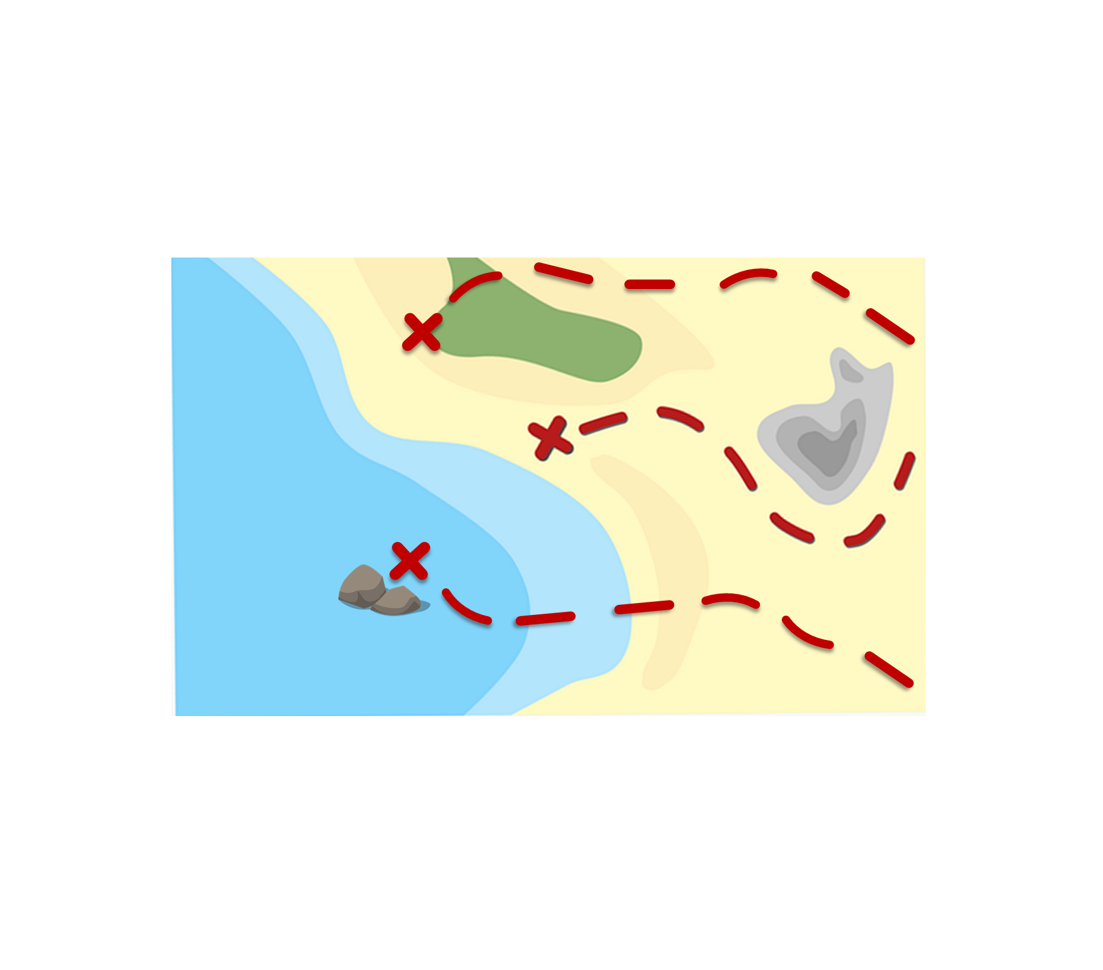


prononcer
Follow up 1:
*la pièce – piece, coin
Prononce les mots et collecte des pièces*.
correction
organisation
60
motivation
relation
émotion
condition
création
S
fiction
direction
mention
option
pollution
station
portion
0
population
motion
position
DÉBUT
Notes:
Timing: 5 minutes [2 rounds]
Aim: To practise the pronunciation of French words with the SSC [-tion].
Procedure:
Pupils work in pairs to practise pronunciation. They can choose where to start and have one minute to collect as many coins as possible.
Divide the class in A & B and click to indicate it’s ‘personne A’’s turn.
Pupil A starts from either ‘cantar, ‘dulce’ or ‘queso’, and follows the path to pronounce the words and collect the corresponding coins.
Pupil B listens and notes down the number of coins for his/her partner.
Click to bring up Personne B’s turn.
Click on each word to hear it pronounced, as required.
Frequency of unknown words and cognates:
condition [281] correction [3005] création [634] direction [582] émotion [1854] fiction [3612] mention [3347] motivation [3522] motion [855] option [2156] organisation [570] pollution [3073] population [509] portion [3806] position [383] relation [356] station [1399]
4

Slide 5


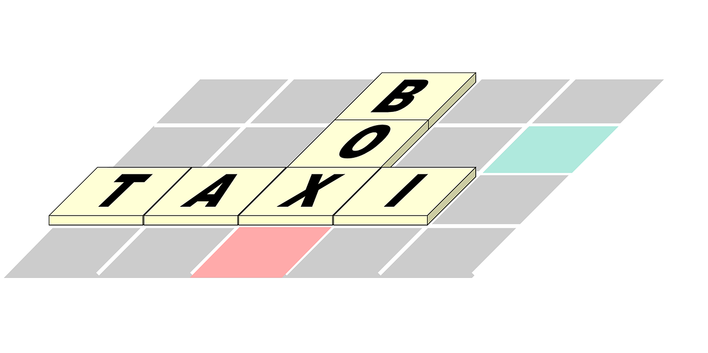





Follow up 2
Écoute. Écris le numéro correspondant pour chaque image.
écouter
1
2
3
4
5
6
7
8
9
E
H
C
I
A
F
B
D
G
A | B | C
D | E | F
G | H | I
Notes:
Timing: 5 minutes
Aim: to practise recognition of the newly learnt expressions with ‘faire’ in the oral modality.
Procedure:
Click on the numbers to play the audio.
Pupils write 1 = A etc… (To challenge higher proficiency learners, ask them to record who is doing the action or just weather.
Click to provide answers.
Transcript:
Tu fais le ménage.
Il fait beau.
Je fais une activité.
Il fait la cuisine.
Il fait chaud.
je fais les devoirs.
Il fait mauvais.
Il fait froid.
Elle fait les courses.

Slide 6



Follow up 3
Organise les mois.
Mars est au printemps.
Mars est en quelle saison ?
écrire
lire
To mean ‘in’ with seasons, use ‘au’ with printemps and ‘en’ with the rest.
Au printemps | En été
En automne | En hiver
mars
juin
avril
juillet
mai
aout
septembre
décembre
octobre
janvier
novembre
février
j______r
f______r
m___s
a____l
m__i
j__n
j_______t
a___t
s_______e
o______e
n______e
d______e
Notes:
Timing: 5 minutes
Aim: to practise written production of the 12 months of the year.
Procedure:
Pupils draw 4 ‘season’ boxes and label them with the French words for the four seasons.
They then try to recall and produce in writing as many of the 12 months as they can. Initial and final letters are given to prompt them.
Remind pupils there is no need to work in order (i.e., to stop if there is one they cannot remember).
After 4 minutes, click to reveal the answers. NB: Click on the gapped word (MUST be right on the word, not to the side or the slide will move on), and it will be highlighted and the month will appear in the correct season box.
Ask pupils to write down and highlight any that they didn’t remember.
Click on each word to hear it pronounced, if desired.
Ask pupils to tell which season different months are in, to practice saying both the seasons (which are new this week) and the months.

Slide 7

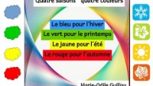
Follow up 3b
écouter
parler
Notes:
Timing: 2 minutes
Aim: to listen to and join in with a short poem about seasons.
Procedure:
Click to listen to the poem.
Play again and encourage pupils to join in, saying the words aloud.

Slide 8
Follow up 4 – [1/7]
à
en
parler
10
il
c’est
In August it is always good weather.
En aout il fait toujours beau.
toujours
fait
S
aout
beau
souvent
0
DÉBUT
Notes:
Timing: 5 minutes (7 slides)
Aim: to practise supported oral sentence creation of this week’s target structure and vocabulary.
Procedure:
Click for the English prompt.
Give pupils 10 sentences to work out the sentence and practise it aloud.
Click again to ‘disappear’ the distractor words.
Say ‘trois-deux-un’ to cue choral production of the sentence.
Click to bring up the French sentence.
Repeat steps 1-3 for the remaining six slides.

Slide 9
Follow up 4 [2/7]
chaud
en
parler
10
il
c’est
In winter it is often cold.
En hiver il fait souvent froid.
souvent
fait
S
hiver
froid
toujours
0
DÉBUT
Notes:
[2/7]

Slide 10
Follow up 4 [3/7]
fait
en
parler
souvent
10
au
In November it is often bad weather in France.
En novembre il fait souvent mauvais en France.
à
France
S
en
hiver
mauvais
novembre
il
chaud
0
DÉBUT
Notes:
[3/7]

Slide 11
Follow up 4 [4/7]
Canada
en
parler
hiver
10
au
En hiver au Canada il fait froid.
In winter in Canada it is cold.
à
printemps
S
mauvais
froid
fait
il
0
DÉBUT
Notes:
[4/7]

Slide 12
Follow up 4 [5/7]
il
en
parler
été
10
au
Normally in spring it is fine weather.
Normalement au printemps il fait beau.
beau
printemps
S
chaud
fait
à
normalement
0
DÉBUT
Notes:
[5/7]

Slide 13
Follow up 4 [6/7]
fait
il
parler
beau
10
au
À Haïti il fait toujours chaud.
In Haiti it is always hot.
à
Haïti
S
en
été
chaud
toujours
0
DÉBUT
Notes:
[6/7]

Slide 14
Follow up 4 [7/7]
fait
la France
parler
il
beau
10
au
In summer it is hot in the south of France.
En été il fait chaud dans le sud de la France.
été
dans
S
en
à
le sud
de
chaud
0
DÉBUT
Notes:
[7/7]

Slide 15

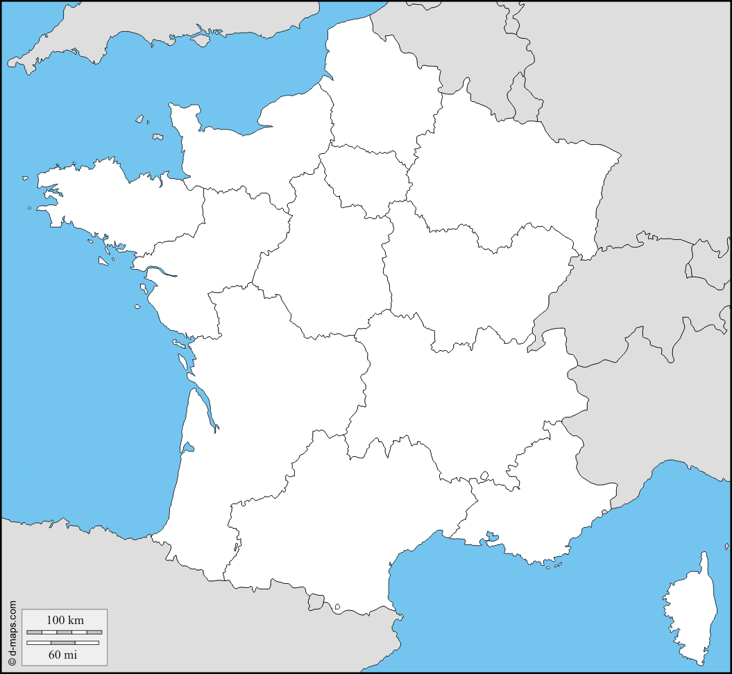
Follow up 5:

Écris sept phrases.

5
Calais
Exemple:
écrire
Il fait froid à La Rochelle.
1 _____________________________
2
Brest
3
Paris
Il fait mauvais à Brest.
2 _____________________________
1
La Rochelle
6
Blois
3 _____________________________
Il fait beau à Paris.
7
Bordeaux
4 _____________________________
4
Toulouse
Il fait chaud à Toulouse.
Rhyme the ? phrases.
5 _____________________________
Il fait mauvais à Calais.
7 ________________________________________
6 _____________________________
Il fait beau/chaud à Bordeaux.
Il fait froid à Blois.
Notes:
Timing: 5 minutes
Aim: to practise written production of ‘il fait’ and the four weather items from this week’s vocabulary.
Procedure:
1. Teacher models the task with sentence 1, using a ‘think aloud’ to interpret the picture, and eliciting suggestions from pupils as to a suitable sentence (perhaps initially in English and then French, or just in French).
2. Tell pupils that items 4 – 7 should rhyme – the words they choose for the weather should rhyme with the city/place name.
Note: Teachers can differentiate the task, providing more support to lower proficiency learners by:
i. shortening the task (choose 3 of the 7 sentences to write).
ii. providing the initial letters of each word as prompts.
iii. enabling pupils to look at the four vocabulary words (beau, chaud, mauvais, froid) first and practise those on mini whiteboards etc..

Slide 16



Follow up 5:

Écris six phrases.

You are on holiday.
Write any six sentences about your activities.
écrire
Notes:
ALTERNATIVE TO THE PREVIOUS WRITING TASK FOR HIGHER PROFICIENCY LEARNERS
Aim: to practise more independent written production of first person singular of ‘faire’ along with this week’s target vocabulary.
Procedure:
Pupils write sentences using the first person singular form of ‘faire’ in response to the pictures, in order to narrate an imaginary day on holiday.
For an additional challenge, pupils could then be asked to do this using the second person singular form – i.e. writing about what ‘you’ do – or the third person singular form – i.e. writing about what s/he does.
Make it clear to pupils that they are writing in the present tense, i.e. saying what happens normally or is happening whilst they are on holiday.
Remind learners that the weather expressions are always used impersonally – i.e. with ‘il’.

Slide 17




vocabulaire
Follow up 5a - Écris en anglais : Can you get at least 15 points?
mots
 | l’année | les gens | porter
 | la santé | le vêtement | l’histoire
 | le marché | la piscine | tu vas
 | je vais | tu es | chaud
 | je suis | à | froid
 | l’hiver | beau | le printemps
 | l’éte | mauvais | l’automne
(the) year
(the) people
to wear, carry
x3
(the) health
(the) item of clothing
(the) history
(the) market
(the) pool
you go, are going
I go, am going
you are
heat, (hot)
x2
I am
at, to, in
cold
(the) winter
fine/good
(the) spring
x1
(the) summer
bad
(the) autumn
Notes:
Timing: 5-10 minutes
Aim: to practise written production of vocabulary from this week and two revisited weeks.
Procedure:
1. Give pupils a blank grid. They fill in the English meanings of any of the words they know, trying to reach 15 points in total.
2. Remind pupils that adjectives can refer to male or female persons and they should note this in their translations. E.g. pleased (f), short (m).
Note:
The most recently learnt and practised words are pink, words from revisit 1 are green and those from revisit 2 are blue, thus more points are awarded for them, to recognise that memories fade and more effort (heavy lifting!) is needed to retrieve them.
17

Slide 18
vocabulaire
Follow up 5b - Écris en français : Can you get at least 15 points?
mots
 | (the) history | (the) health | (the) item of clothing
 | to wear, carry | (the) year | (the) people
 | to, at, in | (the) market | (the) pool
 | I go, am going | you are | I am
 | cold | heat (hot) | you go
 | winter | fine/good | bad
 | autumn | summer | spring
l’histoire
la santé
le vêtement
x3
porter
l’année
les gens
à
le marché
la piscine
je vais
tu es
je suis
x2
froid
chaud
tu vas
l’hiver
beau
mauvais
x1
l’automne
l’été
le printemps
Notes:
Timing: 5-10 minutes
Aim: to practise written comprehension of vocabulary from this week and previous weeks.
Procedure:
Give pupils a blank grid. They fill in the French meanings of any of the words they know, trying to reach 15 points in total.
Note:
The most recently learnt and practised words are pink, words from the previous week are green and those from earlier are blue, thus more points are awarded for them, to recognise that memories fade and more effort (heavy lifting!) is needed to retrieve them.
18

Slide 19
vocabulaire
Follow up 5a - Écris en anglais : Can you get at least 15 points?
mots
 | l’année | les gens | porter
 | la santé | le vêtement | l’histoire
 | le marché | la piscine | tu vas
 | je vais | tu es | chaud
 | je suis | à | froid
 | l’hiver | beau | le printemps
 | l’éte | mauvais | l’automne
x3
x2
x1
Notes:
HANDOUT
19

Slide 20
vocabulaire
Follow up 5b - Écris en français : Can you get at least 15 points?
mots
 | (the) history | (the) health | (the) item of clothing
 | to wear, carry | (the) year | (the) people
 | to, at, in | (the) market | (the) pool
 | I go, am going | you are | I am
 | cold | heat (hot) | you go
 | winter | fine/good | bad
 | autumn | summer | spring
x3
x2
x1
Notes:
HANDOUT
20

