Slide 1
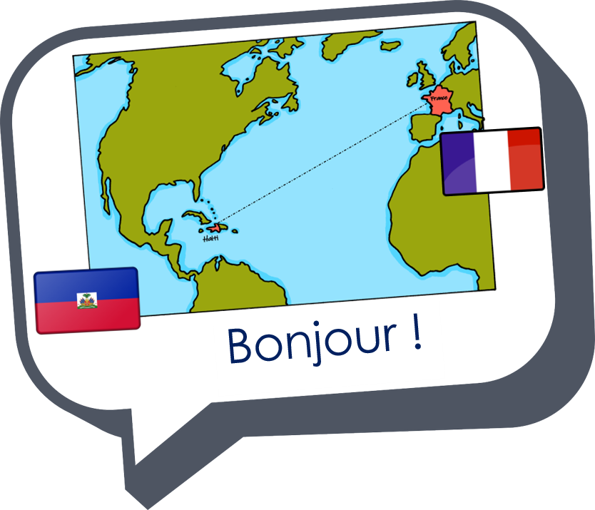
Saying what I and others do
bleu
Follow ups 1-5
Notes:
Artwork by Steve Clarke. Pronoun pictures from NCELP (www.ncelp.org). All additional pictures selected from Pixabay and are available under a Creative Commons license, no
attribution required.
Phonics: Revisit SSC [ç/c] (soft -c) ici [167] français [251] garçon [1599] cinéma [1623] décider [165]
Vocabulary (new words in bold): tu fais [25] effort [388] voyage [904] carte [955] gâteau [4845] liste [924]
Revisit 1: aller [53] je vais il/elle va à (meaning ‘at/in/to’)[4] Canada [N/A] France [N/A] nord [1090] sud [1242] est [4603] ouest [1690]
Revisit 2: aimer [242] avoir [8] vous2 [50] animal [1002] cadeau [2298] chapeau [2908] cheval [2220] fanal [>5000] gâteau [4845] feu [786] jeu [291] vœu [2103]
Londsale, D., & Le Bras, Y. (2009). A Frequency Dictionary of French: Core vocabulary for learners London: Routledge.
The frequency rankings for words that occur in this PowerPoint which have been previously introduced in these resources are given in the SOW and in the resources that first
introduced and formally re-visited those words.
For any other words that occur incidentally in this PowerPoint, frequency rankings will be provided in the notes field wherever possible.

Slide 2



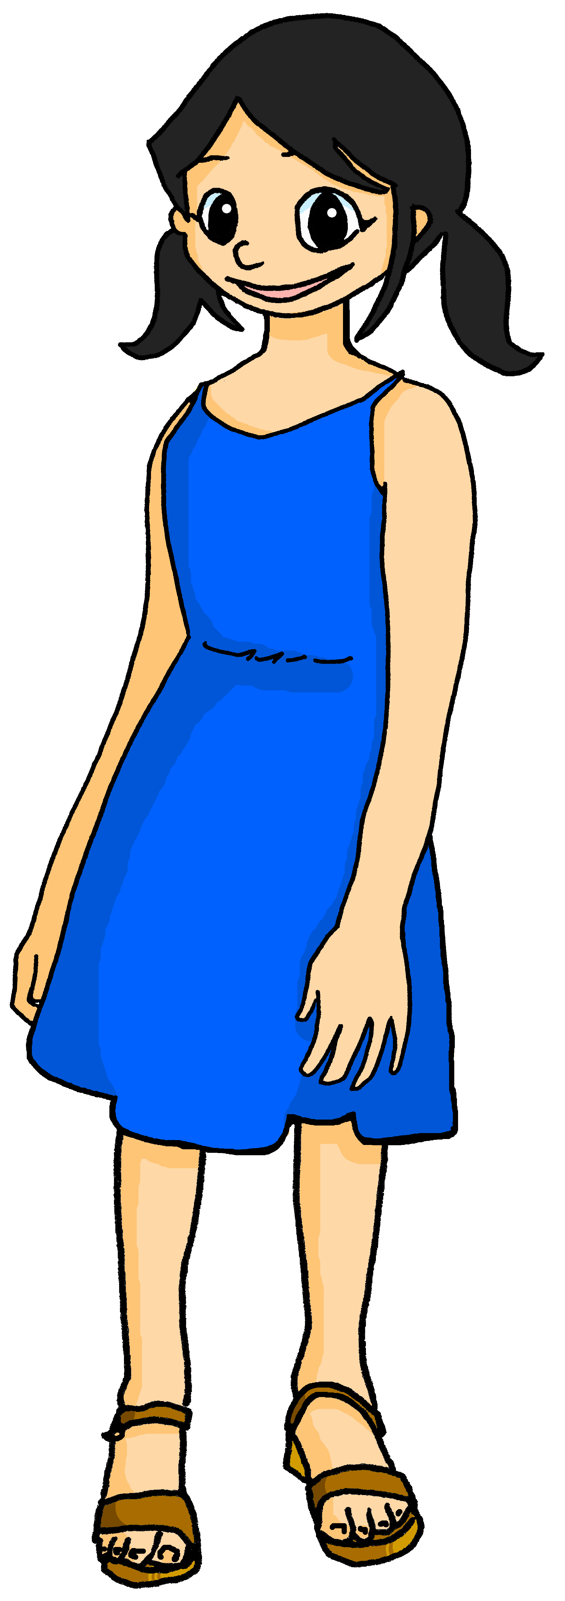
Follow up 1
Écoute et écris.
Léa pose la question : C’est quand, ton anniversaire ?
écouter
Yves
Pierre
Madame Vidal
le 22 octobre
le 25 juin
le 31 janvier
____
____
___
Léa
Adèle
Use le before the number
to mean ‘(on) the’ with dates.
le 16 mai
le 15 aout
____
__
Eugénie
Clémentine
el 13 avril
le 27 novembre
___
___
Notes:
Time: 6 minutes
Note: This recaps an activity from Term 1 but it feels useful to revisit a few numbers again this week, as we have the theme of Léa’s birthday running across these two weeks.
Aim: to practise understanding cardinal numbers in birthday dates.
Procedure:
1. Click on each set of balloons to hear the audio.
2. Pupils listen to the date given for each person’s birthday, and write down the number.
2. In feedback, teachers can ask: ‘Qui dit “mon anniversaire est le X X ?”’ to elicit the names from pupils, and allow them another opportunity to hear and understand the dates one more time.
Transcript:
[Yves] Mon anniversaire est le 22 octobre
[Pierre] Mon anniversaire est le 25 juin.
[Madame Vidal] Mon anniversaire est le 31 janvier.
[Léa ] Mon anniversaire est le 16 mai.
[Adèle] Mon anniversaire est le 15 aout.
[Eugénie] Mon anniversaire est le 13 avril.
[Clémentine] Mon anniversaire est le 27 novembre.
[Jean-Michel] Mon anniversaire est le 27 novembre, aussi !
2

Slide 3





vocabulaire
Follow up 2a - Écris en anglais : Can you get at least 15 points?
mots
 | aimer | vous | aller
 | le feu | le vœu | le chapeau
 | à | le sud | le nord
 | je vais | aller | l’est
 | le Canada | elle va | l’ouest
 | l’effort | le voyage | tu fais
to like, liking
you (all, formal)
to go, going
x3
(the) fire
(the) good wish
(the) hat
to, at, in
(the) south
(the) north
I go, am going
to go, going
(the) east
x2
(the) Canada
she goes, is going
(the) west
x1
(the) effort
(the) trip, journey
you do, make
Notes:
Timing: 5-10 minutes
Aim: to practise written production of vocabulary from this week and two revisited weeks.
Procedure:
1. Give pupils a blank grid. They fill in the English meanings of any of the words they know, trying to reach 15 points in total.
2. Remind pupils that adjectives can refer to male or female persons and they should note this in their translations. E.g. pleased (f), short (m).
Note:
The most recently learnt and practised words are pink, words from revisit 1 are green and those from revisit 2 are blue, thus more points are awarded for them, to recognise that memories fade and more effort (heavy lifting!) is needed to retrieve them.
3

Slide 4
vocabulaire
Follow up 2b - Écris en français : Can you get at least 15 points?
mots
 | (the) hat | (the) fire | (the) good wish
 | to like, liking | to have, having | you (all, formal)
 | (the) south | (the) east | (the) west
 | to, at, in | (the) Canada | (the) north
 | to go, going | I go, am going | she goes, is going
 | you do, make | (the) journey | (the) effort
le chapeau
le feu
le vœu
x3
aimer
avoir
vous
le sud
l’est
l’ouest
à
le Canada
le nord
x2
aller
je vais
elle va
x1
tu fais
le voyage
l’effort (m)
Notes:
Timing: 5-10 minutes
Aim: to practise written comprehension of vocabulary from this week and previous weeks.
Procedure:
Give pupils a blank grid. They fill in the French meanings of any of the words they know, trying to reach 15 points in total.
Note:
The most recently learnt and practised words are pink, words from the previous week are green and those from earlier are blue, thus more points are awarded for them, to recognise that memories fade and more effort (heavy lifting!) is needed to retrieve them.
4

Slide 5



Follow up 3:
Parle ou écris en français.
C’est qui ? C’est quoi ?
parler
Je fais les devoirs.
Notes:
Timing: 5 minutes for seven slides
Aim: to practise written or spoken production of vocabulary and grammar learned this week and last week.
Procedure:
Click to reveal an image representing a pronoun and an imagine representing an activity.
Pupils write or say the French.

Slide 6
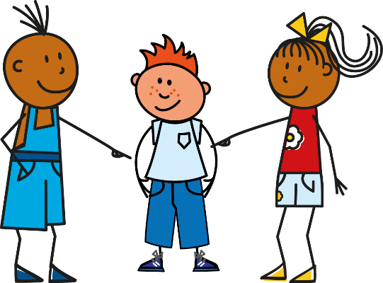

Follow up 3:
Parle ou écris en français.
C’est qui ? C’est quoi ?
parler
Il fait la cuisine.
Notes:
[2/7]

Slide 7
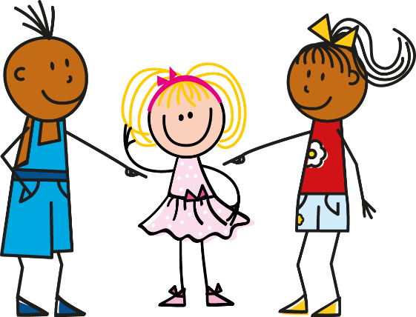

Follow up 3:
Parle ou écris en français.
C’est qui ? C’est quoi ?
parler
Elle fait les courses.
Notes:
[3/7]

Slide 8
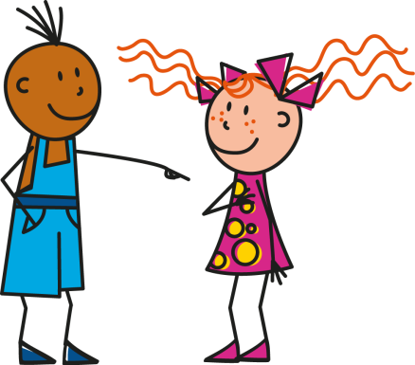

Follow up 3:
Parle ou écris en français.
C’est qui ? C’est quoi ?
parler
Tu fais le ménage.
Notes:
[4/7]

Slide 9

Follow up 3:
Parle ou écris en français.
C’est qui ? C’est quoi ?
parler
Je fais une activité avec mon amie.
Notes:
[5/7]

Slide 10
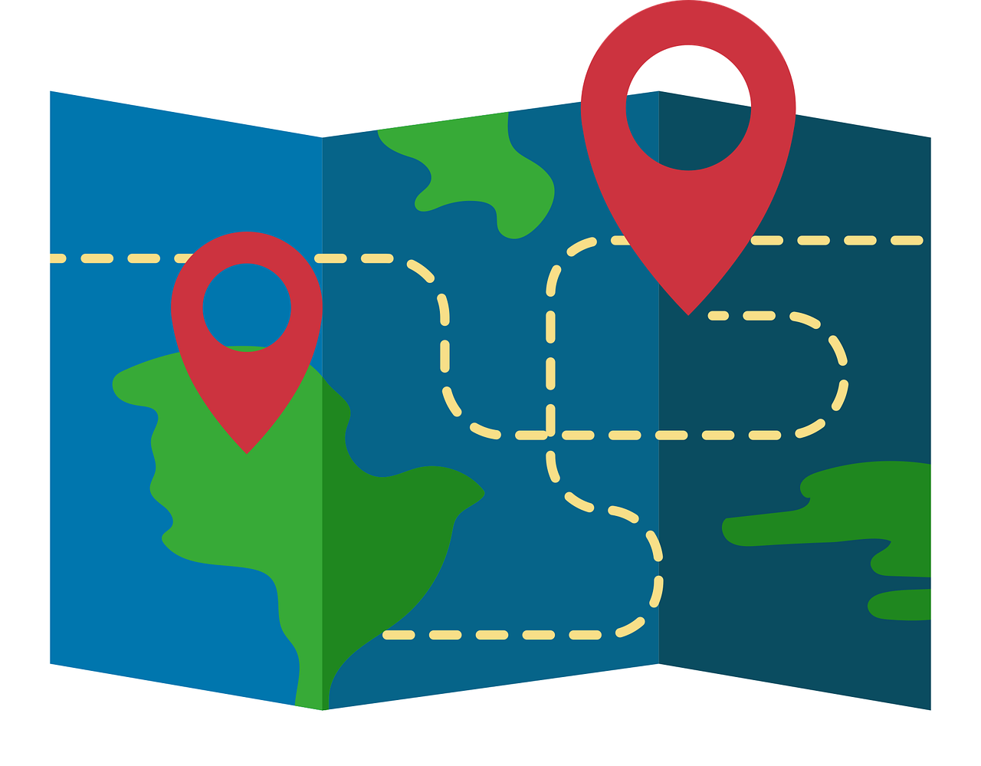

Follow up 3:
Parle ou écris en français.
C’est qui ? C’est quoi ?
parler
Elle fait un voyage.
Notes:
[6/7]

Slide 11

Follow up 3:
Parle ou écris en français.
C’est qui ? C’est quoi ?
parler
Il fait un effort.
Notes:
[7/7]

Slide 12


Asking questions using Est-ce que…
-ER verbs: tu (you), vous (you, formal)
Remember! To make it clear that a yes/no question is being asked, we can add Est-ce que (‘Is it that…?’) at the start of any statement:
Est-ce qu’il fait les courses ?
Oui, il fait les courses.
Does he do the shopping?
Yes, he does the shopping.
Is he doing shopping?
Yes, he is doing the shopping.
To ask a ‘what’ question, we can add Qu’est-ce que (‘What is it that…?’) at the start of any statement:
Qu’est-ce que tu fais ?
Je fais la cuisine.
What do you do?
I do the cooking.
What are you doing?
I’m doing the cooking.
Notes:
Do this recap before Follow up 4.
Timing: 2 minutes
Aim: to recap the use of Est-ce que to ask questions and introduce Qu’ est-ce que
(Remember that pupils have already also been taught Où est-ce que)
Procedure:
Click through the animations to present the information.
Elicit English translations for the French examples provided.

Slide 13
Asking questions using ‘Qu’est-ce que…
The ‘s’ sound is the soft ‘c’.
Let’s practise saying Qu’est-ce que questions:
The –st are silent.
1
Qu’est-ce que tu fais ?
2
Qu’est-ce que tu fais ?
What do you do, are you doing?
What do you do, are you doing?
When you say it slowly there are five separate syllables.
In conversation we speed up and there are four syllables.
Notes:
Timing: 2 minutes
Aim: to practise pronouncing Qu’est-ce que
Procedure:
Click through the animations to present the information.
Click each audio button to hear Qu’est-ce que at two different speeds.

Slide 14
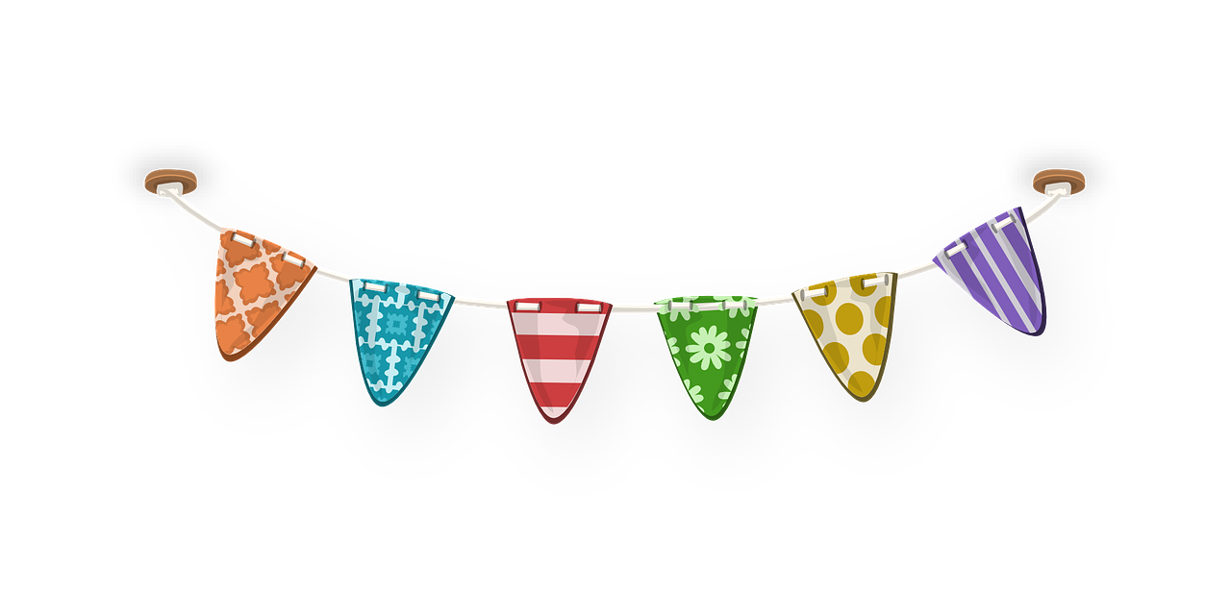
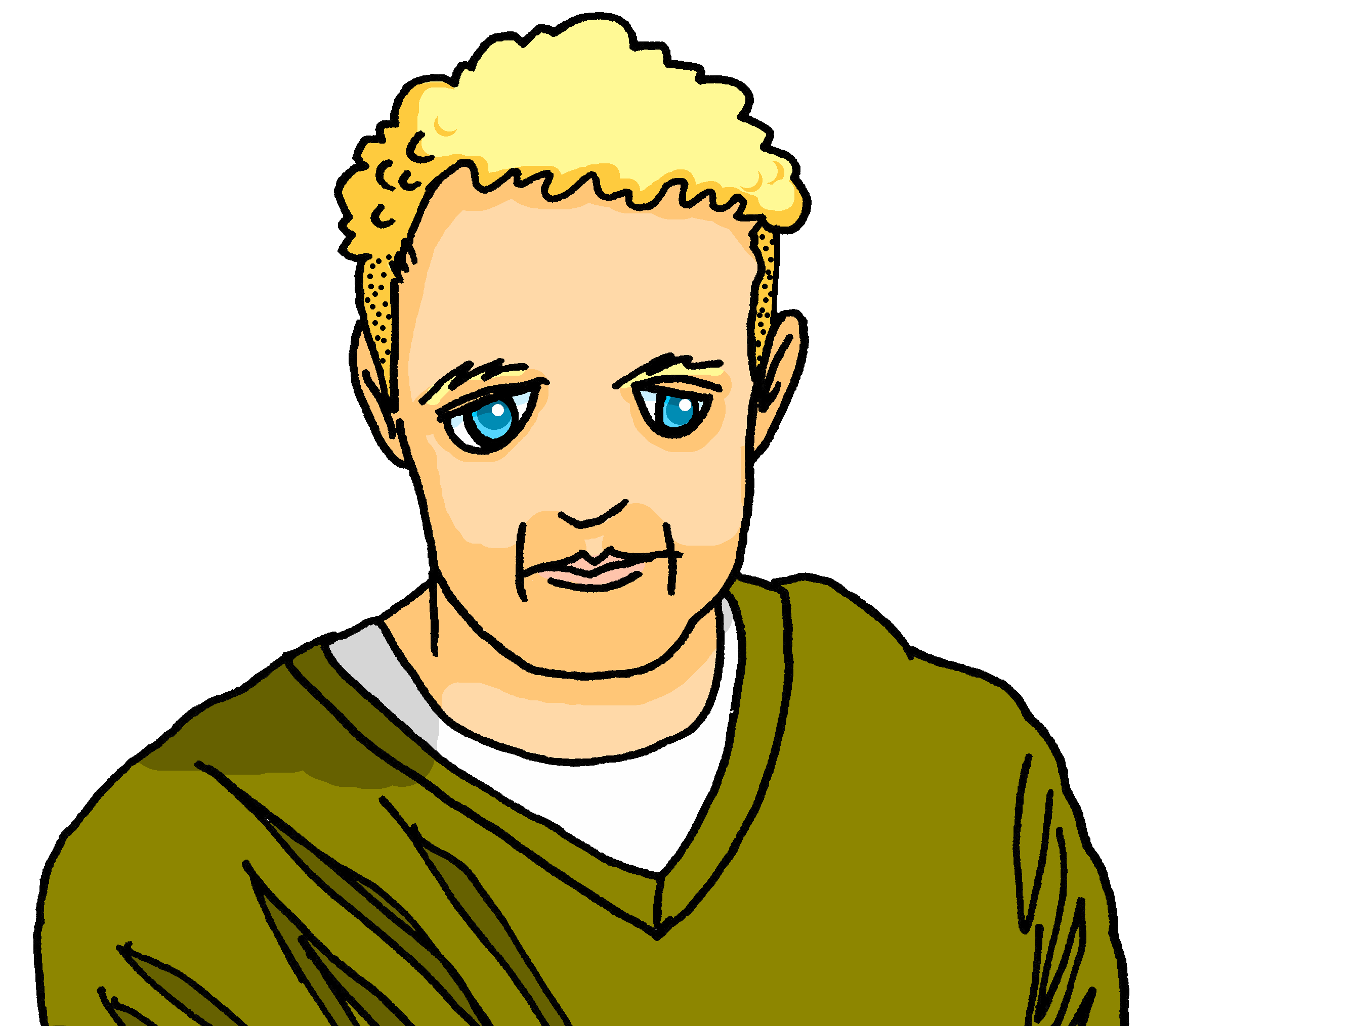
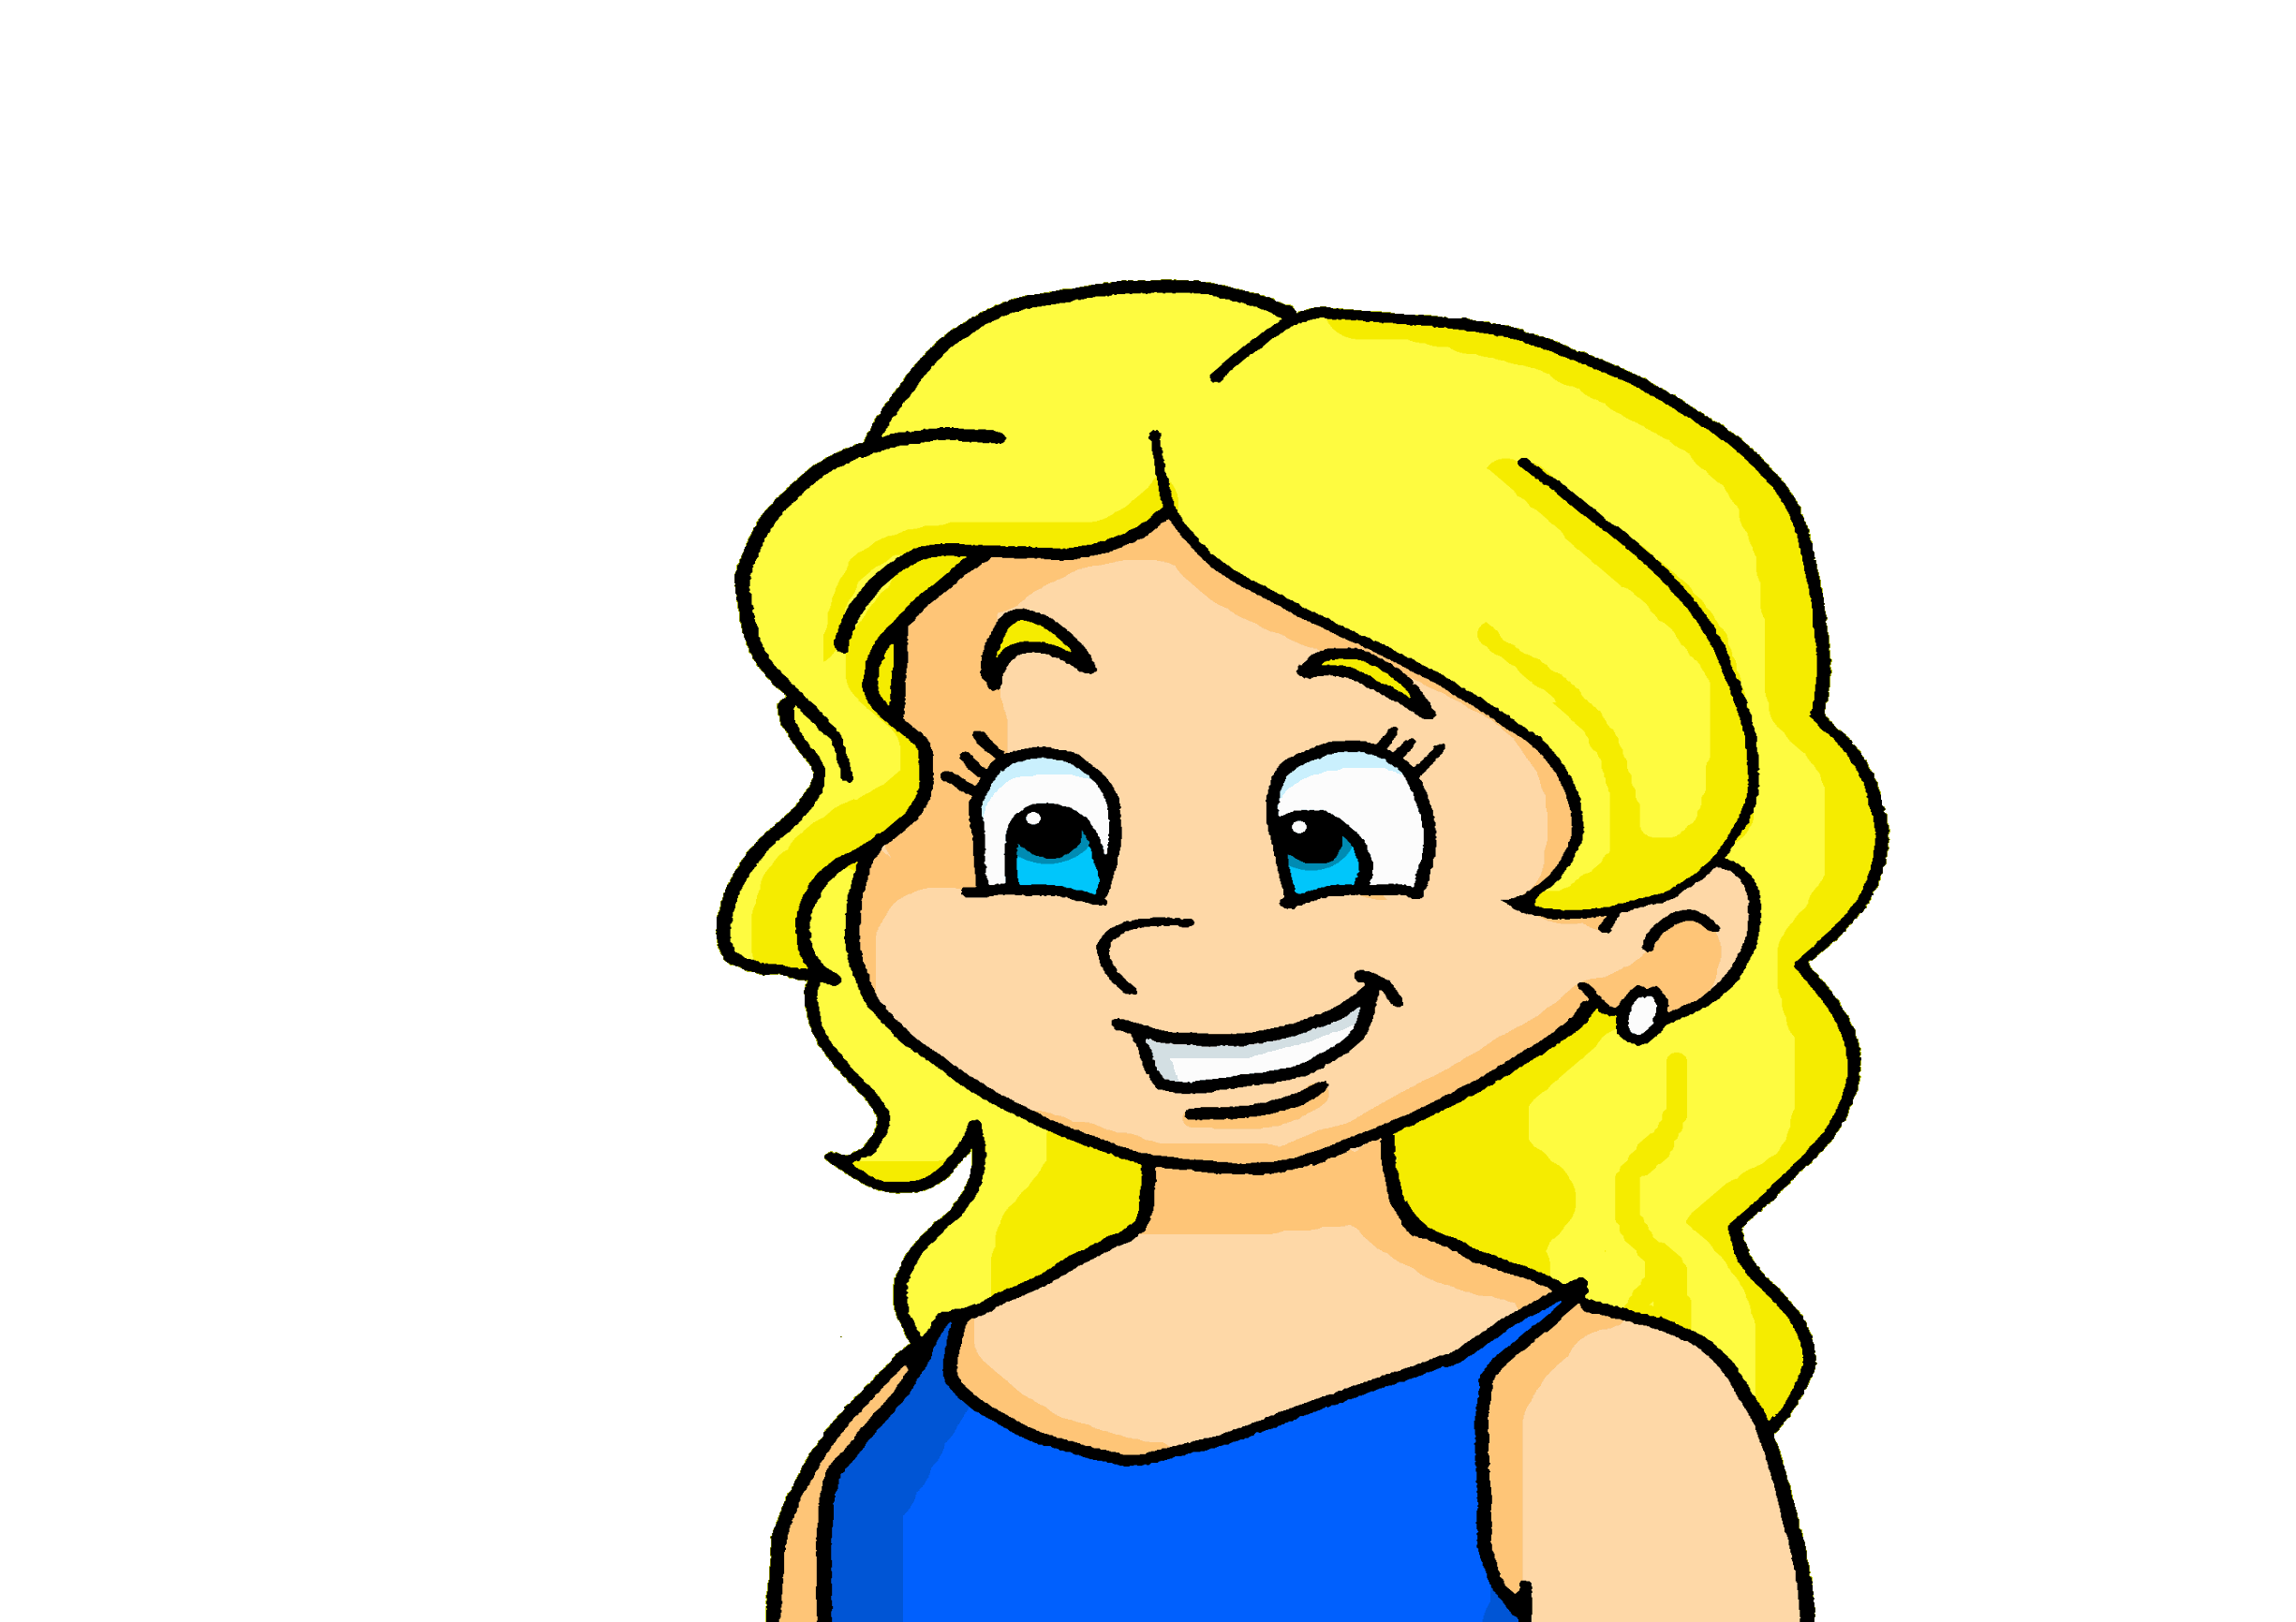
Follow up 4
Écoute. Quelle est la réponse correspondante ?
écouter
1
2
3
4
5
A
B
1
Oui, je fais le lit.
Je fais le lit.
2
Je fais la cuisine.
Oui, j’aime ça.
3
J’ai la liste.
Oui, j’ai la liste ici.
4
Je prépare la fête.
Oui, je prépare la fête.
5
Non, je ne fais pas les courses.
Je fais les courses.
Notes:
Timing: 5 minutes
Aim: to practise aural comprehension of and differentiation between ‘qu’est-ce que’ and ‘est-ce que’ questions.
Procedure:
Read the instruction in French. Explain that Est-ce que (is/are) questions are ‘yes/no’ questions, but that qu’est-ce que (what) questions require information and can’t be answered with a yes/no.
Do [1] with the pupils. Click to listen. Pupils write A or B, depending on the question they hear.
Click for answer.
Complete items 2-5 and click to correct with the class.
Transcript:
Qu’est-ce que tu fais maintenant ?
Est-ce que tu fais la cuisine ?
Est-ce que tu as la liste ?
Qu’est-ce que tu fais aujourd’hui ?
Est-ce que tu fais les courses ?

Slide 15
Follow up 5:
Parle avec ton/ta partenaire.
B: Ask your partner: What are you doing?
parler
Qu’est-ce que tu fais ?
A: Tell your partner: I am doing/making… and the 3 activities on your card.
Remember:
je fais means I do/make AND I am doing/making.
B: Ask your partner: What am I doing?
Qu’est-ce que je fais ?
A: Tell your partner: You are doing/making… and the 3 activities on your card.
Then swap roles!
B: Make sure you write down all six activities.
Notes:
Timing: 5 minutes
Aim: to practise oral production and comprehension of positive and negative statements with il y a/il n’y a pas and previously taught nouns.
Procedure:
1. Pupil A has Handout A (see end of this lesson PPT).
2. Pupil B listens to Pupil A and writes the three activities that start ‘You are doing/making…’ and the three that start ‘I am doing/making…’
3. Swap roles and move to the next slide.

Slide 16

Follow up 4A:
Réponses
A: Parle.
B: Écris.
Say: ‘You are doing/making …’ 3 activities
and ‘I am doing/making’… 3 activities.
parler
Listen and write the six activities.
Tu…
Tu…
Tu…
Je…
Je…
Je…
I am …
I am …
I am …
You are …
You are …
You are …
fais une liste.
making a list.
fais les courses.
doing the shopping.
fais un effort.
making an effort.
fais une carte.
making a card.
fais les devoirs.
doing homework.
fais un voyage.
doing/going on a trip.
Notes:
ANSWERS – DO NOT DISPLAY DURING THE ACTIVITY
Procedure:
Elicit French from partner As and English from partner Bs.
Click to reveal written answers.
Continue with the answers for 4B on the next slide.

Slide 17
Follow up 4B:
Réponses
A: Écris.
B: Parle.
Tell your partner: ‘You are going …’ to 3 places and ‘I am going’… to 3 places.
parler
Listen and write the six places.
Tu…
Tu…
Tu…
Je…
Je…
Je…
I am …
I am …
I am …
You are …
You are …
You are …
fais un cadeau.
making a present.
fais la cuisine.
doing the cooking.
fais une activité.
doing an activity.
fais un gâteau.
making a cake.
fais le ménage.
doing the housework.
fais les courses.
doing the shopping.
Notes:
ANSWERS – DO NOT DISPLAY DURING THE ACTIVITY

Slide 18
vocabulaire
Follow up 2a - Écris en anglais : Can you get at least 15 points?
mots
 | aimer | vous | aller
 | le feu | le vœu | le chapeau
 | à | le sud | le nord
 | je vais | aller | l’est
 | le Canada | elle va | l’ouest
 | l’effort | le voyage | tu fais
x3
x2
x1
Notes:
HANDOUT
18

Slide 19
vocabulaire
Follow up 2b - Écris en français : Can you get at least 15 points?
mots
 | (the) hat | (the) fire | (the) good wish
 | to like, liking | to have, having | you (all, formal)
 | (the) south | (the) east | (the) west
 | to, at, in | (the) Canada | (the) north
 | to go, going | I go, am going | she goes, is going
 | you do, make | (the) journey | (the) effort
x3
x2
x1
Notes:
HANDOUT
19

Slide 20



Follow up 4A:
Parle avec ton/ta partenaire.
A: Parle.
A: Écris.
Say: ‘You are doing/making …’ 3 activities
and ‘I am doing/making’… 3 activities.
Listen and write the six activities with either ‘doing’ or ‘making’.
parler
Tu…
Tu…
Tu…
Je…
Je…
Je…
I am …
I am …
I am …
You are …
You are …
You are …
Notes:
HANDOUT PARTENAIRE A

Slide 21

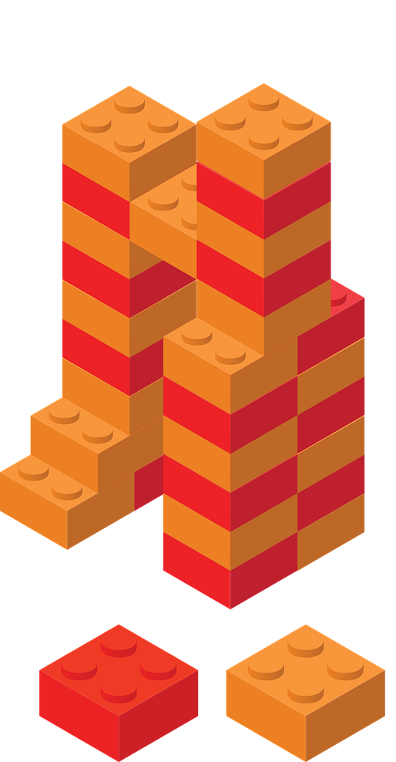
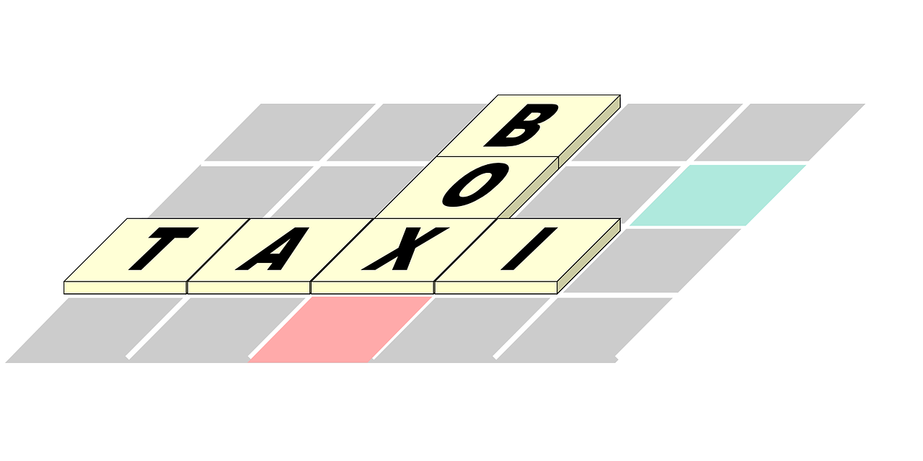



Follow up 4B:
Parle avec ton/ta partenaire.
B: Écris.
B: Parle.
parler
Listen and write the six activities with either ‘doing’ or ‘making’.
Say: ‘You are doing/making …’ 3 activities
and ‘I am doing/making’… 3 activities.
I am …
I am …
I am …
You are …
You are …
You are …
Tu…
Tu…
Tu…
Je…
Je…
Je…
Notes:
HANDOUT PARTENAIRE B

