Slide 1
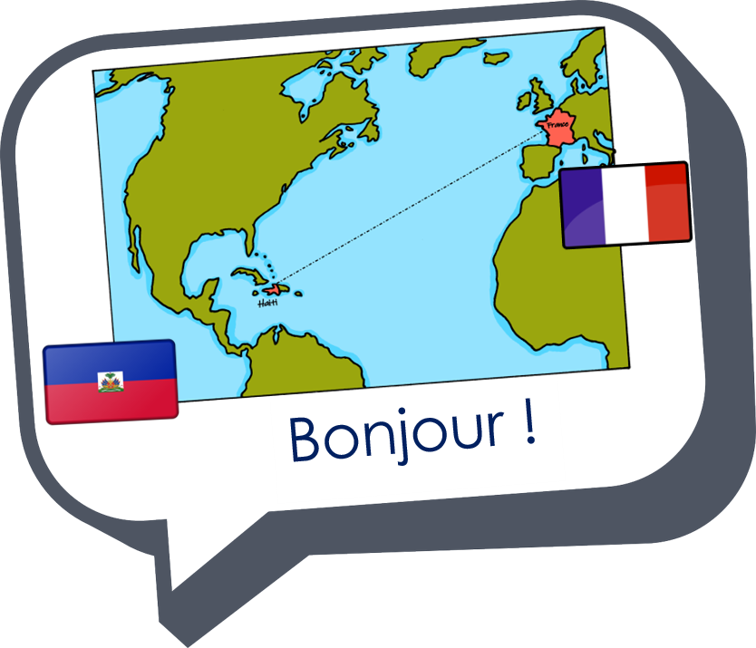


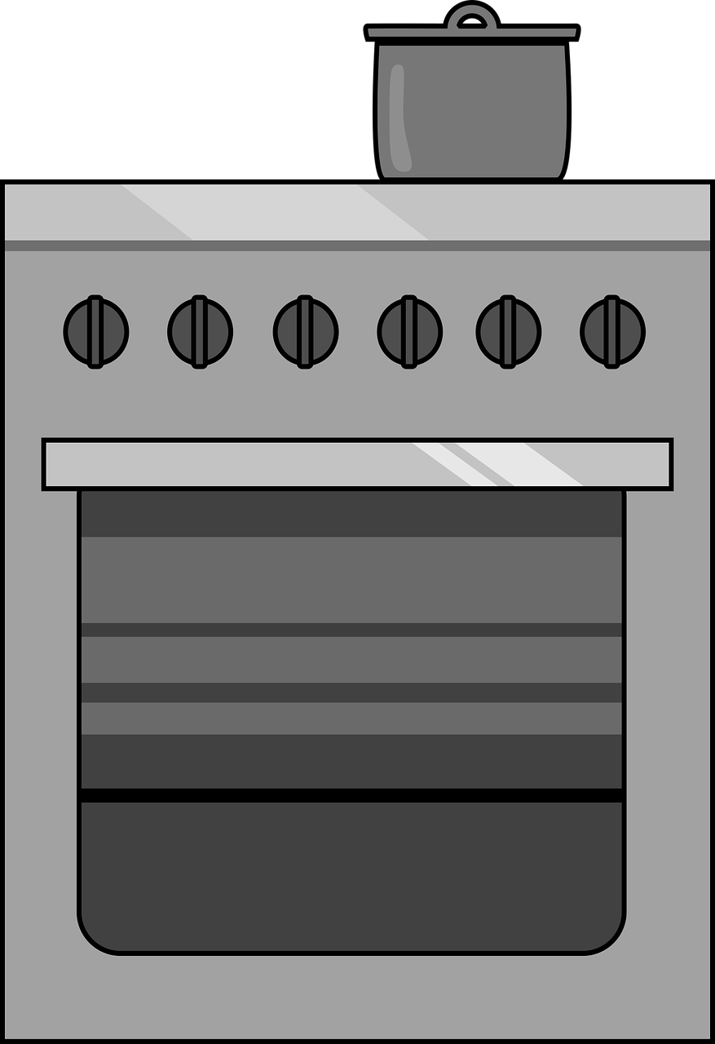

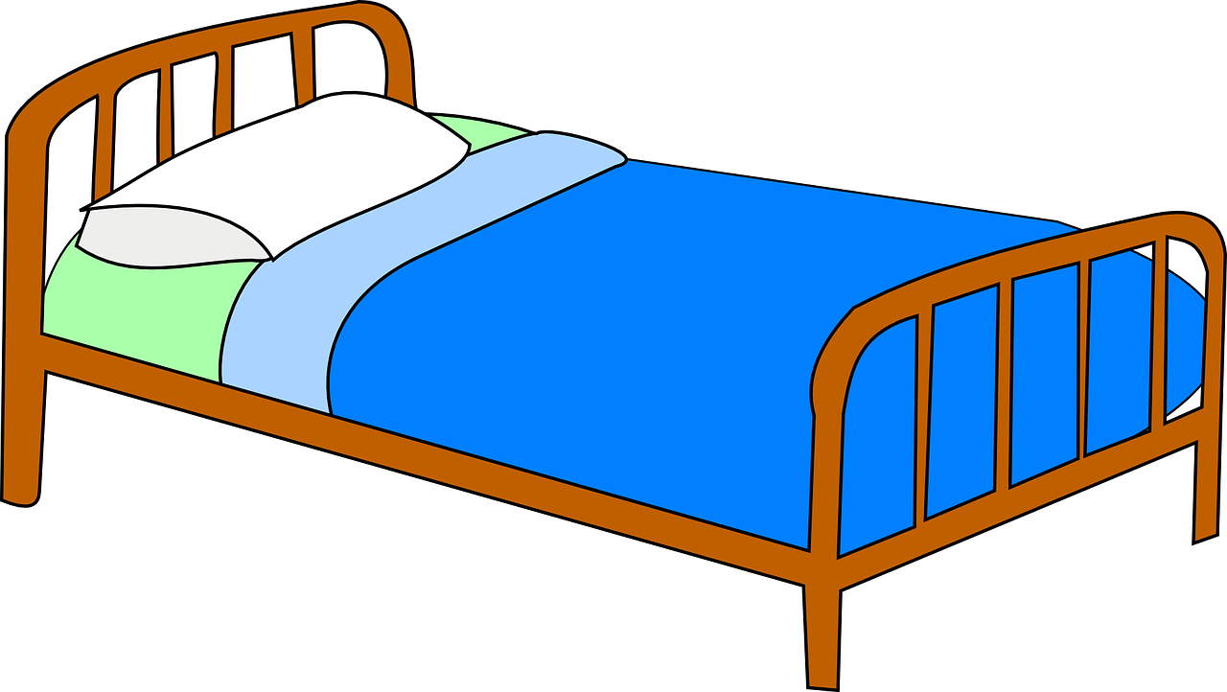
Saying what I and others do
bleu
faire (je fais, tu fais)
SFe or SFC
Notes:
Artwork by Steve Clarke. Pronoun pictures from NCELP (www.ncelp.org). All additional pictures selected from Pixabay and are available under a Creative Commons license, no
attribution required.
Phonics: Revisit SSC [SFe] - vrai [292] maison [325] aider [413] raison [72] aimer [242] semaine [245]
Vocabulary (new words in bold): faire, je fais, il/elle fait [25] activité [452] cuisine [2618] courses [1289] ménage [2326]
Revisit 1: il y a un [3] deux [41], trois [115], quatre [253], cinq [288], six [450], sept [905], huit [877], neuf [787], dix [372], onze [2447], douze [1664] des [2] combien [800] treize [3285], quatorze [3359], quinze [1472], seize [3285], dix-sept [3812], dix-huit [3592], dix-neuf [4851], vingt [1273], vingt et un [1273/6/3], vingt-deux, vingt-trois, vingt-quatre, vingt-cinq, vingt-six, vingt-sept, vingt-huit, vingt-neuf, trente [1646]
Revisit 2: célébrer [2170] échanger [1452] fabriquer [1231] souhaiter [403] feu d'artifice [>5000] rue [598] tout le monde [n/a]
Londsale, D., & Le Bras, Y. (2009). A Frequency Dictionary of French: Core vocabulary for learners London: Routledge.
The frequency rankings for words that occur in this PowerPoint which have been previously introduced in these resources are given in the SOW and in the
resources that first introduced and formally re-visited those words.
For any other words that occur incidentally in this PowerPoint, frequency rankings will be provided in the notes field wherever possible.
1

Slide 2



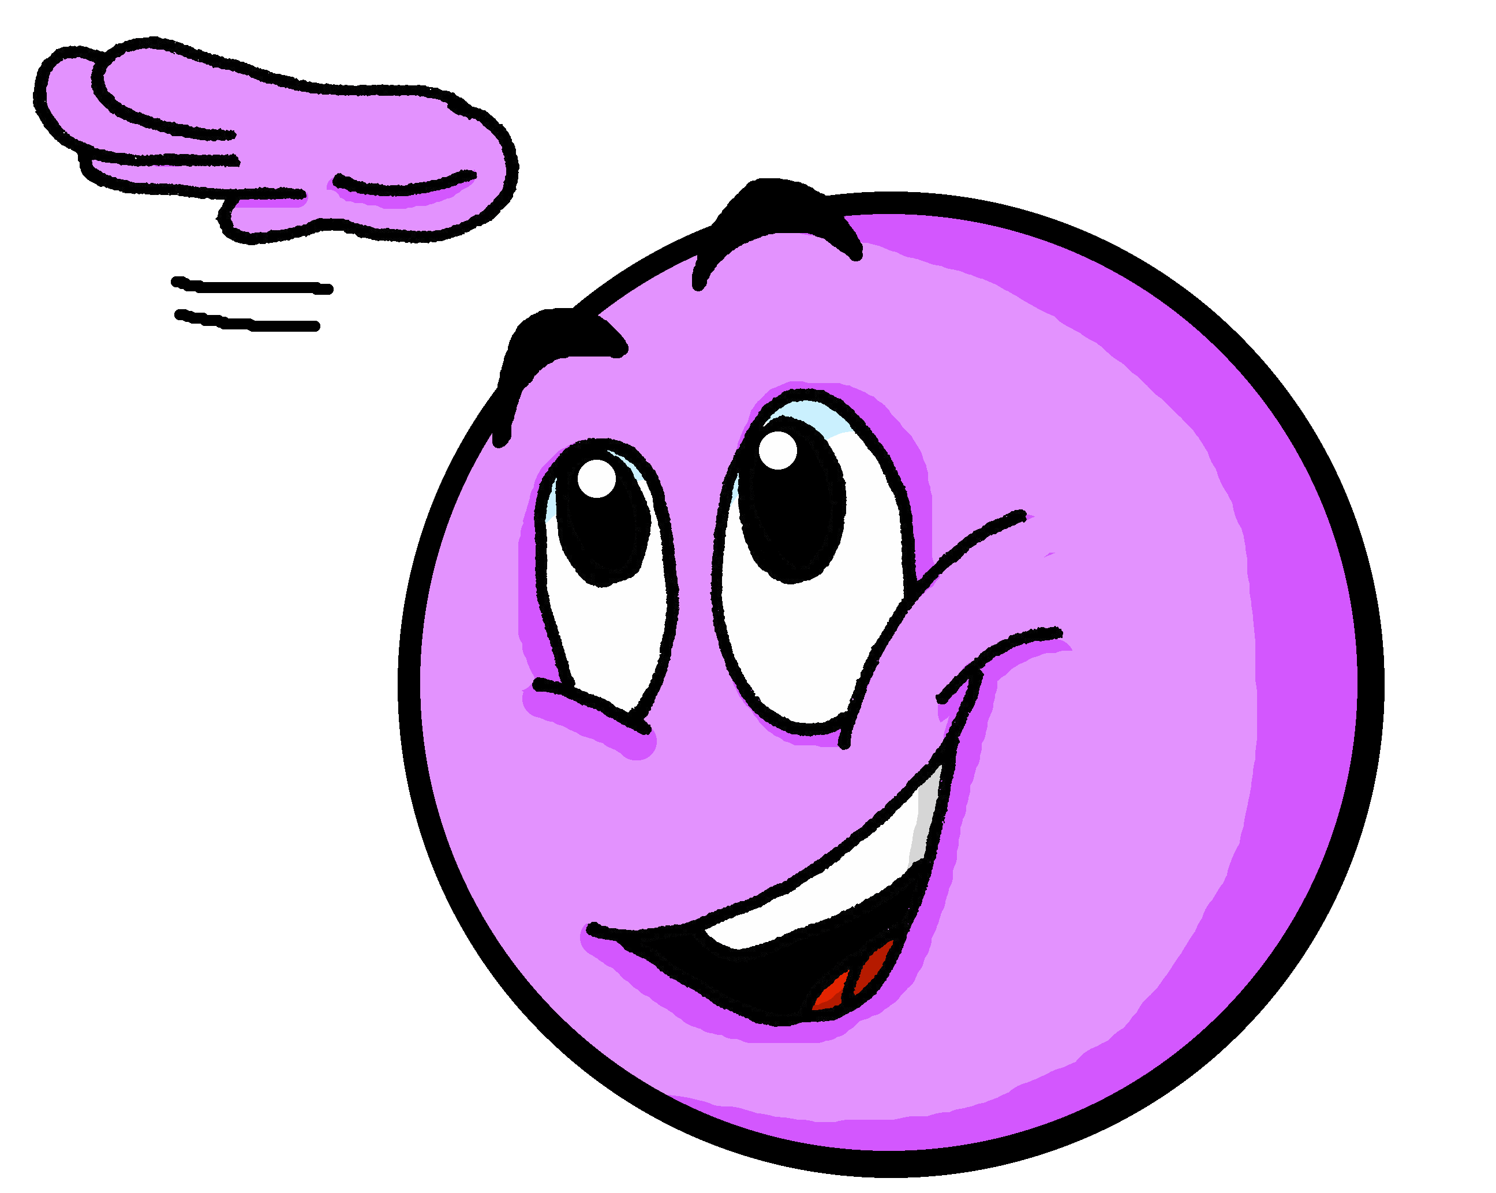




[SFC] Silent final consonant
prononcer
You know that in French we often don’t pronounce the final consonant:
petit
mais
grand
deux
[but]
Notes:
Timing: 1 minute
Aim: to recap [SFC] with –t, -s, -d, -x and introduce awareness of consonants –c, -r, -f, and –l, which are often pronounced.
Procedure:
Click through the animations to present the information.
2

Slide 3






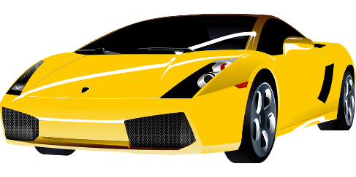

prononcer
[SFe]
monde
timide
douze
[shy]
centre
moderne
Notes:
Timing: 2 minutes
Aim: to recap SSC [SFe]
Procedure:
1. Practise the pronunciation of the individual SSC [SFe] and then the source word again ‘timide’ (with gesture, if using).
2. Then present and elicit the pronunciation of the four cluster words.
Frequency:
monde [77] moderne [1239] centre [491] vie [132] douze [1664] timide [3835]
Source: Londsale, D., & Le Bras, Y. (2009). A Frequency Dictionary of French: Core vocabulary for learners London: Routledge.
3

Slide 4


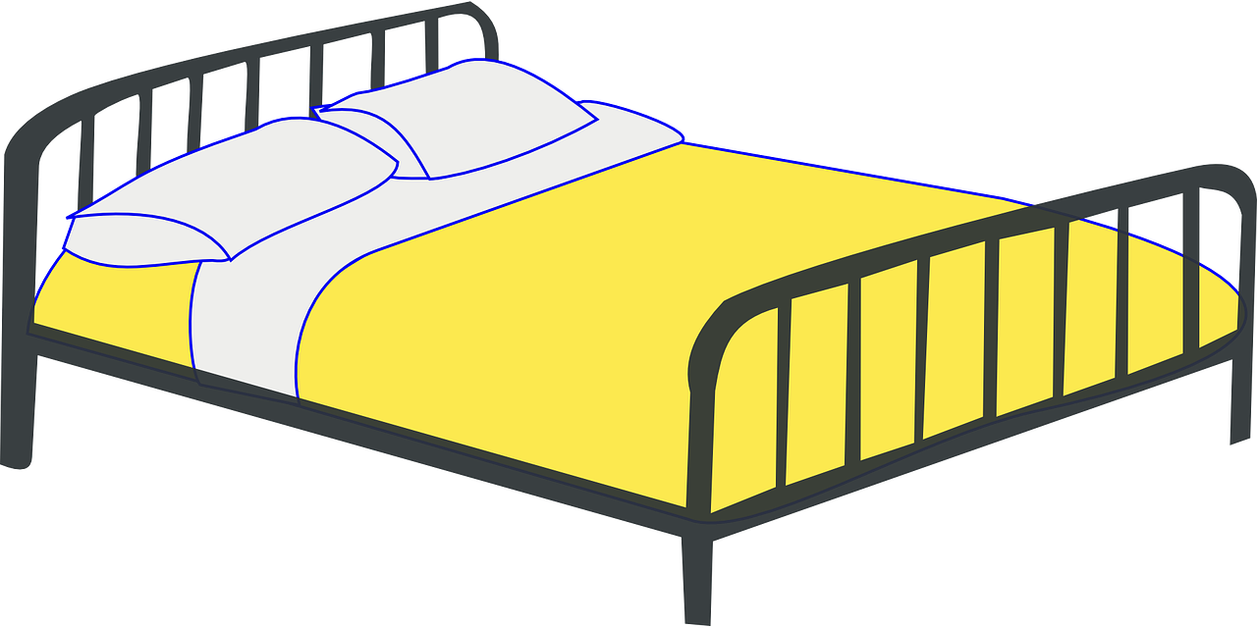



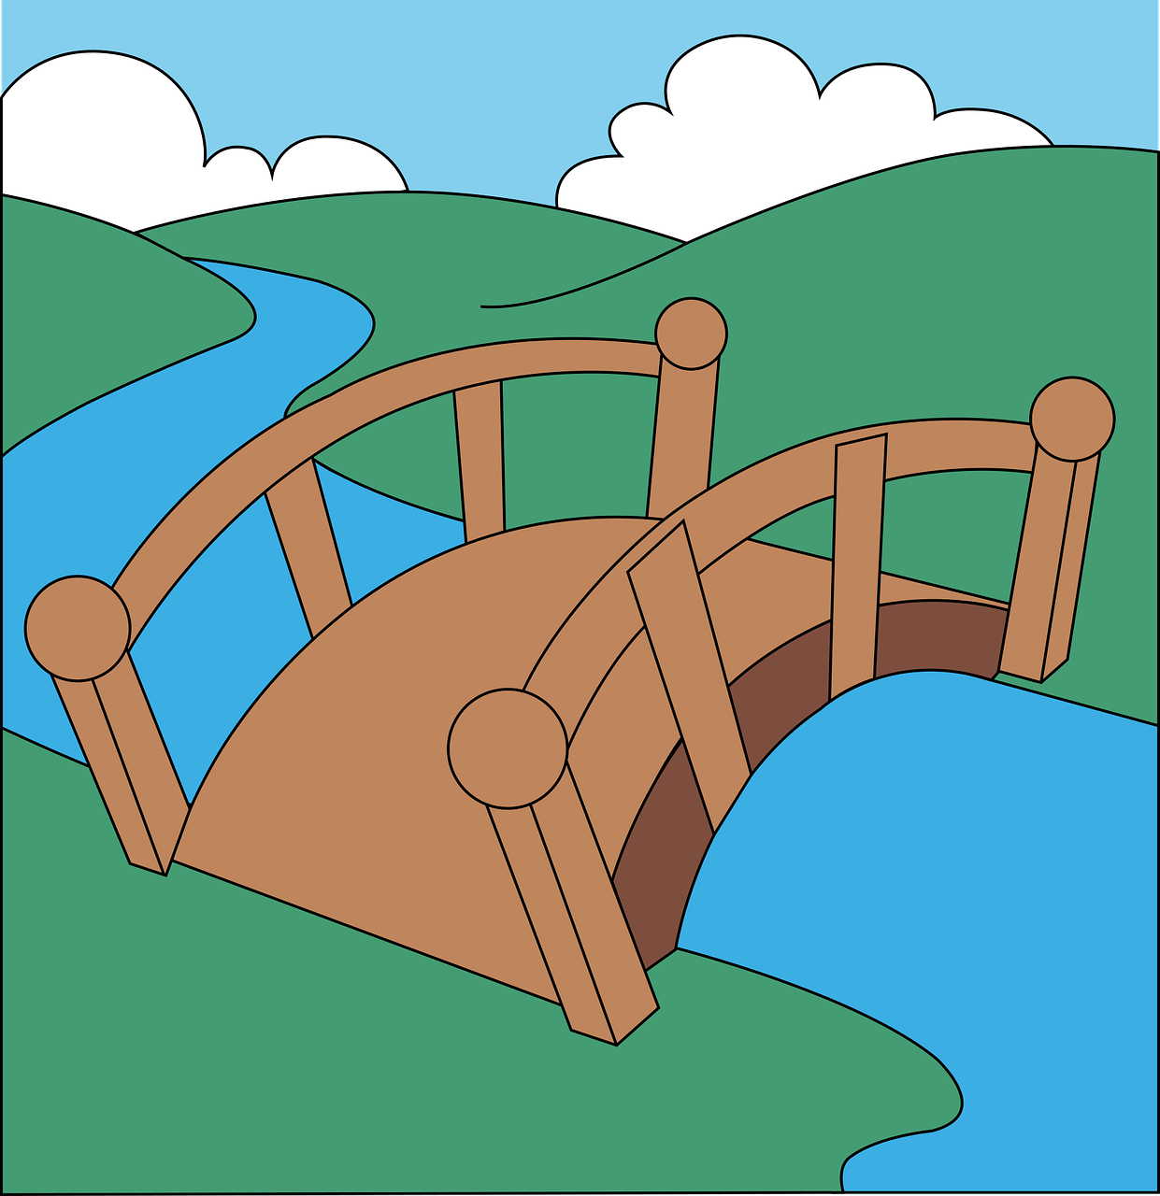
SFe ou SFC ?
Écoute. C’est avec ‘e’ ou sans ‘e’ ?
prononcer
Puis, prononce les mots.
c u i s i n e
l i t
c o u r s e
l i s t e
c a r t e
p o è t e
e f f o r t
p o n t
1
_
5
_
2
_
6
_
_
7
_
3
4
_
8
_
Notes:
Timing: 5 minutes
Aim: to practise aural distinction between words with SFe and SFC.
Procedure:
Read the instruction.
Do the first one with pupils. Remind them that if they hear the final consonant pronounced there is a SFe.
They can write down either [e] or [--].
Elicit responses chorally, and click to reveal the answers.
Transcript:
cuisine
lit
course
liste
carte
poète
effort
pont
Frequency of unknown words and cognates:
course(s) [1289] cuisine [2618] effort [388] poète [2307] pont [j1889]
Londsale, D., & Le Bras, Y. (2009). A Frequency Dictionary of French: Core vocabulary for learners London: Routledge.

Slide 5



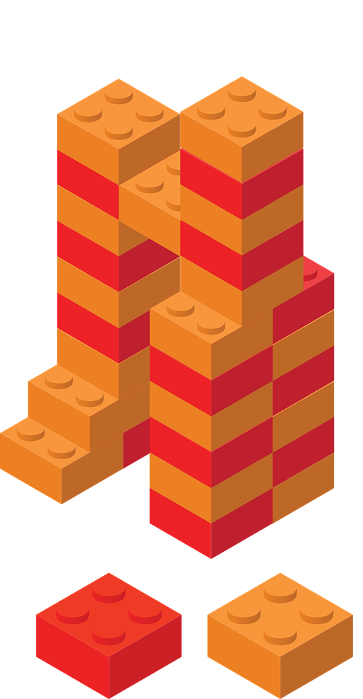
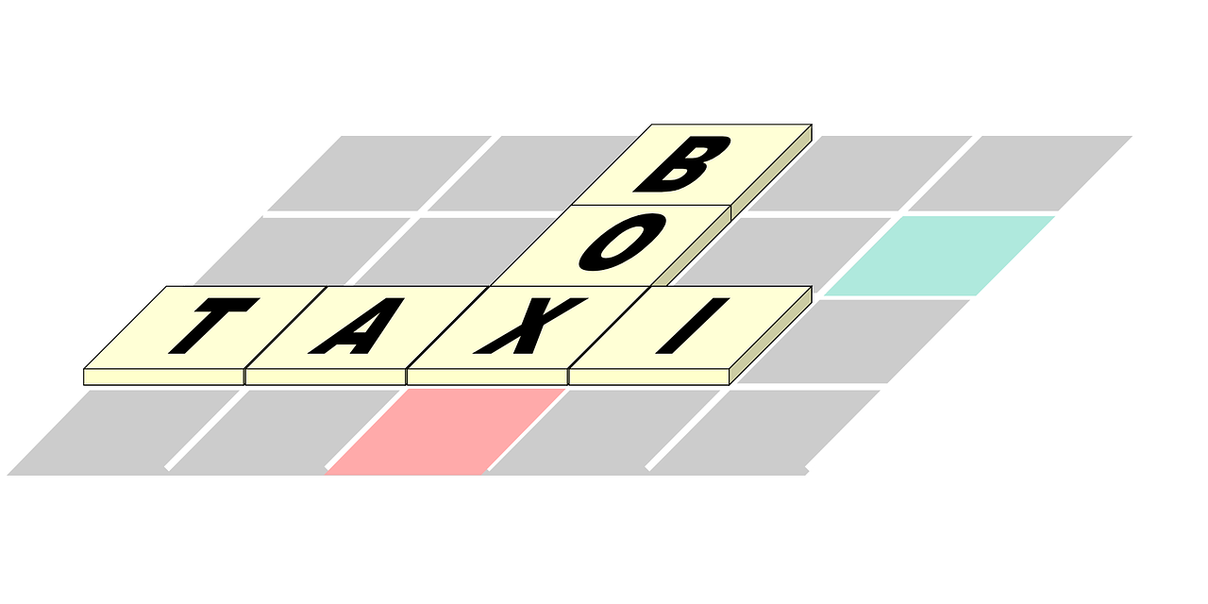
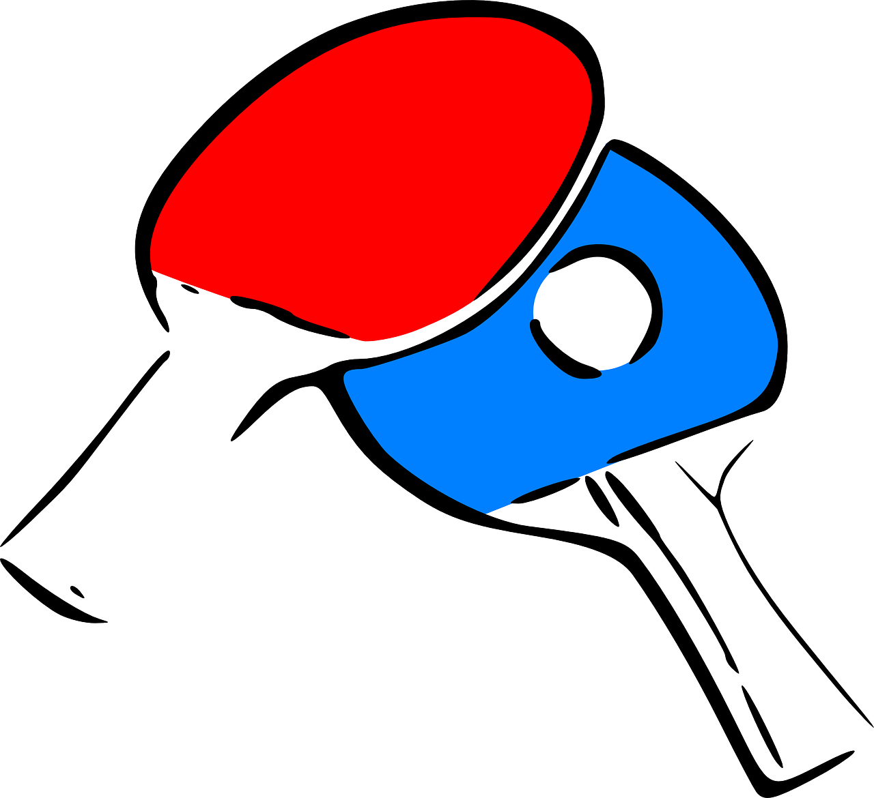
vocabulaire
Vocabulaire
mots
Comment dit-on ça en français ?
la cuisine
le ménage
cooking
housework
les courses
l’activité
shopping
activity
Notes:
Timing: 5 minutes
Aim: to present and practise written comprehension and read aloud of the new vocabulary for this week.
Procedure:
1. Click for a French word. Elicit pronunciation from pupils.
2. Click for the English meaning and picture prompt. Elicit the French word again.
3. Present all five words like this, in order.
4. Click for one English meaning to disappear. Elicit the English meaning from pupils. Continue with the remaining items.
5. Click for the French word to disappear. Elicit the French from pupils. Continue with the remaining items.
5

Slide 6


faire (to do and to make)
We use the verb faire to mean to do and to make.
⚠ The –s is a Silent Final Consonant (SFC).
je fais
I do|I make
⚠ The –t is a Silent Final Consonant (SFC).
il fait
he does | he makes
Elle fait
she does | she makes
Notes:
Timing: 2 minutes
Aim: to introduce two forms of the irregular verb faire.
Procedure:
Click through the animations to present the information.
Elicit English translations for the French examples provided.

Slide 7



faire le pont
Faire le pont literally means ‘to make the bridge’.
But French people say this to mean ‘to take a long weekend’.
When a national holiday day falls on a Tuesday or Thursday, many people will ‘faire le pont’ to make a four-day weekend.
Mai 2022
Lu. | Ma. | Me. | Je. | Ve. | Sa. | Di.
23 | 24 | 25 | 26 | 27 | 28 | 29
Ascension
Notes:
Timing: 2 minutes
Aim: to introduce an idiomatic expression with ‘faire’.
Procedure:
Click through the animations to present the information.
Explain that Ascension day is a national holiday in France and falls on a Thursday this year, so many people will take Friday off work and create a bridge from jeudi (Thursday) to dimanche (Sunday).

Slide 8
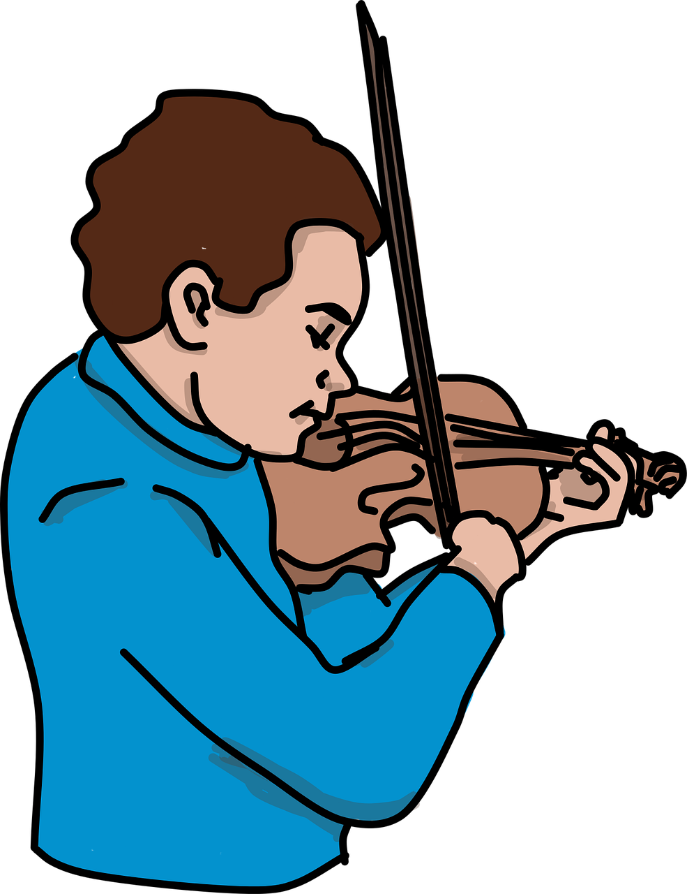
vocabulaire
Vocabulaire
mots
Comment dit-on ça en anglais ?
activity
effort
bed
cooking
shopping
music lesson
homework
housework
faire un cours de musique
faire la cuisine
faire une activité
faire les courses
faire le ménage
faire un effort
faire les devoirs
faire le lit
Notes:
Timing: 5 minutes
Aim: to consolidate understanding and pronunciation of faire + complementary nouns.
Procedure:
Click for French prompt.
Elicit English from pupils, paying attention to when it is it ‘to do’ and when ‘to make’.
Click to confirm.
Then click again to reveal each picture again and use the English to elicit the French for each phrase from pupils.
Note: with the exception of the cognate ‘effort’, all words have been previously taught or presented this lesson.
Word frequency of unknown words or cognates used (1 is the most frequent word in French):
effort [388]
Source: Londsale, D., & Le Bras, Y. (2009). A Frequency Dictionary of French: Core vocabulary for learners London: Routledge.
8

Slide 9

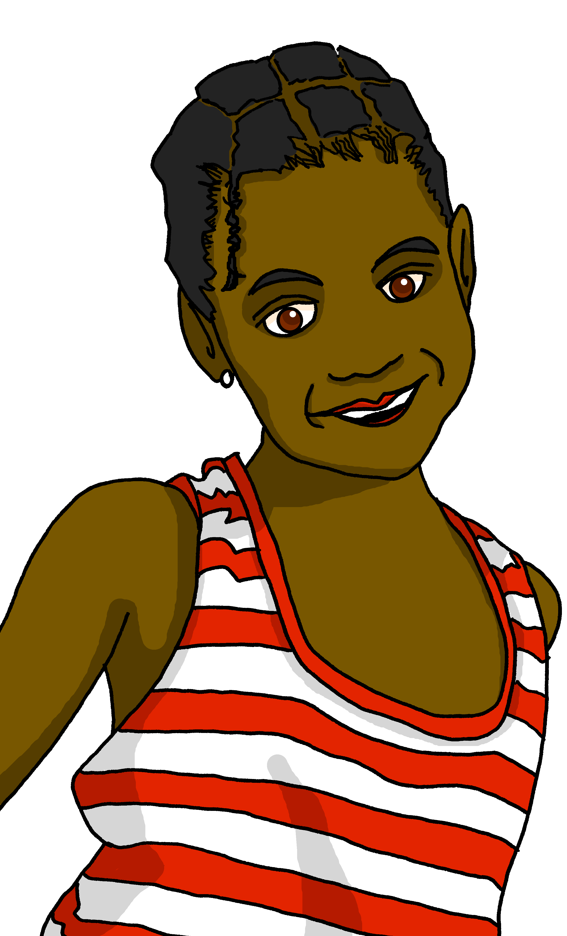
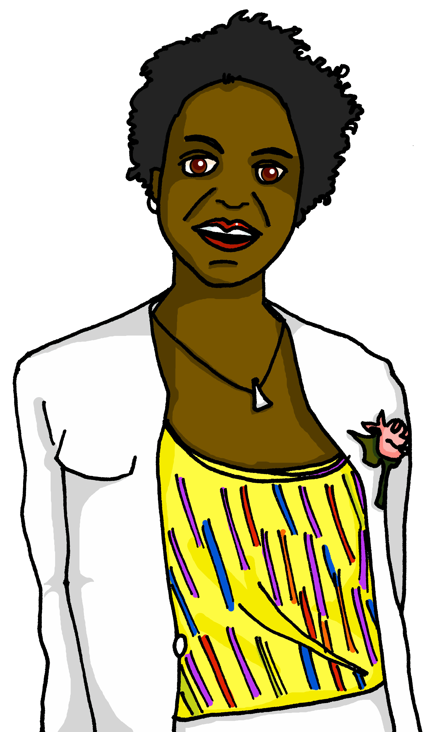

lire
Clémentine décrit ses* activités et les activités de sa* mère.
Qui fait quoi ? C’est Clémentine (I...) ou sa mère Annick (she...) ?
 | (je) | (elle)
Je fais la cuisine.
Je fais un effort.
Elle fait le ménage.
Je fais les devoirs.
 | (je) | (elle)
Elle fait un cours de musique.
Elle fait une activité.
Je fais le lit.
Elle fait les courses.
1
5
2
6
3
7
4
8
*sa, ses = her
Notes:
Timing: 5 minutes
Aim: to practise written recognition of the first and third person singular forms of ‘faire’ and connect these with meaning.
Procedure:
1. Pupils read the parts of sentences they can see and tick who they think it applies to. They should use their knowledge of verb forms to decide.
2. Answers revealed on clicks.
3. Optional – click the numbered buttons to hear the full sentences.
4. Ask additional questions to assess comprehension – e.g., who does the shopping? Who makes an effort?
5. Finally, ask pupils if any of the statements surprises them (e.g. Clémentine doing the cooking, or her mum doing a music lesson) – ask them if they do the same things as Clémentine at home. Do any of them do different things – e.g. the housework, the shopping or music lessons?
Word frequency of unknown words or cognates used (1 is the most frequent word in French):
effort [388]
Source: Londsale, D., & Le Bras, Y. (2009). A Frequency Dictionary of French: Core vocabulary for learners London: Routledge.

Slide 10

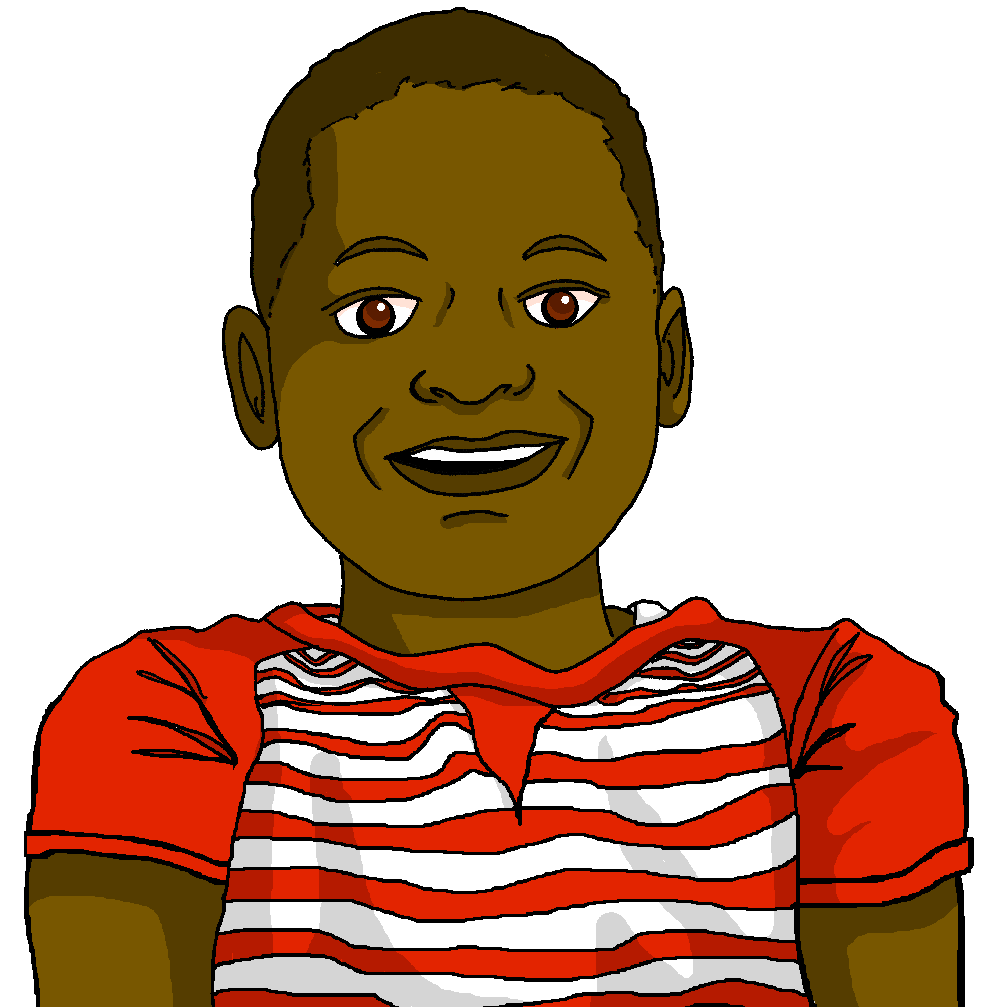
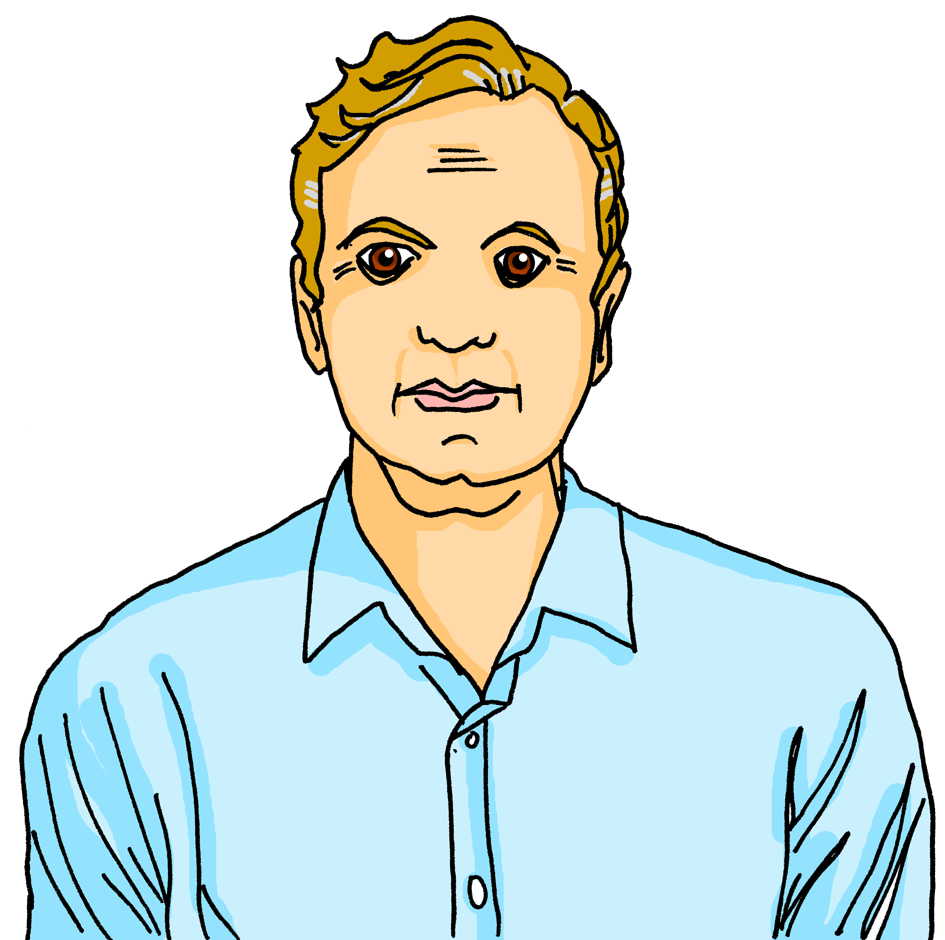
écouter
Écoute. Qui fait quoi ? Écris en anglais.
 | Activité | Extra info
1
makes bed
every day
does homework
Clémentine
does cooking
at the weekend
does housework
sometimes
2
does (lots of) activities
in the garden
Jean-Michel
does shopping
on Saturday
3
has a car
is doing cooking
Jacques
at the moment
Notes:
Timing: 5 minutes
Aim: to practise aural comprehension of this week’s vocabulary and use of 1st and 3rd persons of faire.
Procedure:
Pupils listen to each phrase.
Pupils note what each person does as well as any extra information they hear.
Click first to reveal what they do and then to reveal the extra information.
Transcript:
Je fais le lit et je fais les devoirs tous les jours. Le weekend, je fais la cuisine.
Parfois, je fais le ménage. Je fais beaucoup d’activités dans le jardin, aussi.
J’ai une voiture et samedi je fais les courses. En ce moment, je fais la cuisine.
Word frequency of unknown vocabulary used (1 is the most frequent word in French):
sur [16], week-end [2475], normalement [2018]
Source: Londsale, D., & Le Bras, Y. (2009). A Frequency Dictionary of French: Core vocabulary for learners London: Routledge.
10

Slide 11
Au revoir !
bleu
Notes:
11

