Slide 1
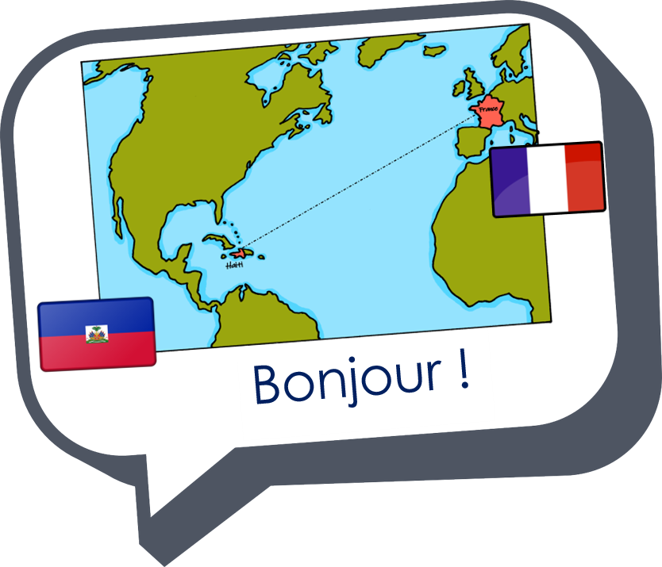

Describing me and others
bleu
lire un poème
Term 3 Week 13
Notes:
Artwork by Steve Clarke. Pronoun pictures from NCELP (www.ncelp.org). All additional pictures selected from Pixabay and are available under a Creative Commons license, no
attribution required.
Phonics: Revisit
Vocabulary: Revisit
Revisit 1: acheter [636] boire [1879] café [1886] eau [475] glace [2580] pain [2802] poisson [1616] manger [1338] partager [527] fruit [896]
Revisit 2: tu fais [25] effort [388] voyage [904] carte [955] gâteau [4845] liste [924]
Londsale, D., & Le Bras, Y. (2009). A Frequency Dictionary of French: Core vocabulary for learners London: Routledge.
The frequency rankings for words that occur in this PowerPoint which have been previously introduced in these resources are given in the SOW and in the resources that first
introduced and formally re-visited those words.
For any other words that occur incidentally in this PowerPoint, frequency rankings will be provided in the notes field wherever possible.
1

Slide 2


parler
Prononce les mots.
C’est [ien] ou [(a)in] ?
canadien
marocain
africain
60
italien
brésilien
haïtien
S
tunisien
égyptien
indien
0
DÉBUT
Notes:
Timing: 2 minutes
Aim: to practise pronunciation of the difference between [ien] and [(a)in].
Procedure:
Pupils pronounce the words in pairs.
2

Slide 3

écouter
Écoute. Écris le mot en français.
1
2
3
i n d i e n
__ __ __ __ __ __ __ __
__ __ __ __ __ __
t u n i s i e n
__ __ __ __ __ __ __
i t a l i e n
4
5
6
__ __ __ __ __ __ __ __
__ __ __ __ __ __ __ __
__ __ __ __ __ __ __
a f r i c a i n
m a r o c a i n
h a ï t i e n
Notes:
Timing: 4 minutes
Aim: to practise transcription of the difference between [ien] and [(a)in].
Procedure:
Pupils write the words they hear.
Transcript:
indien
tunisien
italien
africain
marocain
haïtien
3

Slide 4

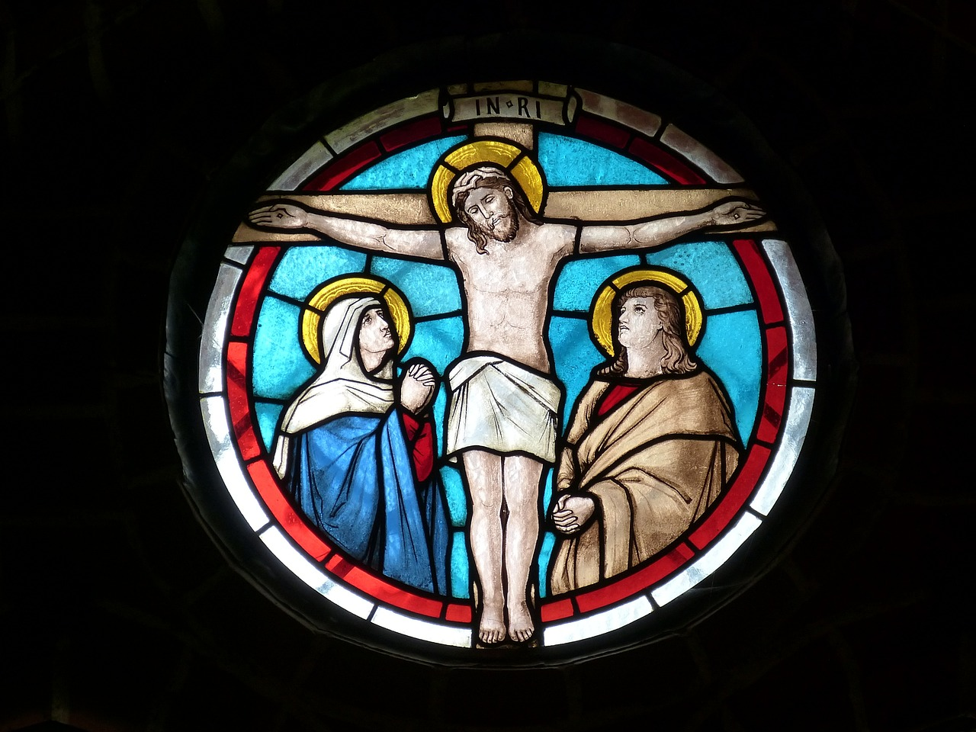
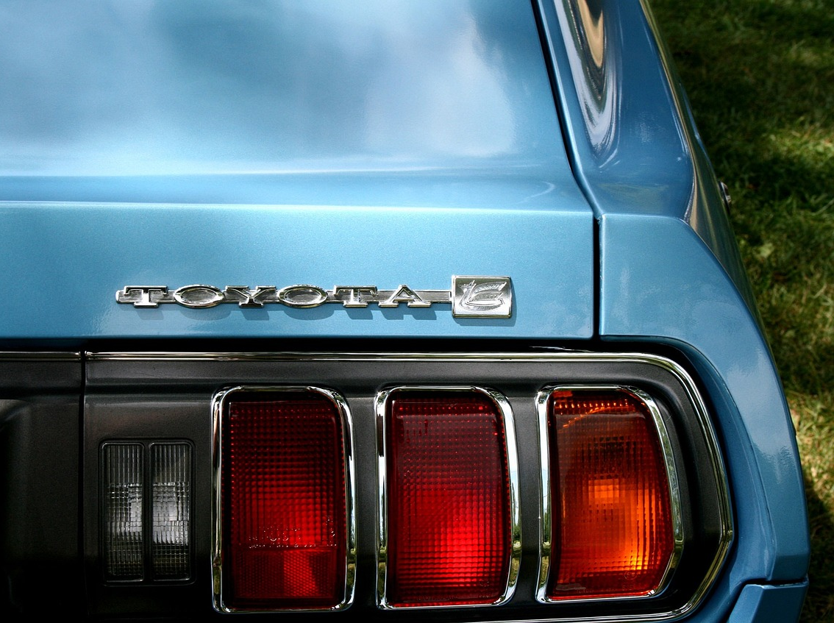
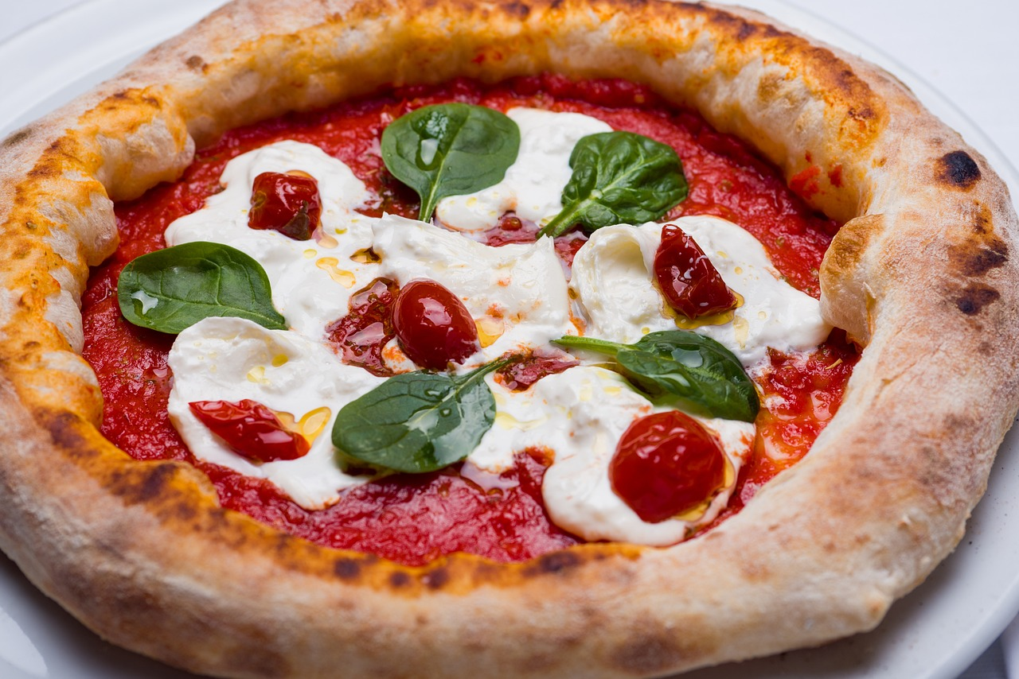
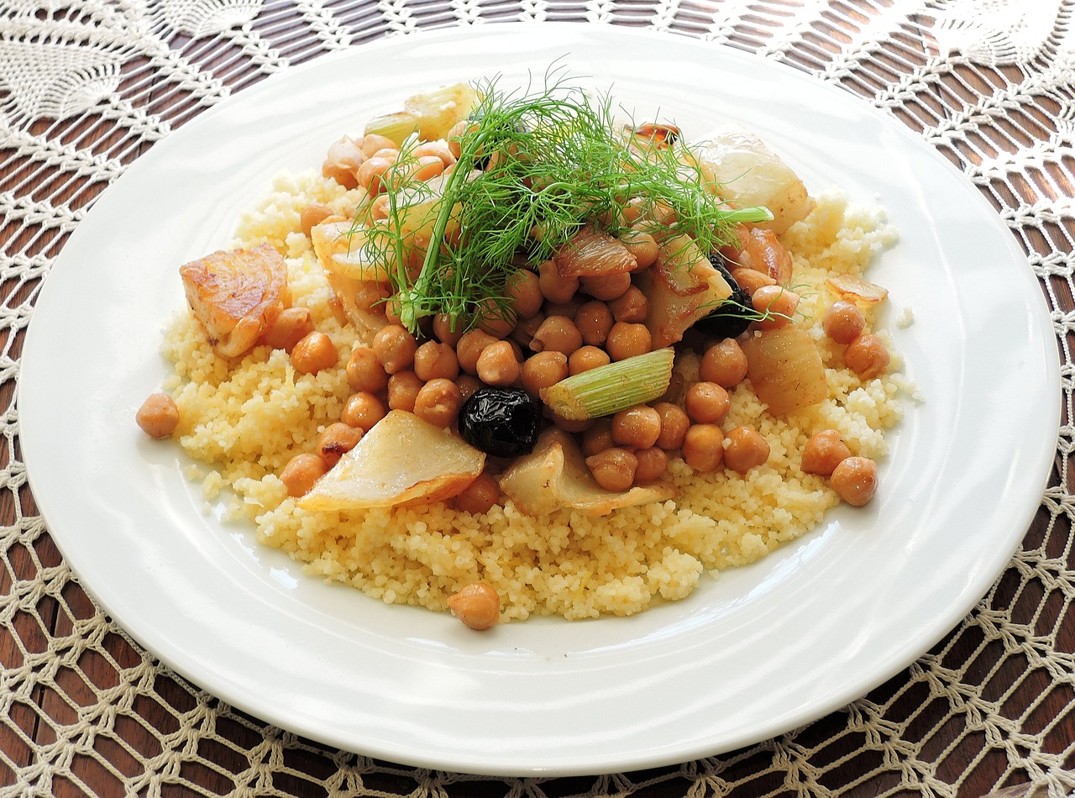

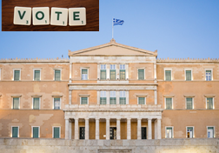
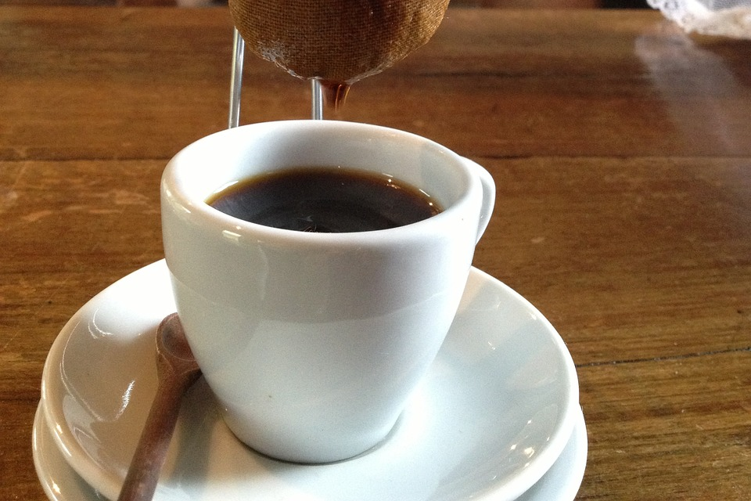

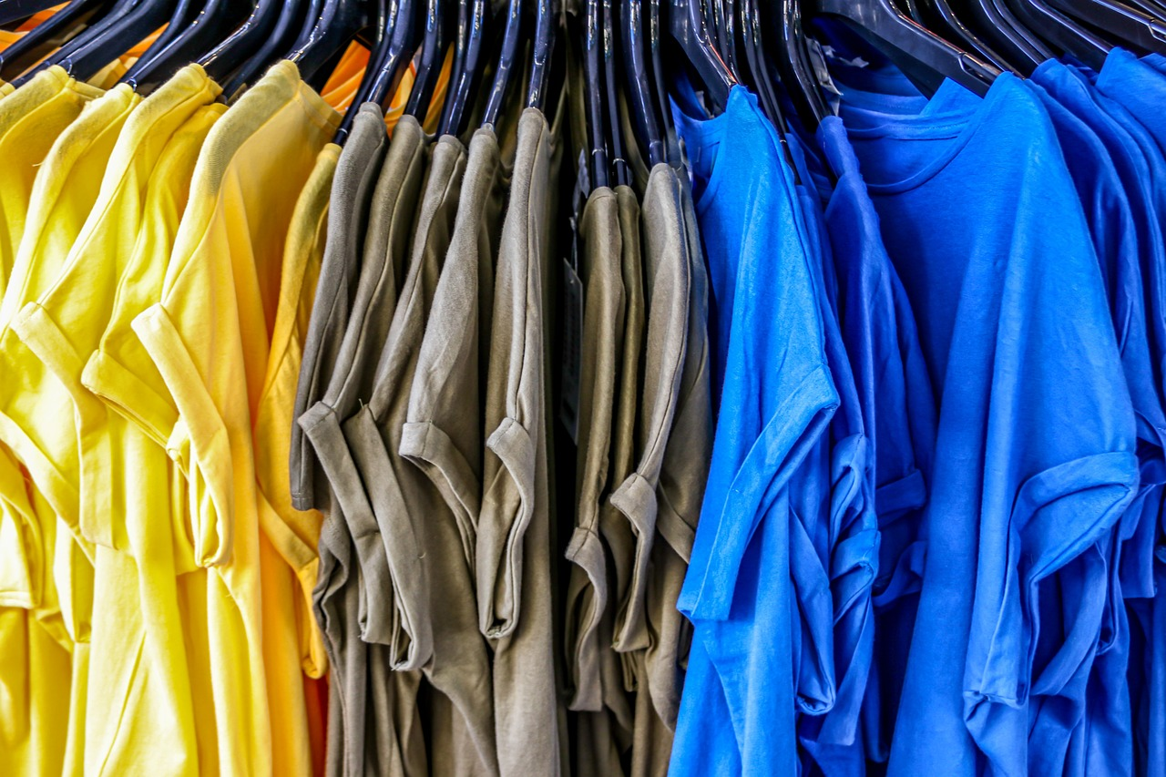
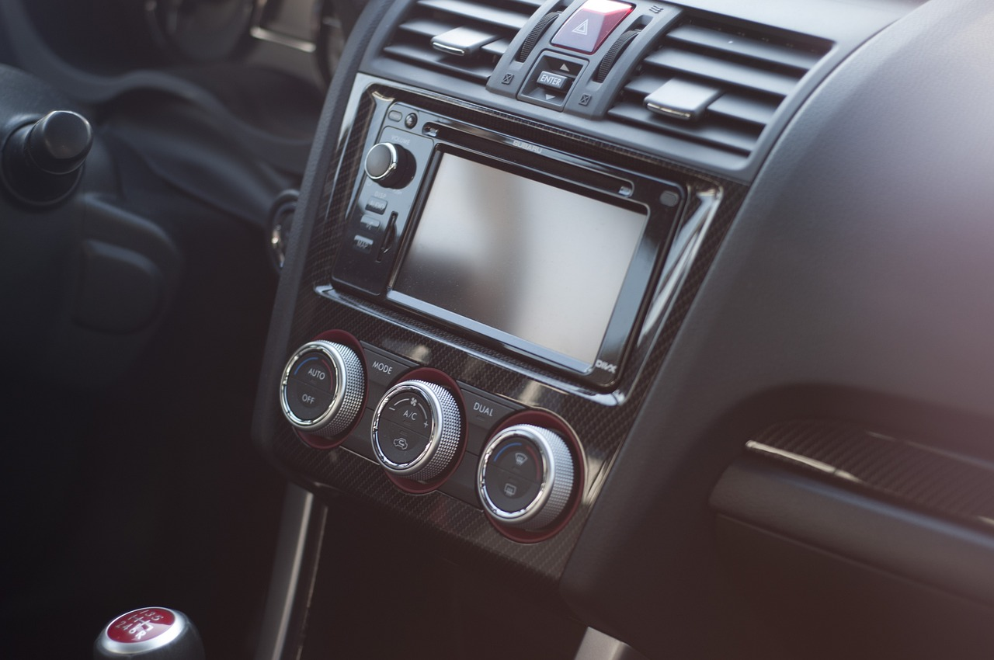
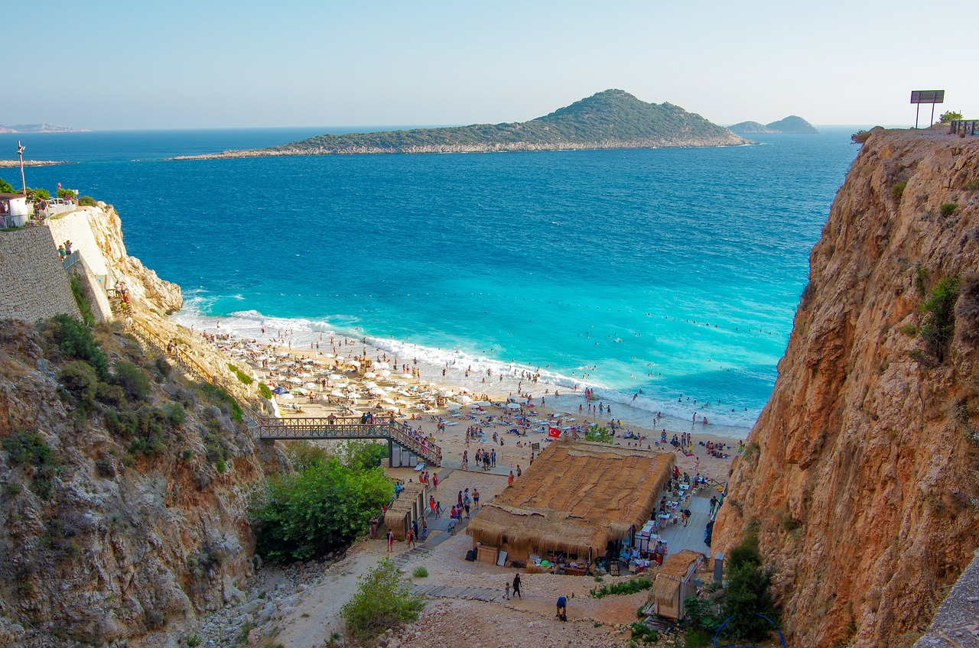
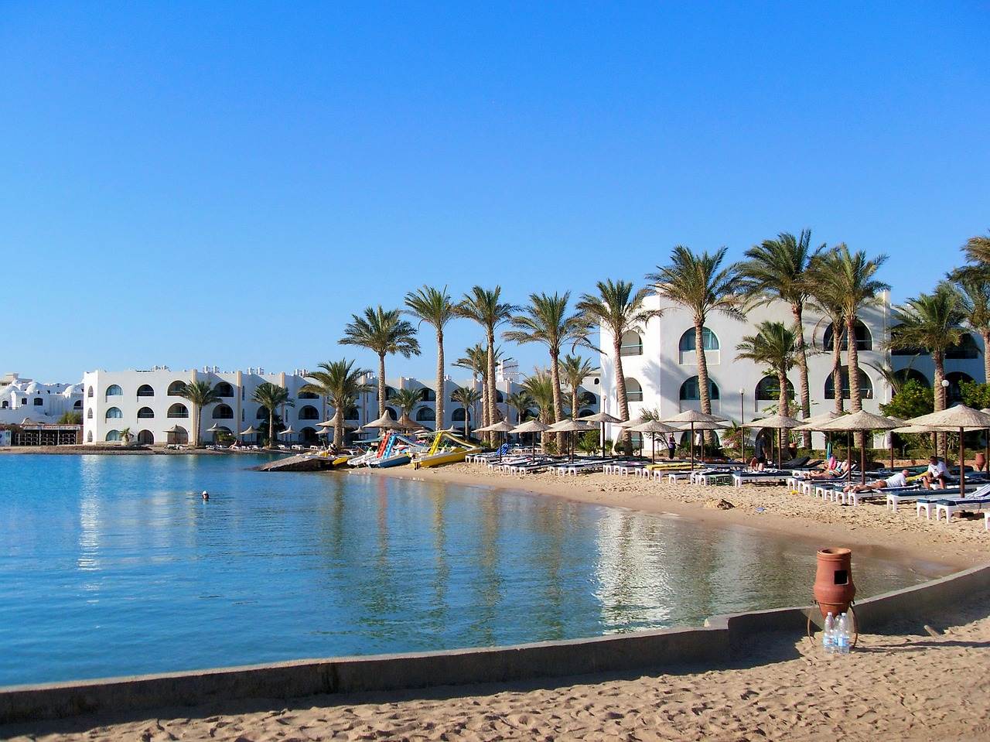

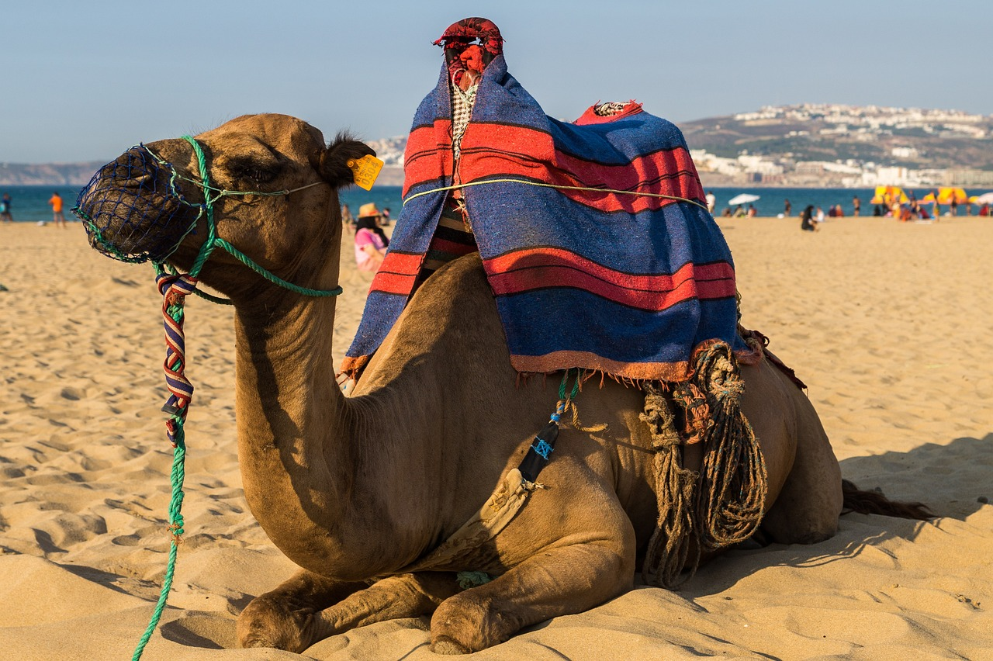
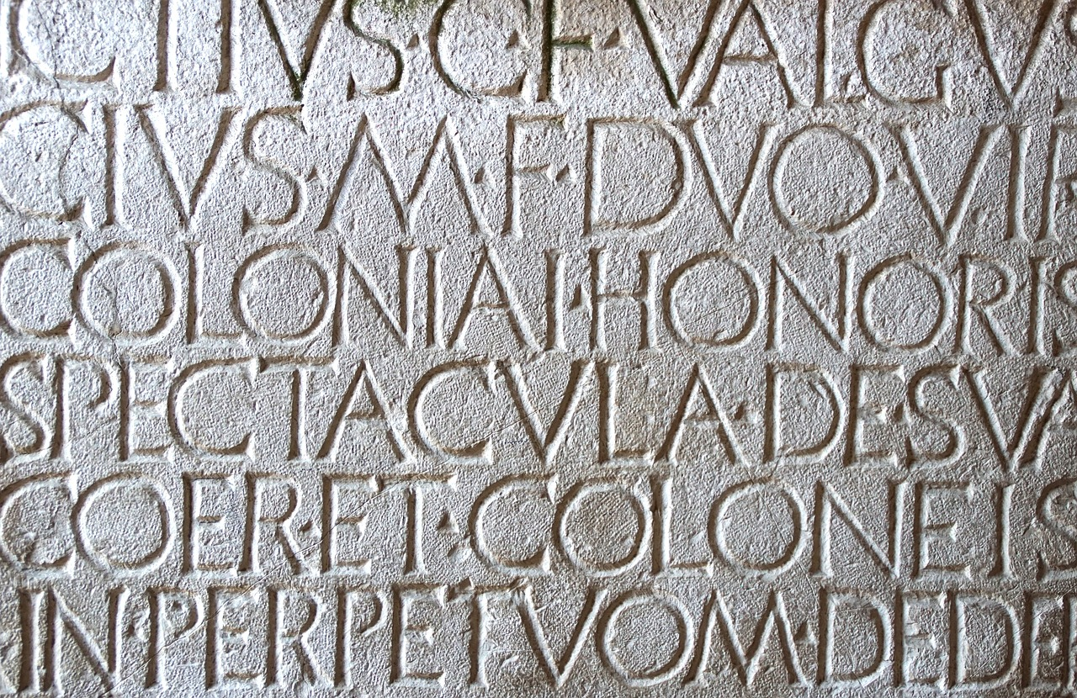

lire
Lis le poème avec ton/ta partenaire.
Ton Christ est juif,
Ta voiture est japonaise,
Ta pizza est italienne et ton coucous algérien,
Ta démocratie est grecque,
Ton café est brésilien,
Ta montre est suisse, ta chemise est indienne,
Ta radio est coréenne,
Tes vacances sont turques, tunisiennes ou marocaines,
Tes chiffres sont arabes, ton écriture est latine,
Et…Tu reproches à ton voisin d’être étranger.
Notes:
Timing: 2 minutes
Aim: to practise read aloud in pairs.
Procedure:
Pupils take turns to read a line of the poem each, in pairs.
4

Slide 5

parler
Il est comment, le poème ?
Quel est le message ?
simple
vrai
60
Le poème est…
positif
et aussi…
heureux
drôle
S
sérieux
différent
mais il n’est pas…
important
intéressant
0
utile
DÉBUT
Notes:
Timing: 4 minutes
Aim: to appreciate the poem and respond to it by exchanging their opinion with a partner; to revisit previously taught adjectives in a new context.
Procedure:
Teachers to read the instruction and model the exchange. For example: ‘Le poème est positif…’.
Give pupils a minute to exchange their opinion, using two adjectives.
Click to bring up further question: Le message, c’est quoi ? and ensure meaning is clear. This is an opportunity to gather ideas on what they think the message of the poem is about (‘We’re all different, with different characteristics and abilities, and yet of equal value’.).
Give pupils a minute to exchange their opinion on the message of the poem.
5

Slide 6
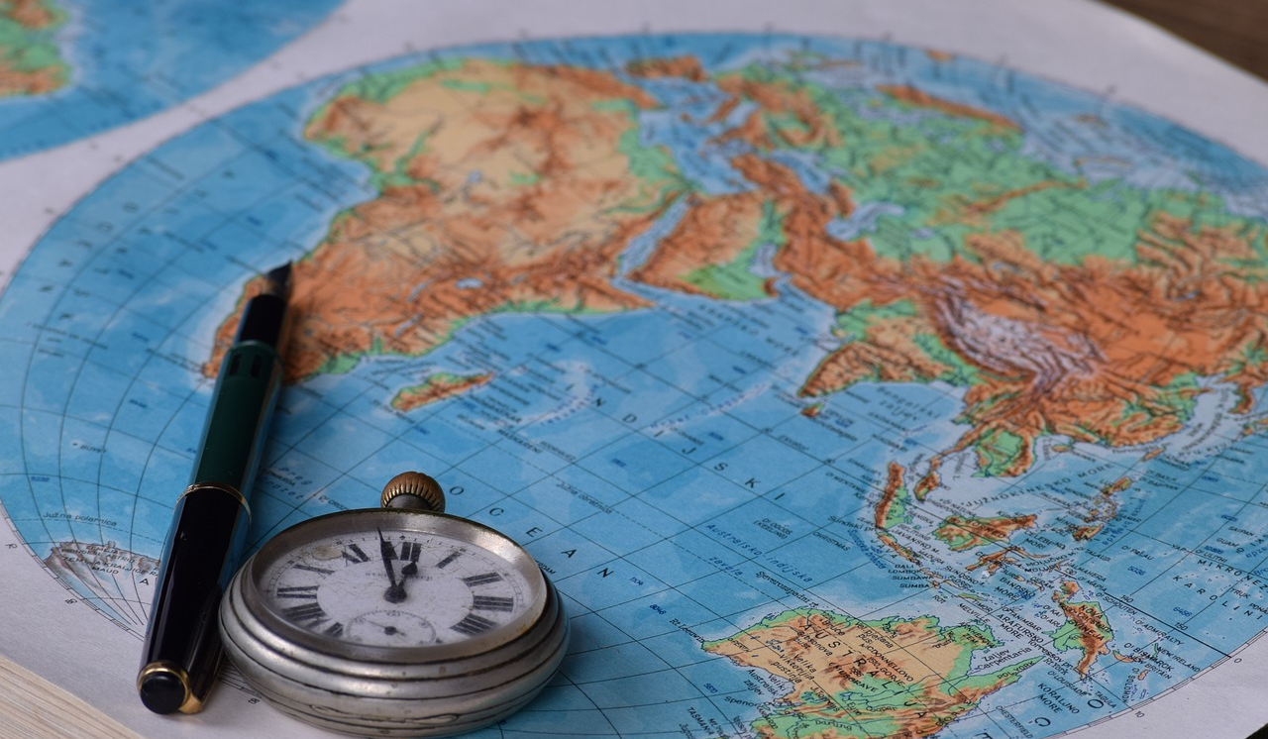
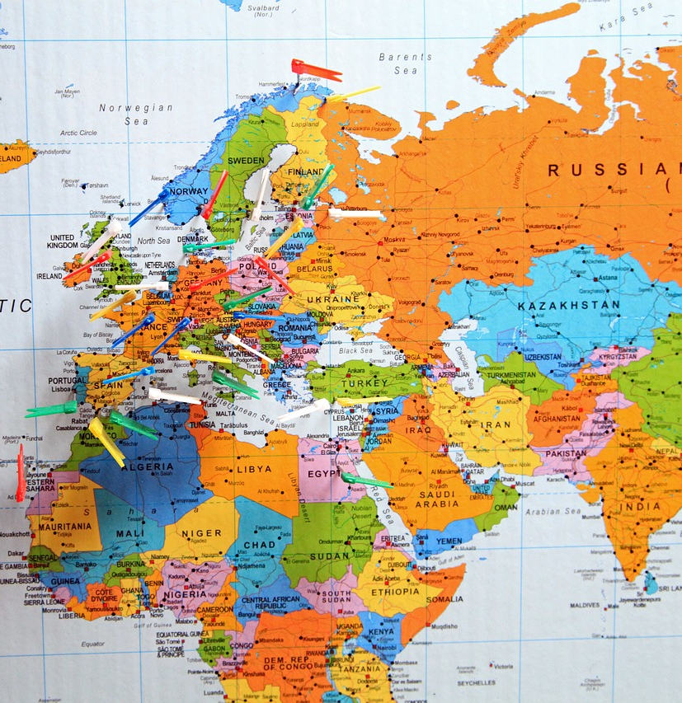
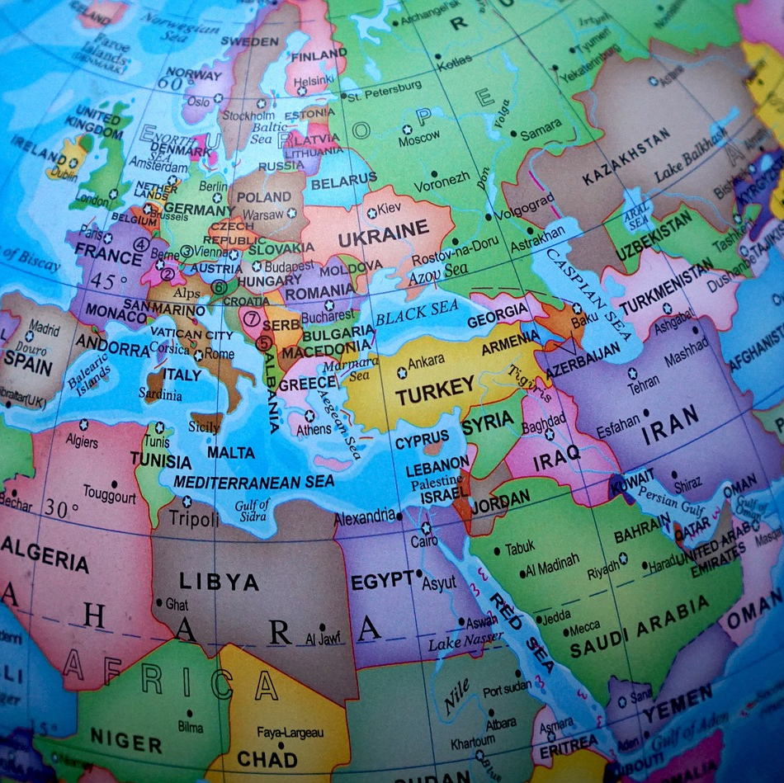
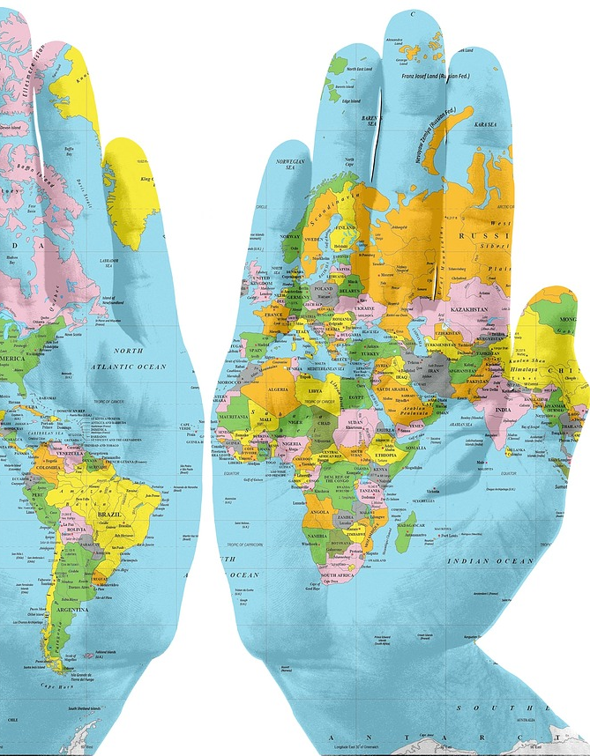
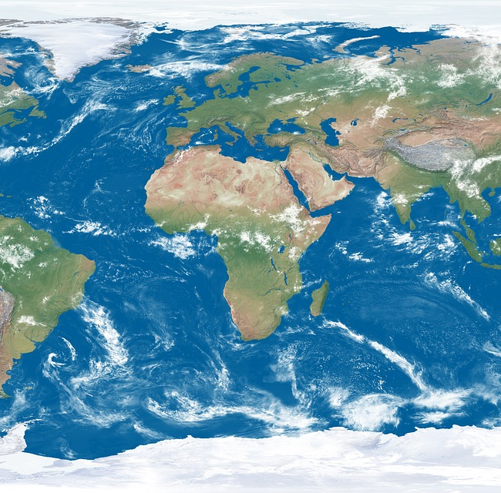
Mon monde
(my world)
Notes:
Timing: 2 minutes
Aim: to remind pupils about this week’s project activity.
Procedure:
Use this slide as a backdrop to ask pupils what they found out about the origins of some of their favourite things or everything items.
Ask them if they know the French for all of these items or their origin.
Move to the next slide for a revisit of reference skills.

Slide 7

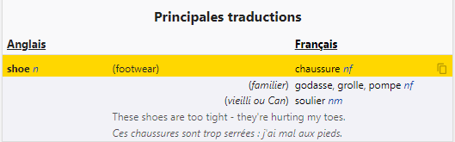
Using reference materials [nouns]
[understanding symbols]
www.wordreference.com
When using an online or paper dictionary, you find symbols with useful information (type of word – e.g., noun, adjective, and gender – i.e. masculine and feminine).
n = noun
m = masculine
feminine noun
f = feminine
Cherche le mot dans un dictionnaire.
This can help us find out the spelling of a word (and the grammatical gender of a noun).
la
______ chaussure [the shoe]
______ chaussure [my shoe]
ma
______ chaussures [my shoes]
mes
Exemple: shoe → ??
Notes:
Timing: 4 minutes (two slides)
Aim: to recap reference skills – looking up English to French; understanding codes in a dictionary in order to find out the gender of a noun; applying grammatical knowledge to get the definite article and the possessive adjectives.
Procedure:
Teachers click to go through the slide.

Slide 8
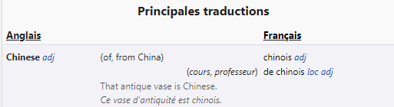

Using reference materials [adjectives]
[understanding symbols]
www.wordreference.com
When looking up adjectives, we always find them in the masculine form:
Cherche le mot dans un dictionnaire.
masculine singular
Exemple: Chinese → ??
______ Chinese [masculine]
chinois
In this online dictionary, click the French adjective to show how it changes to describe feminine and masculine/feminine plural nouns, too.
chinoise
______ Chinese (feminine)
Notes:
Procedure:
Teachers click to go through the slide.

Slide 9

vocabulaire
Cherche les mots dans un dictionnaire.
mots
Écris aussi les adjectifs au féminin.
nf
la veste
jacket
phone
umbrella
shoes
trousers
trainers
Spanish
German
Moroccan
Japanese
nm
le portable
Make sure you select the correct direction (English to French).
nm
le parapluie
nfpl
les chaussures
You may already know some or most of these words.
nm
le pantalon
nfpl
les baskets
espagnol/espagnole
Of course, you can search for your own words. These are just ideas.😉
allemand/allemande
marocain/marocaine
japonais/japonaise
Notes:
Timing: flexible
Aim: to practise reference skills – applying understanding of codes in a dictionary in order to find out the gender of a noun.
Procedure:
Pupils will need paper dictionaries or access to laptops / tablets to access an online dictionary.
Read the instruction and check understanding.
Click x1 to bring up further instruction.
Click x1 to bring up speech bubble that reminds pupils about choosing the correct default language.
Click to bring up the other two call outs.
Note: there are no answers provided here as these are just ideas.
Other vocabulary that pupils have previously learnt: le chocolat, l’émission, le fruit, le livre, la television, le vélo, la voiture.
9

Slide 10
lire
Écris un poème
Remember!
mon | ma | mes = my
mon = masculine nouns, and nouns beginning with a vowel or silent ‘h’.
ma = feminine nouns
mes = all plural nouns.
Ton Christ est juif,
Ta voiture est japonaise,
Ta pizza est italienne et ton coucous algérien,
Ta démocratie est grecque,
Ton café est brésilien,
Ta montre est suisse, ta chemise est indienne,
Ta radio est coréenne,
Tes vacances sont turques, tunisiennes ou marocaines,
Tes chiffres sont arabes, ton écriture est latine,
?????????????????????????????????????
Et…Tu reproches à ton voisin d’être étranger.
Et…Tu reproches à ton voisin d’être étranger.c
Notes:
Timing: 2 minutes
Aim: to show a version of the poem with nouns and nationality/origin adjectives in bold, suggesting that these are the elements to change, when describing their own chosen possessions.
Procedure:
Click to bring up the callout reminding pupils about mon, ma, mes and ton, ta, tes.
Encourage pupils to set out the pictures, photos or other visuals for their collage and to use French to describe them.
Explain that the final line of the poem will need to change because in our collages we are showing that we know how inter-connected we all are, even if we haven’t personally travelled to places, the places have come to us through the things we make use of every day. Suggest that perhaps we might say: Je suis un peu de tout et partout (I am a bit of everything and everywhere).
Note: there is scope for adaption here, according to ability. Some pupils may confidently adapt this poem to say what they want to say. Other pupils may simply, within the time there is, prefer to look up their chosen items and label them in French with ‘mon, ma, mes’ – they might add simple opinions from memory, ‘J’adore XXX’, J’aime YYY’, ‘ZZZ, c’est super ! genial !’
10

Slide 11
Au revoir !
bleu
Notes:
11

