Slide 1
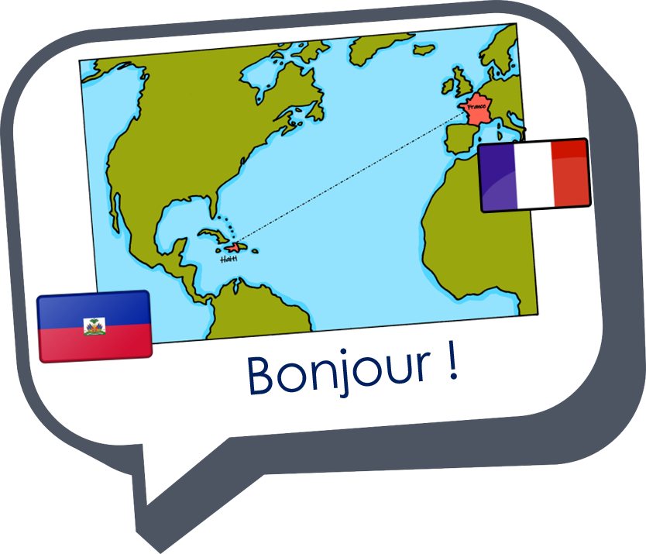
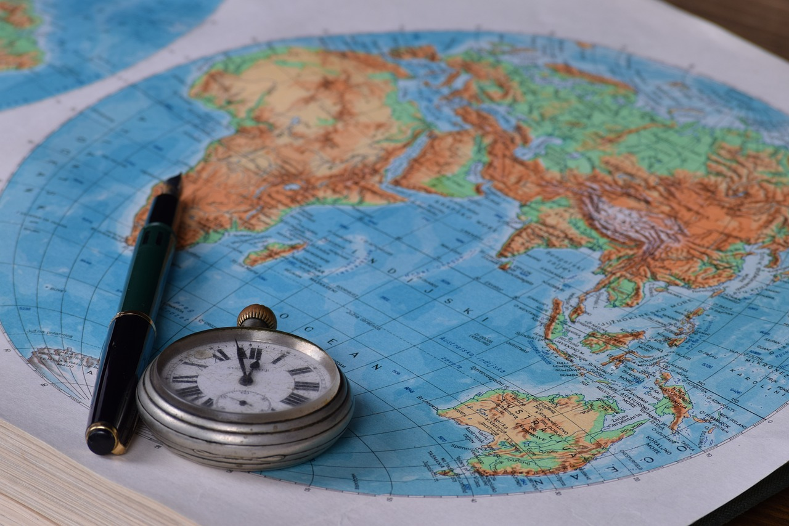
Describing me and others
bleu
Follow ups 1-5
Term 3 Week 12
Notes:
Artwork by Steve Clarke. Pronoun pictures from NCELP (www.ncelp.org). All additional pictures selected from Pixabay and are available under a Creative Commons license, no
attribution required.
Phonics: Revisit [ien] chien [1744] rien [168] bientôt [1208] ancien [392] combien? [800] bien [47]
Vocabulary: Revisit
Revisit 1: donner à manger [n/a] faisons, faites, font [25] laver [3503] ranger [2774] cuisine² [2618] repas [2948] Revisit: aimer [242] détester [2898]
Revisit 2: faire [25] je fais, il/elle fait activité [452] cuisine [2618] courses [1289] ménage [2326] cours (de musique)[169] devoirs [39] lit [1837]
Londsale, D., & Le Bras, Y. (2009). A Frequency Dictionary of French: Core vocabulary for learners London: Routledge.
The frequency rankings for words that occur in this PowerPoint which have been previously introduced in these resources are given in the SOW and in the resources that first
introduced and formally re-visited those words.
For any other words that occur incidentally in this PowerPoint, frequency rankings will be provided in the notes field wherever possible.

Slide 2
Follow up 1
Écoute et lis le poème.
Ton Christ est juif,
C’est quelle carte ?
Ta voiture est japonaise,
lire
Ta pizza est italienne et ton coucous algérien,
Ta démocratie est grecque,
Ton café est brésilien,
Ta montre est Suisse, ta chemise est indienne,
Ta radio est coréenne,
Tes vacances sont turques, tunisiennes ou marocaines,
Tes chiffres sont arabes, ton écriture est latine,
Et…Tu reproches à ton voisin d’être étranger.
Notes:
Timing: 8 minutes
Aim: to practise listening and reading lines from the poem, connecting the words with meaning.
Procedure:
Click to bring up the first line from the poem. (Either read aloud or play with audio).
Pupils respond by selecting the cards that represent the meaning of that line.
Click to bring up the cards to confirm the answers.
Continue with the rest of the poem.

Slide 3
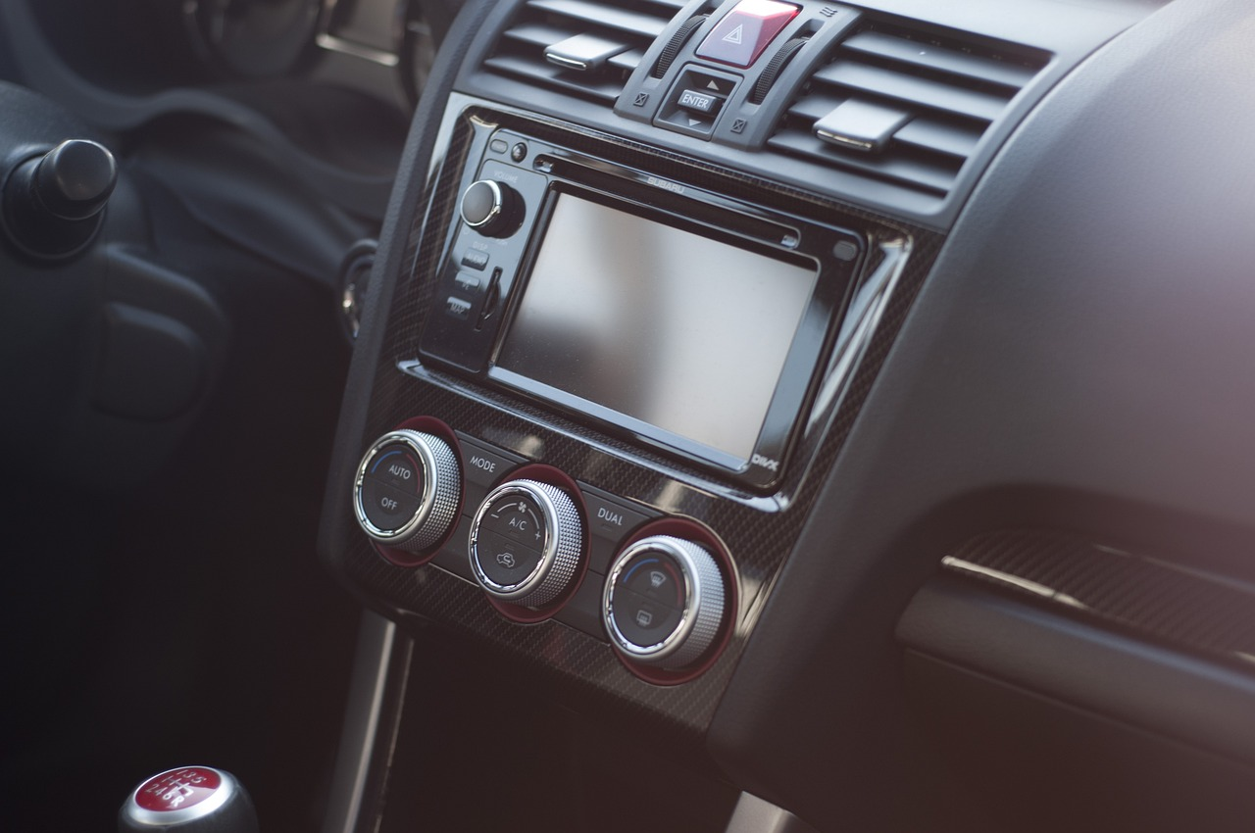
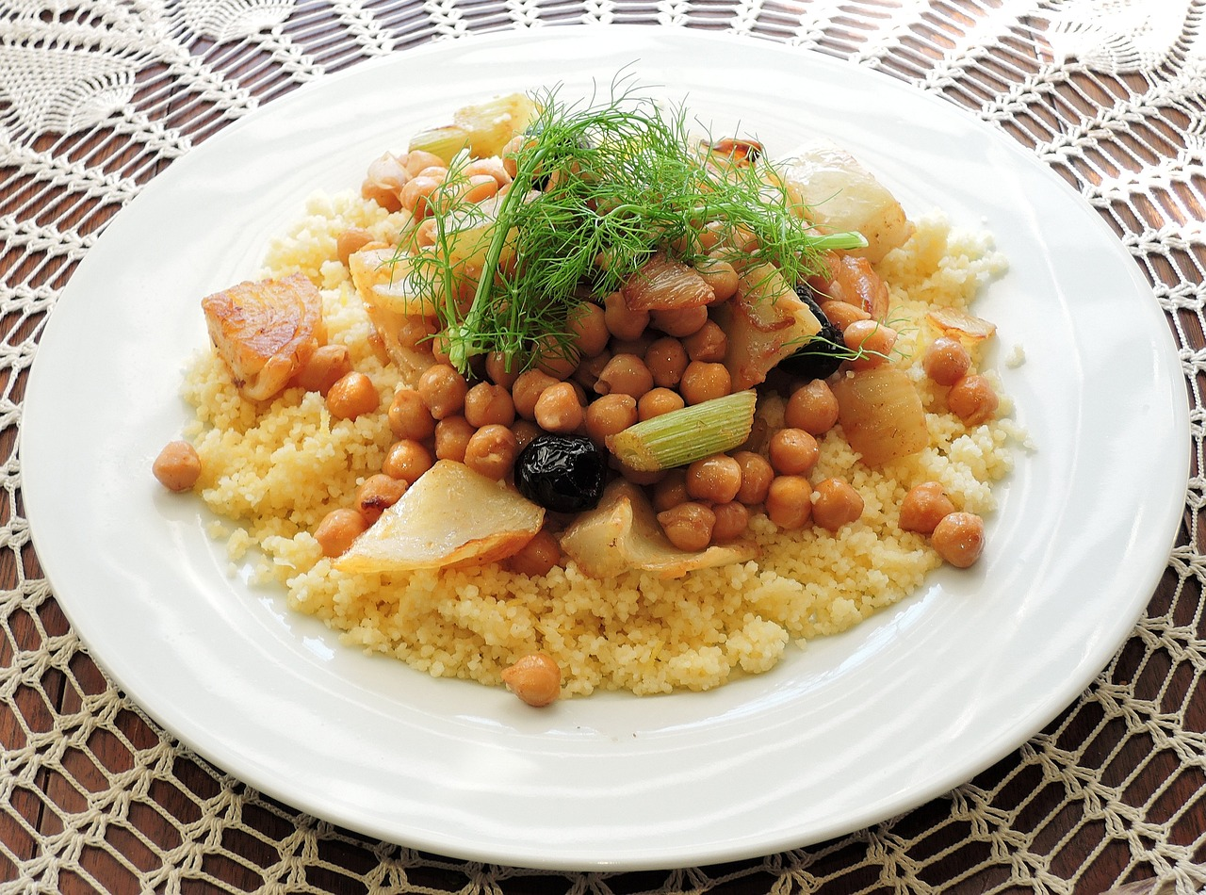
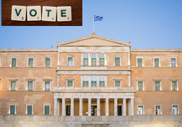
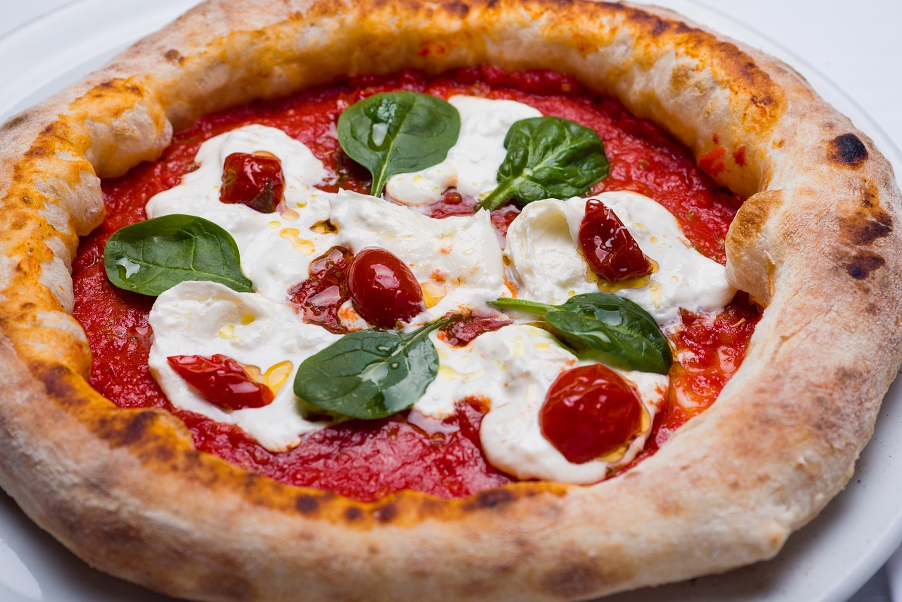
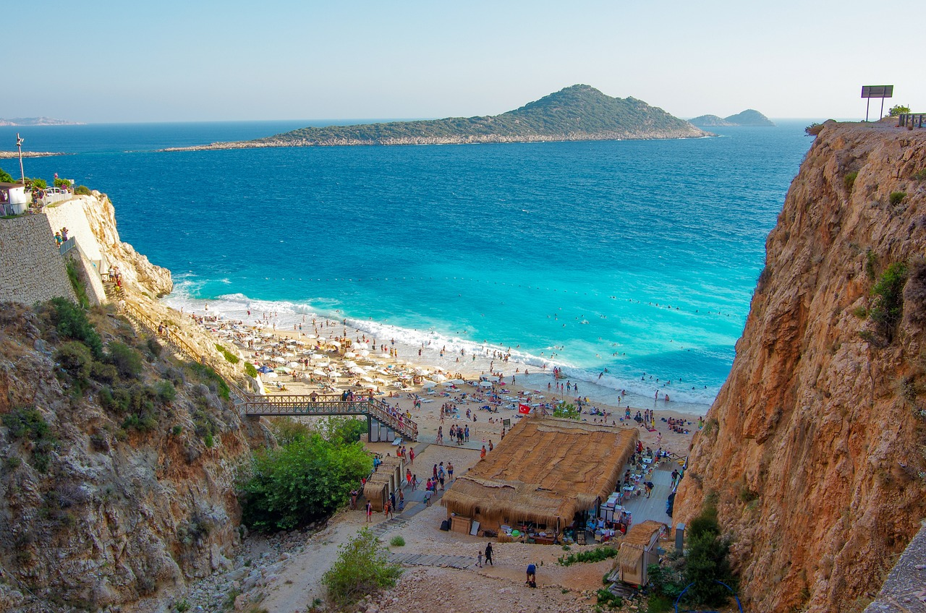
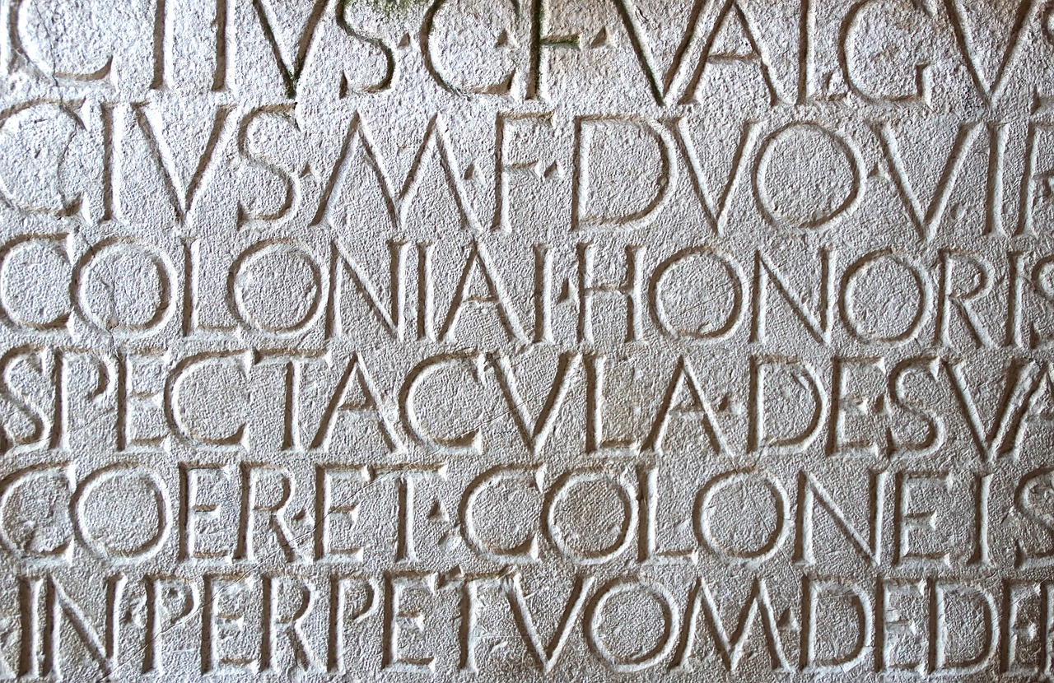
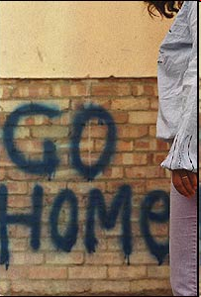
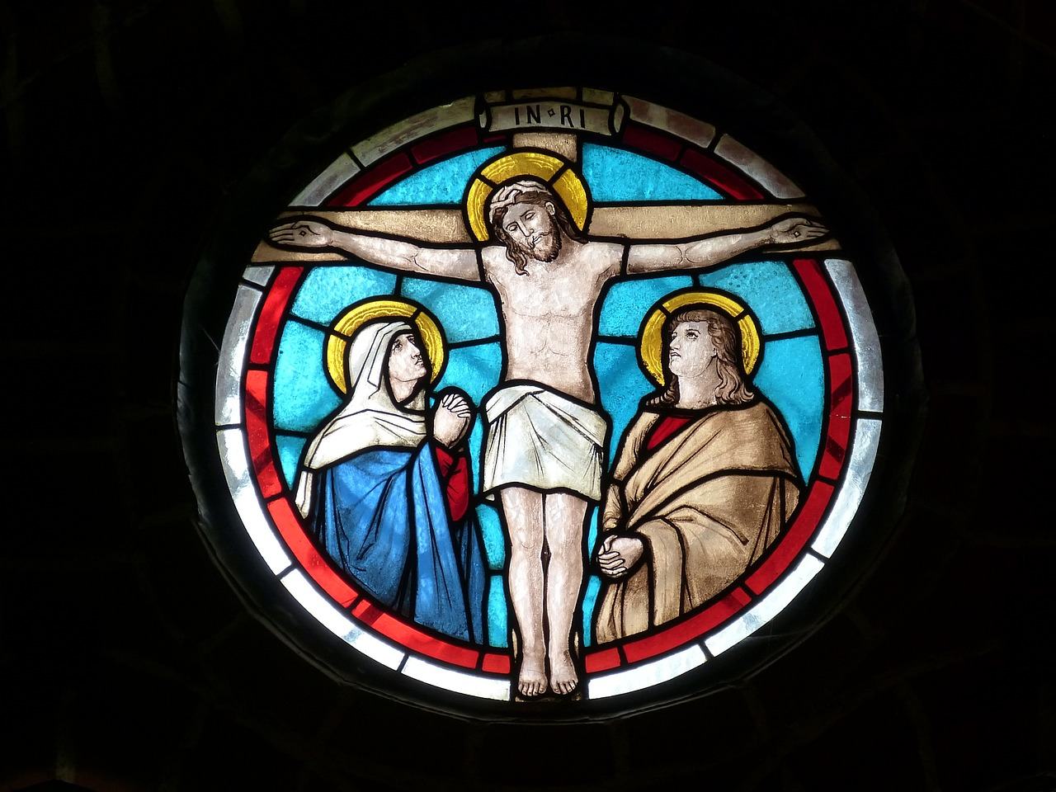
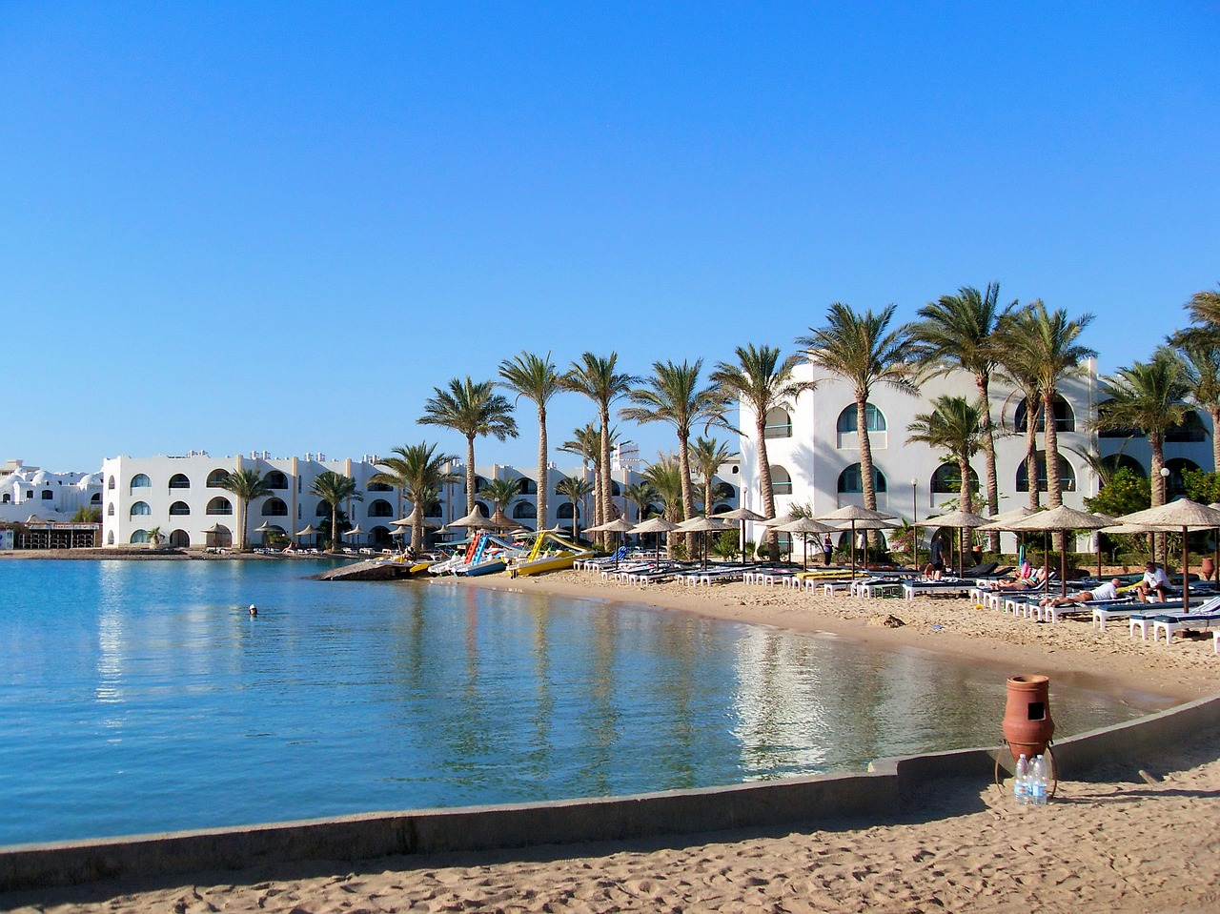
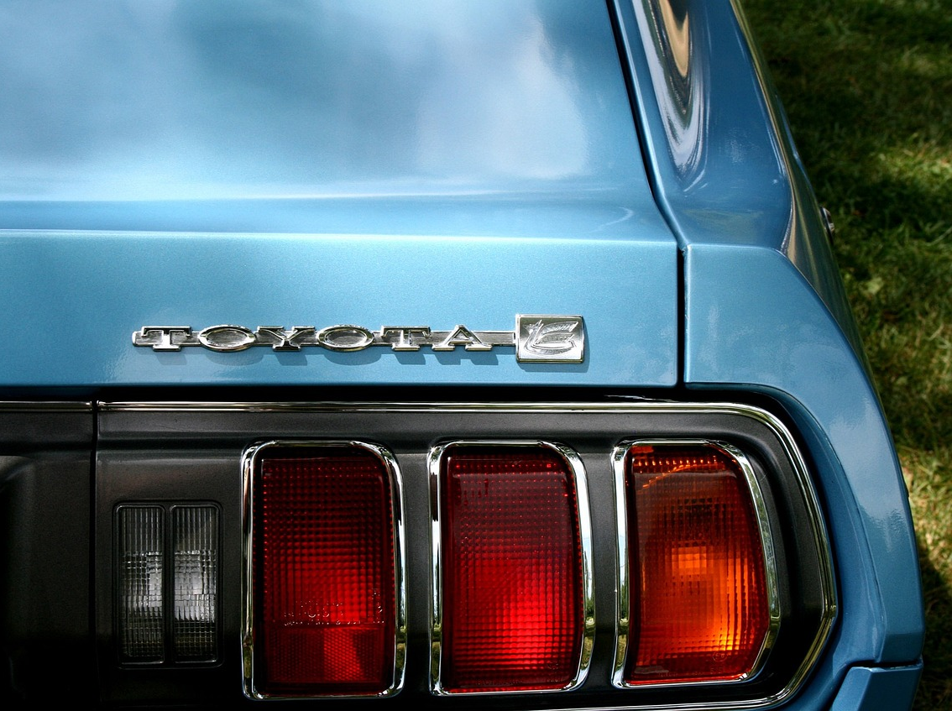
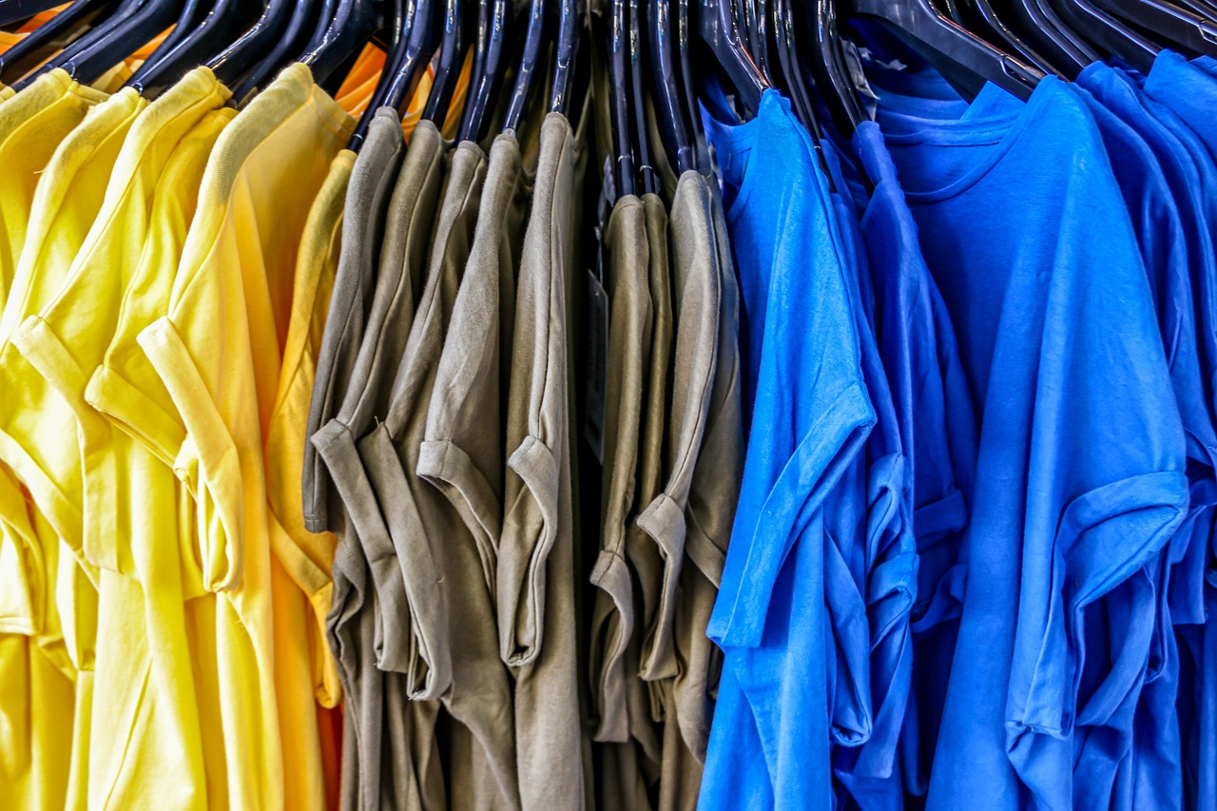
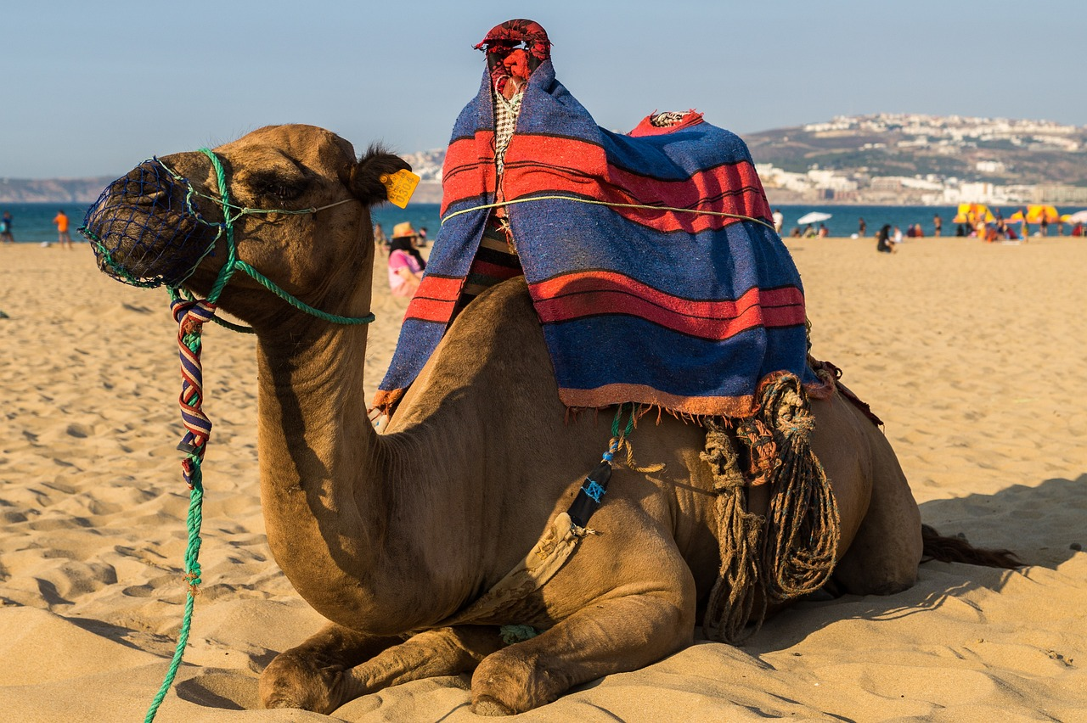
Notes:
CARDS FOR FOLLOW UP 1

Slide 4
Follow up 2
Lis avec ton/ta partenaire.
Ton Christ est juif,
Ta voiture est japonaise,
lire
Ta pizza est italienne et ton coucous algérien,
d’une façon triste🙁
Ta démocratie est grecque,
lentement 🐌
Ton café est brésilien,
rapidement 🌠
à voix basse 🤫
Ta montre est Suisse, ta chemise est indienne,
Ta radio est coréenne,
Tes vacances sont turques, tunisiennes ou marocaines,
Tes chiffres sont arabes, ton écriture est latine,
d’une façon … - in a … way
lentement – slowly à voix basse – quietly (la ) voix – voice
Et…Tu reproches à ton voisin d’être étranger.
Notes:
Timing: 2 minutes
Aim: to practise read aloud in pairs, including different tones of voice; to continue familiarising pupils with the poem.
Procedure:
Pupils take turns to read a line of the poem each, in pairs.

Slide 5
vocabulaire

Follow up 3
Écris en anglais. Can you get at least 15 points?
mots
 | le lit | le ménage | les courses
 | il fait | le cours (de musique) | les devoirs
 | je fais | la cuisine | le repas
 | faire | laver | ranger
 | ils font | donner à manger | donner
 | nous faisons | elles font | vous faites
(the) bed
(the) housework
(the) shopping
x3
he does, makes
(the) (music) lesson
(the) homework
I do, make
(the) kitchen
(the) meal
x2
to do, make
to wash, washing
to tidy, put away
to feed
to give, giving
they do, make (mpl)
x1
we do, make
they do, make (fpl)
you (all) do, make
Notes:
Timing: 5 minutes
Aim: to practise written comprehension of vocabulary.
Procedure: 1. Give pupils a blank grid. They fill in the English meanings of any of the words they know, trying to reach 15 points in total. 2. Remind pupils that adjectives can refer to male or female persons and they should note this in their translations. E.g. pleased (f), short (m).
Note: The most recently learnt and practised words are pink, words from the previous week are green and those from week 1 are blue, thus more points are awarded for them, to recognise that memories fade and more effort (heavy lifting!) is needed to retrieve them.
5

Slide 6
vocabulaire

Follow up 3
Écris en français. Can you get at least 15 points?
mots
 | (the) homework | (the) (music) lesson | (the) bed
 | he does, makes | (the) shopping | (the) housework
 | (the) meal | to do, make | I do, make
 | to wash | to tidy, put away | (the) kitchen
 | you (all) do | they do, make (mpl) | they do, make (fpl)
 | to give, giving | to feed (give to eat) | we do, make
les devoirs
le cours (de musique)
le lit
x3
il fait
les courses
le ménage
le repas
faire
je fais
x2
laver
ranger
la cuisine
vous faites
ils font
elles font
x1
donner
donner à manger
nous faisons
Notes:
Timing: 5 minutes
Aim: to practise written comprehension of vocabulary from week 1, last week and this week.
Procedure: 1. Give pupils a blank grid. They fill in the English meanings of any of the words they know, trying to reach 15 points in total. 2. Remind pupils that adjectives can refer to male or female persons and they should note this in their translations. E.g. pleased (f), short (m).
Note: The most recently learnt and practised words are pink, words from the previous week are green and those from week 1 are blue, thus more points are awarded for them, to recognise that memories fade and more effort (heavy lifting!) is needed to retrieve them.
6

Slide 7
vocabulaire

Follow up 3
Écris en anglais. Can you get at least 15 points?
mots
 | le lit | le ménage | les courses
 | il fait | le cours (de musique) | les devoirs
 | je fais | la cuisine | le repas
 | faire | laver | ranger
 | ils font | donner à manger | donner
 | nous faisons | elles font | vous faites
x3
x2
x1
Notes:
HANDOUT
7

Slide 8
vocabulaire

Follow up 3
Écris en français. Can you get at least 15 points?
mots
 | (the) homework | (the) (music) lesson | (the) bed
 | he does, makes | (the) shopping | (the) housework
 | (the) meal | to do, make | I do, make
 | to wash | to tidy, put away | (the) kitchen
 | you (all) do | they do, make (mpl) | they do, make (fpl)
 | to give, giving | to feed (give to eat) | we do, make
x3
x2
x1
Notes:
HANDOUT
8

Slide 9
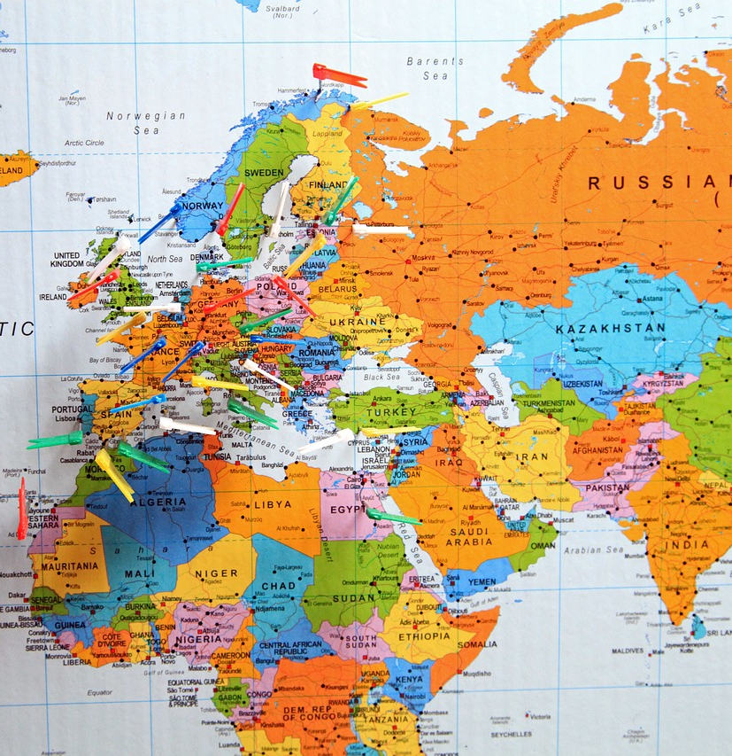
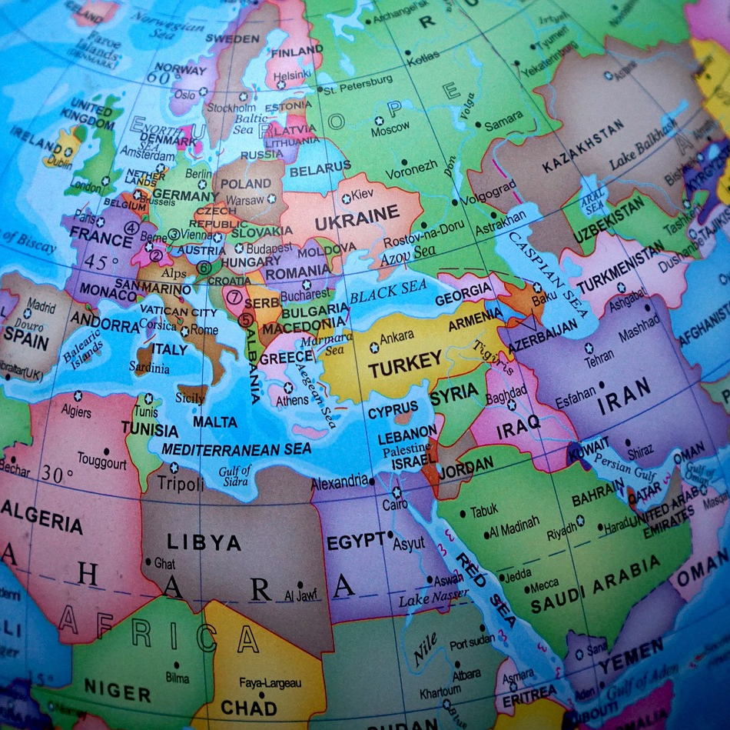
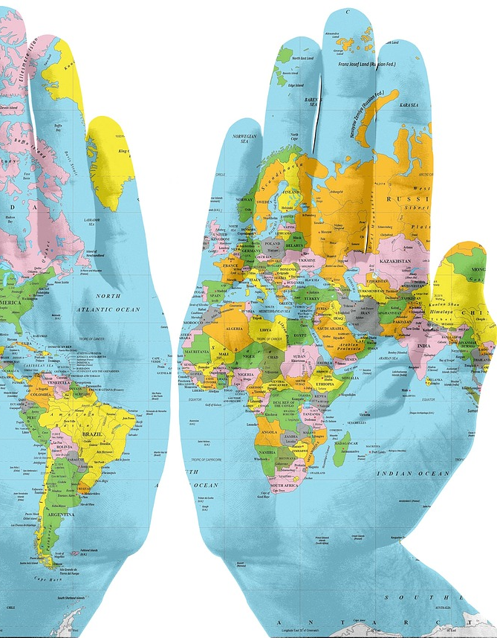
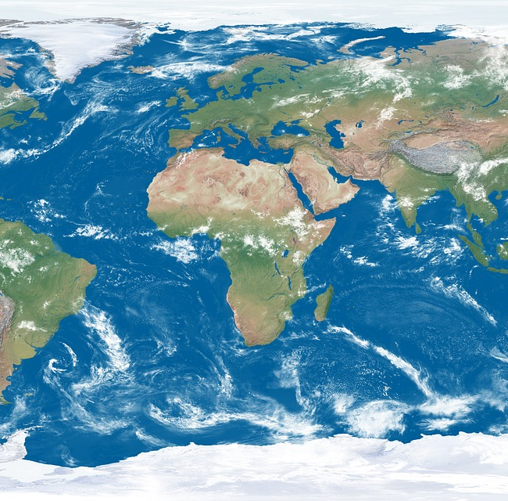
Mon monde (my world)
Notes:
Timing: 5 minutes
Aim: to tell pupils about their project work next week, based on the theme of the poem.
Procedure:
1. Use this slide as a backdrop to talk about how our personal worlds are made up of a huge number of influences from different countries.
2. Ask pupils if they know where their TV is from, their shoes, some of the food they eat.
3. Explain that their activity next week is going to be to make a collage of themselves and their world. They can use computers or just draw and label OR cut from a magazine.
4. They will label all the items and for some they will write full sentences, using nationality adjectives that they look up.
5. Between now and next week they should look at home for 5-6 items that are important in their daily lives and find out where they come from/were made. They should make a note of the information somewhere and bring it to school next week.

