Slide 1
What do I know now?
bleu
Phonics Quiz
Notes:
Artwork by Steve Clarke. Pronoun pictures from NCELP (www.ncelp.org). All additional pictures selected from Pixabay and are
available under a Creative Commons license, no attribution required.
This lesson contains a phonics quiz to assess knowledge of the SSC (sound-symbol correspondences) taught and practised so far. 50% of the items contain SSC practised this term, 50% are drawn from previous learning in terms 1 and 2. Almost all of the SSC from the KS2 course are included.
aube [2728] bise [>5000] coin [1798] début [364] féroce [4888] garage [4881] heurter [2601] musician [3100] pêche [1790] pleurer
[2253] pouce [3298] quitter [507] tapis [3783] tradition [1371]
Londsale, D., & Le Bras, Y. (2009). A Frequency Dictionary of French: Core vocabulary for learners London: Routledge.
1

Slide 2
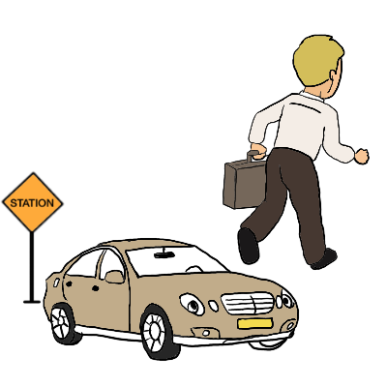
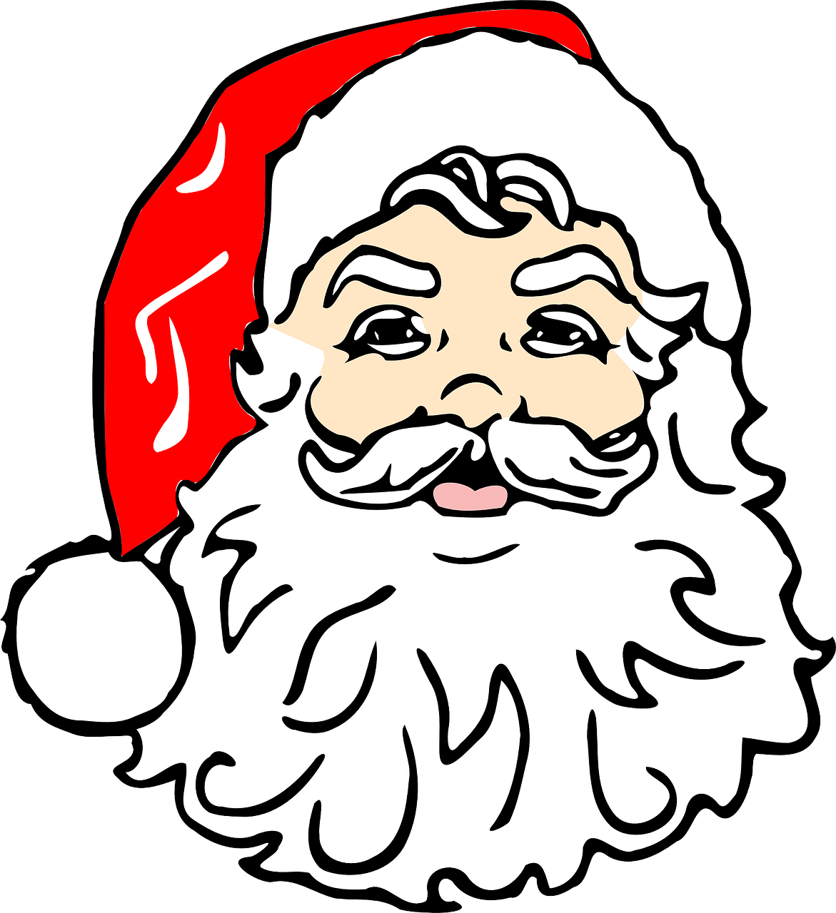
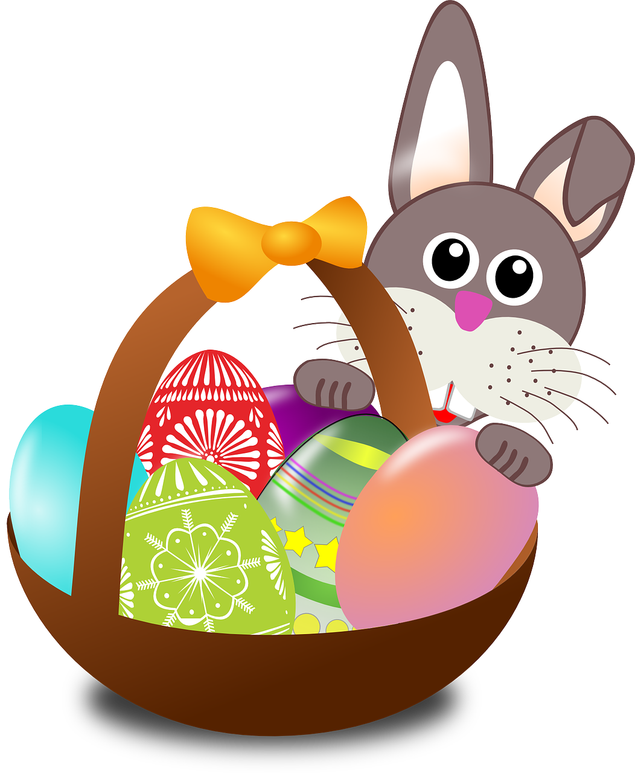
prononcer
[-tion]
[qu]
prononcer
la tradition
quitter
[to leave (a place)]
Notes:
Phonics quiz
Timing: flexible during Week 11 Procedure:
Print out one set of these 14 phonics cards.
Working with one pupil at a time, elicit the pronunciation of each word.
Say: You have not learnt these words, but you have learnt how to read aloud these sounds, so just have a go at reading each word aloud.
Focus only on the accurate pronunciation of the target SSC and tolerate any other inaccuracies.
Use the pupil scoring sheet at the end of this presentation to assess SSC knowledge and give feedback.
Note: Whilst working with individual children, others can be doing the independent activities at the end of this presentation.
2

Slide 3
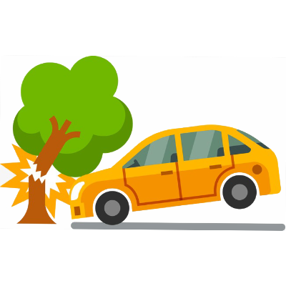
prononcer
[-s-]
[h]
prononcer
la bise
heurter
Notes:
3

Slide 4
prononcer
[-ien]
[j/g]
prononcer
le musicien
le garage
Notes:
4

Slide 5
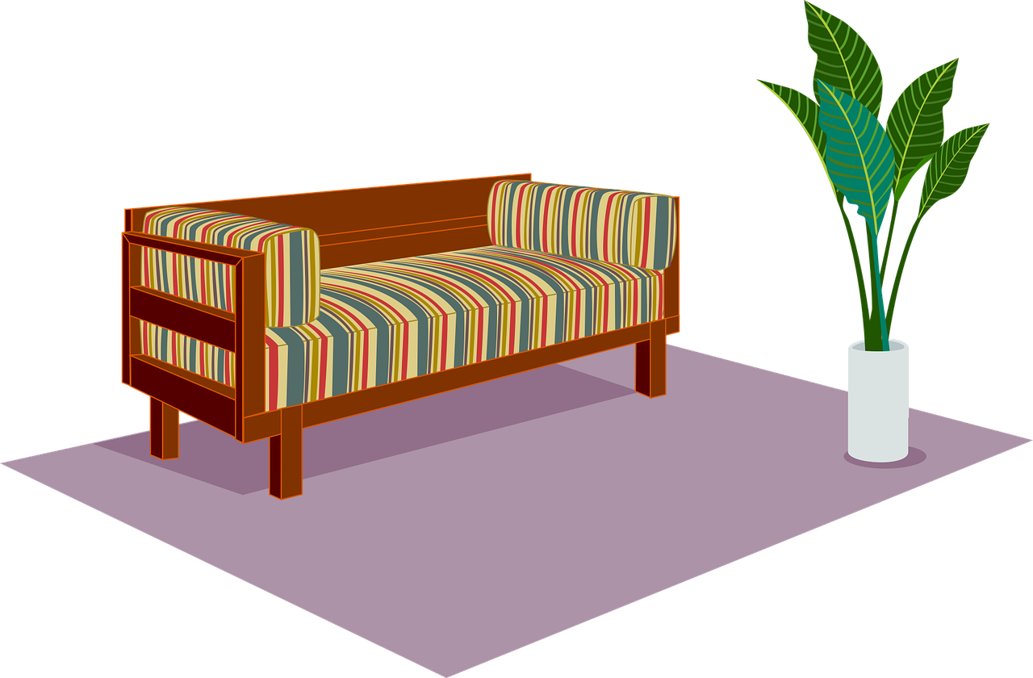
prononcer
[ç/c]
[SFC]
prononcer
féroce
le tapis
[fierce]
Notes:
5

Slide 6
prononcer
[u]
[ou]
prononcer
le début
le pouce
[(the) start]
Notes:
6

Slide 7
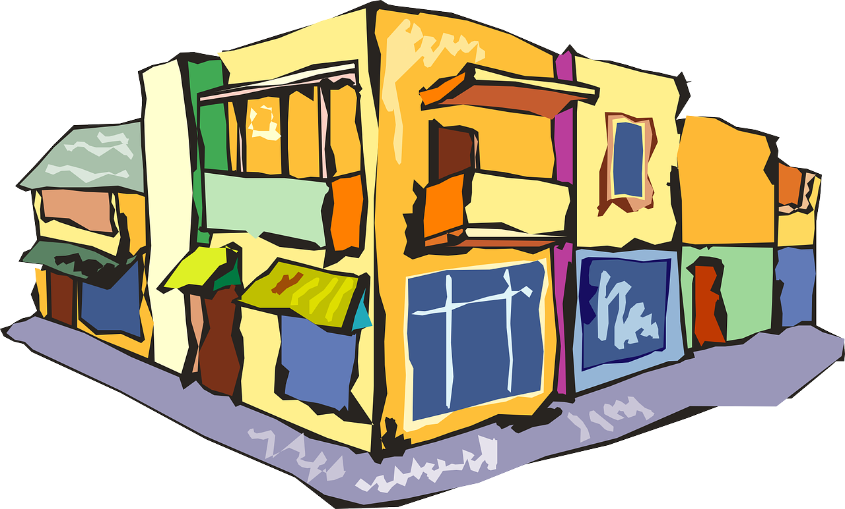
prononcer
open
[(a)in]
[eu]
prononcer
le coin
pleurer
[(the) corner]
[to cry, crying]
Notes:
7

Slide 8
prononcer
[ch]
[(e)au]
prononcer
la pêche
l’aube
[(the) dawn]
Notes:
8

Slide 9
prononcer
Pupil name:
Pupil name:
SSC and wordc | px
la tradition
quitter
la bise
heurter
le musicien
legarage
féroce
le tapis
le début
le pouce
le coin
pleurer
la pêche
l’aube
SSC and word | px
la tradition
quitter
la bise
heurter
le musicien
le garage
féroce
le tapis
le début
le pouce
le coin
pleurer
la pêche
l’aube
Notes:
Pupil feedback and assessment sheet [14 points]
9

Slide 10
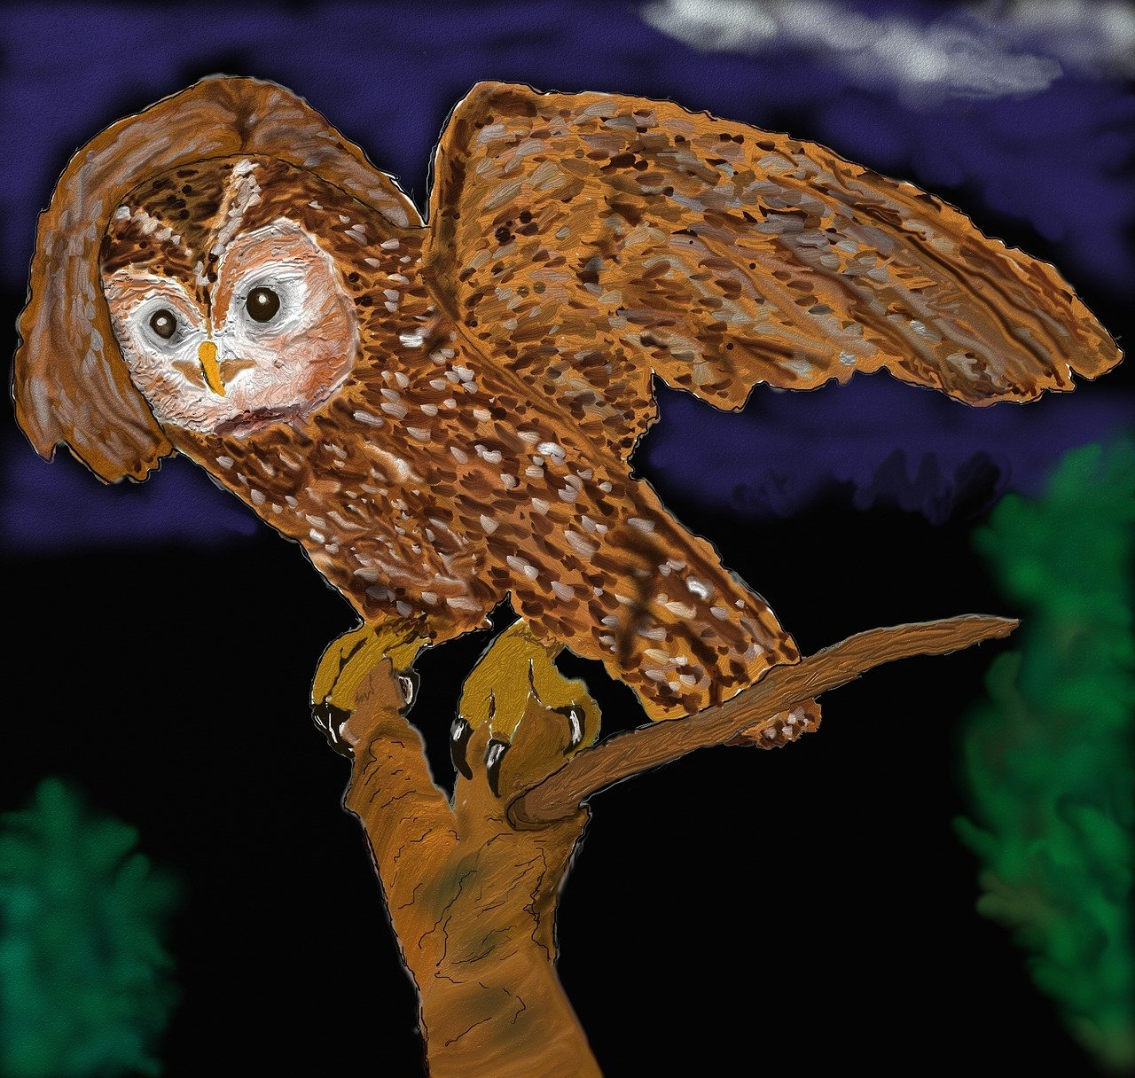
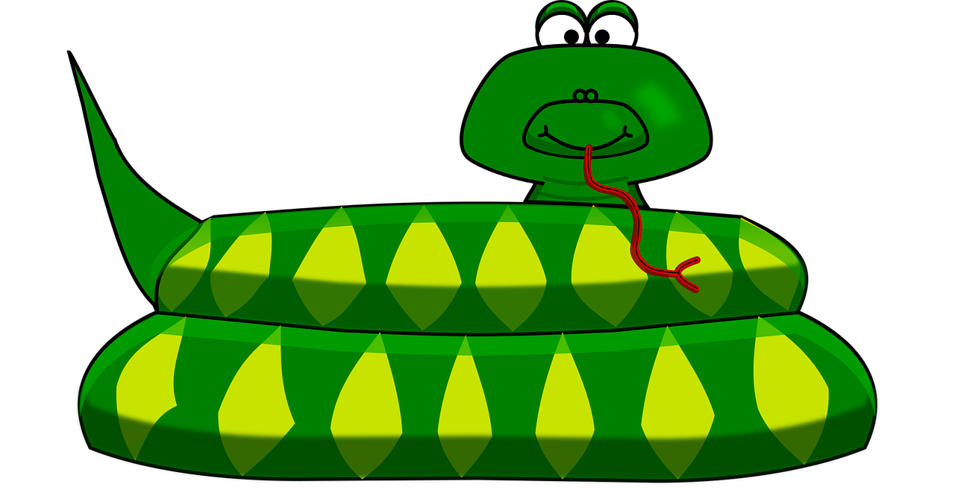
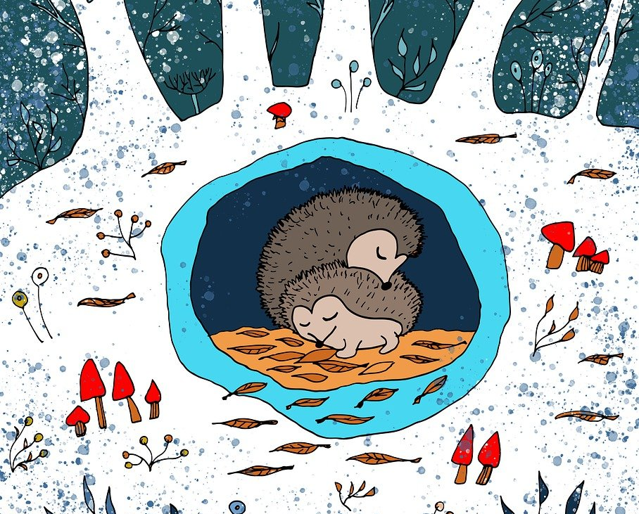
prononcer
1. Le chamois bêle sur le rocher.
2. Le zèbre mange des légumes frais.
3. La chouette vole dans la nuit.
4. Le serpent chuchote.
5. Les hérissons hibernent.
Notes:
Optional additional sentence read aloud [10 points]
10

Slide 11
Teacher audio version for checking
SSC and wordc | px
la tradition
quitter
la bise
heurter
le musicien
le garage
féroce
le tapis
le début
le pouce
le coin
pleurer
la pêche
l’aube
prononcer
1. Le chamois bêle sur le rocher.
2. Le zèbre mange des légumes frais.
3. La chouette vole dans la nuit.
4. Le serpent chuchote.
5. Les hérissons hibernent.
Notes:
11

