Slide 1
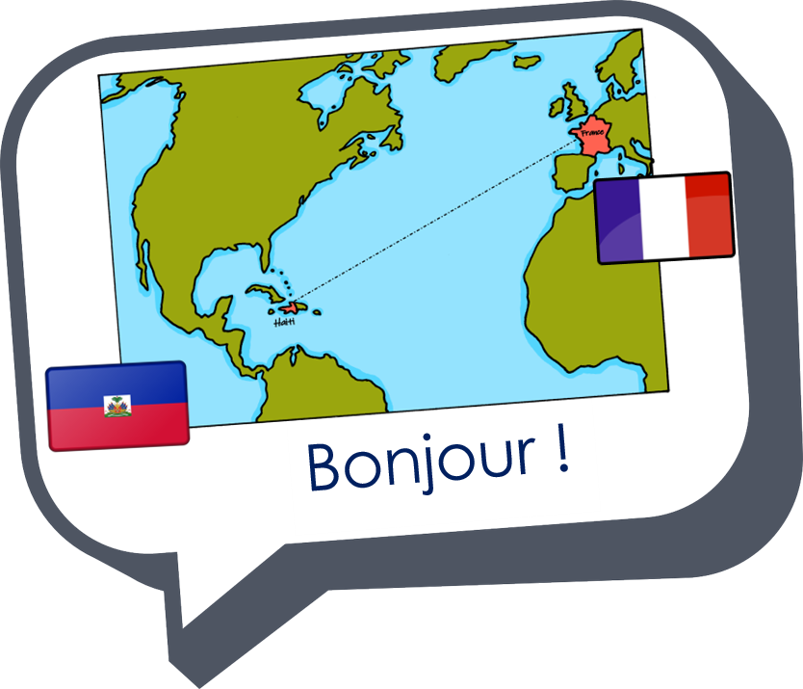


Saying where you are going and what there is there
bleu
aller (je vais, tu vas)
SSC [ai] & [a]
Notes:
Artwork by Steve Clarke. Pronoun pictures from NCELP (www.ncelp.org). All additional pictures selected from Pixabay and are available under a Creative Commons license, no
attribution required.
Phonics: Revisit SSC [ai] - vrai [292] maison [325] aider [413] raison [72] aimer [242] semaine [245]
Vocabulary (new words in bold): tu vas je vais [53] tu es je suis [5] à (meaning ‘at/in/to’)[4] marché [280] piscine [>5000]
Revisit 1: cacher [914] maintenant [192] normalement [2018]
Revisit 2: --
Londsale, D., & Le Bras, Y. (2009). A Frequency Dictionary of French: Core vocabulary for learners London: Routledge.
The frequency rankings for words that occur in this PowerPoint which have been previously introduced in these resources are given in the SOW and in the
resources that first introduced and formally re-visited those words.
For any other words that occur incidentally in this PowerPoint, frequency rankings will be provided in the notes field wherever possible.
1

Slide 2


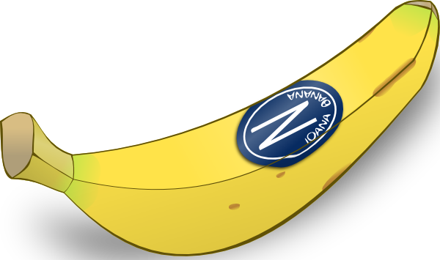
[a]
[ai]
prononcer
banane
vrai
Notes:
Timing: 1 minute
Aim: To recap SSC [a] and [ai].
Procedure:
Introduce and elicit the pronunciation of the individual SSC [a] and then the source word ‘banane’ (with gesture, if using).
Click to bring on the picture and get students to repeat (with gesture, if using).
Present the letter(s) and say the [ai] sound first, on its own. Students repeat it with you.
Bring up the word ”vrai” on its own, say it, students repeat it, so that they have the opportunity to focus all of their attention on the connection between the written word and its sound.
Repeat again, along with the picture, and with gesture, if using.
Suggested gestures:
gesture for ‘banana’ – we suggest making the shape of a banana with both hands – start with finger tips together in the middle, pull them apart and upwards to trace the shape of a banana (like the shape of a smile).
gesture for vrai – either mime a tick
Or use the BSL (4th video is the best one): https://www.signbsl.com/sign/true
2

Slide 3



prononcer
Quel mot a le son [ai] ? [1/6]
Écoute et identifie le mot correct.
A
B
(sometimes)
(perfect)
parfois
__
parfait
__
Notes:
[1/6]
Timing: 5 minutes for 6 slides
Aim: to practise aural recognition of SSC [ai]
Procedure:
1. Click the images to play the audio.
2. Students choose which word has [ai].
3. Students could also complete the word with the correct spelling
4. Answers revealed on a click.
Transcript:
parfait
parfois
Word frequency (1 is the most frequent word in French):
parfait [1600] parfois [410]
Source: Londsale, D., & Le Bras, Y. (2009). A Frequency Dictionary of French: Core vocabulary for learners London: Routledge.
Note: some words are unknown, some are known.
3

Slide 4
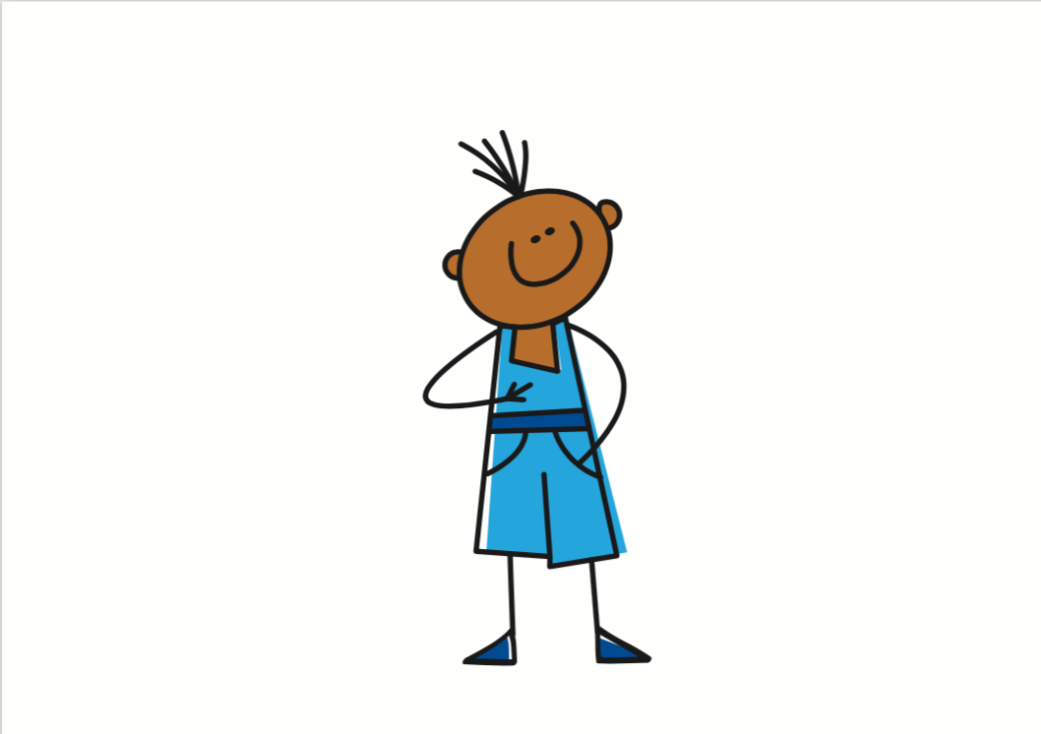

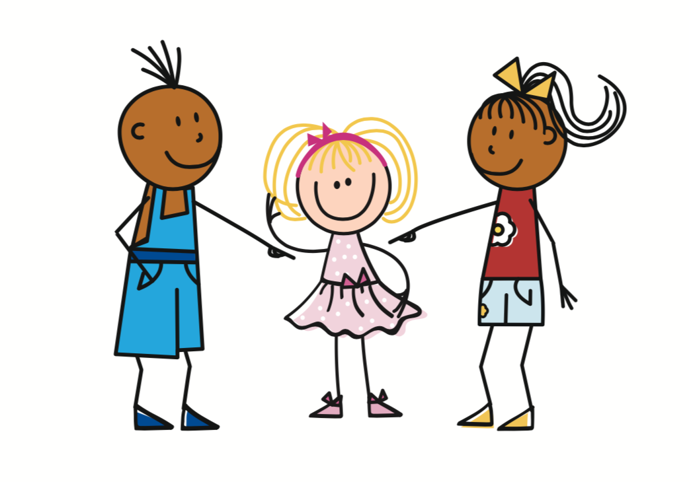
prononcer
Quel mot a le son [ai] ? [2/6]
Écoute et identifie le mot correct.
A
B
vais
va
__
__
Notes:
[2/6]
Timing: 5 minutes for 6 slides
Transcript:
vais
va
4

Slide 5


prononcer
Quel mot a le son [ai] ? [3/6]
Écoute et identifie le mot correct.
A
B
animal
anglais
__
__
Notes:
[3/6]
Timing: 5 minutes for 6 slides
Transcript:
animal
anglais
5

Slide 6

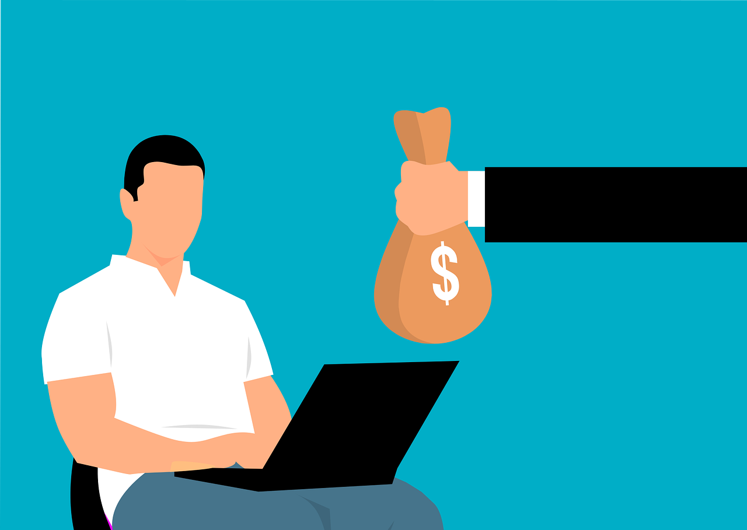
prononcer
Quel mot a le son [ai] ? [4/6]
Écoute et identifie le mot correct.
A
B
pain
paie
__
__
Notes:
[4/6]
Timing: 5 minutes for 6 slides
Transcript:
pain
paie
Word frequency (1 is the most frequent word in French):
pain [2802] paie [>5000]
Source: Londsale, D., & Le Bras, Y. (2009). A Frequency Dictionary of French: Core vocabulary for learners London: Routledge.
6

Slide 7
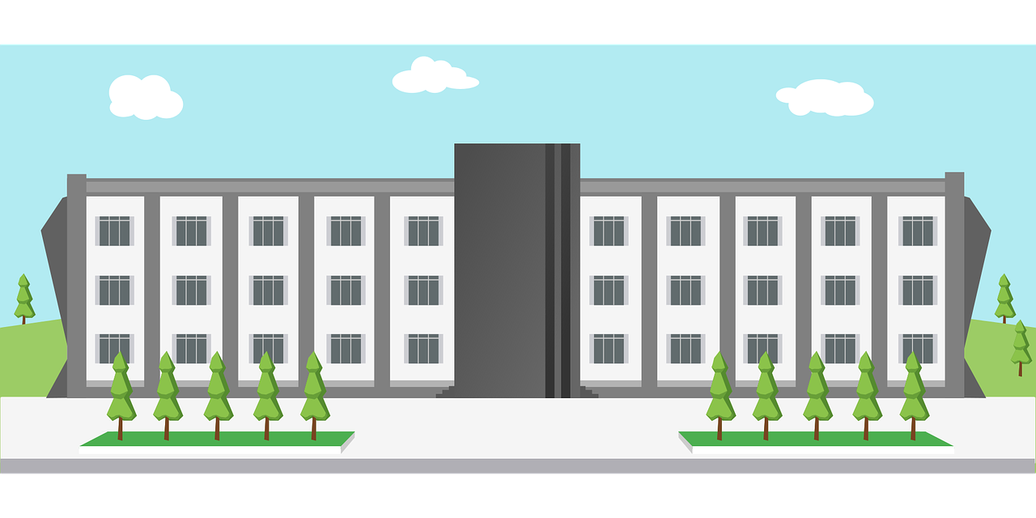

prononcer
Quel mot a le son [ai] ? [5/6]
Écoute et identifie le mot correct.
A
B
anniversaire
université
__
__
Notes:
[5/6]
Timing: 5 minutes for 6 slides
Transcript:
université
anniversaire
Word frequency (1 is the most frequent word in French):
université [1192] anniversaire [2043]
Source: Londsale, D., & Le Bras, Y. (2009). A Frequency Dictionary of French: Core vocabulary for learners London: Routledge.
7

Slide 8
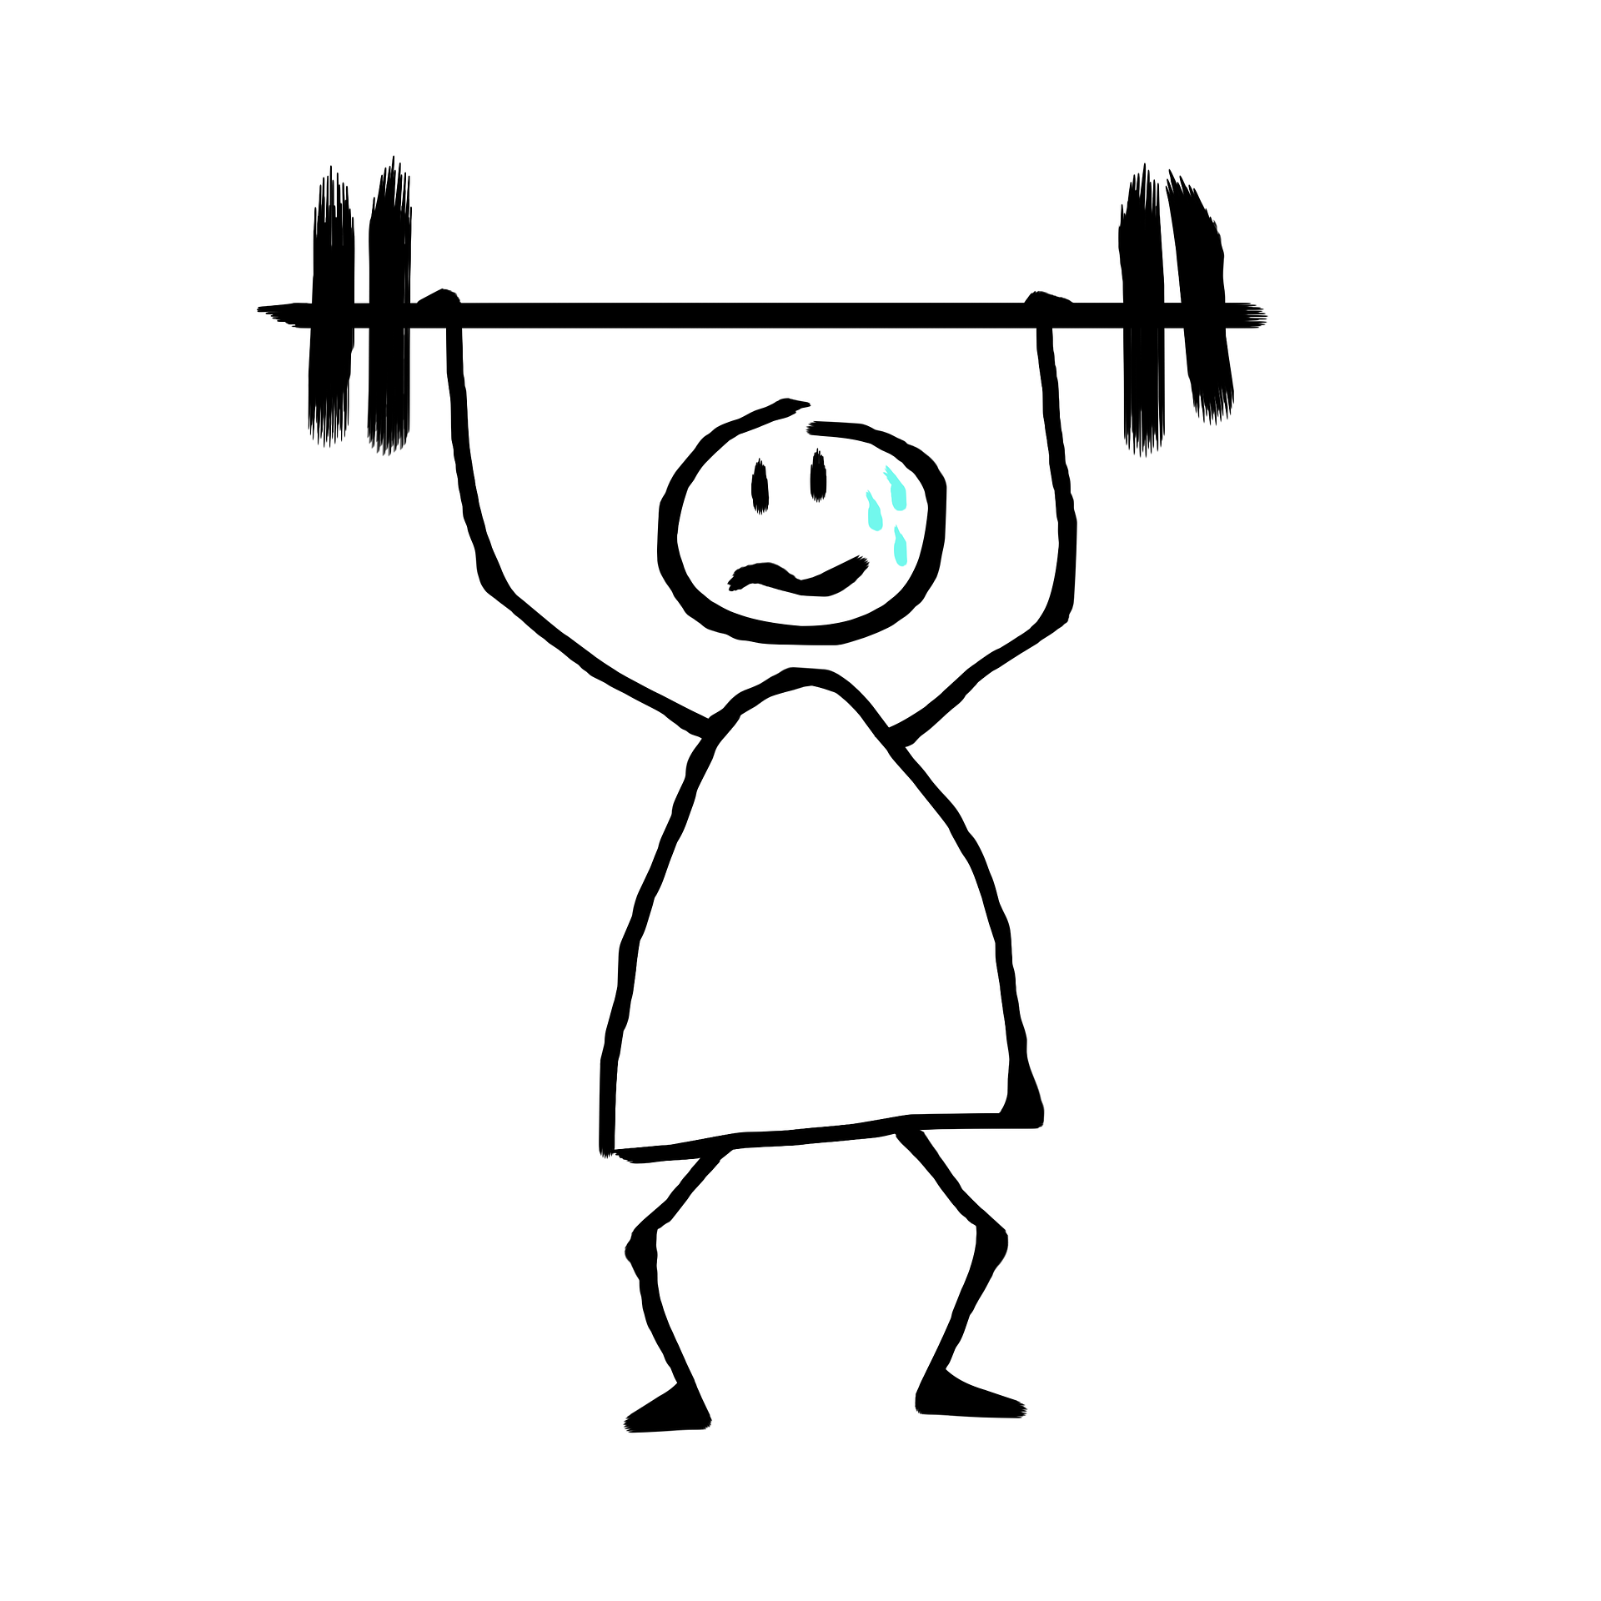
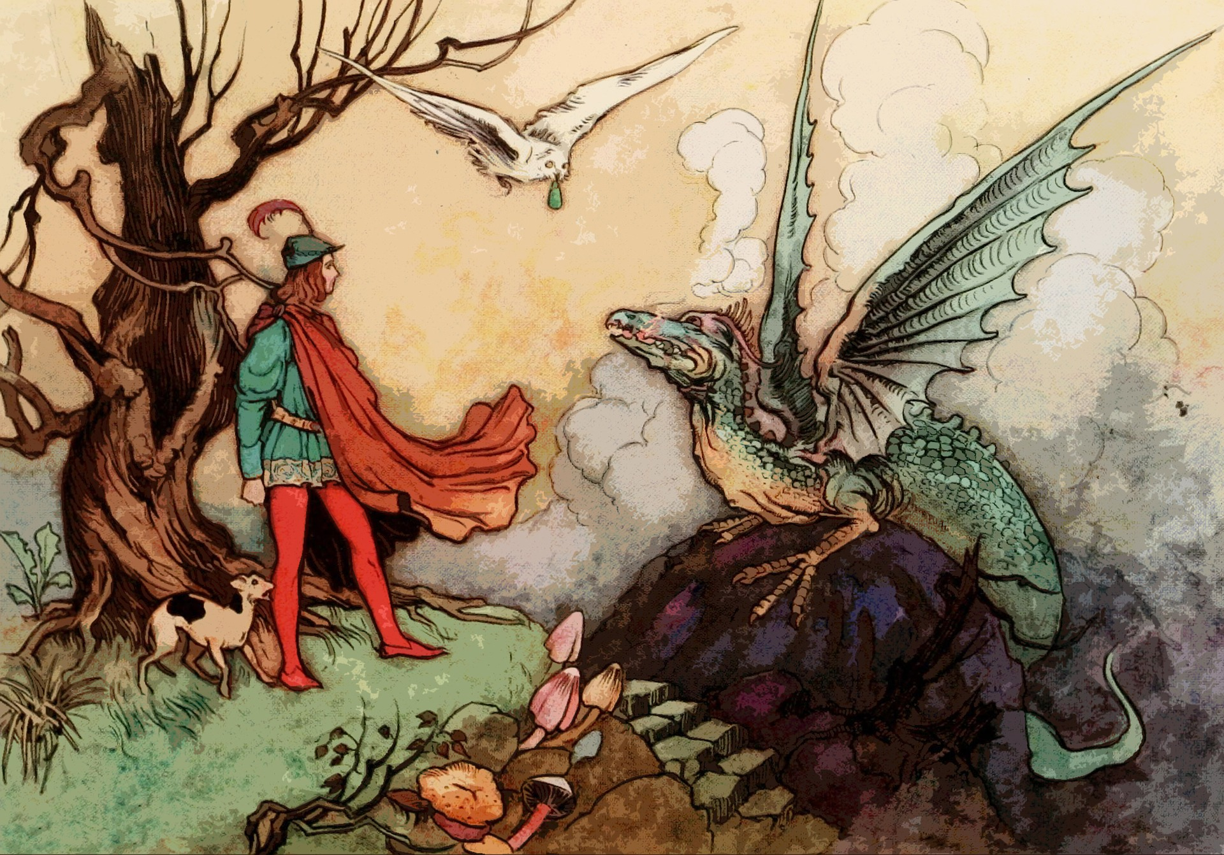
prononcer
Quel mot a le son [ai] ? [6/6]
Écoute et identifie le mot correct.
A
B
(weak)
faible
fa ble
__
__
Notes:
[6/6]
Timing: 5 minutes for 6 slides
Transcript:
faible
fable
Word frequency (1 is the most frequent word in French):
faible [723] fable [>5000]
Source: Londsale, D., & Le Bras, Y. (2009). A Frequency Dictionary of French: Core vocabulary for learners London: Routledge.
8

Slide 9


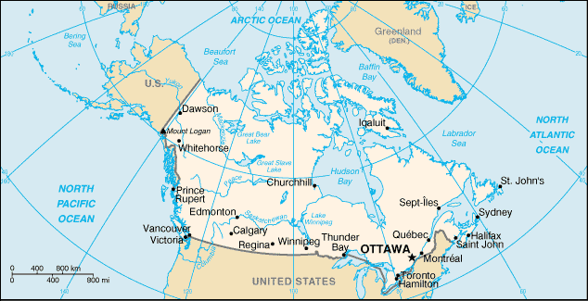
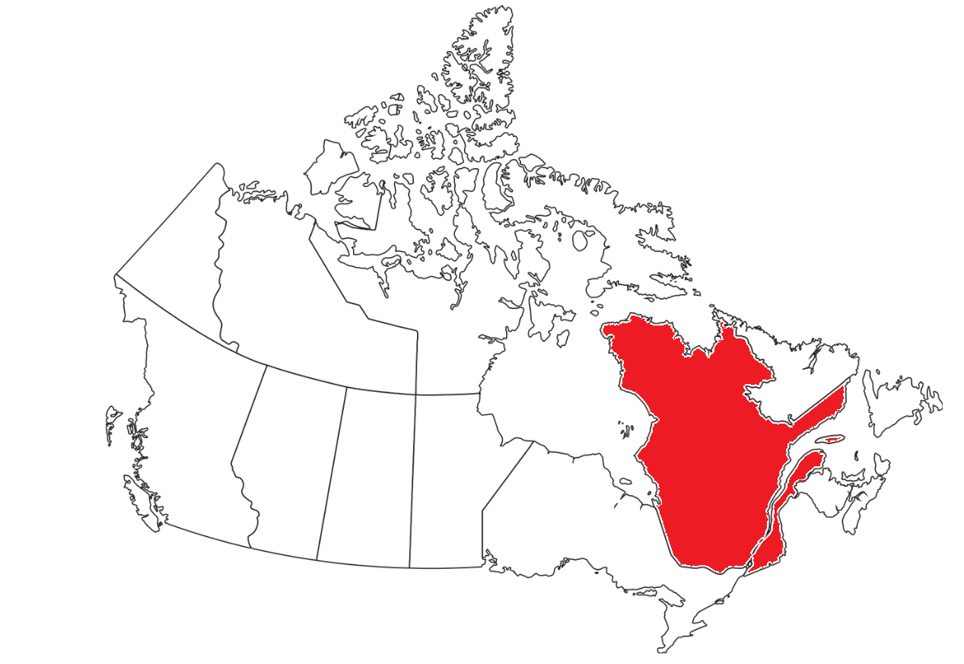
aller (to go, to be going)
Aller is an irregular verb meaning to go, to be going.
⚠ The –s is a Silent Final Consonant (SFC).
Je vais
I go|I am going
⚠ Here –s is sometimes pronounced because it is followed by a vowel. Pronounce the –s like English ‘z’.
This is an example of optional liaison.
Je vais à Ottawa.
I go|I am going to Ottawa.
Tu vas au Québec.
You go | You are going to Quebec.
⚠ It is also optional to liaise after tu vas.
Notes:
Timing: 2 minutes
Aim: to introduce two forms of the irregular verb aller.
Procedure:
Click through the animations to present the information. Stress the highly irregular nature of aller and perhaps ask pupils if they can think of another highly irregular verb e.g. être (je suis, il/elle est).
Elicit English translations for the French examples provided.

Slide 10
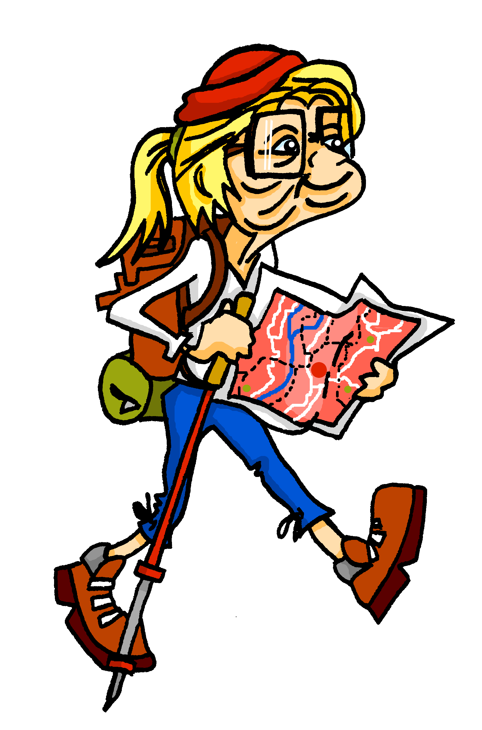


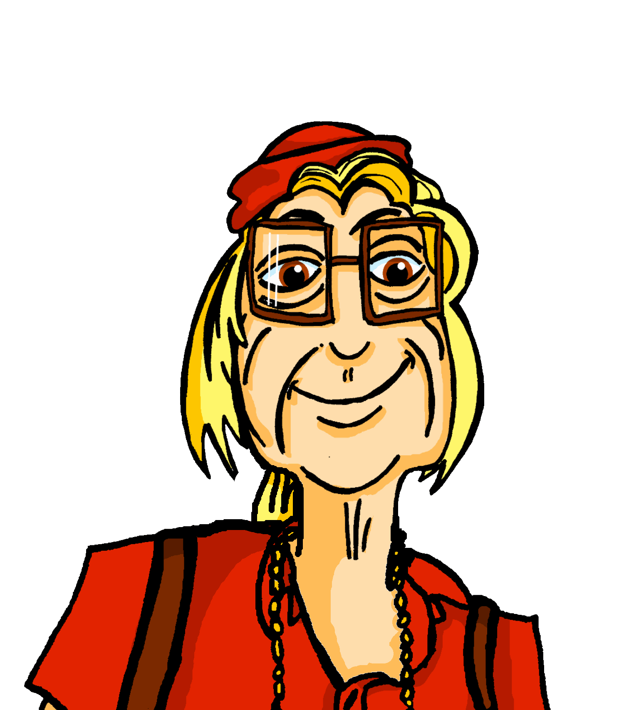
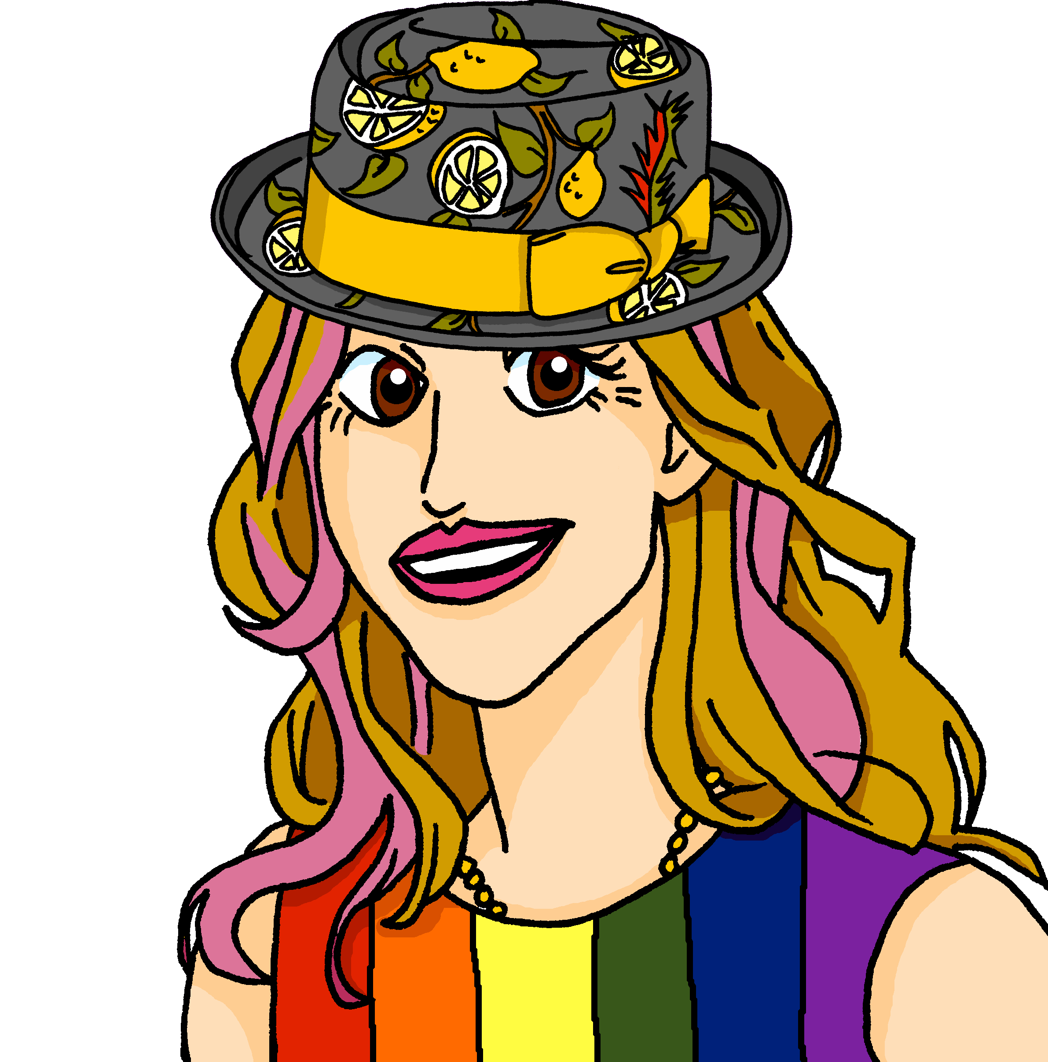

écouter
Mylène parle à Renée.
Écoute. Qui va où ? C’est Mylène (je) ou Renée (tu) ?
 | Mylène (je) | Renée (tu)
 | Mylène (je) | Renée (tu)
1
1
5
5
2
2
6
6
3
7
3
7
4
8
4
8
Notes:
Timing: 5 minutes
Aim: to practise aural comprehension of the two forms of aller, vais and vas, without the support of the pronouns je and tu.
Procedure:
Click to listen to the sentence, with pronoun obscured.
Pupils write the numbers 1-6 and for each item the answer ‘je’ or ‘tu’ depending on the form of aller they hear.
Click to reveal the answers. An audio button appears for each answer, so pupils can listen to the full sentence and check, if desired.
Transcript:
[Tu] vas à Gaspé.
[Je] vais à Bonaventure.
[Je] vais à Tadoussac.
[Je] vais à Matane.
[TU] vas à Sainte-Luce.
[Tu] vas à Mont-Joli.
[Je] vais à Baie-Cameau.
[Tu] vas à Rimouski.
10

Slide 11



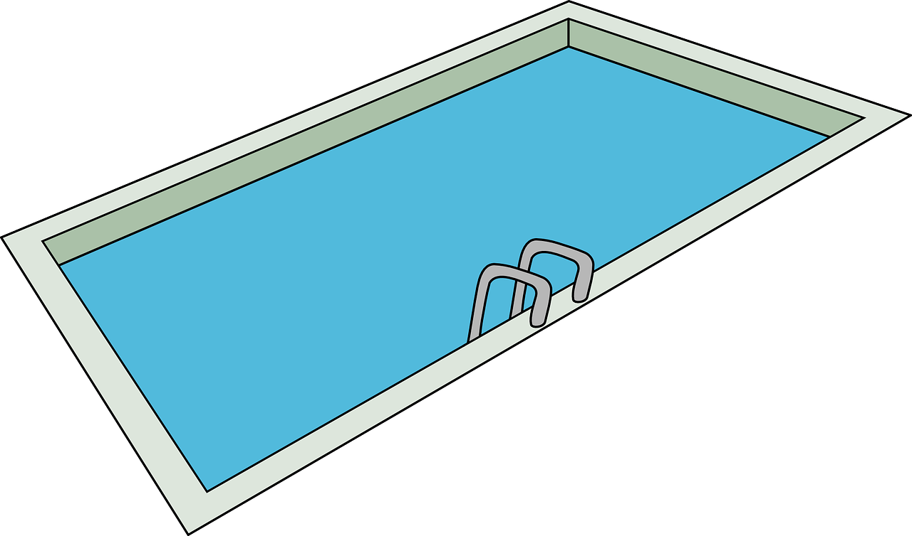

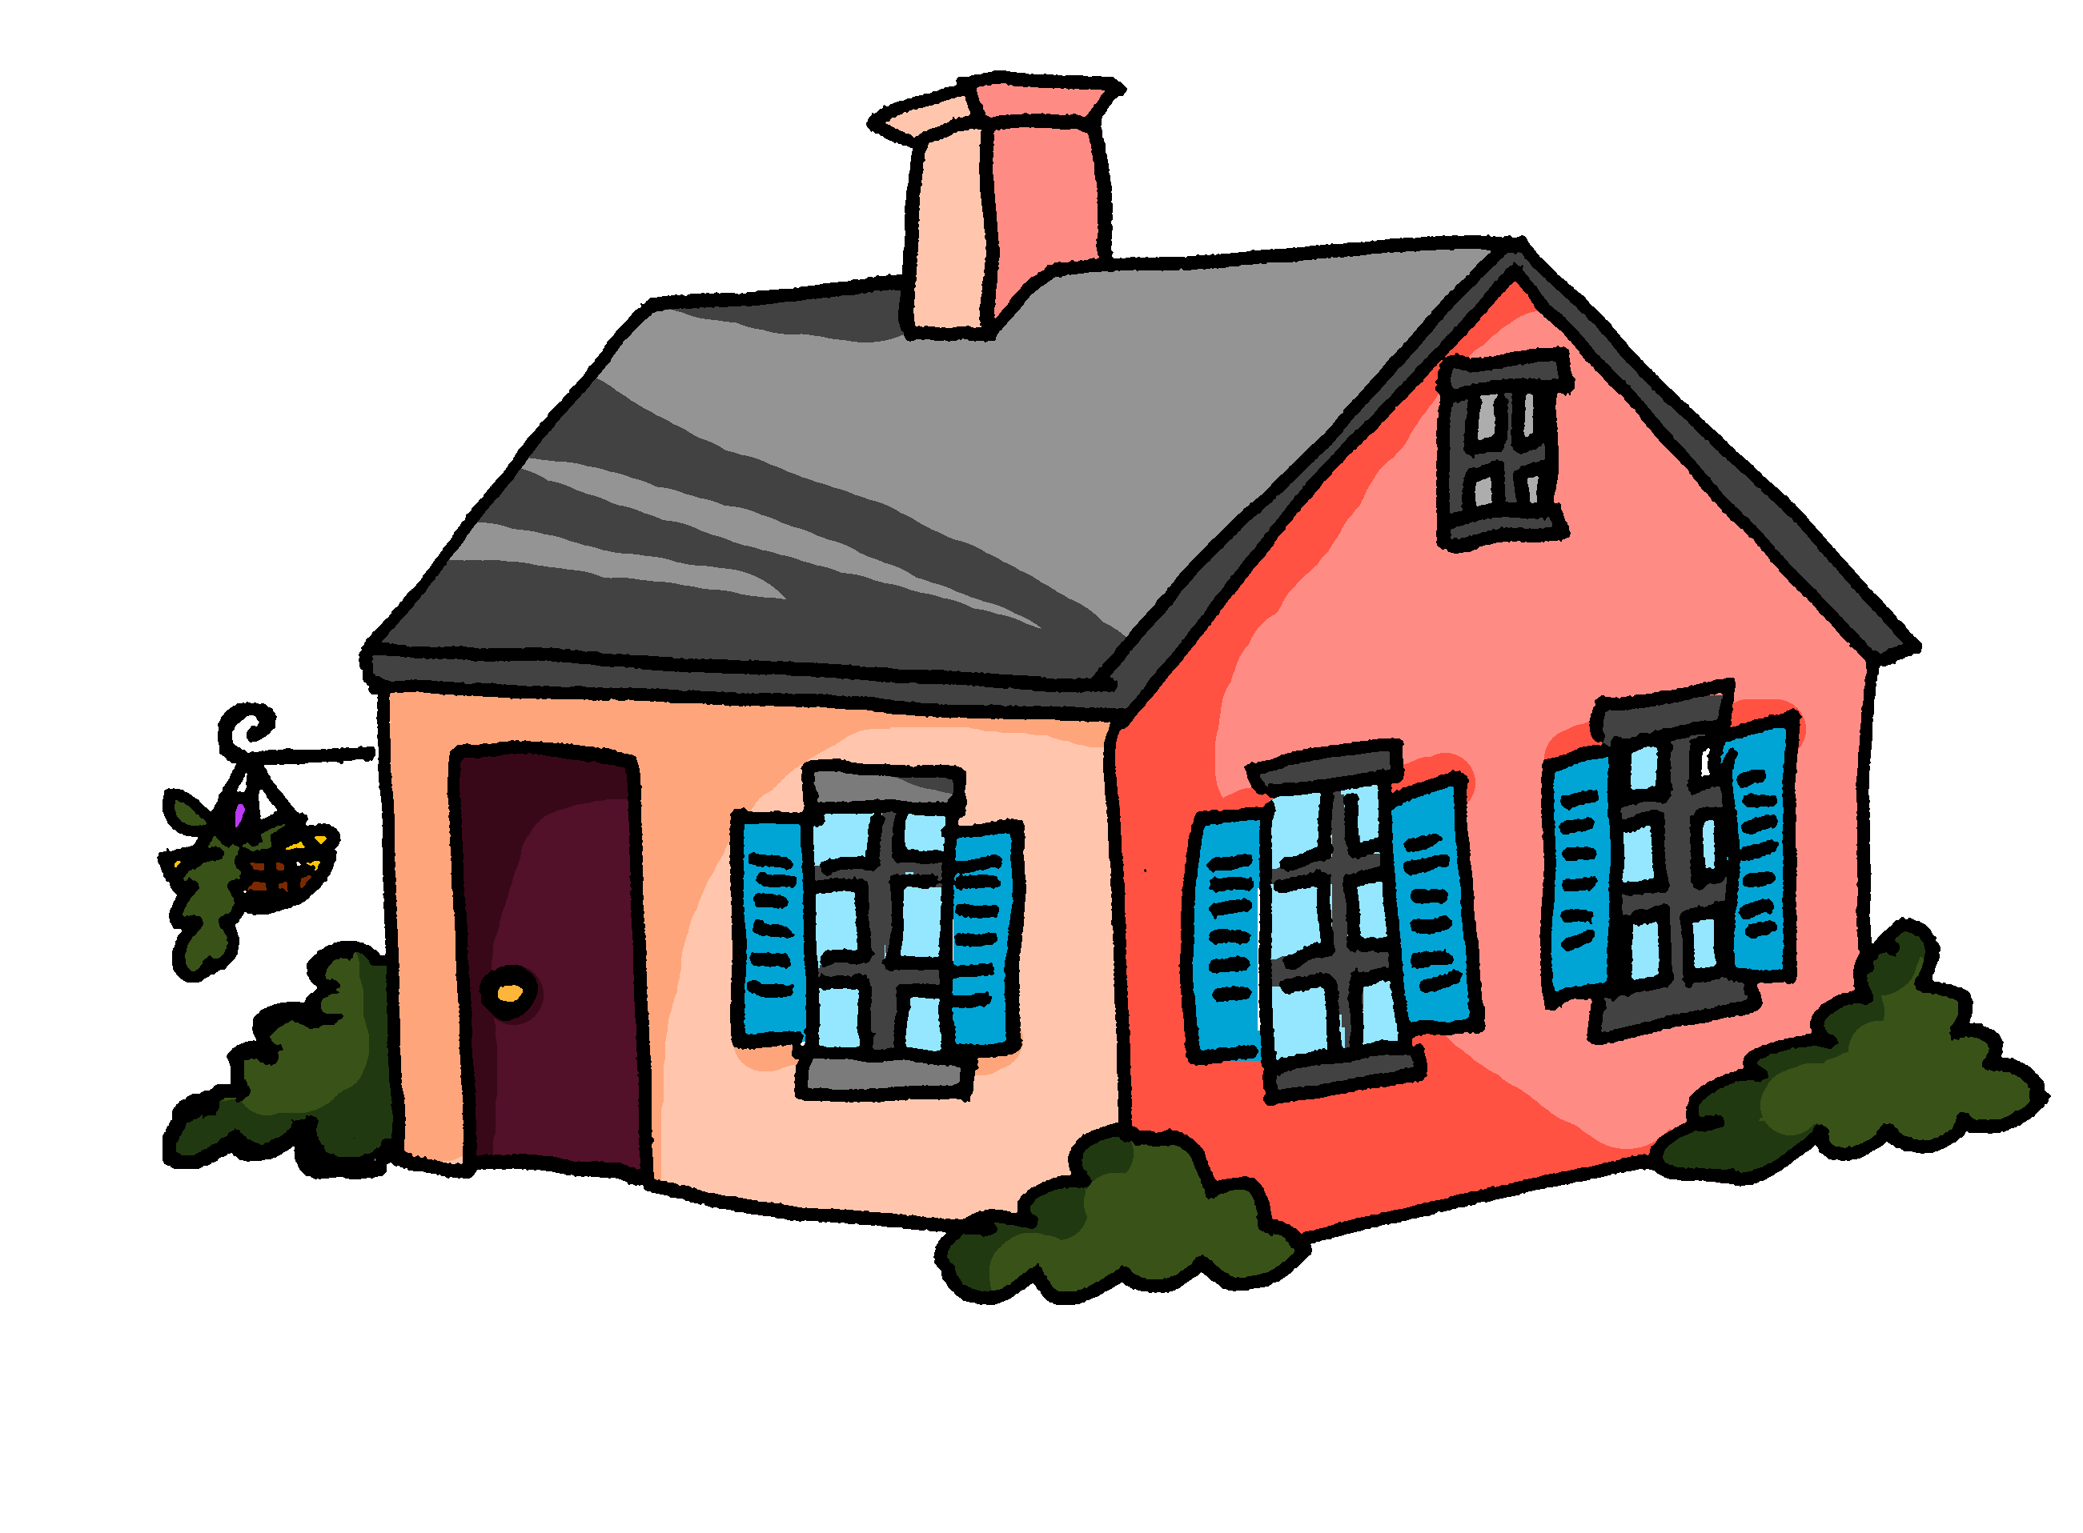
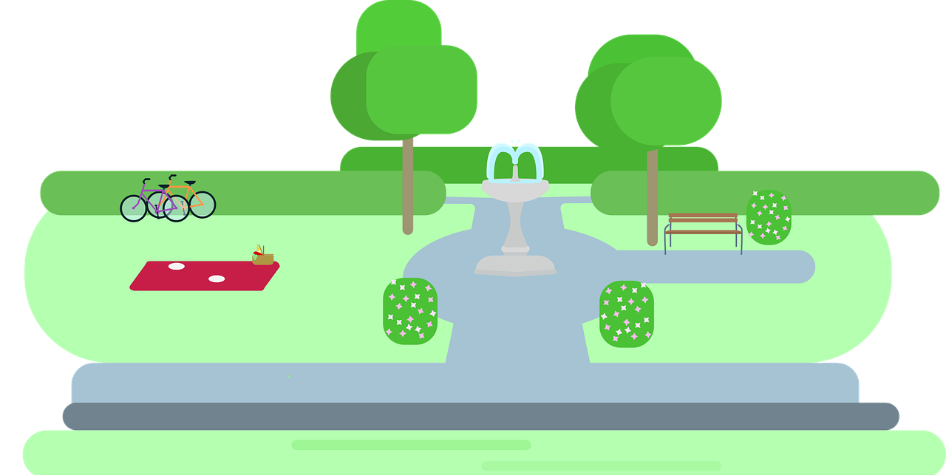

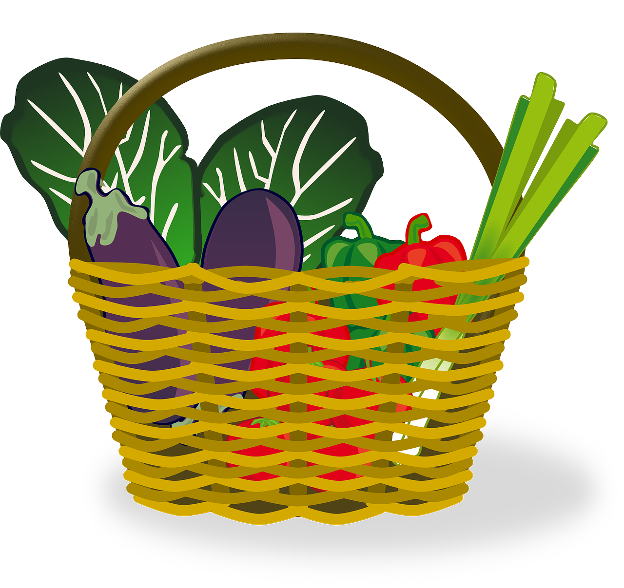
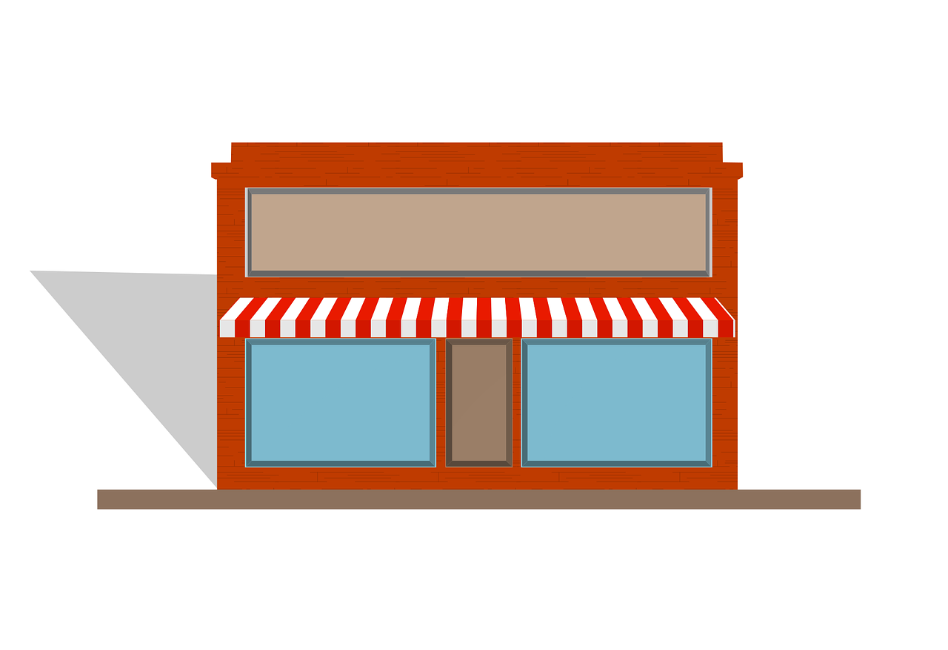
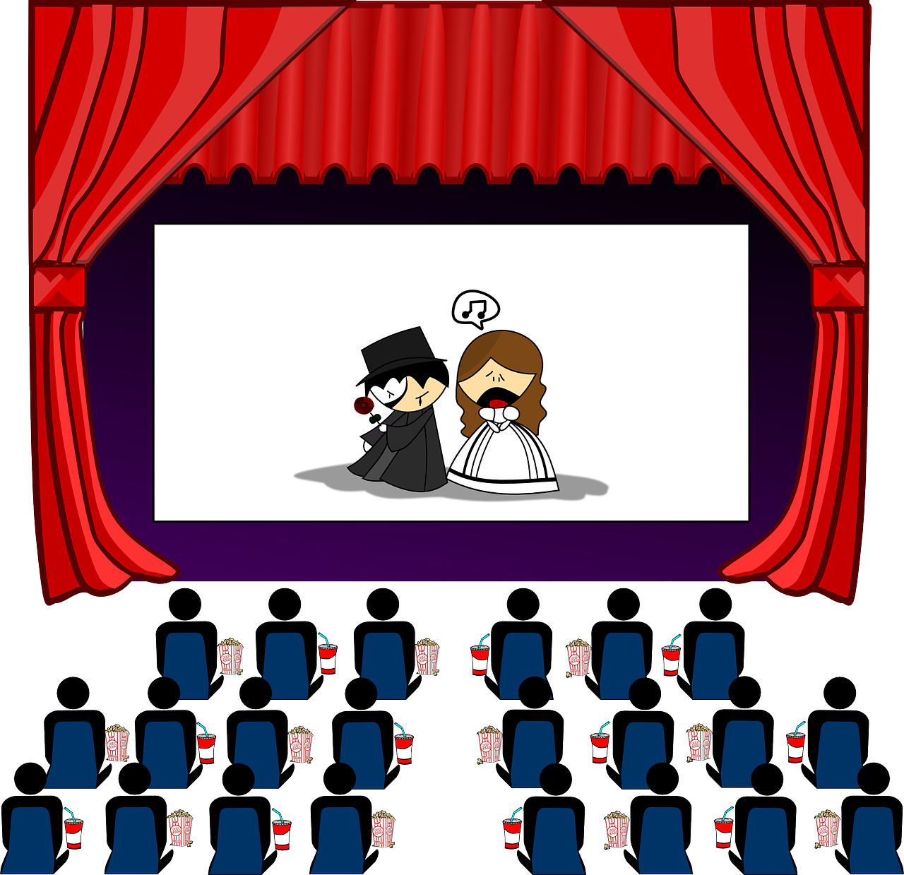
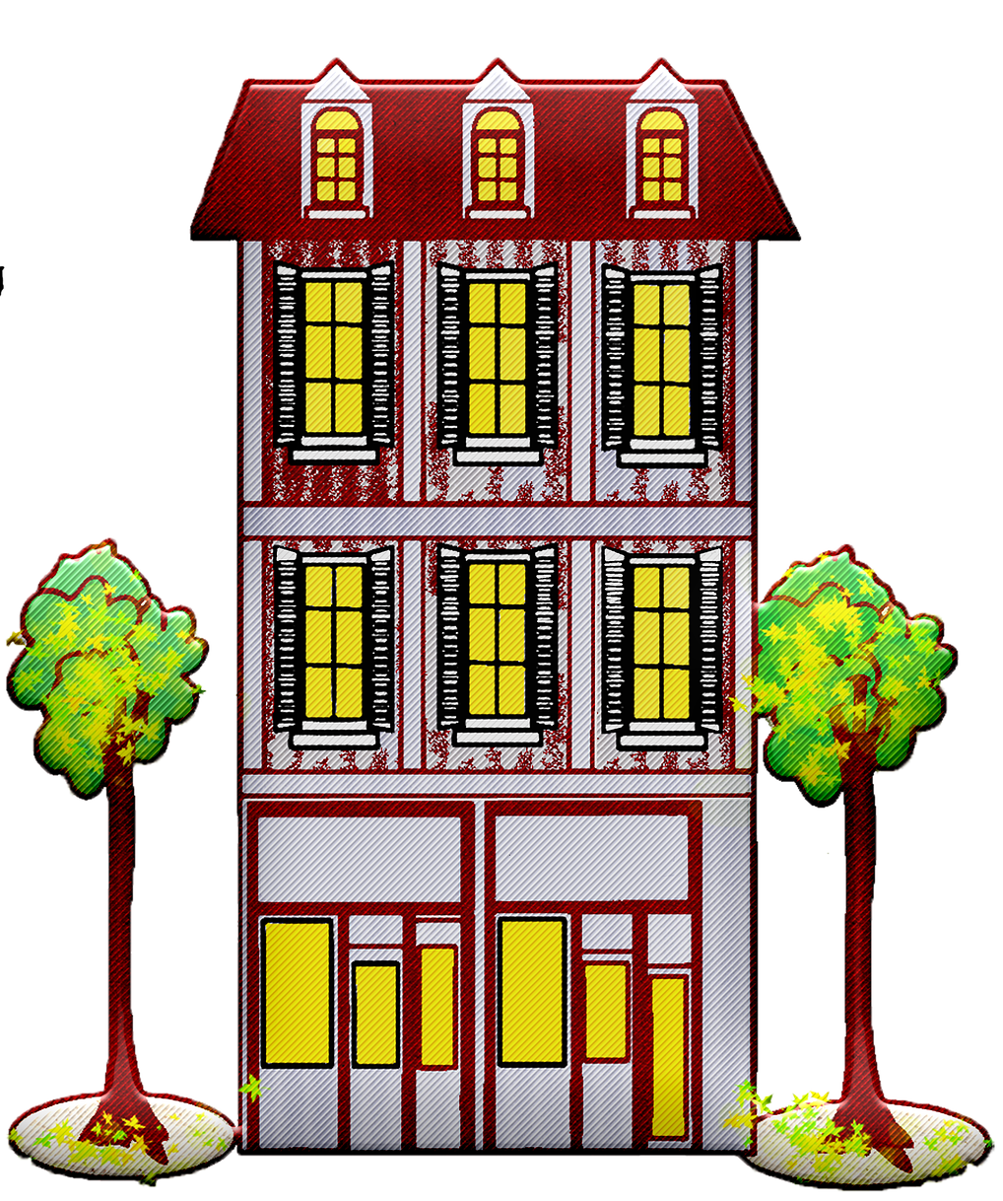

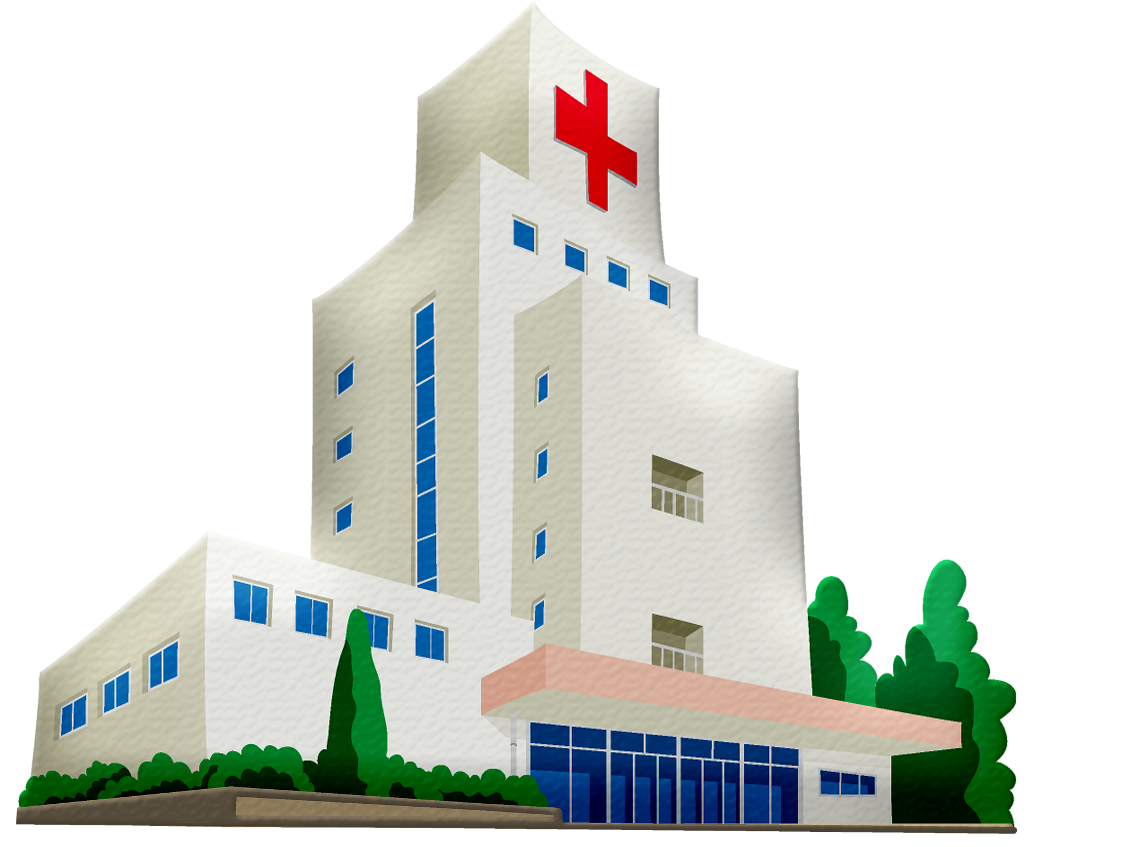
vocabulaire
Vocabulaire
mots
Comment dit-on ça en français?
le marché
la piscine
la poste
la maison
le parc
le magasin
le cinéma
l’hôtel
l’école
l’hôpital
school
hotel
post office
park
hospital
market
cinema
house
pool
shop
Notes:
Timing: 3 minutes
Aim: to practise written recognition and read aloud of 6 previously taught words and 2 new words.
Procedure:
Click for English prompt.
Elicit French from pupils.
Click to confirm.
Repeat with all items.
11

Slide 12
Saying ‘to (the)’ in French
When we mean ‘to (the)…’ in French before a noun, we use au if the following noun is masculine:
⚠ use au not
à + le for ‘to the’.
au parc
to the park
au marché
to the market
To mean ‘to (the)’ before a feminine noun, we use à la:
à la maison
to the house
à la poste
to the post office
When the noun starts with a vowel or ‘h’, we use à l’:
à l’hôtel
to the hotel
à l’école
to the school
Notes:
Timing: 2 minutes
Aim: to present the three ways to say ‘to (the)’ in French.
Procedure:
Click through the animations to present the information.
Elicit English translations for the French examples provided.

Slide 13

Follow up 4
Mylène écrit à Adèle.
Où va Mylène (je) ? Où va Renée (elle) ?
C’est ‘au’ ou ‘à la’ ?
lire
1
Je vais à la poste.
Mylène is going to the..
1.
2.
3.
4.
post office
2
Je vais au parc.
park
pool
3
Elle va au magasin.
market
4
Elle va au cinéma.
Renée is going to the..
1.
2.
3.
5
shop
Je vais à la piscine.
cinema
6
house
Je vais au marché.
7
Elle va à la maison.
Notes:
Timing: 5 minutes
Aim: to practise written understanding of vocabulary; to practise connecting ‘au’ and ‘à la’ with masculine and feminine nouns.
Procedure:
Clarify French instruction.
Model number [1] with pupils
Pupils look at the verb ‘vais’ or ‘va’ to determine whether it is Mylène (je) or Renée (elle) going.
Elicit answer and click to reveal ‘je’ or ‘elle’
Elicit the place, and click to reveal.
Pupils finally decide if it is ‘au’ or ‘à la’.
Click to reveal the answer. If desired, click on the audio button to hear the full message.
Pupils complete numbers 2-7.
Conduct feedback as above.
Transcript:
Je vais à la poste.
je vais au parc.
Elle va au magasin.
Elle va au cinéma.
Je vais à la piscine.
Je vais au marché.
Elle va à la maison.

Slide 14
Au revoir !
bleu
Notes:
14

