Slide 1
Saying where you are going and what there is there
bleu
Follow ups 1-5
Notes:
Artwork by Steve Clarke. Pronoun pictures from NCELP (www.ncelp.org). All additional pictures selected from Pixabay and are available under a Creative Commons license, no
attribution required.
Phonics: Revisit SSC [ai] - vrai [292] maison [325] aider [413] raison [72] aimer [242] semaine [245]
Vocabulary (new words in bold): tu vas je vais [53] tu es je suis [5] à (meaning ‘at/in/to’)[4] marché [280] piscine [>5000]
Revisit 1: cacher [914] maintenant [192] normalement [2018]
Revisit 2: --
Londsale, D., & Le Bras, Y. (2009). A Frequency Dictionary of French: Core vocabulary for learners London: Routledge.
The frequency rankings for words that occur in this PowerPoint which have been previously introduced in these resources are given in the SOW and in the resources that first
introduced and formally re-visited those words.
For any other words that occur incidentally in this PowerPoint, frequency rankings will be provided in the notes field wherever possible.

Slide 2
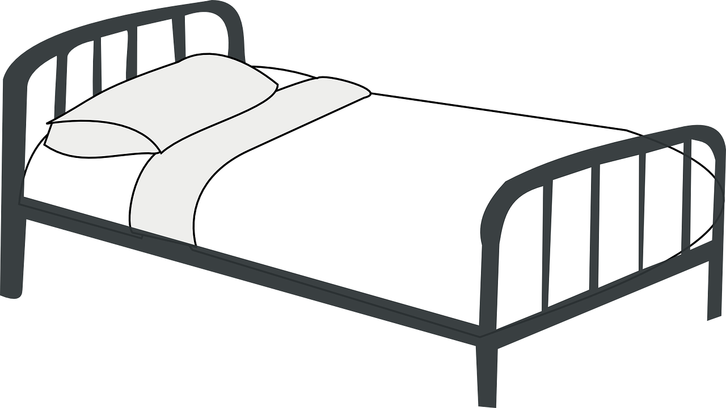
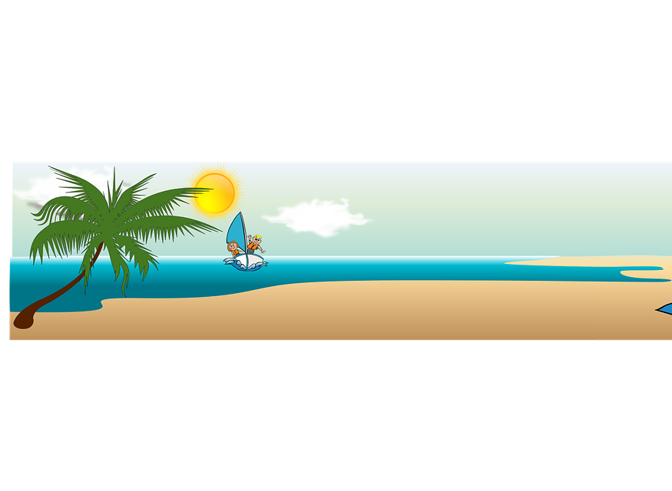
prononcer
Follow up 1
Écoute. C’est [ai] ou [a] ?
Écris A ou B.
A
B
 | vais | vas
 | faire | phare
 | ma | mais
 | taie | ta
 | par | paire
 | pas | paix
 | lait | la
 | bas | baie
1
2
3
4
5
6
7
8
Notes:
Timing: 3 minutes
Aim: to practise aural distinction between [ai] and [a] in a mixture of known and unknown words.
Procedure:
Click to play the audio.
Pupils select A or B.
Click to reveal the answer.
Transcript: vas
phare [lighthouse]
mais
taie [pillow case]
paire
pas [step]
lait
bas [(at the)bottom]
2

Slide 3
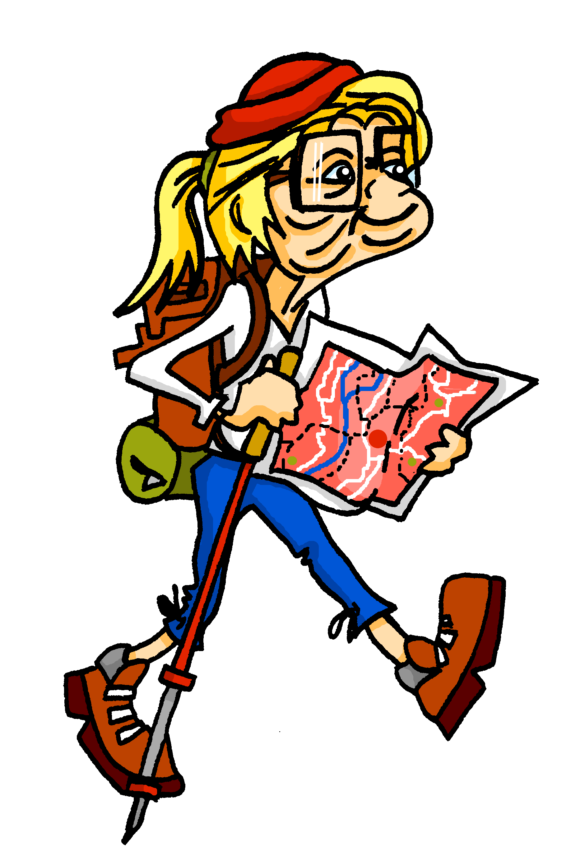
écouter
Follow up 2
A busy day for Mylène and Renée. Where do they finally meet up?
Mylène parle à Renée.
Écoute. Qui va où ? C’est Mylène (je) ou Renée (tu) ?
 | Mylène (I) | Renée (you)
 |  |  | rue | mur
 |  |  | salle | sud
 |  |  | marché | maison
 |  |  | fenêtre | déjeuner
 |  |  | feu | fête
 |  |  | parc | piscine
1
1
Tu es à la piscine. Salut, Renée !
2
2
3
3
4
4
5
5
6
6
Notes:
Timing: 5 minutes
Aim: to practise aural connection of au and à la with familiar masculine and feminine nouns.
Procedure:
Click to listen to the sentence, with final noun missing.
Pupils write the numbers 1-6 and for each item they note M or R and the place each goes to, depending on whether they hear ‘au’ or à la’.
Click to reveal a new set of audio buttons. Listen to each full sentence to check the answer, and click to reveal.
At the end click for the final speech bubble – Mylène and Renée meet up at the pool.
Transcript:
[Elle] va à Sayabec. [Je] vais à Saint-Fabien. [Elle] va à Grande-Vallée. [Elle] va à Gaspé. [Je] vais à Bonaventure. [Je] vais à Baie-Trinité.
3

Slide 4
vocabulaire
Follow up 3a - Écris en anglais : Can you get at least 15 points?
mots
 | le déjeuner | rarement | la maison
 | toujours | le cinéma | la poste
 | cacher | normalement | le mur
 | le cours | maintenant | l’école
 | le marché | Il va | la piscine
 | je vais | tu vas | aller
(the) lunch
rarely
(the) house
x3
always
(the) cinema
(the) post office
x2
to hide, hiding
normally
(the) wall
(the) lesson
now
school
(the) market
he goes, he is going
(the) pool
x1
I go, I am going
you go, you are going
to go, going
Notes:
Timing: 5-10 minutes
Aim: to practise written production of vocabulary from this week and two revisited weeks.
Procedure: 1. Give pupils a blank grid. They fill in the English meanings of any of the words they know, trying to reach 15 points in total. 2. Remind pupils that adjectives can refer to male or female persons and they should note this in their translations. E.g. pleased (f), short (m).
Note: The most recently learnt and practised words are pink, words from revisit 1 are green and those from revisit 2 are blue, thus more points are awarded for them, to recognise that memories fade and more effort (heavy lifting!) is needed to retrieve them.
4

Slide 5
vocabulaire
Follow up 3b - Écris en français : Can you get at least 15 points?
mots
 | (the) cinema | always | rarely
 | (the) house | (the) post office | (the) lunch
 | (the) lesson | (the) school | (the) wall
 | now | normally | to hide, hiding
 | to go, going | I go, I am going | he goes, he is going
 | you go, you are going | (the) market | (the) pool
le cinéma
toujours
rarement
x3
la maison
la poste
le déjeuner
x2
le cours
l’école
le mur
maintenant
normalement
cacher
aller
je vais
il va
x1
tu vas
le marché
la piscine
Notes:
Timing: 5-10 minutes
Aim: to practise written comprehension of vocabulary from this week and previous weeks.
Procedure: Give pupils a blank grid. They fill in the French meanings of any of the words they know, trying to reach 15 points in total.
Note: The most recently learnt and practised words are pink, words from the previous week are green and those from earlier are blue, thus more points are awarded for them, to recognise that memories fade and more effort (heavy lifting!) is needed to retrieve them.
5

Slide 6
Asking questions using Est-ce que…
-ER verbs: tu (you), vous (you, formal)
To make it clear that a yes/no question is being asked, we can add Est-ce que (‘Is it that…?’) at the start of any statement:
Est-ce qu’il va à la poste ?
Oui, il va à la poste.
Does he go to the post office?
Yes, he goes to the post office.
Is he going to the post office?
Yes, he is going to the post office.
To ask a ‘where’ question, we can add Où est-ce que (‘Where Is it that…?’) at the start of any statement:
Où est-ce qu’il va ?
Il va à la poste.
Where does he go?
He goes to the post office.
Where is he going?
He is going to the post office.
Notes:
Timing: 2 minutes
Aim: to recap the use of Est-ce que to ask questions and introduce Où est-ce que
Procedure:
Click through the animations to present the information.
Elicit English translations for the French examples provided.

Slide 7
Asking questions using Où est-ce que …
-ER verbs: tu (you), vous (you, formal)
The ‘s’ sound is the soft ‘c’.
Let’s practise saying Où est-ce que questions:
The –st are silent.
1
Où est-ce que tu vas ?
2
Où est-ce que tu vas ?
Where do you go, are you going?
Where do you go, are you going?
When you say it slowly there are six separate syllables.
In conversation we speed up and there are five syllables.
3
Où est-ce que je vais ?
4
Où est-ce que je vais?
Where do I go, am I going?
Where do I go, am I going?
Notes:
Timing: 2 minutes
Aim: to practise pronouncing Où est-ce que
Procedure:
Click through the animations to present the information.
Click each audio button to hear Où est-ce que at two different speeds.

Slide 8
Follow up 4:
Parle avec ton/ta partenaire.
Use au or à la to mean ‘to the’.
parler
B: Ask your partner: Where are you going?
Où est-ce que tu vas ?
A: Tell your partner: I am going… and the 3 places on your card.
Then swap roles!
B: Ask your partner: Where am I going?
Où est-ce que je vais?
A: Tell your partner: You are going… and the 3 places on your card.
B: Make sure you write down all six places.
Notes:
Timing: 5 minutes
Aim: to practise oral production and comprehension of positive and negative statements with il y a/il n’y a pas and previously taught nouns.
Procedure:
1. Pupil A has Handout A (see end of this lesson PPT).
2. Pupil B listens to Pupil A and compares the three classroom pictures with what s/he hears.
3. B identifies the correct room and teacher clicks to reveal the answer.
Note: every sentence must be listened to in order to identify the correct classroom.
4. Swap roles and move to the next slide.

Slide 9
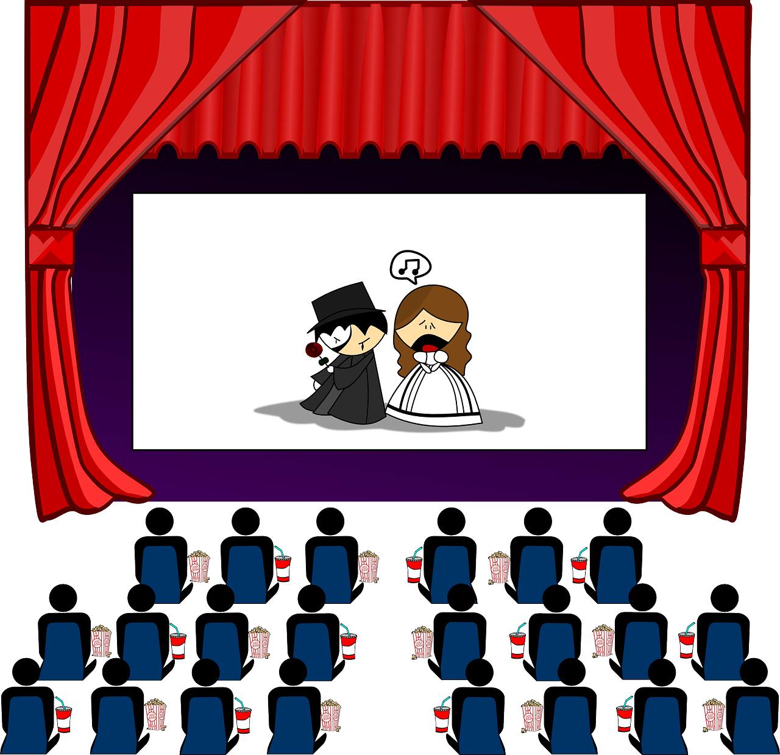
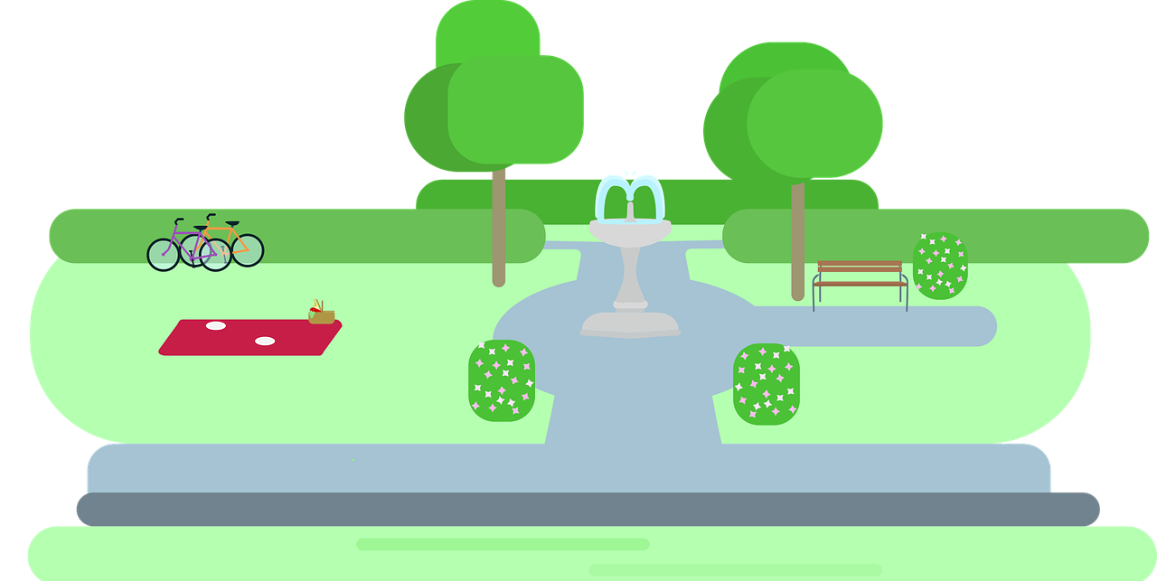
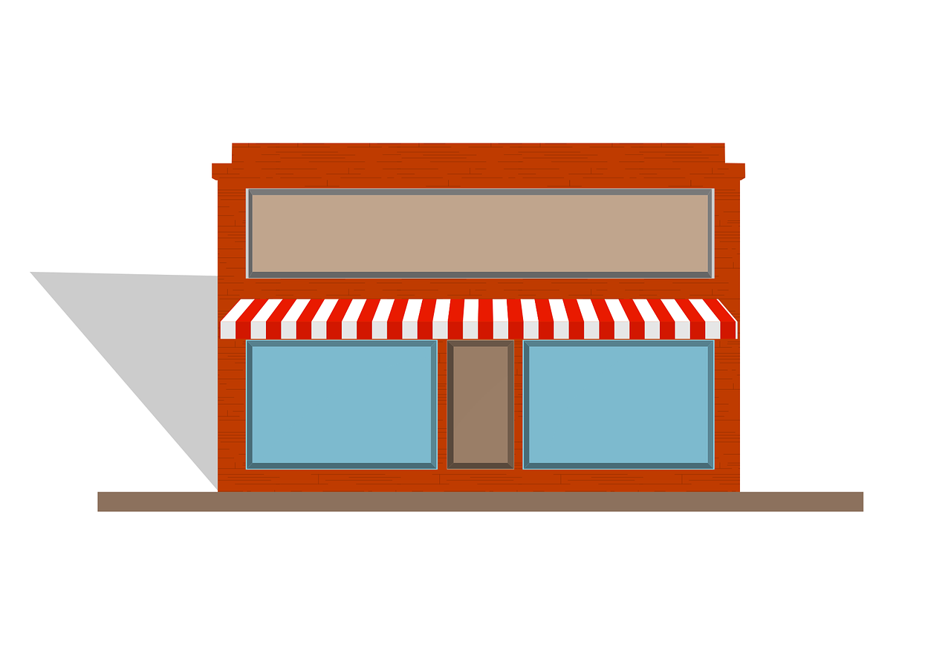
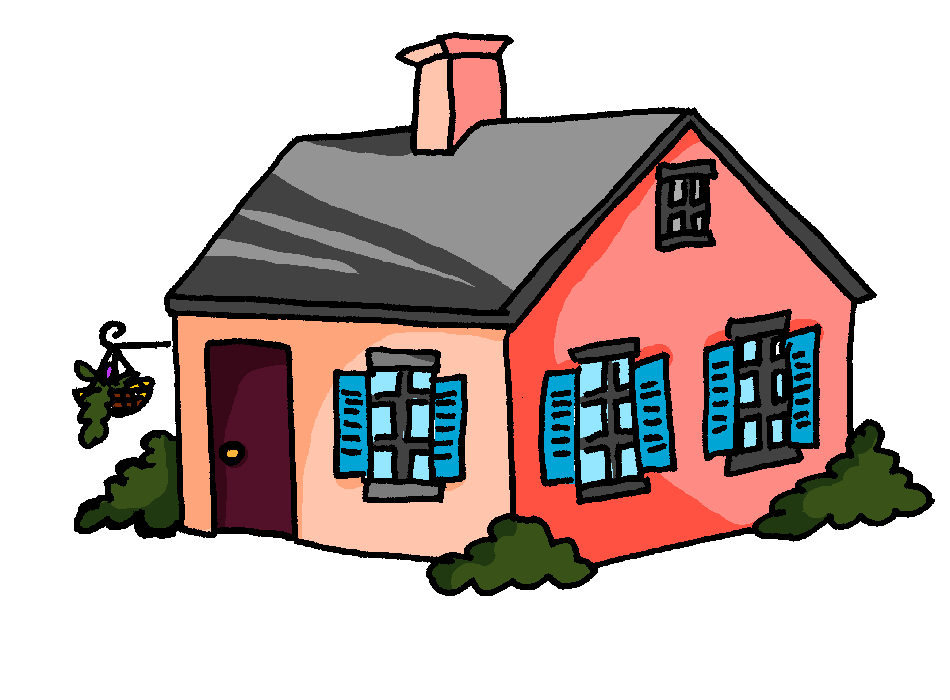
Follow up 4A:
Réponses
A: Parle.
B: Écris.
Tell your partner: ‘You are going …’ to 3 places and ‘I am going’… to 3 places.
parler
Listen and write the six places.
Tu…
Tu…
Tu…
Je…
Je…
Je…
I am going…
I am going…
I am going…
You are going…
You are going…
You are going…
vas à l’école.
to school.
vas au cinéma.
to the cinema.
vas au marché.
to the market.
vais au parc.
to the park.
vais au magasin.
to the shop.
vais à la maison.
to the house.
Notes:
ANSWERS – DO NOT DISPLAY DURING THE ACTIVITY
Procedure:
Elicit French from partner As and English from partner Bs.
Click to reveal written answers.
Continue with the answers for 4B on the next slide.

Slide 10
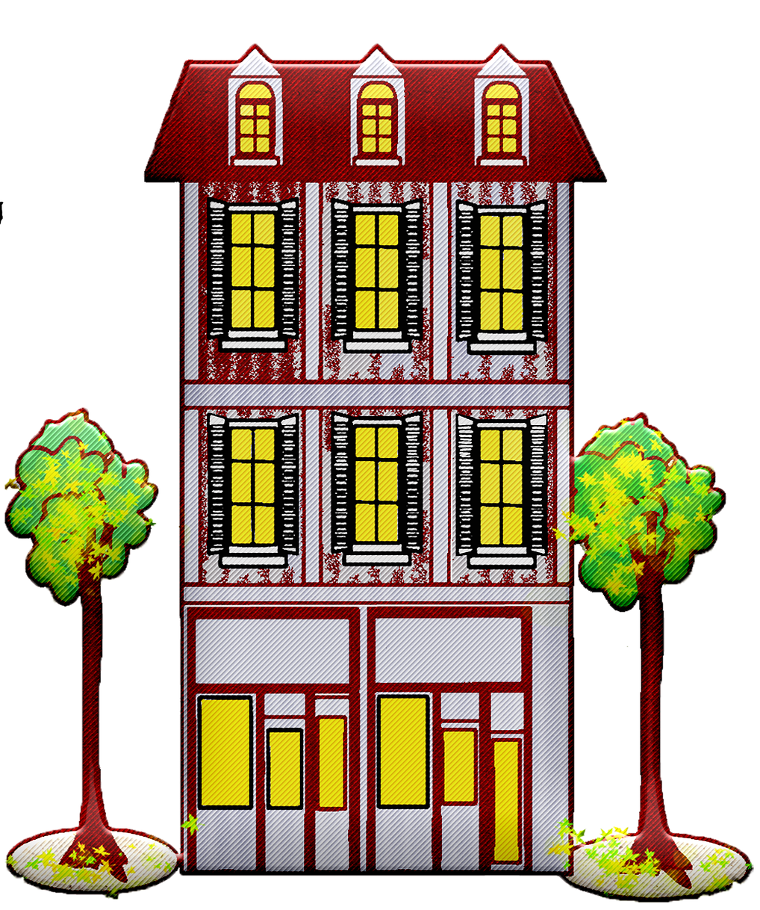
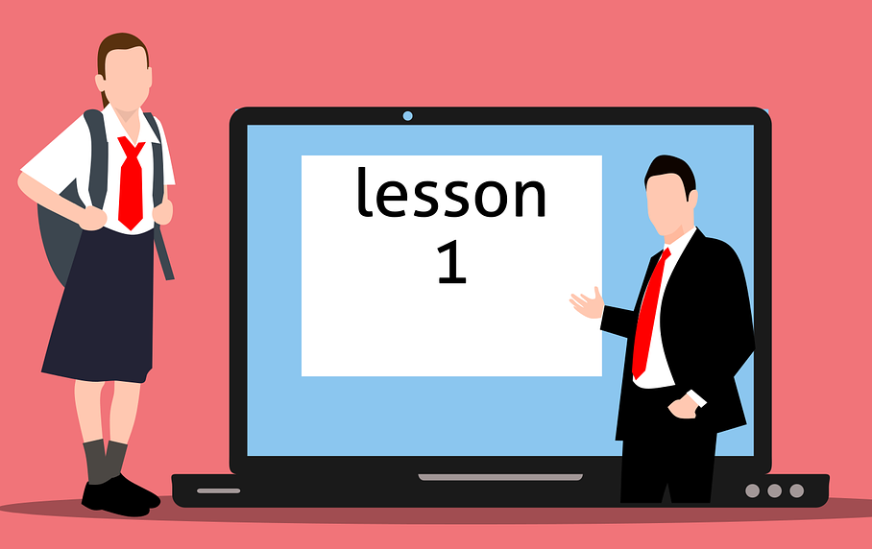
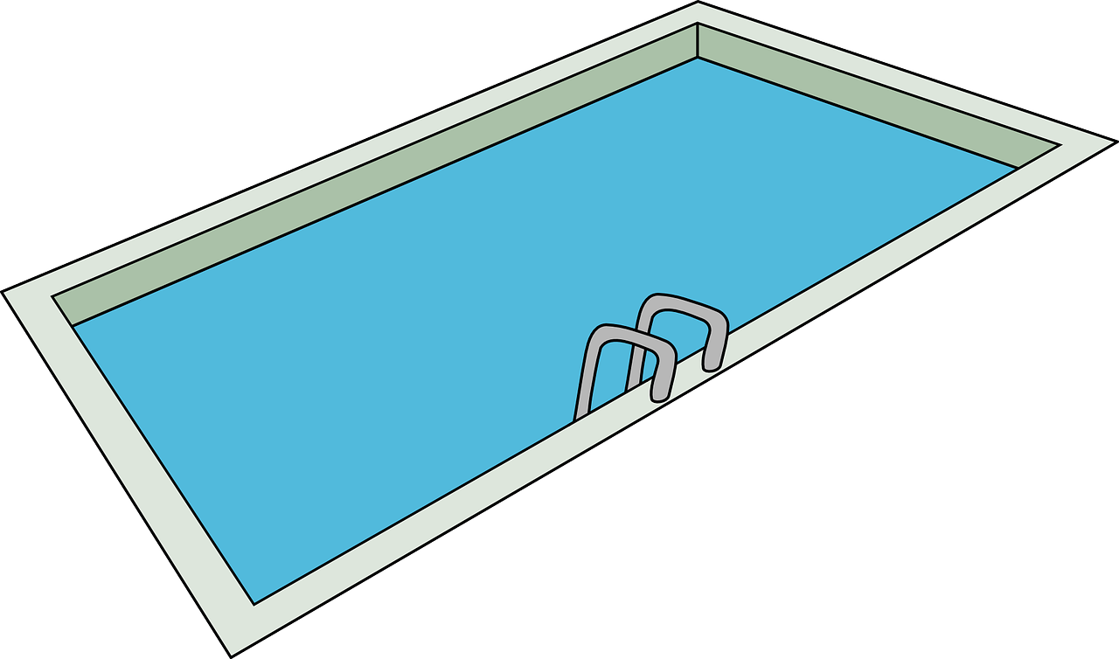
Follow up 4B:
Réponses
A: Écris.
B: Parle.
Tell your partner: ‘You are going …’ to 3 places and ‘I am going’… to 3 places.
parler
Listen and write the six places.
Tu…
Tu…
Tu…
Je…
Je…
Je…
I am going…
I am going…
I am going…
You are going…
You are going…
You are going…
vas à l’hôtel.
to the hotel.
vas au cours.
to the lesson.
vas à la piscine.
to the pool.
vais à la montagne.
to the mountain(s).
vais à la poste.
to the post office.
vais au feu.
to the fire.
Notes:
ANSWERS – DO NOT DISPLAY DURING THE ACTIVITY

Slide 11
Follow up 5:

Écris les mots correspondants en français et en anglais.
Tu ____ ___ parc maintenant ?
______ _____au cinéma rarement.
Je _____ au cours _____ _____ _____.
Où est-ce que __ ___ normalment ?
Il va ___________ au __________.
_____ ___’elle va _ __ __________?
___ you _____ to the park _____?
She goes to the cinema ______.
___ go ___ _________ everyday.
______ ____ you go __________?
___ always _____ to the _______.
Does ___ _____ to the pool?
écrire
vas au
Are
going
now
Elle va
rarely
vais
tous les jours
I
to lesson(s)
tu vas
Where do
normally
toujours
market
He
goes
market
Est-ce qu
à la piscine
she go
Notes:
Timing: 5-10 minutes
Aim: to practise written production of singular forms of aller, this week’s new vocabulary and written comprehension of other new and revisited vocabulary.
This is a jigsaw translation task.
Procedure:
Students write the missing words in both French and English to complete the sentences.
Teacher clicks to provide the written answers and/or clicks the audio buttons to hear the full French sentences.
Differentiation: 1. For a different challenge (i.e. to practise spelling rather than full written recall of the missing French words), the task could be completed as a transcription task initially, by listening to the full sentences and writing the words.
2. Then pupils could complete the English part of the jigsaw.

Slide 12
Follow up 4A:
Parle avec ton/ta partenaire.
A: Parle.
A: Écris.
Tell your partner: ‘You are going …’ to 3 places and ‘I am going’… to 3 places.
parler
Listen and write the six places.
Tu…
Tu…
Tu…
Je…
Je…
Je…
I am going…
I am going…
I am going…
You are going…
You are going…
You are going…
Notes:
HANDOUT PARTENAIRE A

Slide 13
Follow up 4B:
Parle avec ton/ta partenaire.
B: Écris.
B: Parle.
Tell your partner: ‘You are going …’ to 3 places and ‘I am going’… to 3 places.
parler
Listen and write the six places.
I am going…
I am going…
I am going…
You are going…
You are going…
You are going…
Tu…
Tu…
Tu…
Je…
Je…
Je…
Notes:
HANDOUT PARTENAIRE B

Slide 14
vocabulaire
Follow up 3a - Écris en anglais : Can you get at least 15 points?
mots
 | le déjeuner | rarement | la maison
 | toujours | le cinéma | la poste
 | cacher | normalement | le mur
 | le cours | maintenant | l’école
 | le marché | Il va | la piscine
 | je vais | tu vas | aller
x3
x2
x1
Notes:
HANDOUT
14

Slide 15
vocabulaire
Follow up 3b - Écris en français : Can you get at least 15 points?
mots
 | (the) cinema | always | rarely
 | (the) house | (the) post office | (the) lunch
 | (the) lesson | (the) school | (the) wall
 | now | normally | to hide, hiding
 | to go, going | I go, I am going | he goes, he is going
 | you go, you are going | (the) market | (the) pool
x3
x2
x1
Notes:
HANDOUT
15

