Slide 1
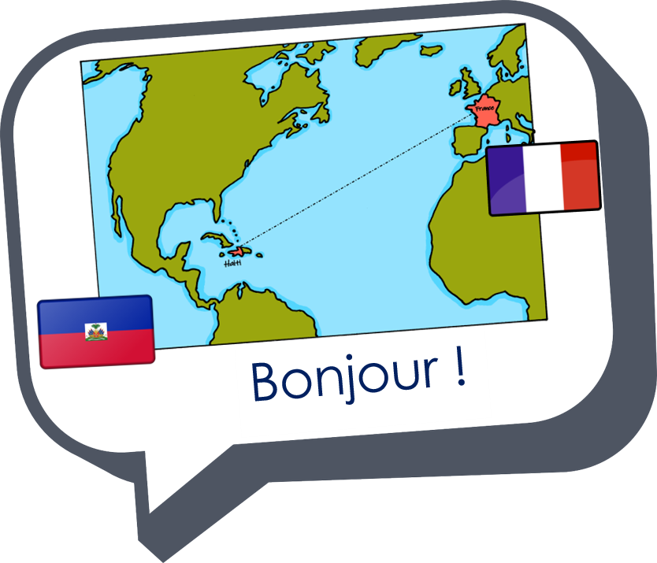


Saying where you are going and what there is there
bleu
aller (je vais, il/elle va)
dans, en, au
SSC [ai] & [(a)in]
Notes:
Artwork by Steve Clarke. Pronoun pictures from NCELP (www.ncelp.org). All additional pictures selected from Pixabay and are available under a Creative Commons license, no
attribution required.
Phonics: Revisit SSC [ai] - vrai [292] maison [325] aider [413] raison [72] aimer [242] semaine [245]
and [(a)in] - train [232] fin [111] matin [442] vingt [1273] main [418]
Vocabulary (new words in bold): aller, je vais, il/elle va [53] à (meaning ‘at/in/to’)[4] dans [11] Canada [N/A] France [N/A] nord [1090] sud [1242] est [4603] ouest [1690]
Revisit 1: étudier [960] partager [527] parfois [410]
Revisit 2: --
Londsale, D., & Le Bras, Y. (2009). A Frequency Dictionary of French: Core vocabulary for learners London: Routledge.
The frequency rankings for words that occur in this PowerPoint which have been previously introduced in these resources are given in the SOW and in the
resources that first introduced and formally re-visited those words.
For any other words that occur incidentally in this PowerPoint, frequency rankings will be provided in the notes field wherever possible.
1

Slide 2





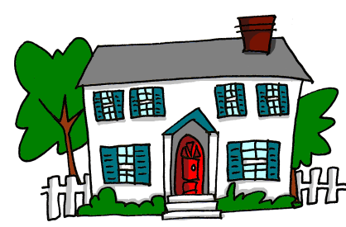
prononcer
[ai]
vrai
to like, liking
to help, helping
aimer
aider
week
maison
semaine
Notes:
Timing: 2 minutes
Aim: To consolidate SSC [ai]
Procedure:
1. Introduce and elicit the pronunciation of the individual SSC [ai] and then the source word again ‘vrai’ (with gesture, if using).
2. Then present and elicit the pronunciation of the five cluster words.
Word frequency (1 is the most frequent word in French):
aider [413] aimer [232] maison [325] semaine [245] vrai [292]
Source: Londsale, D., & Le Bras, Y. (2009). A Frequency Dictionary of French: Core vocabulary for learners London: Routledge.
Word frequency (1 is the most frequent word in French):
vrai [292].
Source: Londsale, D., & Le Bras, Y. (2009). A Frequency Dictionary of French: Core vocabulary for learners London: Routledge.
2

Slide 3




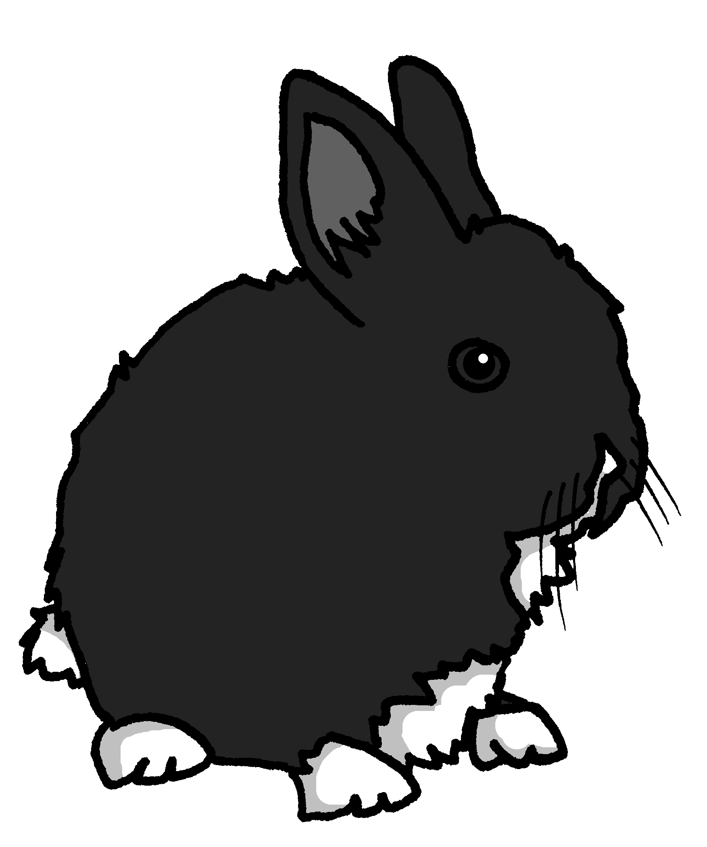
prononciation
[(a)in]
train
vingt
fin
main
lapin
Notes:
Timing: 2 minutes
Aim: To consolidate SSC [ain/in].
Procedure:
1. Introduce and elicit the pronunciation of the individual SSC [(a)in] and then the source word again ‘train’ (with gesture, if using).
2. Then present and elicit the pronunciation of the five cluster words.
The cluster words have mainly been chosen for their high-frequency, from a range of word classes, with the SSC (where possible) positioned within a variety of syllables within the words (e.g. initial, 2nd, final etc.).
Note: gesture for train – fist closed, arm by side, forearm at right angle to body, thrust fist forward miming the movement of a fast train
https://www.signbsl.com/sign/train – scroll down to the noun train videos.
Word frequency (1 is the most frequent word in French):
fin [111] lapin [>5000] main [418] train [232] vingt[1273]
Source: Londsale, D., & Le Bras, Y. (2009). A Frequency Dictionary of French: Core vocabulary for learners London: Routledge.
3

Slide 4
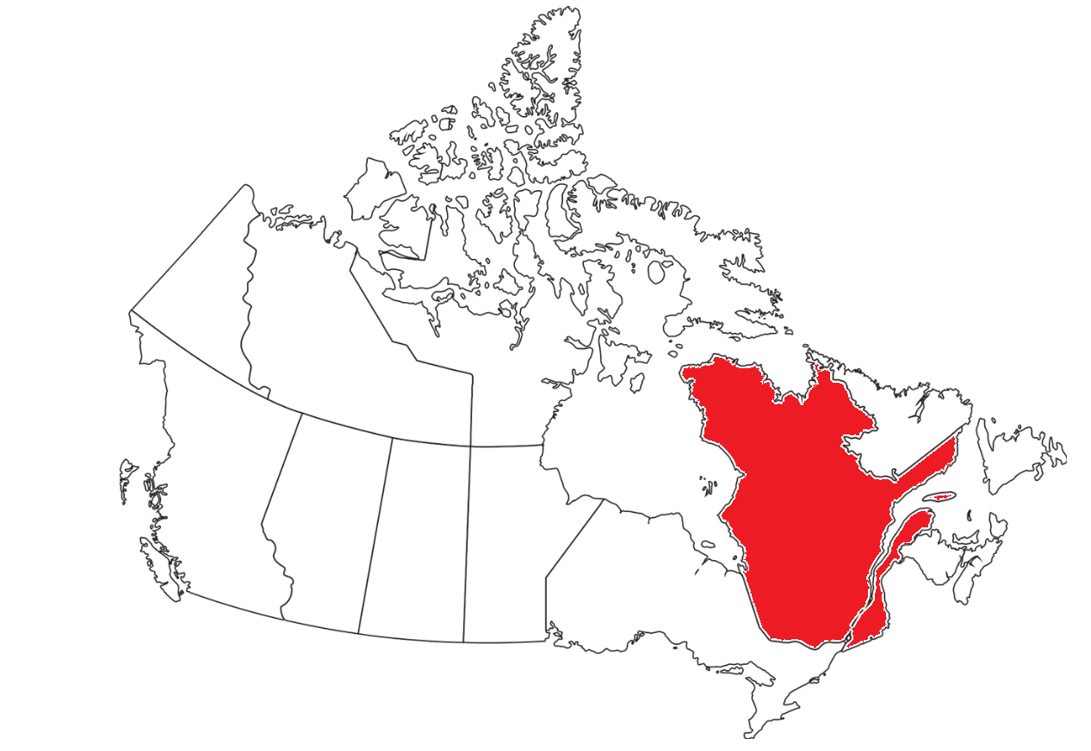
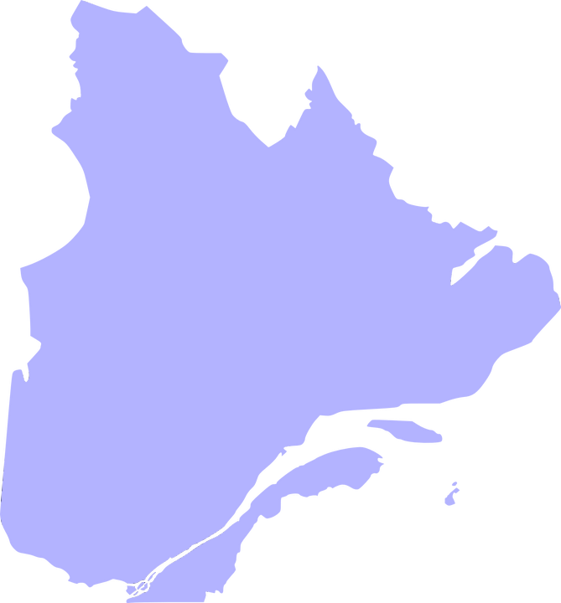

prononcer
[ai] ou [(a)in] ?
Prononce le nom* des villes. C’est le son [ai] ou [(a)in] ?
Le Canada
Chapais
Québec
Sainte-Adèle
La Malbaie
Quebec is a region in Canada. French is its only official language.
Baie-Saint-Paul
Blainville
La Prairie
Pointe-Claire
Lorraine
⚠ Note: when [(a)in] is followed by SFe, the sound changes to [ai], as in semaine.
le nom – name
Notes:
Timing: 3 minutes
Aim: to practise oral production of place names containing SSC [ai] and [(a)in]; to learn about Quebec and Canada.
Procedure:
1. Show students the maps of Canada and Quebec. Demonstrate the location of Quebec on the east coast. Explain to students that Quebec is the only Canadian province with French as its sole official language.
2. Each click brings up the missing a town/city name, starting with Blainville, going left to right around the region and ending with Lorraine.
3. After each click, pupils try to say the name (focusing on SSCs [ai] and [(a)in])
4. Click on the speech bubbles to hear the towns pronounced by a native speaker.
5. Pupils repeat.
Transcript:
Blainville
Sainte-Adèle
Chapais
La Malbaie
Baie-Saint-Paul
La Prairie
Pointe-Claire
Lorraine
4

Slide 5



aller (to go, to be going)
Aller is an irregular verb meaning to go, to be going.
⚠ The –s is a Silent Final Consonant (SFC).
Je vais
I go|I am going
⚠ Now –s is often pronounced because it is followed by a vowel. Pronounce the –s like English ‘z’.
This is an example of optional liaison.
Je vais à Paris.
I go|I am going to Paris.
Elle va à Paris.
She goes|is going to Paris.
Il va aussi à Paris.
He also goes|is also going to Paris.
Notes:
Timing: 2 minutes
Aim: to introduce two forms of the irregular verb aller.
Procedure:
Click through the animations to present the information. Stress the highly irregular nature of aller and perhaps ask pupils if they can think of another highly irregular verb e.g. être (je suis, il/elle est).
Elicit English translations for the French examples provided.

Slide 6

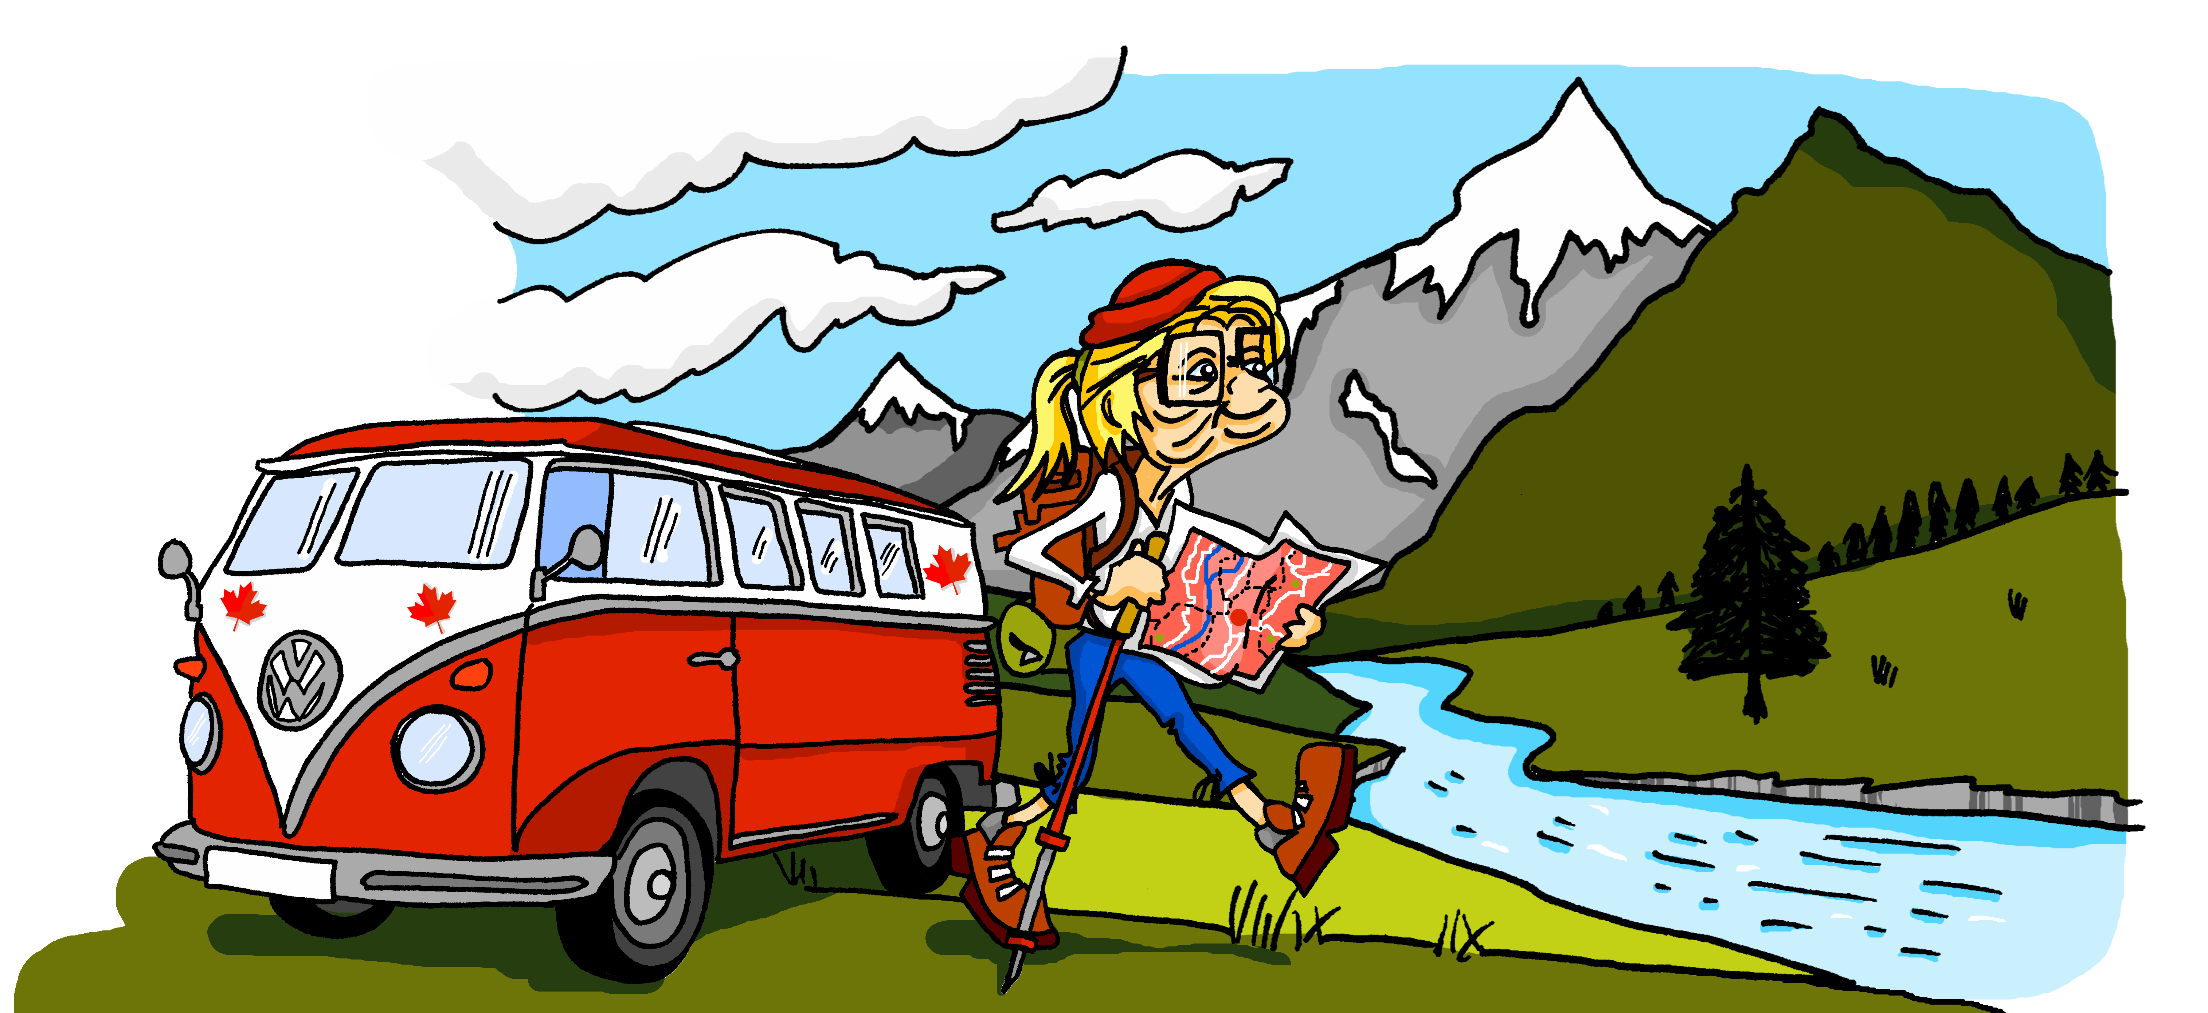



lire
Mylène est au Canada et cherche Renée, sa tante*.
la tante - aunt
Mais Renée va où exactement ? Et Mylène ?
1
4
Je vais à
Puis,
je vais à Matane.
Tadoussac.
Mylène (je) | Renée (elle)
2
5
[1]
Je vais ensuite à
Elle va à
[2]
Baie-Comeau.
Sainte-Luce.
[3]
[4]
3
6
Elle va aussi à
[5]
Aujourd’hui,
elle va à Mont-Joli.
[6]
Rimouski.
Notes:
Timing: 5 minutes
Aim: to pay attention to two forms of the verb aller to identify who is going where.
Procedure:
Students write down 1-6.
Model number 1 with the class, so pupils are clear that they select the person (je) or (elle) based on the form of aller. Note that the pronoun is obscured by a crack on the phone.
Click the number to listen and check the full sentence and/or click to reveal the full written sentence.
Pupils complete 2 – 6.
Teacher clicks to correct.
If desired, click on the numbers to hear the full sentences.
Transcript:
Je vais à Tadoussac.
Je vais ensuite à Baie-Comeau.
Aujourd’hui elle va à Mont-Joli.
Puis je vais à Matane.
Elle va à Sainte-Luce.
Elle va aussi à Rimouski.

Slide 7



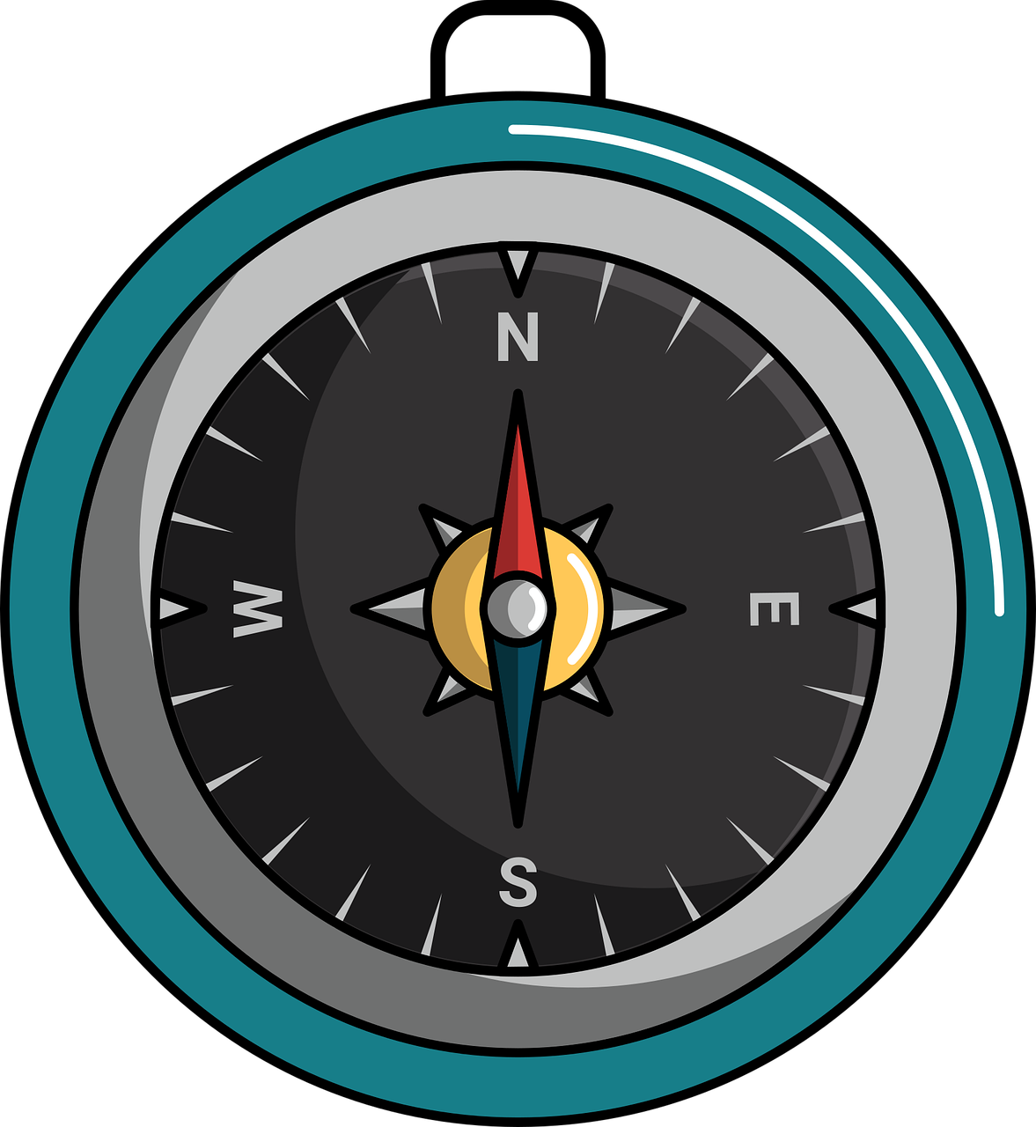
vocabulaire
Vocabulaire
mots
Noah est sans orientation.
le nord
Noah is without direction.
[the north]
l’ouest
l’est
[the west]
[the east]
le sud
[the south]
Notes:
Timing: 3 minutes
Aim: to introduce and practise the new vocabulary for this week.
Procedure:
1. Click for the French word.
Say and elicit the pronunciation from pupils.
Click for the English meaning.
Click again to re-animate the French word. Elicit the French word again from pupils.
Continue for the remaining 3 items.
Finally, click to bring up a phrase – it’s a French mnemonic to remember the order of the cardinal points – like the English one that pupils may know (Never Eat Shredded Wheat). Note: we do not believe there is an authentic French mnemonic for this, so we created this one.
7

Slide 8
dans (in, (in)to)
You have learnt that dans means ‘in’.
Je suis dans le Nord.
Il est dans l’Est.
I am in the north.
He is in the east.
⚠ Note the capital letters on the cardinal points in French.
After aller, dans means ‘into’ or just ‘to’.
Je vais dans le Sud.
Elle va dans l’Ouest.
I go|I am going to the south.
She goes|is going to the west.
Notes:
Timing: 2 minutes
Aim: to introduce a new meaning of ‘dans’ when used with aller.
Procedure:
Click through the animations to present the information.
Elicit English translations for the French examples provided.

Slide 9

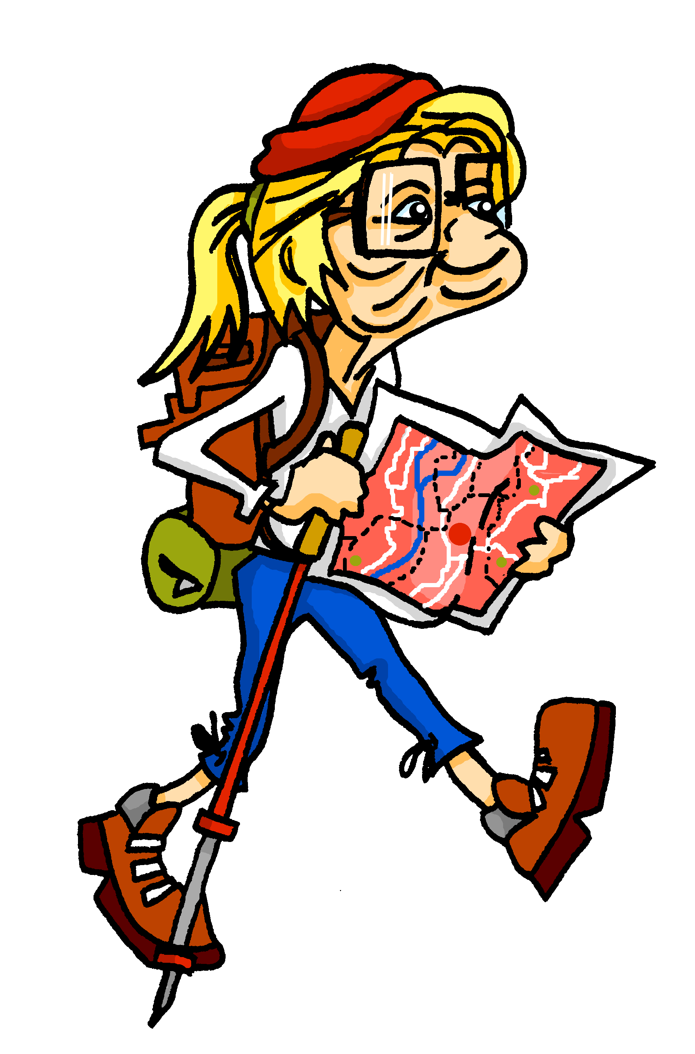
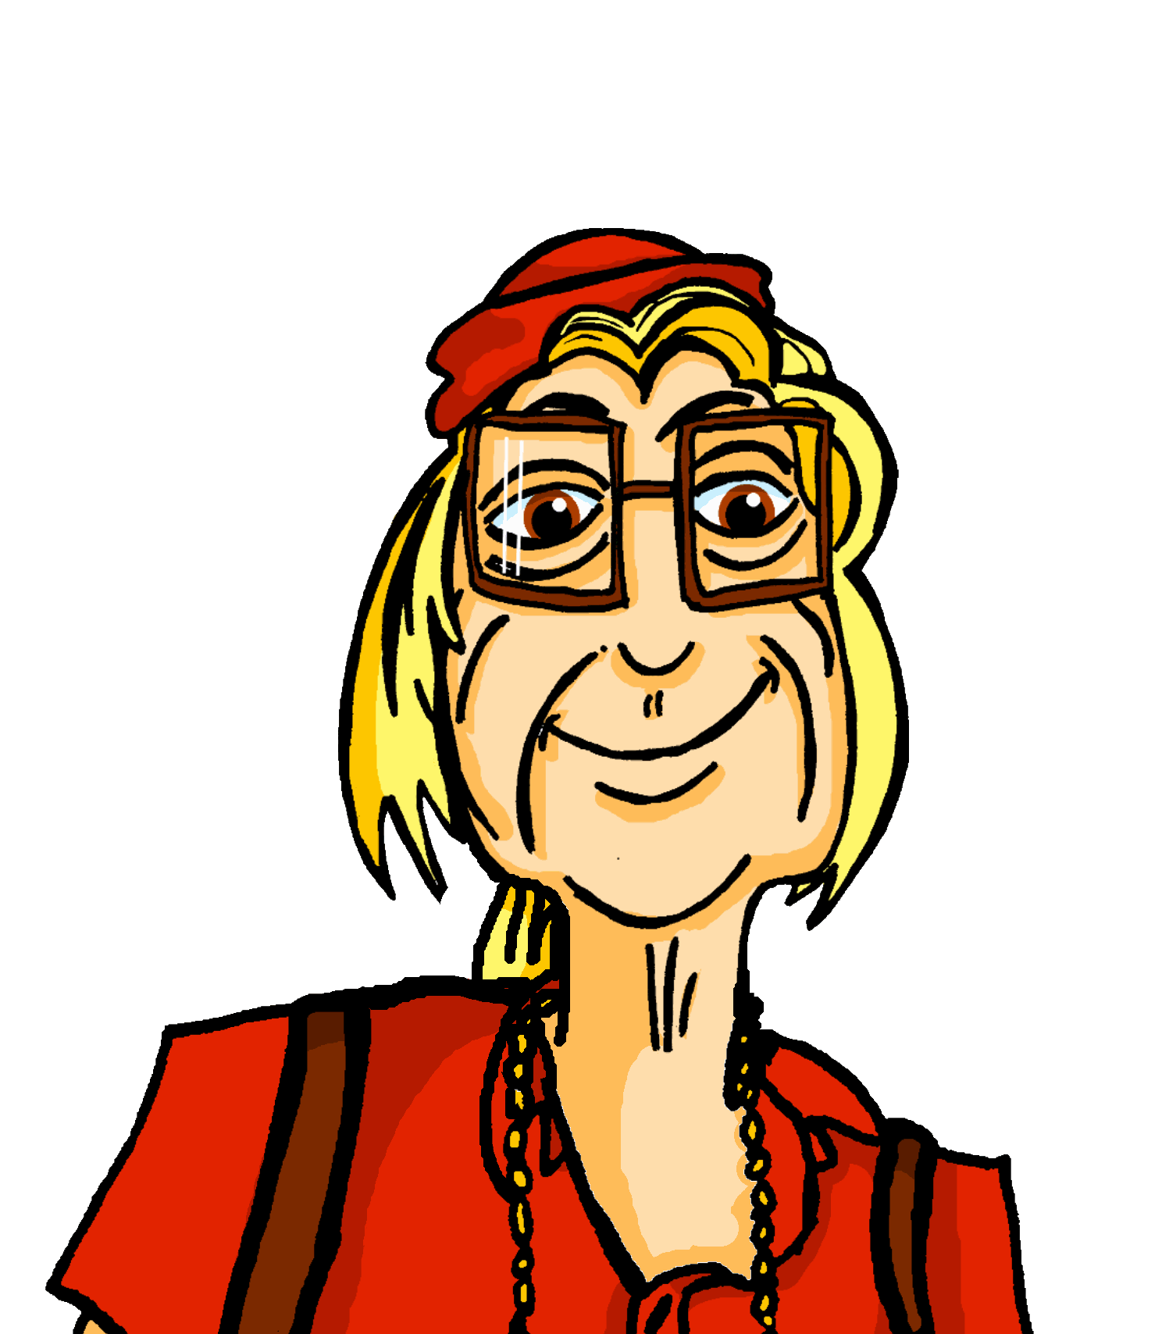
écouter
The next day Mylène is still looking for Aunt Renée.
Mylène parle au téléphone.
Écoute. Qui va dans quelle direction ?
Québec
C’est Mylène (je) ou Renée (elle) ? Écris la direction en anglais.
 | Mylène (je) | Renée (elle) | to/in
 |  |  | in | the west
 |  |  | to | the south
 |  |  | in | the south
 | Mylène (je) | Renée (elle) | to/in
 |  |  | to | the north
 |  |  | to | the east
 |  |  | to | the west
1
4
1
4
2
5
2
5
3
6
3
6
Notes:
Timing: 5 minutes
Aim: to practise aural comprehension of the two forms of aller, without the support of the pronouns je and elle.
Procedure:
Click to listen to the sentence, with pronoun obscured.
Pupils write the numbers 1-6 and for each item the answer ‘je’ or ‘elle’ depending on the form of aller they hear.
Click to reveal the answers.
Click to listen again. This time pupils write to or in and the direction in English.
Click to reveal the answers.
Click again for a 2nd set of audio buttons to listen to the full sentences.
Note that this could provide the opportunity for additional practice – e.g., using mini whiteboards (turning away from the board) and listening to the full sentences in a jumbled order.
Differentiation:
Additional practice stages could precede this task. For example, pupils could be given the different sentence elements in smaller phrases. For example, ‘le sud’, ‘je suis’, ‘elle va’. Pupils could hear these and respond chorally in English, to speed up the processes of meaning recognition.
Transcript:
[Elle] est dans l’Ouest.
[Elle] va dans le Sud.
[Je] suis dans le Sud.
[Je] vais dans le Nord.
[Elle] va dans l’Est.
[Je] vais dans l’Ouest.
9

Slide 10
Au revoir !
bleu
Notes:
10

