Slide 1
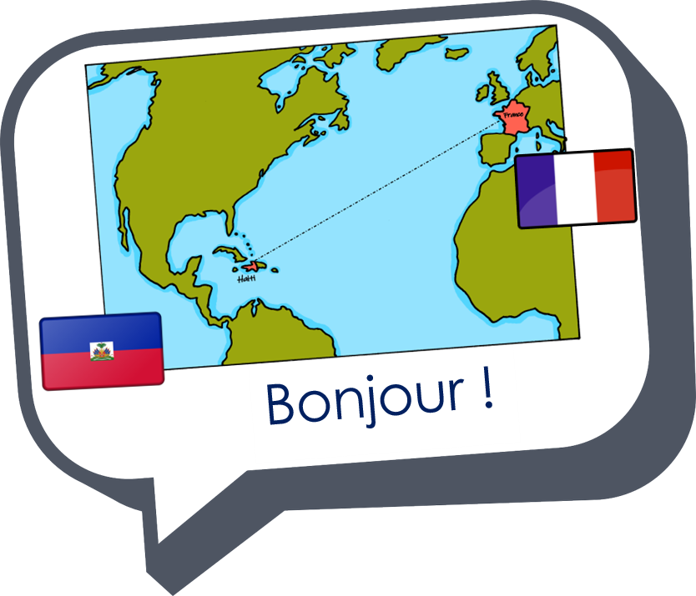


Saying where you are going and what there is there
bleu
Follow ups 1-5
Notes:
Artwork by Steve Clarke. Pronoun pictures from NCELP (www.ncelp.org). All additional pictures selected from Pixabay and are available under a Creative Commons license, no
attribution required.
Phonics: Revisit SSC [ai] - vrai [292] maison [325] aider [413] raison [72] aimer [242] semaine [245]
and [(a)in] - train [232] fin [111] matin [442] vingt [1273] main [418]
and revisit liaison.
Vocabulary (new words in bold): aller, je vais, il/elle va [53] à (meaning ‘at/in/to’)[4] dans [11] Canada [N/A] France [N/A] nord [1090] sud [1242] est [4603] ouest [1690]
Revisit 1: étudier [960] partager [527] parfois [410]
Revisit 2: --
Londsale, D., & Le Bras, Y. (2009). A Frequency Dictionary of French: Core vocabulary for learners London: Routledge.
The frequency rankings for words that occur in this PowerPoint which have been previously introduced in these resources are given in the SOW and in the resources that first
introduced and formally re-visited those words.
For any other words that occur incidentally in this PowerPoint, frequency rankings will be provided in the notes field wherever possible.

Slide 2

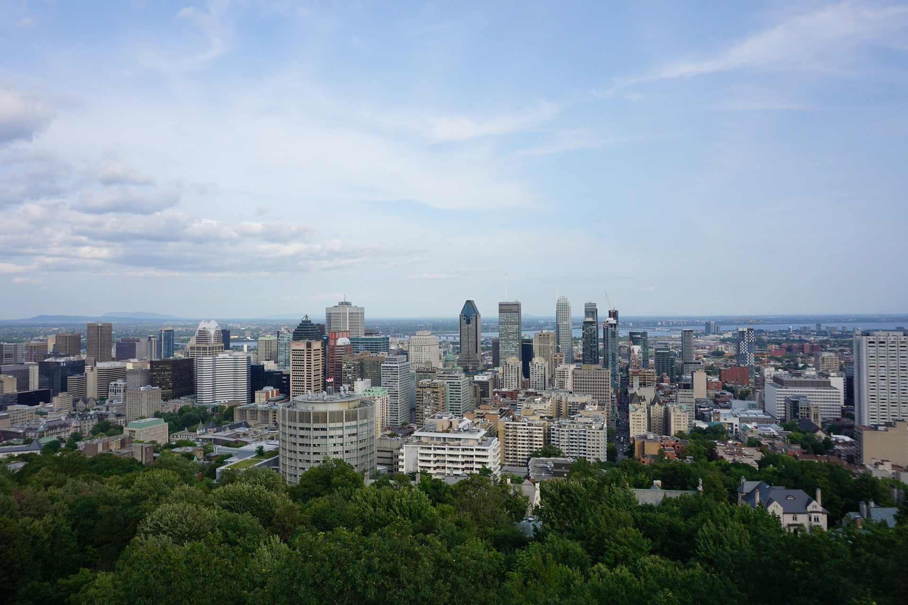

prononcer
Liaison
Prononce les phrases🗣.
Je vais à Montréal.
I go/I am going to Montréal.
1
Notes:
Timing: 3 minutes (6 slides)
Aim: to consolidate s- liaison after ‘je vais’ alternating with no liaison after dans.
Procedure:
Click to play the audio.
Pupils repeat.
Elicit the English meaning.
Ask pupils to read the phrase aloud again.
Transcript:
Je vais à Montréal.
2

Slide 3

prononcer
Liaison
Prononce les phrases🗣.
Toronto est une grande ville au Canada.
Je suis à Toronto.
I am in Toronto.
2
Notes:
[2/6]
Transcript:
Je suis à Toronto.
3

Slide 4
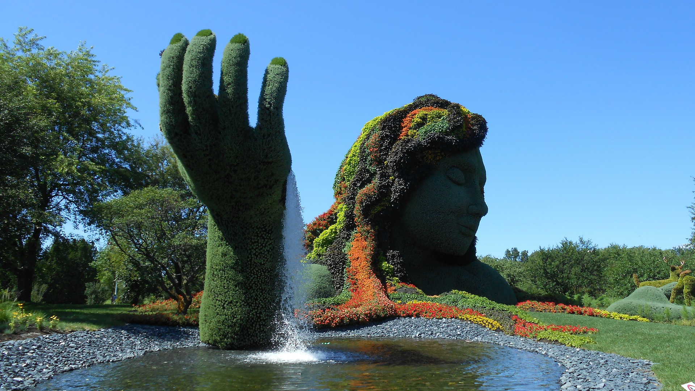
prononcer
Liaison
Prononce les phrases🗣.
C’est le jardin botanique à Montréal.
Je vais dans le jardin.
I go / I am going (in)to the garden.
3
Notes:
[3/6]
Transcript:
Je vais dans le jardin.
4

Slide 5
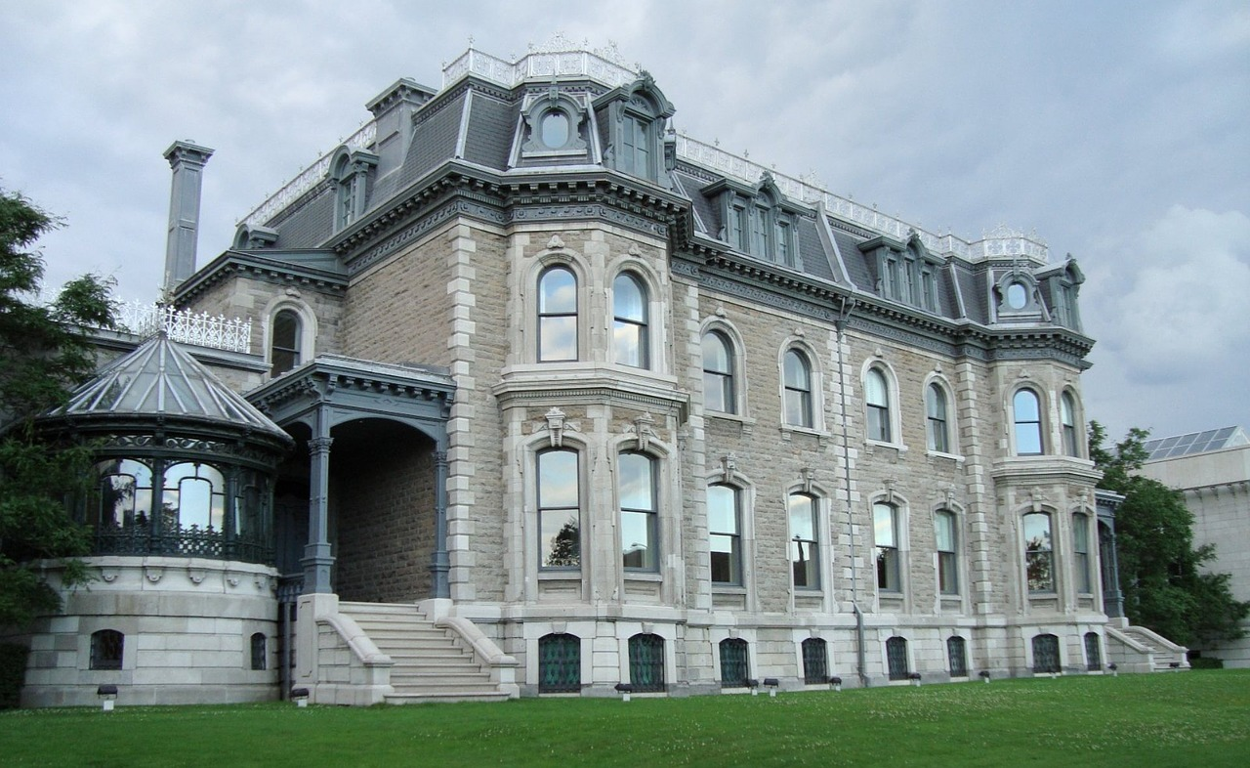
prononcer
Liaison
Prononce les phrases🗣.
C’est une grande maison à Montréal.
Je vais dans la maison.
I go / I am going into the house.
4
Notes:
[4/6]
Transcript:
Je vais dans la maison.
5

Slide 6
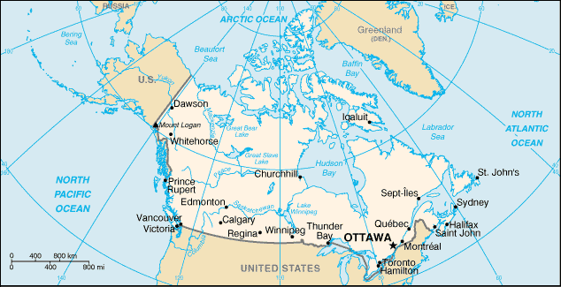

prononcer
Liaison
Prononce les phrases🗣.
Ottawa est la capitale.
Je vais à Ottawa.
I go / I am going to Ottawa.
5
Notes:
[5/6]
Transcript:
Je vais à Ottawa.
6

Slide 7

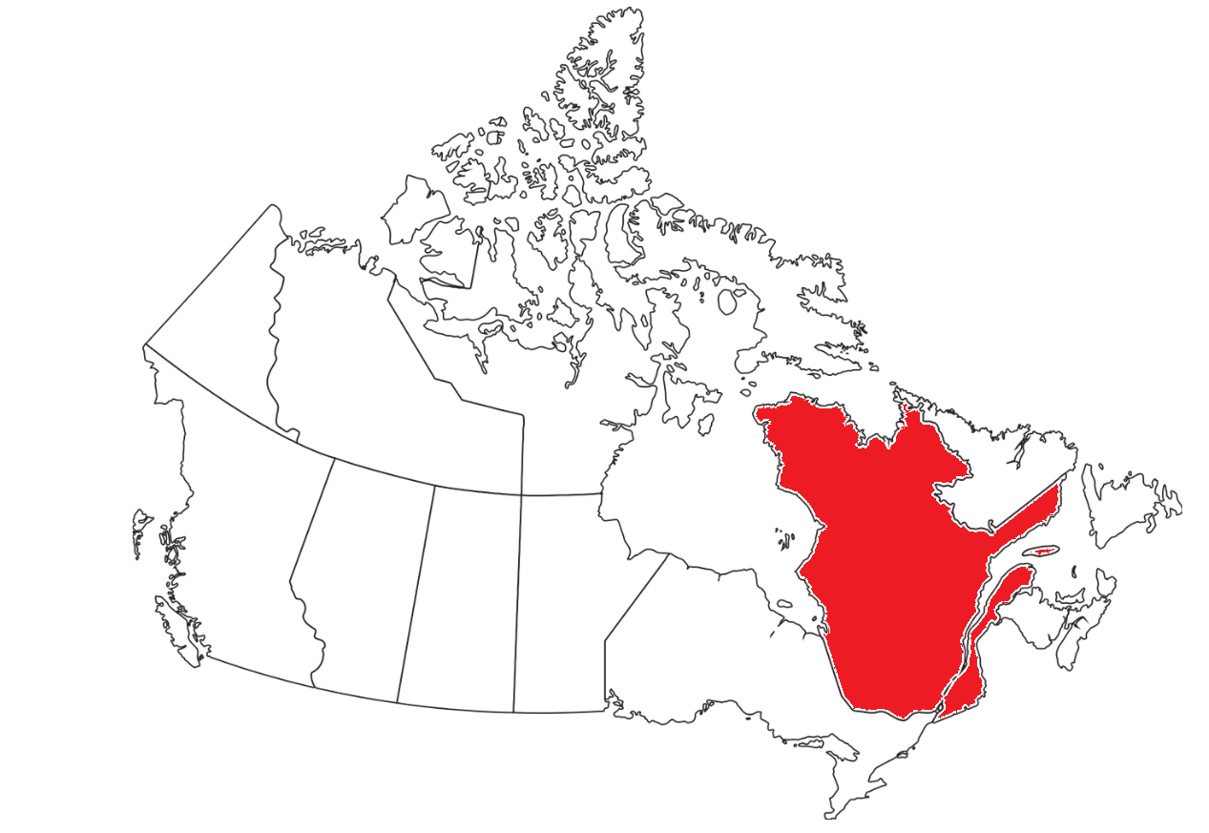
prononcer
Liaison
Prononce les phrases🗣.
Je vais dans le Sud.
I go / I am going to the south.
6
Notes:
[6/6]
Transcript:
Je vais dans le Sud.
7

Slide 8


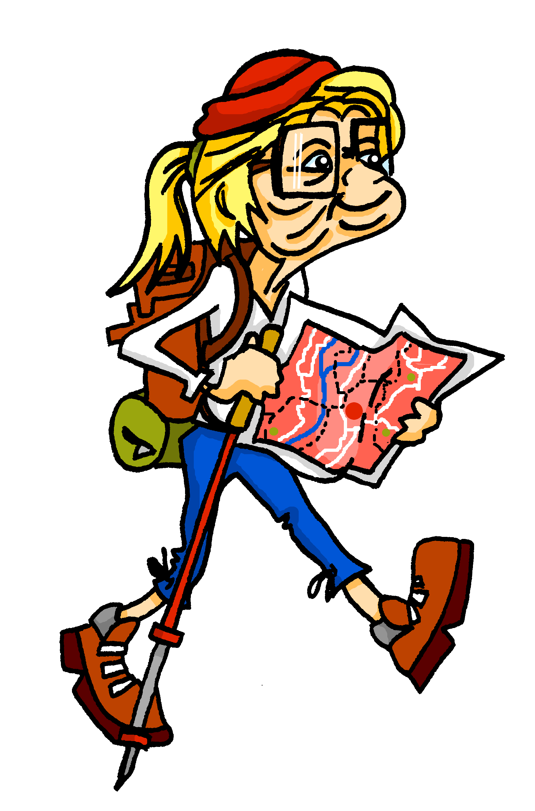

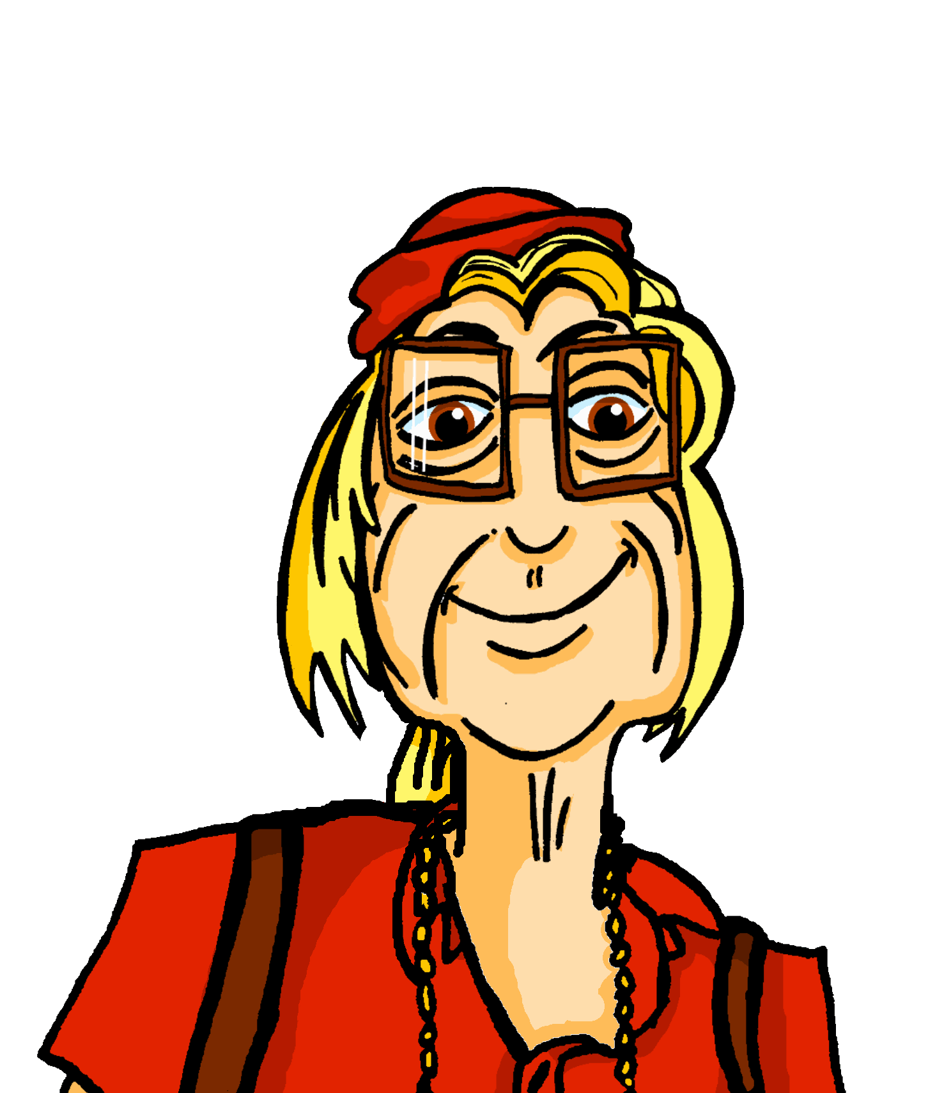


écouter
Mylène is still looking for Aunt Renée.
Mylène parle au téléphone.
Écoute. Qui va où ? C’est Mylène (je) ou Renée (elle) ?
 | Mylène (je) | Renée (elle)
 | Mylène (je) | Renée (elle)
1
4
1
4
2
5
2
5
3
6
3
6
Notes:
Timing: 5 minutes
Aim: to practise aural comprehension of the two forms of aller, without the support of the pronouns je and elle.
Procedure:
Click to listen to the sentence, with pronoun obscured.
Pupils write the numbers 1-6 and for each item the answer ‘je’ or ‘elle’ depending on the form of aller they hear.
Click to reveal the answers.
Transcript:
[Elle] va à Sayabec.
[Je] vais à Saint-Fabien.
[Elle] va à Grande-Vallée.
[Elle] va à Gaspé.
[Je] vais à Bonaventure.
[Je] vais à Baie-Trinité.
8

Slide 9


Saying ‘to’ and ‘in’ [1/2]
Remember we use the preposition à to talk about going to or being in a town/city:
Je vais…
à Paris.
Je suis…
à Paris.
I go/am going to Paris.
I am … in Paris.
We use the preposition dans to talk about going to or being in the north, south, east or west:
Je vais…
dans le Sud.
Je suis…
dans le Sud.
I go/am going to the south.
I am … in the south.
⚠ It is the verb that tells us whether à and dans mean to or in.
Notes:
Use before follow up 3.
Timing: 2 minutes (two slides)
Aim: to revisit meanings and uses of à and dans.
Procedure:
Click through the animations to present the information.
Elicit English translations for the French examples provided.

Slide 10
Saying ‘to’ and ‘in’ [2/2]
We use the preposition en to talk about going to or being in a feminine country:
Il va…
en France.
Il est…
en France.
He goes/is going to France.
He is… in France.
⚠ Most countries ending in –e are feminine.
We use the preposition au (à + le) talk about going to or being in a masculine country or a masculine region:
Je vais…
au Canada.
Je suis…
au Canada.
I go/am going to Canada.
I am … in Canada.
Elle va…
au Québec.
Elle est…
au Québec.
She goes/is going to Quebec.
She is… in Quebec.
Notes:
Aim: to introduce the use of en for to and in with feminine countries and au (à + le) for masculine countries and regions.
Procedure:
Click through the animations to present the information.
Elicit English translations for the French examples provided.

Slide 11



Follow up 3
Écoute. Choisis le mot correct pour compléter la phrase.
écouter
 | C’est quelle destination? |  | phrase en anglais
 | France | Canada
 | Paris | Sud
 | Canada | Montréal
 | Ottawa | Nord
 | Est | Toronto
 | Québec | France
1
She goes/is going to France.
1
2
I go/am going to the south.
2
3
Is he going to Canada?
3
4
Today she is going to Ottawa.
4
5
On Monday I’m going to the east.
5
6
Am I going to France?
6
Notes:
Timing: 5 minutes
Aim: to pay attention to the preposition (preposition + article) used for cities, feminine and masculine countries, and cardinal points; to practise aural comprehension of vocabulary for this week.
Procedure:
Students write down 1-6 and headings ‘destination’ and ‘English’.
Model number 1 with the class, so pupils are clear that they select the destination based on the preposition (en, à, au, dans) that they hear.
Click the number to listen to the sentence beginning.
Pupils write the destination. Then they write the meaning of the whole sentence, if able. They might need to listen twice to do this. Less proficient learners can be asked to write the English for any words they hear, rather than the full sentence.
Click to listen and check the full sentence and reveal the answers.
Pupils complete 2 – 6.
Teacher clicks to correct.
Ask pupils to say which sentence/destination they would most like to apply to them.
Transcript 1:
1. Elle va en [beep].
2. Je vais dans le [beep]
3. Est-ce qu’il va au [beep] ?
4. Aujourd’hui, elle va à [beep]
5. Lundi je vais dans l‘ [beep]
6. Est-ce que je vais en [beep] ?
Transcript 2:
1. Elle va en France.
2. Je vais dans le Sud.
3. Est-ce qu’il va au Canada ?
4. Aujourd’hui, elle va à Ottawa.
5. Lundi je vais dans l‘ Est.
6. Est-ce que je vais en France ?

Slide 12



Follow up 4:

Écris les mots correspondants en français et en anglais.
Aujourd’hui, __ ______ au Canada.
__ _____ __ Québec.
Mon amie ________ ___ France.
Mon père ____ ___ Paris.
Je suis dans ___ ______ de la France.
_______ I am going __ _________.
I go to __________.
___ ________ is studying in _____.
___ ________ goes to _________.
____ _____ ___ the north __ _________.
écrire
je vais
Today
to Canada
Je vais au
Quebec
étudie en
My friend (f)
France
va à
My dad
Paris
le Nord
I am in
of
France
Notes:
Timing: 5-10 minutes
Aim: to practise written production of this week’s two verb forms, new vocabulary and written comprehension of other new and revisited vocabulary.
This is a jigsaw translation task.
Procedure:
Students write the missing words in both French and English to complete the sentences.
Teacher clicks to provide the written answers and/or clicks the audio buttons to hear the full French sentences.
Differentiation:
1. For a different challenge (i.e. to practise spelling rather than full written recall of the missing French words), the task could be completed as a transcription task initially, by listening to the full sentences and writing the words.
2. Then pupils could complete the English part of the jigsaw.

Slide 13





vocabulaire
Follow up 5 - Écris en anglais : Can you get at least 15 points?
mots
 | parfois | étudier | partager
 | le Canada | le Québec | en
 | le Sud | l’Ouest | la France
 | elle va | le Nord | l’Est
 | aller | je vais | il va
x3
sometimes
to study, studying
to share, sharing
x2
Canada
Quebec
in, to
(the) south
(the) west
France
x1
she goes, is going
(the) north
(the) east
to go, going
I go, am going
he goes, is going
Notes:
Timing: 5-10 minutes
Aim: to practise written production of vocabulary from this week and two revisited weeks.
Procedure:
1. Give pupils a blank grid. They fill in the English meanings of any of the words they know, trying to reach 15 points in total.
2. Remind pupils that adjectives can refer to male or female persons and they should note this in their translations. E.g. pleased (f), short (m).
Note:
The most recently learnt and practised words are pink, words from revisit 1 are green and those from revisit 2 are blue, thus more points are awarded for them, to recognise that memories fade and more effort (heavy lifting!) is needed to retrieve them.
13

Slide 14
vocabulaire
Follow up 5b - Écris en français : Can you get at least 15 points?
mots
 | sometimes | to study, studying | to share, sharing
 | Canada | Quebec | in, to (fem. countries)
 | (the) south | (the) west | France
 | she goes, is going | (the) north | (the) east
 | to go, going | I go, am going | he goes, is going
x3
parfois
étudier
partager
x2
le Canada
le Québec
en
le Sud
l’Ouest
la France
x1
elle va
le Nord
l’Est
aller
je vais
il va
Notes:
Timing: 5-10 minutes
Aim: to practise written comprehension of vocabulary from this week and previous weeks.
Procedure:
Give pupils a blank grid. They fill in the French meanings of any of the words they know, trying to reach 15 points in total.
Note:
The most recently learnt and practised words are pink, words from the previous week are green and those from earlier are blue, thus more points are awarded for them, to recognise that memories fade and more effort (heavy lifting!) is needed to retrieve them.
14

Slide 15
vocabulaire
Follow up 5 - Écris en anglais : Can you get at least 15 points?
mots
 | parfois | étudier | partager
 | le Canada | le Québec | en
 | le Sud | l’Ouest | la France
 | elle va | le Nord | l’Est
 | aller | je vais | il va
x3
x2
x1
Notes:
HANDOUT
15

Slide 16
vocabulaire
Écris en français : Can you get at least 15 points?
mots
 | sometimes | to study, studying | to share, sharing
 | Canada | Quebec | in, to (fem. countries)
 | (the) south | (the) west | France
 | she goes, is going | (the) north | (the) east
 | to go, going | I go, am going | he goes, is going
x3
x2
x1
Notes:
HANDOUT
16

