Slide 1
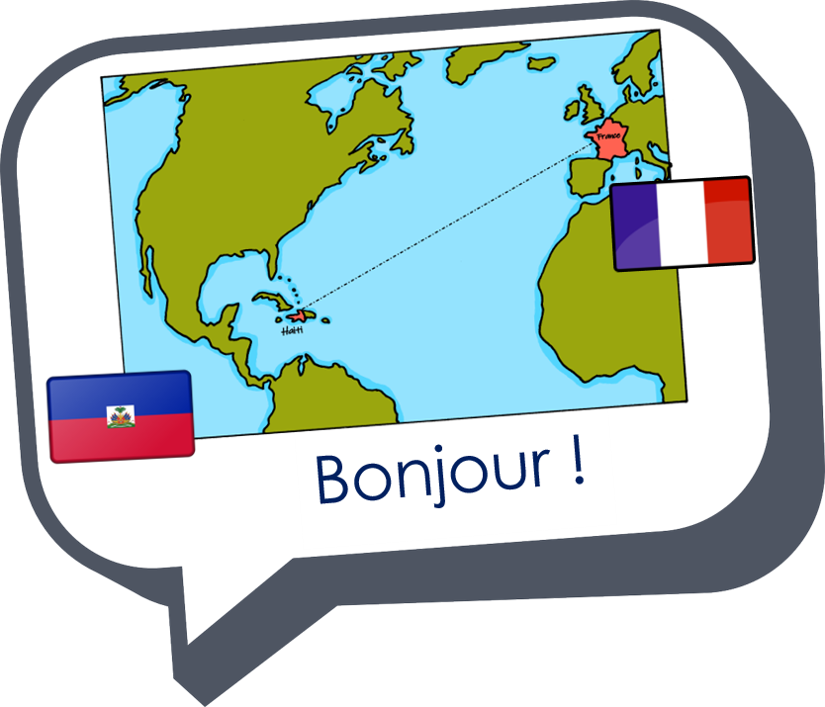










Saying where you are going and what there is there
Les nombres
bleu
Numbers 1-31
Il n’y a pas de
SSC [oi] & [(a)in]
Notes:
Artwork by Steve Clarke. Pronoun pictures from NCELP (www.ncelp.org). All additional pictures selected from Pixabay and are available under a Creative Commons license, no
attribution required.
Phonics: Revisit SSC [oi] - voir [69] avoir [8] au revoir [4/1274] pourquoi ? [193] trois [115]
and [(a)in] - train [232] fin [111] matin [442] vingt [1273] main [418]
Vocabulary (new words in bold): il y a un [3] deux [41], trois [115], quatre [253], cinq [288], six [450], sept [905], huit [877], neuf [787], dix [372], onze [2447], douze [1664] des [2] combien [800] treize [3285], quatorze [3359], quinze [1472], seize [3285], dix-sept [3812], dix-huit [3592], dix-neuf [4851], vingt [1273], vingt et un [1273/6/3], vingt-deux, vingt-trois, vingt-quatre, vingt-cinq, vingt-six, vingt-sept, vingt-huit, vingt-neuf, trente [1646]
Revisit 1: corriger [1639] expliquer [252] fermer [757] demander [80] écouter [49] regarder [425] poser [218] aide [457] classe [778] devoirs [39] idée [239] question [144] phrase [2074] porte [696] professeur/professeure [110] réponse [456] solution [608]
Revisit 2: ont [8] ils [13] elles [38] bureau [273] chaise [3419] chose [125] espace [870] fenêtre [1601] jardin [2284] idée [239] lampe [4699] ordinateur [2201] salle [812] beau belle [393] bon bonne [94] mauvais [274] nouveau nouvelle [52] vieux vieille [671] de² [2] beaucoup de [150] chez [206]
Londsale, D., & Le Bras, Y. (2009). A Frequency Dictionary of French: Core vocabulary for learners London: Routledge.
The frequency rankings for words that occur in this PowerPoint which have been previously introduced in these resources are given in the SOW and in the
resources that first introduced and formally re-visited those words.
For any other words that occur incidentally in this PowerPoint, frequency rankings will be provided in the notes field wherever possible.
1

Slide 2

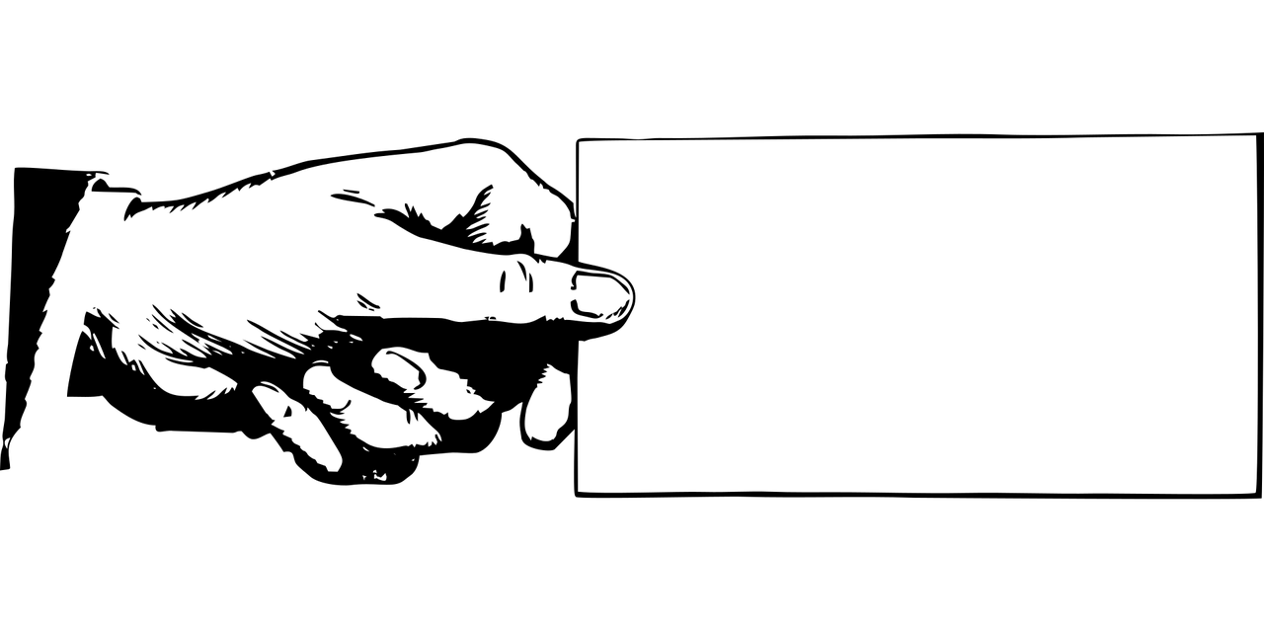


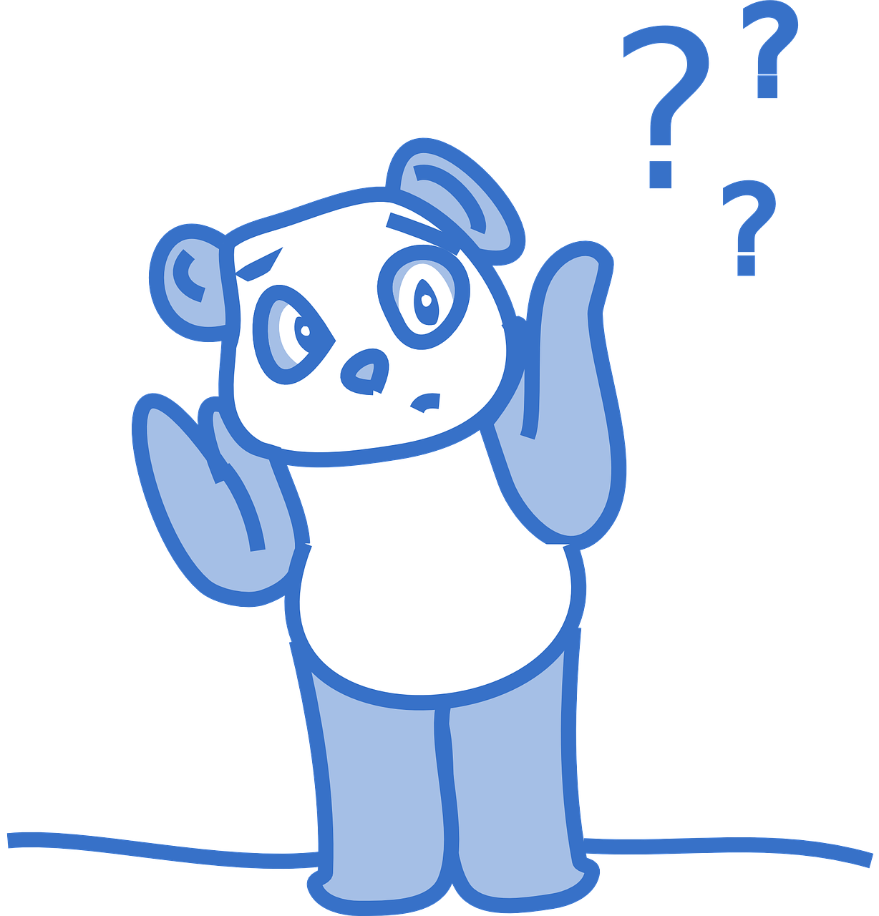

prononcer
[oi]
voir
to have, having
avoir
Au revoir !
[to see, seeing]
[why?]
trois
pourquoi ?
Notes:
Timing: 2 minutes
Aim: to recap SSC [oi].
Procedure:
Introduce and elicit the pronunciation of the individual SSC [oi] and the source word ‘voir’.
Click to bring on the picture and get students to repeat (with gesture, if using).
Present and practise the cluster words.
Gesture:
gesture for voir – hand with thumb and two fingers pointing forwards doing a three downwards motions, one for each syllable of the word.
https://www.signbsl.com/sign/see (scroll down to the correct definition of ‘see’ and we recommend the 1st video of these three) – right index finger comes up to the eye and then points away from the body as if tracing the path of sight from the eyes towards an object in view.
2

Slide 3









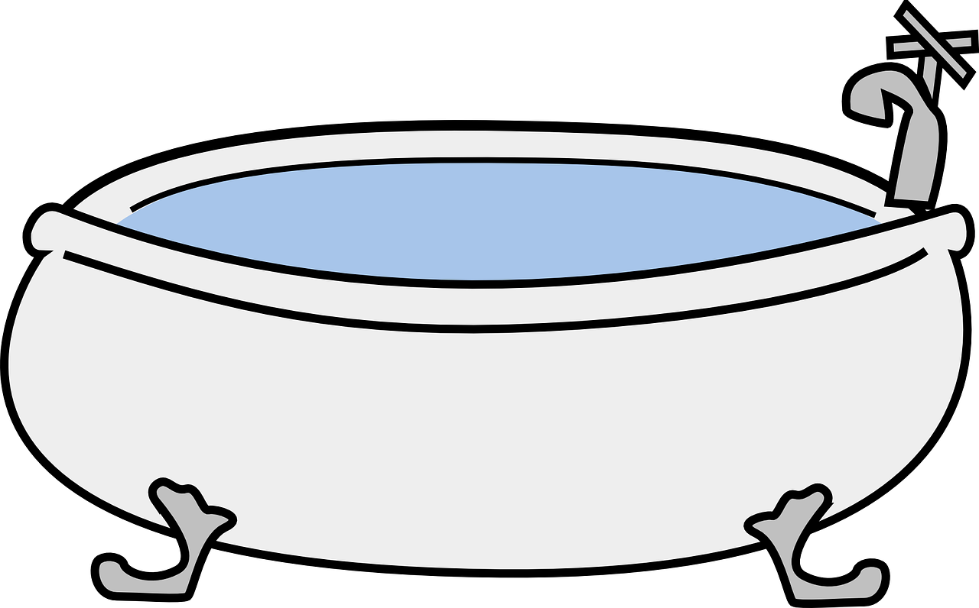



prononcer
[oi] ou [(a)in] ?
Écoute. Le mot avec le son [oi], c’est A ou B ?
Écris 1-6 et A B ou B A.
A
B
1 | pain [bread] | poids [weight]
2 | soi [him/herself] | sain [healthy]
3 | foi [faith] | fin [end]
4 | moi [me] | main [hand]
5 | bain [bath] | bois [wood]
6 | voix [voice] | vingt [twenty]
A B
B A
A B
B A
B A
B A
Notes:
Timing: 5 minutes
Aim: to consolidate SSC [oi] and contrast it with [(a)in].
Procedure:
Make sure pupils understand the task. They need to identify the order in which they hear the two words, either A B or B A.
Pupils number 1 – 6 in their books. Click to hear number 1 and work through as an example.
Click to reveal the answers.
Complete items 2-6.
Reveal the answers
Given pupils one minute to practise pronouncing each pair of words.
Frequency of unknown words and cognates:
bain [3458] bois [1425] fin [111] foi [1368] main [418] moi [131] pain [2802] poids [1102] vingt [1273] voix [414]
Source: Londsale, D., & Le Bras, Y. (2009). A Frequency Dictionary of French: Core vocabulary for learners London: Routledge.
Transcript:
pain poids
sain soi
fin foi
main moi
bain bois
vingt voix
Answers:
A B
B A
A B
B A
B A
B A
3

Slide 4

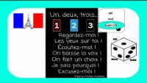
prononcer
Un-deux-trois regardez moi !
Écoute et parle.
un, deux, trois
Regardez-moi !
Les yeux sur toi !
Écoutez-moi !
On baisse la voix !
On fait un choix !
Je sais pourquoi !
Excusez-moi !
baisser – to lower
le choix – choice
je sais – I know
Notes:
Timing: 5 minutes
Aim: to consolidate SSC [oi] and practise the sound in a short comptine.
Procedure:
Click to play the 2 minute clip (up to 2m11s)
Model suitable actions and have pupils copy them along with you as they listen.
Play the clip again and encourage pupils to join in with the words and actions.
Either elicit the translation of each line from the onslide text or show the end of the video clip, which has the translation.
Note: pupils have not met the imperative form but they do know the –ez form of the verb, referring to you (plural) or you (formal). Draw their attention to the verb without the pronoun and with the exclamation mark and explain that this is how you give instructions or commands to a group. Pupils do not yet know the use of ‘on’ but teachers can explain that this can mean ‘we’ or ‘people/you in general’.
Frequency of unknown words and cognates:
baisser [911] choix [436] excuser [1987] savoir [67] voix [414]
Source: Londsale, D., & Le Bras, Y. (2009). A Frequency Dictionary of French: Core vocabulary for learners London: Routledge.
Transcript:
un, deux, trois
Regardez-moi !
Les yeux sur toi !
Écoutez-moi !
On baisse la voix !
On fait un choix !
Je sais pourquoi !
Excusez-moi !
4

Slide 5


Il y a
⚠ Remember: un/une means a/an and one.
Remember, to say how many of something there are, use __ __ __ + number or des (some):
Il y a
Il y a un jardin.
Il y a une lampe.
⚠ Liaison s-, x- if the noun starts with a vowel or h-.
There is a/one garden.
There is a/one lamp.
Il y a huit portes.
Il y a trois espaces.
There are eight doors.
There are three spaces.
Il y a des bureaux.
⚠ Remember: many French nouns add –s for plural but nouns ending in –eau add –x.
There are some desks.
Notes:
Timing: 2 minutes
Aim: To revisit il y a + number or + des.
Procedure:
Click through the animations to present the information.
Elicit English translations for the French examples provided.

Slide 6




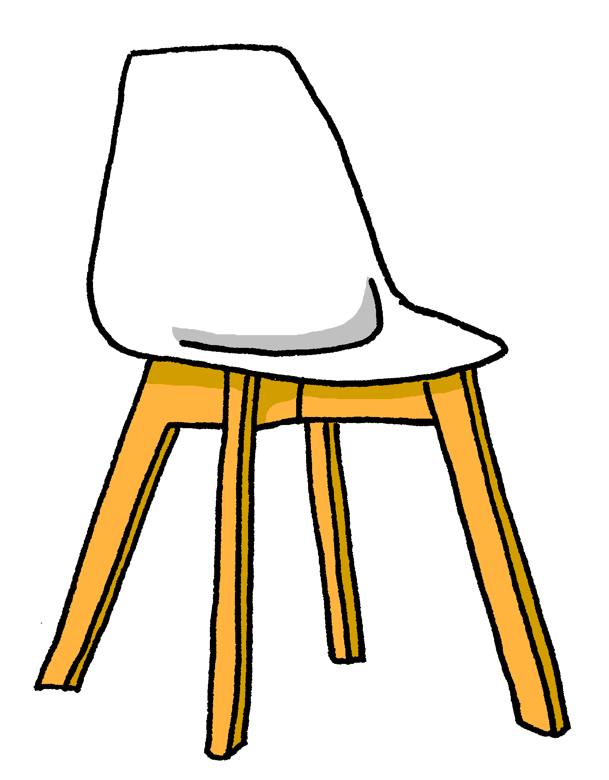


écouter
Écoute. Il y a quoi ? [1/6]
Écoute la phrase et écris le nombre et l’objet en anglais. ✍.
1
Notes:
Timing: 5 minutes
Aim: to practise aural comprehension of numbers and previously taught vocabulary that we are revisiting this week.
Procedure:
Click to listen to the sentence.
Pupils write the number (in digits) and the item in English. (e.g. 13 bottles)
Click to highlight the number answer and reveal the noun.
Repeat for the follow 5 sentences.
Differentiation:
For more challenge in terms of comprehension remove the number options (or in a mixed proficiency class, some pupils can turn away from the board).
For additional transcription practice, ask pupils to transcribe the sentence and then translate it.
Transcription:
Il y a treize chaises.
6

Slide 7





écouter
Écoute. Il y a quoi ? [2/6]
Écoute la phrase et écris le nombre et l’objet en anglais. ✍.
2
Notes:
2/6
Transcription:
Il y a des questions.
7

Slide 8





écouter
Écoute. Il y a quoi ? [3/6]
Écoute la phrase et écris le nombre et l’objet en anglais. ✍.
3
Notes:
3/6
Transcription:
Il y a quinze fenêtres.
8

Slide 9




écouter
Écoute. Il y a quoi ? [4/6]
Écoute la phrase et écris le nombre et l’objet en anglais. ✍.
4
Notes:
4/6
Transcription:
Il y a vingt-et-un ordinateurs.
9

Slide 10



écouter
Écoute. Il y a quoi ? [5/6]
Écoute la phrase et écris le nombre et l’objet en anglais. ✍.
5
Notes:
5/6
Transcription:
Il y a quatre idées.
10

Slide 11
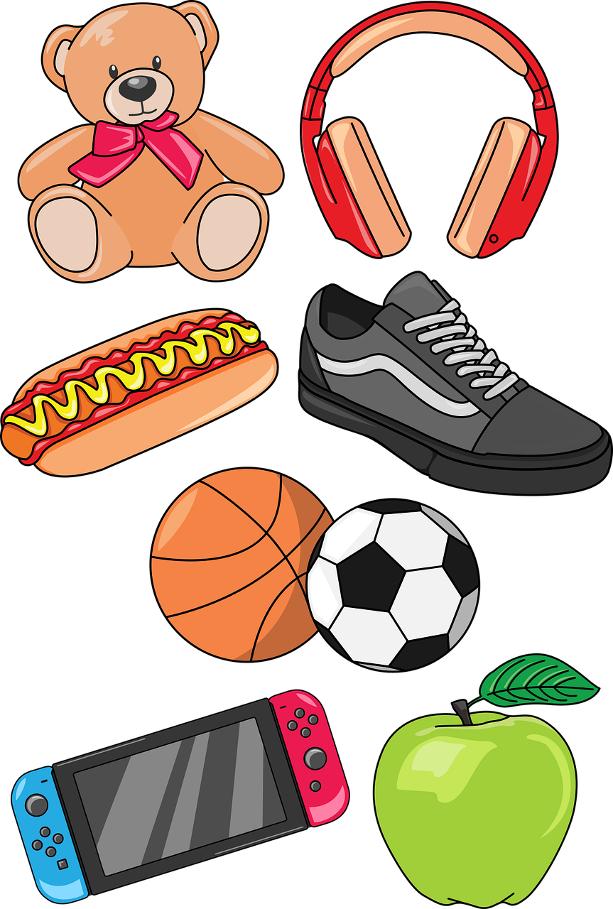

écouter
Écoute. Il y a quoi ? [6/6]
Écoute la phrase et écris le nombre et l’objet en anglais. ✍.
6
Notes:
6/6
Transcription:
Il y a dix choses.
11

Slide 12


Il y a | Il n’y a pas
⚠ Ne changes to n’ before a verb starting with a vowel;
‘y’ can be a vowel in French, with the same sound as [i].
⚠ Note that pas is always followed by de (or d’), NOT un/une/des.
Remember, to say ‘there is a/an’ or ‘there are some’, use il y a un/une or il y a des:
To say ‘there isn’t a/an’ or ‘there aren’t any’, use il n’y a pas de/d’:
Il y a une salle.
Il n’y a pas de salle.
There is a room.
There isn’t a room.
Il y a un jardin.
Il n’y a pas de jardin.
There is a garden.
There isn’t a garden.
Il y a des professeurs.
Il n’y a pas de professeurs.
There are some teachers.
There aren’t any teachers.
Notes:
Timing: 2 minutes
Aim: to introduce il n’y a pas de.
Procedure:
Click through the animations to present the information.
Elicit English translations for the French examples provided.

Slide 13


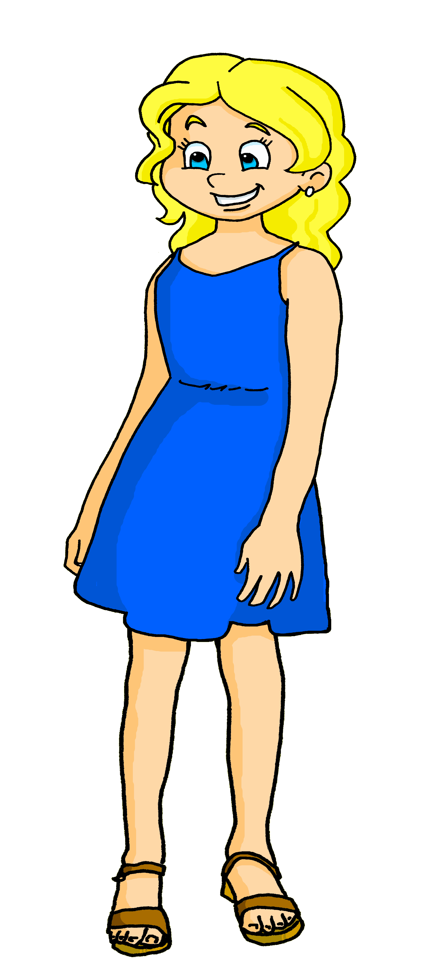
lire
Adèle décrit son école à Sanaya mais elle a un problème avec Whatsapp !
Il y a quoi ? Il n’y a pas quoi ?
1
¶»ƨ†łʏΰǈǔθ des salles.
Il y a des salles.
2
¶»ƨ†łʏΰǈǔθ d’ordinateurs.
Il n’y a pas d’ordinateurs.
¶»ƨ†łʏΰǈǔθ des professeurs.
3
Il y a des professeurs.
4
Il y a un jardin.
¶»ƨ†łʏΰǈǔθ un jardin.
5
¶»ƨ†łʏΰǈǔθ de cantine.
Il n’y a pas de cantine.
6
¶»ƨ†łʏΰǈǔθ de lampes.
Il n’y a pas de lampes.
7
¶»ƨ†łʏΰǈǔθ de portes.
Il n’y a pas de portes.
8
Il y a des chaises.
¶»ƨ†łʏΰǈǔθ des chaises.
la cantine – canteen
Notes:
Timing: 8 minutes
Aim: to pay attention to the form of the article for affirmative and negative sentences, and practise written distinction between simple positive and negative sentence structures.
Procedure:
Students write down 1-8.
Model number 1 with the class, so pupils are clear that they select the sentence beginning (il y a or il n’y a pas) based on the form of the article before the noun.
Click the number to listen and check the full sentence and/or click to reveal the full written sentence.
Pupils complete 2 – 8.
Teacher clicks to correct.
Give pupils a minute in pairs to make a list of what there is and isn’t at Adèle’s school. Ask them to decide if anything seems odd about any of the details (e.g. there are no doors, canteen, computers).
Transcript:
Il y a des salles.
Il n’y a pas d’ordinateurs.
Il y a des professeurs.
Il y a un jardin.
Il n’y a pas de cantine.
Il n’y a pas de lampes.
Il y’a pas de portes.
Il y a des chaises.
Answers:
There is/are: classrooms, teachers, a garden, chairs
There isn’t/are not: computers, canteen, lamps, doors.

Slide 14

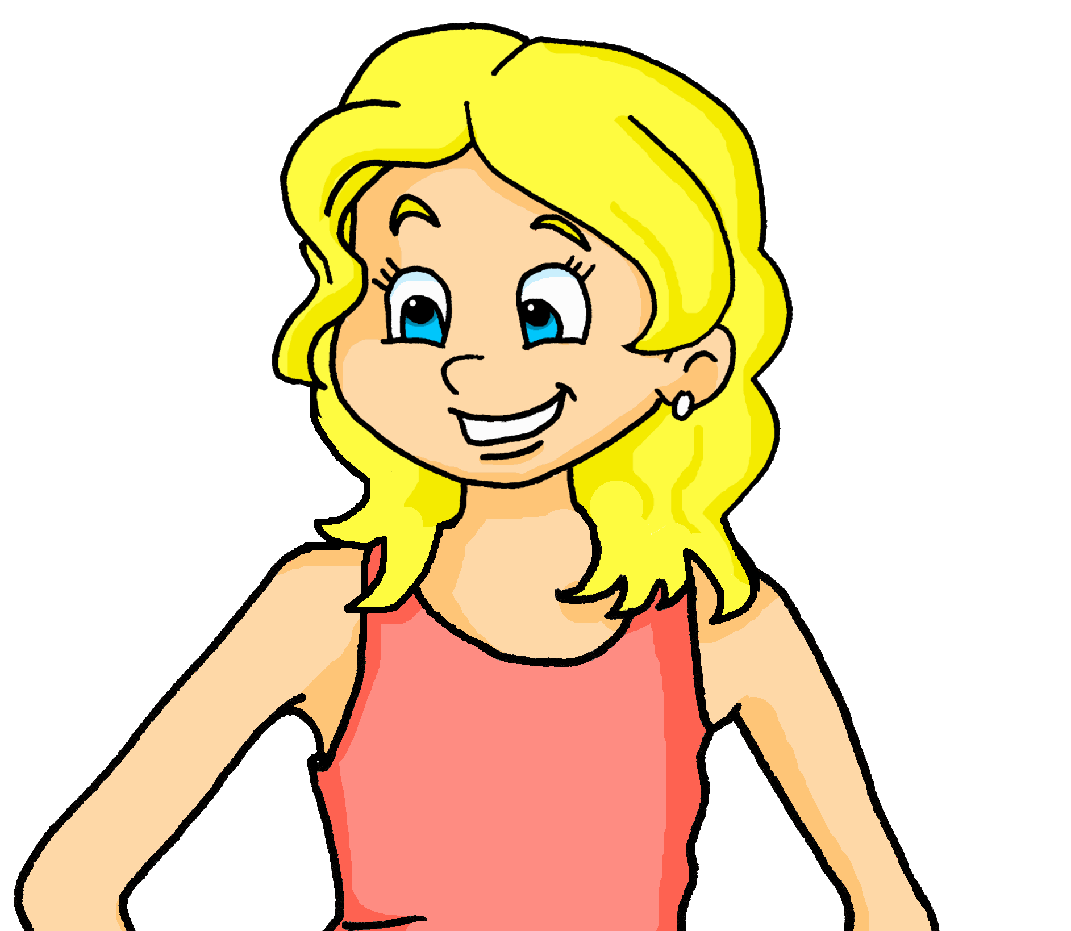
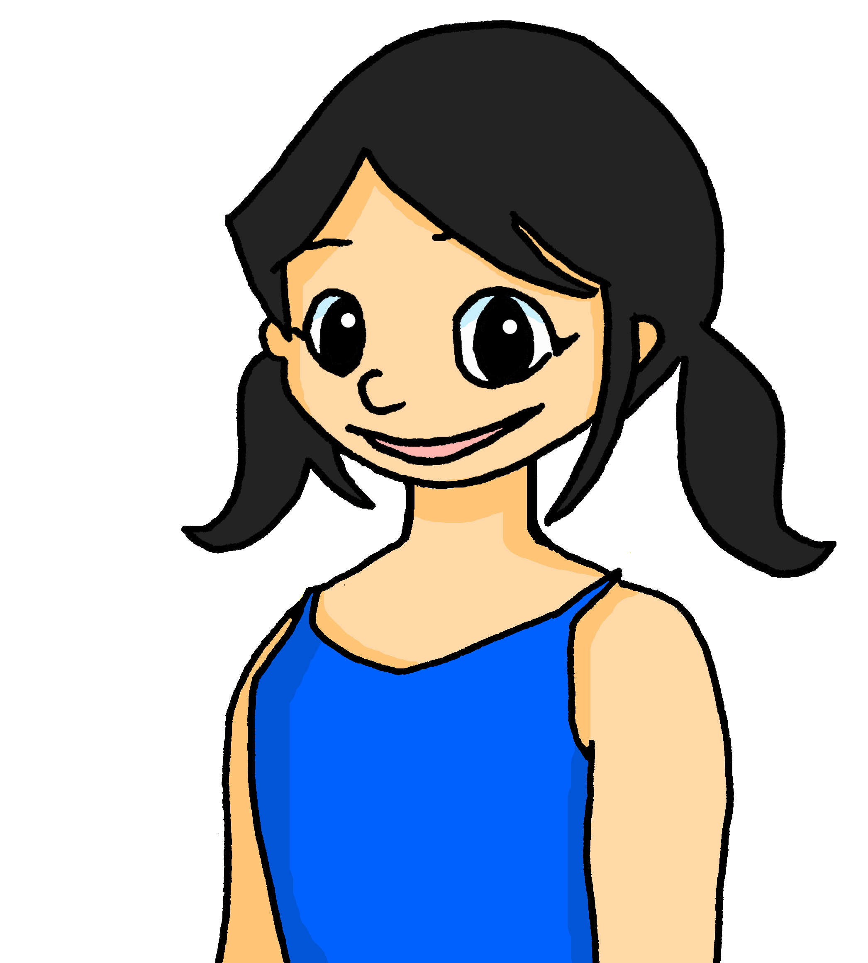
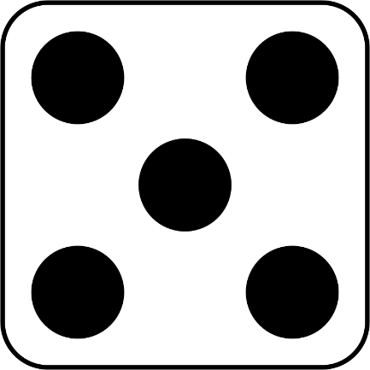
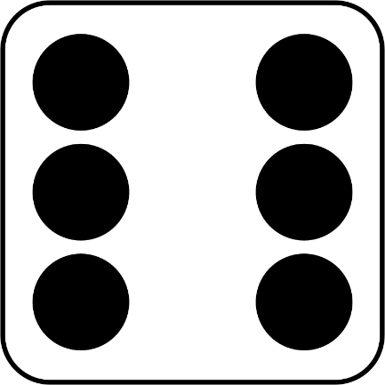
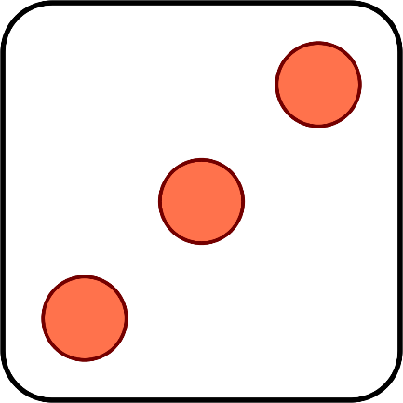
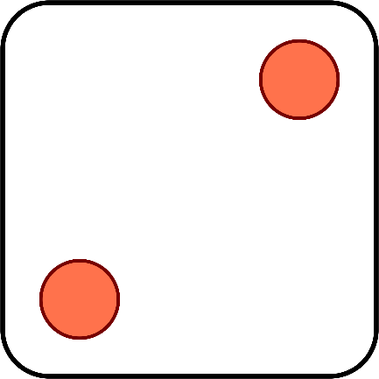
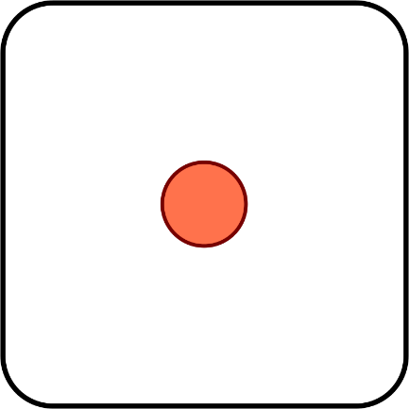
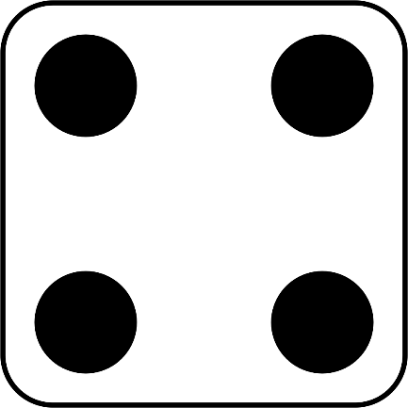
parler
Adèle et Léa inventent un jeu amusant.
Elles ont combien de points au total ? Parle en français.
quinze
vingt-trois
treize
dix-sept
seize
quatorze
vingt-et-un
dix-huit
Notes:
Timing: 2 minutes
Aim: to practise oral recall of numbers.
Procedure:
1. Click to ‘roll’ the dice Adèle and Léa.
2. Students say the total shown on the two dice in French.
3. Click again to move on to the next number.
Word frequency of unknown words and cognates used (1 is the most frequent word in French):
point [97]
Source: Londsale, D., & Le Bras, Y. (2009). A Frequency Dictionary of French: Core vocabulary for learners London: Routledge
14

Slide 15
Au revoir !
bleu
Notes:
15

