Slide 1











Saying where you are going and what there is there
Les nombres
bleu
Follow ups 1-5
Notes:
Artwork by Steve Clarke. Pronoun pictures from NCELP (www.ncelp.org). All additional pictures selected from Pixabay and are available under a Creative Commons license, no
attribution required.
Phonics: Revisit SSC [oi] - voir [69] avoir [8] au revoir [4/1274] pourquoi ? [193] trois [115]
and [(a)in] - train [232] fin [111] matin [442] vingt [1273] main [418]
Vocabulary (new words in bold): il y a un [3] deux [41], trois [115], quatre [253], cinq [288], six [450], sept [905], huit [877], neuf [787], dix [372], onze [2447], douze [1664] des [2] combien [800] treize [3285], quatorze [3359], quinze [1472], seize [3285], dix-sept [3812], dix-huit [3592], dix-neuf [4851], vingt [1273], vingt et un [1273/6/3], vingt-deux, vingt-trois, vingt-quatre, vingt-cinq, vingt-six, vingt-sept, vingt-huit, vingt-neuf, trente [1646]
Revisit 1: corriger [1639] expliquer [252] fermer [757] demander [80] écouter [49] regarder [425] poser [218] aide [457] classe [778] devoirs [39] idée [239] question [144] phrase [2074] porte [696] professeur/professeure [110] réponse [456] solution [608]
Revisit 2: ont [8] ils [13] elles [38] bureau [273] chaise [3419] chose [125] espace [870] fenêtre [1601] jardin [2284] idée [239] lampe [4699] ordinateur [2201] salle [812] beau belle [393] bon bonne [94] mauvais [274] nouveau nouvelle [52] vieux vieille [671] de² [2] beaucoup de [150] chez [206]
Londsale, D., & Le Bras, Y. (2009). A Frequency Dictionary of French: Core vocabulary for learners London: Routledge.
The frequency rankings for words that occur in this PowerPoint which have been previously introduced in these resources are given in the SOW and in the resources that first
introduced and formally re-visited those words.
For any other words that occur incidentally in this PowerPoint, frequency rankings will be provided in the notes field wherever possible.

Slide 2


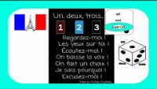
prononcer
Un-deux-trois regardez moi !
Écoute et parle 🗣.
un, deux, trois
Regardez-moi !
Les yeux sur toi !
Écoutez-moi !
On baisse la voix !
On fait un choix !
Je sais pourquoi !
Excusez-moi !
baisser – to lower
le choix – choice
je sais – I know
Notes:
Timing: 3 minutes
Aim: to consolidate SSC [oi] and practise the sound in the short comptine that pupils were introduced to in the lesson this week.
Procedure:
Click to play the 2 minute clip (up to 2m11s)
Encourage pupils to join in saying the words and doing the actions they practised in the lesson.
Frequency of unknown words and cognates:
baisser [911] choix [436] excuser [1987] savoir [67] voix [414]
Source: Londsale, D., & Le Bras, Y. (2009). A Frequency Dictionary of French: Core vocabulary for learners London: Routledge.
Transcript:
un, deux, trois
Regardez-moi !
Les yeux sur toi !
Écoutez-moi !
On baisse la voix !
On fait un choix !
Je sais pourquoi !
Excusez-moi !
2

Slide 3













Follow up 1:
Écoute les numéros. [1/2]
Écris le son correspondant et les numéros.
prononcer
[closed]
[on]
[è]
[eu]
[a]
[ou]
1
11
2
2, 22, 32
3
7, 13, 16, 17, 27
4
12
5
4, 14, 24
Notes:
Timing: 5 minutes [two slides]
Aim: to practise connecting several SSC with numbers that contain the same sound; to practise aural recognition of several numbers.
Procedure:
Do the first one with pupils to model the task.
Click 1. to play the audio.
Pupils listen to the number (or numbers) and identify the common SSC. They write down the SSC and the number(s).
Click to show the connections.
Click again to remove the lines and reveal the written number(s) next to the item number, for clarity.
Continue with items 2-5 on this slide and correct them.
Move to slide 2 for items 6-11.

Slide 4

















Follow up 1:
Écoute les numéros. [2/2]
prononcer
[open]
[in]
[en]
[un]
[eu]
[i]
[oi]
6
1, 21
7
3, 23
8
5, 15, 20
9
6, 8, 10, 18, 26, 28
10
9, 19, 29
11
30
Notes:
[2/2]

Slide 5


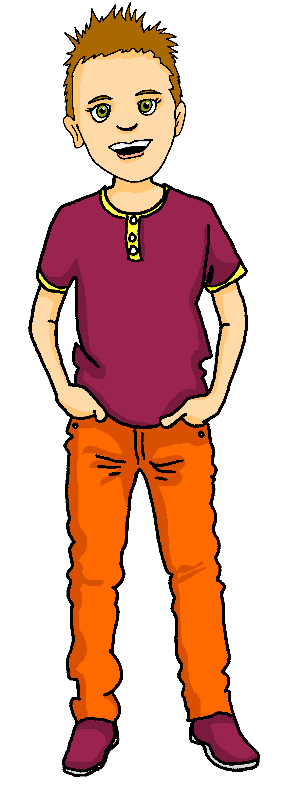


Follow up 2
Pierre décrit son école à Max.
Il y a quoi ?
Il n’y a pas quoi ?
écouter
 | Il y a | il n’y a pas | en anglais
1
a garden
1
2
(some) windows
2
3
(any) animals
3
4
(any) teachers
4
5
(some) computers
5
6
(some) rooms
6
7
(any) chairs
7
8
(any) green space
8
Notes:
Timing: 5 minutes
Aim: to pay attention to the form of the article for affirmative and negative sentences, and practise aural comprehension of simple positive and negative sentences with il y a/il n’y a pas.
Procedure:
Students write down 1-8 and headings ‘il y a’ and ‘il n’y a pas’
Model number 1 with the class, so pupils are clear that they select il y a or il n’y a pas based on the form of the article before the noun. (if they hear un, une, des it is an affirmative statement, if they hear de/d’ it is a negative sentence.
Click the number to listen to the sentence ending.
Pupils tick and also write the noun in English. They might need to listen twice to do this.
Click to listen and check the full sentence and reveal the answers.
Pupils complete 2 – 8.
Teacher clicks to correct.
Ask pupils to comment on which items they think Pierre is joking about.
Transcript:
Il y a un jardin.
Il y a des fenêtres.
Il n’y a pas d’animaux.
Il n’a pas de professeurs !
Il y a des ordinateurs.
Il y a des salles.
Il n’a pas de chaises.
Il n’y a pas d’espace vert.
Answers:
There is/are: a garden, windows, computers, classrooms
There isn’t/are not: animals, teachers, chairs, green space

Slide 6


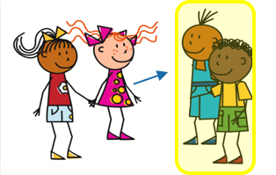
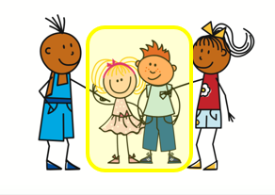
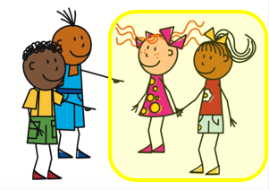
They have and they are
⚠ liaison here!
ils ont
elles ont
Remember, to mean ‘they have’ use ___ _____ or _____ _____.
ils sont
elles sont
To mean ‘they are’ use ___ _____ or _____ _____.
⚠ Remember: the word for ‘they’ needs to match the gender of the noun it describes: they (the chairs) = elles (les chaises (fpl).
Ils ont des chaises mais elles sont vieilles.
They have some chairs but they are old.
⚠ ils = all male or mixed male and female group.
⚠ Adjectives match the gender and number of the noun.
vieux = m, mpl
vieille = f, vieilles = fpl
Elles ont des ordinateurs mais ils sont vieux.
They have some computers but they are old.
⚠ elles = all female group.
Notes:
Timing: 2 minutes
Aim: to revisit ils/elles ont and ils/elles sont meanings, uses and forms of the pronouns ‘they’ and adjectival agreement.
Procedure:
Click through the animations to present the information.
Elicit English translations for the French examples provided.

Slide 7
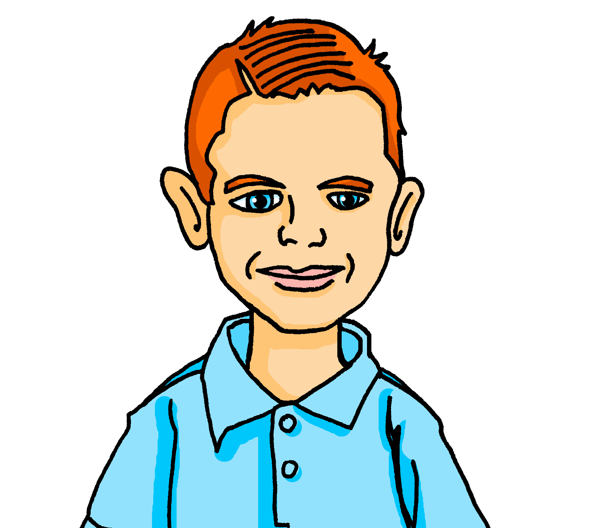



Follow up 3 Pierre décrit son école à Max.
Max reports back to his class about Pierre’s school. Oh no! He has spilt his hot chocolate on his homework and can’t remember which form of the adjective to use. Help him out.
lire
beau | belle
petites | petits
nouvelles | nouveaux
grand | grande
beaux | belles
vieux | vieille
1. Ils ont un jardin et il est .
They have a garden and it is beautiful.
2. Ils ont des fenêtres mais elles sont .
They have some windows but they are small.
3. Ils ont des ordinateurs et ils sont .
They have some computers and they are new.
4. Ils ont un espace vert et il est .
They have a green space and it is big.
5. Ils ont des salles et elles sont .
They have some rooms and they are beautiful.
6. Ils ont une piscine mais elle est .
They have a pool but it is old.
Notes:
Timing: 5 slides
Aim: to revisit previously taught vocabulary including irregular adjectives; to practise written comprehension of longer, compound sentences.
Procedure:
Pupils read the scenario.
They write 1-6 and for each sentence they select the correct form of the adjective.
Click to listen and check, and click to reveal answers.
Give pupils two minutes in pairs to work out translations of the sentences.
Elicit the English meanings chorally from pupils and click to reveal the English translations.

Slide 8




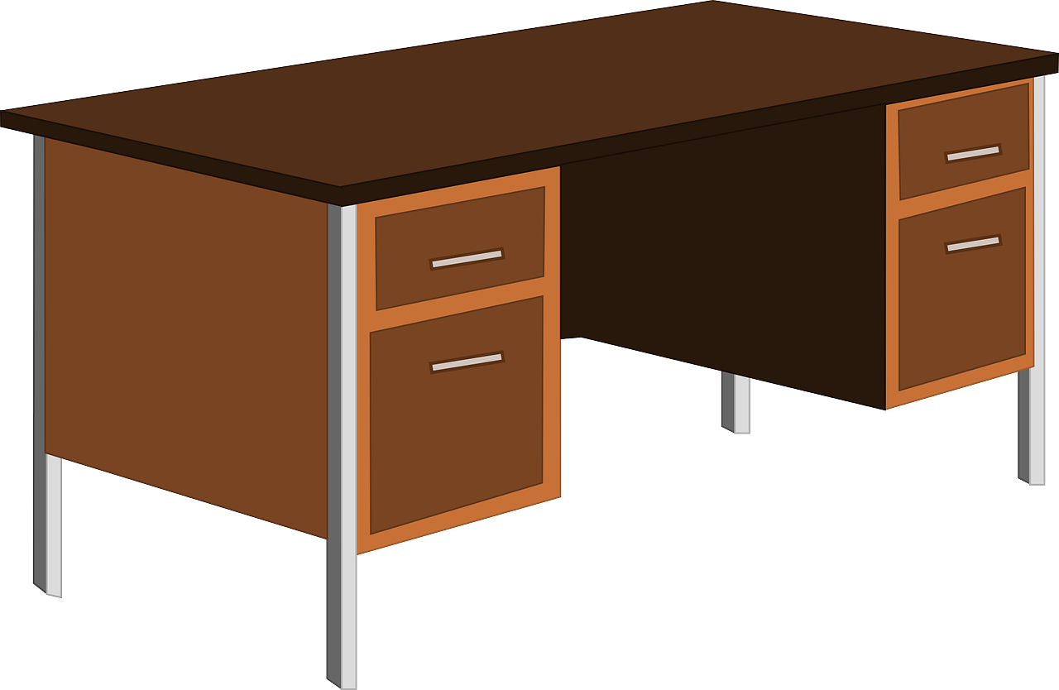


Follow up 4:
Dans ma salle de classe. 1/2
Personne A: Décris une salle. Ton/ta partenaire identifie la salle correspondante.
parler
A
Bonjour tout le monde!
B
C
Bonjour tout le monde!
Bonjour tout le monde!
Bonjour tout le monde!
Bonjour tout le monde!
Bonjour tout le monde!
Bonjour tout le monde!
Bonjour tout le monde!
Bonjour tout le monde!
Bonjour tout le monde!
Bonjour tout le monde!
Bonjour tout le monde!
Bonjour tout le monde!
Bonjour tout le monde!
Notes:
Timing: 5 minutes
Aim: to practise oral production and comprehension of positive and negative statements with il y a/il n’y a pas and previously taught nouns.
Procedure:
1. Pupil A has Handout A (see end of this lesson PPT).
2. Pupil B listens to Pupil A and compares the three classroom pictures with what s/he hears.
3. B identifies the correct room and teacher clicks to reveal the answer.
Note: every sentence must be listened to in order to identify the correct classroom.
4. Swap roles and move to the next slide.

Slide 9
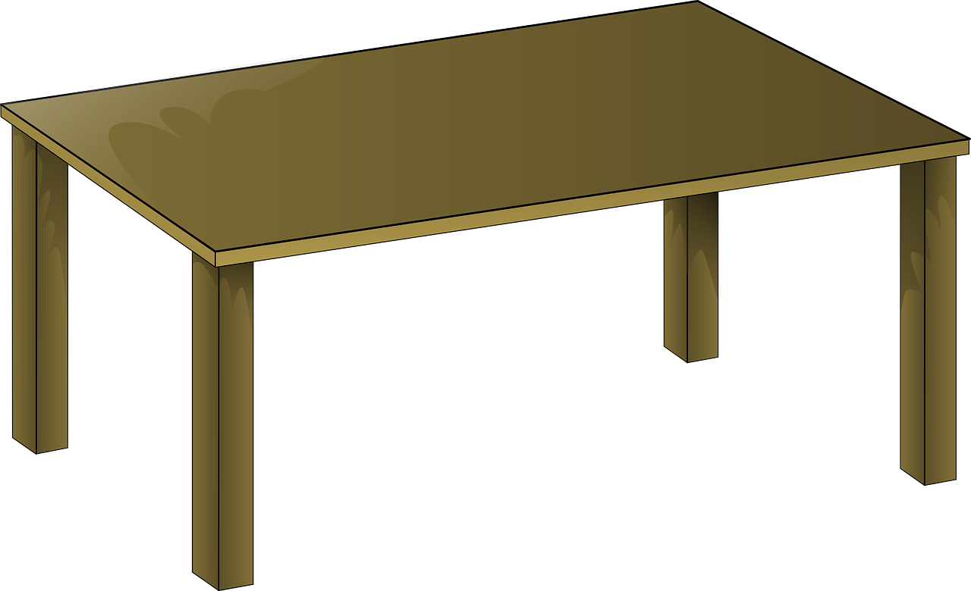




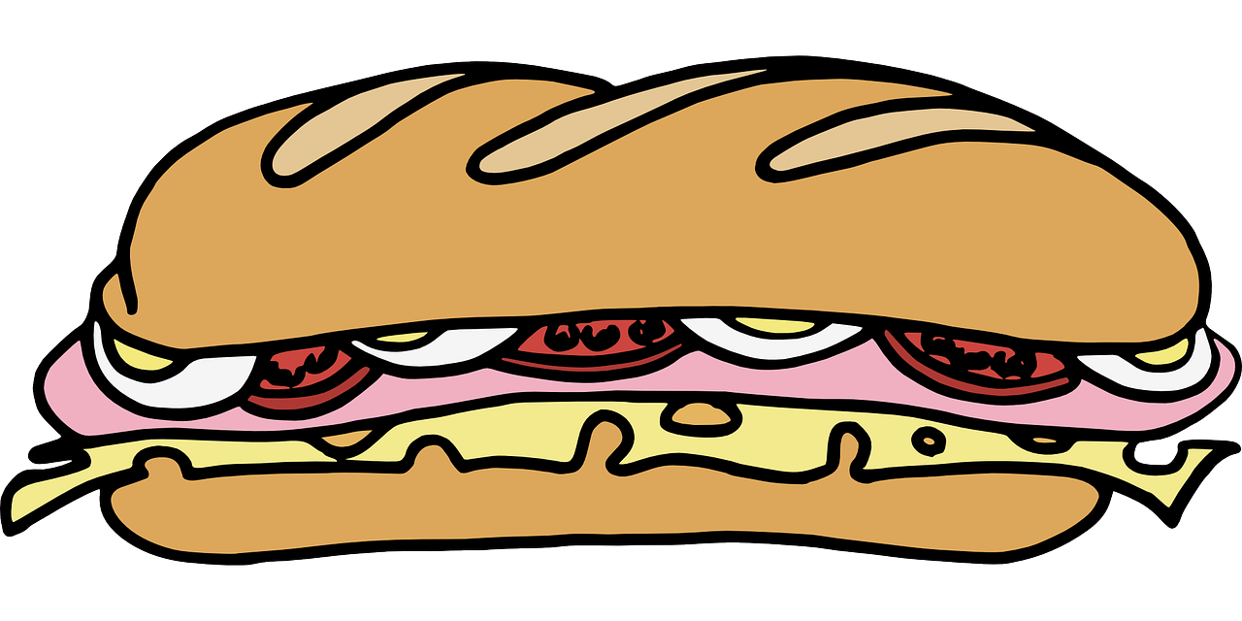
Follow up 4:
Dans ma salle de classe. 2/2
Personne A: Décris une salle. Ton/ta partenaire identifie la salle correspondante.
parler
A
B
C
Il y a quoi ?
Il y a quoi ?
Il y a quoi ?
Il y a quoi ?
Il y a quoi ?
Il y a quoi ?
Il y a quoi ?
Il y a quoi ?
Il y a quoi ?
Il y a quoi ?
Il y a quoi ?
Il y a quoi ?
Notes:
2/2

Slide 10
Follow up 4:
Handout
Personne A: Décris une salle.
Personne B: Décris une salle.
parler
There are two windows.
There are ten chairs.
There isn’t any lamp.
There isn’t a desk.
There are six phrases on the board.
There are two computers.
There are six tables.
There aren’t any exercise books.
There aren’t any things on the desk.
There are four questions on the board.
Il y a deux fenêtres.
Il y a deux ordinateurs.
Il y a dix chaises.
Il y a six tables.
Il n’y a pas de cahiers.
Il n’y a pas de lampe.
Il n’y a pas de choses sur le bureau.
Il n’y a pas de bureau.
Il y a six phrases sur
le tableau.
Il y a quatre questions sur le tableau.
Notes:
Follow up 4: ANSWERS

Slide 11




vocabulaire
Follow up 5 - Écris en anglais : Can you get at least 15 points?
mots
 | nouvelle | vieux | vieille
 | nouveau | mauvais | bonne
 | bon | belle | beau
 | chez | les devoirs | l’aide
 | corriger | expliquer | fermer
 | trente-et-un | vingt-quatre | douze
 | Il y a | des | combien
new (f)
old (m)
old (f)
x3
new (m)
bad (m)
good (f)
good (m)
beautiful (f)
beautiful (m)
x2
at the house of
homework
help
to correct, correcting
to explain, explaining
to close, shut
thirty-one
twenty-four
twelve
x1
there is/there are
some
how many
Notes:
Timing: 5-10 minutes
Aim: to practise written production of vocabulary from this week and two revisited weeks.
Procedure:
1. Give pupils a blank grid. They fill in the English meanings of any of the words they know, trying to reach 15 points in total.
2. Remind pupils that adjectives can refer to male or female persons and they should note this in their translations. E.g. pleased (f), short (m).
Note:
The most recently learnt and practised words are pink, words from revisit 1 are green and those from revisit 2 are blue, thus more points are awarded for them, to recognise that memories fade and more effort (heavy lifting!) is needed to retrieve them.
11

Slide 12
vocabulaire
Follow up 5b - Écris en français : Can you get at least 15 points?
mots
 | new (f) | old (m) | old (f)
 | new (m) | bad (m) | good (f)
 | good (m) | beautiful (f) | beautiful (m)
 | at the house of | (the) homework | (the) help
 | to correct, correcting | to explain, explaining | to close, shut
 | thirty-one | twenty-four | twelve
 | there is/there are | some | how many
nouvelle
vieux
vieille
x3
nouveau
mauvais
bonne
bon
belle
beau
x2
chez
les devoirs
l’aide
corriger
expliquer
fermer
trente-et-un
vingt-quatre
douze
x1
il y a
des
combien
Notes:
Timing: 5-10 minutes
Aim: to practise written comprehension of vocabulary from this week and previous weeks.
Procedure:
Give pupils a blank grid. They fill in the French meanings of any of the words they know, trying to reach 15 points in total.
Note:
The most recently learnt and practised words are pink, words from the previous week are green and those from earlier are blue, thus more points are awarded for them, to recognise that memories fade and more effort (heavy lifting!) is needed to retrieve them.
12

Slide 13
Follow up 4:
Handout
Personne A: Décris une salle.
Personne B: Décris une salle.
parler
There are two windows.
There are ten chairs.
There isn’t any lamp.
There isn’t a desk.
There are six phrases on the board.
There are two computers.
There are six tables.
There aren’t any exercise books.
There aren’t any things on the desk.
There are four questions on the board.
Notes:
Follow up 4: Handout

Slide 14
vocabulaire
Follow up 5 - Écris en anglais : Can you get at least 15 points?
mots
 | nouvelle | vieux | vieille
 | nouveau | mauvais | bonne
 | bon | belle | beau
 | chez | les devoirs | l’aide
 | corriger | expliquer | fermer
 | trente-et-un | vingt-quatre | douze
 | Il y a | des | combien
x3
x2
x1
Notes:
HANDOUT
14

Slide 15
vocabulaire
Écris en français : Can you get at least 15 points?
mots
 | new (f) | old (m) | old (f)
 | new (m) | bad (m) | good (f)
 | good (m) | beautiful (f) | beautiful (m)
 | at the house of | (the) homework | (the) help
 | to correct, correcting | to explain, explaining | to close, shut
 | thirty-one | twenty-four | twelve
 | there is/there are | some | how many
x3
x2
x1
Notes:
HANDOUT
15

