Slide 1

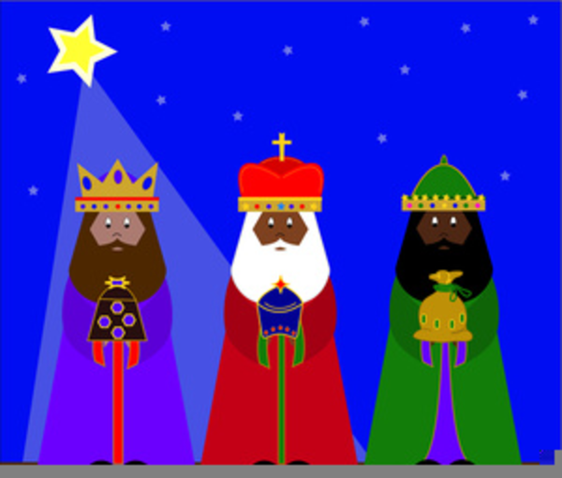
Saying what I and others do
Les trois Rois mages
bleu
Negation
Est-ce que questions
SSC [oi]
Notes:
Artwork by Steve Clarke. Pronoun pictures from NCELP (www.ncelp.org). All additional pictures selected from Pixabay and are available under a Creative Commons license, no
attribution required.
Phonics: Revisit SSC [oi] - voir [69] avoir [8] au revoir [4/1274] pourquoi ? [193] trois [115]
Vocabulary (new words in bold): cacher [914] maintenant [192] normalement [2018]
Revisit 1: aimer [242] avoir [8] vous² [50] animal [1002] cadeau [2298] chapeau [2908] cheval [2220] fanal [>5000] gâteau [4845] feu [786] jeu [291] vœu [2103]
Revisit 2: cheveu [2296] médecin [827] nez [2661] œil, yeux [474] visage [1292] bleu [1216] blond [4585] brun [>5000] court [545] crépu [>5000] gris [2769] long [202] noir [572] ovale [>5000] rond [2268] roux [>5000] vert [1060]
Londsale, D., & Le Bras, Y. (2009). A Frequency Dictionary of French: Core vocabulary for learners London: Routledge.
The frequency rankings for words that occur in this PowerPoint which have been previously introduced in these resources are given in the SOW and in the
resources that first introduced and formally re-visited those words.
For any other words that occur incidentally in this PowerPoint, frequency rankings will be provided in the notes field wherever possible.
1

Slide 2
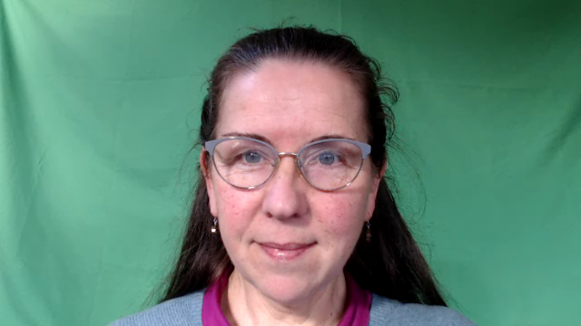

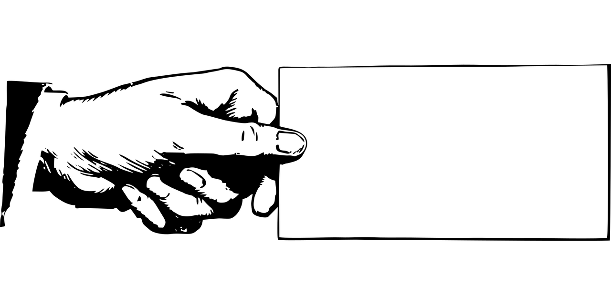


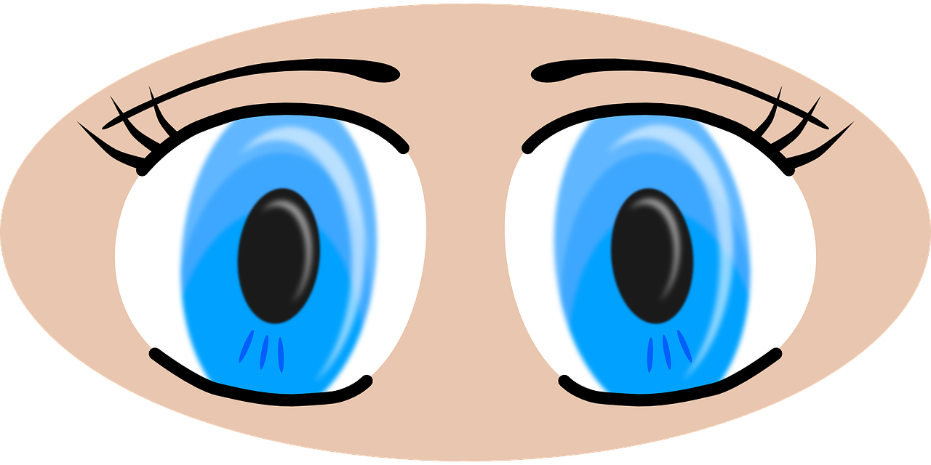
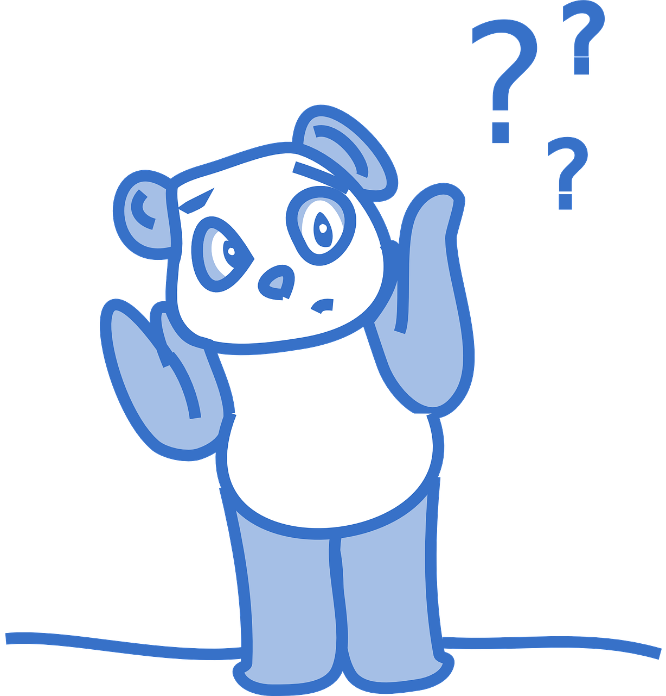

prononcer
[oi]
voir
to have, having
avoir
Au revoir !
[to see, seeing]
[why?]
trois
pourquoi ?
Notes:
Timing: 2 minutes
Aim: to recap SSC [oi].
Procedure:
Introduce and elicit the pronunciation of the individual SSC [oi] and the source word ‘voir’.
Click to bring on the picture and get students to repeat (with gesture, if using).
Present and practise the cluster words.
Gesture:
gesture for voir – hand with thumb and two fingers pointing forwards doing a three downwards motions, one for each syllable of the word.
https://www.signbsl.com/sign/see (scroll down to the correct definition of ‘see’ and we recommend the 1st video of these three) – right index finger comes up to the eye and then points away from the body as if tracing the path of sight from the eyes towards an object in view.
2

Slide 3

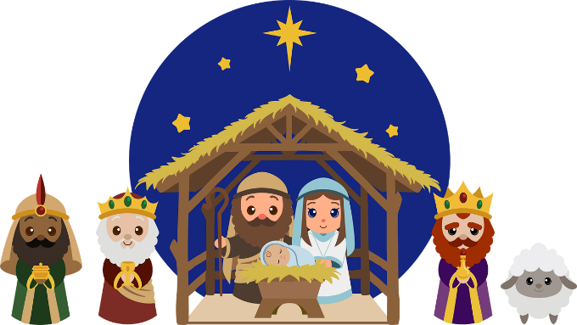
prononcer
Les trois Rois mages
[oi]
on voit = you/one see(s)
le roi = king
la droite = right
Écoute et note le son [oi]. Puis, prononce le texte.
/
///
--
/
/
///
[oi]
Le six janvier est un jour spécial. Pourquoi ?
On voit l’arrivée des trois Rois mages.
Bonjour Balthazar, Gaspard et Melchior.
Melchior est à droite.
Ils ont trois cadeaux pour le bébé Jésus.
Au revoir, les trois Rois mages !
Notes:
Timing: 8 minutes
Aim: to consolidate SSC [oi].
Procedure:
Make sure pupils understand the context, and the task. First, they need to tally the number of [oi] they hear in each sentence.
Pupils number 1 – 6 in their books. Click to hear number 1 and work through as an example.
Click to reveal the tally. Click to reveal the full sentence. Pupils pronounce the sentence.
Complete items 2-6.
Reveal the answers
Given pupils time to practise pronouncing each sentence in pairs.
Frequency of unknown words and cognates:
arrivée [1075] bébé [2271] droite [1293] mage [>5000] roi [1364]
Source: Londsale, D., & Le Bras, Y. (2009). A Frequency Dictionary of French: Core vocabulary for learners London: Routledge.
3

Slide 4


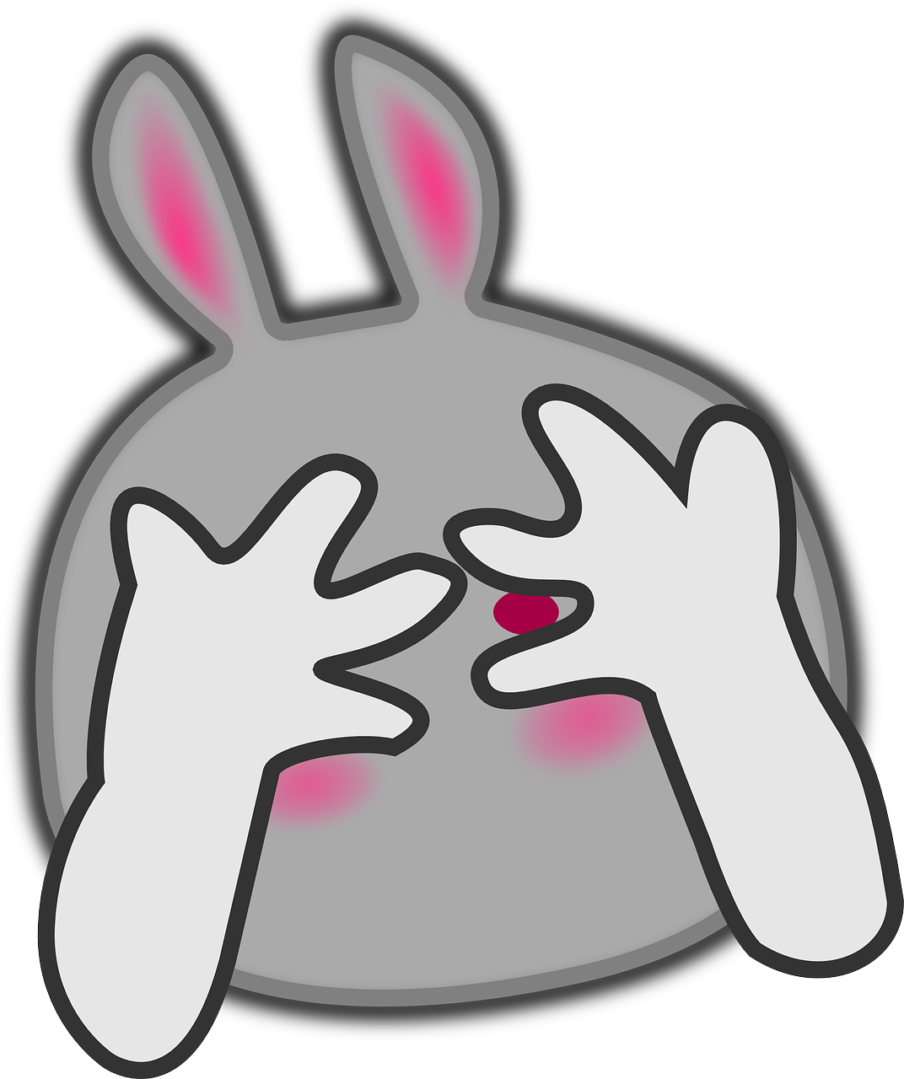




vocabulaire
Vocabulaire
mots
[now]
[to hide, hiding]
[usually]
maintenant
cacher
normalement
Notes:
Timing: 3 minutes
Aim: to introduce and practise the new vocabulary for this week.
Procedure:
1. Click for the French word.
Say and elicit the pronunciation from pupils.
Click for the English meaning and picture prompt.
Elicit the French word again from pupils.
Continue for the remaining 2 items.
Click to disappear one of the English meanings – elicit it from pupils. Continue with the other two items.
Click again to disappear one of the French meanings – elicit it from pupils. Continue with the remaining items.
4

Slide 5




Making sentences negative
ne…pas
Remember, to make a sentence negative, add ne before the verb and pas after it.
Je porte la couronne !
Je ne porte pas la couronne !
I am wearing the crown!
I am not wearing the crown!
Tu portes la couronne !
Tu ne portes pas la couronne !
You are wearing the crown!
You are not wearing the crown!
⚠ Remember: Ne changes to n’ before a verb starting with a vowel (or a silent h).
For example: je n’aime pas [I don’t like]
Notes:
Timing: 2 minutes
Aim: Introduce ne…pas negation with single-verb structures and draw attention to differences between French and English negation structure
Procedure:
Click through the animations to present the information.
Elicit English translations for the French examples provided.

Slide 6

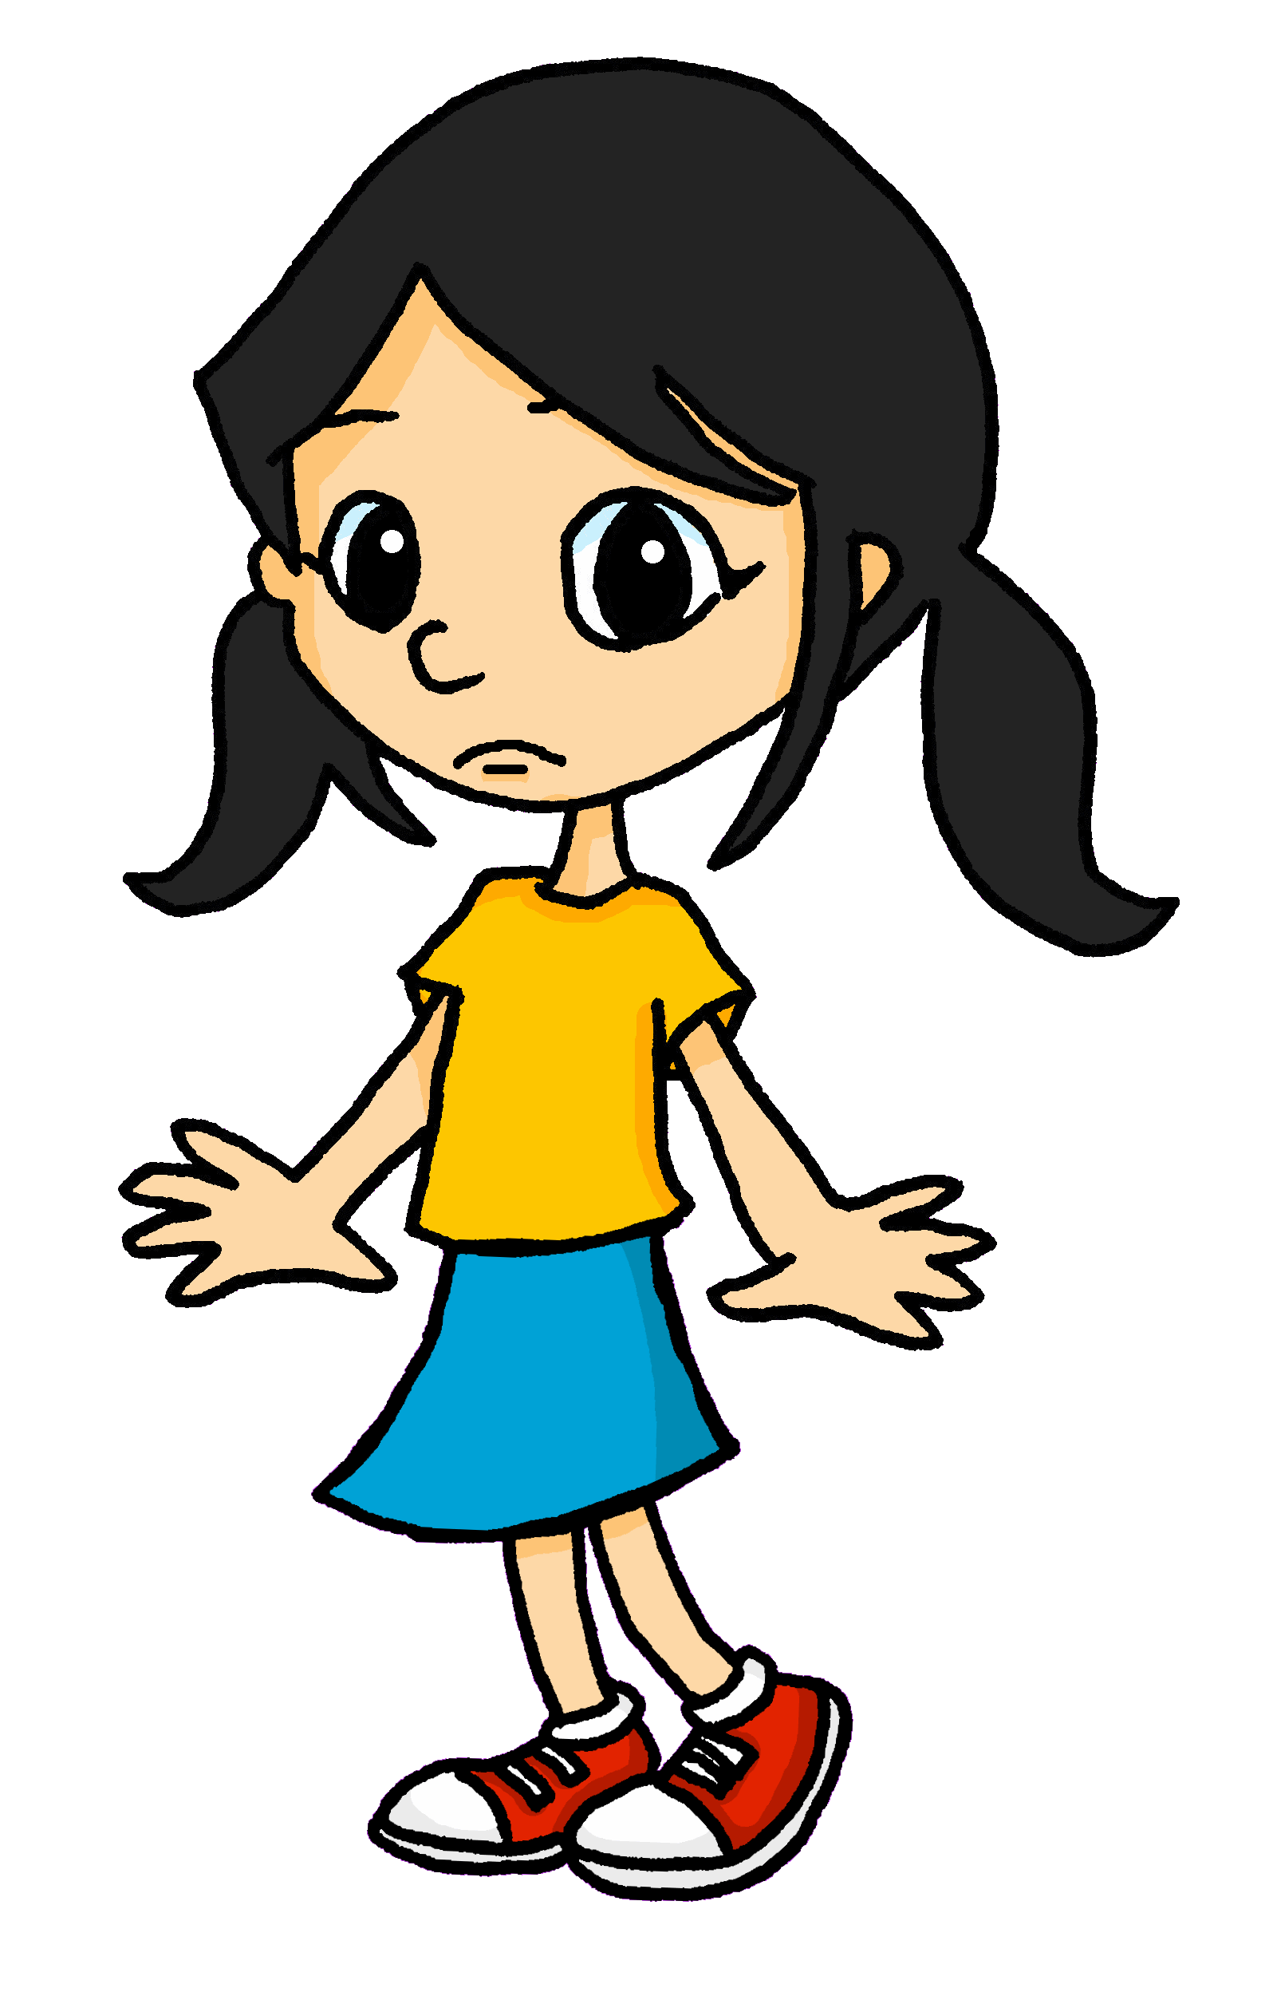
lire
La fête des Rois
Lis et décide le reste de la phrase. C’est A ou B ?
1
Ma famille célèbre…
pas la Fête des Rois.
la Fête des Rois.
2
Je ne prépare…
pas la galette.
la galette.
3
Maman cache…
la fève.
pas la fève.
4
Je donne…
pas des cadeaux.
des cadeaux.
5
Je suis…
pas sous la table.
sous la table.
6
Je ne trouve…
la fève.
pas la fève.
7
Je ne suis…
pas la reine.
la reine.
8
Elle porte…
la couronne.
pas la couronne.
9
Maintenant, je ne mange…
la galette !
pas la galette !
Notes:
Timing: 8 minutes
Aim: to pay attention to the position of ne…pas and practise written distinction between simple positive and negative sentence structures.
Procedure:
Students write down 1-9.
Model number 1 with the class, so pupils are clear that they select the sentence ending based on the present or absence of ‘ne’ in the sentence beginnings.
Click to leave the correct sentence ending.
Elicit the English meaning from pupils.
Pupils complete 2 – 8.
Teacher clicks to correct and elicit the English for the remainder of the story. Ask pupils to tell you why Eugénie is not happy.
Click the audio to hear the full sentences, if desired.
English meanings:
1. My family is celebrating Epiphany.
2. I don’t prepare the cake.
3. Mum hides the figurine.
4. I give some presents.
5. I am under the table.
6. I don’t find the figurine.
7. I am not the queen.
8. She is wearing the crown.
9. Now, I don’t eat the cake!

Slide 7

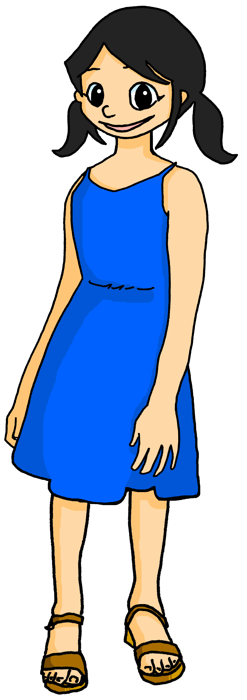
écouter
Écoute.
Eugénie won’t say what is wrong. Her sister Léa thinks she knows.
What does she say? She doesn’t finish her sentences, so you have to!
Écris 1-6 et A ou B.
 | A | B
 | … le gâteau. | … pas le gâteau.
 | … pas la fève. | … la fève.
 | … pas toujours la galette avec ta famille. | … toujours la galette avec ta famille.
 | … souvent la fève. | … pas souvent la fève.
 | … la couronne. | … pas la couronne.
 | … pas triste. | … triste.
1
1
2
2
3
3
4
4
5
5
6
6
Notes:
Timing: 7 minutes
Aim: to practise aural distinction of positive and negative sentences in the 2nd person present; to practise comprehension of several previously taught verbs.
Procedure:
1. Ensure pupils are clear about the task.
2. Click to play the example. Ask pupils to select the correct sentence ending A or B. Click on the audio button to listen to the full sentence and reveal the written answer on a mouse click.
3. Continue with items 2-6.
5. Listen and check the answers and click to reveal.
Transcript:
Normalement, tu ne prépares [pas le gâteau].
Normalement, tu ne caches [pas la fève].
Tu partages [toujours la galette avec ta famille].
Tu ne trouves [pas souvent la fève].
Aujourd’hui, tu ne portes [pas la couronne].
Maintenant, tu es [triste].
7

Slide 8
Au revoir !
bleu
Notes:
8

