Slide 1
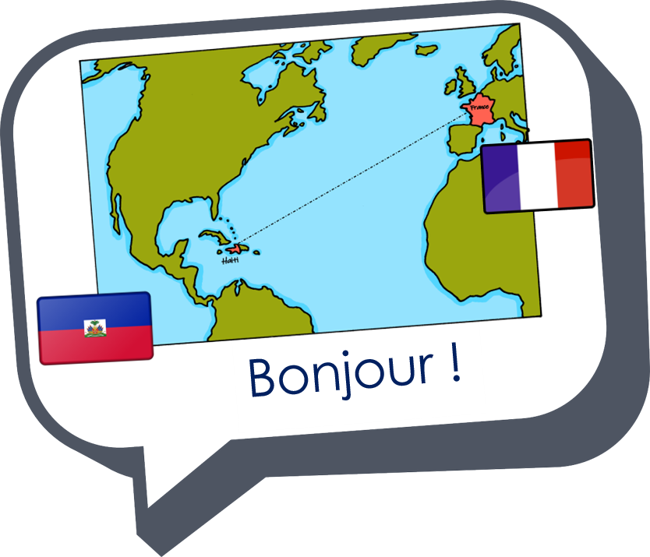
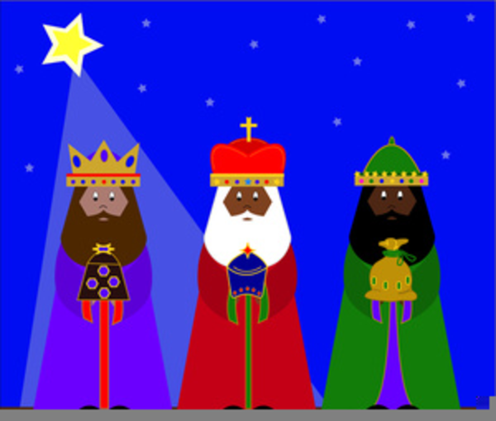
Saying what I and others do
Les trois Rois mages
bleu
Follow ups 1-5
Notes:
Artwork by Steve Clarke. Pronoun pictures from NCELP (www.ncelp.org). All additional pictures selected from Pixabay and are available under a Creative Commons license, no
attribution required.
Phonics: Revisit SSC [oi] - voir [69] avoir [8] au revoir [4/1274] pourquoi ? [193] trois [115]
Vocabulary (new words in bold): cacher [914] maintenant [192] normalement [2018]
Revisit 1: aimer [242] avoir [8] vous² [50] animal [1002] cadeau [2298] chapeau [2908] cheval [2220] fanal [>5000] gâteau [4845] feu [786] jeu [291] vœu [2103]
Revisit 2: cheveu [2296] médecin [827] nez [2661] œil, yeux [474] visage [1292] bleu [1216] blond [4585] brun [>5000] court [545] crépu [>5000] gris [2769] long [202] noir [572] ovale [>5000] rond [2268] roux [>5000] vert [1060]
Londsale, D., & Le Bras, Y. (2009). A Frequency Dictionary of French: Core vocabulary for learners London: Routledge.
The frequency rankings for words that occur in this PowerPoint which have been previously introduced in these resources are given in the SOW and in the resources that first
introduced and formally re-visited those words.
For any other words that occur incidentally in this PowerPoint, frequency rankings will be provided in the notes field wherever possible.

Slide 2
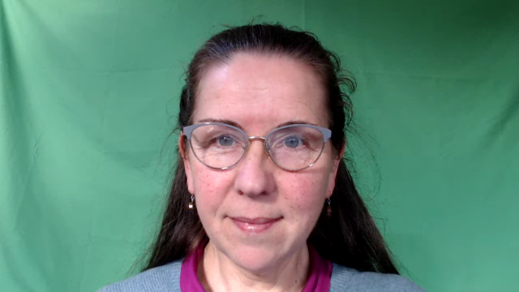



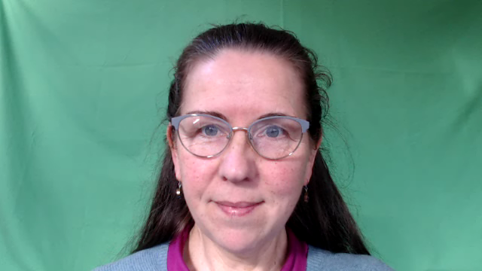
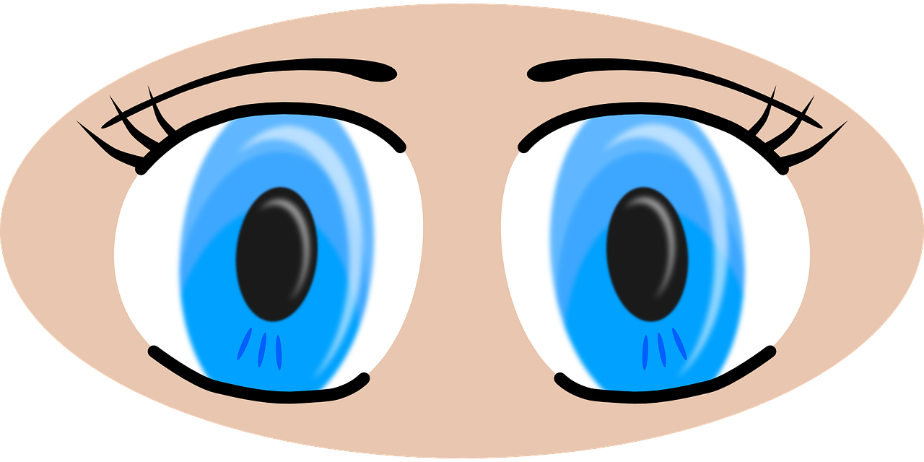
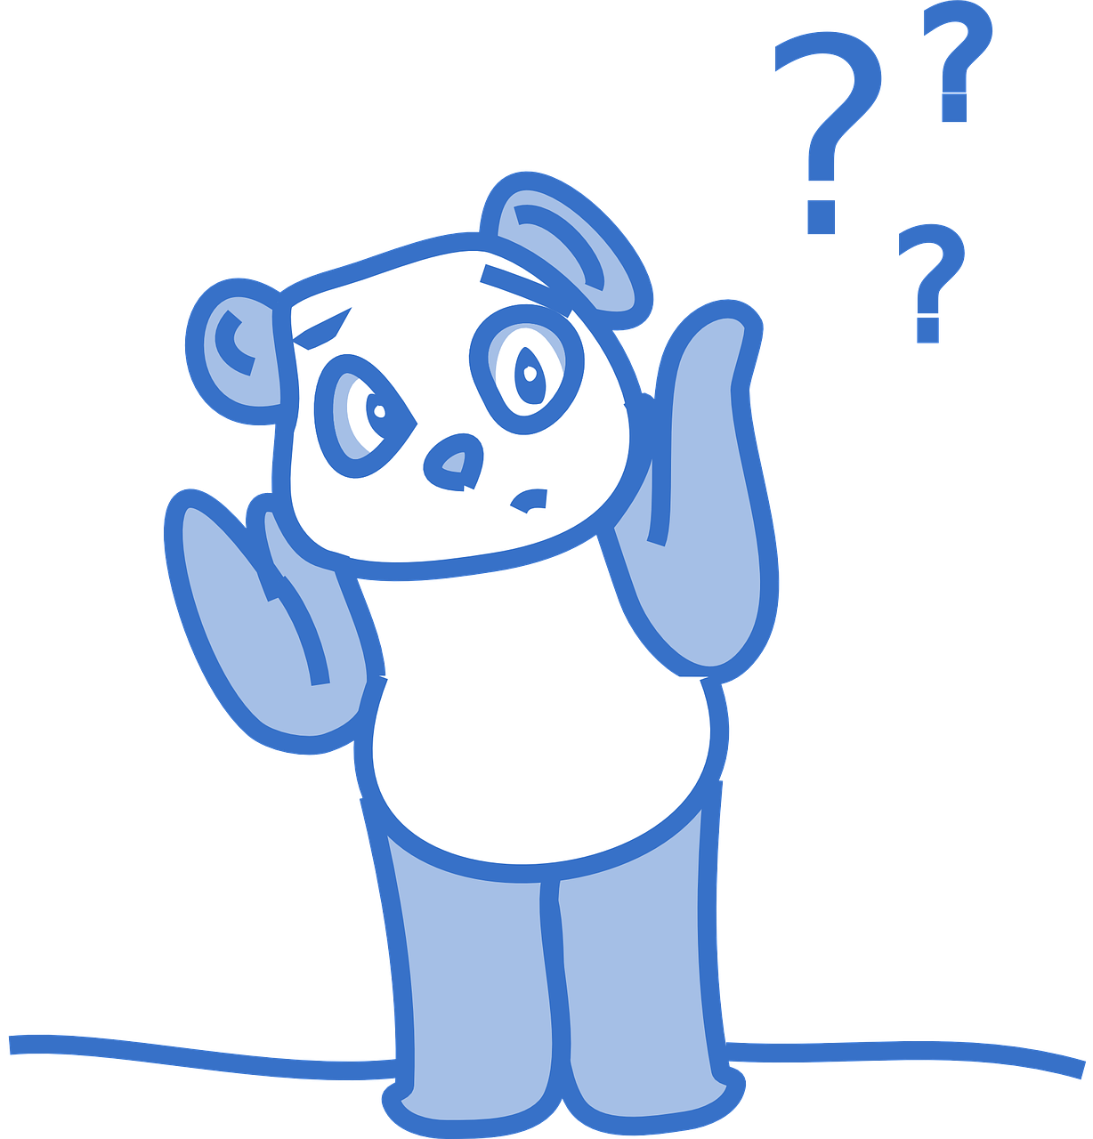

prononcer
[oi]
voir
to have, having
avoir
Au revoir !
[to see, seeing]
[why?]
trois
pourquoi ?
Notes:
Timing: 2 minutes
Aim: to recap SSC [oi].
Procedure:
Introduce and elicit the pronunciation of the individual SSC [oi] and the source word ‘voir’.
Click to bring on the picture and get students to repeat (with gesture, if using).
Present and practise the cluster words.
Gesture:
gesture for voir – hand with thumb and two fingers pointing forwards doing a three downwards motions, one for each syllable of the word.
https://www.signbsl.com/sign/see (scroll down to the correct definition of ‘see’ and we recommend the 1st video of these three) – right index finger comes up to the eye and then points away from the body as if tracing the path of sight from the eyes towards an object in view.
2

Slide 3



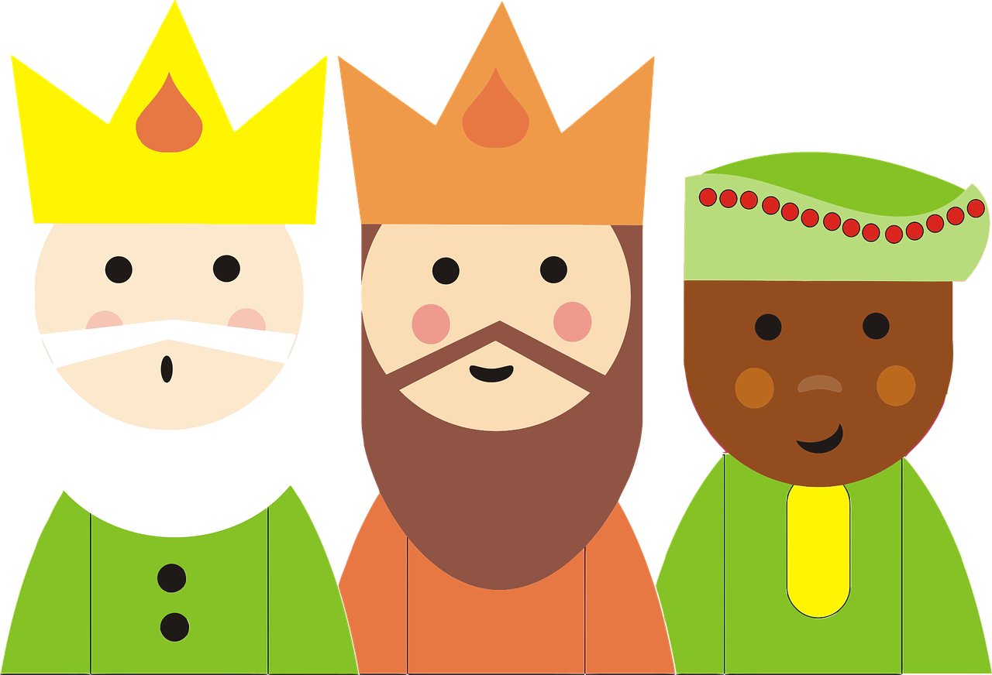

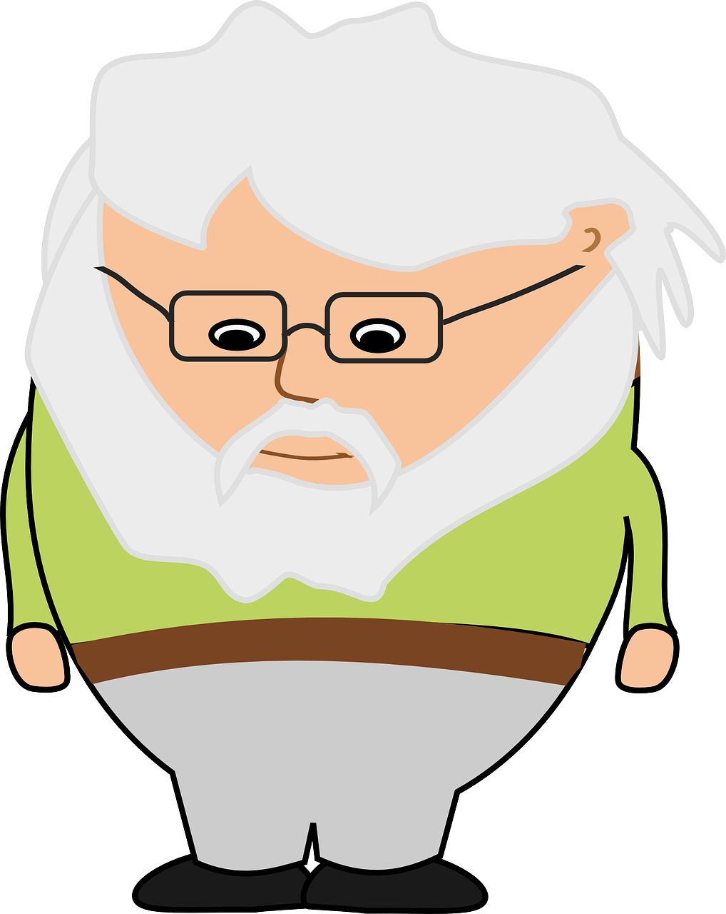
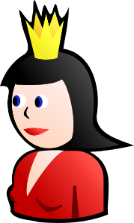

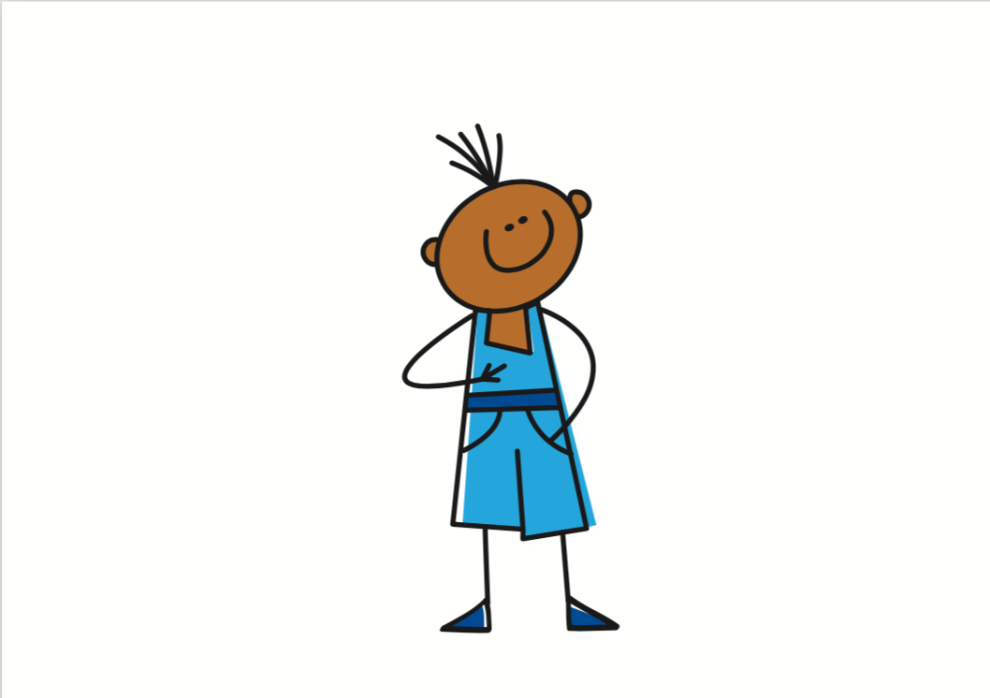

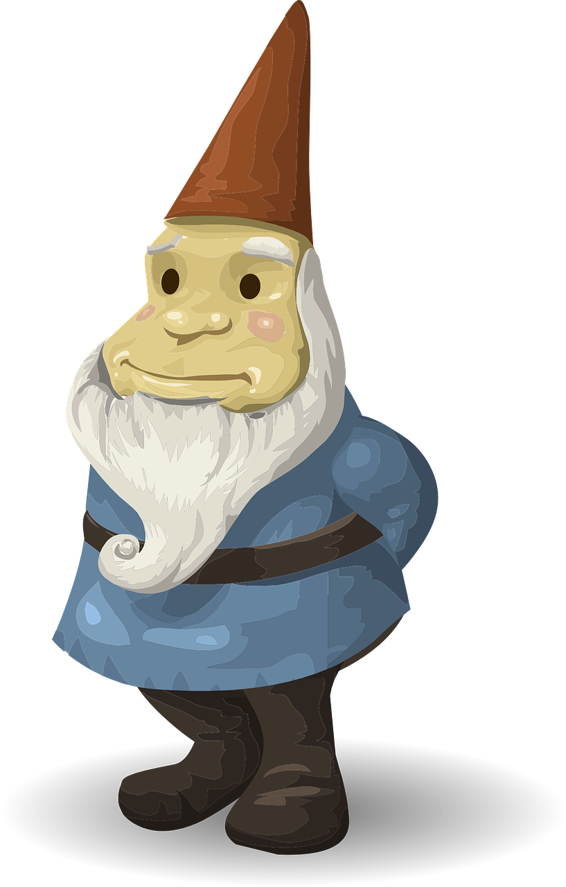

Follow up 1:
Prononce la chanson.🗣
C'est la jolie fête
La fête des Rois
On mange la galette
Chez mon oncle Éloi
Si maman est reine
Papa sera roi
Mais si j'ai la fève
La couronne pour moi.
C'est la jolie fête
La fête des Rois
On mange la galette
Chez mon oncle Éloi
Si maman est reine
Papa sera roi
Mais si j'ai la fève
La couronne pour moi.
C'est la jolie fête
La fête des Rois
On mange la galette
Chez mon oncle Éloi
Si maman est reine
Papa sera roi
Mais si j'ai la fève
La couronne pour moi.
C'est la jolie fête
La fête des Rois
On mange la galette
Chez mon oncle Éloi
Si maman est reine
Papa sera roi
Mais si j'ai la fève
La couronne pour moi.
It’s the pretty festival.
prononcer
The festival of the Kings (Epiphany)
We eat the (Epiphany) cake
At my uncle Éloi’s house.
If mum is the queen
dad will be the king.
But if I have the fève (figurine)
l’oncle = uncle
si = if
sera = (s/he) will be
the crown for me.
Notes:
Timing: 5 minutes
Aim: to practise pronouncing the [oi] sound in an authentic poem.
Procedure:
Remind pupils that they met this poem last week, and that it has four examples of the [oi] sound.
Pupils work in pairs to pronounce the song first of all.
Click to listen to the song.
Play the song again and encourage pupils to sing along.
Source:
https://www.mamalisa.com/?t=es&p=3006
(Sing to tune of Au clair de la lune)
Frequency:
couronne [>5000] fève [>5000] galette [>5000] roi [1364]
Source: Londsale, D., & Le Bras, Y. (2009). A Frequency Dictionary of French: Core vocabulary for learners London: Routledge.

Slide 4

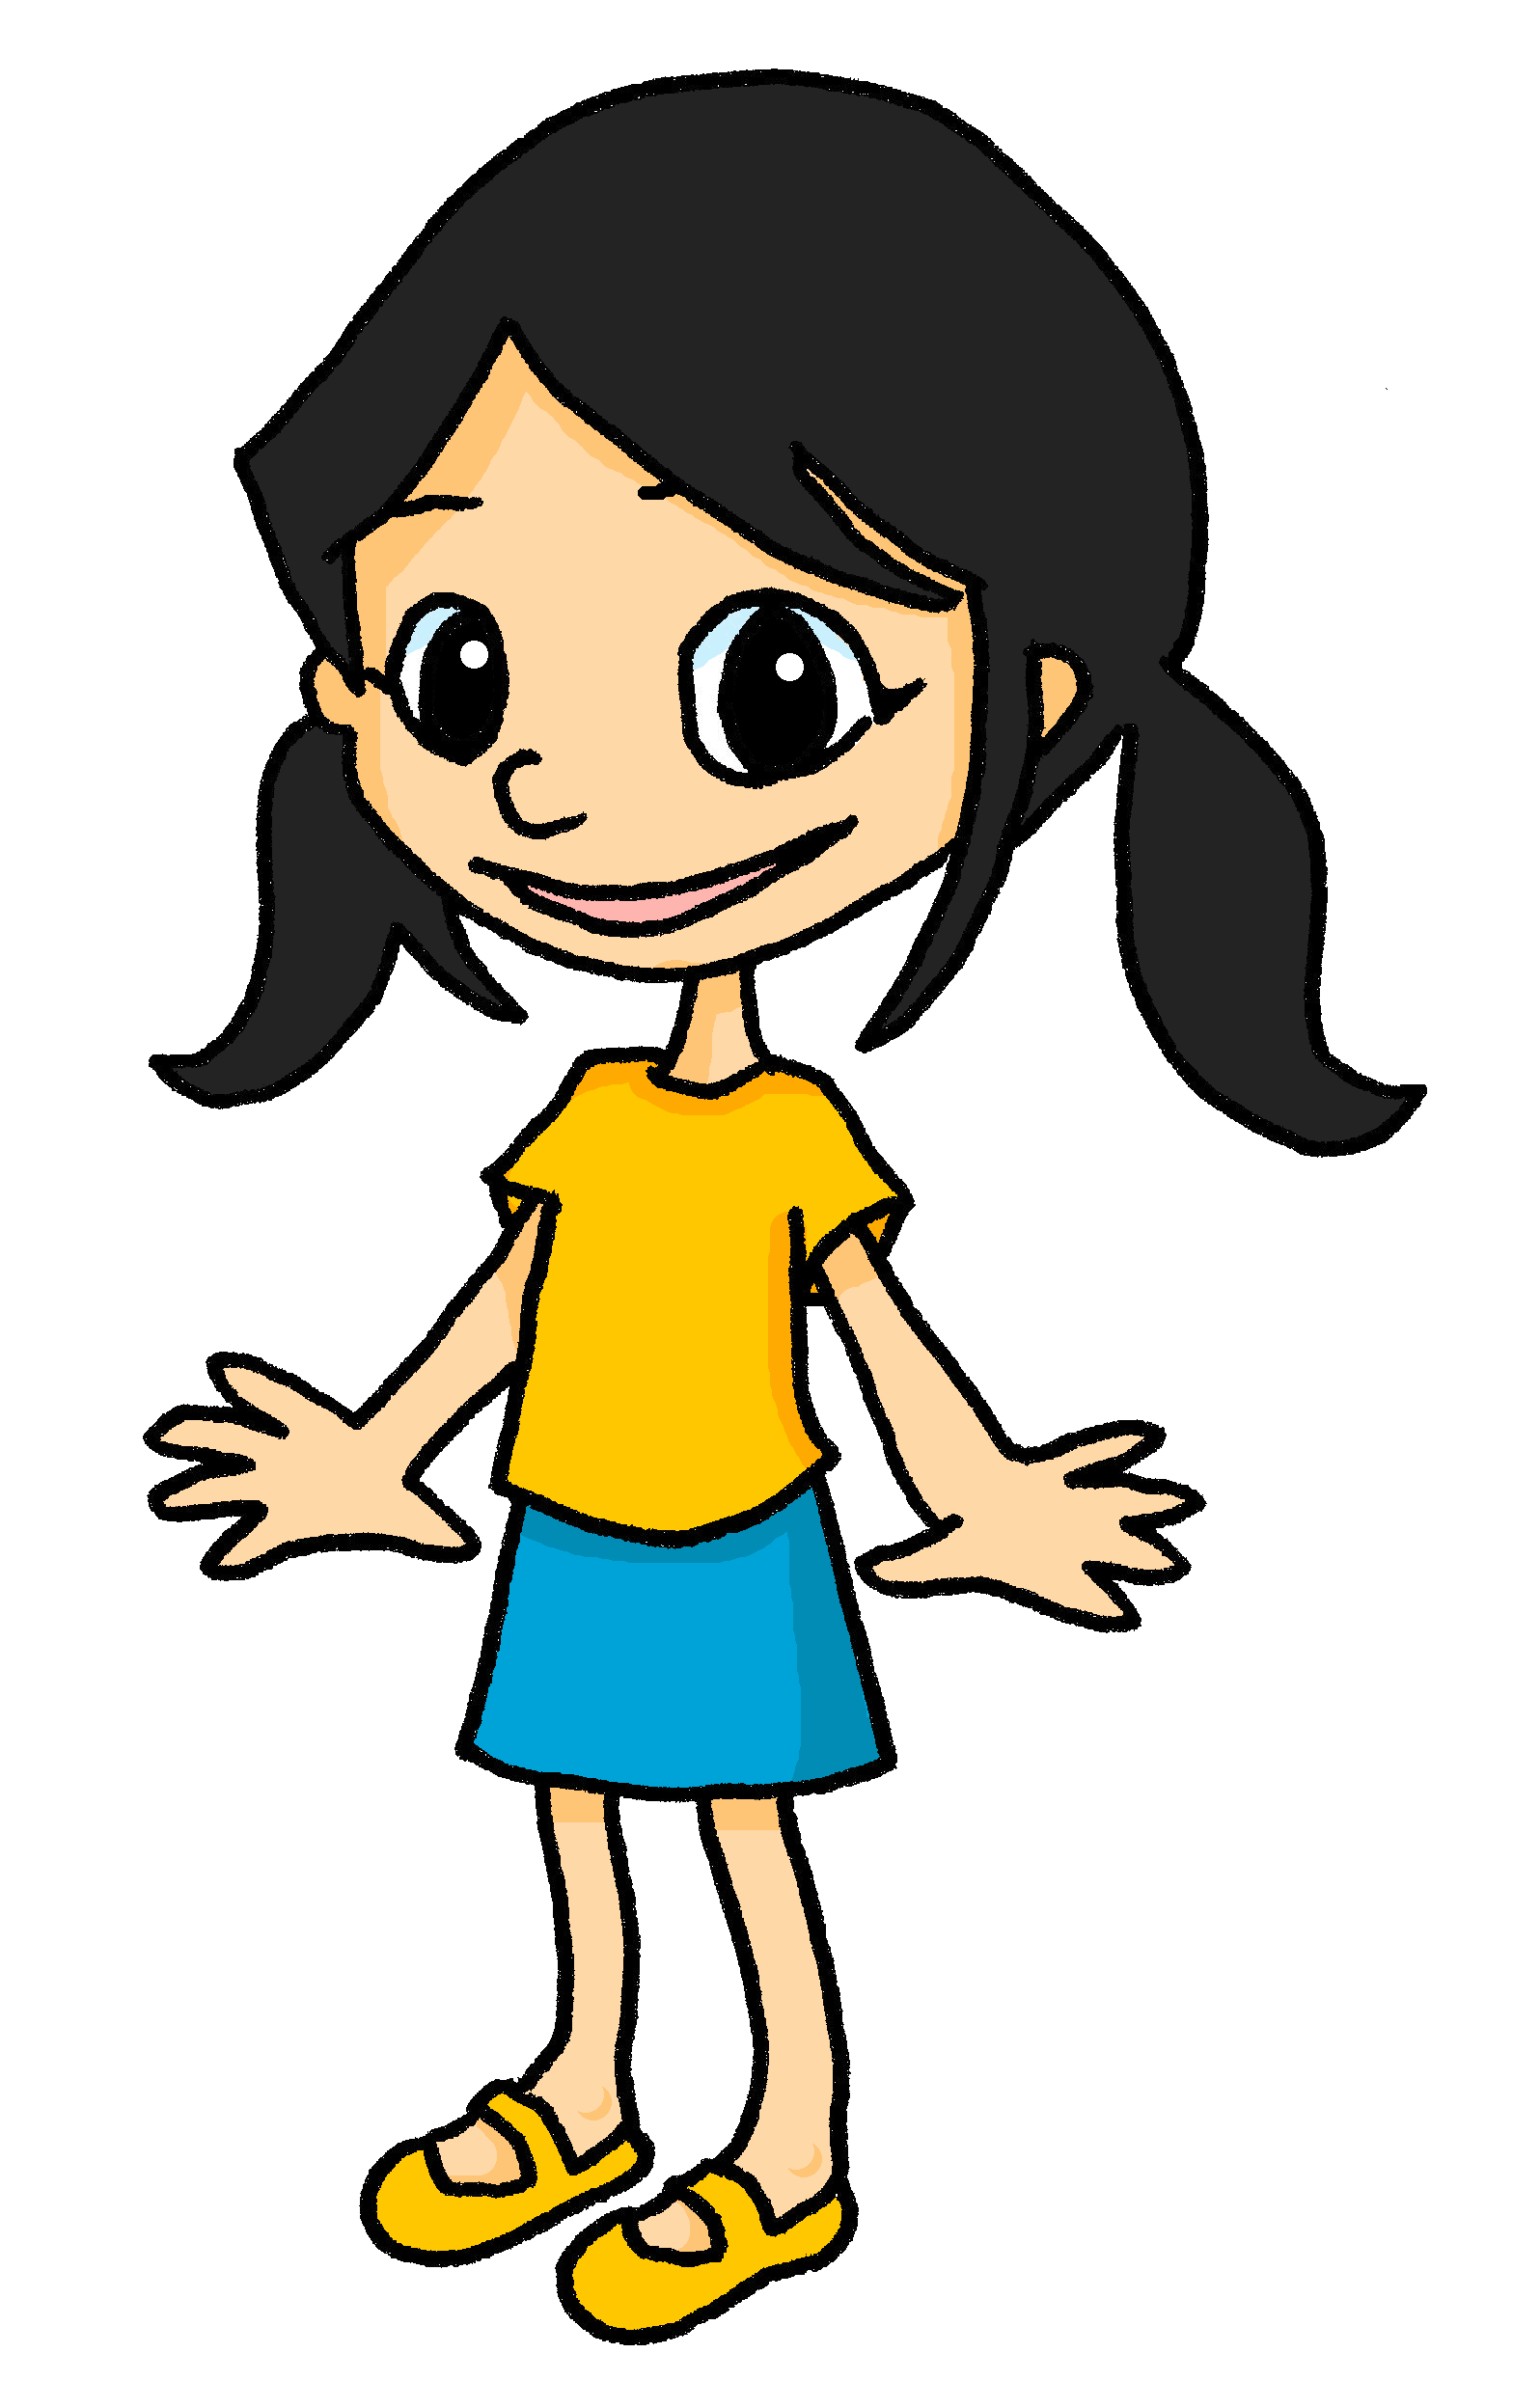



Asking yes/no questions with est-ce que
Remember, use est-ce que to ask yes/ no questions:
Est-ce que Eugénie est grande ?
Oui, elle est grande.
Non, elle n’est pas grande.
Yes, she is tall.
Non, she is not tall.
Est-ce que Eugénie a le visage ovale ?
Oui, elle a le visage ovale.
Non, elle n’a pas le visage ovale.
Yes, she has an oval face.
No, she doesn’t have an oval face.
⚠ Remember: to answer with a negative, add ne/n’ before the verb and pas after it.
Notes:
Timing: 2 minutes
Aim: to revisit ne…pas negation with examples using avoir and être, which prime for the listening task.
Procedure:
Click through the animations to present the information.
Elicit English translations for the French examples provided.

Slide 5

Follow up 2
Une description d’Eugénie
Écoute les questions. C’est quelle réponse, A ou B ?
écouter
? | A | B
1
A
Elle n’est pas petite.
B
Elle est petite.
2
A
Elle est la sœur d’Adèle.
B
Elle n’est pas la sœur d’Adèle.
3
A
Elle n’a pas le visage rond.
B
Elle a le visage rond.
4
A
Elle a les cheveux roux.
B
Elle n’a pas les cheveux roux.
5
A
Elle n’a pas les yeux bleus.
B
Elle a les yeux bleus.
6
A
Elle aime la couleur jaune.
B
Elle n’aime pas la couleur jaune.
Notes:
Timing: 5 minutes
Aim: to practise aural comprehension of positive and negative sentences and est-ce que questions.
Procedure:
Clarify the task. Pupils listen to questions about Eugénie and two possible answers. The answers relate to the picture of Eugénie and what pupils already know about her (i.e. that she is Léa’s younger sister).
Pupils write 1-6 and A or B.
Elicit answers orally from pupils and click to reveal both sets of written answers.
There is no need for comprehension tasks, here, as the next task is a reading comprehension based on similar language.

Slide 6


Follow up 3 Une description d’Eugénie
black (pl)
clothes
frizzy (pl)
eyes
lire
noirs
vêtements
crépus
les yeux
Eugénie est jeune et petite. Elle est la sœur de Léa. Elle n’a pas le visage ovale, elle a le visage rond.
Elle n’a pas les cheveux roux ou crépus, elle a les cheveux noirs. Elle n’a pas les yeux bleus, elle a les yeux noirs, aussi.
Elle adore les vêtements jaunes. Aujourd’hui, elle porte un t-shirt jaune et une jupe* bleue. Elle n’aime pas la couleur verte.
la jupe = skirt
red (pl)
hair (pl)
young
today
face
roux
les cheveux
jeune
aujourd’hui
le visage
Notes:
Timing: 5 slides
Aim: to revisit previously taught vocabulary in an extended text; to practise written comprehension of negative and positive sentences.
Procedure:
Pupils read the text. Click on Eugénie to hear the full text, if desired.
Teachers elicits answers in any order, clicking on the English to reveal the French.
Pupils volunteer an oral description of Eugénie based on the details of the text.

Slide 7


Follow up 4 [1/6]
Écoute la question. Donne une réponse en français.
parler
1
Non, je ne suis pas petit.
Notes:
[1/6]
Timing: 5-10 minutes (7 slides)
Aim: to practise aural comprehension of est-ce que questions and respond with negative sentences.
Procedure:
Teacher says (or clicks for the audio of) the question.
Pupils respond, chorally, with a short negative sentence, using the picture as a prompt.
Click to bring up a written version of the response to read and check.
Transcript:
Est-ce que tu es petit ?

Slide 8

Follow up 4 [2/6]
Écoute la question. Donne une réponse en français.
parler
2
Non, je n’ai pas le visage rond.
Notes:
[2/6]
Transcript:
Est-ce que tu as le visage rond ?

Slide 9

Follow up 4 [3/6]
Écoute la question. Donne une réponse en français.
parler
3
Non, je n’ai pas les cheveux blonds.
Notes:
[3/6]
Transcript:
Est-ce que tu as les cheveux blonds ?

Slide 10

Follow up 4 [4/6]
Écoute la question. Donne une réponse en français.
parler
4
Non, je n’ai pas les yeux verts.
Notes:
[4/6]
Transcript:
Est-ce que tu as les yeux verts ?

Slide 11


Follow up 4 [5/6]
Écoute la question. Donne une réponse en français.
parler
5
Non, je n’aime pas la couleur jaune.
Notes:
[5/6]
Transcript:
Est-ce que tu aimes la couleur jaune ?

Slide 12
Follow up 4 [6/6]
Écoute la question. Donne une réponse en français.
parler
6
Non, je n’aime pas la couleur rouge.
Notes:
[6/6]
Transcript:
Est-ce que tu aimes la couleur rouge ?

Slide 13

Follow up 4
Parle avec ton/ta partenaire.
Répète l’exercice.
Écoute la question. Donne une réponse en français.
parler
Est-ce que tu es petit ?
Est-ce que tu as le visage rond ?
Est-ce que tu as les cheveux blonds ?
Est-ce que tu as les yeux verts ?
Est-ce que tu aimes la couleur jaune ?
Est-ce que tu aimes la couleur rouge ?
1
2
This time, give your own answers to the questions. They may be positive or negative.
3
4
5
6
Notes:
Aim: to practise aural comprehension of est-ce que questions and respond with personal responses.
Procedure:
Pupils works in pairs, asking and answering the questions.
This time they answer for themselves and may answer positively or negatively.
Differentiation:
For greater challenge, present the prompts as short French phrases. e.g. Tu es petit.
For greater challenge still, prompt the questions with English or pictures.

Slide 14




vocabulaire
Follow up 5a - Écris en anglais : Can you get at least 15 points?
mots
 | ovale | rond | roux
 | blond | crépu | long
 | le cheveu | le/la médecin | le visage
 | les animaux | les feux | les vœux
 | le cheval | les chevaux | l’animal (m)
 | vous | le feu | le vœu
 | cacher | normalement | maintenant
oval
round
red
x3
blonde
frizzy
long
(the) hair
(the) doctor (m/f)
(the) face
(the) animals
(the) fires
(the) wishes
x2
(the) horse
(the) horses
(the) animal
you (pl, formal)
(the) fire
(the) wish
x1
to hide, hiding
usually
now
Notes:
Timing: 5-10 minutes
Aim: to practise written comprehension of vocabulary from this week and previous weeks.
Procedure:
Give pupils a blank grid. They fill in the English meanings of any of the words they know, trying to reach 15 points in total.
Note:
The most recently learnt and practised words are pink, words from the previous week are green and those from earlier are blue, thus more points are awarded for them, to recognise that memories fade and more effort (heavy lifting!) is needed to retrieve them.
14

Slide 15
vocabulaire
Follow up 5b - Écris en français : Can you get at least 15 points?
mots
 | oval | round | red
 | blonde | frizzy | long
 | (the) hair | (the) doctor (m/f) | (the) face
 | (the) animals | (the) fires | (the) wishes
 | (the) horse | (the) horses | (the) animal
 | you (pl, formal) | (the) fire | (the) wish
 | to hide, hiding | usually | now
ovale
rond
roux
x3
blond
crépu
long
le cheveu
le/la médecin
le visage
les animaux
les feux
les vœux
x2
le cheval
les chevaux
l’animal
vous
le feu
le vœu
x1
cacher
normalement
maintenant
Notes:
Timing: 5-10 minutes
Aim: to practise written comprehension of vocabulary from this week and previous weeks.
Procedure:
Give pupils a blank grid. They fill in the French meanings of any of the words they know, trying to reach 15 points in total.
Note:
The most recently learnt and practised words are pink, words from the previous week are green and those from earlier are blue, thus more points are awarded for them, to recognise that memories fade and more effort (heavy lifting!) is needed to retrieve them.
15

Slide 16
vocabulaire
Écris en anglais : Can you get at least 15 points?
mots
 | ovale | rond | roux
 | blond | crépu | long
 | le cheveu | le/la médecin | le visage
 | les animaux | les feux | les vœux
 | le cheval | les chevaux | l’animal
 | vous | le feu | le vœu
 | cacher | normalement | maintenant
x3
x2
x1
Notes:
HANDOUT
16

Slide 17
vocabulaire
Écris en français : Can you get at least 15 points?
mots
 | oval | round | red
 | blonde | frizzy | long
 | (the) hair | (the) doctor (m/f) | (the) face
 | (the) animals | (the) fires | (the) wishes
 | (the) horse | (the) horses | (the) anima
 | you (pl, formal) | (the) fire | (the) wish
 | to hide, hiding | usually | now
x3
x2
x1
Notes:
HANDOUT
17

