Slide 1
Saying what I and others do
La Galette des Rois
bleu
Negation
Est-ce que questions
SSC [é,er,ez,et], [è|ê]
Notes:
Artwork by Steve Clarke. Pronoun pictures from NCELP (www.ncelp.org). All additional pictures selected from Pixabay and are available under a Creative Commons license, no
attribution required.
Phonics: Revisit SSC [é|er|ez|et] and [è|ê] - répéter [630] écrire [382] bébé [2271] donner [46] parler [106] et [6] nez [2661] fête [1490] tête [343] frère [1043] être [5] problème [188]
Vocabulary (new words in bold): étudier [960] partager [527] parfois [410]
Revisit 1: aimer [242] arriver [174] célébrer [2170] organiser [701] porter [105] préparer [368] année [102] fête [1490] gens [236] histoire [262] santé [641] vêtement [2383]
Revisit 2: avons [8] avez [8] nous [31] vous [50] exercice [1290] chaise [3419] cours [169] enfant [126] où [48] sur [16] ici [167] là [109]
Londsale, D., & Le Bras, Y. (2009). A Frequency Dictionary of French: Core vocabulary for learners London: Routledge.
The frequency rankings for words that occur in this PowerPoint which have been previously introduced in these resources are given in the SOW and in the
resources that first introduced and formally re-visited those words.
For any other words that occur incidentally in this PowerPoint, frequency rankings will be provided in the notes field wherever possible.
1

Slide 2
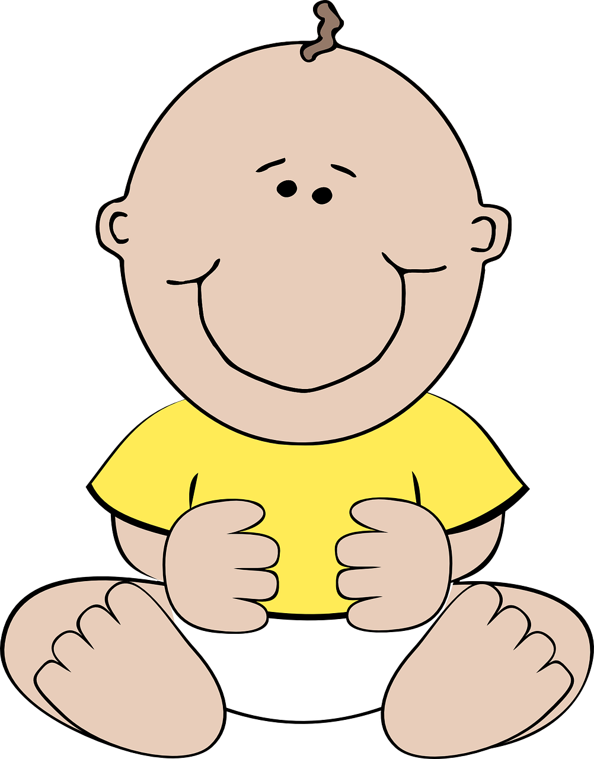
prononcer
[é]
[er]
[et]
[ez]
Remember that [é], [er],[et] and [ez] sound the same.
répéter
[and]
écrire
parler
et
bébé
donner
nez
[to give]
Notes:
Timing: 2 minutes
Aim: to recap SSC [é] [er] [et] [ez], which are the same sound written differently.
Procedure:
Introduce and elicit the pronunciation of the individual SSC [é, et, et, ez] and the source word ‘répéter’, which has both spellings of the sound.
Click to bring on the picture and get students to repeat (with gesture, if using).
Present and practise the cluster words.
Gesture: gesture for répéter – hand with thumb and two fingers pointing forwards doing a three downwards motions, one for each syllable of the word.
https://www.signbsl.com/sign/repeat (the 2nd video marked again: repeat with the female signer)
2

Slide 3
prononcer
[è|ê]
[è] and [ê] sound almost the same. [ê] is a little longer and deeper.
to be, being
fête
être
frère
(brother)
(party, celebration)
tête
problème
(head)
Notes:
Timing: 2 minutes
Aim: to recap SSC [è] and [ê] which are almost the same sound.
Procedure:
Introduce and elicit the pronunciation of the individual SSC [è] and the source word ‘xxx’, which has both spellings of the sound.
Click to bring on the picture and get students to repeat (with gesture, if using).
Present and practise the cluster words.
Gesture: gesture for fête: raise both hands in the air (middle three fingers facing down in a partial fist, with thumb and pinkie facing upwards) and move up and down alternate left and right to suggest a celebration-style dance.
Source: https://www.signbsl.com/sign/party (the 3rd video from the right is the best one, in my view)
3

Slide 4
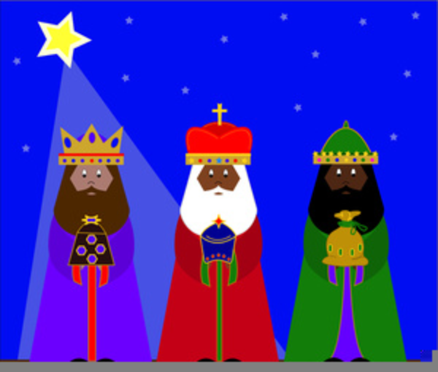
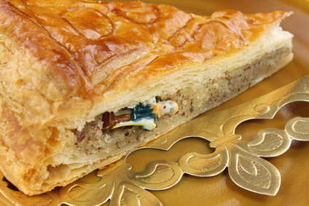
prononcer
Le six janvier à Lorient en France
[è|ê] ou [é|er]
Écoute et écris les mots en français. Puis, prononce le texte.
Le six [1] janvier, c’est [2] la fête des Rois. [3] La mère de Léa et Eugénie [4] prépare la galette des Rois. C’est pour l’Épiphanie et l’ [5] arrivée des trois Rois mages à Bethléem. C’est une tradition. La galette est un gâteau avec une [6] fève (ou figurine) et une couronne ! Maintenant, pour [7] célébrer ‘La Fête des Rois’, Eugénie est sous la table et elle [8] décide comment partager la galette. C’est la tradition. Cette* [9] année, Léa trouve la [10] fève. Elle porte la couronne. Elle est [11] très contente. Bon [12] appétit, Léa !
____
_ ___
_ ___
____
____
___
____
____
____
___
__
____
cette = this
la couronne = crown
Notes:
Timing: 8 minutes
Aim: to consolidate SSC [è|ê] and [é|er].
Procedure:
Tell pupils that all of the missing words have either the SSC [è|ê] or [é|er] and that there some words they have met before and a few words they don’t know. They should just listen and have a go at writing down what they hear.
Pupils number 1 – 12 in their books.
Click to listen to each sentence. Pupils write the missing words (or just SSC letters – see below).
They may need to listen to each sentence several times.
Click to reveal and check answers.
Teachers elicit pupils’ understanding of the text (Note that they are resources about the Fête des Rois in Y3/4 lessons so the context may be familiar to them).
If time allows, pupils can read the text aloud again in pairs.
Differentiation:
For learners who need more support, just the SSC letters can be gapped, instead.
Frequency: arrivée [1075] couronne [>5000] figurine [>5000] galette [>5000] roi [1364] Source: Londsale, D., & Le Bras, Y. (2009). A Frequency Dictionary of French: Core vocabulary for learners London: Routledge.
4

Slide 5
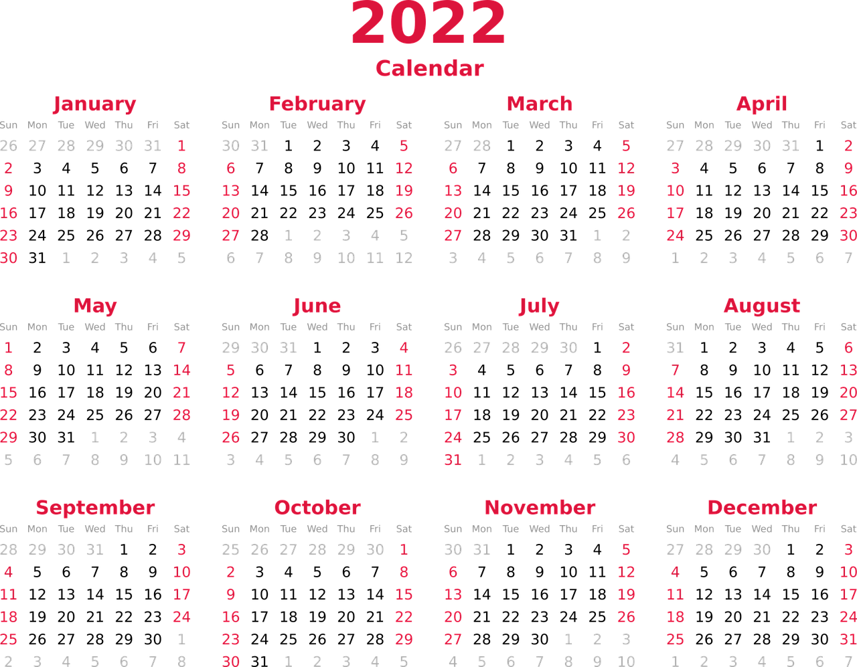
vocabulaire
Vocabulaire
mots
l’histoire
la santé
party, celebration, festival
la fête
item of clothing
le vêtement
year
history
people
health
l’année
les gens
Notes:
Timing: 4 minutes (4 slides)
Aim: to practise pronunciation and written comprehension of previously taught vocabulary for this week.
Procedure: 1. Click for an English word.
Elicit the French word from the six words provided.
Continue for the remaining 5 items.
Move to the next three slides to practise spoken recall.
5

Slide 6
vocabulaire
Vocabulaire
mots
5
S
la fête
l’année
0
DÉBUT
Notes:
[1/3]
Aim: to practise spoken recall of previously taught vocabulary
Procedure: 1. Click for two picture prompts.
2. Start the 5 second timer.
3. Pupils say the words to a partner.
4. Teacher elicits the two words chorally from pupils.
5. Click to confirm the written answers.
6. Continue for the next two slides.
6

Slide 7
vocabulaire
Vocabulaire
mots
5
S
les gens
la santé
0
DÉBUT
Notes:
[2/3]
7

Slide 8
vocabulaire
Vocabulaire
mots
5
S
l’histoire
le vêtement
0
DÉBUT
Notes:
[3/3]
8

Slide 9
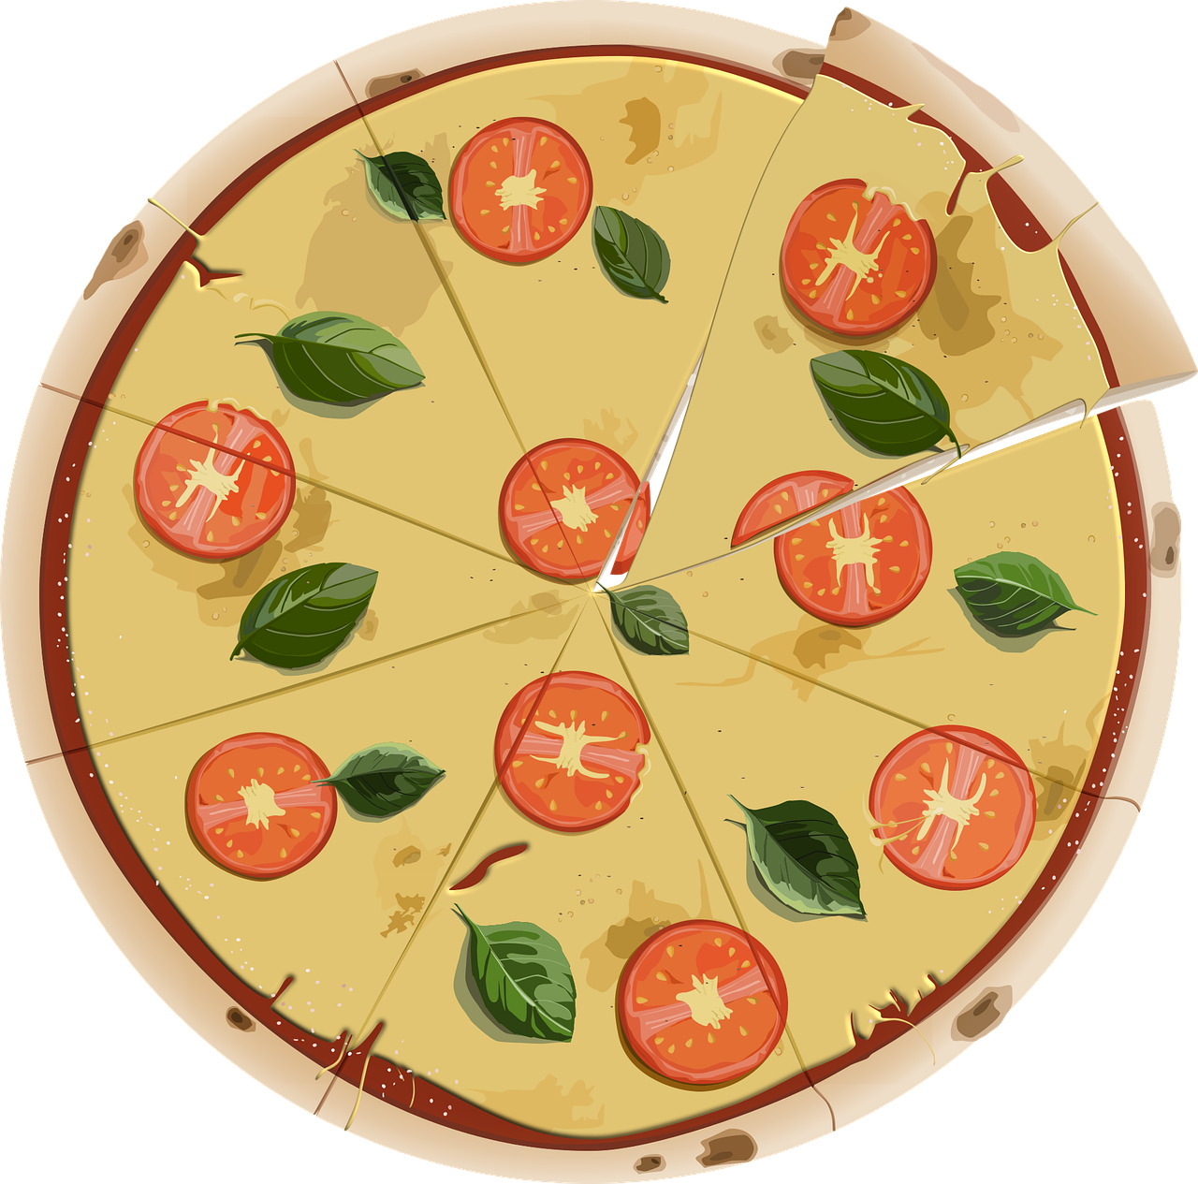
vocabulaire
Vocabulaire
mots
partager
parfois
étudier
(to share, sharing)
(sometimes)
(to study, studying)
Notes:
Timing: 4 minutes
Aim: to present the new vocabulary for this week.
Procedure: 1. Click for a French word. Elicit pronunciation from pupils.
2. Click for the English meaning and picture prompt. Elicit the French word again.
3. Present all three words like this, in order.
4. Click for one English meaning to disappear. Elicit the English meaning from pupils. Continue with the remaining items.
5. Click for the French word to disappear. Elicit the French from pupils. Continue with the remaining items.
9

Slide 10
Making sentences negative
ne…pas
⚠ Ne changes to n’ before a verb starting with a vowel (or a silent h).
For example: je n’aime pas [I don’t like]
In English…
In French…
I speak.
I don’t speak.
Je parle.
Je ne parle pas.
…add don’t before the verb to make the sentence negative.
…add ne before the verb and pas after the verb to make the sentence negative.
Notes:
Timing: 2 minutes
Aim: Introduce ne…pas negation with single-verb structures and draw attention to differences between French and English negation structure
Procedure:
Click through the animations to present the information.
Elicit English translations for the French examples provided.

Slide 11
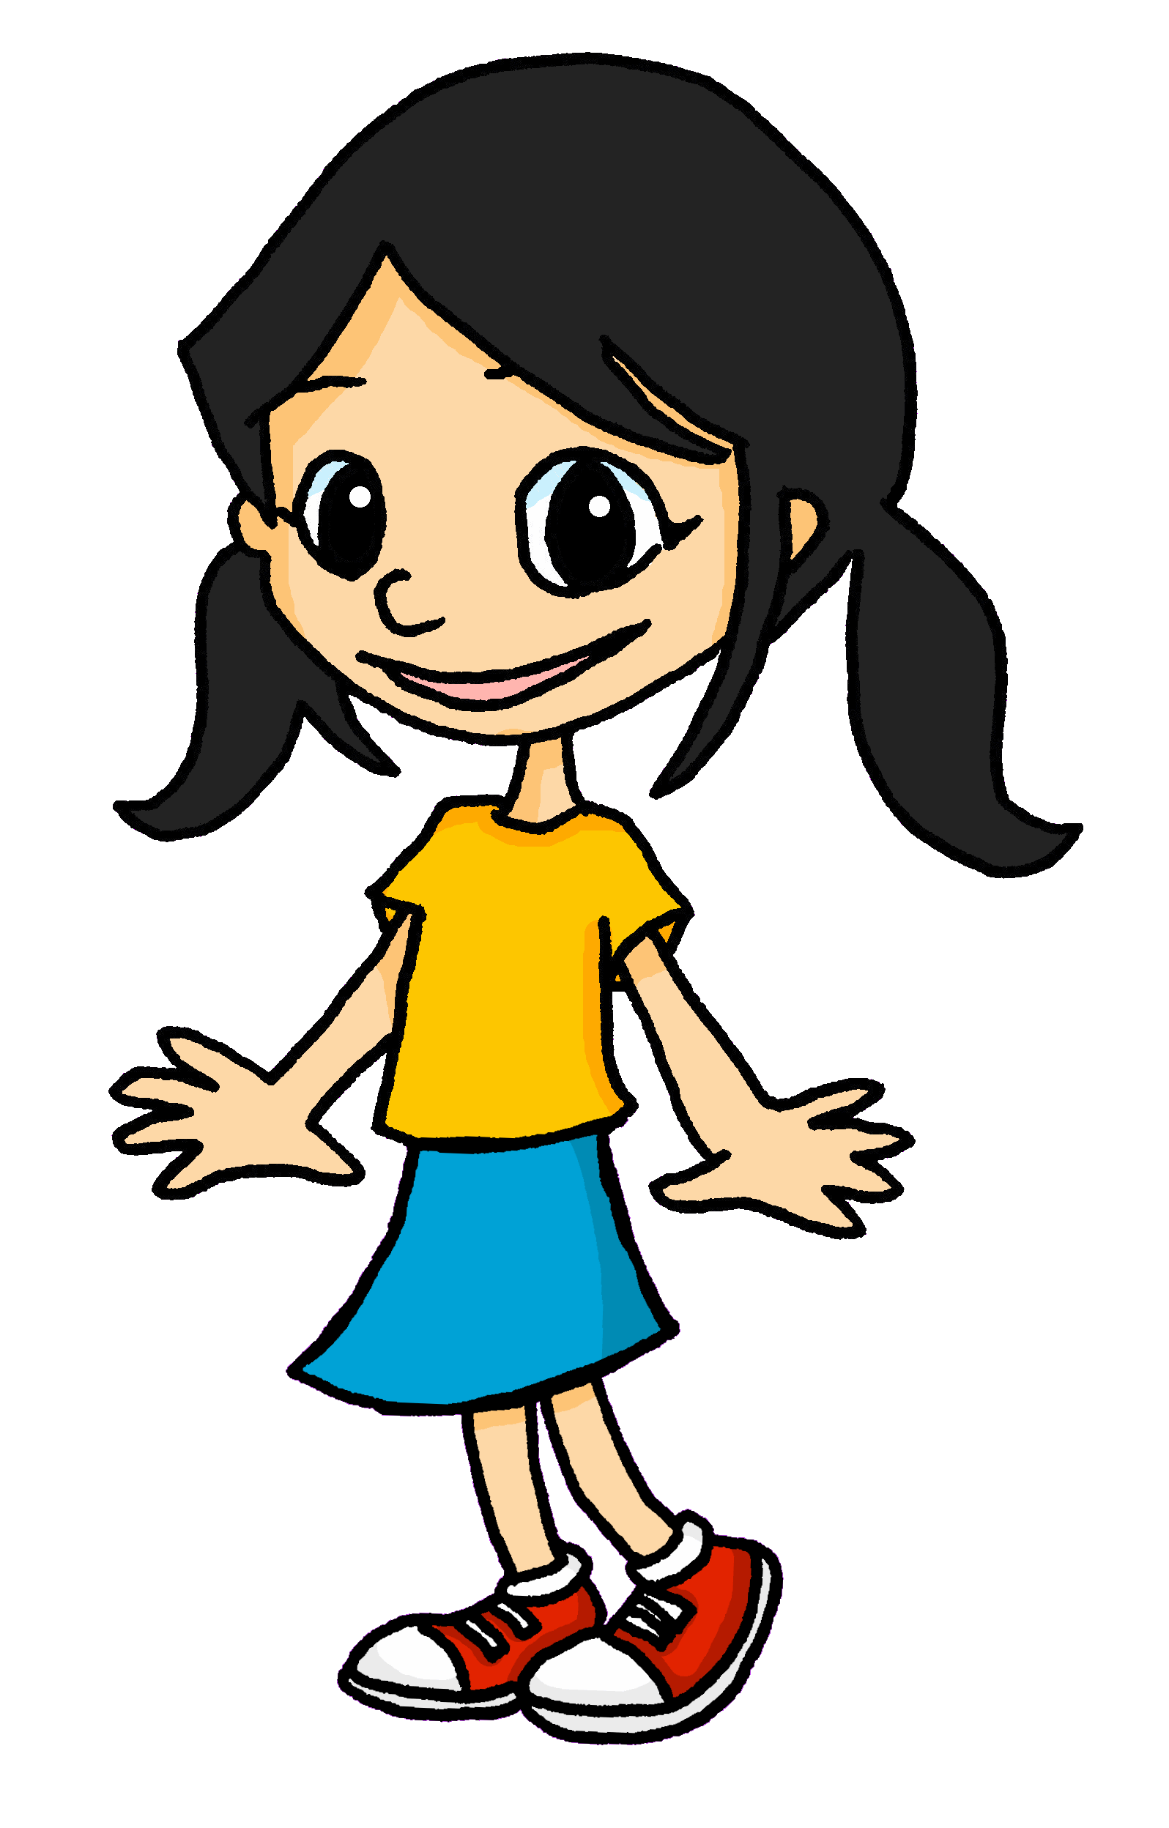
lire
La fête des Rois
1
Elle ne prépare pas
Elle ne trouve pas
5
2
Elle n’ arrive pas
Elle ne porte pas
6
3
Elle célèbre
Elle n’ est pas contente.
7
4
Elle décide
Le six janvier, c’est la fête des Rois. La mère de Léa et Eugénie prépare la galette des Rois. C’est pour l’Épiphanie et l’arrivée des trois Rois mages à Bethléem. C’est une tradition. La galette est un gâteau avec une fève (ou figurine) et une couronne ! Maintenant, pour célébrer ‘La Fête des Rois’, Eugénie est sous la table et elle décide comment partager la galette. C’est la tradition. Cette année, Léa trouve la fève. Elle porte la couronne. Elle est très contente. Bon appétit, Léa !
Notes:
THIS IS THE MORE CHALLENGING VERSION
Timing: 5 minutes
Aim: to pay attention to the position of ne..pas and practise written distinction between simple positive and negative sentence structures, using the previous text about La Fête des Rois as the source of information. Differentiation: note that there is a simpler version of this task on the next slide. There are picture prompts with ticks and crosses for each sentence to indicate positive and negative.
Procedure:
Students write down 1-7. Ensure that pupils know that all the sentence items are asking about Eugénie (she-elle).
Using the text as a prompt, students decide for each and they write either ne/n’… pas OR (–), meaning the splodges are hiding nothing.
Click to highlight the text where each answer is. Answers splodges disappear one by one on clicks.
Teachers can elicit the answers from students in French by asking e.g. ‘Est-ce que Eugénie prepare ?’ → students reply yes or no.

Slide 12
lire
La fête des Rois
1
Elle ne prépare pas
Elle ne trouve pas
5
2
Elle n’ arrive pas
Elle ne porte pas
6
3
Elle célèbre
Elle n’ est pas contente.
7
4
Elle décide
Notes:
THIS IS THE MORE SUPPORTED VERSION
Timing: 5 minutes
Aim: to pay attention to the position of ne..pas and practise written distinction between simple positive and negative sentence structures, using the previous text about La Fête des Rois as the source of information. Differentiation: this is an more supported version of the task for lower proficiency learners.
Procedure:
Students write down 1-7. Ensure that pupils know that all the sentence items are asking about Eugénie (she-elle).
Using the pictures and ticks/crosses as a prompt, students decide for each and they write either ne/n’…pas OR (–), meaning the splodges are hiding nothing.
Answers splodges disappear one by one on clicks.
Teachers can elicit the answers from students in French by asking e.g. ‘Est-ce que Eugénie prépare?’ → students reply yes or no.

Slide 13
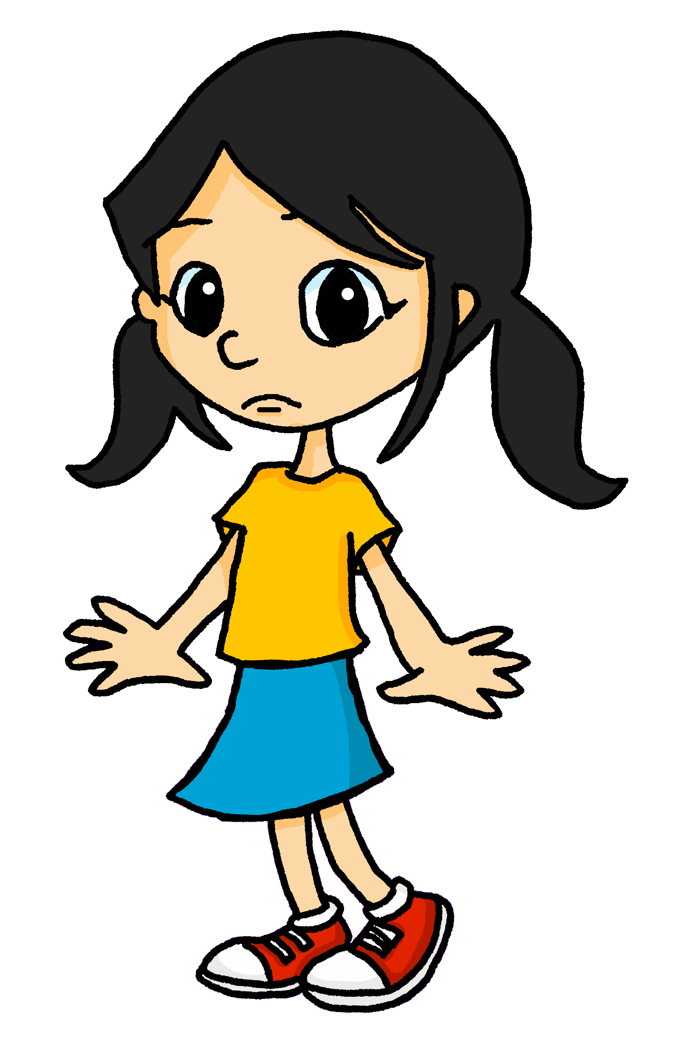
écouter
Écoute.
Eugénie changes her mind a lot. Sometimes she does one thing, something another.
Does she say she sometimes does or doesn’t do each activity?
 |  | Écris en anglais
 |  | Sometimes I sing.
 |  | Sometimes I don’t speak.
 |  | Sometimes I listen.
 |  | Sometimes I eat.
 |  | Sometimes I don’t share.
 |  | Sometimes I dance.
 |  | Sometimes I don’t draw.
 |  | Sometimes I don’t explain.
Ex
1
2
3
4
5
6
7
Notes:
Timing: 5 minutes
Aim: to practise aural distinction of positive and negative sentences in the 1st person present; to practise comprehension of several previously taught verbs.
Procedure:
1. Ensure pupils are clear about the task.
2. Click to play the example. Ask pupils to either tick or cross. Click to listen again. This time pupils write down the English meaning.
3. Click to reveal the answers.
4. Continue with items 1-7.
Transcript:
Parfois, je chante. Parfois, je ne parle pas. Parfois, j’écoute. Parfois, je mange. Parfois, je ne partage pas. Parfois, je danse. Parfois, je ne dessine pas. Parfois, je n’explique pas.
13

Slide 14
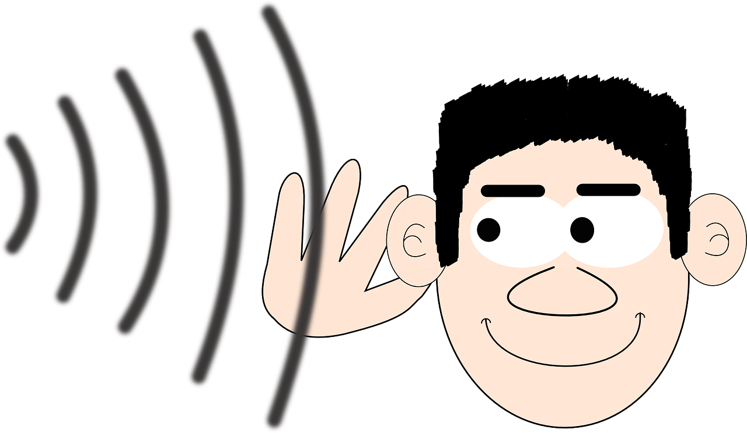
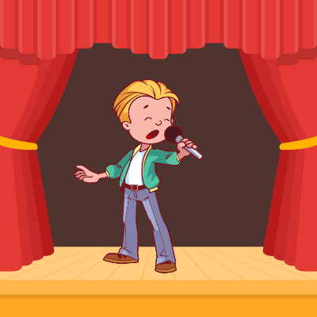
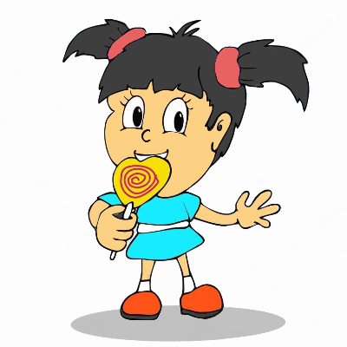
parler
C’est vrai ?
lire
Lis la description et trouve l’image.
C’est vrai ? Ce n’est pas vrai ?
1
Il écoute.
C’est vrai !
5
Il parle.
Ce n’est pas vrai !
Ce n’est pas vrai !
2
Elle danse.
6
Elle regarde.
C’est vrai !
Ce n’est pas vrai !
7
Elle étudie.
Ce n’est pas vrai !
3
Elle mange.
8
Elle travaille.
Ce n’est pas vrai !
4
Il chante.
C’est vrai !
Notes:
Timing: 5 minutes
Aim: to practise written comprehension of a variety of short verb phrases, and respond orally as to their correct/incorrectness, using c’est vrai and ce n’est pas vrai.
Procedure:
Teacher to draw attention to the fact that vrai comes after pas – i.e. ne and pas always surround the verb, and pas is not necessarily the last thing in the sentence.
Teacher elicits responses (That’s true, That isn’t true) by making a statement about each picture. E.g., il chante.
Students respond orally, using c’est vrai or ce n’est pas vrai only at this stage. Answers appear on clicks.
Note: in the follow ups this week, pupils will use these same prompts to practise writing simple negative sentences.
14

Slide 15
Au revoir !
bleu
Notes:
15

