Slide 1
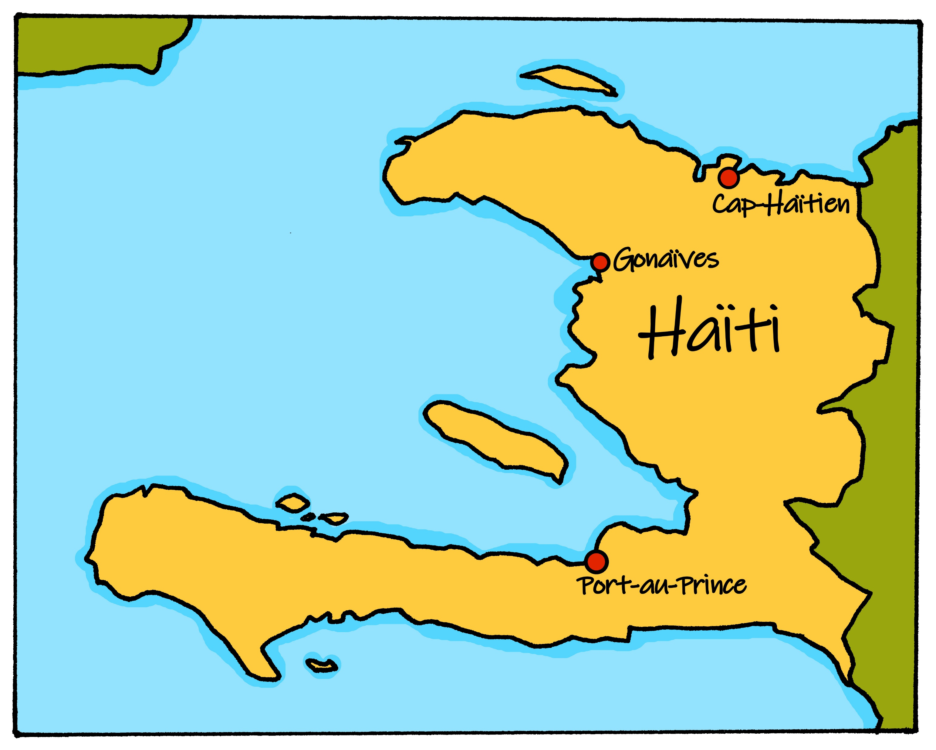
Saying what I and others do
Le jour de l’Indépendance
bleu
Est-ce que questions
SSC [é,er,ez,et], SFe
Notes:
Artwork by Steve Clarke. Pronoun pictures from NCELP (www.ncelp.org). All additional pictures selected from Pixabay and are available under a Creative Commons license, no
attribution required.
Phonics: Revisit SSC [é|er|ez|et] and SFe - répéter [630] écrire [382] bébé [2271] donner [46] parler [106] et [6] nez [2661] SFE - timide [3835] monde [77] moderne [1239] centre [491] douze [1664]
Vocabulary (new words in bold): no new vocabulary this week
Revisit 1: célébrer [2170] échanger [1452] fabriquer [1231] souhaiter [403] feu d'artifice [>5000] rue [598] tout le monde [n/a]
Revisit 2: as [8] a [8] donner [46] organiser [791] parler [106] poser [218] préparer [368] trouver [83] utiliser [345] livre [358] question [144] phrase [2074] problème [188] sac [2343] réponse [456] solution [608] court [545] simple [212] spécial [726] vrai [292] faux [555] des [de-2] calme [1731] difficile [296] facile [822] important [215] indépendant [854] intéressant [1244] rapide [672] utile [1003]
Londsale, D., & Le Bras, Y. (2009). A Frequency Dictionary of French: Core vocabulary for learners London: Routledge.
The frequency rankings for words that occur in this PowerPoint which have been previously introduced in these resources are given in the SOW and in the resources that first
introduced and formally re-visited those words.
For any other words that occur incidentally in this PowerPoint, frequency rankings will be provided in the notes field wherever possible.
1

Slide 2
prononcer
[é]
[er]
[et]
[ez]
Remember that [é], [er],[et] and [ez] sound the same.
répéter
[and]
écrire
parler
et
bébé
donner
nez
[to give]
Notes:
Timing: 2 minutes
Aim: to recap SSC [é] [er] [et] [ez], which are the same sound written differently.
Procedure:
Introduce and elicit the pronunciation of the individual SSC [é, et, et, ez] and the source word ‘répéter’, which has both spellings of the sound.
Click to bring on the picture and get students to repeat (with gesture, if using).
Present and practise the cluster words.
Gesture: gesture for répéter – hand with thumb and two fingers pointing forwards doing a three downwards motions, one for each syllable of the word.
https://www.signbsl.com/sign/repeat (the 2nd video marked again: repeat with the female signer)
2

Slide 3
prononcer
[SFe]
⚠ Remember: The Silent Final -e means you pronounce the final consonant.
monde
timide
douze
[shy]
centre
moderne
Notes:
Timing: 2 minutes
Aim: To introduce/consolidate SSC [SFe]
Procedure:
1. Practise the pronunciation of the individual SSC [SFe] and then the source word again ‘timide’ (with gesture, if using). 2. Then present and elicit the pronunciation of the four cluster words.
Frequency: monde [77] moderne [1239] centre [491] vie [132] douze [1664] timide [3835] Source: Londsale, D., & Le Bras, Y. (2009). A Frequency Dictionary of French: Core vocabulary for learners London: Routledge.
3

Slide 4
prononcer
Écoute et écris [e] ou [é].
Puis, prononce les mots.
l e c a f é
l a g l a c e
l a s a n t é
l e m a r c h é
l e p o r t a b l e
l’ e x e r c i c e
l e t h é
l’ é t é
l’ i m a g e
l’ E s pa g n e
1
_
6
_
2
_
7
_
_
8
_
3
4
_
9
_
5
_
10
_
Notes:
Timing: 4 minutes
Aim: to consolidate SSC [SFe] and [é].
Procedure:
Click to listen to each word.
Pupils write either [e] or [é].
Click to reveal the answers.
Pupils pronounce in pairs (in jumbled order) and the listening partner identifies the meaning (using the pictures for support).
Frequency: café [1886] Espagne [n/a] été [623] exercice [1290] glace [2580] image [659] marché [280] portable [4002] santé [641] thé [3517] Source: Londsale, D., & Le Bras, Y. (2009). A Frequency Dictionary of French: Core vocabulary for learners London: Routledge.
4

Slide 5
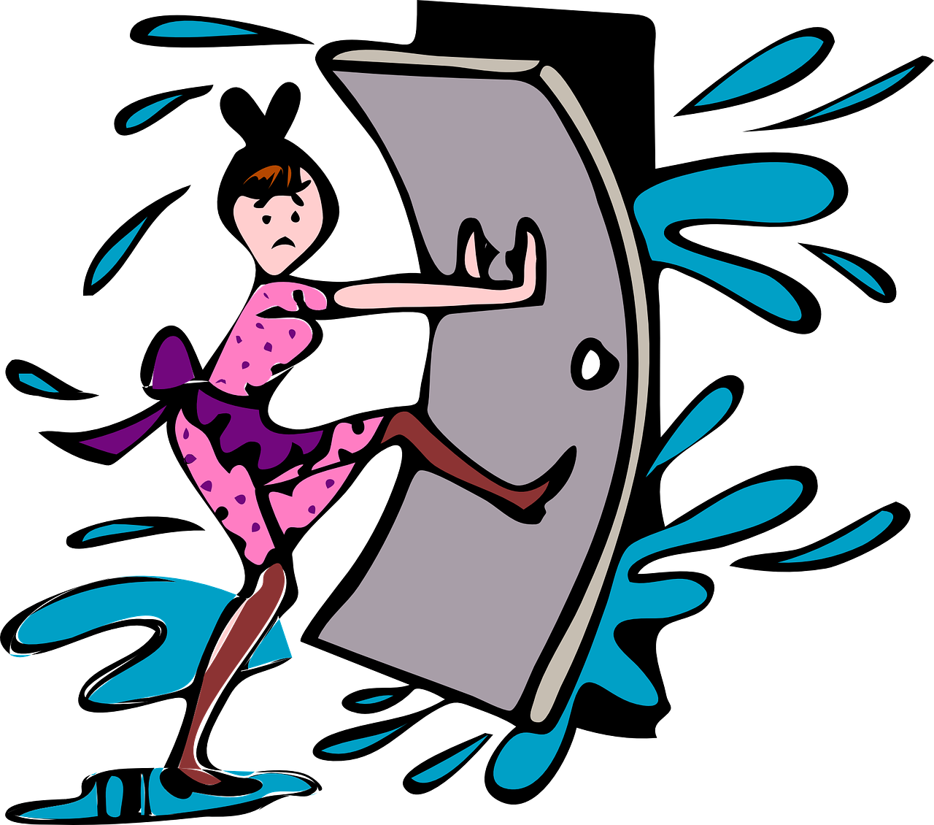
vocabulaire
Vocabulaire
mots
corriger
expliquer
fermer
to correct, correcting
to explain, explaining
to close, shut
les devoirs
l’aide (f)
homework
Notes:
Timing: 4 minutes
Aim: to present and practise written comprehension and read aloud of the new vocabulary for this week.
Procedure: 1. Click for a French word. Elicit pronunciation from pupils.
2. Click for the English meaning and picture prompt. Elicit the French word again.
3. Present all five words like this, in order.
4. Click for one English meaning to disappear. Elicit the English meaning from pupils. Continue with the remaining items.
5. Click for the French word to disappear. Elicit the French from pupils. Continue with the remaining items.
5

Slide 6
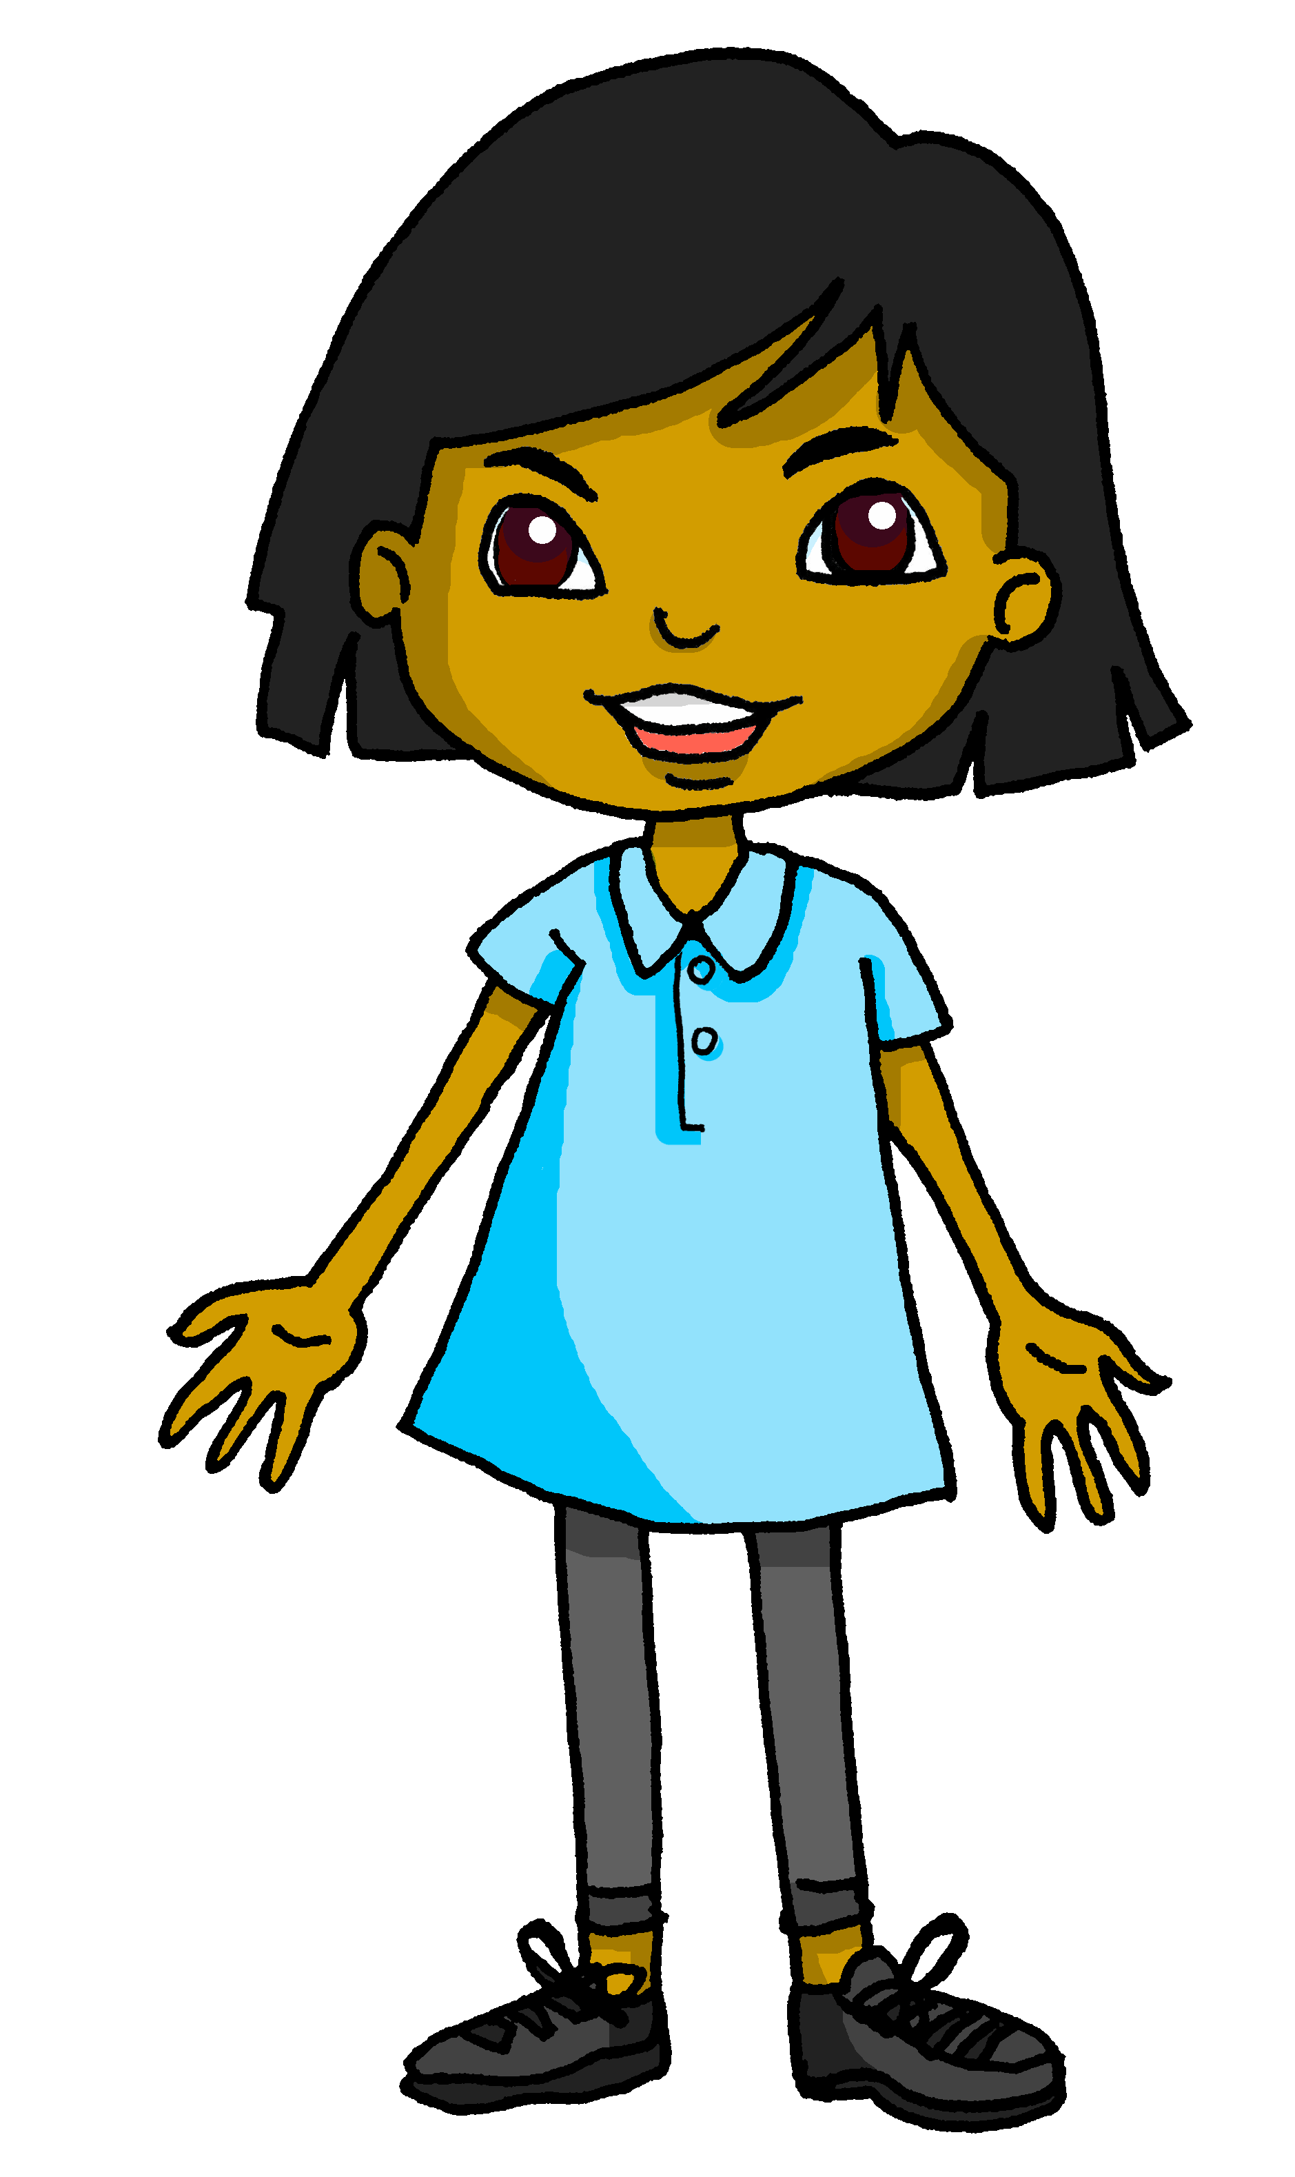
lire
La présentation de Sanaya
to find
prepares
about
explains
trouver
prépare
sur
explique
Dans la classe de Sanaya, la professeure de français explique les devoirs. L’idée est de trouver des informations sur une tradition d’un pays francophone. Sanaya prépare une présentation sur Haïti. Elle demande de l’aide à Adèle.
a country
in
homework
help
un pays
dans
les devoirs
l’aide
Notes:
Timing: 5 minutes
Aim: to set the scene for this week’s lesson; to practise written comprehension of previously taught vocabulary and three of this week’s new words (devoirs, demander, expliquer).
Procedure:
Pupils read the text aloud with teacher support, as needed.
Click on Sanaya to hear an audio version of the text, if desired.
3. Pupils focus on the English words and identify the French words from the bold words in the text. Pupils can volunteer answers in any click – teacher clicks on the English word and the French translation appears.
4. Teachers elicit an oral translation of the text from the class to establish the context of this week’s lesson.

Slide 7
Asking questions
-ER verbs: tu (you), vous (you, formal)
⚠ Note: The –es ending is Silent Final -e and Silent Final Consonant (–s).
⚠ Note: The –ez ending sounds the same as [é].
To mean ‘you’ to one person you know well, use tu.
To mean ‘you’ to someone you call Mr or Mrs, use vous.
Tu aimes l’histoire.
Vous aimez l’histoire.
You like history.
You like history.
Remember: to turn a statement into a question, raise your voice at the end:
Tu aimes l’histoire ?
Vous aimez l’histoire ?
Do you like history?
Do you like history?
Notes:
Timing: 2 minutes
Aim: to recall the use of tu and vous and formation of intonation questions.
Procedure:
Click through the animations to present the information.
Elicit English translations for the French examples provided.

Slide 8
écouter
Écoute.
Sanaya is working on her presentation and has questions. But who is she asking?
Sanaya parle à la professeure (vous) ou a un ami (tu) ?
 | tu (friend) | vous (teacher) | les questions
 |  |  | … posez des questions ?
 |  |  | … utilises un livre ?
 |  |  | … prépares des réponses ?
 |  |  | … fermez la porte ?
 |  |  | … expliques les devoirs ?
 |  |  | … écoutez les présentations ?
 |  |  | … corrigez les phrases ?
 |  |  | … trouves une solution ?
Ex
1
2
3
4
5
6
7
Notes:
Timing: 10 minutes (two slides)
Aim: to practise aural identification of tu and vous questions, based on the verb ending.
Procedure:
1. Ensure pupils are clear about the task.
2. Click to play the example. Ask pupils to write either tu or vous.
3. Click to reveal the answer.
4. Click to reveal the full written question.
Continue with items 1-7.
Go to the next slide for a comprehension task.
Transcript:
[vous] posez des questions ? [tu] utilises un livre ? [tu] prépares des réponses ? [vous] fermez la porte ? [tu] expliques les devoirs ? [vous] écoutez les présentations ? [vous] corrigez les phrases ? [tu] trouves une solution ?
Frequency of unknown words and cognates: présentation [1723]
Londsale, D., & Le Bras, Y. (2009). A Frequency Dictionary of French: Core vocabulary for learners London: Routledge.
8

Slide 9
écouter
Lis les questions. Écris les questions en anglais.
Sanaya is checking that her questions make sense.
Vous posez des questions ? can mean ‘Do you ask questions?’ OR ‘Are you asking questions?’
 | les questions
 | Vous posez des questions ?
 | Tu utilises un livre ?
 | Tu prépares des réponses ?
 | Vous fermez la porte ?
 | Tu expliques les devoirs ?
 | Vous écoutez les présentations ?
 | Vous corrigez les phrases ?
 | Tu trouves une solution ?
lire
Ex
Are you asking questions?
I am working in class right now, so ‘Are you …’ questions make more sense here.
1
Are you using a book?
2
Are you preparing answers?
3
Are you closing the door?
4
Are you explaining the homework?
5
Are you listening to the presentations?
6
Are you correcting the sentences?
7
Are you finding a solution?
Notes:
Timing: 5 minutes
Aim: to practise comprehension of present tense questions, and translation using English present continuous meaning.
Procedure:
Click to bring up the two callout explanations.
Pupils write translations for each question 2-7.
Click to play the full question audio and elicit question meanings in English from pupils.
Click to reveal answers.
Transcript:
Vous posez des questions ? Tu utilises un livre ? Tu prépares des réponses ? Vous fermez la porte ? Tu expliques les devoirs ? Vous écoutez les présentations ? Vous corrigez les phrases ? Tu trouves une solution ?
9

Slide 10
Asking questions using Est-ce que…
-ER verbs: tu (you), vous (you, formal)
Remember - with intonation questions we need the punctuation ? in writing and raised voice in speaking to know it is a question.
Tu aimes l’histoire ?
Vous aimez l’histoire ?
Do you like history?
Do you like history?
To make it clear that a yes/no question is being asked, we can add Est-ce que (‘Is it that…?’) at the start of any statement:
Est-ce que tu aimes l’histoire ?
Est-ce que vous aimez l’histoire ?
Do you like history?
Do you like history?
Est-ce que works like a spoken question mark!
Notes:
Timing: 2 minutes
Aim: to present the use of Est-ce que to ask questions
Procedure:
Click through the animations to present the information.
Elicit English translations for the French examples provided.

Slide 11
Asking questions using Est-ce que…
-ER verbs: tu (you), vous (you, formal)
The ‘s’ sound is the soft ‘c’.
Let’s practise saying Est-ce que:
The –st are silent.
1
Est-ce que…
When you say it slowly there are three separate syllables.
2
Est-ce que…
3
Est-ce que…
In conversation we speed up and it sounds like two syllables.
Notes:
Timing: 2 minutes
Aim: to practise pronouncing Est-ce que
Procedure:
Click through the animations to present the information.
Click each audio button to hear Est-ce que at three different speeds.

Slide 12
lire
Sanaya organise les notes.
Mais c’est une question ou c’est une réponse ?
Lis les phrases. Écris ? ou ?/.
Or is it impossible to know without punctuation?
1) ……………………………….
2) ……………………………….
3) ……………………………….
4) ……………………………….
5) ………………………………..
6) ………………………………..
7) ……………………………….
8) ……………………………….
9) ……………………………….
10) ……………………………….
11) ………………………………..
12) ………………………………..
Vous visitez la capitale Port-au-Prince
?/.
?
Est-ce que vous expliquez l’histoire d’Haïti
?
?/.
Est-ce que tu danses dans la rue
Tu chantes des chansons
Tu portes des vêtements élégants
?/.
Est-ce que vous chantez l’hymne national
?
?
?/.
Est-ce que vous donnez des cadeaux
Vous préparez la ‘soup joumou’
?
Est-ce que tu regardes les feux d’artifice
Est-ce que tu souhaites ‘Bonne fête de l’Indépendance’
?
?/.
?/.
Vous écoutez la radio
Vous aimez les célébrations
Notes:
Timing: 5 minutes
Aim: to practise written recognition of est-ce que questions and contrast them with sentences which could either be statements or raised intonation questions (though without punctuation this is unclear); this reinforces the idea that est-ce que is a written question mark.
Procedure:
Pupils read the sentences and determine if they are definitely questions or could be either statements or questions.
They add punctuation – either ? or ?/.
Click to provide punctuation.

Slide 13
parler
Sanaya pratique les questions.
Remember! The est-ce que is a spoken ? Your voice doesn’t have to go up, (though it might do for extra emphasis).
Sanaya is going to interview Clémentine and Annick about the 1st January in Haiti. Help her practise asking all of her questions.
1) ……………………………….
2) ……………………………….
3) ……………………………….
4) ……………………………….
5) ………………………………..
6) ………………………………..
7) ……………………………….
8) ……………………………….
9) ……………………………….
10) ……………………………….
11) ………………………………..
12) ………………………………..
Vous visitez la capitale Port-au-Prince ?
7
Est-ce que vous expliquez l’histoire d’Haïti ?
1
2
Est-ce que tu danses dans la rue ?
8
Tu chantes des chansons ?
3
Tu portes des vêtements élégants ?
9
Est-ce que vous chantez l’hymne national ?
4
Est-ce que vous donnez des cadeaux ?
10
Vous préparez la ‘soup joumou’ ?
5
Est-ce que tu regardes les feux d’artifice ?
11
Est-ce que tu souhaites ‘Bonne fête de l’Indépendance’ ?
6
Vous écoutez la radio ?
12
Vous aimez les célébrations ?
Notes:
Timing: 3 minutes
Aim: to practise spoken pronunciation of both intonation and est-ce que questions.
Procedure:
Pupils practise reading aloud the questions from the previous task, chorally.
Click the audio buttons to listen and check pronunciation and intonation.
Elicit from pupils whether each question is for Clémentine (tu) or Clémentine’s mother, Annick (vous).
Teacher asks ‘Question numéro 1 – c’est pour Clémentine ou Annick ?’
Click to bring up an image of either Clémentine or Annick.
13

Slide 14
Au revoir !
bleu
Notes:
14

