Slide 1
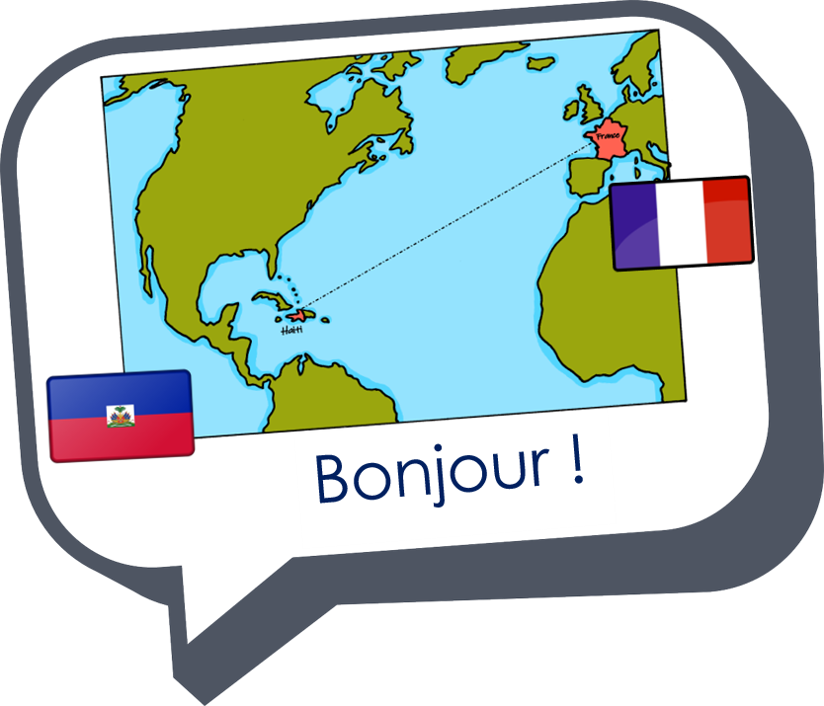

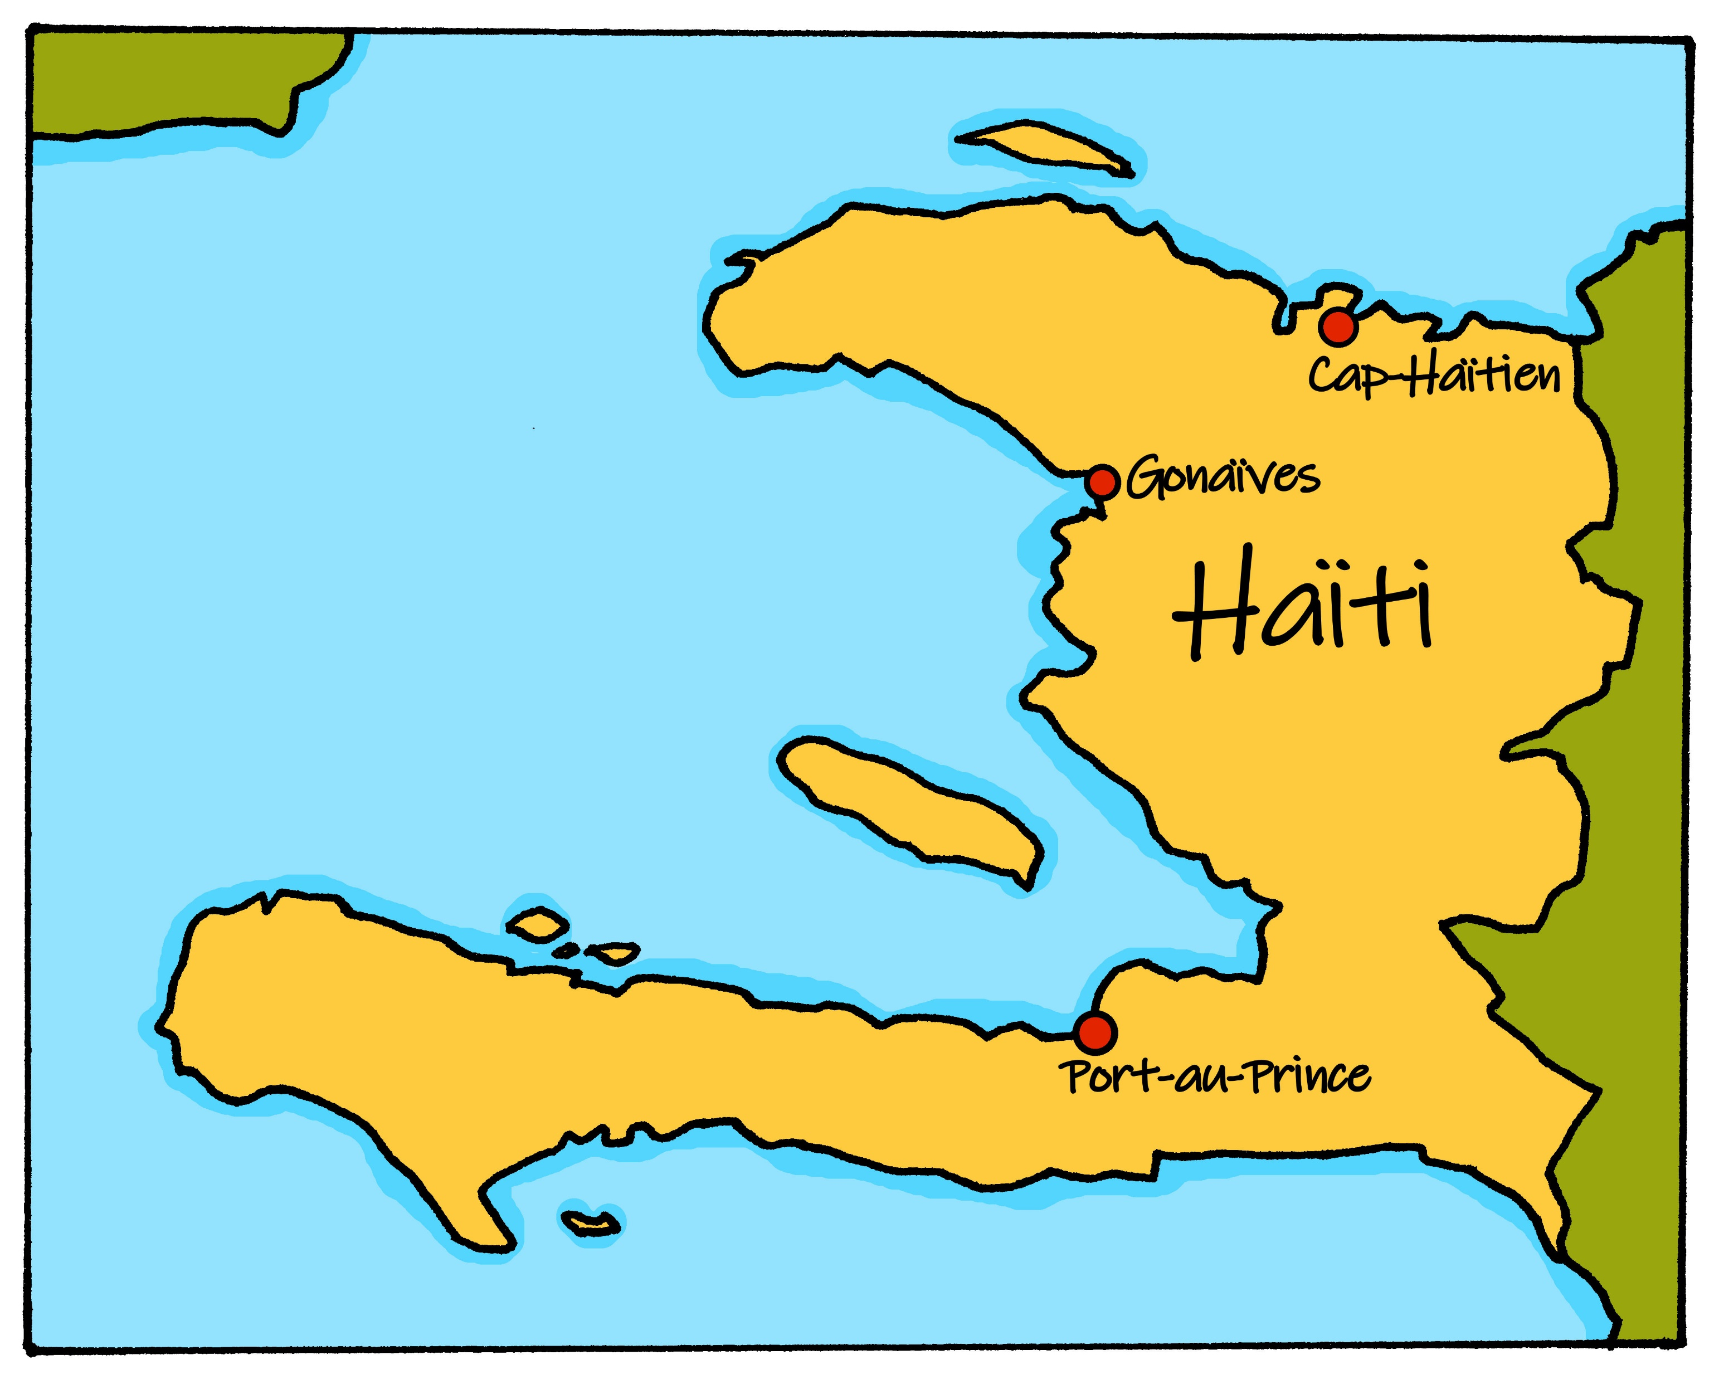
Saying what I and others do
Le jour de l’Indépendance
bleu
Follow ups 1-5
Notes:
Artwork by Steve Clarke. Pronoun pictures from NCELP (www.ncelp.org). All additional pictures selected from Pixabay and are available under a Creative Commons license, no
attribution required.
Phonics: Revisit SSC [è / ê] fête [1490] tête [343] frère [1043] être [5] problème [188]
Vocabulary (new words in bold): aimer [242] arriver [174] célébrer [2170] organiser [701] porter [105] préparer [368] année [102] fête [1490] gens [236] histoire [262] santé [641] vêtement [2383] voisin [979]
Revisit 1: Joyeux Noёl [mwu]
Revisit 2: avoir [8] j’ai [8] il a [8] elle a [8] un [3] une [3] animal [1002] chambre [633] livre [358] maison [325] professeur/ professeure [110] problème [188] tâche [887] amusant [4695] différent [350] idéal [1429] important [215] indépendant [854] lent [2572] lourd [1026] parfait [1600] propre¹ [237] sage [2643] strict [1859] très [66]
Londsale, D., & Le Bras, Y. (2009). A Frequency Dictionary of French: Core vocabulary for learners London: Routledge.
The frequency rankings for words that occur in this PowerPoint which have been previously introduced in these resources are given in the SOW and in the resources that first
introduced and formally re-visited those words.
For any other words that occur incidentally in this PowerPoint, frequency rankings will be provided in the notes field wherever possible.

Slide 2


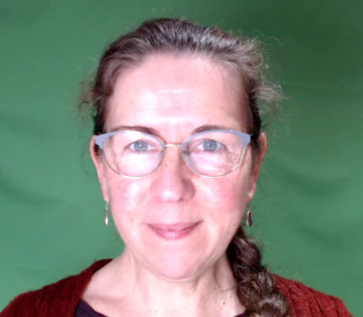
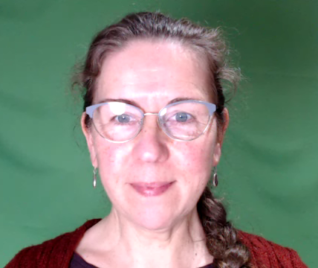
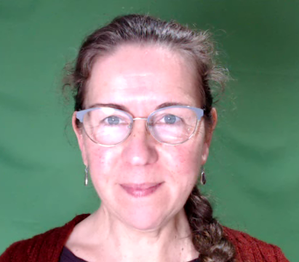




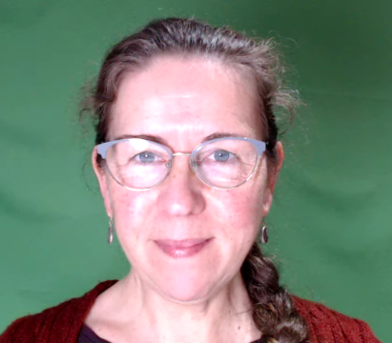
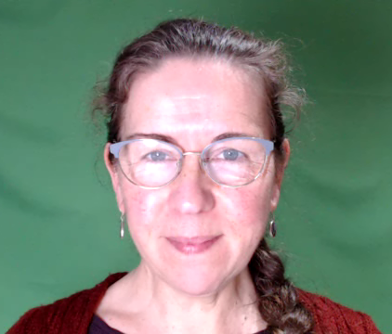
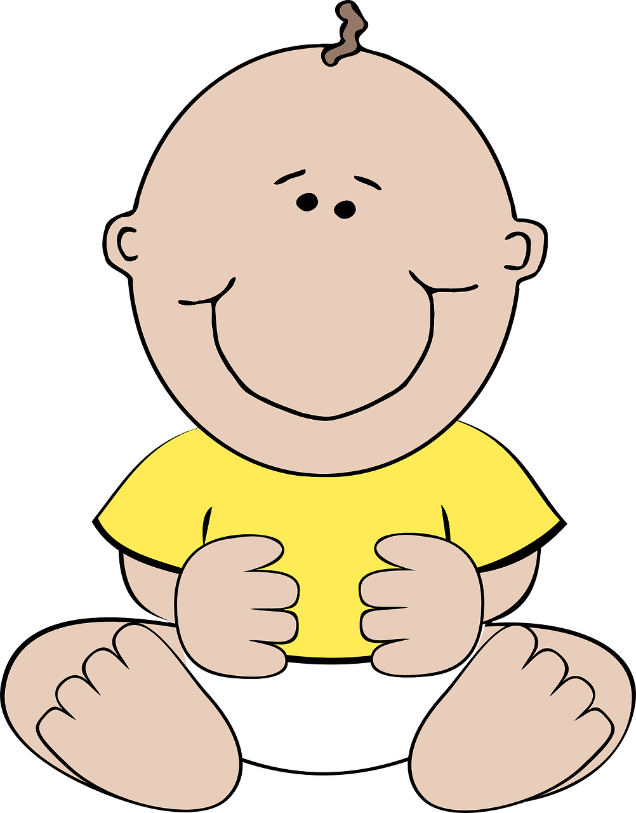
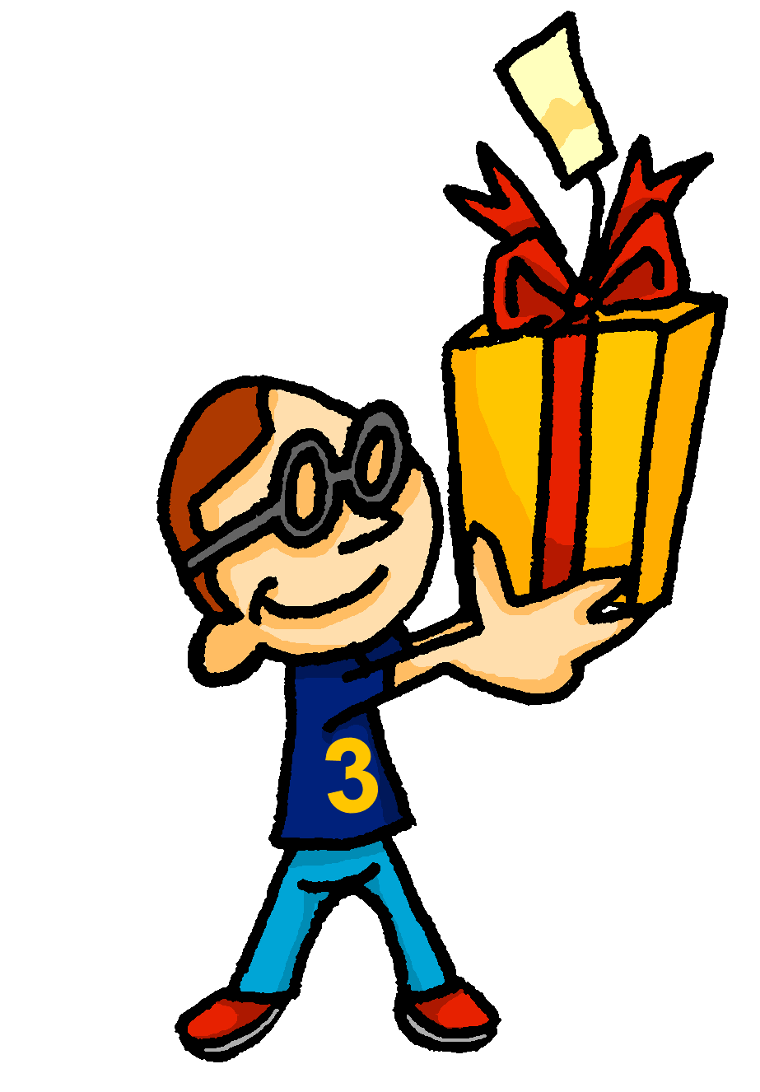

prononcer
[é]
[er]
[et]
[ez]
Remember that
[é], [er],[et] and [ez] sound the same.
répéter
[and]
écrire
parler
et
bébé
donner
nez
[to give]
Notes:
Timing: 2 minutes
Aim: to recap SSC [é] [er] [et] [ez], which are the same sound written differently.
Procedure:
Introduce and elicit the pronunciation of the individual SSC [é, et, et, ez] and the source word ‘répéter’, which has both spellings of the sound.
Click to bring on the picture and get students to repeat (with gesture, if using).
Present and practise the cluster words.
Gesture:
gesture for répéter – hand with thumb and two fingers pointing forwards doing a three downwards motions, one for each syllable of the word.
https://www.signbsl.com/sign/repeat (the 2nd video marked again: repeat with the female signer)
2

Slide 3
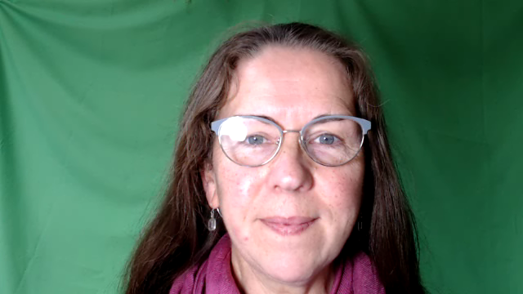








prononcer
[SFe]
⚠ Remember: The Silent Final -e means you pronounce the final consonant.
monde
douze
timide
centre
moderne
[shy]
Notes:
Timing: 2 minutes
Aim: To introduce/consolidate SSC [SFe]
Procedure:
1. Practise the pronunciation of the individual SSC [SFe] and then the source word again ‘timide’ (with gesture, if using).
2. Then present and elicit the pronunciation of the four cluster words.
Frequency:
monde [77] moderne [1239] centre [491] vie [132] douze [1664] timide [3835]
Source: Londsale, D., & Le Bras, Y. (2009). A Frequency Dictionary of French: Core vocabulary for learners London: Routledge.
3

Slide 4



Follow up 1:
la possibilité
possi-bility
la
liberté
mots
Complète les dominos. 🗣
utile
useful
activity
vocabulaire
easy
la réponse
l’année
freedom
facile
la difficulté
l’année
answer
fast
difficult
answer
useful
simple
la réponse
year
rapide
difficile
l’activité
difficulty
la liberté
facile
activity
simple
simple
fast
difficulty
year
easy
possibility
freedom
la possibilité
la difficulté
difficile
difficult
l’activité
rapide
utile
simple
Notes:
Timing: 5 minutes
Aim: to practise written comprehension and spoken pronunciation of previously taught vocabulary ending in either SFe or [é].
Procedure:
Starting from the play button, pupils work in pairs or chorally, led by the teacher, to complete the domino orally.
Note: they only need to pronounce the French word each time.
If working as a whole class the teacher can click to provide the answers at each turn.
4. The activity can be repeated to speed up recall.

Slide 5


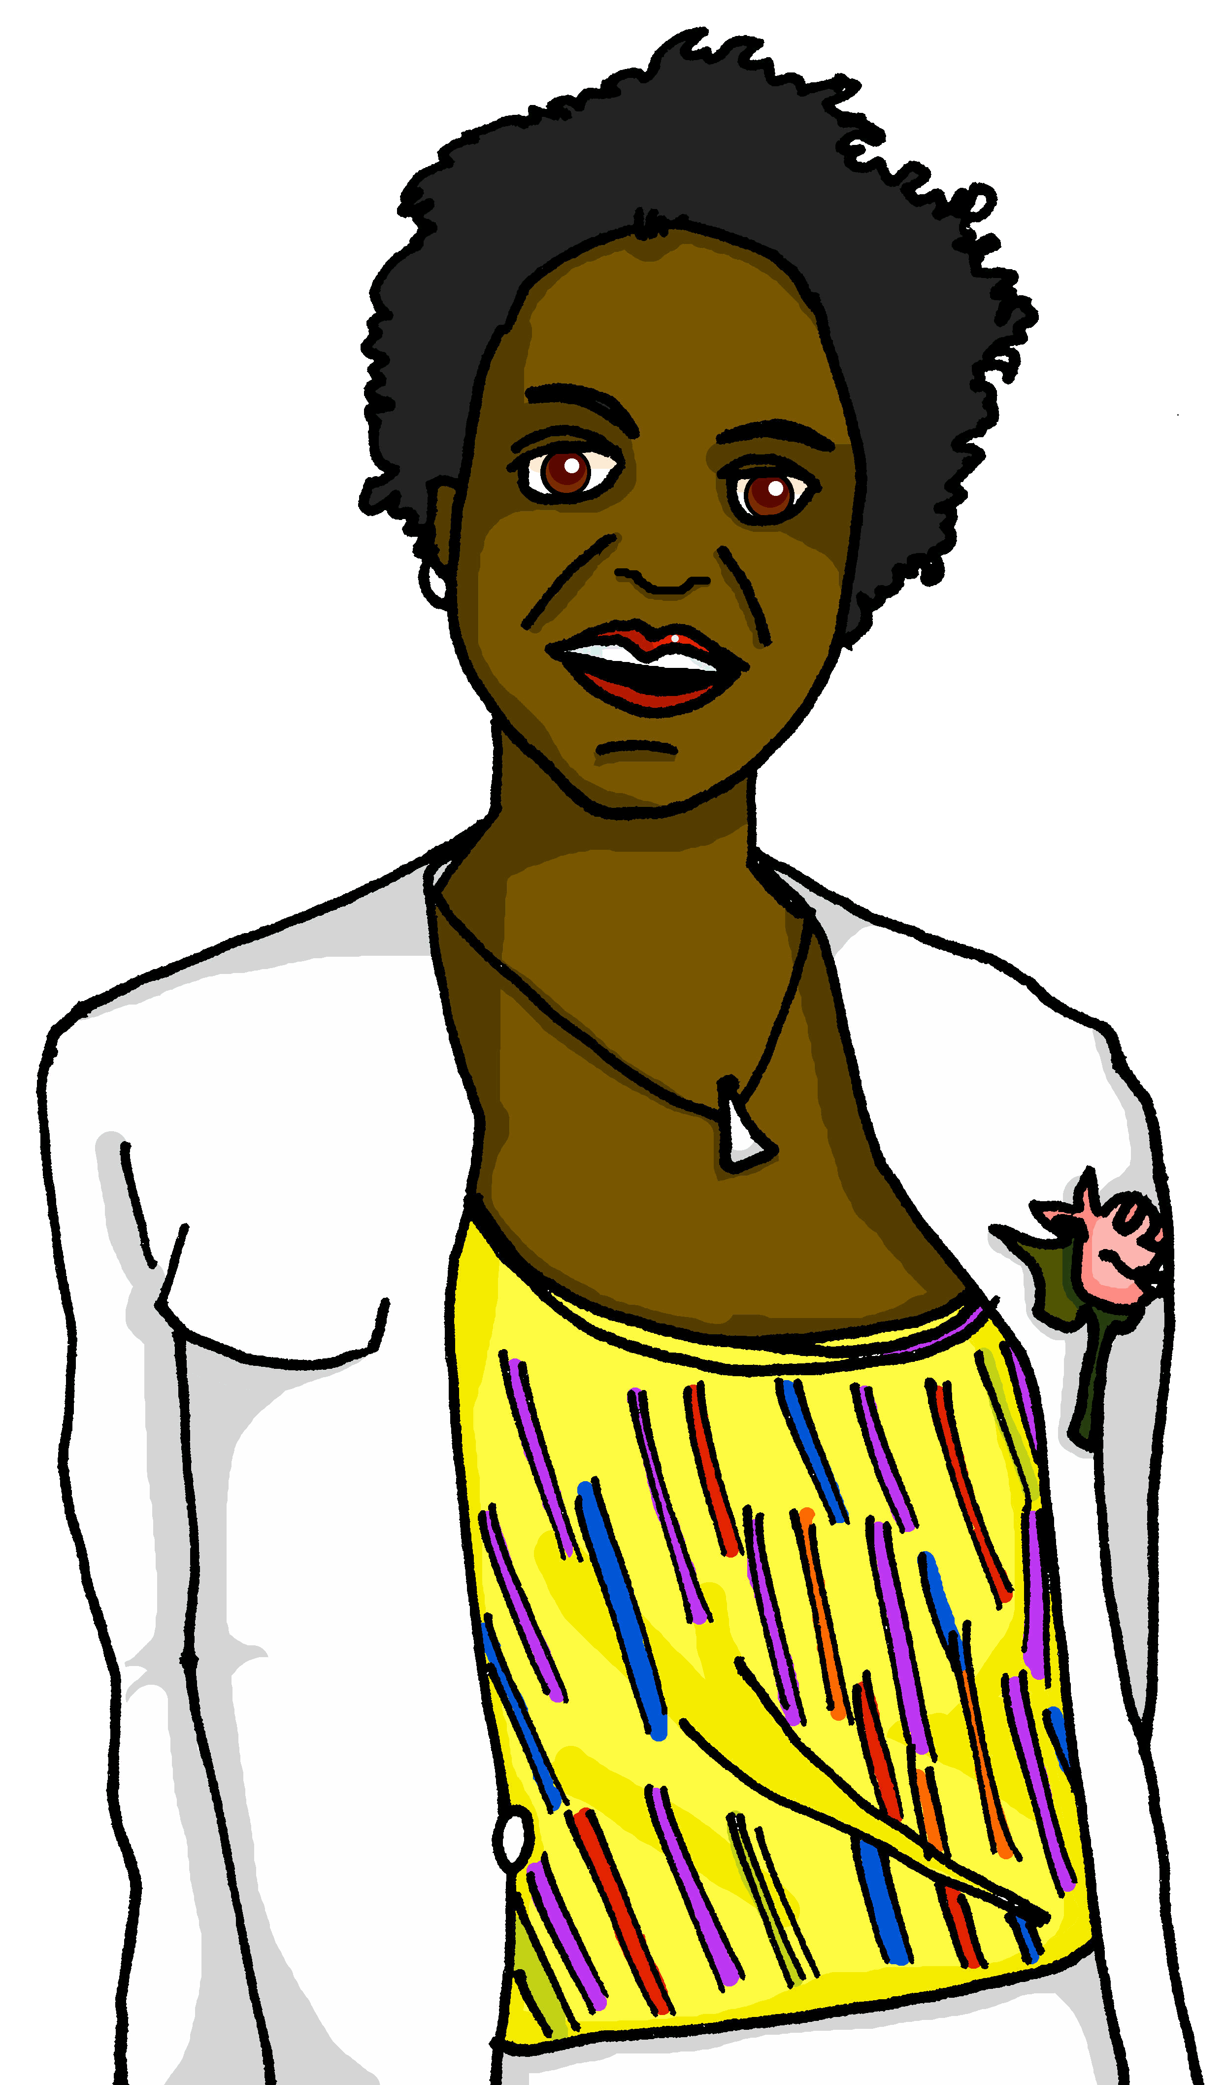
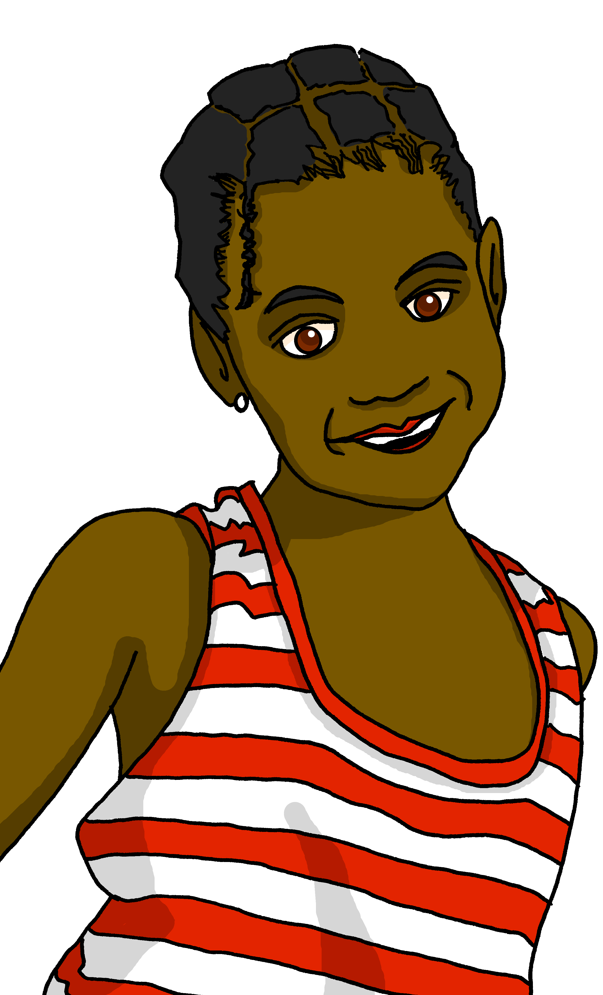


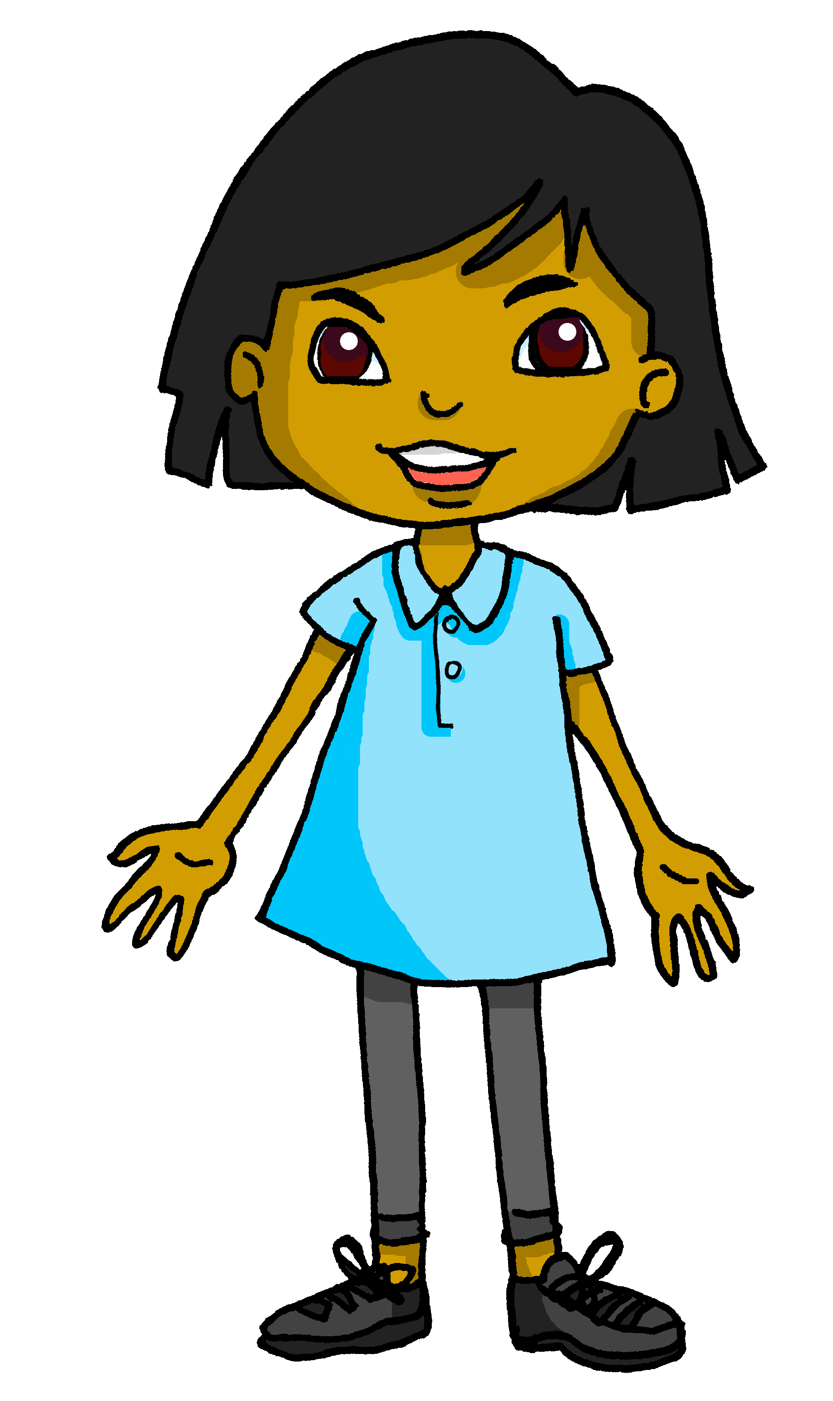
Follow up 2 [1/8]
Le premier janvier à Haïti
écouter
Sanaya pose des questions à Clémentine et à Annick.
1
Est-ce que tu aimes la fête de l’Indépendance ?
Notes:
Timing: 8 minutes (8 slides)
Aim: to practise aural comprehension of tu and vous forms of the verb in est-ce que questions, and their connection with meaning.
Procedure
Read the title and scenario and clarify the context and the activity with pupils. Remind pupils that the tu form means ‘you’ for one person you know well and vous form is ‘you’ in a formal context (e.g. to an adult you don’t call by their first name).
Pupils listen to each question and decide who it is addressed to, depending on the form of the verb they hear. The pronouns are beeped out to focus pupils’ attention on the verb form.
Click to highlight the answer and see the question in writing.
Elicit the English meaning of the question.
Transcript:
Est-ce que [tu] aimes la fête de l’Indépendance ?

Slide 6
Follow up 2 [2/8]
Le premier janvier à Haïti
écouter
Sanaya pose des questions à Clémentine et à Annick.
2
Est-ce que vous chantez et dansez ?
Notes:
[2/8]
Transcript:
Est-ce que [vous] chantez et dansez ?

Slide 7
Follow up 2 [3/8]
Le premier janvier à Haïti
écouter
Sanaya pose des questions à Clémentine et à Annick.
3
Est-ce que vous portez des vêtements élégants ?
Notes:
[3/8]
Transcript:
Est-ce que [vous] portez des vêtements élégants ?

Slide 8
Follow up 2 [4/8]
Le premier janvier à Haïti
écouter
Sanaya pose des questions à Clémentine et à Annick.
4
Est-ce que tu écoutes la radio ?
Notes:
[4/8]
Transcript:
Est-ce que [tu] écoutes la radio ?

Slide 9
Follow up 2 [5/8]
Le premier janvier à Haïti
écouter
Sanaya pose des questions à Clémentine et à Annick.
5
Est-ce que vous préparez la ‘soup joumou’?
Notes:
[5/8]
Transcript:
Est-ce que [vous] préparez la ‘soup joumou’?

Slide 10
Follow up 2 [6/8]
Le premier janvier à Haïti
écouter
Sanaya pose des questions à Clémentine et à Annick.
6
Est-ce que tu donnes des cadeaux ?
Notes:
[6/8]
Transcript:
Est-ce que [tu] donnes des cadeaux ?

Slide 11
Follow up 2 [7/8]
Le premier janvier à Haïti
écouter
Sanaya pose des questions à Clémentine et à Annick.
7
Est-ce que tu visites le Palais national ?
Notes:
[7/8]
Transcript:
Est-ce que [tu] visites le Palais national ?

Slide 12
Follow up 2 [8/8]
Le premier janvier à Haïti
écouter
Sanaya pose des questions à Clémentine et à Annick.
8
Est-ce que vous regardez les feux d’artifice ?
Notes:
[8/8]
Transcript:
Est-ce que [vous] regardez les feux d’artifice ?

Slide 13


Follow up 3:
Sanaya organise les notes.
But she has mixed up the answers to her questions.
Can you help her sort them out?
lire
1) ……………………………………………
2) ……………………………………………
3) ……………………………………………
4) ……………………………………………
5) ……………………………………………
6) ……………………………………………
7)…………………………………………….
8)…………………………………………….
B
Est-ce que tu aimes la fête de l’Indépendance ?
F
A
Non, je préfère écouter et regarder les parades sur YouTube.
Est-ce que vous chantez et dansez ?
B
Oui, c’est une fête très importante pour moi.
E
Est-ce que vous portez des vêtements élégants ?
C
Oui, nous échangeons des cadeaux.
Est-ce que tu écoutes la radio ?
A
D
Oui, quand je visite la capitale Port-au-Prince.
Est-ce que vous préparez la ‘soup joumou’?
H
E
Oui, et j’adore mon nouveau chapeau.
Est-ce que tu donnes des cadeaux ?
C
F
Oui, tout le monde chante et danse pour célébrer.
D
Est-ce que tu visites le Palais national ?
G
Oui, le soir. J’adore ça.
Est-ce que vous regardez les feux d’artifice ?
G
H
Oui, et c’est très important de manger ensemble le 1er janvier.
Notes:
Timing: 5 minutes
Aim: to practise written distinction and production of 3rd person singular and plural verb forms.
Procedure:
1. Pupils can number 1-8 to avoid copying the full text.
2. Pupils read the questions and identify their answers.
3. For feedback of answers and to practise read aloud, click to hear each question in full.
4. Pupils respond with their selected answer, reading it aloud.
5. Click to bring up the letter answer.
Differentiation: In feedback, for more challenge, pupils could be divided into two halves. One half could read the question aloud and the other half could respond with the answer.

Slide 14
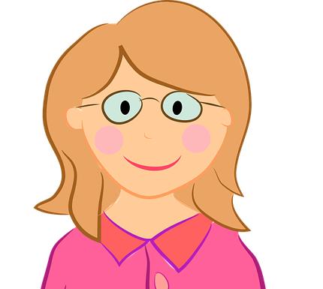


Follow up 4:
Parle avec ton/ta partenaire.
Personne A pose la question.
Personne B identifie l’image correspondante et écrit en anglais.
parler
Personne A
Ask:
[Are you (formal) asking] des questions ?
[Mme Smith]
[Alex]

Est-ce que
vous posez des questions ?
asking questions?
……………………………….
A
B
Notes:
Timing: 5-10 minutes
Aim: to practise receptive and productive knowledge of est-ce que questions in the present tense in tu and vous forms.
Procedure:
1. Use this slide to model the task.
2. Pupil A produces the est-ce que + pronoun + verb in French.
3. Pupil B identifies the correct picture – Madame Smith or Alex.
4. If able, pupil B writes down what pupil A is asking, too.
4. Complete items 1-5.
5. Then pupils swap roles and repeat the task.
6. See next slides for answers, and handouts at the end of the presentation.

Slide 15
parler
Round 1
parler
1
2
3
[Alex]
[Mme Smith]
[Alex]
[Mme Smith]
[Alex]
[Mme Smith]



……………………………….
……………………………….
……………………………….
4
5
[Alex]
[Mme Smith]
[Alex]
[Mme Smith]


……………………………….
……………………………….
Notes:
Display during Round 1
Person B to use and decide Alex or Madame Smith each time, depending on the verb (and pronoun) used.
Note: There is no need to print this. Pupils write 1-5, the correct name and the meaning of the question in English.
15

Slide 16
parler
Round 2
parler
1
2
3
[Mme Smith]
[Alex]
[Mme Smith]
[Alex]
[Mme Smith]
[Alex]



……………………………….
……………………………….
……………………………….
4
5
[Mme Smith]
[Alex]
[Mme Smith]
[Alex]


……………………………….
……………………………….
Notes:
Display during Round 2
Person B to use and decide Alex or Madame Smith each time, depending on the verb (and pronoun) used.
Note: There is no need to print this. Pupils write 1-5, the correct name and the meaning of the question in English.
16

Slide 17
parler
Round 1
parler
1
2
3
[Alex]
[Mme Smith]
[Alex]
[Mme Smith]
[Alex]
[Mme Smith]
listening to the song?
preparing questions?
explaining the history?
……………………………….
……………………………….
……………………………….
4
5
[Alex]
[Mme Smith]
[Alex]
[Mme Smith]
speaking to the class?
like the presentation?
……………………………….
……………………………….
Notes:
Round 1 answers
Person B’s answers
17

Slide 18
parler
Round 2
parler
1
2
3
[Mme Smith]
[Alex]
[Mme Smith]
[Alex]
[Mme Smith]
[Alex]
shutting the door?
asking some questions?
giving an answer?
……………………………….
……………………………….
……………………………….
4
5
[Mme Smith]
[Alex]
[Mme Smith]
[Alex]
organising the chairs?
correcting the presentation?
……………………………….
……………………………….
Notes:
Round 1 answers
Person A’s answers
18

Slide 19
parler
Round 1
Round 2
parler
Personne A
Ask:
1) [Are you (formal) listening to] la chanson ?
……………………………….
2) [Are you (formal) preparing]
des questions ?
……………………………….
3) [Are you (informal) explaining] l’histoire ?
……………………………….
4) [Are you (formal) speaking] à la classe ?
……………………………….
5) [Do you (informal) like] la présentation?
………………………………..
Personne B
Ask:
1) [Are you (informal) shutting] la porte ?
……………………………….
2) [Are you (formal) asking] des questions ?
……………………………….
3) [Are you (informal) giving] une réponse ?
……………………………….
4) [Are you (informal) organising] les chaises?
……………………………….
5) [Do you (formal) correcting] la présentation?
………………………………..
Est-ce que vous écoutez…
Est-ce que tu fermes…
Est-ce que vous posez…
Est-ce que vous préparez…
Est-ce que tu donnes…
Est-ce que tu expliques…
Est-ce que tu organises…
Est-ce que vous parlez…
Est-ce que tu aimes…
Est-ce que vous corrigez…
Notes:
Questions for Rounds 1 & 2
19

Slide 20
parler
Round 1
Round 2
parler
Personne A
Ask:
1) [Are you (formal) listening to] la chanson ?
……………………………….
2) [Are you (formal) preparing]
des questions ?
……………………………….
3) [Are you (informal) explaining] l’histoire ?
……………………………….
4) [Are you (formal) speaking] à la classe ?
……………………………….
5) [Do you (informal) like] la présentation?
………………………………..
Personne B
Ask:
1) [Are you (informal) shutting] la porte ?
……………………………….
2) [Are you (formal) asking] des questions ?
……………………………….
3) [Are you (informal) giving] une réponse ?
……………………………….
4) [Are you (informal) organising] les chaises?
……………………………….
5) [Do you (formal) correcting] la présentation?
………………………………..
Notes:
Handouts Round 1 and 2
20

Slide 21



vocabulaire
Follow up 5 - Écris en anglais : Can you get at least 15 points?
mots
 | calme | intéressant | rapide
 | spécial | vrai | faux
 | utile | le problème | court
 | le mot | tu as | elle a
 | la porte | des | utiliser
 | les devoirs | l’aide | demander
 | corriger | expliquer | fermer
calm (m/f)
interesting (m)
fast (m/f)
x3
special (m)
true (m)
false (m)
useful
(the) problem
short (length) (m)
x2
(the) word
you have(singular, informal)
she has
(the) door
some
to use, using
(the) homework
(the) help
to ask (for)
x1
to correct, correcting
to explain, explaining
to close, shut
Notes:
Timing: 5-10 minutes
Aim: to practise written production of vocabulary from this week and two revisited weeks.
Procedure:
1. Give pupils a blank grid. They fill in the English meanings of any of the words they know, trying to reach 15 points in total.
2. Remind pupils that adjectives can refer to male or female persons and they should note this in their translations. E.g. pleased (f), short (m).
Note:
The most recently learnt and practised words are pink, words from revisit 1 are green and those from revisit 2 are blue, thus more points are awarded for them, to recognise that memories fade and more effort (heavy lifting!) is needed to retrieve them.
21

Slide 22
vocabulaire
Follow up 5 - Écris en anglais : Can you get at least 15 points?
mots
 | calme | intéressant | rapide
 | spécial | vrai | faux
 | utile | le problème | court
 | le mot | tu as | elle a
 | la porte | des | utiliser
 | les devoirs | l’aide | demander
 | corriger | expliquer | fermer
x3
x2
Notes:
HANDOUT
22

Slide 23
vocabulaire
Follow up 5 - Écris en français : Can you get at least 15 points?
mots
 | calm | interesting | fast
 | special | true | false
 | useful | (the) problem | short (length)
 | (the) word | you (informal) have | he has
 | (the) door | some | to use, using
 | (the) homework | (the) help | to ask for
 | to correct, correcting | to explain, explaining | to close, shut
calme
intéressant
rapide
x3
spécial
vrai
faux
utile
le problème
court
x2
le mot
tu as
il a
la porte
des
utiliser
les devoirs
l’aide
demander
x1
corriger
expliquer
fermer
Notes:
Timing: 5-10 minutes
Aim: to practise written production of vocabulary from this week and two revisited weeks.
Procedure:
1. Give pupils a blank grid. They fill in the French meanings of any of the words they know, trying to reach 15 points in total.
2. Remind pupils that adjectives can refer to male or female persons and they should note this in their translations. E.g. pleased (f), short (m).
Note:
The most recently learnt and practised words are pink, words from revisit 1 are green and those from revisit 2 are blue, thus more points are awarded for them, to recognise that memories fade and more effort (heavy lifting!) is needed to retrieve them.
23

Slide 24
vocabulaire
Follow up 5 - Écris en français : Can you get at least 15 points?
mots
 | calm | interesting | fast
 | special | true | false
 | useful | (the) problem | short (length)
 | (the) word | you (informal) have | she has
 | (the) door | some | to use, using
 | (the) homework | (the) help | to ask for
 | to correct, correcting | to explain, explaining | to close, shut
x3
x2
Notes:
HANDOUT
24

