Slide 1
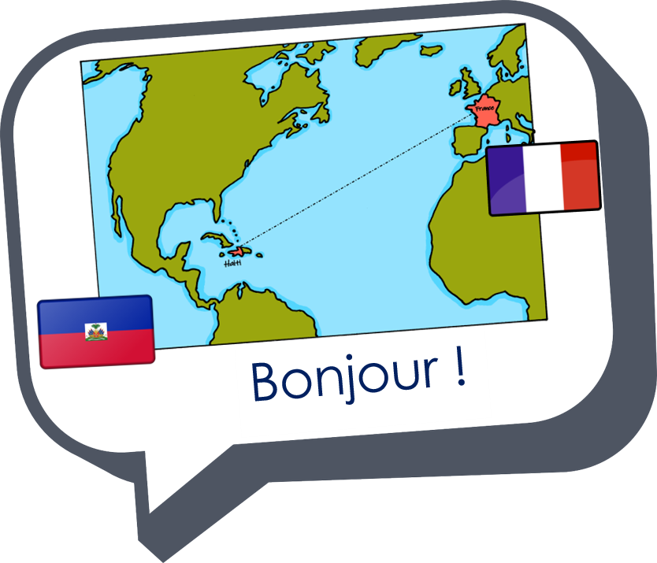

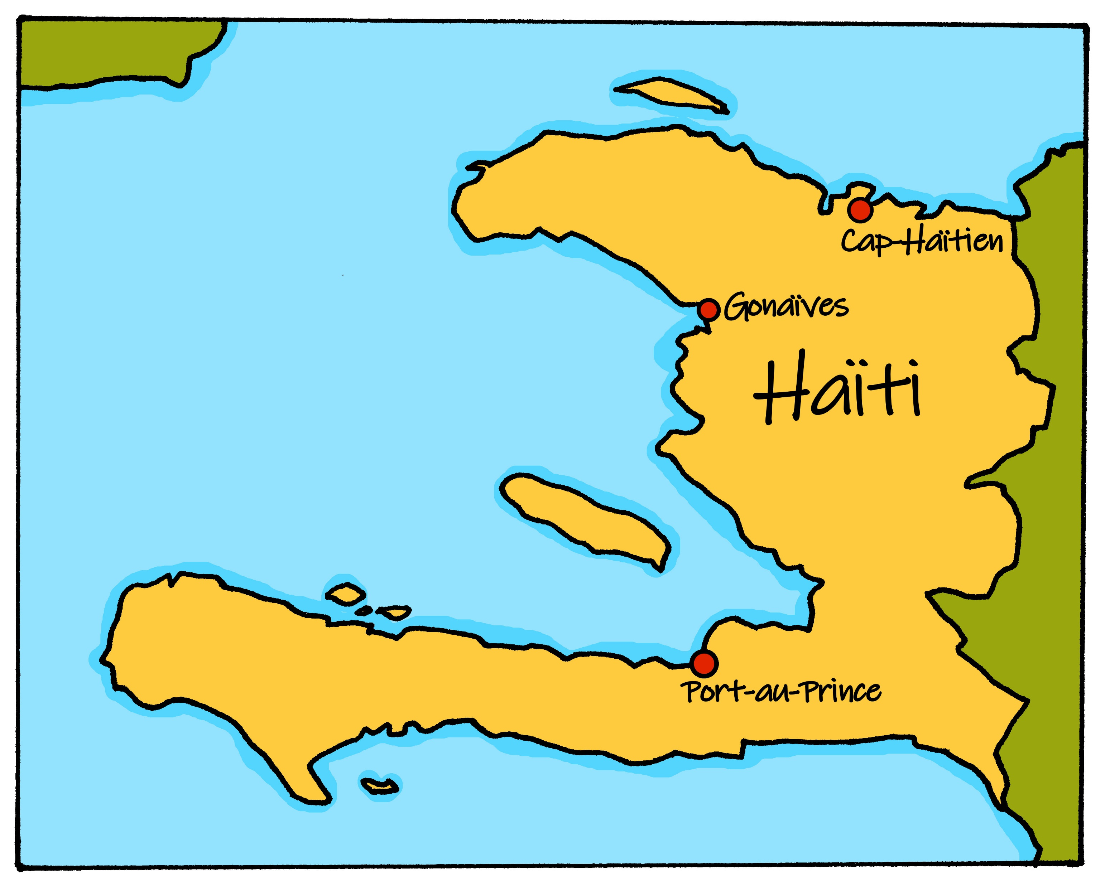
Saying what I and others do
Le jour de l’Indépendance
bleu
-ER verbs:
they and s/he
SSC [è, ê]
Notes:
Artwork by Steve Clarke. Pronoun pictures from NCELP (www.ncelp.org). All additional pictures selected from Pixabay and are available under a Creative Commons license, no
attribution required.
Phonics: Revisit SSC [è / ê] fête [1490] tête [343] frère [1043] être [5] problème [188]
Vocabulary (new words in bold): aimer [242] arriver [174] célébrer [2170] organiser [701] porter [105] préparer [368] année [102] fête [1490] gens [236] histoire [262] santé [641] vêtement [2383]
Revisit 1: Joyeux Noёl [mwu]
Revisit 2: avoir [8] j’ai [8] il a [8] elle a [8] un [3] une [3] animal [1002] chambre [633] livre [358] maison [325] professeur/ professeure [110] problème [188] tâche [887] amusant [4695] différent [350] idéal [1429] important [215] indépendant [854] lent [2572] lourd [1026] parfait [1600] propre¹ [237] sage [2643] strict [1859] très [66]
Londsale, D., & Le Bras, Y. (2009). A Frequency Dictionary of French: Core vocabulary for learners London: Routledge.
The frequency rankings for words that occur in this PowerPoint which have been previously introduced in these resources are given in the SOW and in the resources that first
introduced and formally re-visited those words.
For any other words that occur incidentally in this PowerPoint, frequency rankings will be provided in the notes field wherever possible.
1

Slide 2





prononcer
[è|ê]
[è] and [ê]
sound almost the same. [ê] is a little longer and deeper.
fête
(party, celebration)
Notes:
Timing: 2 minutes
Aim: to recap SSC [è] and [ê] which are almost the same sound.
Procedure:
Introduce and elicit the pronunciation of the individual SSC [è] and the source word ‘xxx’, which has both spellings of the sound.
Click to bring on the picture and get students to repeat (with gesture, if using).
Present and practise the cluster words.
Gesture:
gesture for fête: raise both hands in the air (middle three fingers facing down in a partial fist, with thumb and pinkie facing upwards) and move up and down alternate left and right to suggest a celebration-style dance.
Source: https://www.signbsl.com/sign/party (the 3rd video from the right is the best one, in my view)
2

Slide 3

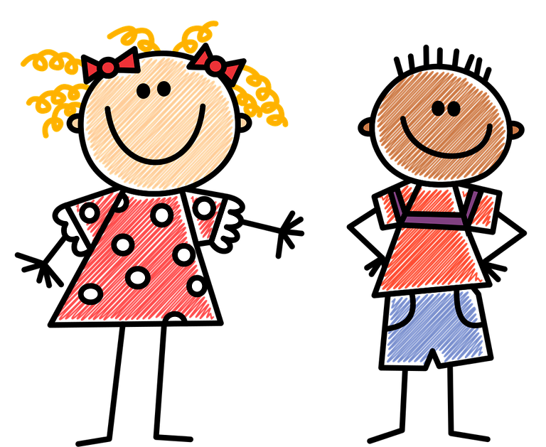

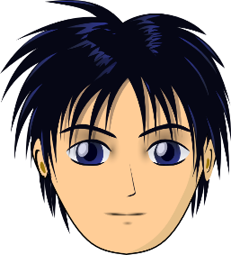



prononcer
[è|ê]
to be, being
être
frère
(brother)
tête
problème
(head)
Notes:
Timing: 2 minutes
Aim: to recap SSC [è] and [ê] which are almost the same sound.
Procedure:
Introduce and elicit the pronunciation of the individual SSC [è] and the source word ‘xxx’, which has both spellings of the sound.
Click to bring on the picture and get students to repeat (with gesture, if using).
Present and practise the cluster words.
Gesture:
gesture for fête: raise both hands in the air (middle three fingers facing down in a partial fist, with thumb and pinkie facing upwards) and move up and down alternate left and right to suggest a celebration-style dance.
Source: https://www.signbsl.com/sign/party (the 3rd video from the right is the best one, in my view)
3

Slide 4

prononcer
[è|ê]
Prononce les mots avec le son [è] [ê].
Écoute et vérifie.
1
2
3
4
5
6
café
crème
thé
fête
danser
célébrer
planète
forêt
créature
frère
sœur
père
extrême
problème
désert
héros
conquête
révolution
Notes:
Timing: 3 minutes
Aim: to practise written recognition and spoken production of [è] and [ê] in individual words.
Procedure:
Ensure that pupils understand the instruction to pronounce only the words with the SSC [è] and [ê].
Give pupils 2 minutes to decide which words to pronounce and to practise pronouncing them.
Click to hear only the word or words from each row that contain the correct SSC.
Elicit from pupils the pronunciation of the other words, those with SSC [é].
Transcript:
crème
fête
planète
forêt
frère
père
extrême
problème
conquête
4

Slide 5








vocabulaire
Vocabulaire
Trouve la connexion.
mots
1
2
3
4
5
6
café
crème
thé
fête
danser
célébrer
planète
forêt
créature
frère
sœur
père
extrême
problème
désert
héros
conquête
révolution
Notes:
Timing: 2 minutes
Aim: to practise written comprehension of previously taught words and (near) cognates by associating them with a broader theme; to practise pronunciation of words with SSC [è/ê] and [é].
Procedure:
1. Explain the task. Pupils can volunteer answers for any line in any order.
2. To volunteer a connection, pupils say the three French words followed by the English category word they suggest.
3. Teacher clicks on the English category – it will reappear next to the correct row of French words that it links to.
Note: rows 2 and 6 link to our theme this week, Haiti Independence Day.
5

Slide 6


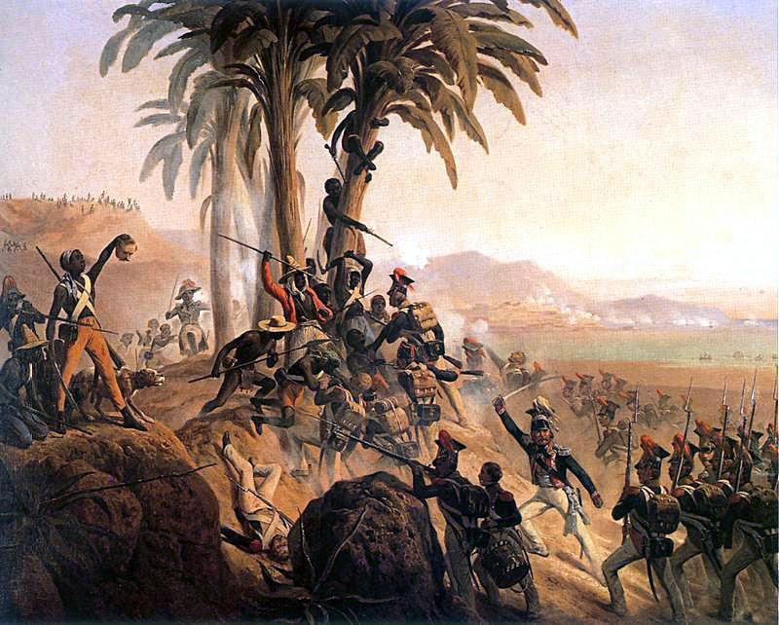
culture
L’histoire d’Haïti
Haiti was controlled by Spain from 1492 and by France from 1665.
But on 1st January 1804 Haiti became an independent nation, following a revolution.
The battles were led by black slaves.
Haiti became the first independent nation in Latin America and the first post-colonial independent black-led nation in the world.
Haiti is also the only nation ever whose independence was gained as part of a successful slave rebellion.
Notes:
Timing: 2 minutes
Aim: to present cultural information about the history of Haiti’s independence.
Procedure:
Read the title.
Click to present and read the information in English about the Haitian revolution.
Sources:
https://encyclopedia2.thefreedictionary.com/Haiti+Independence+Day
https://countercurrents.org/2021/01/haiti-independence-day/
https://www.newyorklatinculture.com/haitian-independence-day/
https://www.officeholidays.com/holidays/haiti/haiti-independence-day
Picture attribution:
Battle for Palm Tree Hill - painting
January Suchodolski, Public domain, via Wikimedia Commons
6

Slide 7
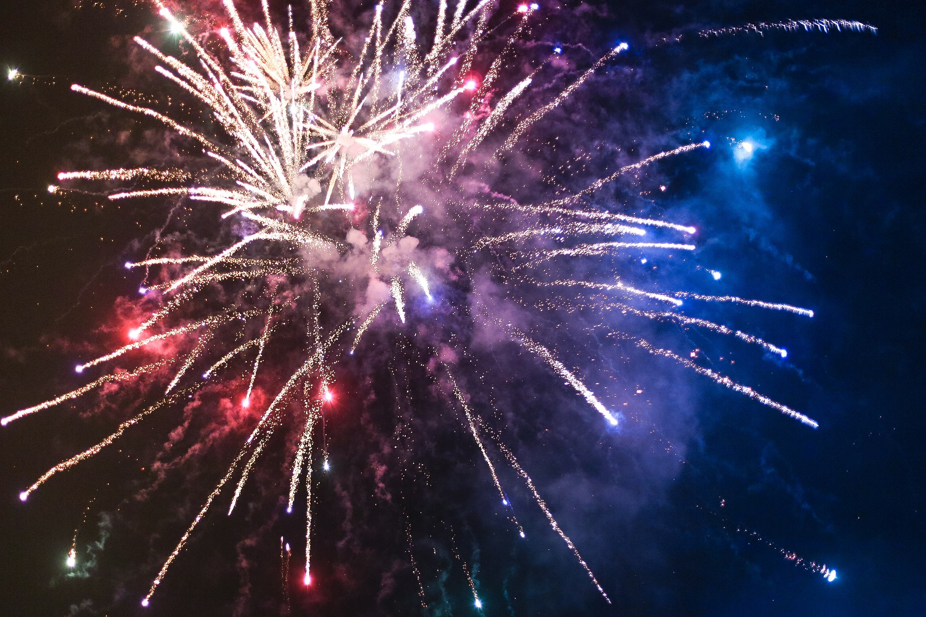

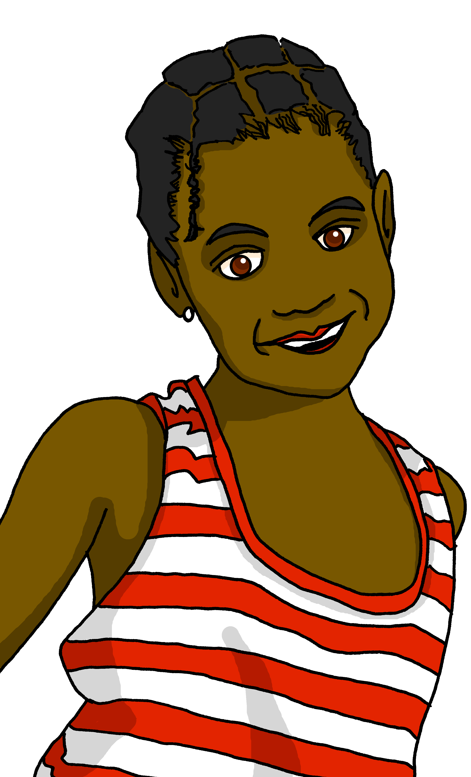
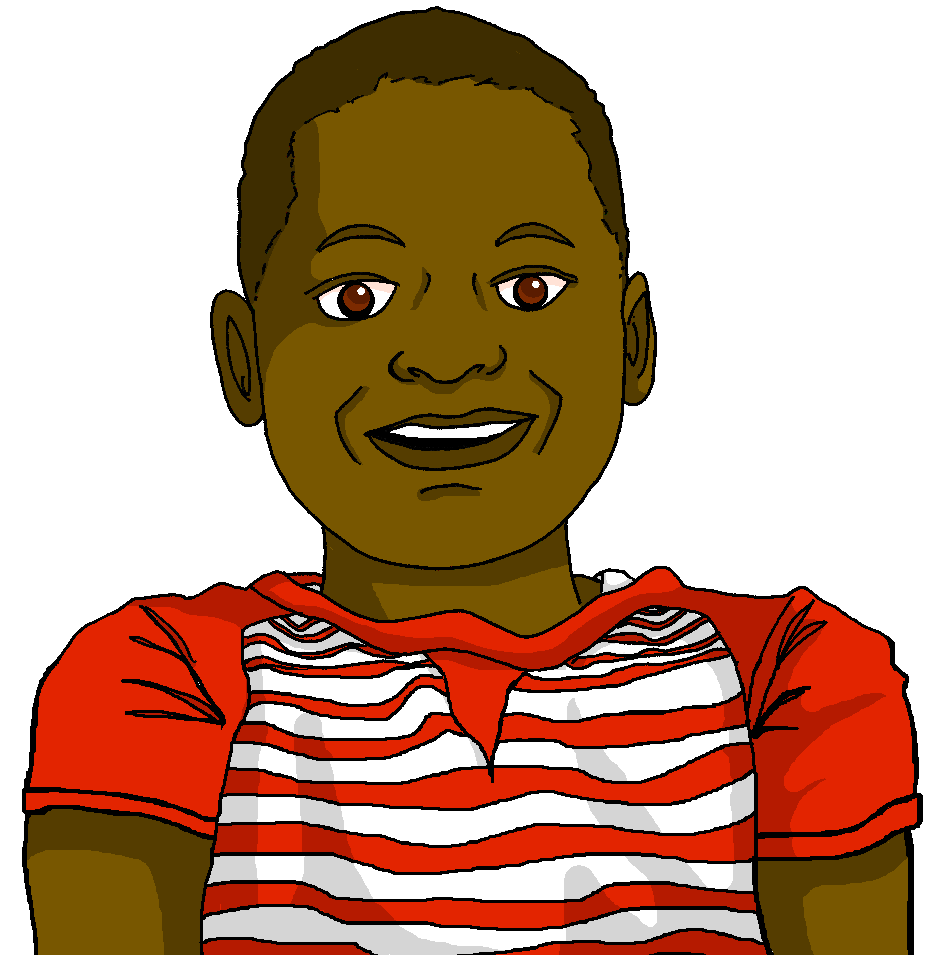
lire
Le premier janvier à Haïti
Le premier janvier à Haïti, c’est le jour national.
Le premier janvier à Haïti
nous souhaitons «Bònn Ane!» et «Bònn Fèt Lendepandans!»
En français, c’est « Bonne année ! » et « Bonne fête de l’Indépendance ! »
Notes:
Timing: 2 minutes
Aim: to present cultural information about the 1st January in Haiti.
Procedure:
Read the title.
Click on the first speech bubble to hear the audio.
Clarify meaning.
Click to bring up the 2nd speech bubble.
Elicit the English meaning.
7

Slide 8
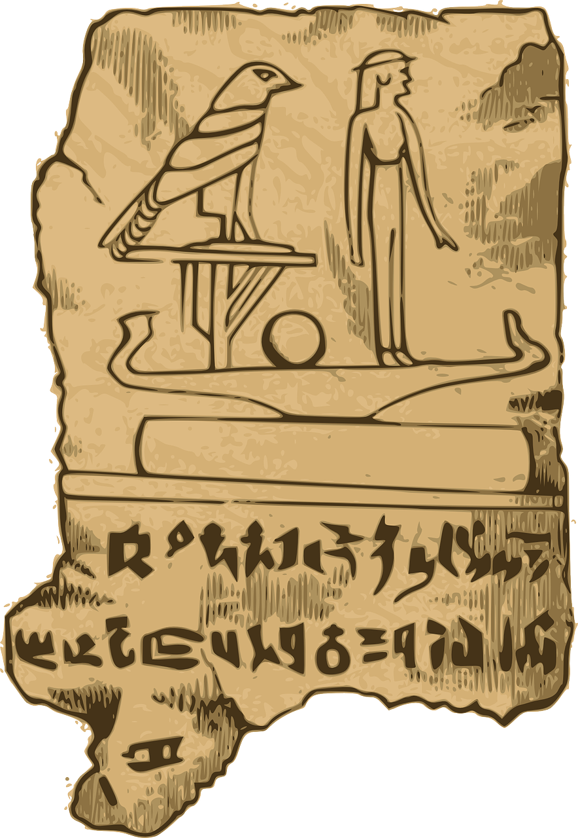

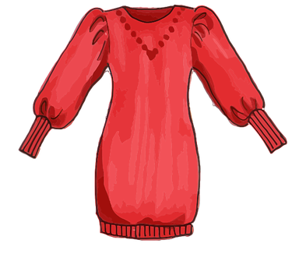

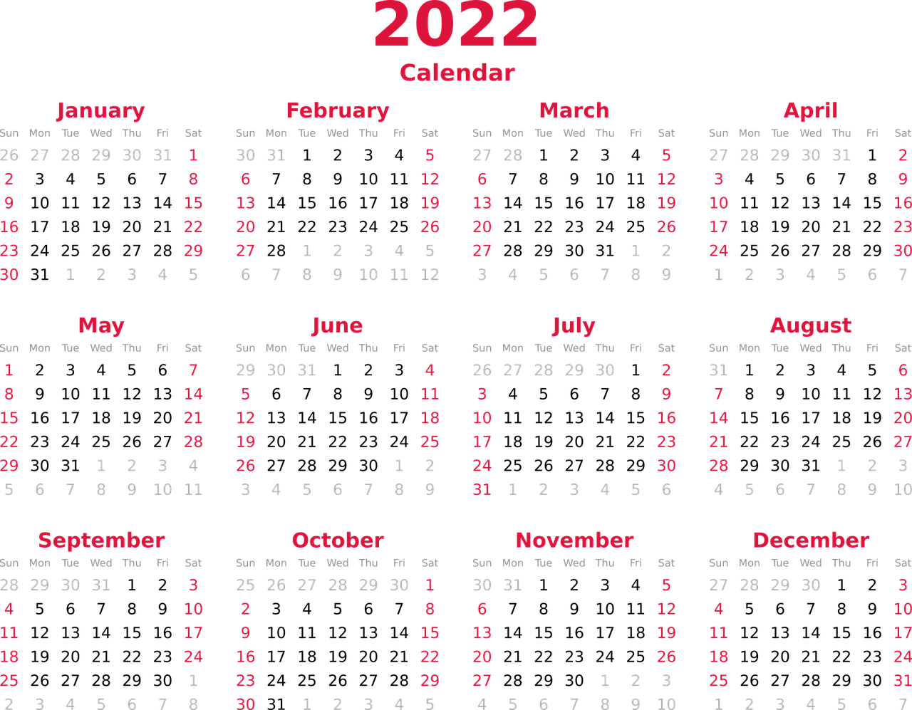
vocabulaire
Vocabulaire
mots
l’histoire
la santé
le vêtement
la fête
les gens
l’année
(the) people
(the) item of clothing
(the) party, celebration
(the) history
(the) health
(the) year
Notes:
Timing: 4 minutes
Aim: to present and practise written comprehension and read aloud of the new vocabulary for this week.
Procedure:
1. Click for an English prompt.
2. Elicit the French word from pupils where they can recognise and read it aloud. Or say the word for pupils to repeat.
3. Continue until all 8 items have been seen and heard.
8

Slide 9

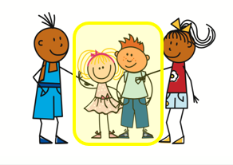
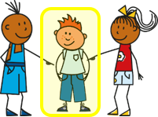

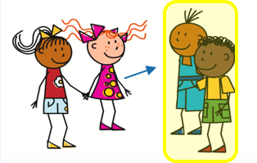
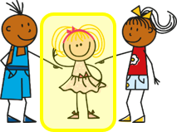
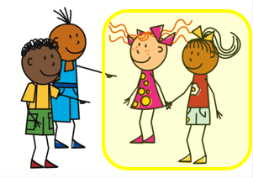
Knowing who does what
-ER verbs: they (ils, elles)
You know that to say s/he, it + -ER verb in French, the verb ends in –e.
ils is for either a group of boys or a mixed group.
To say they + -ER verb in French, the verb ends in –ent.
Il prépare la fête.
Ils préparent la fête.
He prepares the party.
They prepare the party.
Elle organise la musique.
Elles organisent la musique.
Elles organisent la musique.
She organises the music.
They organise the music.
The endings are silent so –e and –ent sound the same!
Remember the liaison –s before verbs starting with a vowel.
Notes:
Timing: 2 minutes
Aim: to introduce the 3rd person plural of –ER verbs and contrast it with the 3rd person singular.
Procedure:
Click through the animations to present the information.
Elicit English translations for the French examples provided.

Slide 10

lire
La fête nationale à Haïti
C’est qui ? Jean-Michel ou Jean-Michel et Clémentine ?
Everyone in Haiti celebrates the 1st January. But what does J-M do on his own, and what do J-M and Clémentine do together? |  | ils (they) | il (he)
1 | …. arrive à la capitale Port-au-Prince.
2 | …. chantent l’hymne nationale.
3 | …. écoutent la radio.
4 | …. visite le Palais national.
5 | …. regarde les parades.
6 | …. aiment l’histoire d’Haïti.
7 | ….. regardent les feux d’artifice.
8 | …. portent des vêtements élégants.
Notes:
Timing: 5 minutes
Aim: to practise written recognition of singular and plural –ER verb endings, and their connection with meaning.
Procedure:
1. Students write 1-8 and ils (they) or il (he) according to whether the verb is singular or plural.
2. Answers are revealed on a mouse click.
3. Move on to the next slide for a comprehension task based on the same text.

Slide 11
lire
La fête nationale à Haïti
C’est quoi en anglais ?
l’hymne national = national anthem
le palais = palace
Everyone in Haiti celebrates the 1st January. But what does J-M do on his own, and what do J-M and Clémentine do together?
1 | …. arrive à la capitale Port-au-Prince.
2 | …. chantent l’hymne nationale.
3 | …. écoutent la radio.
4 | …. visite le Palais national.
5 | …. regarde les parades.
6 | …. aiment l’histoire d’Haïti.
7 | ….. regardent les feux d’artifice.
8 | …. portent des vêtements élégants.
1
He arrives in the capital Port-au-Prince.
2
They sing the national anthem.
3
They listen to the radio.
4
He visits the national palace.
5
He watches the parades.
6
They like the history of Haiti.
7
They watch the fireworks.
8
They wear smart clothes.
Notes:
Timing: 5 minutes
Aim: to practise written comprehension or a range of singular and plural –ER verbs and vocabulary associated with 1st January celebrations in Haiti.
Procedure:
Pupils volunteer English meanings of each sentence.
Teacher clicks to reveal written answers.
If desired, click the buttons to play full sentence audio.
Encourage pupils to identify French words that remind them of English words, and volunteer their meaning (e.g. capitale, hymne, national, radio, parade, histoire, artifice, élégant). Tell pupils these are called cognates (or near-cognates, when there are minor differences), that there are many such words between French and English, but that usually the pronunciation will be different. Encourage them to pronounce them in English and French in pairs.

Slide 12





parler
les verbes (‘they’)
organisent
préparent
portent
[organise]
[wear]
[prepare]
visitent
célèbrent
aiment
[visit]
[like]
[celebrate]
Notes:
Timing: 2 minutes (three slides)
Aim: to reinforce the specific pronunciation of third person plural, along with the subject pronouns ils and elles.
Procedure:
Click to bring up each verb form on its own, model its pronunciation and elicit the pronunciation from students.
Elicit choral responses from students of the third person plural from by clicking to disappear the five verbs at random.
12

Slide 13
parler
les verbes (‘they’)
organisent
Remember the liaison –s before verbs starting with vowels.
préparent
portent
ils
visitent
célèbrent
aiment
Remember the liaison –s before verbs starting with vowels.
Notes:
Procedure:
Click to bring up ‘ils’ and all six verbs again, with audio.
Click to bring up the reminder about the ‘s’ liaison with the initial vowel of verbs beginning with a vowel (e.g., aimer, organiser).
Elicit choral responses from students of the third person plural from by clicking to disappear the five verbs and ‘ils’ at random.
Click to bring the pronoun + verb back, with 2nd time audio to reinforce.
13

Slide 14
parler
les verbes (‘they’)
organisent
Remember the liaison –s before verbs starting with vowels.
préparent
portent
elles
célèbrent
visitent
aiment
Remember the liaison –s before verbs starting with vowels.
Notes:
Procedure:
Click to bring up ‘elles’ and all six verbs again.
Click to bring up the reminder about the ‘s’ liaison with the initial vowel of verbs beginning with a vowel (e.g., aimer, organiser).
Elicit choral responses from students of the third person plural from by clicking to disappear the five verbs and ‘elles’ at random.
Note: this slide has been left without audio.
14

Slide 15
Au revoir !
bleu
Notes:
15

