Slide 1
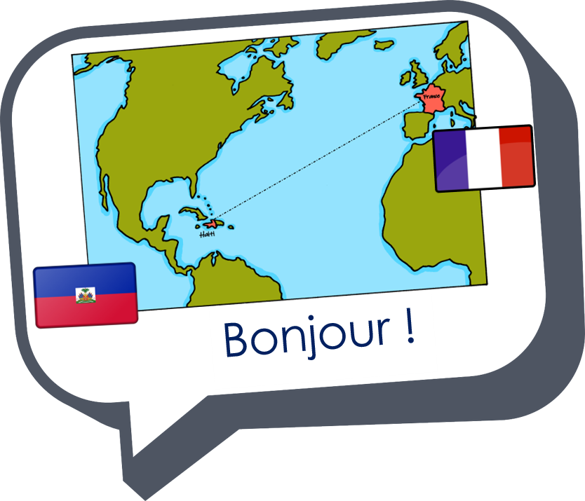

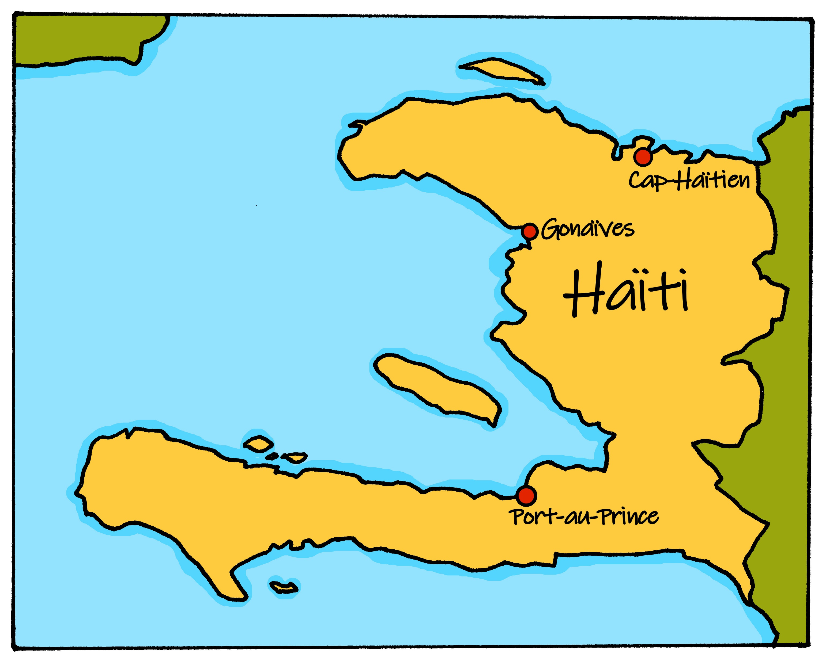
Saying what I and others do
Le jour de l’Indépendance
bleu
Follow ups 1-5
Notes:
Artwork by Steve Clarke. Pronoun pictures from NCELP (www.ncelp.org). All additional pictures selected from Pixabay and are available under a Creative Commons license, no
attribution required.
Phonics: Revisit SSC [è / ê] fête [1490] tête [343] frère [1043] être [5] problème [188]
Vocabulary (new words in bold): aimer [242] arriver [174] célébrer [2170] organiser [701] porter [105] préparer [368] année [102] fête [1490] gens [236] histoire [262] santé [641] vêtement [2383] voisin [979]
Revisit 1: Joyeux Noёl [mwu]
Revisit 2: avoir [8] j’ai [8] il a [8] elle a [8] un [3] une [3] animal [1002] chambre [633] livre [358] maison [325] professeur/ professeure [110] problème [188] tâche [887] amusant [4695] différent [350] idéal [1429] important [215] indépendant [854] lent [2572] lourd [1026] parfait [1600] propre¹ [237] sage [2643] strict [1859] très [66]
Londsale, D., & Le Bras, Y. (2009). A Frequency Dictionary of French: Core vocabulary for learners London: Routledge.
The frequency rankings for words that occur in this PowerPoint which have been previously introduced in these resources are given in the SOW and in the resources that first
introduced and formally re-visited those words.
For any other words that occur incidentally in this PowerPoint, frequency rankings will be provided in the notes field wherever possible.

Slide 2

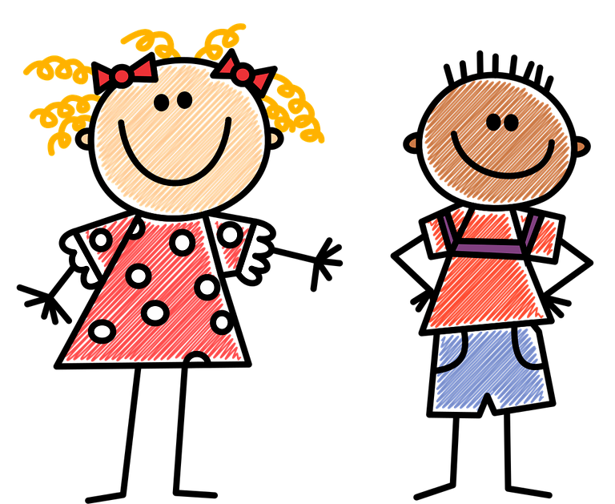


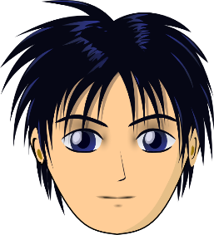

prononcer
[è]
[ê]
[è] and [ê]
sound almost the same. [ê] is a little longer and deeper.
to be, being
fête
être
frère
(brother)
(party, celebration)
tête
problème
(head)
Notes:
Timing: 2 minutes
Aim: to recap SSC [è] and [ê] which are the same sound written differently.
Procedure:
Introduce and elicit the pronunciation of the individual SSC [è] and the source word ‘xxx’, which has both spellings of the sound.
Click to bring on the picture and get students to repeat (with gesture, if using).
Present and practise the cluster words.
Gesture:
gesture for fête: raise both hands in the air (middle three fingers facing down in a partial fist, with thumb and pinkie facing upwards) and move up and down alternate left and right to suggest a celebration-style dance.
Source: https://www.signbsl.com/sign/party (the 3rd video from the right is the best one, in my view)
2

Slide 3




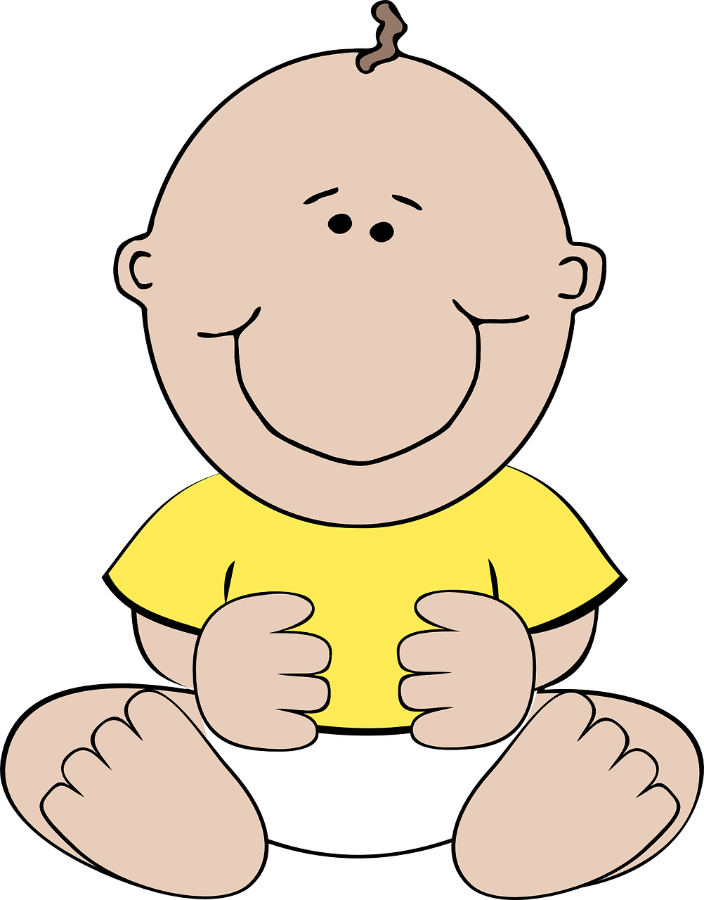
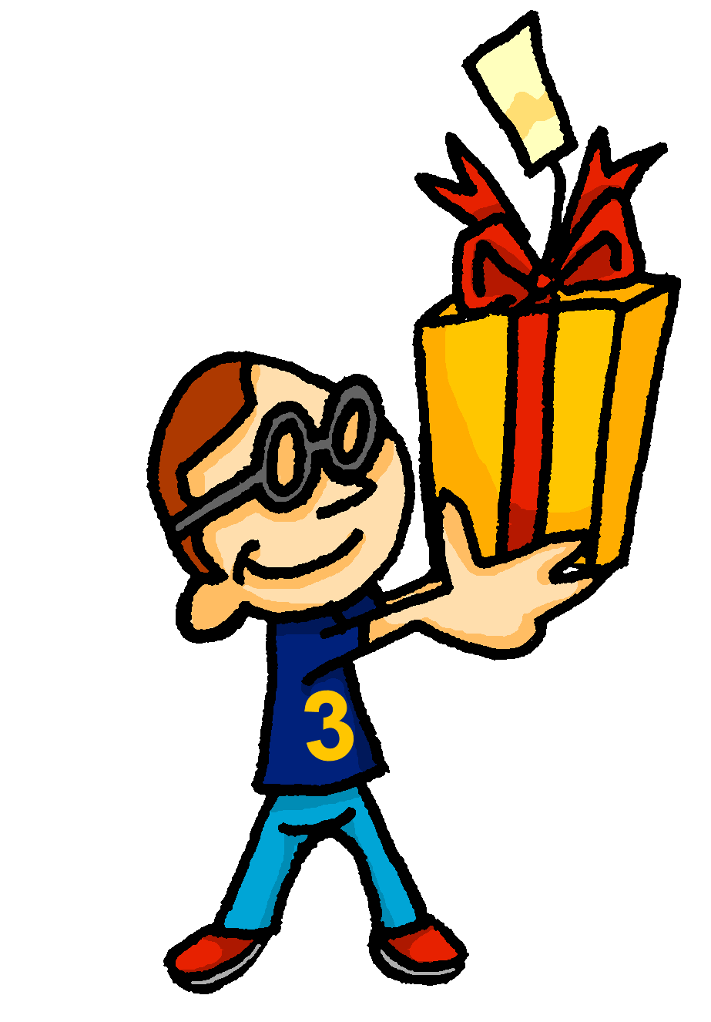

prononcer
[é]
[er]
[et]
[ez]
Remember that
[é], [er],[et] and [ez] sound the same.
répéter
[and]
écrire
parler
et
bébé
donner
nez
[to give]
Notes:
Timing: 2 minutes
Aim: to recap SSC [é] [er] [et] [ez], which are the same sound written differently.
Procedure:
Introduce and elicit the pronunciation of the individual SSC [é, et, et, ez] and the source word ‘répéter’, which has both spellings of the sound.
Click to bring on the picture and get students to repeat (with gesture, if using).
Present and practise the cluster words.
Gesture:
gesture for répéter – hand with thumb and two fingers pointing forwards doing a three downwards motions, one for each syllable of the word.
https://www.signbsl.com/sign/repeat (the 2nd video marked again: repeat with the female signer)
3

Slide 4



Follow up 1
Écoute. Décide si c’est le son [é] ou [è|ê].
écouter
 |  | [é] | [è|ê]
1 | i d é e
2 | p o è t e
3 | k i l o m è t r e
4 | c é r é a l e
5 | c r é a t i o n
6 | c a r a c t è r e
7 | h o n n ê t e
8 | m y s t è r e
_
_
_
_
_
_
_
_
_
Notes:
Timing: 5 minutes
Aim: to apply knowledge of SSC [é] in a transcription task.
Procedure:
1. Click to listen.
2. Pupils note either [é] or [è|ê] for each one.
3. Click to correct.
4. Elicit pronunciation of all words, chorally.
5. Words are cognates. Teachers may additionally prompt pupils to volunteer English meanings.
Transcript:
1. idée
2. poète
3. kilometre
4. céréale
5. creation
6. caractère
7. honnête
8. mystère

Slide 5
Follow up 1
Écoute. Décide si c’est le son [é] ou [è|ê].
écouter
 |  | [é] | [è|ê]
1 | i d é e
2 | p o è t e
3 | k i l o m è t r e
4 | c é r é a l e
5 | c r é a t i o n
6 | c a r a c t è r e
7 | h o n n ê t e
8 | m y s t è r e
_
_
_
_
_
_
_
_
_
Notes:
Timing: 5 minutes
Aim: to apply knowledge of SSC [é] in a transcription task.
Procedure:
1. Click to listen.
2. Pupils note either [é] or [è|ê] for each one.
3. Click to correct.
4. Elicit pronunciation of all words, chorally.
5. Words are cognates. Teachers may additionally prompt pupils to volunteer English meanings.
Transcript:
1. idée
2. poète
3. kilometre
4. céréale
5. creation
6. caractère
7. honnête
8. mystère

Slide 6
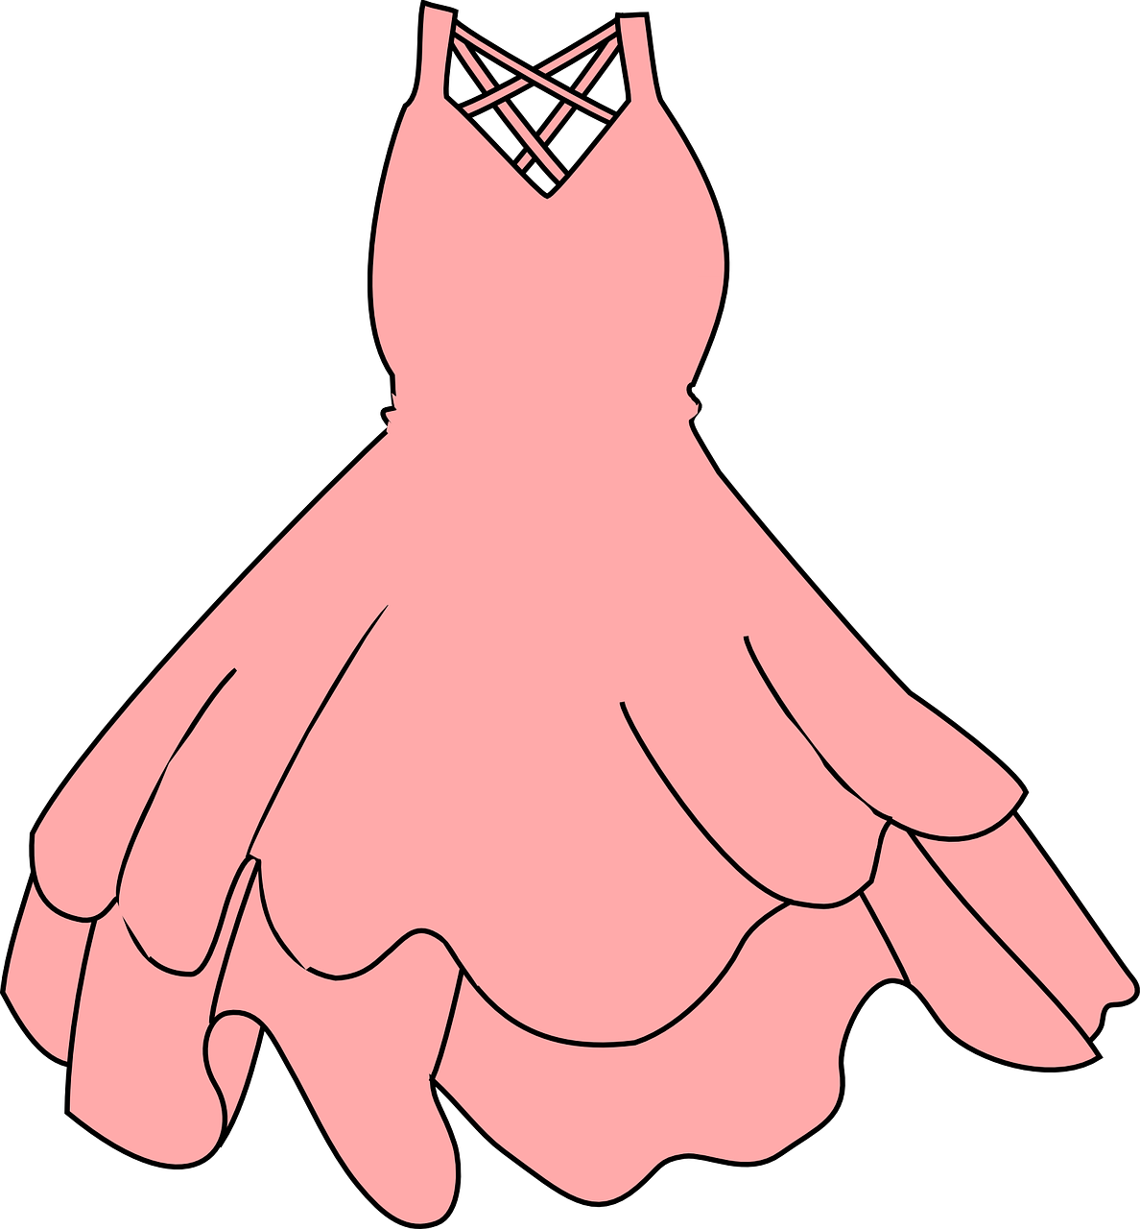

Follow up 2
Écoute.
écouter
Il ou ils ?
Elle ou elles ?
Écoute, regarde et écris en français.
écrire
Exemple
elles portent
Notes:
Timing: 5 minutes (seven slides)
Aim: This is an example of a bimodal task which connects the spoken form with the written form simultaneously, as in this case listening alone does not indicate singular or plural.
It is useful to practise bimodal tasks in this case because pupils practise the idea that you can only tell which verb ending to use in writing when you know whether the person is singular or plural – so, here the pupils get a visual cue (the picture) and this tells them what the written verb ending would be (the oral verb ending doesn’t help!).
Procedure:
1. Use this slide to model the task instructions.
2. Click to bring up the image and again for the audio. Pupils will hear a verb (e.g., elles portent). At the same time a circle will appear around the picture to indicate whether it is 3rd person singular or 3rd person plural.
3. Once they have heard the audio and seen whether it is singular or plural, students write the correct form.
4. Click to reveal the correct written form.
Transcript:
ils portent
Note: Teachers need to mouse click on the ‘Exemple’ box, which triggers the audio to play the word ‘exemple’
If this step is missed, the first verb may not play in full.

Slide 7
Follow up 2
[1/6]
écouter
écrire
ils donnent
Notes:
[1/6]
Transcript:
ils donnent

Slide 8



Follow up 2
[2/6]
écouter
écrire
il célèbre
Notes:
[2/6]
Transcript:
il célèbre

Slide 9


Follow up 2
[3/6]
écouter
écrire
elle visite
Notes:
[3/6]
Transcript:
elle visite

Slide 10

Follow up 2
[4/6]
écouter
écrire
il regarde
Notes:
[4/6]
Transcript:
il regarde

Slide 11
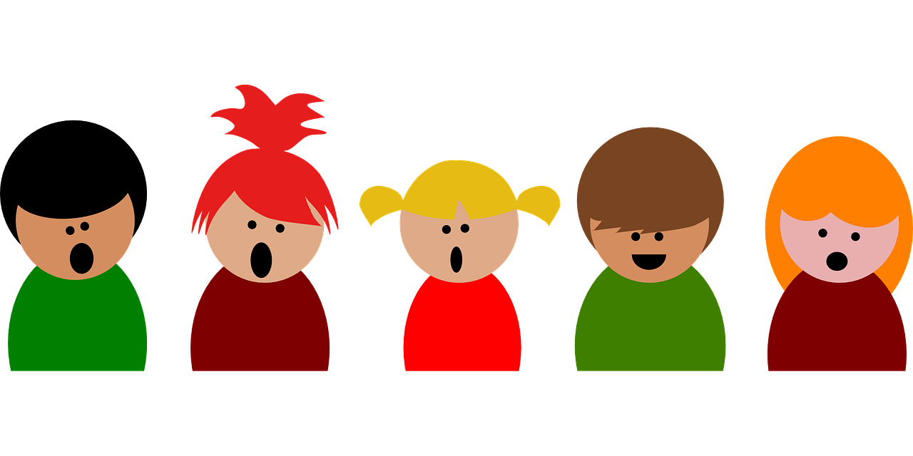
Follow up 2
[5/6]
écouter
écrire
elles chantent
Notes:
[5/6]
Transcript:
elles chantent

Slide 12


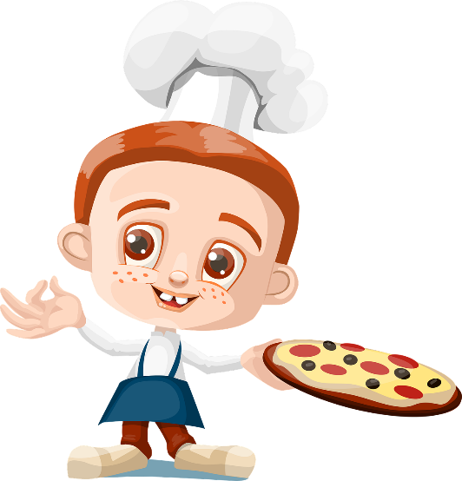

Follow up 2
[6/6]
écouter
écrire
ils préparent
Notes:
[6/6]
Transcript:
ils préparent

Slide 13


Knowing who does what
-ER verbs: 3rd person singular and plural
Remember! To say ‘everyone’ + ER verb, use tout le monde and the s/he, it ending –e.
Tout le monde regarde les feux d’artifice.
Everyone watches the fireworks.
To say ‘the people’ + -ER verb in French, use les gens and the verb ending –ent.
Les gens regardent les feux d’artifice.
The people watch the fireworks.
Notes:
Timing: 1 minute
Aim: to connect ‘tout le monde’ (everyone) and ‘les gens’ (the people) with the correct verb form in French.
Procedure:
Click through the animations to present the information.
Elicit English translations for the French examples provided.

Slide 14
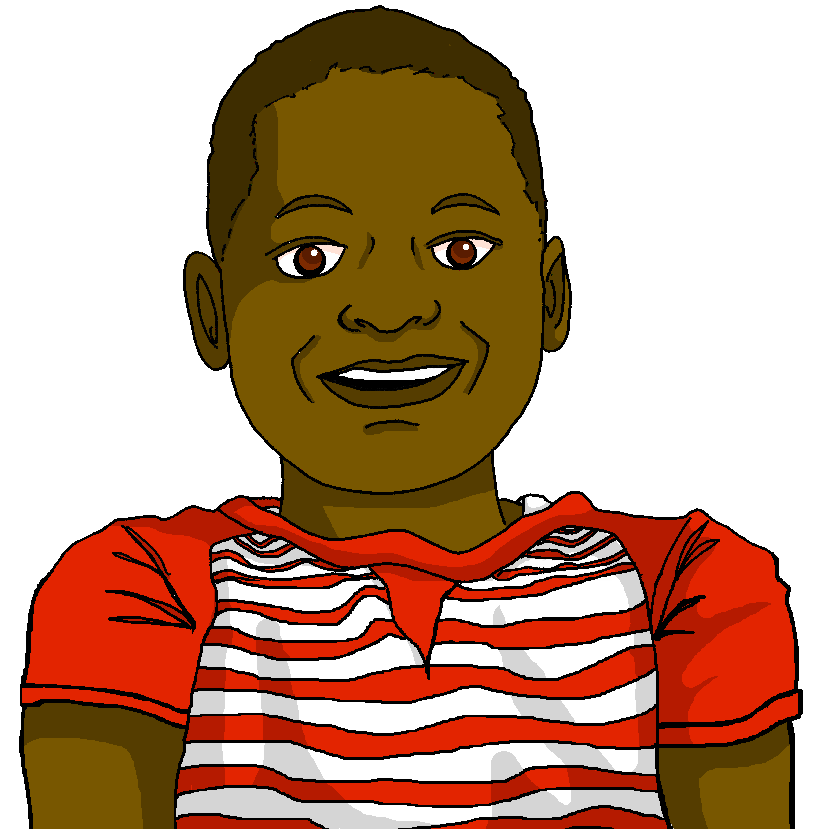





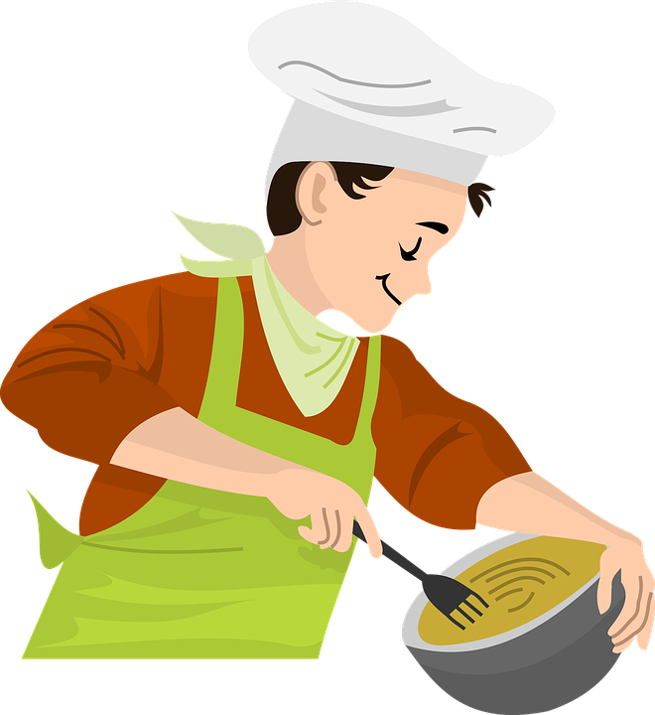




Follow up 3:
Écoute et écris le verb.
Ici, c’est super ! Tout le monde chante et danse dans la rue.
écouter
Les gens portent des vêtements élégants et donnent des cadeaux, aussi.
The story is that only slave owners were allowed to eat this pumpkin soup (‘soup joumou’). After the revolution, this soup was for everyone and came to symbolise Haitian freedom and independence.
Now note down in English everything you know about 1st January celebrations in Haiti.
prepare
écrire
Tout le monde prépare et partage la « soup joumou ». C’est délicieux et symbolique !
Ils célèbrent l’histoire d’Haïti et ils regardent les feux d’artifice.
Bisous (kisses) is a way to sign off your messages to close friends and family.
Tout le monde souhaite « Bonne année », « Bonne santé » et
« Bonne fête de l’Indépendance ».
Bisous, Jean-Michel
Notes:
Timing: 5 minutes
Aim: to practise written distinction and production of 3rd person singular and plural verb forms.
Procedure:
1. Pupils can number 1-8 to avoid copying the full text (or have a gapped handout).
2. Click to listen to each sentence.
3. Paying careful attention to the subject - is it ‘tout le monde’ (everyone) or ‘les gens’ (people), pupils write the verb they hear in either the 3rd person singular (-e ending) or 3rd person plural (-ent ending).
4. Click to reveal the answers and hear each sentence again.
Differentiation: for more challenge, pupils could write the verbs before listening (meaning they must recall the verbs themselves, rather than only the endings).

Slide 15



Follow up 4:
Parle avec ton/ta partenaire.
Personne A parle.
Personne B identifie l’image correspondante.
parler
Personne A
He prepares
Personne B
[A] [B] [C]
Il prépare
B
A
Notes:
Timing: 5-10 minutes
Aim: to practise receptive and productive knowledge of third person singular and plural of –er verbs in present tense.
Procedure:
1. Use this slide to model the task.
2. Pupil A produces the verb and pronoun in French.
3. Pupil B identifies the correct picture – A, B or C.
4. Complete items 1-5.
5. Then pupils swap roles and repeat the task.
6. See next slides for answers, and handouts at the end of the presentation.

Slide 16




parler
Round 1
Personne B
Personne A
1) He wears
……………………………….
2) They sing (mixed group)
……………………………….
3) They give (mixed group)
……………………………….
4) She watches
……………………………….
5) They organise (mixed group)
………………………………..
[A] [B] [C]
parler
1)
Il porte
2)
Ils chantent
3)
Ils donnent
Elle regarde
4)
ils organisent
5)
Notes:
ANSWERS ROUND 1
16

Slide 17


parler
Round 2
Personne A
Personne B
1) They celebrate (all girls)
……………………………….
2) He prepares
……………………………….
3) She wishes
……………………………….
4) They make (mixed group)
……………………………….
5) They like (all girls)
………………………………..
[A] [B] [C]
parler
1)
Elles célèbrent
2)
Il prépare
3)
Elle souhaite
Ils fabriquent
4)
Elles aiment
5)
Notes:
ANSWERS ROUND 2
17

Slide 18
parler
Round 2
Round 1
Personne A
Personne A
1) He wears
……………………………….
2) They sing (mixed group)
……………………………….
3) They give (mixed group)
……………………………….
4) She watches
……………………………….
5) They organise (mixed group)
………………………………..
[A] [B] [C]
parler
1)
2)
3)
4)
5)
Remember the liaison!
Notes:
HANDOUT Personne A
18

Slide 19
parler
Round 1
Round 2
Personne B
Personne B
1) They celebrate (all girls)
……………………………….
2) He prepares
……………………………….
3) She wishes
……………………………….
4) They make (mixed group)
……………………………….
5) They like (all girls)
………………………………..
parler
[A] [B] [C]
1)
2)
3)
4)
5)
Remember the liaison!
Notes:
HANDOUT Personne B
19

Slide 20




vocabulaire
Follow up 5 - Écris en anglais : Can you get at least 15 points?
mots
 | le problème | la tâche | très
 | lourd | avoir | lente
 | Joyeux Noёl | Bonne année ! | Bonne santé !
 | ils | elles | indépendant
 | ils portent | elles célèbrent | ils donnent
 | l’année | le vêtement | les gens
 | la fête | l’histoire | la santé
problem
task
very
x3
heavy (m)
to have, having
slow (f)
Merry Christmas
Happy New Year!
Good health!
x2
they (mfpl)
they (fpl)
independent (m)
they wear (mpl)
they celebrate (fpl)
they give (mfpl)
year
item of clothing
people
x1
party, celebration
history
health
Notes:
Timing: 5-10 minutes
Aim: to practise written production of vocabulary from this week and two revisited weeks.
Procedure:
1. Give pupils a blank grid. They fill in the English meanings of any of the words they know, trying to reach 15 points in total.
2. Remind pupils that adjectives can refer to male or female persons and they should note this in their translations. E.g. pleased (f), short (m).
Note:
The most recently learnt and practised words are pink, words from revisit 1 are green and those from revisit 2 are blue, thus more points are awarded for them, to recognise that memories fade and more effort (heavy lifting!) is needed to retrieve them.
20

Slide 21
vocabulaire
Follow up 5 - Écris en anglais : Can you get at least 15 points?
mots
 | le problème | la tâche | très
 | lourd | avoir | lente
 | Joyeux Noёl | Bonne année ! | Bonne santé !
 | ils | elles | indépendant
 | ils portent | elles célèbrent | ils donnent
 | l’année | le vêtement | les gens
 | la fête | l’histoire | la santé
x3
x2
Notes:
HANDOUT
21

Slide 22
vocabulaire
Follow up 5 - Écris en français : Can you get at least 15 points?
mots
 | problem | task | very
 | heavy (m) | to have, having | slow (f)
 | they (fpl) | Happy New Year! | Good health!
 | they (mpl) | independent (m) | Merry Christmas
 | they wear (mpl) | they celebrate (fpl) | they give (mfpl)
 | year | item of clothing | people
 | party, celebration | history | health
le problème
la tâche
très
x3
lourd
avoir
lente
elles
Bonne année !
Bonne santé !
x2
ils
indépendant
Joyeux Noёl
ils portent
elles célèbrent
ils donnent
l’année
le vêtement
les gens
x1
la fête
l’histoire
la santé
Notes:
Timing: 5-10 minutes
Aim: to practise written production of vocabulary from this week and two revisited weeks.
Procedure:
1. Give pupils a blank grid. They fill in the French meanings of any of the words they know, trying to reach 15 points in total.
2. Remind pupils that adjectives can refer to male or female persons and they should note this in their translations. E.g. pleased (f), short (m).
Note:
The most recently learnt and practised words are pink, words from revisit 1 are green and those from revisit 2 are blue, thus more points are awarded for them, to recognise that memories fade and more effort (heavy lifting!) is needed to retrieve them.
22

Slide 23
vocabulaire
Follow up 5 - Écris en français : Can you get at least 15 points?
mots
 | problem | task | very
 | heavy | to have, having | show
 | they (fpl) | Happy New Year! | Good health!
 | they (mpl) | independent (m) | Merry Christmas
 | people | they wear (mpl) | they celebrate (fpl)
 | year | item of clothing | neighbour
 | party, celebration | history | health
x3
x2
Notes:
HANDOUT
23

