Slide 1
Saying what I and others do
-ER verbs: you (formal)
plural nouns: – eu/au + x, -al → aux
SSC [é, er, et, ez]
bleu
Notes:
Artwork by Steve Clarke. Pronoun pictures from NCELP (www.ncelp.org). All additional pictures selected from Pixabay and are available under a Creative Commons license, no
attribution required.
Phonics: [é] [er] [et] [ez] répéter [630] écrire [382] bébé [2271] donner [46] parler [106] et [6] nez [2661]
Vocabulary (new words in bold): aimer [242] avoir [8] vous² [50] animal [1002] cadeau [2298] chapeau [2908] cheval [2220] fanal [>5000] gâteau [4845] feu [786] jeu [291] vœu [2103]
Revisit 1: --
Revisit 2: sont [5] ils [13] elles [38] combien [800] affiche [2886] bouteille [2979] crayon [>5000] fleur [2305] gomme [>5000] livre [358] mur [1335] ordinateur [2201] règle [488] sac [2343] vrai [292] faux [555] de [2]
Londsale, D., & Le Bras, Y. (2009). A Frequency Dictionary of French: Core vocabulary for learners London: Routledge.
The frequency rankings for words that occur in this PowerPoint which have been previously introduced in these resources are given in the SOW and in the resources that first
introduced and formally re-visited those words.
For any other words that occur incidentally in this PowerPoint, frequency rankings will be provided in the notes field wherever possible.
1

Slide 2
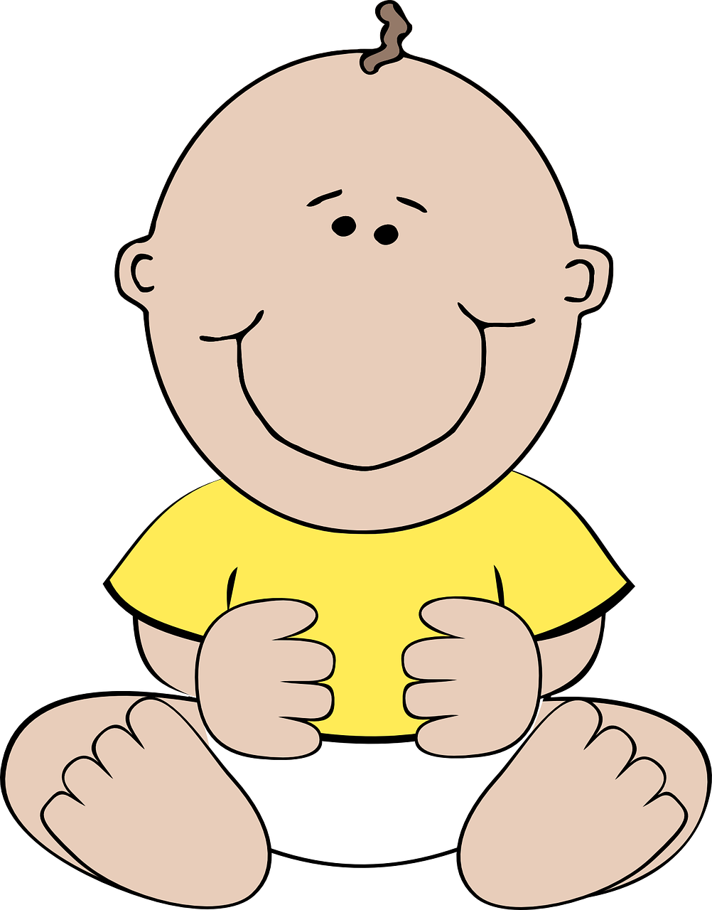
prononcer
[é]
[er]
[et]
[ez]
Remember that [é], [er],[et] and [ez] sound the same.
répéter
[and]
écrire
parler
et
bébé
donner
nez
[to give]
Notes:
Timing: 2 minutes
Aim: to recap SSC [é] [er] [et] [ez], which are the same sound written differently.
Procedure:
Introduce and elicit the pronunciation of the individual SSC [é, et, et, ez] and the source word ‘répéter’, which has both spellings of the sound.
Click to bring on the picture and get students to repeat (with gesture, if using).
Present and practise the cluster words.
Gesture: gesture for répéter – hand with thumb and two fingers pointing forwards doing a three downwards motions, one for each syllable of the word.
https://www.signbsl.com/sign/repeat (the 2nd video marked again: repeat with the female signer)
2

Slide 3
prononcer
Bonne année et bonne santé
Écoute et lis le poème.
Identifie les verbes.
Célébrer et souhaiter « Bonne Année »
C´est fêter le premier jour de l´année
Échanger des vœux jusqu´à fin janvier
C´est participer aux festivités
Regarder les feux d´artifice passer
Se baigner dans de l´eau assez glacée
C´est chanter, manger, jouer et danser
C´est partager une galette bien dorée
Aller à son restaurant préféré
Organiser une fête improvisée
Donner des étrennes, se dire « Bonne santé ! »
S´embrasser, souhaiter une bonne année !
Celebrate and wish “Happy New Year” It’s celebrating the first day of the year Exchanging good wishes until the end of January It’s taking part in the festivities Watching the fireworks pass Bathing in ice cold water It’s singing, eating, playing and dancing It’s sharing a golden galette Going to your favourite restaurant Organising a small party Giving presents, saying “Good health” Hugging, wishing a happy new year!
Marie-Odile Guillou
Notes:
Timing: 7 minutes
Aim: to practise the pronunciation of SSC [é, er] in a poem about the new year.
Procedure:
Pupils listen to each line of the poem and then read it aloud chorally, themselves.
They then practise once again, reading each line aloud before the teacher clicks for them to hear it.
Using the English translation provided, the teacher asks Comment dit-on ‘January’ etc.. to provide additional practice of words with the target SSC.
The teacher points out that the English version of the poem has lots of –ing forms of the verb, and asks if pupils can identify the corresponding pattern in French (i.e. –er).
Then, the teacher asks pupils to say all of the –ER verbs aloud, and clicks to highlight each one.
Note: we recap this poem and provide some further cultural information about January in France in the follow ups for this week.
In addition, here is a link to a video version of the poem on YouTube: https://youtu.be/7rbE1MfmU20
3

Slide 4
Vous
So, if you would say Mr or Mrs to someone, use vous in French.
[you (plural) and you (formal)]
You have learnt that tu is you when speaking to one person.
You know that vous is you for two or more people.
We also use vous to mean you with an adult or adults we don’t know well.
Vous célébrez Noёl chez vous.
You [all] celebrate Christmas at your house.
You [formal] celebrate Christmas at your house..
Vous aimez les cadeaux ?
Do you [all] like presents?
Do you [formal] like presents?
Notes:
Timing: 2 minutes
Aim: to introduce the 2nd meaning of vous.
Procedure:
Click through the animations to present the information.
Elicit English translations for the French examples provided.

Slide 5
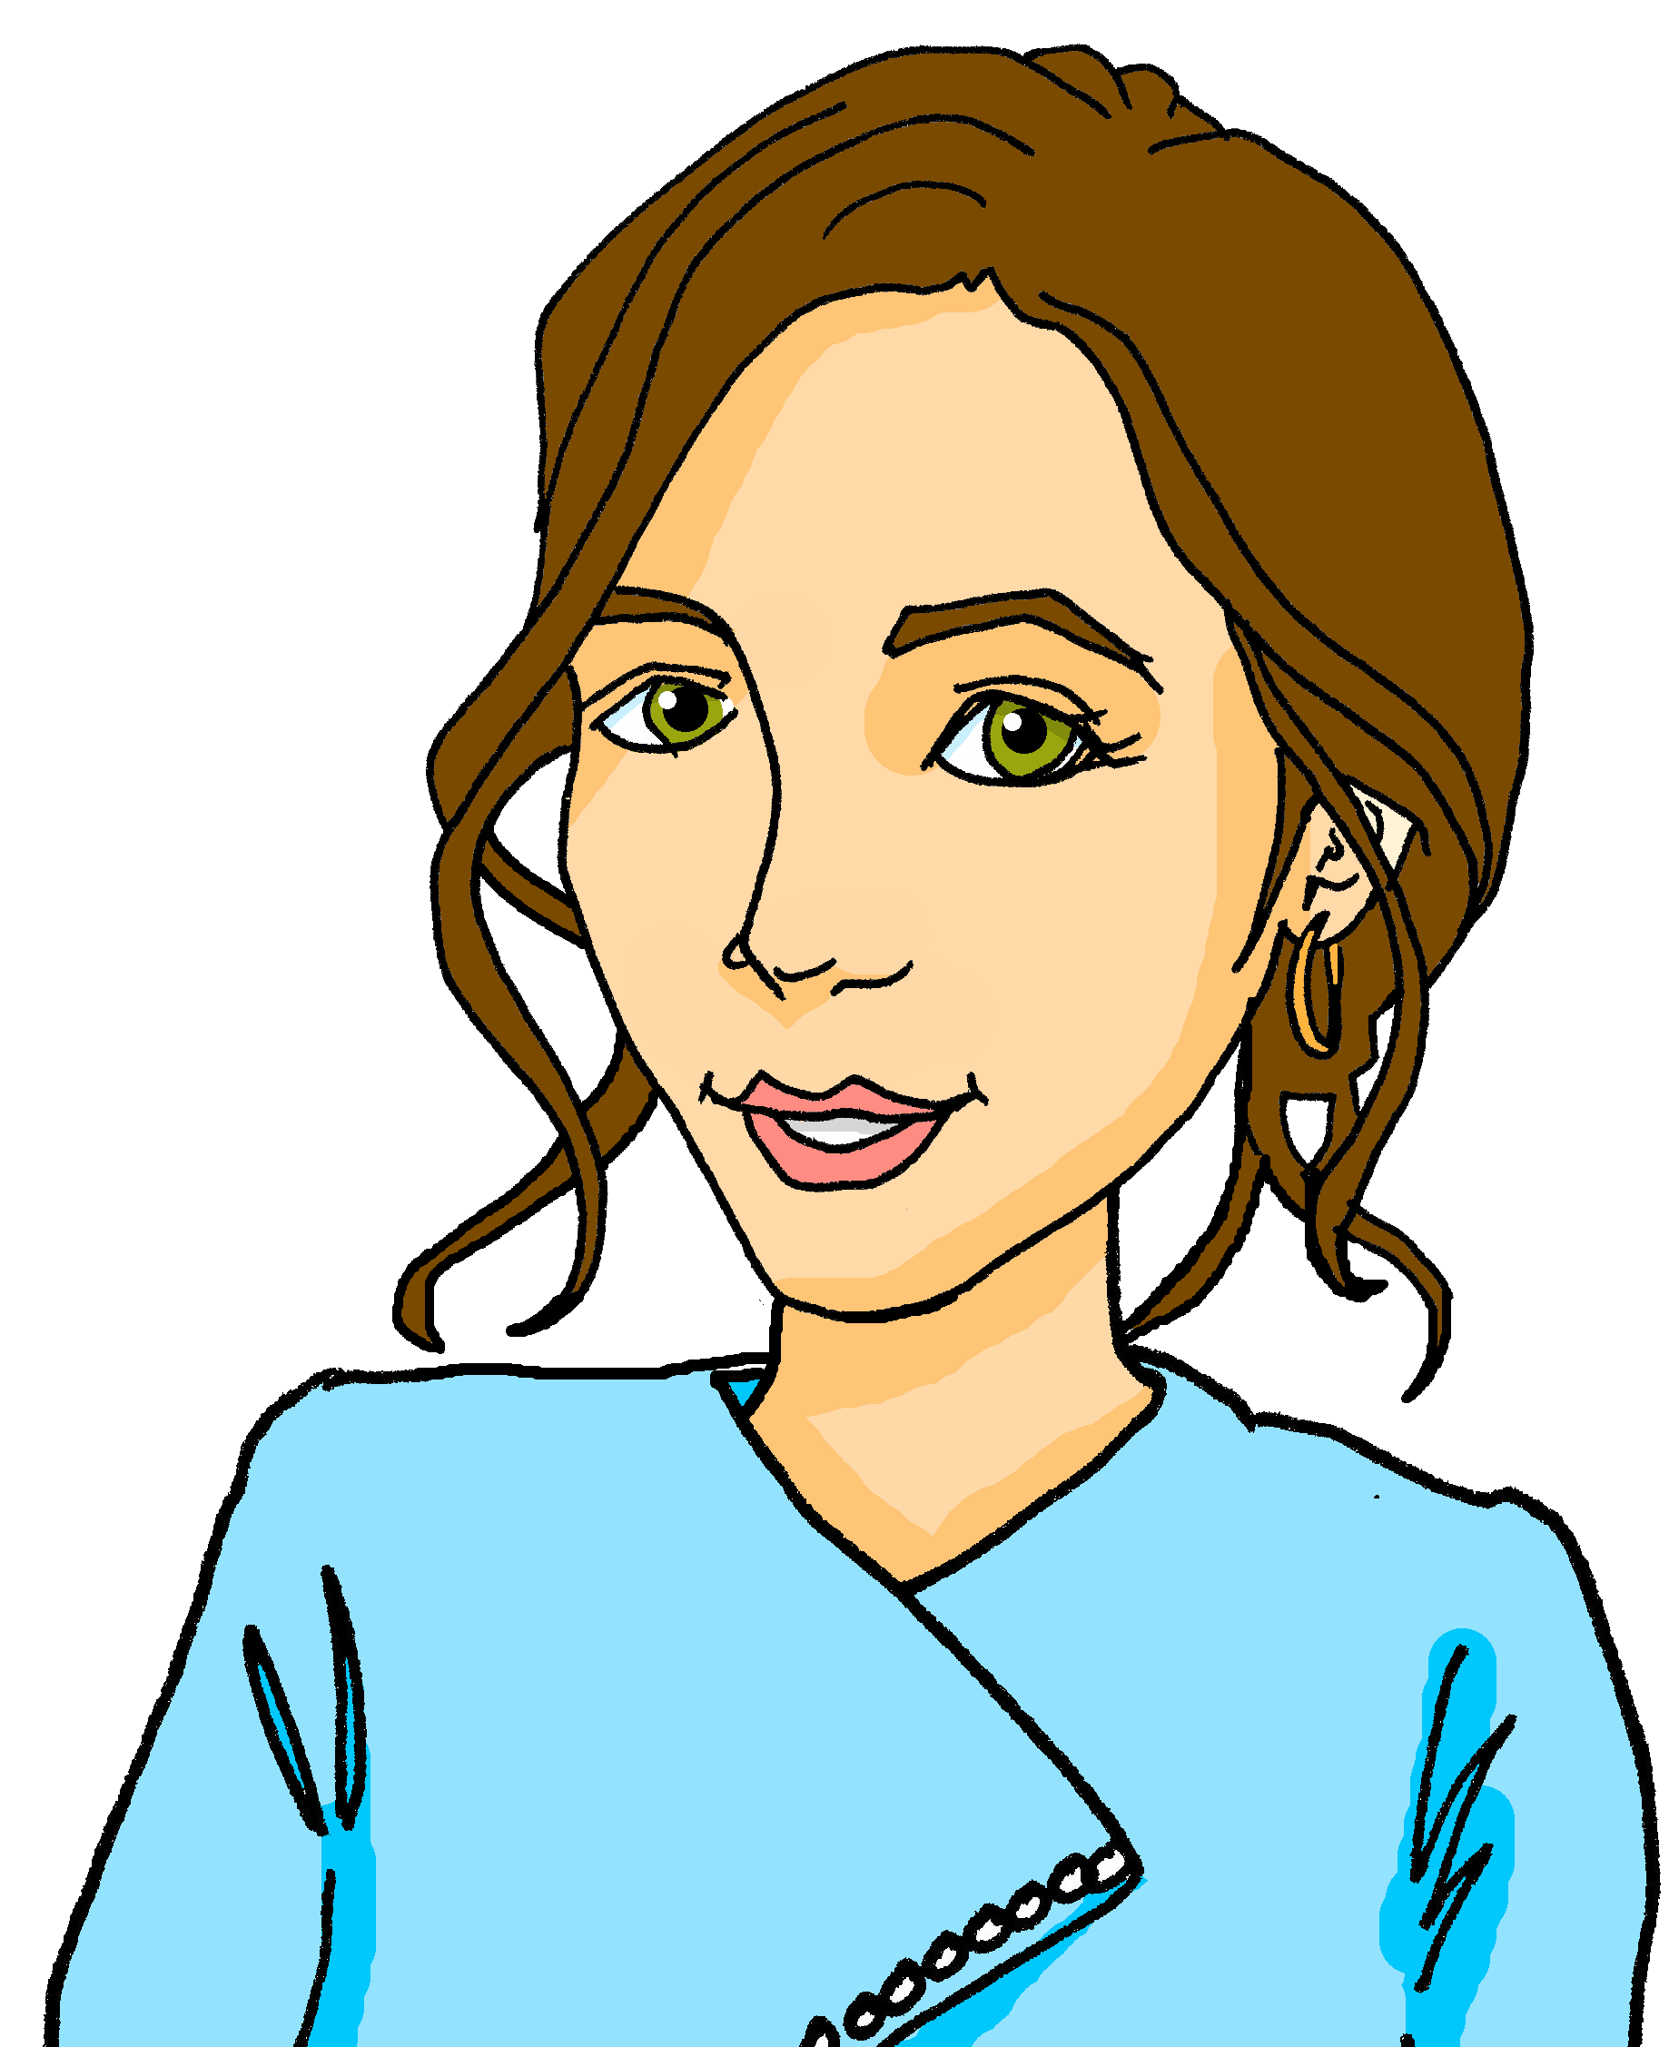
écouter
Les traditions en France [1/7]
Max parle avec la classe de Pierre. Il pose des questions.
Écoute. C’est une question pour la professeure ou pour Pierre ?
1
[Tu] prépares une galette en janvier ?
Notes:
Timing: 8 minutes (7 slides)
Aim: to practise aural comprehension of tu and vous forms of the verb, and their connection with meaning.
Procedure
Read the title and scenario and clarify the context and the activity with pupils. Remind pupils that the tu form means ‘you’ for one person you know well and vous form is ‘you’ in a formal context (e.g. to your teacher).
Pupils listen to each question and decide who it is addressed to, depending on the form of the verb they hear. The pronouns are beeped out to focus pupils’ attention on the verb form.
Click to highlight the answer and see the question in writing.
Elicit the English meaning of the question.
Transcript:
[Tu] prépares une galette en janvier ?
5

Slide 6
écouter
Les traditions en France [2/7]
Max parle avec la classe de Pierre. Il pose des questions.
Écoute. C’est une question pour la professeure ou pour Pierre ?
2
[Vous] avez la tradition des fanaux en France ?
Notes:
[2/7]
Transcript:
[Vous] avez la tradition des fanaux en France ?
6

Slide 7
écouter
Les traditions en France [3/7]
Max parle avec la classe de Pierre. Il pose des questions.
Écoute. C’est une question pour la professeure ou pour Pierre ?
3
[Vous] organisez des jeux en classe en décembre ?
Notes:
[3/7]
Transcript:
[Vous] organisez des jeux en classe en décembre ?
7

Slide 8
écouter
Les traditions en France [4/7]
Max parle avec la classe de Pierre. Il pose des questions.
Écoute. C’est une question pour la professeure ou pour Pierre ?
4
[Tu] chantes des chansons de Noёl en anglais ?
Notes:
[4/7]
Transcript:
[Tu] chantes des chansons de Noёl en anglais ?
8

Slide 9
écouter
Les traditions en France [5/7]
Max parle avec la classe de Pierre. Il pose des questions.
Écoute. C’est une question pour la professeure ou pour Pierre ?
5
[Tu] donnes les cadeaux quel jour en France ?
Notes:
[5/7]
Transcript:
[Tu] donnes les cadeaux quel jour en France ?
9

Slide 10
écouter
Les traditions en France [6/7]
Max parle avec la classe de Pierre. Il pose des questions.
Écoute. C’est une question pour la professeure ou pour Pierre ?
6
[Vous] aimez Noёl ?
Notes:
[6/7]
Transcript:
[Vous] aimez Noёl ?
10

Slide 11
écouter
Les traditions en France [7/7]
Max parle avec la classe de Pierre. Il pose des questions.
Écoute. C’est une question pour la professeure ou pour Pierre ?
7
[Tu] souhaites ‘Bonne Année’ à tout le monde ?
Notes:
[7/7]
Transcript:
[Tu] souhaites ‘Bonne Année’ à tout le monde ?
11

Slide 12
Plural nouns
You know you can add –s to many nouns to make them plural.
J’ai un livre et une fleur.
J’aime les livres et les fleurs.
I have a book and a flower.
I like (the) books and (the) flowers.
Nouns ending in –au and –eu add –x to make them plural.
The –x is a Silent Final Consonant.
J’ai un cadeau.
J’aime les cadeaux.
I have a present.
I like (the) presents.
J’ai un jeu.
J’aime beaucoup les jeux.
I have a game.
I really like (the) games.
You hear the –al → -aux change.
Nouns ending in –al change to –aux.
J’ai un animal.
J’adore les animaux.
I have an animal.
I love (the) animals.
Notes:
Timing: 2 minutes
Aim: to recap the –s plural noun pattern, and introduce two more plural patterns.
Procedure:
Click through the animations to present the information.
Elicit English translations for the French examples provided.

Slide 13
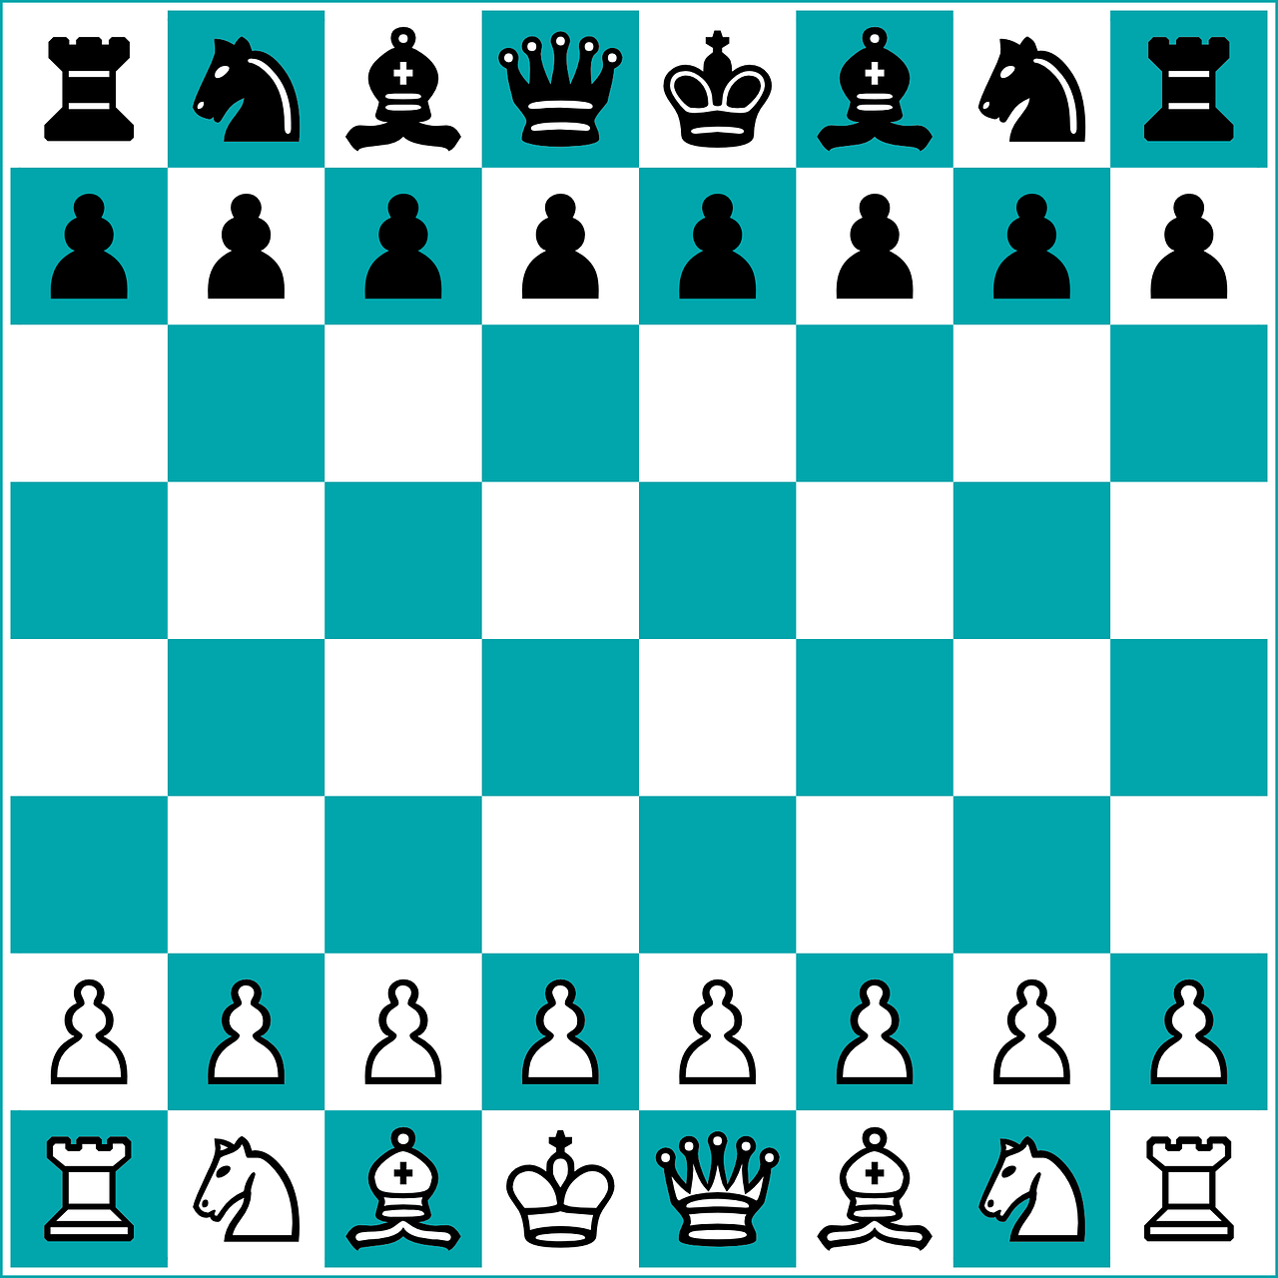
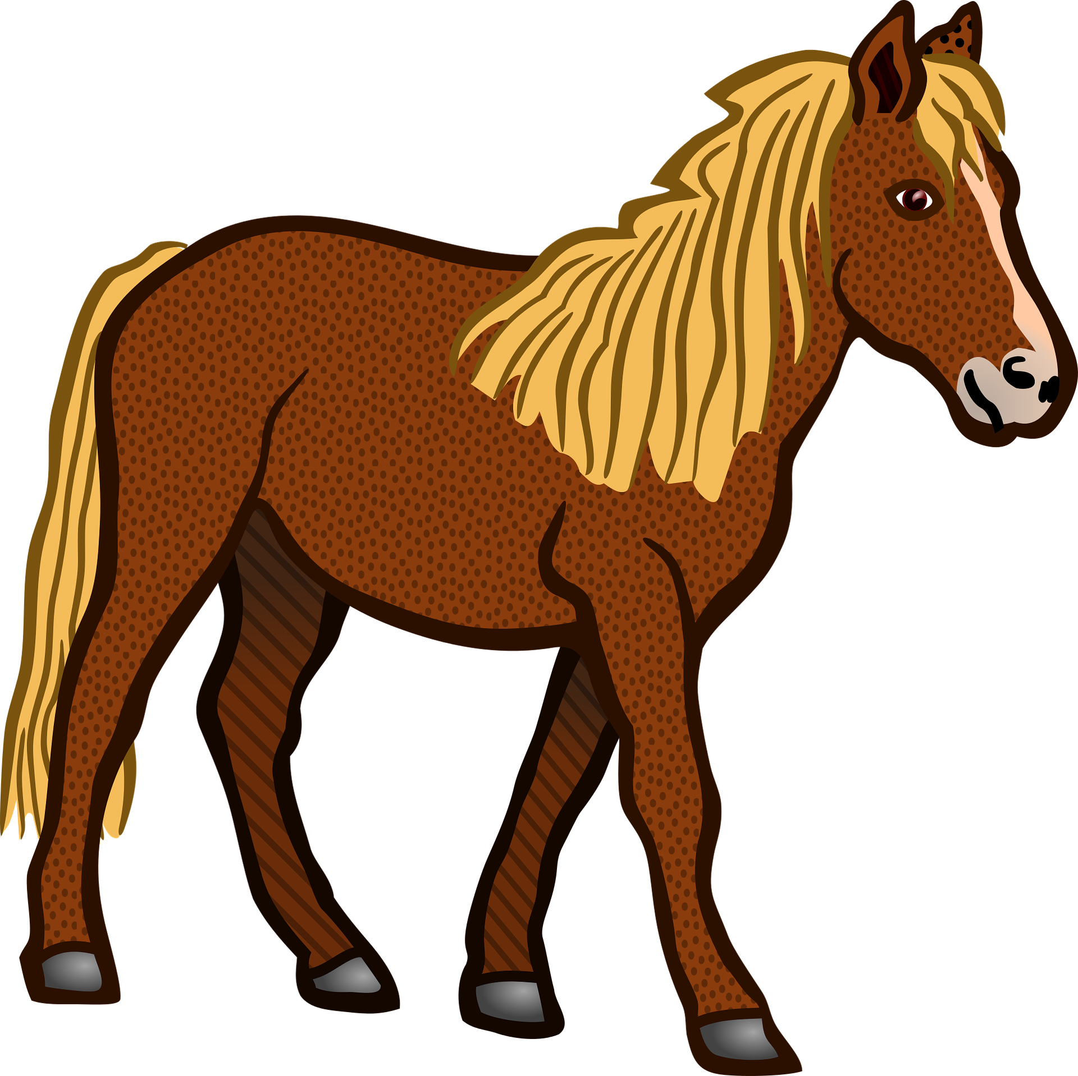
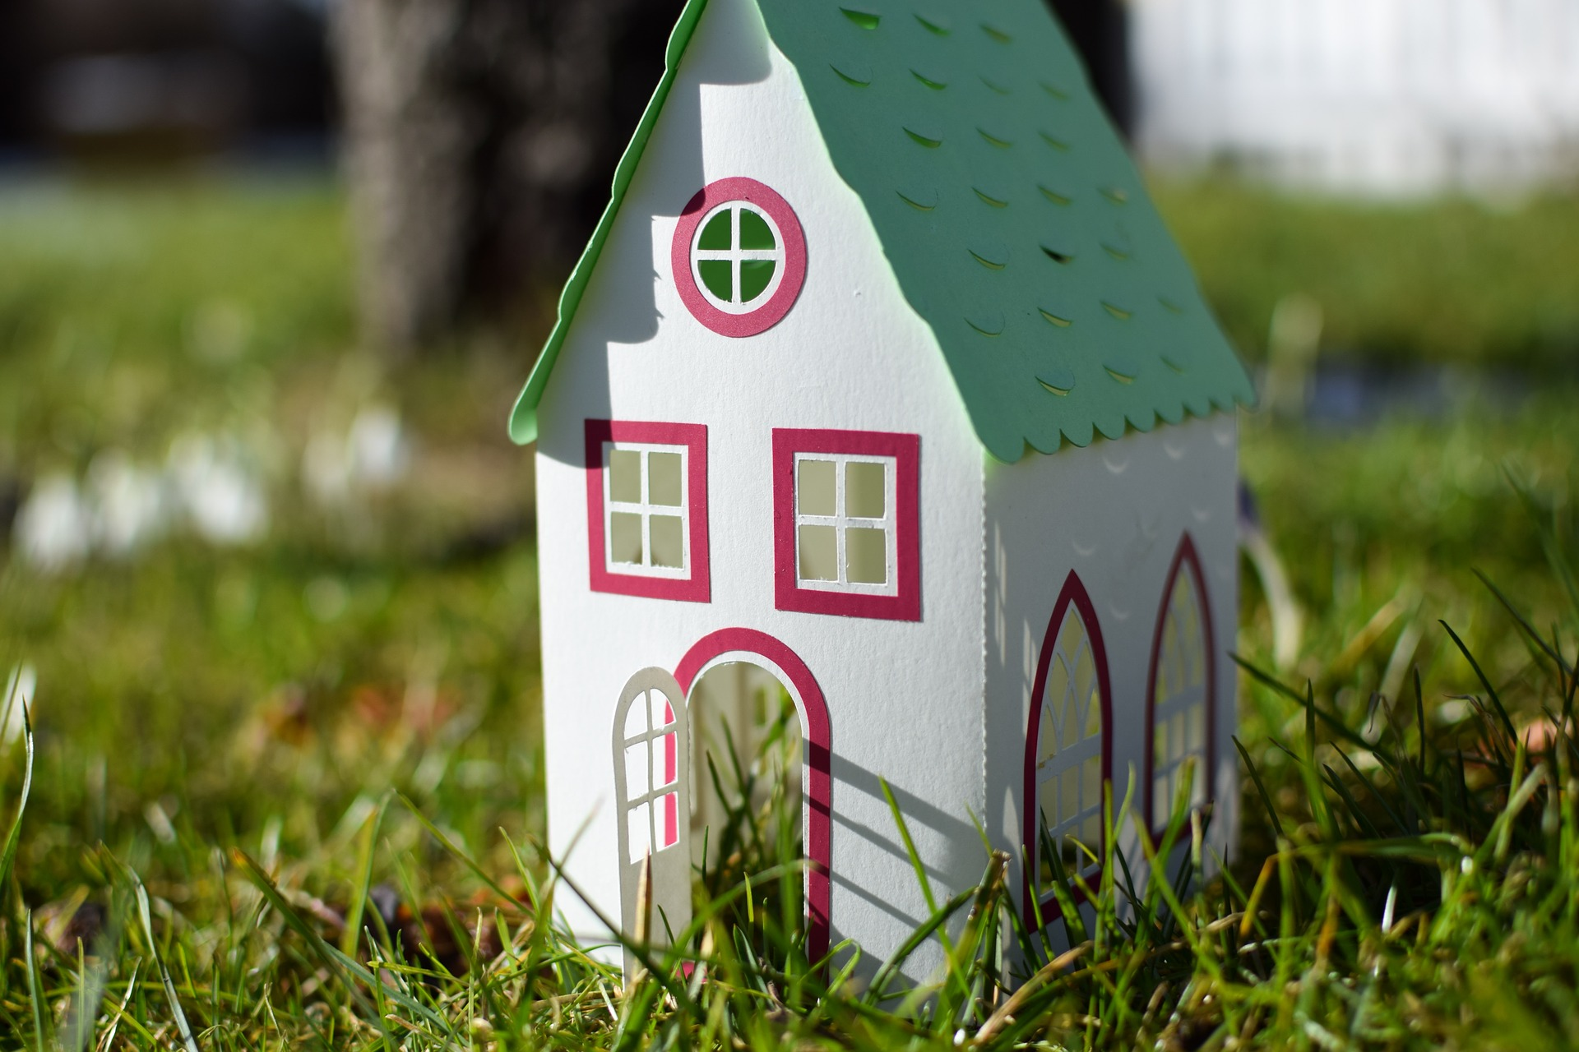
vocabulaire
Vocabulaire
mots
jeu
jeux
cadeau
cadeaux
animal
animaux
feu
feux
chapeau
chapeaux
cheval
chevaux
vœu
vœux
gâteau
gâteaux
fanal
fanaux
Notes:
Timing: 4 minutes
Aim: to practise pronunciation of the plural forms of previously taught vocabulary and to introduce two new items of vocabulary.
Note: for nouns ending in –eu and –(e)au the singular and plural forms sound identical; for those ending in –al the plural forms sound different.
Procedure: 1. Click to bring up each picture.
2. Pupils say the French word (before or after it appears, depending on their knowledge)
3. If desired, click on each word to hear it pronounced.
13

Slide 14
lire
Singulier ou pluriel ?
Lis et écris le numéro (1-9) et la bonne lettre (a ou b).
chevaux |  | chapeau |  | animaux
1a | 1b | 4a | 4b | 7a | 7b
fanal |  | vœux |  | jeux
2a | 2b | 5a | 5b | 8a | 8b
cadeaux |  | feu |  | gâteau
3a | 3b | 6a | 6b | 9a | 9b
Notes:
Timing: 5 minutes
Aim: Written recognition of singular and plural noun markers, ending -eu, -au, and -al.
Procedure:
1. Students write 1-9 and a or b according to whether the noun is singular or plural.
2. Answers are revealed on a mouse click.
3. Clarify meanings in English (if necessary) with students before moving on.

Slide 15
Au revoir !
bleu
Notes:
15

