Slide 1
Saying what I and others do
Des traditions de Noёl
bleu
-ER verbs: we, you (plural)
des + plural nouns
SSC [é, er, et, ez]
Notes:
Artwork by Steve Clarke. Pronoun pictures from NCELP (www.ncelp.org). All additional pictures selected from Pixabay and are available under a Creative Commons license, no
attribution required.
Phonics: revisit [é] [er] [et] [ez] - répéter [630] écrire [382] bébé [2271] donner [46] parler [106] et [6] nez [2661]
Vocabulary (new words in bold): célébrer [2170] échanger [1452] fabriquer [1231] souhaiter [403] feu d'artifice [>5000] rue [598] tout le monde [n/a]
Revisit 1: ont [8] ils [13] elles [38] bureau [273] chaise [3419] chose [125] espace [870] fenêtre [1601] jardin [2284] idée [239] lampe [4699] ordinateur [2201] salle [812] beau belle [393] bon bonne [94] mauvais [274] nouveau nouvelle [52] vieux vieille [671] de2 [2] beaucoup de [150] chez [206]
Revisit 2: sont [5] ils [13] elles [38] sérieux [412], heureux [764] curieux [2424] courageux [2198] aussi [44] et [6] mais [30] Londsale, D., & Le Bras, Y. (2009). A Frequency Dictionary of French: Core vocabulary for learners London: Routledge.
The frequency rankings for words that occur in this PowerPoint which have been previously introduced in these resources are given in the SOW and in the resources that first
introduced and formally re-visited those words.
For any other words that occur incidentally in this PowerPoint, frequency rankings will be provided in the notes field wherever possible.
1

Slide 2
prononcer
[é]
[er]
[et]
[ez]
Remember that [é], [er],[et] and [ez] sound the same.
répéter
[and]
écrire
parler
et
bébé
donner
nez
[to give]
Notes:
Timing: 2 minutes
Aim: to recap SSC [é] [er] [et] [ez], which are the same sound written differently.
Procedure:
Introduce and elicit the pronunciation of the individual SSC [é, et, et, ez] and the source word ‘répéter’, which has both spellings of the sound.
Click to bring on the picture and get students to repeat (with gesture, if using).
Present and practise the cluster words.
Gesture: gesture for répéter – hand with thumb and two fingers pointing forwards doing a three downwards motions, one for each syllable of the word.
https://www.signbsl.com/sign/repeat (the 2nd video marked again: repeat with the female signer)
2

Slide 3
vocabulaire
Écoute et répète. [1/2]
mots
célébrer
échanger
[to exchange, exchanging]
[to celebrate, celebrating]
fabriquer
souhaiter
[to make, create making, creating]
[to wish, wishing]
Notes:
Timing: 4 minutes (two slides)
Aim: to introduce key vocabulary for the context of classroom activities (a range of infinitive verbs).
Procedure: 1. Pupils either work in pairs, reading the French words out loud and looking at the English meanings (1 minute). 2. Then the teacher removes the English words or pictures (one by one) and pupils try to recall the English orally (chorally), looking at the French (1 minute). 3. Then the French meanings are removed (one by one) and pupils try to recall them orally (again, chorally), looking at the English (1 minute) 4. Further rounds of learning can be facilitated by one pupil turning away from the board, and his/her partner asking him/her the meanings (‘Comment dit-on XXX en anglais/français ?’). This activity can work from L2 → L1 or L1 → L2.
3

Slide 4
vocabulaire
Écoute et répète. [2/2]
mots
le feu d’artifice
la rue
[road, street]
[firework]
tout le monde
[everyone]
les feux d’artifice
l’église (f)
[fireworks]
[church]
Notes:
[2/2]
4

Slide 5
vocabulaire
mots
le feu d’artifice
échanger
souhaiter
tout le monde
la rue
l’église (f)
les feux d’artifice
fabriquer
célébrer
road, street
to exchange, exchanging
to wish, wishing
to celebrate, celebrating
to make, create
everyone
fireworks
church
firework
Notes:
Timing: 3 minutes
Aim: to practise written recognition of the new vocabulary for this week.
Procedure: 1. Elicit pronunciation from pupils for the French words.
2. Click for an English prompt.
3. Elicit the French word from pupils. 4. Continue until all 9 items have been seen and heard.
5

Slide 6
Knowing who does what [1/2]
It is also the form of a verb you see in a dictionary.
[–er verbs: ‘we’ and ‘you (plural)’]
We know the infinitive verb tells us the general meaning:
célébrer
to celebrate
To mean ‘we’ with a verb, remove –er and add –ons:
Remember: chez means ‘at the house of’.
chez nous literally means at the house of ‘we/us’.
Nous célébrons Noёl chez nous.
We celebrate Christmas at our house.
To mean ‘you(plural)’ with a verb:
Vous célébrez Noёl chez vous.
You celebrate Christmas at your house.
Notes:
[1/2]
Timing: 3 minutes (two slides)
Aim: to introduce 1st and 2nd persons plural for –er verbs.
Procedure:
Click through the animations to present the new information.
Elicit English translations for the French examples provided.

Slide 7
Knowing who does what [2/2]
[–er verbs: ‘we’ and ‘you (plural)’]
échanger
to exchange
Note: add an ‘e’ to the nous form when the verb stem ends in –g (e.g. échang-)
Nous échangeons des cadeaux.
We exchange presents.
Vous échangez des cartes, aussi.
You exchange cards, too.
Joyeux Noёl
Notes:
Timing: 3 minutes (two slides)
Aim: to introduce 1st and 2nd persons plural for –er verbs.
Procedure:
Click through the animations to present the new information.
Elicit English translations for the French examples provided.

Slide 8
lire
Un accident !
Clémentine has spilled glitter over her Christmas English homework.
1
Nous célébrons Noёl à la maison avec la famille.
We celebrate Christmas at home with family.
 | we | you (all)
1
2
3
4
5
6
2
Nous préparons une salade de fruits.
Verbe
We prepare a fruit salad.
we celebrate
3
Vous chantez des chansons dans la rue.
You (all) sing songs in the street.
we prepare
4
Nous fabriquons des fanaux en papier. C’est une belle tradition.
you (all) sing
We make paper lanterns. It’s a lovely tradition.
5
Vous cherchez les décorations.
we make
You (all) look for the decorations.
6
Vous souhaitez « Joyeux Noёl » à tout le monde.
you (all) look for
You (all) wish ‘Happy Christmas’ to everyone.
you (all) wish
Notes:
Timing: 7 minutes
Aim: to practise written comprehension of 1st and 2nd person plural –ER verbs.
Procedure:
Read the title and explain the context of the task.
Do [1] with them to model the task and draw their attention to the verb (célébrons). Is it ‘we’ or ‘you (plural)’?
Pupils complete 2-6.
Click through the animations to bring up answers.
Finally, if desired, click on the numbered buttons to hear full audio for each sentence.
8

Slide 9
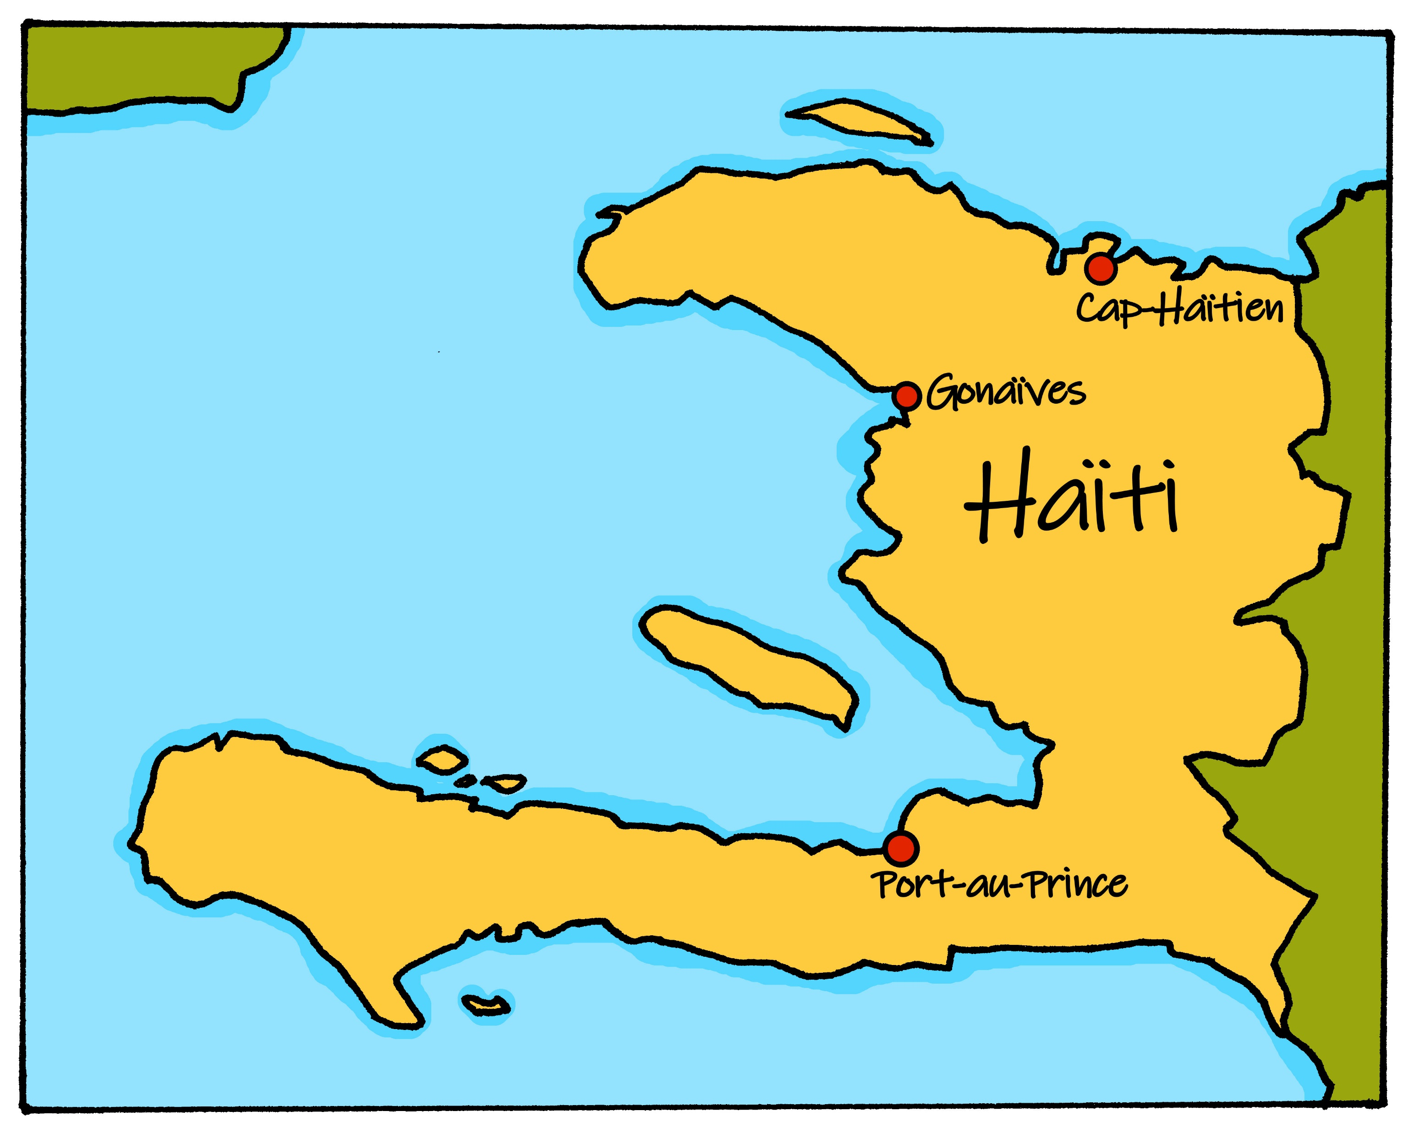
lire
Noёl à Haïti
Nous célébrons Noёl comment ?
Un fanal est une sorte de lanterne. C’est une belle tradition à Haïti.
En général, nous souhaitons « Jwaye Nwel » à Haïti. C’est la phrase typique en créole haïtien.
Notes:
Timing: 2 minutes
Aim: to present cultural information about Christmas in Haiti.
Procedure:
Read the title.
Click on the first speech bubble to hear the audio.
Clarify meaning.
Click to bring up the 2nd speech bubble.
Elicit the English meaning.
Practise saying Merry Christmas in Haitian Creole.
Sources: https://haitiancreole.net/merry-christmas/
Short 1 minute video clip about les fanaux: https://www.youtube.com/watch?v=KPLZfpmA31Q
Permission: permission for photos requested 24 November 2021 www.haitifriends.org
9

Slide 10
écouter
Noёl à Haïti et en France.
Écoute les messages de Clémentine.
C’est Clémentine et Jean-Michel (nous) ? Ou c’est Adèle et Pierre (vous) ?
 | we | you (all)
Écoute et écris en anglais.
1
1
make paper decorations.
… __________________________________________
2
2
prepare activities for the family.
… __________________________________________
3
3
wish everyone ‘Merry Christmas’.
… __________________________________________
4
4
listen to songs in the church.
… __________________________________________
5
5
La température à Haïti en décembre est d’environ 30 degrés !
watch fireworks from the window of my bedroom.
… __________________________________________
6
6
watch films on the tv.
… __________________________________________
7
7
celebrate in the house but we celebrate in the garden.
… __________________________________________
Notes:
Timing: 7 minutes
Aim: to practise aural recognition of infinitive verbs, their position and corresponding meaning in English.
Procedure:
Read the title and click to bring up the instructions.
Clarify the task. Pupils listen out first for the infinitive and note its position in the sentence.
Click to bring up the answers.
Click to bring up the 2nd table and instruction.
Pupils listen again and write the infinitive.
They also write the English meaning, using the gapped English sentence for support.
Note: for additional challenge pupils could turn away and try to complete the task without the English sentence support.
7. Click to elicit and confirm the answers.
Transcript:
[Vous] fabriquez des décorations en papier. [Nous] préparons des activités pour la famille. [Nous] souhaitons ‘Joyeux Noёl’ à tout le monde.
[Vous] écoutez des chansons dans l’église. [Nous] regardons des feux d’artifice de la fenêtre de ma chambre. [Vous] regardez des films à la télé. [Vous] célébrez dans la maison mais nous célébrons dans le jardin.
10

Slide 11
Au revoir !
bleu
Notes:
11

