Slide 1
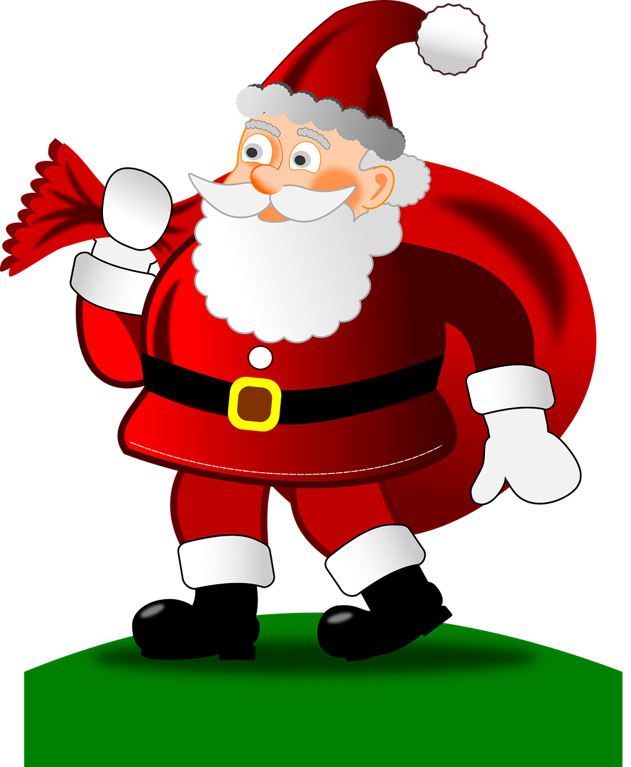
Saying what I and others do
Des traditions de Noёl
bleu
Follow ups 1-5
Notes:
Artwork by Steve Clarke. Pronoun pictures from NCELP (www.ncelp.org). All additional pictures selected from Pixabay and are available under a Creative Commons license, no
attribution required.
Phonics: revisit [é] [er] [et] [ez] - répéter [630] écrire [382] bébé [2271] donner [46] parler [106] et [6] nez [2661]
Vocabulary (new words in bold): célébrer [2170] échanger [1452] fabriquer [1231] souhaiter [403] feu d'artifice [>5000] rue [598] tout le monde [n/a]
Revisit 1: ont [8] ils [13] elles [38] bureau [273] chaise [3419] chose [125] espace [870] fenêtre [1601] jardin [2284] idée [239] lampe [4699] ordinateur [2201] salle [812] beau belle [393] bon bonne [94] mauvais [274] nouveau nouvelle [52] vieux vieille [671] de2 [2] beaucoup de [150] chez [206]
Revisit 2: sont [5] ils [13] elles [38] sérieux [412], heureux [764] curieux [2424] courageux [2198] aussi [44] et [6] mais [30]
Londsale, D., & Le Bras, Y. (2009). A Frequency Dictionary of French: Core vocabulary for learners London: Routledge.
The frequency rankings for words that occur in this PowerPoint which have been previously introduced in these resources are given in the SOW and in the resources that first
introduced and formally re-visited those words.
For any other words that occur incidentally in this PowerPoint, frequency rankings will be provided in the notes field wherever possible.

Slide 2
Follow up 1: la liaison
You know that ‘s’ is usually a Silent Final Consonant.
prononcer
But…
when the ‘s’ is followed by a vowel you often pronounce it.
Always pronounce ‘s’ between pronoun and verbs that start with a vowel…
and between article and nouns that start with a vowel.
Vous avez des ordinateurs.
You (all) have some computers.
Remember: liaison can occur with –t as well as –s. E.g., ils ont une maison.
Remember that this is called liaison.
Notes:
Timing: 1 minute
Aim: to recap knowledge about liaison.
Procedure:
Click to present the information.
Click the audio button to hear the French example.
Elicit the English meaning.

Slide 3
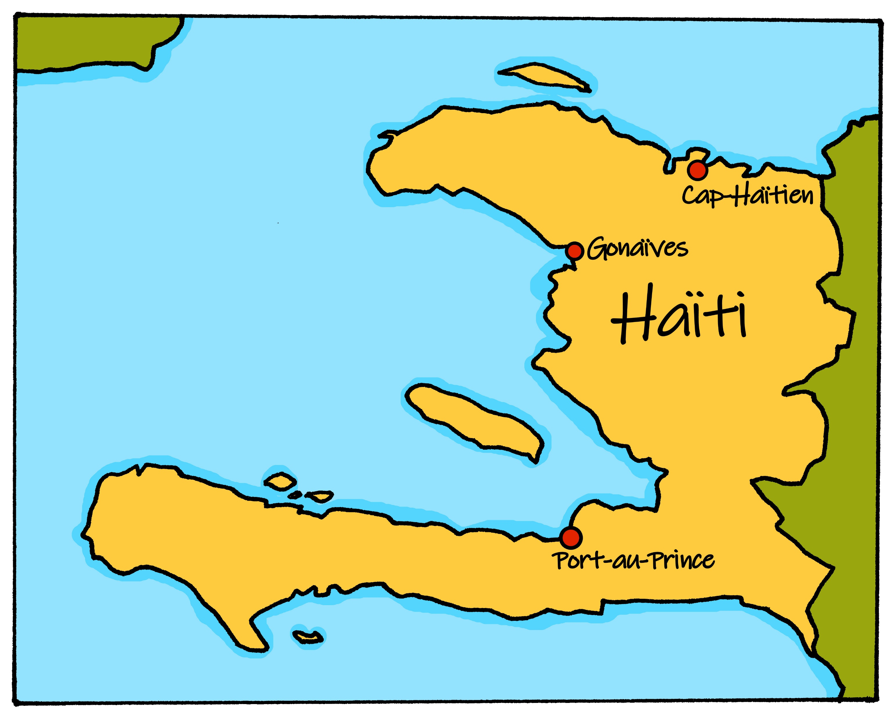
Follow up 1: la liaison [1/2]
Lis les phrases avec ton/ta partenaire. Trouve les liaisons.
prononcer
Exemple:
Port-au-Prince est la capitale d’Haïti.
A
Vous échangez des opinions.
Vous échangez des opinions.
B
//
 | A | B
Nous avons des cadeaux pour tout le monde.
/
1
Nous avons des cadeaux pour tout le monde.
Nous visitons la famille à Port-au-Prince.
/
2
Nous visitons la famille à Port-au-Prince.
Vous écoutez des chansons.
/
3
Vous écoutez des chansons.
Notes:
Timing: 4 minutes (two slides)
Aim: to practise oral production of liaison with –s and –t.
Procedure:
Present the example. Pupil A reads a sentence. Pupil B faces away from the board and notes the number of liaisons heard.
After the example, Pupil B faces away.
Click to bring up Pupil A’s 3 sentences.
Pupil A reads. Pupil B notes the liaisons.
Pupil B turns back.
Click to show the liaisons and click the audio buttons to hear each sentence.
Move to the next slide to swap roles.

Slide 4
Follow up 1: la liaison [2/2]
Lis les phrases avec ton/ta partenaire. Trouve les liaisons.
prononcer
 | B | A
It is possible to pronounce the ‘s’ before avec, but not compulsory: Nous jouons avec des amis.
Vous organisez une fête.
/
1
Vous organisez une fête.
2
Nous jouons avec des amis.
/[/]
Nous jouons avec des amis.
Vous aimez les décorations.
/
3
Vous aimez les decorations.
Notes:
[2/2]

Slide 5
Follow up 2:
a good idea
they have (fpl)
beaucoup de choses
elles ont
mots
Complète les dominos. 🗣
a big room
vocabulaire
une b… idée
une n… lampe
un b… espace
a lot of things
une b… chaise
une n… lampe
an old desk
a good space
they have (fpl)
they have (mpl)
a beautiful garden
a good computer
a new lamp
a good space
a beautiful chair
un v… bureau
une g… salle
beaucoup de choses
ils ont
un b… espace
un b.. jardin
un v… bureau
a big room
un b… ordinateur
a good computer
they have (mpl)
a good idea
a beautiful chair
a new lamp
an old desk
a lot of things
un b.. jardin
a beautiful garden
une g… salle
une b… idée
elles ont
une b… chaise
ils ont
un b… ordinateur
Notes:
Timing: 5 minutes
Aim: to practise written comprehension and spoken pronunciation of vocabulary.
Procedure:
Starting from the play button, pupils work in pairs or chorally, led by the teacher, to complete the domino orally.
If working as a whole class the teacher can click to provide the answers at each turn.
3. The activity can be repeated to speed up recall.
Note: Follow up 3 will focus on practising the adjectives.

Slide 6
Follow up 3:
a good idea
they have (fpl)
beaucoup de choses
elles ont
Écris les adjectifs 1-8. 
mots
vocabulaire
une b… idée
a lot of things
Attention! You do not need all the adjectives.
une b… chaise
une n… lampe
an old desk
a new lamp
a good space
a beautiful chair
ils ont
un b… espace
un v… bureau
a big room
un b… ordinateur
a good computer
they have (mpl)
une g… salle
bon | belle | mauvais | nouvelle
bonne | grand | mauvaise | vieux
beau | grande | nouveau | vieille
un b.. jardin
a beautiful garden
Notes:
Timing: 5 minutes (two slides)
Aim: to practise written production of previously taught prenominal adjectives.
Procedure:
Starting from the play button, pupils write 1-8 and the correct forms of the missing adjectives.
Move to the next slide to provide a scaffold for the answers, and then the answers themselves.

Slide 7
Follow up 3: les réponses
Écris les adjectifs 1-8 . 
mots
vocabulaire
nouvelle
1 | une …………… lampe
2 | un …………….. jardin
3 | une ……………. salle
4 | un …………… espace
5 | un ……………. bureau
6 | une ……………. idée
7 | une …………….. chaise
8 | un ………… ordinateur
beau
grande
bon
vieux
bonne
belle
bon | belle | mauvais | nouvelle
bonne | grand | mauvaise | vieux
beau | grande | nouveau | vieille
bon
Notes:
ANSWERS
Procedure:
Elicit the answers as phrases, orally.
Click to confirm the written answers.
Elicit the English meanings of the remaining adjectives in the table.

Slide 8
Some | des
un, une = a/an, one des = some
des
To say ‘some’ (plural), use _______.
Il a des livres.
He has some books.
⚠ Remember to pronounce the ‘s’ when des is followed by a vowel:
Il a des questions.
He has (some) questions.
Vous avez des ordinateurs.
⚠ In English we can miss out ‘some’ but we always need des in French.
You (all) have (some) computers.
Notes:
Use before Follow Up 4
Timing: 1 minute
Aim: to revisit the indefinite article ‘des’ (some).
Procedure:
Click through the animations to present the information.
Elicit English translations for the French examples provided.

Slide 9
Follow up 4:
Parle avec ton/ta partenaire.
Personne A commence et personne B termine la phrase.
parler
Personne A
1) We wish…
……………………………….
Personne B
[we] | [you all]

… «Joyeux Noёl » à tout le monde.
… «Joyeux Noёl » à Maman et Papa.
|
We wish ‘Merry Christmas’ to everyone.
Nous souhaitons…
… «Joyeux Noёl » à tout le monde.
B
A
Notes:
Timing: 5 minutes
Aim: to practise oral production and aural recognition of ‘we’ and ‘you (plural)’ verbs; to practise clear pronunciation when reading aloud.
Procedure: 1. Use this slide to model the task.
2. Pupil A produces the verb and pronoun in French.
3. Pupil B completes the sentence, based on the verb form heard.
4. Pupil A writes down the full sentence meaning in English.
5. Then they will swap roles and repeat the task. 6. See next slides for answers, and handouts at the end of the presentation.

Slide 10
parler
Round 1
Personne A
1) We wish…
……………………………….
2) We watch…
……………………………….
3) You (all) sing…
……………………………….
4) You (all) make…
……………………………….
5) We eat…
………………………………..
6) We exchange… ………………………………..
Personne B
[we] | [you all]
parler
… «Joyeux Noёl » à tout le monde.
… «Joyeux Noёl » à Maman et Papa.
We wish ‘Merry Christmas’ to everyone.
… des feux d’artifice.
… des films.
We watch fireworks.
… des chansons de Noёl.
… des chansons dans la rue.
You (all) sing songs in the street.
… des fanaux.
… des décorations en papier.
You (all) make paper decorations.
… une salade de fruits.
… un grand gâteau.
We eat a fruit salad.
… des cadeaux.
… des cartes.
We exchange cards.
Notes:
ANSWERS ROUND 1
10

Slide 11
parler
Round 2
Personne B
1) You (all) have…
……………………………….
2) You (all) dance…
……………………………….
3) We prepare…
……………………………….
4) You (all) celebrate…
……………………………….
5) We exchange…
………………………………..
6) You (all) are… ………………………………..
Personne A
[we] | [you all]
parler
… Tonton Noёl.
… Père Noёl.
You (all) have Father Christmas.
… dans la maison.
… dans le jardin.
You (all) dance in the garden.
… des activités.
… des chansons.
We prepare some activities.
… Noёl chez vous.
… Noёl dans le jardin.
You (all) celebrate Christmas n the garden.
… des cadeaux.
… des cartes.
We exchange presents.
… heureux.
… curieux.
You (all) are curious.
Notes:
ANSWERS ROUND 2
11

Slide 12
vocabulaire
Follow up 5 - Écris en français : Can you get at least 15 points?
mots
 | but | brave (fpl) | serious (mpl)
 | they are (mpl) | they are (fpl) | also
 | at the house of | a lot of | window
 | bad (f) | new (m) | old (f)
 | church | fireworks | everyone
 | to wish | firework | road, street
 | to celebrate | to exchange | to make, create
mais
courageuses
sérieux
x3
ils sont
elles sont
aussi
chez
beaucoup de
la fenêtre
x2
mauvaise
nouveau
vieille
l’église
les feux d’artifice
tout le monde
souhaiter
le feu d’artifice
la rue
x1
célébrer
échanger
fabriquer
Notes:
Timing: 5-10 minutes
Aim: to practise written production of vocabulary from this week and two revisited weeks.
Procedure: 1. Give pupils a blank grid. They fill in the French meanings of any of the words they know, trying to reach 15 points in total. 2. Remind pupils that adjectives can refer to male or female persons and they should reflect this in their translations. E.g. pleased (f) → contente.
Note: The most recently learnt and practised words are pink, words from revisit 1 are green and those from revisit 2 are blue, thus more points are awarded for them, to recognise that memories fade and more effort (heavy lifting!) is needed to retrieve them.
12

Slide 13
vocabulaire
Follow up 5 - Écris en français : Can you get at least 15 points?
mots
 | but | brave (fpl) | serious (mpl)
 | they are (mpl) | they are (fpl) | also
 | at the house of | a lot of | window
 | bad (f) | new (m) | old (f)
 | church | fireworks | everyone
 | to wish | firework | road, street
 | to celebrate | to exchange | to make, create
x3
x2
Notes:
HANDOUT
13

Slide 14
parler
Round 1
Round 2
Personne A
1) We wish…
……………………………….
2) We watch…
……………………………….
3) You (all) sing…
……………………………….
4) You (all) make…
……………………………….
5) We eat…
………………………………..
6) We exchange ………………………………..
Personne A
[we] | [you all]
parler

… Tonton Noёl.
… Père Noёl.

… dans la maison.
… dans le jardin.

… des activités.
… des chansons.

… Noёl chez vous.
… Noёl dans le jardin.

… des cadeaux.
… des cartes.

… heureux.
… curieux.
Notes:
Handout A
14

Slide 15
parler
Round 1
Round 2
Personne B
Personne B
1) You (all) have…
……………………………….
2) You (all) dance…
……………………………….
3) We prepare…
……………………………….
4) You (all) celebrate…
……………………………….
5) We exchange…
………………………………..
6) You (all) are… ………………………………..
[we] | [you all]
parler
… «Joyeux Noёl » à tout le monde.
… «Joyeux Noёl » à Maman et Papa.

… des feux d’artifice.

… des films.
… des chansons de Noёl.
… des chansons dans la rue.

… des fanaux.
… des décorations en papier.

… une salade de fruits.
… un grand gâteau.


…des cadeaux.
… des cartes.
Notes:
Handout B
15

