Slide 1
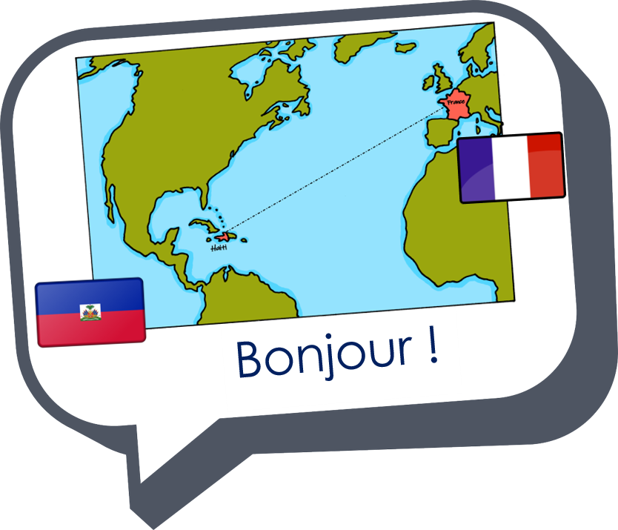









Saying where you are going and what there is there
bleu
Phonics Quiz
Notes:
Artwork by Steve Clarke. Pronoun pictures from NCELP (www.ncelp.org). All additional pictures selected from Pixabay and are
available under a Creative Commons license, no attribution required.
This lesson contains the phonics assessment to check progress in reading aloud the SSC (Sound-symbol correspondences) in the first 23 weeks of this year’s course.
The ratio of old to new language in the quiz is very approximately 50:50.
1

Slide 2

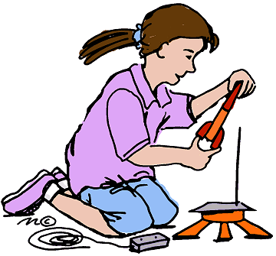

prononcer
[è|ê]
[oi]
prononcer
le modèle
le poisson
Notes:
Phonics quiz
Timing: flexible during Week 11
Procedure:
Print out one set of these 14 phonics cards.
Working with one pupil at a time, elicit the pronunciation of each word.
Say: You have not learnt these words, but you have learnt how to read aloud these sounds, so just have a go at reading each word aloud.
Focus only on the accurate pronunciation of the target SSC and tolerate any other inaccuracies.
Use the pupil scoring sheet at the end of this presentation to assess SSC knowledge and give feedback.
Note: Whilst working with individual children, others can be doing the Easter activities at the end of this presentation.
2

Slide 3



prononcer
[en|an]
closed
[eu]
prononcer
[German (f)]
allemande
je peux
Notes:
3

Slide 4

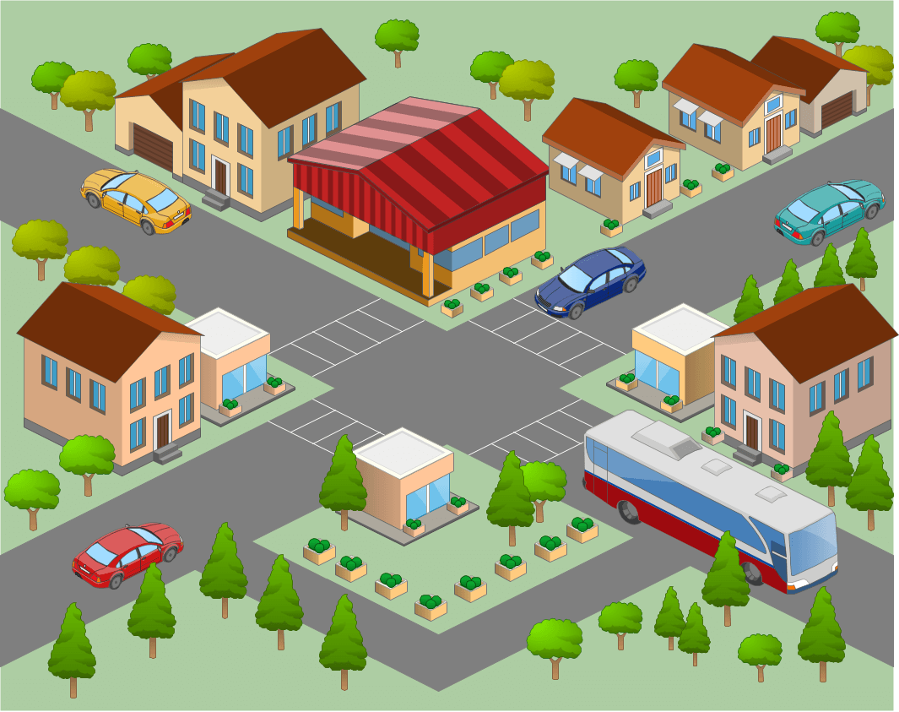

prononcer
[en|an]
[a]
prononcer
le centre
frapper
Notes:
4

Slide 5
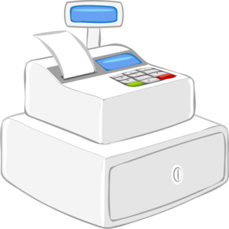

prononcer
[i]
[ai]
prononcer
[till]
le prix
la caisse
Notes:
5

Slide 6


prononcer
[on]
[é|er|ez]
prononcer
l’escalier
l’avion
Notes:
6

Slide 7
prononcer
Pupil name:
Pupil name:
SSC and word | px
le modèle
le poisson
allemande
je peux
le centre
frapper
le prix
la caisse
l’avion
l’escalier
SSC and word | px
le modèle
le poisson
allemande
je peux
le centre
frapper
le prix
la caisse
l’avion
l’escalier
Notes:
Pupil feedback and assessment sheet [10 points]
7

Slide 8
prononcer
prononcer
1. Nous avons un pain.
1. Nous avons un pain.
2. Il y a deux acteurs.
2. Il y a deux acteurs.
3. Je vais à Blois .
3. Je vais à Blois .
4. Didier va à Roubaix .
4. Didier va à Roubaix .
5. Le tableau est en Angleterre.
5. Le tableau est en Angleterre.
Notes:
Optional additional sentence read aloud [10 points]
8

Slide 9

Teacher audio version for checking
SSC and word | px
le modèle
le poisson
allemande
je peux
le centre
frapper
le prix
la caisse
l’avion
l’escalier
prononcer
1. Nous avons un pain.
2. Il y a deux acteurs.
3. Je vais à Blois .
4. Didier va à Roubaix .
5. Le tableau est en Angleterre.
Notes:
9

