Slide 1
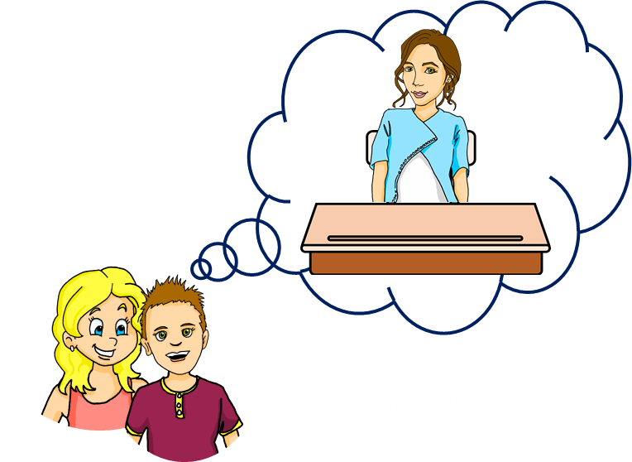
Saying what I and others have
bleu
des (some)
plural adjectives
SSC [au]
Term 1 Week 9
Notes:
Artwork by Steve Clarke. Pronoun pictures from NCELP (www.ncelp.org). All additional pictures selected from Pixabay and are available under a Creative Commons license, no
attribution required.
Phonics: revisit au/eau/o: gauche [607] faux [555] eau [475] photo [1412] aussi [44]
Vocabulary (new words in bold): as [8] a [8] donner [46] organiser [791] parler [106] poser [218] préparer [368] trouver [83] utiliser [345] livre [358] question [144] phrase [2074] problème [188] sac [2343] réponse [456] solution [608] court [545] simple [212] spéciale [726] vrai [292] faux [555] des [de-2] calme [1731] difficile [296] facile [822] important [215] indépendant [854] intéressant [1244] rapide [672] utile [1003]
Revisit 1: sont [5] ils [13] elles [38] sérieux [412], heureux [764] curieux [2424] courageux [2198] aussi [44] et [6] mais [30]
Londsale, D., & Le Bras, Y. (2009). A Frequency Dictionary of French: Core vocabulary for learners London: Routledge.
The frequency rankings for words that occur in this PowerPoint which have been previously introduced in these resources are given in the SOW and in the resources that first
introduced and formally re-visited those words.
For any other words that occur incidentally in this PowerPoint, frequency rankings will be provided in the notes field wherever possible.
1

Slide 2
[au]
prononcer
[au / eau / o]
gauche
Notes:
Timing: 2 minutes
Aim: to present SSC [au].
Procedure:
Click to bring up the SSC [au]. Repeat the SSC [au] and the source word gauche with the class. Introduce the gesture, if using.
Click to bring up the picture.
Pupils to practise saying the SSC and source word several times.
Suggested gesture: https://www.signbsl.com/sign/left Tap the left forearm with the right hand.

Slide 3
[au]
gauche
prononcer
[au / eau / o]
faux
eau
photo
aussi
[also]
Notes:
Timing: 2 minutes
Aim: To introduce SSC [au]
Procedure:
1. Introduce and elicit the pronunciation of the individual SSC [au] and then the source word again ‘gauche’ (with gesture, if using). 2. Then present and elicit the pronunciation of the five cluster words.
Frequency:
gauche [607] faux [555] eau [475] photo [1412] aussi [44]
Londsale, D., & Le Bras, Y. (2009). A Frequency Dictionary of French: Core vocabulary for learners London: Routledge.

Slide 4
écouter
Écoute. C’est [(e)au] ou [ou] ?
Écris les numéros 1 et 2 dans le bon ordre.
ou
1 | 2
chaud | chou
seau | sous
tôt | tout
doux | dos
trop | trou
1
1
2
2
1
2
3
2
1
4
2
1
5
2
1
Notes:
Timing: 5 minutes
Aim: to practise aural recognition of SSC [(e)au, o] and differentiation between [(e)au, o] and SSC [ou] in unknown words.
Procedure
Pupils listen to the pairs of words.
They write down the order that they hear the words in, either 1-2 or 2-1
Click to reveal the answers.
Transcript:
chaud, chou seau, sous tout, tôt dos, doux trou, trop
Frequency of unknown words and cognates: chaud [1852] chou [>5000] seau [>5000] sous [122] tout [24] tôt [513] dos [1672] doux [2062] trou [2180] trop [195]
Source: Londsale, D., & Le Bras, Y. (2009). A Frequency Dictionary of French: Core vocabulary for learners London: Routledge.
4

Slide 5
Some | des
un, une = a/an, one des = some
des
To say ‘some’ (plural), use _______.
il y a
Remember! To say ‘there are’, use __________.
Il a des livres.
Il y a des livres.
He has some books.
There are some books.
Il a des questions.
Il y a des questions.
He has (some) questions.
There are (some) questions.
⚠ In English we can miss out ‘some’ but we always need des in French.
⚠ In French, he has (il a) and there are (il y a) look and sound a bit similar.
Notes:
Timing: 2 minutes
Aim: to revisit the indefinite article ‘des’ (some).
Procedure:
Click through the animations to present the information.
Elicit English translations for the French examples provided.

Slide 6
écouter
Écoute. C’est au singulier ou au pluriel ?
… !
Choisis ‘one’ ou ‘some’ de 1 à 6.
Écoute encore. C’est ‘he has’ ou ‘there is/are’ ?
 | Il y a une réponse.
 | il y a des questions.
 | Il a des crayons.
 | il a un livre.
 | Il y a des tâches.
 | Il a un problème.
one | some
he has | there is /are
1
2
3
4
5
6
Notes:
Timing: 5 minutes
Aim: to practise aural recognition of one or more than one, from the indefinite article.
Remind pupils that the article is the only way to tell – the –s on the written form of a plural French noun is not pronounced (i.e. is a silent final consonant)!
Procedure
Student listen to the short sentences and decide if they hear un/une or des.
Click to elicit and reveal the answers.
Now, pupils listen again to decide if they hear ‘he has’ or ‘there is/as’
Click to elicit and reveal the answers.
Finally, click to reveal the full sentences and elicit English meanings.
In addition, the pictures at the bottom could be used to elicit ‘un livre’, ‘des livres’ etc.. for additional practice.
Transcript:
Il y a une réponse. Il y a des questions. Il a des crayons. Il a un livre. Il y a des tâches. Il a un problème.
6

Slide 7
Plural adjectives
Singular and plural adjectives sound the same.
As you know many adjectives add -s for plural:
Il y a un crayon vert.
Il y a une question importante.
There is a green pencil.
There is an important question.
Il y a des crayons verts.
Il y a des questions importantes.
There are some green pencils.
There are some important questions.
You don’t hear the difference between singular and plural adjectives because of SFC, so you need to listen out for the article.
Notes:
Timing: 2 minutes
Aim: to recap patterns of plural adjective agreement; to establish that you can often hear gender difference with adjectives but not number difference, so the article is very important.
Procedure:
Click to present the information.
Elicit English translation for the French examples provided.
7

Slide 8
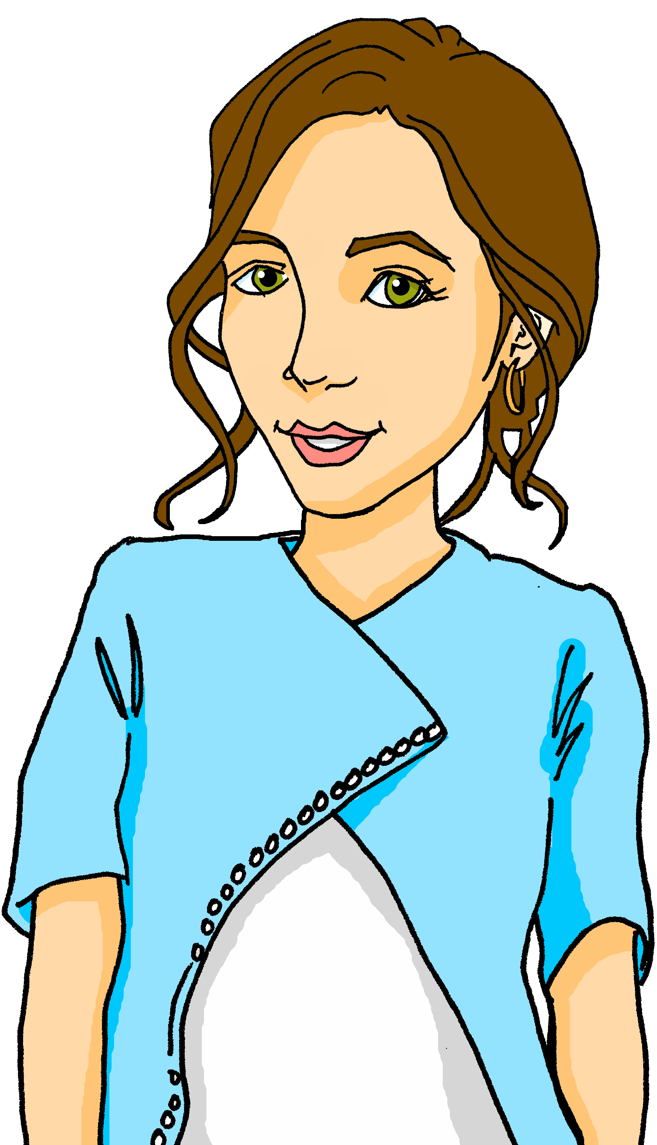
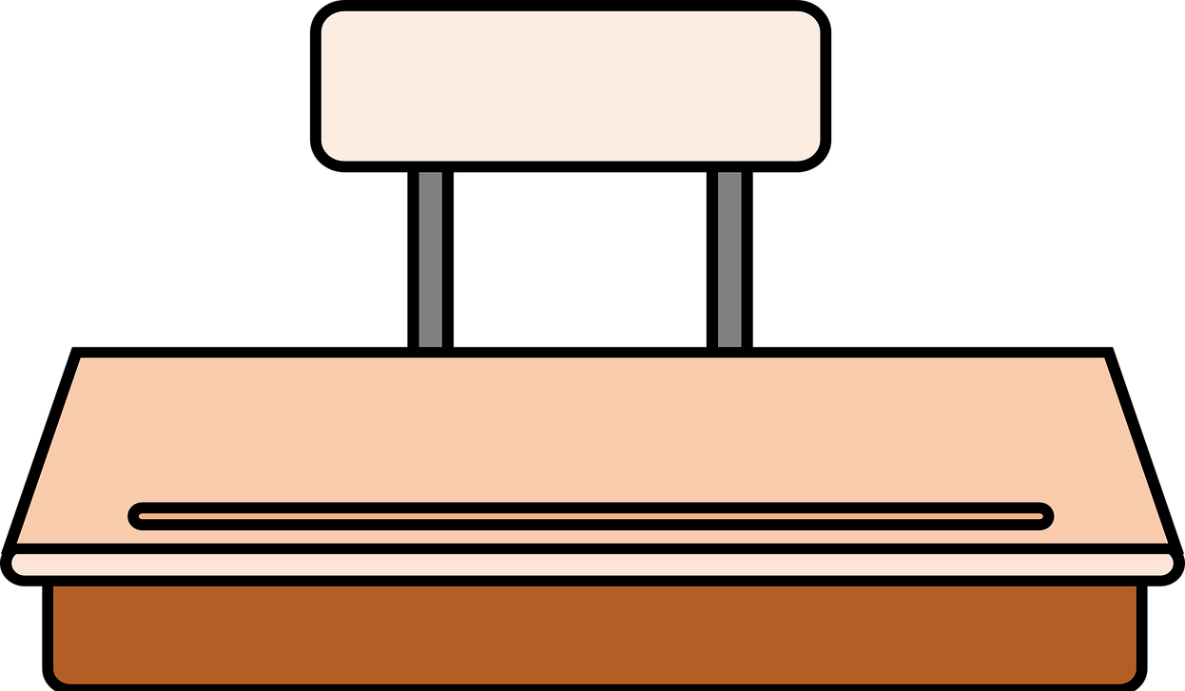
lire
Ma professeure idéale.
Mais c’est un/une ou des ?
Pierre décrit la professeure idéale.
Exemple :
Au début*, elle pose une question facile.
At the start, she asks an easy question.
1
Elle donne des réponses calmes.
She gives quiet/calm responses.
2
Elle écoute des problèmes sérieux.
She listens to serious problems.
3
Elle trouve une solution rapide.
She finds a quick solution.
4
Elle prépare un livre intéressant.
She prepares an interesting book.
5
Elle utilise des phrases courtes.
She uses short sentences/phrases.
6
Elle organise une tâche spéciale.
She organises a special task.
au début – at the start
Notes:
Timing: 10 minutes
Aim: to practise written recognition of the connection between the articles un/une and des and singular/plural nouns and adjectives.
Procedure:
Read the title and instructions and ensure the task scenario is understood.
Complete the example with the class.
Pupils write the correct article for items 1-6.
Click to reveal answers.
Give pupils time to write English meanings, then check them. Alternatively elicit English meanings of the phrases orally.
6. Finally, click ON EACH FRENCH SENTENCE to listen to the full sentences. Draw pupils’ attention to the fact that you cannot hear the difference between singular/plural nouns and adjectives because of Silent Final Consonants. This prepares them for the speaking task that follows, where they will need to keep focusing on the articles un/une vs. des.
8

Slide 9
parler
Parle avec ton/ta partenaire.
Say there are these things.
Write what your partner says there is in English.
A
B
It is saying un/une or des which makes your meaning clear.
Il y a des livres intéressants.
 | a/an | some
1
2
3
4
5
interesting books
Il y a __________ intéressants.
Many singular and plural adjectives and nouns sound the same.
Notes:
Timing: 7 minutes (including modelling slide)
Aim: to practise spoken production and aural comprehension of correct indefinite articles un/une and des.
Procedure:
Click through the animations to present the information and to model the task.
Partner Bs then turn away from the board, having copied the table headings and numbered 1-5 as per the table on this slide.
9

Slide 10
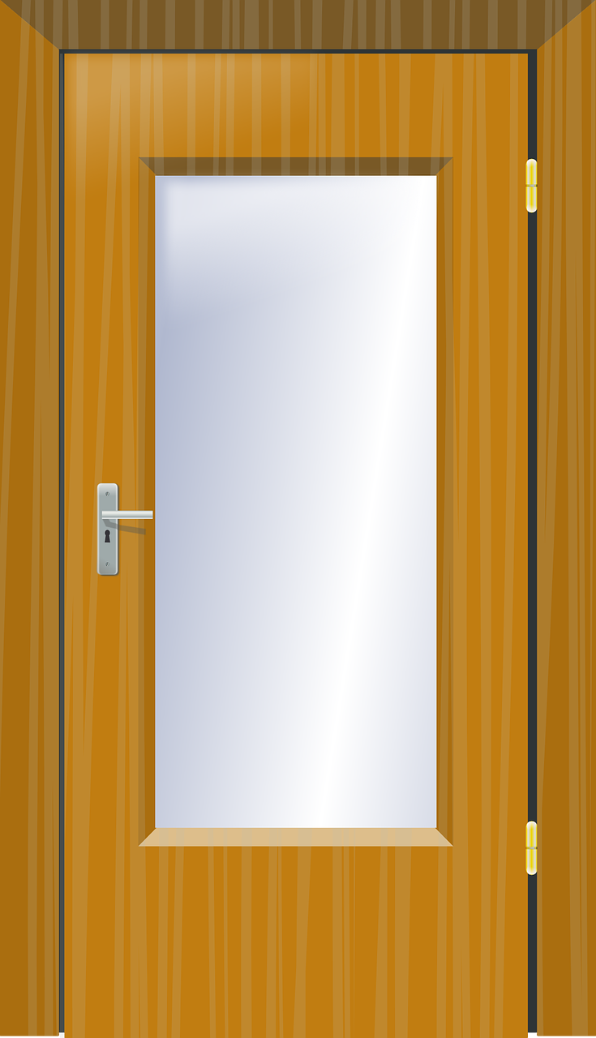
parler
Parle avec ton/ta partenaire.
Say there are these things.
Write what your partner says there is in English.
A
B
 | a/an | some
1
2
3
4
5
Il y a bleu.
blue exercise book
Il y a rouges.
red pencils
Il y a modernes.
modern doors
Il y a importantes.
important dates
important book
Il y a important.
Notes:
Round 1
Aim: to practise spoken production and aural comprehension of correct indefinite articles un/une and des.
Procedure:
Partner Bs turn away.
Partner As say each of the 5 sentences.
Partner Bs note the item and whether it is a/an (singular) or some (plural).
Partner Bs turn back to the board.
Click to reveal answers.
Move to the next slide to swap roles.
10

Slide 11
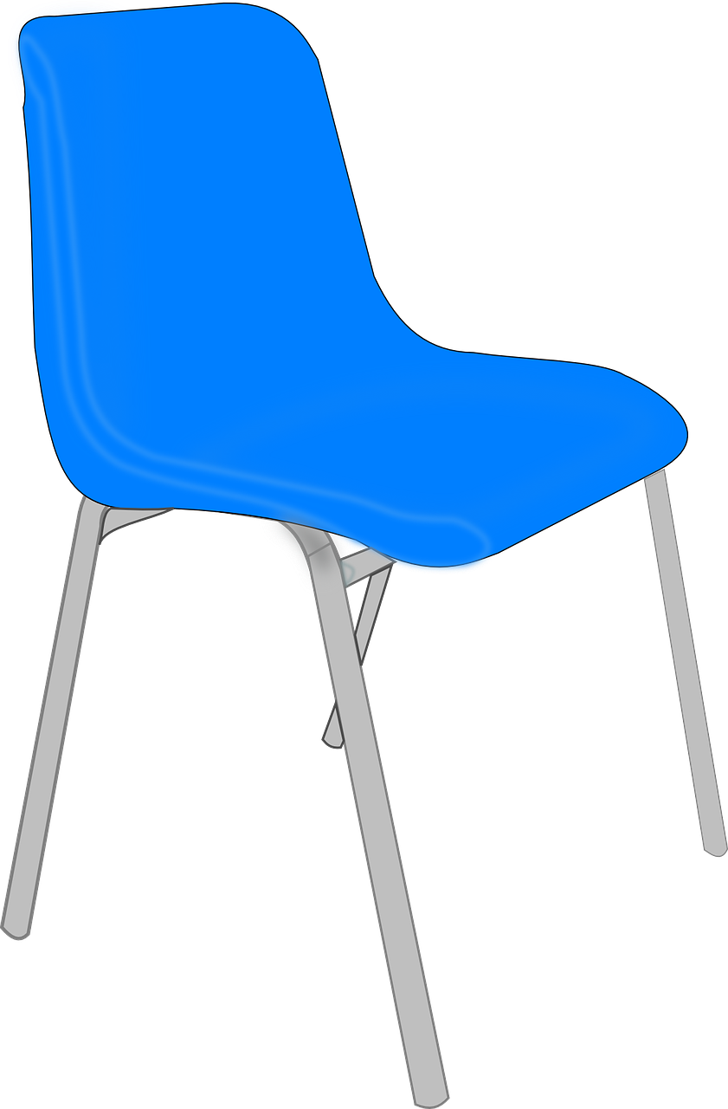
parler
Parle avec ton/ta partenaire.
Say there are these things.
Write what your partner says there is in English.
B
A
 | a/an | some
1
2
3
4
5
Il y a modernes.
modern chairs
Il y a ouverte.
open window
Il y a simples.
simple ideas
Il y a importants.
important days
Fri
Sat
Il y a spéciale.
special list
Notes:
Round 2
Aim: to practise spoken production and aural comprehension of correct indefinite articles un/une and des.
Procedure:
Partner As turn away.
Partner Bs say each of the 5 sentences.
Partner As note the item and whether it is a/an (singular) or some (plural).
Partner As turn back to the board.
Click to reveal answers.
11

Slide 12
Au revoir !
bleu
Notes:
12

