Slide 1
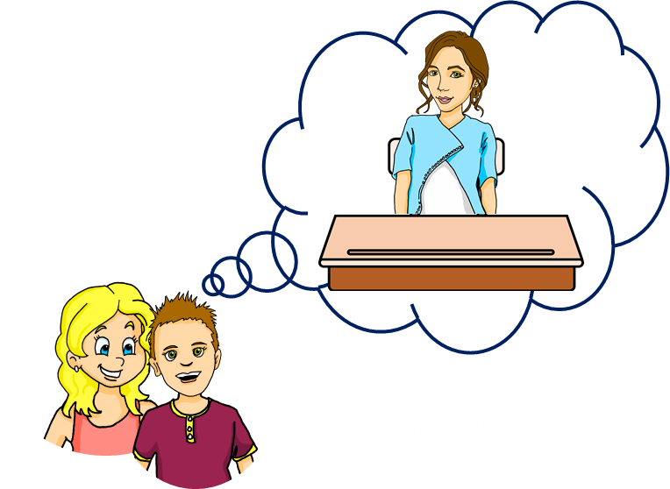
Saying what I and others have
bleu
Follow ups 1-5
Term 1 Week 9
Notes:
Artwork by Steve Clarke. Pronoun pictures from NCELP (www.ncelp.org). All additional pictures selected from Pixabay and are available under a Creative Commons license, no
attribution required.
Phonics: revisit au/eau/o: gauche [607] faux [555] eau [475] photo [1412] aussi [44]
Vocabulary (new words in bold): as [8] a [8] donner [46] organiser [791] parler [106] poser [218] préparer [368] trouver [83] utiliser [345] livre [358] question [144] phrase [2074] problème [188] sac [2343] réponse [456] solution [608] court [545] simple [212] spéciale [726] vrai [292] faux [555] des [de-2] calme [1731] difficile [296] facile [822] important [215] indépendant [854] intéressant [1244] rapide [672] utile [1003]
Revisit 1: sont [5] ils [13] elles [38] sérieux [412], heureux [764] curieux [2424] courageux [2198] aussi [44] et [6] mais [30]
Londsale, D., & Le Bras, Y. (2009). A Frequency Dictionary of French: Core vocabulary for learners London: Routledge.
The frequency rankings for words that occur in this PowerPoint which have been previously introduced in these resources are given in the SOW and in the resources that first
introduced and formally re-visited those words.
For any other words that occur incidentally in this PowerPoint, frequency rankings will be provided in the notes field wherever possible.

Slide 2
Follow up 1:
[au]
[au / eau / o]
gauche
prononcer
faux
eau
photo
aussi
[also]
Notes:
Timing: 2 minutes
Aim: to recap SSC [au]
Procedure:
1. Introduce and elicit the pronunciation of the individual SSC [au] and then the source word again ‘gauche’ (with gesture, if using). 2. Then present and elicit the pronunciation of the five cluster words.
Frequency:
gauche [607] faux [555] eau [475] photo [1412] aussi [44]
Londsale, D., & Le Bras, Y. (2009). A Frequency Dictionary of French: Core vocabulary for learners London: Routledge.

Slide 3
écouter
Écoute. C’est [(e)au] ou [ou] ?
ou
Écris les numéros 1 et 2 dans le bon ordre.
1 | 2
fou | faux
vous | veau
pousser | poser
bout | beau
peau | pot
1
1
2
[mad]
2
2
1
[veal]
3
2
1
[to blow]
[to put, ask]
4
1
2
[tip, end]
[beautiful]
5
?
?
[skin]
[jar]
Notes:
Timing: 5 minutes
Aim: to practise aural recognition of SSC [(e)au, o] and differentiation between [(e)au, o] and SSC [ou] in unknown words.
Procedure
Pupils listen to the pairs of words.
They write down the order that they hear the words in, either 1-2 or 2-1
Click to reveal the answers.
Note! the final one – pupils should listen and realise that these sound the same and there is no ‘ou’
Transcript:
fou, faux veau, vous poser, pousser bout, beau peau, pot
Frequency of unknown words and cognates: fou [1852] faux [>5000] veau [>5000] vous [122] poser [24] pousser [513] bout [1672] beau [2062] peau [2180] pot [195]
Source: Londsale, D., & Le Bras, Y. (2009). A Frequency Dictionary of French: Core vocabulary for learners London: Routledge.
3

Slide 4
Follow up 2
Écoute. C’est A ou B ? L’objet, c’est comment ?
A
B
?
modern
1
A
B
?
useful
2
A
B
?
important
3
A
B
?
difficult
4
A
B
?
interesting
5
A
B
?
special
6
Notes:
Timing: 5 minutes
Aim: to differentiate aurally between singular and plural nouns/adjectives, based on the indefinite article; to practise aural comprehension of several adjectives.
Procedure:
Click on the number to hear the audio.
Pupils select the correct picture, based on the singular or plural article, and then write the adjective.
Click to reveal the answers.
Differentiation: i. for greater challenge (without additional preparation) encourage pupils to turn away from the board and write the full English sentence meanings instead.
Transcript:
Il y a des ordinateurs modernes. Il y a des crayons útiles. Il y a un livre important. Il y a des problèmes difficiles. Il y a une question intéressante. Il y a un professeur spécial.

Slide 5
There are | These are
il y a
Remember! To say ‘there are’, use __________.
ce sont
To say ‘these are’, use __________.
⚠ This is the plural of c’est (it is).
Il y a des mots courts.
Ce sont des mots courts.
There are some short words.
These are (some) short words.
Il y a des idées importantes.
Ce sont des idées importantes.
There are important ideas.
These are important ideas.
⚠ In English we can miss out ‘some’ but we always need des in French.
Notes:
Use this slide as the preparation for Follow up 3.
Timing: 5 minutes (two slides)
Aim: to revisit the meaning of il y a and contrast it with ce sont. These are very similar in English (there are – these are).
Procedure:
Click through the animations to present the information.
Elicit English translations for the French examples provided.

Slide 6
Follow up 3
Parle en anglais.
Translate the sentences on sight.
lire
1
Il y a des affiches utiles.
There are (some) useful posters.
2
Ce sont des idées intéressantes.
These are (some) interesting ideas.
3
Ce sont des chaises bleues.
These are (some) blue chairs.
4
Il y a des mois difficiles.
There are (some) difficult months.
5
Ce sont des jours faciles.
These are (some) easy days.
Notes:
Aim: to practise sight interpreting from French into English of sentences with il y a and ce sont.
Procedure:
Click to bring up the first French sentence.
Pupils translate it on sight chorally into English.
Click to bring up the English translation.
Repeat 1-3 with the remaining four sentences.
Differentiation / Alternative task: Pupils could practise aural interpreting instead. Click to hear the sentence (before clicking to bring up the writing version). On hearing it, pupils translate the sentence into English orally.

Slide 7
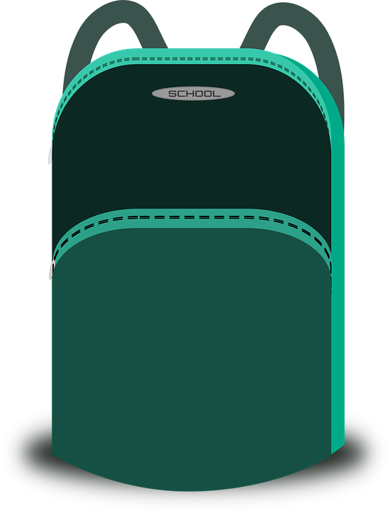
Follow up 4
Écris les phrases en français.
There are some independent boys and girls.
Il y a des garçons et des filles indépendants.
écrire
There are some useful sentences.
Il y a des phrases utiles.
There is a special task.
Il y a une tâche spéciale.
Il y a des mots difficiles.
There are some difficult words.
There is an important list.
Il y a une liste importante.
There are some heavy bags.
Il y a des sacs lourds.
Notes:
Timing: 10 minutes
Aim: to practise written productions of sentences using singular and plural indefinite articles, nouns and adjectives.
Procedure: 1. Pupils write the sentences in French. Note: they can do this on mini whiteboards or on their arms or in their books. 2. Click on each answer bubble to hear the phrase pronounced. Differentiation / Alternative tasks: i. for a lower level of challenge provide the first letter of every word. ii. for more scaffolding still, focus only on the articles, or on the articles and nouns (prompting with English), providing the rest of the sentence. iii. for a transcription task, blank the screen and listen to the audio first, transcribing the sentences. (Note: the animations can be altered using a disappear affect on the answers to reveal the English meanings underneath, if desired.)

Slide 8
vocabulaire
Follow up 5 - Écris en français : Can you get at least 15 points?
mots
 | curious (m) | brave (m) | but
 | to put, ask | also | and
 | are (they) | serious (m) | happy (m)
 | they (m, m/f) | to prepare, preparing | they (f)
 | to use, using | to speak, speaking | to give, giving
 | short (m, pl) | some | useful (m, f)
 | solution | simple (pl) | special (m)
curieux
courageux
mais
x3
poser
aussi
et
sont
sérieux
heureux
x2
ils
préparer
elles
utiliser
parler
donner
courts
des
useful
x1
la solution
simples
spécial
Notes:
Timing: 5-10 minutes
Aim: to practise written production of vocabulary from this week and two revisited weeks.
Procedure: 1. Give pupils a blank grid. They fill in the French meanings of any of the words they know, trying to reach 15 points in total. 2. Remind pupils that adjectives can refer to male or female persons and they should note this in their translations. E.g. pleased (f), short (m).
Note: The most recently learnt and practised words are pink, words from revisit 1 are green and those from revisit 2 are blue, thus more points are awarded for them, to recognise that memories fade and more effort (heavy lifting!) is needed to retrieve them.
8

Slide 9
vocabulaire
Follow up 5 - Écris en français : Can you get at least 15 points?
mots
 | curious (m) | brave (m) | but
 | to put, ask | also | and
 | are (they) | serious (m) | happy (m)
 | they (m, m/f) | to prepare, preparing | they (f)
 | to use, using | to speak, speaking | to give, giving
 | short (m, pl) | some | useful
 | solution | simple (pl) | special (m)
x3
x2
Notes:
HANDOUT
9

