Slide 1
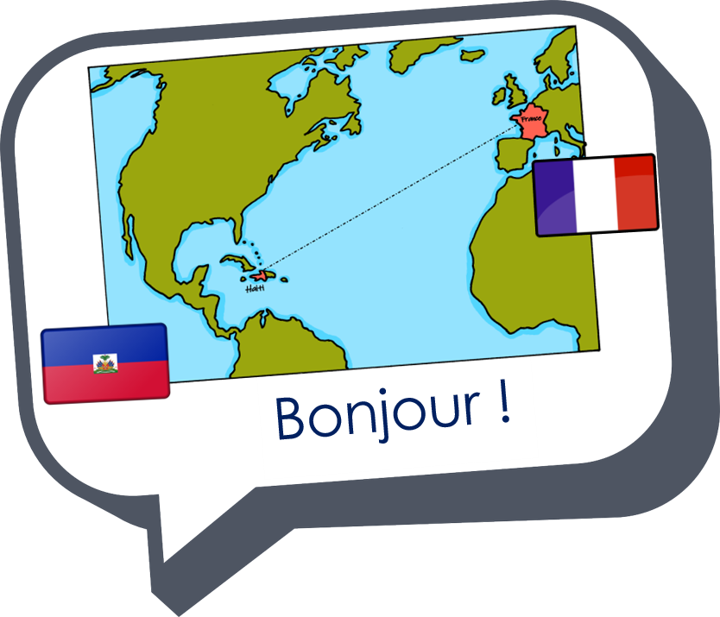
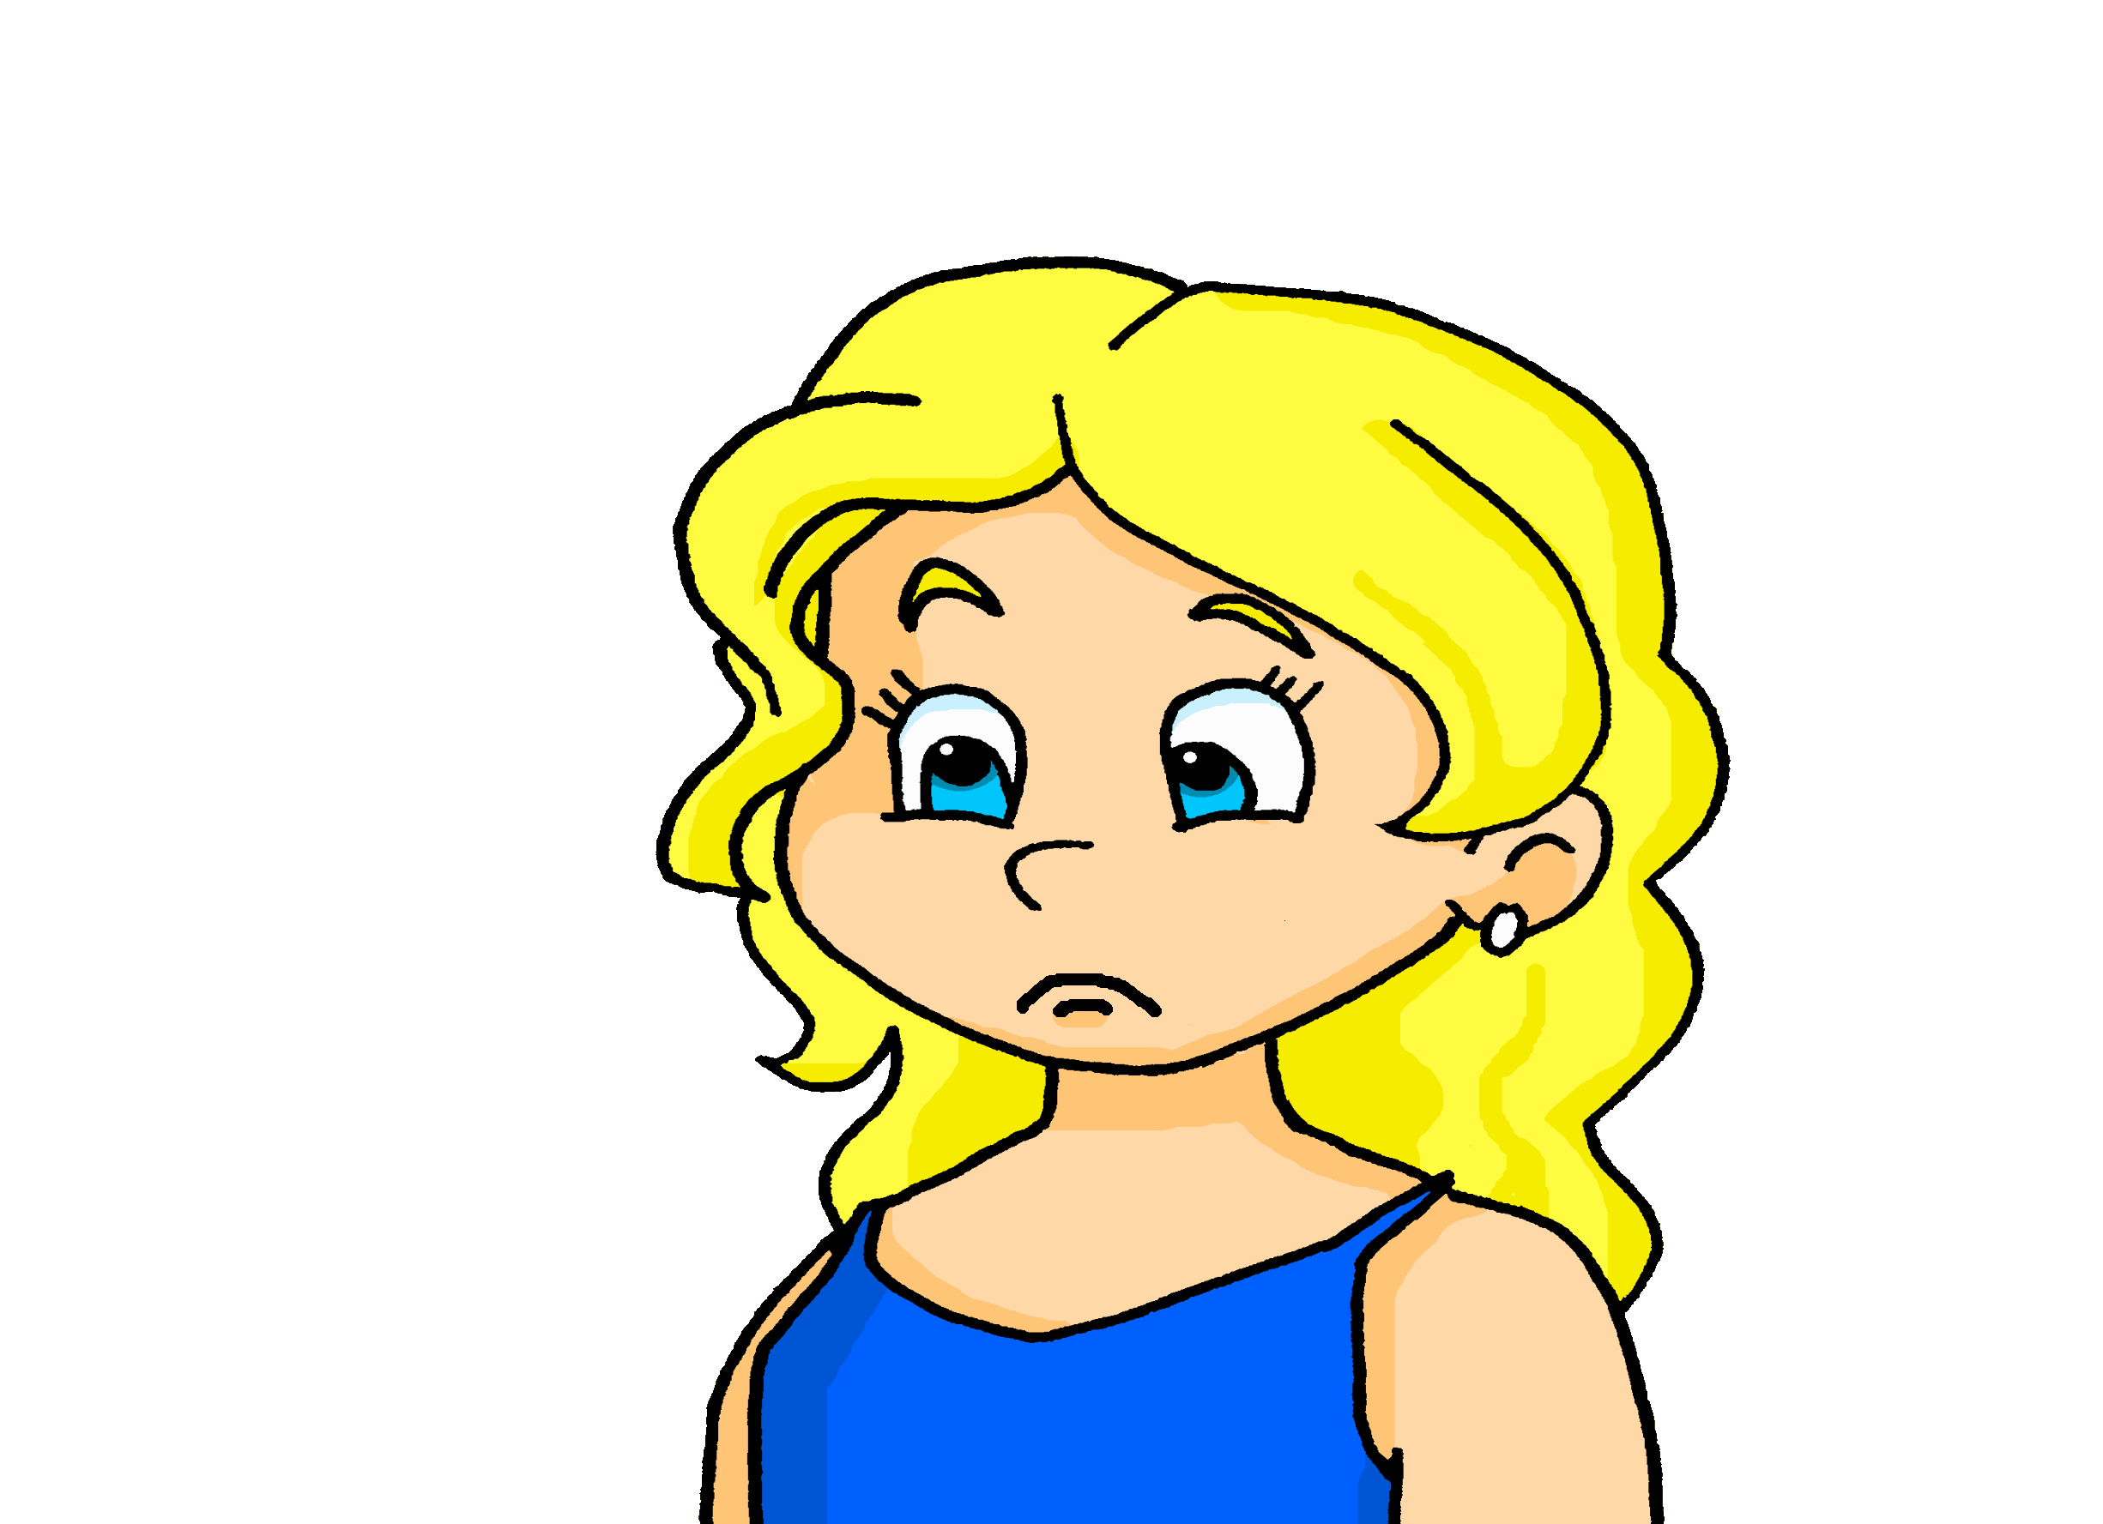
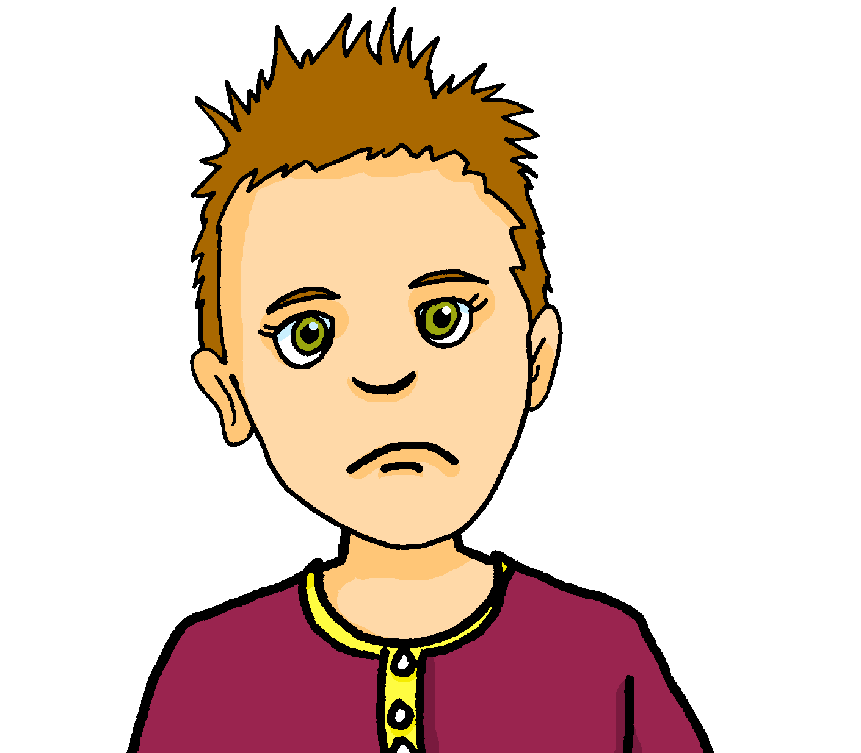
Saying what I and others have
un jour horrible
bleu
Follow ups 1-5
Term 1 Week 8
Notes:
Artwork by Steve Clarke. Pronoun pictures from NCELP (www.ncelp.org). All additional pictures selected from Pixabay and are available under a Creative Commons license, no
attribution required.
Phonics: revisit SFe (Silent Final [e])
Vocabulary (new words in bold): avoir [8] j’ai [8] il a [8] elle a [8]un [3] une [3] animal [1002] chambre [633] livre [358] maison [325] professeur/ professeure [110] problème [188] tâche [887] amusant [4695] différent [350] idéal [1429] important [215] indépendant [854] inquiet [1392] lent [2572] lourd [1026] parfait [1600] sage [2643] strict [1859] très [66]
Revisit 1: êtes [5] vous [50] ensemble [124] maintenant [192] toujours [103] rarement [2535] souvent [287]
Revisit 2: revisit chanter [1820] écouter [429] regarder [425] chercher [336] parler [106] passer [90] rester [100]
Londsale, D., & Le Bras, Y. (2009). A Frequency Dictionary of French: Core vocabulary for learners London: Routledge.
The frequency rankings for words that occur in this PowerPoint which have been previously introduced in these resources are given in the SOW and in the resources that first
introduced and formally re-visited those words.
For any other words that occur incidentally in this PowerPoint, frequency rankings will be provided in the notes field wherever possible.

Slide 2







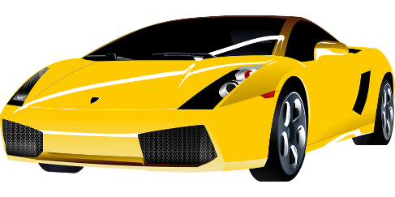

Follow up 1:
[SFe]
prononcer
monde
timide
douze
[shy]
centre
moderne
Notes:
Timing: 1 minute (+ 5 minutes for following 8 slides)
Aim: To introduce/consolidate SSC [SFe]
Procedure:
1. Practise the pronunciation of the individual SSC [SFe] and then the source word again ‘timide’ (with gesture, if using).
2. Then present and elicit the pronunciation of the four cluster words.
Frequency:
monde [77] moderne [1239] centre [491] vie [132] douze [1664] timide [3835]
Source: Londsale, D., & Le Bras, Y. (2009). A Frequency Dictionary of French: Core vocabulary for learners London: Routledge.

Slide 3


écouter
[Sfe]
Écoute. C’est avec ‘e’ ou sans ‘e’ ?
élégant
1
?
Notes:
Timing: 5 minutes (8 slides)
Aim: to practise aural recognition of the presence of SFe contrasted with SFC (Silent Final Consonant) when there is no ‘e’.
Procedure:
Click to listen to the word.
Pupils respond ‘avec ‘e’’ if they decide there is a SFe and ‘sans ‘e’’ if they decided there is no ‘e’.
Click to remove the rectangle to see the presence or absence of ‘e’.
Click again to bring up the corresponding emoji, and ensure that pupils are clear about the meaning of the word (i.e. smart for a masculine noun/male person)
Repeat steps 1-4 for the next 7 slides.
Transcript:
élegant
3

Slide 4
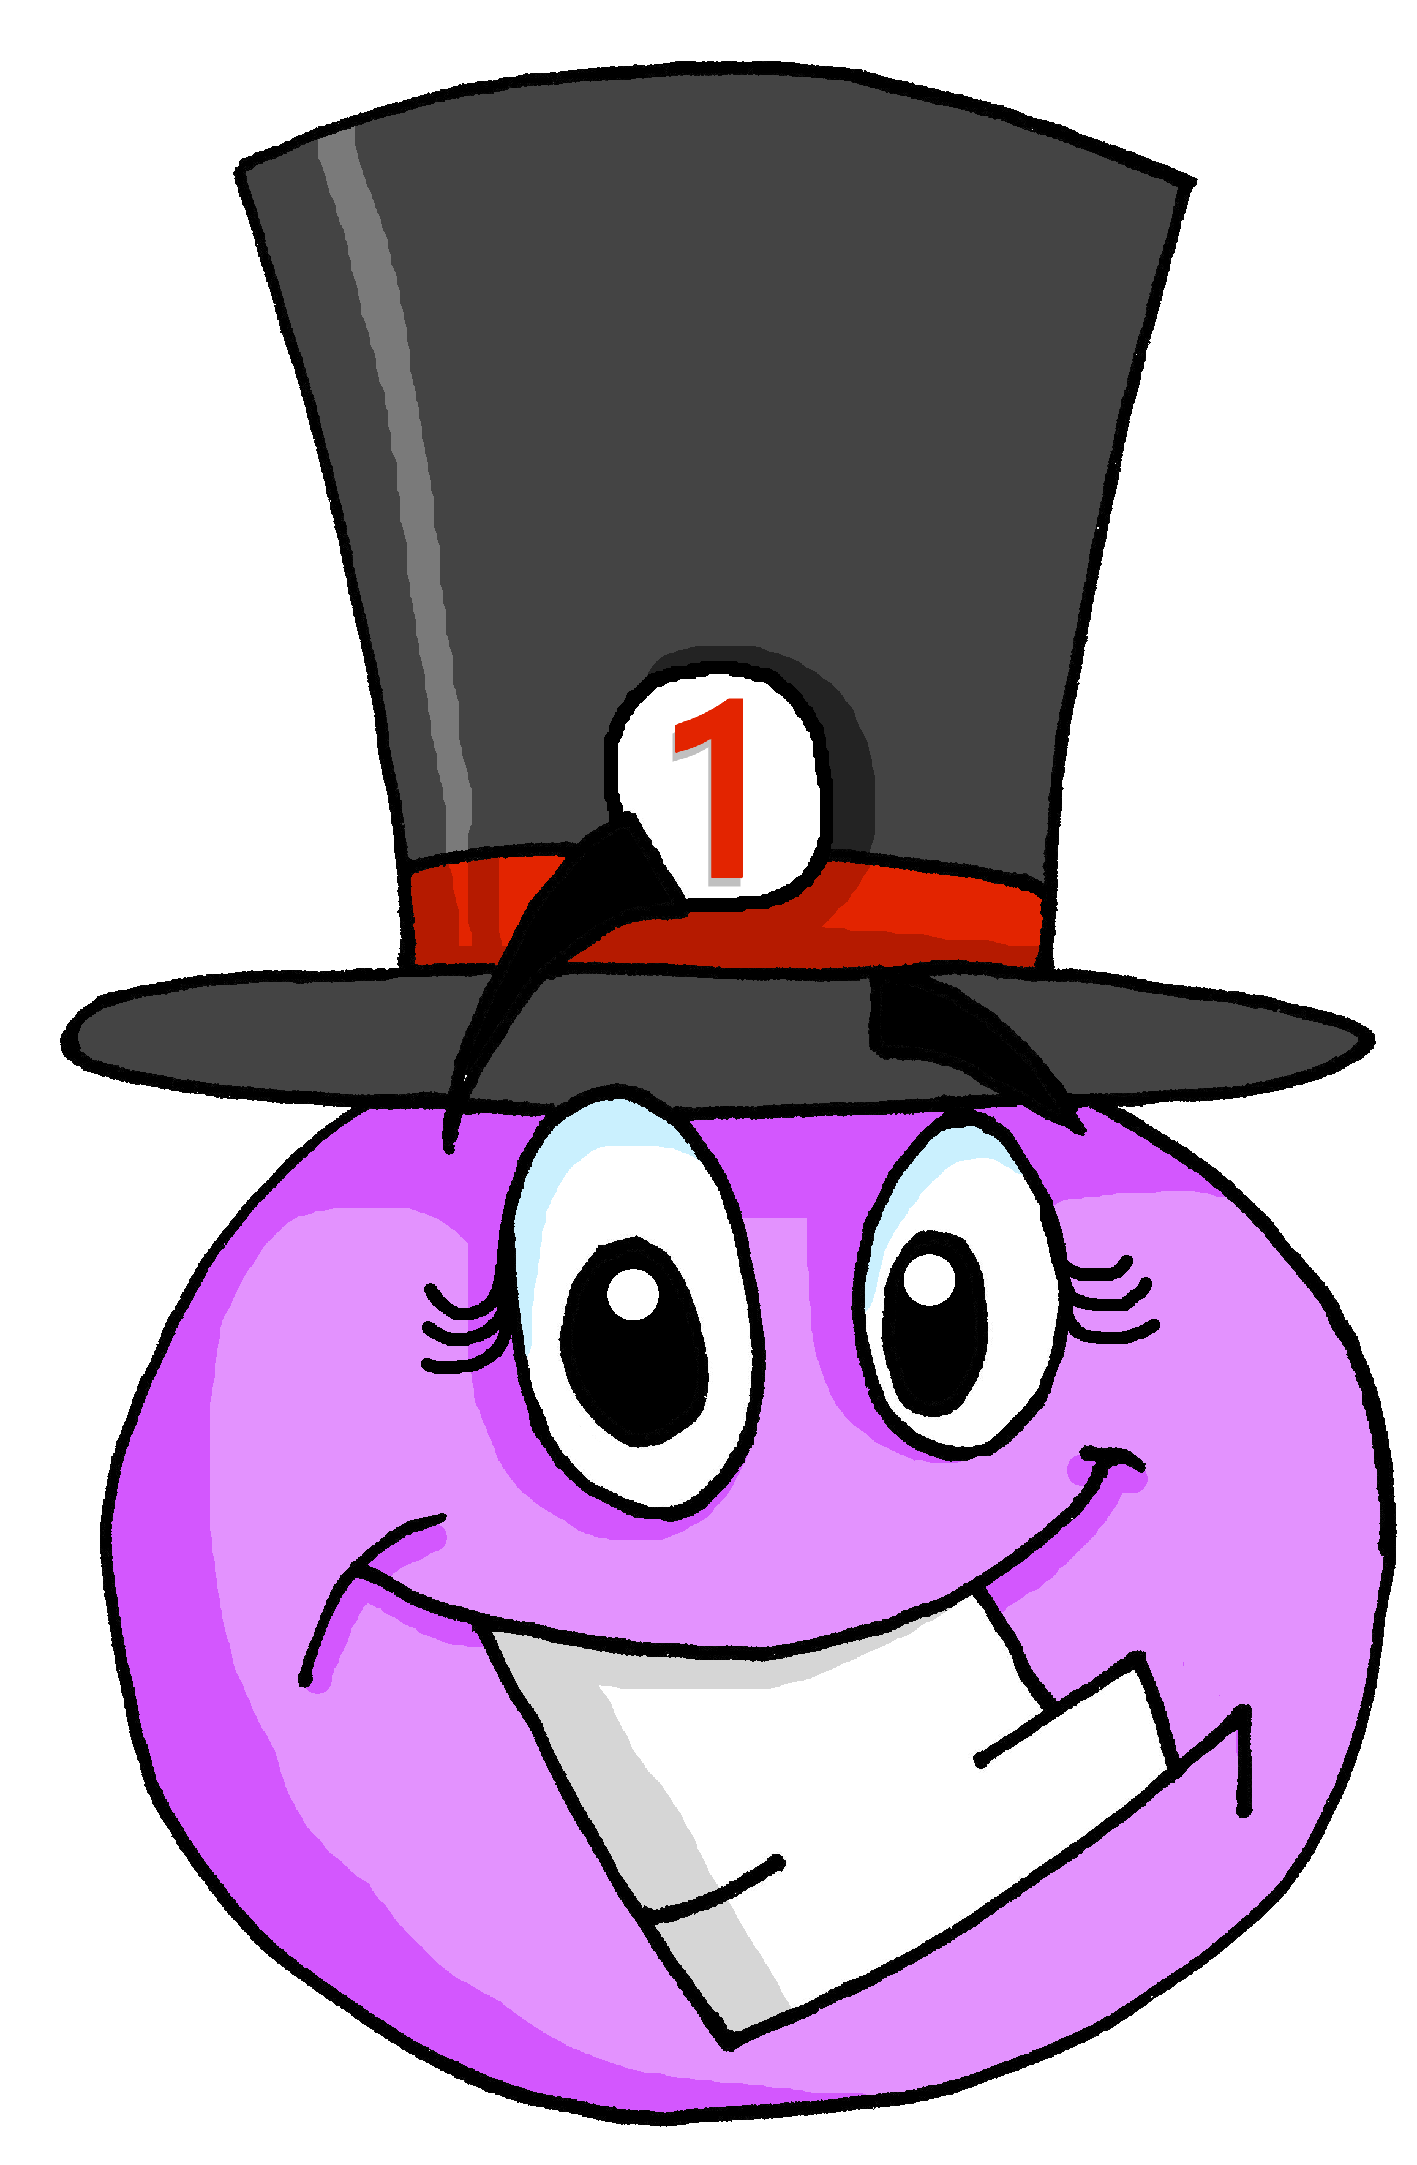
écouter
[Sfe]
Écoute. C’est avec ‘e’ ou sans ‘e’ ?
importante
2
?
Notes:
[2/8]
Transcript:
importante
4

Slide 5

écouter
[Sfe]
Écoute. C’est avec ‘e’ ou sans ‘e’ ?
indépendante
3
?
Notes:
[3/8]
Transcript:
indépendante
5

Slide 6

écouter
[Sfe]
Écoute. C’est avec ‘e’ ou sans ‘e’ ?
amusant
4
?
Notes:
[4/8]
Transcript:
amusant
6

Slide 7

écouter
[Sfe]
Écoute. C’est avec ‘e’ ou sans ‘e’ ?
inquiet
5
?
Notes:
[5/8]
Transcript:
inquiet
7

Slide 8

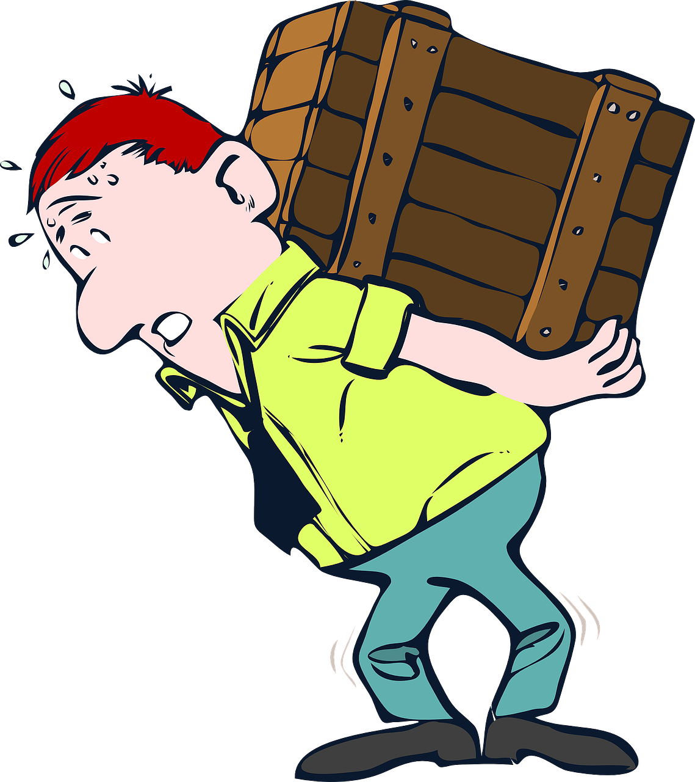
écouter
[Sfe]
Écoute. C’est avec ‘e’ ou sans ‘e’ ?
C’est une boîte lourde !
lourde
6
?
Notes:
[6/8]
Transcript:
lourde
Frequency of unknown words:
boîte [1771]
8

Slide 9

écouter
[Sfe]
Écoute. C’est avec ‘e’ ou sans ‘e’ ?
intelligent
7
?
Notes:
[7/8]
Transcript:
intelligent
9

Slide 10
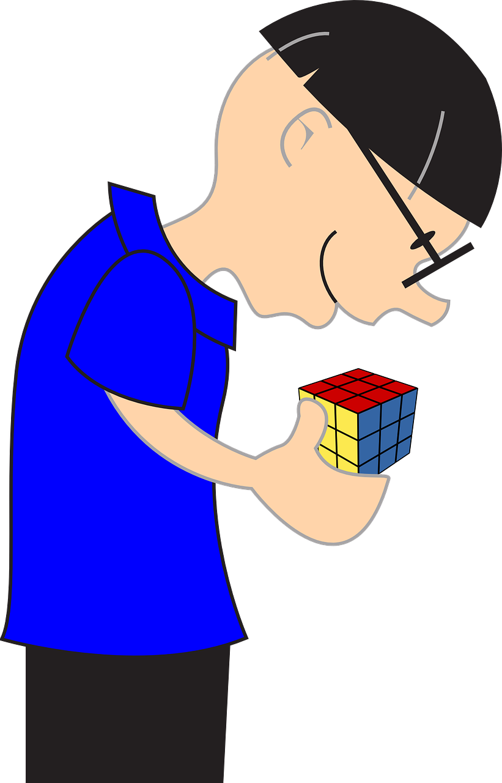
écouter
[Sfe]
Écoute. C’est avec ‘e’ ou sans ‘e’ ?
l’activité est intéressante !
intéressante
8
?
Notes:
[8/8]
Transcript:
intéressante
10

Slide 11
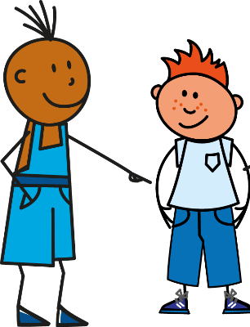
Follow up 2:
Listen carefully, then practise saying these words:
1
tu as [you have]
2
tu es [you are]
3
Il a [he has]
4
il est [he is]
5
elle a [she has]
6
elle est [she is]
Notes:
Timing: 1 minute (as preparation for the listening task that follows)
Aim: to differentiate between the [a] or [ê/è] sounds
Procedure:
Click on the numbers to hear the native speaker, then students repeat.
Transcript:
Tu as
Tu es
Il a
Il est
Elle a
Elle est

Slide 12

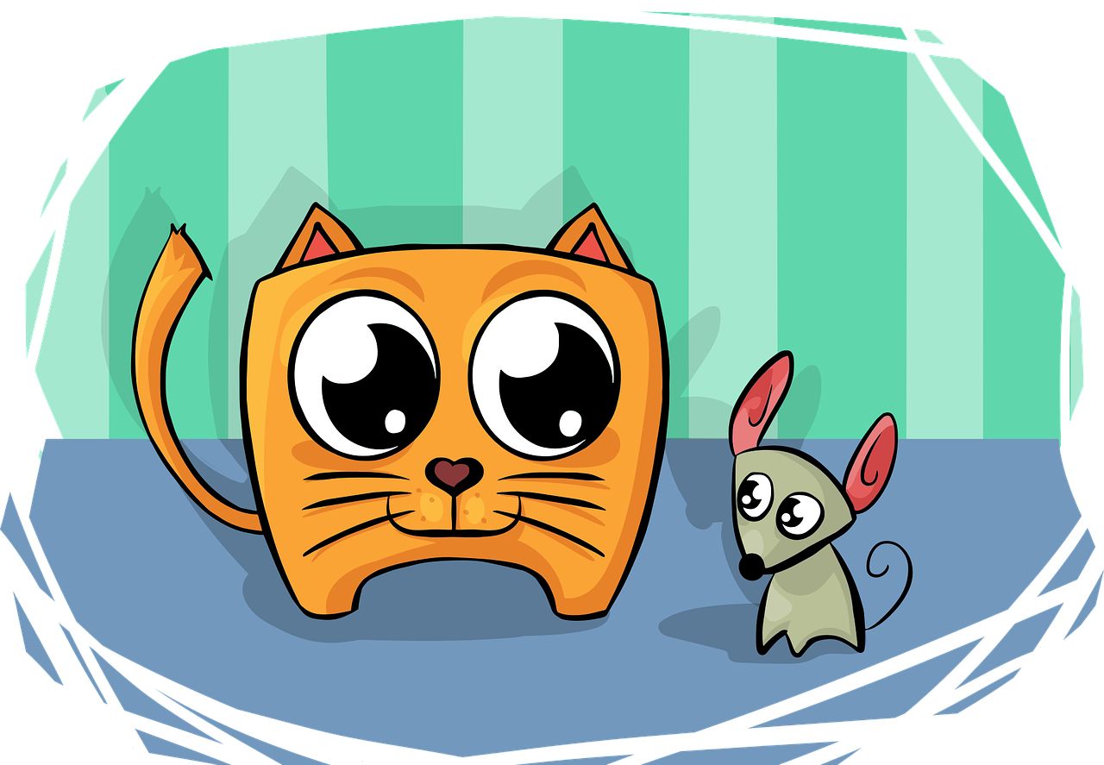
Follow up 2:
Écoute. C’est a(s) ou es(t) ?
C’est quoi ?
écouter
il | est | a
Le chat | est | a
Tu | as | es
Tu | es | as
Elle | a | est
Il | est |a
1
1
content. | un animal.
2
intelligent. | une souris.
2
lire
3
intéressante. | un sac lourd.
3
4
un ami inquiet. | timide.
4
5
élégant. | un problème.
5
6
une tâche indépendante. | intelligente.
6
Notes:
Timing: 5 minutes
Aim: to practise aural recognition of a(s) and es(t) and to connect these with meaning in a written comprehension.
Procedure:
1. Click each number to listen. The end of the sentence is beeped out to focus all attention initially on the difference between a(s) and es(t) sounds.
2. Pupils select (a)s or es(t) verb forms.
3. Click to reveal the verb answers.
4. Pupils then decide how the sentence ends, based on the meaning of the verb (have/has or are/is).
5. Click to reveal answers and check understanding of the whole sentences by eliciting English meanings.
6. If desired, click to bring up a 2nd set of audio buttons (green, over the top of the 1st set) to hear the full sentences.
Transcript:
1. Il est [content].
2. Le chat a [une souris].
3. Tu as [un sac lourd].
4. Tu es [timide].
5. Elle a [une tâche indépendante].
6. Il est [élégant].
Transcript 2:
1. Il est content.
2. Le chat a une souris.
3. Tu as un sac lourd.
4. Tu es timide.
5. Elle a une tâche indépendante.
6. Il est élégant.

Slide 13



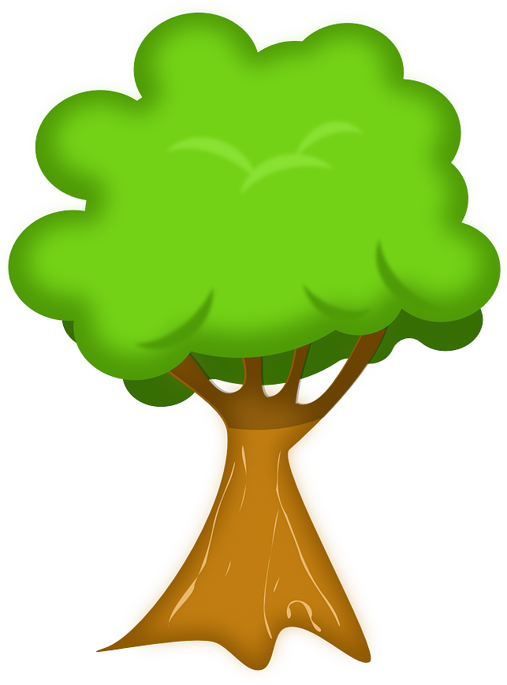


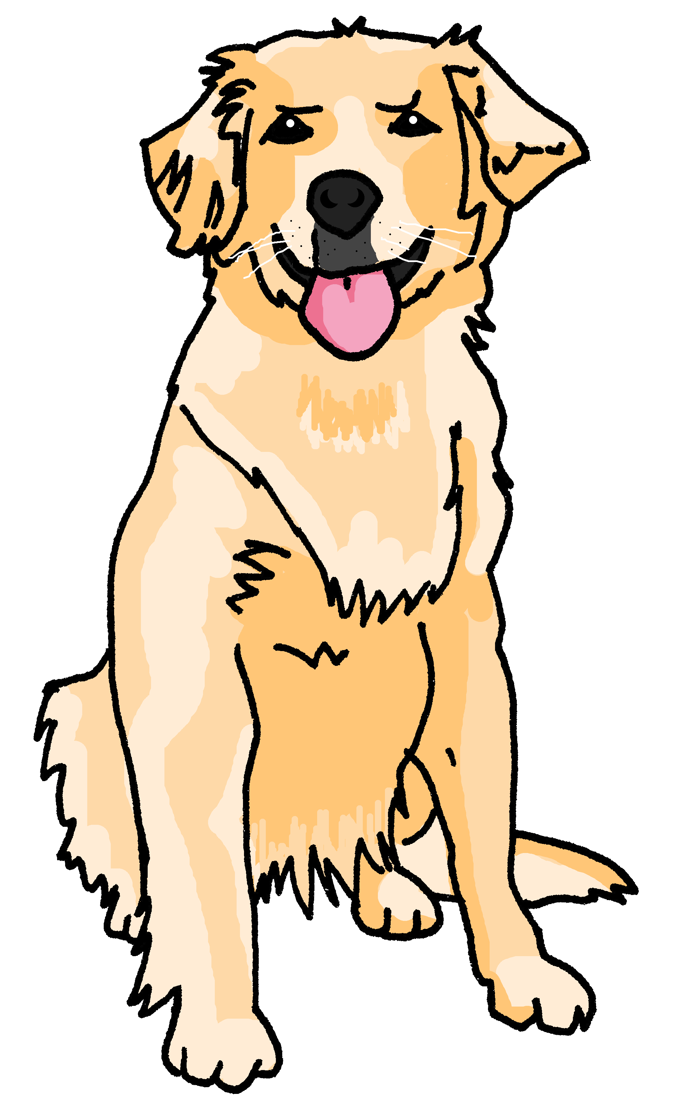
Follow up 3: Complète les phrases.
Où est Médor ?
lire
Adèle cherche Médor.
Elle regarde dans le jardin.
Elle appelle ‚Médor‘ et elle écoute mais il est absent.
Elle reste dans le jardin et elle chante.
Tout à coup, Médor est là. Il est heureux.
_________
est
écoute
regarde
chante
reste
est
passe
cherche
_________
_________
________
________
_________.
________
Notes:
Timing: 5 minutes
Aim: to practise written comprehension of revisited vocabulary in a longer context.
Procedure:
Ensure pupils understand the title of the story (where is Médor?), and who Médor is (the family dog).
Pupils read each sentence and select the correct verb from the list (there is one verb they will not need).
Click on Adèle to listen and check answers.
Click to reveal the written French answers.
Alternative tasks / Differentiation:
i. for a written production task, put the verb prompts in English.
ii. for a greater level of challenge, remove the verb prompts altogether.
iii. for a lesser level of challenge, play the audio at the start and pupils write the verbs in.
iv. for a transcription task, play the audio but remove the list of French verbs.

Slide 14




Follow up 4:
C’est a (has) ou est (is) ?
Numéro 1 est un chien.
parler
A
1. Number 1 is a dog.
B
Notes:
Timing: 5 minutes
Aim: to practise spoken production of sentences to describe a picture using the correct verb ‘a’ or ‘est’ plus correct noun.
Procedure:
1. Model the task using this slide, clicking through the animations.
2. Move onto the next slide for part 1 of the task.
Procedure:
1. Give out the handout to partner Bs and ask them to turn away from the board.
2. Click to reveal English prompts. Partner As need to say the correct sentence in French.
3. Pupil B decides if his/her picture matches the description, and puts a tick or cross.
4. Then s/he turns back to the board to check.
5. Swap roles and move on to the next slide.

Slide 15

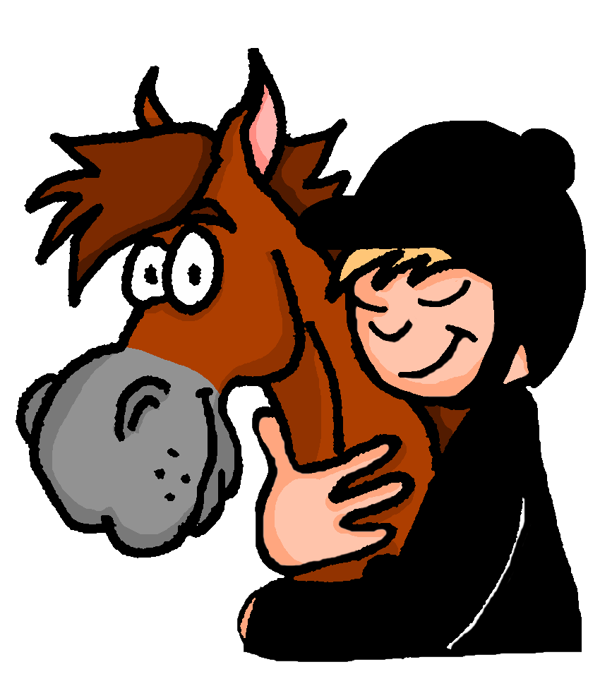



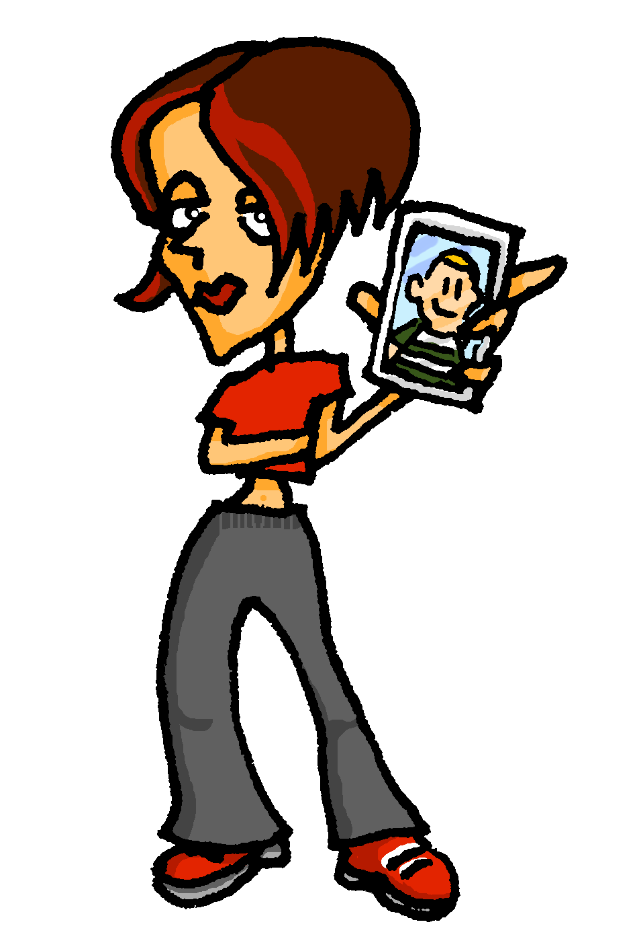
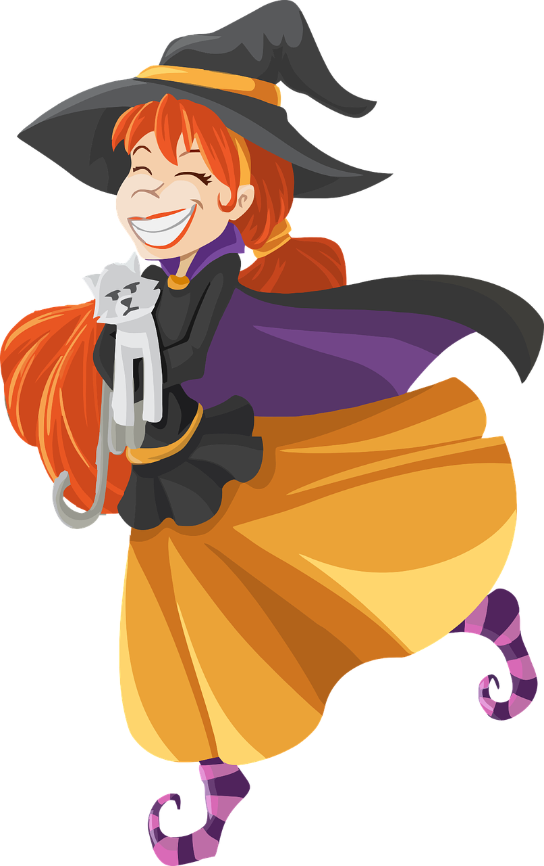
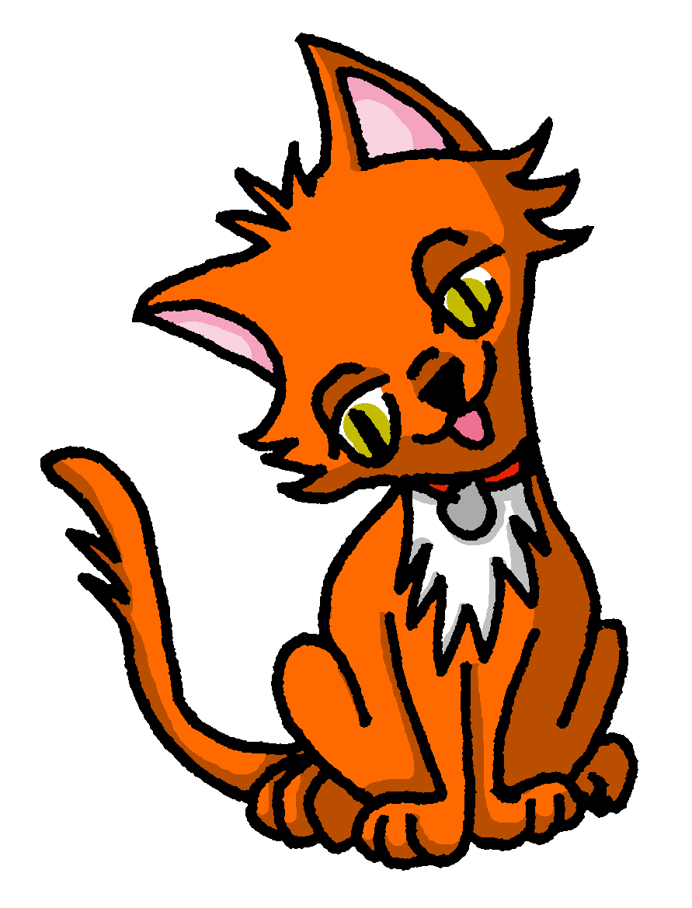


Handout
Round 1
B
1
2
3
4
5
parler
A
1. Numéro un a un cheval.
2. Numéro deux est une table.
3. Numéro trois est une photo.
4. Numéro quatre a un chat.
5. Numéro cinq a un cinéma.
Notes:
HANDOUT
15

Slide 16
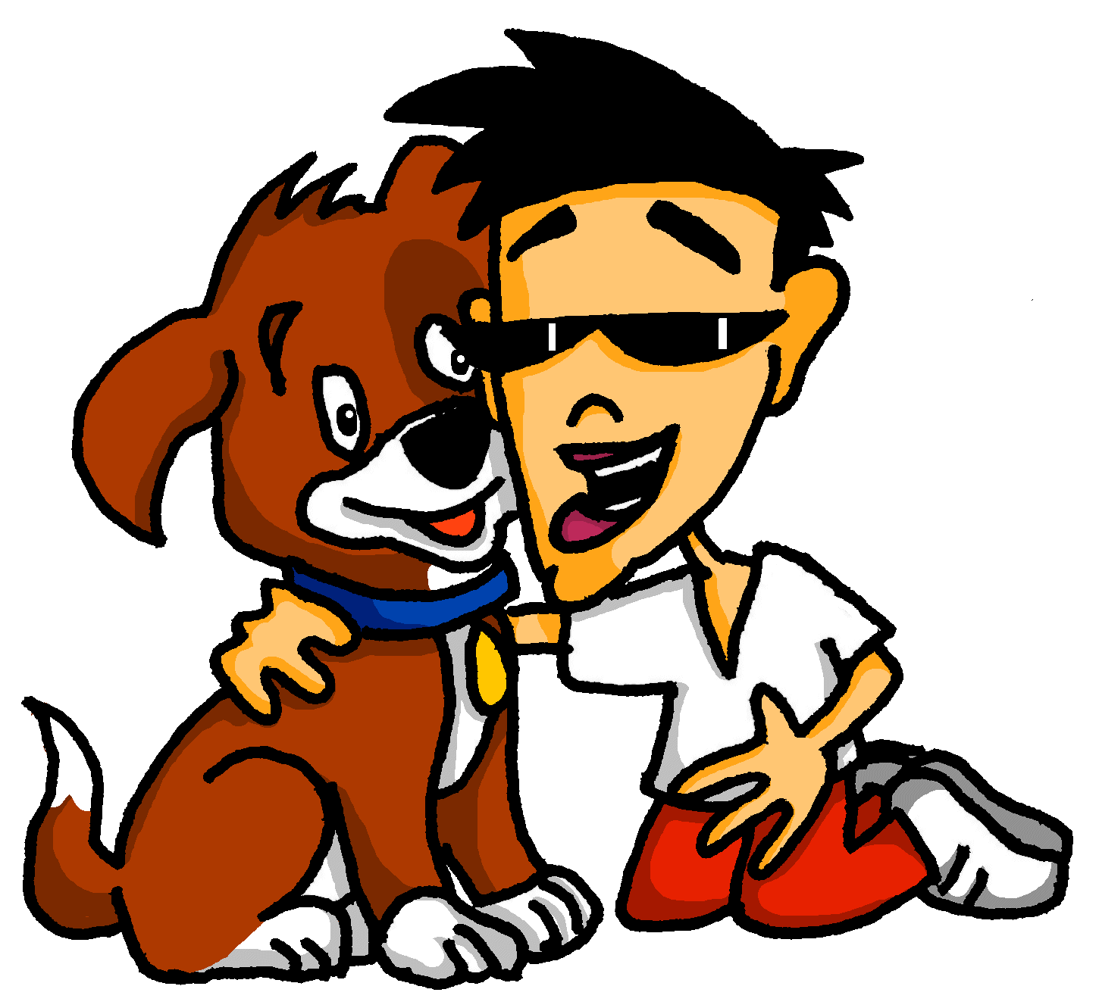
Handout
Round 2
1
2
3
4
5
A
parler
B
1. Numéro un a un chien.
2. Numéro deux est un cinéma.
3. Numéro trois est un chat.
4. Numéro quatre a une table.
5. Numéro cinq a une photo.
Notes:
HANDOUT
16

Slide 17




vocabulaire
Follow up 5 - Écris en français : Can you get at least 15 points?
mots
 | interesting (m) | well-behaved | worried (m)
 | often | to spend (time) | naughty (f)
 | you (pl) | are (you, pl) | together
 | rarely | now | always
 | you have | heavy (f) | he has
 | very | she has | I have
 | heavy (m) | to have, having | intelligent (m)
intéressant
sage
inquiet
x3
souvent
passer
méchante
vous
êtes
ensemble
x2
rarement
maintenant
toujours
you have
lourde
il a
très
elle a
j’ai
x1
lourd
avoir
intelligent
Notes:
Timing: 5-10 minutes
Aim: to practise written production of vocabulary from this week and two revisited weeks.
Procedure:
1. Give pupils a blank grid. They fill in the French meanings of any of the words they know, trying to reach 15 points in total.
2. Remind pupils that adjectives can refer to male or female persons and they should note this in their translations. E.g. pleased (f), short (m).
Note:
The most recently learnt and practised words are pink, words from revisit 1 are green and those from revisit 2 are blue, thus more points are awarded for them, to recognise that memories fade and more effort (heavy lifting!) is needed to retrieve them.
17

Slide 18
vocabulaire
Follow up 5 - Écris en français : Can you get at least 15 points?
mots
 | interesting (m) | well-behaved | worried (m)
 | often | to spend (time) | naughty (f)
 | you (pl) | are (you, pl) | together
 | rarely | now | always
 | you have | heavy (f) | he has
 | very | she has | I have
 | heavy (m) | to have, having | intelligent (m)
x3
x2
Notes:
HANDOUT
18

Slide 19
Handout
A
1
2
3
4
5
parler
A
1. Number 1 has a horse.
2. Number 2 is a table.
3. Number 3 is a photo.
4. Number 4 has a cat.
5. Number 3 has a cinema.
Notes:
HANDOUT
Reduce to A5 on copier
19

Slide 20
Handout
B
1
2
3
4
5
B
parler
1. Number 1 has a dog.
2. Number 2 is a cinema.
3. Number 3 is a cat.
4. Number 4 has a table.
5. Number 5 has a photo.
Notes:
HANDOUT
Reduce to A5 on copier
20

