Slide 1
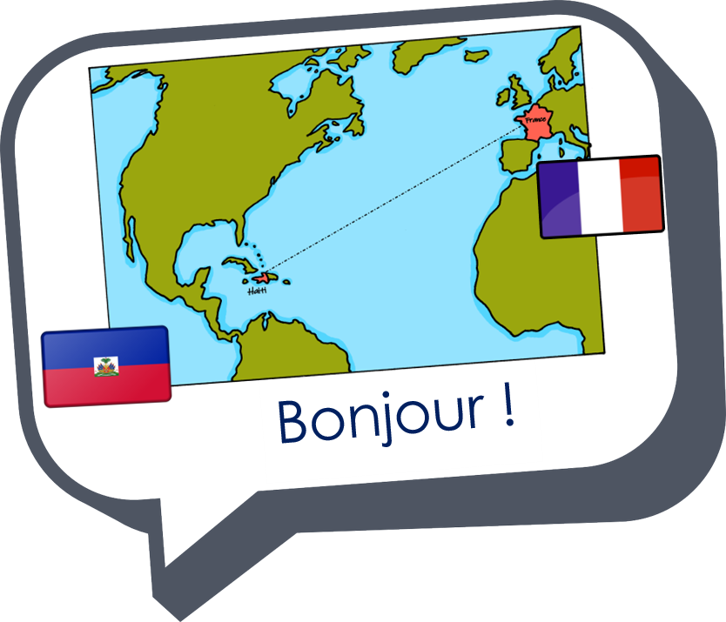
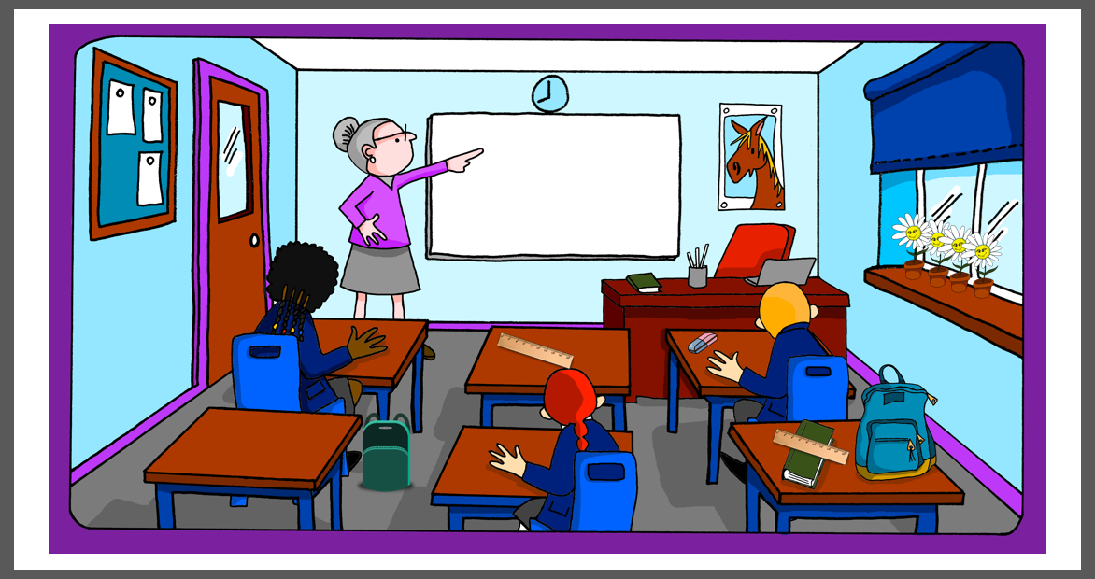
Describing me and others
la salle de classe
la salle de classe
bleu
« être » ils / elles sont
(they are)
adjective agreement (plural)
SSC closed and open [eu]
Term 1 Week 7
Notes:
Artwork by Steve Clarke. Pronoun pictures from NCELP (www.ncelp.org). All additional pictures selected from Pixabay and are available under a Creative Commons license, no
attribution required.
Phonics: revisit closed and open [eu] - un peu [91] peur [755] fleur [2305] jeune [152] neuf [787] acteur [1552] seul [102]
Vocabulary (new words in bold): sont [5] ils [13] elles [38] combien [800] affiche [2886] bouteille [2979] crayon [>5000] fleur [2305] gomme [>5000] livre [358] mur [1335] ordinateur [2201] règle [488] sac [2343] vrai [292] faux [555] de [2]
Revisit 1: sommes [5] nous [31] quel, quelle [146] date [660] jour [78] semaine [245] saison [1667] lundi [1091], mardi [1044] mercredi [1168] jeudi [1112] vendredi [1086] samedi [1356] dimanche [1235] aujourd’hui [233]
Revisit 2: chaque [151] jour [78] revisit days of the week jouer [219] avec [23] ami [367] amie [467]
Londsale, D., & Le Bras, Y. (2009). A Frequency Dictionary of French: Core vocabulary for learners London: Routledge.
The frequency rankings for words that occur in this PowerPoint which have been previously introduced in these resources are given in the SOW and in the resources that first
introduced and formally re-visited those words.
For any other words that occur incidentally in this PowerPoint, frequency rankings will be provided in the notes field wherever possible.
1

Slide 2



closed [eu]
open [eu]
prononcer
un peu
peur
It sounds like the ‘ur’ in ‘hurt’.
[a bit]
[fear]
This is a closed vowel. When you say this sound, your tongue is near the top of your mouth.
This is an open vowel. When you say this sound, your tongue is near the bottom of your mouth.
Notes:
Timing: 2 minutes
Aim: to revisit closed [eu] and introduce open [eu].
Procedure:
Click to bring up the closed [eu]. Repeat the SSC [eu] with the class.
Click to bring up the phrase ‘un peu’ (with gesture, if using).
Click to bring up the English translation and picture.
Pupils to practise saying the phrase several times.
Click to bring up the callout about closed vowel tongue position.
Click to bring up the open [eu]. Repeat the SSC with the class.
Click to bring up the word ‘peur’ (with gesture, if using).
Click to bring up the English translation and picture, and the callout hint about ‘hurt’.
Say this SSC several times with the class.
Click to bring up the call out about open SSC [eu].
Practise alternating between ‘peu’ and ‘peur’ several times.

Slide 3
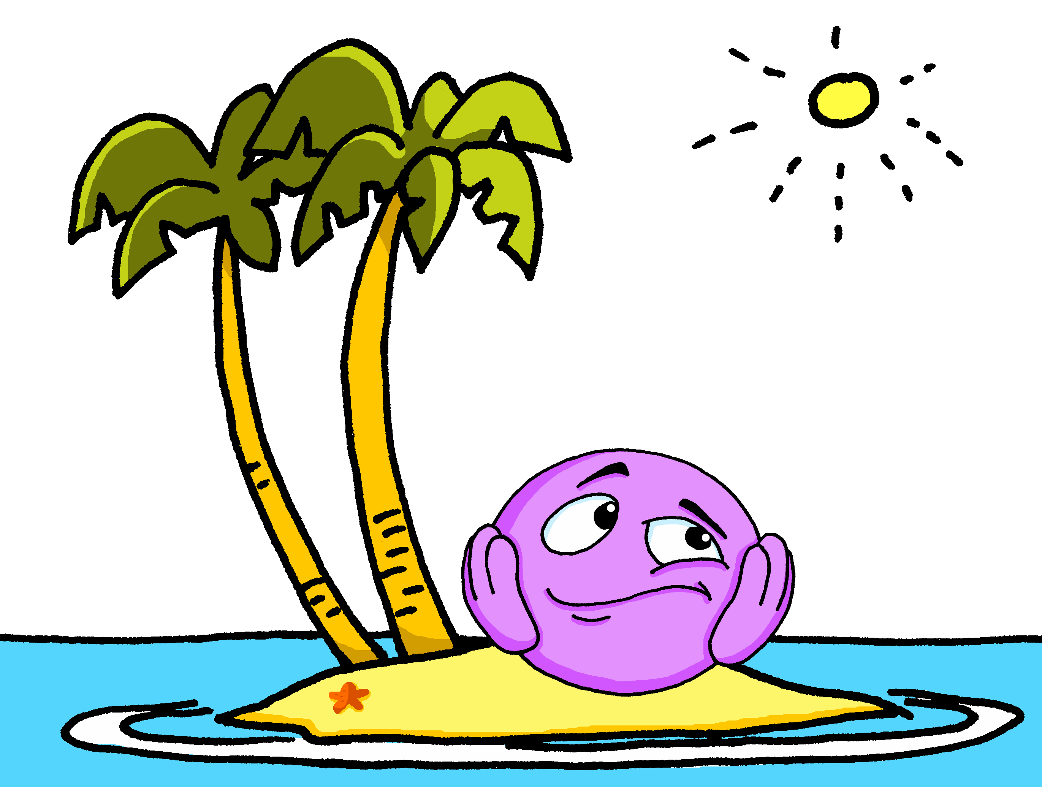

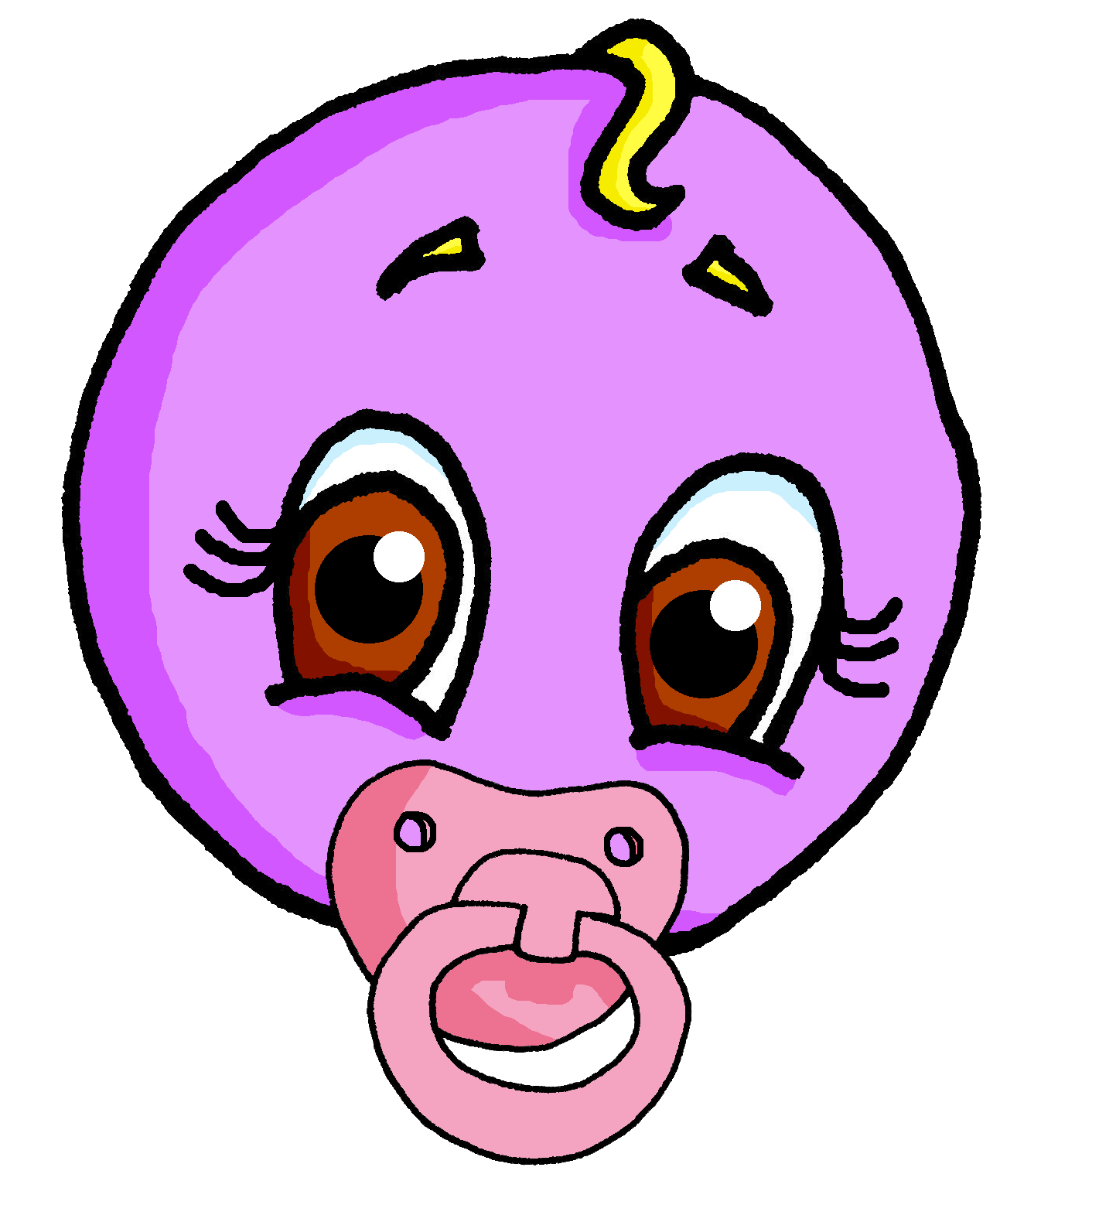





prononcer
open[eu]
fleur
jeune
seul
[eu] is often open when followed by final r, f, l, but closed before final x, s.
neuf
acteur
Notes:
Timing: 2 minutes
Aim: to practise open SSC [eu] in words where [eu] is followed by –l, -f, -r, -n(e).
Procedure:
Elicit the pronunciation of the individual SSC [eu].
Click to bring on the first picture and word and elicit the pronunciation from pupils.
Click again to bring up four cluster words to practise the sound. Repeat the words several times. Note: jeune, neuf and seul are already known.
Finally, click to bring up the callout.
3

Slide 4


écouter
Écoute.
C’est avec [eu] comme ‘un peu’ ou avec [eu] comme ‘peur’ ?
Ou avec les deux sons ?
Monsieur is an exception; the [eu] is closed.
 | Il y a trois fleurs.
 | J’ai un ordinateur moderne.
 | Oui, Monsieur. J’adore les couleurs.
 | Je trouve deux erreurs.
 | Le jeu coûte douze euros.
 | Dans la salle, il y a neuf professeurs.
[eu] un peu | [eu] peur
Ex
v
1
v
2
v
Euro(s) is another exception because the [eu] is closed.
3
v
4
v
5
v
l’ordinateur - computer
Notes:
Timing: 5 minutes
Aim: to practise aural recognition of and differentiation between closed and open [eu].
Procedure
Student listen to the short sentences and decide if they hear closed [eu], open [eu] or both.
Click to check and reveal the written sentences.
Now, pupils are challenged read each sentence aloud chorally.
Teacher corrects, as necessary, or replays the audio, as preferred.
Transcript:
Ex. Il y a trois fleurs.
1. J’ai un ordinateur moderne.
2. Oui, Monsieur. J’adore les couleurs.
3. Je trouve deux erreurs.
4. Le jeu coûte douze euros.
5. Dans la salle, il y a neuf professeurs.
Frequency of unknown words and cognates:
euro [1753] salle [812]
Source: Londsale, D., & Le Bras, Y. (2009). A Frequency Dictionary of French: Core vocabulary for learners London: Routledge.
4

Slide 5


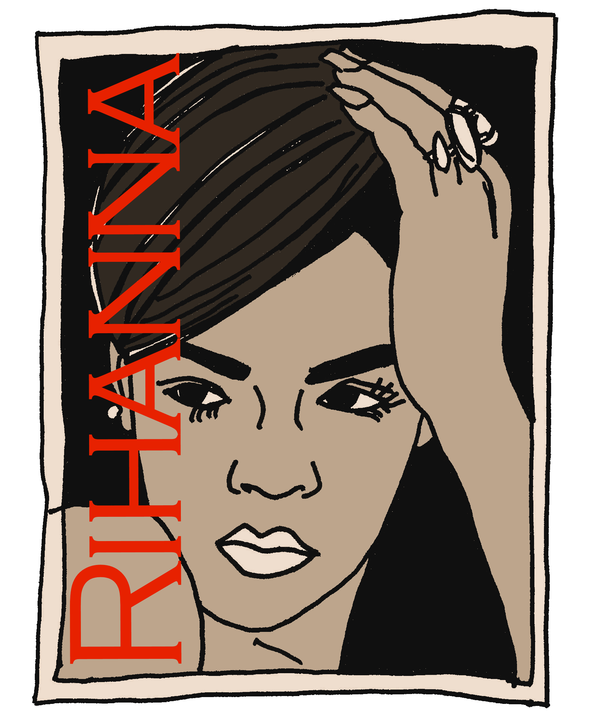



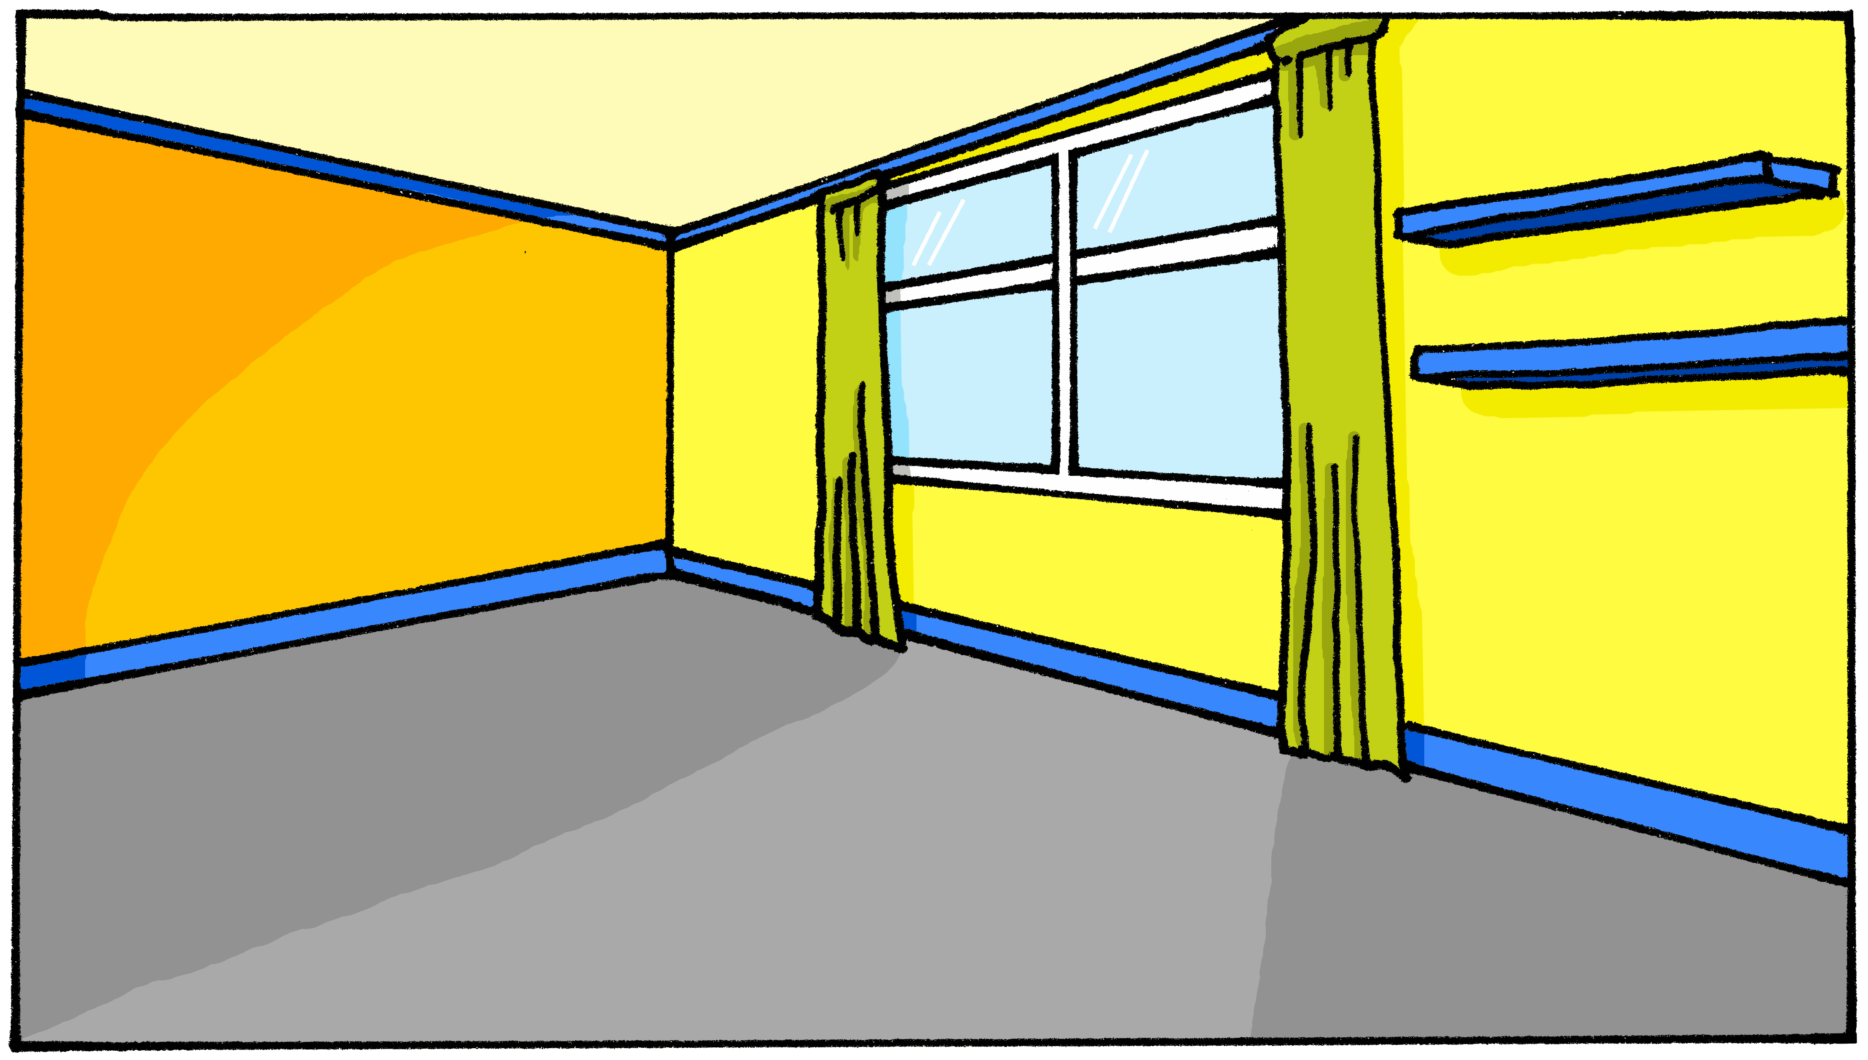
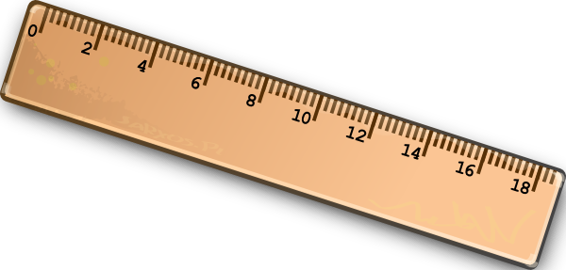

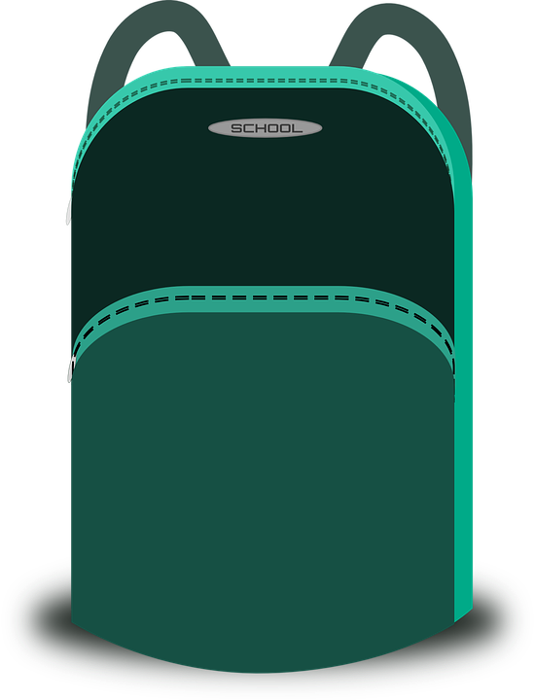

vocabulaire
Écoute et répète.
mots
une bouteille
une affiche
un livre
un crayon
un mur
une règle
a flower
a rubber
a bottle
a computer
a pencil
a book
a wall
a ruler
a poster
a bag
un ordinateur
un sac
une gomme
une fleur
Notes:
Timing: 4 minutes
Aim: to revisit previously taught vocabulary and to introduce three new words.
Procedure:
1. Click for an English prompt.
2. Elicit the French article from pupils (un or une) and the French word. In most cases, pupils will recognise and be able to read the word aloud independently.
Note that pupils have previously learnt 7/10 of these words. In addition they have now practised the SSC sufficiently well to be able to try to pronounce all of these words from the written form. However, they may still need some support from the teacher.
3. Continue until all 10 items have been seen and heard.
5

Slide 6

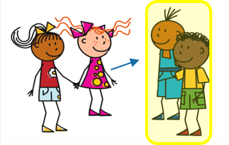

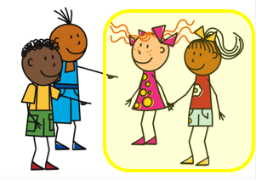



ils / elles:
the pronouns ‘they’
[they]
You know to use ils or elles to mean ‘they’ for people:
Ils sont contents.
Elles sont contentes.
They (m) are pleased.
They (f) are pleased.
Also use ils to mean ‘they’ for
all masculine nouns:
And use elles to mean ‘they’ for all feminine nouns:
Ils sont verts.
Elles sont jaunes.
They (m) are green.
They (f) are yellow.
Notes:
Timing: 2 minutes
Aim: to recap use of 3rd person plural pronouns ils and elles for people, and introduce their use for other nouns.
Procedure:
Click to present the information.
Elicit English translation for the French examples provided.
6

Slide 7



écouter
C’est quelle image ?
1
A
B
Ils sont jolis.
(They are pretty.)
Notes:
Timing: 5 minutes (6 slides)
Aim: to practise distinguishing aurally between ils and elles and connecting the two pronouns for ‘they’ with meaning (nouns of the correct gender).
Procedure:
1. Click the button to play audio.
2. Students use their knowledge of ils and elles and the gender of the two nouns shown to decide which picture is being described.
3. They then write the English meaning of the adjective used in each sentence (to force vocabulary recall).
4. Answers appear upon clicking the mouse.
Transcript:
Ils sont jolis.
7

Slide 8

écouter
C’est quelle image ?
2
A
B
Ils sont sur la table.
(They are on the table.)
Notes:
[2/6]
Transcript:
Ils sont sur la table.
8

Slide 9
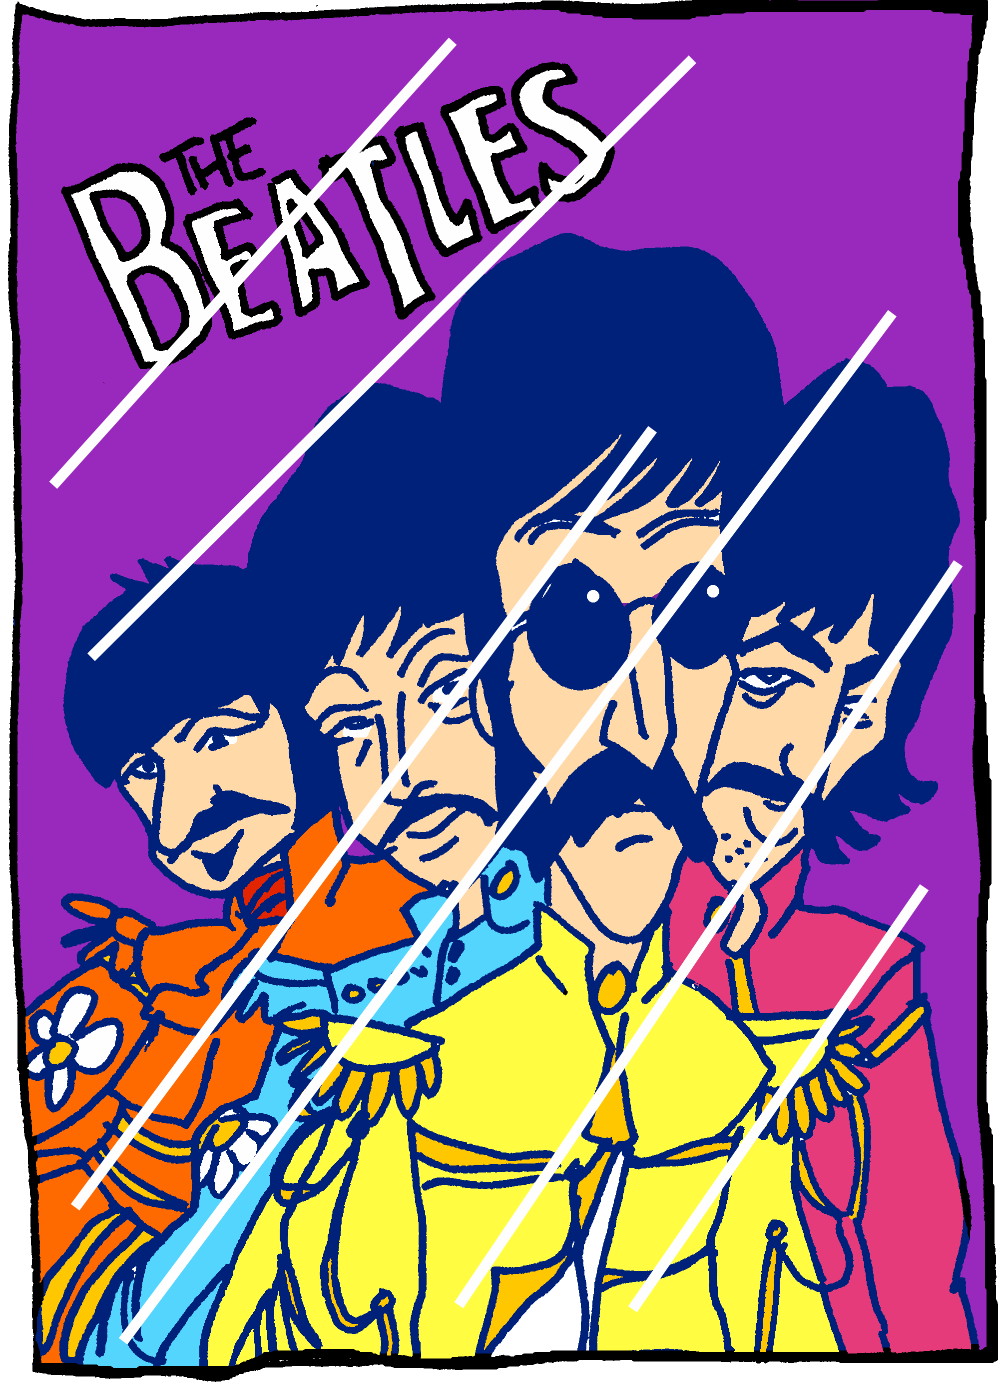


écouter
C’est quelle image ?
3
A
B
Elles sont dans la salle de classe.
(They are in the classroom.)
Notes:
[3/6]
Transcript:
Elles sont dans la salle de classe.
9

Slide 10
écouter
C’est quelle image ?
4
A
B
Elles sont dans le sac.
(They are in the bag.)
Notes:
[4/6]
Transcript:
Elles sont dans le sac.
10

Slide 11

écouter
C’est quelle image ?
5
A
B
Ils sont rouges.
(They are red.)
Notes:
[5/6]
Transcript:
Ils sont rouges.
11

Slide 12


écouter
C’est quelle image ?
6
A
B
Elles sont sur la chaise.
(They are on the chair.)
Notes:
[6/6]
Transcript:
Elles sont sur la chaise.
12

Slide 13

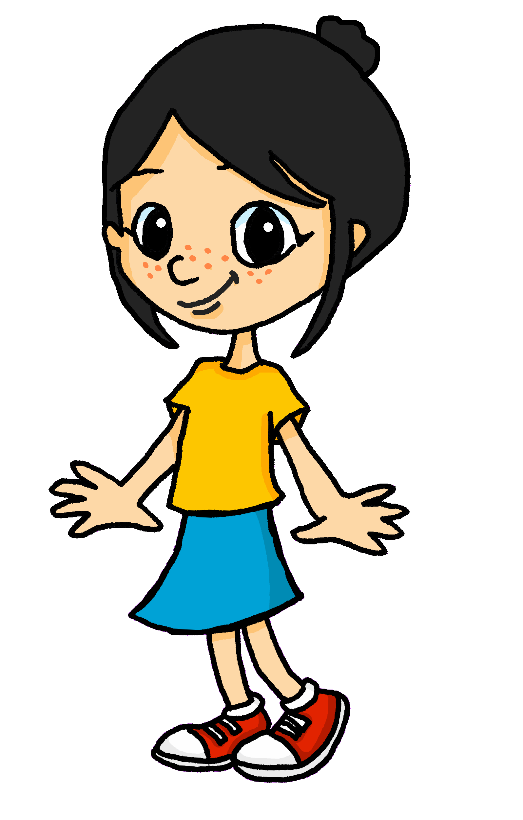
lire
Eugénie décrit sa classe.
Lis les phrases. C’est quel mot ?
Choisis le mot correspondant de 1 à 6.
Exemple :
Il y a trois murs | tables. Ils sont bleus.
1
Il y a six ordinateurs | chaises. Ils sont modernes.
2
Il y a deux sacs| règles. Elles sont utiles.
3
Il y a quatre livres| affiches. Ils sont intéressants.
4
Il y a trois crayons | bouteilles. Ils sont sur le bureau.
5
Il y a trois fleurs | sacs. Elles sont jolies.
6
Il y a deux sacs | gommes. Elles sont sur les tables.
Notes:
Timing: 5 minutes
Aim: to practise written recognition of 3rd person plural subject pronouns and their connection to masculine and feminine plural nouns.
Procedure:
Read the title and instructions and ensure the task scenario is understood.
Complete the example with the class.
Pupils write the correct noun for items 1-6.
Click to reveal answers and elicit English meanings of the phrases.
Note: The activity on the next slide focuses on understanding sentence meanings.
13

Slide 14
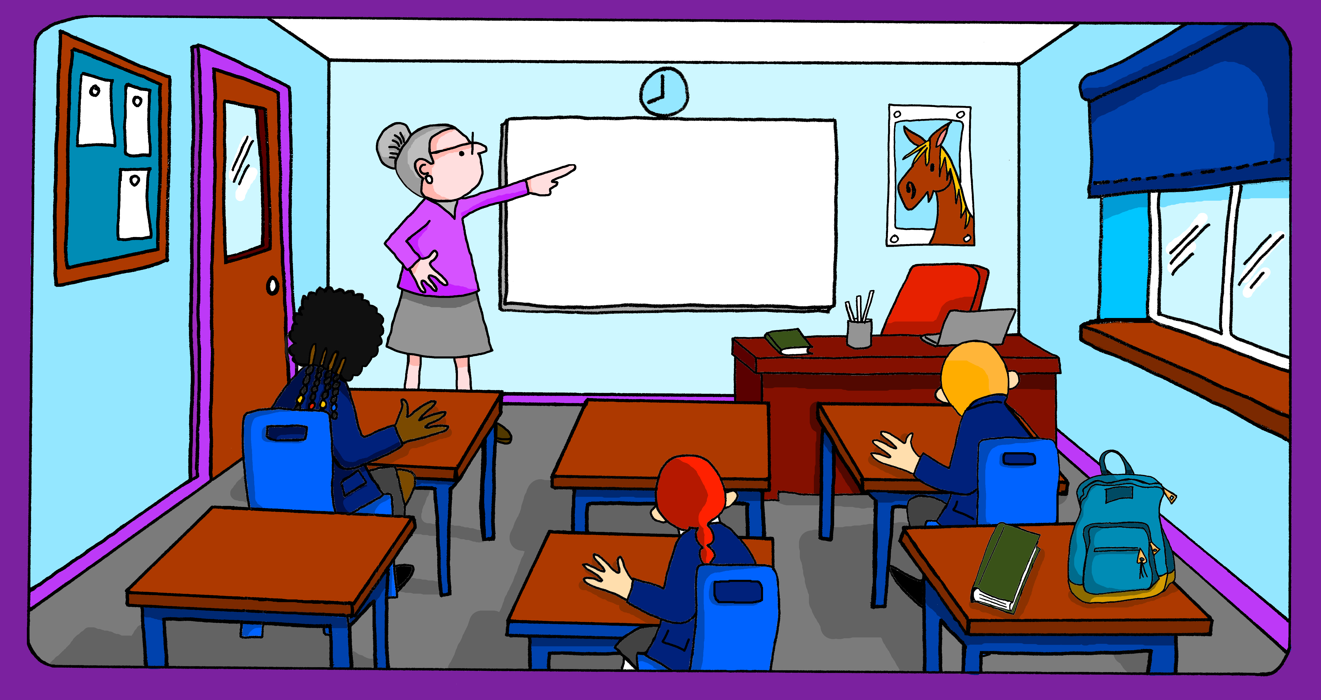

lire
La salle de classe d’Eugénie ! C’est vrai ou faux ?
Il y a trois crayons. Ils sont sur le bureau.
Il y a quatre livres. Ils sont intéressants.
Il y a trois fleurs. Elles sont jolies.
Il y a deux gommes. Elles sont sur les tables.
Il y a six ordinateurs. Ils sont modernes.
Il y a deux règles. Elles sont utiles.
Il y a trois murs. Ils sont bleus.
Notes:
Timing: 5 minutes
Aim: to practise written comprehension of vocabulary and structures for this week.
Procedure:
Click to bring up the first example sentence in French.
Pupils write (or say) ‘vrai’ ou ‘faux’ from pupils.
Click to reveal the answer.
Continue with items 1-6.
14

Slide 15
Au revoir !
bleu
Notes:
15

