Slide 1
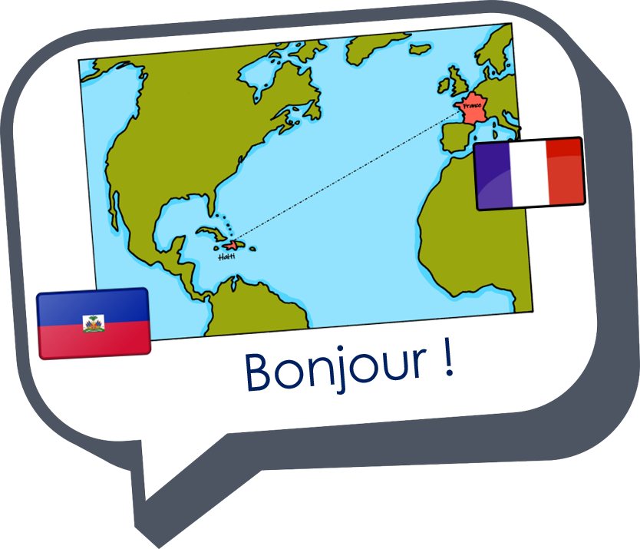
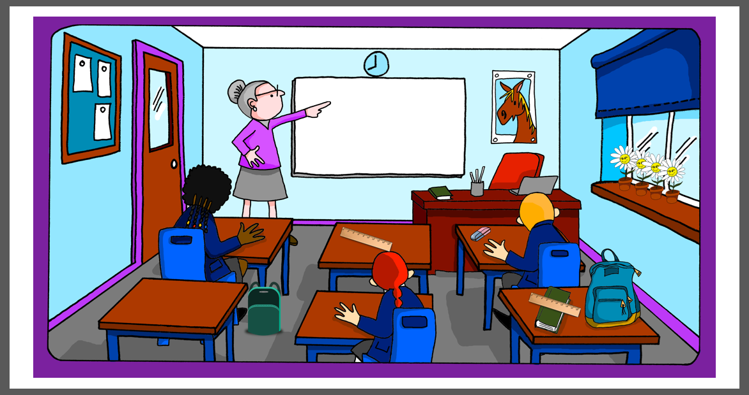
Describing me and others
la salle de classe
bleu
Follow ups 1-5
Term 1 Week 7
Notes:
Artwork by Steve Clarke. Pronoun pictures from NCELP (www.ncelp.org). All additional pictures selected from Pixabay and are available under a Creative Commons license, no
attribution required.
Phonics: revisit closed and open [eu] - un peu [91] peur [755] fleur [2305] jeune [152] neuf [787] acteur [1552] seul [102]
Vocabulary (new words in bold): sont [5] ils [13] elles [38] combien [800] affiche [2886] bouteille [2979] crayon [>5000] fleur [2305] gomme [>5000] livre [358] mur [1335] ordinateur [2201] règle [488] sac [2343] vrai [292] faux [555] de [2]
Revisit 1: sommes [5] nous [31] quel, quelle [146] date [660] jour [78] semaine [245] saison [1667] lundi [1091], mardi [1044] mercredi [1168] jeudi [1112] vendredi [1086] samedi [1356] dimanche [1235] aujourd’hui [233]
Revisit 2: chaque [151] jour [78] revisit days of the week jouer [219] avec [23] ami [367] amie [467]
Londsale, D., & Le Bras, Y. (2009). A Frequency Dictionary of French: Core vocabulary for learners London: Routledge.
The frequency rankings for words that occur in this PowerPoint which have been previously introduced in these resources are given in the SOW and in the resources that first
introduced and formally re-visited those words.
For any other words that occur incidentally in this PowerPoint, frequency rankings will be provided in the notes field wherever possible.

Slide 2
Follow up 1:
La Chandeleur est le 2 février. C’est une fête d’origine païenne et latine . En France, la tradition est de manger beaucoup de crêpes, surtout en Bretagne !
La chandeleur
prononcer
La Chandeleur Que du bonheur Avec ma sœur ! Beaucoup de beurre Pour mon quatre-heures Mais sans rancœur ! L’hiver se meurt Ou prend vigueur Je n’ai pas peur ! Plein de couleurs Comme de belles fleurs Près de mon cœur !
œ is called e dans l'o which means e in the o. When followed by ‘ur’ it sounds the same as open [eu]
Notes:
Link to video: https://www.youtube.com/watch?v=On0N7lrY0Mg
Timing: 5 minutes
Aim: to practise aural recognition and production of open [eu]; cultural awareness: La Chandeleur (Candlemas)
Procedure:
1. Blank the screen and play the audio for the poem without showing the words. 2. Pupils respond with a gesture (could be hands up and immediately down) each time they hear the SSC open [eu]. 3. Click to bring up the callout explaining the title of the poem. Ensure all pupils understand.
4. Click to bring up the poem text and the callout about e dans l’o.
5. Pupils then practise reading the poem aloud.
6. Play the video and pupils read along to practise producing the words in time with the audio.
Frequency of unknown words and cognates (1 is the most frequent word in French): bonheur [1948] beurre [4112] rancœur [>5000] hiver [1586] mourir [722] prendre [43] vigueur [>5000] peur [755] plein [394] beau [393] cœur [568]
Source: Londsale, D., & Le Bras, Y. (2009). A Frequency Dictionary of French: Core vocabulary for learners London: Routledge.
Rough translation: Candlemas. What happiness With my sister! Lots of butter For my four-o'clock afternoon snack But without resentment! Winter is dying Or gaining strength I'm not afraid! Full of colours Like beautiful flowers Close to my heart!

Slide 3
Follow up 2:
Écoute. Trouve la phrase correspondante.
écouter
1
B
A
C’est la date de la Chandeleur.
2
A
B
Ce sont des jours de la semaine.
C
L’hiver est une saison.
3
E
D
Aujourd’hui, c’est l’anniversaire de ma sœur.
4
C
E
C’est le weekend.
5
D
l’hiver – winter
Notes:
Timing: 5 minutes
Aim: to practise aural comprehension vocabulary that we are revisiting this week.
Procedure:
1. Click each number to listen. 2. Pupils write down the letter of the sentence whose meaning matches the aural clue.
3. Click to reveal the answers.
Transcript:
1. lundi, mardi, mercredi, jeudi vendredi 2. le deux février 3. samedi et dimanche 4. décembre, janvier, février. 5. Elle a six ans.

Slide 4
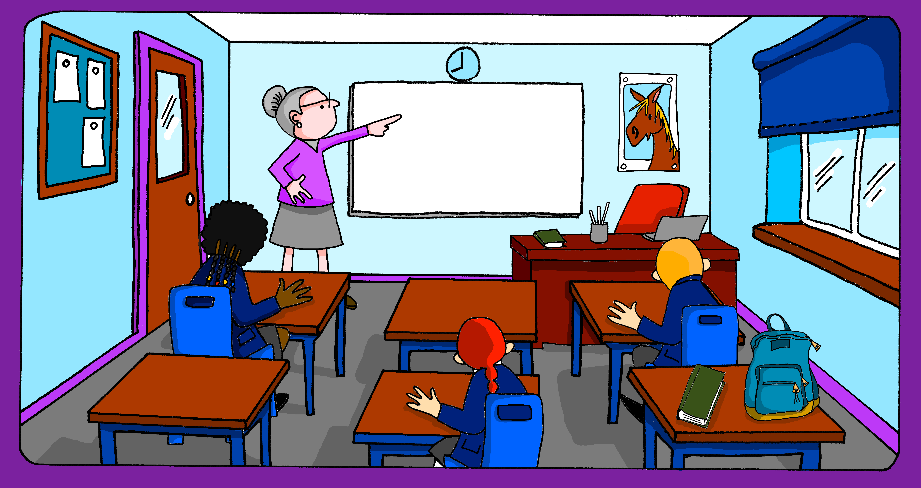
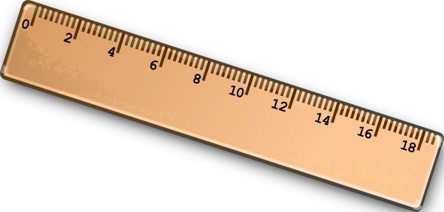
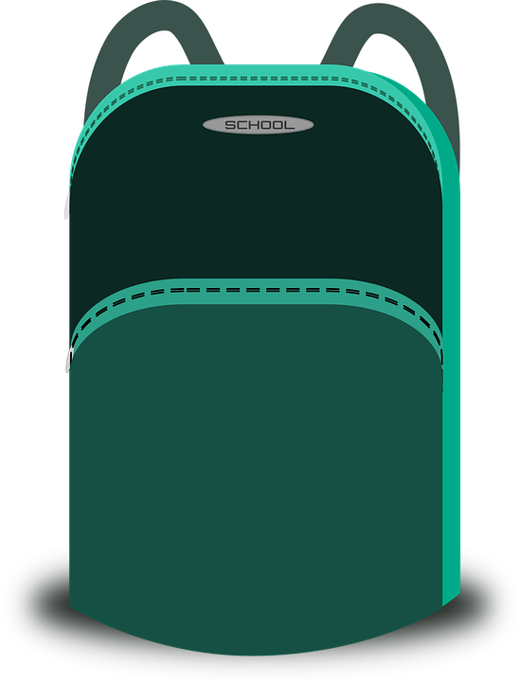
Follow up 3: Complète les phrases.
parler
Il y a six tables. Elles sont modernes.
Il y a quatre personnes. Elles sont intelligentes.
Il y a une gomme. Elle est utile.
There are six tables. They are modern.
Il y a quatre fleurs. Elles sont petites.
Il y a deux livres. Ils sont verts.
Il y a un ordinateur. Il est sur le bureau.
There is a computer. It is on the desk.
There is a rubber. It is useful.
There are four flowers. They are small.
There are four people. They are intelligent.
There are two books. They are green.
Notes:
Timing: 5 minutes
Aim: to practise structured production of sentences using 3rd person plural subject pronouns; to describe a picture in sentences.
Procedure:
Click to reveal the first English sentences.
Pupils say the French out loud.
Click to reveal the French answer.
Continue with items 2-6.

Slide 5
Follow up 4:
Écris trois phrases en français.
écrire
Notes:
Timing: 5-10 minutes
Aim: to practise written production of sentences to describe a picture.
Procedure: 1. Pupils write three sentences of their choice to describe the picture. 2. Teacher circulates to support pupils, as needed.

Slide 6
vocabulaire
Follow up 5 - Écris en anglais : Can you get at least 15 points?
mots
 | chaque | le jour | l’ami
 | l’amie | jouer | avec
 | elles | aujourd’hui | seule
 | ils | jeune | nous sommes
 | quel | quelle | la semaine
 | faux | combien | vrai
 | le mur | l’ordinateur | la fleur
each, every
day
friend (m)
x3
friend (f)
to play | playing
with
they (f)
today
alone (f)
x2
they (m, mixed)
young (m/f)
we are
which (m)
which (f)
week
false
how much/many
true
x1
wall
computer
flower
Notes:
Timing: 5 minutes
Aim: to practise written comprehension of vocabulary from this week and two revisited weeks.
Procedure: 1. Give pupils a blank grid. They fill in the English meanings of any of the words they know, trying to reach 15 points in total. 2. Remind pupils that adjectives can refer to male or female persons and they should note this in their translations. E.g. pleased (f), short (m).
Note: The most recently learnt and practised words are pink, words from revisit 1 are green and those from revisit 2 are blue, thus more points are awarded for them, to recognise that memories fade and more effort (heavy lifting!) is needed to retrieve them.
6

Slide 7
vocabulaire
Follow up 5 - Écris en anglais : Can you get at least 15 points?
mots
 | chaque | le jour | l’ami
 | l’amie | jouer | avec
 | elles | aujourd’hui | seule
 | ils | jeune | nous sommes
 | quel | quelle | la semaine
 | faux | combien | vrai
 | le mur | l’ordinateur | la fleur
x3
x2
Notes:
HANDOUT
7

