Slide 1
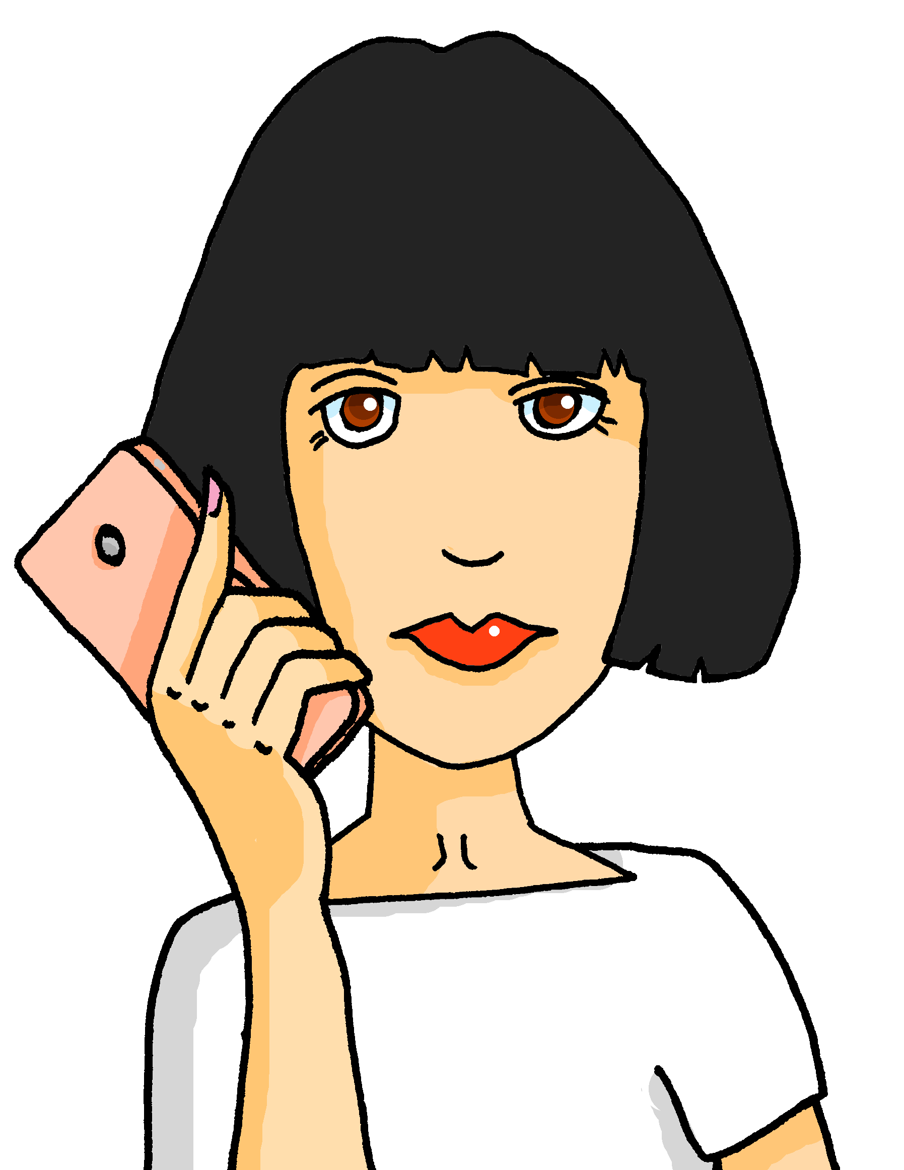
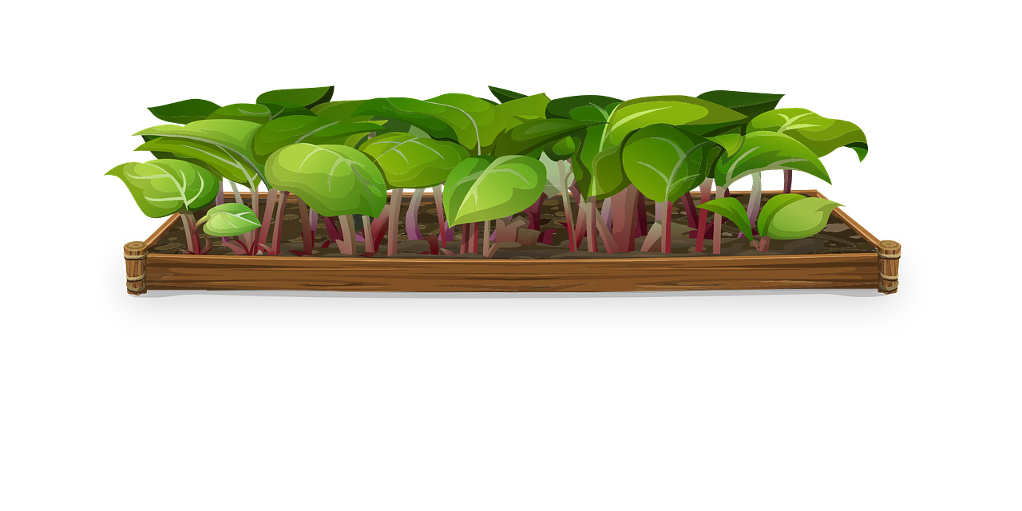
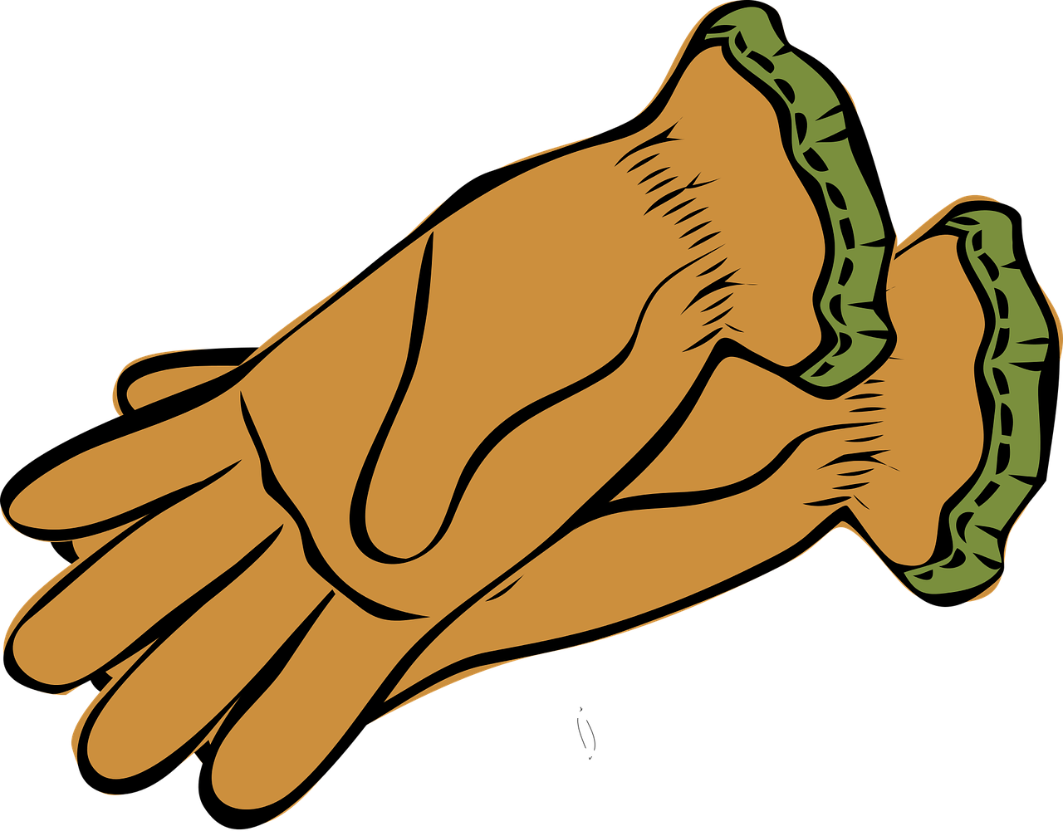
Describing me and others
Miam miam !
Maman est contente
bleu
Follow ups 1-5
Term 1 Week 6
Notes:
Artwork by Steve Clarke. Pronoun pictures from NCELP (www.ncelp.org). All additional pictures selected from Pixabay and are available under a Creative Commons license, no
attribution required.
Phonics: revisit [on] and introduce [om] - non ! [72] crayon [>5000] onze [2447] monde [77] pont [1889] nom [171] combat [1062] tomber [547]
Vocabulary (new words in bold): sont [5] ils [13] elles [38] sérieux [412], heureux [764] curieux [2424] courageux [2198] aussi [44] et [6] mais [30], vrai [292] faux [555]
Revisit 1: anniversaire [2043] mois [179] janvier [939] février [1139] mars [868] avril [1022] mai [943] juin [931] juillet [1326] aout [1445] septembre [944] octobre [826] novembre [982] décembre [891] quand [119] treize [3285] quatorze [3359] quinze [1472] seize [3285] dix-sept [3812] dix-huit [3592] dix-neuf [4851] vingt [1273] vingt-et-un [1273/6/3] vingt-deux, vingt-trois vingt-quatre vingt-cinq vingt-six vingt-sept vingt-huit vingt-neuf trente [1646]
Revisit 2: les [1] pomme [2847] merci [1070] s'il te plaît/s'il vous plaît [n/a]
Londsale, D., & Le Bras, Y. (2009). A Frequency Dictionary of French: Core vocabulary for learners London: Routledge.
The frequency rankings for words that occur in this PowerPoint which have been previously introduced in these resources are given in the SOW and in the resources that first
introduced and formally re-visited those words.
For any other words that occur incidentally in this PowerPoint, frequency rankings will be provided in the notes field wherever possible.

Slide 2
Follow up 1:
The SSC [on] and [an|en] are similar nasal vowels. Make the difference with your mouth shape: [an/en] = [on] =
Une chanson
Sur le pont d’Avignon
On y* danse, on y danse
Sur le pont d’Avignon
On y danse tous en rond*
Les beaux messieurs* font comme ça
Et puis encore comme ça …
_
_
On the Avignon bridge
People are dancing there (x2)
On the Avignon bridge
People are dancing round and round
_
_
_
_
prononcer
_
_
_
_
_
_
_
The handsome gentlemen do this
And then do this again …
_
The lyrics say that people danced ‘sur le pont’, but the bridge was quite narrow. It is believed that people actually used to dance on the islands in the river under the bridge’s arches.
Notes:
Timing: 5 minutes
Aim: to practise aural recognition of SSCs [on] and [en/an]; cultural awareness: folk song and geography
Procedure:
1. Tell pupils they are going to hear a traditional folk song about a famous French bridge. Point out that the end of the bridge is missing in the picture!
2. Explain that the rhyme scheme is based on [on] and [en/an]. The sounds are quite similar to an English speaker, so they will have to listen very carefully!
3. Open video in a new tab – don’t let pupils see the video while they listen as it has the lyrics on screen https://www.youtube.com/watch?v=jjOSNnXbIdU
3. Play first 25s of the video. On the first play, pupils simply listen and read along, focusing on the sounds covered by the question marks and listening for a difference.
4. Pupils listen to the audio again as many times as needed and fill the gaps in the text with either [on] or [en/an]. (NB: It may be easiest to let pupils copy out the text first, or to provide printed gapped versions).
5. Click to reveal answers one by one.
6. Click to reveal translation.
8. Listen again, allowing pupils to read through/ watch video and sing along.
9. Click to bring up additional cultural information.
Frequency of unknown words and cognates (1 is the most frequent word in French): danser [2934] y [36], rond [2268], messieurs [1549]
Source: Londsale, D., & Le Bras, Y. (2009). A Frequency Dictionary of French: Core vocabulary for learners London: Routledge.

Slide 3
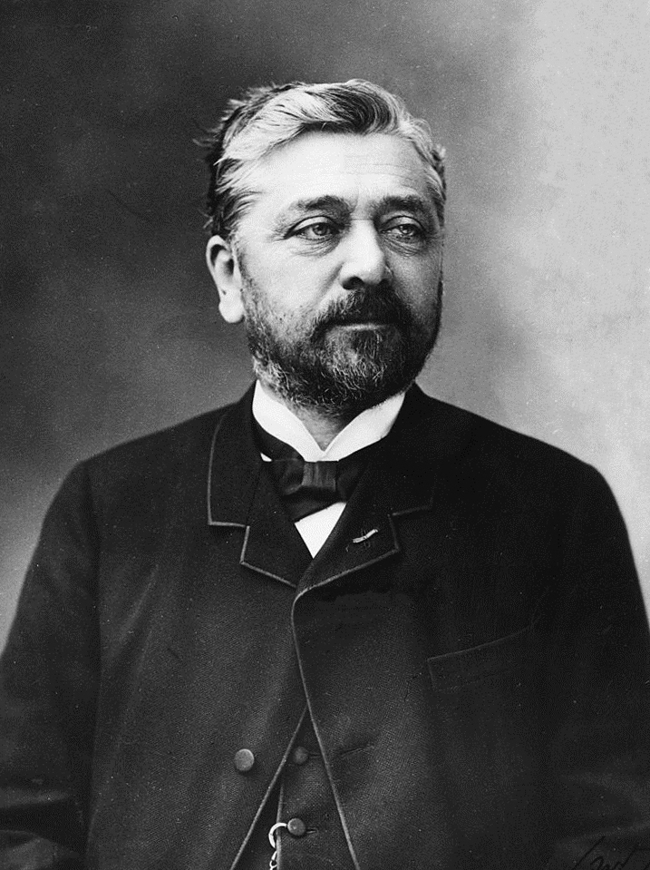
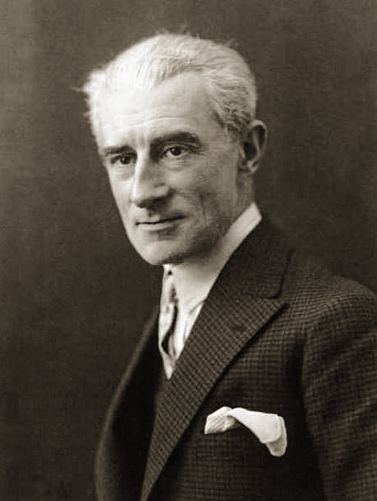
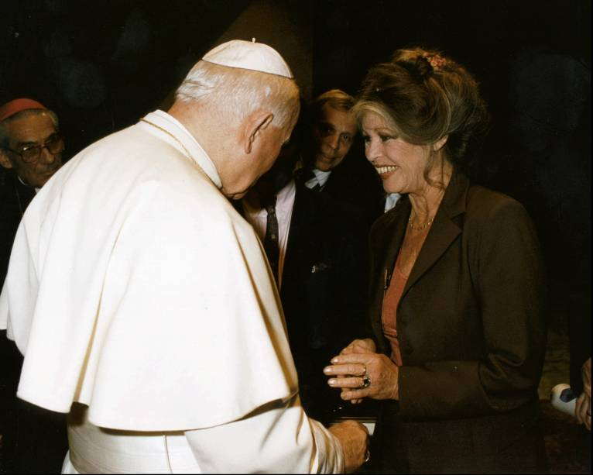
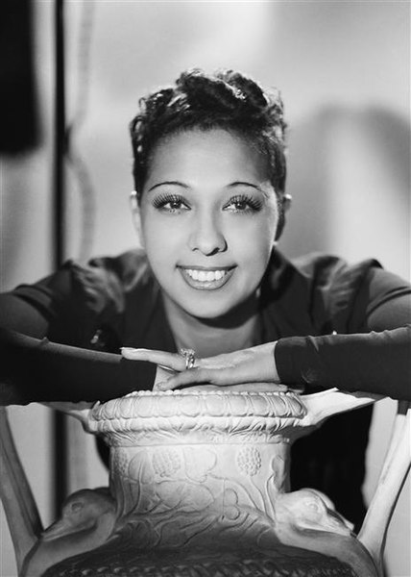
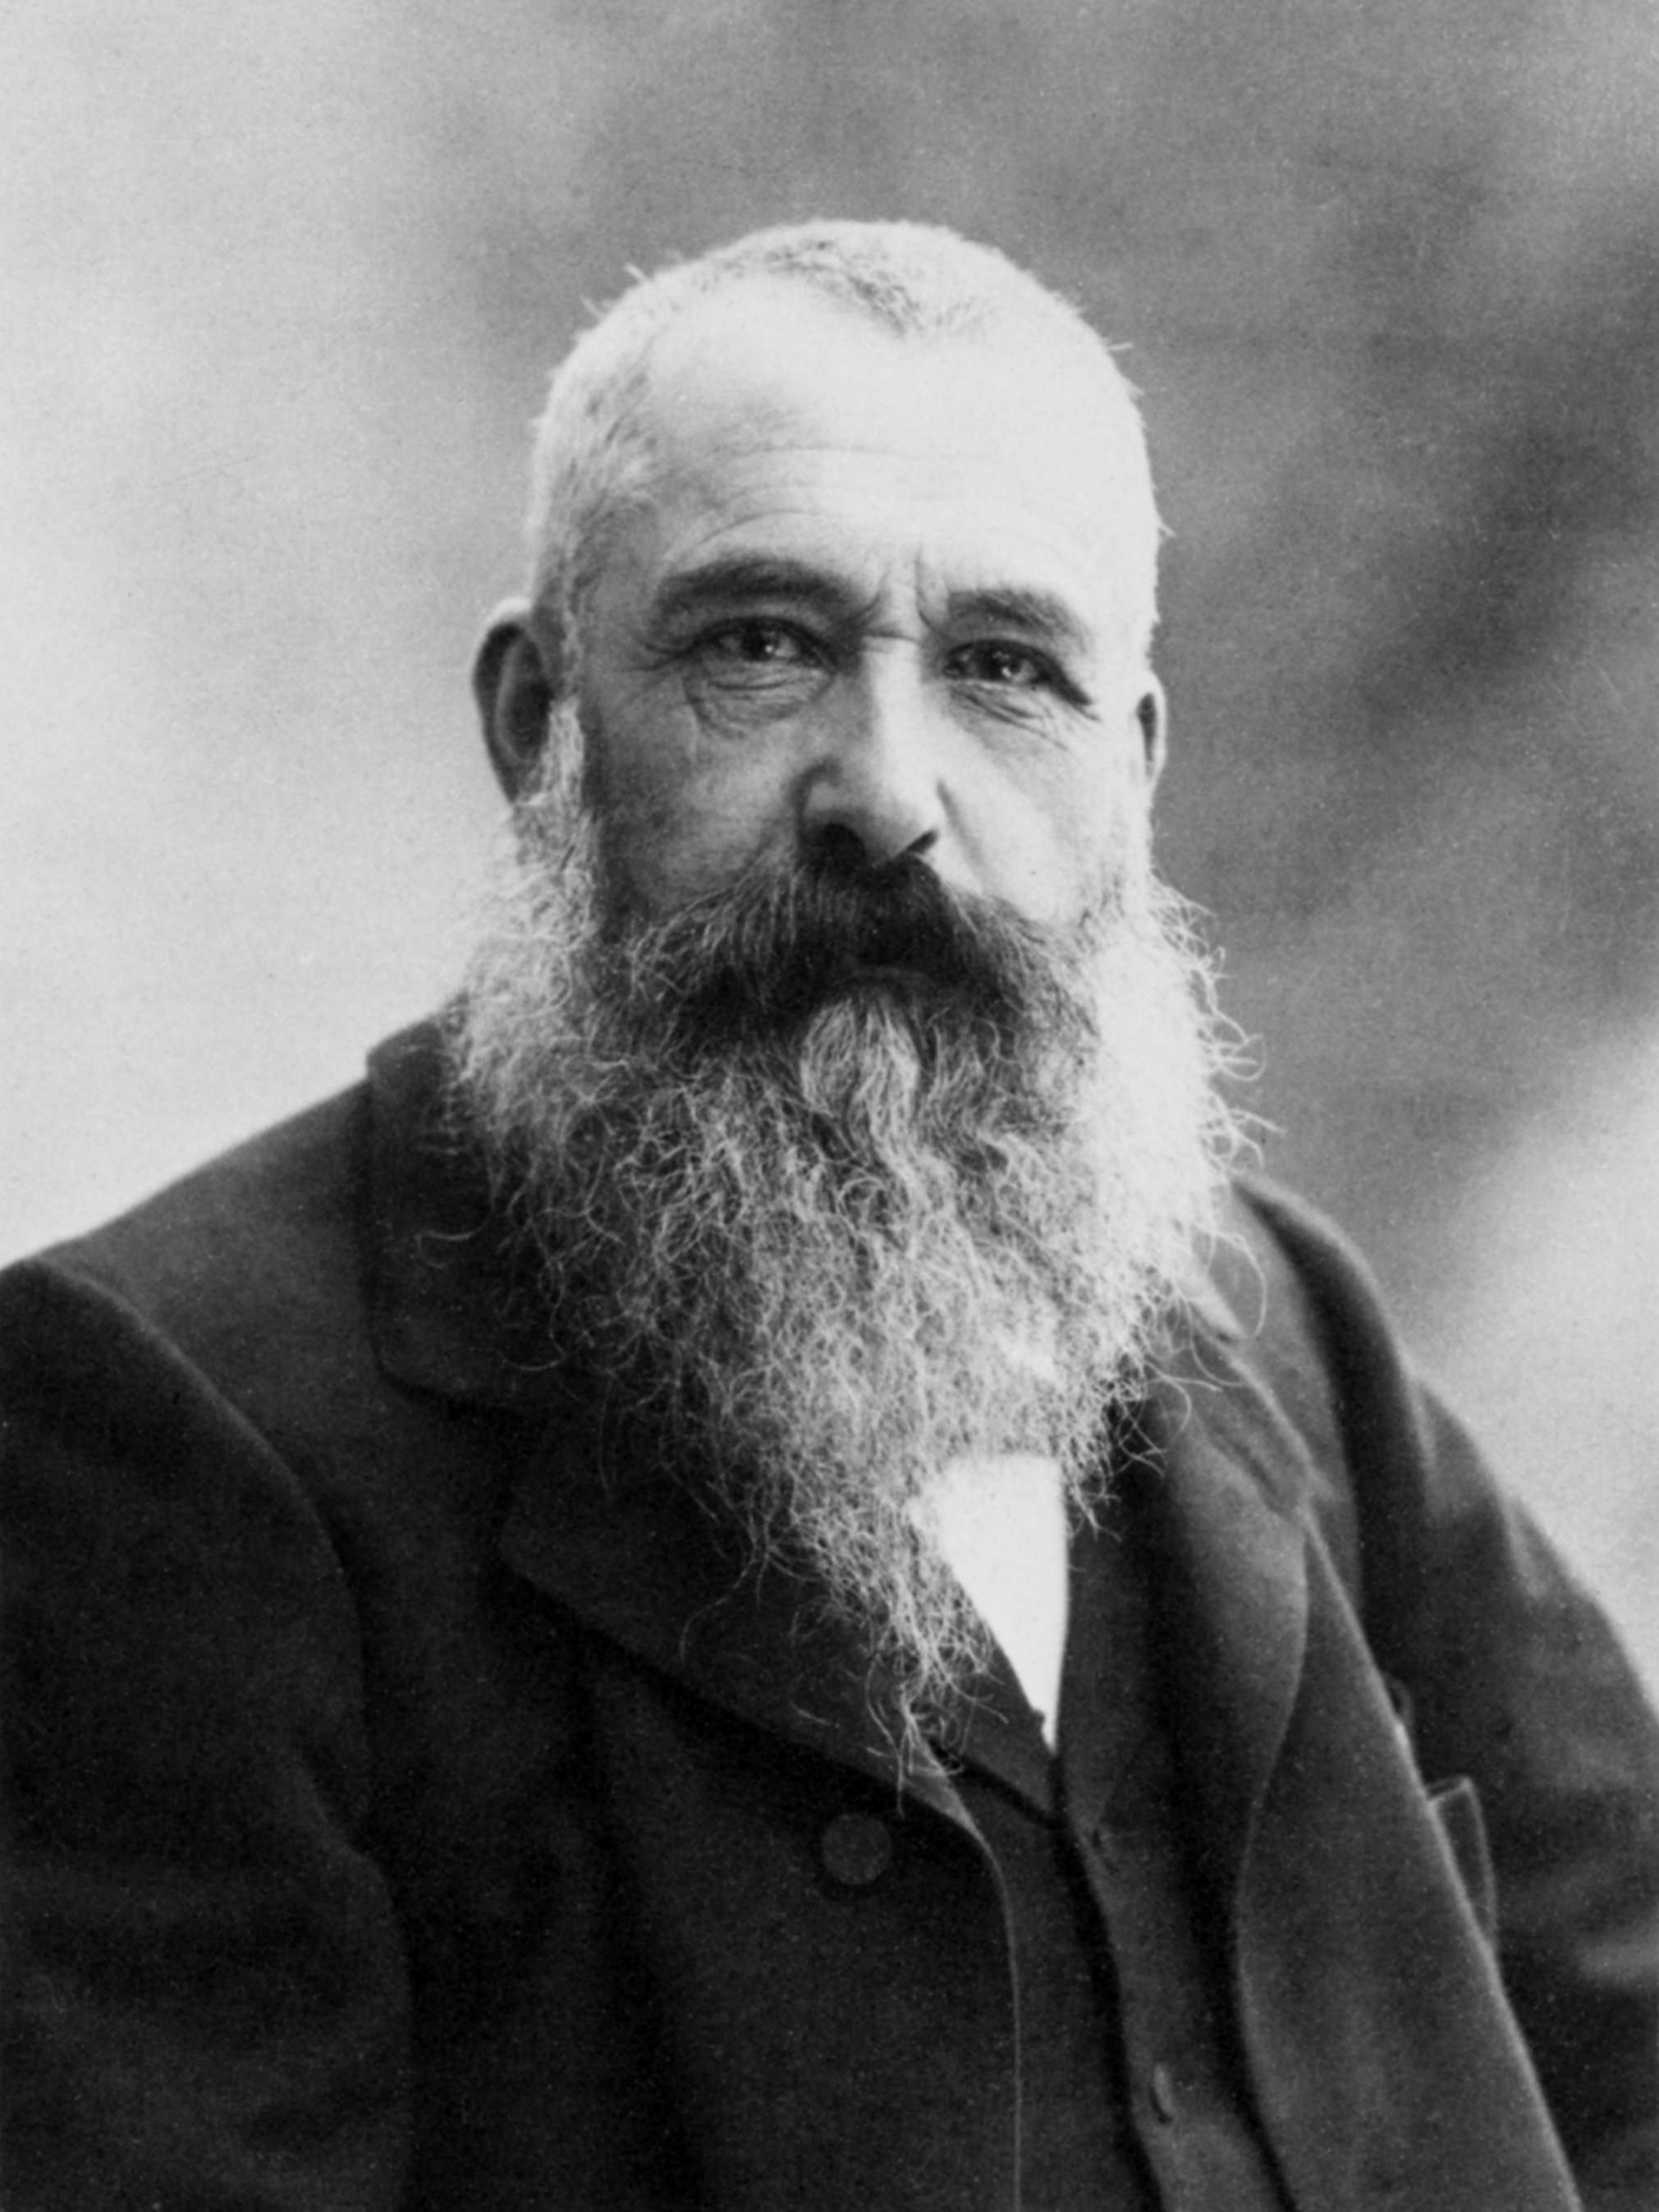
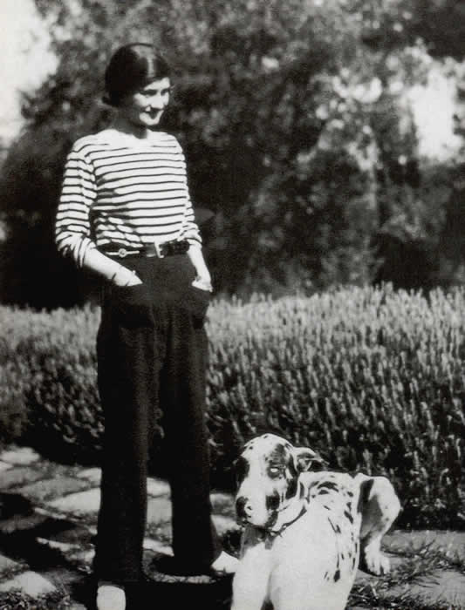
Follow up 2:
Écoute. Écris les anniversaires en français.
écouter
1
2
3
…… ……………..
…… ……………..
le 7 mars
le 15 décembre
le 28 septembre
…… ……………..
Gustave Eiffel
Brigitte Bardot
Maurice Ravel
4
5
6
…… ……………..
le 3 juin
le 14 novembre
…… ……………..
le 19 aout
…… ……………..
Joséphine Baker
Claude Monet
Coco Chanel
Notes:
Timing: 5 minutes
Aim: to practise aural comprehension of numbers and months.
Procedure:
1. Click each number to listen. 2. Pupils write down the number (in digits) and transcribe the month in French. 3. Click to reveal the answers.
4. See if pupils know anything about any of these people.
Photo attributions: 1. Gustave Eiffel Nadar, Public domain, via Wikimedia Commons 2. Brigitte Bardot Livio ANTICOLI/Gamma-Rapho via Getty Images, Public domain, via Wikimedia Commons
3. Maurice Ravel Unknown authorUnknown author The image holder, the Bibliothèque nationale de France has not identified a photographer. (Follow link and click on "Detailed information".), Public domain, via Wikimedia Commons 4. Joséphine Baker Studio Harcourt, Public domain, via Wikimedia Commons 5. Claude Monet Nadar, Public domain, via Wikimedia Commons 6. Coco Chanel Unknown authorUnknown author, Public domain, via Wikimedia Commons
Transcript:
1. L’anniversaire de Gustave Eiffel est le quinze décembre. 2. L’anniversaire de Brigitte Bardot es le vingt-huit septembre. 3. L’anniversaire de Maurice Ravel est le sept mars. 4. L’anniversaire de Joséphine Baker est le trois juin. 5. L’anniversaire de Claude Monet est le catorze novembre. 6. L’anniversaire de Coco Chanel est le dix-neuf aout.

Slide 4
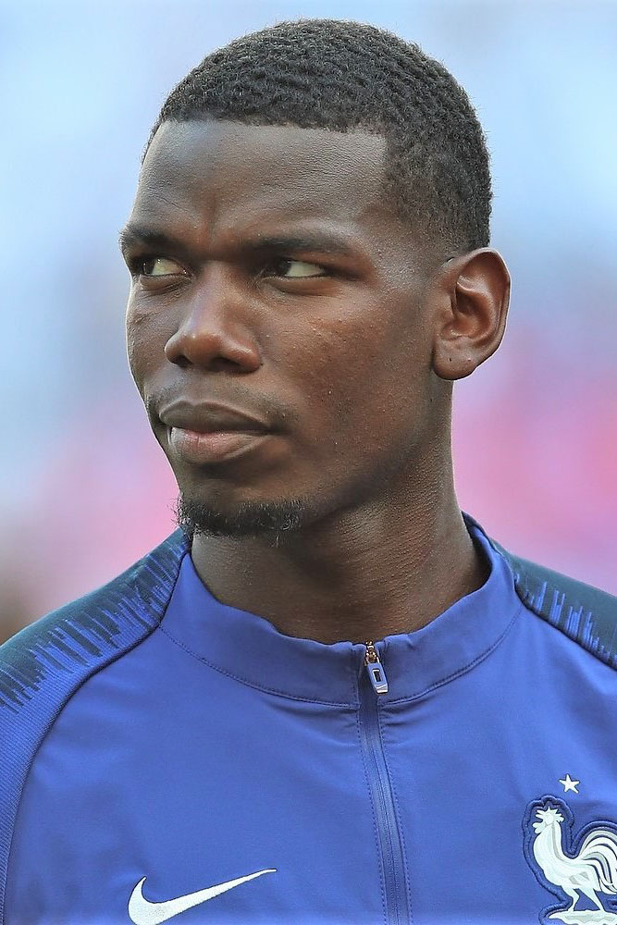
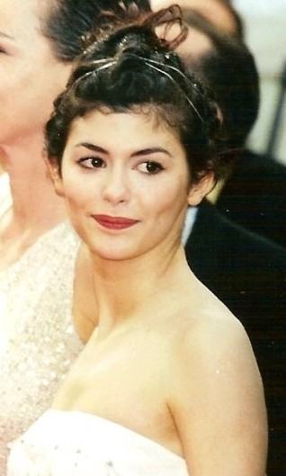
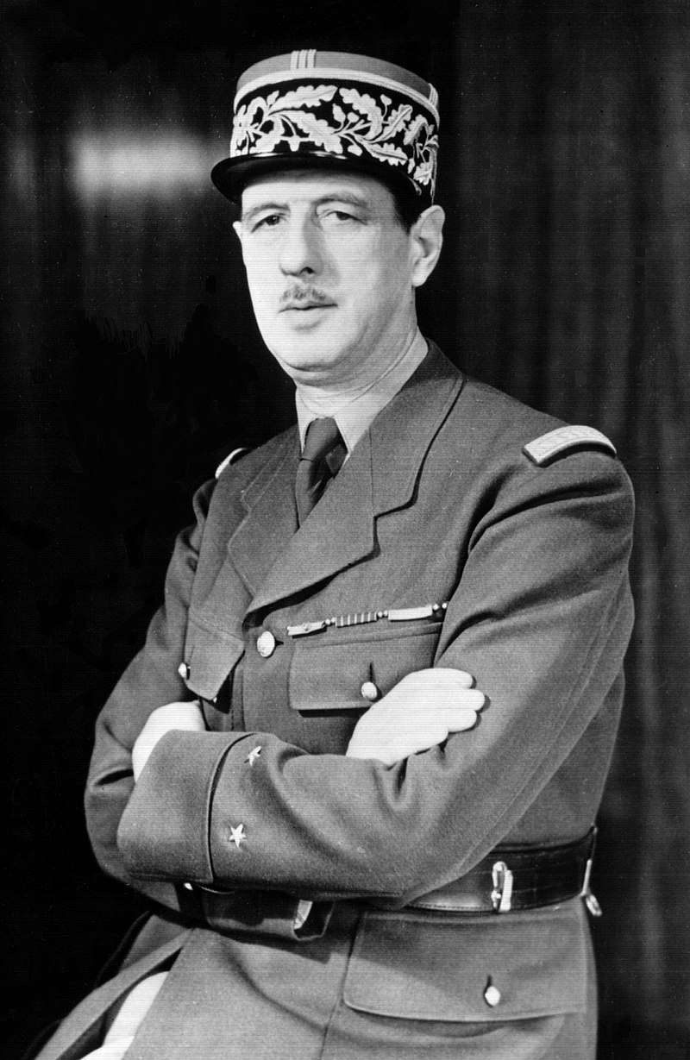
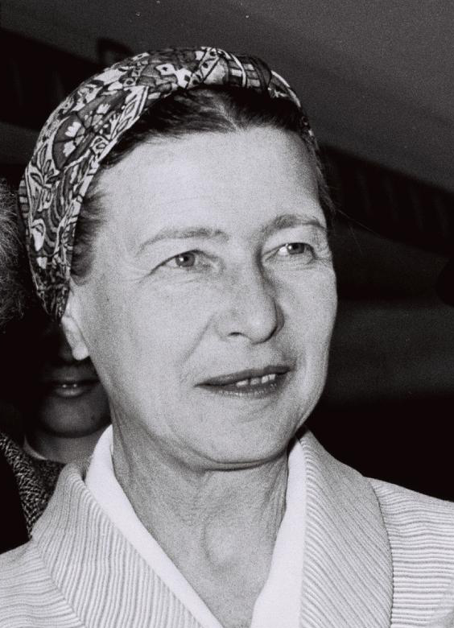
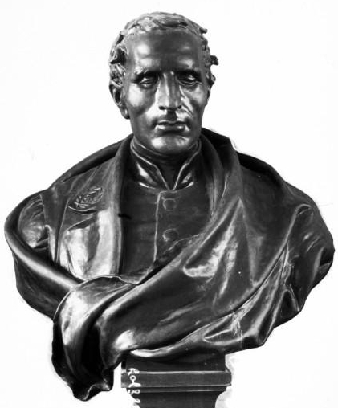
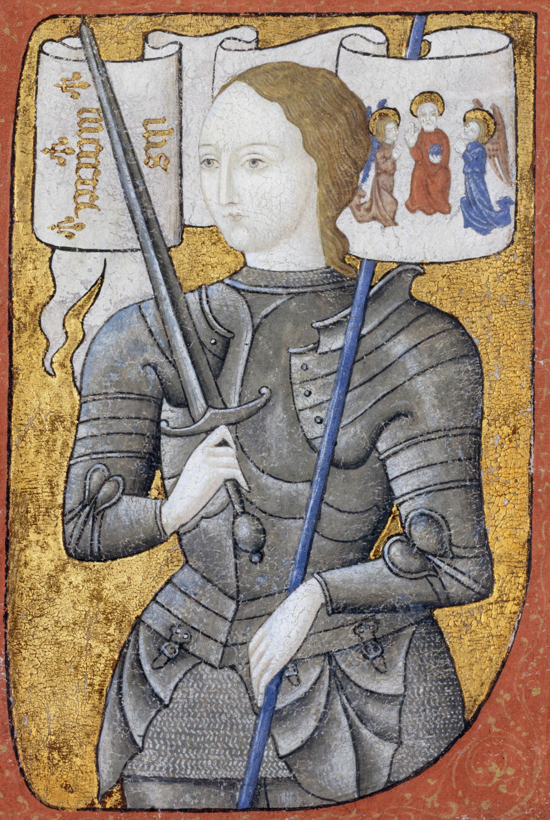
Follow up 3:
Écris les anniversaires en français.
Mon anniversaire est le quinze mars.
Paul Pogba
écrire
15.03
Mon anniversaire est le neuf aout.
Audrey Tautou
09.08
Mon anniversaire est le vingt-deux novembre.
22.11
Charles de Gaulle
09.01
Mon anniversaire est le neuf janvier.
Simone de Beauvoir
Jeanne d’Arc (Joan of Arc)’s birthday (and year of her birth) are unknown. 30th May is her Feast Day when she is celebrated as a Saint.
04.01
Mon anniversaire est le quatre janvier.
Louise Braille
30.05
Mon anniversaire est le trente mai.
Jeanne d’Arc
Notes:
Timing: 5-10 minutes
Aim: to practise written production of dates.
Procedure: 1. Explain that all of these are or were important and well-known French citizens. 2. Pupils write a sentence for each giving his/her birthday, writing the numbers in words to practise accuracy spelling. 3. Click to bring up written sentences.
Note: Joan of Arc’s birth date (even the year!) is unknown, so we list her Feast Day here, instead. Photo attributions:
Paul Pogba - Антон Зайцев, CC BY-SA 3.0 GFDL, via Wikimedia Commons Audrey TauTou - Georges Biard, CC BY-SA 3.0 <https://creativecommons.org/licenses/by-sa/3.0>, via Wikimedia Commons Simone de Beauvoir - Moshe Milner, CC BY-SA 3.0 <https://creativecommons.org/licenses/by-sa/3.0>, via Wikimedia Commons Charles de Gaulle - Office of War Information, Overseas Picture Division. [1] The image prefix (LC-USW3) at the Library of Congress image page matches that of pictures from the OWI collection (see prefix list here., Public domain, via Wikimedia Commons Louis Braille - Agence Rol, Public domain, via Wikimedia Commons Jeanne D’Arc - Archives nationales, Public domain, via Wikimedia Commons

Slide 5
Follow up 4:
Un jour horrible !
Pierre décrit la situation.
Des détails sont absents.
Écris bien les phrases.
écrire
1
Adèle et Léa sont méchantes.
Adèle and Léa are naughty.
2
Maman est contente mais les tomates sont vertes !
Mum is pleased but the tomatoes are green!
3
Ma professeure est très stricte maintenant.
My teacher is very strict now.
Mes amis sont absents et je suis seul à l’école.
4
My friends are absent and I am alone at school. ☹
Notes:
Timing: 5 minutes
Aim: to practise written production of the 3rd persons singular and plural of être.
Procedure:
Pupils need to write the missing words.
Click to reveal and check answers.
Note: to add a further element of challenge, remove the English translations.

Slide 6
Follow up 5:
Improvise des phrases.
Les amis … …
parler
60
Les pommes … …
Les parents … …
S
Les professeures … …
Les maths … …
0
Les livres … …
DÉBUT
Notes:
Timing: 5 minutes
Aim: to practise freer oral production of sentences with 3rd person plural être and adjectives.
Procedure:
Take it in turns with a partner saying a phrase with one of the sentence starters. (E.g. Les amis sont importants).
Pupils should take care to agree the adjectives (2, 4, 6 are feminine and we should hear the consonant before the ‘e’).
Pupils aim to complete all 6 sentences within one minute.
Repeat the task 1-2 times to improve confidence and speed in production.

Slide 7
vocabulaire
Follow up 5b - Écris en anglais : Can you get at least 15 points?
mots
 | la pomme | s’il te plait | merci
 | aimer | s’il vous plait | les
 | seize | vingt-quatre | treize
 | quinze | trente-et-un | quatorze
 | sont | elles | ils
 | courageuse | heureuses | sérieux
(the) game
to bring, bringing
(the) morning
x3
to love, loving
(the) language
the (pl)
16
24
13
x2
15
31
14
are (they)
they (f)
they (m)
x1
brave (f)
happy (fpl)
serious (m, mpl)
Notes:
Timing: 5 minutes
Aim: to practise written comprehension of vocabulary from this week and two revisited weeks.
Procedure: 1. Give pupils a blank grid. They fill in the English meanings of any of the words they know, trying to reach 15 points in total. 2. Remind pupils that adjectives can refer to male or female persons and they should note this in their translations. E.g. pleased (f), short (m).
Note: The most recently learnt and practised words are pink, words from revisit 1 are green and those from revisit 2 are blue, thus more points are awarded for them, to recognise that memories fade and more effort (heavy lifting!) is needed to retrieve them.
7

Slide 8
vocabulaire
Follow up 5b - Écris en anglais : Can you get at least 15 points?
mots
 | la pomme | s’il te plait | merci
 | aimer | s’il vous plait | les
 | seize | vingt-quatre | treize
 | quinze | trente-et-un | quatorze
 | sont | elles | ils
 | courageuse | heureuses | sérieux
x3
x2
x1
Notes:
HANDOUT
8

