Slide 1
Describing me and others
les cousins
« être » vous êtes (you all are, plural)
adjective agreement (plural)
Revisit [u] and [ou]
bleu
Term 1 Week 5
Notes:
Artwork by Steve Clarke. Pronoun pictures from NCELP (www.ncelp.org). All additional pictures selected from Pixabay and are available under a Creative Commons license, no
attribution required.
Phonics: revisit [u] and [ou] - tu [12] nous [31]
Vocabulary (new words in bold): êtes [5] vous [50] ensemble [124] maintenant [192] toujours [103] rarement [2535] souvent [287], known adjectives
Revisit 1: sommes [5] nous [31] absent [2016] amusant [4695] calme [1731] content [1841] différent [350] difficile [296] drôle [2166] fort [107] grand [59] jeune [152] lent [2572] malade [1066] méchant [3184] intelligent [2509] indépendant [954] important [215] petit [138] présent [216] prudent [1529] seul [102] rapide [672] strict [1859] sage [2643] triste [1843]
Revisit 2: détester [2898] jouer [219] travailler [290] silence [1281] en retard [n/a]
Londsale, D., & Le Bras, Y. (2009). A Frequency Dictionary of French: Core vocabulary for learners London: Routledge.
The frequency rankings for words that occur in this PowerPoint which have been previously introduced in these resources are given in the SOW and in the resources that first
introduced and formally re-visited those words.
For any other words that occur incidentally in this PowerPoint, frequency rankings will be provided in the notes field wherever possible.
1

Slide 2
[u]
[ou]
prononcer
tu
nous
Notes:
Timing: 1 minute
Aim: to recap SSC [u] and [ou]
Procedure:
Introduce and elicit the pronunciation of the individual SSC [u] and [ou] and then the source words ‘tu’ and ‘nous’(with gestures, if using).
Click to bring on the picture and get students to repeat (with gesture, if using).
Note: i) gesture for tu – pointing away to an imaginary person in front of you.
ii) gesture for nous – spreading arms out in front palms down, do a sweeping motion (similar to a breastroke in swimming), motioning inclusivity ‘we’.
2

Slide 3
prononcer
Prononce les mots.
cousin
couple
super
20
adulte
double
pollution
S
plus
routine
nature
stupide
0
touriste
troupe
DÉBUT
Notes:
Timing: 2 minutes
Aim: to practise oral production of SSC [u] and [ou]
Procedure:
Start the timer.
Pupils tried to say as many words as they can correctly in twenty seconds.
Pupil B listens carefully and stops his/her partner for a count of 3 every time s/he pronounces a word with the English [u] or [ou] sound.
Pupils swap roles and the timer is restarted.
The person who has pronounced the greatest number of words correctly wins. If there is a tie, the student with the greatest amount of time remaining wins.
Click on the words to hear them said by a native speaker. Pupils repeat.
Go over the meaning of the words. These are all cognates or near-cognates, purposefully chosen for unlearning the connection between the SSC and the English sound.
Word frequency (1 is the most frequent word in French): adulte [1580] couple [1167] cousin [3387] double [574] nature [542] plus [19] pollution [3073] routine [3120] stupide [3407] super [2993] touriste [2653] troupe [1282]
Source: Londsale, D., & Le Bras, Y. (2009). A Frequency Dictionary of French: Core vocabulary for learners London: Routledge.
3

Slide 4
écouter
Ferdinand the frog is hungry!
la mouche – fly
Ferdinand cherche une mouche !
Exemple :
Tu es où ? Tu as la mouche ?!
.
Écoute. C’est vue [1] ou vous [2] ?
vous, vue
A
1
1
2
B
2
D
1
2
C
la vue – view vous – you (all)
Notes:
Attribution: with thanks to Natalie Finlayson for the idea for this minimal pairs activity. Timing: 5 minutes (4 slides) Aim: To distinguish aurally between [u] and [ou] and to connect this difference in sound with a change in meaning (view or you (all)). Procedure: 1. Use this example to prepare students for the full game on the slide that follows.
2. Explain to students that they will hear a ‘code’ in French which will direct them to the lily pad where the fly is. The ‘code’ will be two words long in the example (five words long in the game) and will consist of a mix of vue and vous. If they vue they should follow the arrow labelled ‘1’. If they hear vous they should follow the arrow labelled ‘2’.
3. Click on the arrow to hear the code.
4. Pupils hear vous. Starting on the lily pad with the frog on it, they move down one lily pad, following the ‘2’ arrow. They then hear vue and move left one lily pad, following the ‘1’ arrow, hopefully ending on lily pad ‘D’.
5. Click to reveal a transcript so that students can check their answer.
6. Click on the lily pad with the letter the students call out. If they are correct, the lily pad disappears to reveal a fly. If they are incorrect, the lily pad disappears to reveal a net.
Transcript:
vous, vue
4

Slide 5
écouter
Ferdinand cherche une mouche ! [1/3]
vue [1] | vous [2]
P
1
2
O
2
2
2
A
1
1
1
1
M
1
2
1
1
1
B
2
1
2
2
2
L
1
2
1
1
C
2
1
1
2
K
2
1
2
2
1
2
1
2
1
1
2
J
1
2
2
D
1
F
2
1
2
I
2
1
1
2
E
G
H
1
Notes:
[1/3]
Procedure: 1. Explain to students that they are now going to hear three longer codes consisting of five words (singular and plural forms of vue and vous). Click on vue | vous to hear the two words again.
2. Click on ‘1’ to play the first code. Starting on the lily pad with the frog on it, students trace the route with their fingers, or mini versions of the slide can be printed to trace with a pen.
3. Play the audio for a second time if necessary.
4. Ask ‘tu es où ?’ to elicit letters from the class.
5. Click on the lily pad to reveal whether the students were correct (fly) or incorrect (net).
6. Repeat steps 2-5 for the second and third codes (on the next two slides).
Transcript: 1. vue, vous, vue, vous, vous (Answer = L)
5

Slide 6
écouter
Ferdinand cherche une mouche ! [2/3]
vue [1] | vous [2]
P
1
2
O
2
2
2
A
1
1
1
1
M
1
2
1
1
1
B
2
1
2
2
2
L
1
2
1
1
C
2
1
1
2
K
2
1
2
2
1
2
1
2
1
1
2
J
1
2
2
D
1
F
2
1
2
I
2
2
2
1
1
E
G
H
Notes:
[2/3]
Transcript: 1. vous, vue, vue, vue, vous (Answer = C)
6

Slide 7
écouter
Ferdinand cherche une mouche ! [3/3]
vue [1] | vous [2]
P
1
2
O
2
2
2
A
1
1
1
1
M
1
2
1
1
1
B
2
1
2
2
2
L
1
2
1
1
C
2
1
1
2
K
2
1
2
2
1
2
1
2
1
1
2
J
1
2
2
D
1
F
2
1
2
I
2
1
1
2
3
E
G
H
Notes:
[3/3]
Transcript: 1. vous, vous, vue, vous, vue (Answer = H)
7

Slide 8
Être
[to be | being]
You already know how to say you are to one person:
être
Tu es grand. | You are tall.
___ _______ _______.
To say ‘you’ + être to more than one person, say:
(z)
Vous êtes grands. | You (all) are tall.
Vous êtes grands.
___ _______ _______.
You hear the ‘s’ (like ‘z’) on vous because of the ‘e’. This liaison is always made.
Plural ‘you’ (vous) needs a plural adjective.
Notes:
Timing: 2 minutes
Aim: to revise the 2nd person singular of être and to present the 2nd person plural vous êtes.
Procedure:
Elicit the French ‘tu es grand’ from pupils.
Click to present vous êtes and elicit the English meaning.
Click to tell pupils about liaison between vous and êtes.
Click to draw attention to the plural adjective ending and the formal speech that French natives use when using vous.
8

Slide 9
écouter
Écoute. Pierre parle à Jean-Michel et Clémentine (vous) ou de Pierre et Adèle (nous) ?
Écris vous ou nous de 1à 6. Puis, écris la description en anglais.
vous (you plural) | nous (we)
description
Ex
naughty
1
well-behaved
2
funny
3
independent
4
fast
5
careful
6
intelligent
Notes:
Timing: 8 minutes
Aim: to practise aural distinction between ‘nous’ and ‘vous’ forms of être.
Procedure:
Do the example with pupils first. Click to play audio. Pupils decide whether they hear ‘êtes’ or ‘sommes’ and write the corresponding pronoun ‘vous’ or ‘nous’. Click to reveal answers.
Click to listen again and pupils write the adjective meaning in English. Click to reveal it.
Repeat for items 1-6.
Transcript: Exemple: ...... sommes méchants.
...... êtes sages.
...... êtes drôles.
...... sommes indépendants.
...... êtes rapides.
...... sommes prudents.
……êtes intelligents.
9

Slide 10
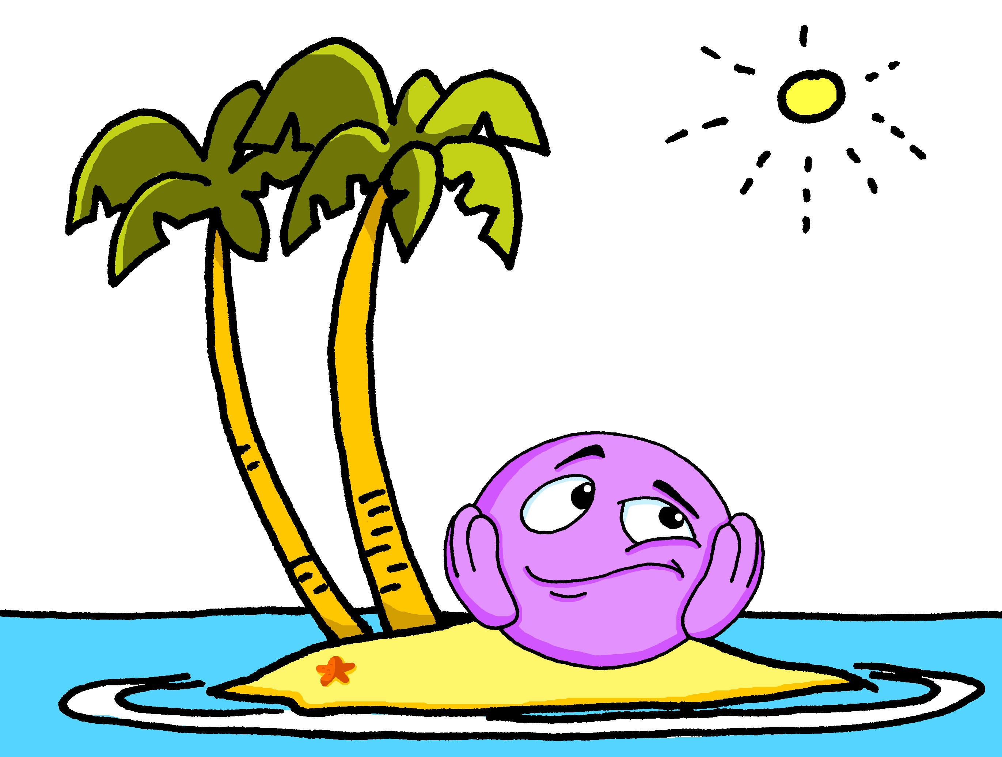
vocabulaire
Écoute et répète.
mots
ensemble
seul
[together]
[alone]
Notes:
Timing: 4 minutes (three slides)
Aim: to present and practise three new words and revisit three previously taught words.
Procedure:
Click to bring up the word and its English meaning and image.
Repeat to practise pronunciation.
Repeat steps 1 and 2 with the next two slides.
10

Slide 11
vocabulaire
Écoute et répète.
mots
toujours
maintenant
[always]
[now]
Notes:
[2/3]
11

Slide 12
vocabulaire
Écoute et répète.
mots
souvent
rarement
[often]
[rarely]
Notes:
[2/3]
12

Slide 13
écouter
Écoute. C’est quel mot ?
Clémentine parle. Elle dit quoi ?
Choisis le mot correspondant de 1 à 6.
Vous êtes…
 | You are
 | We are often
 | We are
 | You are
 | You are
 | We are always
 | You are
always | often | rarely
ill | together | alone
here | there | together
now | rarely | always
together | alone | naughty
intelligent | slow | fast
often | always | rarely
present.
at school.
now.
difficult.
at home.
in class.
absent.
Ex
1
2
3
4
5
6
Notes:
Timing: 4 minutes
Aim: to practise aural comprehension of new vocabulary.
Procedure:
1. Click to hear the example. Demonstrate that pupils need to select the adjective / adverb they hear from the three options provided. They could write the word in English (or additionally also in French to practise transcribing it).
2. Click to show answer.
3. Repeat steps 1 and 2 with items 1-6.
Transcript:
Exemple: Vous êtes souvent présents.
Nous sommes souvent ensemble à l’école.
Nous sommes ici maintenant.
Vous êtes maintenant difficiles.
Vous êtes seuls à la maison.
Nous sommes toujours rapides en classe.
Vous êtes rarement absents.
13

Slide 14
lire
Adèle écrit un message à Jean-Michel et Clémentine.
Zut ! Elle fait des erreurs ! Écris les mots en français.
Lorient, le 10.10.21.
Salut Jean-Michel et Clémentine ! Ça va ?
Nous sommes ensemble, chez nous, Pierre et moi. Et vous ? Vous êtes où ?
ℓ≠∂ФΘ
écrire
ℓ≠∂ФΘ
Pierre fait ses devoirs. Il déteste ça, mais c’est important car la prof est souvent stricte. Et vous ? Vous êtes sages aussi ? Aujourd’hui, nous sommes dimanche 10 octobre. C’est super, c’est le weekend ! ☺ Je suis heureuse ! Et vous, vous êtes contents ? Bisous,
Adèle
ℓ≠∂ФΘ
ℓ≠∂ФΘ
ℓ≠∂ФΘ
ℓ≠∂ФΘ
ℓ≠∂ФΘ
ℓ≠∂ФΘ
ℓ≠∂ФΘ
Notes:
Timing: 8 minutes
Aim: to practise written production of known parts of être and understanding of a longer text.
Procedure:
Pupils write 1-9 and the correct French verb (part of être).
Click audio (player bottom right of phone screen) to listen to the whole message and check answers. Click to reveal written answers, too.
Teacher uses questioning to ensure pupils’ understanding of the text. E.g. What questions does Adèle ask? How do the brother and sister feel about homework? How is Adèle feeling and why?
Transcript: Salut Jean-Michel et Clémentine !
Ça va ?
Nous sommes ensemble, chez nous, Pierre et moi. Et vous ? Vous êtes où ?
Pierre fait ses devoirs. Il déteste ça, mais c'est important car la prof est souvent stricte.
Et vous ? Vous êtes sages aussi ?
Aujourd'hui, nous sommes dimanche 10 octobre. C'est super, c'est le weekend ! :)
Je suis heureuse ! Et vous, vous êtes contents ?
Bisous,
Adèle
14

Slide 15
Au revoir !
bleu
Notes:
15

