Slide 1
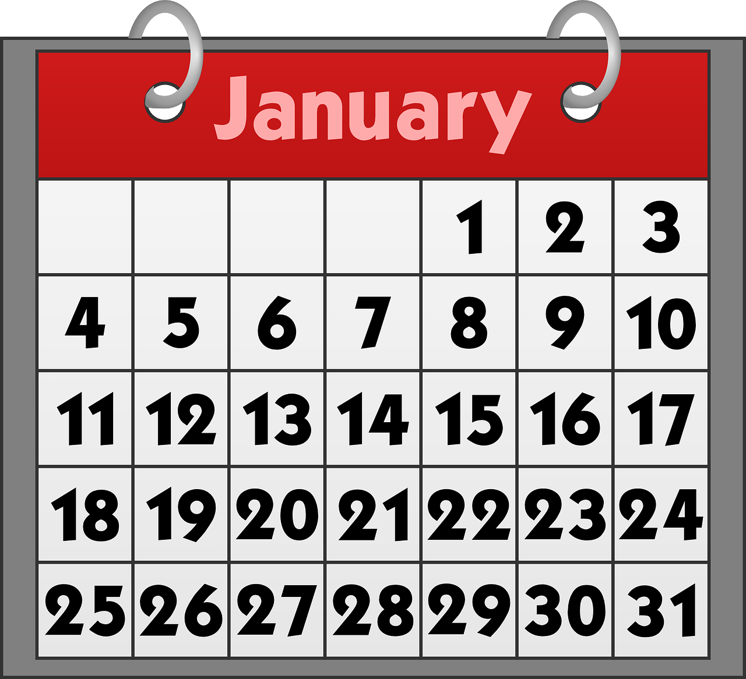
Describing me and others
bleu
Follow ups 1-5
Term 1 Week 4
Notes:
Artwork by Steve Clarke. Pronoun pictures from NCELP (www.ncelp.org). All additional pictures selected from Pixabay and are available under a Creative Commons license, no
attribution required.
Phonics: revisit SSC [an|en] enfant [138] and introduce [am|em] temps [64]
Vocabulary (new words in bold): sommes [5] nous [31] quel, quelle [146] date [660] jour [78] mois [179] saison [1667] semaine [245] lundi [1091], mardi [1044] mercredi [1168] jeudi [1112] vendredi [1086] samedi [1356] dimanche [1235] aujourd’hui [233]
Revisit 1: être [5] suis, est, es [5] je [22] tu [112] il [13] elle [38] qui ? [14] ami(e) [467] école [477] monsieur [79] madame [294] professeur(e) [110] anglais [784] français [251] calme [1731] amusant [4695] heureux [764] important [215] inquiet [1392] intelligent [2509] perdu [2264] prêt [422] sérieux [412] bien [47] mal [277] comment ? [234] Salut ! [2205] Ça va ? [54/53] Oui [284] Non [75] Bonjour ! [1972] Au revoir [4/1274] Revisit 2: an [76] faim [1986] raison [72] soif [4659] tort [1652]
Londsale, D., & Le Bras, Y. (2009). A Frequency Dictionary of French: Core vocabulary for learners London: Routledge.
The frequency rankings for words that occur in this PowerPoint which have been previously introduced in these resources are given in the SOW and in the resources that first
introduced and formally re-visited those words.
For any other words that occur incidentally in this PowerPoint, frequency rankings will be provided in the notes field wherever possible.

Slide 2
[an|en]
[am|em]
prononciation
Where the [an|en] sound is followed by ‘p’ or ‘b’, it is written [am|em]. The sound is the same.
enfant
temps
[time]
Notes:
DO THESE TWO SLIDES AS PART OF FOLLOW UP 1.
Timing: 1 minute
Aim: to revisit SSC [an|en] and introduce pupils to [am|em].
Procedure:
Elicit the pronunciation of the individual SSC [an|en]. Practise saying it several times.
Click to bring up the source word ‘enfant’ (with gesture, if using). Say the word several times.
Click to bring up the picture and get pupils to repeat the words (with gesture, if using).
Bring up the callout about [am|em].
Introduce the source word ‘temps’. Repeat the word several times.

Slide 3
[am|em]
prononciation
camp
temps
chambre
[bedroom]
ensemble
printemps
[together]
[spring]
[time]
Notes:
Timing: 2 minutes
Aim: to practise [em/am]
Procedure:
Introduce and elicit the pronunciation of the individual SSC [em/am] and then the source word again ‘temps’ (with gesture, if using).
Then present and elicit the pronunciation of the four cluster words.
Frequency of cluster words: camp [1084] chambre [633] ensemble [124] printemps [1288] temps [65] Source: Londsale, D., & Le Bras, Y. (2009). A Frequency Dictionary of French: Core vocabulary for learners London: Routledge.

Slide 4
Follow up 1
.
Prononce les mots.
ambition
central
champion
parler
60
parent
danse
exemple
lampe
S
orange
éléphant
membre
0
DÉBUT
Notes:
Timing: 2 minutes
Aim: to practise oral production of SSC [an|am|en|em] in a read aloud task.
Procedure:
Start the timer.
Pupils tried to say as many words as they can correctly in twenty seconds.
Pupil B listens carefully and stops his/her partner for a count of 3 every time s/he pronounces a word with an English sound.
Pupils swap roles and the timer is restarted.
The person who has pronounced the greatest number of words correctly wins. If there is a tie, the student with the greatest amount of time remaining wins.
Click on the words to hear them said by a native speaker. Pupils repeat.
Time allowing, go over the meaning of the words. These are all cognates or near-cognates, purposefully chosen for unlearning the connection between the SSC and the English sound.
Frequency of unknown words and cognates: ambition [2280] central [992] champion [2443] danse [2934] éléphant [>5000] exemple [259] lampe [4699] membre [390] orange [3912] parent [546]
Source: Londsale, D., & Le Bras, Y. (2009). A Frequency Dictionary of French: Core vocabulary for learners London: Routledge.

Slide 5
Follow up 2a:
.
Écoute. C’est quel mot ?
écouter
Monday | today | Thursday
E
worried | important | ready
1
well | badly | how ?
2
3
month | day | date
Spanish | Mrs, Miss (teacher) | French
4
5
you | he | she
6
funny | lost | important
Notes:
Timing: 5 minutes (two slides)
Aim: to practise aural and written comprehension of this week’s new vocabulary and revisited vocabulary sets.
Procedure:
Click to listen. Pupils circle the correct word (if they have the sheet printed). If not, they can use numbers 1-6 and A, B, C to identify the answers. Alternatively, they can transcribe the words.
Click for answers.
Transcript:
Ejemple: Aujourd’hui, le professeur est sérieux. 1. Mon amie est inquiète. 2. Salut ! Ça va bien ? 3. Nous sommes quel jour ? 4. Monsier Lemaire a une leçon de français ou d’anglais, aujourd’hui ? 5. Elle est toujours calme et heureuse. 6. Je suis intelligent mais aujourd’hui je suis un peu perdu !

Slide 6
Follow up 2:
Écris les phrases. Puis, écoute et vérifie.
. Écoute les noms des animaux. C’est [ien] ou [(a)in]?
Use the correct words to rewrite the sentences. There are some extra ones!
lire
 | nous | samedi | est | sommes | aujourd’hui | jour
 | Today it’s Saturday.
 | jour | quand | ton | est | anniversaire | c’ | nous
 | When is your birthday?
 | mois |aujourd’hui| quelle | sommes | nous | quel
 | What month is it?
 | sommes | avril | quinze| le | aujourd’hui| nous | quatorze
 | Is it the 15th April?
 | quelle | nous | le | mois | aujourd’hui |quel| date | sommes
 | What is the date today?
E
Aujourd’hui nous sommes samedi.
1
C’est quand ton anniversaire ?
2
Nous sommes quel mois ?
3
Nous sommes le quinze avril ?
4
Nous sommes quelle date aujourd’hui ?
Notes:
Timing: 5 minutes
Aim: to practise aural and written comprehension of this week’s new vocabulary and revisited vocabulary sets.
Procedure:
Pupils write the sentences, translating the English prompts, selecting from the options given (there are additional words that are not needed).
Click the audio buttons to listen and pupils double check their written answers.
Click to reveal the written answers (audio also attached to each sentence as it appears).
Transcript:
Exemple. Aujourd’hui nous sommes samedi.
1. C’est quand ton anniversaire ?
2. Nous sommes quel mois ?
3. Nous sommes le quinze avril ?
4. Nous sommes quelle date aujourd’hui ?

Slide 7
Using ‘le’ with dates
[the/on the]
Remember, we use the definite article ‘le’ to mean ‘the’ or ‘on the’ with dates with numbers.
Par exemple :
Noël est le 25 décembre.
Christmas day is on the 25th December.
Le Jour du Drapeau d’Haϊti est le 18 mai.
Haϊti’s Flag Day is on the 18th May.
Notes:
Use this recap slide ahead of Follow up 3.
Time: 2 minutes Aim: to recap the use of “le” with the meaning of “(on) the”
Procedure: 1. Click to present the information. It is animated to allow for a paced, interactive delivery. 2. Elicit the English translation from the examples.

Slide 8
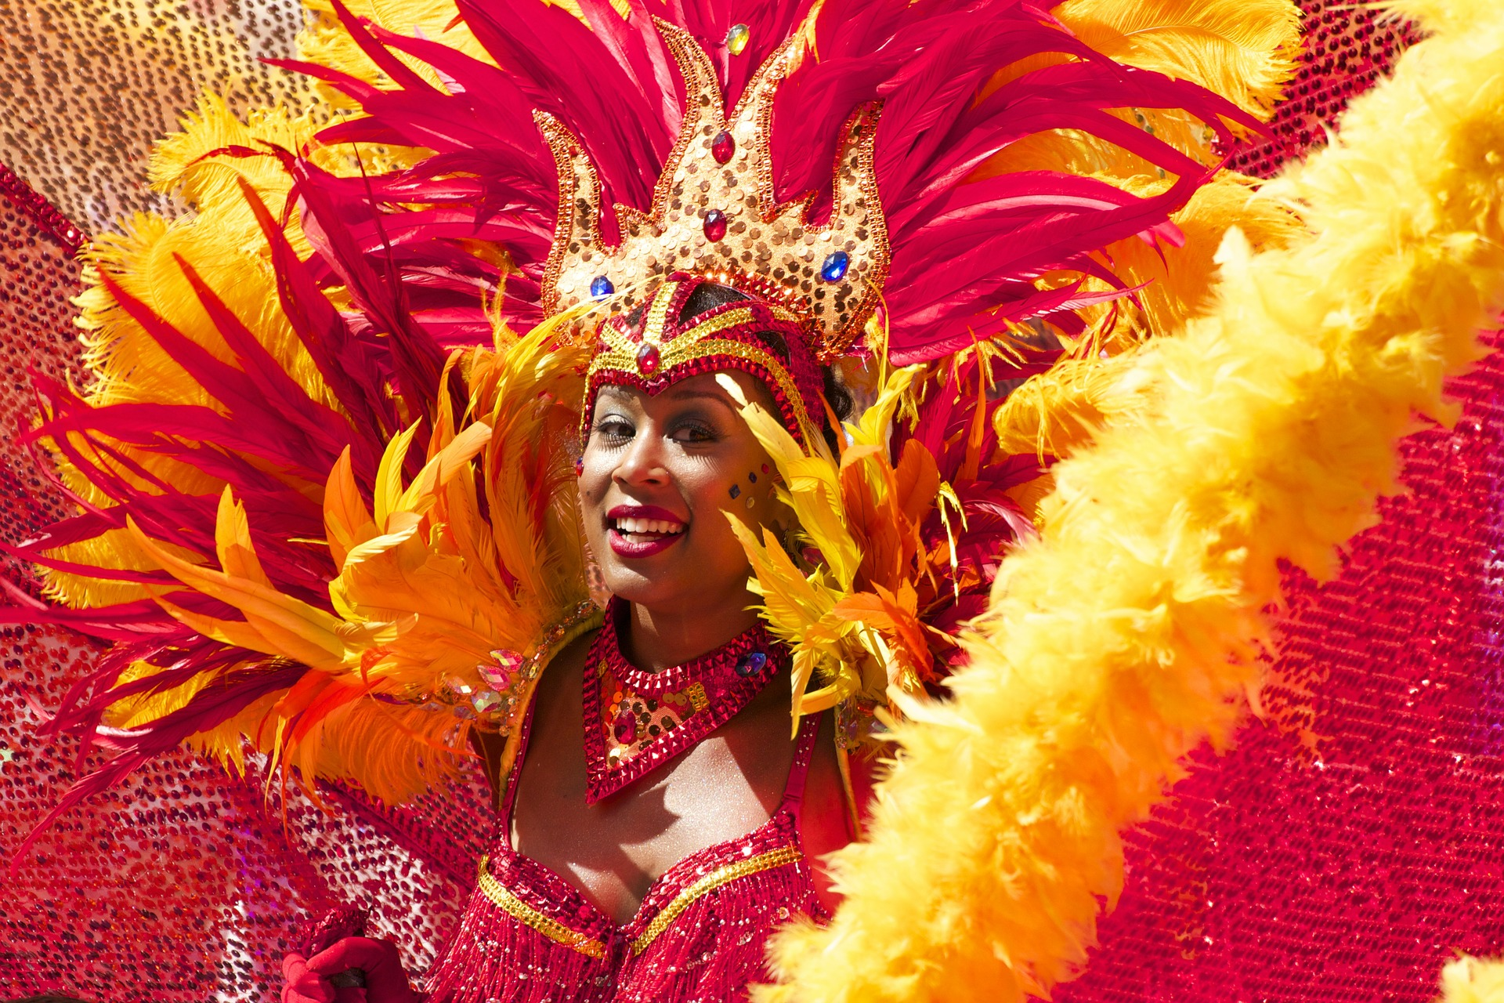
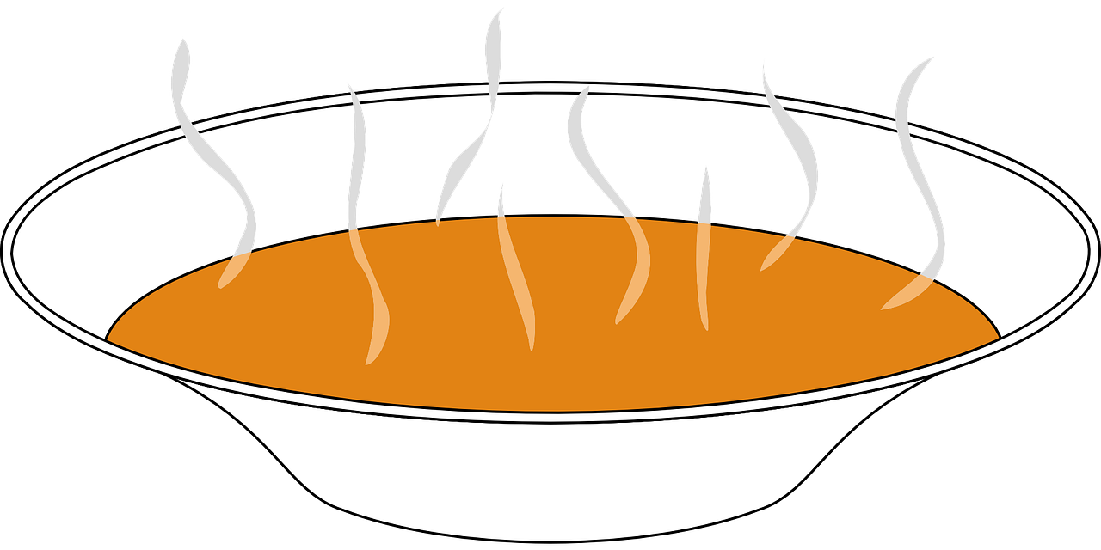
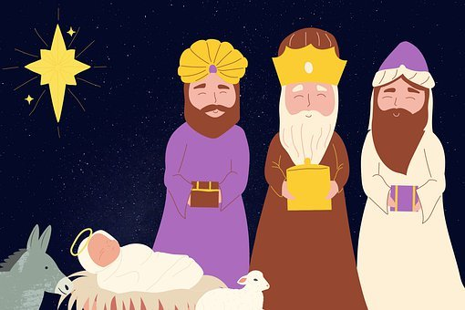
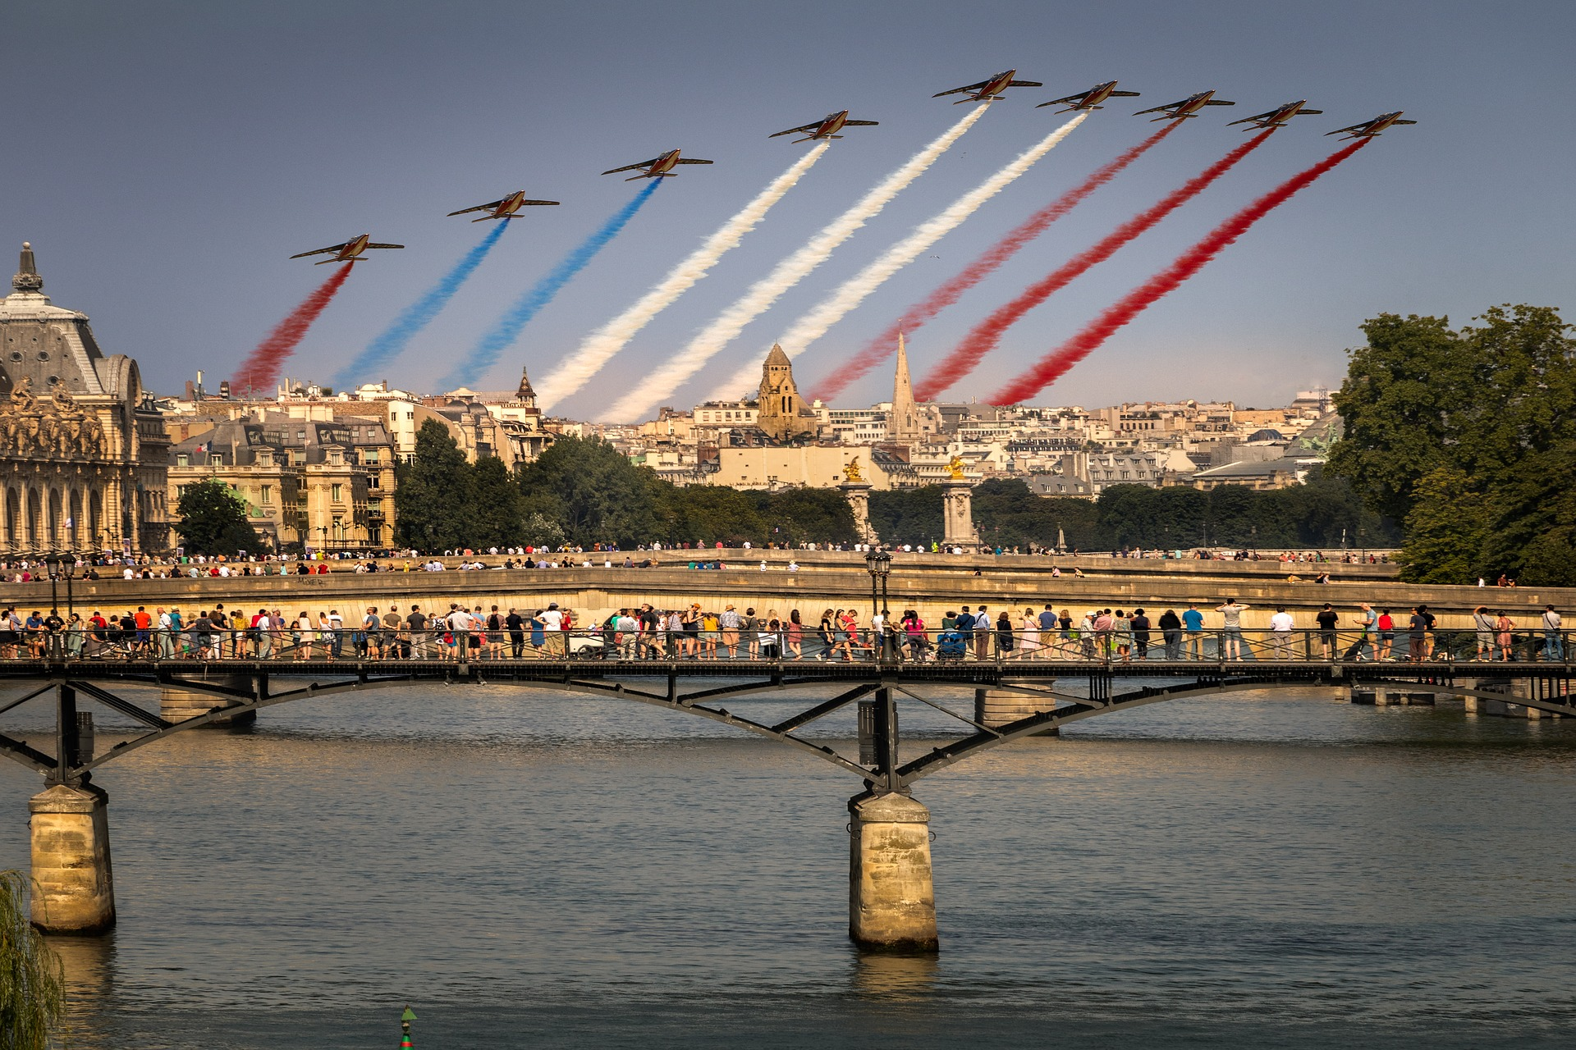
Follow up 3:
. Écoute les noms des animaux. C’est [ien] ou [(a)in]?
Écoute et lis les textes. Puis, complète le tableau.
[1] La Fête de l’Indépendance d'Haïti est le 1er janvier. On mange de la soupe traditionnelle et il y a des petits cadeaux pour les enfants.
[2] La Fête des Rois est le six janvier. C’est un jour fêté en France. On mange la galette des Rois dans le Nord de la France et la couronne des Rois dans le Sud de la France.
[3] Le Carnaval d’Haïti est une fête de plusieurs semaines en février. Il y a beaucoup de couleurs, de danses et de costumes.
[4] La Fête Nationale en France est le 14 juillet. C’est un jour très important pour les Français.
lire
event | date | month | where | extra
La Fête de l’Indépendance
Le Carnaval
La Fête des Rois
La Fête Nationale
Notes:
Time: 8 minutes (2 slides) Aim: to practise written comprehension of numbers, months and other vocabulary in longer sentence contexts; to learn key details about two festivals in France and two in Haïti.
Procedure: 1. Read instructions in French. 2. Pupils to copy the table.
3. Click to listen and read each text.
4. Pupils fill in the details in English. 5. Move to next slide to check answers.
Transcript:
[1] La Fête de l’Indépendance d'Haïti est le 1er janvier. On mange de la soupe traditionnelle et il y a de petits cadeaux pour les enfants.
[2] La Fête des Rois est le six janvier. C’est un jour fêté en France. On mange la galette des Rois dans le Nord de la France et la couronne des Rois dans le Sud de la France.
[3] Le Carnaval de Haïti est une fête de plusieurs semaines en février. Il y a beaucoup de couleurs, de danses et de costumes.
[4] La Fête Nationale en France est le 14 juillet. C’est un jour très important pour les Français.

Slide 9
Follow up 3:
Les réponses.
event | date | month | where | extra
[1] La Fête de l’Indépendance d'Haïti
[2] La Fête des Rois
[3] Le Carnaval d’Haïti
[4] La Fête Nationale en France
lire
eat soup / little presents for children
1st
January
Haϊti
eat galette in north and couronne in south
6th
January
France
lots of colour, dances, costumes
--
February
Haϊti
very important day for French people
14
July
France
Notes:
Procedure: Click to check pupil answers.

Slide 10
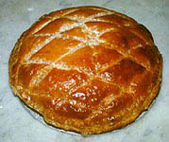
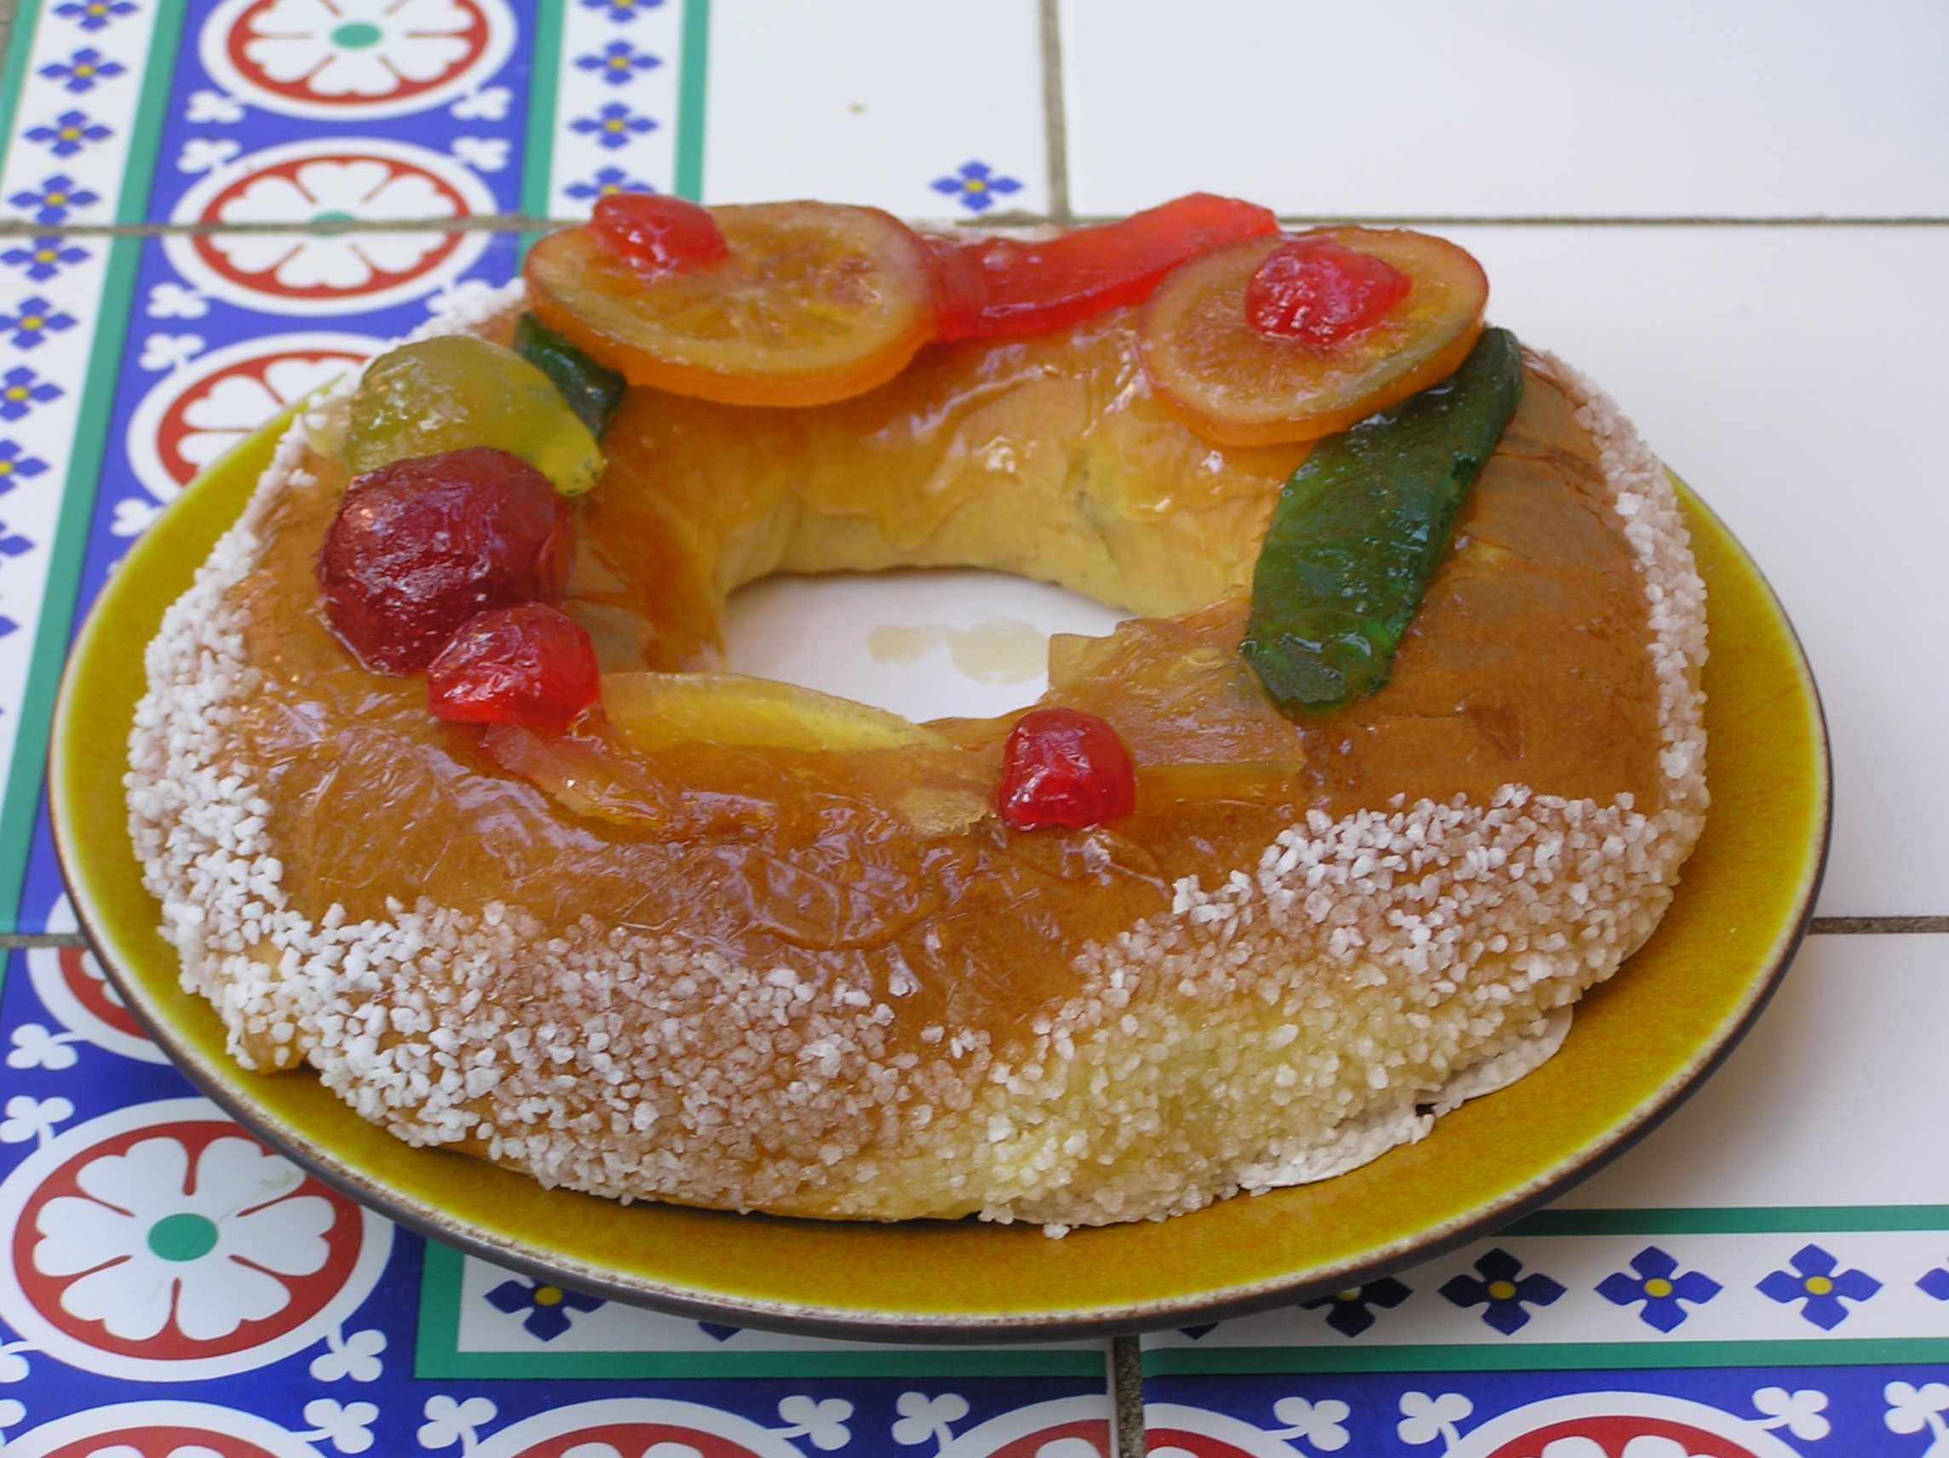
La Fête des Rois
On mange la galette des rois dans le Nord de la France...
…et la couronne des rois dans le Sud de la France.
La galette des rois (Kings’ cake) est une tarte à pâte feuilletée (flaky pastry) et à la frangipane (almond paste).
La couronne des rois (Kings’ crown) est un gâteau de brioche. Il est recouvert de sucre (sugar) et de fruits confits.
Notes:
Timing: 1 minute
Aim: to provide more detail about the two different Epiphany cakes.
Procedure:
Click to hear the two phrases from the listening task again.
Read the additional information with pupils. In line glosses of the trickier words are provided.
Note: an additional lesson on La Fête des Rois is available here (Week 11, Autumn Term, Year 4: http://www.rachelhawkes.com/Resources/Y4_French/Yr4AutumnFr.php)
In January, this would make a good opportunity for a class assembly as there are elements of the Epiphany tradition (including the galette des rois) that can be role-played.
Attributions: Couronne des rois: No machine-readable author provided. David.Monniaux assumed (based on copyright claims)., CC BY-SA 3.0, via Wikimedia Commons

Slide 11
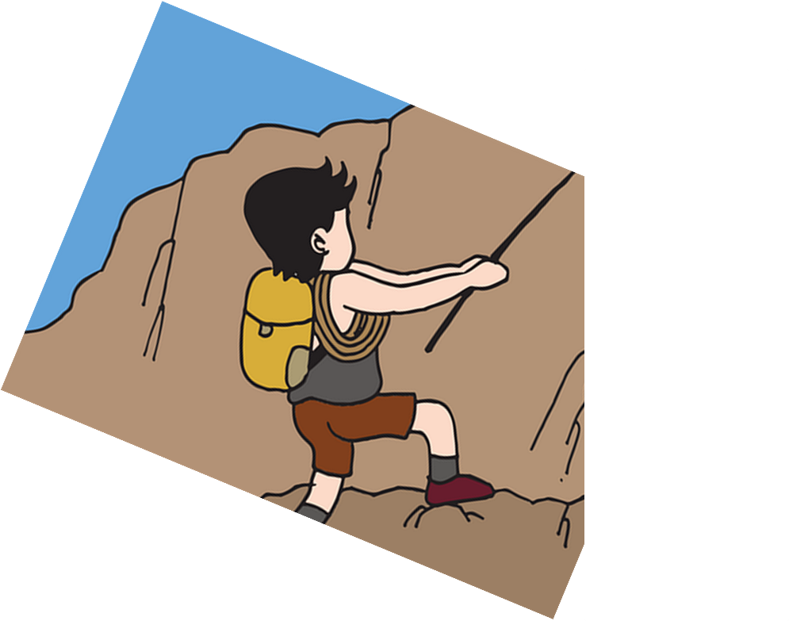
Follow up 4
Today is Sunday the 11th of January.
parler
juin
décembre
janvier
juillet
douze
onze
treize
5
mardi
lundi
samedi
dimanche
4
sommes
suis
est
es
3
c’
je
tu
nous
2
demain
aujourd’hui
maintenant
1
Notes:
Timing: 5 minutes (8 slides)
Aim: to select and produce orally key vocabulary to ask about and give dates; to practise the scaffolded oral production of longer sentences.
Sentence 1/4
Procedure:
Tell pupils they need to use the words, starting from the bottom, to climb up the mountain (And translate the sentence!).
Ask pupils to work in pairs to practise first.
Click to trigger the countdown (15 seconds per sentence).
Ask a volunteer from a pair to say the French sentence out loud – next slide reveals the answer.
Repeat with the next 3 sentences (there are 4 in total).

Slide 12
Follow up 4
Today is Sunday the 11th of January.
parler
juin
décembre
janvier
juillet
douze
onze
treize
mardi
lundi
samedi
dimanche
sommes
suis
est
es
c’
je
tu
nous
demain
aujourd’hui
maintenant
Notes:
ANSWER SLIDE [1/4]

Slide 13
Follow up 4
What date is it today?
parler
aujourd’hui
maintenant
demain
jour
date
mois
semaine
5
4
quel
quand
quelle
qui
3
est
sommes
suis
est
2
c’
nous
je
1
Notes:
[2/4]

Slide 14
Follow up 4
What date is it today?
parler
aujourd’hui
maintenant
demain
jour
date
mois
semaine
quel
quand
quelle
qui
est
sommes
suis
est
c’
nous
je
Notes:
ANSWER SLIDE [2/4]

Slide 15
Follow up 4
Christmas is on the 25th of December.
parler
octobre
décembre
novembre
septembre
5
vingt-cinq
trente-cinq
cinq
cinquante
4
le
la
les
3
suis
sommes
de
es
est
2
La fête
Mon anniversaire
Noël
1
Notes:
[3/4]

Slide 16
Follow up 4
Christmas is on the 25th of December.
parler
octobre
décembre
novembre
septembre
vingt-cinq
trente-cinq
cinq
cinquante
le
la
les
suis
sommes
de
es
est
La fête
Mon anniversaire
Noël
Notes:
[3/4]

Slide 17
Follow up 4
My birthday is on the 12th of May.
parler
mars
avril
mai
aout
5
douze
deux
dix
vingt-deux
4
la
les
le
3
sommes
suis
es
est
el
2
La fête
Mon anniversaire
Le carnaval
1
Notes:
[4/4]

Slide 18
Follow up 4
My birthday is on the 12th of May.
parler
mars
avril
mai
aout
5
douze
deux
dix
vingt-deux
4
la
les
le
3
sommes
suis
es
est
el
2
La fête
Mon anniversaire
Le carnaval
1
Notes:
ANSWER SLIDE [4/4]

Slide 19
Follow up 4
Aujourd’hui, nous sommes quelle date ?
A_ _ _ _ _ _’h_ _, n_ _ _ s_ _ _ _ _ q_ _ _ _ _ d_ _ _ ?
parler
⚠Aujourd’hui (today) can come at the start or end of the question.
jeudi treize mai.
A..….’h.. n… s….. j…. t….. m..
Aujourd’hui nous sommes …
Thursday
May
13
Notes:
Time: 2 minutes (3 slides)
Aim: to practise oral production of questions and answers about dates.
Procedure:
Ask the question “Aujourd’hui nous sommes quelle date ? and encourage pupils to answer in French. The calendar can be adapted for the day / month the lesson is taught.
Click to cover the questions and bring up the hints for the question / answer.
Get pupils to practise asking and answering the question with only first letter prompts.
Repeat step 3 for the next two slides.
Note: this task and the previous one can be shortened to fit the time available for Follow up 4.

Slide 20
Follow up 4
A_ _ _ _ _ _’h_ _, n_ _ _ s_ _ _ _ _ q_ _ _ _ _ d_ _ _ ?
parler
A..….’h.. n… s….. l. 23 n…….
November
23

Slide 21
Follow up 4
A_ _ _ _ _ _’h_ _, n_ _ _ s_ _ _ _ _ q_ _ _ _ _ d_ _ _ ?
parler
A..….’h.. n... s….. v……. 31 m…
Friday
March
31

Slide 22
écouter
Follow up 5a:
⚠Don’t forget the rule about NO capital letters on French months.
. Écoute
Écoute : Écris les phrases.
1
Aujourd’hui, nous sommes mercredi vingt-quatre juin.
vingtquatre | sommes | mercredi | nous | juin | aujourd’hui
2
Aujourd’hui, nous sommes dimanche sept février.
sommes | nous | dimanche | février | sept | aujourd’hui
3
Aujourd’hui, nous sommes samedi seize octobre.
octobre | aujourd’hui | seize | nous | samedi | sommes
4
Aujourd’hui, nous sommes le douze aout.
aujourd’hui | aout | sommes | douze | le | nous
Notes:
Time: 7 minutes Aim: to practise aural and/or written recognition of the structure “Nous sommes + day + number + month”.
Procedure:
Teacher reads the instruction in French.
Click to bring up speech bubble to remind pupils about punctuation.
Pupils to write numbers 1-4 in their books.
Click on the numbers to play the audio for each sentence.
Pupils to write the full sentence.
Elicit oral answers from pupils.
Click to provide written answers for pupils to compare.
Notes:
i) for less challenge, remove white shapes under the answers to reveal a jumbled version of each sentence to support pupils as they listen and write. ii) for a reading task, ask pupils to write the sentences in the correct order, before they listen and check. iii) the next slide re-uses the language of this task for written comprehension, consolidating vocabulary (months, numbers and days of the week).

Slide 23
Follow up 5b:
. Écoute
Lis les phrases. Nous sommes quelle date ?
lire
1
Aujourd’hui, nous sommes mercredi vingt-quatre juin.
2
Aujourd’hui, nous sommes dimanche sept février.
3
Aujourd’hui, nous sommes samedi seize octobre.
4
Aujourd’hui, nous sommes le douze aout.
Notes:
Time: 3 minutes
Aim: to consolidate written comprehension of days of the week, months, and numbers.
Procedure:
Teacher reads the instruction in French.
Pupils can work in pairs to match the sentences with the days of the week and calendars or for a higher level of challenge, they can write down the correct days / months next to the sentences they wrote in the previous listening task. Click to provide the days and dates before or after the task is complete.
Click to provide feedback.

Slide 24
vocabulaire
Follow up Extra - Écris en anglais : Can you get at least 15 points?
mots
 | l’an | la faim | la raison
 | Il a cinq ans | le tort | le soif
 | qui ? | inquiet | inquiète
 | perdu | prêt | quoi ?
 | quel ? | quelle ? | la date
 | la saison | la semaine | le jour
(the) year
(the) hunger
(the) right, reason
x3
He is five years old
young (m/f)
(the) thirst
who?
worried (m)
worried (f)
x2
lost (m)
ready (m)
what?
which? (m)
which (f)
(the) date
x1
(the) season
(the) week
(the) day
Notes:
Timing: 5 minutes
Aim: to practise written comprehension of vocabulary from this week and the revisited set.
Procedure: 1. Give pupils a blank grid. They fill in the English meanings of any of the words they know, trying to reach 15 points in total. 2. Remind pupils that adjectives can refer to male or female persons and they should note this in their translations. E.g. pleased (f), short (m).
Note: The most recently learnt and practised words are pink, words from revisited set 1 are green and those from revisited set 2 are blue, thus more points are awarded for them, to recognise that memories fade and more effort (heavy lifting!) is needed to retrieve them.
24

Slide 25
vocabulaire
Follow up Extra - Écris en anglais : Can you get at least 15 points?
mots
 | l’an | la faim | la raison
 | Il a cinq ans | le tort | le soif
 | qui ? | inquiet | inquiète
 | perdu | prêt | quoi ?
 | quel ? | quelle ? | la date
 | la saison | la semaine | le jour
x3
x2
x1
Notes:
Timing: 5 minutes
Aim: to practise written comprehension of vocabulary from this week and the revisited set.
Procedure: 1. Give pupils a blank grid. They fill in the English meanings of any of the words they know, trying to reach 15 points in total. 2. Remind pupils that adjectives can refer to male or female persons and they should note this in their translations. E.g. pleased (f), short (m).
Note: The most recently learnt and practised words are pink, words from revisited set 1 are green and those from revisited set 2 are blue, thus more points are awarded for them, to recognise that memories fade and more effort (heavy lifting!) is needed to retrieve them.
25

