Slide 1
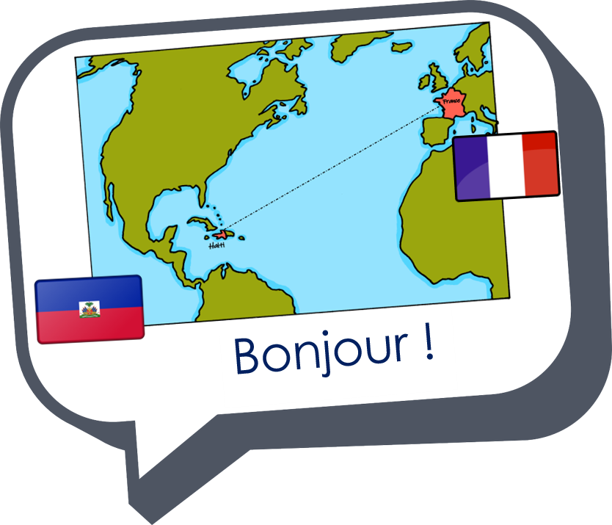

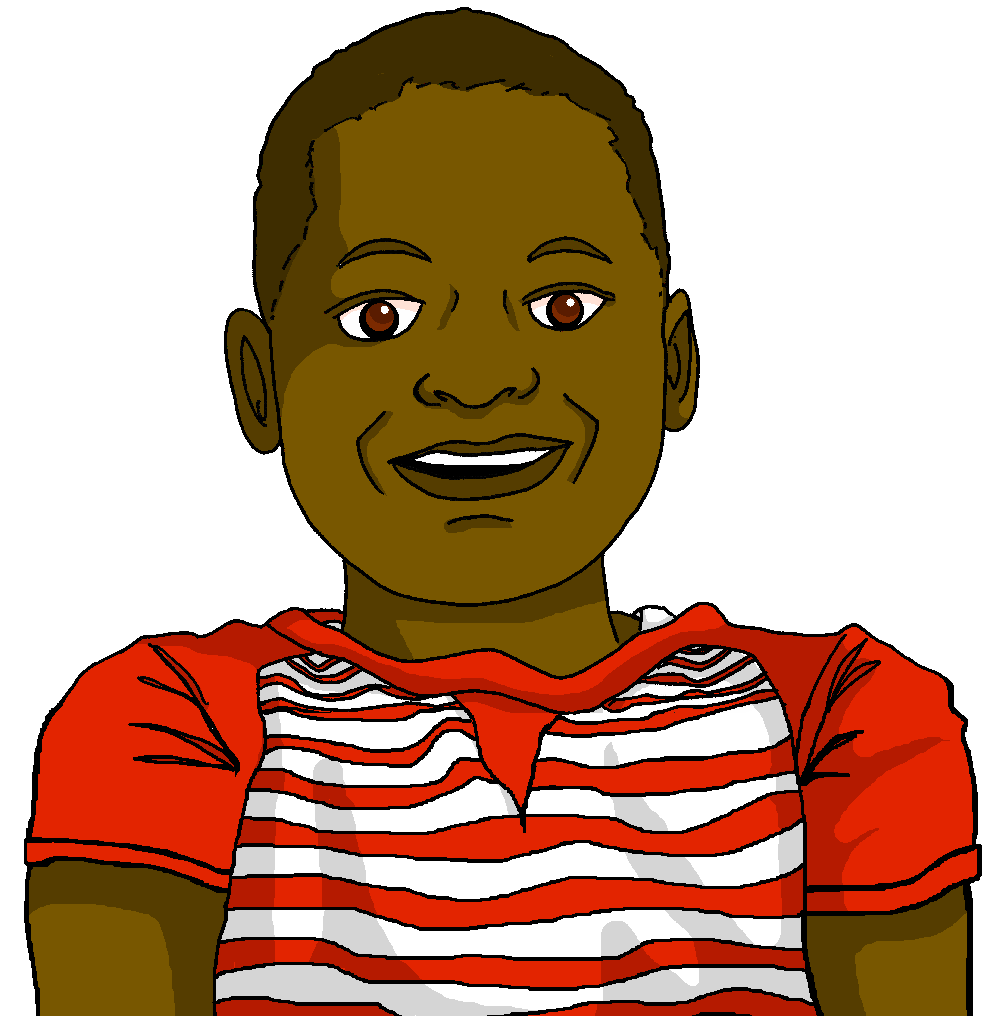

Describing me and others
C’est quand, ton anniversaire ?
bleu
Follow ups 1-5
Term 1 Week 3
Notes:
Artwork by Steve Clarke. Pronoun pictures from NCELP (www.ncelp.org). All additional pictures selected from Pixabay and are available under a Creative Commons license, no
attribution required.
Phonics: revisit Sound-Spelling Correspondence (SSC) [i] [(a)in] and introduce [im] midi [2483] train [232] simple [212]
Vocabulary (new words in bold): mois [179] janvier [939] février [1139] mars [868] avril [1022] mai [943] juin [931] juillet [1326] aout [1445] septembre [944] octobre [826] novembre [982] décembre [891] quand [119] anniversaire [2043] treize [3285] quatorze [3359] quinze [1472] seize [3285] dix-sept [3812] dix-huit [3592] dix-neuf [4851] vingt [1273] vingt-et-un [1273/6/3] vingt-deux, vingt-trois vingt-quatre vingt-cinq vingt-six vingt-sept vingt-huit vingt-neuf trente [1646]
Revisit 1: --
Revisit 2: cousin, cousine [3387] femme [154] homme [136] bleu [1216] rouge [987]
Londsale, D., & Le Bras, Y. (2009). A Frequency Dictionary of French: Core vocabulary for learners London: Routledge.
The frequency rankings for words that occur in this PowerPoint which have been previously introduced in these resources are given in the SOW and in the resources that first
introduced and formally re-visited those words.
For any other words that occur incidentally in this PowerPoint, frequency rankings will be provided in the notes field wherever possible.

Slide 2



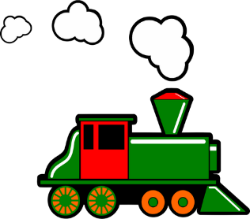

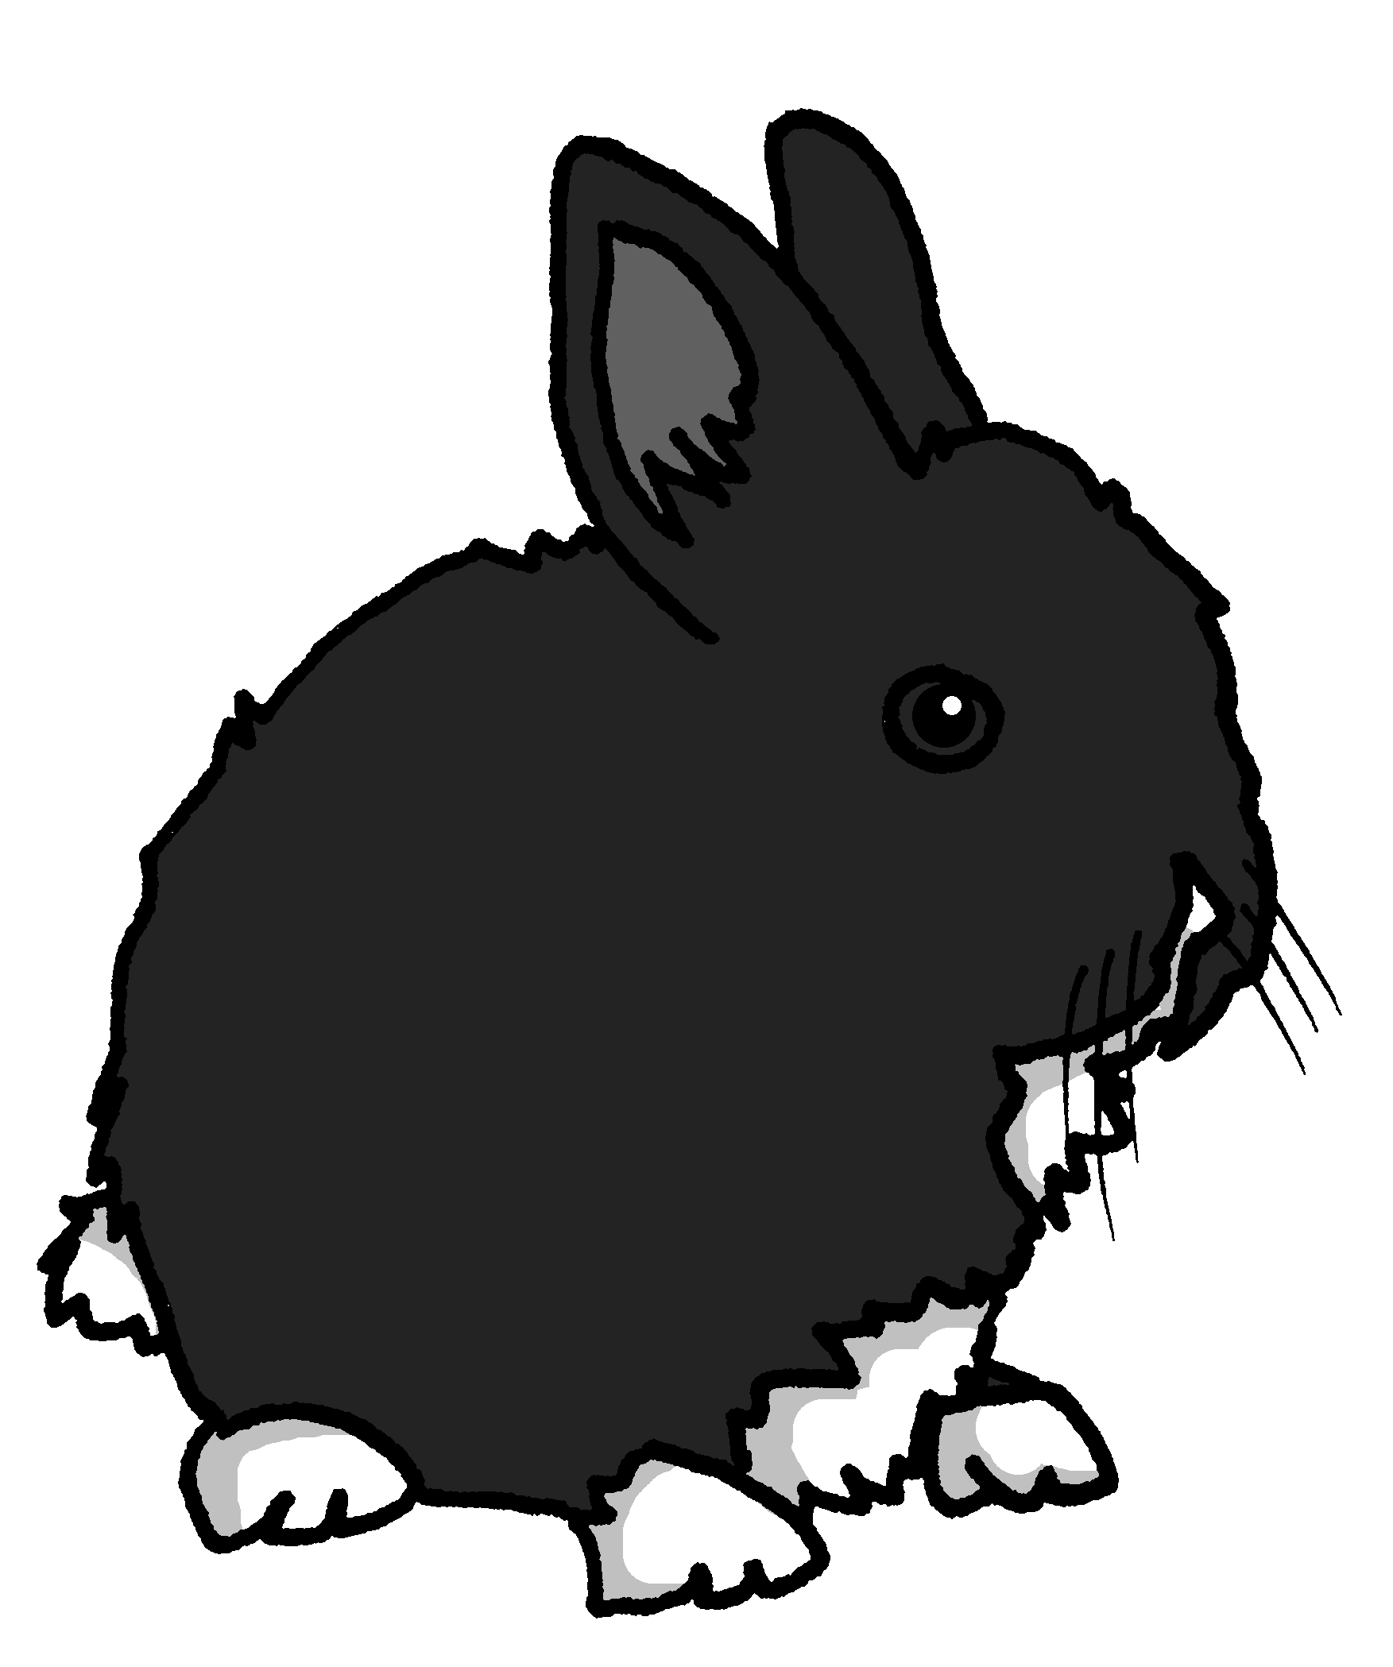
prononcer
Follow up 1:
[(a)in]
train
vingt
fin
main
lapin
Notes:
Timing: 6 minutes (three slides)
Aim: to revisit SSC [(a)in]
Procedure:
Introduce and elicit the pronunciation of the individual SSC [(a)in] and then the source word ‘train’ (with gesture, if using).
Click to bring on the picture and get students to repeat (with gesture, if using).
Click to bring on four cluster words for further practice.
Note: gesture for train – arms at your sides with hands facing forwards do several circular motions recalling the action of train wheels.
2

Slide 3



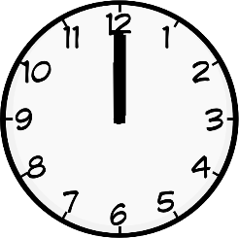
prononcer
Follow up 1:
[i]
[(a)in]
And [i] is an oral vowel.
midi
train
Remember!
[(a)in] is a nasal vowel.
Notes:
Aim: to recap the SSC [i] and source word midi, alongside [(a)in] and train as preparation for the activity that follows.
Procedure:
Introduce and elicit the pronunciation of the individual SSC [i] and [(a)in] and then the source words ‘midi’ and ‘train’ (with gestures, if using).
Click to bring on the picture and get students to repeat the words (with gesture, if using).
Note: gesture for midday – raise both arms above your head, palms touching to mime 12 o’clock.
3

Slide 4



Follow up 1: Écoute.
[i]
midi
[(a)in]
train
. Écoute les noms des animaux. C’est [ien] ou [(a)in]?
L’intrus, c’est quoi ?
écouter
A | B | C
cinq | suis | vingt
janvier | magazine | magasin
quinze | insecte | dix-huit
juillet | avril | pain
minute | prince | simple
[(a)im] is the same sound as [(a)in]. When this sound is before a ‘p’ or ‘b’ it is spelt ‘im’.
Notes:
Aim: to practise aural distinction between the SSC [i] and [(a)in].
Procedure:
Click on each audio symbol to listen to the set of three words.
Click to reveal all of the options.
Click to elicit the odd one out from pupils and click to highlight it.
Clarify word meanings – unknown words are mostly cognates (exception: pain which is a false friend)
Elicit choral pronunciations of all words once more time.
Transcript
a) cinq b) suis c) vingt
a) janvier b) magazine c) magasin
a) quinze b) insecte c) dix-huit
a) juillet b) avril c) pain
a) minute b) prince c) simple
Frequency of unknown words and cognates:
insecte [>5000] magazine [2033] magasin [1723] minute [375] pain [2802] prince [2610] simple [212]
Londsale, D., & Le Bras, Y. (2009). A Frequency Dictionary of French: Core vocabulary for learners London: Routledge.

Slide 5


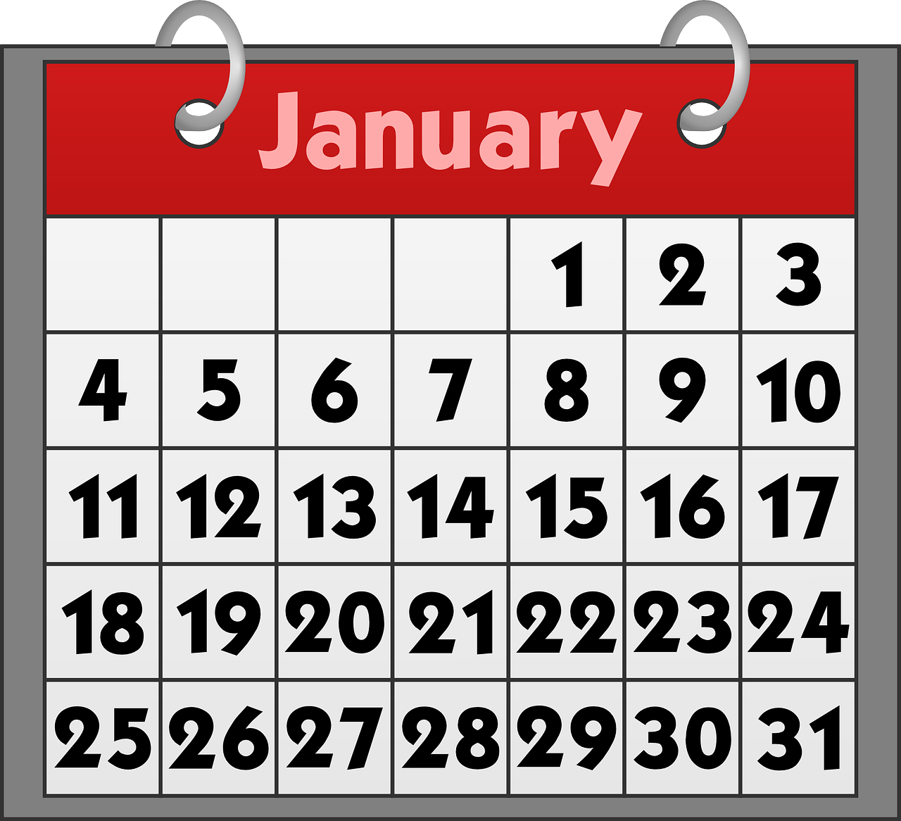
Follow up 2: Using ‘le’ with dates
[on the]
We use the definite article ‘le’ with dates to mean ‘the’ or ‘on the’.
Exemple:
Mon anniversaire est le 19 aout.
My birthday is (on) the 19th of August.
To say dates with days don’t use ‘le’:
Mon anniversaire est dimanche 24 janvier.
My birthday is (on) Sunday 24th of January
(i.e., this year).
Notes:
Time: 6-8 minutes (two slides)
Aim: to learn the use of ‘le’ with the meaning of (on) the with dates and omission of ‘le’ for dates with days of the week.
Procedure:
1. Teachers present the new information. It is animated to allow for a paced, interactive delivery.
2. Elicit the English translation from the examples.

Slide 6


Follow up 2:
C’est quand ?
Do people mention a day or just the number and month?
. Écoute les noms des animaux. C’est [ien] ou [(a)in]?
écouter
Écoute et décide. Puis, écris la date et le mois en anglais.
jour | date | mois
18
September
E
E
1
1
27
June
2
2
11
October
3
3
16
April
4
4
12
August
5
5
28
December
6
6
15
May
Notes:
Aim: to practise aural distinction of number only dates with ‘le’ and dates with days without ‘le’.
Procedure:
1. Explain to pupils that they will most of the sentence, but that there will be a beep which will either obscure a day of the week or nothing. If pupils hear ‘le’ with the date they know there is no day, and put a cross.
2. Click to listen to the example. Pupils either tick or cross.
3. Pupils listen again and write the date in digits and the month in English.
4. Click to reveal the example answers.
5. Complete steps 2 – 4 with items 1-6.
6. Click to bring up a further set of audio buttons. Click to hear the full sentences without beeps. Elicit the meaning of the three days that feature in the sentences, too. We will revisit days in next week’s lesson.
Transcript:
EJ. Mon anniversaire est [beep] le 18 septembre.
1. Mon anniversaire est [samedi] 27 juin.
2. Mon anniversaire est [jeudi] 11 octobre.
3. Mon anniversaire est [beep] le 16 avril.
4. Mon anniversaire est [lundi] douze aout.
5. Mon anniversaire est [beep] le 28 décembre.
6. Mon anniversaire est [beep] le 15 mai.
Transcript 2:
EJ. Mon anniversaire est le 18 septembre.
1. Mon anniversaire est samedi 27 juin.
2. Mon anniversaire est jeudi 11 octobre.
3. Mon anniversaire est le 16 avril.
4. Mon anniversaire est lundi douze aout.
5. Mon anniversaire est le 28 décembre.
6. Mon anniversaire est le 15 mai.

Slide 7


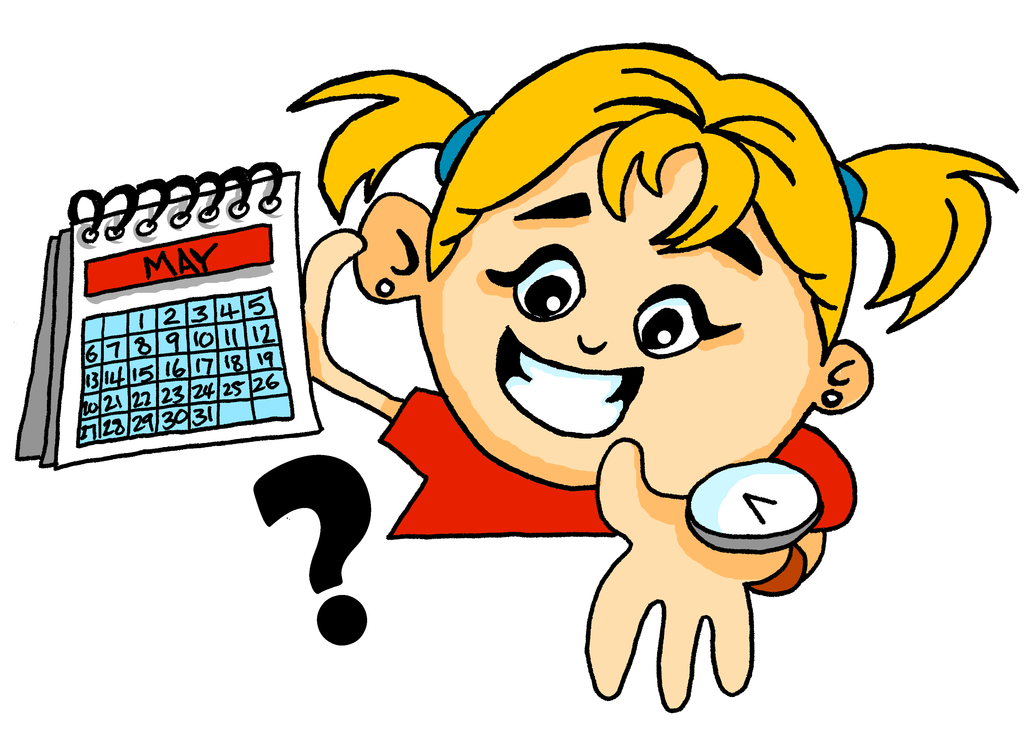
Follow up 3:
Prononce les mots.
parler
60
C’est quand, ton anniversaire ?
Mon anniversaire est le [_____] [______].
S
0
DÉBUT
Notes:
Time: 10 minutes (three slides)
Aim: to ask and answer about birthdays in oral production.
Ask the question “C’est quand, ton anniversaire ? and encourage pupils to answer in French.
With the model answer on the board, tell pupils they have one minute to get as many pupils to ask and answer the question. Click on the timer to start the countdown. (One student asks another who answers the question and also asks another student).
If time allows, repeat for further practice (and encourage class to improve their results from round 1).
Round 2 (next slide). Click to remove support and display clues for each word in the question and answer. Repeat process from round 1, with less support.

Slide 8
Follow up 3:
Prononce les mots.
parler
60
C’… q….., t.. a………… ?
M.. a……….. e.. l. [_____] [______].
S
0
DÉBUT

Slide 9
Follow up 3:
. Écoute les noms des animaux. C’est [ien] ou [(a)in]?
Parle avec ton/ta partenaire. Pose des questions.
C… q.... t.. a……….. ??
M .. a……….. e.. l.. [_____] [_______].
Mon anniversaire est le 5 septembre.
parler
January | February | March | April | May | June | July | August | September | October | November | December
5
Notes:
Read the title.
Tell pupils they are going to conduct a survey in the class on birthdays.
Elicit the questions from pupils using the hints.
Then click to bring up a sample answer (‘Mon anniversaire est le 5 septembre’). Click x1 to model how to use the survey sheet (a 5 will appear).
Tell pupils they have 5 minutes to ask as many pupils in the class about their birthdays. They should aim to ask and answer the questions, from memory, by the end of the survey.
! Encourage pupils to attempt to answer the question from memory
Frequency of unknown vocabulary and cognates:
enquête [866]

Slide 10

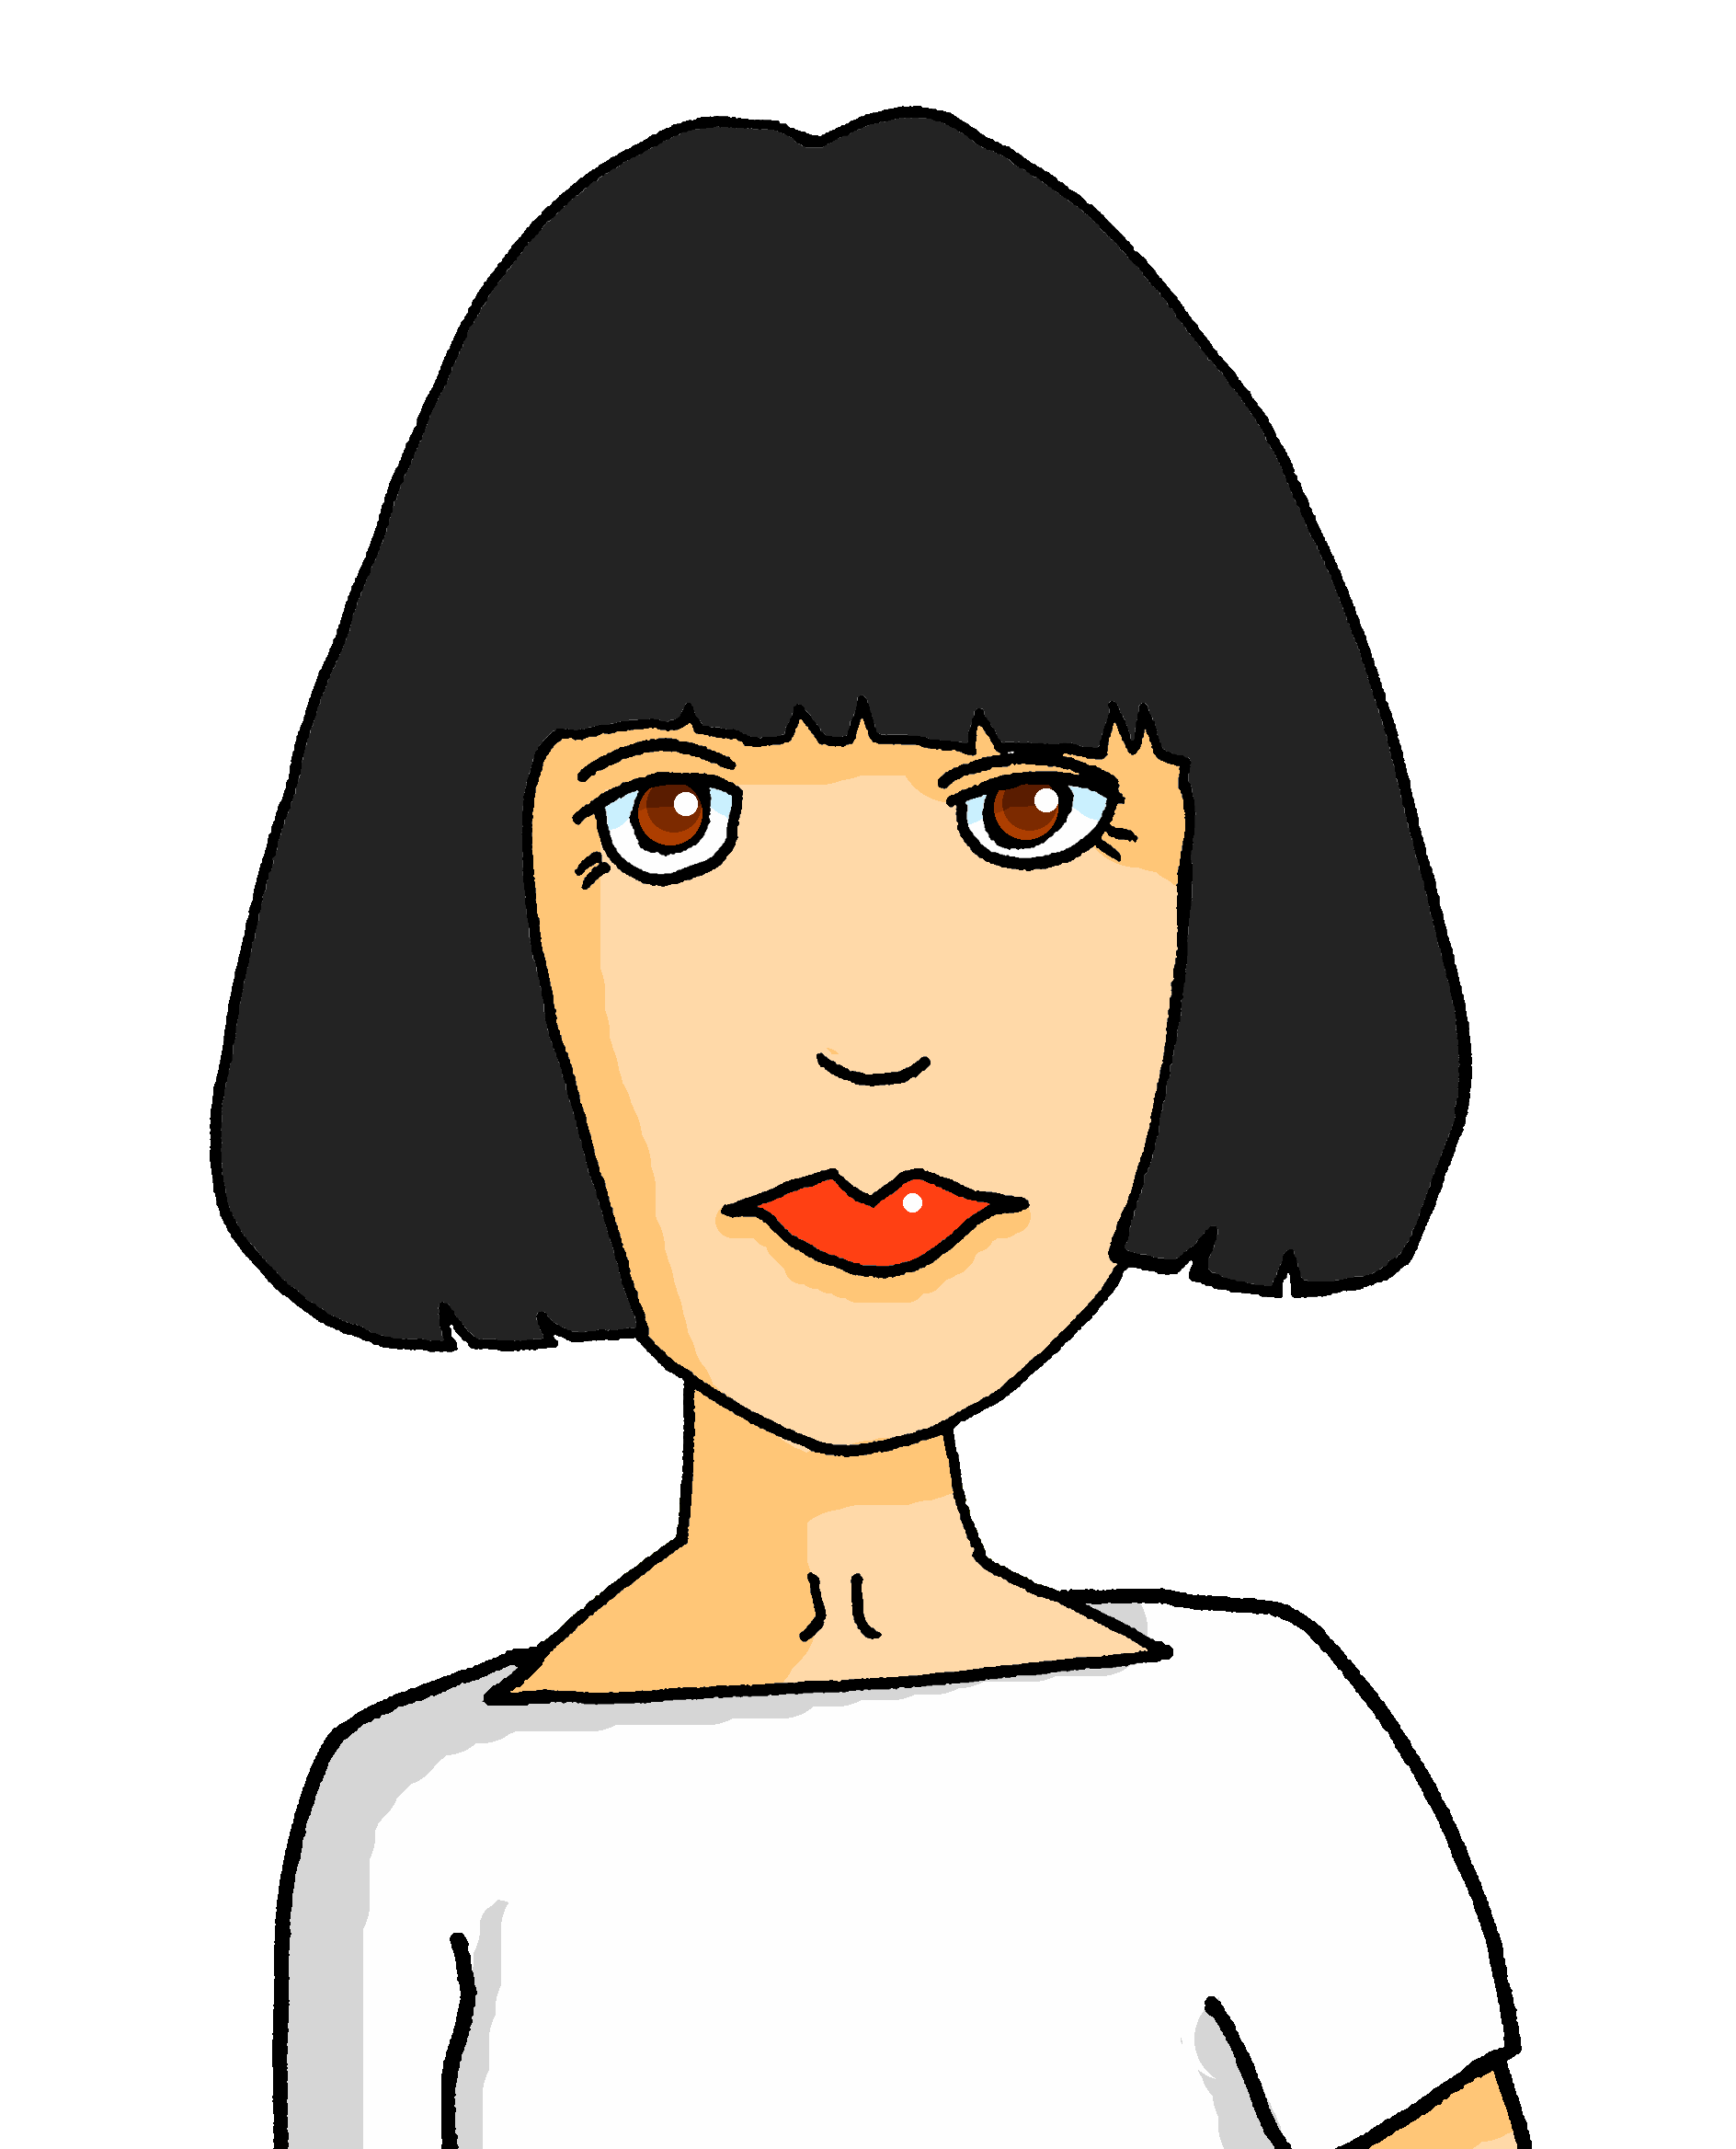
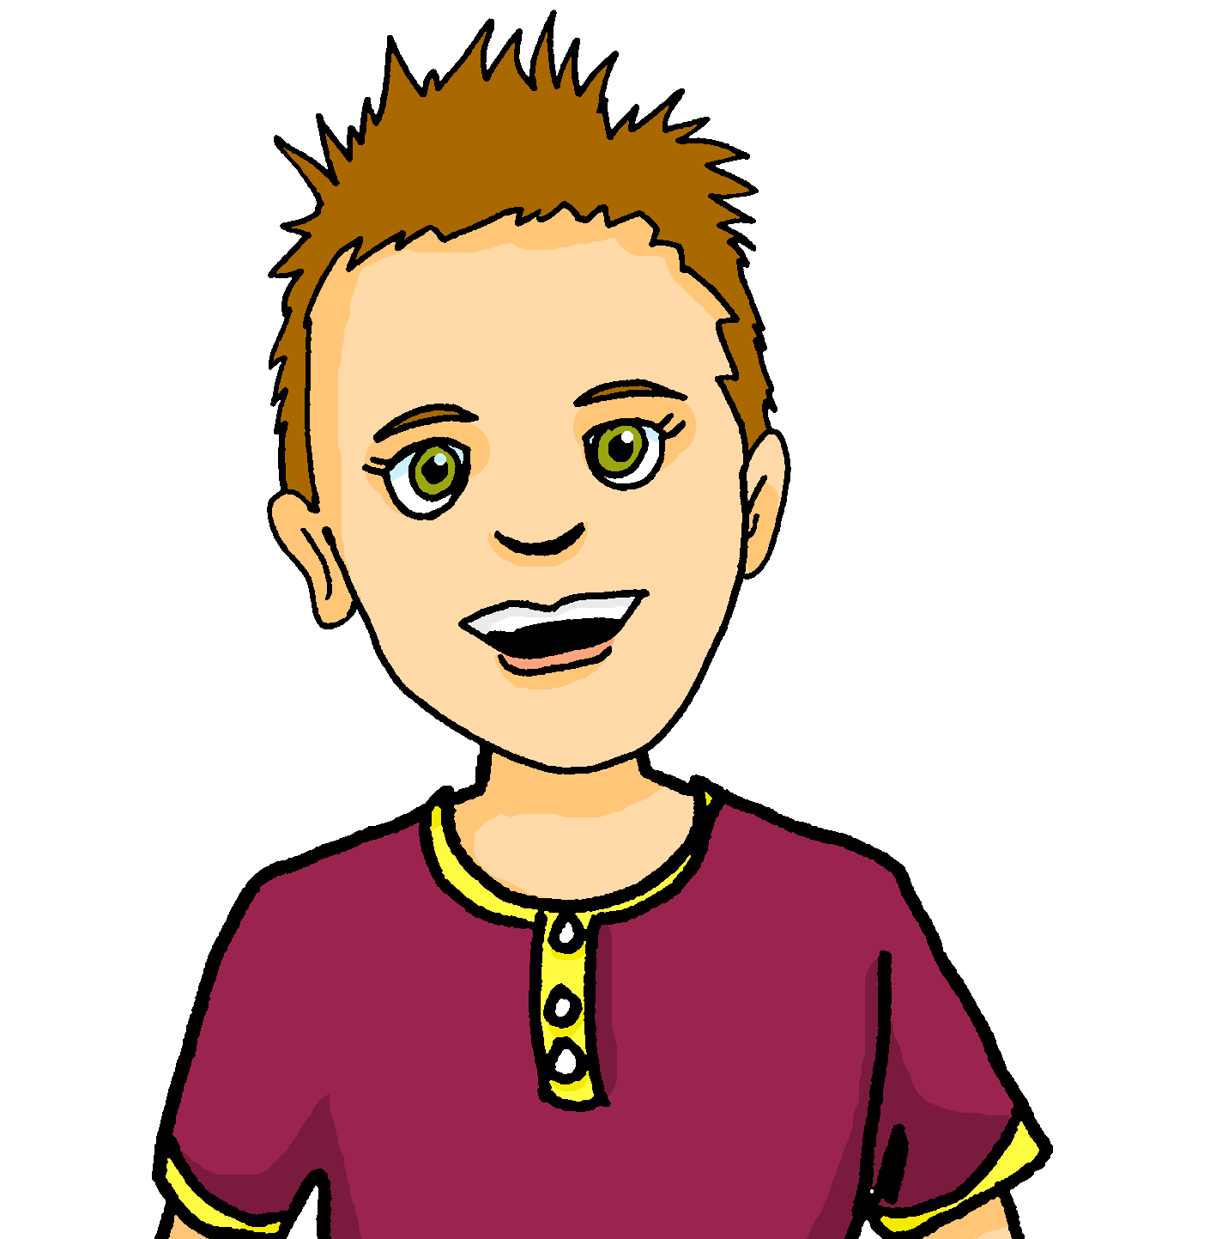
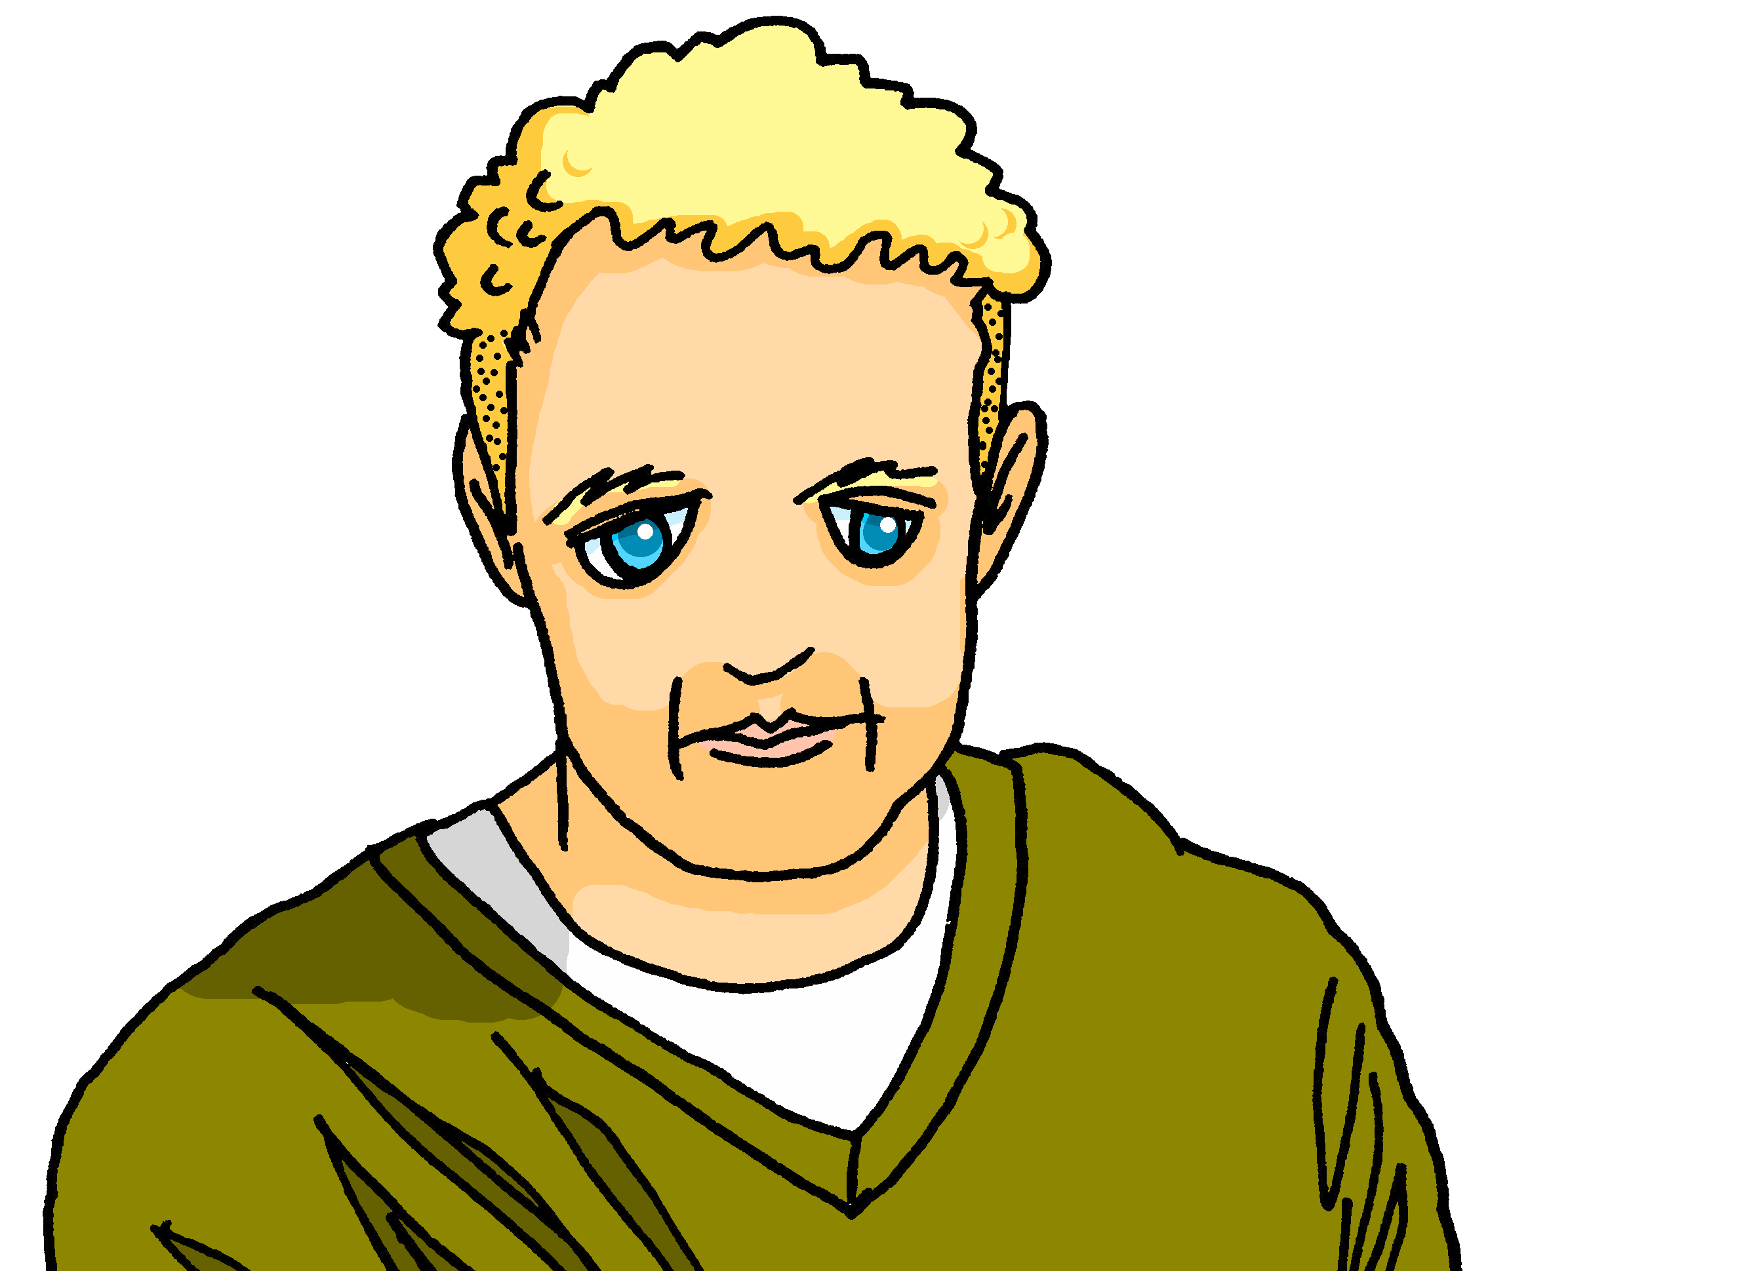
Follow up 4:

. Écoute les noms des animaux. C’est [ien] ou [(a)in]?
Écris les phrases.
⚠Remember that we don’t use capital letters with months in French.
écrire
My birthday is on the 16th March.
Mon anniversaire est le 16 mars.
My birthday is on the 9th September.
Mon anniversaire est le 9 septembre.
My birthday is on the 25th June.
Mon anniversaire est le 25 juin.
My birthday is on the 31st July.
Mon anniversaire est le 31 juillet.
Notes:
Timing: 6-8 minutes
Aim: to practise written production of dates (numbers and months) and use of ‘le’ with dates with numbers (and no days).
Procedure:
1. Pupils write the four sentences in French.
2. Click to bring up written answers.
3. Pupils to check their sentences carefully.

Slide 11




vocabulaire
Follow up 5 - Écris en français : Can you get at least 15 points?
mots
 | the cousin (m) | the cousin (f) | (the) man
 | red | (the) woman | blue
 | June | thirty-one | March
 | fourteen | January | twenty-four
 | thirteen | sixteen | fifteen
 | it is, it’s | twenty | thirty
 | birthday | month | when?
le cousin
la cousine
l’homme
x3
rouge
la femme
bleu
juin
trente-et-un
mars
x2
quatorze
janvier
vingt-quatre
treize
seize
quinze
c’est
vingt
trente
x1
l’anniversaire
le mois
quand ?
Notes:
Timing: 5 minutes
Aim: to practise written production of vocabulary from this week.
Procedure:
1. Give pupils a blank grid. They fill in the French meanings of any of the words they know, trying to reach 15 points in total.
11

Slide 12
vocabulaire
Follow up 5 - Écris en français : Can you get at least 15 points?
mots
 | the cousin (m) | the cousin (f) | (the) man
 | red | (the) woman | blue
 | June | thirty-one | March
 | fourteen | January | twenty-four
 | thirteen | sixteen | fifteen
 | it is, it’s | twenty | thirty
 | birthday | month | when?
x3
x2
x1
Notes:
Handout
12

