Slide 1
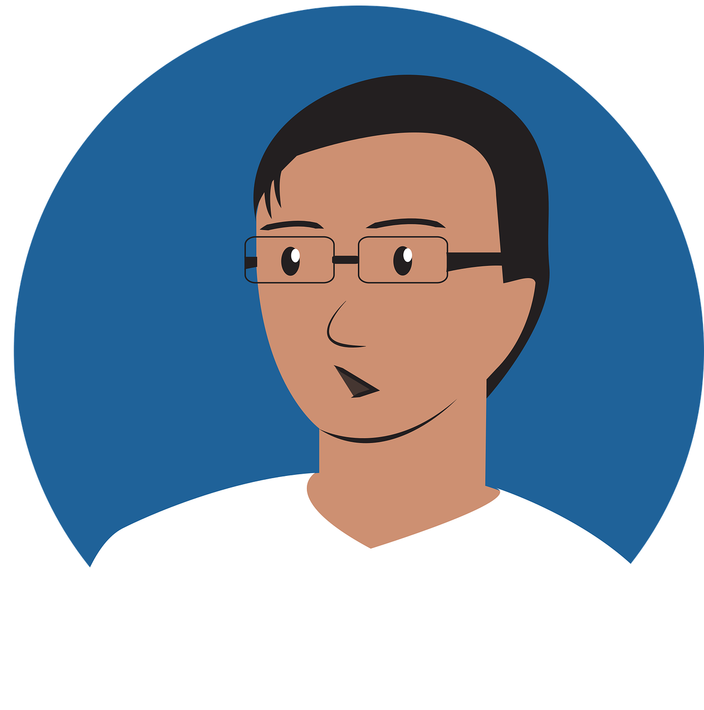
Describing me and others
les professeurs
« être » nous sommes (we are)
adjective agreement (plural)
Revisit [a] and [an|en]
bleu
Term 1 Week 2
Notes:
Artwork by Steve Clarke. Pronoun pictures from NCELP (www.ncelp.org). All additional pictures selected from Pixabay and are available under a Creative Commons license, no attribution required.
Phonics: revisit [a] and [an|en] banane [>5000] enfant [126] maman [2168]
Vocabulary (new words in bold): sommes [5] nous [31] absent [2016] amusant [4695] calme [1731] content [1841] différent [350] difficile [296] drôle [2166] fort [107] grand [59] jeune [152] lent [2572] malade [1066] méchant [3184] intelligent [2509] indépendant [954] important [215] petit [138] présent [216] prudent [1529] rapide [672] strict [1859] sage [2643] triste [1843]
Revisit 1: -- Revisit 2: elle² [38] il² [13] difficile [296] jaune [2585] préféré [597] trop [195]
Londsale, D., & Le Bras, Y. (2009). A Frequency Dictionary of French: Core vocabulary for learners London: Routledge.
The frequency rankings for words that occur in this PowerPoint which have been previously introduced in these resources are given in the SOW and in the resources that first introduced and formally re-visited those words.
For any other words that occur incidentally in this PowerPoint, frequency rankings will be provided in the notes field wherever possible.
1

Slide 2
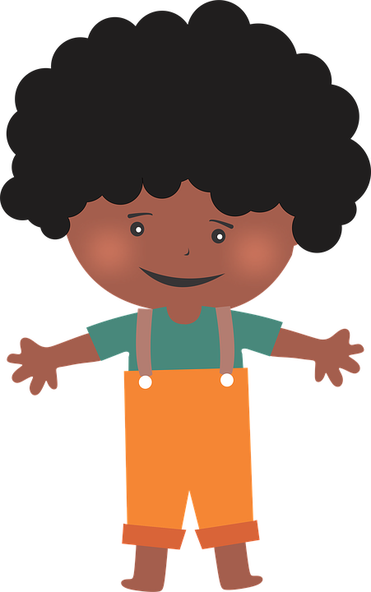
[an|en]
prononciation
enfant
French vowels are either nasal like [an|en] or
non-nasal (oral) like [e] and [a].
When you say a nasal vowel, air passes through your nose as well as your mouth.
Notes:
Timing: 1 minute
Aim: to re-introduce SSC [an|en], which pupils met last week.
Procedure:
Introduce and elicit the pronunciation of the individual SSC [an|en]. Practise saying it several times.
Click to bring up the information about nasal and oral vowel sounds. Practise saying [a] then [an|en] several times.
Click to bring up the source word ‘enfant’ (with gesture, if using). Say the word several times.
Click to bring up the picture and get pupils to repeat the words (with gesture, if using).
Pupils can also practise in pairs.

Slide 3
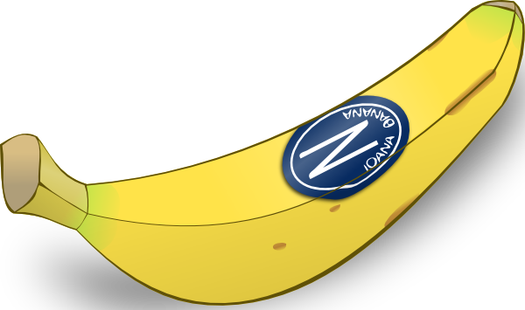
[a]
banane
prononciation
[a] is an oral vowel.
Notes:
Timing: 1 minute
Aim: to remind pupils of SSC [a]
Procedure:
Elicit the pronunciation of the individual SSC [a] and then the source word ‘banane’ (with gesture, if using).
Click to bring on the picture and get students to repeat (with gesture, if using).
Note: a gesture for ‘banana’ – we suggest making the shape of a banana with both hands – start with finger tips together in the middle, pull them apart and upwards to trace the shape of a banana (like the shape of a smile).
3

Slide 4
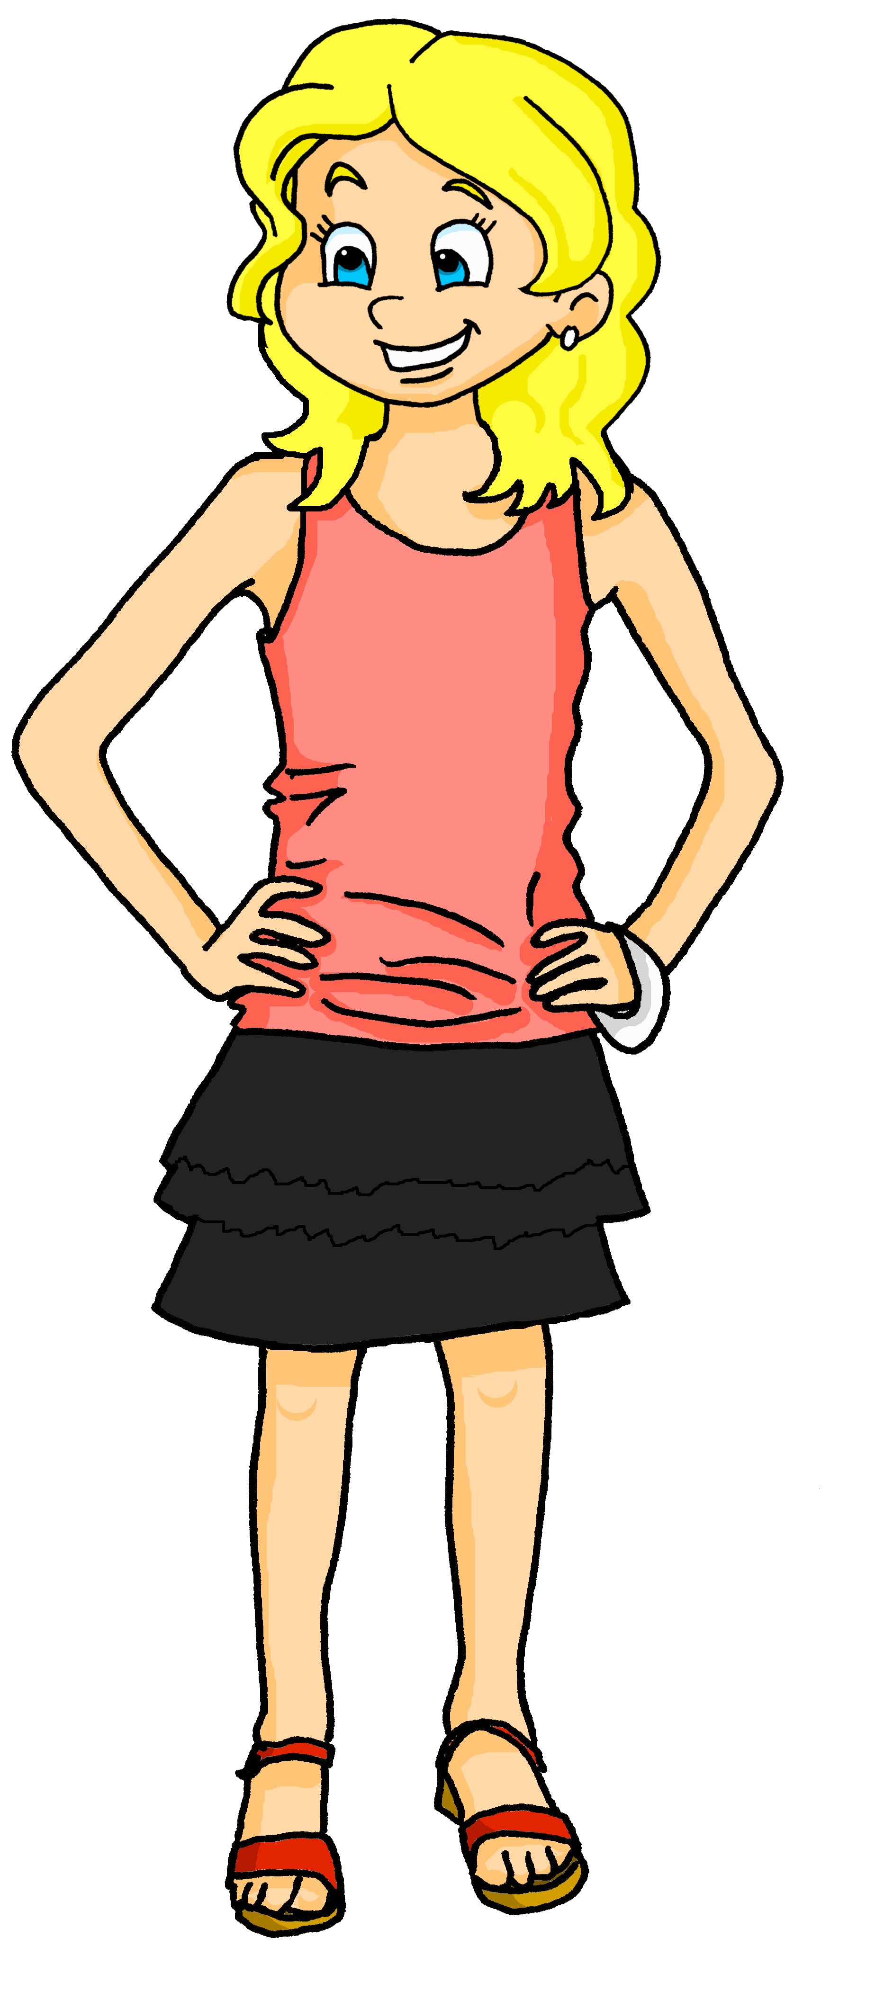
[a]
[an]
prononciation
This common French word has both an oral vowel and a nasal vowel.
Maman
oral vowel
nasal vowel
Voici Claudine, la maman de Pierre et Adèle.
Notes:
Timing: 1 minute
Aim: to focus further on the difference in sound between [a] and [an|en].
Procedure:
Click to bring up the two SSC [a] and [an|en].
Click to bring up the cluster word ‘maman’. Say the word several times.
Click to bring up the call out and labels for [a] and [an|en].
Click to introduce Pierre and Adèle’s mum: Claudine.
4

Slide 5
écouter
Écoute et écris les mots.
1
[a]
banane
[an|en]
enfant
2
3
calme
méchant
4
malade
important
5
idéal
amusant
différent
6
sage
indépendant
7
8
facile
9
10
Notes:
Timing: 5 minutes
Aim: to practise aural comprehension and written production of previously taught vocabulary containing the SSC [a] and [an|en]
Procedure:
Ensure that pupils understand the task. They listen out for the vowel sounds [a] and [an|en] and write the French words. Words go into the overlap if they contain both sounds.
Click to listen to each word.
Pupils transcribe the word into the appropriate part of the Venn diagram.
Click to reveal each word in order.
Elicit the English meanings as these are words that pupils learnt in Y3/4, with the exception of sage, which is a new word for this week.
Transcript méchant calme malade idéal important different sage amusant facile indépendant

Slide 6
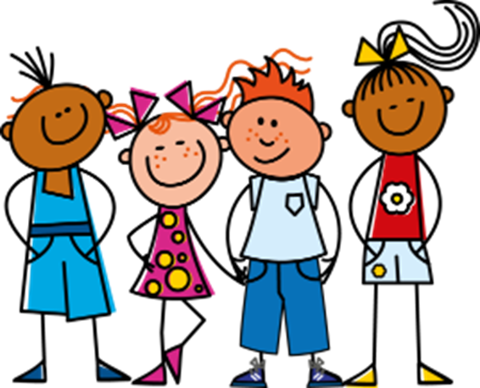
Être
[to be | being]
Remember, the last letter of all these verb forms is a
Silent Final Consonant!
You already know these parts of the verb être (to be):
être
Je suis présent. | I (a boy) am present.
Tu es grande. | You (a girl) are tall.
Il est petit. | He is short.
Elle est absente. | She is absent.
___ _______ _______.
___ _______ _______.
___ _______ _______.
?
Elle est absente.
___ _______ _______.
Except when followed by a vowel!
To say ‘we’ + être:
Nous sommes contents.
We are pleased.
Notes:
Timing: 2 minutes
Aim: to revise the persons of être already met and to present the 1st person plural nous sommes.
Procedure:
Elicit the four French sentences from pupils.
Click to present nous sommes and elicit the English meaning.
Click to remind pupils about SFC and liaison.
6

Slide 7
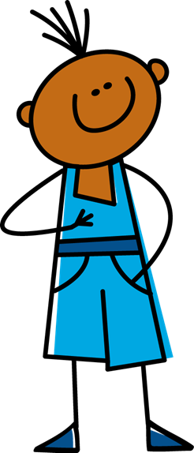
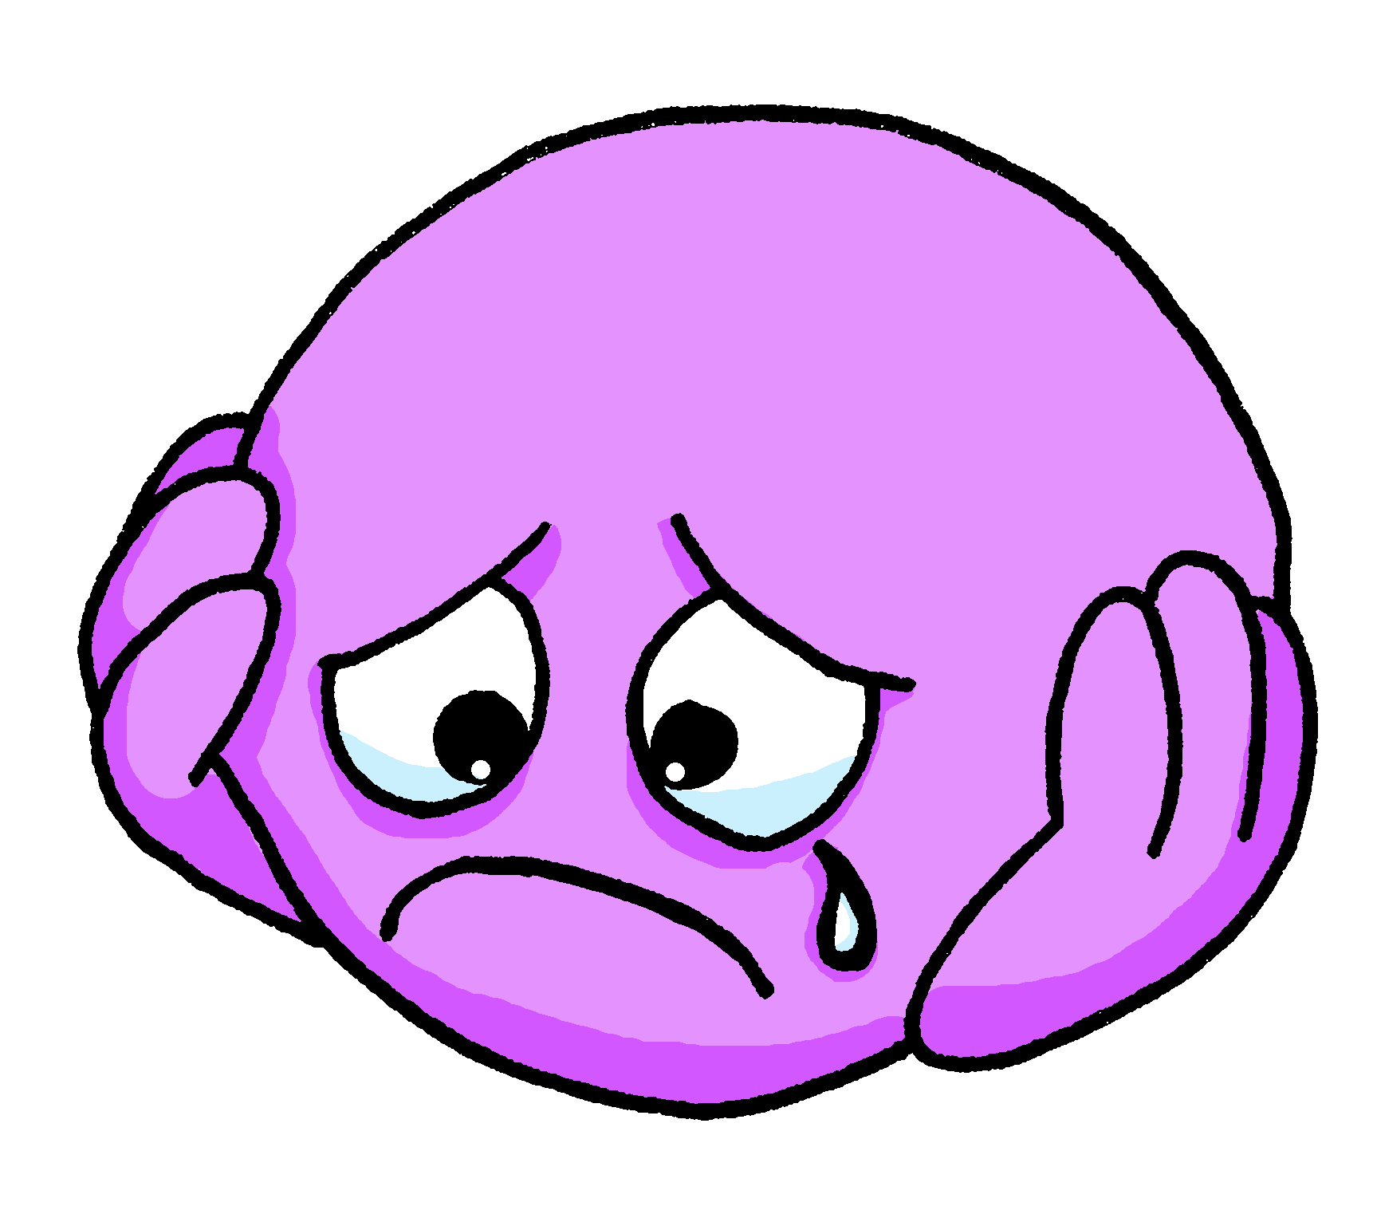
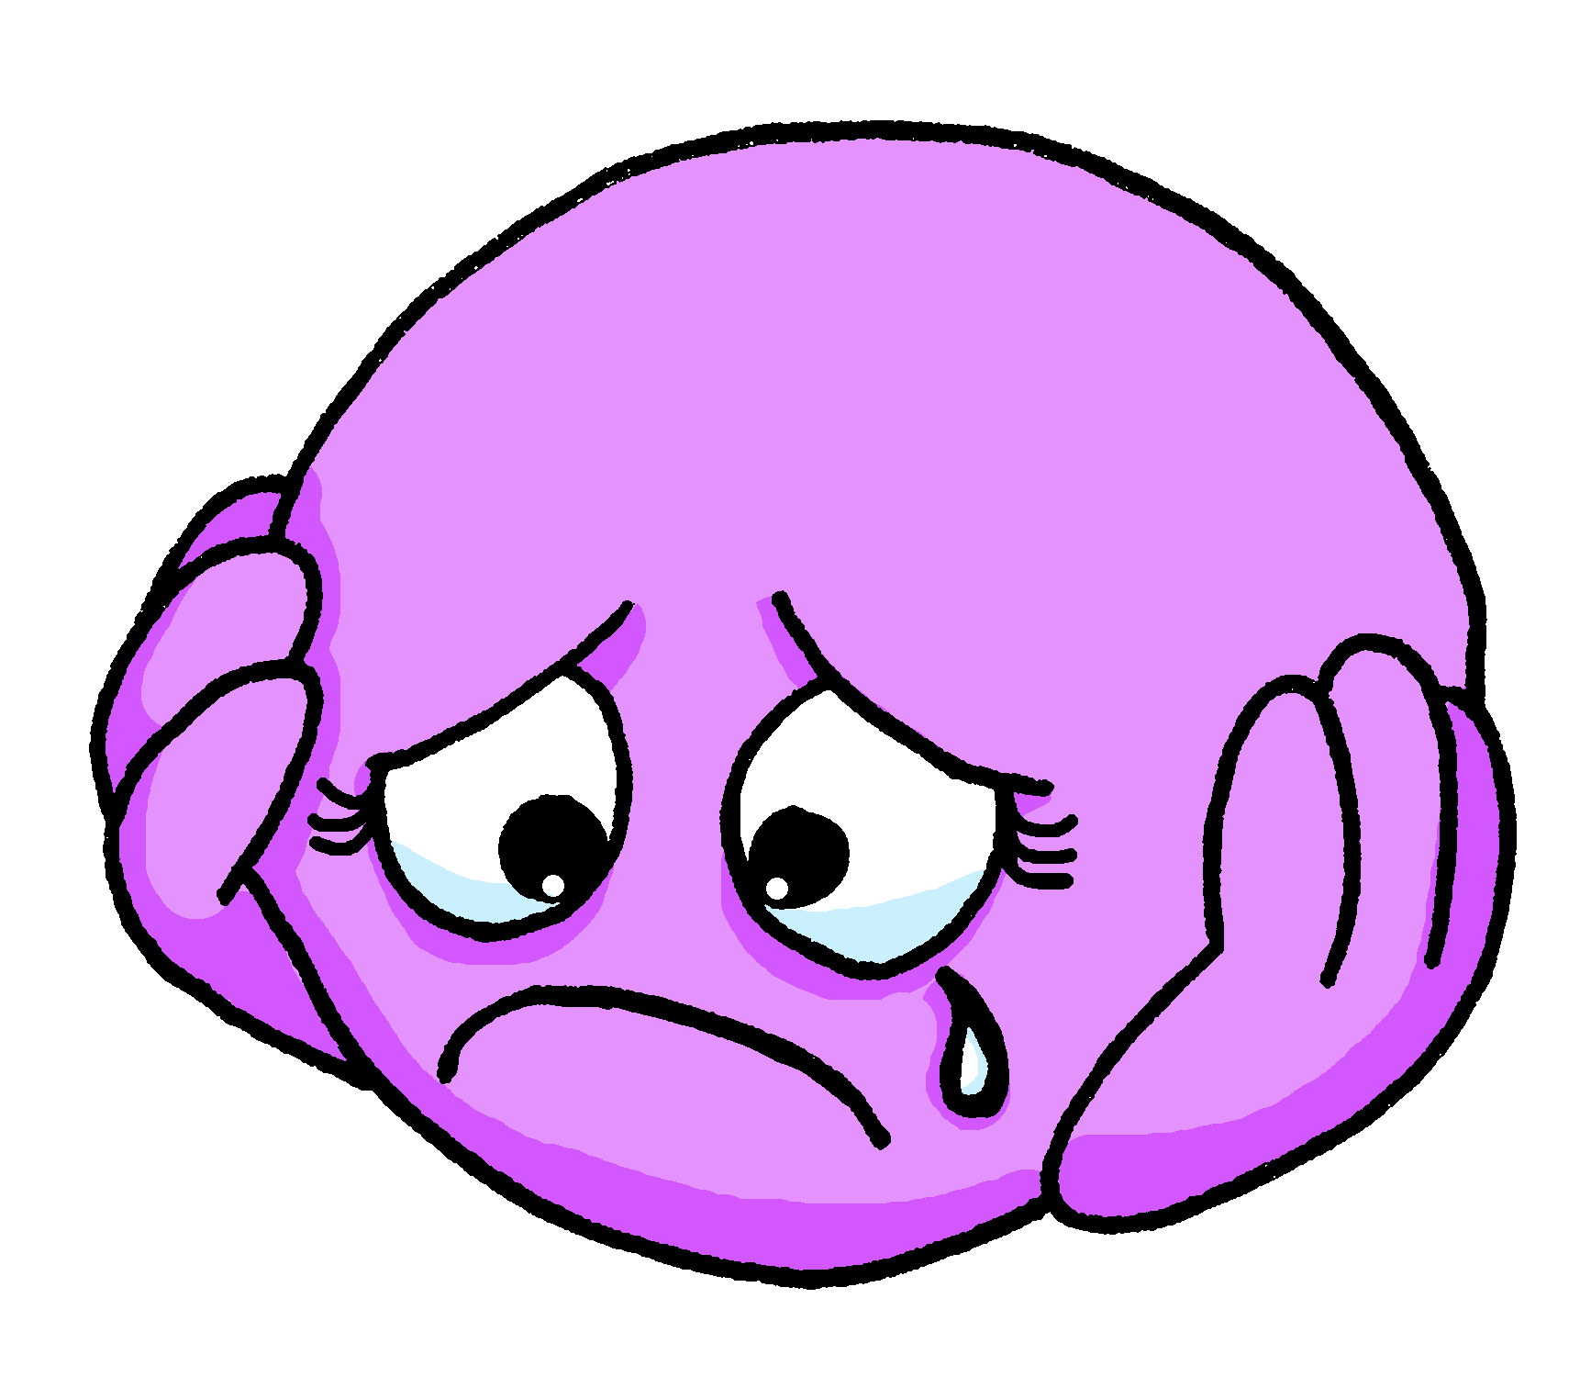
écouter
Je ou nous ?
1
sad
Notes:
Timing: 6 minutes (9 slides)
Aim: to practise distinguishing aurally between the first person singular and first person plural forms of ‘être’.
Procedure:
1. Click the button to play audio with the pronoun obscured.
2. Pupils should note whether the first word of each sentence must be ‘je’ or ‘nous’.
3. They then write the English meaning of the adjective used in each sentence (to force vocabulary recall).
4. Answers appear upon clicking the mouse. Note: in this full audio version a full version of the sentence plays if you click the green tick.
Transcript:
[…] sommes tristes.
7

Slide 8
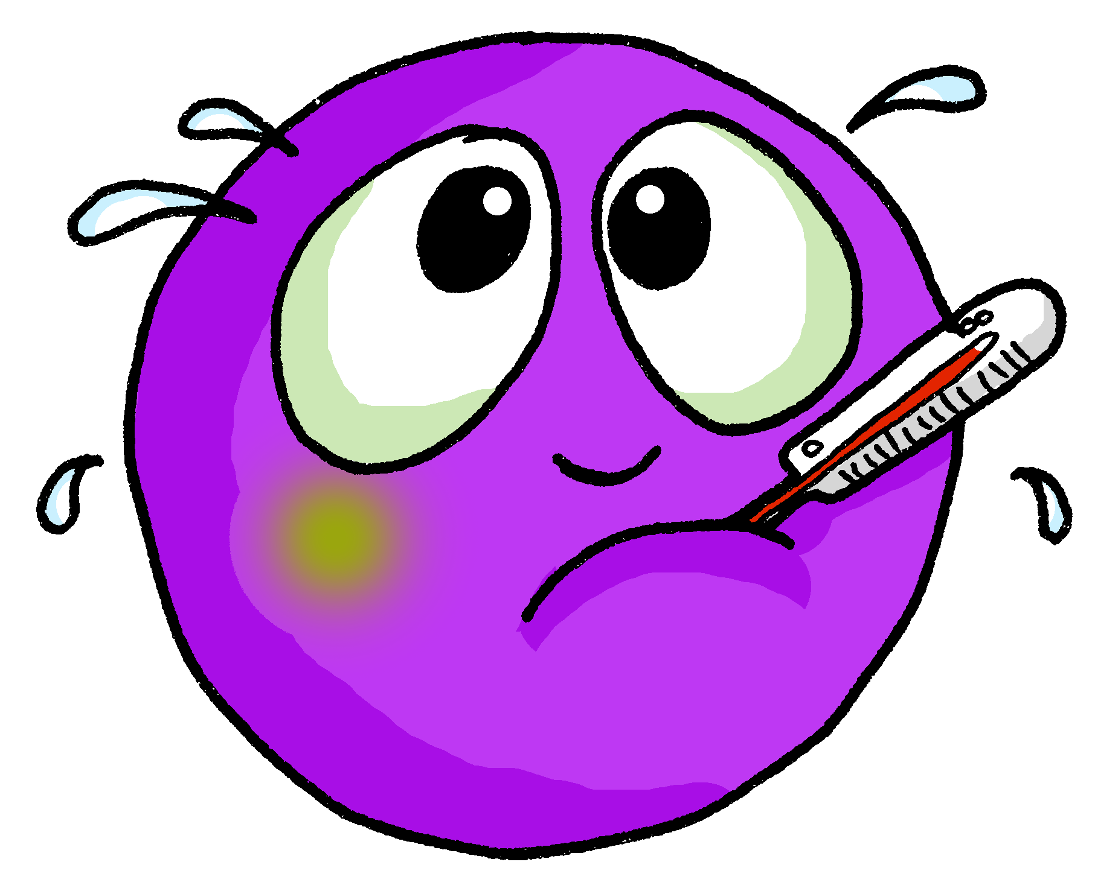
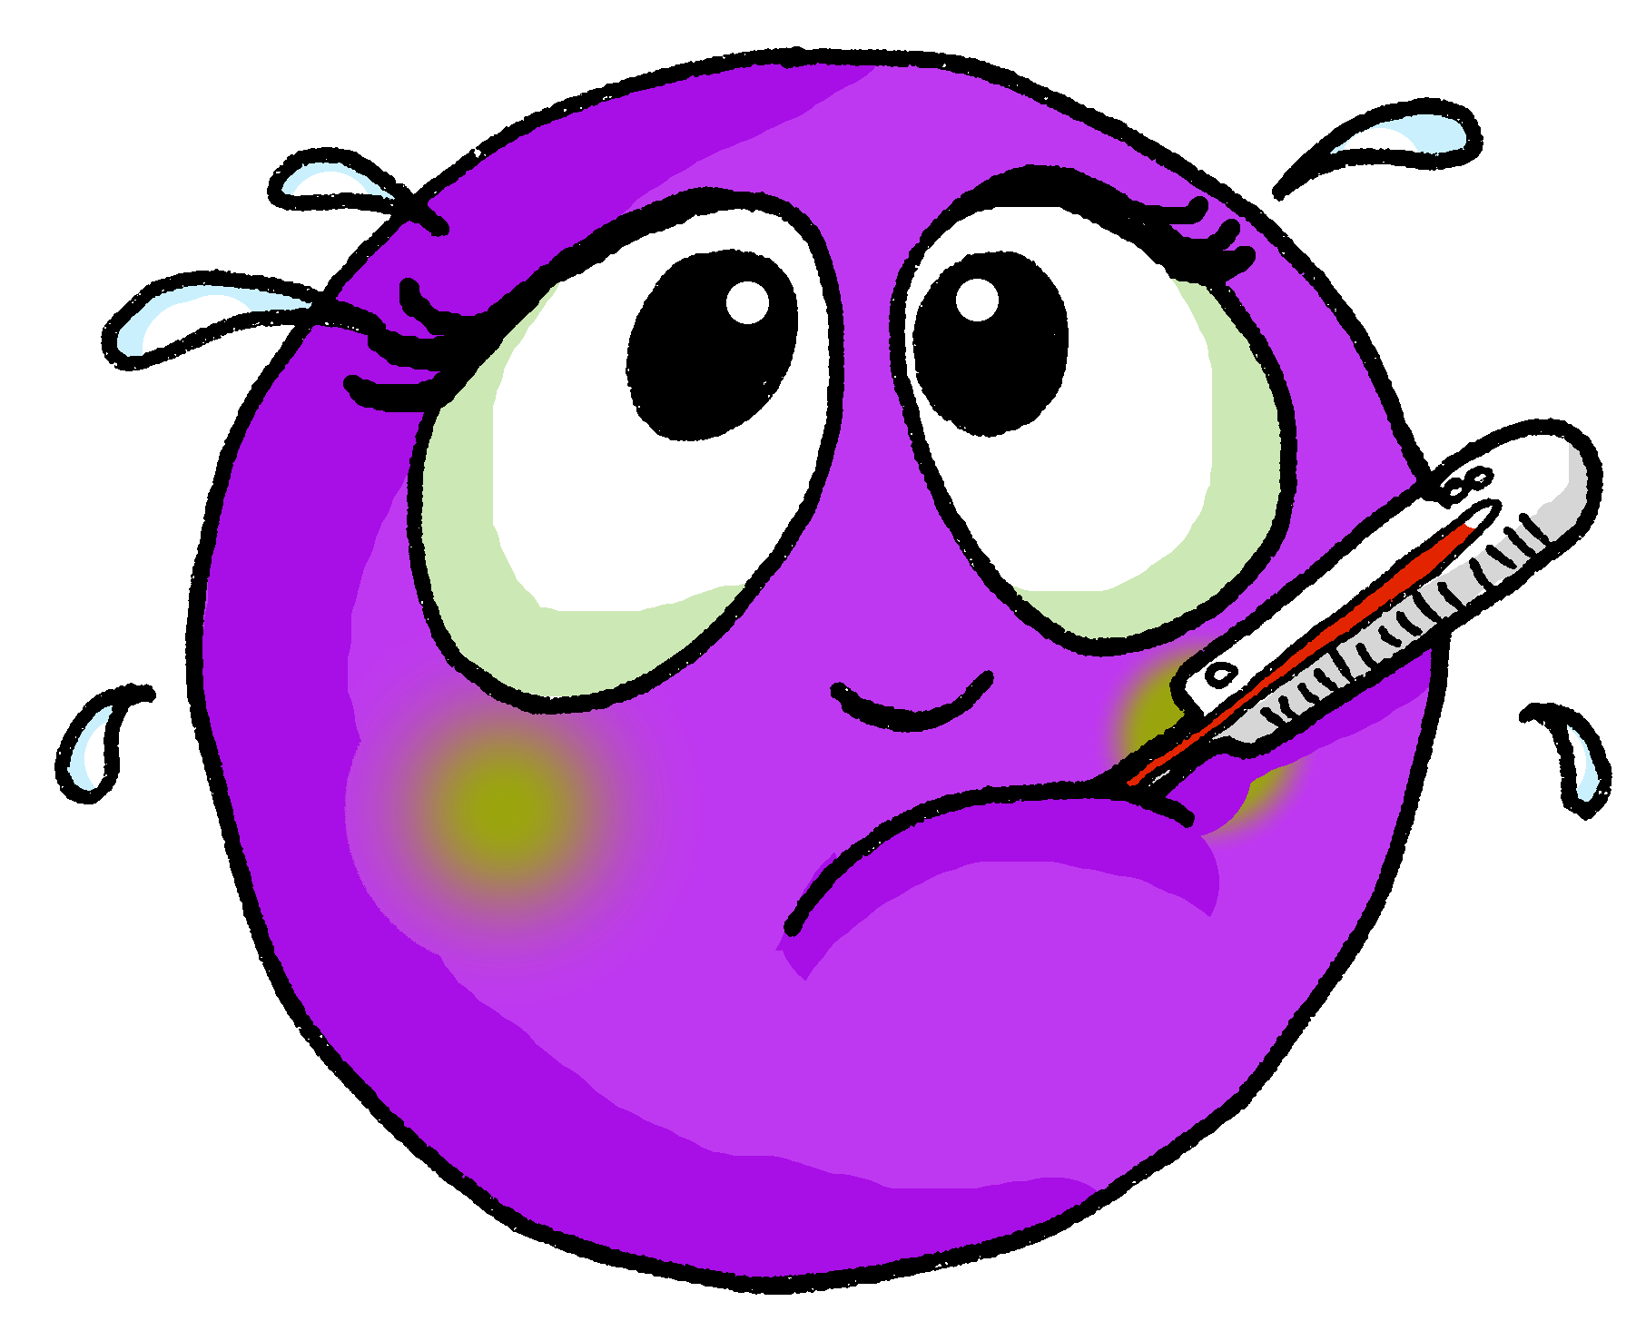
écouter
Je ou nous ?
2
sick, ill
Notes:
Transcript:
[…] sommes malades.
8

Slide 9
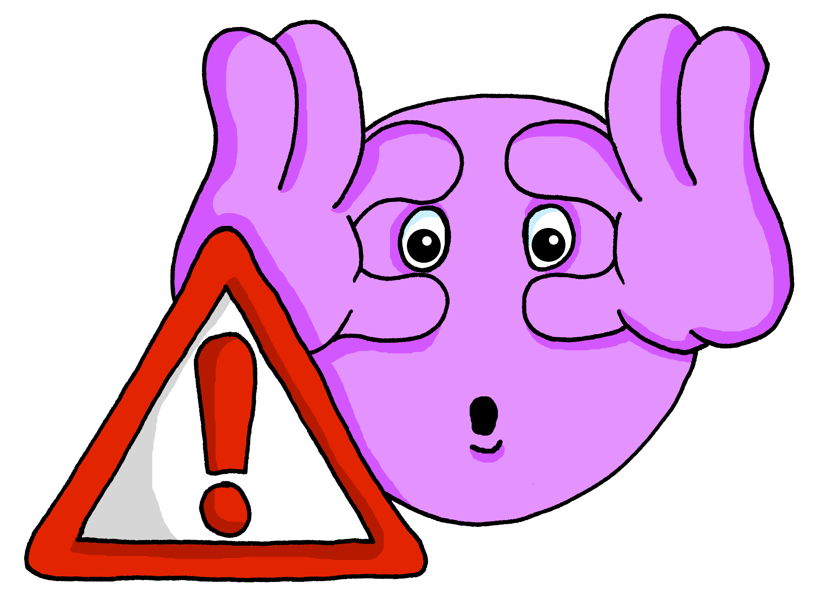
écouter
Je ou nous ?
3
careful
Notes:
Transcript:
[…] suis prudent.
9

Slide 10
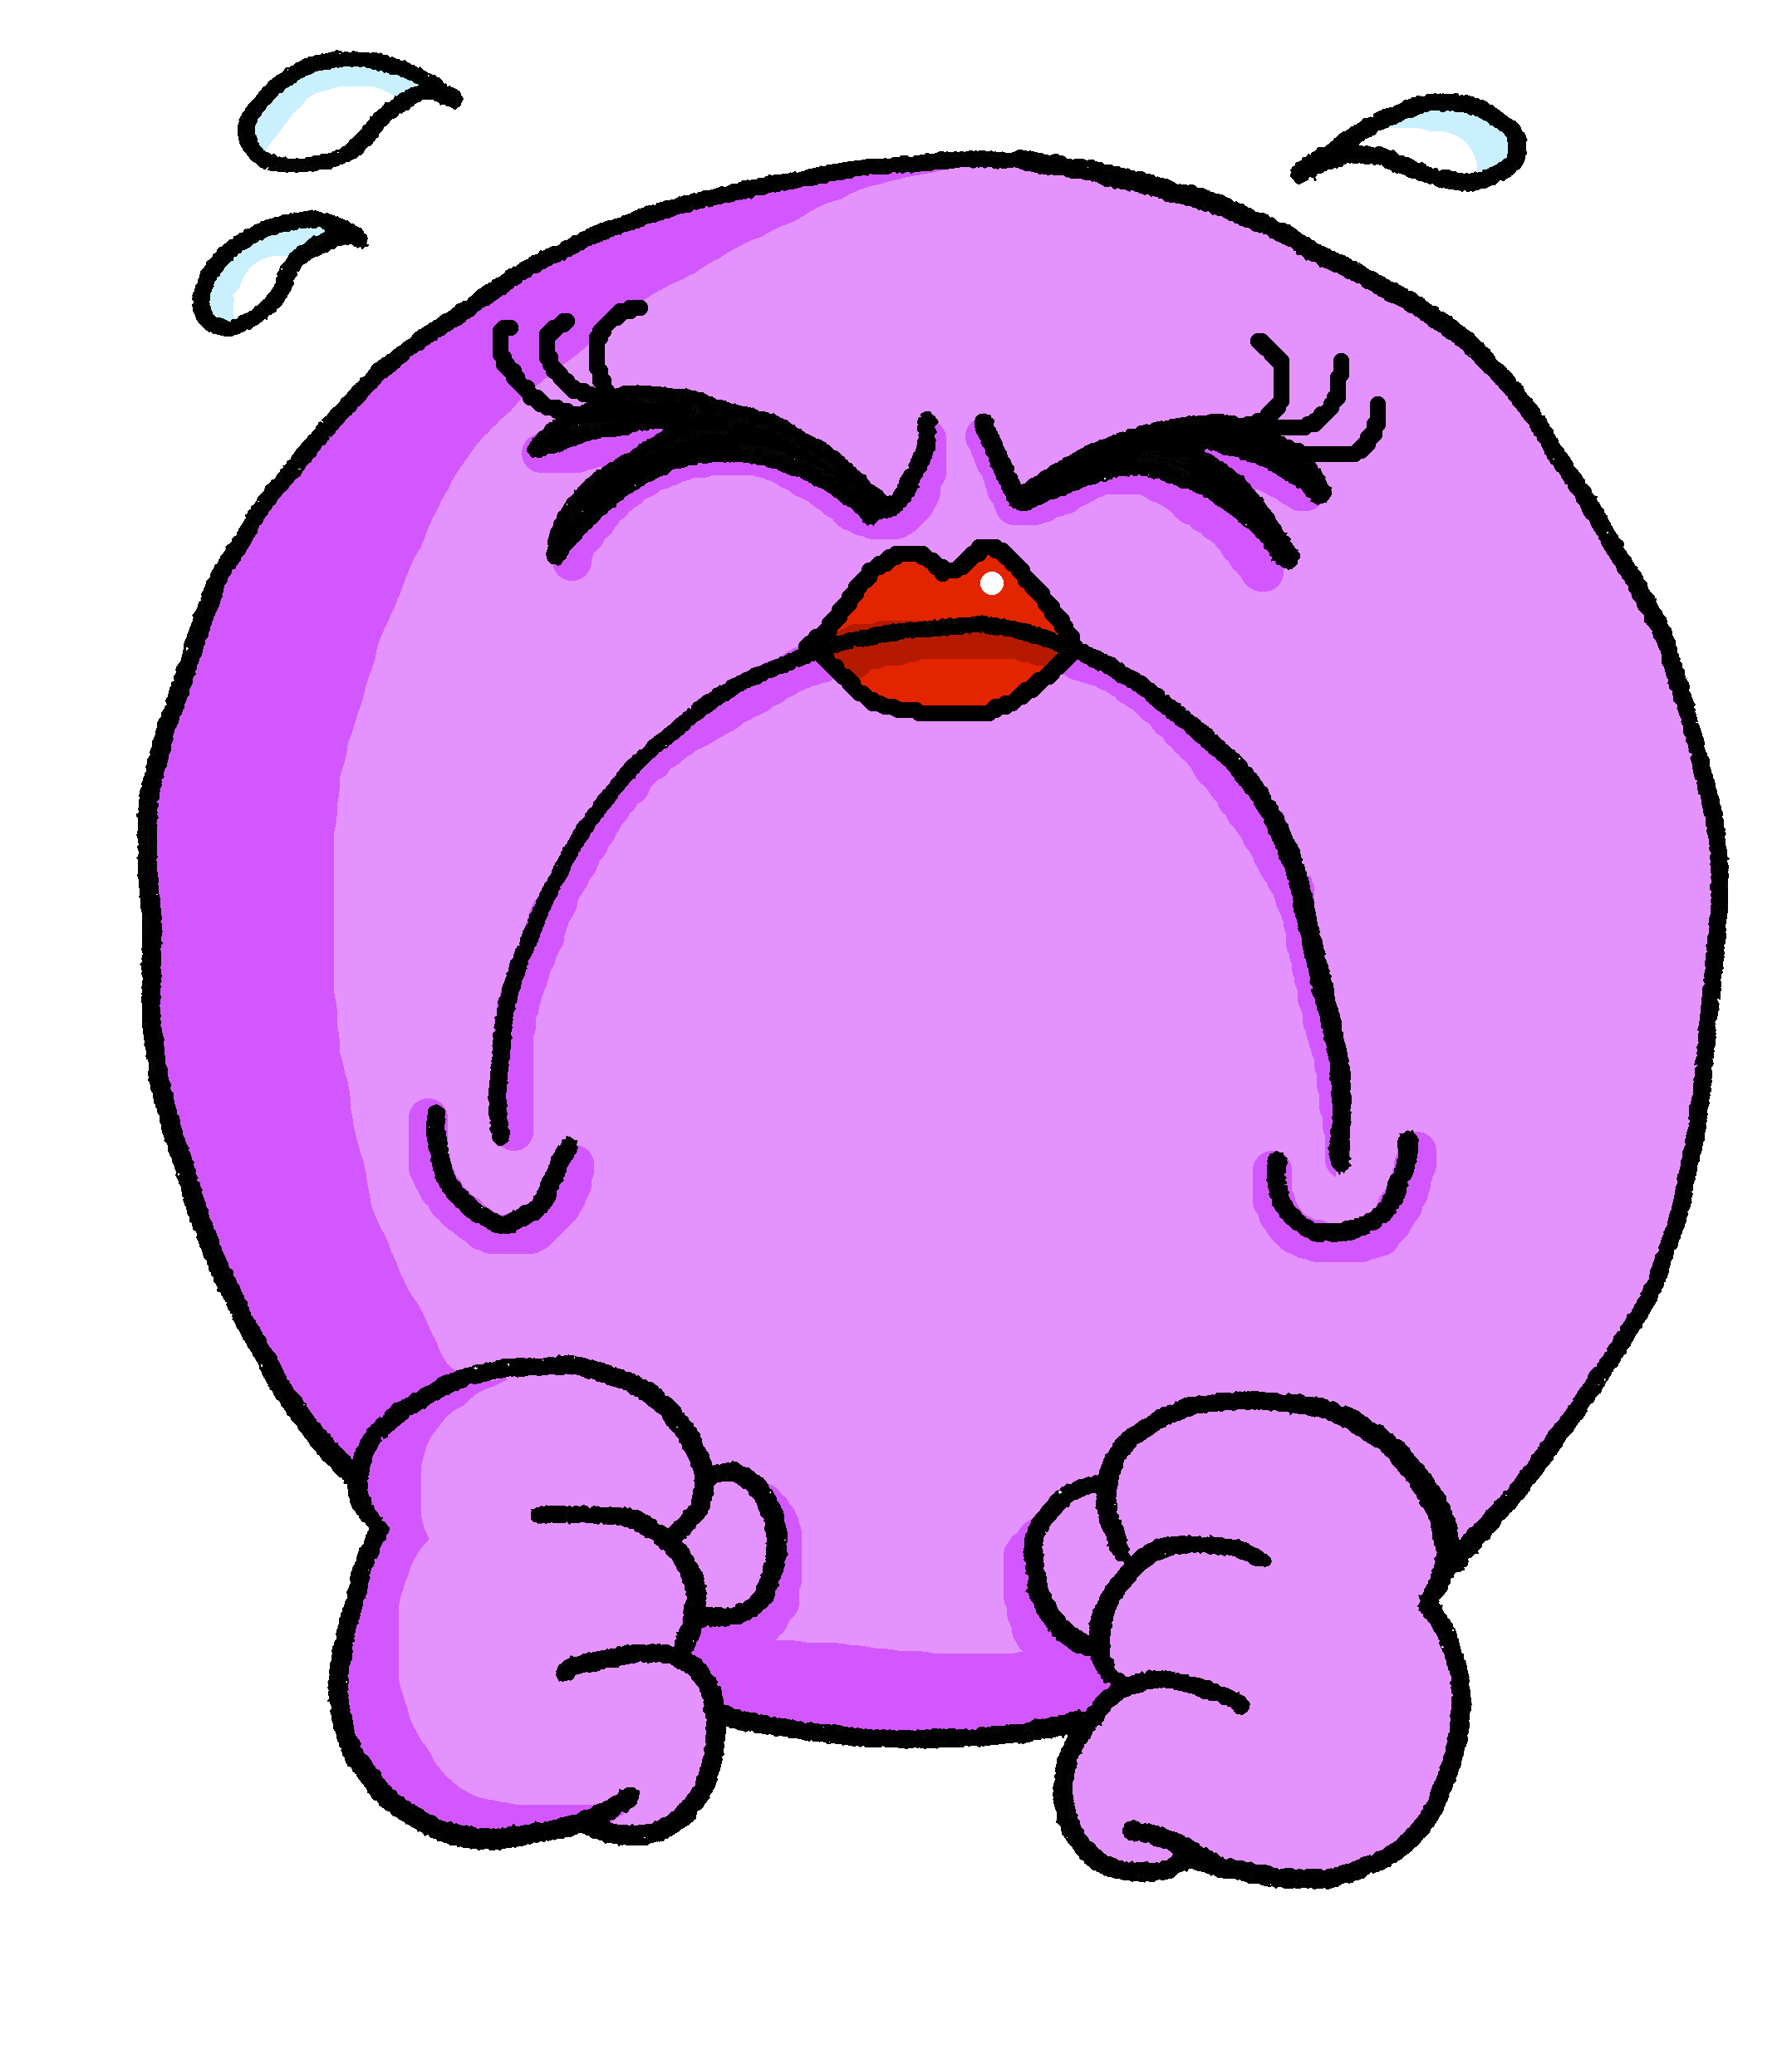
écouter
Je ou nous ?
4
difficult
Notes:
Transcript:
[…] sommes difficiles.
10

Slide 11
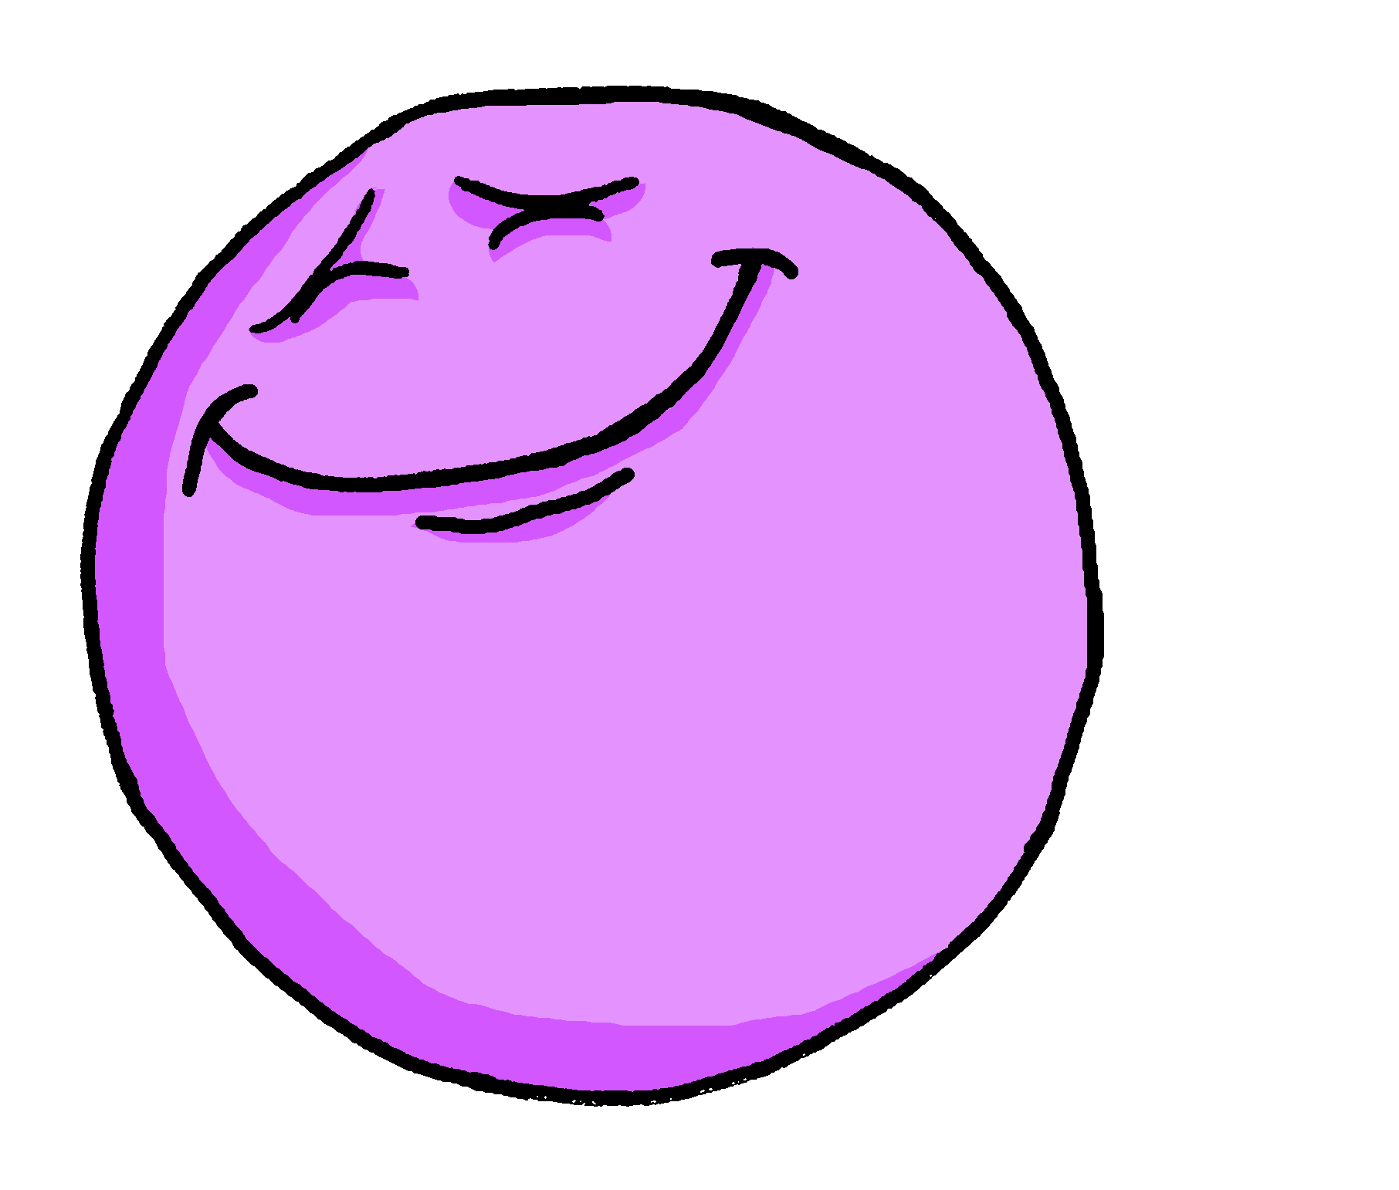
écouter
Je ou nous ?
5
pleased
Notes:
Transcript:
[…] suis content.
11

Slide 12
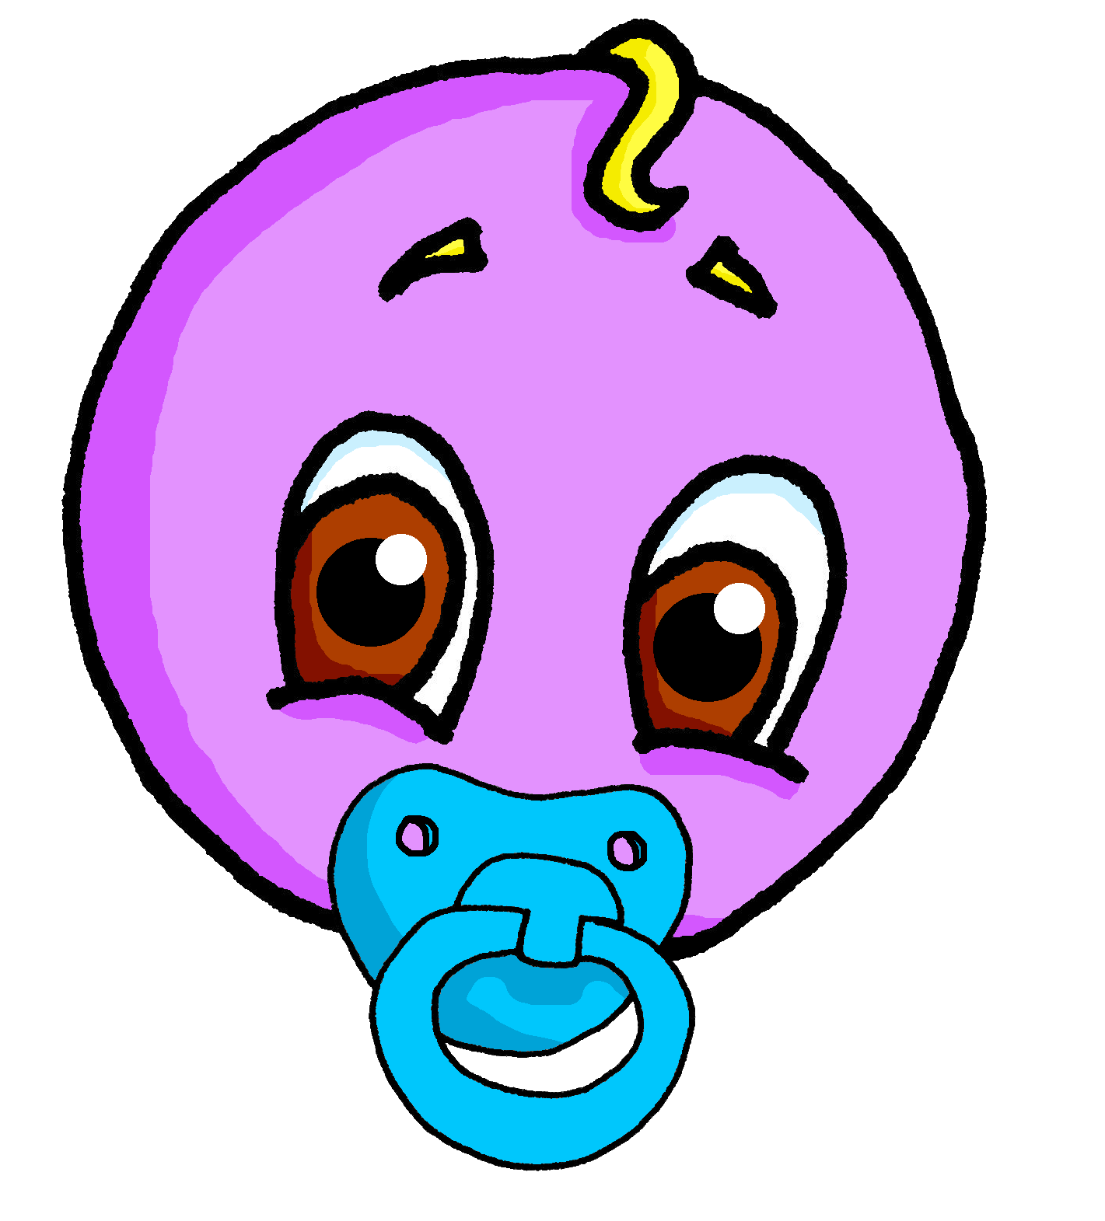
écouter
Je ou nous ?
6
young
Notes:
Transcript:
[…] suis jeune.
12

Slide 13
écouter
Je ou nous ?
7
funny
Notes:
Transcript:
[…] sommes drôles.
13

Slide 14
écouter
Je ou nous ?
8
strong
Notes:
Transcript:
[…] suis fort.
14

Slide 15
écouter
Je ou nous ?
9
well-behaved
Notes:
Transcript:
[…] sommes sages.
15

Slide 16
Describing more than one [1/2]
“Nous” (we) is a plural pronoun – it refers to more than one person.
Remember: There must be agreement between the adjective and noun!
So, adjectives describing “nous” need to be in a plural form:
Nous sommes contents.
We are pleased.
Don’t forget! The -s on the end of ‘sommes’ and the adjective are Silent Final Consonants.
Don’t forget! The -s on the end of ‘sommes’ and the adjective are Silent Final Consonants.
Notes:
Timing: 2 minutes
Aim: to introduce plural adjective agreement.
Procedure:
Click to present the information.
Elicit the English sentence meaning.
Click to remind pupils about SFC.
Note: First we will practise recognising the difference between masculine singular and masculine plural adjectives. Then we will bring in feminine plural agreement.
16

Slide 17
lire
C’est qui ?
Is Monsieur Lemaire talking about himself, or himself AND Monsieur Caput?
Je ou nous ? Écris les adjectifs en anglais.
. Écoute les noms des animaux. C’est [ien] ou [(a)in]?
 |  | nous (we) | je (I)
1
2
3
4
5
6
7
8
… … strict.
strict
… … intelligents.
intelligent
… … grand.
tall
… … rapides.
fast
… … calmes.
calm
… … prudent.
careful
… … fort.
strong
… … différents.
different
Notes:
Timing: 7 minutes
Aim: to practise written recognition of singular and plural adjective agreement and connect these to 1st person singular and plural pronouns and parts of être (which are omitted to focus pupils’ attention on the adjective form.
Procedure:
Explain the task.
Complete number one with pupils. They write noun / je and the adjective meaning in English.
Explain that this difference between plural and singular adjectives can only be detected in writing, because of the SFC.
Pupils complete items 2-8.
Click to correct.
Optional – elicit full sentences from pupils as additional practice. E.g. Comment dit-on ‘we are intelligent’ en français?
17

Slide 18
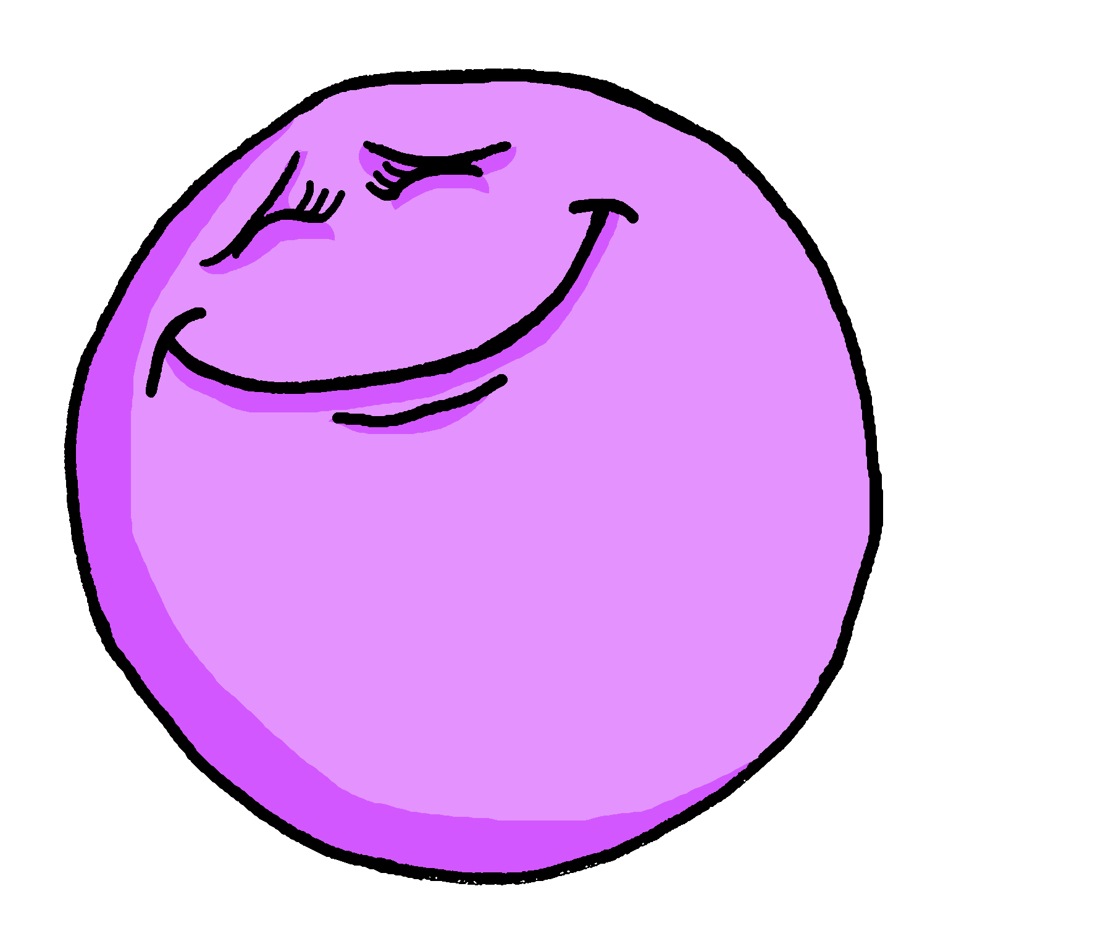
Describing more than one [2/2]
You know that many adjectives add -e to describe a feminine noun.
Je suis contente.
I (a girl) am pleased.
The -s on the end is silent but the –e makes you pronounce the –t.
When the feminine noun is plural, add -e and -s to the adjective:
Nous sommes contentes.
We (girls) are pleased.
If there is a mix of male and female people in the group, we use the masculine plural adjective.
Nous sommes contents.
We (boys|boys & girls) are pleased.
Notes:
Timing: 2 minutes
Aim: to introduce feminine plural adjective agreement.
Procedure:
Click to present the information.
Elicit the English sentence meanings.
Click to remind pupils about SFC.
Explain that masculine endings are used when the group described is all boys or a mixture of boys and girls.
18

Slide 19
lire
Qui parle ?
Je ou nous ? Organise les adjectifs.
. Écoute les noms des animaux. C’est [ien] ou [(a)in]?
… … grand
… … amusants
je
nous
… … content
… … intelligents
… … content
… … intelligents
… … grand
… … importantes
… … lente
… … amusants
… … différente
… … prudentes
Monsieur Lemaire
Monsieur Lemaire et Monsieur Caput
… … prudentes
… … lente
je
nous
… … différente
… … importantes
Madame Vidal
Madame Vidal et Madame Dior
Notes:
Timing: 5 minutes
Aim: to practise written recognition of singular and plural adjective agreement (masculine and feminine) and connect these to 1st person singular and plural pronouns and parts of être (which are omitted to focus pupils’ attention on the verb and adjective forms.
Procedure:
Explain the task.
Complete number one with pupils. They say the full French sentence, then say the correct name or names.
Teacher elicits the meaning of the adjective.
A further click places the callout in the appropriate category.
Teacher guides pupils to complete items 2-8 chorally, providing feedback after each item.
19

Slide 20
Au revoir !
bleu
Notes:
20

