Slide 1
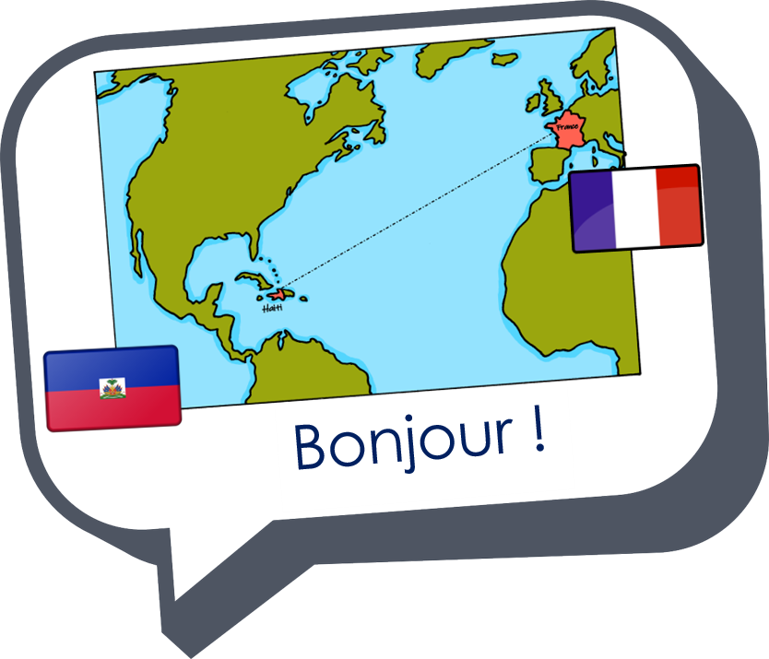

Describing me and others
la rentrée
Back to school
bleu
Revisit « être » (singular)
Revisit adjective agreement (singular)
Revisit intonation questions
Revisit SFC & liaison
Term 1 Week 1
Notes:
Artwork by Steve Clarke. Pronoun pictures from NCELP (www.ncelp.org). All additional pictures selected from Pixabay and are available under a Creative Commons license, no attribution required.
The frequency rankings for words that occur in this PowerPoint which have been previously introduced in these resources are given in the SOW and in the resources that first introduced and formally re-visited those words.
For any other words that occur incidentally in this PowerPoint, frequency rankings will be provided in the notes field wherever possible.
Phonics: petit [138] mais [30] grand [59] deux [41]
Vocabulary (new words in bold): être [5] suis, est, es [5] je [22] tu [112] il [13] elle [38] qui ? [14] ami(e) [467] école [477 ] monsieur [79] madame [294] professeur(e) [110] anglais [784] français [251] calme [1731] amusant [4695] heureux [764] important [215] inquiet [1392] intelligent [2509] perdu [2264] prêt [422] sérieux [412] bien [47] mal [277] comment ? [234] Salut ! [2205] Ça va ? [54/53] Oui [284] Non [75] Bonjour ! [1972] Au revoir [4/1274]
Revisit 1: chanter [1820] écouter [429] regarder [425] chercher [336] parler [106] passer [90] rester [100]
Revisit 2: elle² [38] il² [13] professeur, professeure [110] sympathique [4164] comment [234]
Londsale, D., & Le Bras, Y. (2009). A Frequency Dictionary of French: Core vocabulary for learners London: Routledge.
1

Slide 2








[SFC] Silent final consonant
prononcer
You know that in French we often don’t pronounce the final consonant:
petit
mais
grand
deux
[but]
Notes:
Timing: 1 minute
Aim: to recap [SFC] with –t, -s, -d, -x and introduce awareness of consonants –c, -r, -f, and –l, which are often pronounced.
Procedure:
Click through the animations to present the information.
2

Slide 3


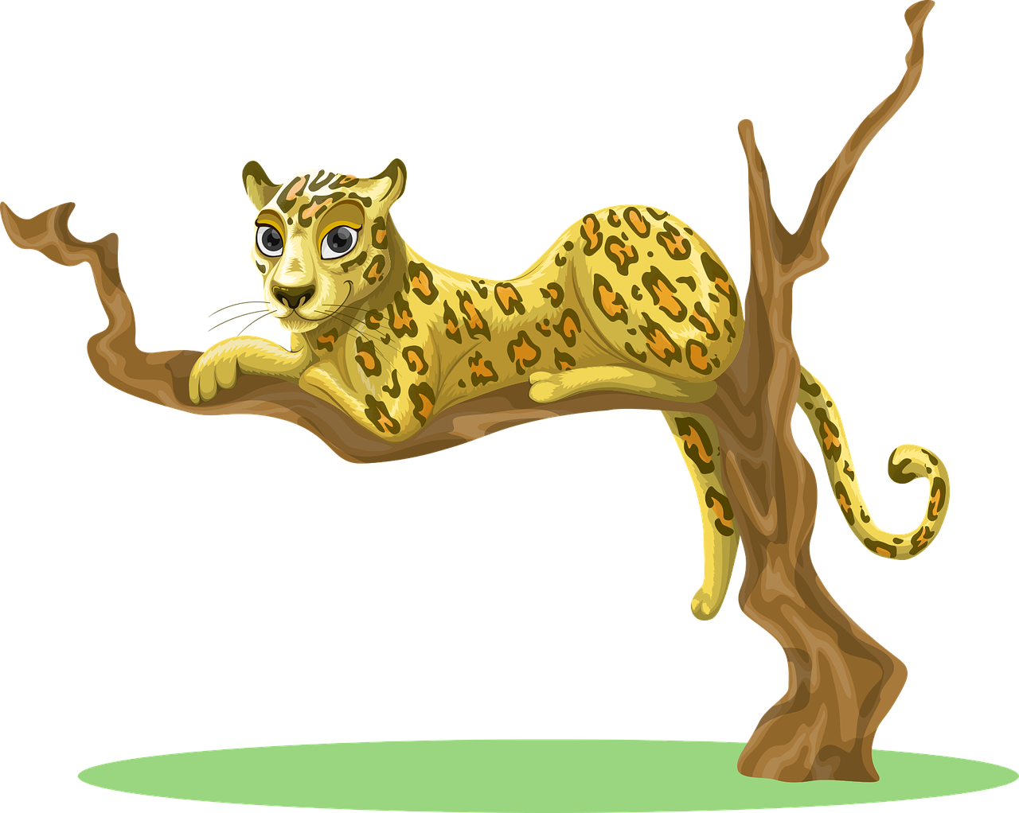
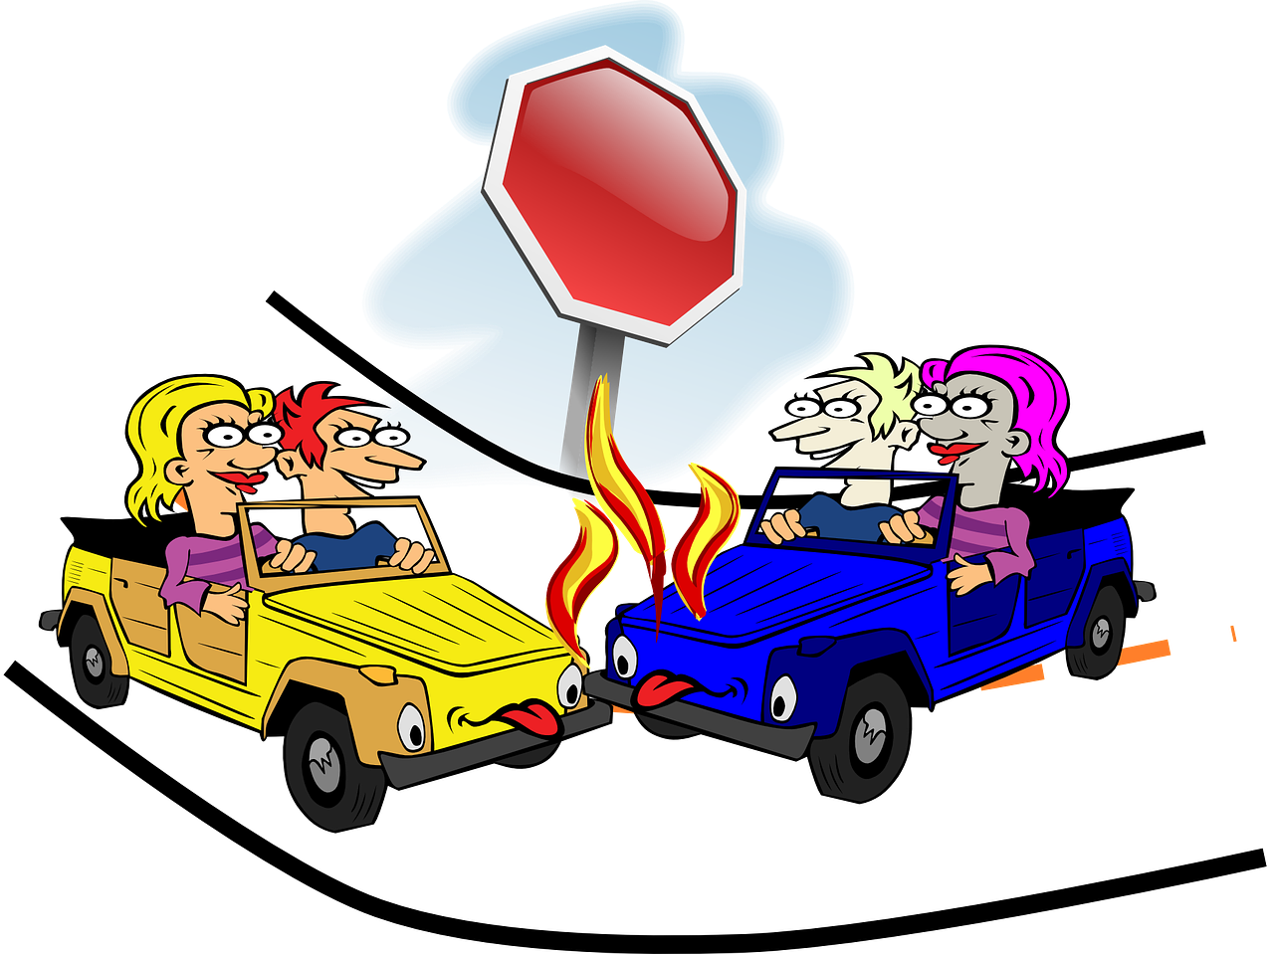




parler
Comment dit-on ça ? [1/3]
Prononce les mots vite mais bien.
20
accident
fruit
léopard
S
palais
0
plan
secret
DÉBUT
Notes:
Timing: 5 minutes
Aim: to correctly pronounce unknown words containing [SFC] in decreasing amounts of time, helping automatisation of SSC production.
Procedure:
1. Pupils pair up.
2. Teacher starts 20 second timer.
3. Pupil A tries to say the words without pronouncing the [SFC].
4. Pupil B makes speaker pause for 3 seconds every time an [SFC] is pronounced.
5. Complete before 20 seconds runs out.
6. Swap roles.
7. Click on the pictures to hear the words pronounced. Pupils repeat.
7. Move onto the next slide.
Frequency of unknown words and cognates:
accident [1227] fruit [896] léopard [>5000] plan [164] secret [796] palais [2794]
Londsale, D., & Le Bras, Y. (2009). A Frequency Dictionary of French: Core vocabulary for learners London: Routledge.

Slide 4
parler
Comment dit-on ça ? [2/3]
15
accident
fruit
léopard
S
palais
0
plan
secret
DÉBUT
Notes:
[2/3]

Slide 5
parler
Comment dit-on ça ? [3/3]
10
accident
fruit
léopard
S
palais
0
plan
secret
DÉBUT
Notes:
[3/3]

Slide 6


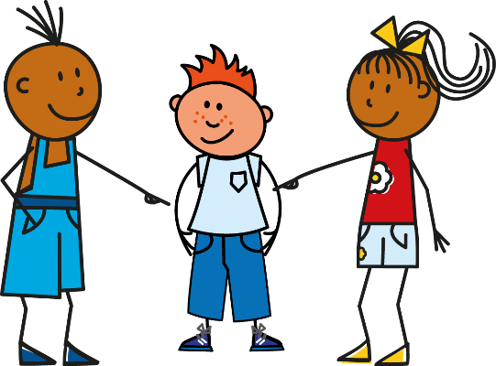
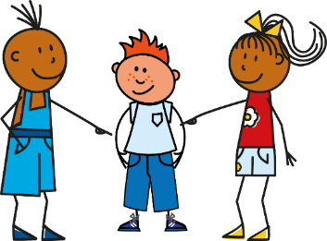
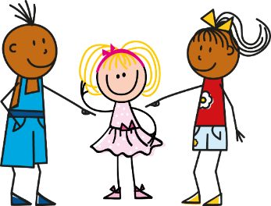
Être
[to be | being]
Complète le verbe.
être
je suis | I am
tu es | you are
il est | he is
elle est | she is
__________
__________
__________
__________
__ est
__ suis
__ es
__ est
Notes:
Timing: 2 minutes
Aim: to revisit the singular persons of être.
Procedure:
Elicit the forms from pupils, who should provide the pronoun as well.
Click to confirm the answers.
6

Slide 7



Liaison [1/2]
je suis français.
prononcer
The final -s in suis is a Silent Final Consonant.
But remember …
After être liaison is optional, but common because it makes sentences flow better.
(z)
This is called liaison.
je suis anglais.
Here the final consonant in suis is not always an SFC.
Because the -s is followed by a vowel, we can pronounce it.
Compare also:
(t)
il est français.
il est anglais.
Notes:
Timing: 2-4 minutes (two slides)
Aim: to recap optional liaison after être and before adjective or adverb complements (e.g., ici).
Procedure:
Click to present the information.
Elicit English translation for the French examples provided.
Go onto the next slide to hear some examples of sentences with and without liaison.
Note:
i) Most sources of information on liaison describe three categories: obligatory (liaison obligatoire); optional (liaison facultative) and forbidden (liaison interdite).
ii) The three main instances of obligatory liaison are:
- between determiner and noun (un enfant, les enfants, deux ours, vingt euros)
- between subject pronoun and verb (nous avons, elles aiment)
- in certain multiword units (c’est-à-dire, de temps en temps, peut-être)
iii) There are many more instances where liaison is optional. For KS2, the relevant cases are:
- between the forms of être and its complements (il est impossible, je suis anglais)
Note that liaison after tu es also falls into this category, though it is less common than other singular persons. This may be because liaison is often associated with increased formality and tu es is the familiar form of you, unlikely to occur as often in more formal oral utterances (e.g. speeches, lectures).
- between single syllable prepositions and the word that follows (sous un abre, dans un village)
- between an adverb and the word it modifies (assez intéressant, mais aussi, pas encore, plus ici, très amusant, trop heureux)
- between a verb and its complement (nous allons à Paris)
iv) Liaison is importantly NOT permitted:
- after et (and)
- after a singular noun that ends in a SFC (un sujet intéressant)
Note: there are many more instances where liaison is not permitted, but these are the only ones we will focus explicitly on at KS2.
Further sources of information:
i) https://fr.m.wikipedia.org/wiki/Liaison_en_fran%C3%A7ais
ii) https://www.etudes-litteraires.com/regles-de-liaison.php
7

Slide 8
Liaison [2/2]
So, liaison between être and adjectives is optional.
prononcer
Not liaising emphasises the adjective!
Compare:
You may hear both variations so it’s helpful to get used to hearing them.
(z)
Tu es amusante.
Tu es amusante.
(z)
Tu es intelligente.
Tu es intelligente.
(t)
Elle est heureuse.
Elle est heureuse.
(t)
Elle est importante.
Elle est importante.
Notes:
Procedure:
Click to present the examples with and without liaison.
Elicit English translation for the French examples provided.
Click to bring up the final information callout.
8

Slide 9





C’est la rentrée
La rentrée literally means re-entry or return and refers to the start of a new school year and return to work after August when not only schools but also many businesses close for summer holidays.
Notes:
Timing: 1 minute
Aim: to introduce the concept of la rentrée.
Procedure:
Click to hear the phrase ‘c’est la rentrée’.
Read the information with pupils.
A rough translation in English could be ‘Back to school’ but it is a bigger concept than this as there’s the sense that the whole country is going back to normal in September after the holiday month of August.

Slide 10

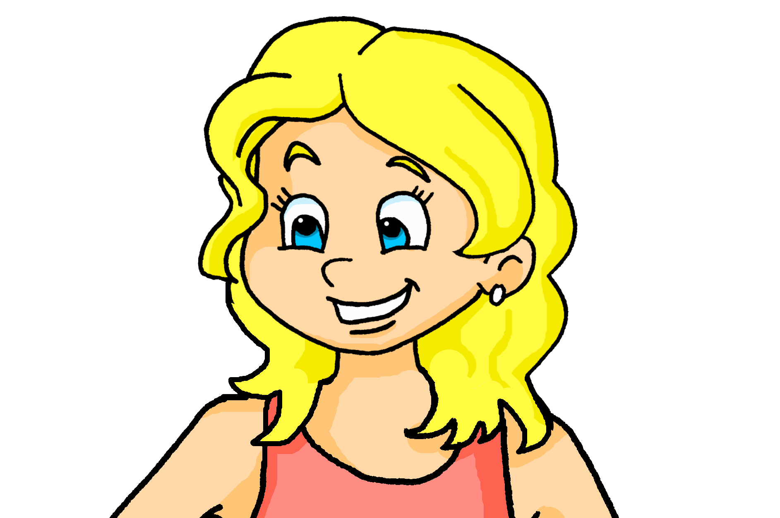



lire
Demain, c’est la rentrée.
School starts tomorrow. Adèle is messaging her friends.
Aϊe ! She keeps mistyping. Is she talking to a friend (you) or about her new teacher (she), who she saw at the shopping centre?
1
4
you
she
Elle est heureuse.
you
she
Elle est calme.


2
5
you
she
Tu es intelligente.
she
you

Tu es amusante.

3
6
she
you
Elle est importante.
she
you

Tu es sérieuse.

Prononce les phrases, avec la liaison, si c’est possible.
. Écoute les noms des animaux. C’est [ien] ou [(a)in]?
Notes:
Timing: 5 minutes
Aim: to practise written comprehension of es and est and several revisited adjectives; to practise liaison in spoken production.
Procedure:
1. Explain the task.
2. Pupils first read the six messages and write either you or she.
3. Click to reveal ticks and full sentences.
4. Ask how Adele describes her new teacher (calm, happy, important) and her friend (funny, serious, intelligent) in the messages, eliciting the adjective meanings in English.
5. Click to bring up the prompt to pronounce the phrases, making a liaison, where it is possible to do so.
6. Elicit the phrases from pupils.
7. Click to indicate where liaisons are possible.
Listen and check; click each audio button to hear the phrases pronounced by a native speaker.
Transcript:
Elle est calme.
Tu es amusante.
Tu es sérieuse.
Elle est heureuse.
Tu es intelligente.
Elle est importante.
10

Slide 11
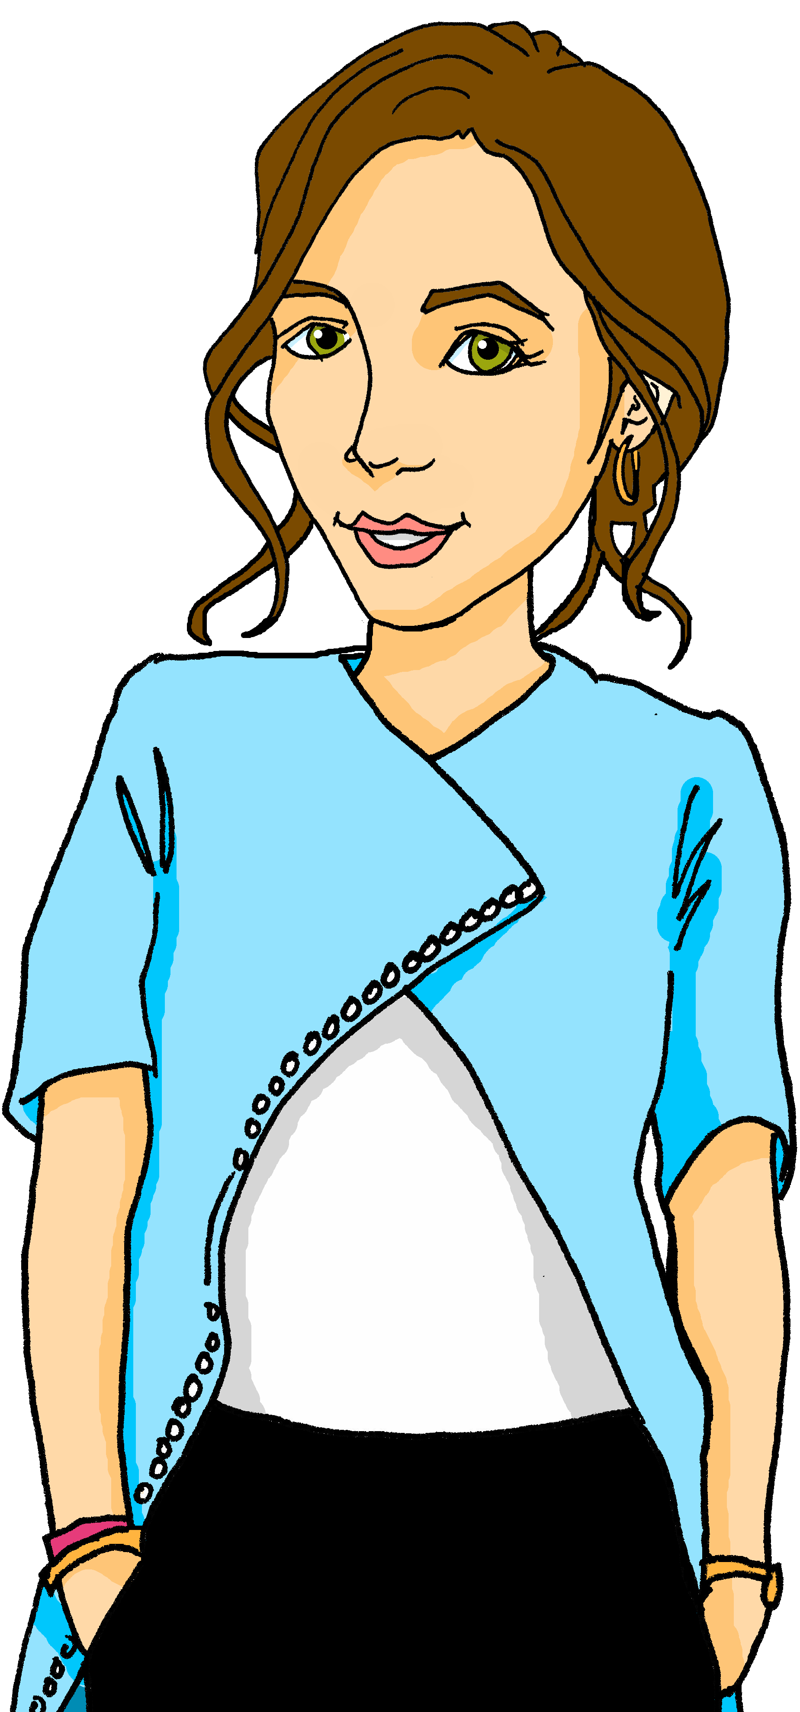



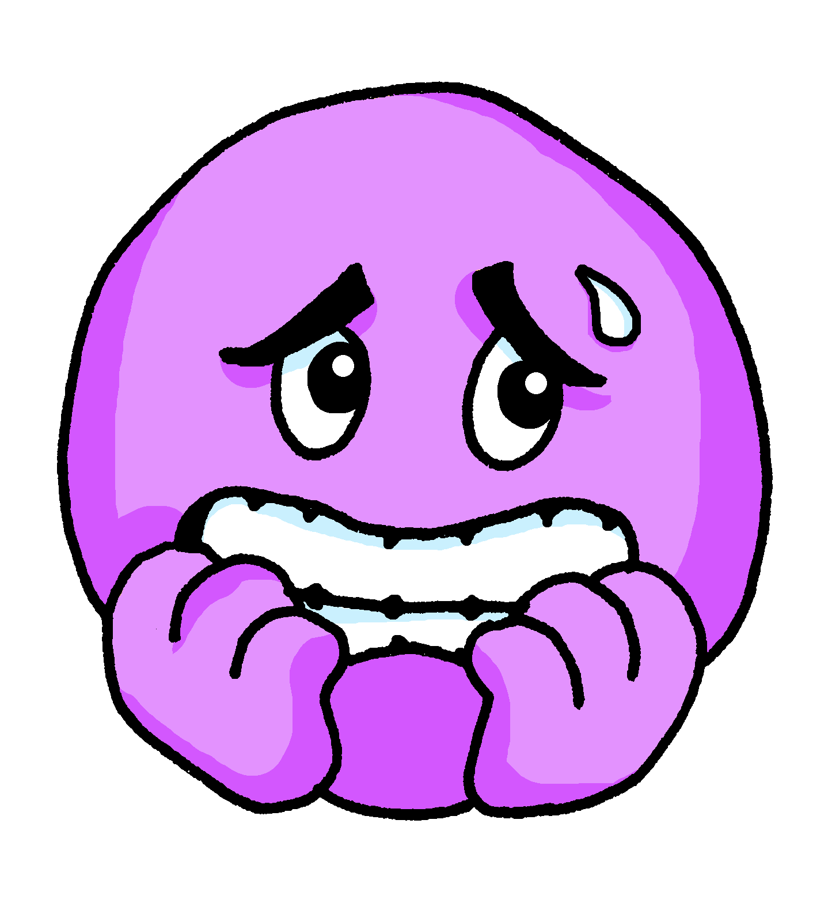







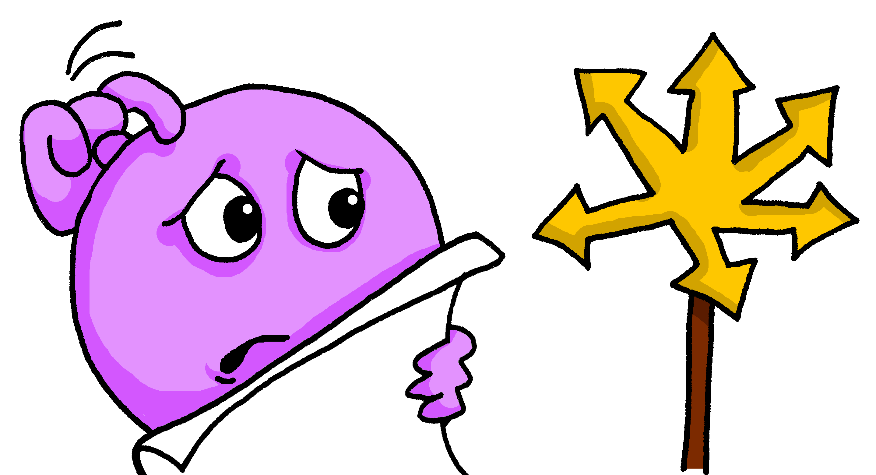

parler
Bonjour, tout le monde !
Bonjour, madame … | monsieur … !
Ça va ?
Aujourd’hui,
je suis…
calme
calme
inquiet
inquiète
[worried]
[worried]
prêt
prête
Madame Dupont
[ready]
[ready]
Oui, ça va bien. ☺
heureux
heureuse
sérieuse
Non, ça va mal. ☹
sérieux
perdu
perdue
[lost]
[lost]
Notes:
Timing: 5 minutes
Aim: to use ‘je suis’ + correct adjectival agreement in guided oral production; to present three new adjectives and revisit others; to revisit how to respond to the register.
Procedure:
Read the title – teacher’s greeting ‘hello, everyone’ and ensure it is understood.
This is the first French lesson (Y5/6) so this is a great opportunity to recap how to respond to the register in French and establish a good routine.
Click to present the adjectives and repeat with pupils. Pupils have been taught three of these words previously, but inquiet, prêt and perdu are new and the English is provided together with the emoji.
Draw pupils’ attention to the different spellings for masculine / feminine adjective forms.
Pupils work in pairs to practise their sentence (1 minute).
Teacher takes (or retakes) the register, giving all pupils the opportunity to practise spoken production. (3 minutes).
Note: pupils can be challenged to respond without referring to the board (e.g. by looking or turning away when responding).

Slide 12



prononcer
qui ?
Remember!
Put a question word at the end of a statement to make it a question.
Your voice goes up.
who?
Tu es qui ?
[Who are you?]
Rachel Hawkes / Emma Marsden
Notes:
Timing: 1 minute
Aim: to introduce the question word qui ?
Procedure:
Pupils listen and repeat the key question word (include gesture if possible).
Display the word and get them to repeat one more time.
Elicit English meaning.
Reveal the sentence.
Click for callout and arrow to remind pupils how to form intonation questions + WH-words.
Gesture: point at yourself and away at an imaginary other (repeating the action several times as you say the word).

Slide 13

comment ?
prononcer
Remember!
To ask
‘How are you today?’
use
‘Ça va comment ?’
how?
Tu es comment ?
[How are you?]
meaning: What are you like?
Rachel Hawkes / Emma Marsden
Notes:
Timing: 1 minute
Aim: To revisit ‘comment’
Procedure:
Pupils listen and repeat the key question word (include gesture if possible).
Display the word and get them to repeat one more time.
Elicit English meaning – insist on “in general” and tell pupils that this is usually translated in English as ‘What are you like?’
Reveal the sentence.
Click for callout to remind pupils of the difference between tu es comment and ça va comment.

Slide 14

écouter
Écoute. Madame Dupont is meeting her new class.
Is she asking who they are or how they are generally (what they are like)?
Qui ou comment ? Write the question word in French and the answer in English.
Who? | How? | Réponse en anglais.
When there is a proper noun, there is never a liaison. (This way, the proper noun is clearly pronounced)
Tu es comment ?
Je suis intelligente.
1
I (a girl) am intelligent.
2
Tu es comment ?
I (a boy) am serious.
3
Tu es qui ?
I’m Lucas.
Madame Dupont
4
Tu es qui ?
I’m Adèle.
Prononce les phrases encore, avec la liaison si c’est possible.
5
Tu es comment ?
I am very calm.
6
Tu es qui ?
I’m Odile.
Notes:
Timing: 5 minutes
Aim: to practise aural comprehension of je suis + name versus je suis + adjective to indicate the missing question word; to practise written production of two question words.
Note: to remove the written support for Qui ? and comment ? during the task, click on the instruction before listening (or at any time during the task) to make it disappear.
Procedure:
Do number 1 as an example with pupils.
Pupils write 1-5.
Click to listen. Pupils write the missing question word in French and the answer in English.
Listen twice, as necessary.
Click to reveal answers.
Transcript
1. Tu es [comment] ? | Je suis intelligente.
2. Tu es [comment] ? | Je suis sérieux.
3. Tu es [qui] ? | Je suis Lucas.
4. Tu es [qui] ? | Je suis Adèle.
5. Tu es [comment] ? | Je suis très calme.
6. Tu es [qui] ? | Je suis Odile.
14

Slide 15


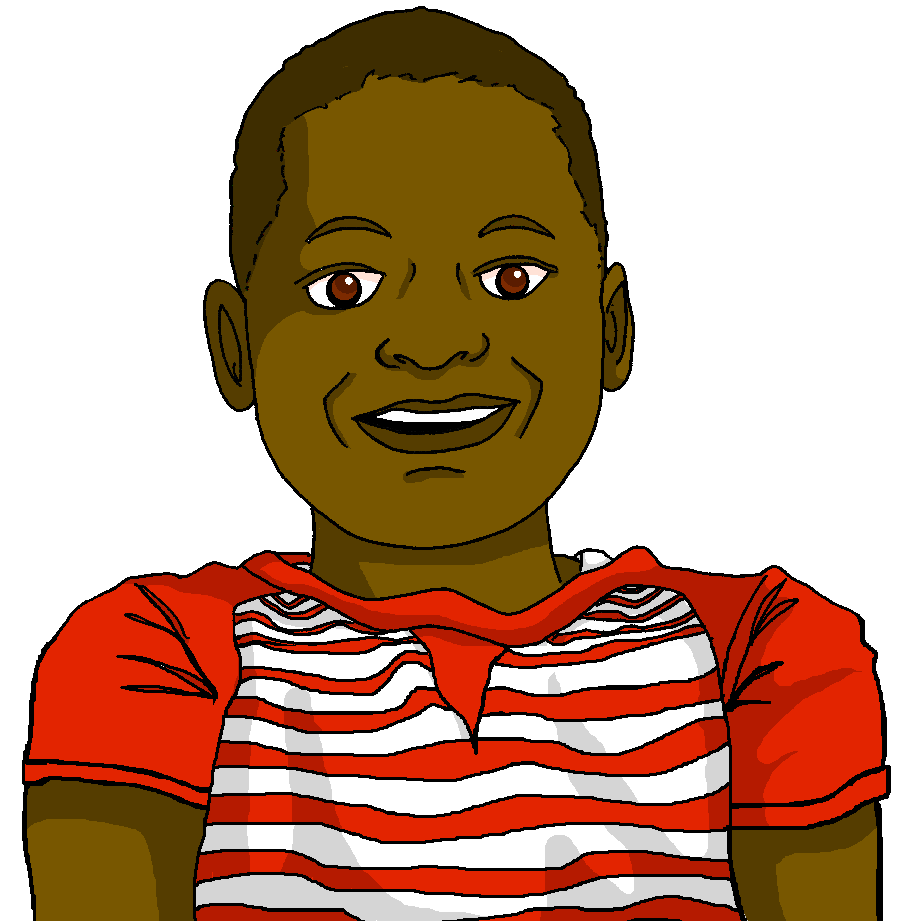
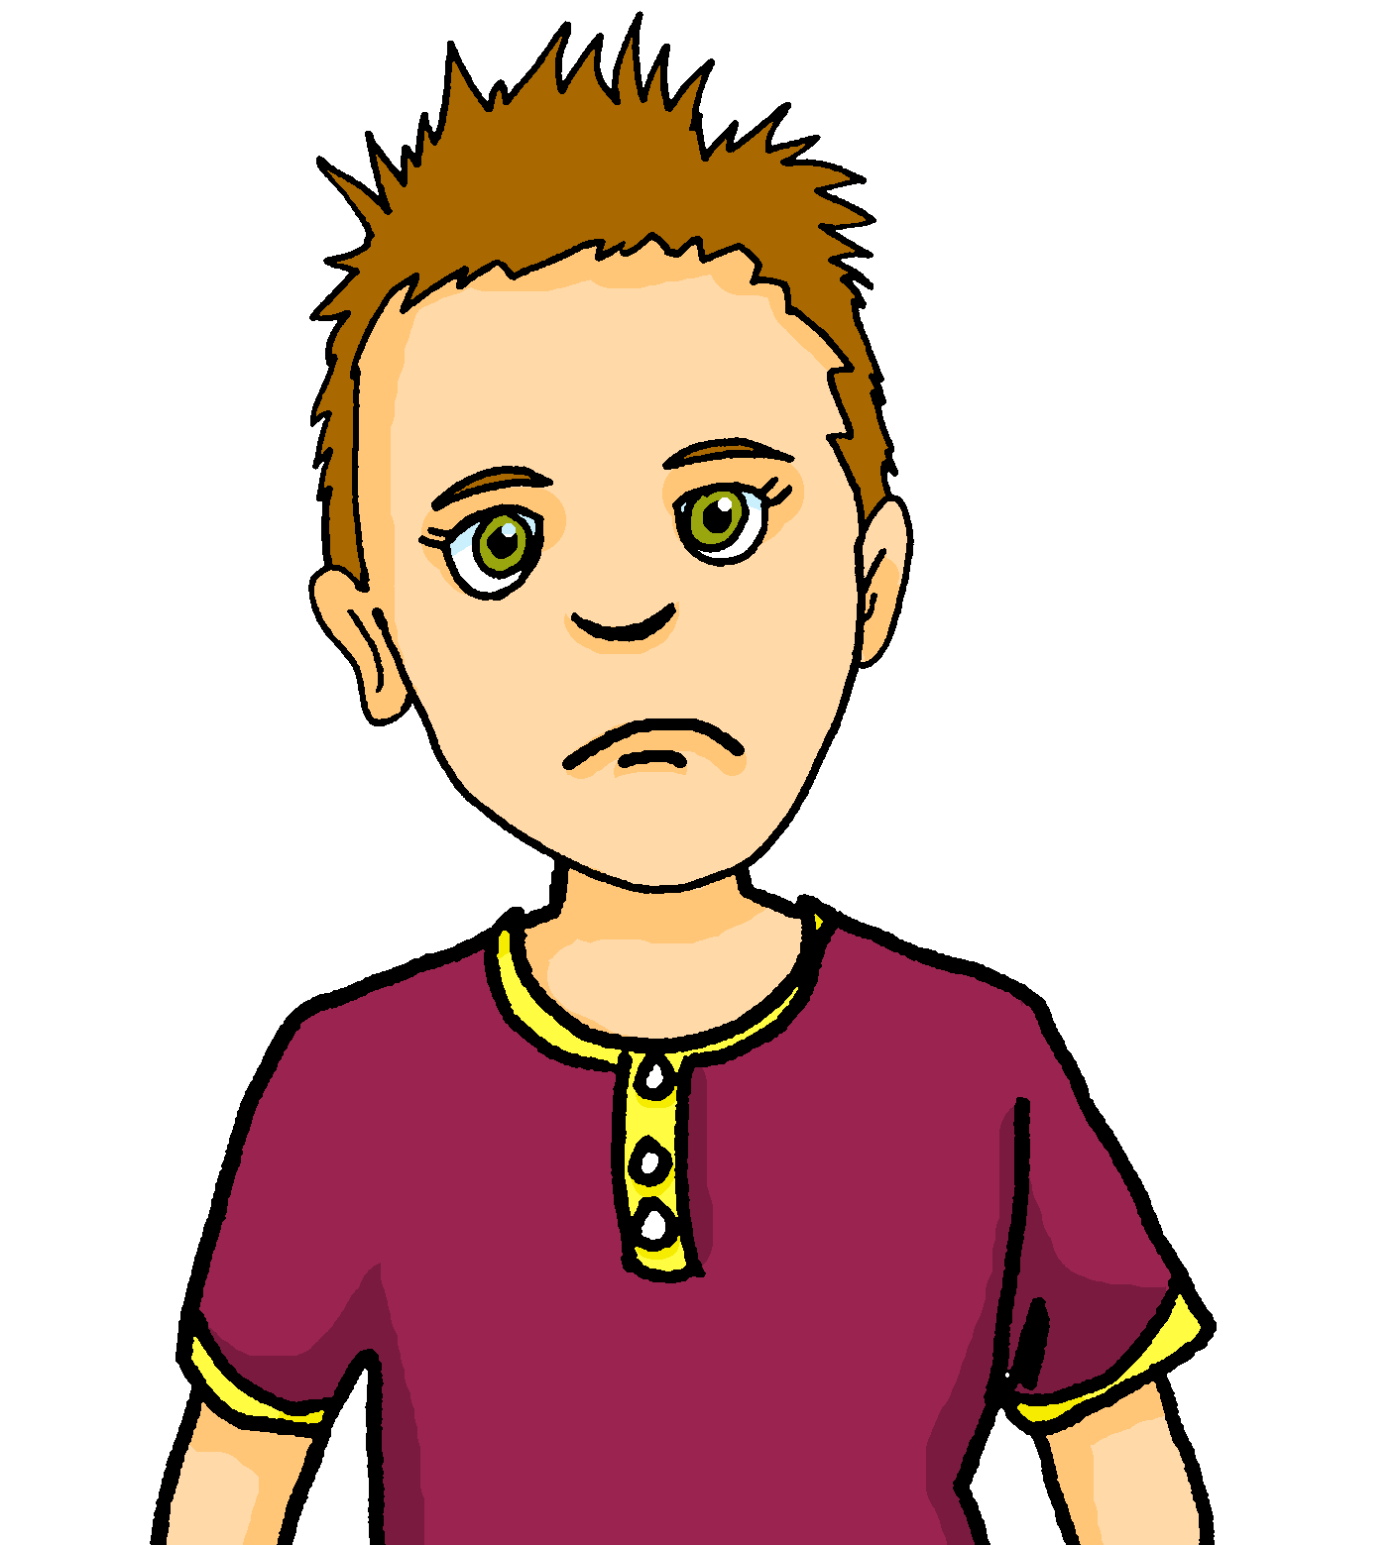

vocabulaire
Comment dit-on ça en anglais ?
Pierre a un problème avec les devoirs d’anglais.
Il a des questions pour Jean-Michel.
mots
Écris les mots en anglais de 1 à 8.
. Écoute les noms des animaux. C’est [ien] ou [(a)in]?
 | en français ? | en anglais ?
 | amusant | funny (m)
 | importante | important (f)
 | sérieuse | serious (f)
 | perdu | lost (m)
 | inquiet | worried (m)
 | heureux | happy (m)
 | intelligente | intelligent (f)
 | prêt | ready (m)
1
2
3
4
5
6
7
8
Notes:
Timing: 3 minutes
Aim: aural recall of eight of this week’s revisited words, presented in the comment dit-on… phrase
Procedure:
Click on the numbers to hear questions in French.
Pupils write or say the English translations.
On a click, a transcription of the French word appears. Pupils check their answers.
Note: perdu is only recognisable as (m) once pupils see the written form so when they listened, they should have written (m/f).
On a second click, the answer is revealed.
Transcript:
Comment dit-on « amusant » en anglais ?
Comment dit-on « importante » en anglais ?
Comment dit-on « sérieuse » en anglais ?
Comment dit-on « perdu » en anglais ?
Comment dit-on « inquiet » en anglais ?
Comment dit-on « heureux » en anglais ?
Comment dit-on « intelligente » en anglais ?
Comment dit-on « prêt » en anglais ?
15

Slide 16
Au revoir !
bleu
Notes:
16

