Slide 1
Describing me and others
la rentrée
Back to school
bleu
Follow ups 1-5
Term 1 Week 1
Notes:
Artwork by Steve Clarke. Pronoun pictures from NCELP (www.ncelp.org). All additional pictures selected from Pixabay and are available under a Creative Commons license, no attribution required.
Phonics: petit [138] mais [30] grand [59] deux [41]
Vocabulary (new words in bold): être [5] suis, est, es [5] je [22] tu [112] il [13] elle [38] qui ? [14] ami(e) [467] école [477 ] monsieur [79] madame [294] professeur(e) [110] anglais [784] français [251] calme [1731] amusant [4695] heureux [764] important [215] inquiet [1392] intelligent [2509] perdu [2264] prêt [422] sérieux [412] bien [47] mal [277] comment ? [234] Salut ! [2205] Ça va ? [54/53] Oui [284] Non [75] Bonjour ! [1972] Au revoir [4/1274]
Revisit 1: chanter [1820] écouter [429] regarder [425] chercher [336] parler [106] passer [90] rester [100] Revisit 2: elle² [38] il² [13] professeur, professeure [110] sympathique [4164] comment [234]
Londsale, D., & Le Bras, Y. (2009). A Frequency Dictionary of French: Core vocabulary for learners London: Routledge.
The frequency rankings for words that occur in this PowerPoint which have been previously introduced in these resources are given in the SOW and in the resources that first introduced and formally re-visited those words.
For any other words that occur incidentally in this PowerPoint, frequency rankings will be provided in the notes field wherever possible.

Slide 2
Follow up 1:
[SFC]
[SFe]
You know that final consonants are often silent in French.
However, a final ‘e’ makes us pronounce the final consonant.
The SFe (Silent Final ‘e’) means that we pronounce the ‘s’.
français
française
Notes:
Timing: 1 minute
Aim: to recap knowledge of SFC and Sfe.
Procedure:
Click to present the information.
Elicit the pronunciation of the words from pupils.

Slide 3
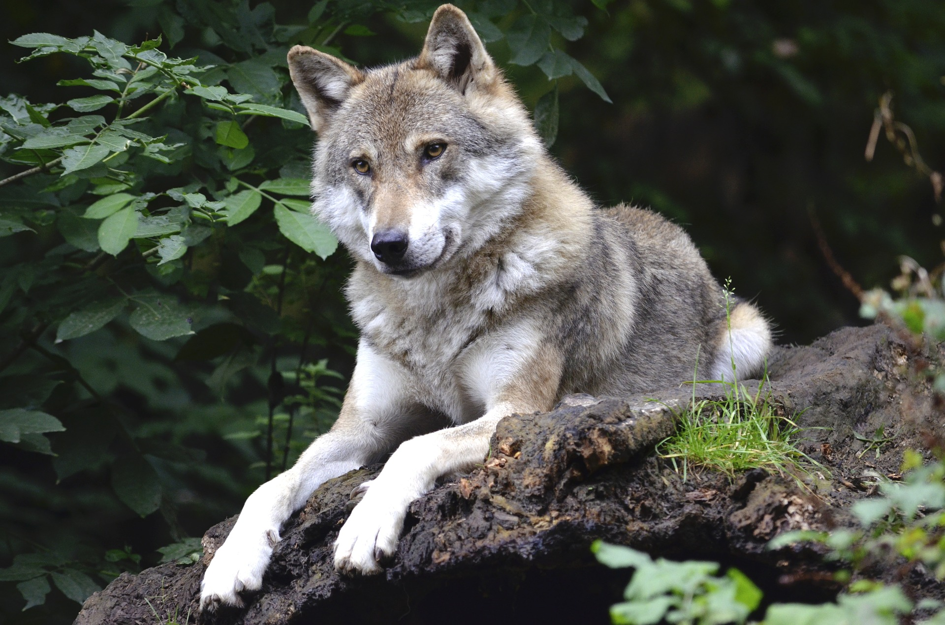
Follow up 1: [1/9]
[SFC]
[SFe]
écouter
loup
Notes:
Timing: 4 minutes (9 slides)
Aim: to practise aural recognition of SFC and SFe in unknown words.
[1/9]
Procedure:
Click on the word to hear it.
Pupils respond SFC or SFe, depending on whether they hear the final consonant pronounced.
Click on the rectangle shape to reveal the spelling of the word, with or without ‘e’ as the final letter.
Repeat for items 2-9.
Frequency of unknown vocabulary or cognates: âne [>5000] canard [>5000] fouine [>5000] loup [3927] pengouin [>5000] perroquet [>5000] renard [>5000] singe [4739] taupe [>5000] Londsale, D., & Le Bras, Y. (2009). A Frequency Dictionary of French: Core vocabulary for learners London: Routledge.

Slide 4
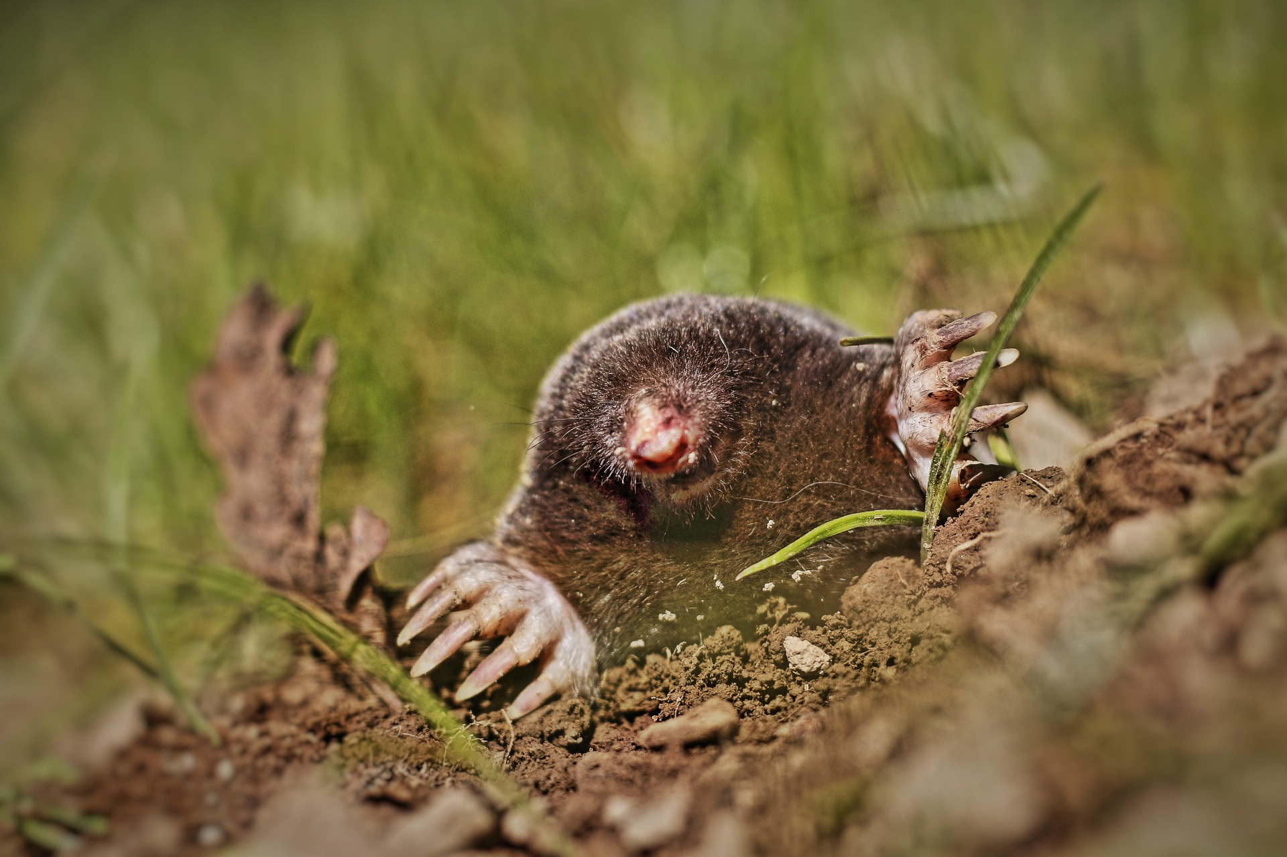
Follow up 1: [2/9]
[SFC]
[SFe]
écouter
taupe
Notes:
[2/9]

Slide 5
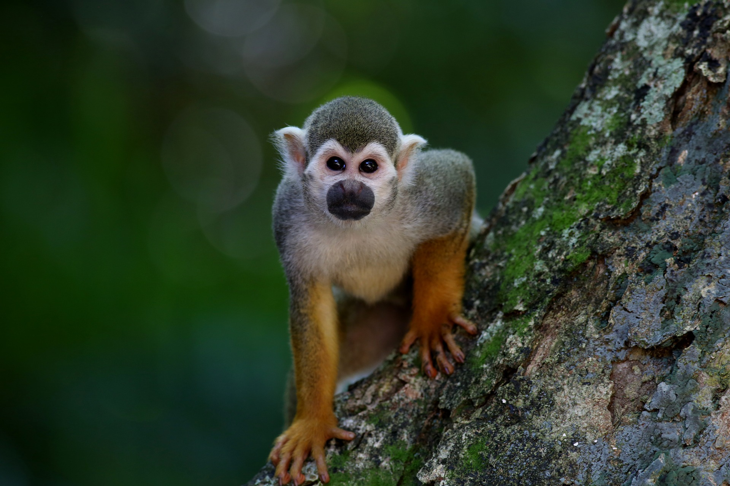
Follow up 1: [3/9]
[SFC]
[SFe]
écouter
singe
Notes:
[3/9]

Slide 6
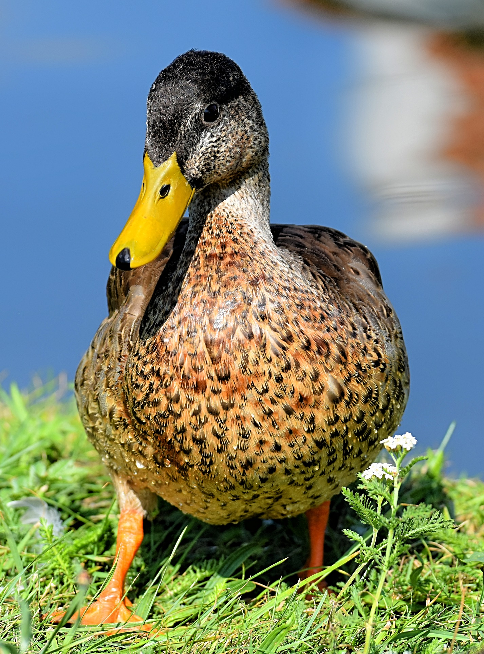
Follow up 1: [4/9]
[SFC]
[SFe]
écouter
canard
Notes:
[4/9]

Slide 7
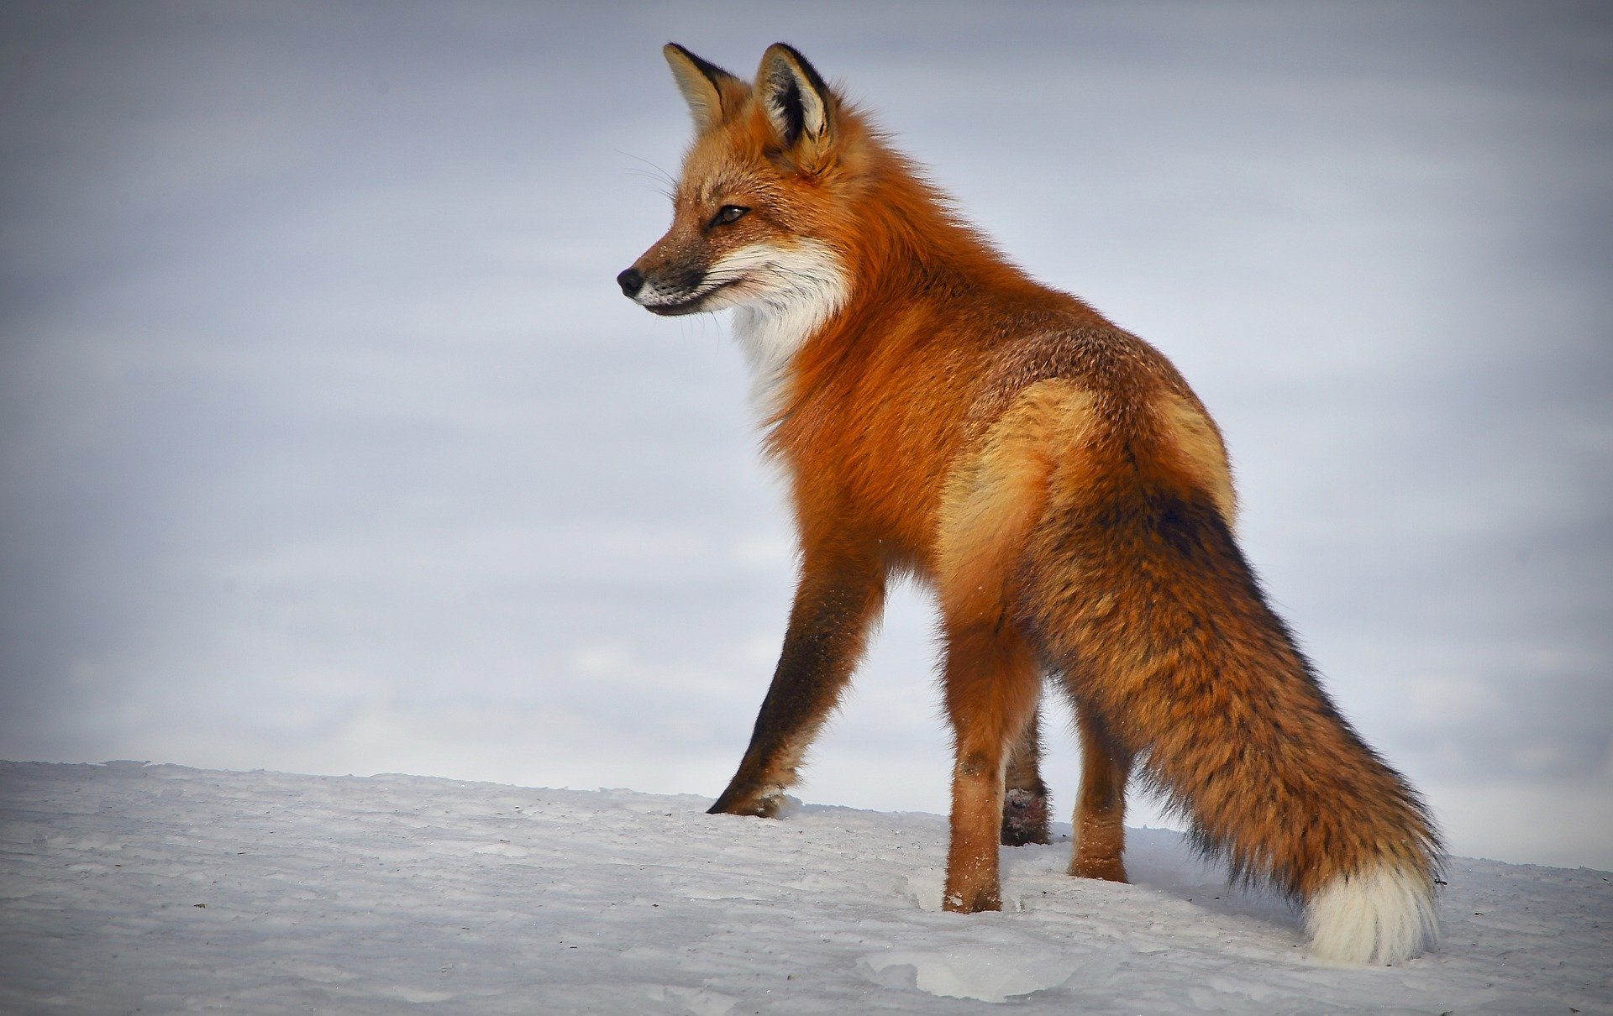
Follow up 1: [5/9]
[SFC]
[SFe]
écouter
renard
Notes:
[5/9]

Slide 8
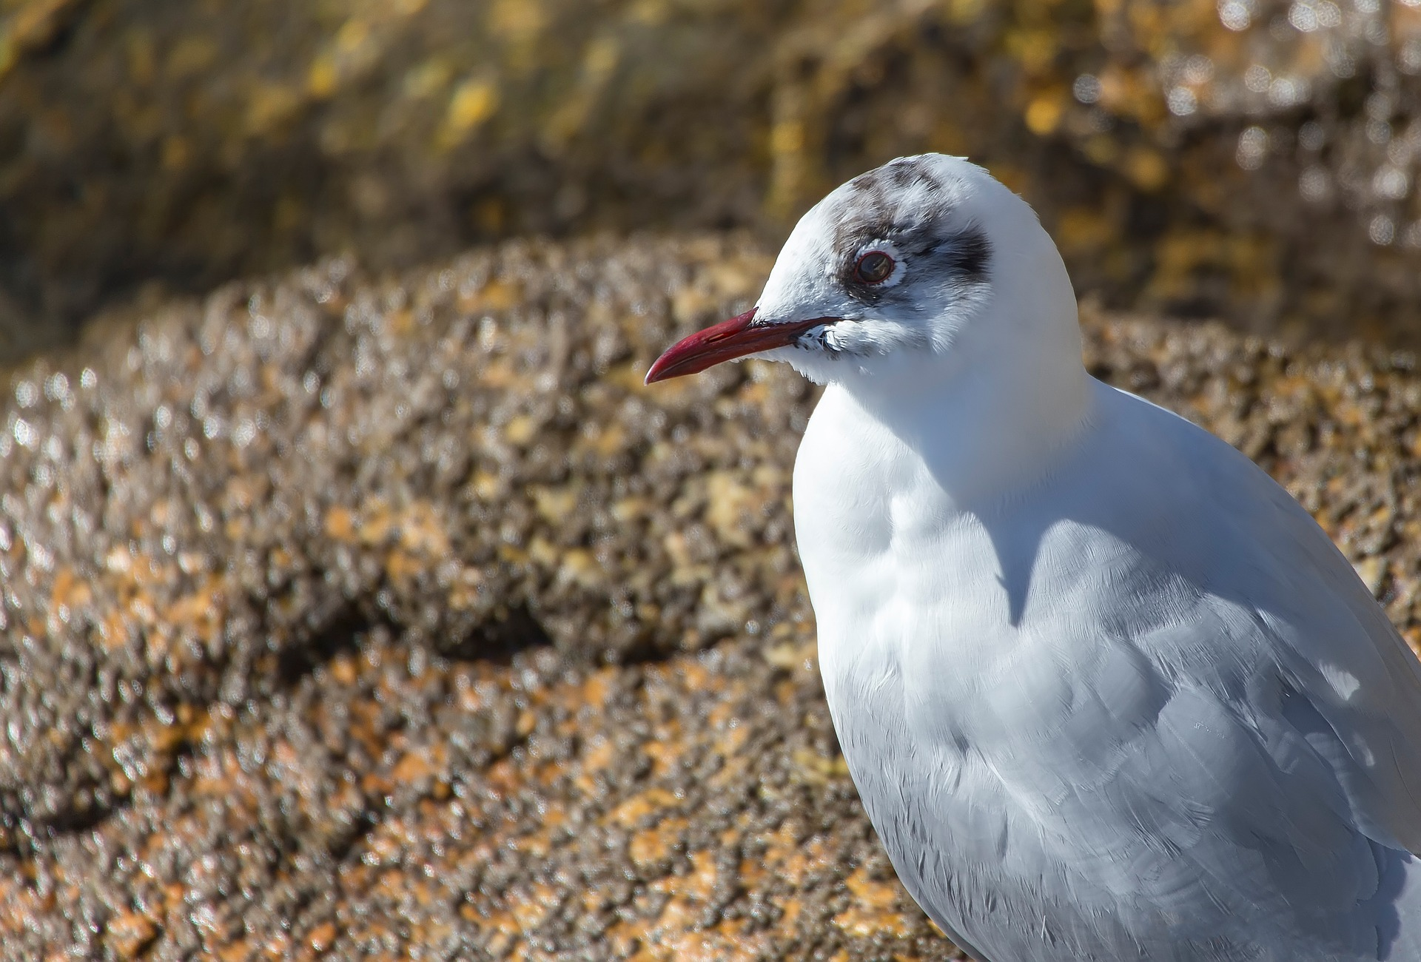
Follow up 1: [6/9]
[SFC]
[SFe]
écouter
pingouin = auk manchot = penguin
pingouin
Notes:
[6/9]
Note: pingouin is a faux ami and means auk (a sea bird) in English. The French for penguin is manchot. Click on the penguin picture to hear the word manchot.

Slide 9
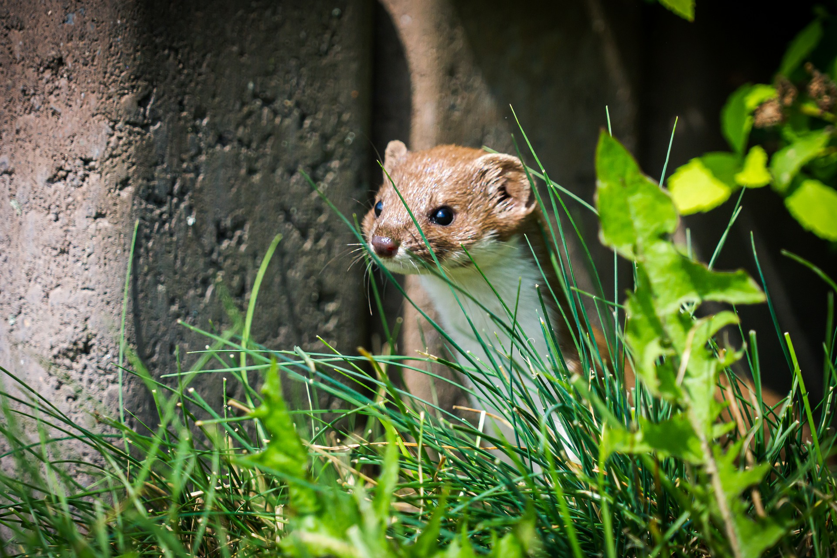
Follow up 1: [7/9]
[SFC]
[SFe]
écouter
fouine
Notes:
[7/9]
Note: fouine = weasel.

Slide 10
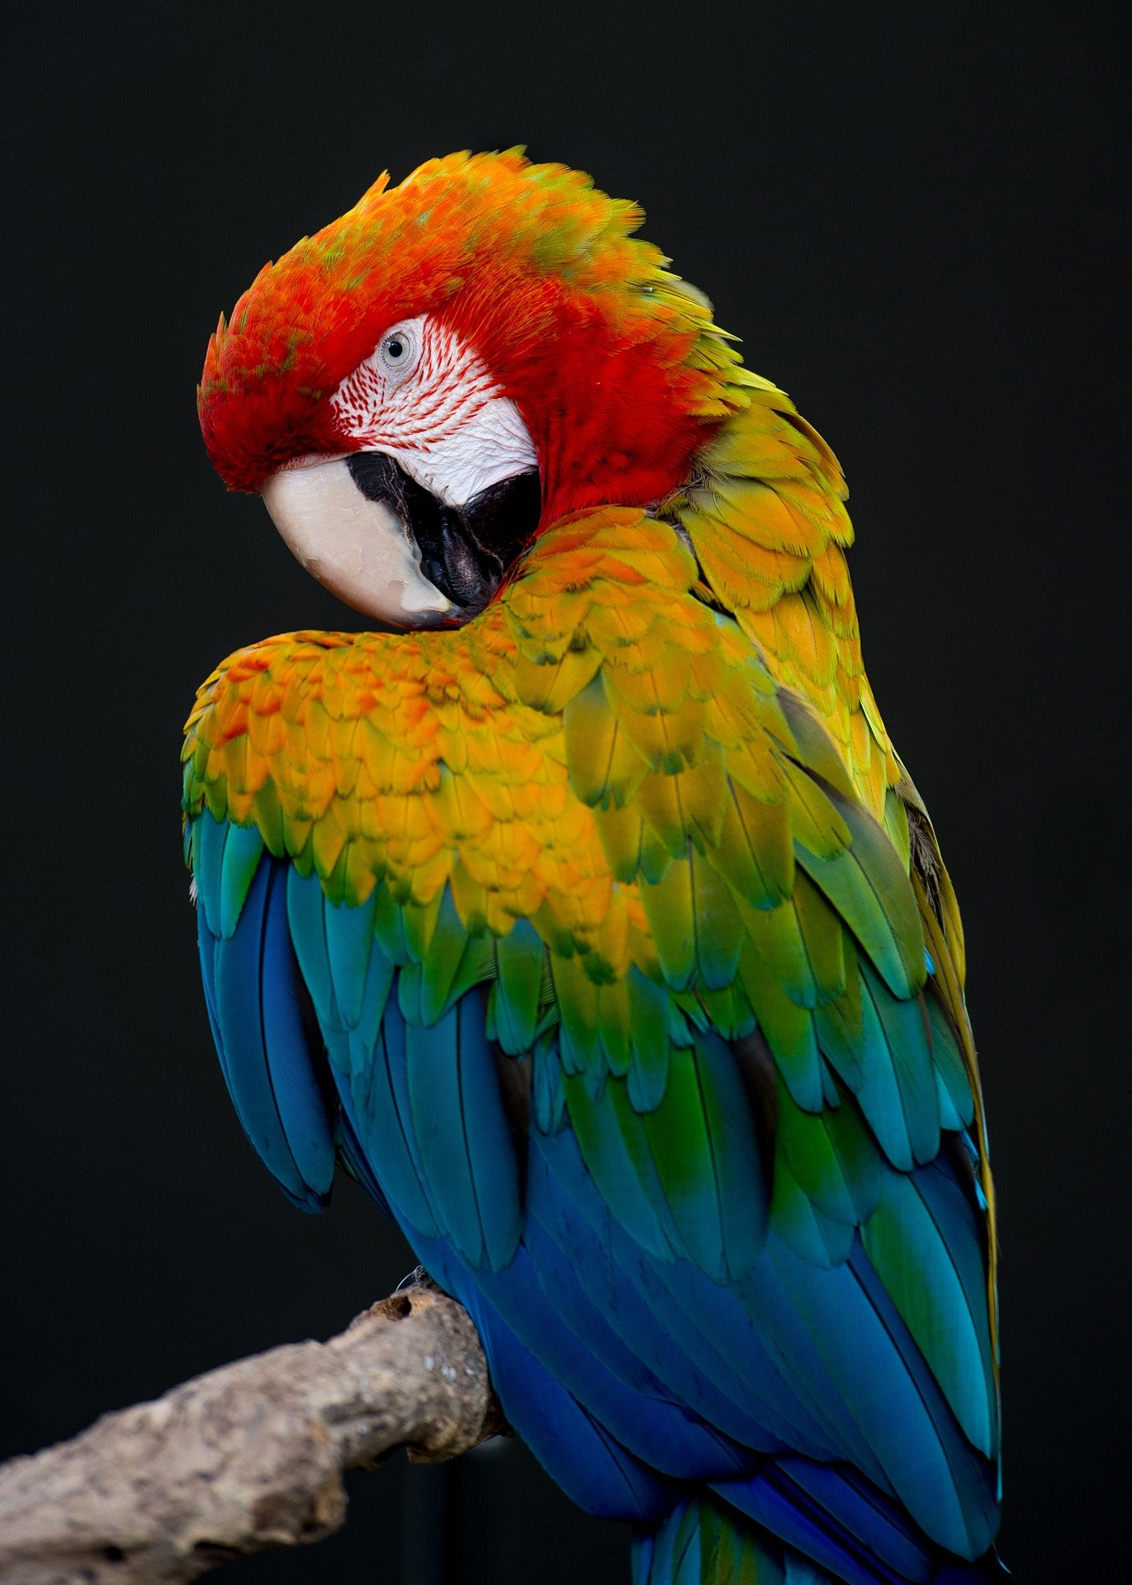
Follow up 1: [8/9]
[SFC]
[SFe]
écouter
perroquet
Notes:
[8/9]

Slide 11
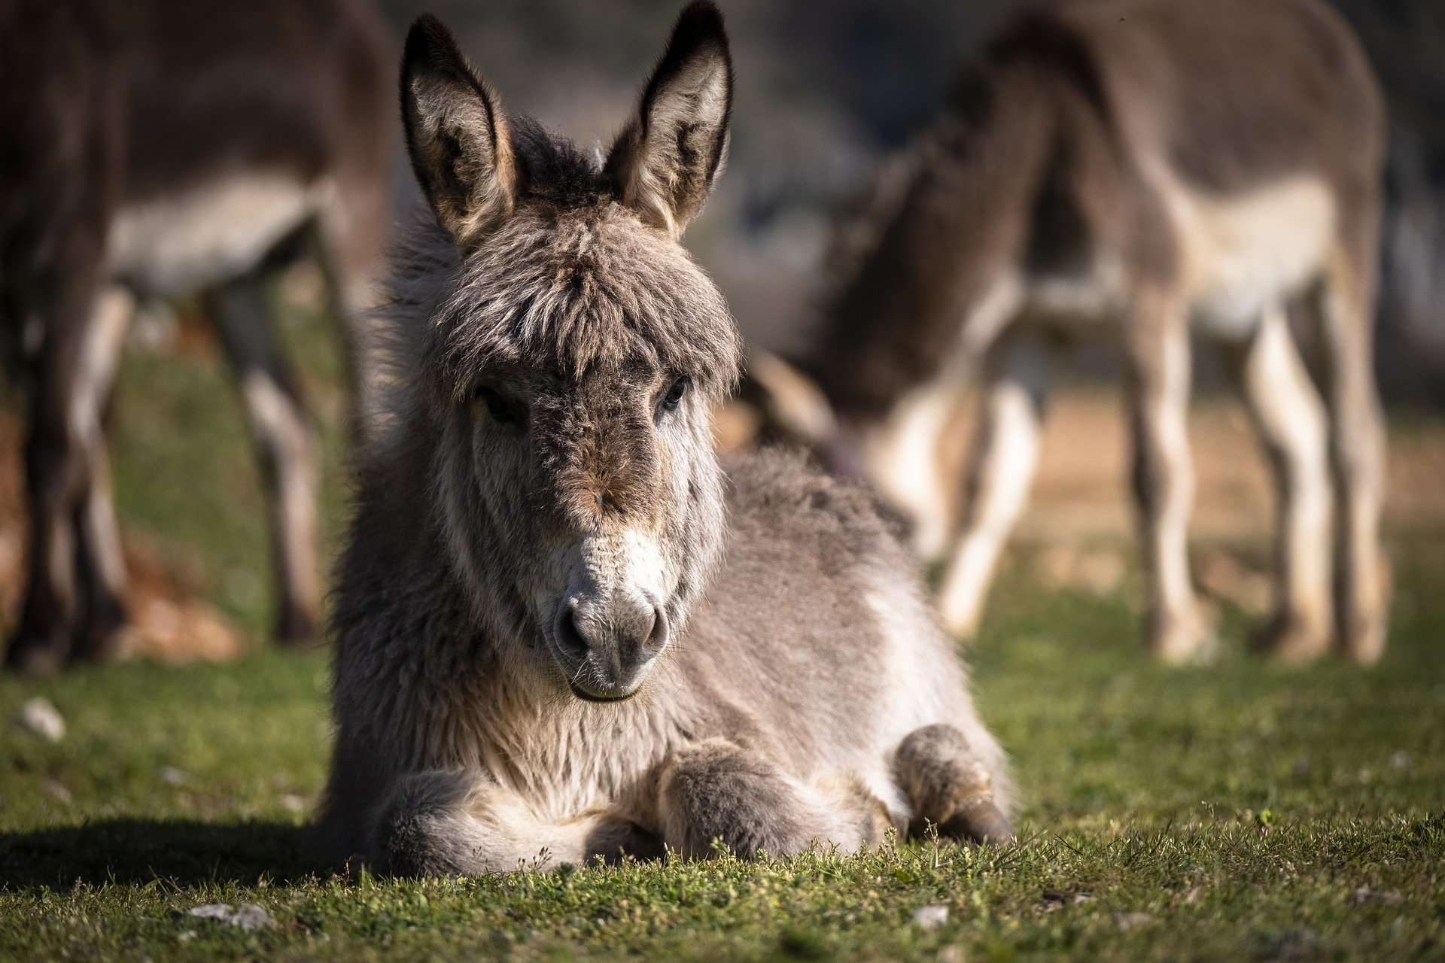
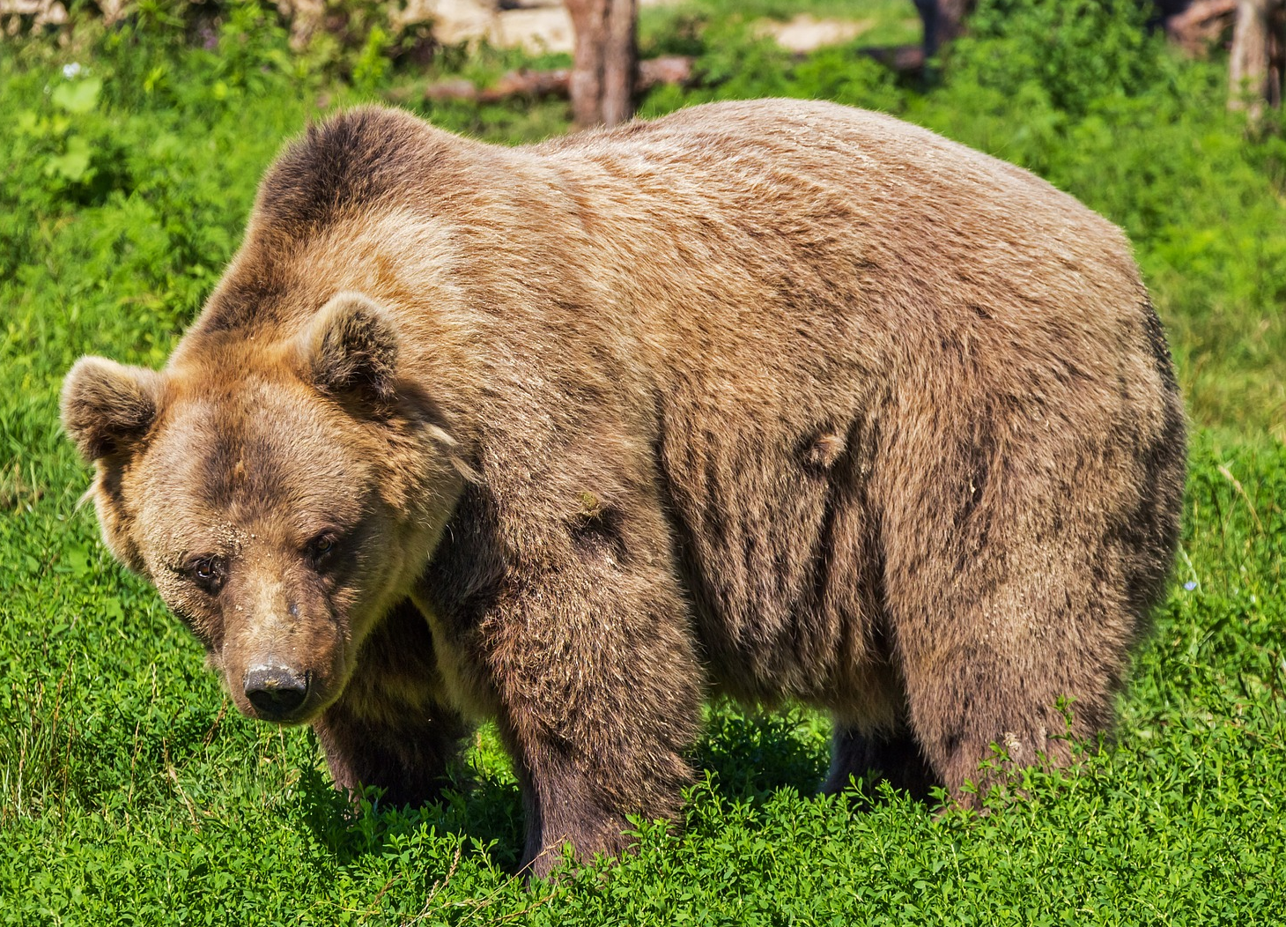
Follow up 1: [9/9]
[SFC]
[SFe]
écouter
There are some exceptions to SFC. un ours = a bear You do pronounce the ‘s’!
âne
Notes:
[9/9] Click on the picture of the bear to hear the word ours.

Slide 12
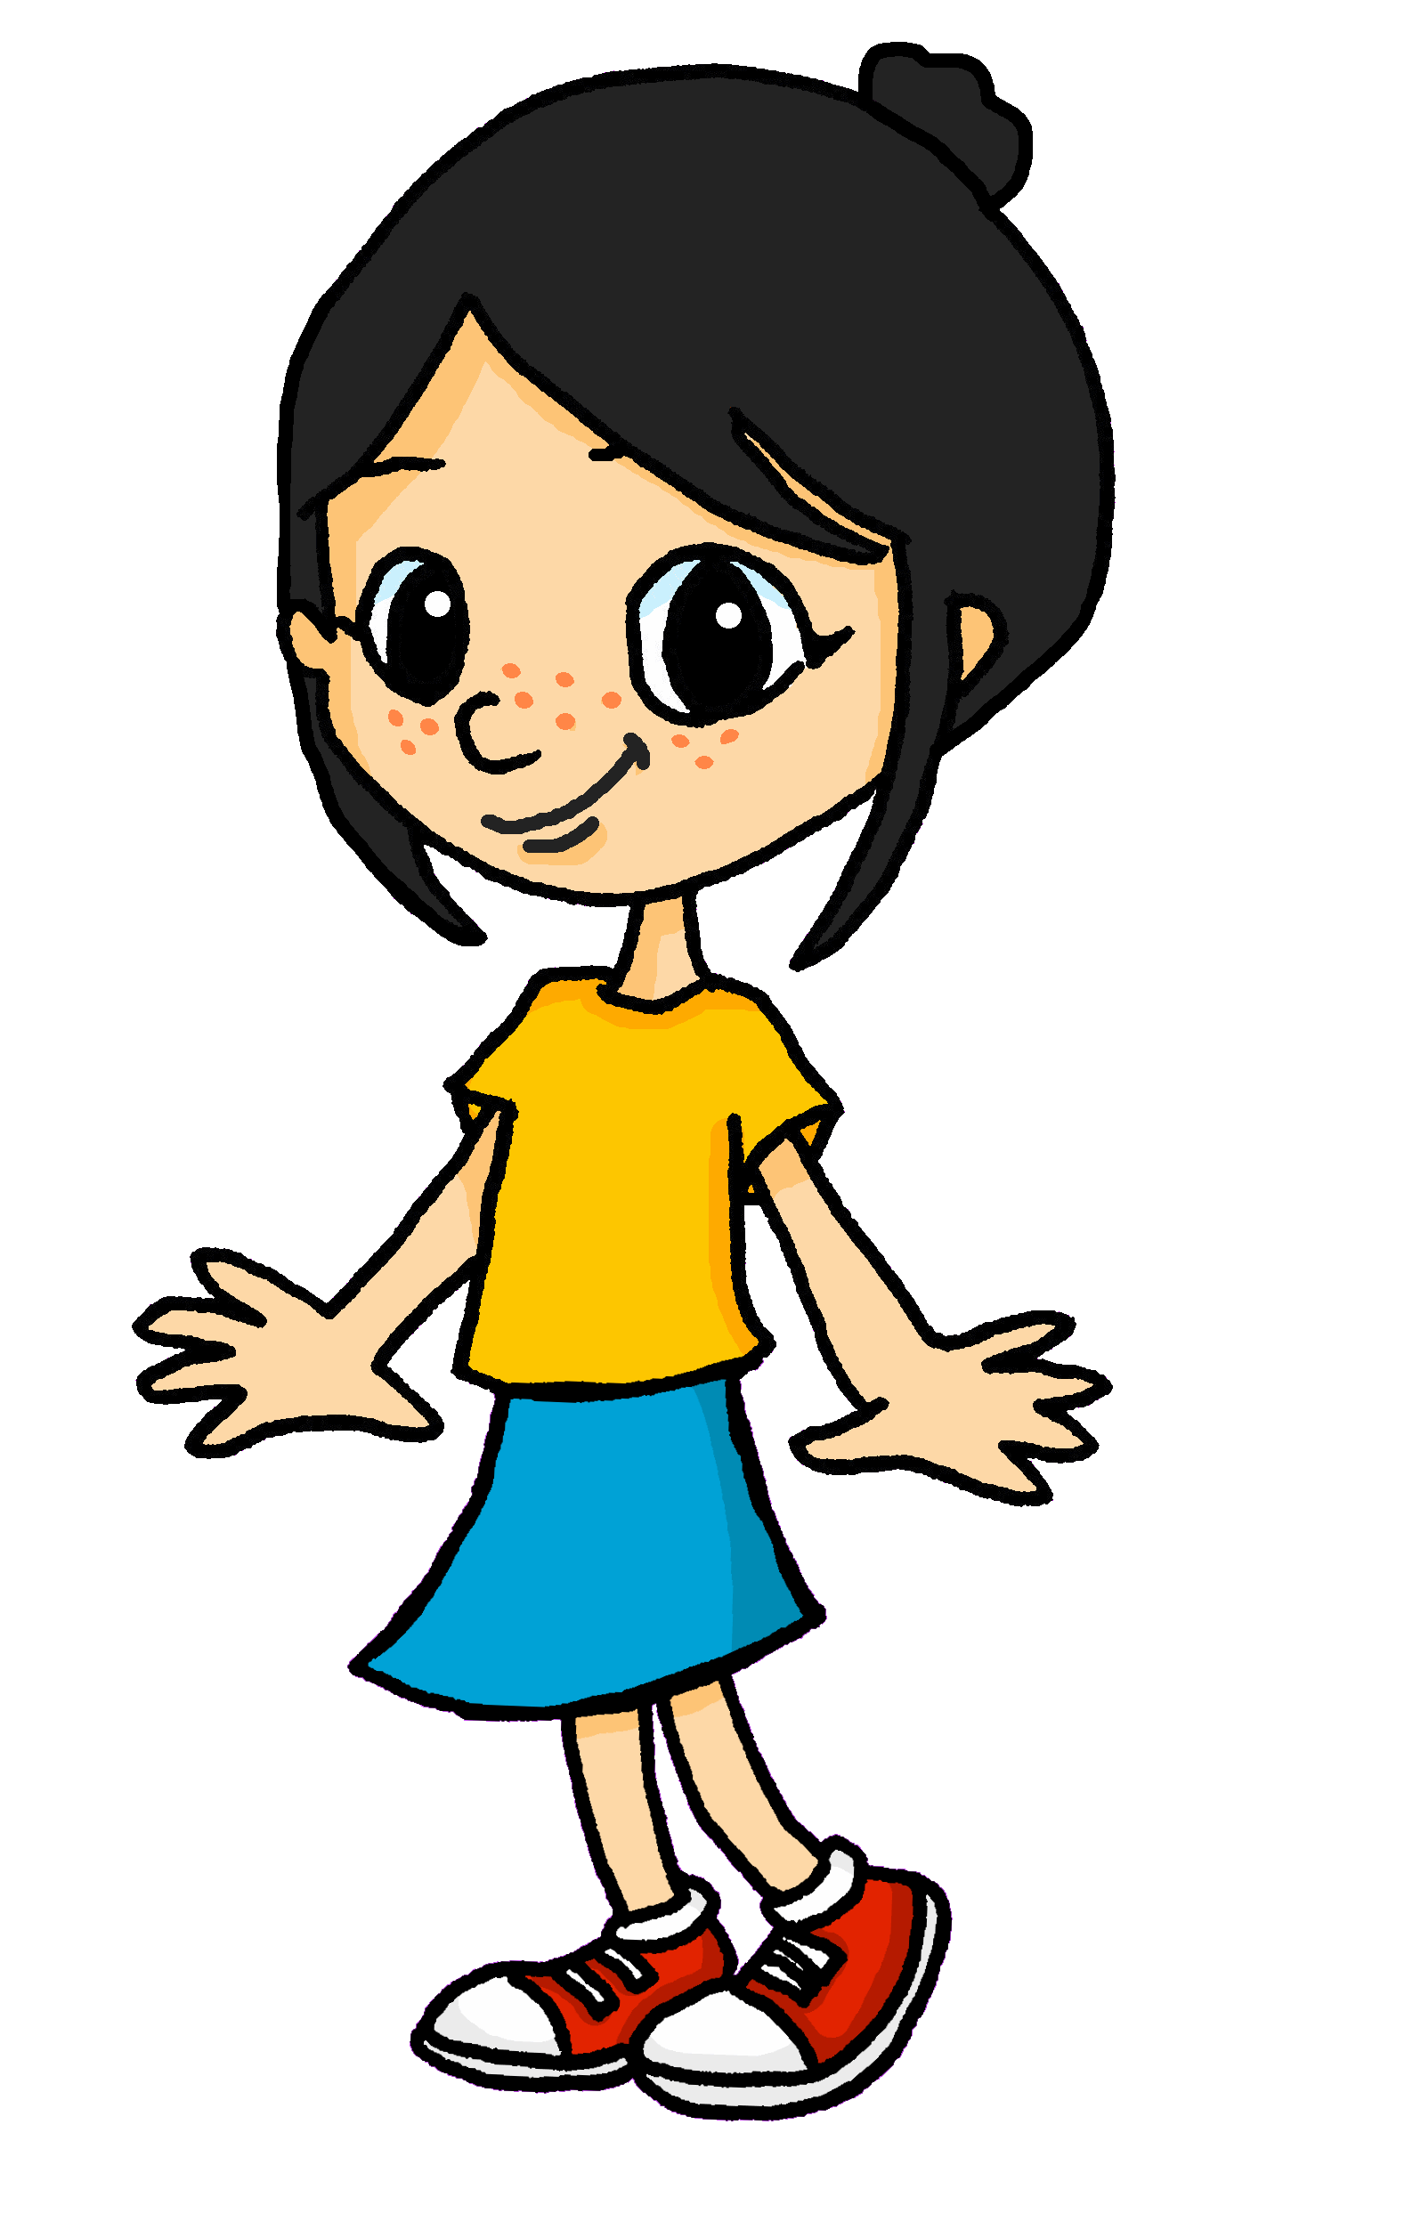
Follow up 2:
Lis le texte et écris les mots en anglais.
Eugénie est inquiète. Demain, elle commence l’école.
Léa a une histoire pour sa sœur.
lire
Soura the mouse is spending her first day at school. She feels alone, lost and
very worried. She looks for a friend.
C‘est le premier jour à l‘école pour Soura la souris.
______
______
Oh ! Je suis seule. Je suis perdue. Je suis très inquiète. Je cherche un ami ou une amie.
_____,
______
______
______
______
______.
Notes:
Timing: 10 minutes (seven slides)
Aim: to practise written comprehension of 26 previously taught words in a longer context.
Procedure:
Ensure pupils understand the task. They need to write the missing words from the right hand pages in English.
Click to reveal the answers.
Continue through the next five slides.

Slide 13
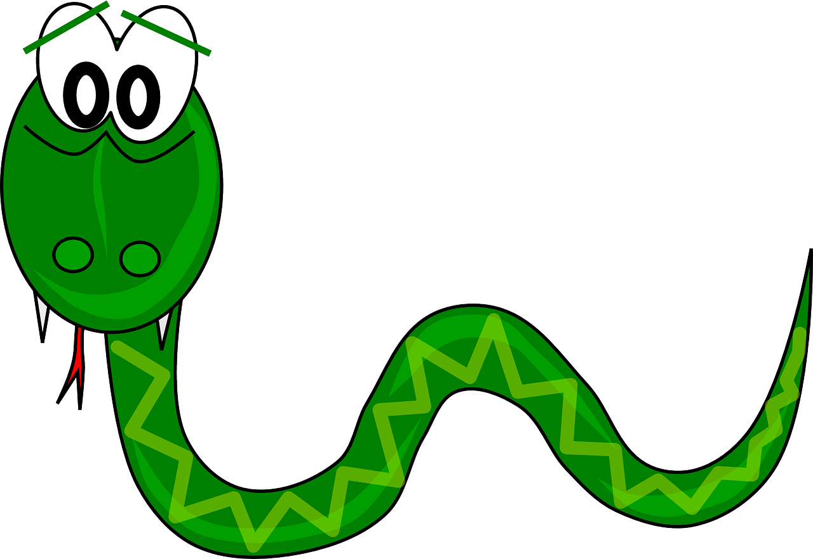
lire
Lis le texte et écris les mots en anglais.
« Salut ! Je suis Laurent » dit un serpent.
A snake says Hi! Soura says he is really different.
______
______
« Tu es bien différent » dit Soura.
______
Notes:
[2/6]

Slide 14
lire
Lis le texte et écris les mots en anglais.
« Salut, Soura ! Je suis Lulu » dit une tortue.
A tortoise called Lulu asks Soura if she is lost.
______
Tu es perdue ?
______.
Notes:
[3/6]

Slide 15
lire
Lis le texte et écris les mots en anglais.
lire
« Bonjour ! Je suis Chantal » dit un cheval.
A horse called Chantal says ‚hello!‘ and asks Soura if things are going badly.
______
______
Ça va mal ?
______
Notes:
[4/6]

Slide 16
lire
Lis le texte et écris les mots en anglais.
Soura meets an elephant. She says he is slow but intelligent.
« Salut ! Je suis Roman » dit un élephant.
______
______
______
Oh ! Tu es lent mais intelligent.
______
Notes:
[5/6]

Slide 17
lire
Lis le texte et écris les mots en anglais.
Soura looks at her friends.
She is happy. She listens to the teacher.
She is ready for school.
Je regarde mes amis. Je suis heureuse. J’écoute la professeure. Je suis prête pour l’école.
______
______
______
______
______
_____
______
Notes:
[6/6]

Slide 18
lire
Lis le texte en français et en anglais.
Eugénie wants to hear the whole story again. Can you read it aloud for her?
parler
Soura la souris passe le premier jour à l’école. « Oh ! Je suis seule. Je suis perdue. Je suis très inquiète. Je cherche un ami ou une amie. » « Salut ! Je suis Laurent » dit un serpent.
« Tu es bien différent » dit Soura.
« Salut, Soura ! Je suis Lulu » dit une tortue.
« Tu es perdue ? »
« Bonjour ! Je suis Chantal » dit un cheval.
« Ça va mal ? »
« Salut ! Je suis Roman » dit un élephant. « Oh ! Tu es lent mais intelligent. »
« Je regarde mes amis. Je suis heureuse. J’écoute la professeure. Je suis prête pour l’école. »
Notes:
Procedure:
In pairs pupils practise reading a line aloud for their partner, who translates into English.
They swap roles each line.
Teacher clicks the audio player. Pupils join in with the storyteller, reading the story aloud, chorally.

Slide 19
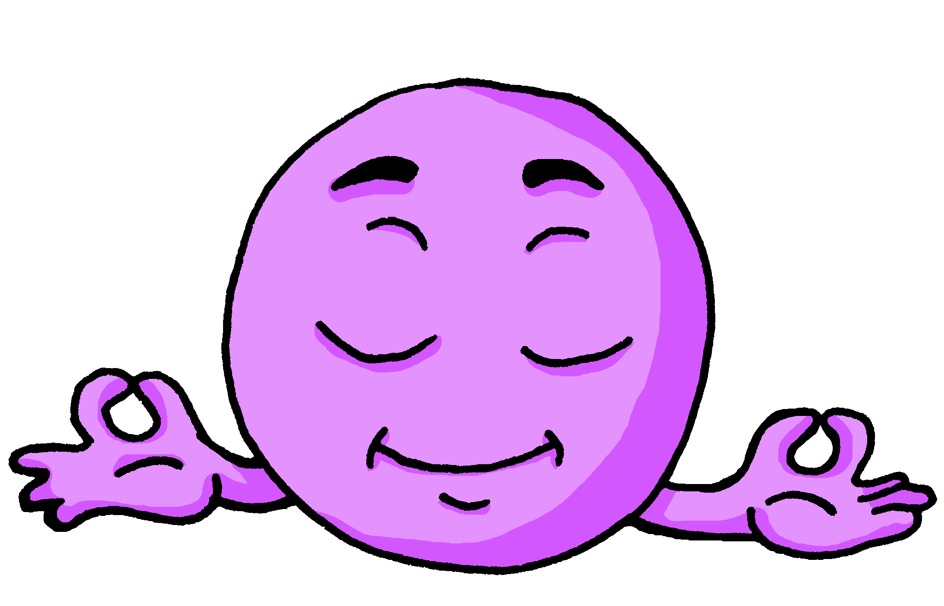
Follow up 3:
Écoute. Écris la bonne lettre.
.
Écris aussi les mots en français et en anglais.
écouter
Qui ? | A | B | en anglais ?
I | amusant | grand | tall
he | important | français | important
she | heureuse | perdue | lost
you | anglais | calme | calm
I | prêt | amusant | funny
she | anglaise | française | English
1
1
2
2
3
3
4
4
5
5
6
6
Notes:
Timing: 5 minutes
Aim: to detect the presence or absence of a t- or s-liaison with parts of être, and connect this with meaning.
Procedure:
Pupils write 1-6. Do the first one as an example, all the way through and click to correct all the elements.
It may be helpful to give pupils a few minutes to recall the adjectives represented by the emojis. Pupils might benefit from writing them down so they have are clear which one of each pair starts with a vowel. Note: for classes or pupils that need more support, the emojis could be replaced with the French words so that they can focus all their attention on the presence or absence of liaison as they listen.
Then click to listen to each sentence beginning. e.g., Je suis [beep].
Based on the presence or absence of a liaison, students decide what comes next. Remind them it is the presence or absence of a -t- or –s- sound that will give them this information – they won’t be able to tell the answer from the picture! They either write A or B OR for additional practice they transcribe the word in French.
Click to reveal answers.
Click to reveal a 2nd set of audio buttons to hear the full sentences.
Transcript 1:
1. Je suis [grand].
2. Il est [important].
3. elle est [perdue].
4. tu es [calme].
5. Je suis [amusant].
6. elle est [anglaise].
Transcript 1:
1. Je suis grand.
2. Il est important.
3. elle est perdue.
4. tu es calme.
5. Je suis amusant.
6. elle est anglaise.

Slide 20
Follow up 4:

.
Écris en français.
- Bonjour, Anne !
- Bonjour, Madame.
- Tu es comment ?
- Je suis intelligente et calme, Madame.
[Hello]
écrire
[Hello]
[Miss]
[how]
Madame Dupont
[intelligent and calm]
- Et qui est Milo ?
- Bonjour, Madame ! Je suis ici. Je suis heureux et amusant.
- Odile ?
- Elle est absente, Madame. Elle est malade, aujourd’hui.
[who]
[I am]
[happy]
[funny]
[She is]
[She is]
Notes:
Timing: 10 minutes
Aim: to practise written production of the vocabulary and structures from this week’s learning.
Procedure: 1. Tell pupils this is a conversation on the first day of a new school year and the new class teacher is getting to know the class better. She has asked them to choose two adjectives to describe themselves. 2. They try to write the French for the pink English prompts. 3. Click to reveal the French words. 4. Click the player to hear the conversation in full.
Transcript:
-Bonjour, Anne !
-Bonjour, Madame.
-Tu es comment ?
-Je suis intelligente et calme, Madame.
-Et qui est Milo ?
-Bonjour, Madame ! Je suis ici. Je suis heureux et amusant.
-Odile ?
-Elle est absente, Madame. Elle est malade, aujourd’hui.

Slide 21
vocabulaire

Follow up 5 -
Écris en anglais. Can you get at least 15 points?
mots
 | le professeur | la professeure | comment ?
 | elle | sympa(thique) | il
 | chanter | passer | parler
 | rester | chercher | regarder
 | tu es | bien | monsieur
 | qui ? | comment ? | elle est
 | perdu | prête | inquiet
(the) teacher (m)
(the) teacher (f)
how?
x3
she, it
nice (m/f)
he, it
to sing, singing
to pass/spend time
to speak
x2
to stay, staying
to look for
to watch, watching
you are
well
Mr., Sir (teacher)
who?
how?
she is
x1
lost (m)
ready (f)
worried (m)
Notes:
Timing: 5 minutes
Aim: to practise written comprehension of vocabulary from this week and the two revisited weeks.
Procedure: 1. Give pupils a blank grid. They fill in the English meanings of any of the words they know, trying to reach 15 points in total. 2. Remind pupils that adjectives can refer to male or female persons and they should note this in their translations. E.g. pleased (f), short (m).
Note: The most recently learnt and practised words are pink, words from revisited set 1 are green and those from revisited set 2 are blue, thus more points are awarded for them, to recognise that memories fade and more effort (heavy lifting!) is needed to retrieve them.
21

Slide 22
vocabulaire
Écris en français. Can you get at least 15 points?
Follow up 5 -
mots
 | how? | she, it | he, it
 | the teacher (m) | the teacher (f) | nice
 | to sing | to pass/spend | to speak
 | to stay | to look for | to watch
 | worried (m) | I am | ready (m)
 | badly | lost (m) | how?
 | you are | who? | Mrs, Miss (teacher)
comment ?
elle
il
x3
le professeur
la professeur
sympa(thique)
chanter
passer
parler
x2
rester
chercher
regarder
inquiet
je suis
prêt
mal
perdu
comment ?
x1
tu es
qui ?
Madame
Notes:
Timing: 5 minutes
Aim: to practise written production of vocabulary from this week and the two revisited weeks.
Procedure: 1. Give pupils a blank grid. They fill in the Spanish meanings of any of the words they know, trying to reach 15 points in total. 2. Remind pupils that adjectives can refer to male or female persons and they should note this in their translations. E.g. pleased (f), short (m).
Note: The most recently learnt and practised words are pink, words from revisited set 1 are green and those from revisited set 2 are blue, thus more points are awarded for them, to recognise that memories fade and more effort (heavy lifting!) is needed to retrieve them.
22

Slide 23
vocabulaire
Follow up 5 - Écris en anglais : Can you get at least 15 points?
mots
 | le professeur | la professeure | comment ?
 | elle | sympa(thique) | il
 | chanter | passer | parler
 | rester | chercher | regarder
 | tu es | bien | monsieur
 | qui ? | comment ? | elle est
 | perdu | prête | inquiet
x3
x2
x1
Notes:
HANDOUT
23

Slide 24
vocabulaire
Follow up 5 - Écris en français : Can you get at least 15 points?
mots
 | how? | she, it | he, it
 | the teacher (m) | the teacher (f) | nice
 | to sing | to pass/spend | to speak
 | to stay | to look for | to watch
 | worried (m) | I am | ready (m)
 | badly | lost (m) | how?
 | you are | who? | Mrs, Miss (teacher)
x3
x2
x1
Notes:
Timing: 5 minutes
Aim: to practise written production of vocabulary from this week and the two revisited weeks.
Procedure: 1. Give pupils a blank grid. They fill in the Spanish meanings of any of the words they know, trying to reach 15 points in total. 2. Remind pupils that adjectives can refer to male or female persons and they should note this in their translations. E.g. pleased (f), short (m).
Note: The most recently learnt and practised words are pink, words from revisited set 1 are green and those from revisited set 2 are blue, thus more points are awarded for them, to recognise that memories fade and more effort (heavy lifting!) is needed to retrieve them.
24

