Slide 1
Saying what I and others have
bleu
Phonics quiz
Christmas traditions in Haiti
Notes:
Artwork by Steve Clarke. Pronoun pictures from NCELP (www.ncelp.org). All additional pictures selected from Pixabay and are
available under a Creative Commons license, no attribution required.
This lesson contains a phonics assessment to check progress in SSC practised in the first 12 weeks of this year’s course.
1

Slide 2
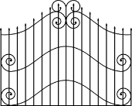
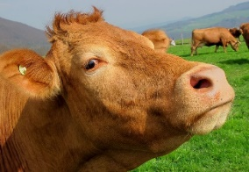
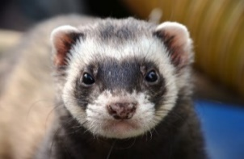
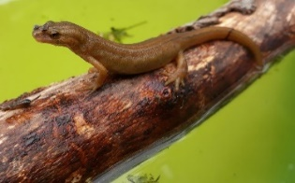
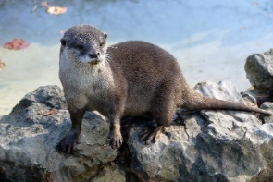
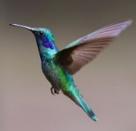
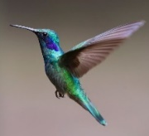
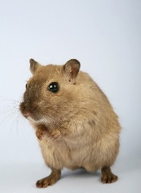
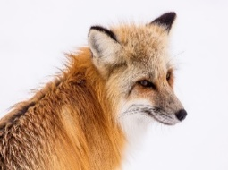
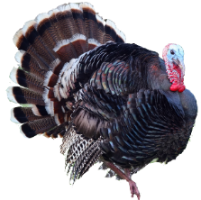
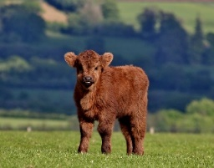
prononcer
Au zoo !
Read aloud the French name and the animal with the same final sound. You have not learnt these words so use what you know about how to pronounce French. Remember Silent Final Consonants!
ZOO
 | Name
1 | Marie-Lou
2 | Treveur
3 | Baltazar
4 | Akash
5 | Marion
6 | Jaufret
7 | Magali
8 | Enzo
9 | Florinde
10 | Cléo
1 | 2 | 3
4 | 5 | 6
la vache
le furet
le triton
le manchot (empereur)
la loutre
les colibris
7 | 8 | 9 | 10
le rongeur
le renard
le veau
la dinde
Notes:
Timing: 1 minute per pupil
Aim: to assess pupils’ ability to read aloud the SSC practised this term. Procedure: 1. Use this slide to explain the phonics task. Tell pupils that you will give them the handout just before you hear each pupil so that the preparation time is the same for all.
2. Then give out the independent task activity sheets (and if desired, nominate a pupil monitor to be i/c of the PPT during the lesson). 3. Whilst pupils work on the independent tasks, listen to individual pupils reading the ten words aloud. Mark in real time, using the grid on the teacher version.
Note:
there are no follow up lessons this week, so it would be possible to continue the speaking assessments in the follow up time during this week, as needed.
if preferred, and the resources are available, pupils could record their answers (e.g. on computer or ipad) though this would involve the teacher listening back to assess them.
2

Slide 3
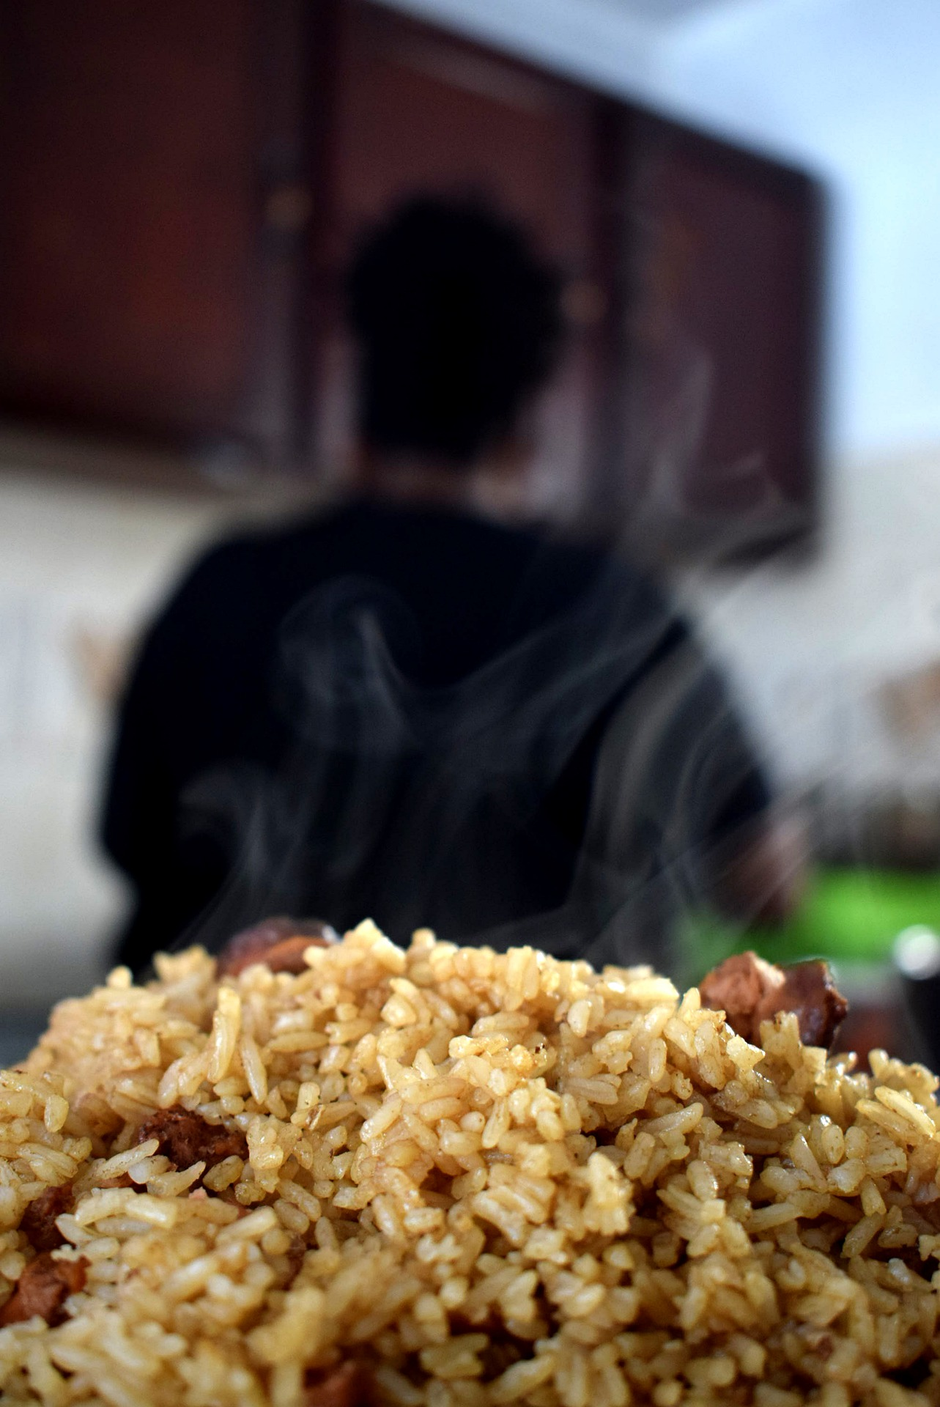
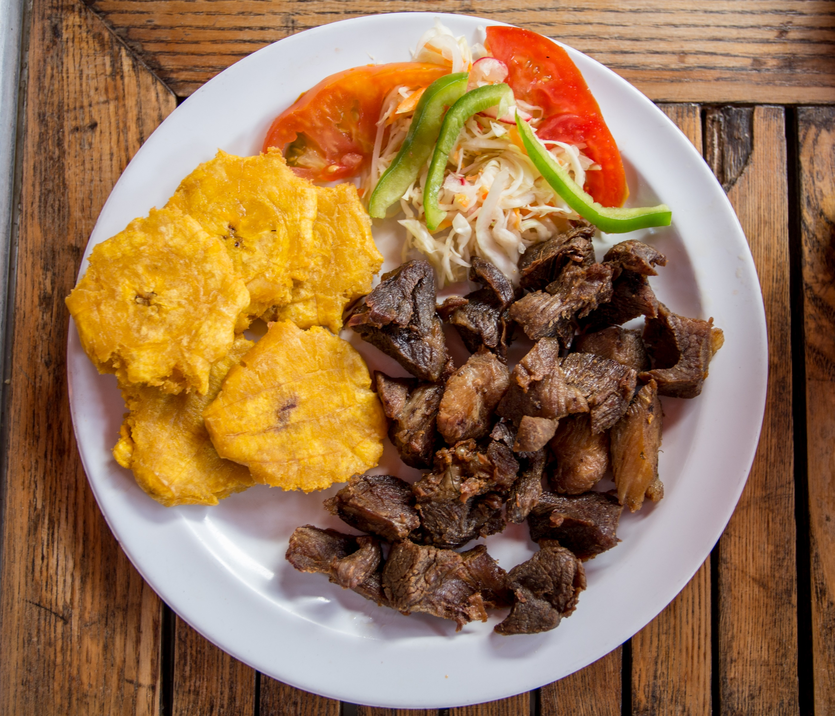
lire
Where? Haiti When? 24th December, Christmas Eve What? Everyone eats pork, with banana, rice and beans, and Pikliz (coleslaw).
Noël à Haïti : Lis le texte.
Write notes: Where? When? What?
Pikliz
À Haïti, le 24 décembre, tout le monde mange du « griot de porc » avec du « banann peze » , et du « riz collé ak pwa » . C’est un riz délicieux avec des pois rouges) et du Pikliz, une sorte de Coleslaw local.
banann peze
griot de porc
riz collé ak pwa
Lëa-Kim Châteauneuf, CC BY-SA 2.0
Notes:
Timing: 20-30 minutes (four slides)
Aim: to introduce pupils to Christmas eating traditions in Haiti.
Procedure: 1. Pupils read the text and make some notes in English under the heading where, when and what. 2. Click to provide suggested answers.
Attribution: Lëa-Kim Châteauneuf, CC BY-SA 2.0 via Wikimedia Commons

Slide 4
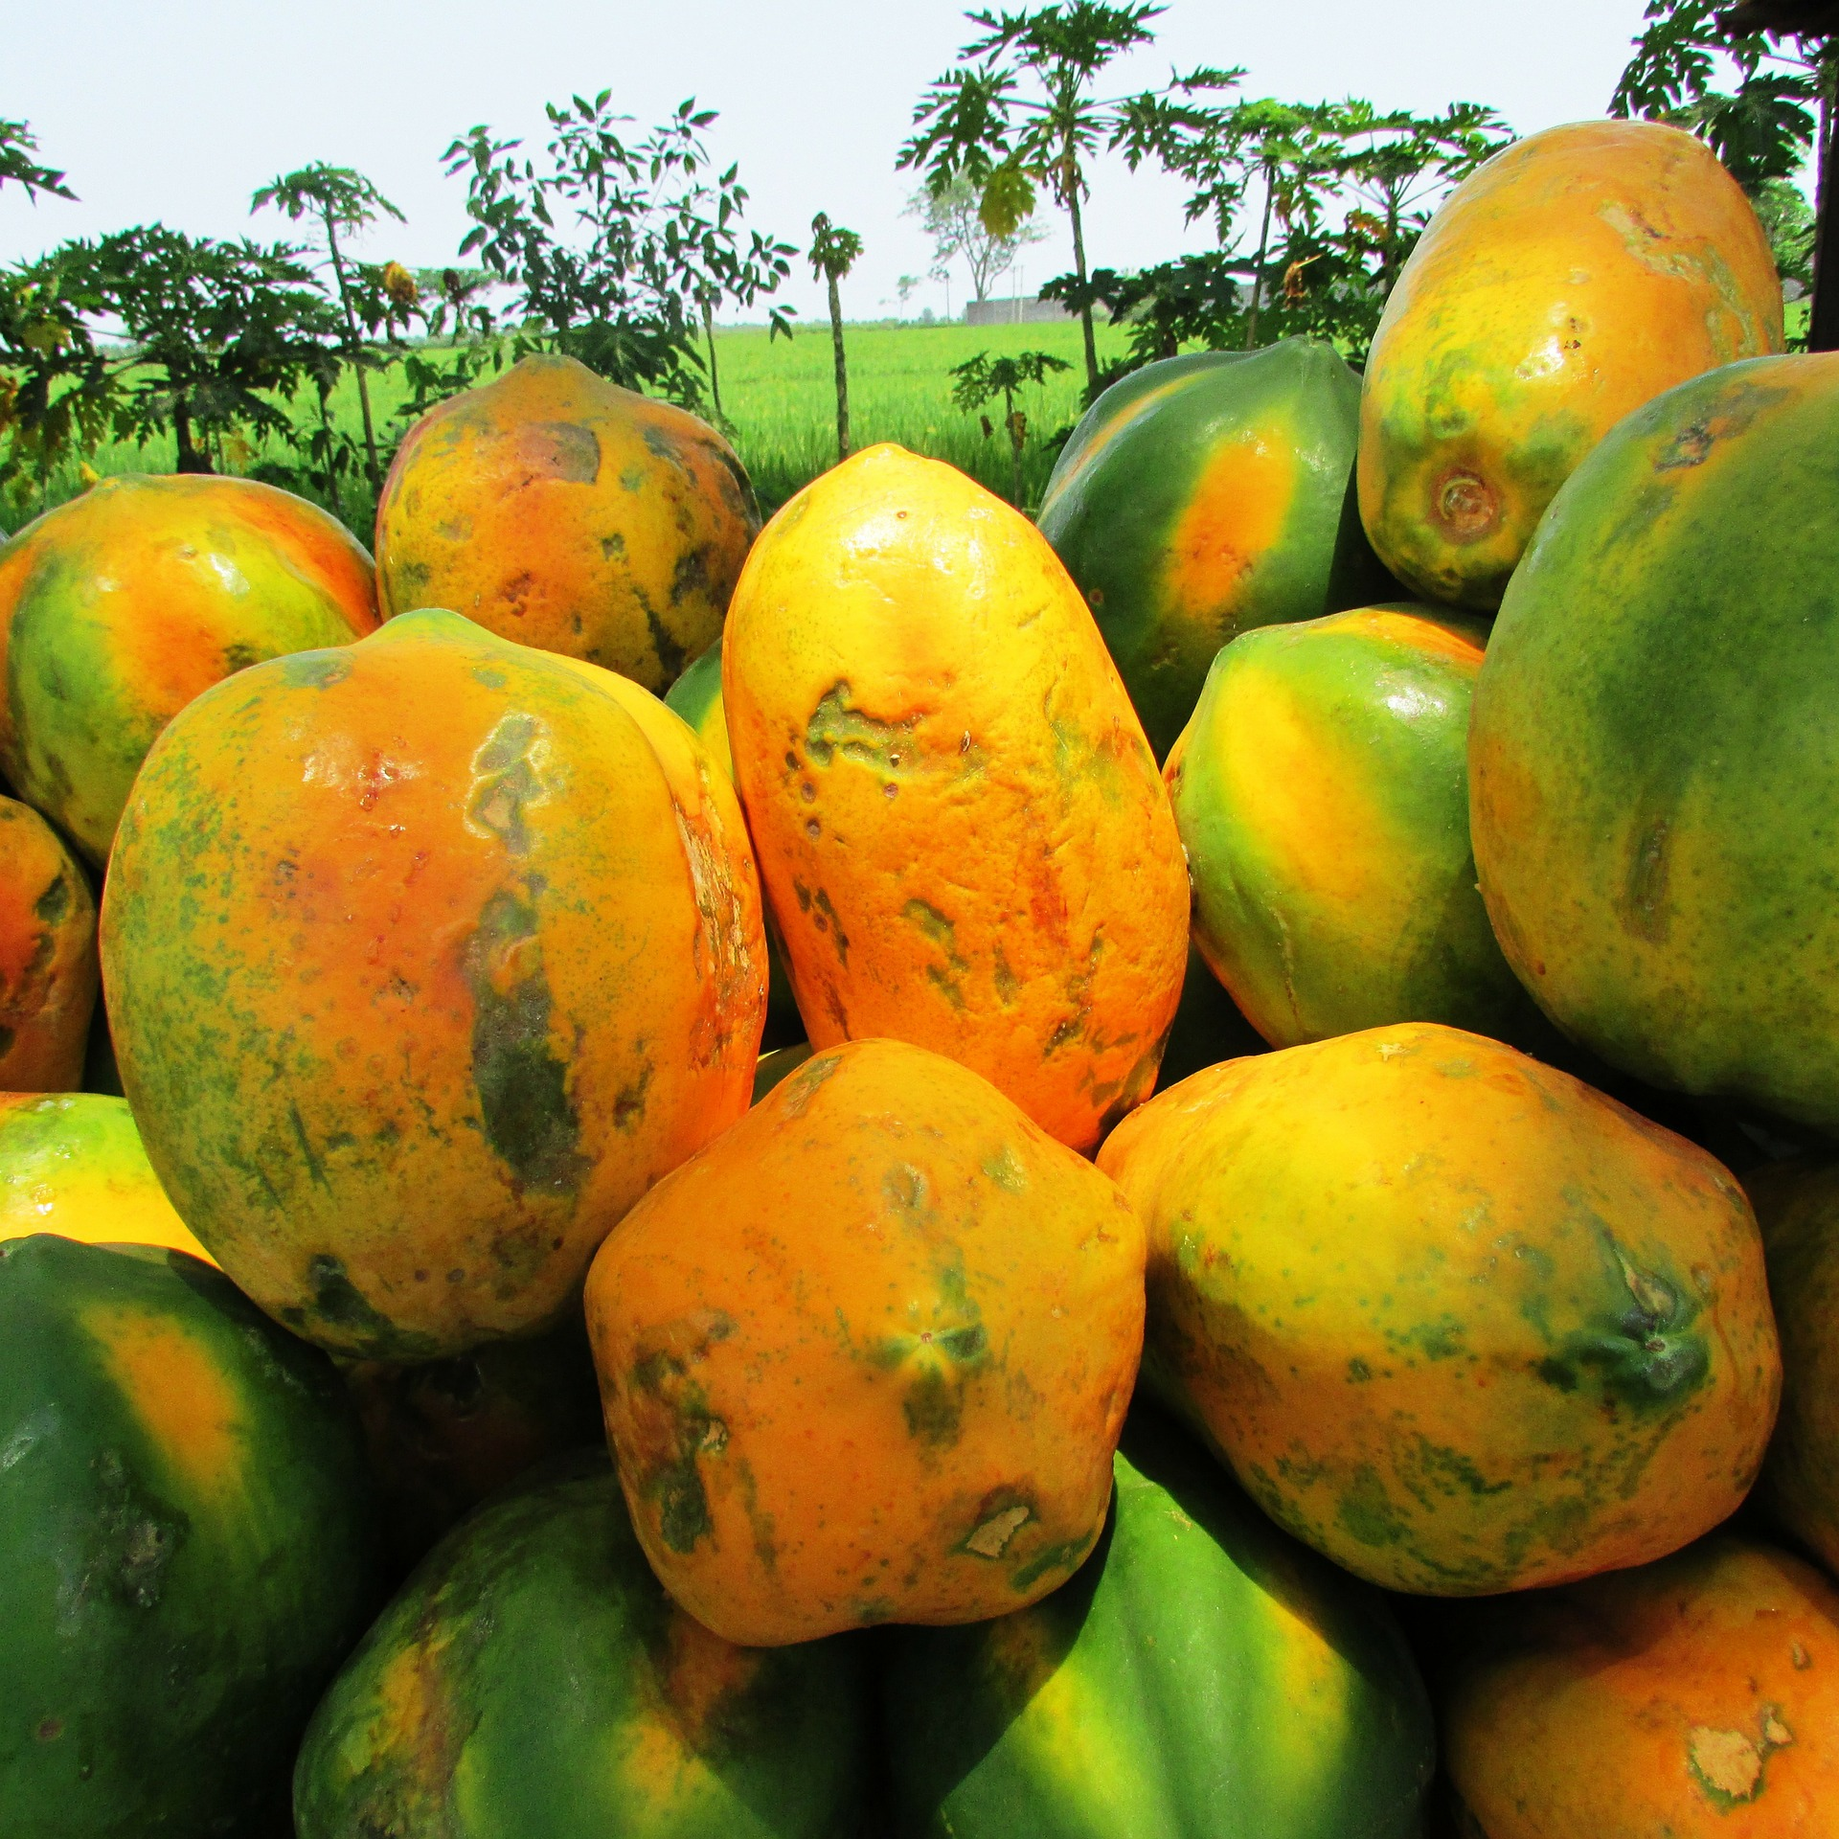
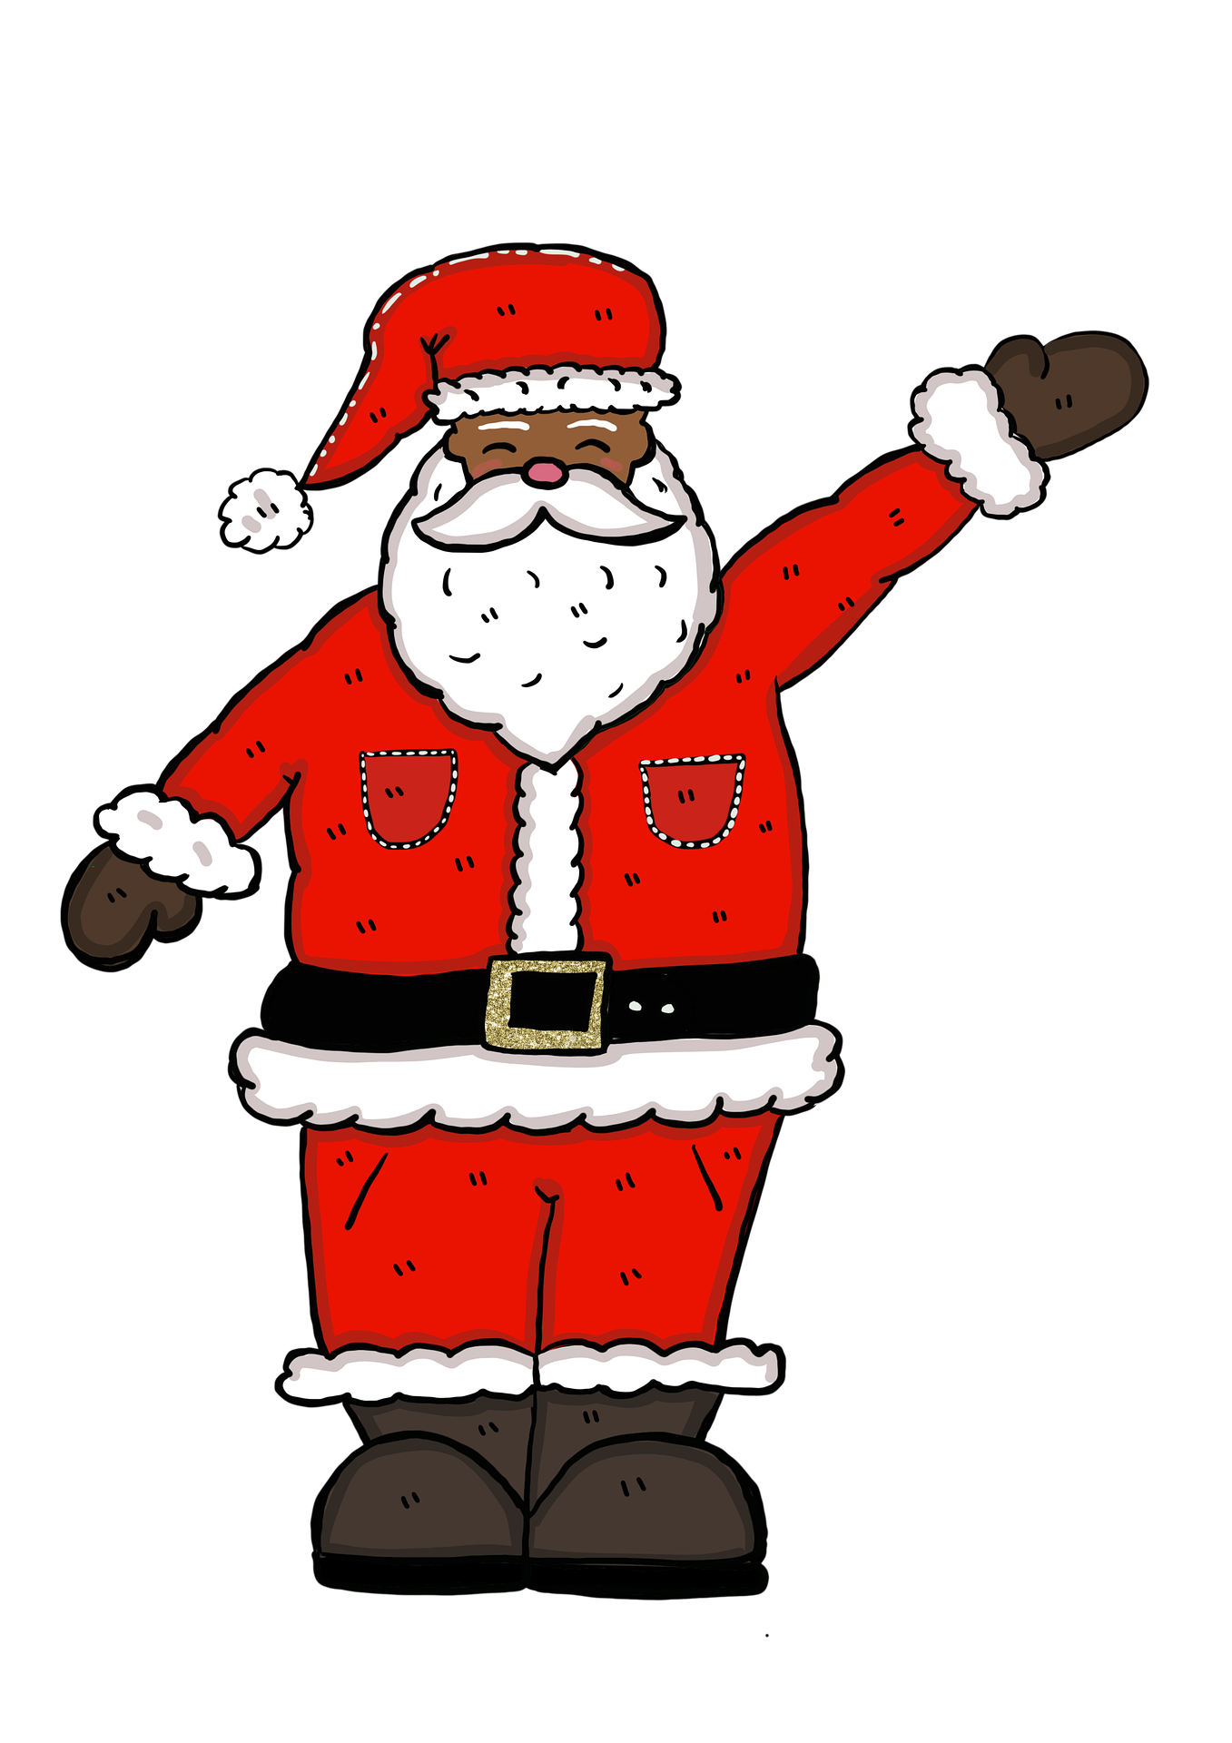
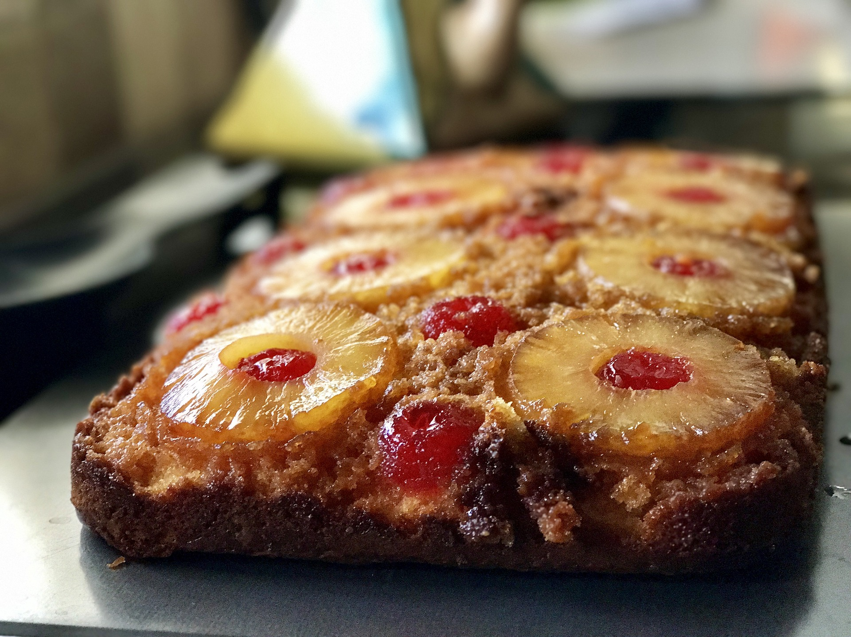
lire
Noël à Haïti : Lis le texte.
3. What do we find out about Tonton Noёl (Father Christmas)?
Pour le dessert on mange généralement une salade de fruits (par exemple, papaye, banane, goyave, fruits de la passion), un gâteau renversé à l'ananas et un gâteau à l'orange.
1. How many fruits are mentioned?
l’ananas – pineapple le soir – in the evening reçoivent - (they) receive
la neige – snow
2. What three things happen in the evening?
Le soir, tout le monde chante et danse. Les enfants reçoivent des cadeaux de Tonton Noël. Il arrive d’Alaska où il y a beaucoup de neige.
Notes:
Aim: to find out more about Christmas Eve in Haiti.
Procedure: 1. Pupils read the text and try to answer the three questions.
2. Click to reveal the answers.

Slide 5
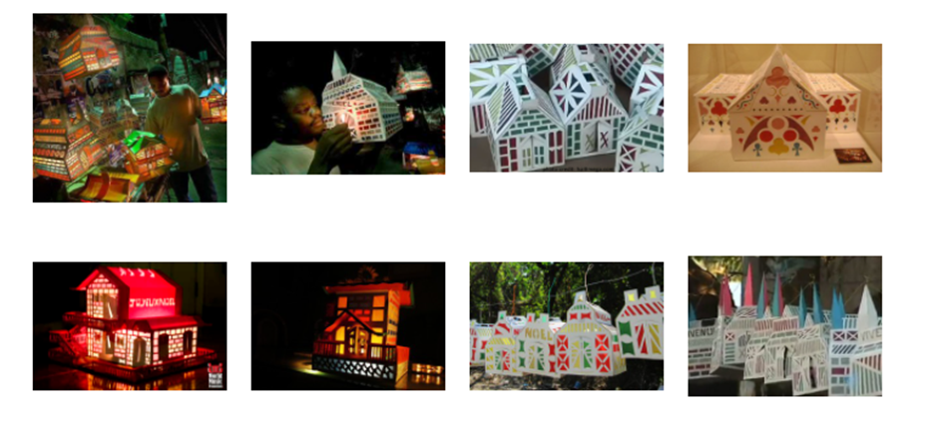
lire
Noël à Haïti : La tradition du fanal.
Un fanal, c’est quoi ?
C’est une maison.
It’s a house.
C’est une lanterne.
It’s a lantern.
C’est fait avec du papier et du carton.
It’s made with paper and cardboard.
Les enfants fabriquent les fanaux pour les fêtes.
Children make them for festivals.
C’est une belle tradition.
It’s a lovely tradition.
Read the text. Tell your partner everything you know about a ‘fanal’.
le fanal – lantern les fanaux – lanterns
le carton – cardboard fabriquent – (they) make
Notes:
Aim: to find out more about Christmas traditions in Haiti
Procedure: 1. Pupils read the text and try to tell a partner everything they know about ‘fanaux’.
2. Click to reveal the answers.
Short 1 minute video clip about les fanaux: https://www.youtube.com/watch?v=KPLZfpmA31Q
Permission: permission for photos requested 24 November 2021 www.haitifriends.org

Slide 6
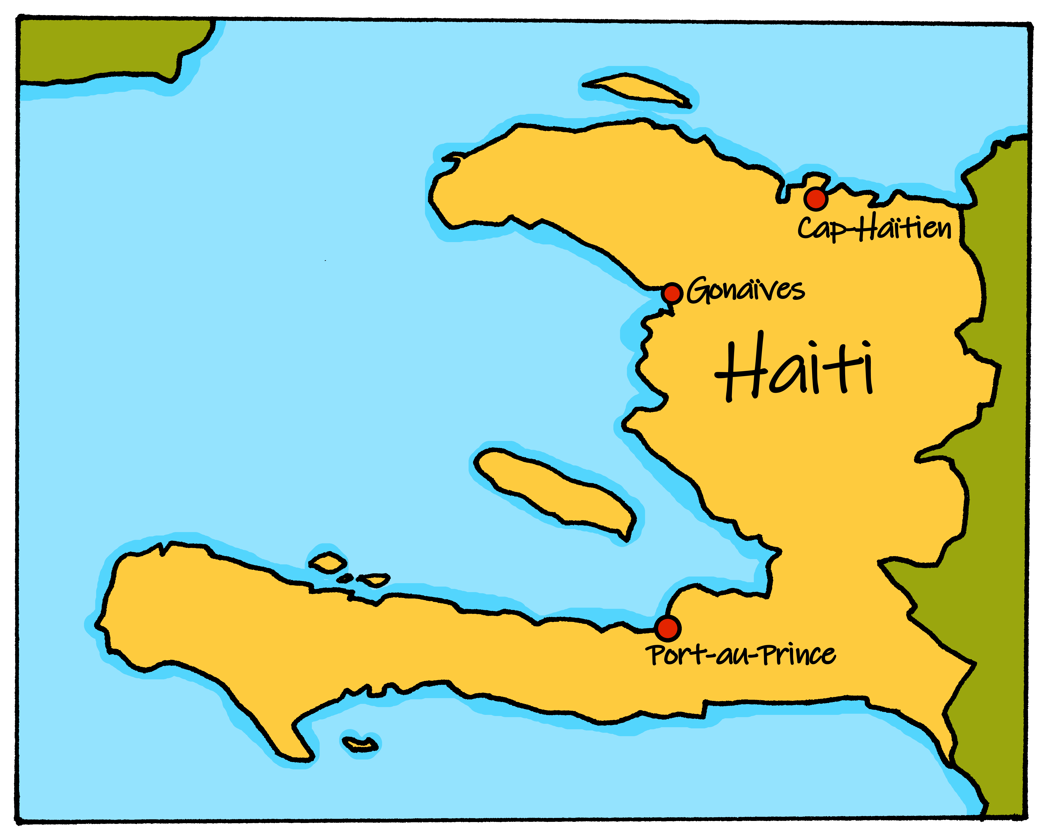
lire
À Haïti : les langues.
The two official languages of Haiti are French and Haitian Creole. Haitian Creole is spoken by almost everyone in Haiti, French by around half.
The vocabulary in Haitian Creole is like French, but its spelling is often different. Complete the table with the missing words in three languages.
chak jou
Sorry!
Haitian Creole | French | English
Bonjou! | Bonjour ! | Hello!
chak jou | chaque jour | every day
Padon! | Pardon ! | Sorry!
mèsi | merci | thank you
tout moun | tout le monde | everyone
mèsi
merci
Boujou!
tout le monde
everyone
Pardon !
chaque jour
Hello!
Notes:
Aim: to find out a bit more about Haitian Creole.
Procedure: 1. Pupils read the words and try to organise the words into the table, matching the meanings in three languages.
2. Click to reveal the answers.
https://en.wikipedia.org/wiki/Haiti#Languages
https://en.wikipedia.org/wiki/Haitian_Creole#Examples

Slide 7
Au revoir !
bleu
Notes:
7

Slide 8
Le zoo Read aloud the French name of each animal.
Le zoo Read aloud the French name of each animal.
You have not learnt these words so just use what you know about how to pronounce French. ☺
ZOO
You have not learnt these words so just use what you know about how to pronounce French. ☺
ZOO
Remember Silent Final Consonants!
Remember Silent Final Consonants!
1 | 2 | 3
4 | 5 | 6
1 | 2 | 3
4 | 5 | 6
 | Name
1 | Marie-Lou
2 | Treveur
3 | Baltazar
4 | Akash
5 | Marion
6 | Jaufret
7 | Magali
8 | Enzo
9 | Florinde
10 | Cléo
 | Name
1 | Marie-Lou
2 | Treveur
3 | Baltazar
4 | Akash
5 | Marion
6 | Jaufret
7 | Magali
8 | Enzo
9 | Florinde
10 | Cléo
la vache
le furet
le triton
la vache
le furet
le triton
le manchot empereur
le manchot empereur
la loutre
les colibris
la loutre
les colibris
7 | 8 | 9 | 10
7 | 8 | 9 | 10
le rongeur
le renard
le veau
la dinde
le rongeur
le renard
le veau
la dinde
Notes:
Pupil handout To copy and cut in half
Note: There is a version with the animals only without names on the next slide, if preferred.

Slide 9
Le zoo Read aloud the French name of each animal.
Le zoo Read aloud the French name of each animal.
You have not learnt these words so just use what you know about how to pronounce French. ☺
ZOO
You have not learnt these words so just use what you know about how to pronounce French. ☺
ZOO
Remember Silent Final Consonants!
Remember Silent Final Consonants!
1 | 2 | 3
4 | 5 | 6
1 | 2 | 3
4 | 5 | 6
la vache
le furet
le triton
la vache
le furet
le triton
le manchot empereur
le manchot empereur
la loutre
les colibris
la loutre
les colibris
7 | 8 | 9 | 10
7 | 8 | 9 | 10
le rongeur
le renard
le veau
la dinde
le rongeur
le renard
le veau
la dinde
Notes:
Alternative version with animals only.

Slide 10
Le zoo Read aloud the French name of each animal.
Pupil name: ___________________________________
Total score: _____ / 14
 | Name | Animal | SSC | p/ x
1 | Marie-Lou | la loutre | [ou]
2 | Treveur | le rongeur | open [eu]
3 | Baltazar | le renard | [e] + SFC-d
4 | Akash | la vache | [ch]
5 | Marion | le triton | [on]
6 | Jaufret | le furet | [u] + SFC -t
7 | Magali | les colibris | [i] + SFC -s
8 | Enzo | le veau | [(e)au]
9 | Florinde | la dinde | [in] + SFe
10 | Cléo | le manchot empereur | [em]
You have not learnt these words so just use what you know about how to pronounce French. ☺
ZOO
Remember Silent Final Consonants!
1 | 2 | 3
4 | 5 | 6
la vache
le furet
le triton
le manchot empereur
la loutre
les colibris
7 | 8 | 9 | 10
le rongeur
le renard
le veau
la dinde
Note: Teachers award one point for each SSC, one or two points per item, as per SSC list above.
Notes:
Teacher handout
Audio provided for teacher preparation, if required.

