Slide 1
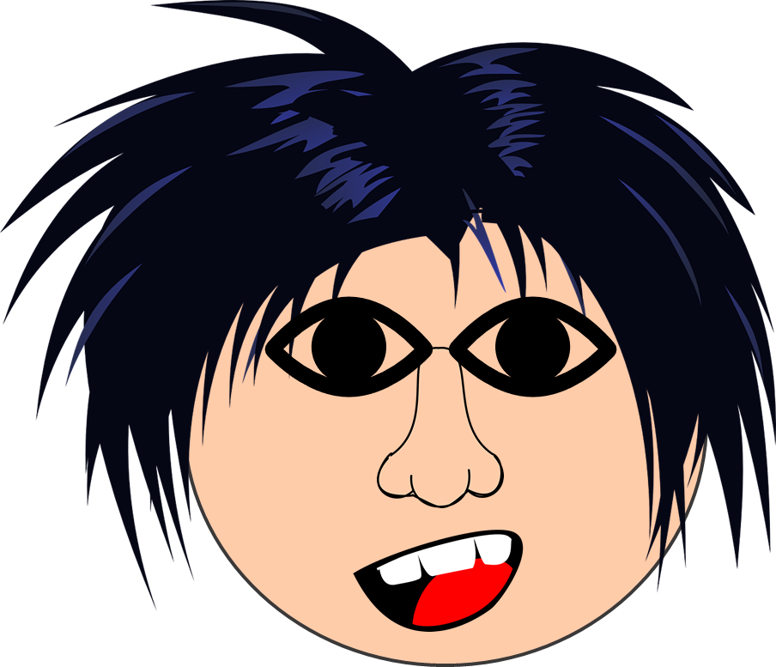
Saying what I and others have
bleu
physical description
singular and plural adjective agreement
SSC [ch]
Term 1 Week 12
Notes:
Artwork by Steve Clarke. Pronoun pictures from NCELP (www.ncelp.org). All additional pictures selected from Pixabay and are available under a Creative Commons license, no
attribution required.
Phonics: revisit [ch] - dimanche [1235] marché [280] chercher [336] chat [3138] bouche [1838]
Vocabulary (new words in bold): bouche [1938] cheveu [2296] médecin [827] nez [2661] œil, yeux [474] visage [1292] bleu [1216] blond [4585] brun [>5000] court [545] crépu [>5000] gris [2769] long [202] marron [>5000] noir [572] ovale >5000] rond [2268] roux [-] vert [1060]
Revisit 1: as [8] a [8] donner [46] organiser [791] parler [106] poser [218] préparer [368] trouver [83] utiliser [345] livre [358] question [144] phrase [2074] problème [188] sac [2343] réponse [456] solution [608] court [545] simple [212] spécial [726] vrai [292] faux [555] des [de-2] calme [1731] difficile [296] facile [822] important [215] indépendant [854] intéressant [1244] rapide [672] utile [1003]
Revisit 2: anniversaire [2043] mois [179] janvier [939] février [1139] mars [868] avril [1022] mai [943] juin [931] juillet [1326] aout [1445] septembre [944] octobre [826] novembre [982] décembre [891] quand [119] treize [3285] quatorze [3359] quinze [1472] seize [3285] dix-sept [3812] dix-huit [3592] dix-neuf [4851] vingt [1273] vingt-et-un [1273/6/3] vingt-deux, vingt-trois vingt-quatre vingt-cinq vingt-six vingt-sept vingt-huit vingt-neuf trente [1646]
Londsale, D., & Le Bras, Y. (2009). A Frequency Dictionary of French: Core vocabulary for learners London: Routledge.
The frequency rankings for words that occur in this PowerPoint which have been previously introduced in these resources are given in the SOW and in the resources that first
introduced and formally re-visited those words.
For any other words that occur incidentally in this PowerPoint, frequency rankings will be provided in the notes field wherever possible.
1

Slide 2
[ch]
prononcer
chercher
[to look for]
Notes:
Timing: 2 minutes
Aim: to recap SSC [ch].
Procedure:
Click to bring up the SSC [ch]. Repeat the SSC [ch] and the source word chercher with the class.
Click to bring up the English translation and picture.
Pupils to practise saying the SSC and source word several times.

Slide 3
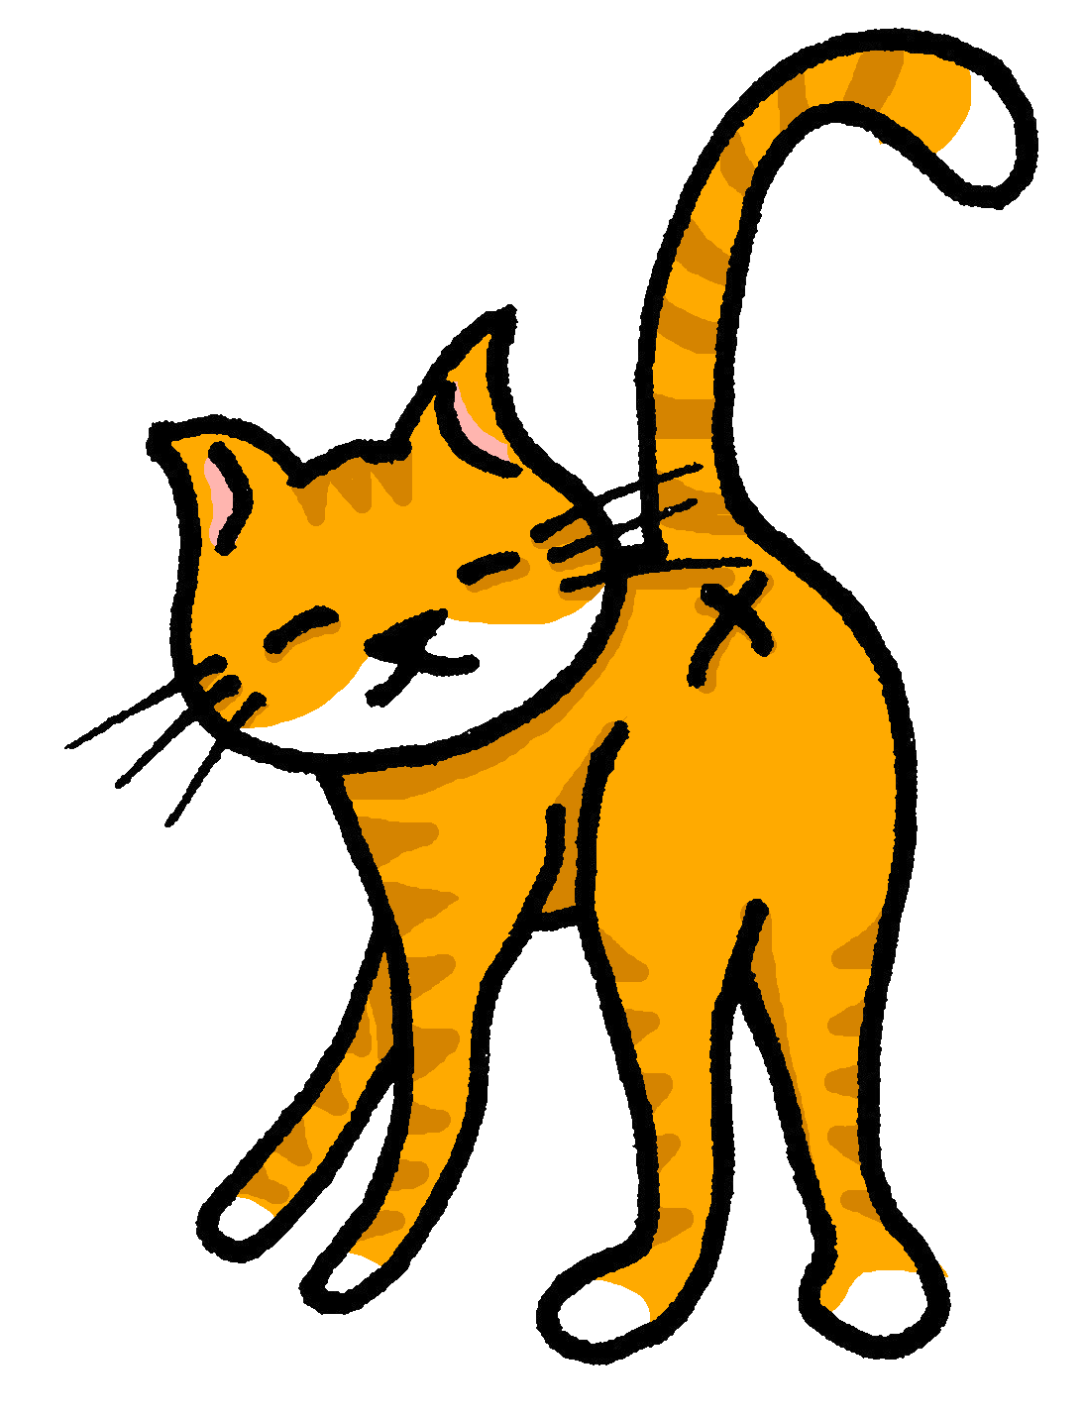
[ch]
chercher
prononcer
bouche
chat
marché
dimanche
[to look for]
Sun
Notes:
Timing: 2 minutes
Aim: to practise the pronunciation of SSC [ch] in four cluster words.
Procedure:
Click to bring up the SSC [ch]. Repeat the SSC [ch] with the class and the source word chercher.
Click to bring up the English translation and picture. Do the gesture, if using.
Click to bring up each cluster word in turn: bouche, chat, marché, dimanche. The pictures appear after the words to give a further opportunity for word repetition.
Suggested gesture: The 3rd video (the woman)’s version is the one I like the best for search, look for: https://www.signbsl.com/sign/search

Slide 4
écouter
Écoute. L’intrus*, c’est quoi ?
L’intrus – odd one out!
Écris A, B ou C de 1 à 5.
 | A | B | C
 | cinq | chien | chat
 | chemise | cheval | facile
 | médecin* | chasser* | chose
 | méchant | difficile | dimanche
 | chercher | prononcer | chanson
1
2
3
4
5
le/la médecin – doctor | chaser – to chase, chasing
Notes:
Timing: 5 minutes
Aim: to practise aural comprehension of avons and ont, and previously taught nouns and adjectives.
Procedure
Pupils listen to the short sentences and decide if they hear the verb form for ‘we have’ or ‘they have’.
Click to check.
Pupils listen again and note in English the noun and description.
Click to reveal answers.
Transcript:
[Nous] avons une maison. [Ils] ont un jardin.
[Ils] ont une salle.
[Nous] avons un bureau.
[Nous] avons uns chamber. [Ils] ont beaucoup d’espace!
4

Slide 5
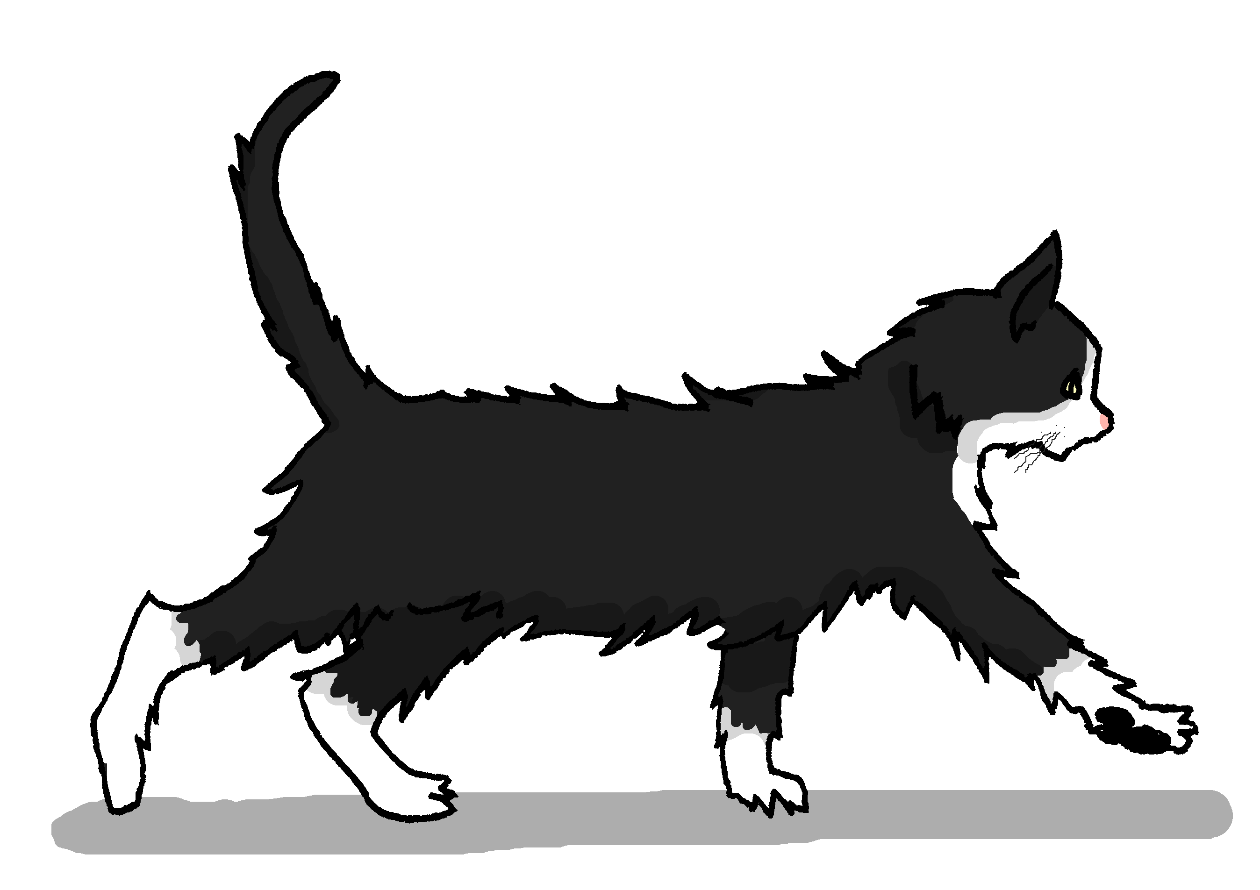
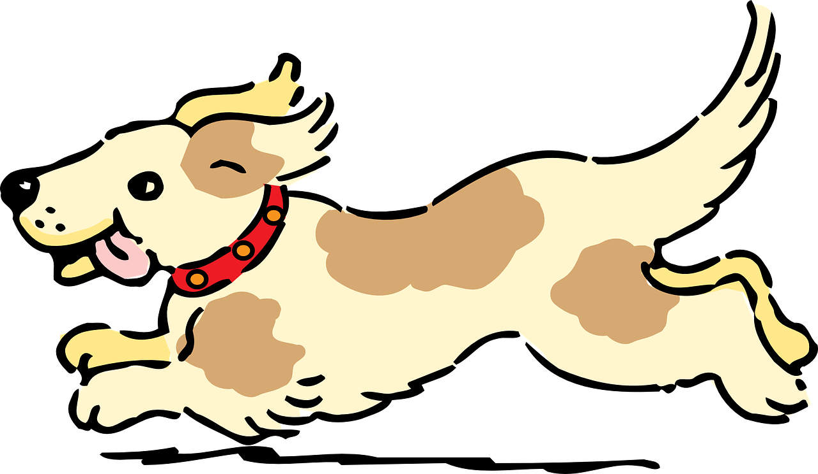
prononcer
Un virelangue
Prononce le virelangue ! Puis, écoute et vérifie.
Cinq chiens chassent six chats.
1
Cinq chiens chassent six chats.
2
Cinq chiens chassent six chats.
3
Notes:
Timing: 2 minutes
Aim: to practise oral production of the [ch] and soft [c] sounds in a well-known tongue twister.
Procedure:
Pupils practise first in pairs.
Then click to listen to the tongue twister said by a native speaker at three different speeds: slow, medium, fast.
Give pupils 30 seconds more to practise saying it.

Slide 6
Definite articles: singular & plural
Or use l’ before a noun that begins with a vowel. E.g. l’œil (eye), un œil (an eye).
This is grammatical, not biological gender! A house (una casa) is not female, it is a feminine noun.
[the]
Remember! In French, things, as well as people and animals, are either masculine or feminine. We say that they have gender.
To say the before a singular noun, you use ‘le’ (m) or ‘la’ (f).
To say the before all plural nouns (more than one), use ‘les’.
Masculine
Feminine
___ professeure
Note that the plural of eye is irregular: l’œil (eye) → les yeux.
___ professeures
the (female) teacher
les
the (female) teachers
le
la
___ cheveux
les
___ cheveu
the hair
the hair(s)
la
the phrase
___ phrases
the phrases
___ phrase
___ chats
les
___ chat
les
le
the cats
the cat
les
l’
___ œil
___ yeux
the eye
___ amie
les
l’
___ amies
the (female) friend
the eyes
the (female) friends

Slide 7
vocabulaire
C’est le, la ou les ? [1/9]
mots
le
la
les
yeux
Comment dit-on en anglais ?
[the] eyes
[the] eye
Notes:
Timing: 4 minutes
Aim: to revisit previously taught vocabulary and to introduce three new words.
Procedure: 1. Click to start the timer.
2. Pupils try in pairs to name the three words in French before the timer runs out.
3. Elicit words from pupils, then click to reveal the full written words.
4. If desired, click on the picture to hear the words pronounced.
5. Continue for the next two slides.
Transcript:
une chambre un ordinateur
une idée
7

Slide 8
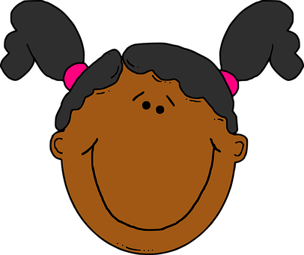
vocabulaire
C’est le, la ou les ? [2/9]
mots
le
la
les
visage
Comment dit-on en anglais ?
[the] faces
[the] face

Slide 9
vocabulaire
C’est le, la ou les ? [3/9]
mots
le
la
les
cheveux
Comment dit-on en anglais ?
[the] (single) hair
[the] hair(s)

Slide 10
vocabulaire
C’est le, la ou les ? [4/9]
mots
le
la
les
médecin
[the] female doctor
Comment dit-on en anglais ?
[the] male doctor

Slide 11
vocabulaire
C’est le, la ou les ? [5/9]
mots
le
la
les
professeurs
[the] male teacher
Comment dit-on en anglais ?
[the] male teachers
Notes:
awaiting audio

Slide 12
vocabulaire
C’est le, la ou les ? [6/9]
mots
le
la
les
nez
Comment dit-on en anglais ?
[the] noses
[the] nose
Notes:
awaiting audio

Slide 13
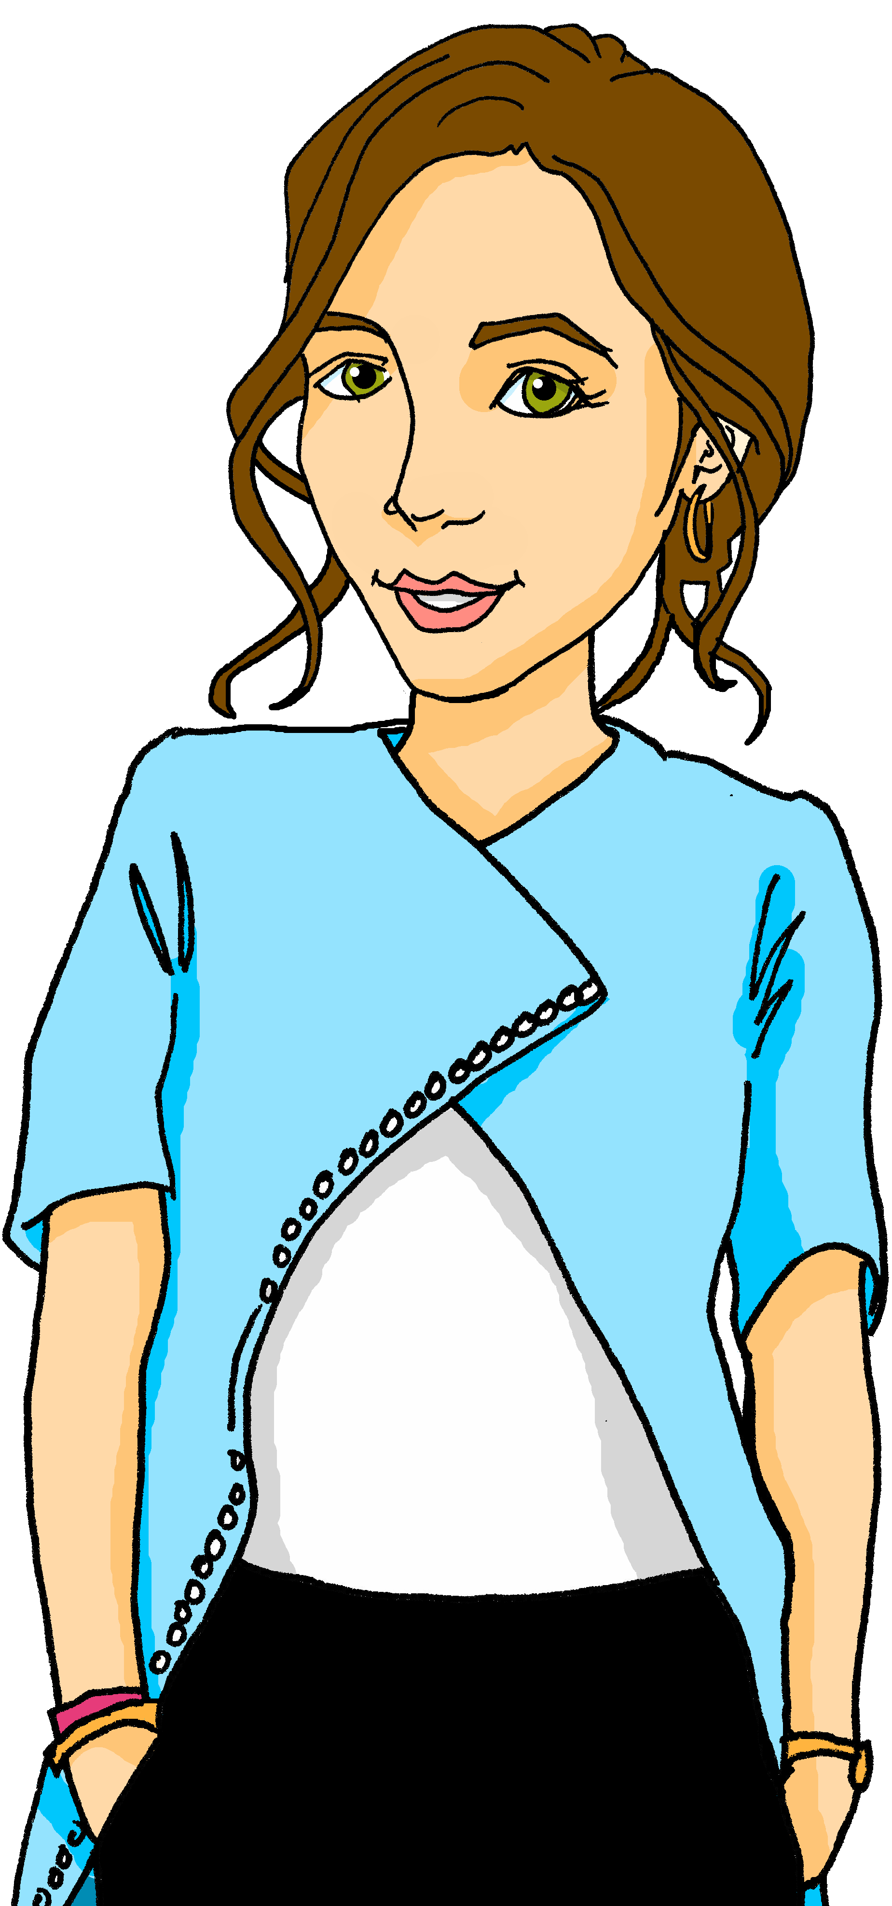
vocabulaire
C’est le, la ou les ? [7/9]
mots
le
la
les
professeure
[the] female teachers
Comment dit-on en anglais ?
[the] female teacher

Slide 14
vocabulaire
C’est le, la ou les ? [8/9]
mots
le
la
les
visages
Comment dit-on en anglais ?
[the] faces
[the] face
Notes:
awaiting audio

Slide 15
vocabulaire
C’est le, la ou les ? [9/9]
mots
le
la
les
médecin
[the] male doctors
Comment dit-on en anglais ?
[the] male doctor

Slide 16
écouter
Jean-Michel décrit des personnes mais il y a un problème avec le son*.
le son – the sound
Écoute. C’est ‘le’, ‘la’ ou ‘les’ ?
Lis. Jean-Michel décrit quoi ?
 | le | les | visage | yeux
 | le | les | cheveux | nez
 | le | les | yeux | visage
 | le | les | cheveux | visage
 | les | le | visage | yeux
 | les | la | bouche | yeux
1
1
2
2
3
3
4
4
5
5
6
6
Notes:
Timing: 5 minutes
Aim: to practise aural comprehension of feminine and masculine forms of new and previously taught prenominal adjectives.
Procedure
Pupils listen to the short sentences and decide which noun they are describing, based on the adjective form (and gender of the noun).
Click to check.
Click again to bring up a 2nd set of audio buttons. Pupils listen again – this time to the full sentences - and note in English the noun and description.
Click to reveal answers.
Transcript 1:
Il a le [visage rond]. Il a les [cheveux longs]. Elle a les [yeux ronds]. Elle a le [visage vert] Elle a les [yeux gris]. Il a la [bouche bleue].
Transcript 2:
Il a le visage [rond]. Il a les cheveux [longs]. Elle a les yeux [ronds]. Elle a le visage [vert] Elle a les yeux [gris]. Il a la bouche [bleue].
16

Slide 17
Adjectives following the noun
Note: in French we often use the definite article ‘the’ in these descriptions. In English, we leave it out or use ‘a’, e.g., has a round face.
We know that many adjectives follow the noun.
Examples:
Il a le visage rond.
Il a le visage ovale.
When there are two adjectives after the noun, join them with ‘et’ (and).
He has a round face.
He has an oval face.
Il a les yeux ronds.
Il a les cheveux longs et bruns.
He has round eyes.
He has long, brown hair.
⚠ Remember: Adjectives agree (match) in gender and number with the noun they are describing.

Slide 18
écouter
Le son* est bon maintenant. ☺
le son – the sound
Écoute. Comment sont les personnes ?
 | le | les | visage | yeux | has a round face
 | le | les | cheveux | nez | has long hair
 | le | les | yeux | visage | has round eyes
 | le | les | cheveux | visage | has a green face
 | les | le | visage | yeux | has grey eyes
 | les | la | bouche | yeux | has a blue mouth
1
_____
2
_____
3
_____
4
_____
5
_____
6
_____
Notes:
Timing: 5 minutes
Aim: to practise aural comprehension of descriptive sentences with definite articles and postnominal adjectives.
Procedure:
Do number 1 as an example. The previous answers are fixed in place to remind pupils that they have listened to part of this information before. Now they listen to the whole sentence and complete the sentences in English. The gapped sentences provide support for comprehension and make the different syntax (word order) visually more concrete.
Click to correct the example.
Complete 2-6. Elicit answers from pupils and click to reveal written answers.
Transcript 3:
Il a le visage rond. Il a les cheveux longs. Elle a les yeux ronds. Elle a le visage vert Elle a les yeux gris. Il a la bouche bleue.

Slide 19
vocabulaire
Ils ont les cheveux comment ?
Brun is for hair. For brown eyes, use marron, which doesn’t change for plural.
mots
noirs
blonds
bruns
roux
[black]
[blond]
[brown]
[ginger, red]
courts
crépus
longs
[long]
[short]
[frizzy]
Notes:
Timing: 2 minutes
Aim: presentation of three new (crépus, roux, longs) and five previously taught vocabulary items.
Procedure:
Click to reveal the French word and picture. Say the word with pupils.
Elicit the English and click to reveal the written English meaning.
Click to animate the French word and picture again and elicit pupil repetition of the word (without first hearing the teacher voice, so that pupils connect the written form with the pronunciation more independently).
Repeat steps 1-3 for the remaining four items.

Slide 20
lire
Lis les descriptions et complète les phrases.
Choisis les bons mots de 1à 7.
1 | Jean-Michel a | les | visage | cheveux | crépus | rond
2 | La professeure a | les | yeux | nez | verts | vert
3 | Le médecin a | le | visage | yeux | rond | ronds
4 | Claudine a | la | cheveux | bouche | roux | rouge
5 | Adèle a | les | visage | cheveux | ovale | blonds
6 | Léa a | les | cheveu | yeux | noir | noirs
7 | Pierre a | les | cheveux | nez | courts | long
1
2
3
4
5
6
7
Notes:
Timing: 4 minutes (the 2nd (comprehension) part of this task is in the follow ups)
Aim: to practise connection of the definitive article with an appropriate noun and correct adjectival form; to practise comprehension this week’s vocabulary in sentence form.
Procedure: 1. Pupils select the correct noun based on the definite article.
2. They then select the correct form of the adjective.
3. Click to correct answers.
4. If desired, click on the purple buttons to hear the answers, too. Note: the language in this task will be the focus of a comprehension task in the follow ups.

Slide 21
Au revoir !
bleu
Notes:
21

