Slide 1
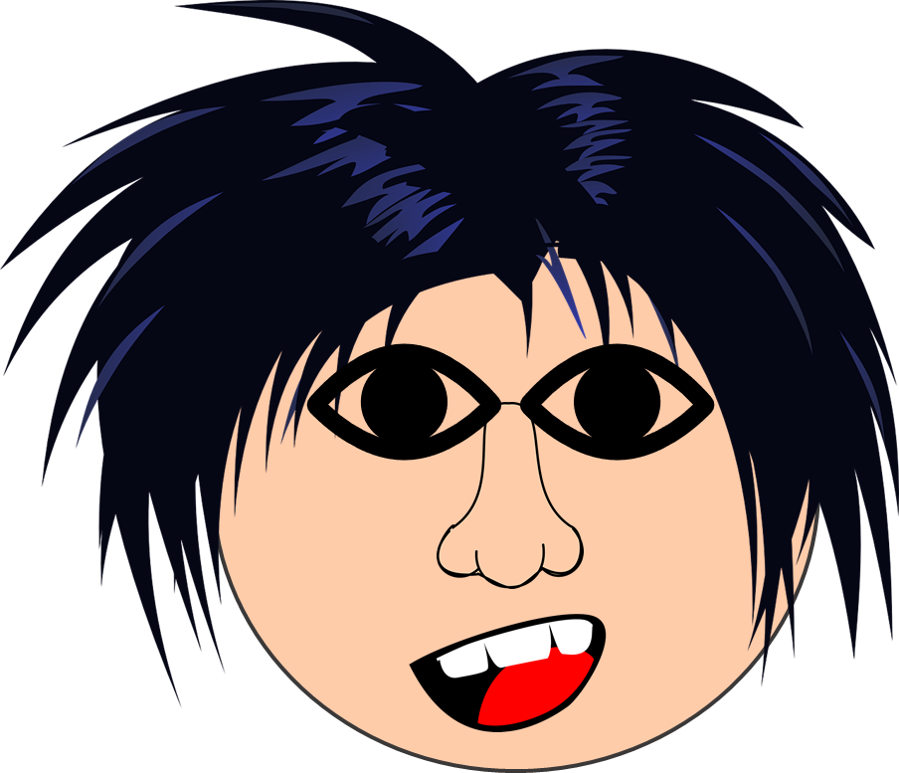
Saying what I and others have
bleu
Follow ups 1-5
Term 1 Week 12
Notes:
Artwork by Steve Clarke. Pronoun pictures from NCELP (www.ncelp.org). All additional pictures selected from Pixabay and are available under a Creative Commons license, no
attribution required.
Phonics: revisit [ch] - dimanche [1235] marché [280] chercher [336] chat [3138] bouche [1838]
Vocabulary (new words in bold): bouche [1938] cheveu [2296] médecin [827] nez [2661] œil, yeux [474] visage [1292] bleu [1216] blond [4585] brun [>5000] court [545] crépu [>5000] gris [2769] long [202] marron [>5000] noir [572] ovale >5000] rond [2268] roux [-] vert [1060]
Revisit 1: as [8] a [8] donner [46] organiser [791] parler [106] poser [218] préparer [368] trouver [83] utiliser [345] livre [358] question [144] phrase [2074] problème [188] sac [2343] réponse [456] solution [608] court [545] simple [212] spécial [726] vrai [292] faux [555] des [de-2] calme [1731] difficile [296] facile [822] important [215] indépendant [854] intéressant [1244] rapide [672] utile [1003]
Revisit 2: anniversaire [2043] mois [179] janvier [939] février [1139] mars [868] avril [1022] mai [943] juin [931] juillet [1326] aout [1445] septembre [944] octobre [826] novembre [982] décembre [891] quand [119] treize [3285] quatorze [3359] quinze [1472] seize [3285] dix-sept [3812] dix-huit [3592] dix-neuf [4851] vingt [1273] vingt-et-un [1273/6/3] vingt-deux, vingt-trois vingt-quatre vingt-cinq vingt-six vingt-sept vingt-huit vingt-neuf trente [1646]
Londsale, D., & Le Bras, Y. (2009). A Frequency Dictionary of French: Core vocabulary for learners London: Routledge.
The frequency rankings for words that occur in this PowerPoint which have been previously introduced in these resources are given in the SOW and in the resources that first
introduced and formally re-visited those words.
For any other words that occur incidentally in this PowerPoint, frequency rankings will be provided in the notes field wherever possible.

Slide 2
Follow up 1A:
[ch] et [c]. Secrectly choose 5 of the words. Your partner will try to say them within 20 seconds. If s/he confuses [ch] and [c], stop him/her for a 2-second penalty!
prononcer
20
bouche
chanter
affiche
décembre
chapeau
spéciale
espace
gauche
chocolat
exercice
cheveux
céréale
centre
médecin
marché
vache
0
DÉBUT
Notes:
Timing: 2-3 minutes
Aim: to practise read aloud of a mixture of known and unknown words, with the SSC [ch] and soft [c] with an element of time pressure.
Procedure:
Pupil A secretly selects 5 words.
Pupil B has 20 seconds to ‘find’ them all by saying them.
If s/he pronounces inaccurately, his/her partner can impose a 2-second penalty.
When time elapses, swap roles.
Continue for several rounds of activity to build up familiarity and fluency in production.

Slide 3
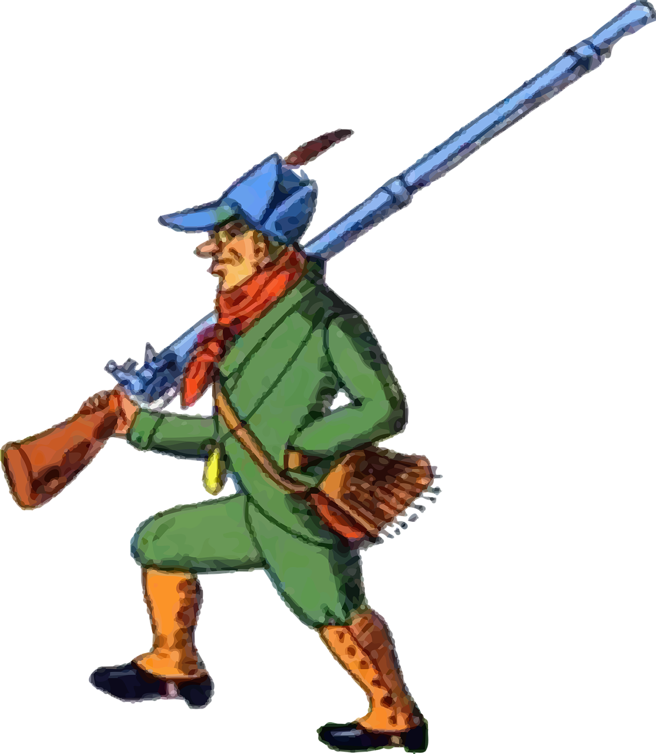
Follow up 1B:
Prononce le virelangue.
.
prononcer
20
1
Un chasseur sachant chasser doit savoir chasser sans son chien.
2
A hunter who knows how to hunt must know how to hunt without his dog.
3
0
DÉBUT
Notes:
Timing: 2 minutes
Aim: to practise oral production of the [ch] and soft [c] sounds in a well-known tongue twister.
Procedure:
Pupils practise first in pairs.
Then click to listen to the tongue twister said by a native speaker at three different speeds: slow, medium, fast.
Give pupils 30 seconds more to practise saying it.

Slide 4
Follow up 2:
Les personnes sont comment ? Écris en anglais.
1 | Jean-Michel a les cheveux crépus.
2 | La professeure a les yeux verts.
3 | Le médecin a le visage rond.
4 | Claudine a la bouche rouge.
5 | Adèle a les cheveux blonds.
6 | Léa a les yeux noirs.
7 | Pierre a les cheveux courts.
Jean-Michel has frizzy hair.
lire
The teacher has green eyes.
The doctor has a round face.
Claudine has a red mouth.
Adèle has blond hair.
Léa has black eyes.
Pierre has short hairs.
Notes:
Timing: 4 minutes
Aim: to practise written comprehension of this week’s vocabulary in sentences.
Procedure:
Do the example with pupils. They write (or say) the English sentence meaning (they could do this on mini whiteboards).
Complete sentences 1-7 and click to correct them. The English sentence meanings appear on consecutive mouse clicks.

Slide 5
Follow up 3:
Écoute. Pierre décrit un ami.
Écris la description an anglais.
?
écouter
_____________________.
E
Today is Monday 24th August.
1
______
It’s my friend Max’s birthday.
____________.
2
_____________________.
Max is English.
3
He has short, red hair.
_____________________________.
4
He has a round face.
_____________________________.
5
In his bag he has some exercise books, some pencils and a pen.
_____________________________________________________________________.
6
He has a bottle and a banana, too.
_______________________________________.
Notes:
Timing: 7 minutes
Aim: to practise aural comprehension of a wide variety of vocabulary from this and revisited weeks.
Procedure:
Click to listen to the example. Pupils complete the sentence in English.
For items 2 and 3, pupils can either turn away from the board and try to write the whole sentence, or use the written support on the board.
After each item, click to reveal the answers.
For items 4 – 7, pupils listen and translate the full sentence.
Click to reveal the answer each time.
The final click reveals Max.
Transcript:
Aujourd’hui, c’est lundi vingt-quatre aout. C’est l’anniversaire de mon ami, Max. Max est anglais. Il a les cheveux courts et roux. Il a le visage rond. Dan le sac il a des cahiers, des crayons et un stylo. Il a une bouteille et une banane, aussi.

Slide 6
Follow up 4:
Écoute. Ils sont comment ?
C’est vrai ou faux ?
écouter
1
Léa has black hair.
Léa has round, black eyes.
2
Hervé has long, blond hair.
Hervé has short, blond hair.
3
Max has blue eyes.
4
The [male] teacher has an oval face.
The [female] doctor has a long nose.
5
The doctor has a round nose.
6
Adèle has long, blond hair.
Notes:
Timing: 5 minutes
Aim: to practise aural comprehension of a wide variety of vocabulary from this and revisited weeks in sentences.
Procedure:
Click to listen.
Pupils write vrai (true) or faux (false).
Click to correct.
Extra: for the incorrect items, pupils can provide a correct sentence.
Transcript:
Léa a les yeux ronds et noirs. Hervé a les cheveux courts et blonds. Max a les yeux bleus. Le professeur a le visage ovale. La médecin a le nez rond. Adèle a les cheveux longs et blonds.

Slide 7
vocabulaire
Follow up 5 - Écris en anglais : Can you get at least 15 points?
mots
 | treize | vingt-et-un | quinze
 | seize | trente | catorze
 | donner | trouver | utiliser
 | spécial | court | utile
 | rond | roux | crépu
 | les yeux | le visage | ovale
 | les cheveux | la médecin | le nez
13
21
15
x3
16
30
14
to give
to find
to use
x2
especial
short
useful
round
ginger, red
frizzy
eyes
face
oval-shaped
x1
hair (pl)
[female] doctor
nose
Notes:
Timing: 5-10 minutes
Aim: to practise written production of vocabulary from this week and two revisited weeks.
Procedure: 1. Give pupils a blank grid. They fill in the English meanings of any of the words they know, trying to reach 15 points in total. 2. Remind pupils that adjectives can refer to male or female persons and they should note this in their translations. E.g. pleased (f), short (m).
Note: The most recently learnt and practised words are pink, words from revisit 1 are green and those from revisit 2 are blue, thus more points are awarded for them, to recognise that memories fade and more effort (heavy lifting!) is needed to retrieve them.
7

Slide 8
vocabulaire
Follow up 5 - Écris en anglais : Can you get at least 15 points?
mots
 | treize | vingt-et-un | quinze
 | seize | trente | catorze
 | donner | trouver | utiliser
 | spécial | court | utile
 | rond | roux | crépu
 | les yeux | le visage | ovale
 | les cheveux | la médecin | le nez
x3
x2
Notes:
HANDOUT
8

