Slide 1
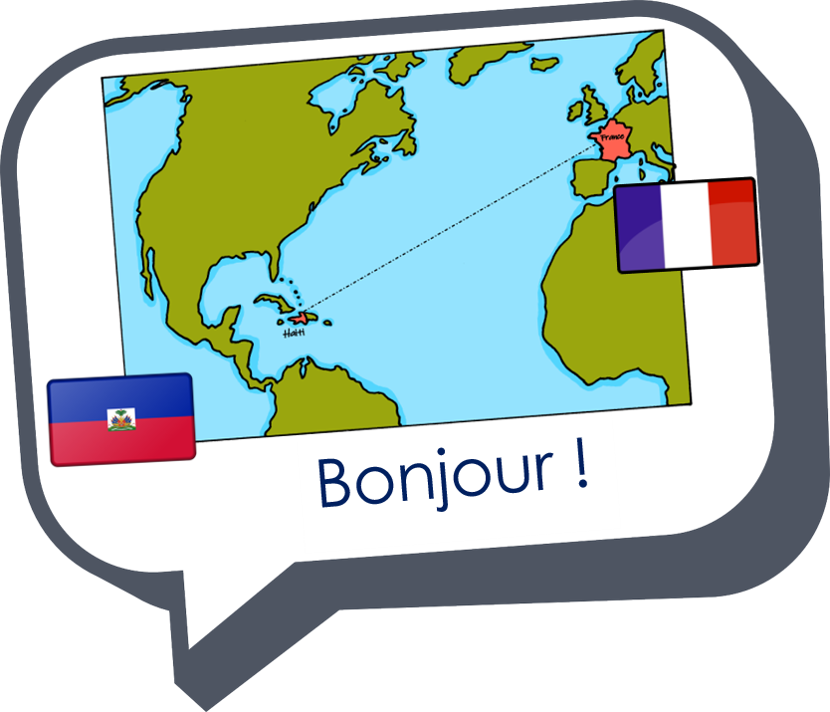

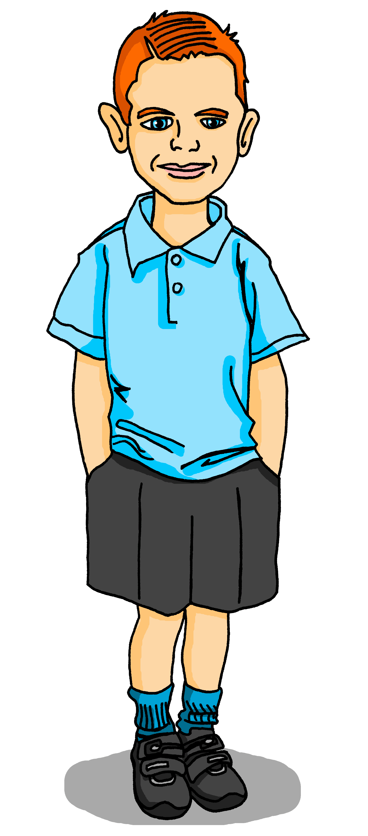
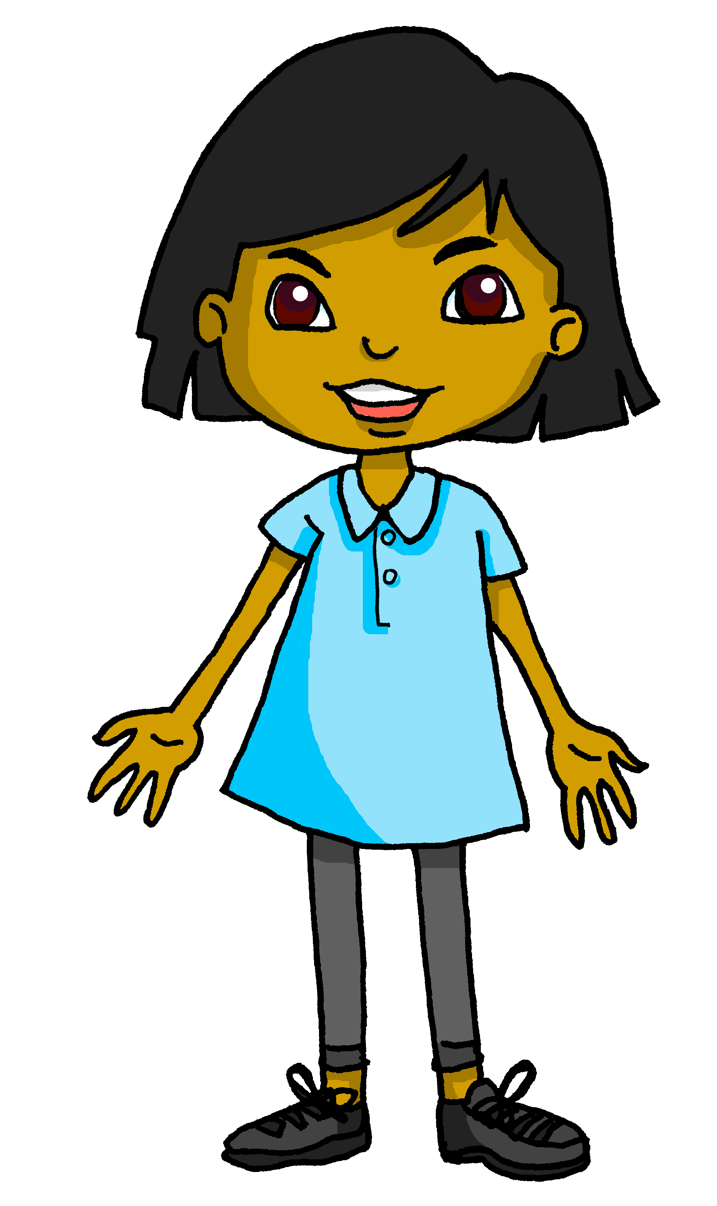

Saying what I and others have
la salle de classe en Angleterre
bleu
Follow ups 1-5
Term 1 Week 10
Notes:
Artwork by Steve Clarke. Pronoun pictures from NCELP (www.ncelp.org). All additional pictures selected from Pixabay and are available under a Creative Commons license, no
attribution required.
Phonics: revisit liaison
Vocabulary (new words in bold): avons [8], avez [8] nous [31] vous [50] exercice [1290] chaise [3419] cours [169] enfant [126] où [48] sur [16] ici [167] là [109]
Revisit 1: sont [5] ils [13] elles [38] combien [800] affiche [2886] bouteille [2979] crayon [>5000] fleur [2305] gomme [>5000] livre [358] mur [1335] ordinateur [2201] règle [488] sac [2343] vrai [292] faux [555] de [2]
Revisit 2: sommes [5] nous [31] absent [2016] amusant [4695] calme [1731] content [1841] différent [350] difficile [296] drôle [2166] fort [107] grand [59] jeune [152] lent [2572] malade [1066] méchant [3184] intelligent [2509] indépendant [954] important [215] petit [138] présent [216] prudent [1529] rapide [672] strict [1859] sage [2643] triste [1843]
Londsale, D., & Le Bras, Y. (2009). A Frequency Dictionary of French: Core vocabulary for learners London: Routledge.
The frequency rankings for words that occur in this PowerPoint which have been previously introduced in these resources are given in the SOW and in the resources that first
introduced and formally re-visited those words.
For any other words that occur incidentally in this PowerPoint, frequency rankings will be provided in the notes field wherever possible.

Slide 2


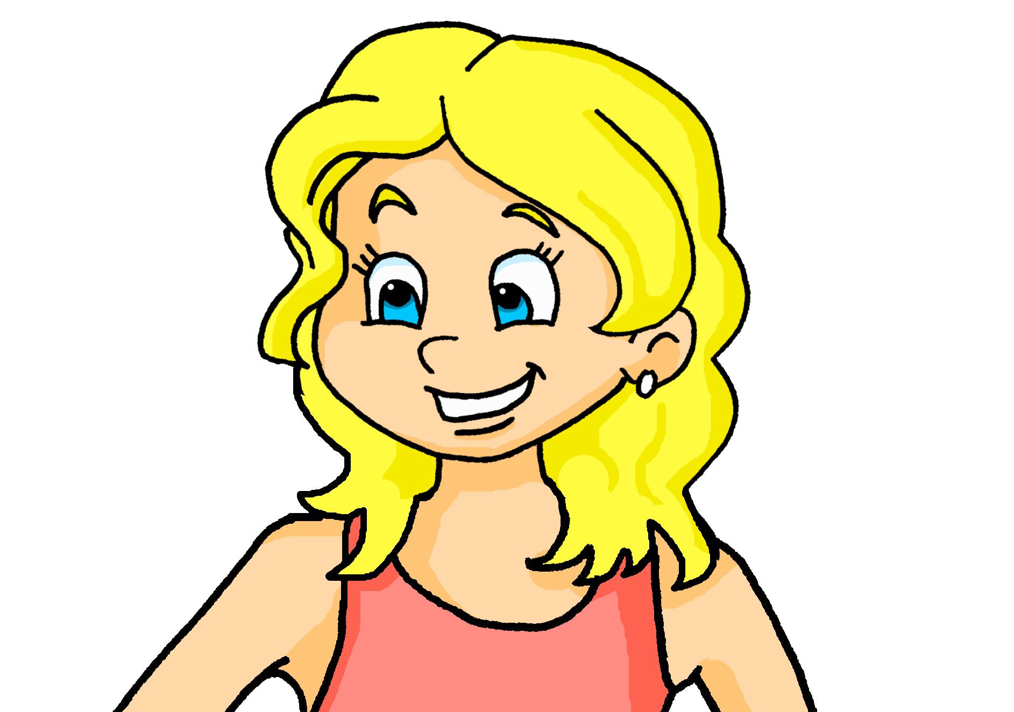

Follow up 1:
Adèle parle à la classe de Sanaya et Max. Lis les messages.
prononcer
Aujourd’hui, vous êtes contents.
Aujourd’hui, vous êtes contents.
Vous avez des exercices faciles…
Vous avez des exercices faciles…
et vous avez des ordinateurs modernes.
et vous avez des ordinateurs modernes.
Nous avons un problème.
Nous avons un problème.
Nous avons des ordinateurs lents…
Nous avons des ordinateurs lents.
… mais nous avons aussi des crayons et des cahiers.
…mais nous avons aussi des crayons et des cahiers. ☺
Notes:
Timing: 2 minutes
Aim: to practise liaison; to revisit previously taught vocabulary in new sentences.
Procedure:
1. Clarify the context; Adèle’s class is talking to Sanaya’s class in England.
2. Then click to reveal the first sentence. Pupils read it aloud, chorally.
3. Click again to reveal the sentence, with audio, and with the liaison highlighted.
4. Ask pupils to interpret (translate orally into English) for Sanaya.
4. Repeat steps 2-4 with items 2-6.

Slide 3


Avoir
[to have | having]
Être
[to be | being]
You hear the ‘s’
(like ‘z’) on ‘nous’ because of the vowel that follows. This liaison is always made.
To say ‘we’ have, use:
There is no liaison here because sommes starts with a consonant.
To say ‘we’ are, use:
nous avons
nous sommes
(z)
Nous avons des stylos
et des crayons.
Nous avons des stylos et des crayons.
Nous sommes prudents.
We have some pens
and some pencils.
We are careful.
Notes:
Use this slide just before Follow up 2.
Timing: 1 minute
Aim: to revisit nous avons (we have) and nous sommes (we are).
Procedure:
Click through animations to present the information.
Elicit English from pupils for the French examples.
3

Slide 4

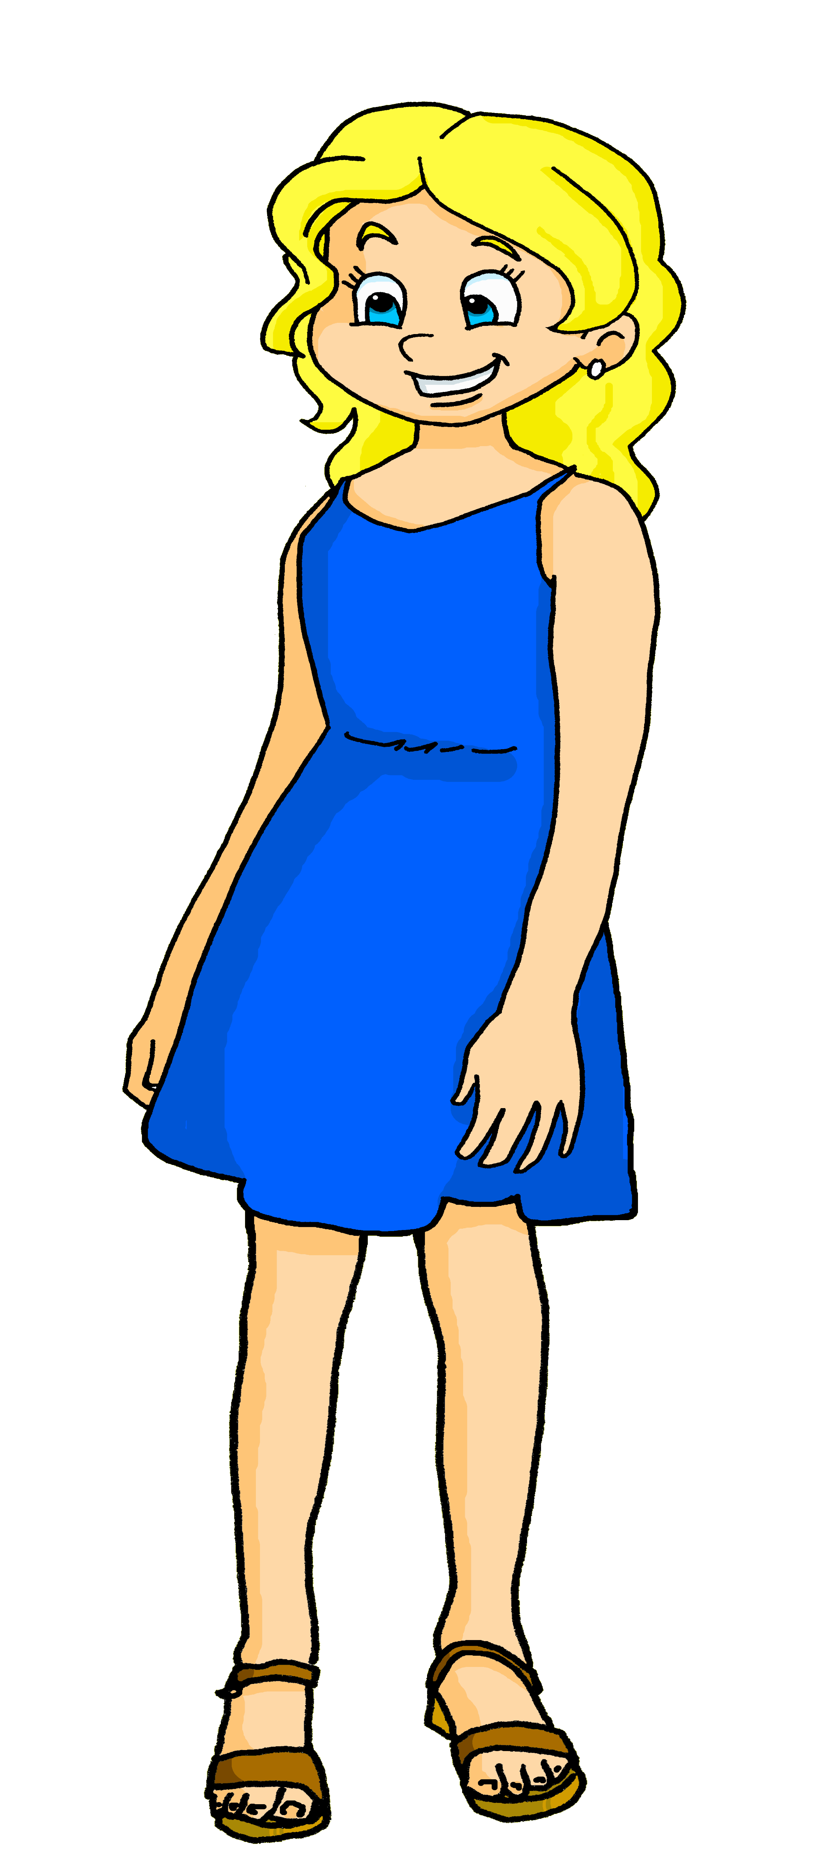
Follow up 2:
Écoute.
Adèle décrit l’école.
Write ‘we are’ or ‘we have’ in French.
Then choose the correct sentence ending.
écouter
Bonjour, Adèle ! Ça va ?
 | we are | we have
 | nous sommes
 |  | nous avons
 | nous sommes
 |  | nous avons
 |  | nous avons
 | Nous sommes
quoi ?
des murs | jeudi 18 novembre
heureux | des animaux
prêts | un cours important
des chaises | ici
là | Monsieur Caput
une professeure | à l’école
1
1
v
v
2
2
v
v
3
3
v
v
4
4
v
v
5
5
v
v
6
6
v
v
Notes:
Timing: 5 minutes
Aim: to practise aural distinction between nous and nous and their connection to sommes and avons; to practise written production of sommes and avons; to practise written comprehension of previously taught vocabulary.
Procedure
Pupils listen to the pronoun and decide (on the basis of liaison) if the verb is sommes or avons.
They write in the correct form.
Click to check.
Pupils listen again and note in English the noun and description.
Click again to reveal a 2nd set of audio buttons. Play the full sentences to listen and check. Click to reveal written answers.
Transcript 1:
Nous [sommes jeudi dix-huit novembre].
Nous [avons des animaux].
Nous [sommes prêts].
Nous [avons des chaises].
Nous [avons Monsieur Caput pour le français].
Nous [sommes à l’école].
Transcript 2:
Nous sommes jeudi dix-huit novembre.
Nous avons des animaux.
Nous sommes prêts.
Nous avons des chaises.
Nous avons Monsieur Caput pour le français.
Nous sommes à l’école.

Slide 5


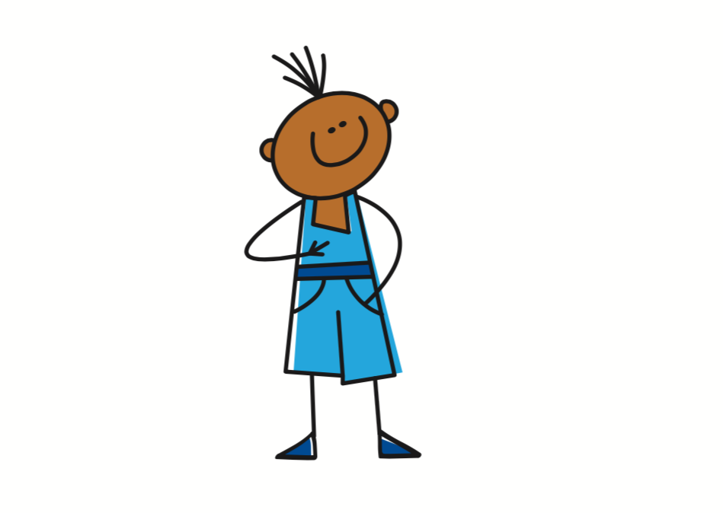

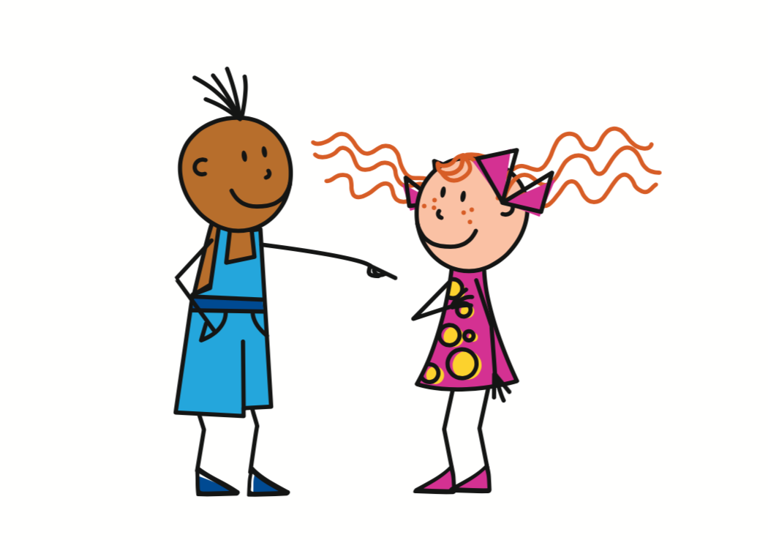


Asking questions
In English, we add ‘do’, in French we just make our voice go up.
Remember! To change a statement into a yes/no question, raise your voice at the end:
J’ai un livre.
J’ai un livre ?
I have a book.
Do I have a book ?
Tu as un livre.
Tu as un livre ?
You have a book.
Do you have a book?
Vous avez des ordinateurs ?
Vous avez des ordinateurs.
You (all) have computers.
Do you (all) have computers?
Notes:
Timing: 2 minutes
Aim: to revisit how to form intonation questions.
Procedure:
Click to present the information.
Elicit the English at each stage from pupils after presenting the French examples.

Slide 6



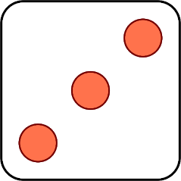
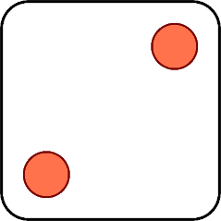


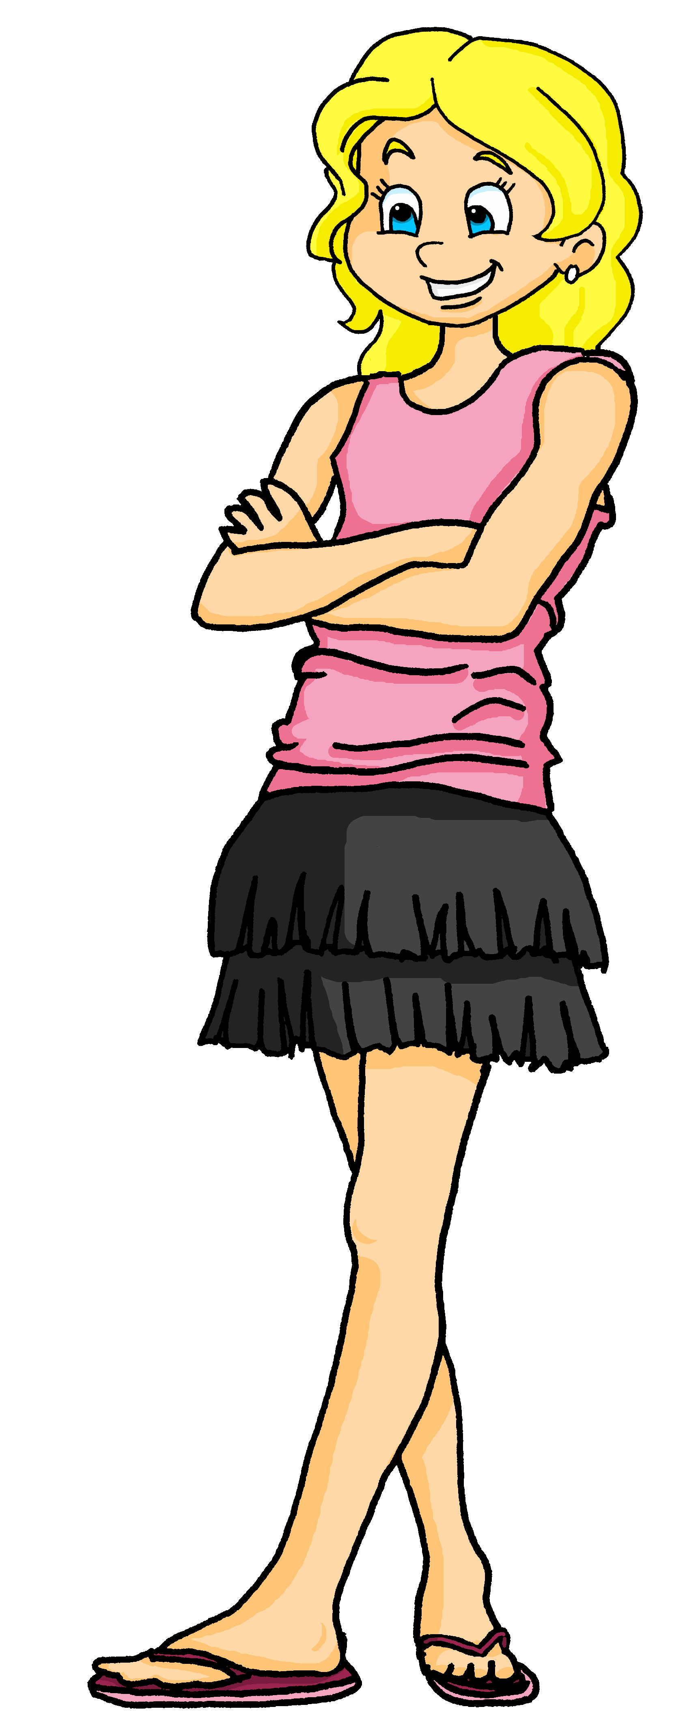
Follow up 3:
Parle en français.
Adèle is helping Sanaya to practise her French. What does Sanaya have to say?
parler
Bonjour, Adèle ! Ça va ?
Nous avons des chaises.
Elle a un animal ?
J’ai un cours d’anglais.
Tu as un exercice intéressant.
Vous avez des ordinateurs ?
Il a Madame Vidal comme professeure.
1 | Madame Vidal as a teacher
2 | an interesting exercise
3 | a lesson of English
4 | some chairs
5 | an animal
6 | computers
1 | I have
2 | You have
3 | Does she have
4 | He has
5 | We have
6 | Do you (all) have
In English, we say an English lesson. In French it’s ‘un cours d’anglais’ (a lesson of English).
Notes:
Timing: 5 minutes
Aim: to practise oral production of statements and questions with parts of avoir, nouns and adjectives.
Procedure:
1. Click to ‘roll’ the dice.
2. Pupils create a short sentence in French from the English prompt. They say the answer chorally.
3. Click to reveal the correct sentence.
4. Repeat until all combinations have been tried.

Slide 7


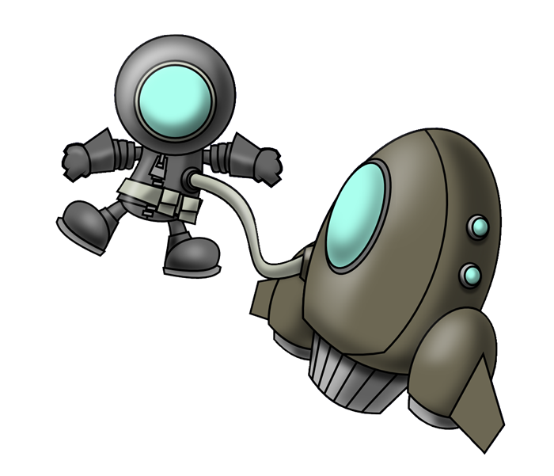

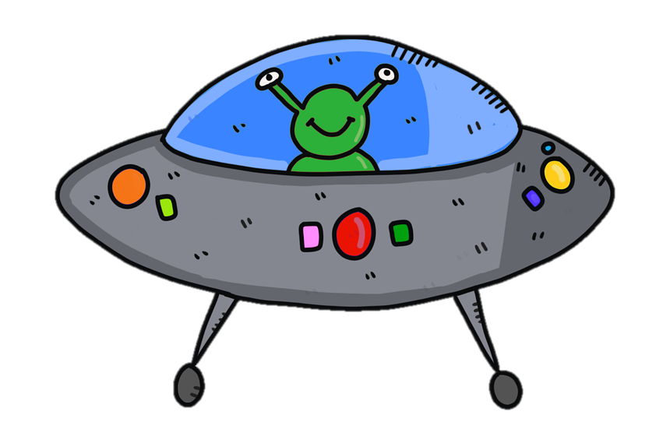

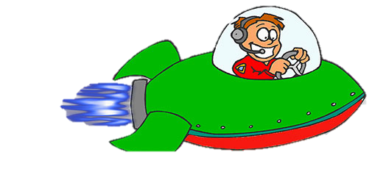

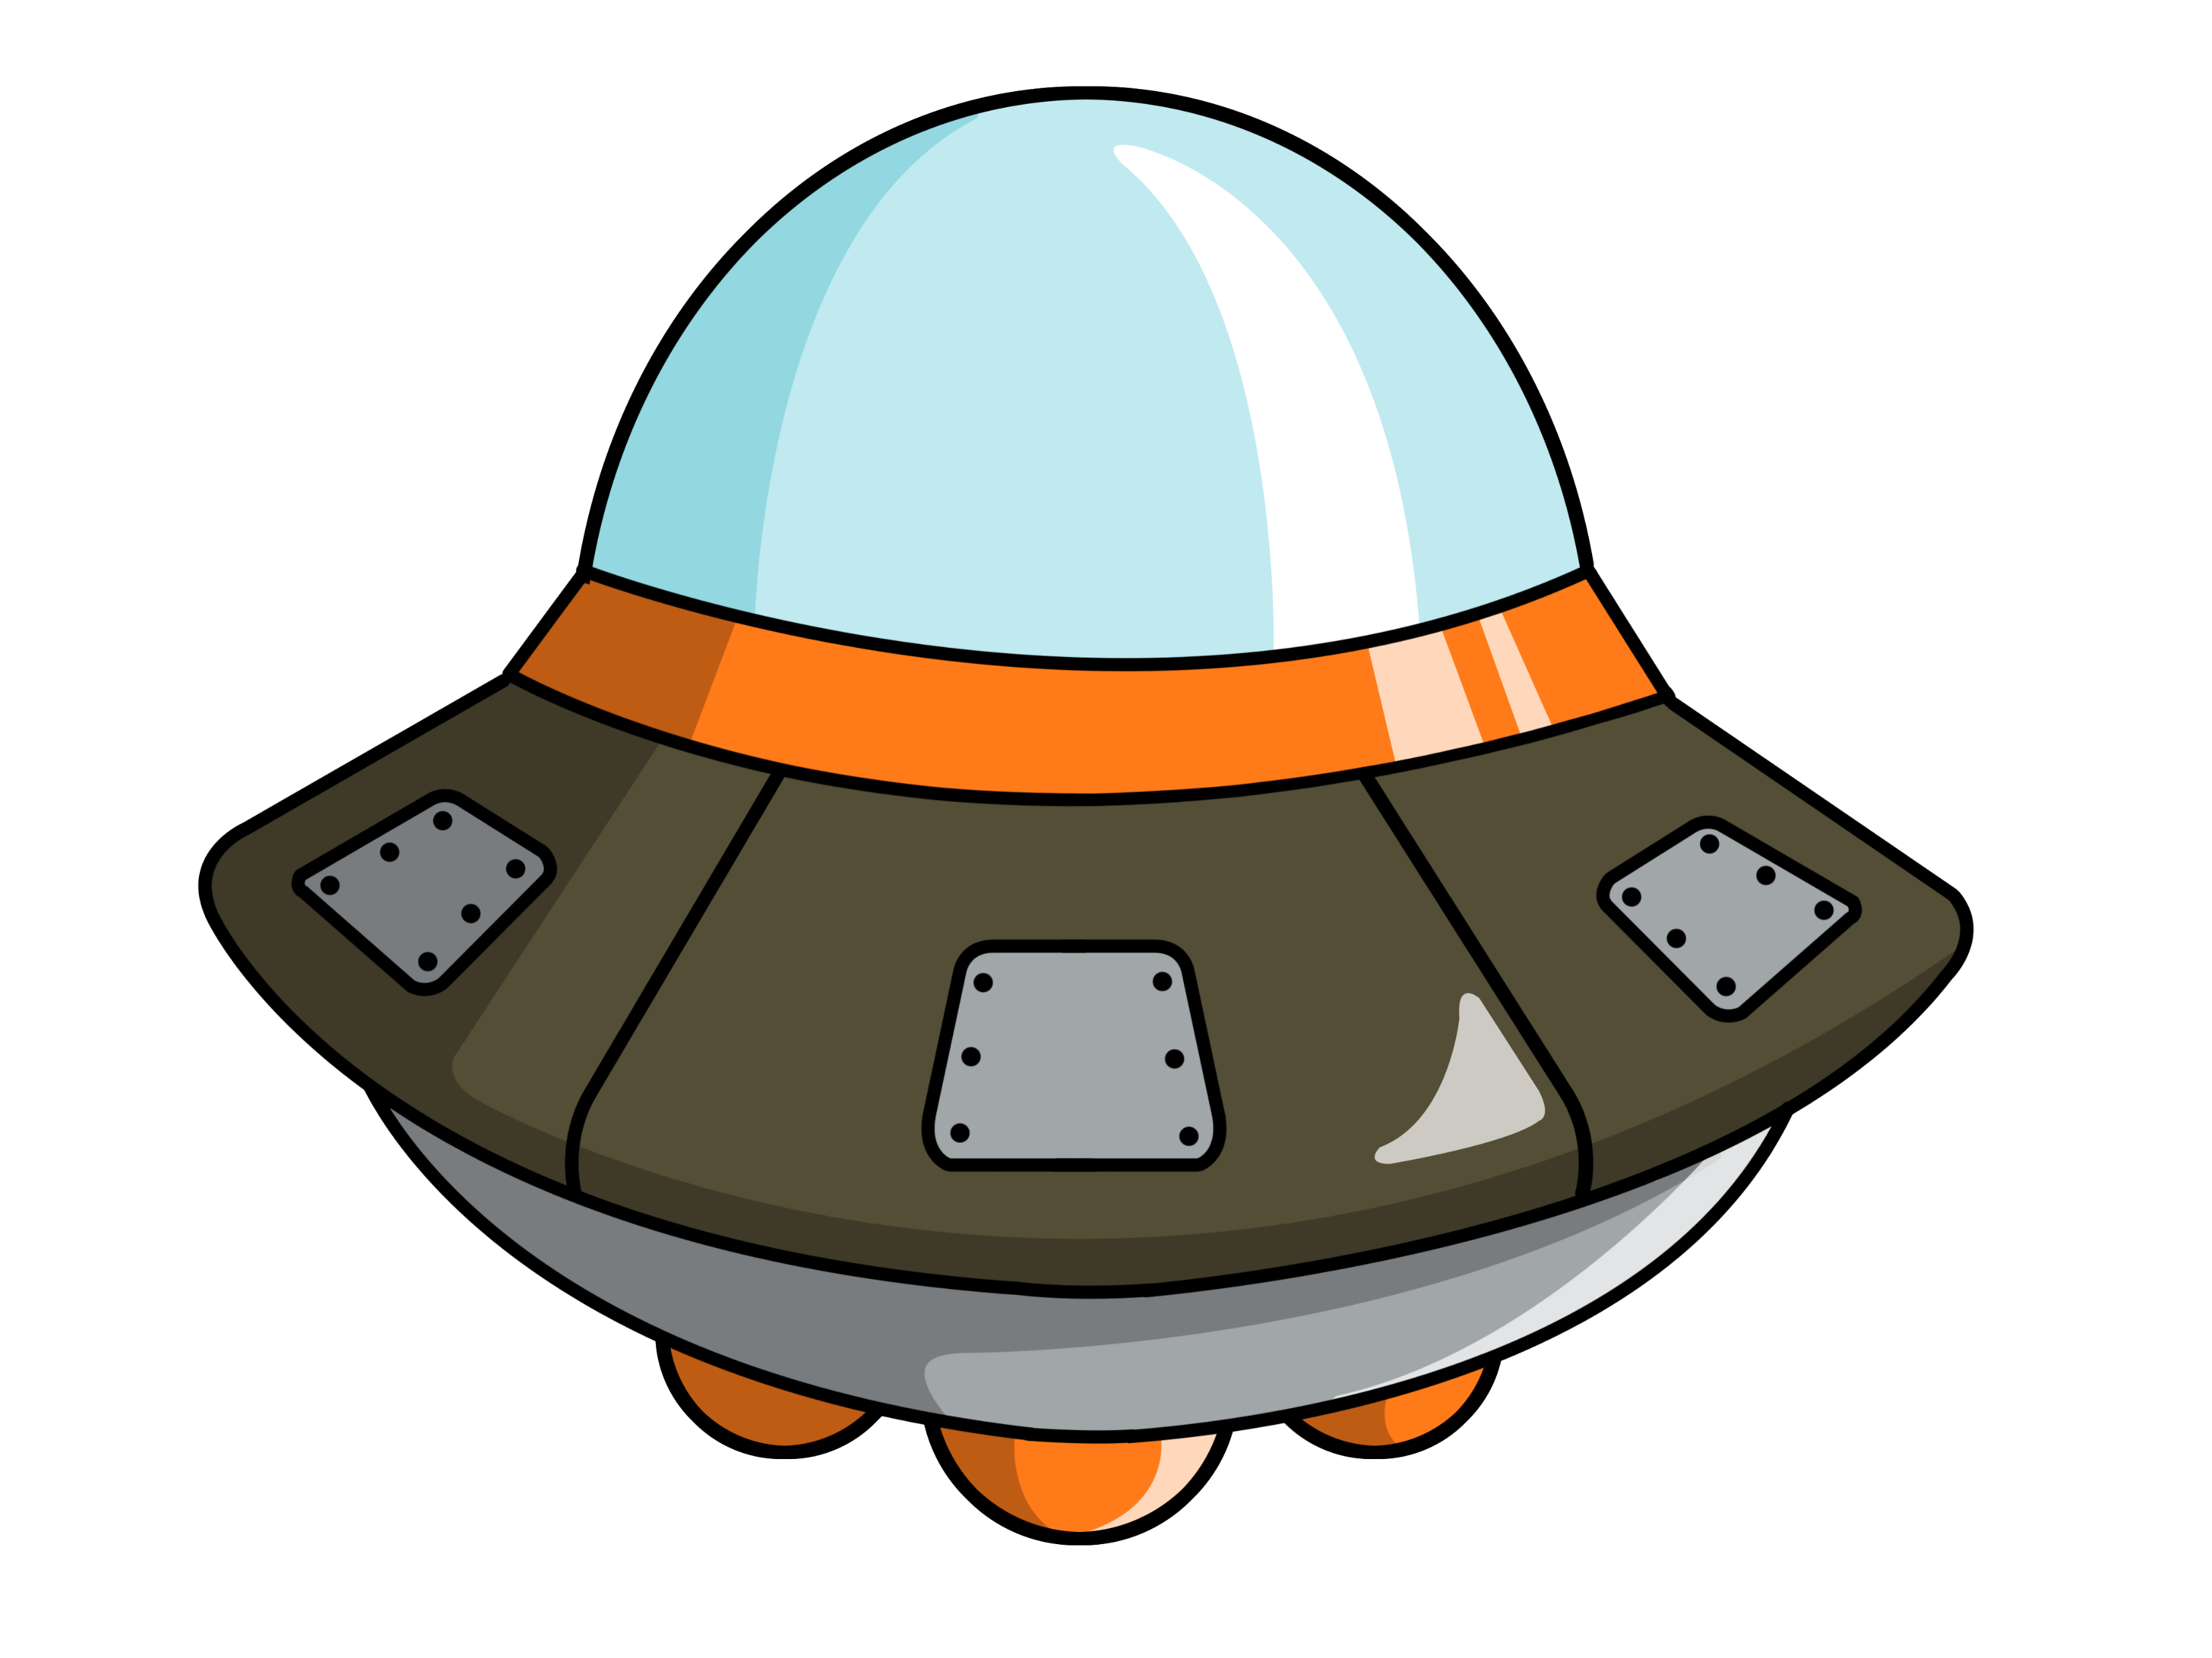
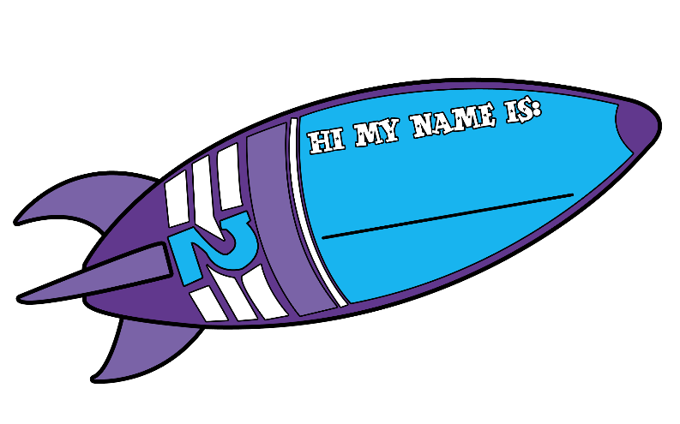


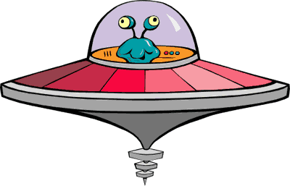

Follow up 4: Écris en anglais.
combien ?
vous avez
Attention ! They disappear fast! Then try to say the French for all the words on your list.
l’exercice
comment ?
nous avons
ils sont
vrai
le cours
faux
ici
l’enfant
où ?
Notes:
With thanks to Amanda Izquierdo for the task design.
Timing: 5 minutes
Aim: to practise written recall of meanings of 12 items of vocabulary from this week’s new and revisited list.
Procedure:
Click to animate. A word will pass across the screen.
Pupils write down the English meaning.
Repeat for items 2-12.
In pairs, pupils try to say the French for all the items on their list.
Note: they may not manage to do them all but should not worry at this stage. Follow up 5 offers another opportunity to revisit much of the same vocabulary.
Answers (in order):
1. we have
2. here
3. you (all) have
4. exercise
5. lesson
6. false, wrong
7. child
8. they are
9. how?
10. when?
11. true, right
12. how many?

Slide 8




vocabulaire
Follow up 5 - Écris en français : Can you get at least 15 points?
mots
 | who? | Mrs, (Miss-teacher) | how?
 | how many? | from, of | to be, being
 | there | true | false
 | here | they are (m, m/f) | they are (f)
 | chair | where? | on
 | you (all) have | lesson | child
 | we | we have | you (all)
qui ?
Madame
comment ?
x3
combien ?
de
être
là
vrai
faux
x2
ici
ils sont
elles sont
la chaise
où ?
sur
vous avez
le cours
l’enfant
x1
nous
nous avons
vous
Notes:
Timing: 5-10 minutes
Aim: to practise written production of vocabulary from this week and two revisited weeks.
Procedure:
1. Give pupils a blank grid. They fill in the French meanings of any of the words they know, trying to reach 15 points in total.
2. Remind pupils that adjectives can refer to male or female persons and they should note this in their translations. E.g. pleased (f), short (m).
Note:
The most recently learnt and practised words are pink, words from revisit 1 are green and those from revisit 2 are blue, thus more points are awarded for them, to recognise that memories fade and more effort (heavy lifting!) is needed to retrieve them.
8

Slide 9
vocabulaire
Follow up 5 - Écris en français : Can you get at least 15 points?
mots
 | who? | Mrs, (Miss-teacher) | how?
 | how many? | from, of | to be, being
 | there | true | false
 | here | they are (m, m/f) | they are (f)
 | chair | where? | on
 | you (all) have | lesson | child
 | we | we have | you (all)
x3
x2
Notes:
HANDOUT
9

